Slide 1
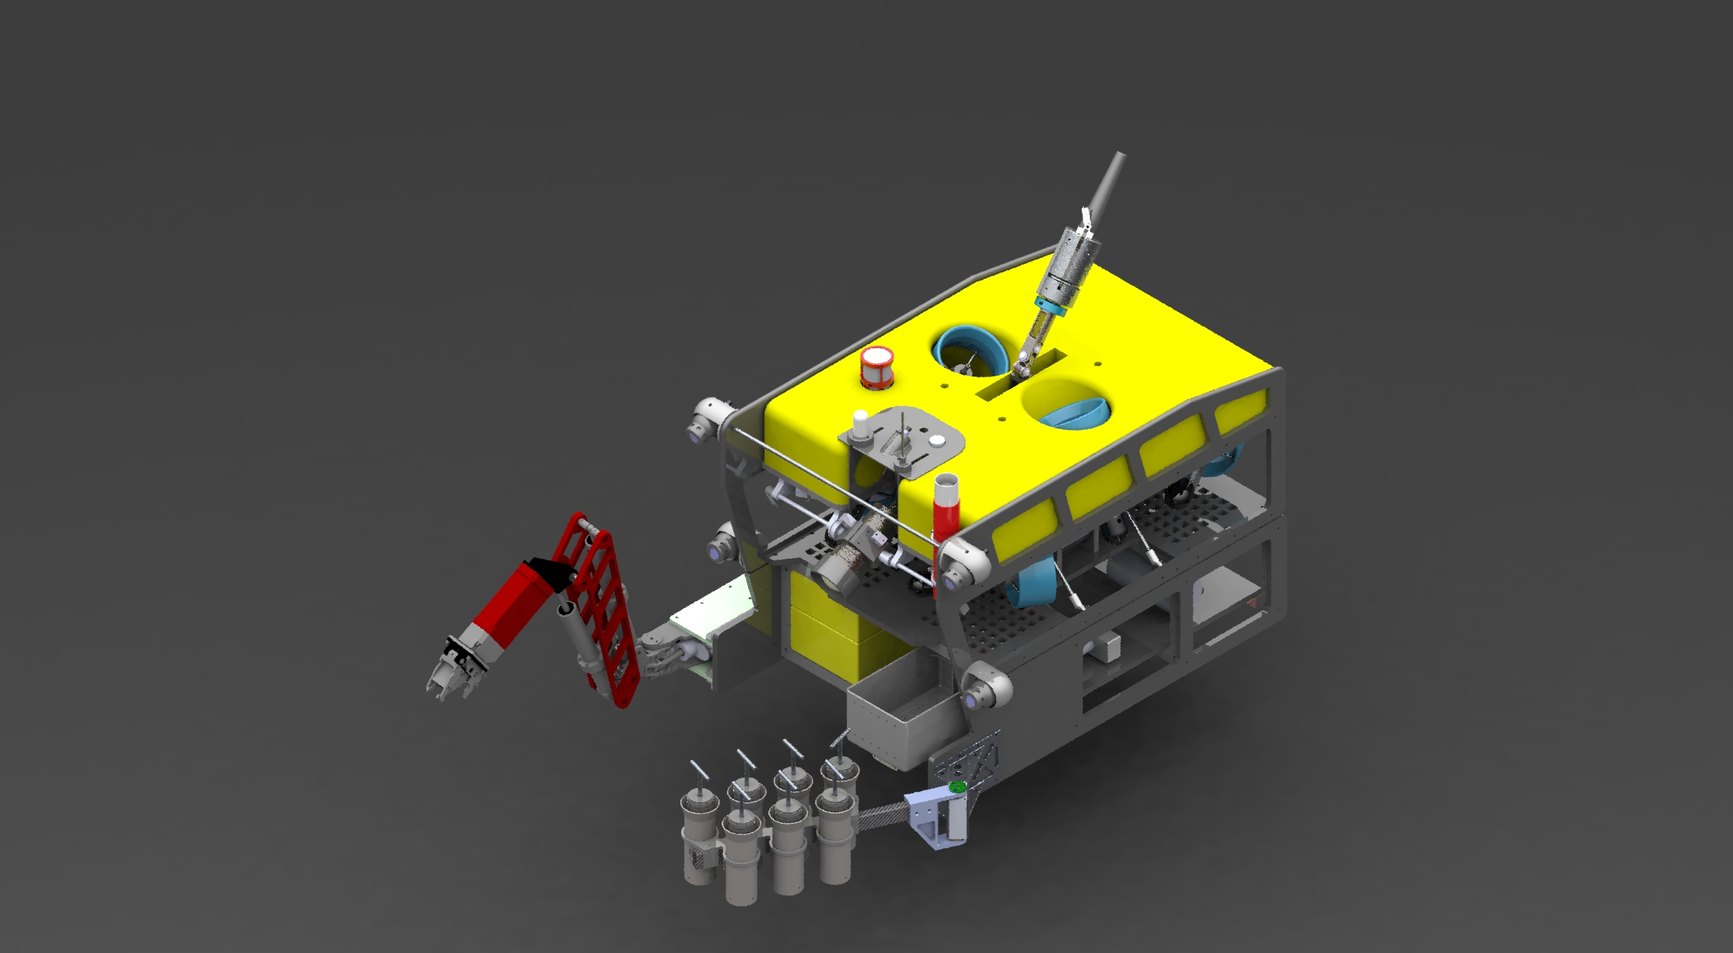

MiniROV Specs And Launch & Recovery Procedure
(DRAFT)

Slide 2
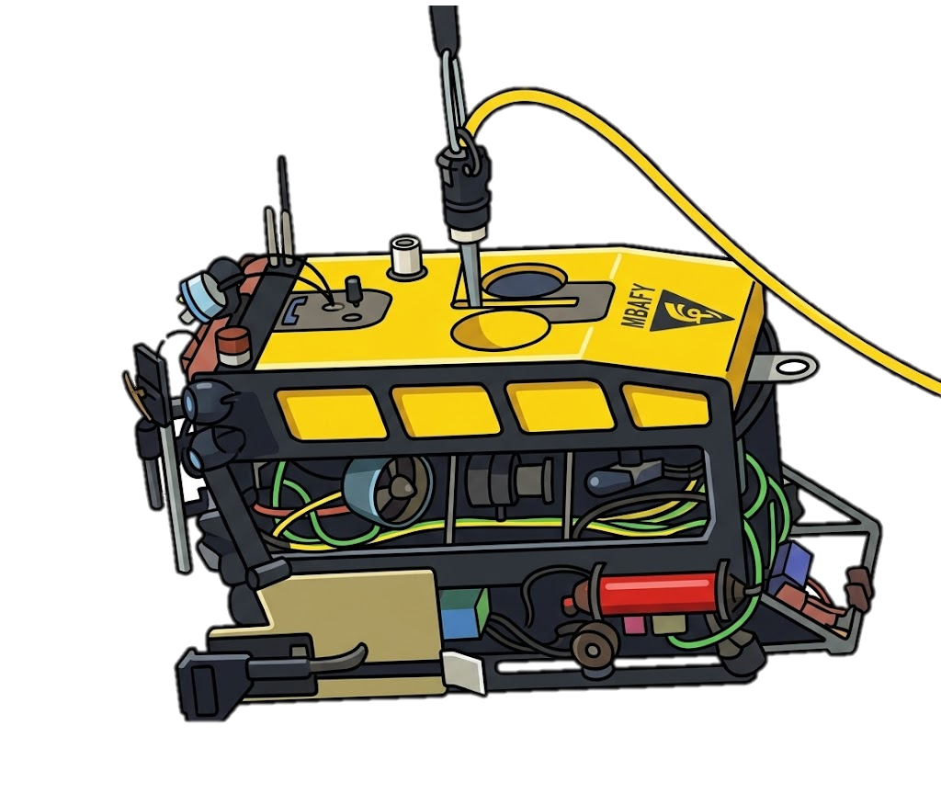
MiniROV Intro
The MINI ROV is MBARI’s next generation (fly away) ROV designed and built at MBARI. The system provides a portable, low cost, 1500 meter inspection class ROV system for the purpose of providing MBARI a compact fly away ROV capable of operating with a small crew (1 to 2 people) on ships of opportunity around the world. The vehicle is capable of light duty work functions such as limited sampling, video transects, instrument deployment and recovery (with a 120 pound instrument payload) and is outfitted with the following suite of core instruments: HD camera, scanning sonar, lasers, LED lights and CTD. In addition, the vehicle has bolt on tool skids for mission specific payload and sampling
The MiniROV Is capable of autonomous functions:
Auto Depth
Auto Heading
Observation Mode (MBARI Mode) – stops forward thrusters pushing water forward
Advance Navigation Mode
Dynamic Station Keeping
The MiniROV uses M3RS for recording the main HD camera and video annotation and reference system (VARS) for observational notes. Additional camera views can be recorded directly onto SD cards.

Slide 3
MiniROV Specs
Specs:
900lbs (408kg)
Electric drive (400VDC, ~5kW)
Thrusters: (6x) ~0.75hp electric DC brushless
Dimensions: 48”L x 35”W x 24”H
1500m Depth Rated
4DOF
Auxiliary instrument power & available voltages
~1kW
240, 48, 24, 12, and 5 VDC
Auxiliary Data
(1) spare single mode fibers
RS-232 serial ports

Slide 4
MiniROV Core Vehicle Sensors
Sensors:
Insite Pacific Mini Zeus III Main HD Camera (On +-75 degree tilt)
(2) DSPL HD Multi SeaCam Cameras
(3) DSPL Analog Cameras
(6) DSPL Sealite
CTD
Scaling Lasers
Valeport UltaP Depth Sensor
PNI 3-axis digital Compass (To be upgraded to a VN100 soon)
Sonardyne WMT USBL transponder with remote head
Imagenex 881-A scanning sonar w/gyro compass

Slide 5
MiniROV Benthic Sled
Benthic Sled Sensors:
Stereo Camera x2
Laser Lines x3
VN100 IMU
Norbit WBMS Bathy
Oculus Forward MBES
Waterlinked A125 DVL (One downward facing, one forward facing)
(4) DSPL Lights
Drawer for sample collections
Swing Arm
Valeport VA500 Altimeter/Depth Sensor
  Gas Sampler
  7 Push Cores
Manipulator 5 DOF, continuously rotating wrist
  Temperature probe and CT attached to a probe motor

Slide 6
MiniROV Midwater Sled
Midwater Sled:
8 Bucket Suction Sampler
Stereo VR camera
Autonomous animal tracking
Deep PIV

Slide 7
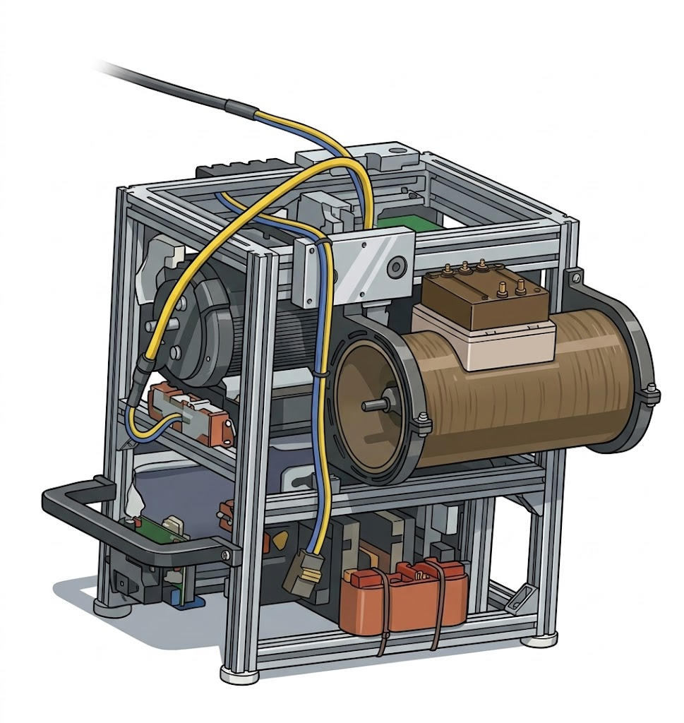
Smart Clump
Weight: 350lbs (159kg)
DSPL HD Multi SeaCam (On +-90 degree tilt)
DSPL Analog Cam
DSPL Light (Dimmable)
Thrusters for auto heading / driving capabilities
Valeport VA500 Altimeter/Depth sensor
Sonardyne WMT USBL transponder
Triggerable Niskin Bottle (5L)
Imagenex 881-A Scanning Sonar (Optional)
Pumped seabird DO sensor
PNI 3-Axis Digital Compass (To be upgraded to a VN100 soon)
Connects directly to winch. Has ~50m flying tether connected to MiniROV. Taps onto the 400VDC from the umbilical

Slide 8
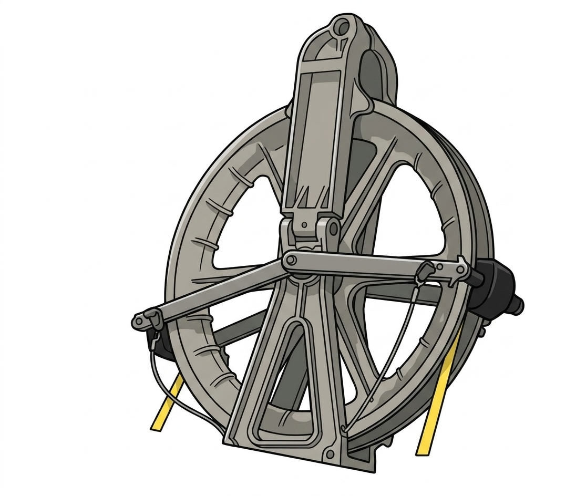
Sheave Block 28-Inch

Slide 9
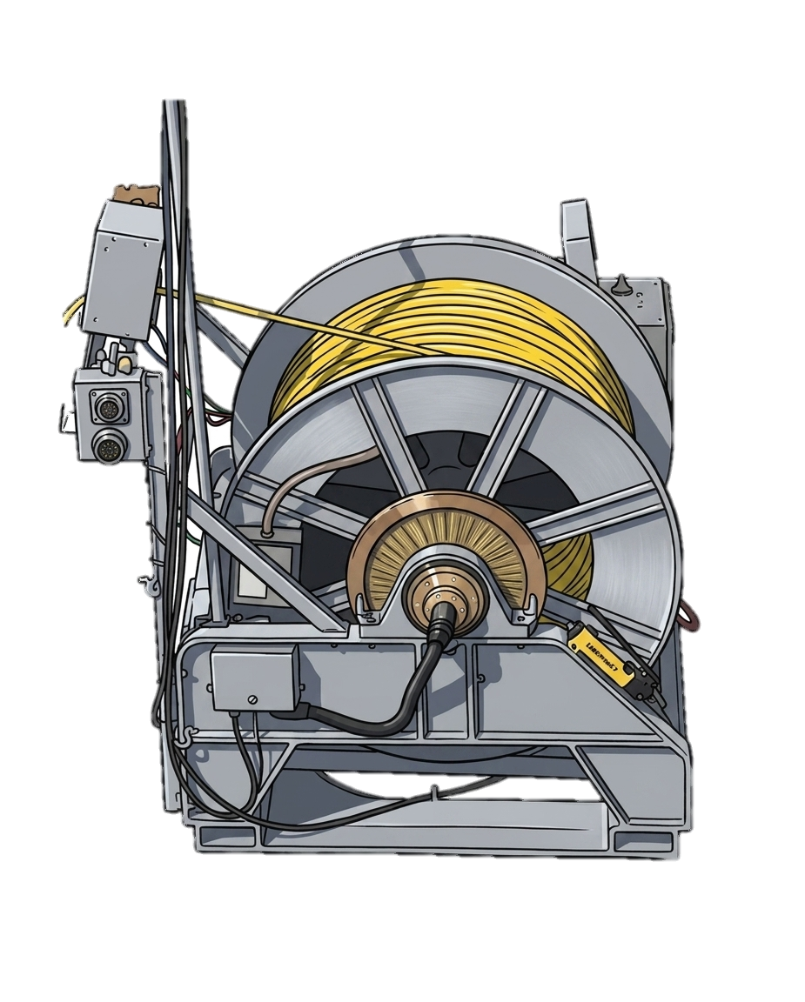
Winch
Winch Specs
1700 m of tether, 0.625” OD
3500 lbs (1600 kg)
Mounts 4 ft x 4 ft 1.25 Inch Threaded Bolt
Dimensions: ~60”x60”x60”
Can be mounted at various angle (22 degree increments)
Variable speed electric drive motor
Power = 240 VAC Single Phase 4 kW (plugs into control van, plug is 21 m long)
Operated directly with winch joysticks or remotely in the control van
Uses 240 VAC Single Phase and plugs directly into control van
Emergency hydraulic brake
Can bolt onto base plate or welded directly to deck

Slide 10
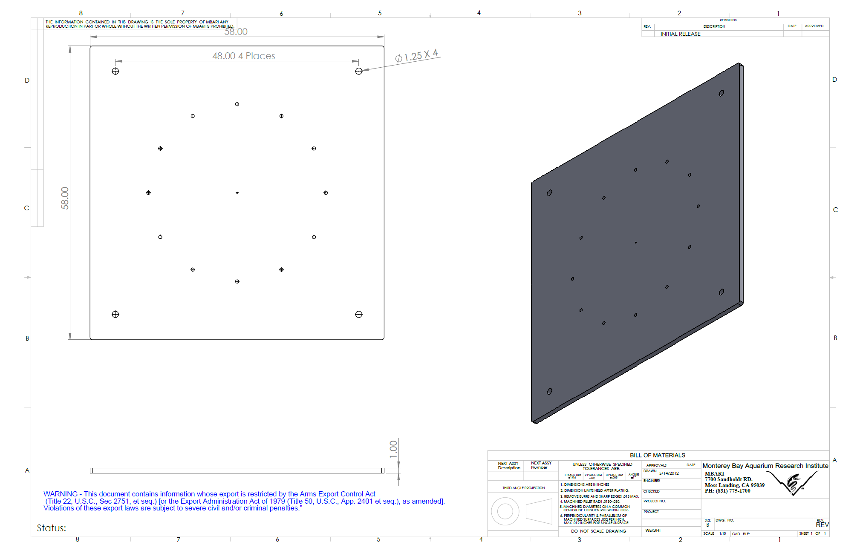
Winch Base Plate
Approximately 1000lbs
4x Lifting eyes used on threaded corner holes to move into place

Slide 11
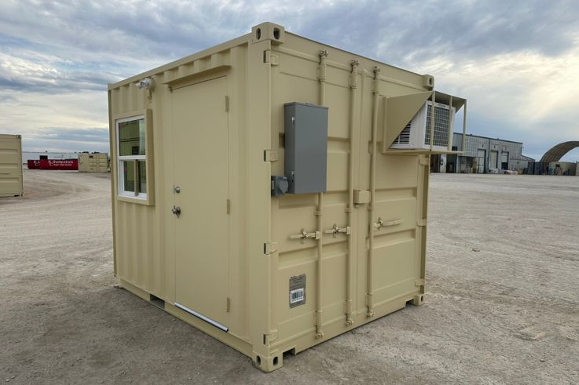
Control Van Option 1: 10Ft
Weight = 9000Lbs
Power In = 408 VAC 3 phase, power cable is 30m long
Personnel Capacity = 4 - 6

Slide 12
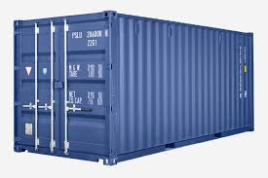
Control Van Option 2: 20Ft
Weight = ?
Power In = 200-500 VAC 3-phase, Power cable = 30m long. Requires >50A circuit
Personnel Capacity ~= 10

Slide 13
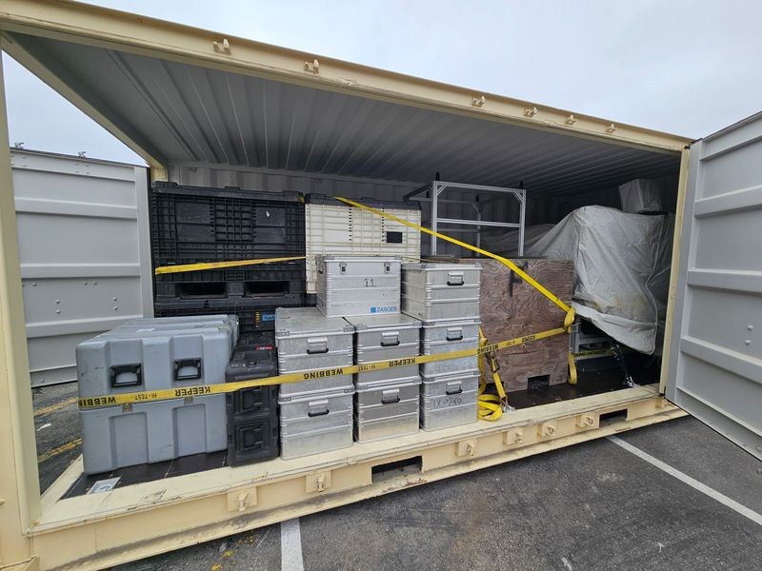
Additional Container for Transporting MiniROV/Winch/Spares
MiniROV
Winch
Spare Power supply
Spare Transformer
4x Rowe packs full of spares
  Smart Clump
Zarges crates full of spares
MiniROV Stand

Slide 14
MiniROV Deployment Procedure
Responsibilities
Personnel Required
Personnel Safety
Communication Protocols
Safety Equipment
ROV Rigging
Pre-Dive Procedure
Launch Procedure
Dive Procedure
Recovery Procedure
Post – Dive Procedure

Slide 15
1. Responsibilities
Captain: Retains overriding authority and ultimate responsibility for the safe execution of the operation, safety of personnel and the vessel. The captain has authority to cancel a dive due to bad weather conditions
Bosun: Responsible to the Master for the deployment/recovery of the ROV and for the safety of personnel involved in the operation. Should the Party Chief be absent, this responsibility may be delegated to the ROV Supervisor.
ROV Chief Pilot: Coordinates launch, inspection, sample collection and recovery operations, he/she will be in charge of overseeing all operations, ensuring effective coordination and communication among all relevant parties. The chief pilot has authority to cancel a dive due to bad weather conditions

Slide 16
2. Personnel
A minimum team of four personnel is required during the launch and recovery of the ROV.
All team members shall be appropriately qualified and adequately trained to carry out their delegated tasks and responsibilities safely.
The team will comprise:
ROV chief pilot – In charge usually on ROV deck remote control.
ROV winch operator (from ROV operators).
2 ROV operators in the control van managing telemetry.
Science party – In charge of scientific tooling on the vehicle

Slide 17
3. Personnel Safety
Before any operation begins, a toolbox meeting will be conducted, in which all personnel associated with the operation are expected to attend. It is crucial to emphasize that while every effort is made to guarantee a safe operation, each crew member has an individual responsibility to ensure not only their own safety but also the safety of others participating in the operation or involved in the task at hand.
Each person involved with the deployment, inspection, sample collection and recovery of the ROV will be instructed and will be required to know their function and position on deck. In any case personnel will remain alert and follow instructions carefully and must be prepared to carry out urgent, immediate instructions should these be given.
Prior to commencement of each operation a risk assessment will be made.
This risk assessment will take into account but will not be limited to the following:
Environmental conditions, e.g., wind speed and direction, sea state, currents, visibility, rain etc.
Vessel motion and station keeping ability
Working area – free from slip/trip hazards
Equipment status and conditions
Personnel abilities
Personnel/Personal Protection Equipment.
Should there be any concerns regarding the safety of the operation, commencement should be postponed until all potential hazards have been addressed and removed.

Slide 18
4. Communications
During all operations good communications are essential for both efficiency and safety.
Hand signals will be used to help complement verbal commands. Correct use of these signals will be fully understood before commencement of the operation and correct procedures adopted.
Before starting operations, communication links between the deployment area, the control room, science party, and the bridge will be set up and tested. Handheld radios will serve as the main form of communication; deck personnel are required to use the provided microphone and earpiece extensions. Proper usage of these radios will be comprehensively briefed, and correct procedures established prior to the operation's initiation.
Anyone on the vessel has authority to call an all stop to the operation for any reason.

Slide 19
5. Safety Equipment
All personnel involved directly or indirectly with the deployment and recovery operations must wear appropriate Personal Protective Equipment (PPE)
Live Jacket
High Voltage Gloves (If handling the high voltage tether)
Steel Toe Shoes
Hard Hat
Foul weather gear (If required)
High Visability gear
On the bridge:
Live video feed of the ROV main camera + overlay will be displayed on the bridge so the captain can see ROV and smart clump heading
USBL positioning will be displayed on the bridge so the captain can see ROV and clump position relative to the ship.
The MiniROV uses 400VDC with an active ground fault interrupter (GFI) to protect personnel. To ensure safety against the high voltage, high voltage gloves will be provided for all crew members who are required to handle the tether during launch and recovery of the system.

Slide 20
6. ROV Rigging
Prior to any deployment, all equipment will be inspected to ensure suitability for the scope.
All sheaves, wires, shackles, lifting hardware, and connections will be checked to ensure they are fit for purpose.
This responsibility is delegated to the ROV team members.
SHOULD THE ROV SUPERVISOR HAVE ANY CONCERNS REGARDING THE VESSEL'S ABILITY TO HOLD ITS POSITION, OPERATIONS WILL BE POSTPONED UNTIL THE PROBLEM IS ADDRESSED OR THERE IS AN IMPROVEMENT IN CONDITIONS.

Slide 21
7. Pre – Dive Procedure
7.1 Unpowered ROV checklist
Visual assessment of the thrusters: no major propeller damage and free/smooth hand rotation
Check power sources compliance
Accurate vehicle and umbilical inspection to ensure there is no visible damage
Check the umbilical is not twisted and is free for vehicle lift and deployment
Check underwater connections are properly tightened and cables are securely fastened to the vehicle frame

Slide 22
7. Pre – Dive Procedure
7.2 Powered ROV checklist
Power up the system
Check ROV communications
Check ROV cameras and overlay data
Check tilt functioning and ranging
Check compass according to ROV relative ship heading
Check lights
Check thrusters movement according to HCU commands
Check auxiliary instruments onboard ROV
Turn on USBL tracking beacon
Turn on RF/strobe
Check ROV science sled tools all functional

Slide 23
8. Launch Procedure
The Chief ROV Pilot verifies with Navigation that the vessel is in the correct location. He will confirm deck crew and science party is ready. He then asks the Bridge for permission to start (green light) with the deployment of the ROV.
The ROV will be lifted with a crane that latches into a lifting block directly attached to the vehicle with a tag line release mechanism. That line will be kept slack until the ROV is in the water and the pilot on belly pack gives the signal for the vehicle to be released
After the ROV is released, deck crew can pay out the flying lead (50m of tether between the MiniROV and the Smart Clump) which will be coiled in a figure 8 patter on deck. The belly pack pilot will begin flying the vehicle away from the ship while maintaining a visual of it on the surface.

Slide 24
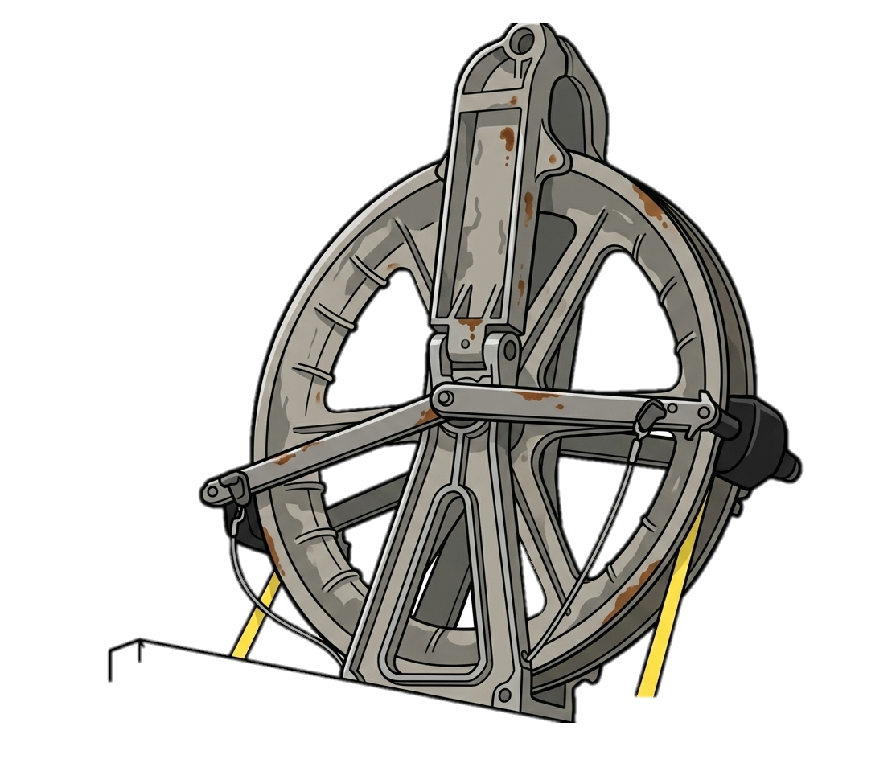
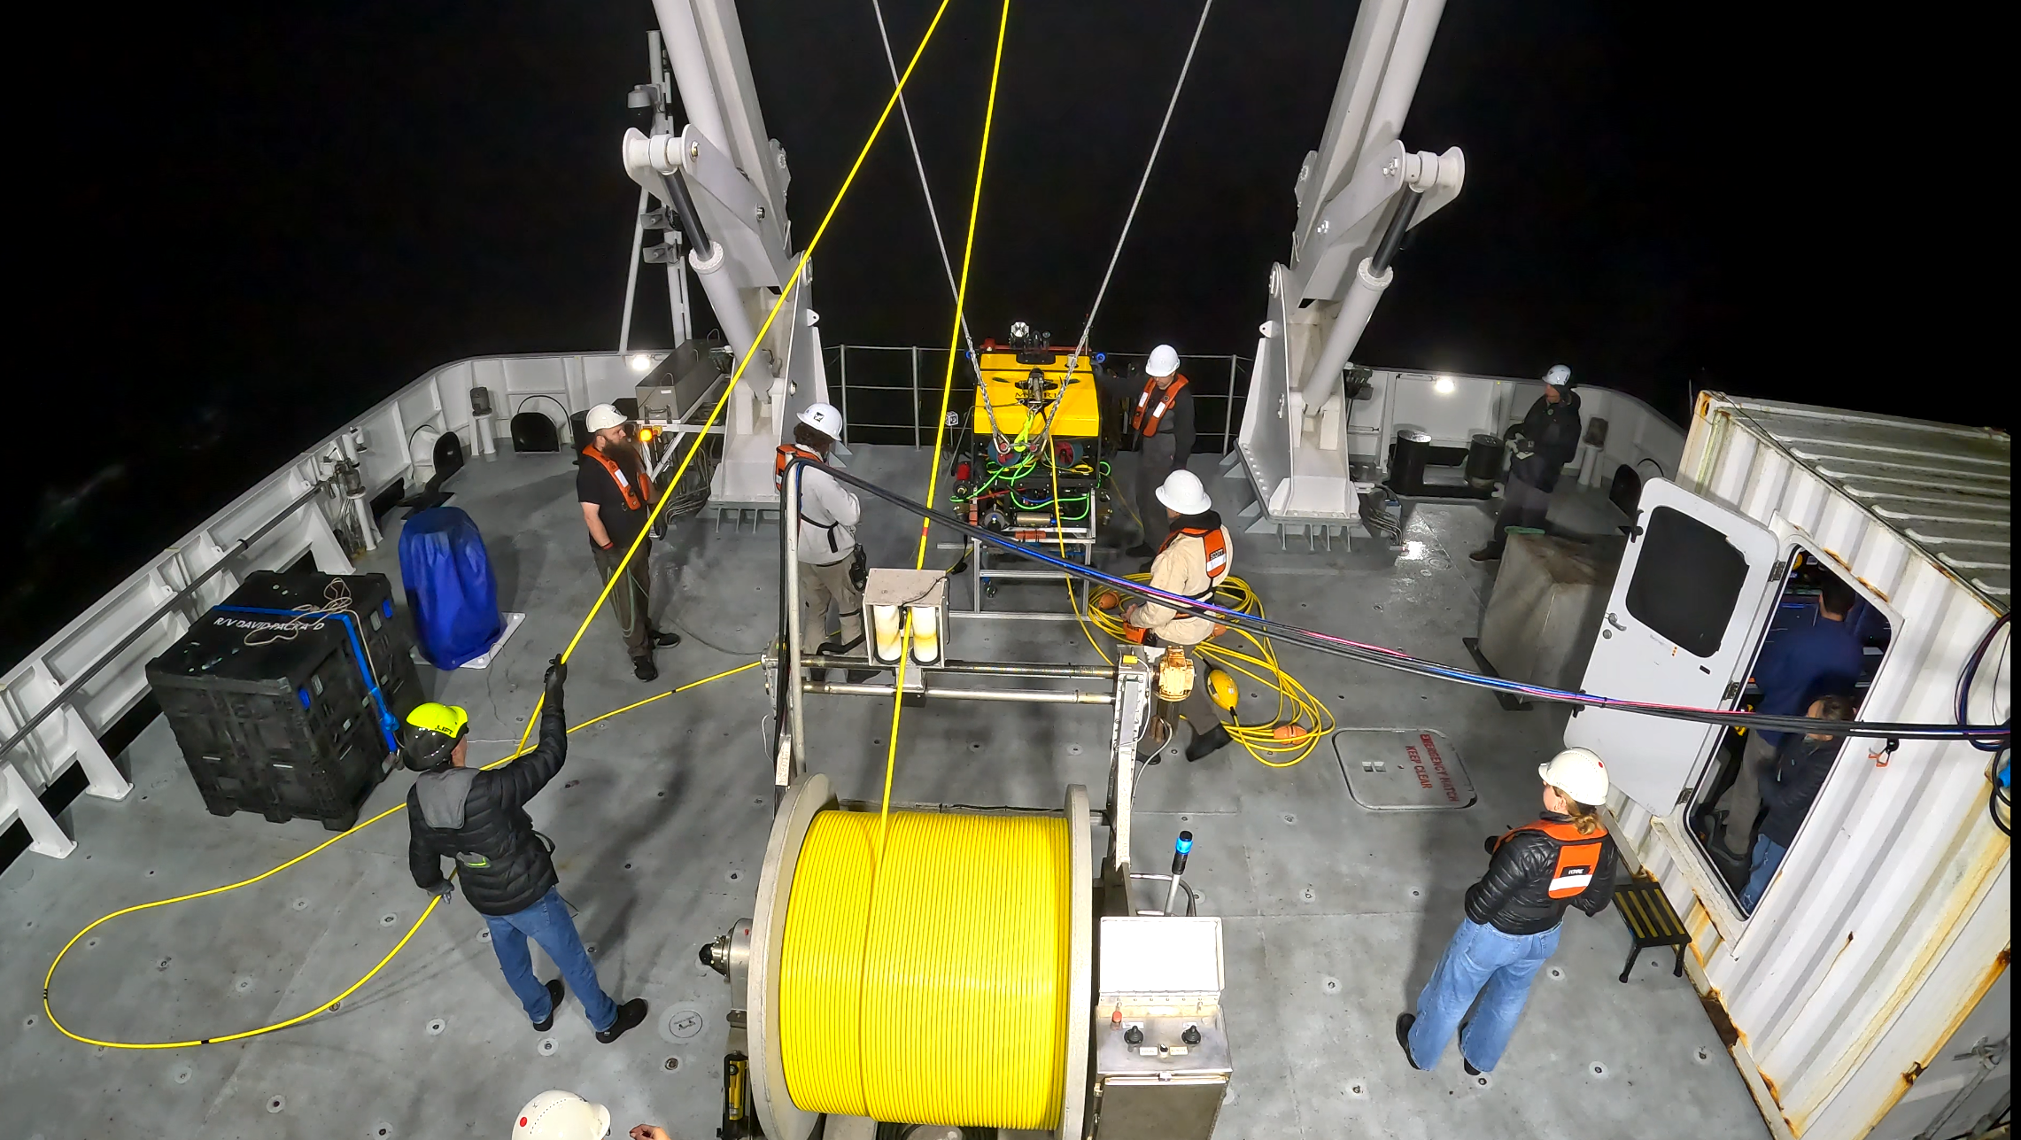
System Components on Deck
Sheave Block
Smart Clump behind MiniROV
Release Line
MiniROV
Remote ROV Pilot
Slack in cable between clump and winch. This is so the A-frame can articulate
50m flying tether
Control Van
Winch

Slide 25
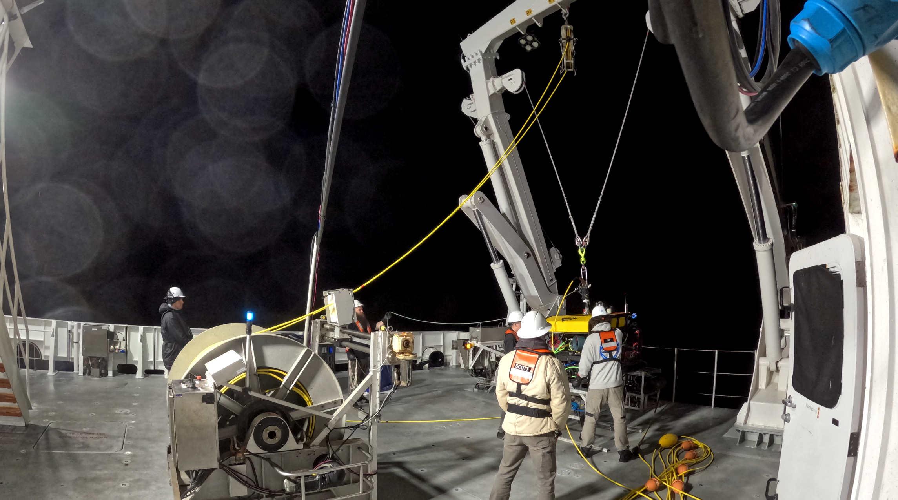
1. Pick up MiniROV

Slide 26
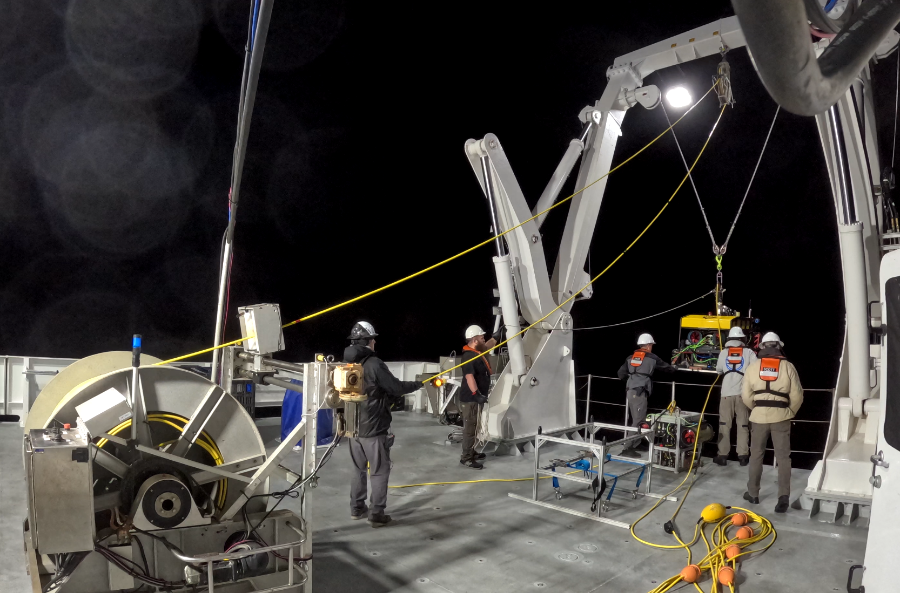
2. Extend A-Frame and lower MiniROV

Slide 27
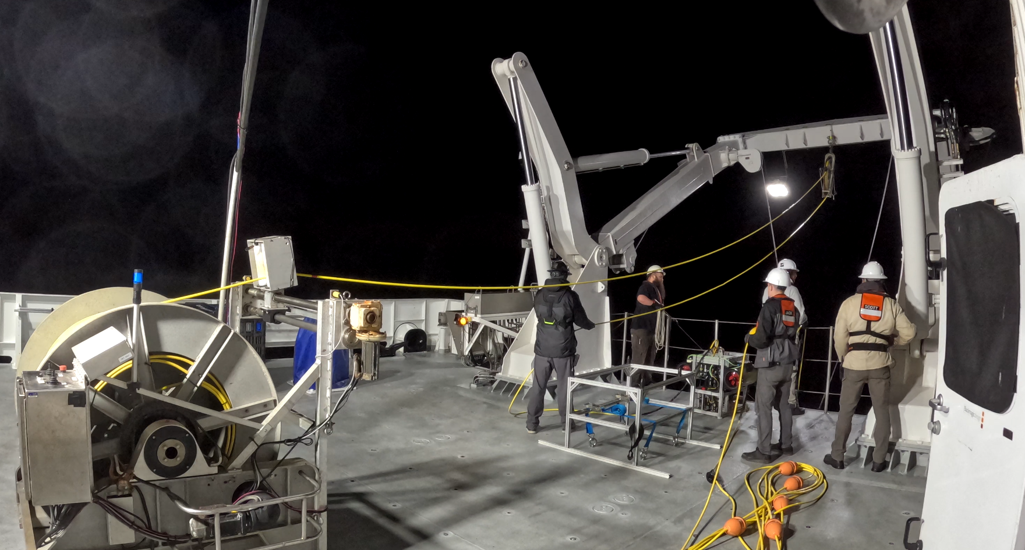
3. Unlatch MiniROV (Pull release line)

Slide 28
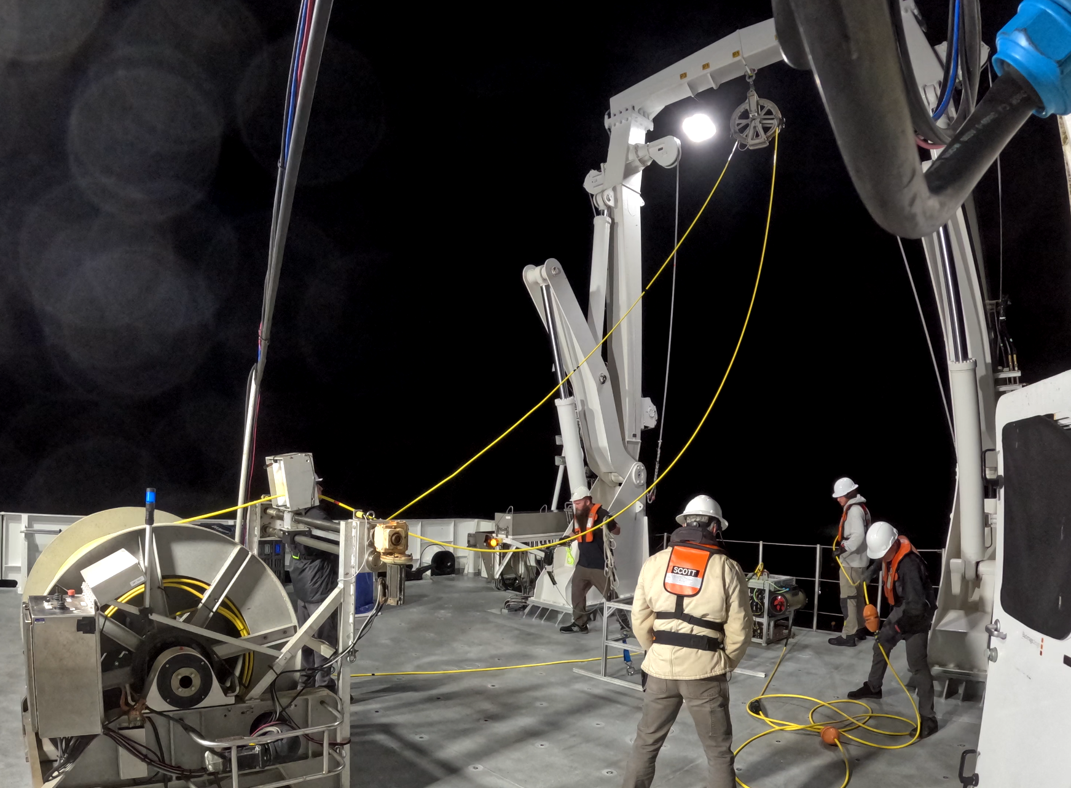
4. MiniROV begins flying away
*Remote pilot on deck with visual to ROV
ROV lights are ON at night
50m of tether between Mini and Smart Clump.
Deck Crew paying out tether while the MiniROV flies aft

Slide 29
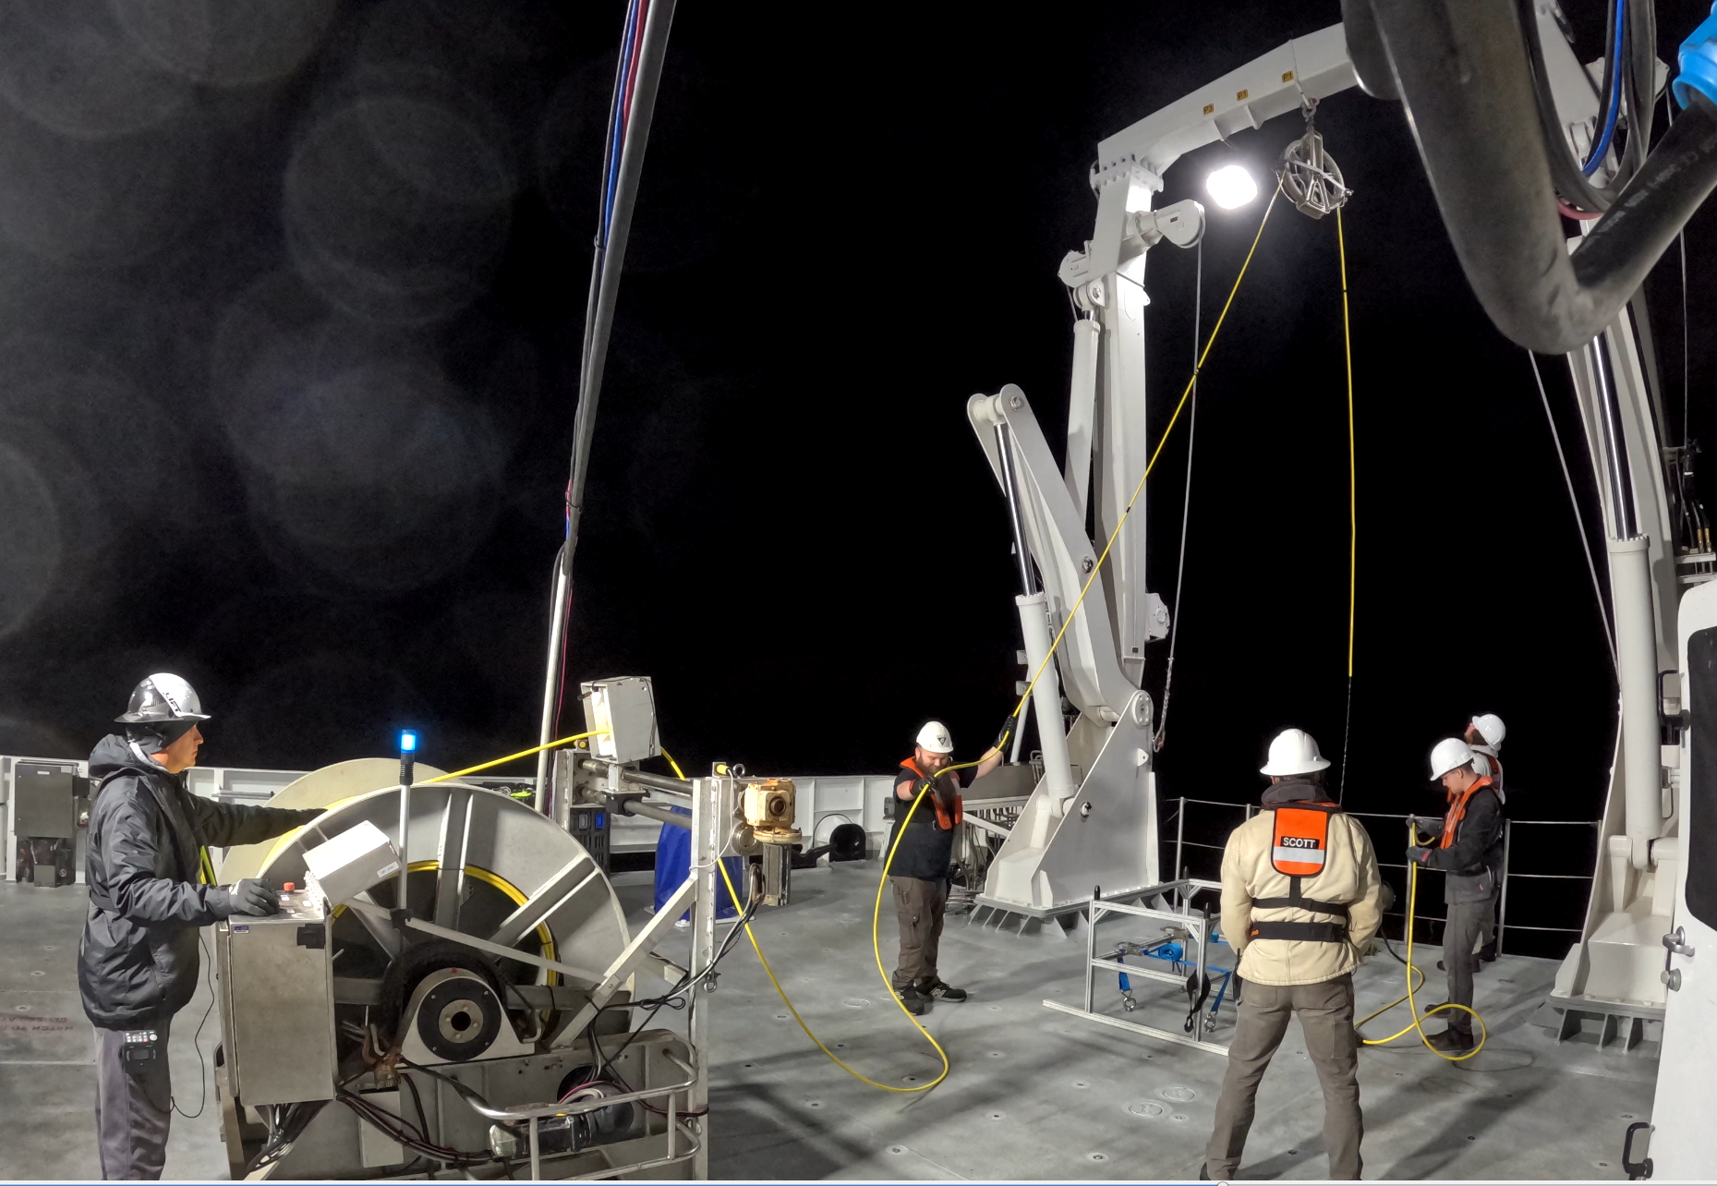
5. Pull in Slack from Smart Clump

Slide 30
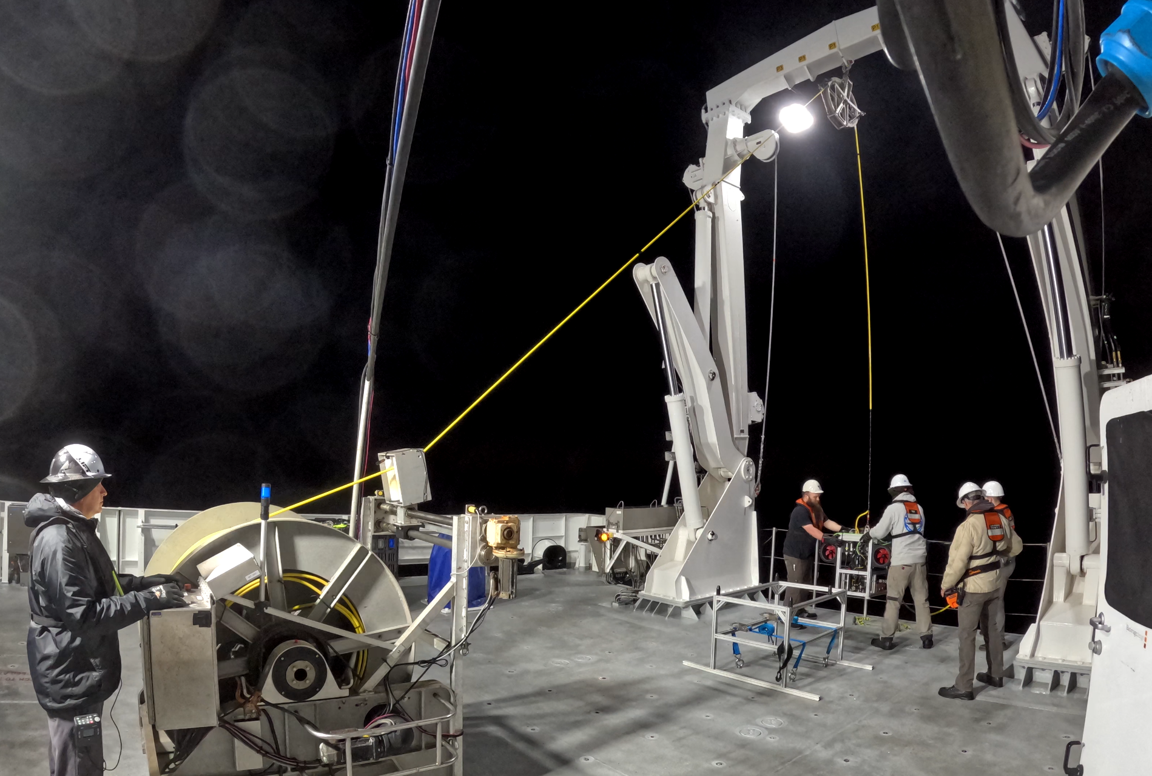
5. Lift Smart Clump over Rail
Lift up Smart Clump

Slide 31
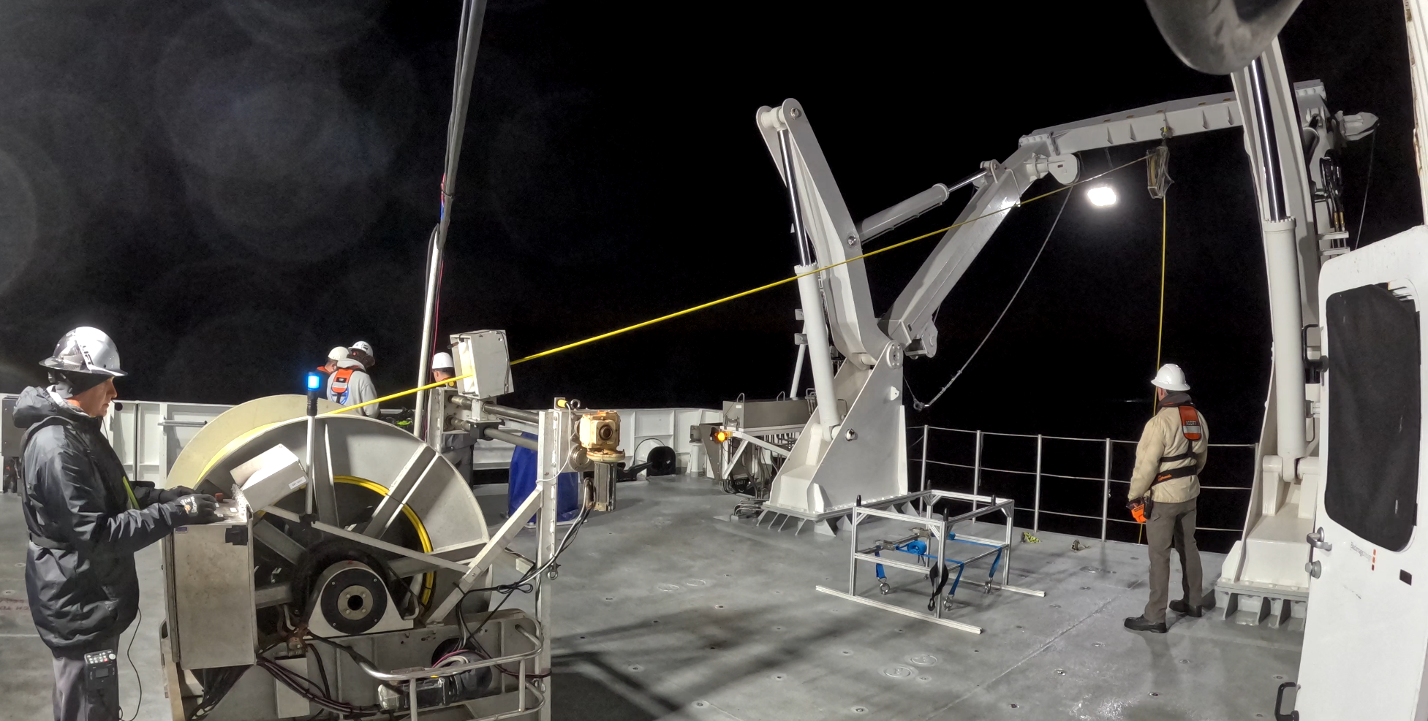
6. Extend A-frame & Lower Clump in water

Slide 32
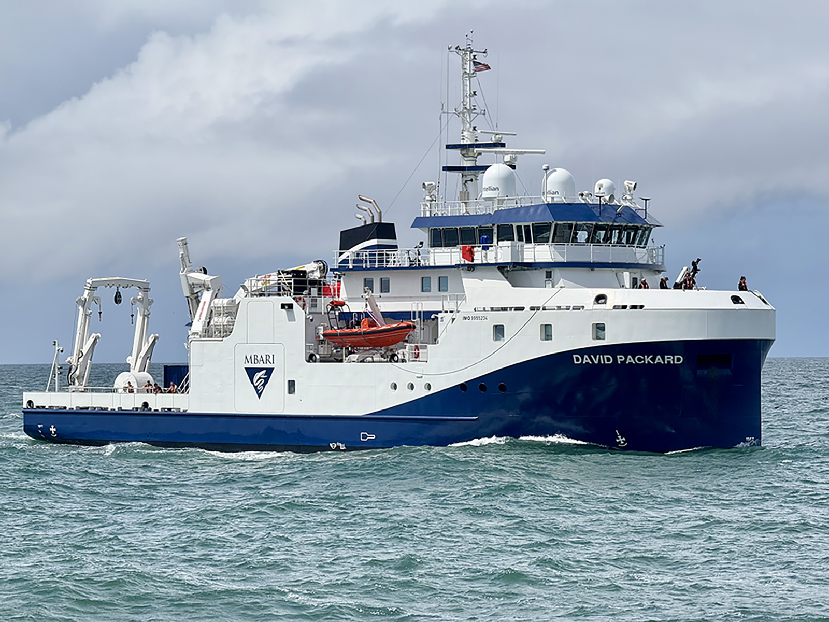
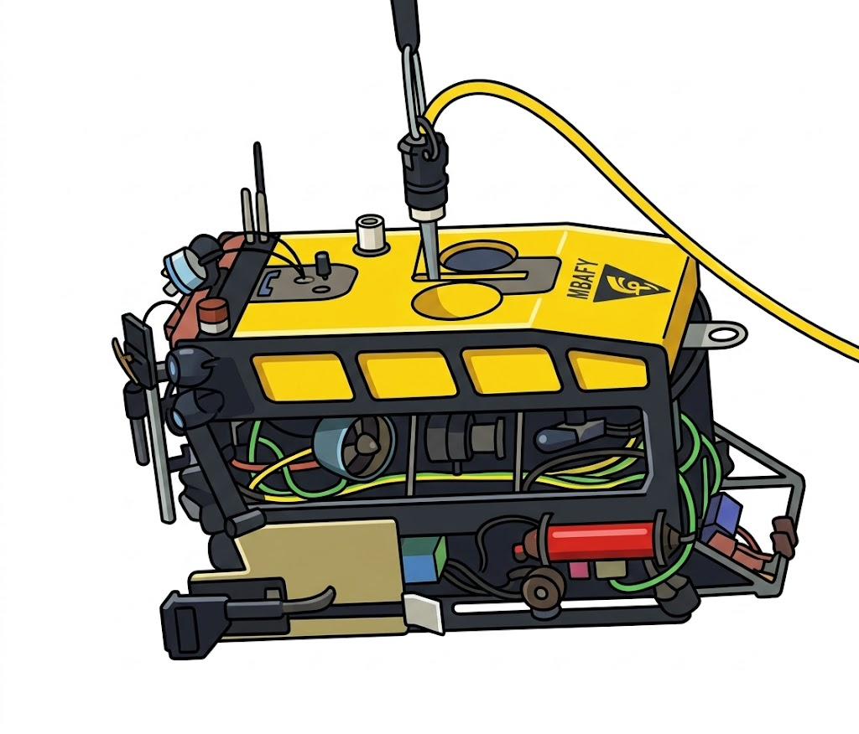
7. Begin lowering Clump and Mini simultaneously
50m Flying Tether stretched out (When on surface small floats keep cable on buoyant, limiting risk of prop entanglement)
*Once the USBL positioning system has acquired tracking and the ROV has reached 40m depth, the winch operator may continue paying out cable to allow the ROV to descend further.

Slide 33
8. System Fully Deployed
1500m max depth
We try to keep the MiniROV
Directly below the clump weight
With a vertical distance (Delta) of ~20-35m
Clump has thrusters to counteract some current, maintaining a vertical tether back to the ship.

Slide 34
Dive Procedure
During operations the ROV operators will pay attention to umbilical twisting, possibly holding on from time to time in order to unwind the cable when needed. The ROV crew may ask the Bridge to maintain a certain heading related to surface currents in order to ensure the cable is carried off the hull and propellers. The umbilical will not be paid out more than necessary for ROV to move freely, in order to avoid to get caught on the bottom.

Slide 35
Recovery Procedure
The Recovery procedure is essentially the deployment in reverse. The Smart Clump and MiniROV will rise together till about 50m below the ship. Deck crew will be in position and the captain will be notified we are ready to recover. Once everyone is ready and in position the final ascent will take place. Using Sonardyne positioning the MiniROV will be flown away down wind/current of the ship until the 50m flying tether is stretched out. The clump will be recovered and secured on deck. The MiniROV will slowly by remotely piloted back towards the ship and the latching mechanism will be slid down the tether until it locks in place. The MiniROV can then be lifted up and placed on the stand on deck.

