Slide 1
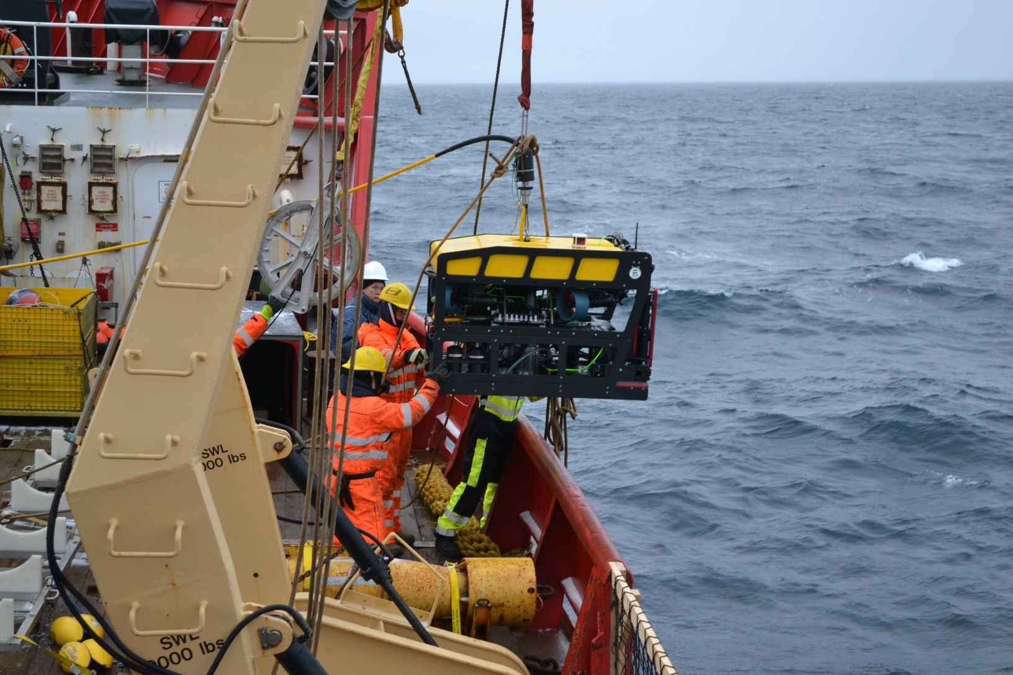
ROV Operations - 2016

Slide 2
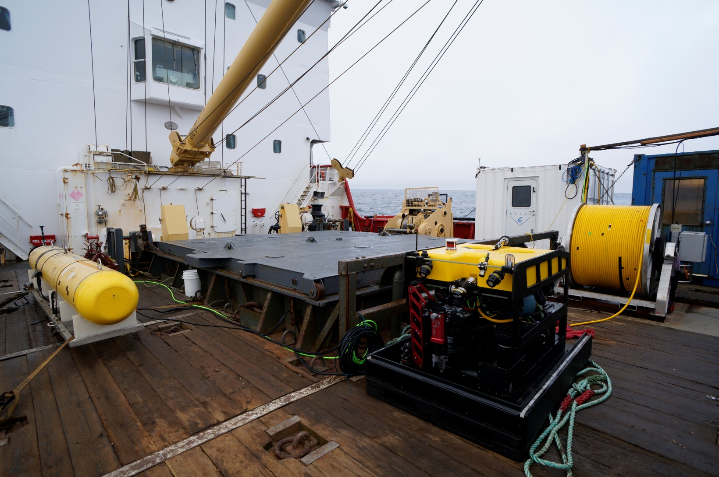
Equipment

Slide 3
Equipment (cont.)
MiniROV (1500 meter rated)
  Developed by MBARI specifically for remote ship of opportunity deployments
  HD camera
  Forward looking multibeam & scanning sonars
  5 function manipulator
  Retractable sample drawer
  Swing arm for storage of sampling gear

Slide 4
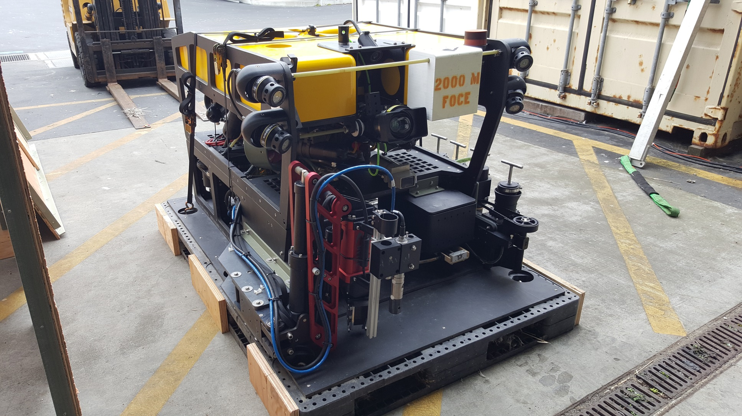
As configured for Arctic 2016

Slide 5
Equipment (cont.)
Umbilical Winch
  1700 meters of .625 EOM umbilical
  Electric drive (25 meters/min, 1500 pound lift)
    Winch is not used to pick the ROV load.
  Level wind (electric drive, manual feed)
  Emergency hydraulic disk brake
  Winch/umbilical design was upgraded in 2014

Slide 6
Equipment (cont.)
ROV Control Van
  8 x 10 modified shipping container
  480vac 3 phase 30 amp input
  Stepdown transformer to 220vac for ROV and winch
  Contains ROV topside electronics & computers
  Room for Pilot, Co-pilot and 3 to 4 scientist/guests
  Feel free to come in and watch at any time

Slide 7
Communications/feeds
VHF radios for communications between the bridge and van
  ROV personnel will communicate the any change in status of the ROV to the bridge.
We will supply a monitor and decoder for the ROV video feed on the Bridge
We will supply our Navigation display of the ROV to the bridge.
  Shows the ROV position relative to the ship.

Slide 8
Communications/feeds (cont.)

Slide 9
Operations
Vehicle deployment/recovery Latch
Belly pack controller (WIFI)
Over boarding sheave
Cable floats
Clump weight system

Slide 10
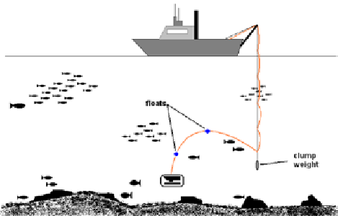
Clump Weight System
What’s the function and why does the MiniROV use one?
  Reduce umbilical drag
  Overcome limited power
Current clump weight design
  Scrap steel (150 lbs)
  USBL Transponder
Drawbacks
  Limited operating area
  2nd body to track

