Slide 1
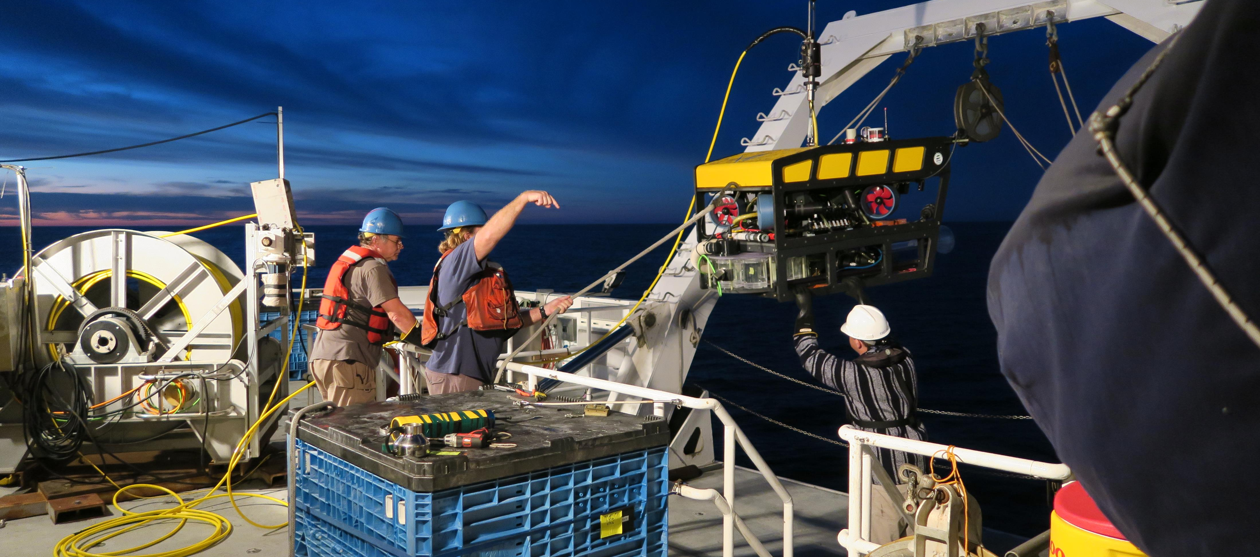
MiniROV Smart Clump

Slide 2
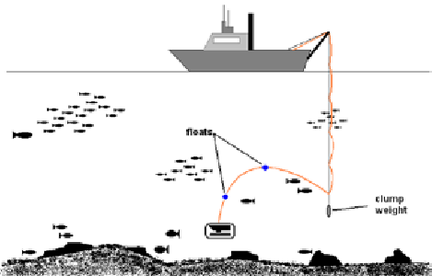
Clump Weight System
What’s the function and why does the MiniROV use one?
  Reduce umbilical drag
  Overcome limited power
Current clump weight design
  Scrap steel (150 lbs)
  USBL Transponder
Drawbacks
  Limited operating area
  2nd body to track

Slide 3
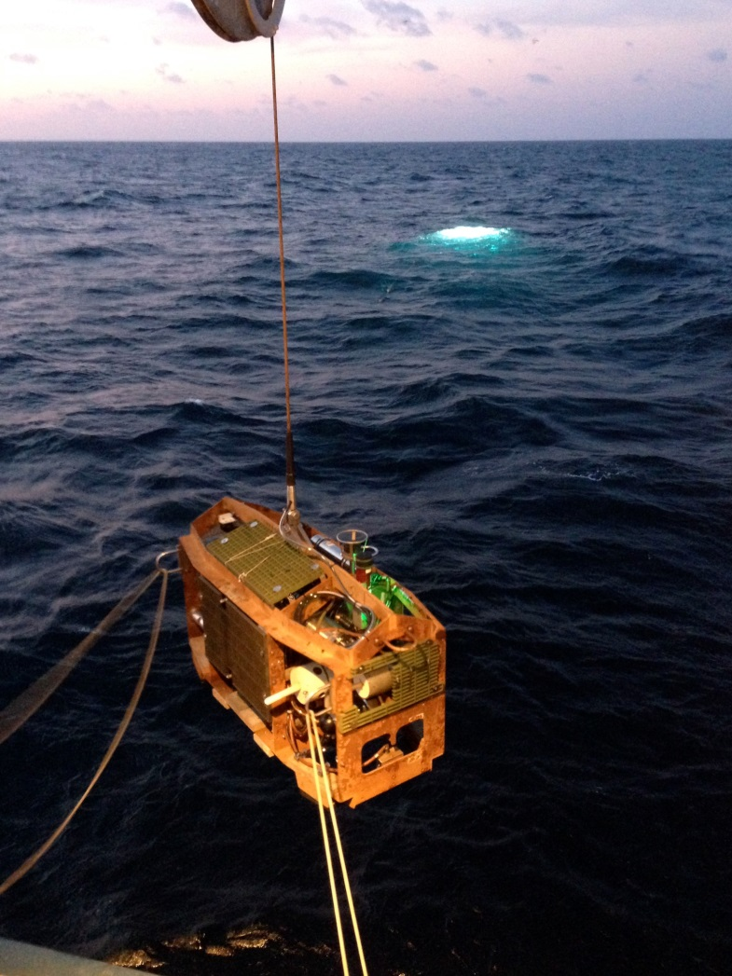
Smart Clump
What is a Smart Clump
  Main function is still a depressor weight
  Access to power & real time data link to the surface
  Addition of cameras, sensors and Instrumentation
  Beneficial to the safe operation of the vehicle
  Enhances observational capabilities

Slide 4
Benefits - Operations
Entanglement on canyon walls
  Altitude sensor and camera insures the clump is clear of the wall
Manage umbilical turns
  Measure twists from cable torque with heading sensor
Overcome bad tracking
  Camera provides feedback of the ROV position to the captain
  Increased efficiency for transects

Slide 5
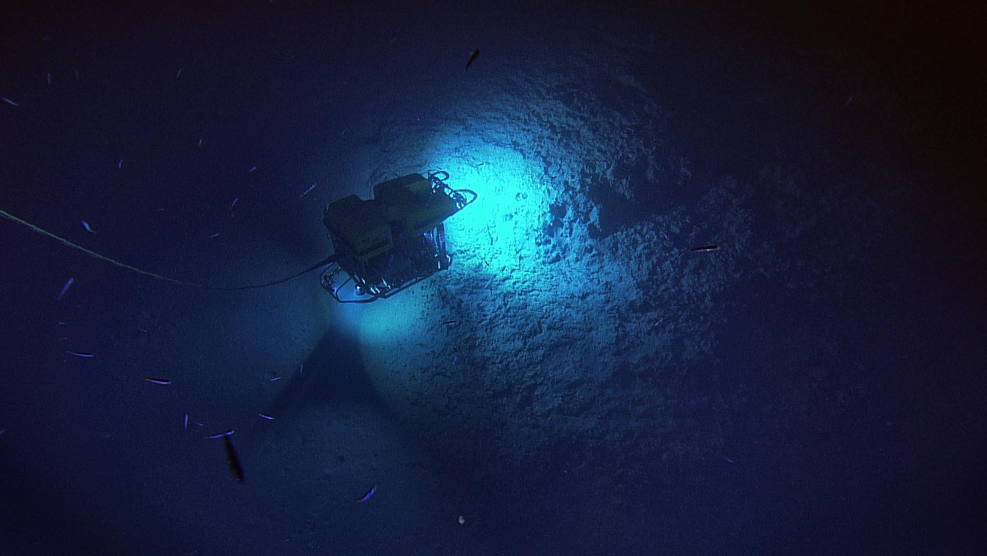
Benefits – “bird’s-eye” view
Better understanding of surrounding area

Slide 6
Design
Low design risk – its been done before
Use identical COTS hardware used on the MiniROV
  Same hardware/software architecture as the MiniROV
  No additional spares required
Reuse of software and instrument drivers
Design of 1 atm housing
Smart clump frame

Slide 7
Instrumentation
Heading – Manage umbilical turns
Altimeter – Keep clump off of the canyon walls and bottom
Depth – Maintain proper separation between ROV and clump
Camera(s) – Provides birds eye view of the ROV and surrounding area
USBL transponder – Provide position of clump
Thrusters – Maintain camera orientation and prevent turns in umbilical
Future additions – Sonar, ??

Slide 8
Budget Estimate
Labor
  Mechanical engineer 200
  Electrical engineer 80
  Software engineer 0
  Machinist 40
  Electrical tech 100
  Mechanical tech 200
Materials – still researching but should be < $50k

Slide 9
Questions

