Slide 1
Test Tank Development Platform
Abstract Presentation

Slide 2
Test Tank Development Platform
We propose to design and build a test-tank capable tethered platform to enable testing of instruments and algorithms destined for MBARI’s ROVs and AUVs.

Slide 3
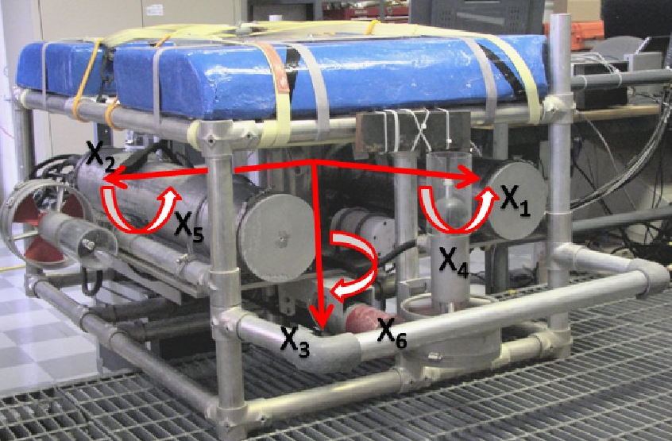
Motivation
The miniROV provides some of this utility but is often unavailable
Accelerate development cycle
Instrument development/calibration
Algorithm development
Increase likelihood of success at sea - makes better use of sea time
Johns Hopkins University test tank ROV

Slide 4
Alignment with MBARI’s Goals
This enabling technology is relevant to all the themes of our Strategic Plan. In particular, many of the initial use cases fall into the categories of Ocean Visualization and Ecosystem Dynamics
This project also aligns with the engineering opportunities outlined in the Tech Roadmap, especially taking the lab into the ocean and advancing persistent presence.

Slide 5
What is it
A tethered platform that:
  Reuses miniROV technology
  Is only test tank capable
  Has interfaces compatible with MBARI’s ROVs
  Is capable of carrying large instrument payloads
  Operable by scientists and engineers

Slide 6
What capabilities will it have
Multiple HD video channels
Standard MBARI ROV interfaces:
  Science ports
  Fiber multiplexer
  Common bus voltages
Configurable tool skid
Subset of MiniROV Labview control software
  Hooks available for direct control
Open frame concept
  Configurable thrusters
GigE
Auxiliary video cameras
Spare fibers
DVL (Optional)
BYO sensor/payload

Slide 7
Use Cases
Kakani Katija
Kelly Benoit-Bird
Matt Kemp
Steve Rock

Slide 8
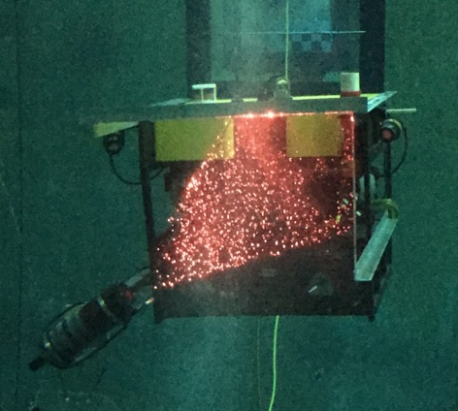
Use Cases - Katija
Kakani Katija proposes to use the TTDP to develop instrumentation that will:
  Allow for fluid visualizations of reflective surfaces
  Expand the utility of DeepPIV to measure three-dimensional fluid interactions
  Quantify temporally varying, shape-shifting surfaces for bio-inspired design applications.
Each of these instrument packages will benefit from the use of TTDP as a test bed and calibration platform prior to cruise deployments.

Slide 9
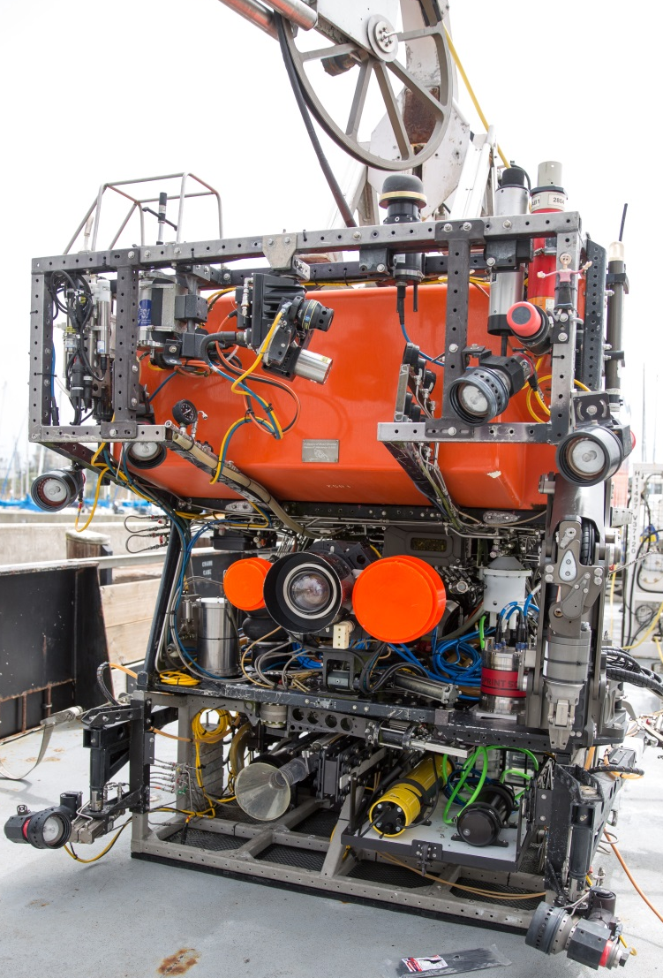
Use Cases – Benoit-Bird
Kelly Benoit Bird would use the TTDP as a development platform for new acoustic sensors, allowing her to experiment with :
Sensor placement
Integration with imaging systems
Coordinate movement, lighting, calibration and intercomparison
Facilitate the development of in situ methods including calibration approaches
“I will tell you that a test tank vehicle would have been very helpful to work out bugs! We spent a couple of hours of our cruise diagnosing cabling issues that only became clear when the ROV was in the water and had one other problem that couldn't be dealt with at sea but was easily fixed in the tank once we replicated the conditions correctly.” – KBB

Slide 10
Use Cases - Kemp
Matt Kemp could make use of TTDP for testing the docking capability of his “sea hive”, which would require thousands of test docks to ensure reliability.
Traditional ship-based approaches would be cost-prohibitive (5,000 hours of testing @ 8 hours per ship day = 62 days at sea = $5M+)
A low-logistic, flexible platform in a controlled environment like the test tank, could achieve cost-realism through testing automation.

Slide 11
Use Cases - Rock
Steve Rock could use the TTDP to aid the development of all of the vision-based control algorithms required in the Precision Control Project.
This includes algorithms for tracking midwater targets (e.g. jellies) as well as advanced control approaches for performing benthic transects using both ROVs and AUVs.
Currently, the only means of validating these control laws is to perform sea trials. The test tank platform would enable a much more time-efficient and much less costly means of performing all the preliminary tests.

Slide 12
Resource required- Estimated Expense
MiniROV Material Costs (see following worksheets)
 | MiniROV | TTDP
ROV | $247,700.00 | $63,000.00
Winch | $118,800.00
Top side gear | $62,800.00 | $26,500.00
Smart Clump (2018) | $96,250.00
Additional items | $85,000.00
Total | $610,550.00 | $89,500.00
< 5 Ventana Days
Estimated continued annual maintenance cost is ~ $5000.

Slide 13
Resources required- Estimated Labor
Machine Shop
Technicians
  Etechs: 240
  Mtechs: 480
Engineering time
  ME: 400
  EE: 300
  SE: 280

Slide 14
Other issues
Who takes care of it: Dale
Where does it live:
  Topside controls: ME lab previously used for miniROV
  Vehicle could sit where nitrogen tanks were previously stored
If needed this project can be split over two years to lessen financial and labor impact

