Slide 1
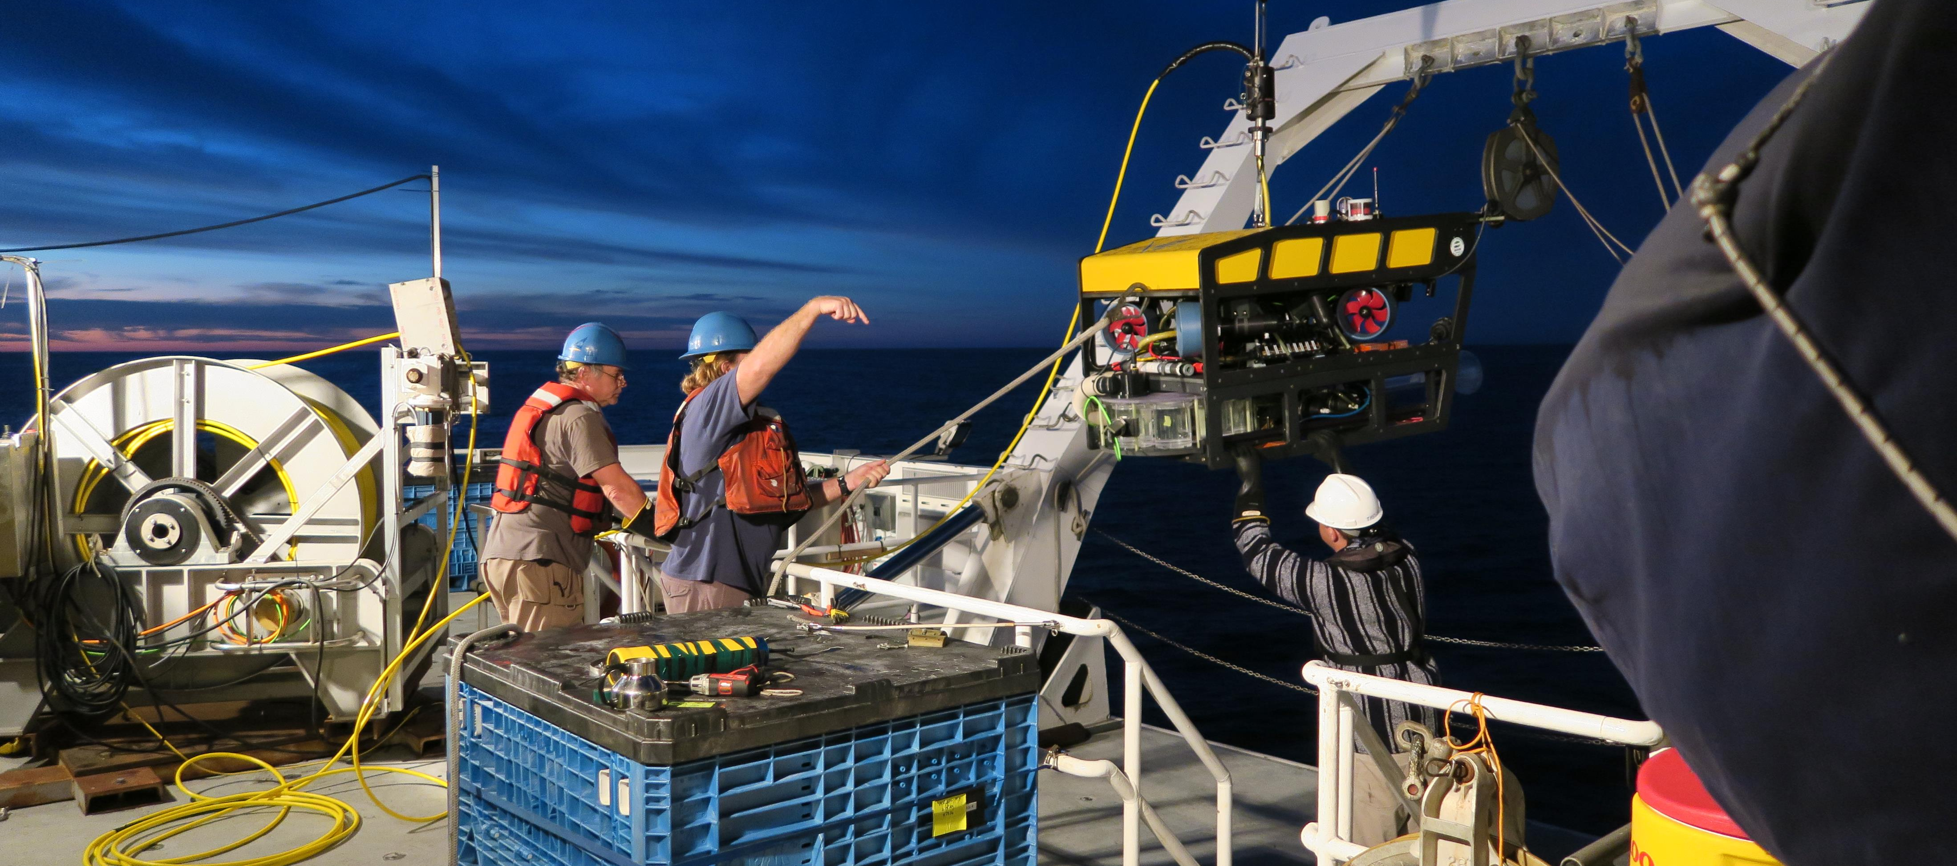
MiniROV Smart Clump Preliminary Design Review

Slide 2
PDR Agenda
Background
Review of design requirements
Mechanical design
Electrical design
Software
Operational considerations

Slide 3
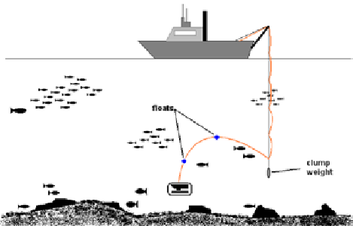
Clump Weight System - Background
What’s the function and why does the MiniROV use one?
  Reduce umbilical drag
  Overcome limited power
Current clump weight design
  Scrap steel (150 lbs)
  USBL Transponder
Drawbacks
  Limited operating area
  2nd body to track

Slide 4
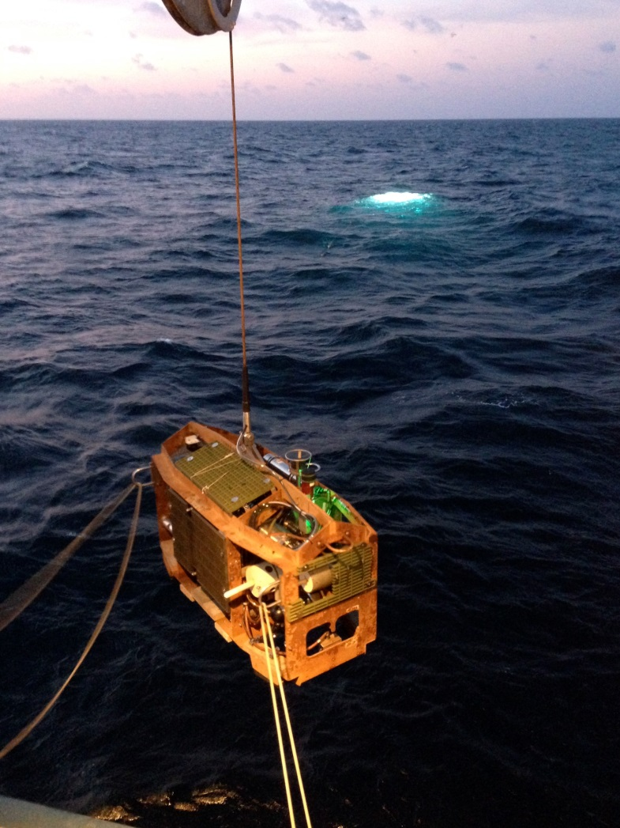
Smart Clump
What is a Smart Clump
  Main function is still a depressor weight
  Access to power & real time data link to the surface
    Addition of cameras, sensors and Instrumentation
  Beneficial to the safe operation of the vehicle
  Enhances observational capabilities

Slide 5
Functional Requirements
ROV operations not dependent on the Smart Clump
  Can be quickly removed and revert back to standard clump configuration
Camera(s) to provide bird’s eye view of the surrounding area
  Assist with navigation
Instrumentation to assist with the positioning of the clump in relation to the seafloor/ROV
Thrusters to assist with position/rotation of the clump
  Assist with transecting
  Assist with tether turns/monitoring
  Assist with camera orientation
Clone MiniROV technology/components to reduce risk

Slide 6
Proposed Design
Low risks
  Use identical COTS hardware used on the MiniROV
    Same hardware/software architecture as the MiniROV
    No additional spares required
  Reuse of software and instrument drivers
Risks
  Manage additional flying tether during Launch & recovery
  Mechanical termination of umbilical at clump weight

Slide 7
Proposed Design - Instrumentation
Heading – Navigation/Manage umbilical turns
Altimeter – Keep clump off of the canyon walls and bottom
Depth sensor – Maintain proper separation between ROV and clump
Camera(s) (HD & analog)– Provides birds eye view of the ROV and surrounding area
  Assist with tracking of the ROV and navigation of the ship
USBL transponder – Provide position of clump
Camera tilt
Thrusters(2) – Maintain camera orientation and prevent turns in umbilical
Sonar

Slide 8
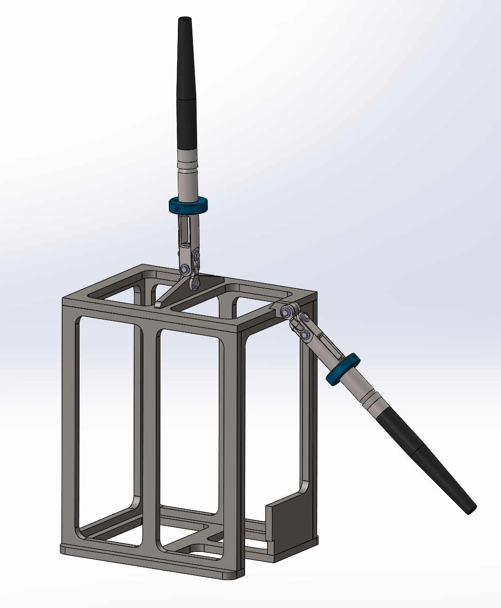
Proposed Design – Mechanical
Simple galvanized open steel frame structure
Try to keep all instrumentation inside frame for protection
Pull two pins and umbilical is disconnected from clump and can be attached directly to the ROV.

Slide 9
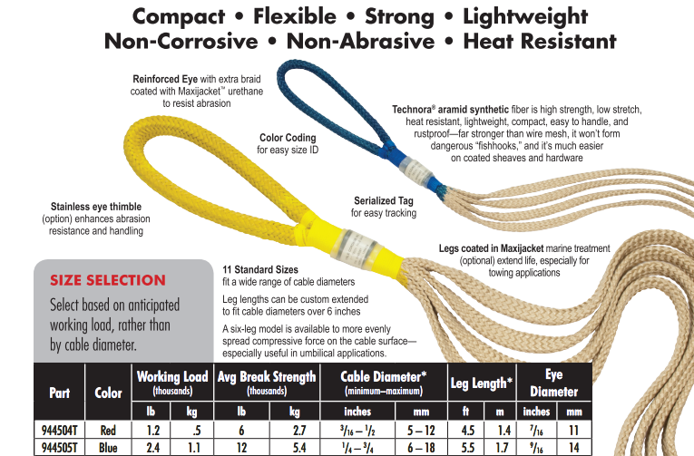
Proposed Design – Mech. (continued)
Try to reuse tether termination/bullet assembly
  Current grip ABS = 2400 lbs
SWL = (Clump + vehicle drag)x 1.75 x 5
  Clump = 250 pounds
  Est. drag force = 200 pounds
  450 x 1.75 x 5 = 3937
Upgrade tether mechanical termination with Yale cable grip (ABS = 6000 lbs)
Test mech. termination for jacket failure @ 4000 lbs.

Slide 10
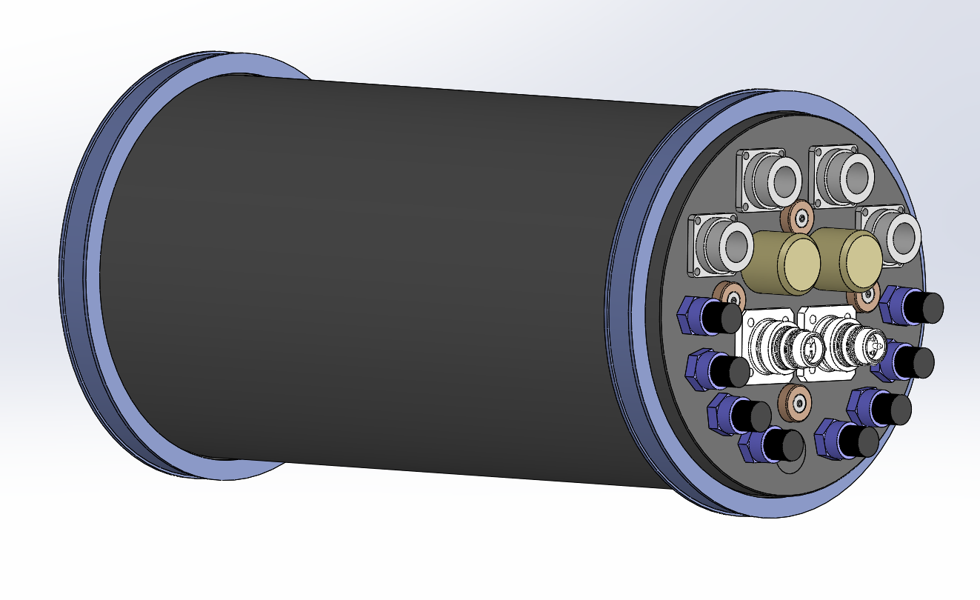
Proposed Design – Mech. (continued)
New EPOD housing
  7” ID X 15” L
  1500 Meter rated
  Anodized 6061-T6
  All penetrations on one endcap
  New low cost single pass fiber connector.

Slide 11
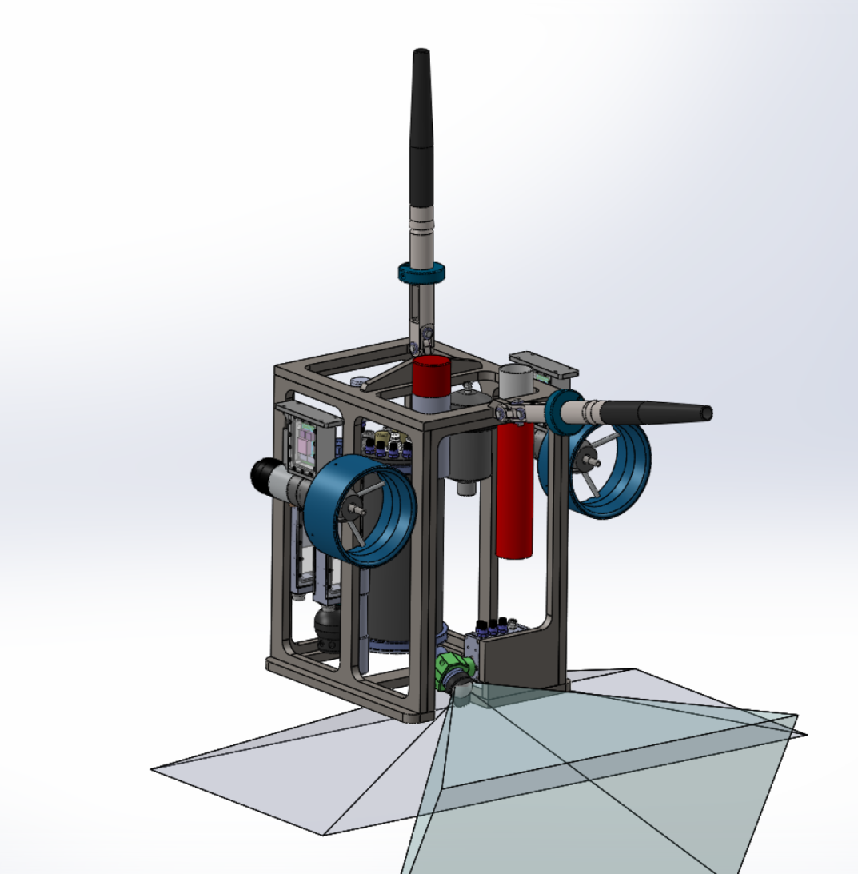
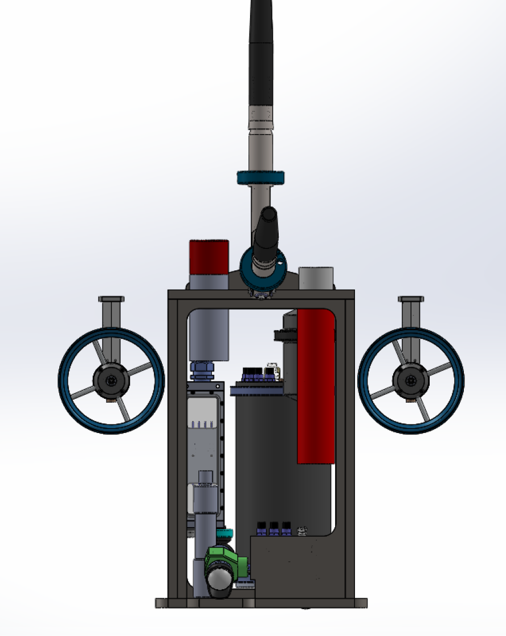
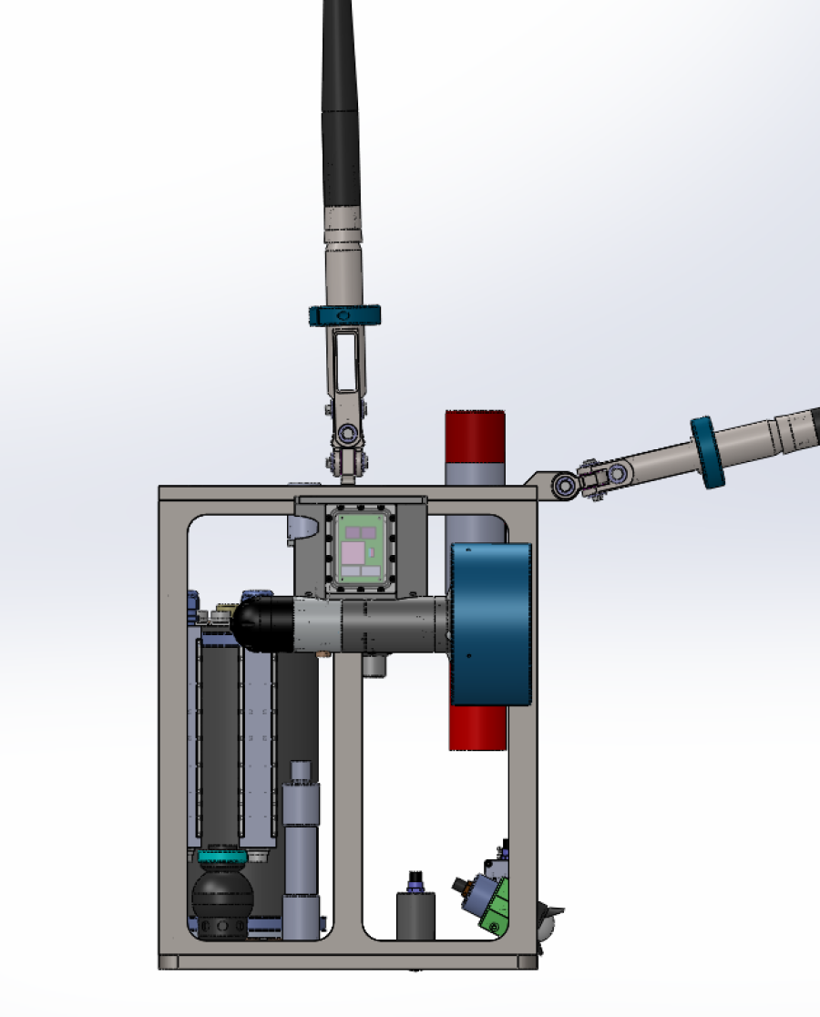
Proposed Design - Mechanical Layout

Slide 12
Proposed Design - Electrical
Overview of system
High voltage power routing through Smart Clump and MiniROV
Power budget and considerations

Slide 14
Proposed Design – Smart Clump EPod
ALL components of Smart Clump Epod currently exist in MiniROV Epod
Focal fiber mux provides:
  3 channels video
  6 channels serial comms
  CWDM board adds two channels of HD video
Terminal blocks and fuse blocks distribute +24V, +5V, Frame Gnd, +375V
Wago modules provide Digital I/O, Analog I/O, can temp sensing
Two GFMs monitor low voltage GFs for +24 bus, +5V bus, +48V bus (thrusters)
GFI monitoring of +375V done on topside

Slide 15
Proposed Design – High Voltage Routing
Existing system

Slide 16
Electrical – Power Considerations: Umbilical
Umbilical length = 1710 m
Total round trip resistance = 9.2 Ohms
Min Voltage for Vicors = 250 V
Max Voltage for Vicors = 425 V
Max current capacity of umbilical = 24 A
Topside power supply provides 600 Vmax, 10 kWatts
Maximum power delivery to bottom side calculated ~ 4.7 kWatts (254V at vehicle)

Slide 17
Electrical – Smart Clump Power Budget
load | Man./Model | qnty | voltage (Volts) | current (Amps) | power per unit (Watts) | Total power (Watts)
+24V
HD Camera | DSP&L, HD Multi Seacam | 1 | 24 | 0.0833 | 1.9992 | 1.9992
Light | DSP&L, LED Sealite | 1 | 24 | 4.42 | 106.08 | 106.08
Altimeter/Depth | Valeport, VA500 | 1 | 24 | 0.0625 | 1.5 | 1.5
Aux Cam | DSP&L, Super Wide-i Seacam | 1 | 24 | 0.145 | 3.48 | 3.48
Sonar | Imagenex, 881A | 1 | 24 | 0.208 | 4.992 | 4.992
Tilt | MBARI | 1 | 24 | 2 | 48 | 48
Wago Stack | Wago | 1 | 24 | 0.5 | 12 | 12
Hotel load Epod | GFM, Relays, SSRs, Fan | 1 | 24 | 0.5 | 12 | 12
 |  |  |  |  | SUM | 190.0512
+5V
Fiber Mux | Focal 907-R/C | 1 | 5 | 2 | 10 | 10
Heading | PNI, Fieldforce TCM | 1 | 5 | 0.12 | 0.6 | 0.6
Hotel load | Rattler, humidity | 1 | 5 | 0.25 | 1.25 | 1.25
 |  |  |  |  | SUM | 11.85
+48V
Thrusters | MBARI | 2 | 48 | 9 | 432 | 864
 |  |  |  |  | SUM | 864.00
Total Power |  |  |  |  |  | 1065.90
Total Power- PreConverter |  |  |  |  | At 85% eff | 1225.79

Slide 18
Electrical – Power Considerations
Top side power supply current measurements from last two years:
Date | Max Current Draw topside @ 400V | Deployment
2/4/2017 | 8.07 | Flyer
2/6/2017 | 8.2 | Flyer
10/1/2016 | 8.08 | Arctic
9/27/2016 | 8.02 | Arctic
9/26/2016 | 8.1 | Arctic
5/5/2016 | 6.87 | Carson
5/3/2016 | 5.38 | Carson
Power draw never exceeded 8.2A @400V = 3.28 kWatts
Estimated max power at vehicle 2.66 kWatts

Slide 19
Proposed Design – Power Considerations
Total combined power for vehicle (all components consuming maximum power draw) is calculated at 4 kW BUT all loads never drawing maximum power at once
Realistic worst case vehicle power draw (all thrusters, lights, core instruments on) calculated to be 3.3 kW
Measured maximum power draw from field deployments over the past two years ~ 2.66 kW
Thus:
4.7 kW available power on bottom side
1.2 kW power for smart clump
2.66 kW measured worst case
= 0.84 kW based on power measurements
(= 0.2 kW remain in calculated worst case scenario )

Slide 20
In Summary
In practice the vehicle is using about half of the total power capacity and a conservative estimate is that the clump will consume 1/3 of the power of the vehicle
Current to the clump/ROV and voltage at the ROV can be measured and trigger an alarm
There is enough reserve in the original design to handle the additional power consumption of the clump

Slide 21
Proposed Design – Software
LabVIEW Development
  Incorporated into existing ROV GUI
  Auto Heading (AH) function
  Delta function – displayed on GUI and overlay
  Joystick lock function – Hands free mode for transects
  Reuse existing instrument drivers for depth, heading, thrust, AH and tilt
  Small Co-pilot USB joystick controller topside

Slide 22
Operations – Launch
Deck setup
  Vehicle and clump staged on well deck.
    Clump must be secured to prevent accidental over-boarding during launch
  (new) 50 meters of flying tether must be stored (figure eighted) on deck
    Floats can be pre-attached now.
  (new) tether is not in over-boarding sheave
Launch
  Deploy ROV with release as normal
  Fly ROV away as previously done, but now the flying tether is hand tended from figure eight.
  As ROV flies away, the clump’s umbilical can be loaded into the sheave

Slide 23
Operational Considerations - Pros
Entanglement on canyon walls
  Altitude sensor and camera insures the clump is clear of the sea floor/wall
Manage umbilical turns
  Measure twists from cable torque with heading sensor
Overcome bad tracking
  Camera provides feedback of the ROV position to the pilot/captain
  Increased efficiency for transects
Better understanding of surrounding area (Bird’s eye view)
Possibly extend the life expectancy of the umbilical.

Slide 24
Operational Considerations - Cons
Can’t remove Clump during launch & recovery
  Unable to spool flying tether section onto winch drum.
    Can’t restrain payout of tether
  Must deal with 50m of tether on deck.
Increase complexity of system – more things can break, more to maintain.
Impact on reliability?

Slide 25
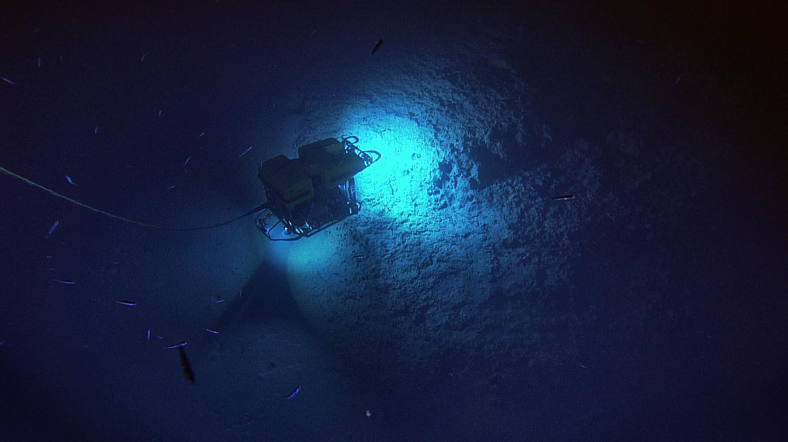
Questions

Slide 26
MiniROV Power Budget
load | Man./Model | qnty | voltage (Volts) | current (Amps) | power per unit (watts) | Total power (Watts) |  | Watts
+5V
Heading | PSN ForceField TCM | 1.00 | 5.00 | 0.120 | 0.60 | 0.60
Fiber Mux | Focal 20907 | 1.00 | 5.00 | 1.000 | 5.00 | 5.00
GigE-Fiber | Focal Dual GigE | 1.00 | 5.00 | 1.500 | 7.50 | 7.50
Humidity Sensor | TE connectivity HM1520 | 1.00 | 5.00 | 0.008 | 0.04 | 0.04
Lasers | OIS Model 400-37 | 2.00 | 5.00 | 0.040 | 0.20 | 0.40
Depth sensor | Valeport ultra-p? | 1.00 | 5.00 | 0.040 | 0.20 | 0.20
Serial Expansion | Focal 907-SER | 1.00 | 5.00 | 1.500 | 7.50 | 7.50
 |  |  |  |  |  |  | 5V Power Sum | 21.24
+12V
CTD | FSI micro-CTD | 1.00 | 12.00 | 0.120 | 1.44 | 1.44
Science port | Science port | 2.00 | 12.00 | 1.000 | 12.00 | 24.00
Rattler | Rattler | 1.00 | 12.00 | 0.050 | 0.60 | 0.60
 |  |  |  |  |  |  | 12V Power Sum | 26.04
+24V
Color Pencil Cam | Insite Tritech Nova | 2.00 | 24.00 | 0.175 | 4.20 | 8.40
Sonar | Imagenex 881A | 1.00 | 24.00 | 0.200 | 4.80 | 4.80
B&W Camera | Insite Tritech IT-1000 | 1.00 | 24.00 | 0.150 | 3.60 | 3.60
Lights (Mains) | DSPL Multi-SeaLite | 4.00 | 24.00 | 3.200 | 76.80 | 307.20
Lights (Secondary) | DSPL Nano sealites | 2.00 | 24.00 | 0.583 | 13.99 | 27.98
DVL | Rowe RTDP1200DR | 1.00 | 24.00 | 0.170 | 4.08 | 4.08
Tilt motor | MBARI stock | 1.00 | 24.00 | 1.000 | 24.00 | 24.00
Manipulator | ECA ARM-5E | 1.00 | 24.00 | 5.000 | 120.00 | 120.00
Controller | Wago stack | 1.00 | 24.00 | 1.000 | 24.00 | 24.00
HD Cam | Insite Pacific MiniZeus II | 1.00 | 24.00 | 0.300 | 7.20 | 7.20
Drawer Motor | MBARI stock | 1.00 | 24.00 | 2.000 | 48.00 | 48.00
Swing Arm | MBARI stock | 1.00 | 24.00 | 2.000 | 48.00 | 48.00
+24V Relays | Crydom CMXE100D10 | 4.00 | 24.00 | 0.012 | 0.29 | 1.15
HV Solid state relays | Crydom SSC800-25-24 | 2.00 | 24.00 | 0.015 | 0.36 | 0.72
Science Port |  | 2.00 | 24.00 | 0.500 | 12.00 | 24.00
 |  |  |  |  |  |  | 24V Power Sum | 653.14
+48V
Thrusters | Cleveland Mtr | 6.00 | 48.00 | 9.000 | 432.00 | 2592.00
Suction sampler | Cleveland Mtr | 1.00 | 48.00 | 9.000 | 432.00 | 432.00
 |  |  |  |  |  |  | 48V Power Sum | 2592.00
Total Power |  |  |  |  |  | 3724.42
Total Power- PreConverter |  |  |  |  | At 85% eff | 4096.86

Slide 27
Proposed Design - Electrical
Total combined power for vehicle (all components consuming maximum power draw) = 4 kW
Realistic worst case vehicle power draw (all thrusters, lights, core instruments on) ~ 3.3 kW
load | qnty | voltage (Volts) | current (Amps) | Total power |  | Watts
+5V: Heading, Focal Stack, Lasers, Depth, Humidity | 1.00 | 5.00 | 4.208 | 21.04 | 5V Power Sum | 21.04
+12V: CTD, Rattler | 1.00 | 12.00 | 0.170 | 2.04 | 12V Power Sum | 2.04
+24V: Aux Cams, Sonar, Lights, DVL, Controller, HD Cam, Sci Ports, Hotel load | 1.00 | 24.00 | 16.040 | 385.15 | 24V Power Sum | 385.15
48V: Thrusters | 6.00 | 48.00 | 9.000 | 2592.00 | 48V Power Sum | 2592.00
Total Power |  |  |  |  |  | 3000.23
Total Power- PreConverter |  |  |  |  |  | 3300.26
Does not include suction pump (400 W), manipulator (120 W), draw motor (48 W), and swing arm (48 W) – none of these loads would likely be in use when all thrusters are on.

Slide 28
Umbilical Power Loss Calculations
SOUTH BAY
1700 m tether calculated based on acceptance testing |  | Units
Tether length | 1710.00 | m
13 AWG conductor resistance | 7.58 | Ohms/km
3 pair 13 AWG | 2.53 | Ohms/km
total resistance for round trip | 9.20 | Ohms
Max Safe Current for 13 AWG conductor | 8.00 | A
topside voltage | 425.00 | V
Current to vehicle | 18.50 | A
drop in cable @ specified current | 170.22 | V
Voltage @ veh for specified current | 254.78 | V
power @veh for specified current | 4713.34 | Watts
power on deck | 7862.50 | Watts

Slide 29
GFI Block Diagram
Mechanical Relay
SSR
MiniROV
Power
Supply
+400 VDC from Power Supply
+400 VDC to Umbilical
Sense
Ground Fault
Interrutper
Seawater Gnd
To Ship Hull

