Slide 1
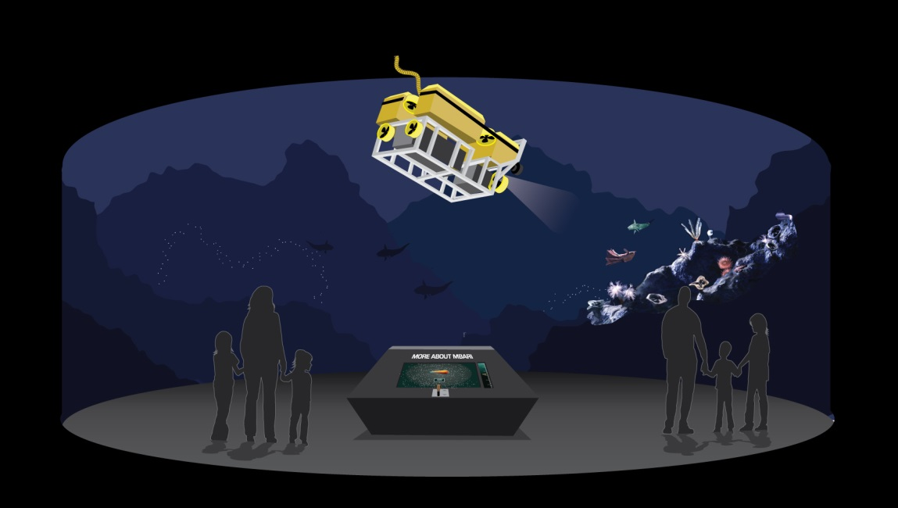
MBA/MBARI AMP Exhibit
PDR
09May2014

Slide 2
Tasks for MBARI
Support/Animation Structure
  Suspension Framework
  Rotation Framework
    Drive Mechanism
      Rate: .25 rev./Minute
    Control hardware/Software
  Tilt/Lifting Mechanism(s)
    Drive Mechanism(s)
      Lifting Rate: 1 inch/Second
  Drape/Camouflage
ROV
        Frame Structure
          Weight Limit ~ 100#
      Foam Pack
          Weight Limit ~50#
          Accessory Mock-ups

Slide 3
9May2014
Preliminary Design Review
  Design Concepts
  Technical Issues
  Exhibit interfaces
    Suspension Framework
    Animation Platform
    Scaled ROV Model
  Update on MBA exhibit space and film
18June2014
Critical Design Review
  Detailed Design
  Project Progress
  Risk Management
  Update on MBA Film, Console, Equipment
01August2014
Final Design Review
  Component Testing and Interfacing
  Integration Details
29August2014
Delivery to MBA of Animated ROV Assembly
MBARI budget for project: $10,000

Slide 4
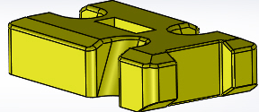
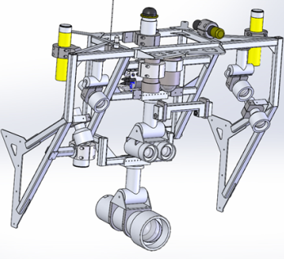
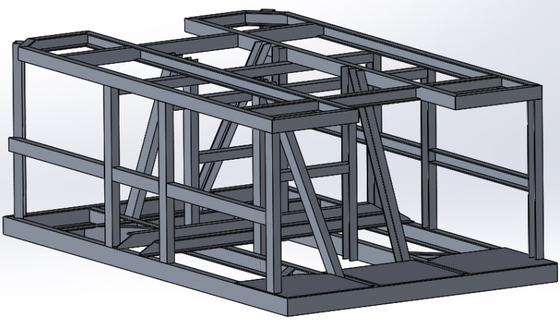
Foam Pack
Light Bar
and Components
Frame

Slide 5
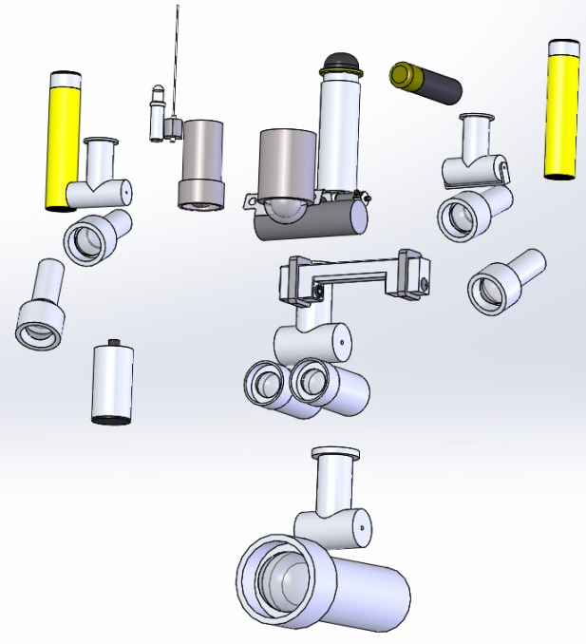
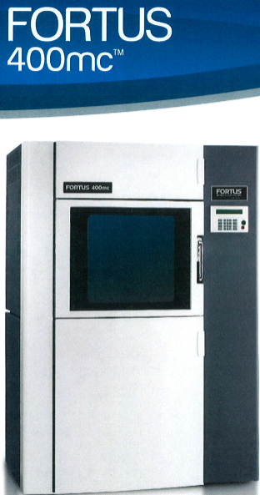
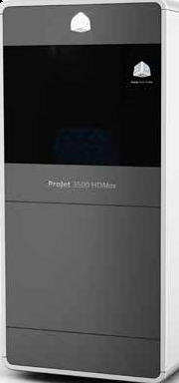
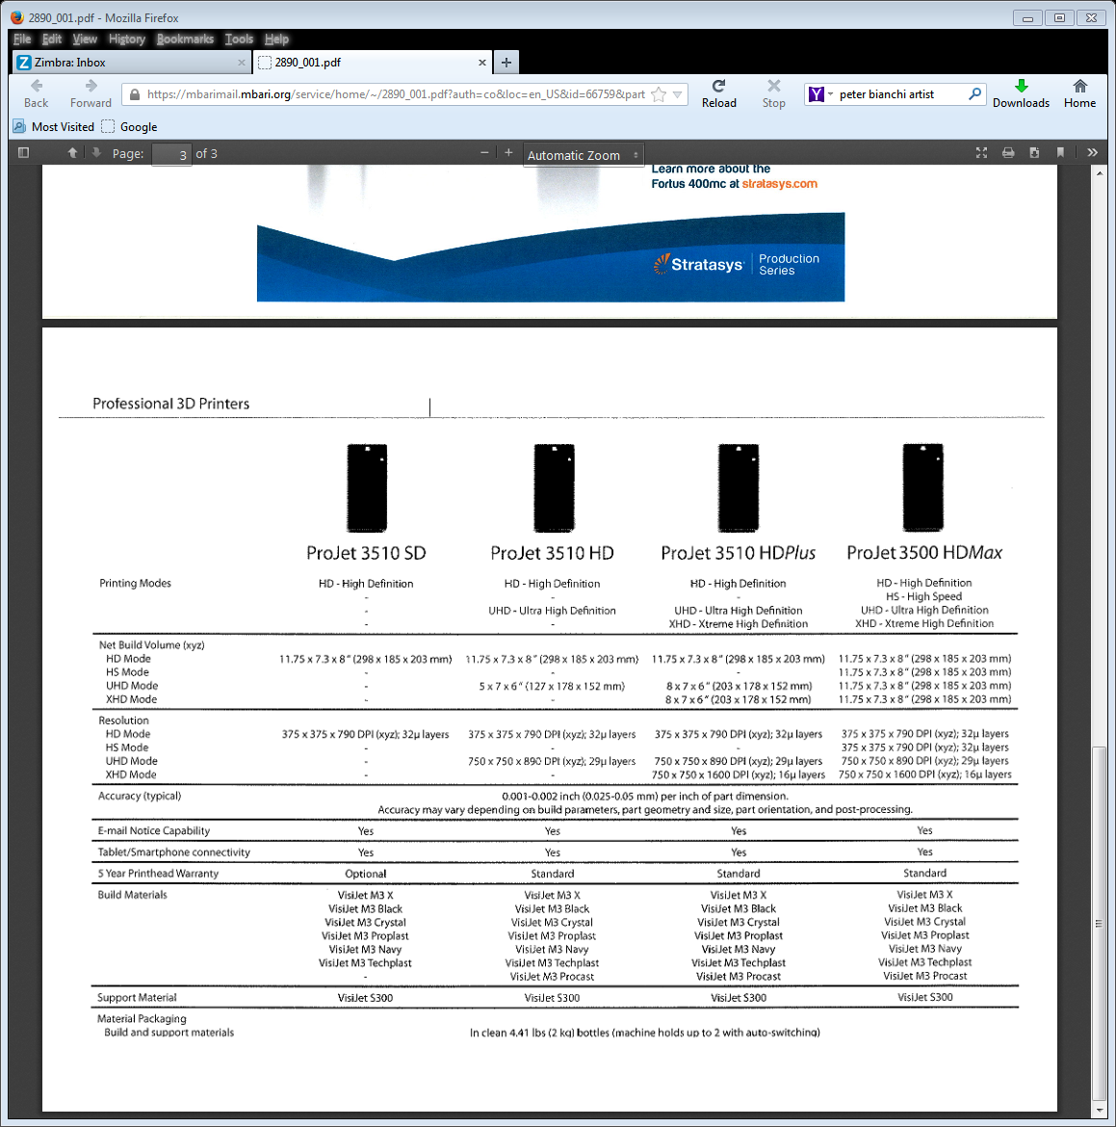
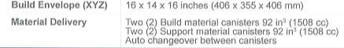
Scaled Component
Fabrication
ProJet 3500 HDMax

Slide 6
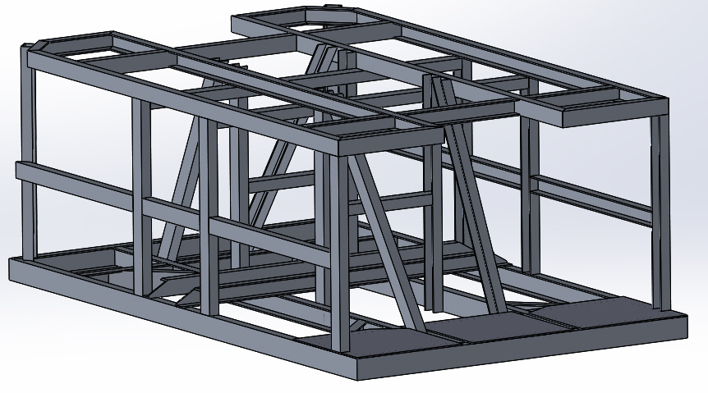
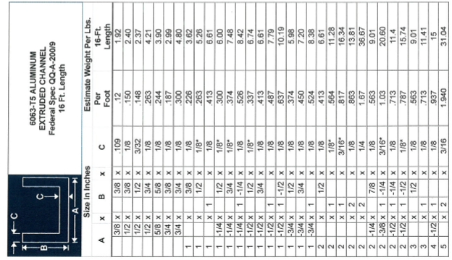
ROV Frame
21.6”
58.6”
35.3”
6063 -T5 Aluminum Channel
~ 56#

Slide 7
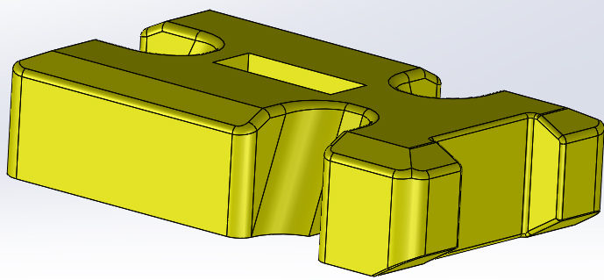
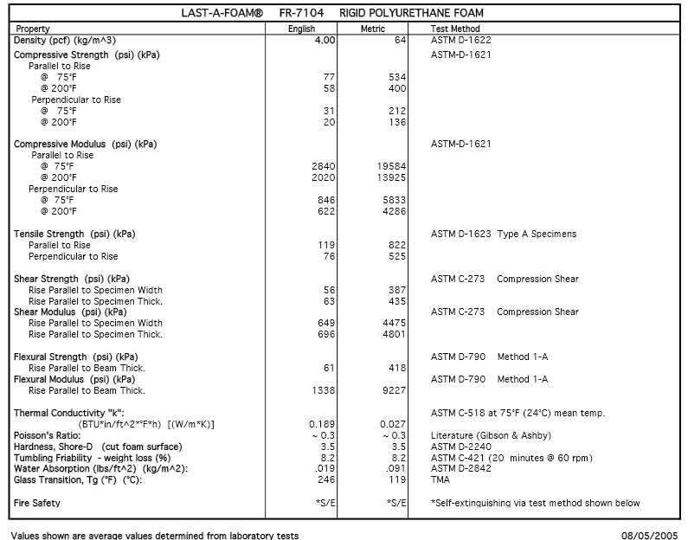
ROV FOAM
14.6”
61”
35.3”
23517 Cu. in - ~54.4#
Advantages /Applications
Fine cell structure supports very smooth finishes
Closed-cell foam does not absorb water or moisture
Easily painted and bonded
Economical and versatile
Dimensionally stable – will not warp, twist or bow
Grain-free surface
Easily shaped with a variety of cutting processes
Proofing NC/CNC machine programs
Prototype models

Slide 8
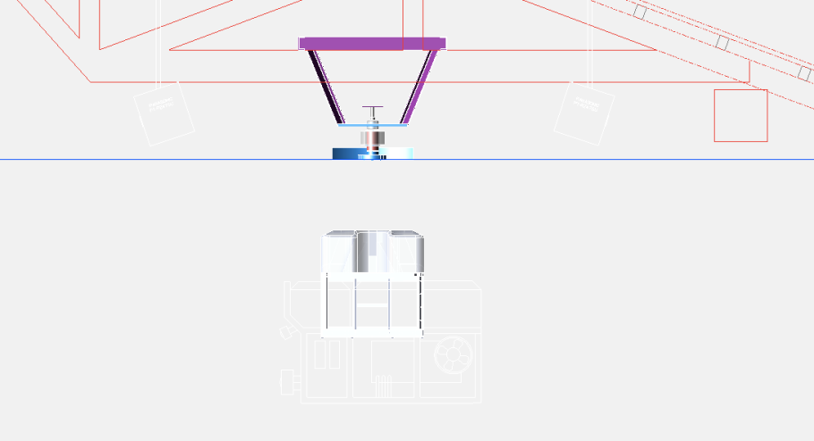
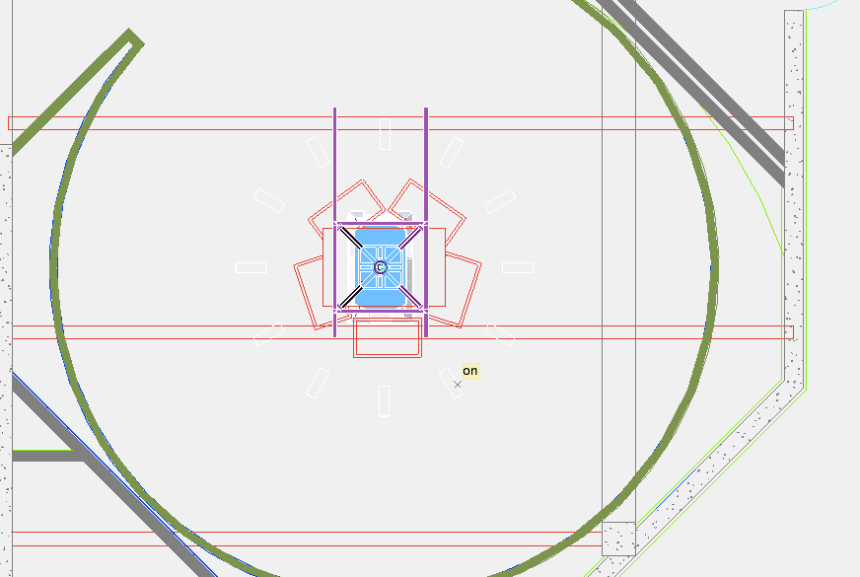
Preliminary Illustration of ROV and Animation Platform
Side View
Top View

Slide 9
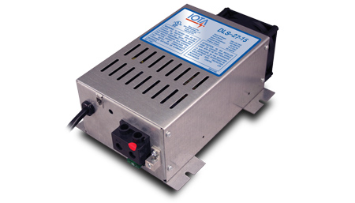
SPECIFICATIONS
DC Output Voltage (No Load) approx. 27.2V (DC)
Output Voltage Tolerance (No Load) + or - .5%
Output Amperage, Max Continuous 15 Amps
Output Voltage (Full Load) approx. >27.0V (DC)
Maximum Power Output, Continuous 400 Watts
Ripple and Noise <100 mV rms
Input Voltage Range 108-132V (AC)
Input Voltage Frequency 47-63
Maximum AC Current @ 108VAC 7.3 Amps
Typical Efficiency >80%
Max Inrush Current, Single Cycle 30 Amps
Short Circuit Protection Yes
Overload Protection >100%
Line Regulation 100 mV rms
Load Regulation <1%
Fan Control Proportional
Thermal Protection YES
Working Temperature Range 0°- 40°C
Storage Temperature -20° to 80°C
Withstand Voltage (VDC)* 1700/1700/500
Dimensions 9.7" x 6.7" x 3.4"
Weight 4.5 lbs
Switch-mode technology
Exceptionally clean DC output
Tight line-load regulation
Quickly and efficiently charges batteries
Designed to withstand low transient AC line voltage
Current limit and thermal/overload protection
Lower operating temperature
Quiet fan operation
External reverse polarity fuse protection from incorrect battery connection
High and normal-stage charging jack

Slide 10
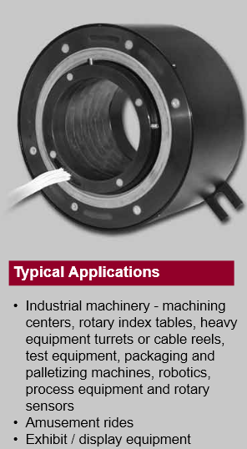
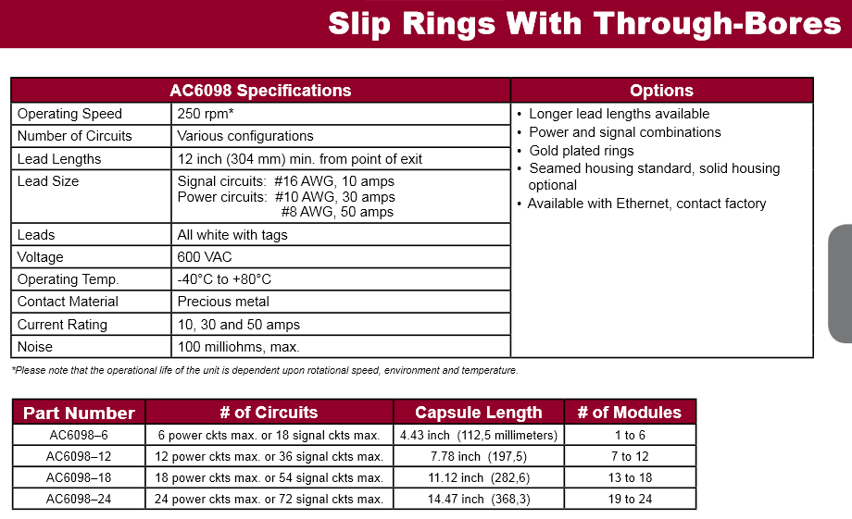
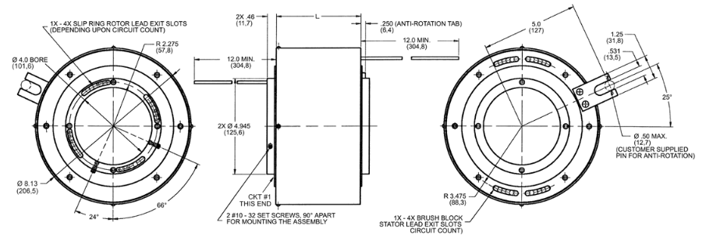

Slide 11
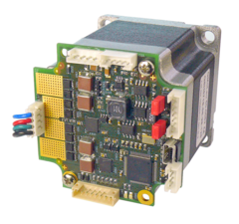
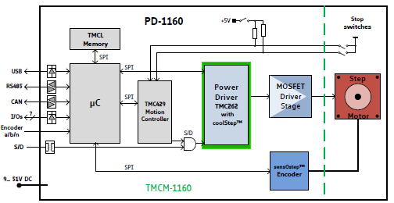
Stepper Motors and Controllers
Motion controller
Motion profile calculation in real-time
High performance microcontroller for overall system control and
serial communication protocol handling
Bipolar stepper motor driver
Up to 256 microsteps per full step
Encoder
sensOstep magnetic encoder (1024 increments per rotation)
e.g. for step-loss detection under all operating conditions and
positioning supervision
Interface for connection of external incremental a/b/n encoder
Interfaces
- RS485 interface
- CAN (2.0B up to 1Mbit/s) interface
- USB full speed (12Mbit/s) interface
- Step/Direction interface (optically isolated)
3 inputs for stop switches and home switch (+24V compatible)
with programmable pull-up
2 general purpose inputs (+24V compatible) and 2 general purpose
outputs (open collector)
Incremental a/b/n encoder interface (TTL and open-collector signals
supported directly)
Safety features
Separate supply voltage inputs for driver and digital logic – driver
supply voltage may be switched off externally while supply for
digital logic and therefore digital logic remains active
Software
TMCL: standalone operation or remote controlled operation,
program memory (non volatile) for up to 2048 TMCL commands, and
PC-based application development software TMCL-IDE available for free.
 | PD60-4-1160
Flange Metric: | 60mm
Flange NEMA: | 24
Holding Torque: | 3.1Nm
Product State: | active
Microstep Resolution: | 1...256
Supported Motor Type: | Stepper
Velocity Ramps: | trapezoidal
coolStep™
spreadCycle™
stallGuard2™
Motor Supply: | 9...51V
Height: | 60mm
Length: | 110mm
Width: | 60mm

Slide 12
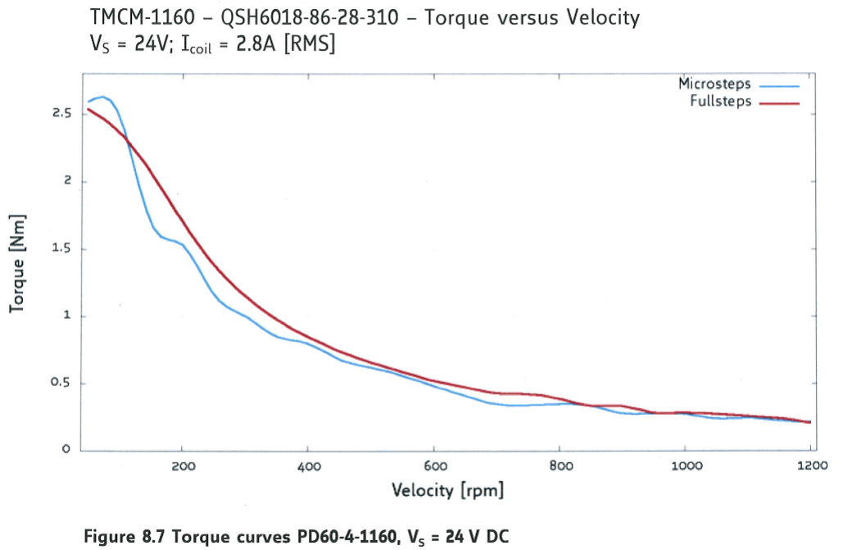

Slide 13


