Slide 1
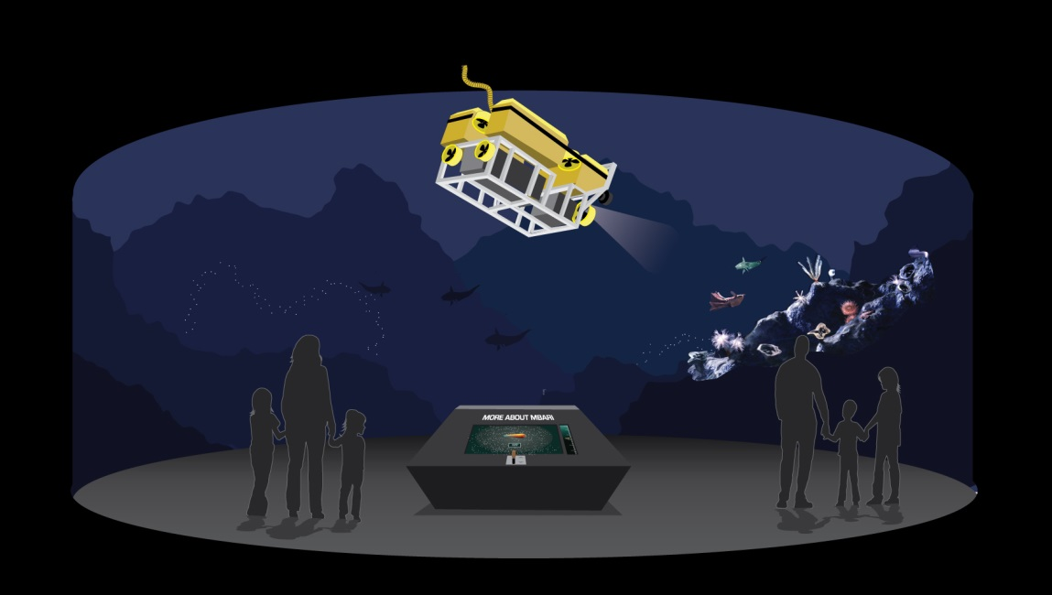
MBA/MBARI AMP Exhibit
PDR
09May2014

Slide 2
Tasks for MBARI
Support/Animation Structure
  Suspension Framework
  Rotation Framework
    Drive Mechanism
      Rate: .25 rev./Minute
    Control hardware
  Tilt/Lifting Mechanism(s)
    Drive Mechanism(s)
      Lifting Rate: 1 inch/Second
  Drape/Camouflage
ROV
        Frame Structure
          Weight Limit ~ 100#
      Foam Pack
          Weight Limit ~50#
          Accessory Mock-ups

Slide 3
9May2014
Preliminary Design Review
  Design Concepts
  Technical Issues
  Exhibit interfaces
    Suspension Framework
    Animation Platform
    Scaled ROV Model
  Update on MBA exhibit space and film
18June2014
Critical Design Review
  Detailed Design
  Project Progress
  Risk Management
  Update on MBA Film, Console, Equipment
01August2014
Final Design Review
  Component Testing and Interfacing
  Integration Details
29August2014
Delivery to MBA of Animated ROV Assembly
MBARI budget for project: $10,000

Slide 4
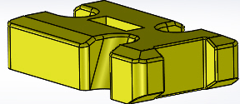
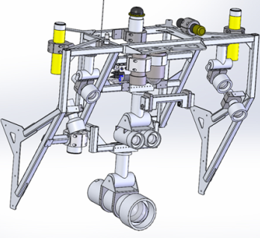
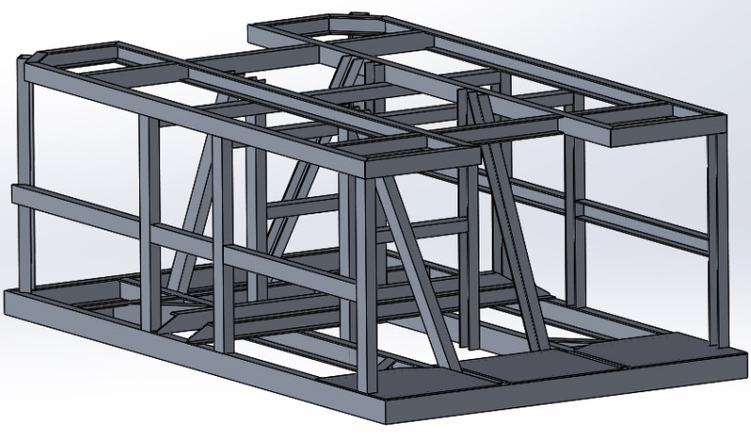
Scale Model of ROV Dock Ricketts
Foam Pack
Camera/Light Bar
and Components
Frame
Not Shown (large electronics Housings, Thrusters, Tubing, Wiring, etc.)

Slide 5
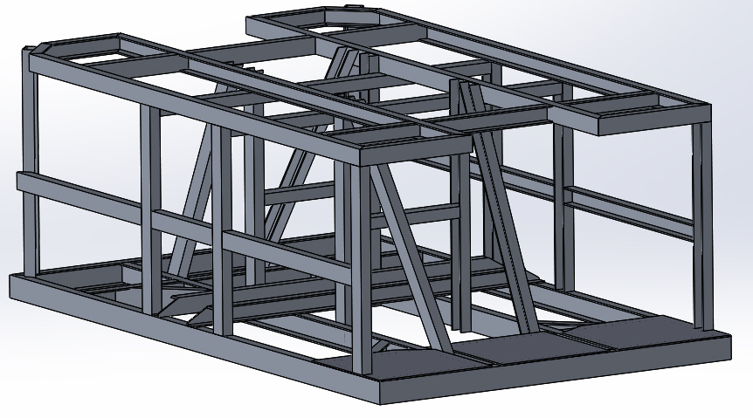
ROV Frame
21.6”
58.6”
35.3”
6063 -T5 Aluminum Channel
~ 56#
1” x 1.5” x 0.13” channel, 0.487 #/ft.
2” x 0.88” x 0.13” channel, 0.567 #/ft.

Slide 6
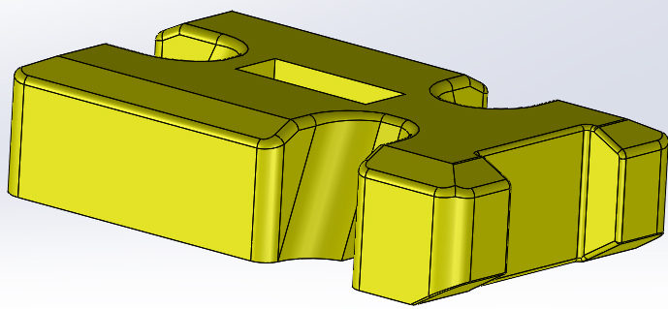
ROV FOAM
14.6”
61”
35.3”
13.6 cu. ft. - ~54.4#
Advantages /Applications
Fine cell structure supports very smooth finishes
Closed-cell foam does not absorb water or moisture
Easily painted and bonded
Economical and versatile
Dimensionally stable – will not warp, twist or bow
Grain-free surface
Easily shaped with a variety of cutting processes
Prototype models
Rigid Polyurethane Foam
(General Plastics FR-7104)
Density 4#/cu.ft.
Compressive Strength 31 – 77 psi

Slide 7

Camera/Light Frame and Components
Camera/Light Frame
1” x 1” x 0.13” 6063 Aluminum
~ 10-12 #
Components
- Rapid Prototyped (3D Printed)
- Fabricated
Estimated weight -- TBD

Slide 8
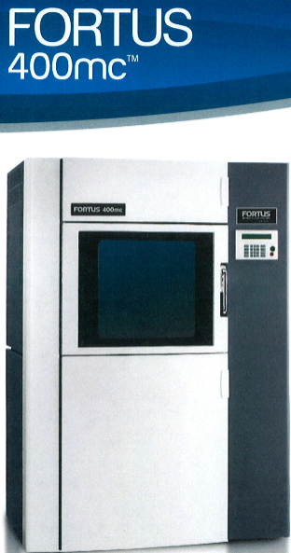
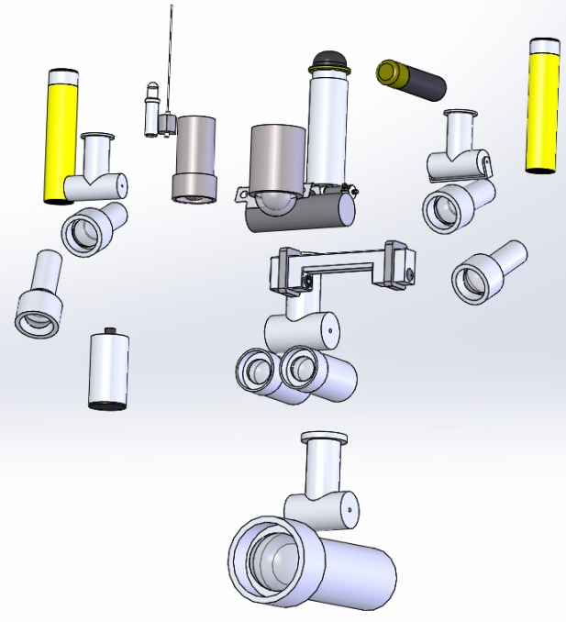
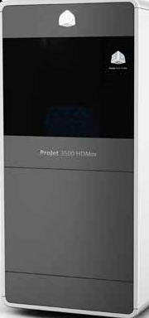
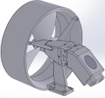
Scaled Component
Fabrication
ProJet 3500 HDMax
Build Envelope
16” x 14” x 16”
Build Envelope
11.75” x 7.3” x 8”
Materials
-- ABS
-- Polycarbonate
-- Ultem
Materials
-- Visijet Crystal
(curable urethane acrylate)

Slide 9
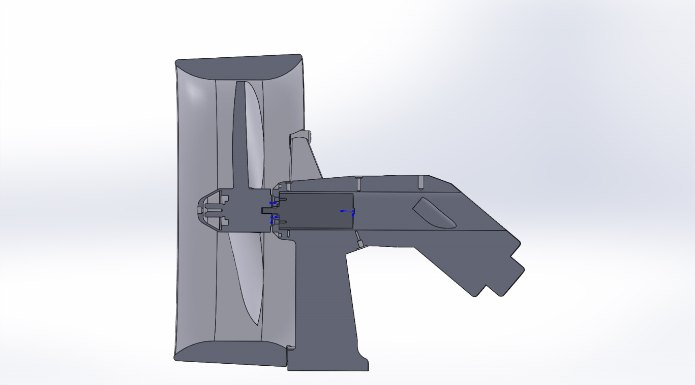
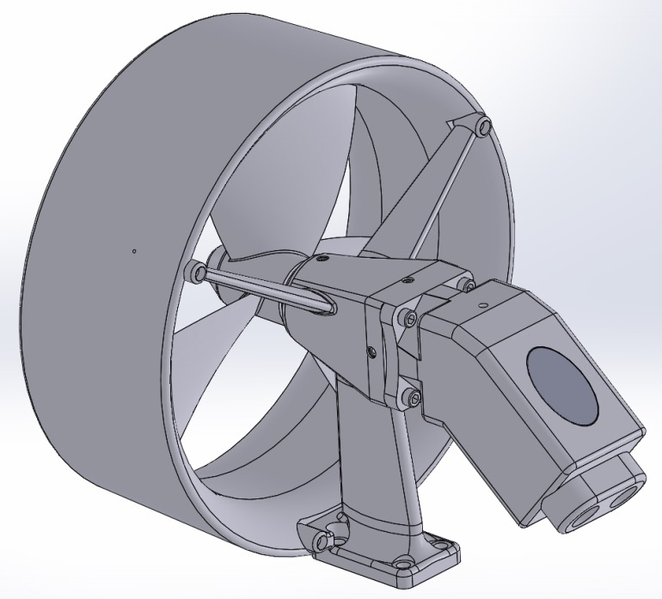
Rotating Thruster
Thruster Shroud and Body
Propeller
Pittman Motor

Slide 10
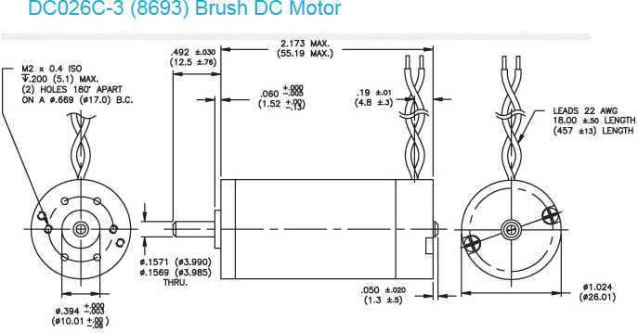
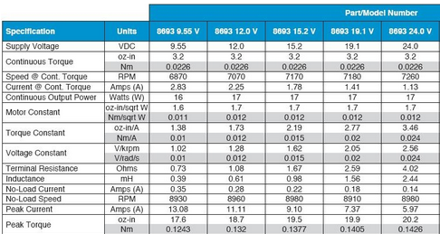
Thruster Motors
Pittman

Slide 11
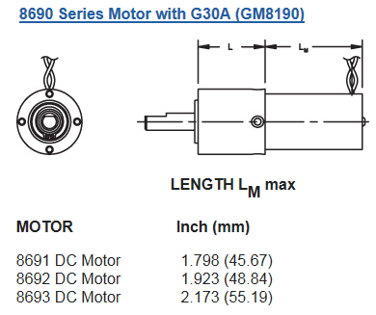
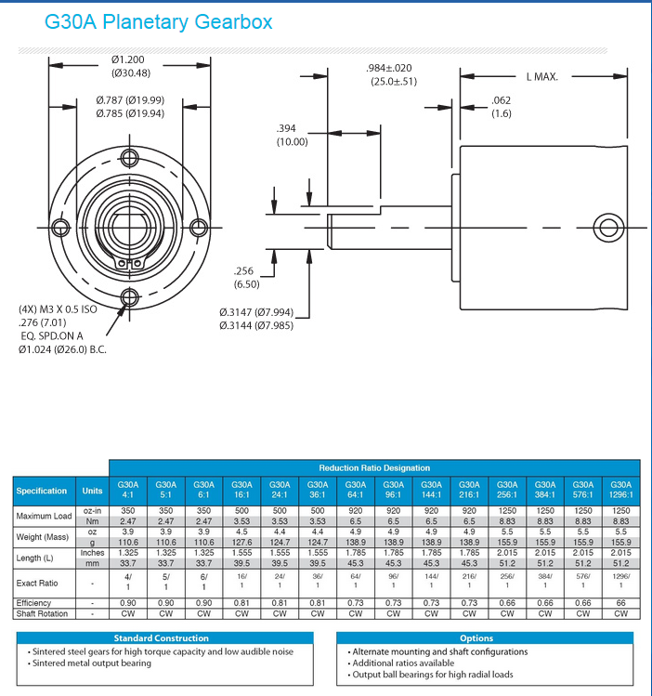
Planetary Gearbox Reduction
Pittman
Total Length = 1.785” + 2.173” = 4.0”
7260 rpm / 144 = 50.4 rpm
Motor
Gearbox
reduction
Propeller

Slide 12
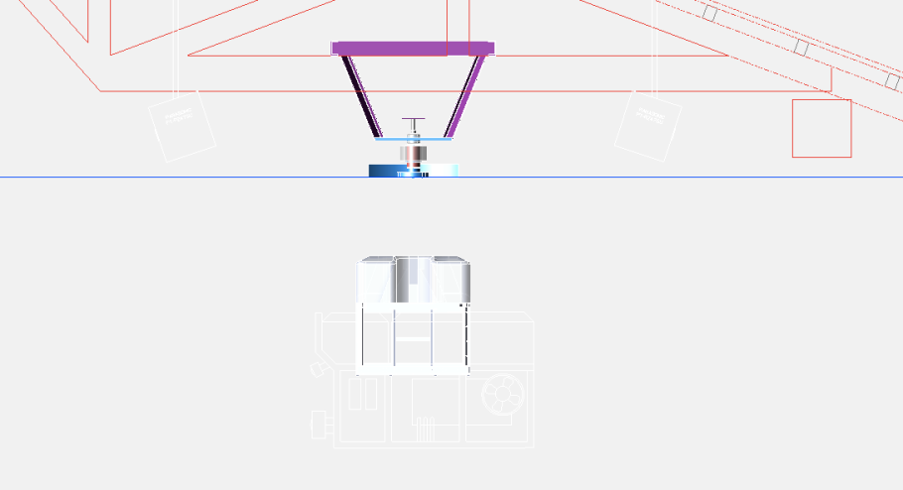
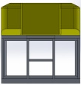
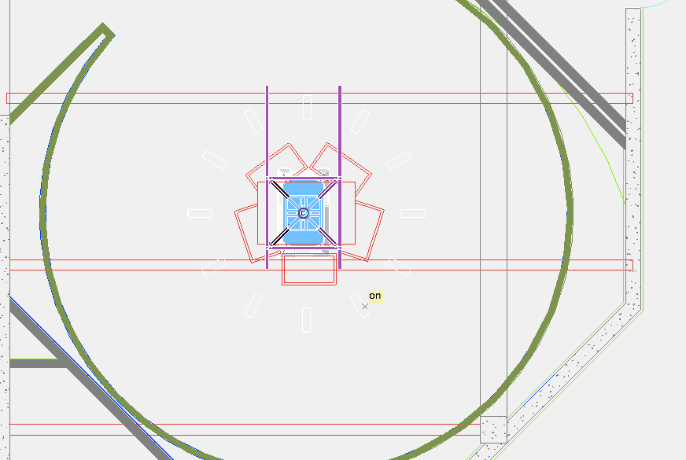
Preliminary Illustration of ROV and Animation Platform
Side View
Top View

Slide 13
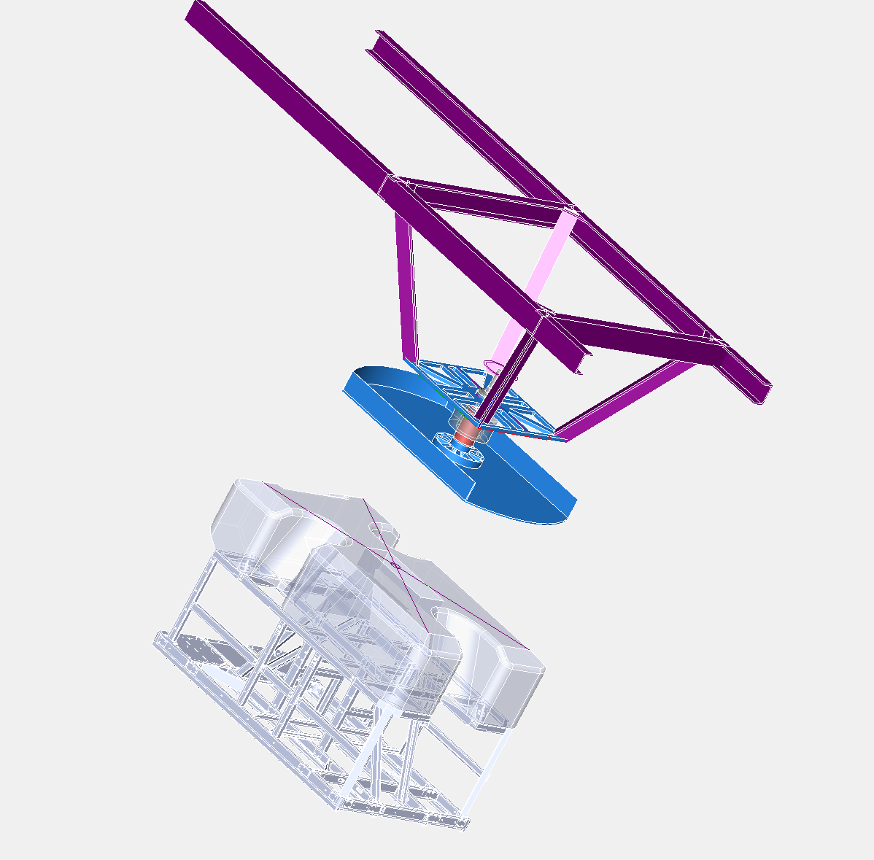
Rotation / Animation Platform
Gussets and angular design give rigidity to the frame
Aluminum
Weldment
Spans between the
rafters at MBA and with enough width to allow it to be centered
The frame is held in place by either a U bolt or two all-thread lengths to a cross plate. The decision is up to MBA.

Slide 14
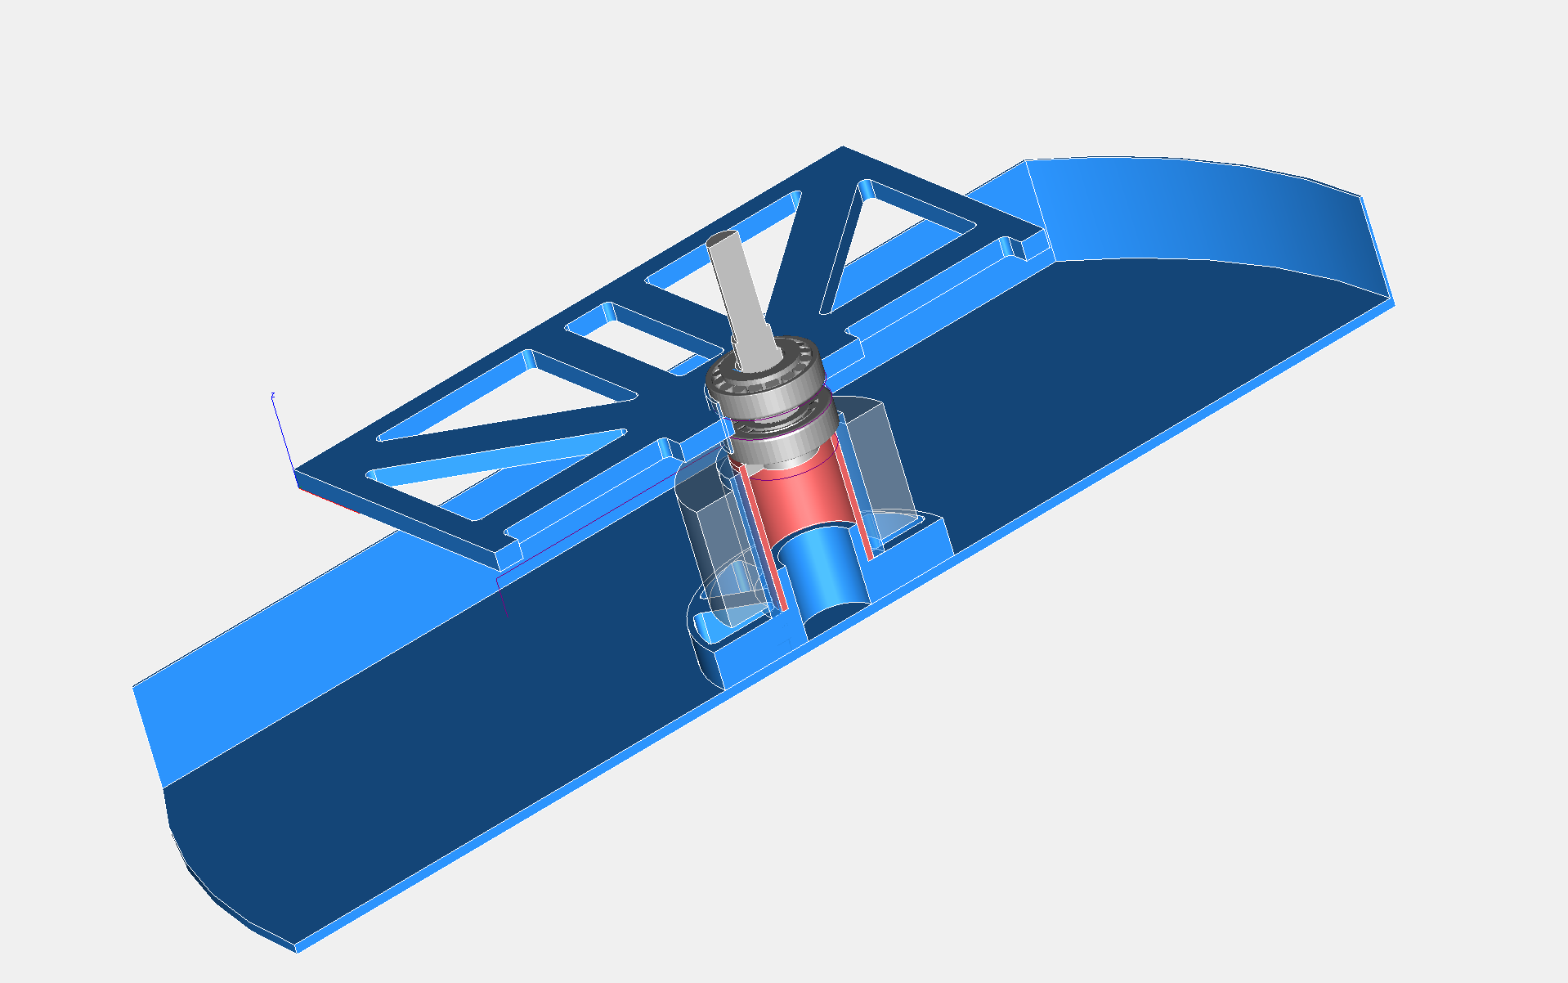
Rotational Sub-Assembly
Frame Plate
Bearings
Drive Shaft
Retention Nut
and Washer
(not shown)
Bearing
Collar
Slip Rings
Torque Tube
Hub
Suspension Tray
(with skirt)

Slide 15
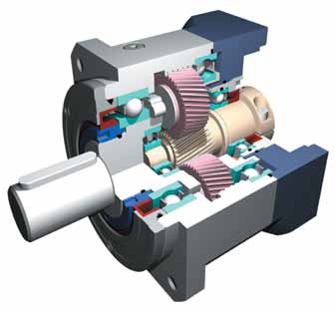
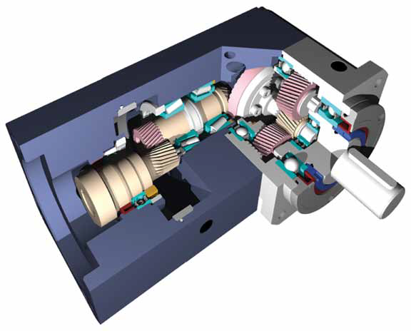
Off-the-Shelf Gearheads
Working belief - 360 degrees in 4 minutes with the motor at 1000 rpm to minimize the cogging noise and make the operation smooth.
1000 rpm x 4 minutes = 4000 revolutions for the vehicle to make one revolution
Therefore we require a 4000 : 1 reduction gearhead. Still looking for a unit but
most likely we will require a compound head

Slide 16
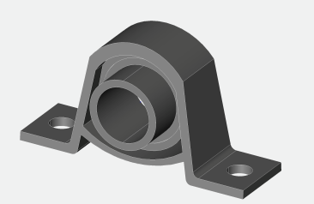
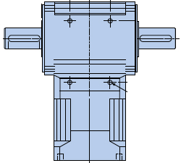
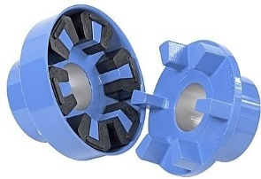
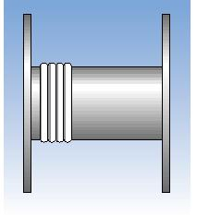
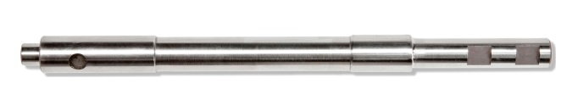
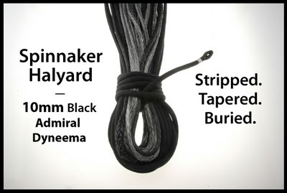
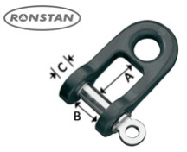
Plan for vehicle lift Off-the-Shelf Gearheads
Pillow block support
Pulley w/
line to ROV
Dual drive head to both sides
Gear head to coupling
Shaft to position
correctly
All black line and tackle
Dual shaft heads for the raising and lowering of the vehicle. We do not need to operate at 1000 rpm as I recommended for continuous vehicle turning.
10 mm breaking load 7920#
1 inch per second assuming 600 rpm (this can always be adjusted) equate to 10 revolutions/sec per inch… assume a drum of 4 inch diameter… and we get
.035 inches/degree >> 28.57 degrees / inch so we need 2.857 degrees / revolution … which calculates out to 125 : 1 ratio. Should be OTS

Slide 17
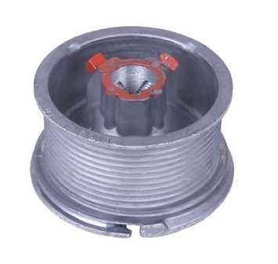
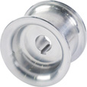
Why a 4 inch drum?
Nothing is settled yet but it turns out parts are easy to find in this size
Readily available off-the-shelf garage door parts. With a simple plate on each end these are easily adapted and prevent line jumping.
These are about $10.00
Readily available portable winch drums are also a good choice. These would also require an end plate to prevent the line ever jumping off the drum.
These are about $80.00

Slide 18
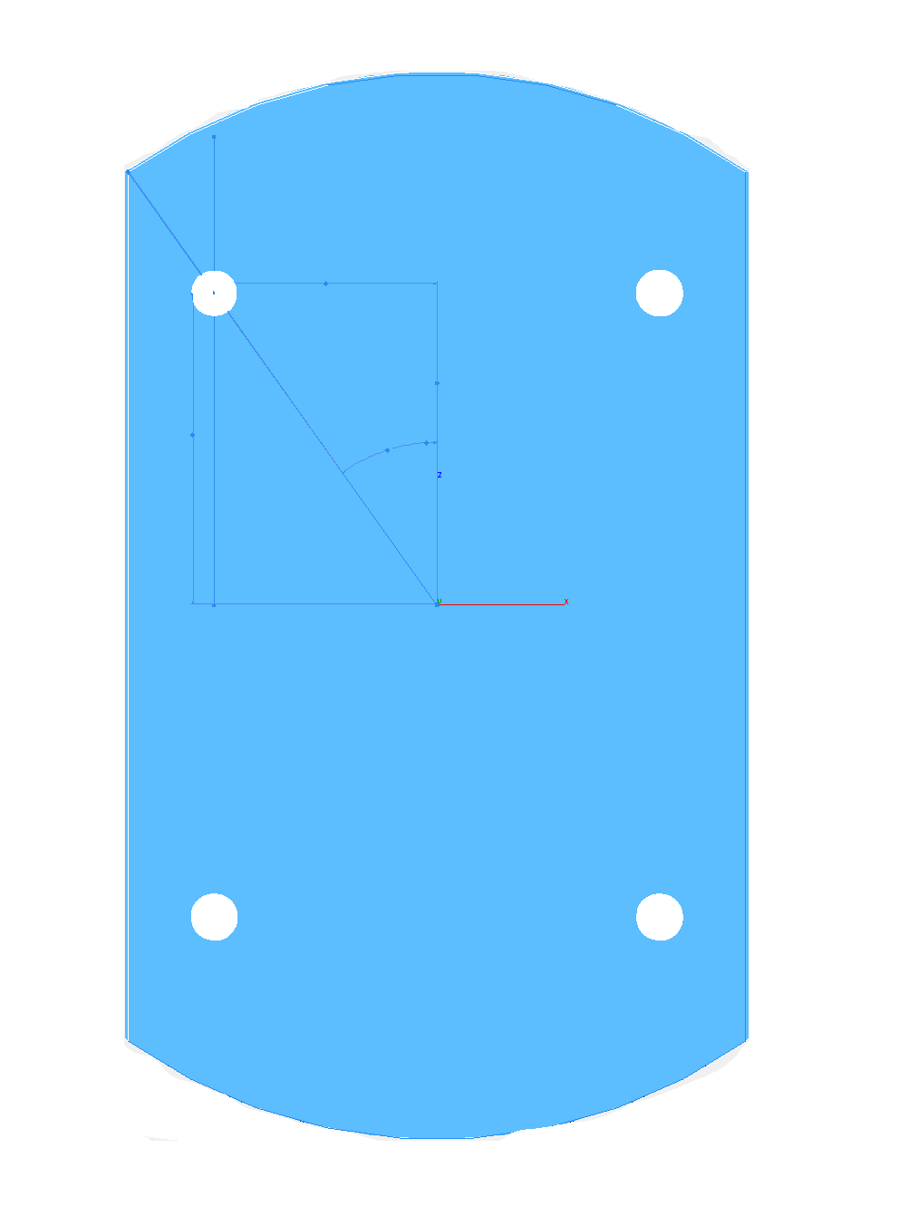
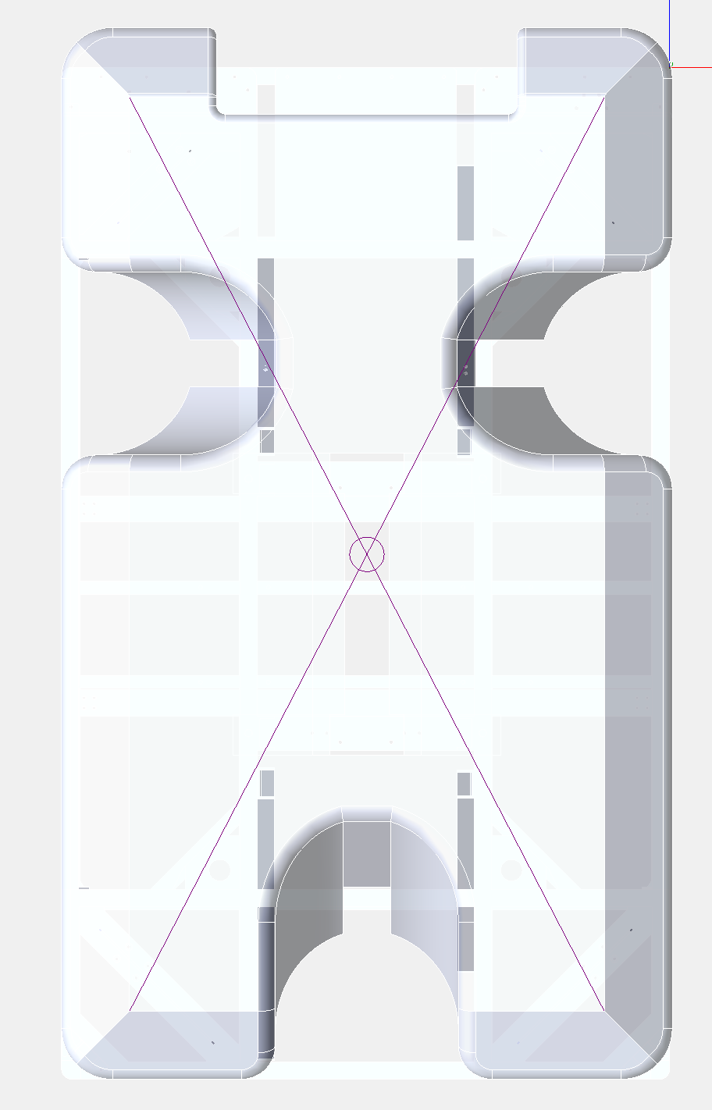
4 pick up points on ROV
Going to 4 pick up points has several advantages.
The mechanisms in the platter are identical so parts and operations / software are also.
The system has better sway stability
14 inches
The ROV tether can align naturally on the center line which will help when moving up and down
1o inches
Additionally, the ROV tether will not rub on the lift lines

Slide 19
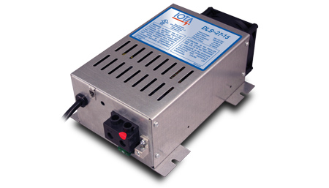
24 Volt power supply
I’m working with the assumption we do not require a computer interface
SPECIFICATIONS
DC Output Voltage (No Load) approx. 27.2V (DC)
Output Voltage Tolerance (No Load) + or - .5%
Output Amperage, Max Continuous 15 Amps
Output Voltage (Full Load) approx. >27.0V (DC)
Maximum Power Output, Continuous 400 Watts
Ripple and Noise <100 mV rms
Input Voltage Range 108-132V (AC)
Input Voltage Frequency 47-63
Maximum AC Current @ 108VAC 7.3 Amps
Typical Efficiency >80%
Max Inrush Current, Single Cycle 30 Amps
Short Circuit Protection Yes
Overload Protection >100%
Line Regulation 100 mV rms
Load Regulation <1%
Fan Control Proportional
Thermal Protection YES
Working Temperature Range 0°- 40°C
Storage Temperature -20° to 80°C
Withstand Voltage (VDC)* 1700/1700/500
Dimensions 9.7" x 6.7" x 3.4"
Weight 4.5 lbs
Switch-mode technology
Exceptionally clean DC output
Tight line-load regulation
Quickly and efficiently charges batteries
Designed to withstand low transient AC line voltage
Current limit and thermal/overload protection
Lower operating temperature
Quiet fan operation
External reverse polarity fuse protection from incorrect battery connection
High and normal-stage charging jack

Slide 20
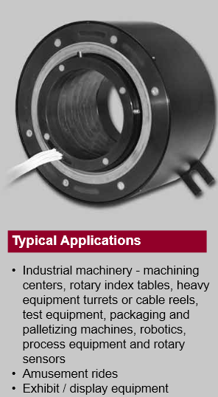
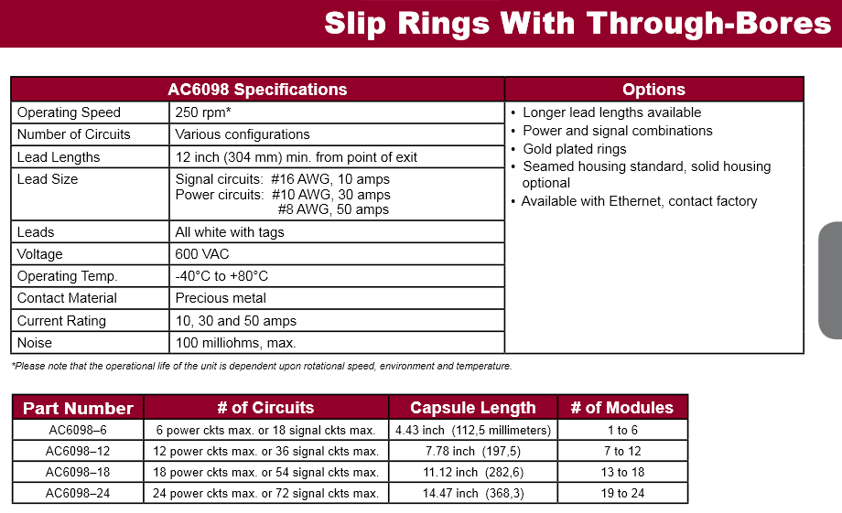
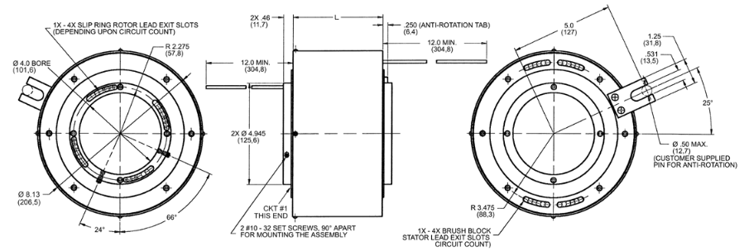
Cost $3284

Slide 21
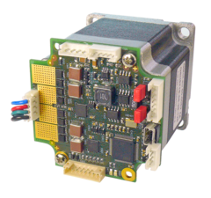
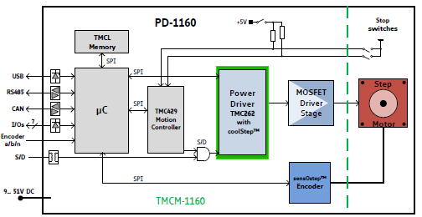
Stepper Motors and Controllers
Motion controller
Motion profile calculation in real-time
High performance microcontroller for overall system control and
serial communication protocol handling
Bipolar stepper motor driver
Up to 256 microsteps per full step
Encoder
sensOstep magnetic encoder (1024 increments per rotation)
e.g. for step-loss detection under all operating conditions and
positioning supervision
Interface for connection of external incremental a/b/n encoder
Interfaces
- RS485 interface
- CAN (2.0B up to 1Mbit/s) interface
- USB full speed (12Mbit/s) interface
- Step/Direction interface (optically isolated)
3 inputs for stop switches and home switch (+24V compatible)
with programmable pull-up
2 general purpose inputs (+24V compatible) and 2 general purpose
outputs (open collector)
Incremental a/b/n encoder interface (TTL and open-collector signals
supported directly)
Safety features
Separate supply voltage inputs for driver and digital logic – driver
supply voltage may be switched off externally while supply for
digital logic and therefore digital logic remains active
Software
TMCL: standalone operation or remote controlled operation,
program memory (non volatile) for up to 2048 TMCL commands, and
PC-based application development software TMCL-IDE available for free.
 | PD60-4-1160
Flange Metric: | 60mm
Flange NEMA: | 24
Holding Torque: | 3.1Nm
Product State: | active
Microstep Resolution: | 1...256
Supported Motor Type: | Stepper
Velocity Ramps: | trapezoidal
coolStep™
spreadCycle™
stallGuard2™
Motor Supply: | 9...51V
Height: | 60mm
Length: | 110mm
Width: | 60mm

Slide 22
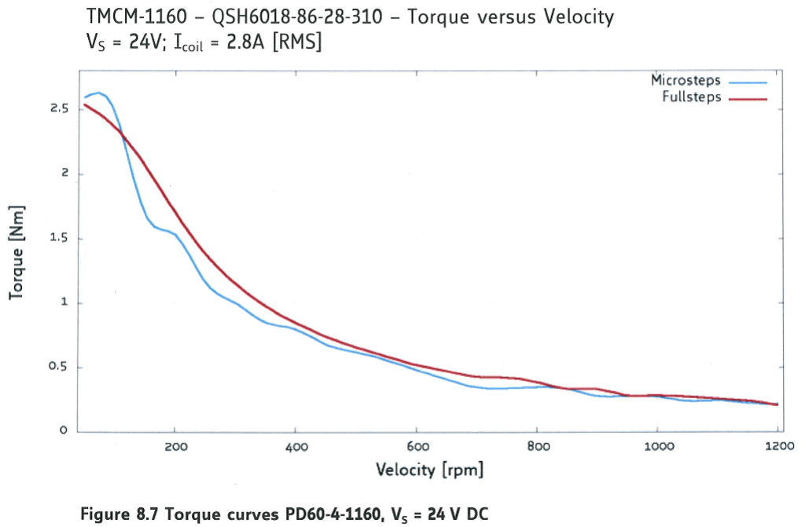
High torque at start up and low ripple torque at speed

Slide 23
Additional Questions?

