Slide 1
Vehicle Control And Stability

Slide 2
Two Mostly Independent Problems
Low speed versus buoyancy.
Lights and bars on the bow destabilize the vehicle.

Slide 3
Problem #1
Speed Versus Buoyancy

Slide 4
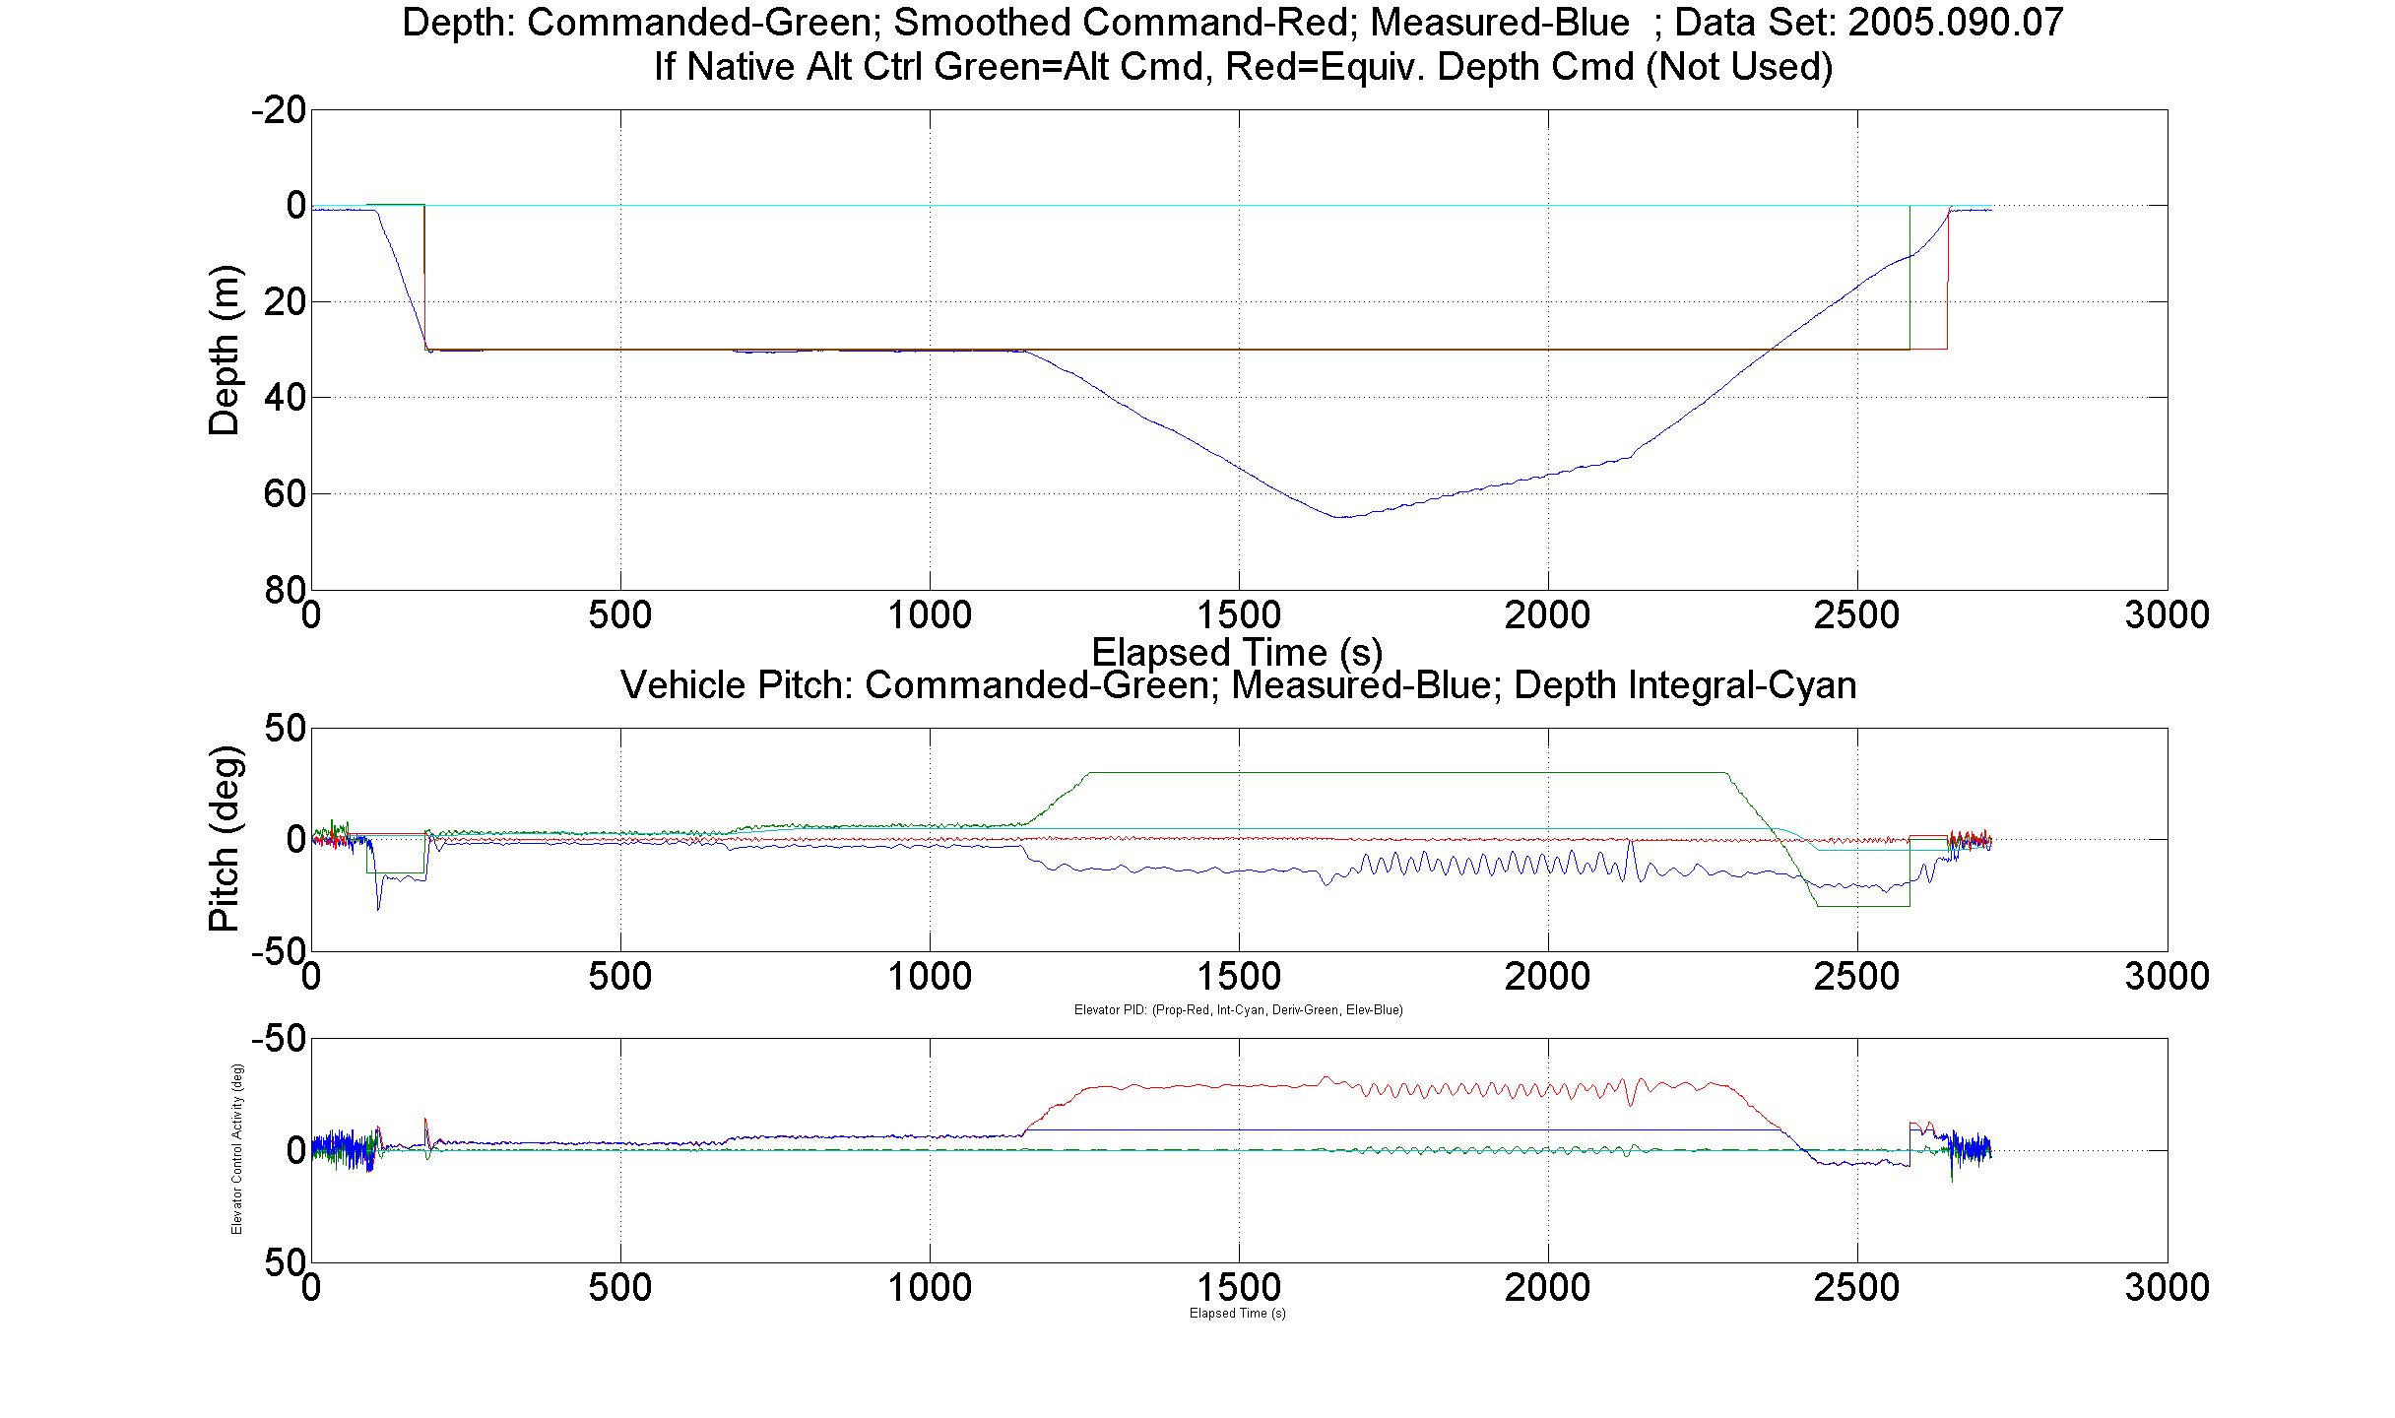
Speed Versus Buoyancy
AUV typically runs at 1.5 m/s (3 kts).
Video historically taken at .55 m/s (1.1 kts).
Buoyancy will overcome lift at .55 m/s:
Mapping AUV
10 lbf Buoyant
1.0 m/s
.50 m/s
.75 m/s

Slide 5
Speed versus Video Tradeoff
Vehicle control and stability deteriorate below 1.0 m/s, but video improves.
Static buoyancy limits slowest speed. Rob asks Mark how fast!
Camera and lights limit max speed. Mark asks Rob how slow!
Either body wings or precision ballasting probably necessary below 1.0 m/s.
Depth control requirement +/- 1 meter.
Steady-state analysis & sea trials determine if vehicle can hold depth for a given speed and buoyancy.
  Assuming vehicle is stable.
  Stall not modeled.
Sea trials were promising.

Slide 6
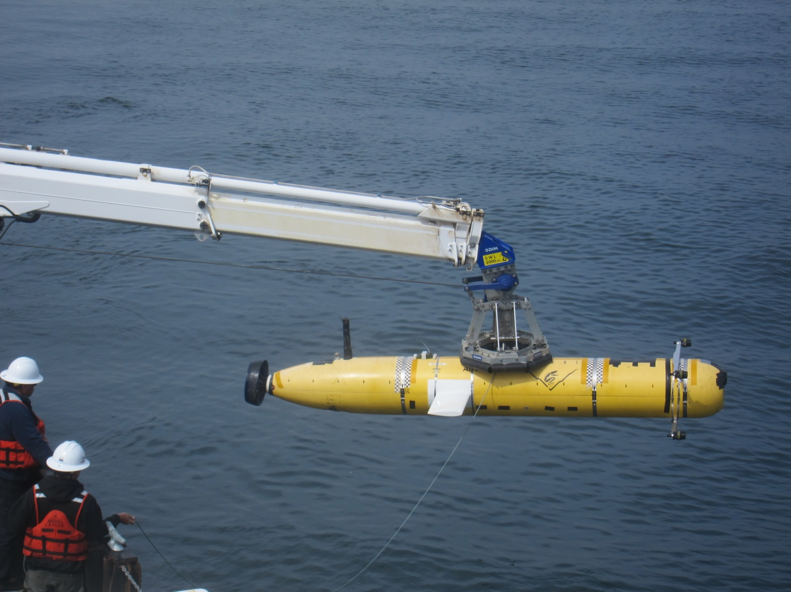
Wings 14” Behind Eye Center, With Bars

Slide 7
Outline
Review analysis that leads to wings and winglets.
Proposed dive plan.
  Round bar, different nose.
  Increase gains.
Propulsion power budget if time permits.
  From LR AUV work.

Slide 8
Two Mostly Independent Problems
Low speed versus buoyancy:
  Steady-state “trim” analysis in straight and level flight.
    Nonlinear algebraic equations instead of differential equations.
    Time is not the independent variable.
  Control gains, time constants, open/closed loop etc. don’t apply.
Destabilizing effect of light bars:
  Affects dynamics. Must include derivative terms.
    Angles versus time.
  Solve linearized ODEs to determine stability.
  Final step is to verify with simulation of nonlinear ODEs.

Slide 9
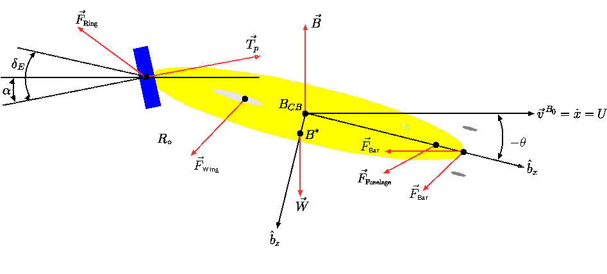
Free-Body Diagram
Steady-State Force and Moment Balance in
Heave/Pitch (Vertical Plane).
Drag vector not dependent on vertical v.s. horizontal plane with round bar.

Slide 10
Buoyancy is Difficult to Measure
But speed is easy to measure with the Dvl.
Flip the problem:
  Assume constant worst-case speed of .5 m/s, vary buoyancy.
Review: what are we trying to determine?
  How much buoyancy before the Auv can’t fly level?
  How much do body wings help?
  If body wings, how far aft?
  Winglets or not?

Slide 11
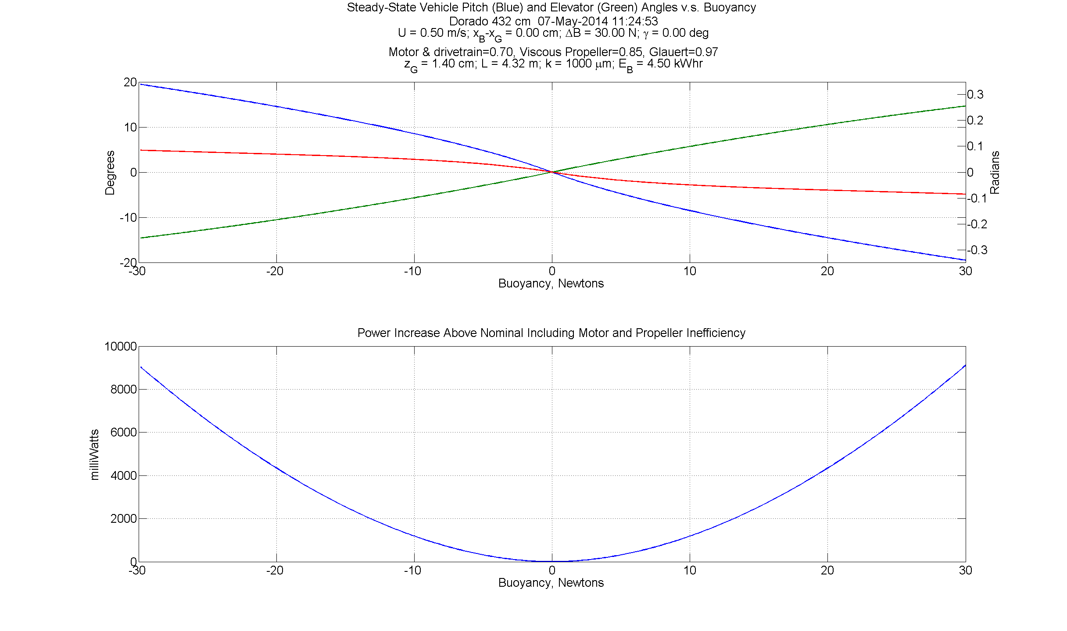
Bare Vehicle with Lights
Guess: Hull stalls at ~10 Deg.
2.25 lbf => 0.29-0.58 kg/m³.
Power analysis carried over from LR AUV.
2.25 lbf
4.50 lbf
6.74 lbf

Slide 12
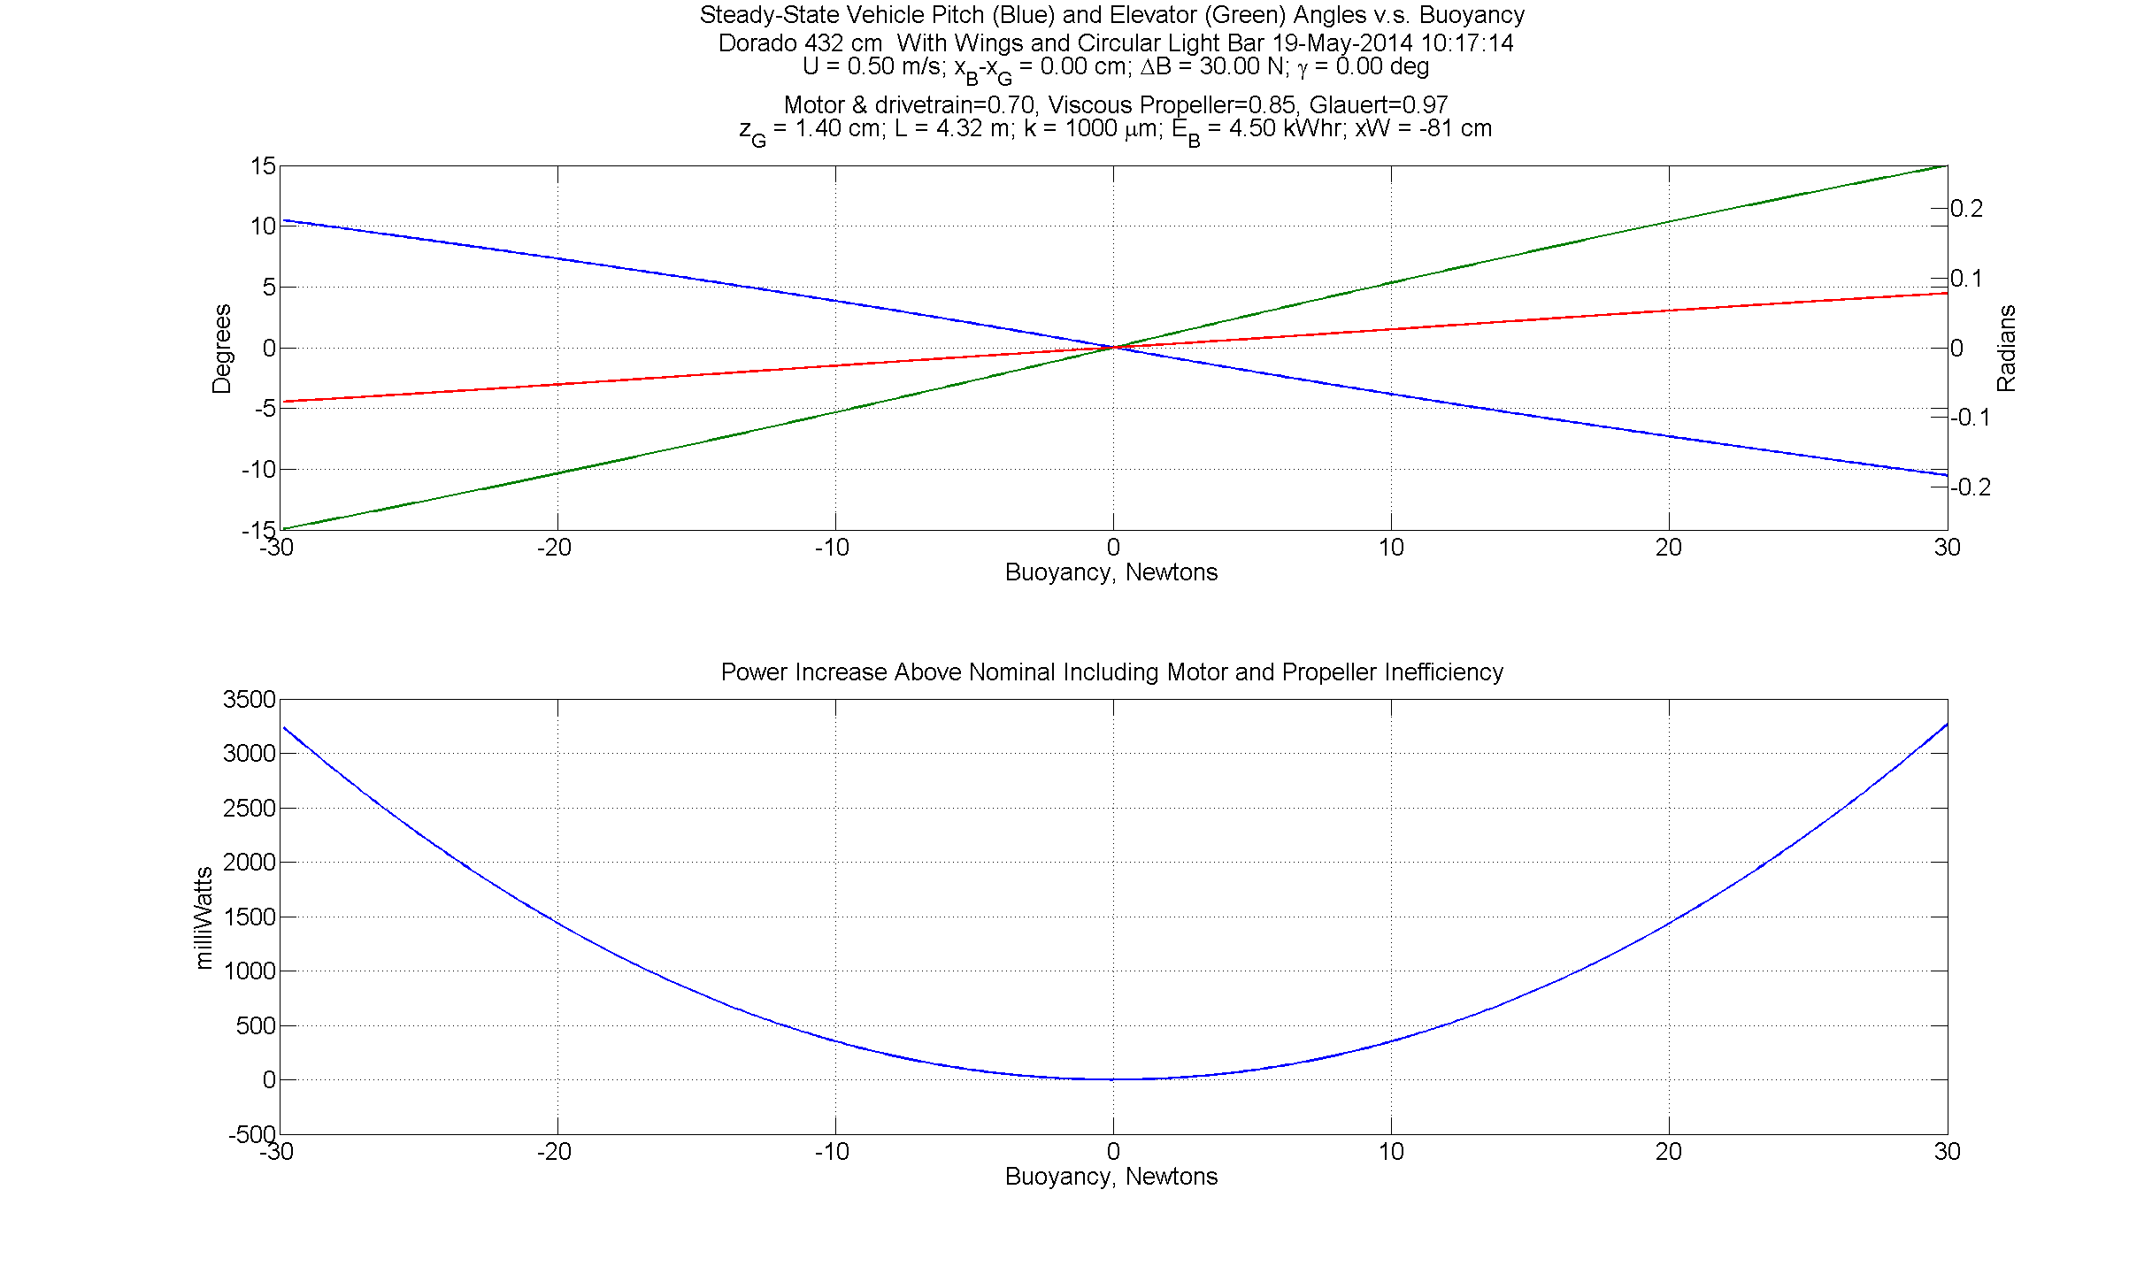
With Body Wings 37” Aft of Lifting Eye
Wing COL is 93 cm aft of c.g.;
-81 cm from origin;
40” aft of eye.

Slide 13
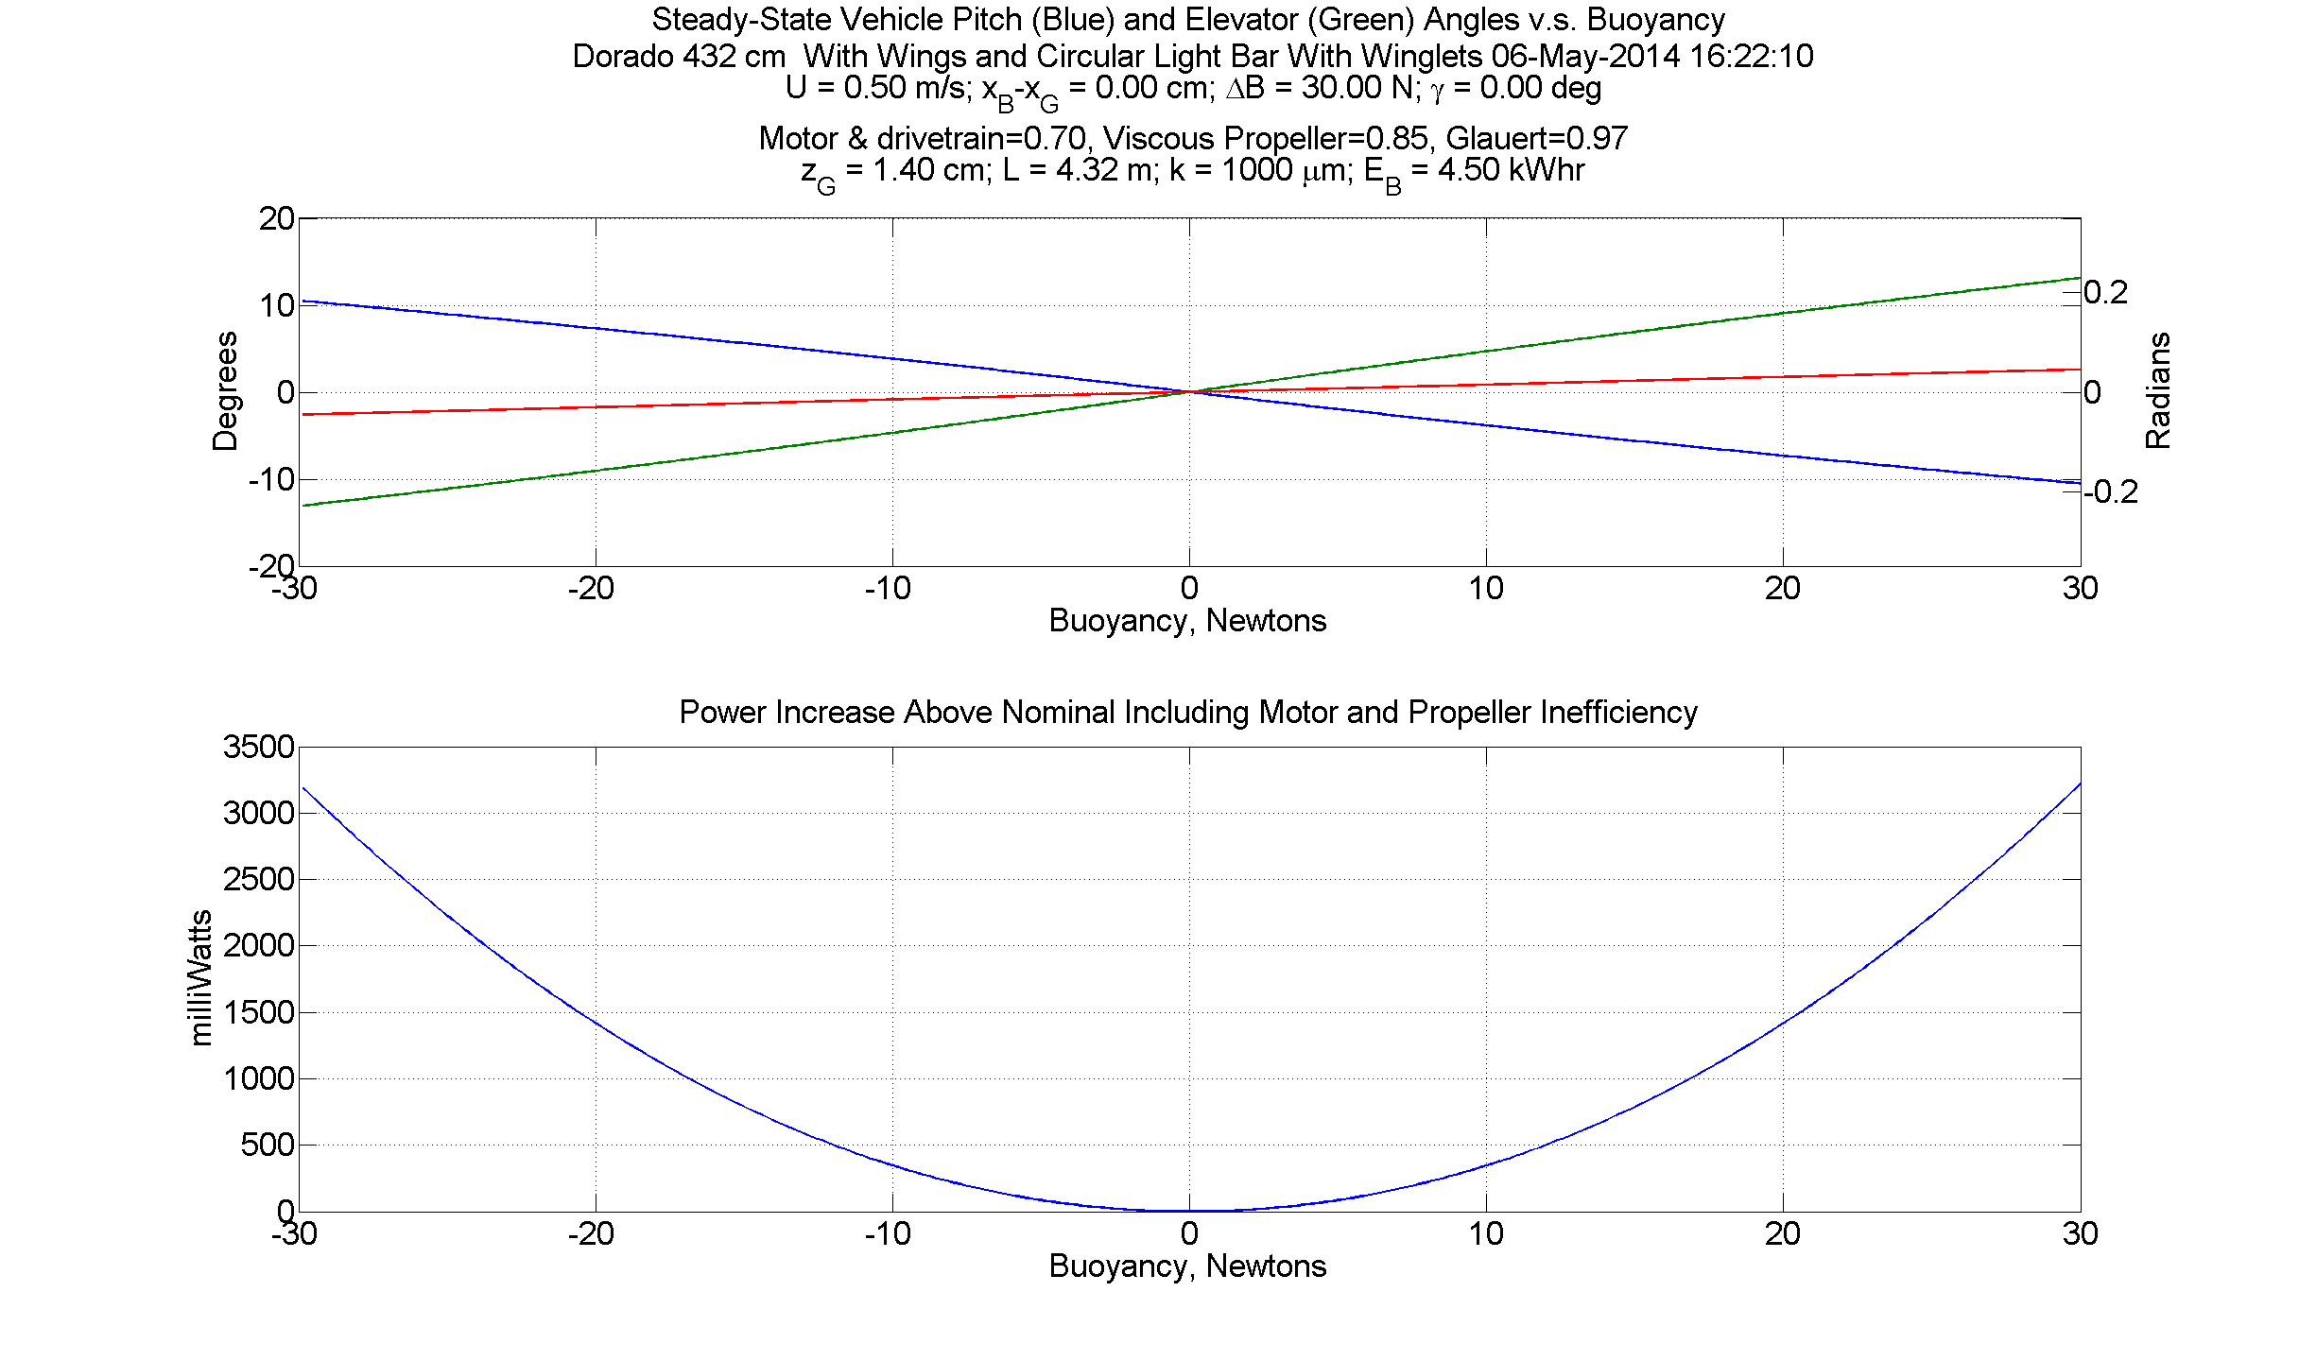
With Body Wings at 37” and Winglets

Slide 14
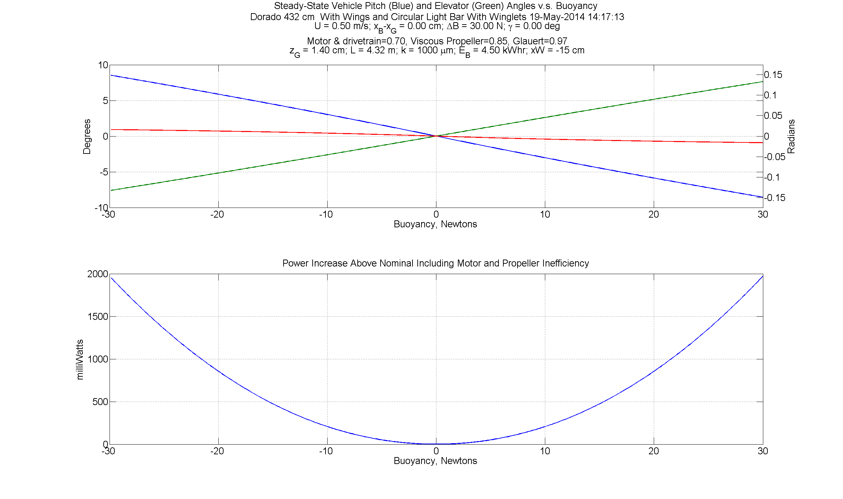
Body Wings 11” Aft of Eye and Winglets
Wing COL is 27 cm aft of c.g.
-15 cm from origin;
14” aft of lifting eye

Slide 15
Stability Analysis
Vehicle depth control sluggish at .5 m/s.
Lift ~ speed².
  At 1/3 the speed (.5 m/s) lifting surfaces produce 1/9 the lift.
  Control gains are a function of speed.
Increase gains to speed time constants back up.
  Tentative set selected.
  Work in progress.

Slide 16
Objectives for Next Dive
  See if it can hold depth at .5 m/s, with usual ballasting, with final nose.
  Test controllability in depth and heading.
  Test the above w/o wings with low buoyancy.

Slide 17
Tentative Dive Plan
Vehicle:
  Ballasted as usual ~ 4.5 lbf.
  New nose with circular bar and lights.
  Wings 14” aft of lifting eye.
  Winglets on duct.
Launch and run:
  50m depth; .5 m/s, S&L, step down 10m, step back up. Expect sluggish response. This tests depth control.
  Repeat with higher control gains (TBD). Should respond faster.
  Box run to test heading control.
Recover. Remove winglets. Possibly shift wings back.
Launch and run:
  Repeat depth step response. (2.1)
  If necessary adjust gains, repeat.
  Box run or possibly out-and-back to test heading control.

Slide 18
Tentative Dive Plan (con’t)
  Recover. Remove wings. Redeploy.
    Repeat step response to test depth control. (2.1)
    Adjust gains, repeat.
    Test heading control.
  Recover. Hans adds lead to lower buoyancy as much as possible.
    Repeat above three.

Slide 19
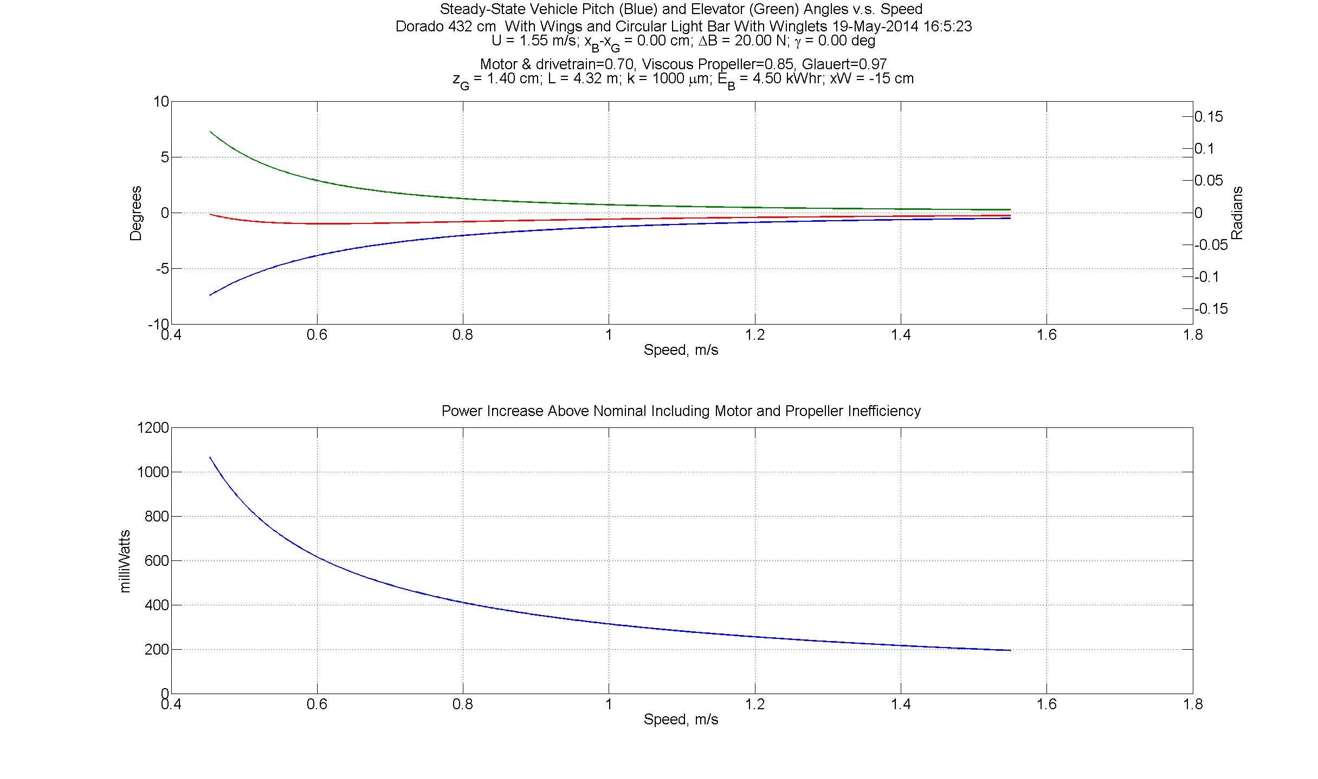
Static Angles Versus Speed

Slide 20
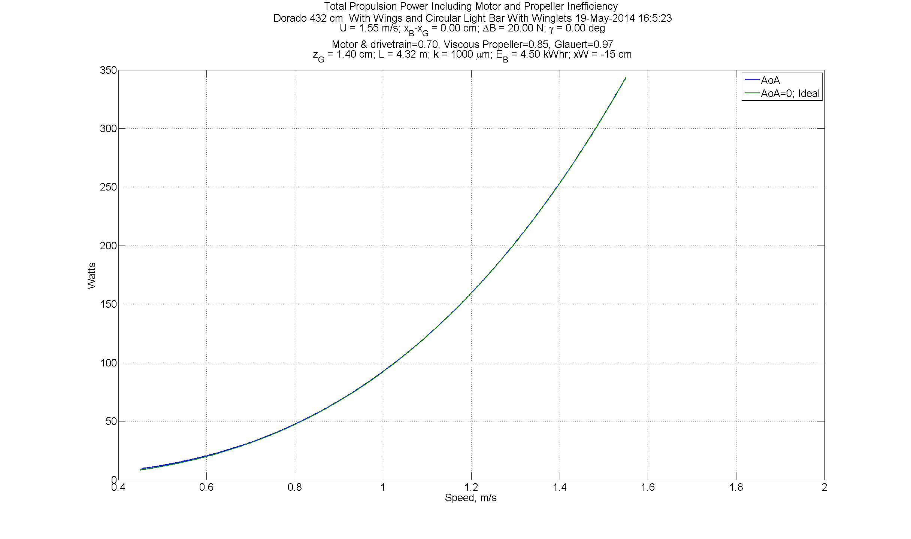
Total Power

Slide 21
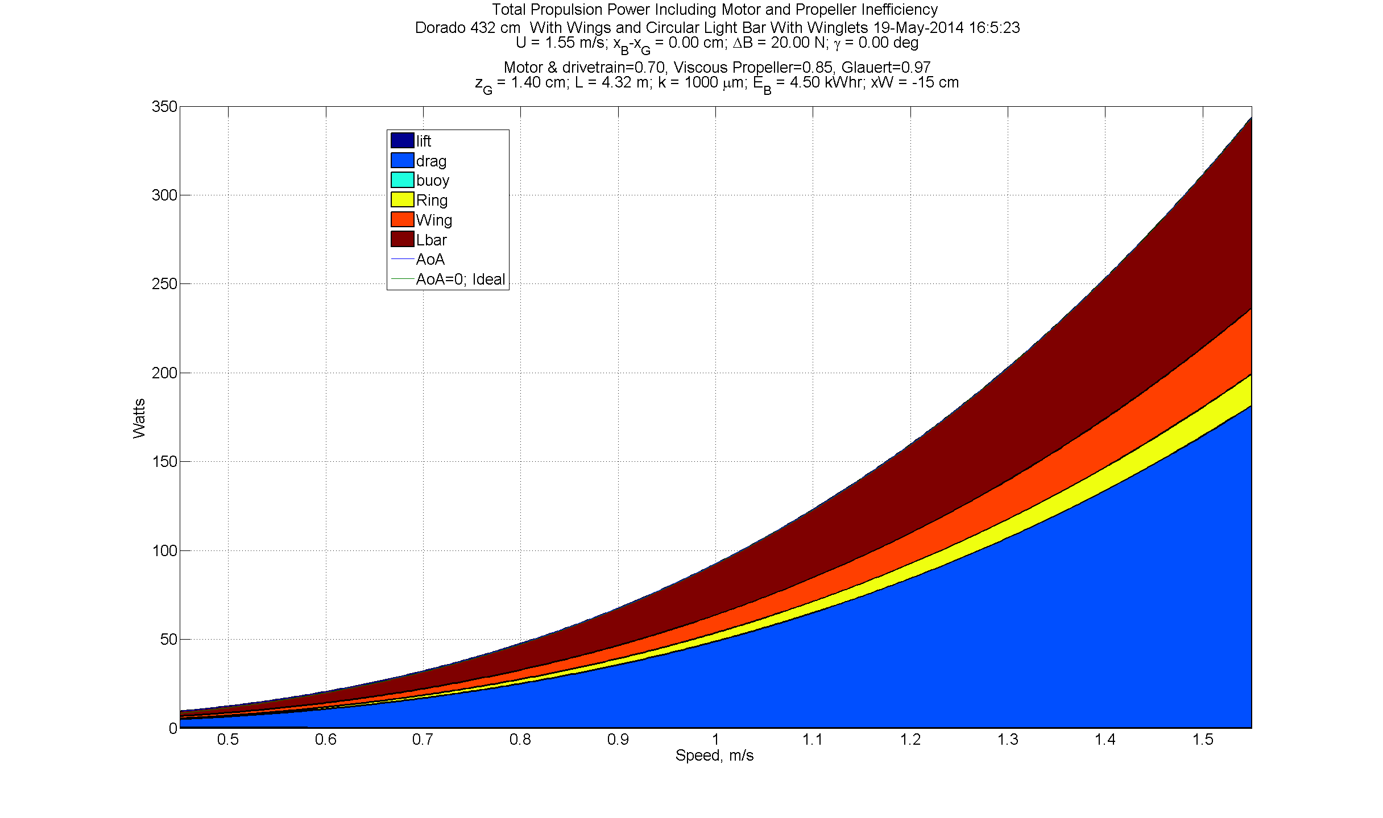
Propulsion Power Stackup

Slide 22
Problem #2
Stability

Slide 23
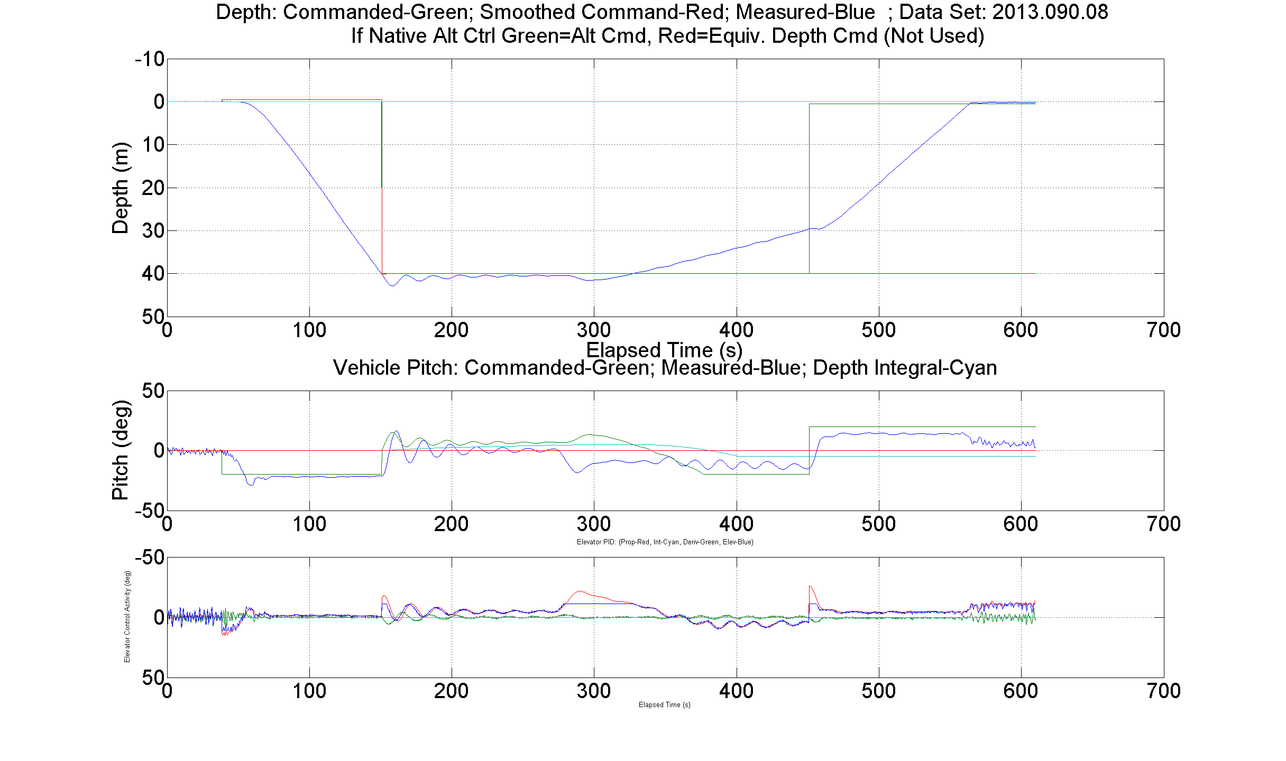
Stability
Adding drag or lift or both to the bow is destabilizing.
Ctd vehicle.
Streamlined bars.
With lights.
No Wings.
4.5 lbf buoyant.
1.4 m/s
.45m/s

Slide 24
Bars and Lights
Shape effects lift, drag and stability.
Round bar adds drag but not lift:
  Not as destabilizing (less tendency to oscillate).
  Affects both vertical and horizontal plane equally.
    Assuming symmetry.
  Will consume more propulsion power.
  May increase the minimum speed due to absence of lift.

Slide 25
Free-Body Diagram
Steady-State Force and Moment Balance in
Heave/Pitch (Vertical Plane).

Slide 26
Stability
General Principle: More drag at the bow tends to destabilize the vehicle.
Reduction of stability causes oscillation in depth and heading.
  Beware that vehicle rate limit will be imposed by camera.
Winglets on duct may be necessary at lower speeds.
Body wings mounted aft of the C.M. also increase stability.
Analysis of natural frequencies + sea trials predict stability.

Slide 27
Conclusions So Far
Sea-trial data and analysis to this point indicate both problems are solvable.
Sea trials were performed with streamlined bars:
  Speeds below 1 m/s at typical ballasting (4 lbf) may require body wings to hold depth.
  Shifting wings aft increased stability.
  Significant loss of control with unmodified duct near .5 m/s.
  Winglets on duct improved control. Further improvements possible with algorithm adjustments.
Further sea trials and analysis required for round bar.
More accurate ballasting possible with 1-atm battery spheres versus pressure-tolerant batteries.

Slide 28
Navigation Problem
Navigation accuracy not better than water currents when DVL can’t see bottom.
Will the vehicle get too close to a wall below 600m?
Assume:
  330m transects
  5 below canyon rim at 600, 700, 800, 900, 1km.
  Canyon 3.4 km wide at 1000m.
  Can dive at .5 m/s vertical rate.
  Transecting at .5 m/s horizontal speed.
Then
  600/.5 + 5*360/.5 + 4*100/.5 = 5600 seconds = 1hr 33 min.
  Assume 25 cm/s lateral current => vehicle displaced 1.4 km
  300 m margin.

Slide 29
Camera Test Problem
Need to test camera’s ability to resolve motion.
How can we simulate the motion of small animals towards the camera?
Use a spinning disk.

Slide 30
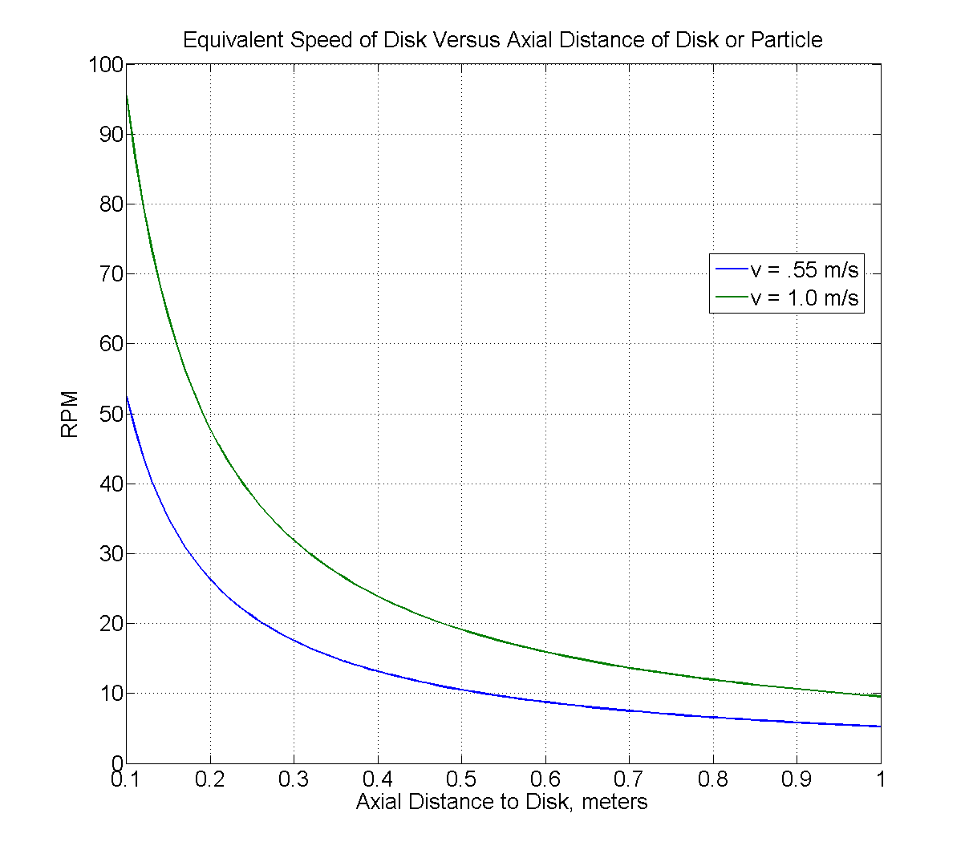
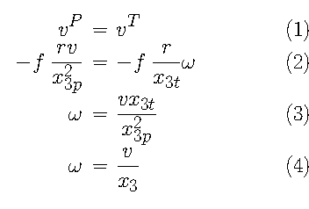
Translation of Vehicle Motion to Focal-Plane
x_3p – focal plane to particle
x_3t – focal plane to disk
Eqn. 3 => 4 if they’re equal.

Slide 31
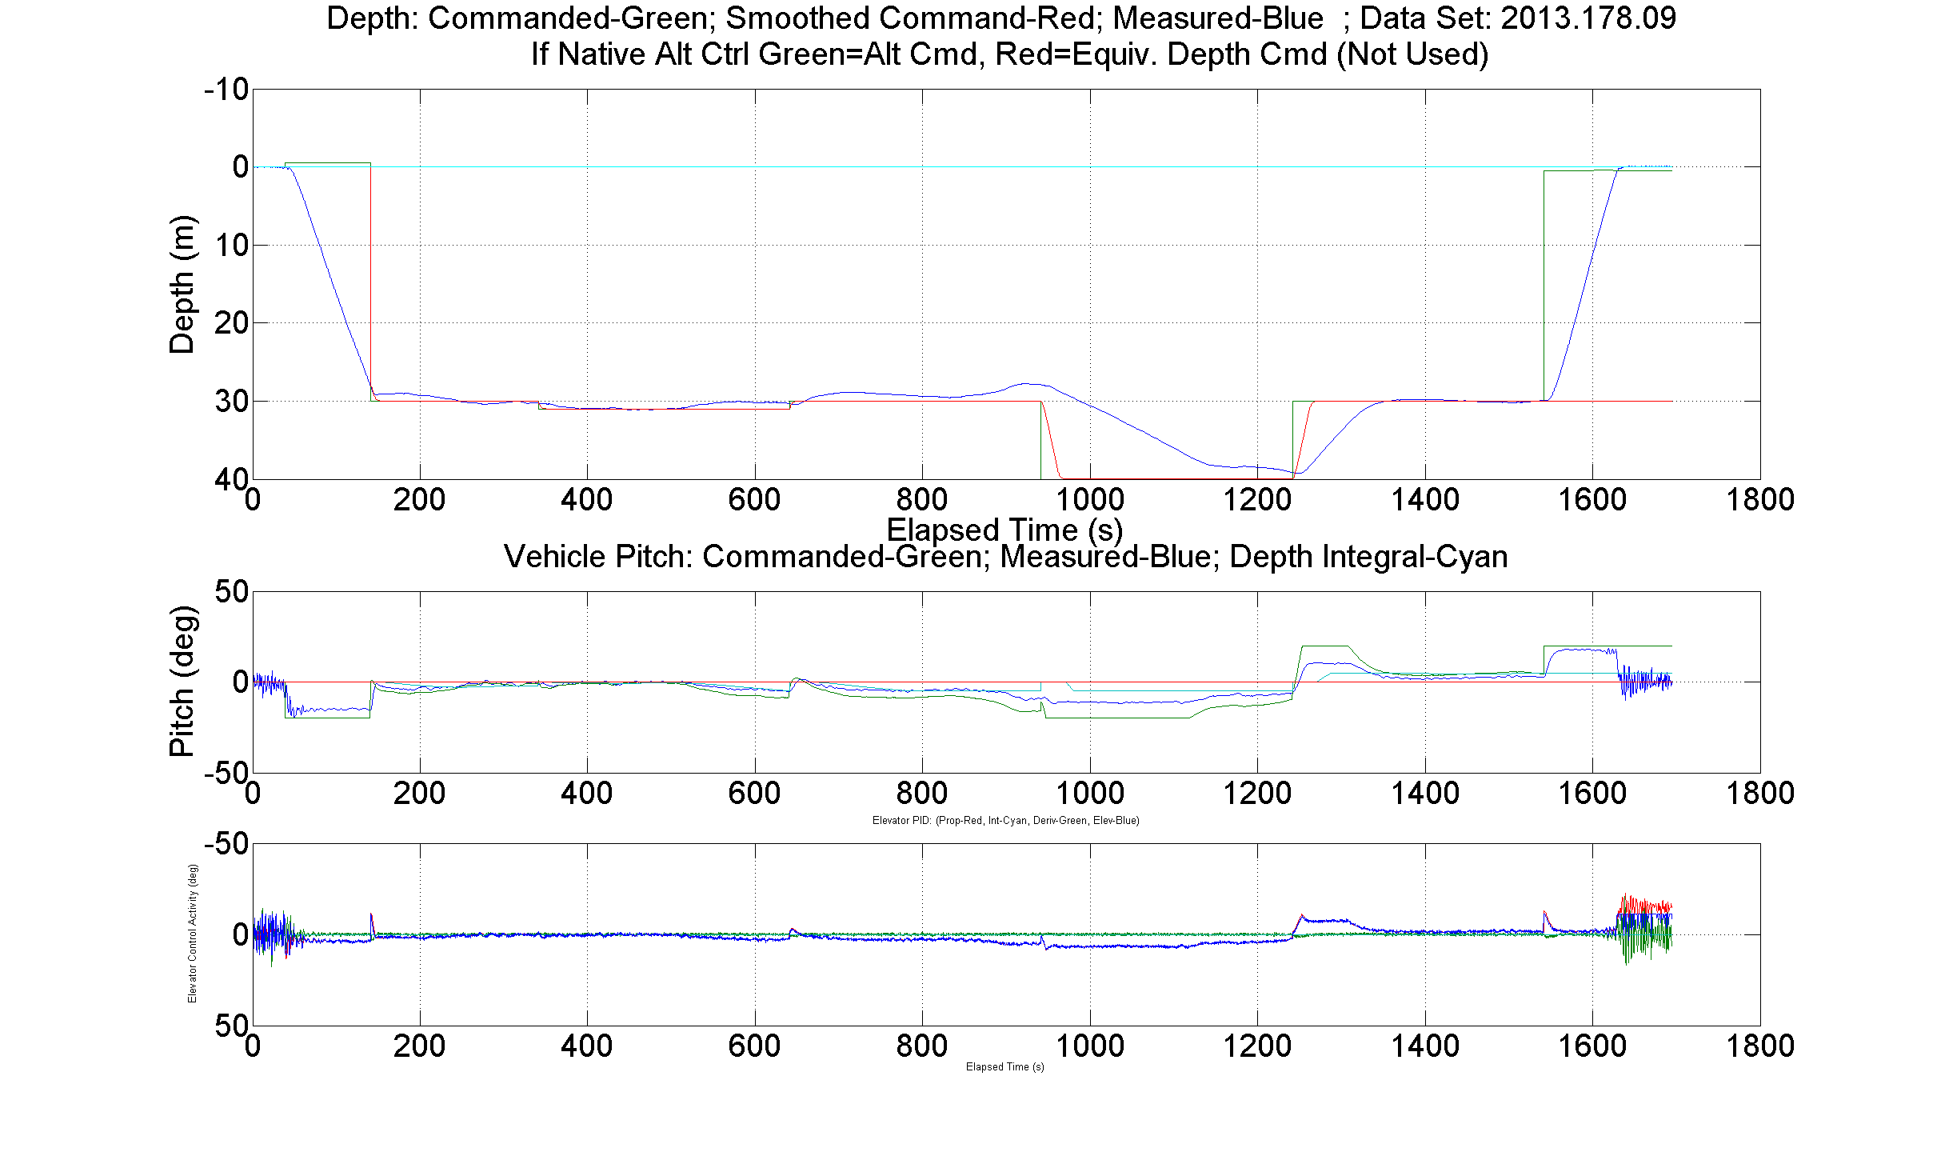
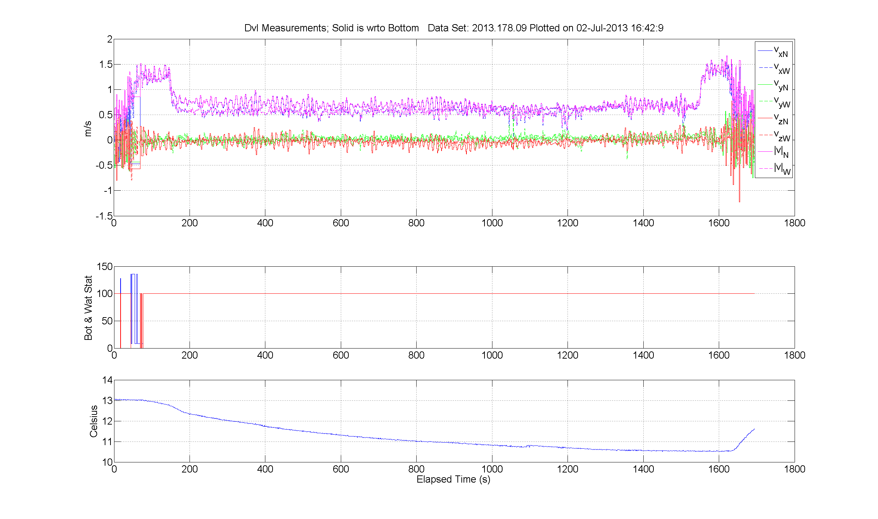
Video from AUV

Slide 32
End

Slide 33
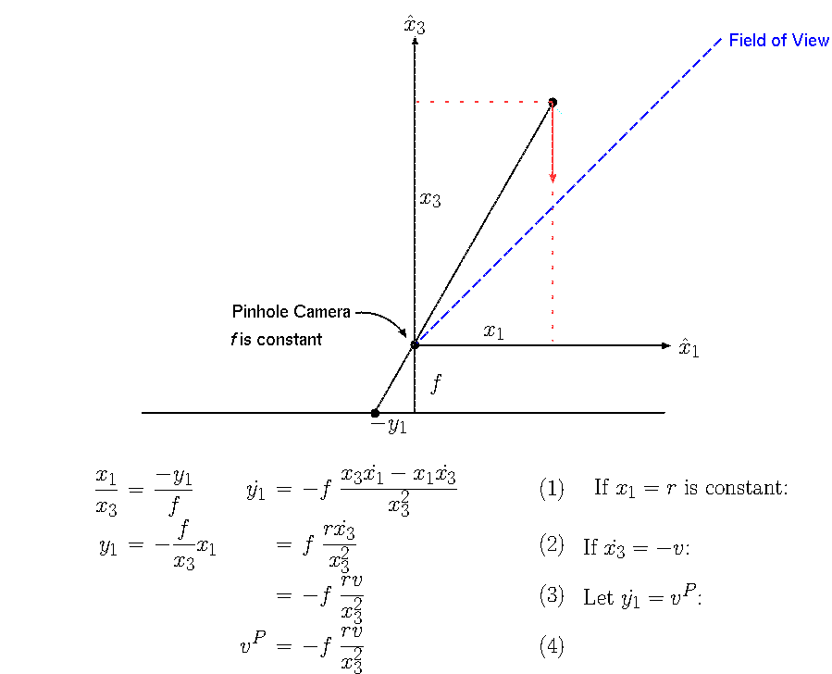
Translation of Vehicle Motion to Focal-Plane
Top View

Slide 34
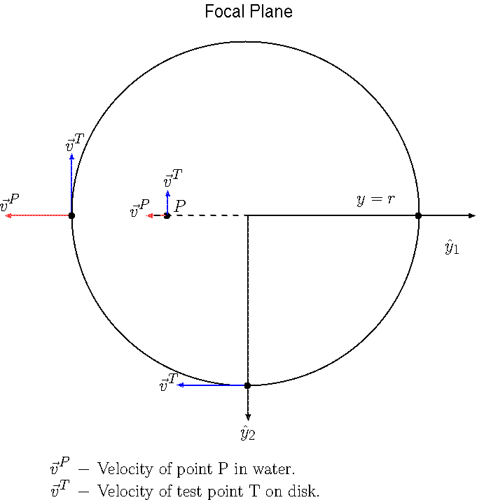
Circular Motion on Focal-Plane

Slide 35
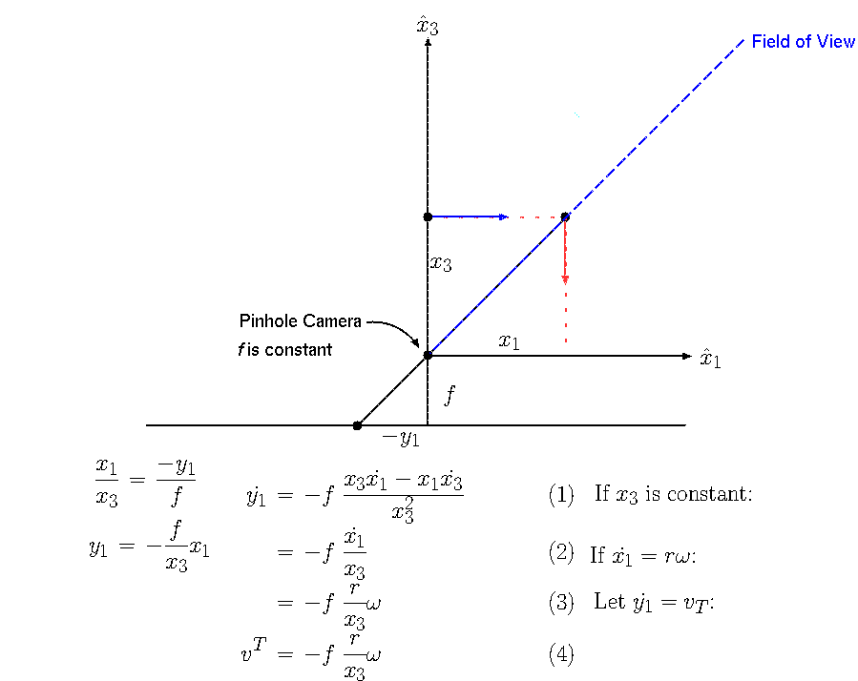
Translation of Circular Motion to Focal-Plane
Top View

Slide 36
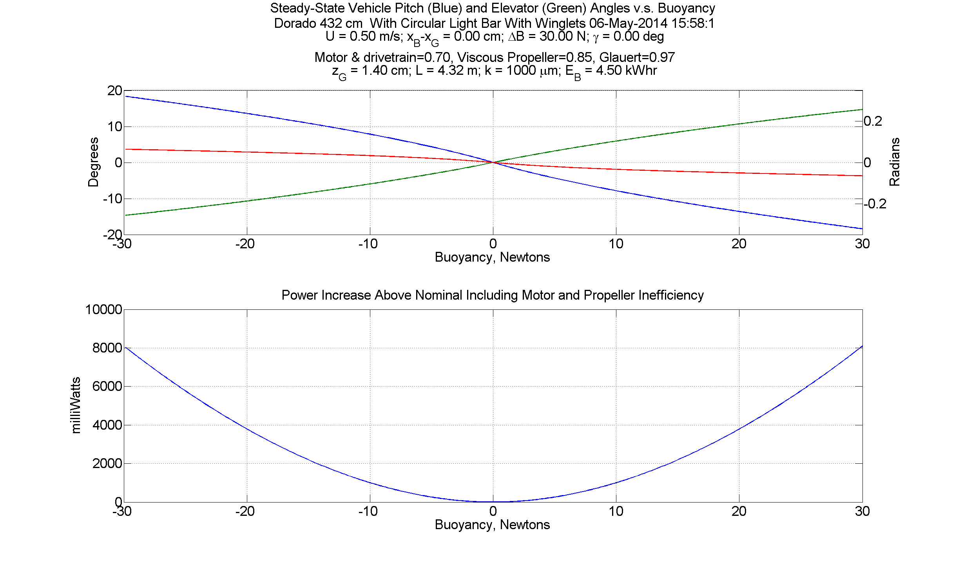
No Body Wings, With Winglets
2.25 lbf
6.7 lbf

Slide 37
Two Mostly Independent Problems
Low speed versus buoyancy:
  Steady-state “trim” analysis in straight and level flight.
  No accelerations, thus derivative terms are zero. Solution of ODEs not required.
  Results in coupled nonlinear algebraic equations.
  Solved by fminsearch () inside of a loop that increments independent variable (speed, buoyancy, wing location).
  Control gains, time constants, open/closed loop etc. don’t apply.
Destabilizing effect of light bars:
  Now must analyze dynamics. Derivative terms included.
  First step is to solve linearized ODEs.
  Final step is to verify with simulation of nonlinear ODEs.

