Slide 1
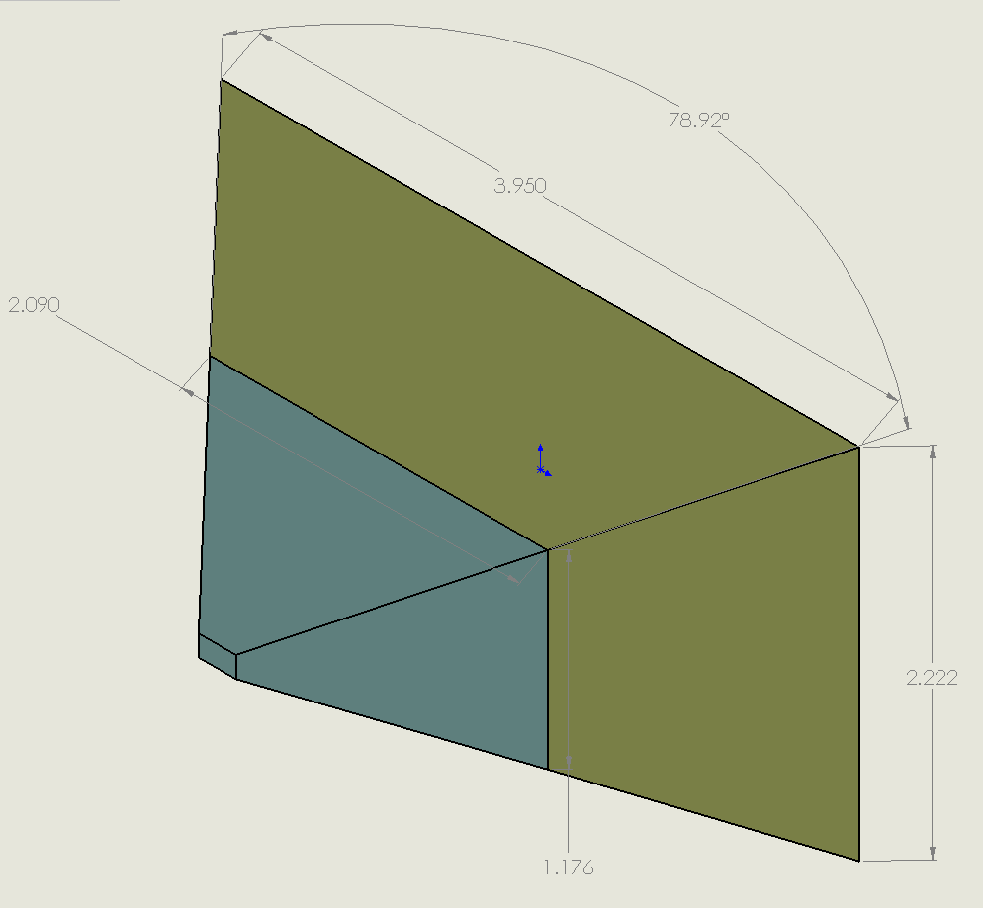
AUGUST 2017 i2MAP Test Tank Calibration
FOCAL LENGTH: 13mm
FOCUS DISTANCE: 0.9m
VIEW ANGLE 79 DEGREES
1 – 2 METER DISTANCE VOLUME = 5.285 CUBIC METERS
0 - 1 METER DISTANCE VOLUME = 0.919 CUBIC METERS

