Slide 1


Slide 2

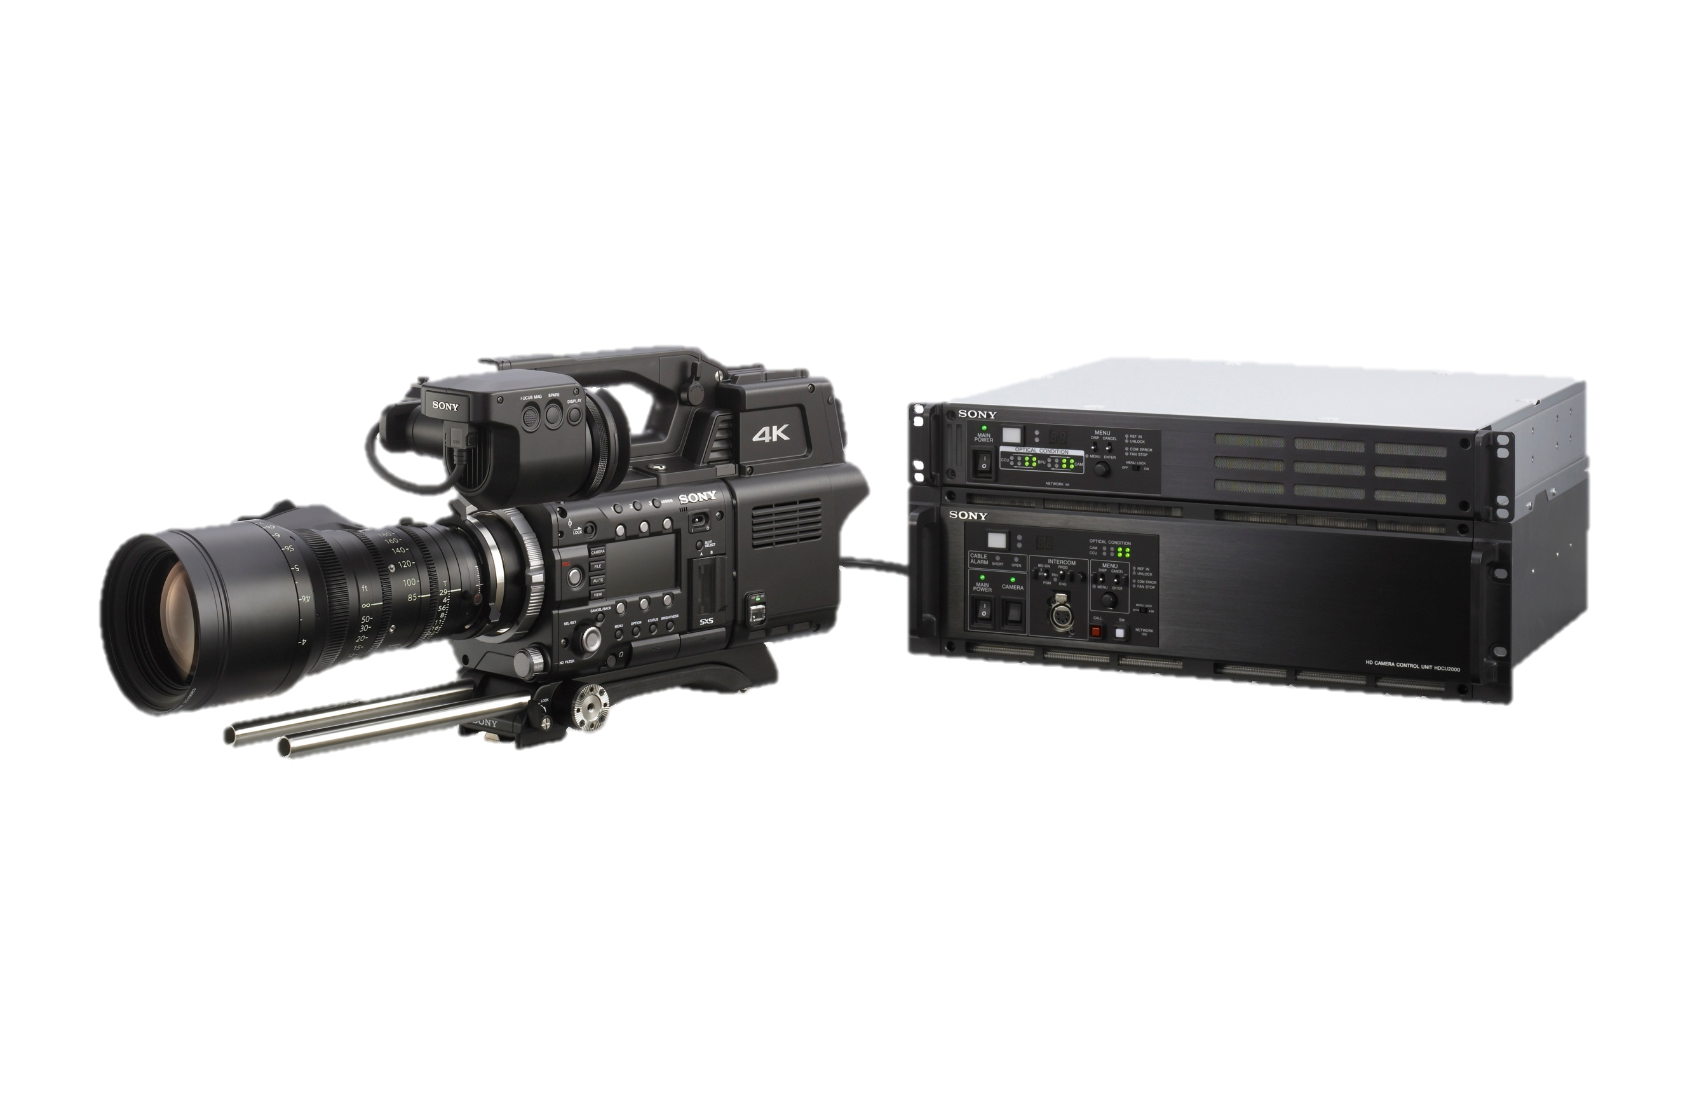
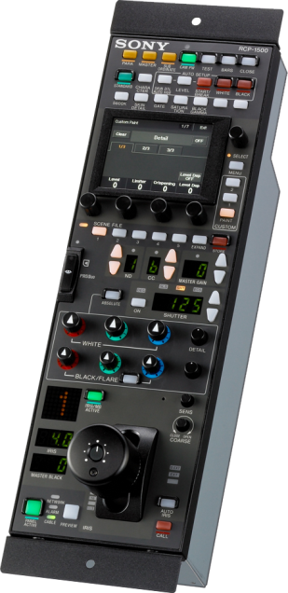
F55/CA4000/BPU4000
HDCU2000/RCP1500 Studio application

Slide 3
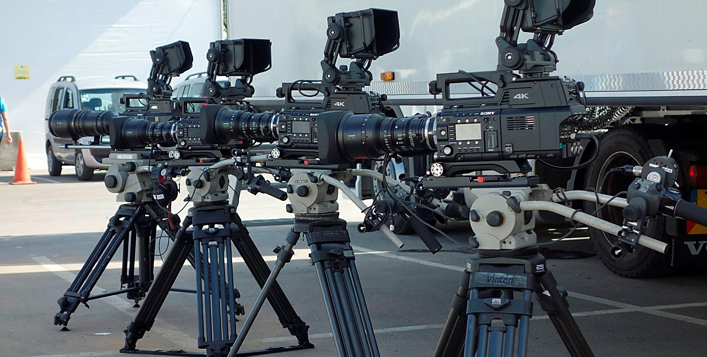
Versatile Live Production Camera System

Slide 4
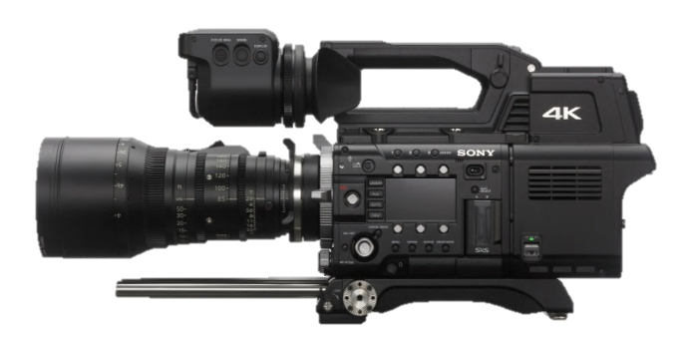
PMW-F55: Application
Drama
Live
4K
HFR
POV
Multi Application
4K-Live System

Slide 5
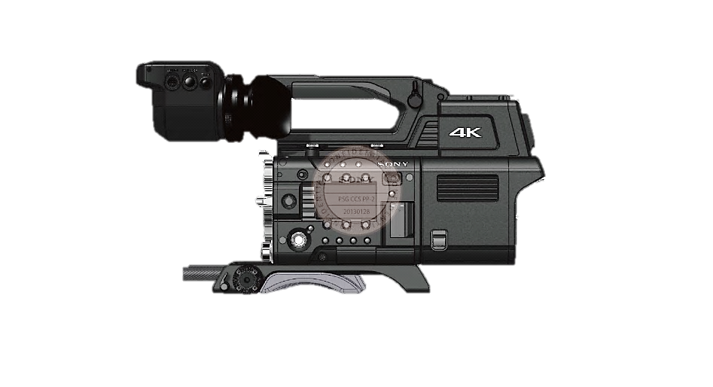
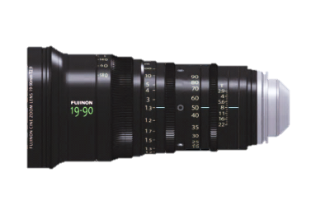
Camera Weight
Approx. 5.85kg
including F55,CA4000.DVF100
Handle & Shoulder pad
Fuji 4.7x Lens
(ZK-4.7x19SAF)
2.7KB
PMW-F55+ Fuji 35mm (ZK-4.7x19SAF)+CA-4000 +DVF-EL100 +VCT-FSA5
VCT-FS5 can be mounted on VCT-14

Slide 6
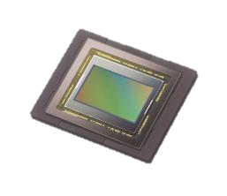
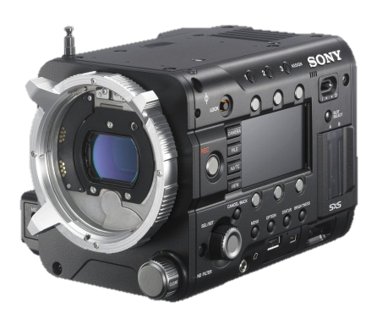
PMW-F55
S35mm 4096 x 2160 Single CMOS Imager,
FZ Mount, PL adapter provided, B4 adapter as option
14 F-stops Exposure latitude
Up to 180P in 4K, Up to 240P in HD
Variable Electronic Shutter angle : 1/24 to 1/6000 Sec
Modular Design
Light weight : 2,2Kg

Slide 7
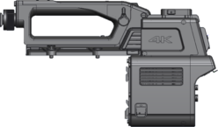
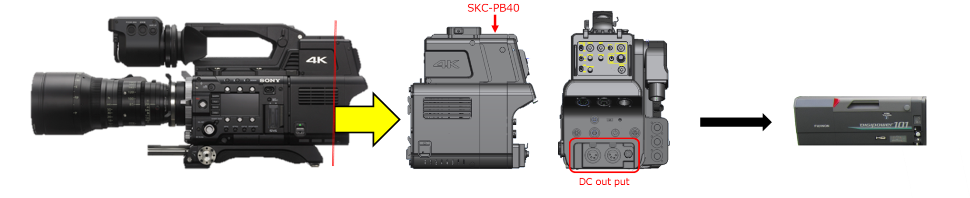
CA-4000
  System Camera Adapter for F55
  Fibre connection to BPU
  RAW data from F55 and transmit to BPU
  System camera IF :
    HDVF Viewfinders, Intercom, Tally, Tracker, Aux, Remote, Ret CTRL, Genlock, Moni Out
  Power Booster kit for Large Lens power supply

Slide 8
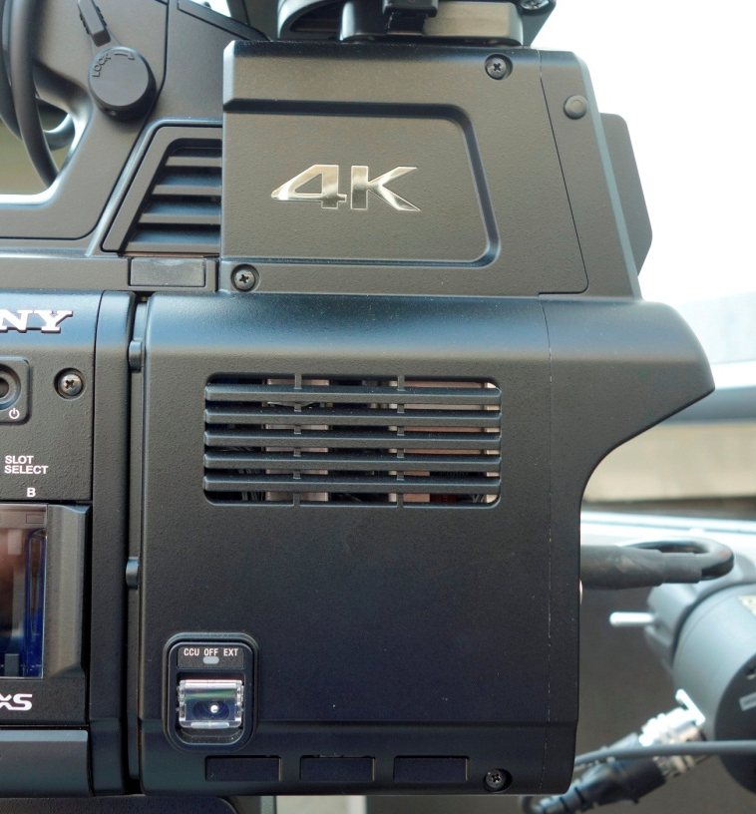
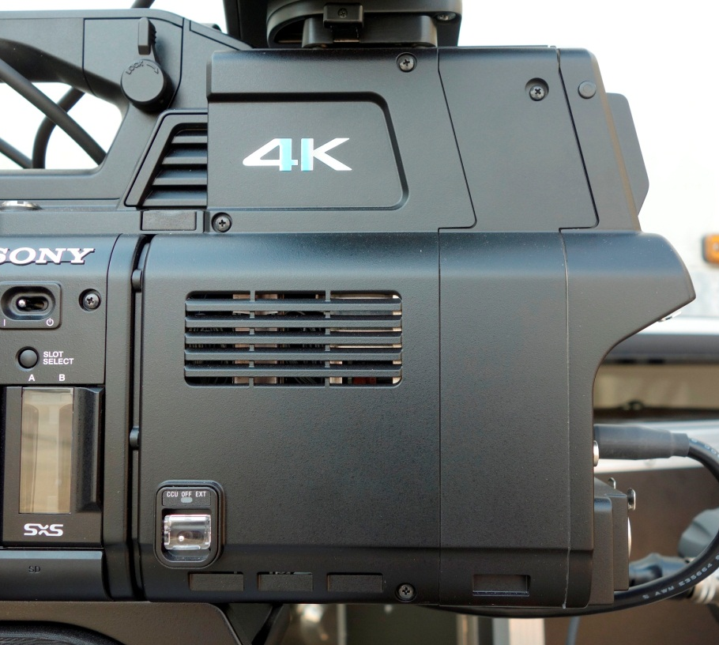
CA4000 & SKC-PB40
CA-4000 (for portable)
CA-4000 + SKC-PB40 (For Large BOX Lens opération )

Slide 9
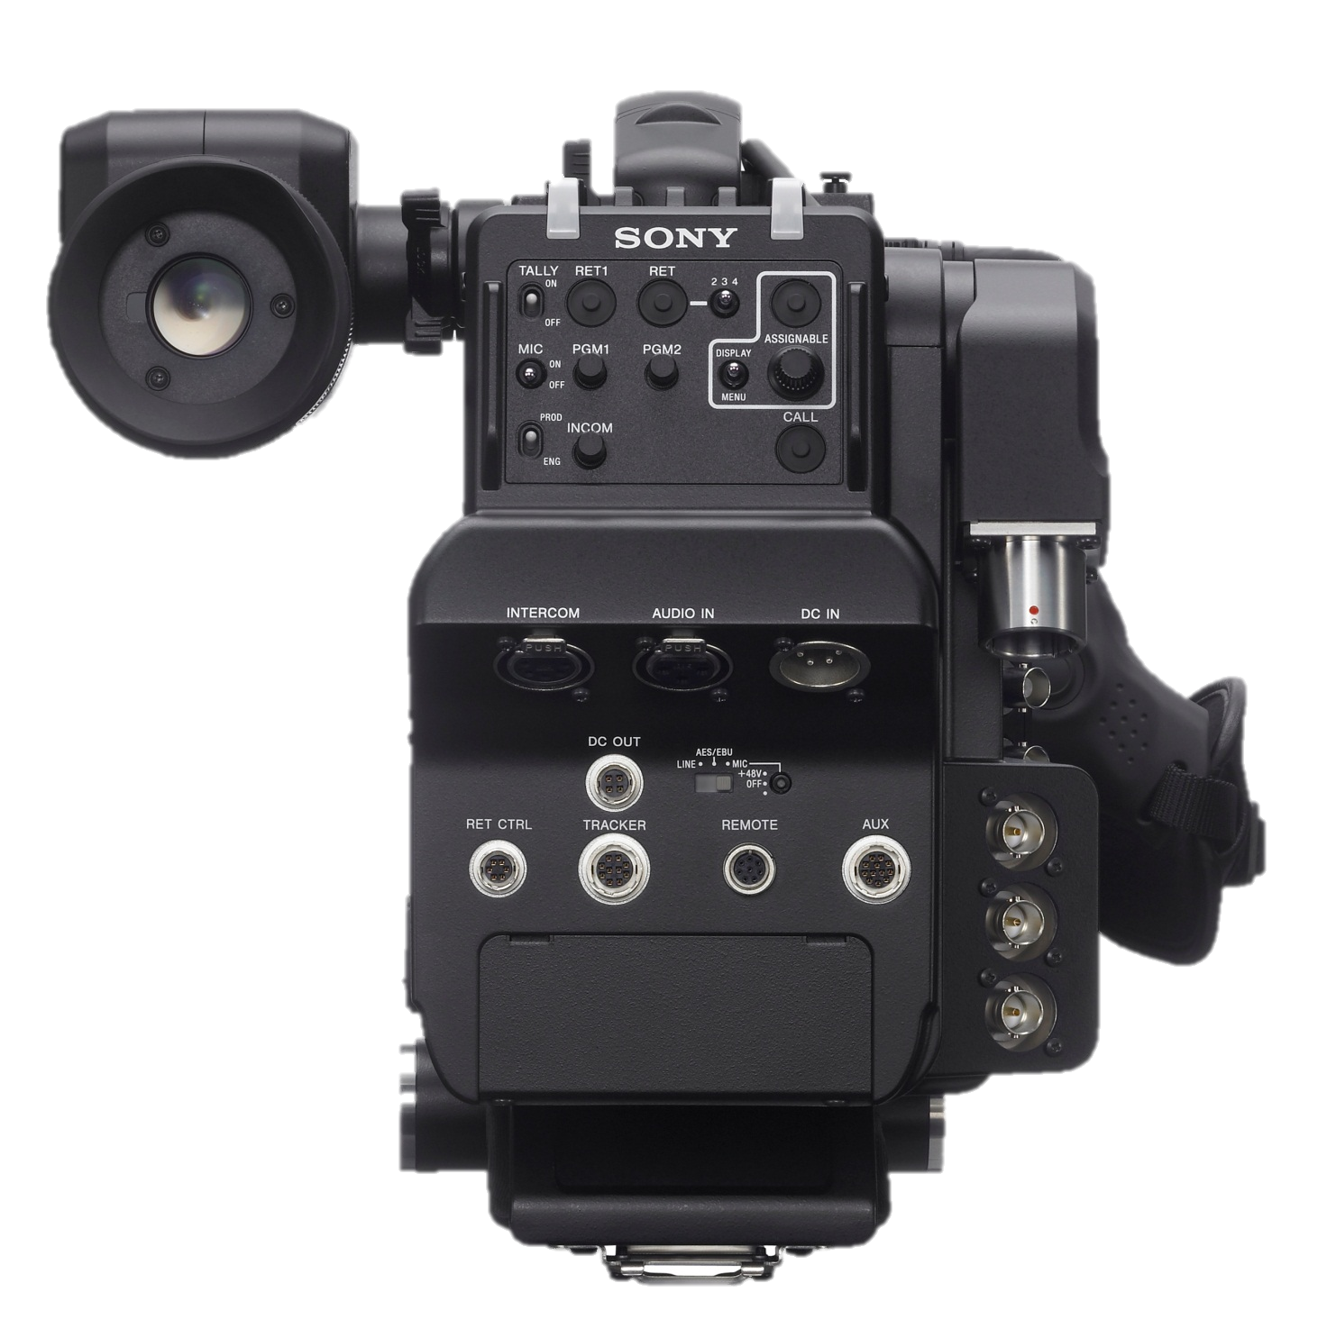
CA4000 Rear View
Similar to HDC arrangement
Rear Tally
RET 1&2,3,4
Tally on/off
Menu (VF operation,
sw assign ,etc)
SMPTE Fiber Connecter
Call
Income: Mic/PGM
DC-IN (XLR)
Audio in
Intercom
Mic Line,AES/EBU,48v
Accessory
DC-out
Prompter/GL (VBS/HD-tri-level)
Prompter-2 (VBS)
RET-control
Trucker
EXT tally contact closure
SDI-Monitor (Menu select
HD-SDI,VF, HD-prompter )
Aux (12 pins lens connecter for lens
which does not have Hot-shoe I/F
8-pins Remote
(CCA)

Slide 10
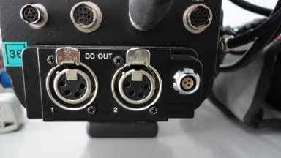
CA-4000 w/ SKC-PB40
Power Module: 3x DC OUTs—Total 135w
  ex: 2=appprox.65w each
  2x 4p XLR (12V) : use for powering box type HD lenses
  1x 3p round mini conn (24Vdc) (used for Cine accessories )

Slide 11
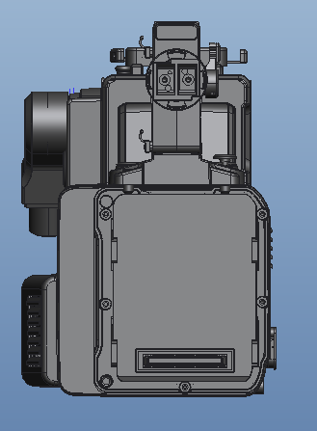
CA4000 Front View
Front Tally
&
Lens Tally
Sw on front
F55 IF connecter

Slide 12
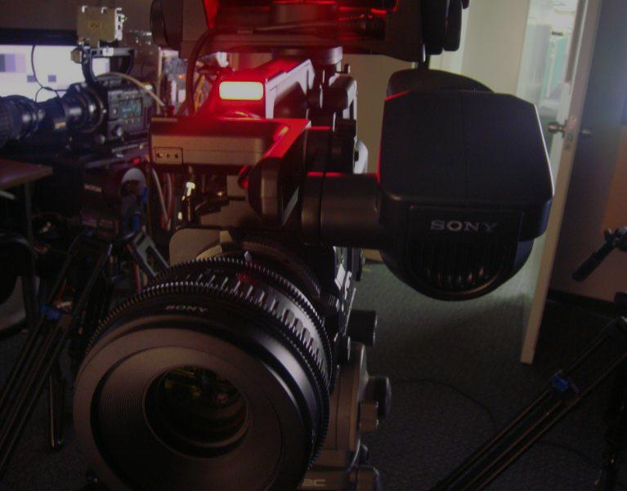
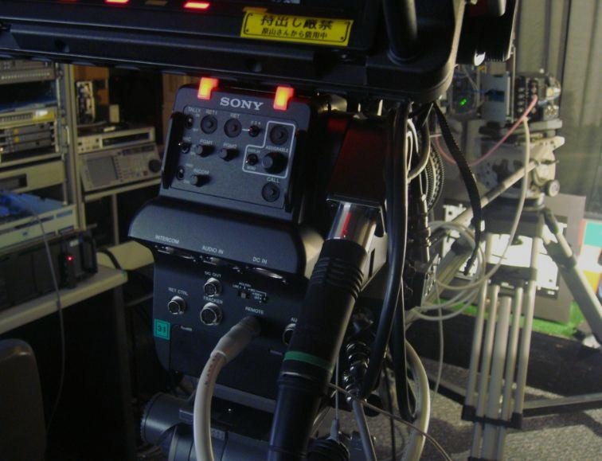
Tally on Handle (Front and Rear)

Slide 13
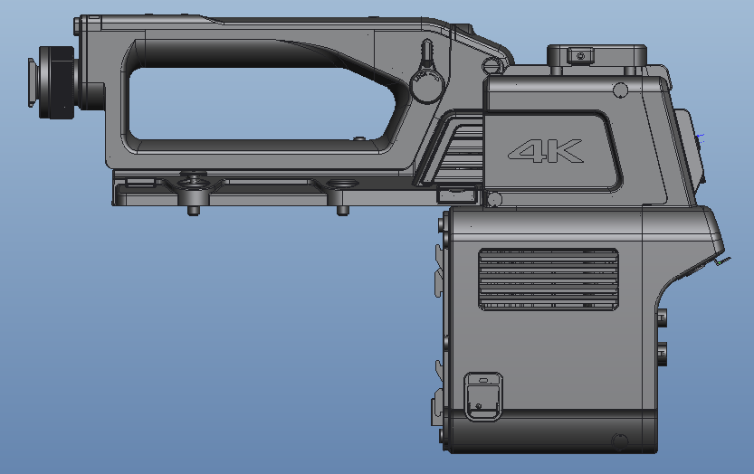
CA4000 (4K Camera System Adapter)
Handel slide Lock lever
Coin Screws
for mounting handle on
the F55 body
Ventilators
Power SW

Slide 14
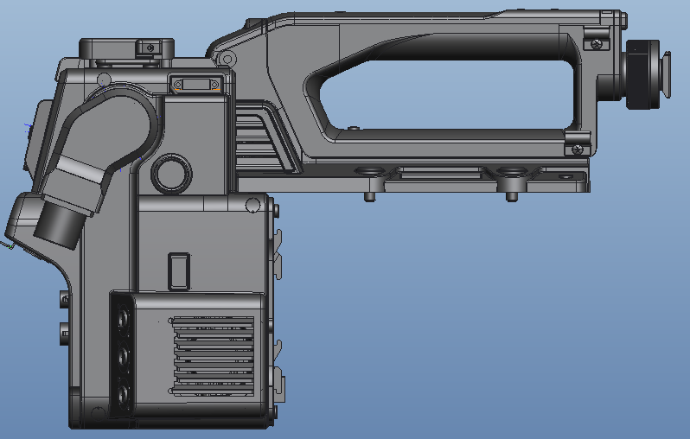
CA4000 (4K Camera System Adapter)
DVF Connecter
HDVF Connecter
USB
-Soft version-up
-Others
(Under the study)
Coin Screws
for mounting handle on
the F55 body
Ventilators

Slide 15
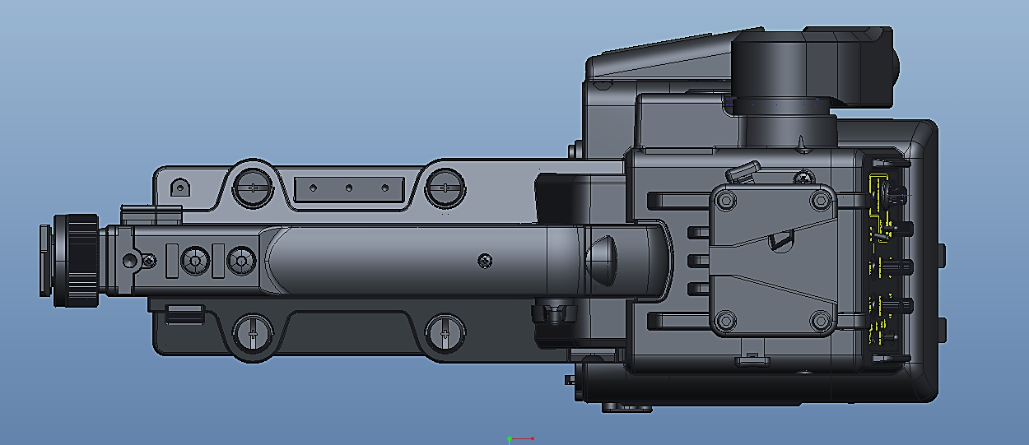
CA4000 (4K Camera System Adapter)
Coin Screws
for mounting handle on
the F55 body
Assignable SW
VF Shoe

Slide 16
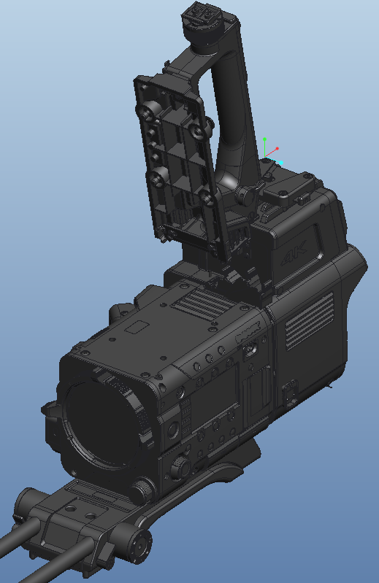
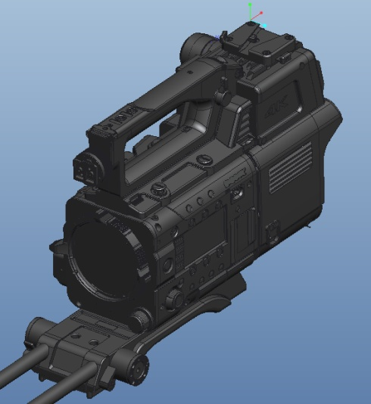
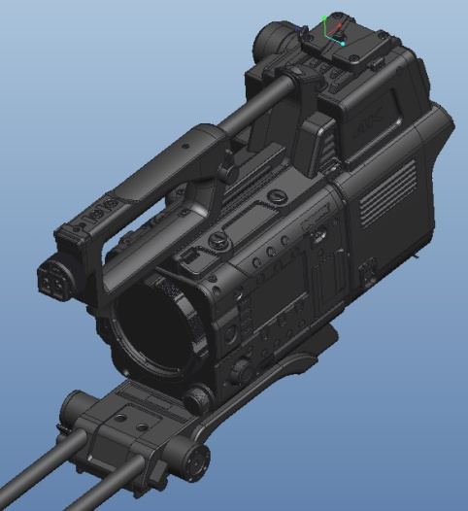
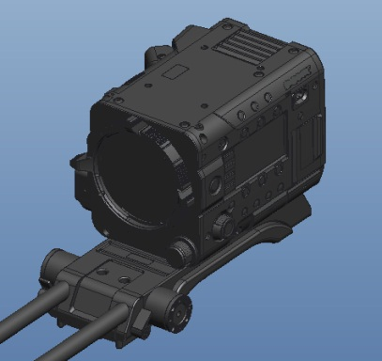
F55 + CA4000 Mounting Method
Not require tools, only needs a coin
Handle can slide for balancing when heavy lens is mounted
Handle can open
Close handle and
use coin to tight
4 screws on the F55
Handle can slide
F55＋VCT-FSA5

Slide 17
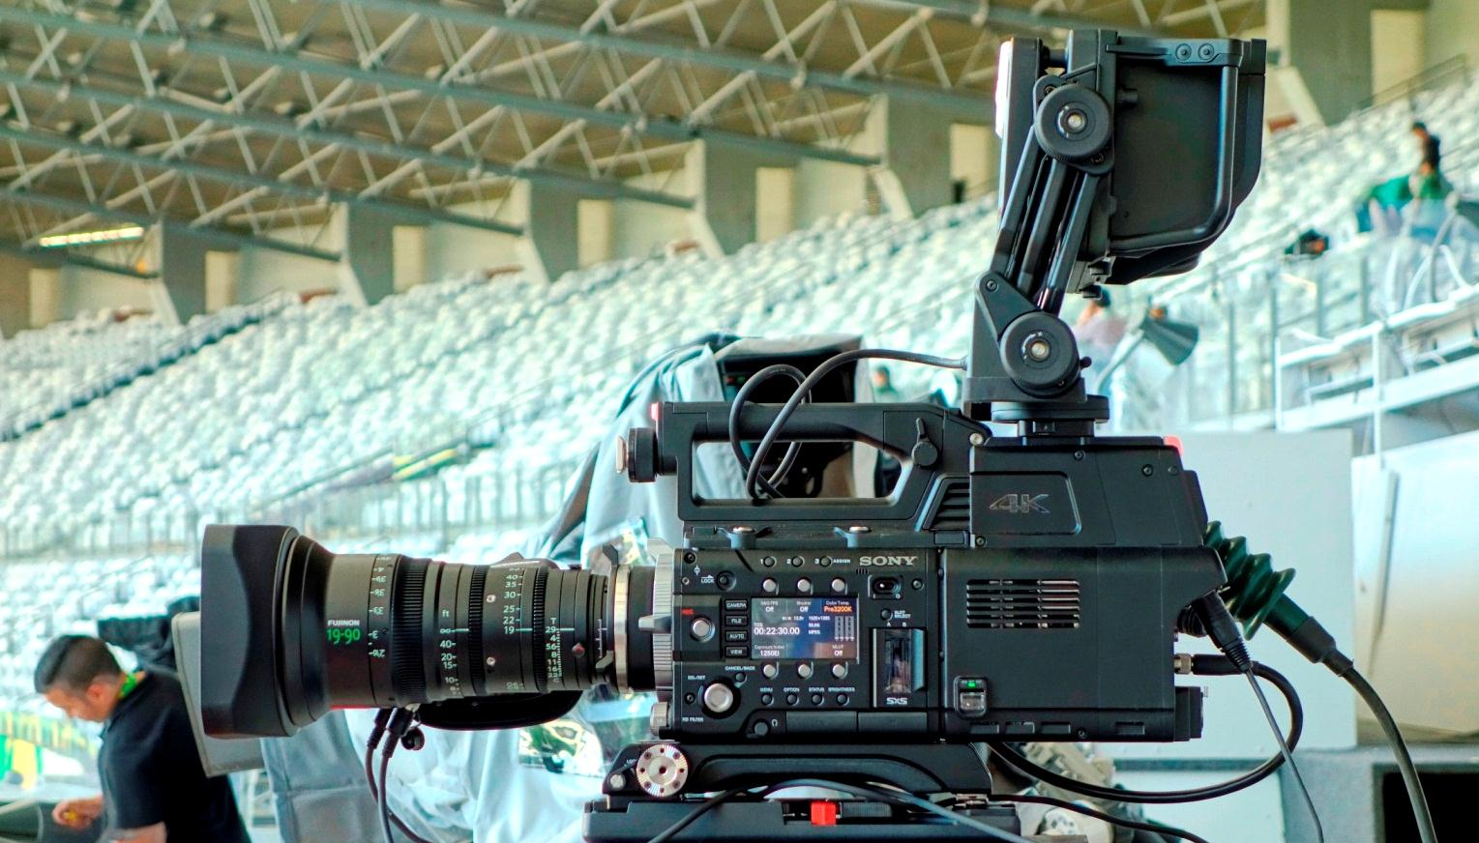
Portable Configuration F55+ CA4000+HDVF-EL75
Fujinon 19-90mm Cabrio Lens (PL)
CA-4000
PMW-F55

Slide 18
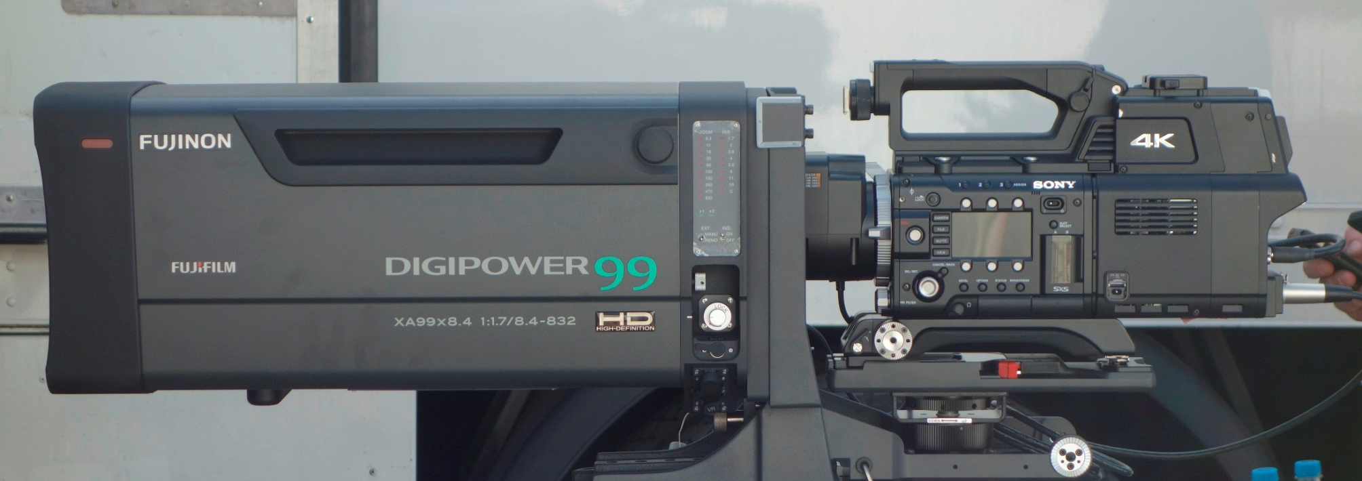
Large Box Lens configuration
LA-FZB2
(FZ to B4 Optical Adapter)
Fujinon 99x Zoom Lens (2/3’’)
PMW-F55
CA-4000
+ Power Booster
(SKC-PB40)
VCT-FSA5

Slide 19

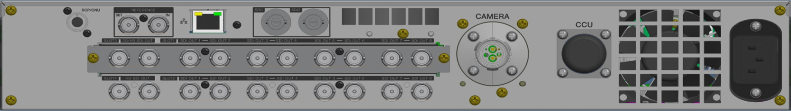
BPU-4000
Base band Processor Unit
  RAW data from F55
  De-bayering and Signal processing (DSP: same as HDC camera)
  Connection to HDCU-2xxx series
    for Camera Power / Intercom, Tally/ Return/Prompter / RCP, MSU & other required Signals
  4K & HD outputs
  Cut out video outputs
  HFR video outputs
  3G out Level-A/B
  (Selectable via
  Menu sw on BPU, RCP・MSU)
Front View
Rear View

Slide 20
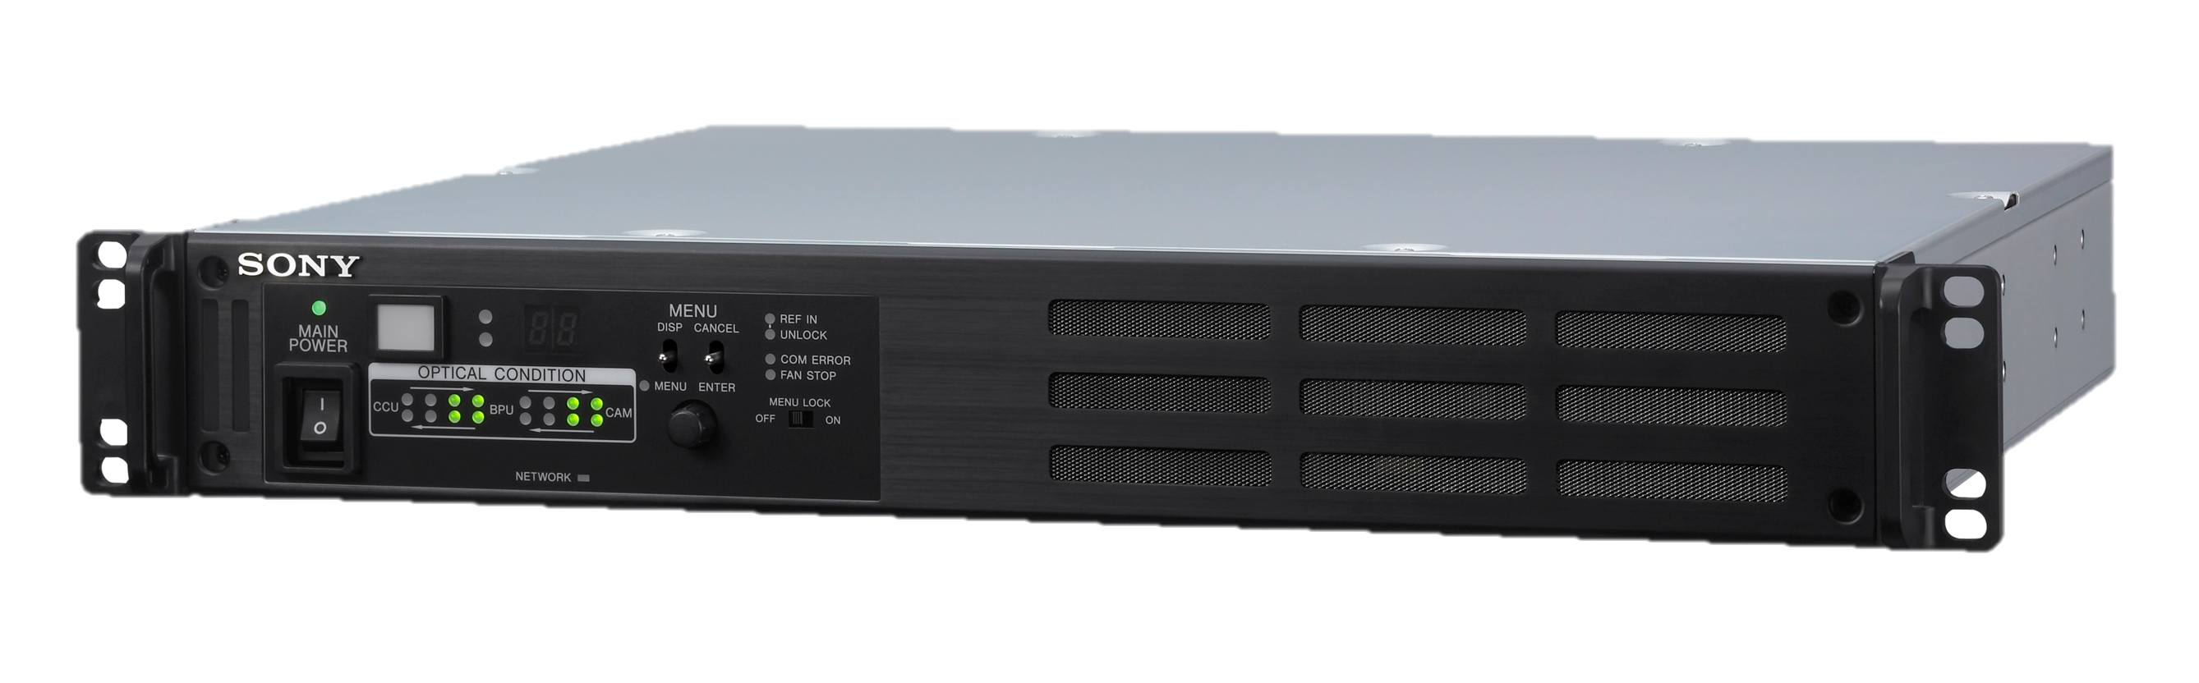
BPU (Base Band Processor Unit)
Menu
-Configuration
-Diagnostic
-Service
Tally
Ventilator
1.5U
Fiber Status info
Front Panel arrangement will be same as HDCU 2000/2500
DSP Processor inside is same as HDC2000 series
No power to camera from this unit (Head needs local power)

Slide 21
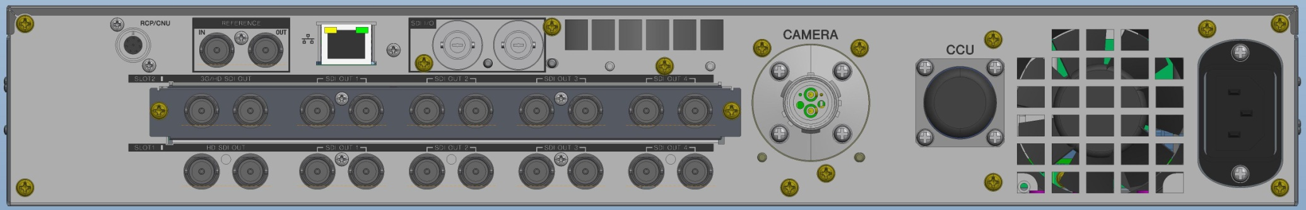
BPU4000 Rear Panel
小さいプロダクションではHDCUなくて使用可能
ただし、incom,.tally audio が無い
LAN
(RCP or PC for CUT-OUT)
REF
To camera
(SMPTE Fiber)
From HDCU
(SMPTE Fiber)
(HＤ,VBS)
SDI I/O
RCP/CNU
3G Out
SDI OUT
(HD-SDI
Monitor
We can use without HDCU
for small productions:
-Wire out
４K OUT
No IF for:
-Income
-Tally
-Audio
2 BNC Pair

Slide 22
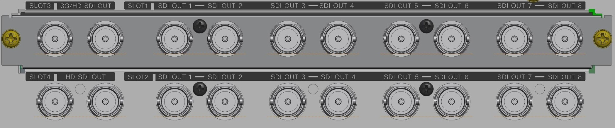
BPU 4K/HD output connector arrangement
3G/HD-SDI（SLOT3）
４K OUT(SLOT1)
４K OUT(SLOT2)
HD-SDI（SLOT4）

Slide 23
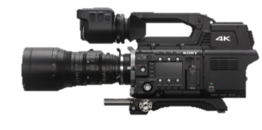

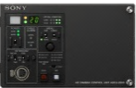
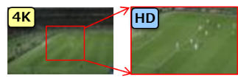


Application
4K Broadcast
4K/QFHD
1080P
1080P/I
4K Mode
Return / intercom / Ref /Tally / RCP
HD
Live Sports
1080/240p
1080P
1080P/I
HFR Mode*
Return / intercom/ Ref /Tally/ RCP
HD
Live Sports
Virtual Camera
4K/QFHD
1080P
1080P/I
HD Cut Out (Option)
Return/intercom/ Ref /Tally/RCP

Slide 24
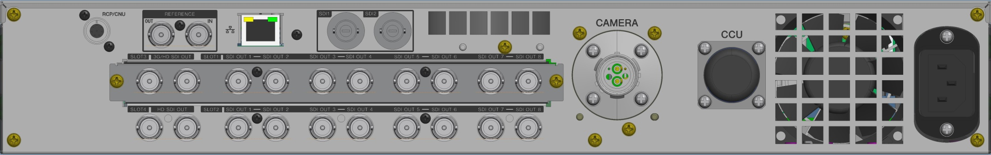
4K Broadcast
4K Broadcast
4K/QFHD
1080P
1080P/I
4K Mode
Return / intercom / Ref /Tally / RCP
4K-OUT(A)
4K-OUT(B)
4K-OUT(C)
4K-OUT(D)
-Slot-1: Main
-Slot-2: Monitor
A
B
C
D

Slide 25
High Frame Rate HD 240P
HD
Live Sports
1080/240p
1080P
1080P/I
HFR Mode*
*Require F55 v1.4, Dec13
Return / intercom / Ref /Tally / RCP
HFR out
Normal Speed 3G/HD
Normal Speed
HD/Moni
HFR monitor

Slide 26
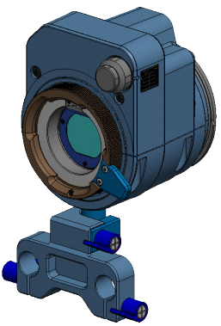
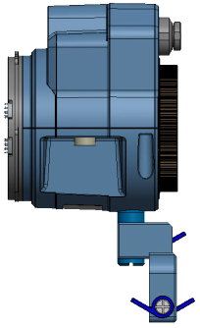
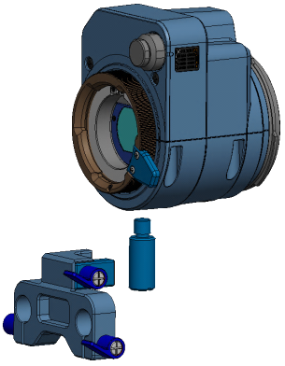
LA-FZB2 : Lens 35mm –2/3”Optical Converter
LA-FZB2
– FZ to B4 lens adapter
  2.6x Magnification
  ALAC
  ND/CC Servo, Filter Wheels
    4 ND: Clear, ¼,1/16,1/64
    4CC:Cross, 3200K,4300K,6300K
  12pin Lens Connecter
  W91mm x H173.4mm x D96mm
  1Kg
  12 PIN connecter IF under standalone operation ex: Rec Trigger:
    Same as LA-FZB1—See following page
12P Lens CN
Cramp
Screw 3/8”
Φ15mm Rod

Slide 27
ALAC function with LA-FZB2
Available Lenses
For Prototype & Pre-Production Models
  Studio Box lens
    Fuji Film XA88x8.8BEPS
    Fuji Film XA99x8.4BESM
  Portable lenses
    Fuji Film HA23x7.6BERD
    Fuji Film HA19x7.4BEZD
For Production Model: TBA

Slide 28
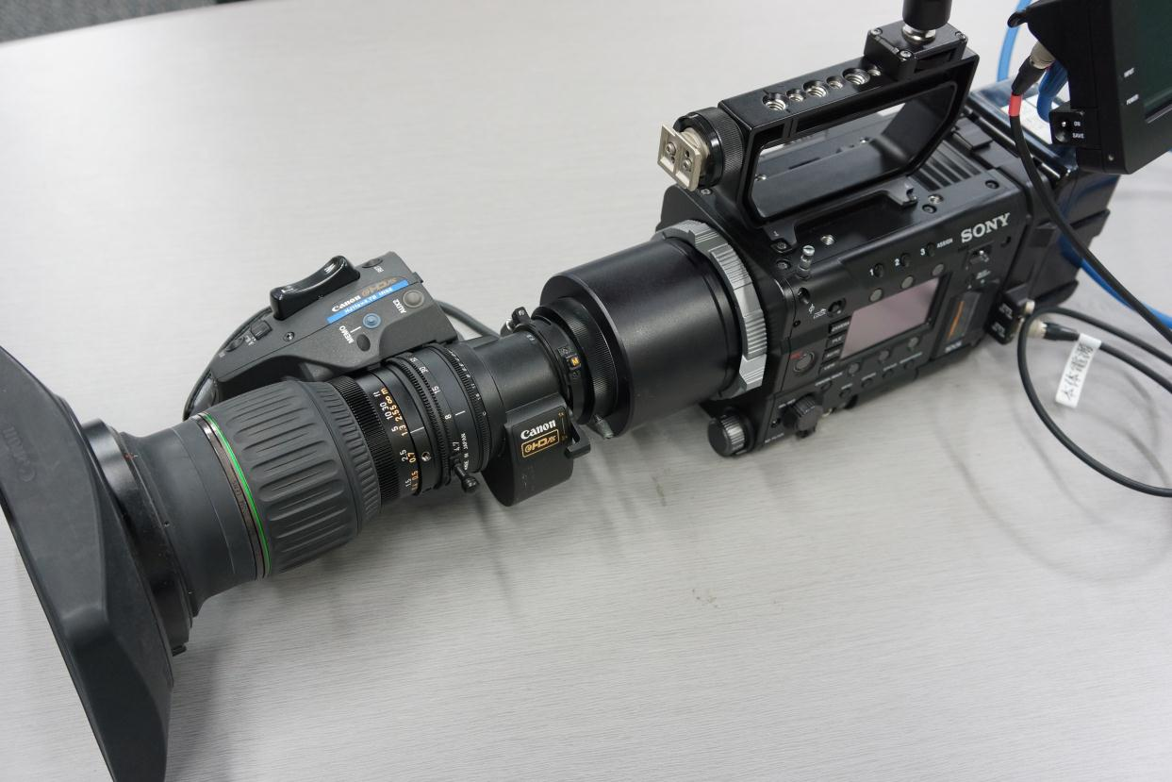
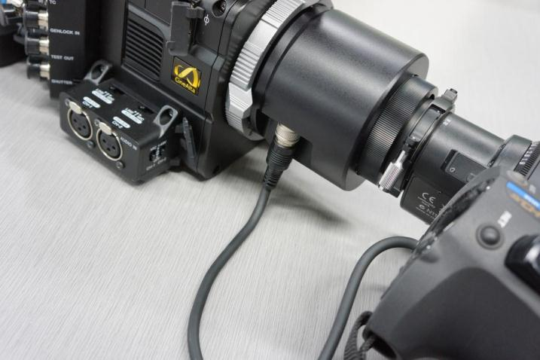
LA-FZB1 : Lens 35mm –2/3”Optical Converter

Slide 29
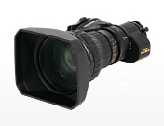
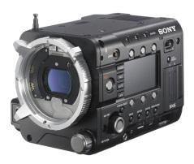
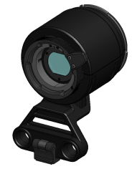
  LA-FZB1 Product Overview
LA-FZB1 : Lens 35mm –2/3”Optical Converter
FZ to B4 lens adapter
  2.6x Magnification
  ALAC
  12pin Lens Connecter
  No ND/CC Filters are available ( use Filters on Camera)
Applicable model:
  PMW-F55/F5
  Can not be used with PMW-F3
2/3” Portable Lens Use w/ LA-FZB1

Slide 30

12 pin interface
12-pin interface make lots of functions be possible.
Available from F55/F5 Ver1.3 (September/2013)
  Rec trigger
  Zoom button
  Lens Information
    (zoom, focus, iris, serial number, model name)
  Control from RM controller (iris)
  Control from CBK-DCB01( zoom controller)
Available from F55/F5 Ver1.4 (December/2013)
  Auto iris

Slide 31
LAFZB1& LAFZB2 comparison
Note: No other manufacture optical adapter has Filter disc
 | LA-FZB1 (w/o FDU) | LA-FZB2 (w/ FDU)
Manufacturer | SONY | SONY
Magnification | 2.6x | 2.6x
Max. Input F Number | 1.44 | 1.44
Mount | FZ to B4 | FZ to B4
Dimensions | Φ91x92.9 | Φ91x95.84
Mass | 664g (1lbs, 7.40oz) (w/ support rod bracket) 505g (1lbs, 1.8oz) (adaptor only) | 848g (w/ support rod bracket)
External interface | 12P | 12P
Filter Disc Unit | n/a | 1:ND0(CLEAR) A:CROSS 2:ND0.6(1/4) B:3200K 3:ND1.2(1/16) C:4300K 4:ND1.8(1/64) D:6300K

Slide 32

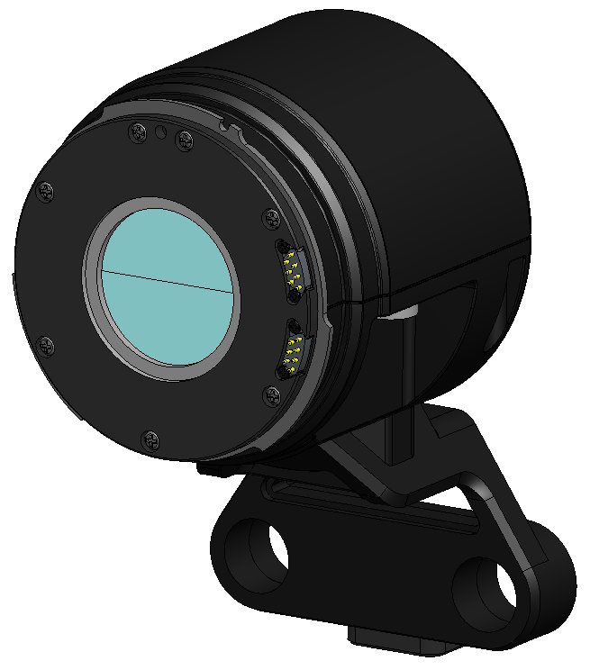
w/ 15mm support rod bracket

Slide 33
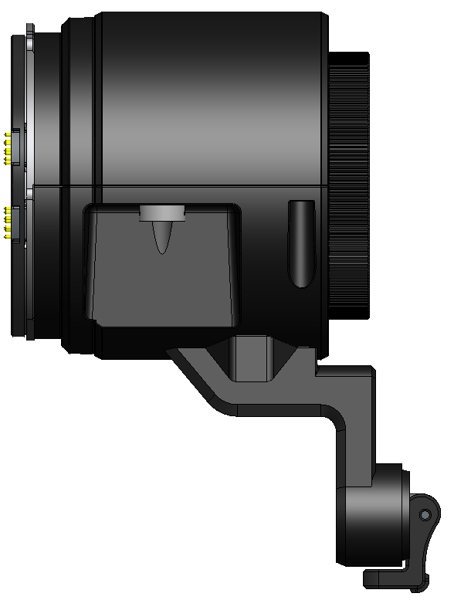
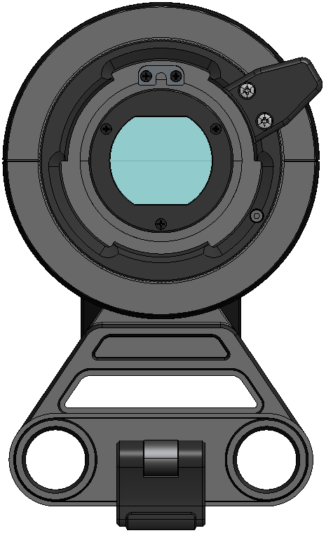
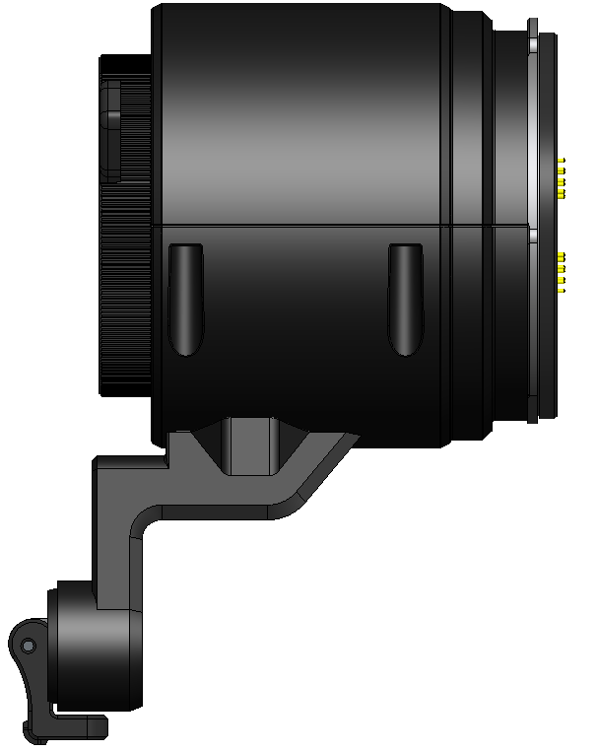
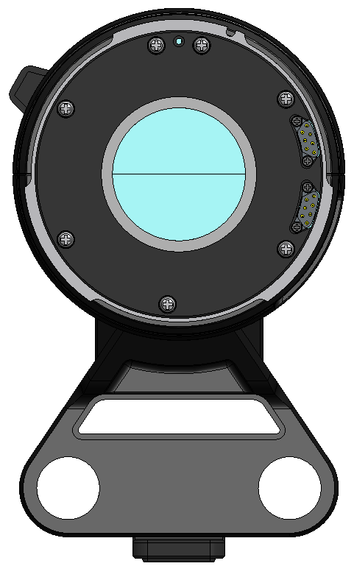
w/ 15mm support rod bracket

Slide 34
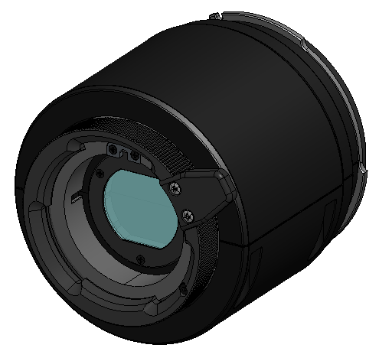
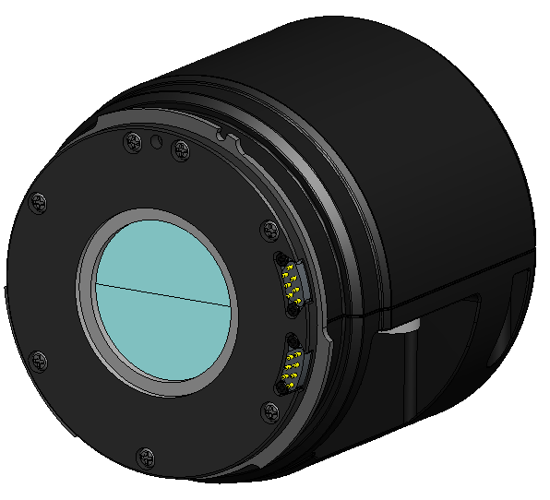
w/o 15mm support rod bracket

Slide 35
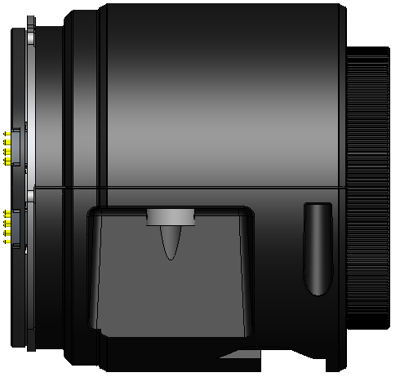



w/o 15mm support rod bracket

Slide 36




Viewfinder Choices
DVF-EL100
0.7” OLED
DVF-L350
3.5” color LCD
DVF-L700
7” LCD
HDVF-EL75
7.4” Color OLED

Slide 37






Control Panels
New Features
Conventional multi-pin cable control
Network control by LAN cable
Programmable menu
MSU-1000
MSU-1500
RCP-1000/1001
RCP-1500/1501
RCP-1530

Slide 38

MVS-7000X & 8000X
Currently: 4K production by setting bus-link of 4M/E (or 2ME+MP2) in 1080P(3G)
  Simple operation with Cut, MIX etc.
Future: 4K Upgrade software
  Wipe, Choma Key etc. will be available
Future: 4K Up-converter Option:
  HD (I or P) to 4K up-conversion will be available

Slide 39

SR-R1000
Recording on ultra-reliable SRMemory
HD, 3D and 4K recording
Simultaneous record and slow motion replay
Compatible with 3rd party external controllers
Open SStP recording format

Slide 40


PVM-X300
30’’ True 4K (4096 x 2160) LCD Panel
Versatility with 3G-SDI x4, HDMIx4 and DisplayPort x2
Quad View Modeamera focus function
Auto White Adjustment with colour probes
Markers setting and Gamma selection

