Slide 1
i2MAP Camera and Lens Testing
Mark Chaffey
MBARI
chma@mbari.org
July 13, 2014
© MBARI 2014

Slide 2
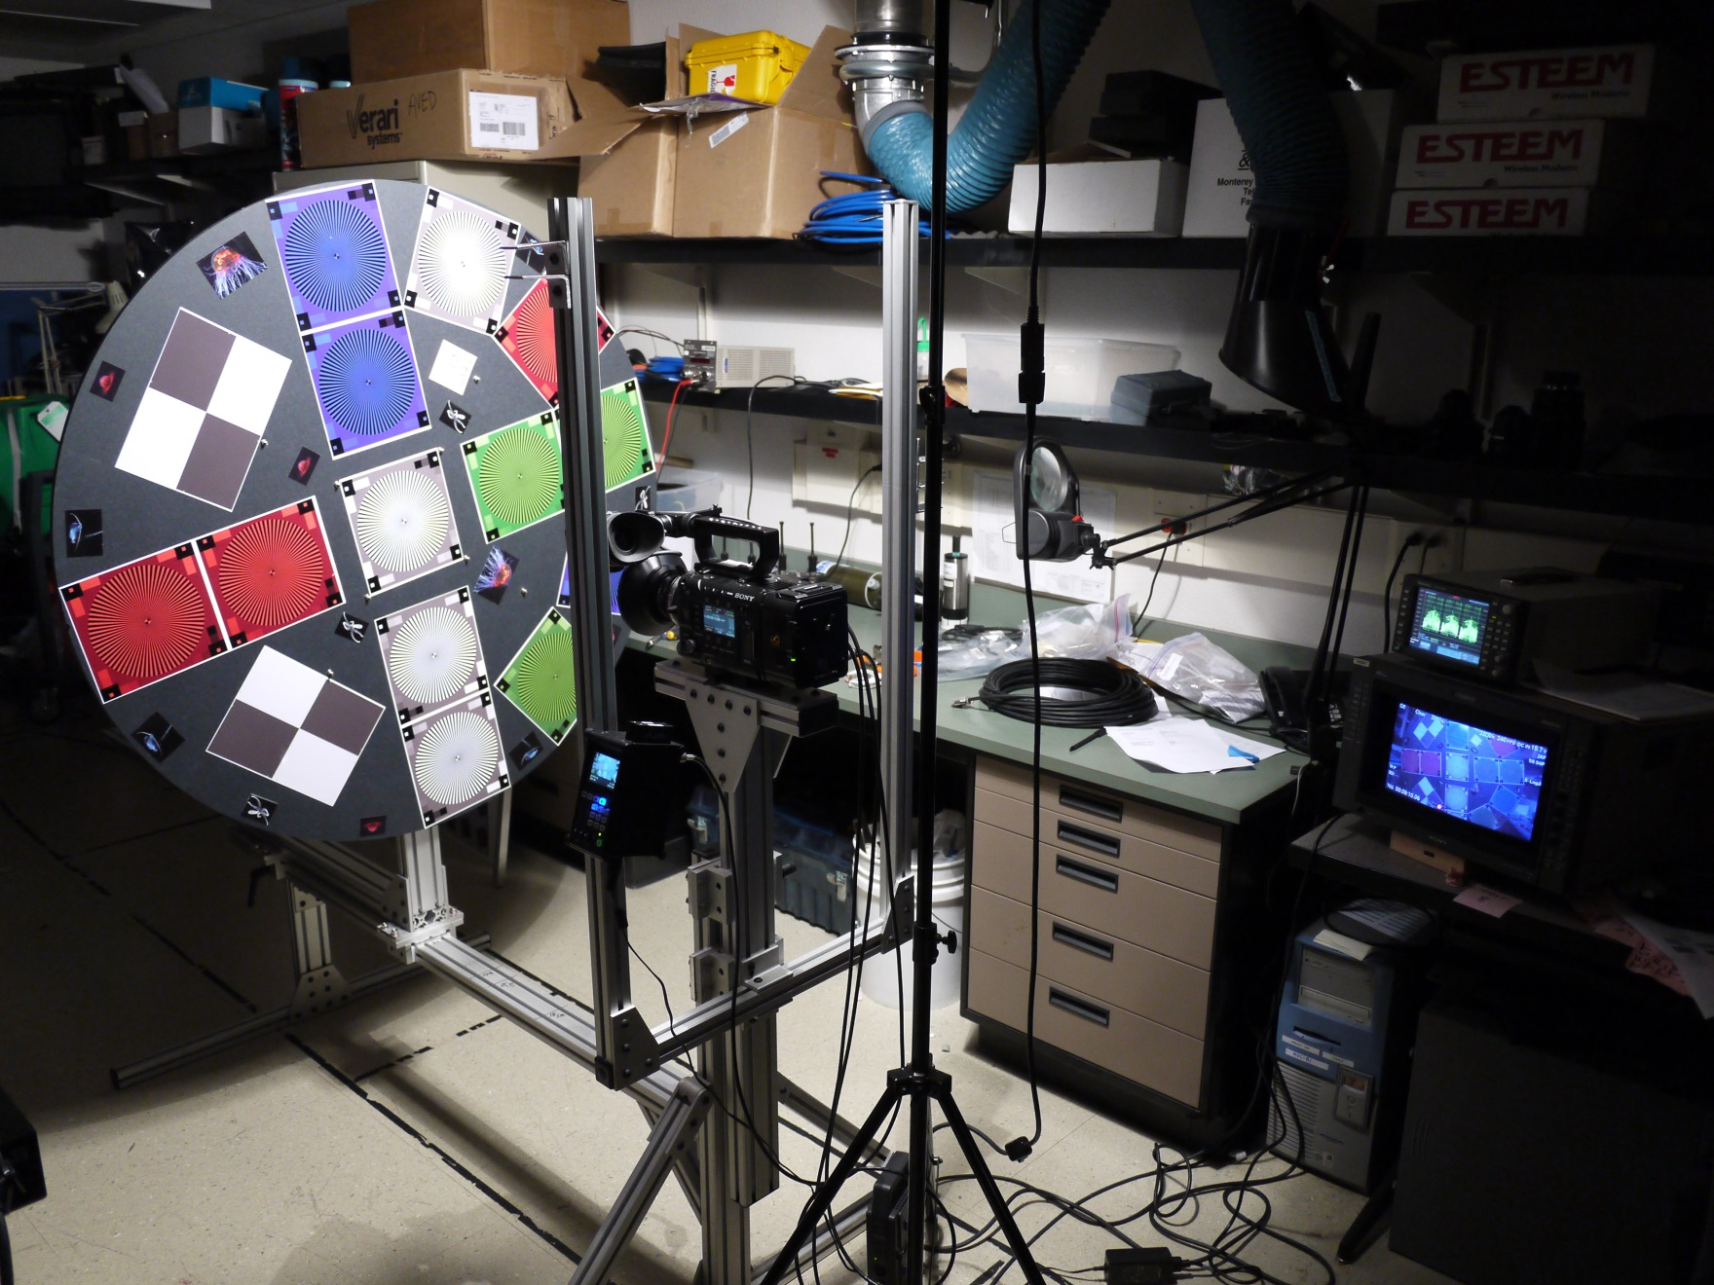
Camera Test Setup

Slide 3
Camera Test Work Flow
CAMERAS
Ikegami
HDL 50/HS
Sony
HDCP1,
NEX-FS700U
Pixel Resolutions
1.9k = 1920 x 1080
2k = 2048 x 1080
4k = 4096 x 2160
AJA Quad Pro ProRes 10 bit 422 (HQ) Recording
1.9k
Sony XAVC Recording (F-5 only)
1.9k
Capture Still Frame in .tiff Format
Export to ProRes 10 bit 422 HQ
2k
Export to ProRes 10 bit 4444
CAMERA
Sony F-5
Sony 16 bit Raw Recording (F-5 only)
4k
Export to DPX Frames
Open in PhotoShop
1.9k
CODEC Comparison Reference
Export to DPX Frames
Open in PhotoShop

Slide 4
Camera Detail Resolution Comparison Locations
Target Distance at “Sweet Spot” ~ 0.5 Meters From Dome
Detail Areas
Edge
Center
Sony F-5, SCL-P11X15 Lens, 400 lux, 70 IRE, Target 36 inches

Slide 5
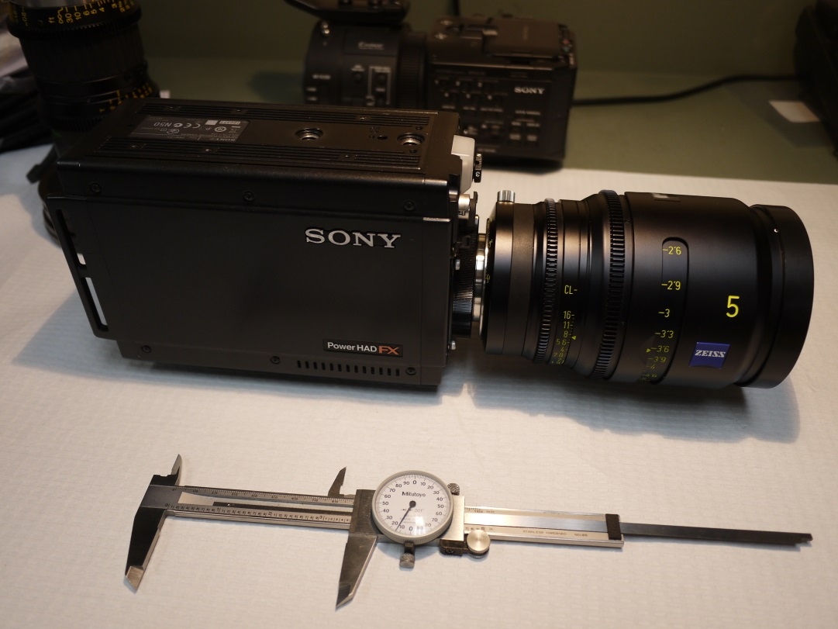
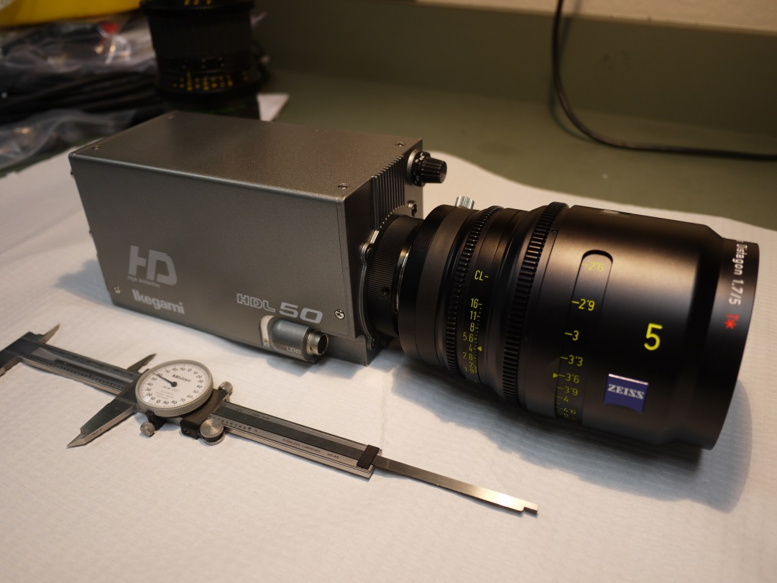
Camera Comparison
Sony HDCP1 vs. Ikegami HDL50/HS
The B4 Mount Lens Winner Was Used for The Camera Test
Zeiss Digi Prime T1,9/5mm

Slide 6
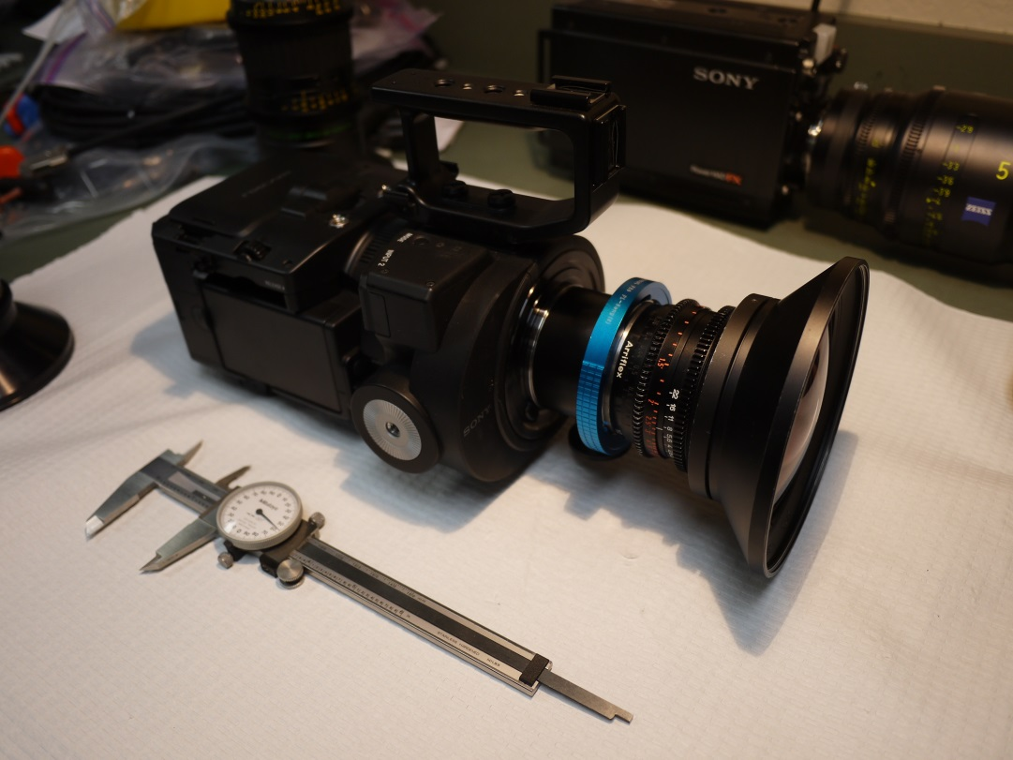
Camera Comparison
Sony NEX-FS700U vs. Ikegami HDL50/HS
The PL and B4 mount Lens Winners Were Used for The Camera Test
Sony SCL-P11X15 Lens and Zeiss Digi Prime T1,9/5mm

Slide 7
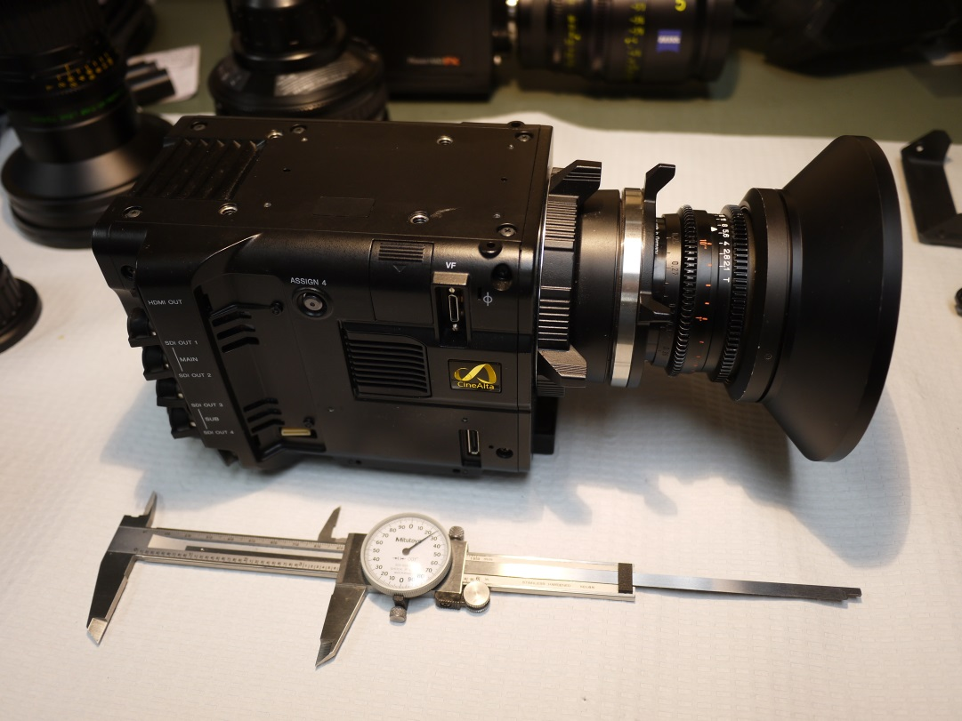
Camera Comparison
Sony F-5 vs. Ikegami HDL50/HS
The PL and B4 mount Lens Winners Were Used for The Camera Test
Sony SCL-P11X15 Lens and Zeiss Digi Prime T1,9/5mm

Slide 8
Camera Comparison
Sony F-5 vs. Ikegami HDL50/HS
The PL and B4 mount Lens Winners Were Used for The Camera Test
Sony SCL-P11X15 Lens and Zeiss Digi Prime T1,9/5mm

Slide 9
Finalist #1 Sony F-5 and Sony SCL-P11X15 Lens
Sony F-5, SCL-P11X15 Lens, 400 lux, 70 IRE, Target 36 inches File: Test_13X.tiff

Slide 10
Finalist #2, Ikegami HDL-50/H and Zeiss Digi Prime T1,9/5mm Lens
Ikegami HDL50/HS, 5mm Lens, 140 lux, 80 IRE, Target 39 inches File: Test_77.tiff

Slide 11
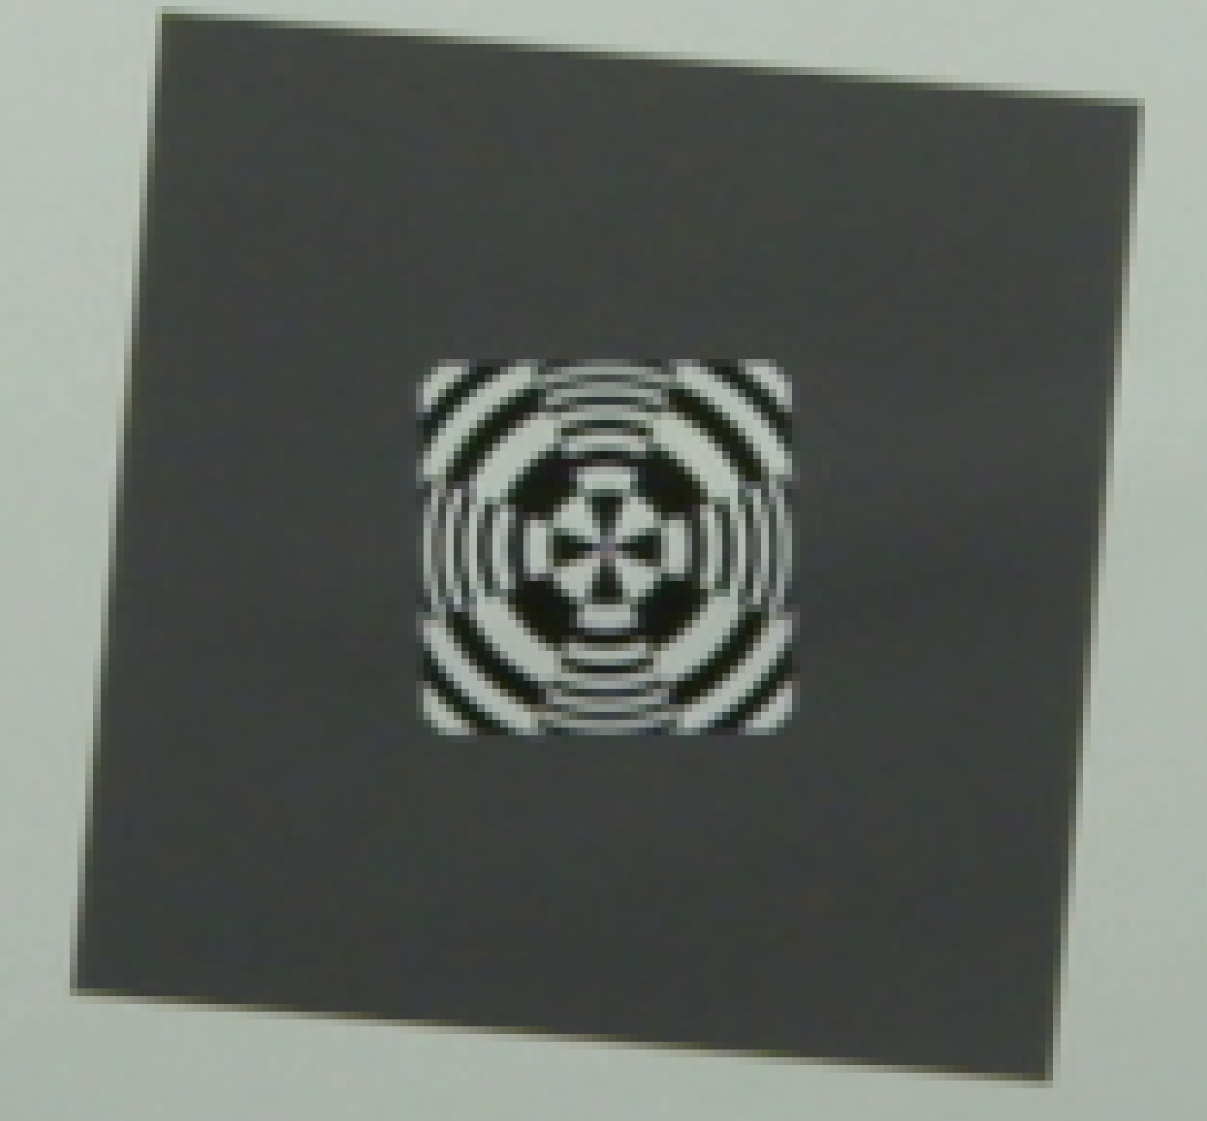
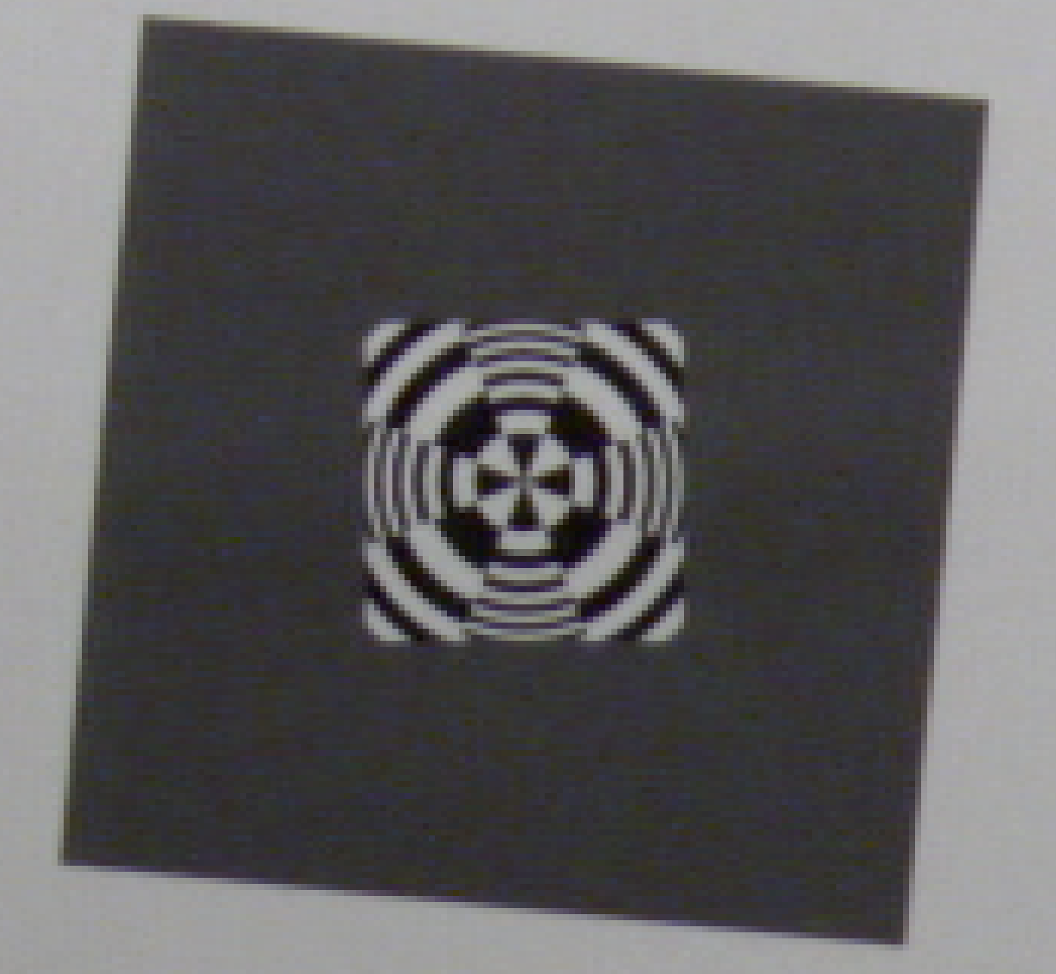
Sony F-5 vs. Ikegami HDL50/HS
Center Resolution
Sony F-5, Sony 11mm Lens, 400 lux,
ISO 800, Target 36 inches, 1920x 1080 P60
File: Test_13X.tiff
Ikegami HDL-50/HS, Zeiss 5mm Lens, 140 lux, 80 IRE, Target 38 inches
File: Test_77.tiff

Slide 12
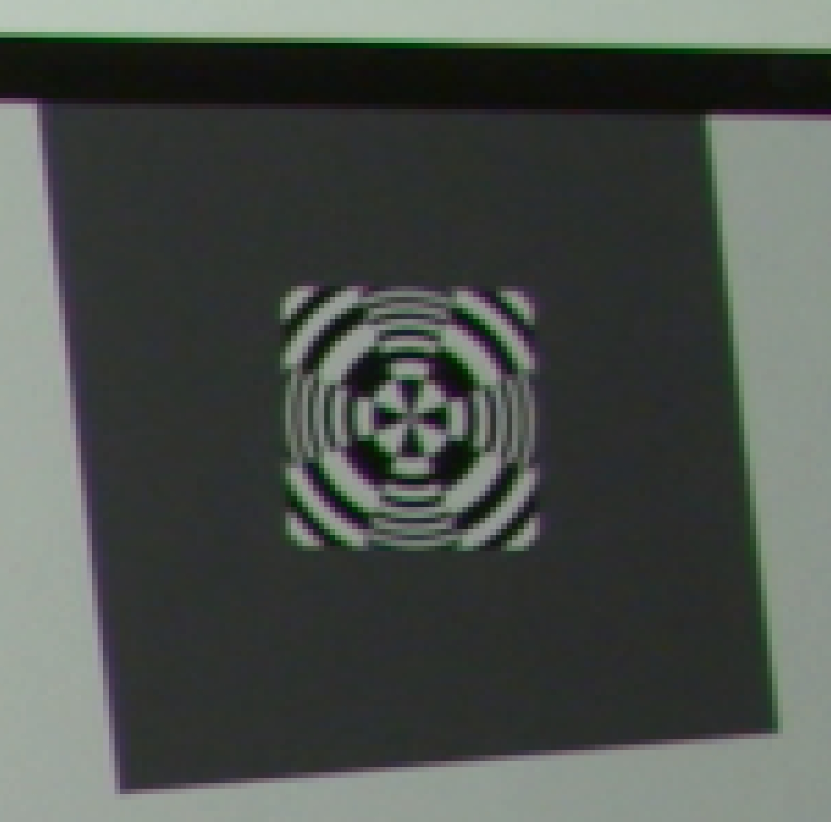
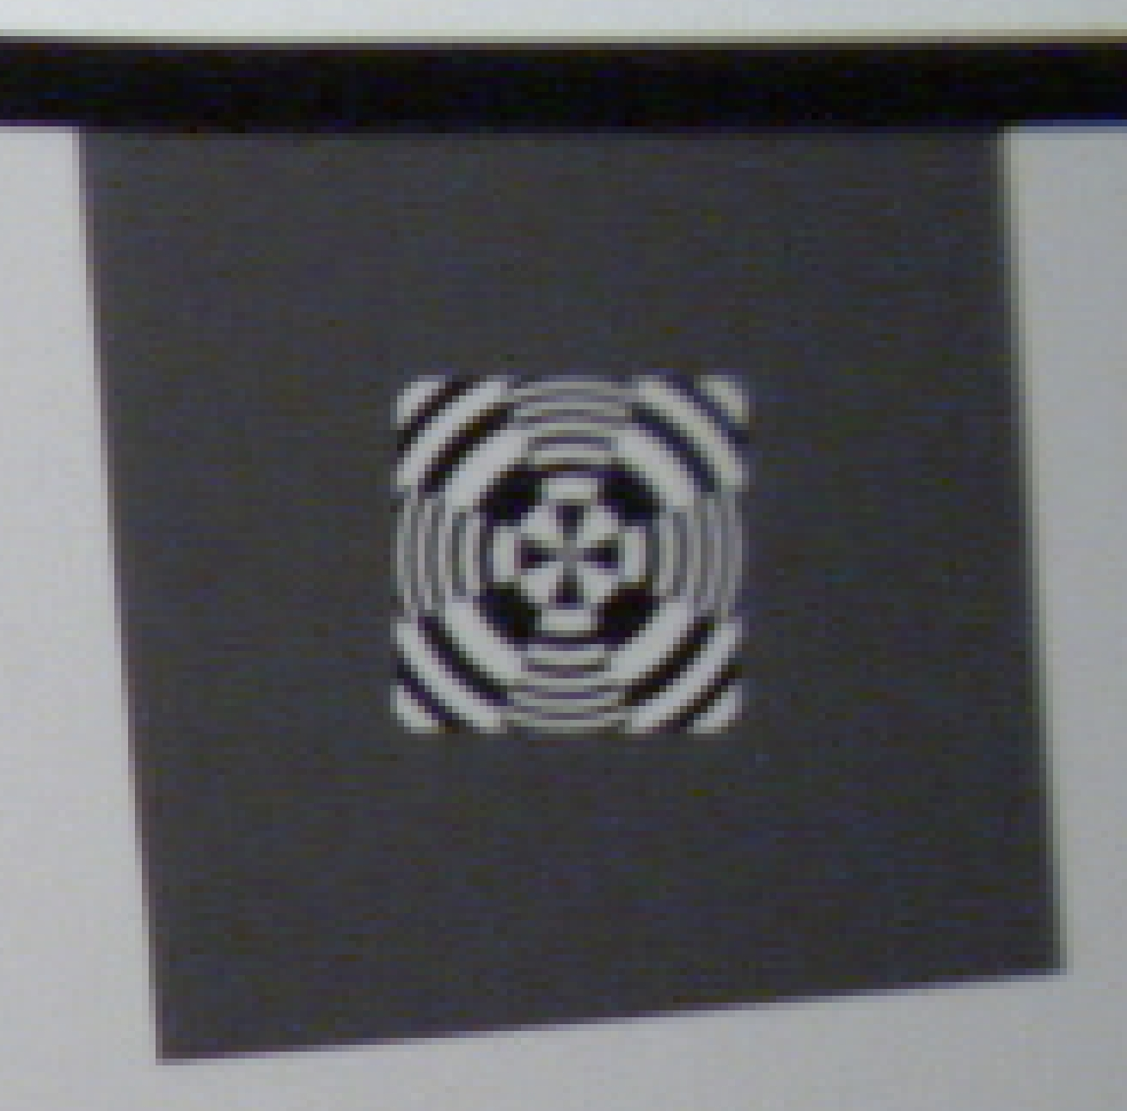
Sony F-5 vs. Ikegami HDL50/HS
Edge Resolution
Sony F-5, Sony 11mm Lens, 400 lux,
ISO 800, Target 36 inches, 1920x 1080 P60
File: Test_13X.tiff
Ikegami HDL-50/HS, Zeiss 5mm Lens, 140 lux, 80 IRE, Target 38 inches
File: Test_77.tiff

Slide 13
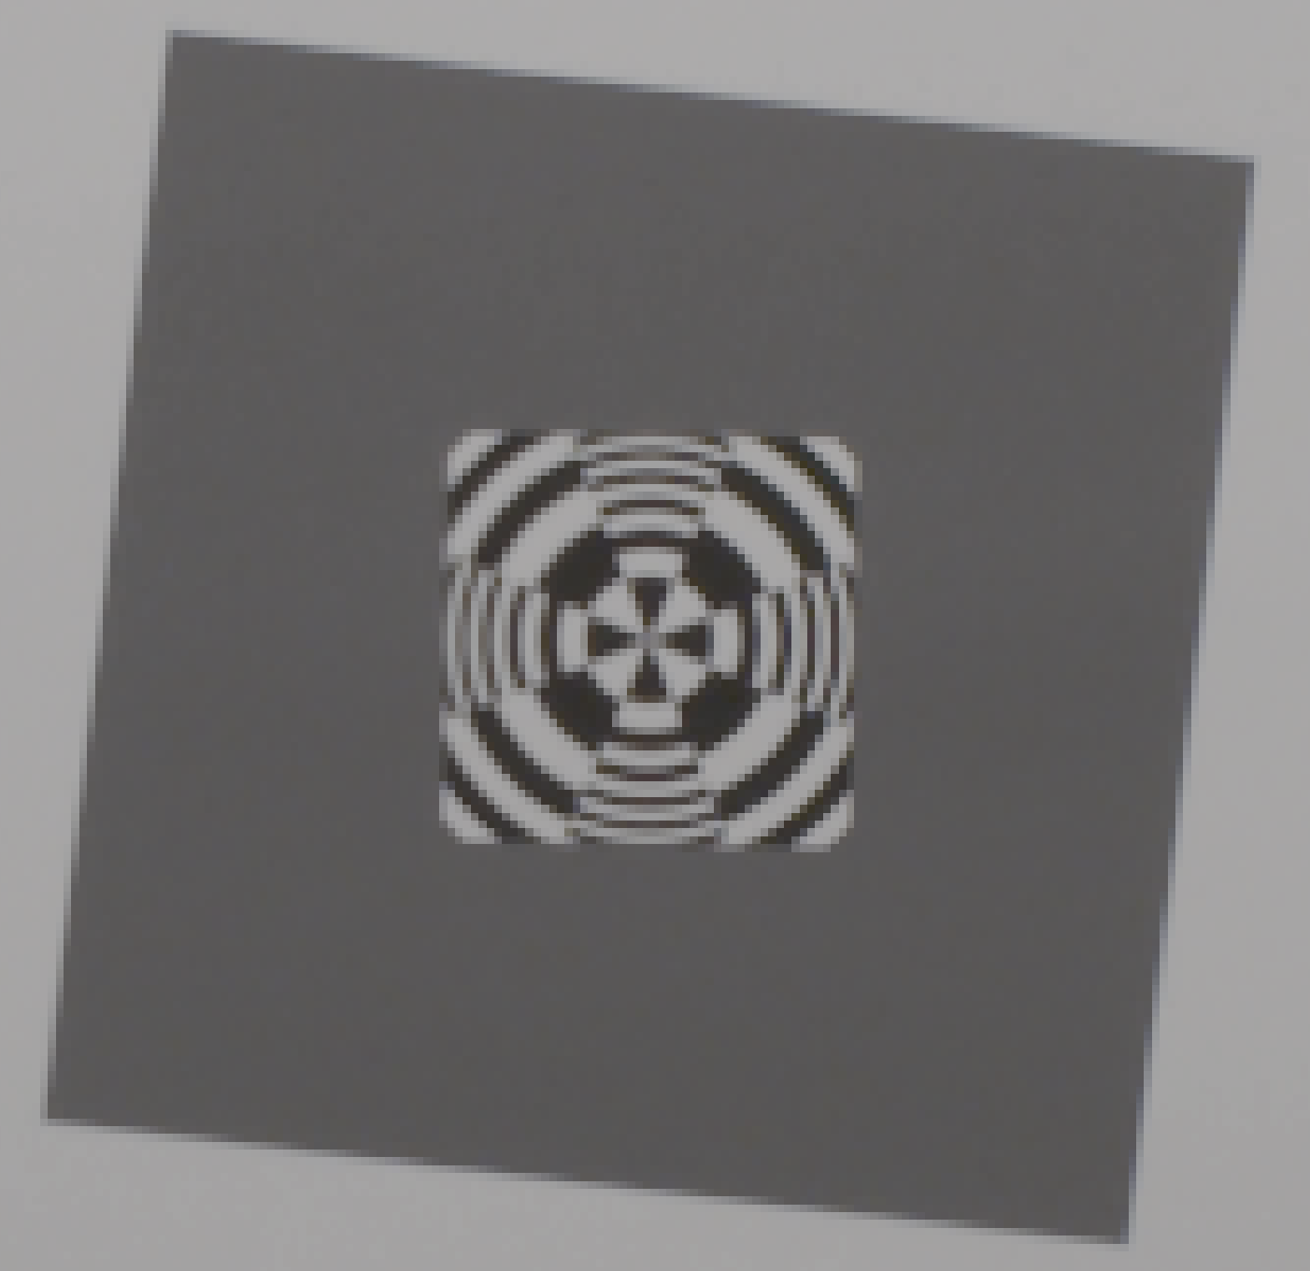
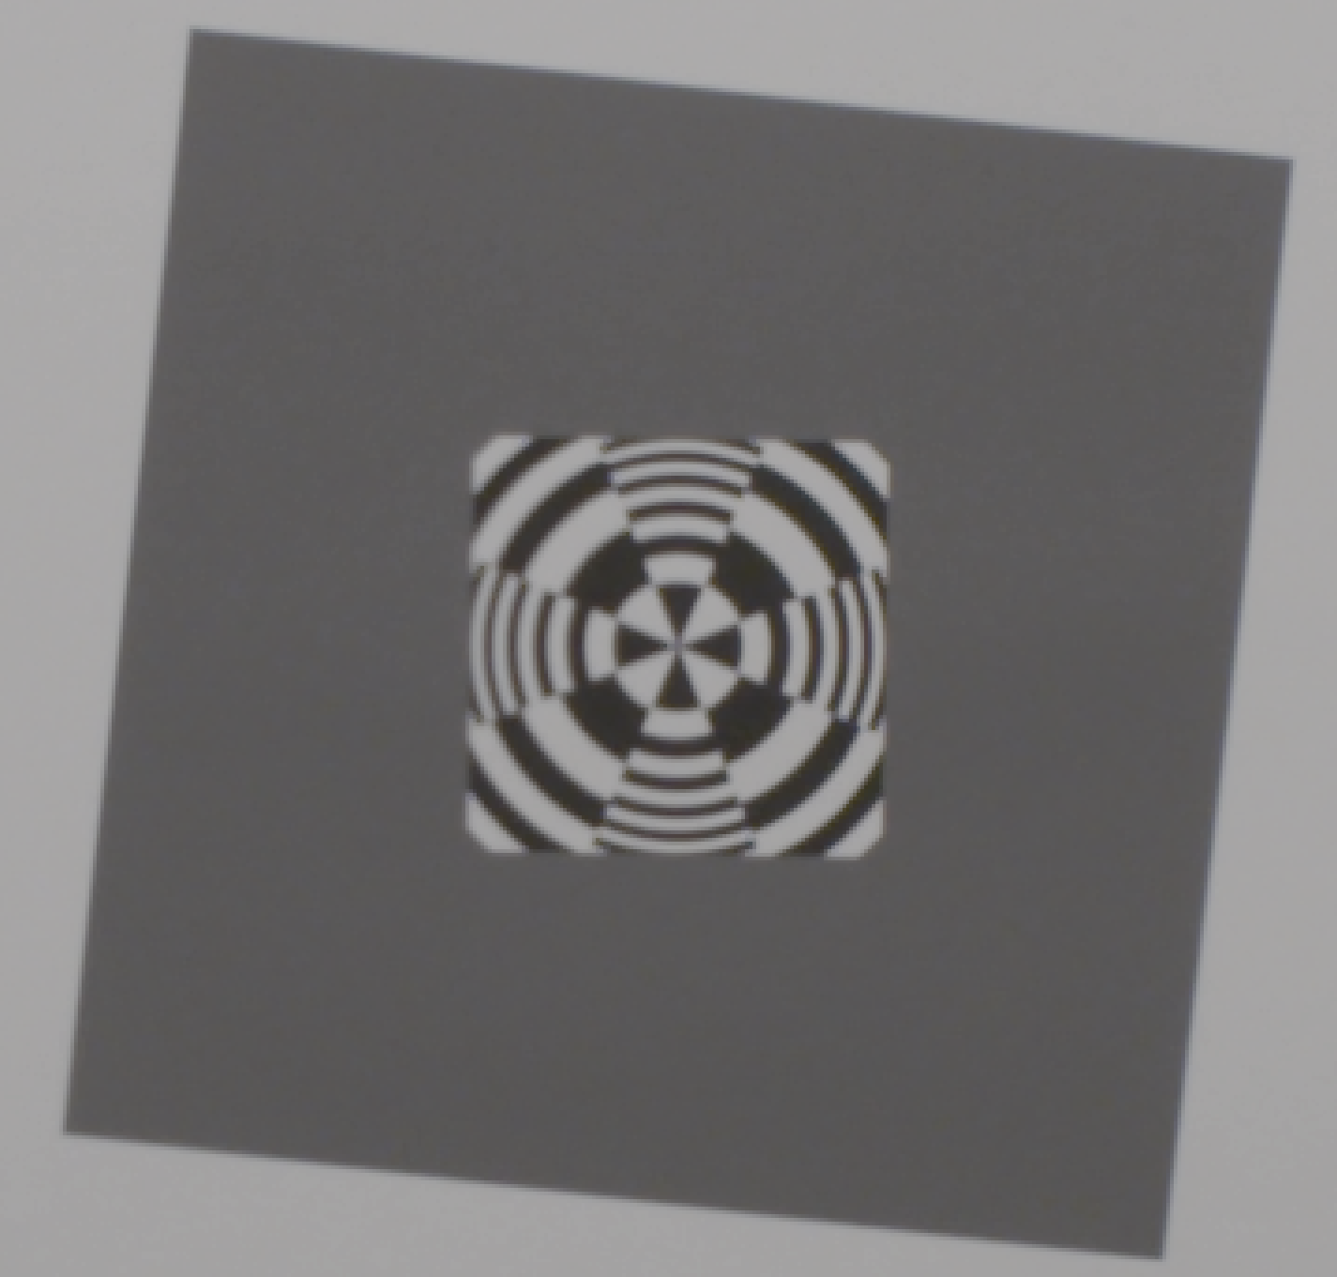
Sony F-5 1920 X 1080 vs. Sony F-5 4096 X 2160 (4K)
Center Resolution
Sony F-5, Zeiss 12mm Lens, 400 lux,
IE 800, Target 36 inches, 1920x 1080 P60
(no color correction)
File: Test_54_1920_4444.tiff
Sony F-5, Zeiss 12mm Lens, 800 lux,
IE 2000, Target 34 inches, 4K P60
(no color correction)
File: Test_54_4K4444.tiff

Slide 14


Sony F-5 1920 X 1080 vs. Sony F-5 4096 X 2160 (4K)
Center Resolution - Detail
Sony F-5, Zeiss 12mm Lens, 400 lux, ISO 800, Target 34 inches, 1920x 1080 P60
(no color correction)
File: Test_54_1920_4444.tiff
Sony F-5, Zeiss 12mm Lens, 800 lux, IE 2000, Target 34 inches, 4K P60
(no color correction)
File: Test_54_4K4444.tiff

Slide 15
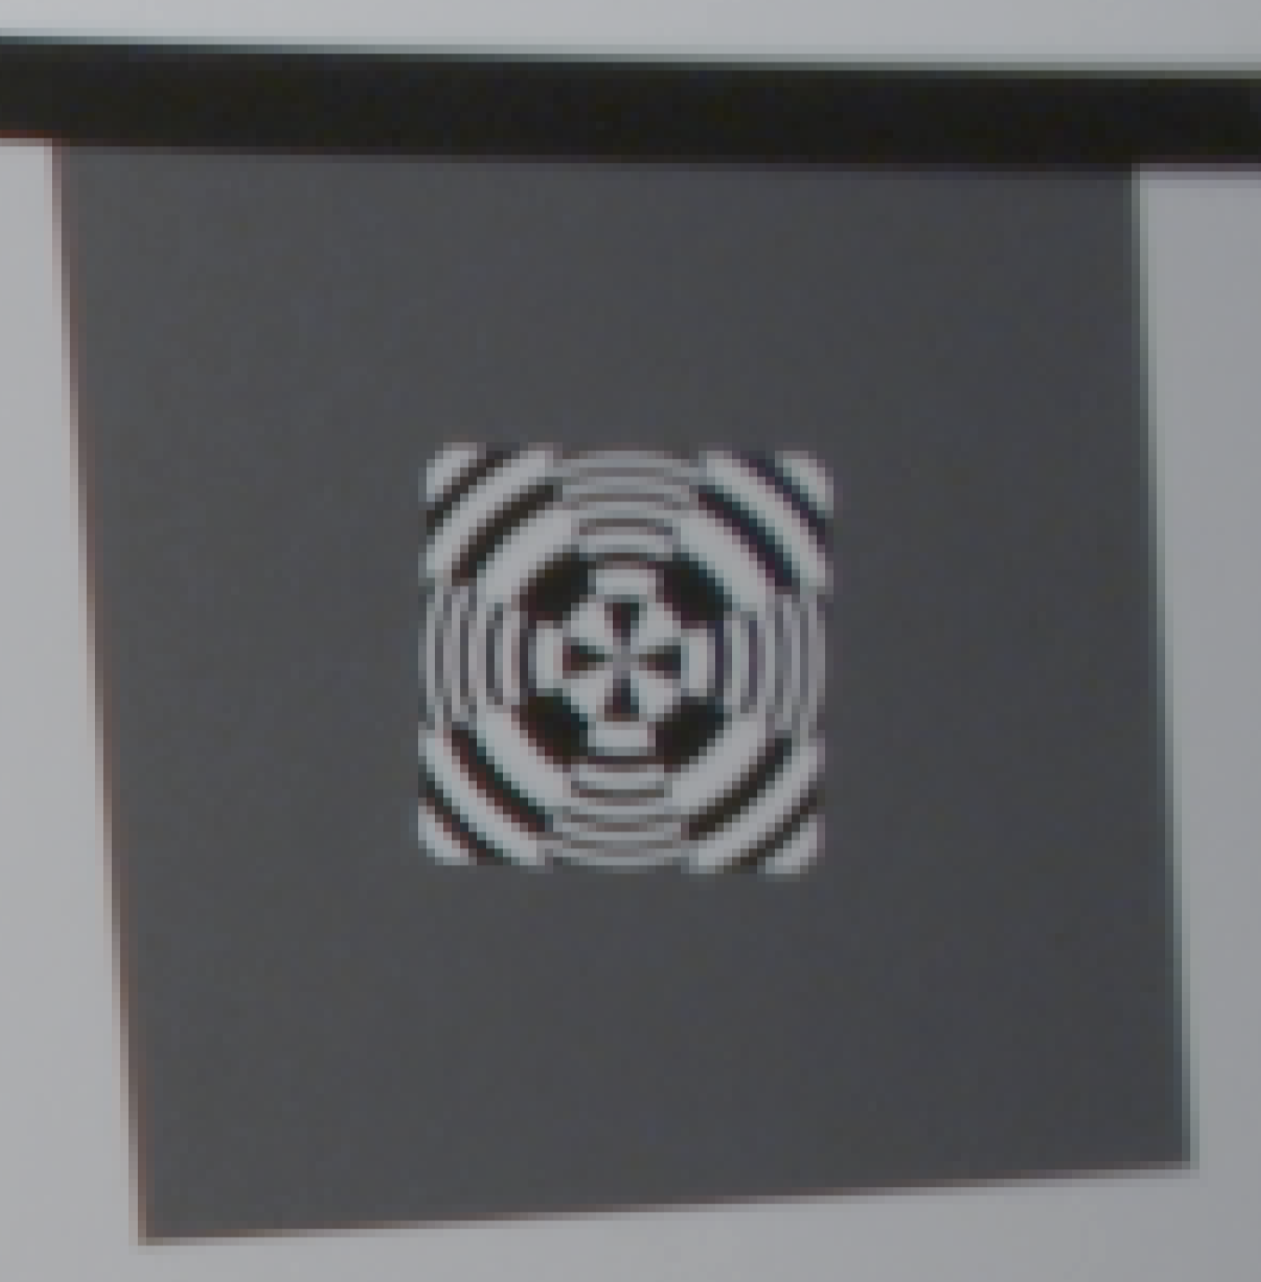
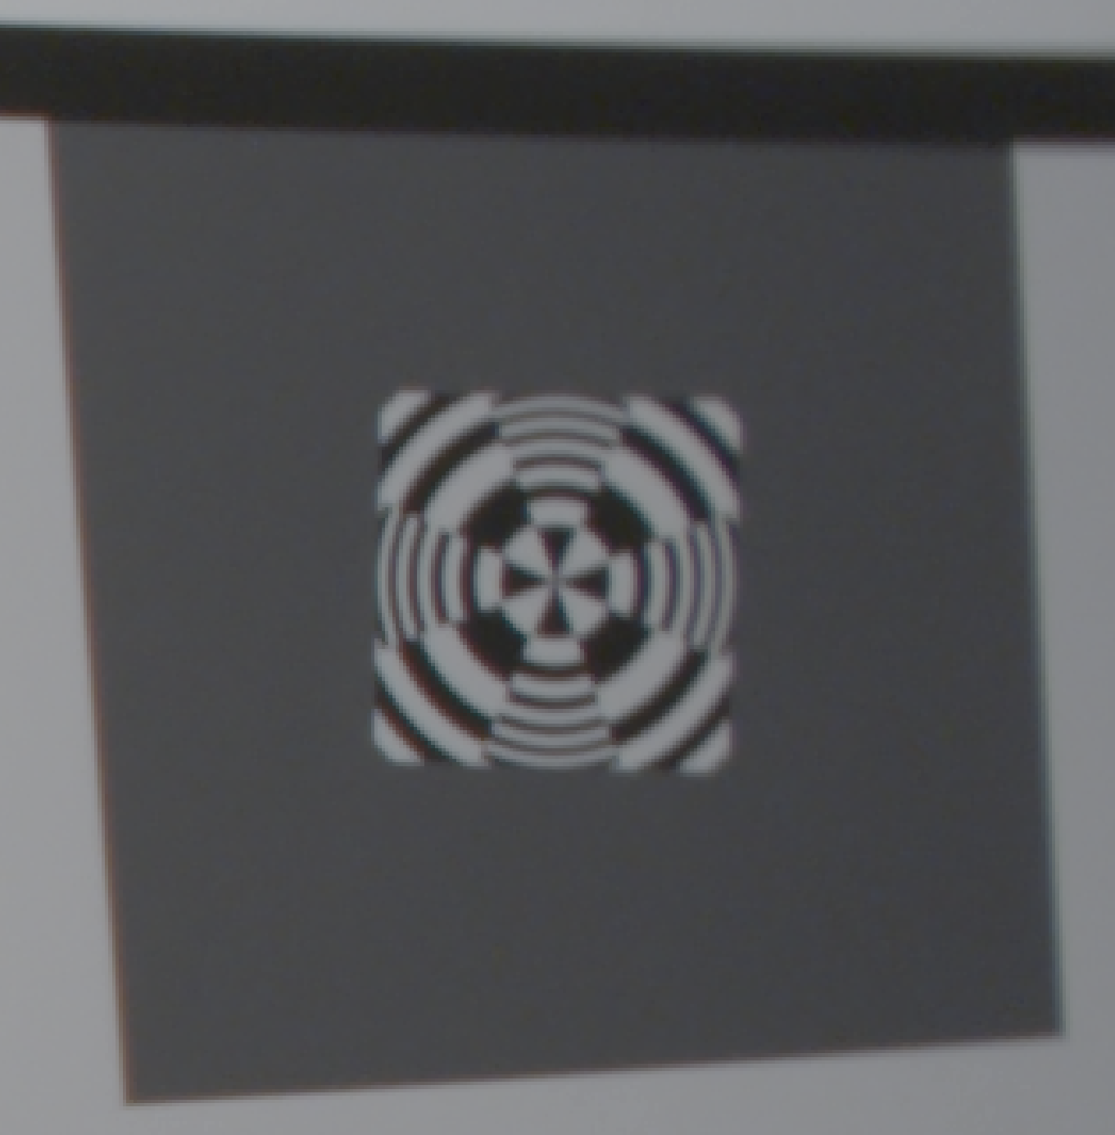
Sony F-5 1920 X 1080 vs. Sony F-5 4096 X 2160 (4K)
Edge Resolution
Sony F-5, Zeiss 12mm Lens, 400 lux, ISO 800, Target 34 inches, 1920x 1080 P60
(no color correction)
File: Test_54_1920_4444.tiff
Sony F-5, Zeiss 12mm Lens, 800 lux, IE 2000, Target 34 inches, 4K P60
(no color correction)
File: Test_54_4K4444.tiff

Slide 16
Sony F-5 vs. Ikegami HDL50/HS
Color Reproduction (4:2:2 Format)
Sony F-5, Sony 11mm Lens, 400 lux, ISO 800, Target 36 inches, 1920x 1080 P60 (no color correction)
Ikegami HDL-50/HS, Zeiss 5mm Lens, 140 lux, 80 IRE, Target 38 inches
(no color correction)

Slide 17
Distance Requirements for the Identification of Representative Organisms in the Camera Field-of View
Required I.D. Distance
Species
Front of Camera Dome
Measured First I.D. Distance (cm) (Rob Sherlock)

Slide 18
Test Showing the Sony F-5 and the Sony SCL-P11X15 Lens Meets the i2MAP Depth of Field Requirements (at F 5.6)
Sony F-5, Sony SCL-P11X15 lens set to 11mm, 560 lux, 75 IRE, Target 18 inches (10cm from dome equiv.), F 5.6, focus distance 31.5 inches
File: Test_14.tiff
Sony F-5, Sony SCL-P11X15 lens set to 11mm, 560 lux, 75 IRE, Target 113 inches (2.5m from dome equiv.), F 5.6, focus distance 31.5 inches
File: Test_45.tiff

Slide 19
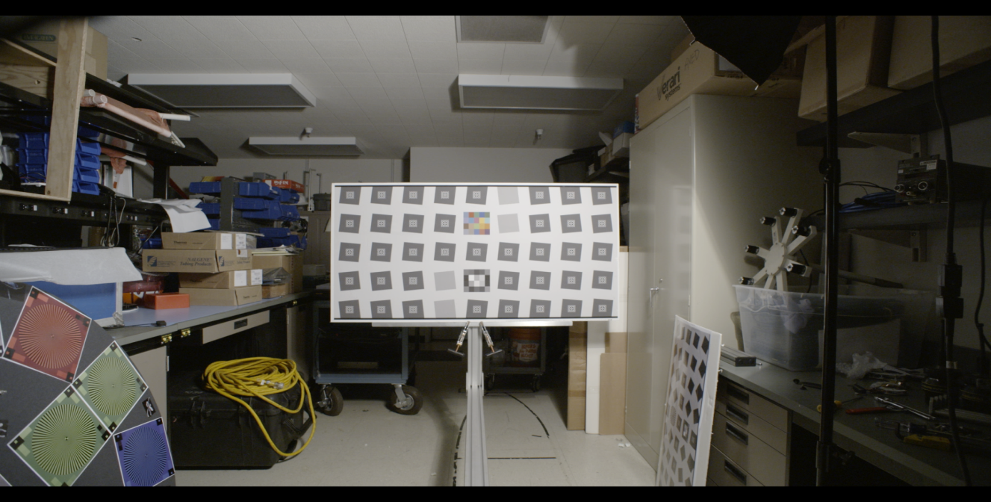
Sony F-5 1920 X 1080 vs. Sony F-5 4096 X 2160 (4K)
Resolution Example
Detail Area
Sony F-5, Zeiss 12mm Lens, 500 lux, IE 2000, Target 113 inches, 2K P60
(no color correction)
File: Test_53_2K.tiff

Slide 20
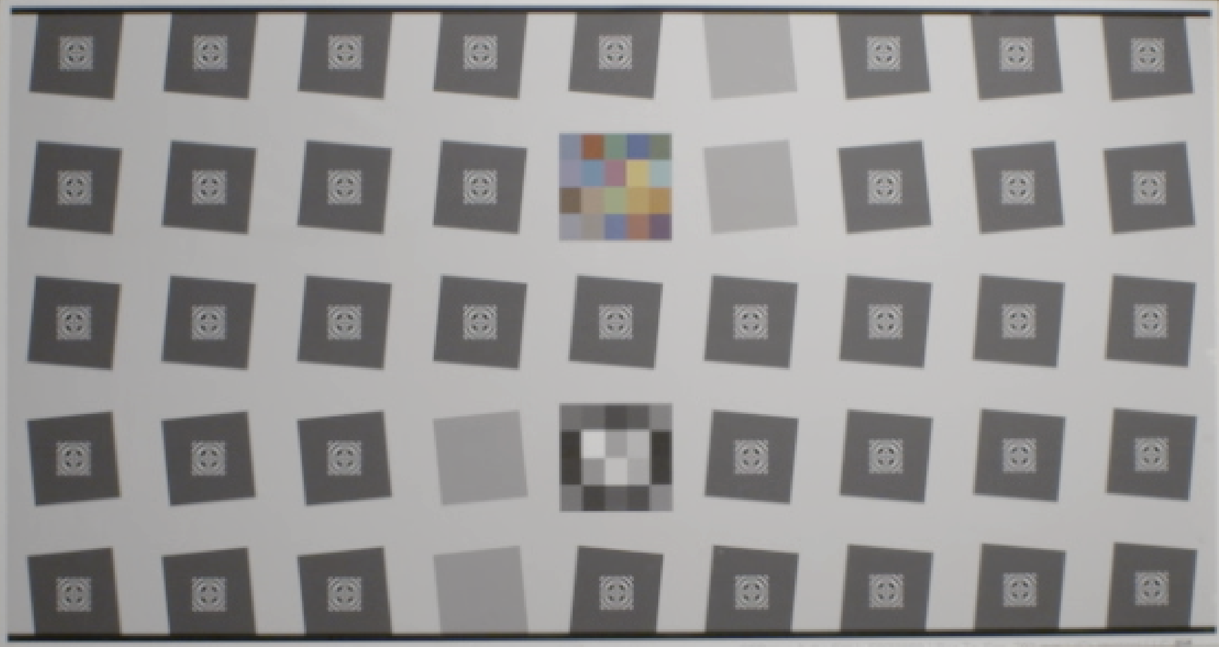
Sony F-5 1920 X 1080 vs. Sony F-5 4096 X 2160 (4K)
Resolution Example 2A
Sony F-5, Zeiss 12mm Lens, 500 lux, IE 2000, Target 113 inches, 2K P60 (Lightened 10%) File: Test_53_2K.tiff

Slide 21
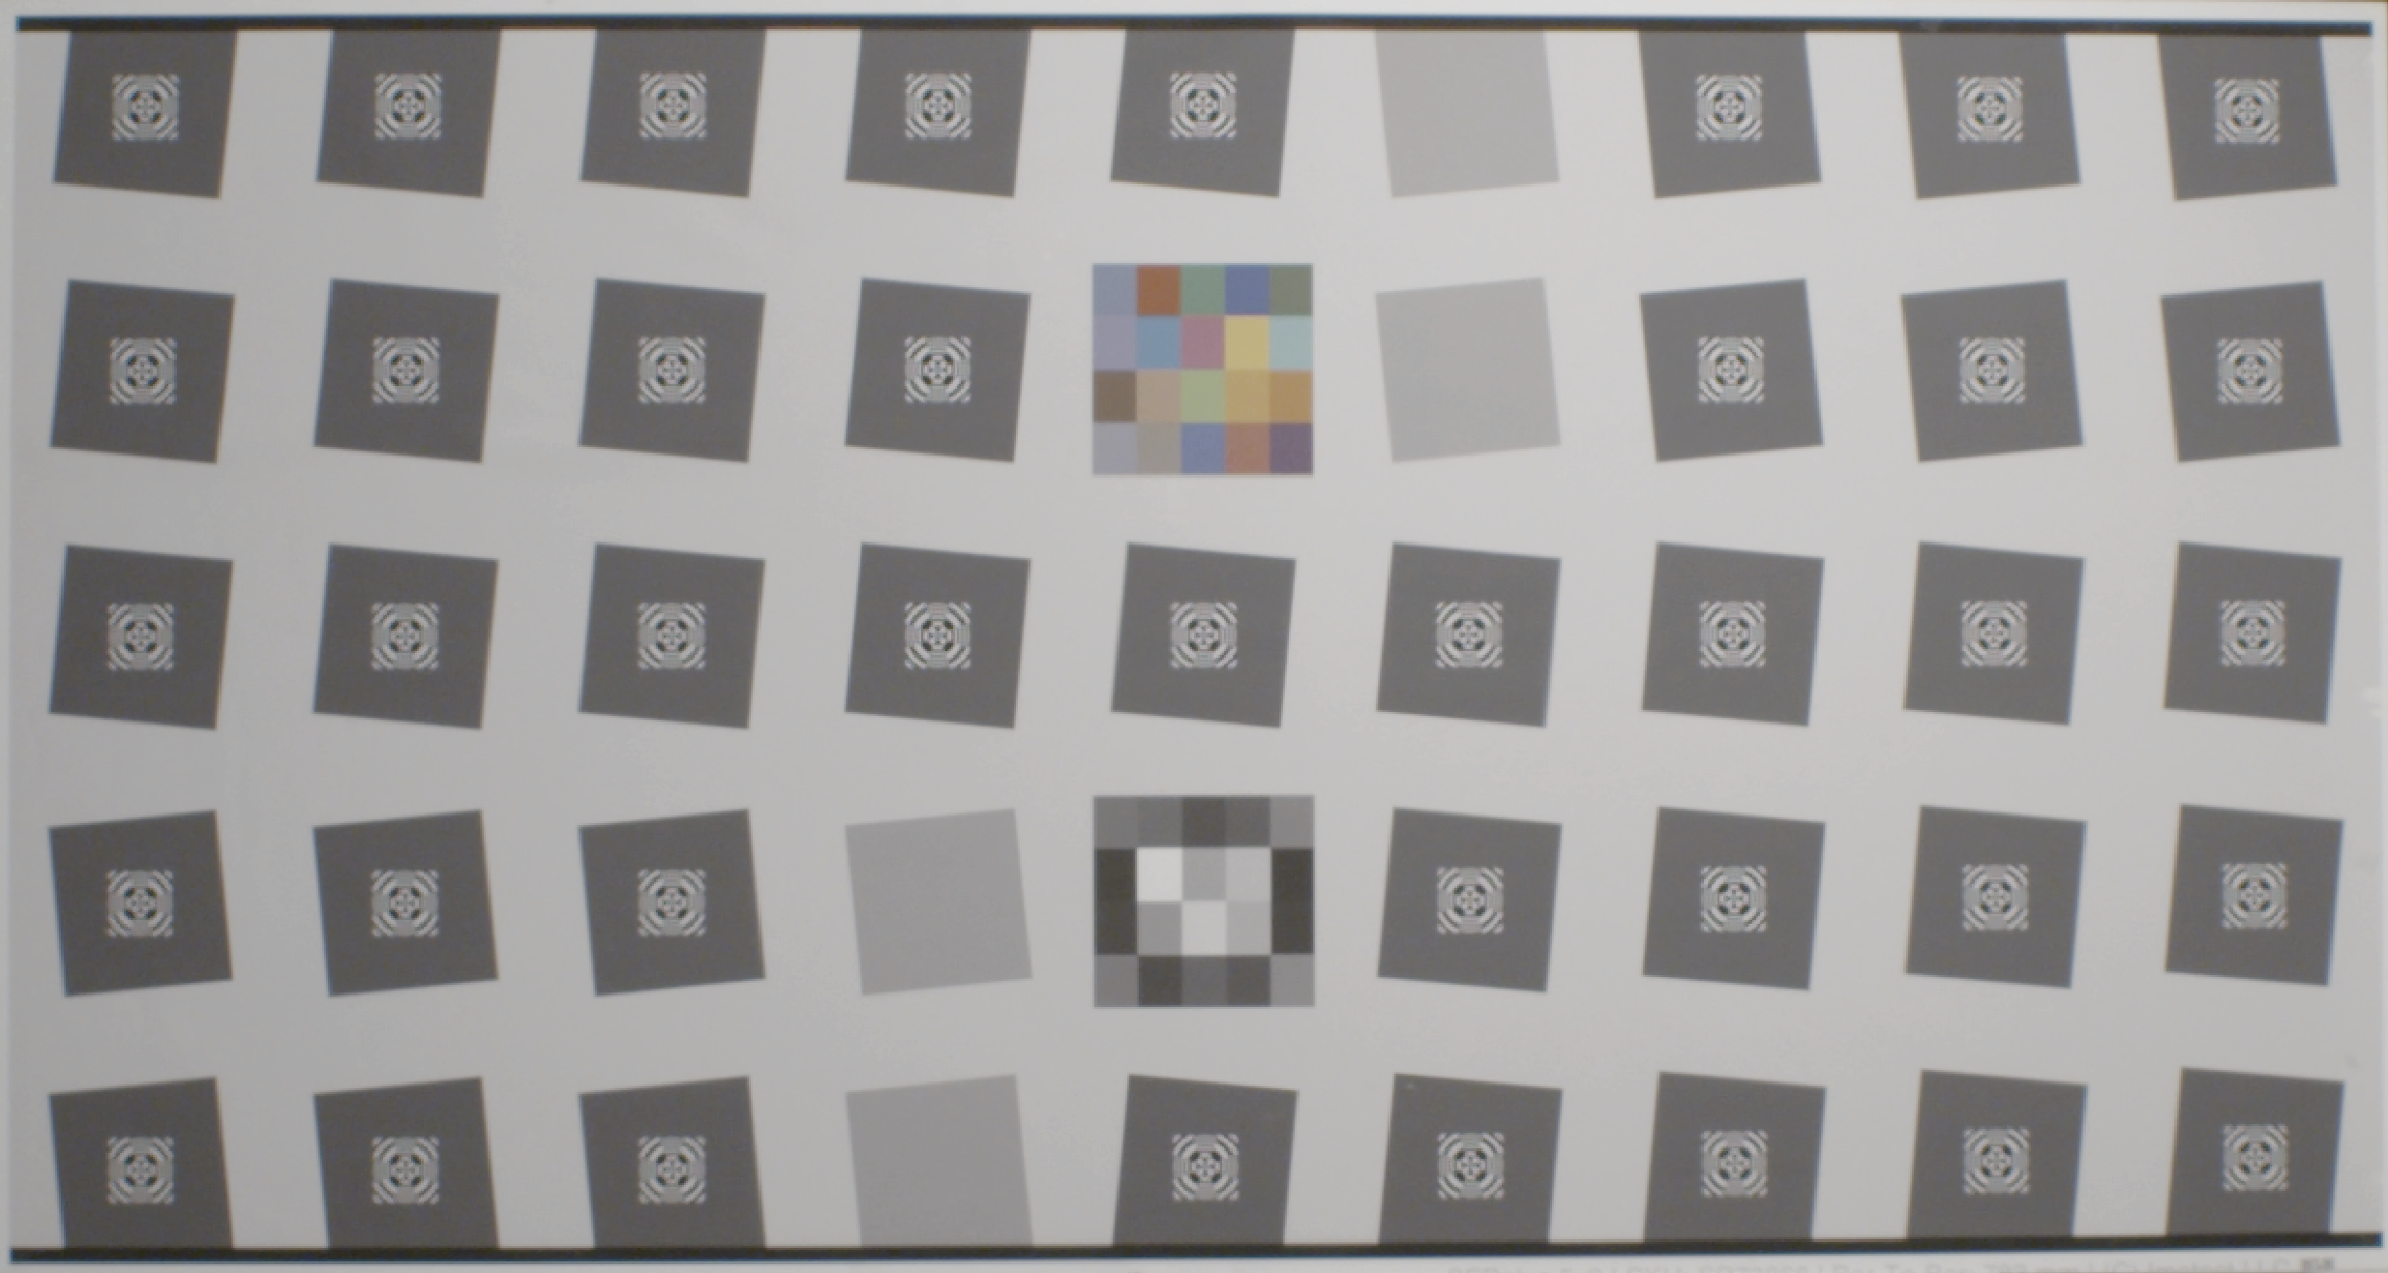
Sony F-5 1920 X 1080 vs. Sony F-5 4096 X 2160 (4K)
Resolution Example 2B
Sony F-5, Zeiss 12mm Lens, 500 lux, IE 2000, Target 113 inches,
4K P60 (Lightened 20%) File: Test_53_4K444.tiff

Slide 22

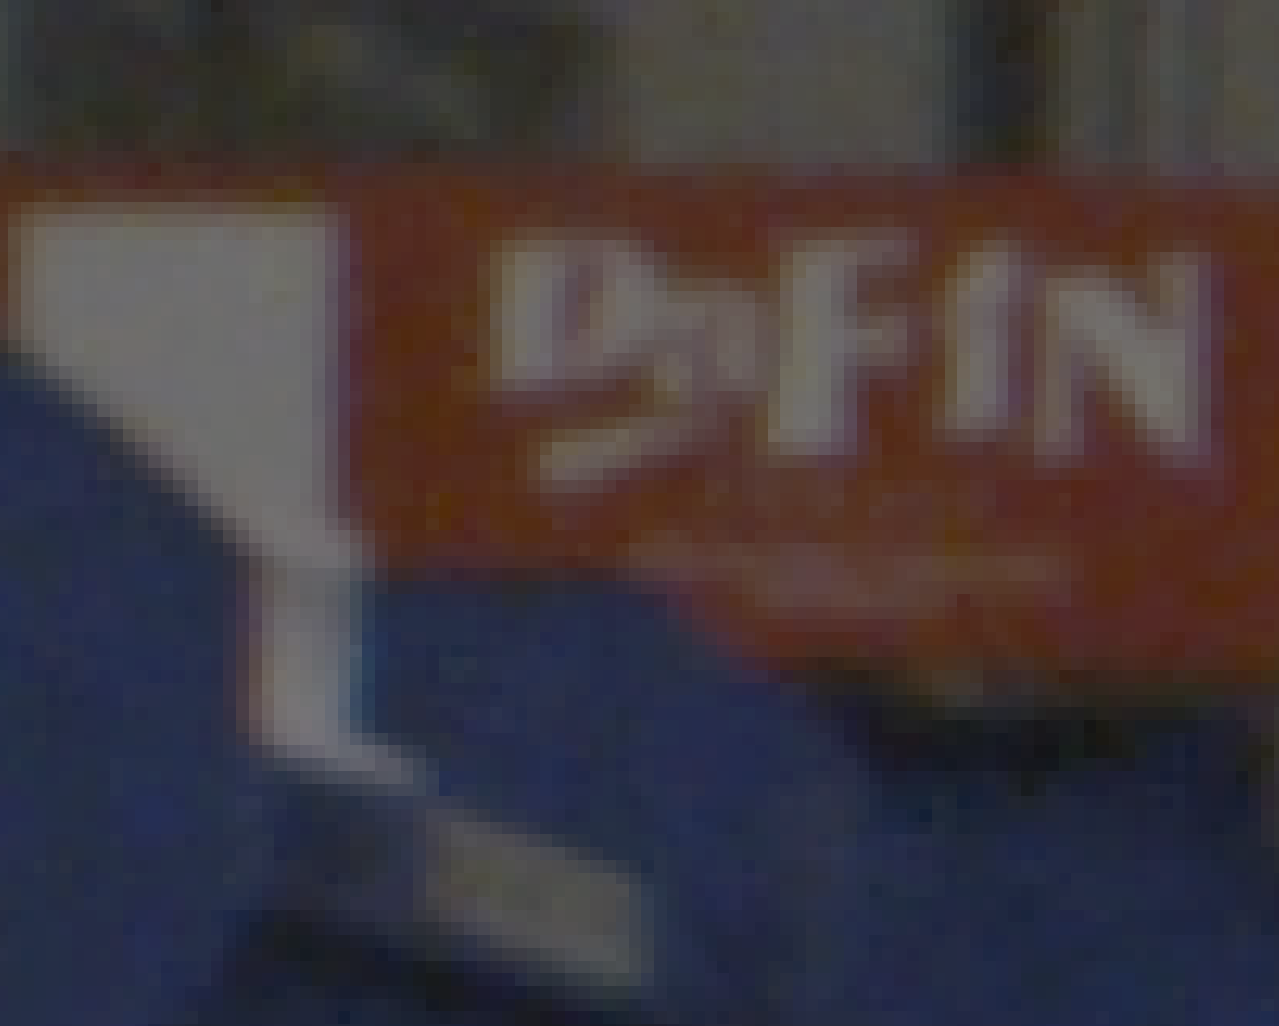
Sony F-5 1920 X 1080 vs. Sony F-5 4096 X 2160 (4K)
Resolution Example 1
Sony F-5, Zeiss 12mm Lens, 400 lux,
IE 800, 1920x 1080 P60
(+20% brightness correction)
File: Test_53_2K4444.tiff
Sony F-5, Zeiss 12mm Lens, 800 lux,
IE 2000, 4K P60
(+20% brightness correction)
File: Test_53_4K4444.tiff

Slide 23
Temporal Resolution Testing
Rotating Test Target Reproduced Object Angular Velocities Simulating AUV Speeds of 0.55 and 1.0 meters per second

Slide 24
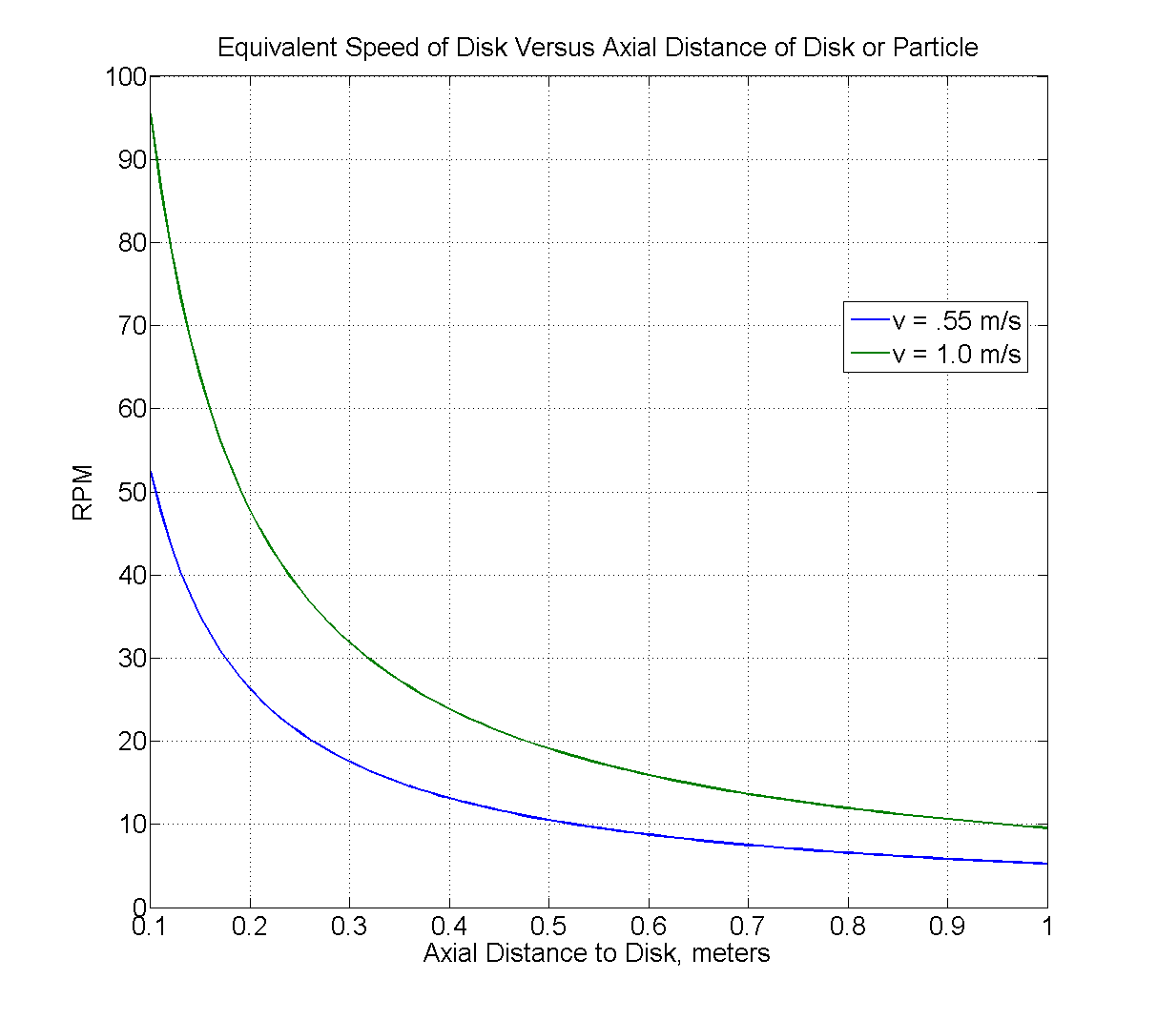
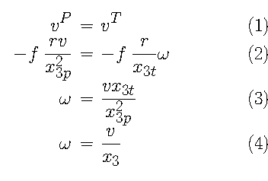
Translation of Vehicle Motion to Focal-Plane
x_3p – focal plane to particle
x_3t – focal plane to disk
Eqn. 3 => 4 if they’re equal.
Super-35 Camera Distance
(adjusted for 0.5 meters from dome front)
2/3” Camera Distance
1.0 m/sec. = 11 RPM
0.55 m/sec. = 6 RPM

Slide 25
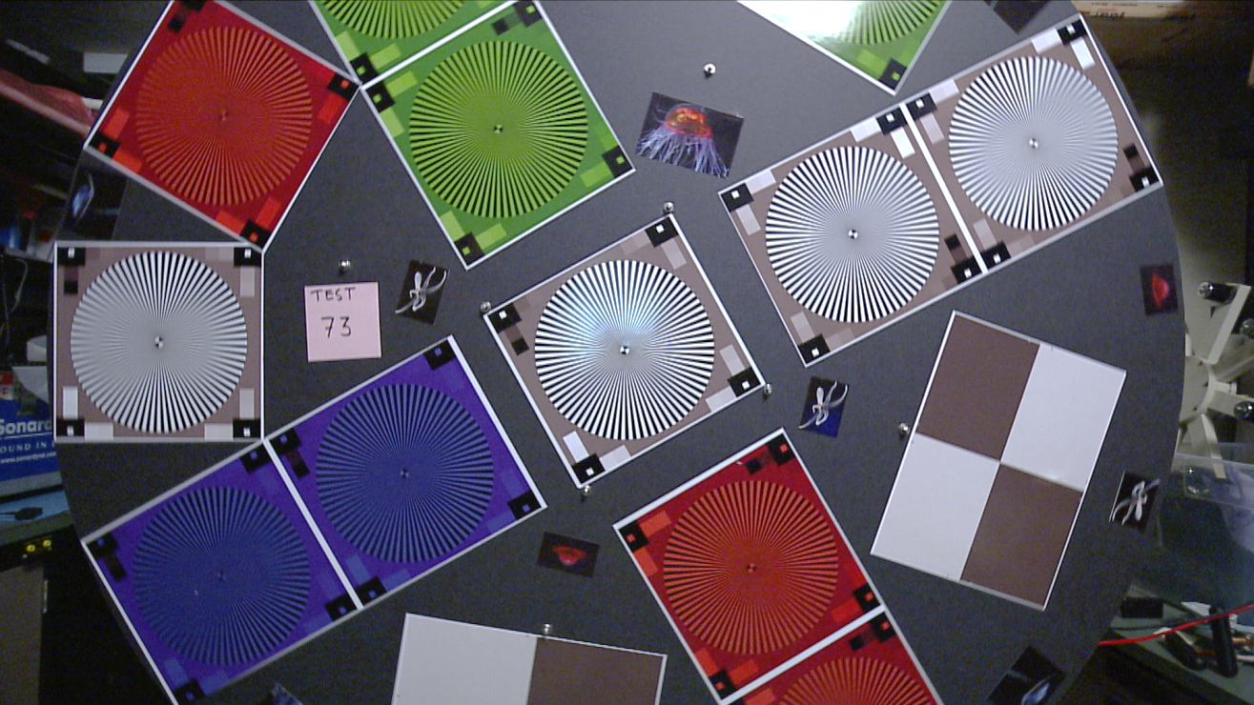
Temporal Resolution, Can We Get Good Image Quality at 1 Meter Per Second? Enter The Wheel of Death
Detail Test Area
Ikegami HDL50/HS, Zeiss 5mm Lens, 100 lux, 1920x 1080i 30
Disk 6 RPM (~0.5 m/sec), File: Test_73_White.tiff (DeInterlaced)

Slide 26
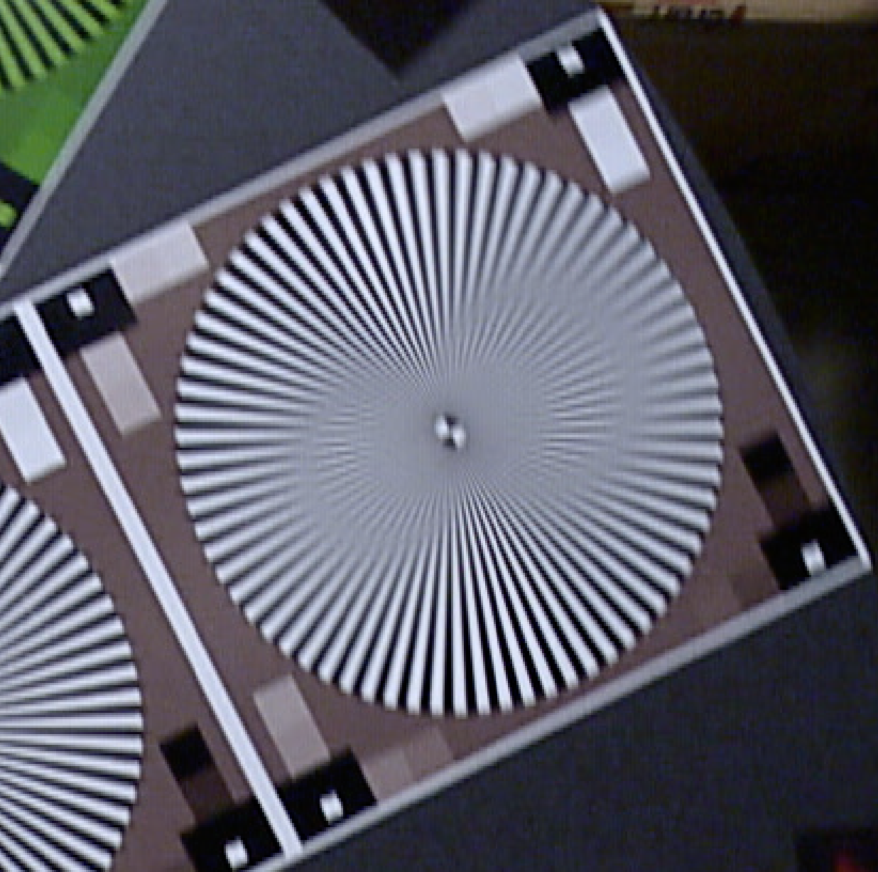
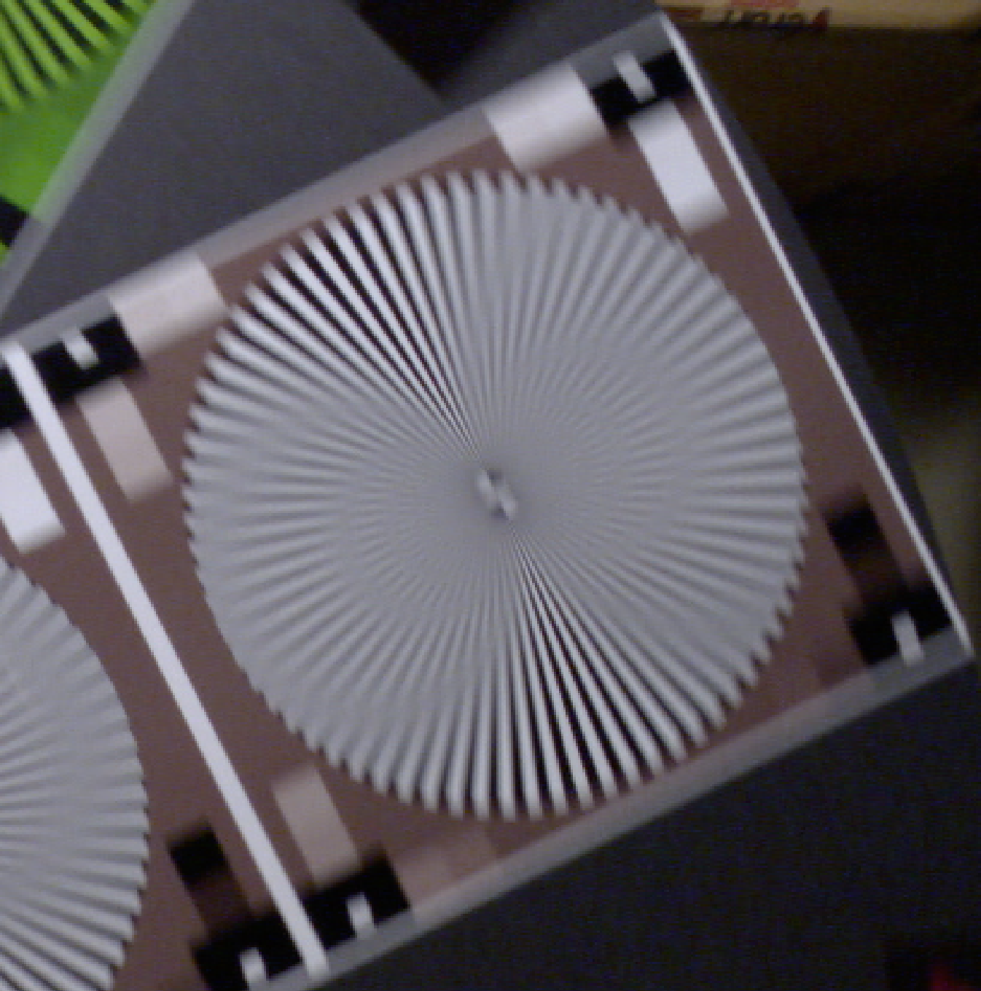
Comparison of Current (0.5 m/sec.) and Planned (1.0 m/sec.) Temporal Resolution at the 0.5 Meter from Dome “Sweet Spot”.
Ikegami HDL50/HS, Zeiss 5mm Lens,
110 lux, 1920x 1080i 30
Disk 6 RPM (~0.5 m/sec)
File: Test_73_White.tiff (DeInterlaced)
Ikegami HDL50/HS, Zeiss 5mm Lens,
170 lux, 1920x 1080 P60
Disk 11 RPM (~1 m/sec)
File: : Test_76_White.tiff

Slide 27
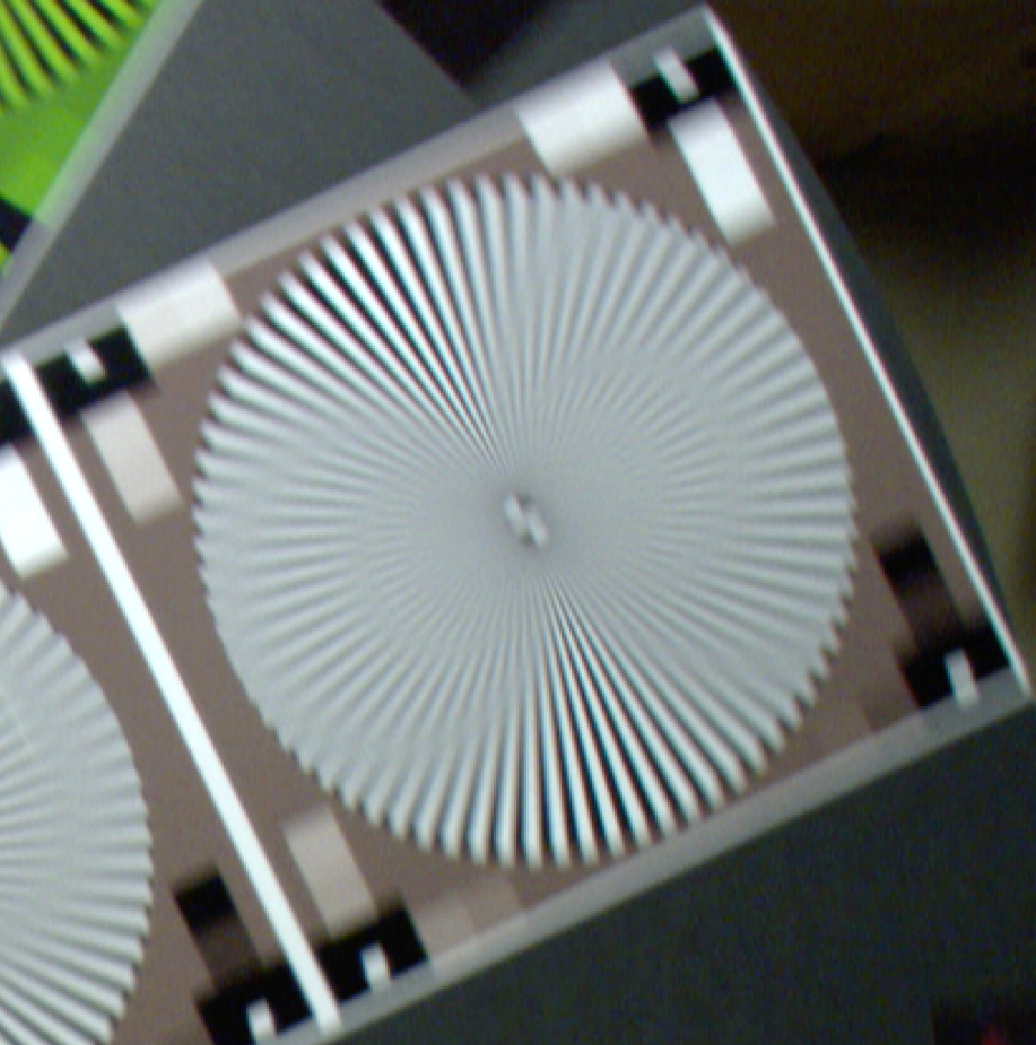
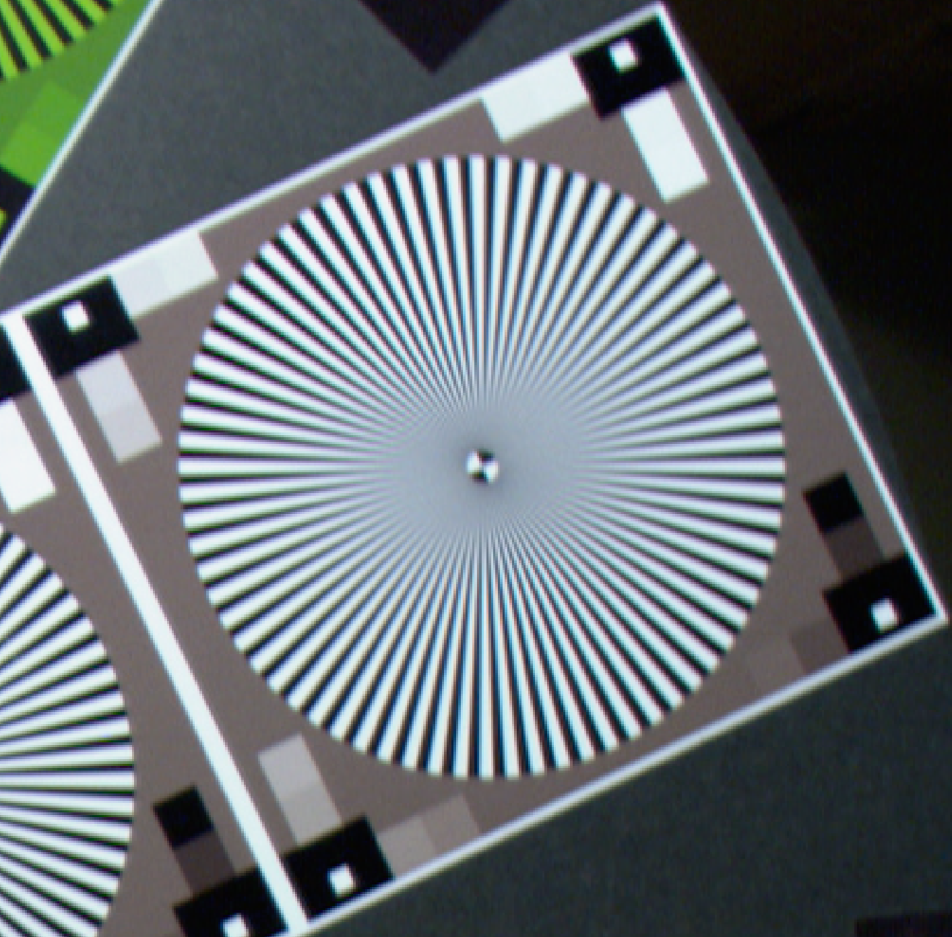
The Effect of Camera Shutter at The Planned (1.0 m/sec.) AUV Velocity tested at the 0.5 Meter from Dome “Sweet Spot”.
Sony HDCP1, Zeiss 5mm Lens,
120 lux, 1920x 1080 P60
Disk 11 RPM (~1 m/sec), No Shutter
File: Test_66_White.tiff
Sony HDCP1, Zeiss 5mm Lens,
800 lux, 1920x 1080 P60
Disk 11 RPM (~1 m/sec), Shutter 1/250
File: Test_68_White.tiff

Slide 28
Additional Testing
Comparison of increased camera resolutions:
  1920 X 1080 to 2048 X 1080 lines (2k) resolutions.
  1920 X 1080 to 4096 X 2160 lines (4k) resolutions.
Color Space Comparison, 422 vs 444 encoding.
Video Compression CODEC Testing
  Can a difference be seen between uncompressed video and Apple ProRes 422(HQ) video?
  Apple ProRes 422(HQ) vs Sony XACV

Slide 29
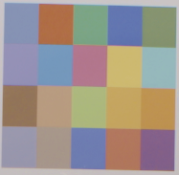
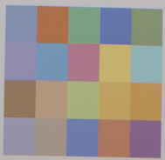
Is There a Significant Dis-Advantage in
4:2:2 Color Space vs 4:4:4?
4:2:2 Color Space
4:4:4 Color Space
Sony F-5, Zeiss 12mm Lens, 800 lux,
IE 2000, Target 34 inches, 1920x 1080 P60
(color saturation 150%)
File: Test_54_1920_422(HQ).tiff
Sony F-5, Zeiss 12mm Lens, 800 lux,
IE 2000, Target 34 inches, 1920x 1080 P60
(color saturation 150%)
File: Test_54_1920_444.tiff

Slide 30
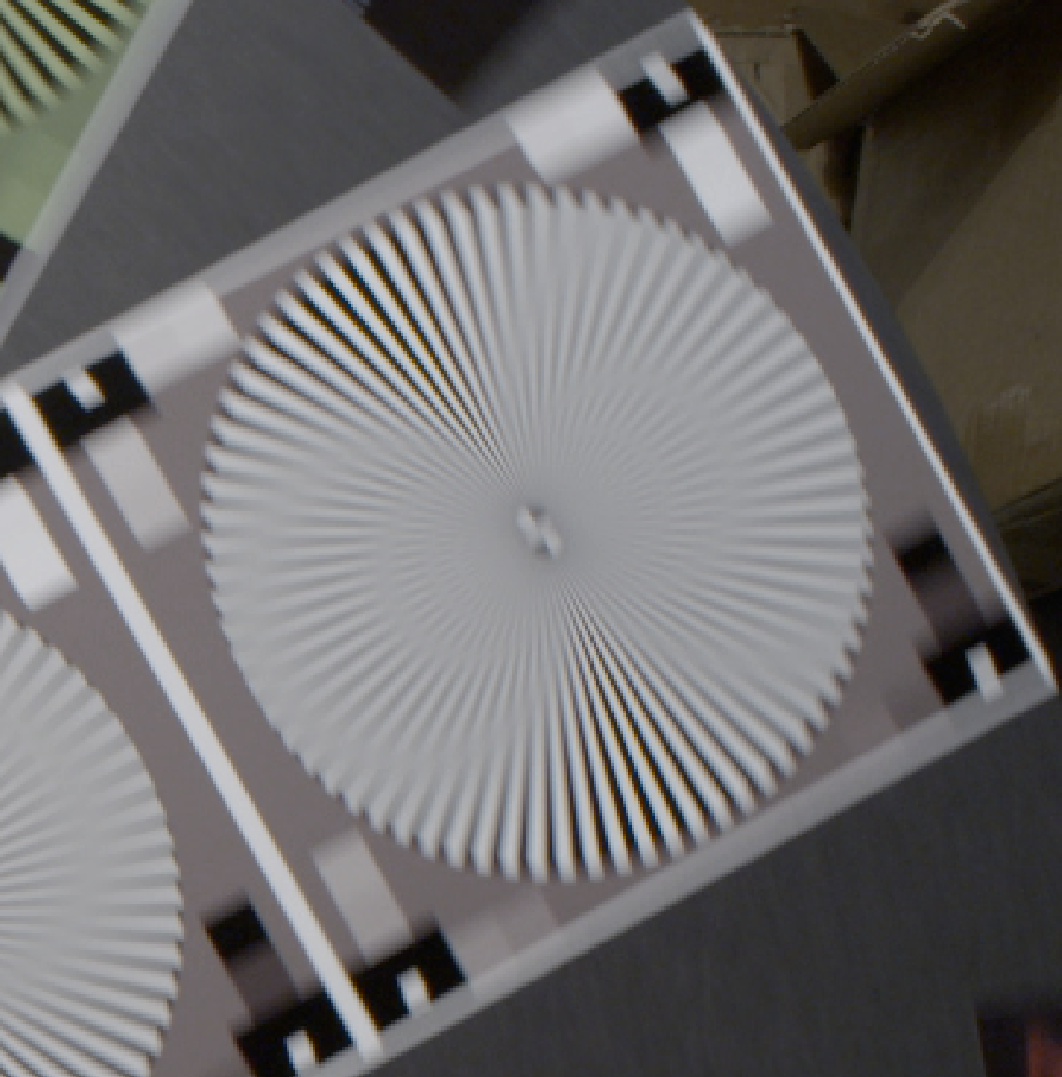
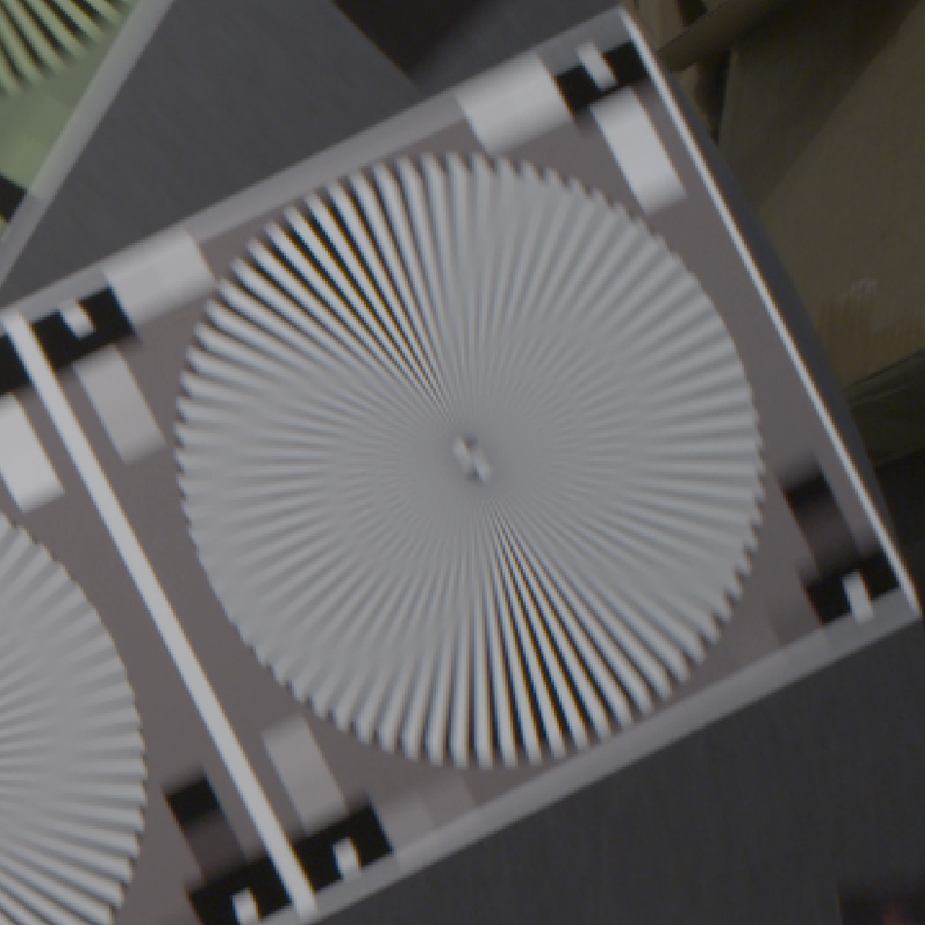
CODEC TEST - How does ProRes 422(HQ) compare to Uncompressed Images?
Sony F-5, Zeiss 12mm Lens, 700 lux,
IE 2000, Target 34 inches, 1920x 1080 P60
File: Test_57_1920_422(HQ)_White.tiff
Sony F-5, Zeiss 12mm Lens, 700 lux,
IE 2000, Target 34 inches, 1920x 1080 P60
File: Test_57_1920_DPX444_White.tiff

Slide 31
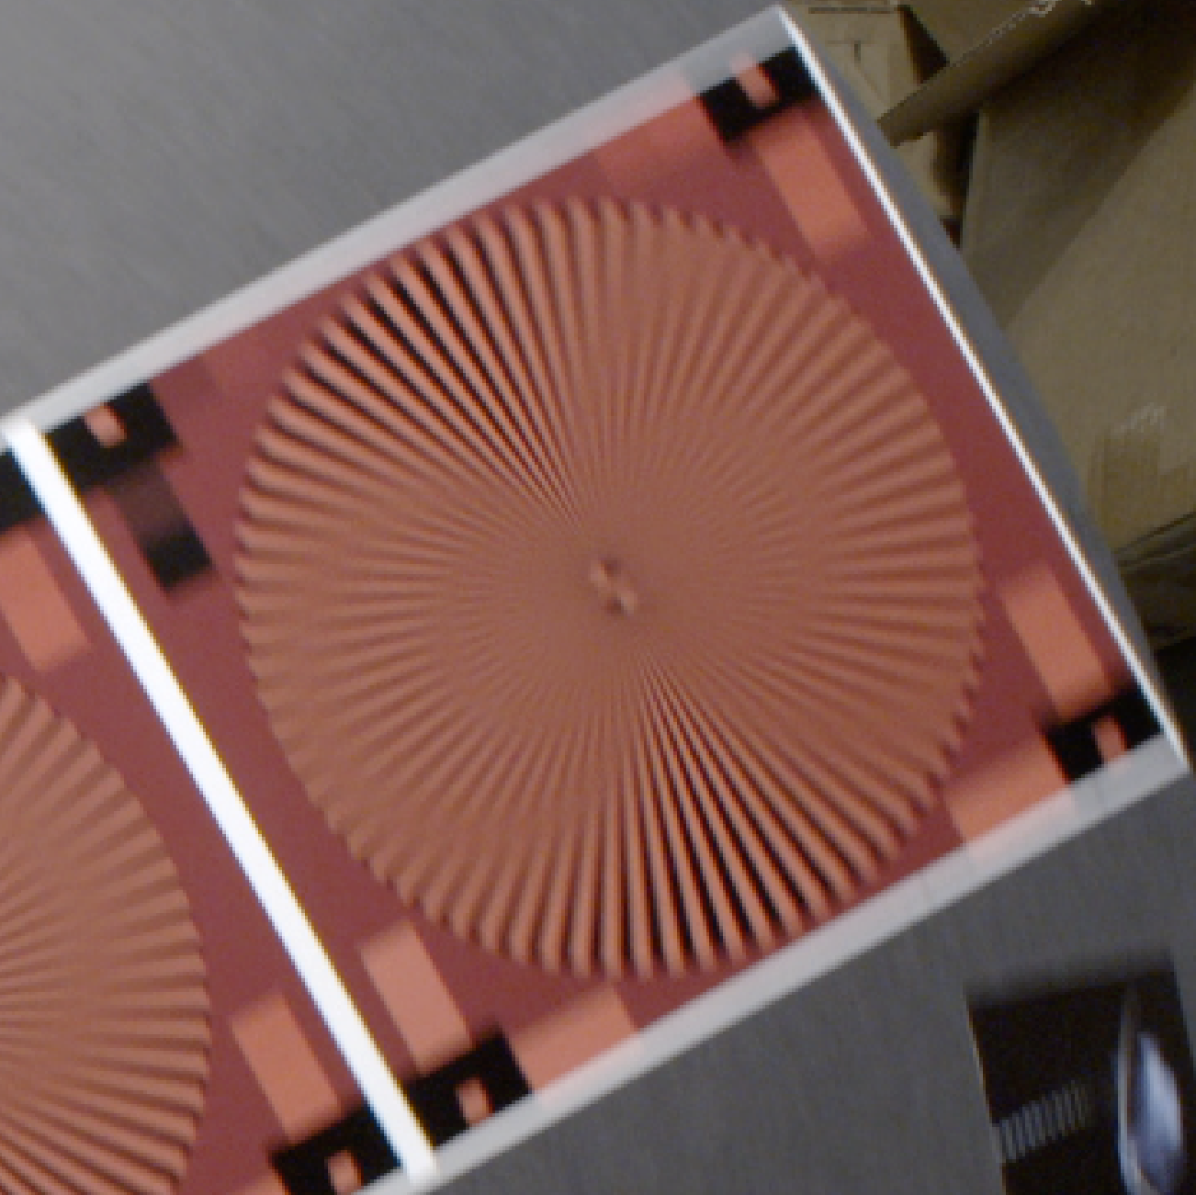
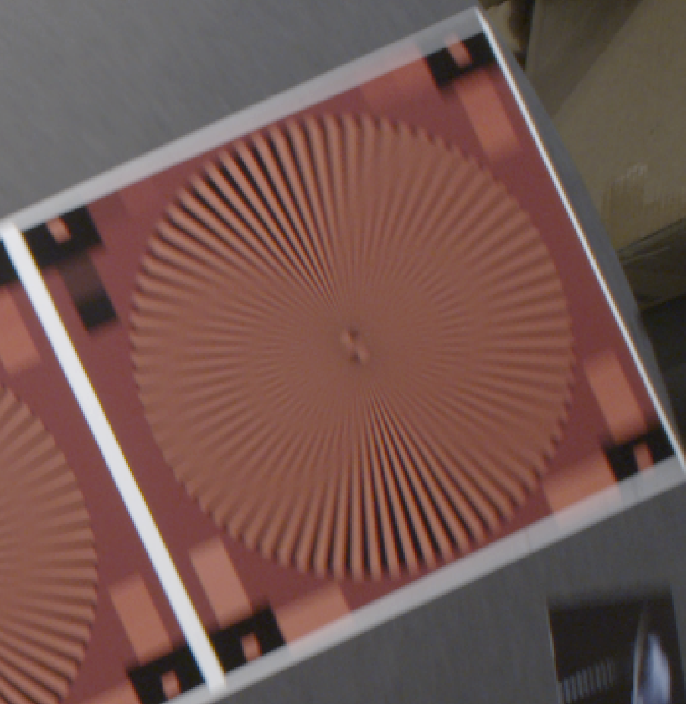
CODEC TEST - How does ProRes 422(HQ) compare to Uncompressed Images?
Sony F-5, Zeiss 12mm Lens, 700 lux,
IE 2000, Target 34 inches, 1920x 1080 P60
File: Test_57_1920_422(HQ)_Red.tiff
Sony F-5, Zeiss 12mm Lens, 700 lux,
IE 2000, Target 34 inches, 1920x 1080 P60
File: Test_57_1920_DPX444_Red.tiff

Slide 32
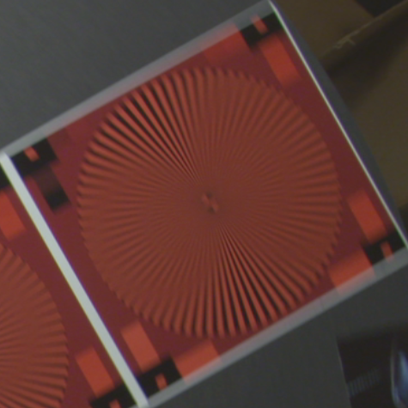
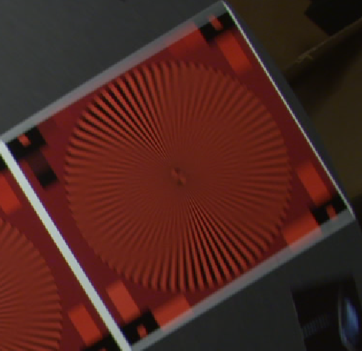
Sony F-5/SCL-P11X15 Lens: Test 6
Spinning Disk - 1920 x 1080 60P
Apple ProRes 422 10 bit HQ (440 mbit/sec.)
Sony XAVC
(223 mbit/sec.)

Slide 33
Issues and Observations
ProRes de-interlaced the 1080i .tiff frame grabs.
De-interlaced video looks surprisingly good compared to progressive scan.
  Quick time playback does NOT de-interlace.
Ikegami has black adjustment issues on power-up boot. Suggest putting 100% filter in one position in filter wheel – would require camera control.
Still need to test the F-5 with the Sony lens at 4K to make sure it will hold up.
Shutter of 1/250 is needed to freeze motion of transect.

Slide 34
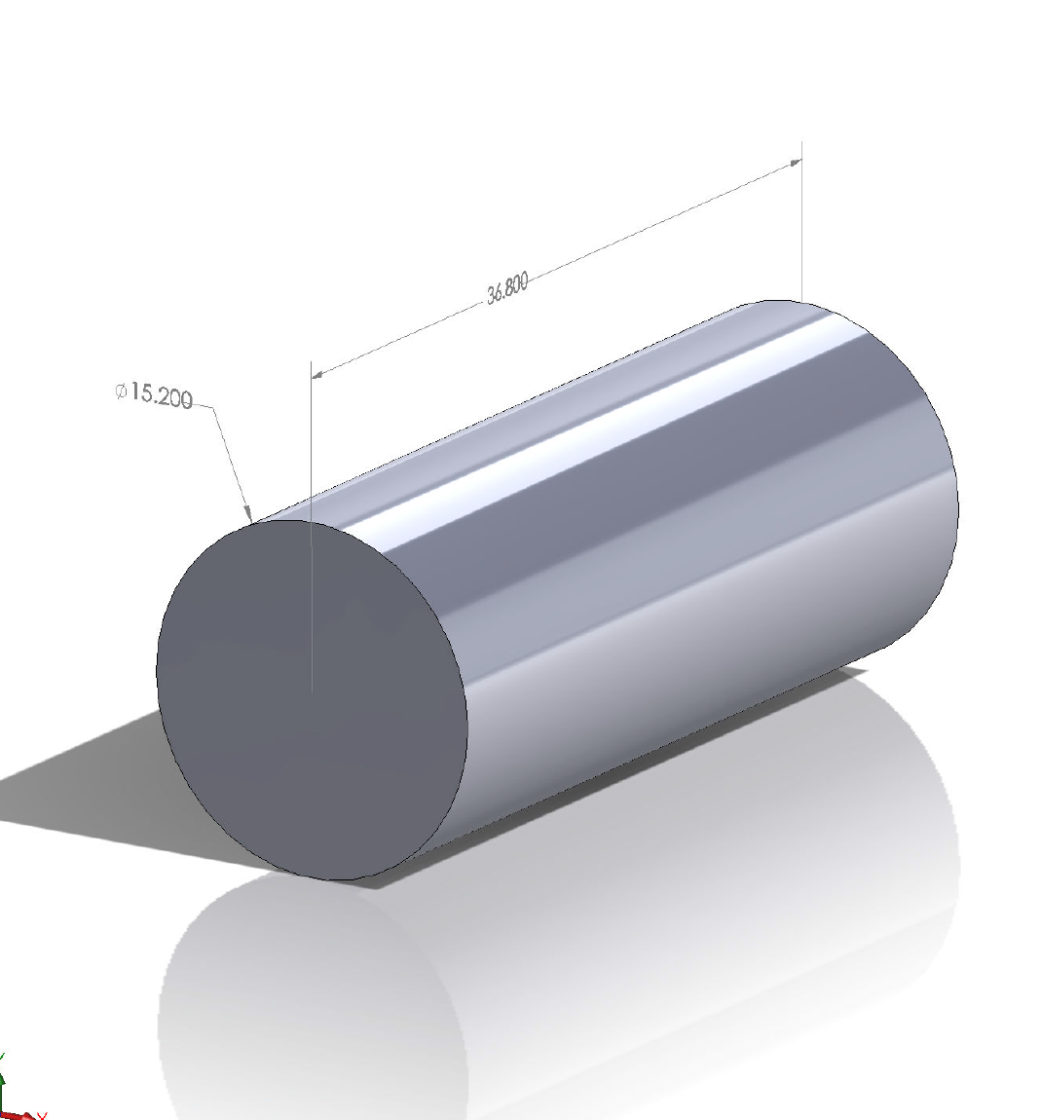
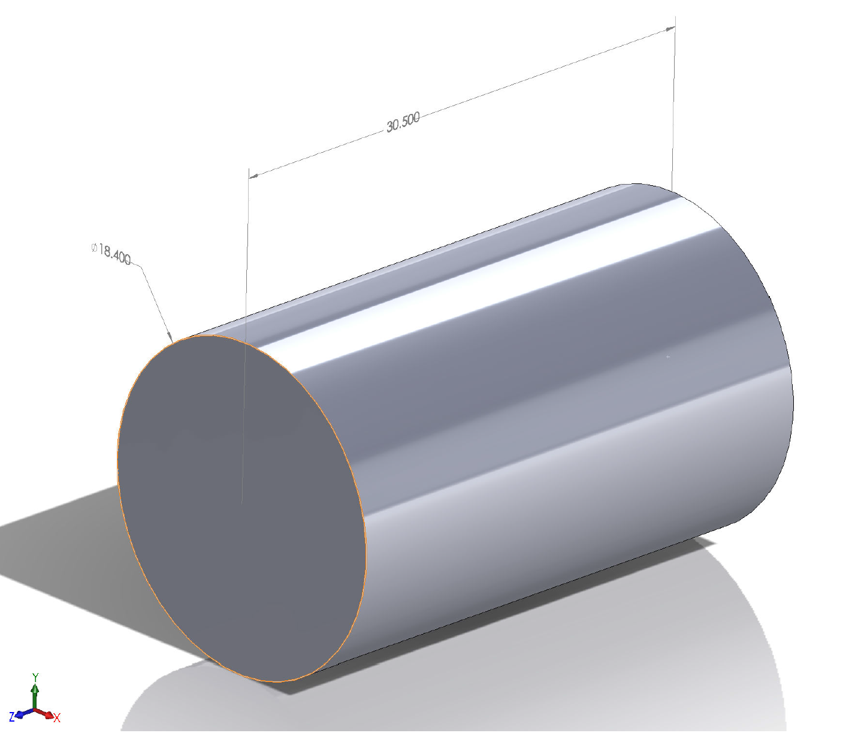
Camera and Lens Size Comparison
(dimensions in centimeters)
Sony F-5, SCL-P11X15 Lens
Ikegami HDL-50/HS, Zeiss 5mm Lens

Slide 35
Estimated Cost Comparison
Cost Comparison | Sony F-5 | Ikegami HDL50/HS
Camera | $17,000 | $28,630
Lens | $7,000 | $9,100
Recorder | $3,995 | $3,995
Memory | $2,590 | $2,590
Total | $30,585 | $44,315
Budget is ~ $57,592

Slide 36
Which is the best camera for us?
Ikegami HDL-50/HS 2/3” box camera Vs the Sony F-5 super 35 format camera.
  Box camera has a great picture but is limited to 1920 X 1080 60 frames per second.
  Box camera is the smallest and likely the easiest to integrate.
  F-5 Cine camera has 4K sensor and offers a migration path to higher resolution formats, 2K and 4K.
    Current recording limitation is 2048 X 1080 60 frames per second.
    AJA has recording hardware in development that supports 4K at 60 frames per second that may be available in the future.
    Sony F-5 can be upgraded to F-55 with 4K output for $12,000.

Slide 37
Preliminary Conclusions
The Ikegmai 2/3” HDL-50HS camera is significantly better in resolution than the Sony HDCP1.
The F-5 camera is about 2 stops slower when depth of field control is taken into account.
The NEX-FS700U is about as fast as the 2/3” cameras and has good resolution but the color reproduction is poor.
The Apple ProRes 422(HQ) CODEC is visually lossless.
The Ikegami HDL-50/HS would completely meet our present requirements.
The Sony F-5 (or F-55) would allow possible future migration:
  To 4K imaging + $12k & new recorder.
  To higher frame rates
We have adequate illumination.
  Need ~ 1000 lux maximum
  4 lights measure at ~ 3500 – 5000 lux at 0.5 meters from dome.
With AUV at 1 m/sec. shuttering at 1/250th has about the spatial resolution of 240 FPS but not temporal resolution.
  Unfortunately we cannot currently record faster than 60 FPS.
  F5 can record internally at 180 FPS for 60 minutes using XAVC CODEC (our current requirement is 120 minutes).
Surprisingly, de-interlaced 1080i 29.94 has similar temporal resolution to 1080P 60, although the spatial resolution is only half.

Slide 38
The Temporal Resolution of Progressive format Vs Interlaced format
Example of 1920 x 1080i 29.97 frames per second (the current ROV video format)
Vs
1920 x 1080 P60 progressively scanned 60 frames pre second as proposed for i2MAP
Example of de-interlaced 1080i video showing the results of dropping the odd lines and interpolating.

Slide 39
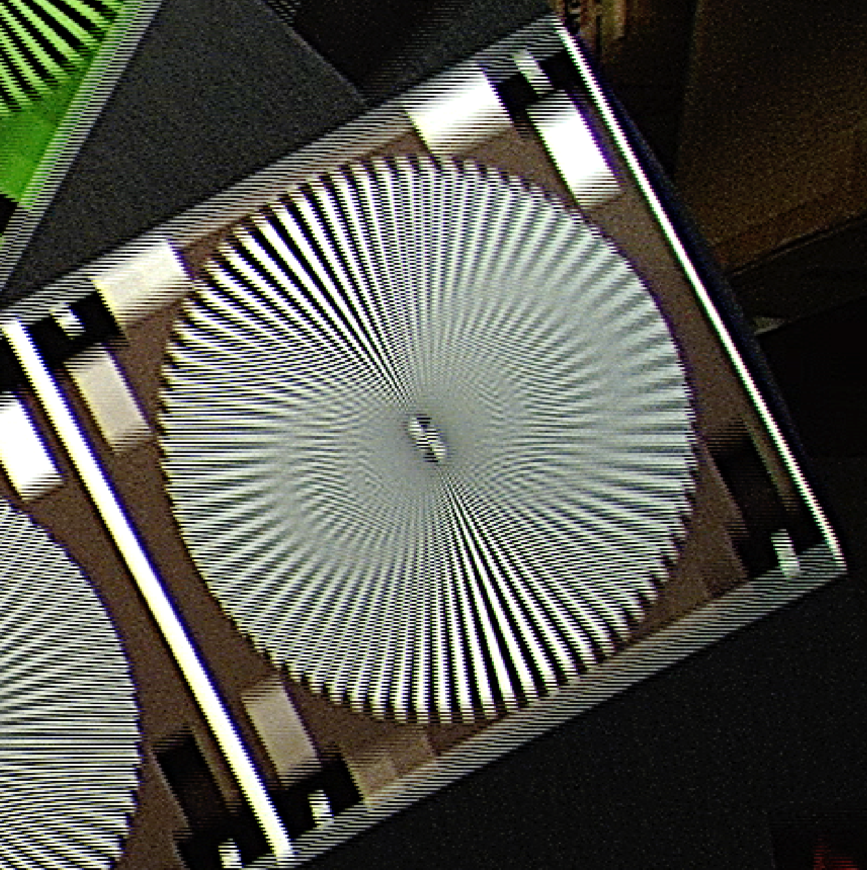
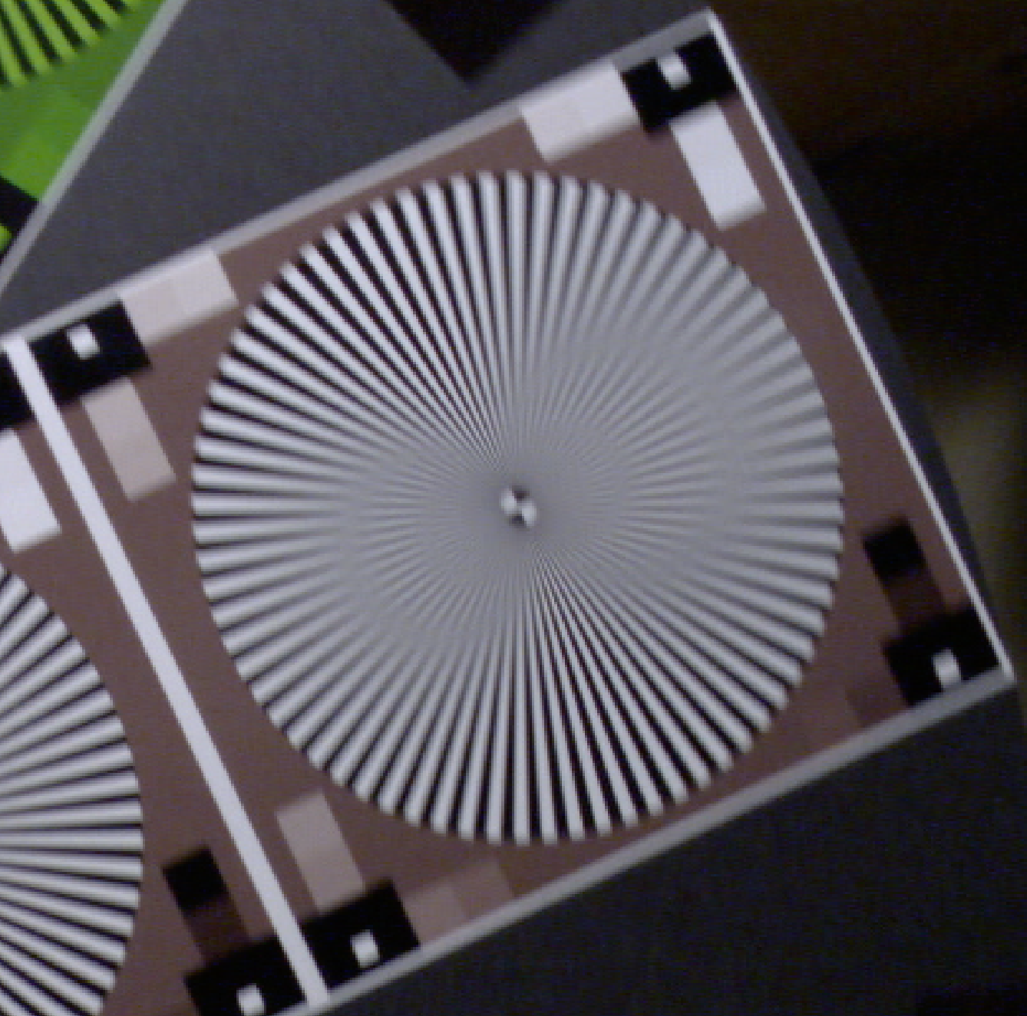
Comparison of the current ROV standard of 1920x 1080i 29.97 at simulated AUV Speed of 0.5 m/sec. and 1920x 1080 P59.4 (Progressively Scanned)
Ikegami HDL45, Fujinon 5.5x10 Lens,
110 lux, 1920x 1080i 29.97
Disk 6 RPM (~0.5 m/sec)
File: Test_103_White.tiff (not DeInterlaced)
Ikegami HDL50/HS, Zeiss 5mm Lens,
170 lux, 1920x 1080 P60
Disk 6 RPM (~0.5 m/sec)
File: : Test_74_White.tiff

Slide 40
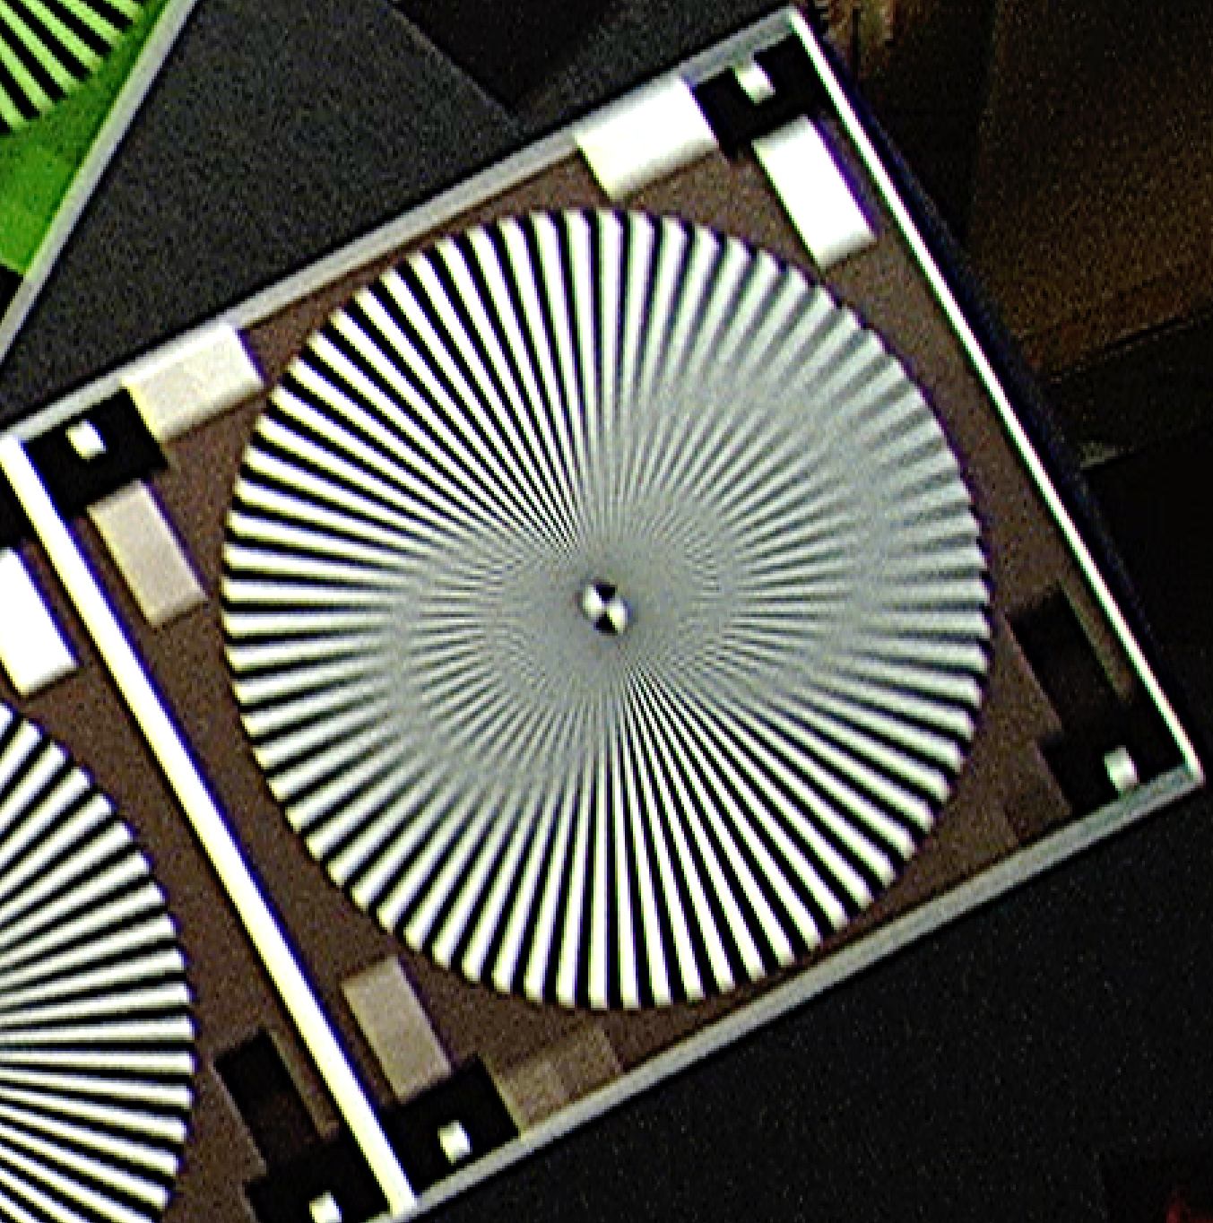
Comparison of the current ROV standard of 1920x 1080i 29.97 at simulated 0.5 m/sec. and the same image de-interlaced using Photoshop
Ikegami HDL45, Fujinon 5.5x10 Lens,
110 lux, 1920x 1080i 29.97
Disk 6 RPM (~0.5 m/sec)
File: Test_103_White.tiff (not DeInterlaced)
Ikegami HDL45, Fujinon 5.5x10 Lens,
110 lux, 1920x 1080i 29.97
Disk 6 RPM (~0.5 m/sec)
File: Test_103_White.tiff (DeInterlaced)

Slide 41
Comparison of the current ROV standard of 1920x 1080i 29.97 at simulated 0.5 m/sec. De-Interlaced and 1920x 1080 P59.4 (Progressively Scanned)
Ikegami HDL45, Fujinon 5.5x10 Lens,
110 lux, 1920x 1080i 29.97
Disk 6 RPM (~0.5 m/sec)
File: Test_103_White.tiff (DeInterlaced)
Ikegami HDL50/HS, Zeiss 5mm Lens,
170 lux, 1920x 1080 P60
Disk 6 RPM (~0.5 m/sec)
File: : Test_74_White.tiff

