Slide 1
Camera Testing

Slide 2
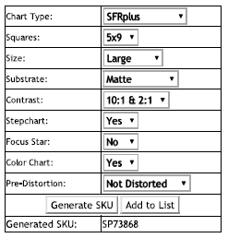
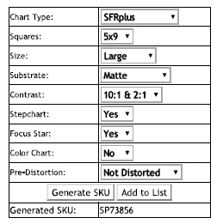
Recommended test charts
Color $400
Focus

Slide 3
Camera Test (draft)
Green – Dry test only Blue – Dry and Tank test

Slide 4
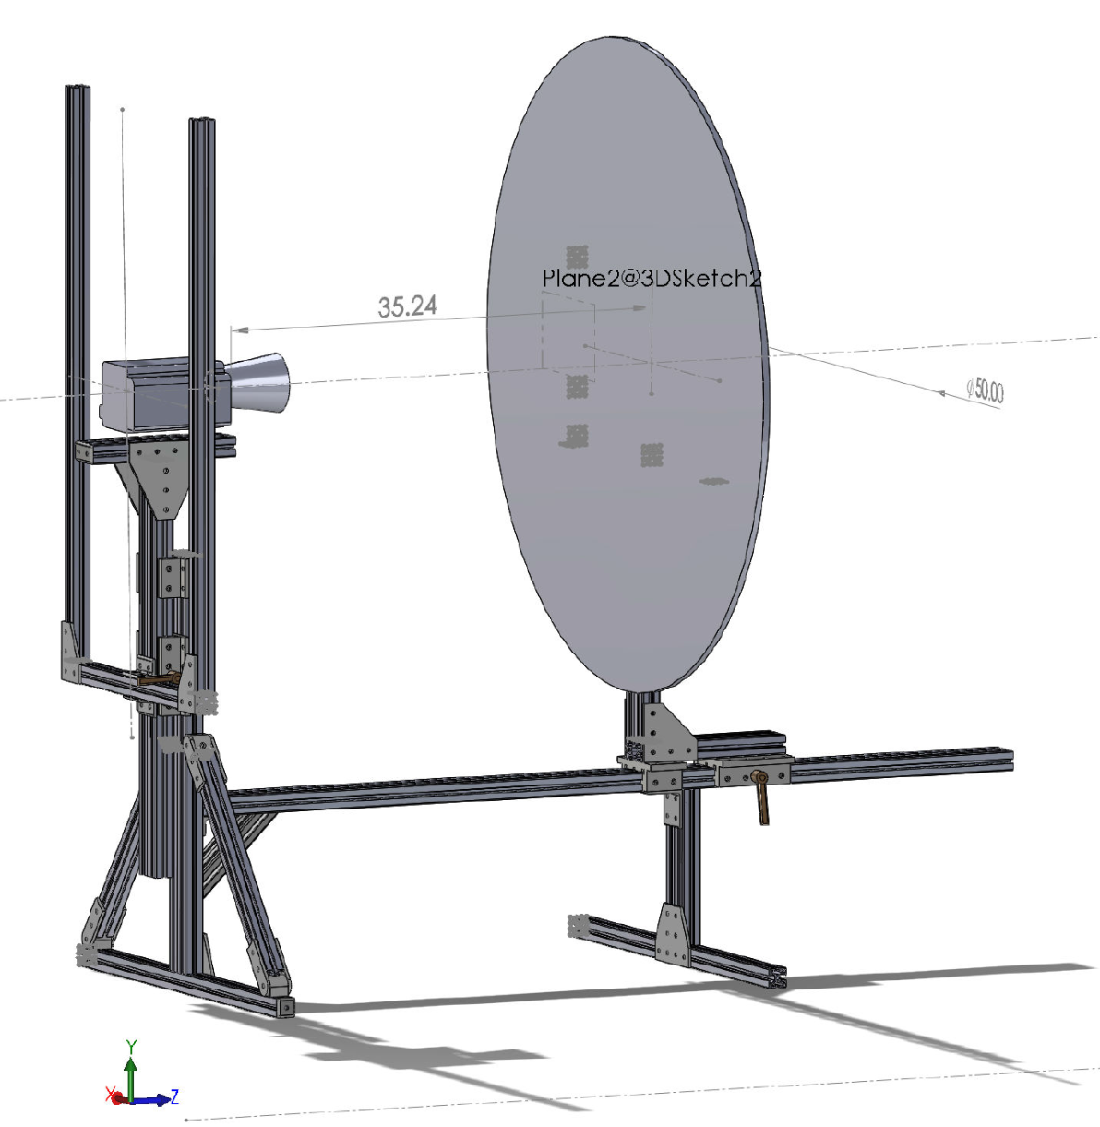
Temporal Test - Rotating Disk
(~ 0.5 m from dome)

Slide 5
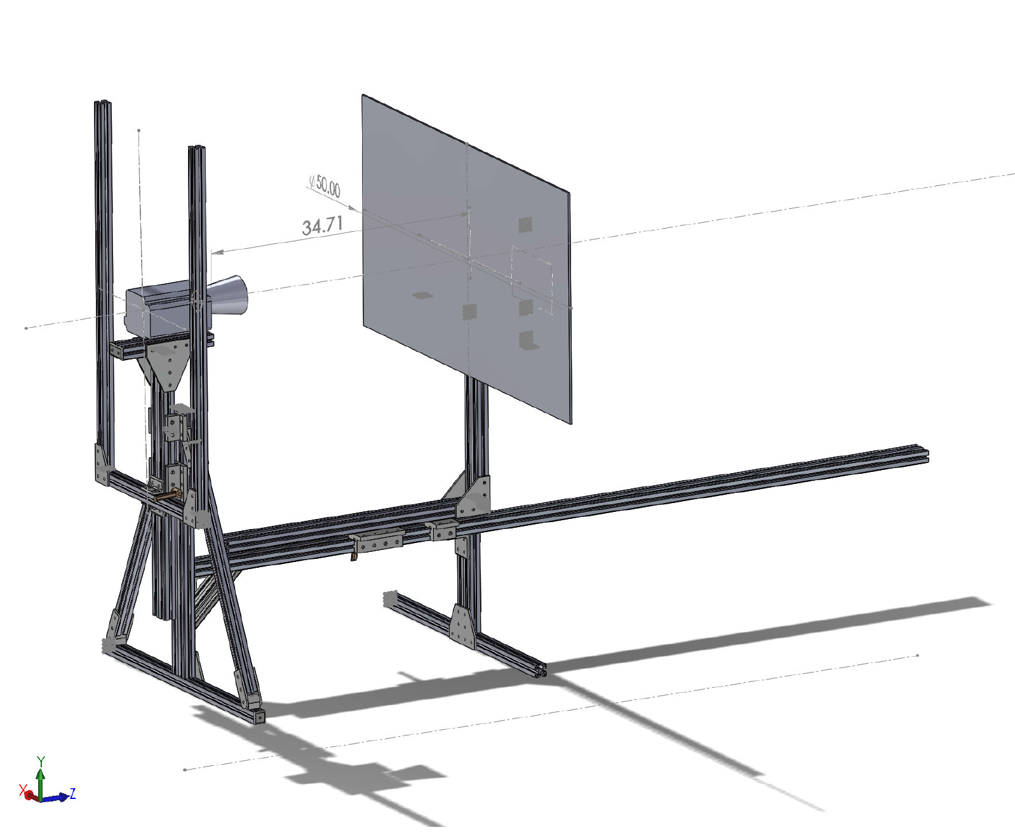
Resolution Testing (~ 0.5 m from dome)

Slide 6
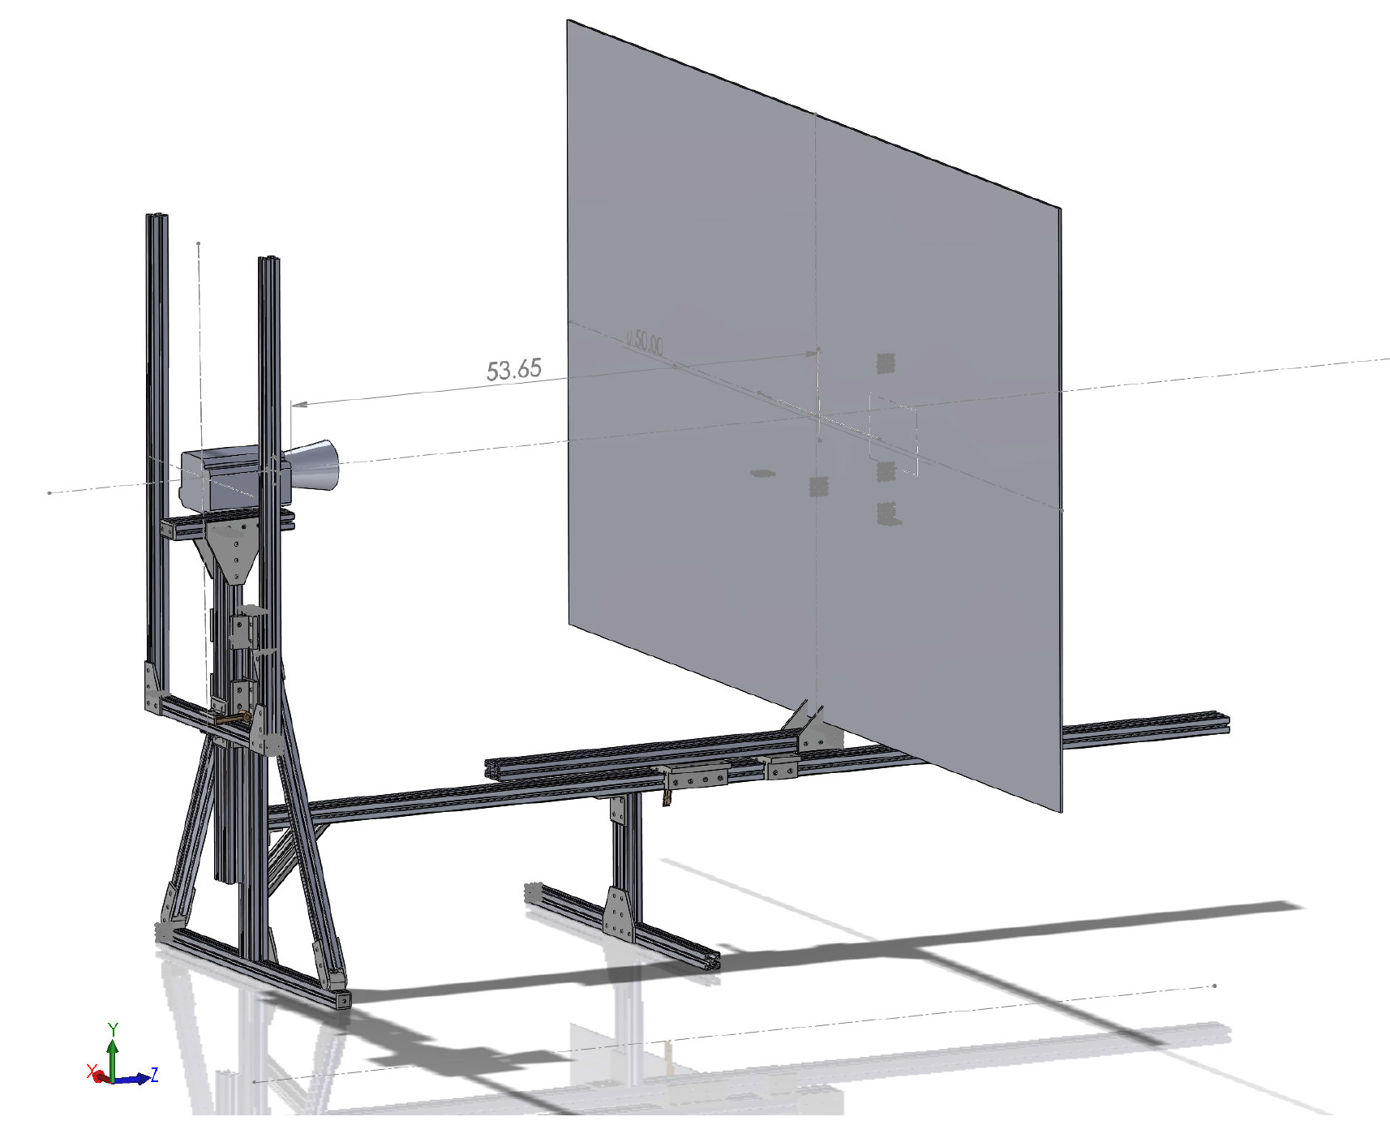
Light Field Testing (~ 1 meter from dome)

Slide 7
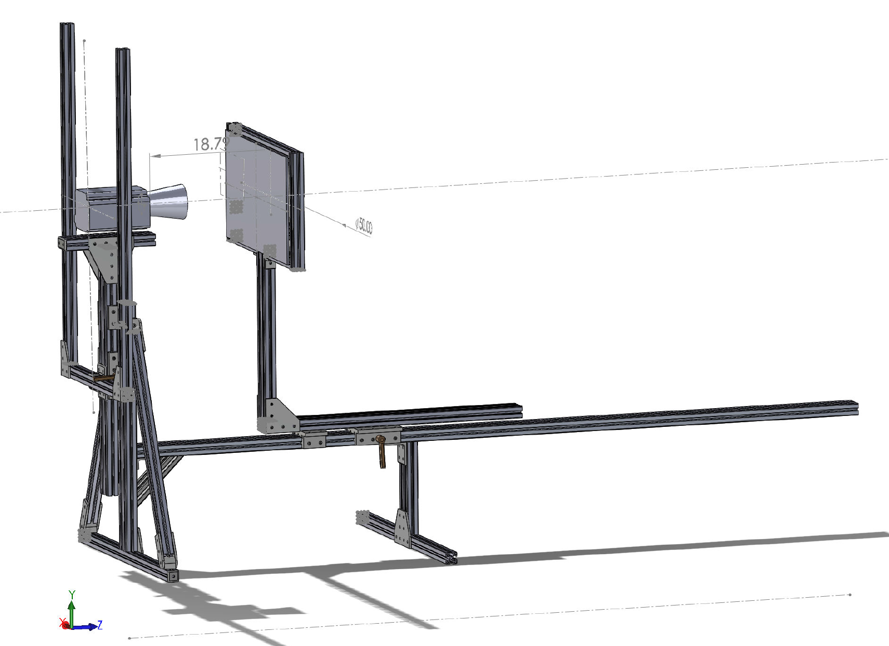
Close Focus Test (~10cm from dome)

Slide 8
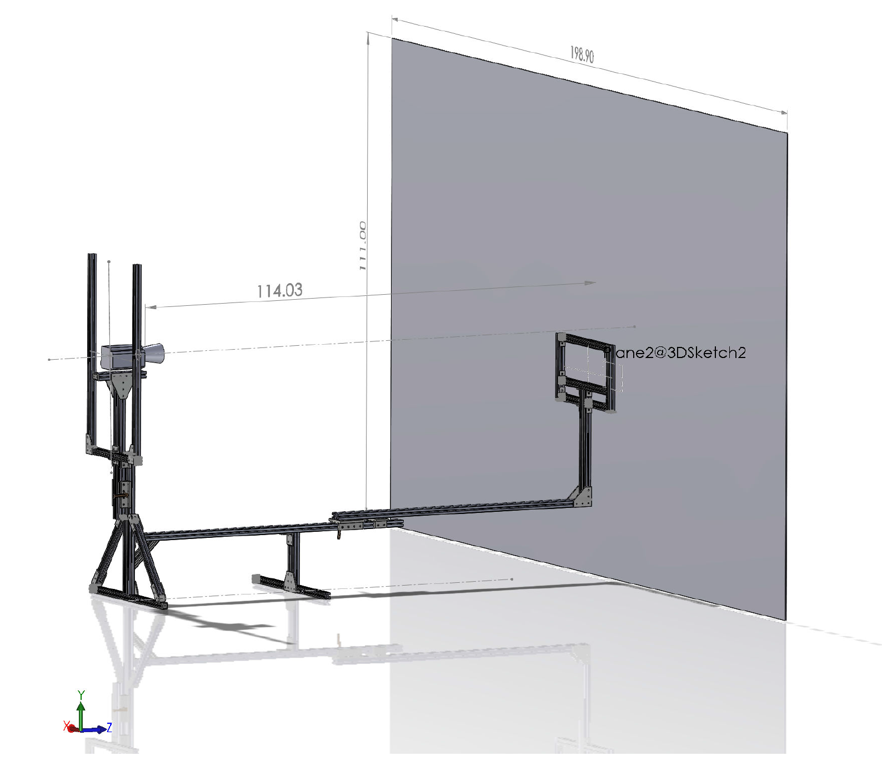
Far Focus (~2.5m from dome)

