Slide 1
i2MAP Camera and Lens Testing – Summary of Sony 11mm Results
Mark Chaffey
MBARI
chma@mbari.org
August 6, 2014
© MBARI 2014

Slide 2
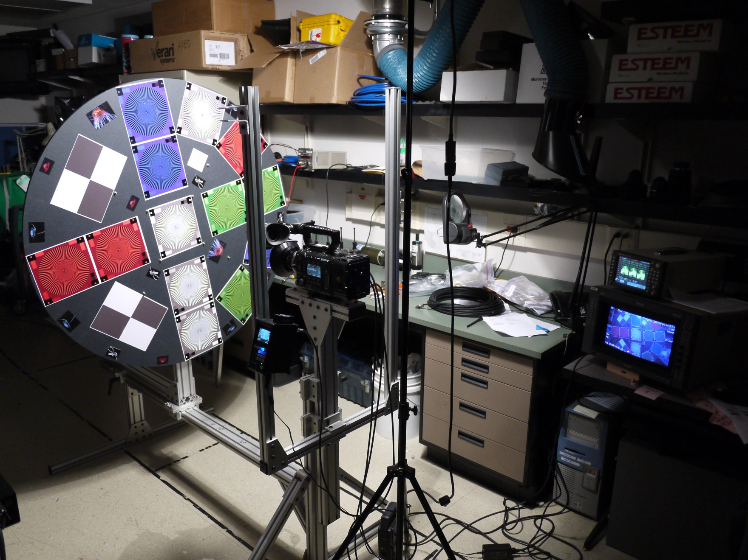
Camera Test Setup

Slide 3
PL Mount Lens Testing Results
The Arri/Zeiss Distagon 12mm T2.1 Standard Prime Lens and Sony SCL-P11X15 wide angle zoom Lens performed equally well in resolution and chromatic aberration.
The Zeiss is $9k used and the Sony is $6-7k available now. The Sony has a hot shoe for reading lens meta data and storing in the camera (not a requirement, but potentially useful).
The Zeiss is much faster T2.1 Vs. T3.0, however we are required to stop down to F5.6 for DOF anyway.
We would use the Sony lens in the 11mm focal position only.

Slide 4
Camera Detail Resolution Comparison Locations
Target Distance at “Sweet Spot” ~ 0.5 Meters From Dome
Detail Areas
Edge
Center
Sony F-5, SCL-P11X15 Lens, 400 lux, 70 IRE, Target 36 inches

Slide 5
Sony F-5 and Sony SCL-P11X15 Lens
Sony F-5, SCL-P11X15 Lens, F 5.6 400 lux, ISO 800, 70 IRE, Target 36 inches File: Test_13X.tiff

Slide 6
Sony F-5 and Arri/Zeiss Distagon 12mm T2.1 Standard Prime Lens
Sony F-5, Zeiss 12mm Lens, F 5.6, 520 lux, ISO 800, 70 IRE, Target 36 inches File: Test_12A.tiff

Slide 7
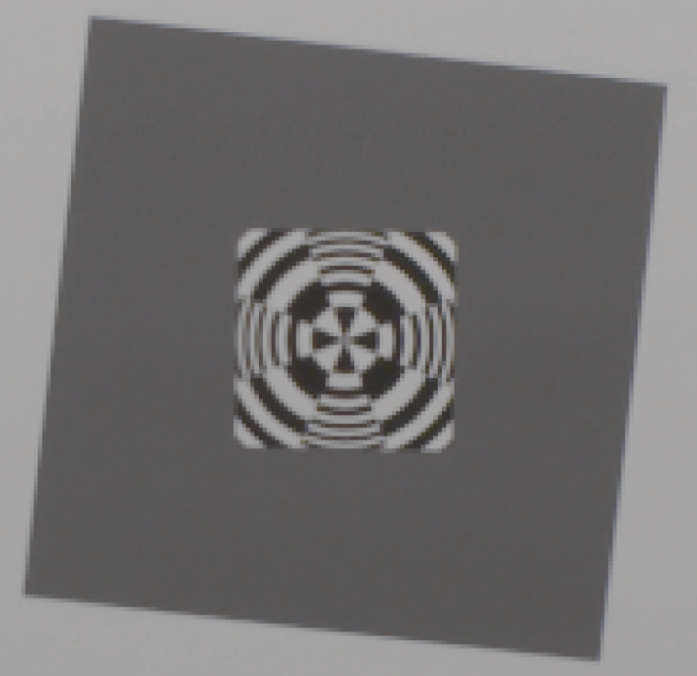
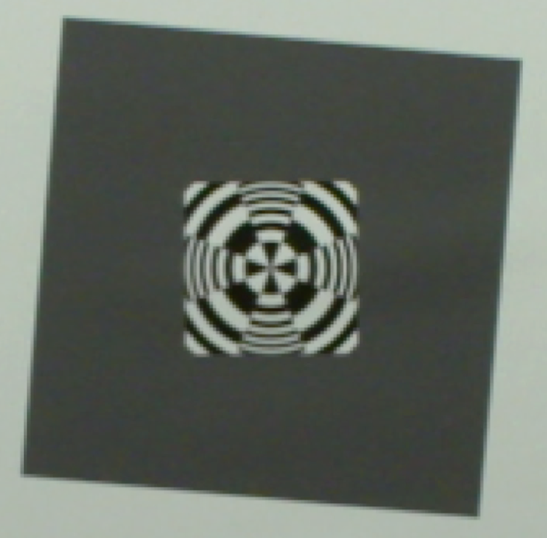
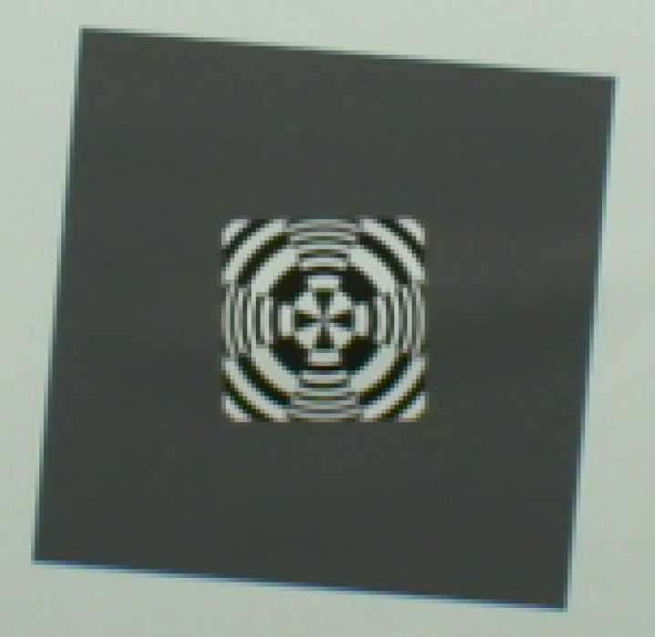
PL Mount Lens Comparison - Center
Sony F-5, SCL-P11X15 Lens, 400 lux, 70 IRE, Target 36 inches File: Test_13X.tiff
Sony F-5, Zeiss 12mm Lens, 520 lux, 70 IRE, Target 36 inches
File: Test_12A.tiff (lightened 20%)
Sony F-5, Optex 12mm Lens, 400 lux, 80 IRE, Target 34 inches
File: Test_8.tiff

Slide 8
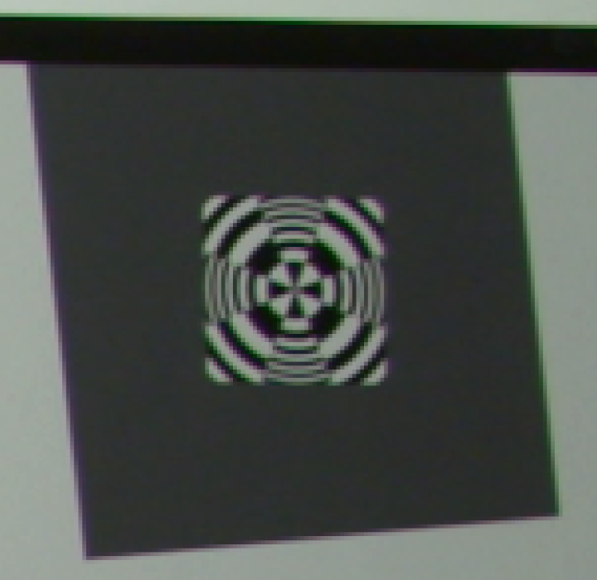
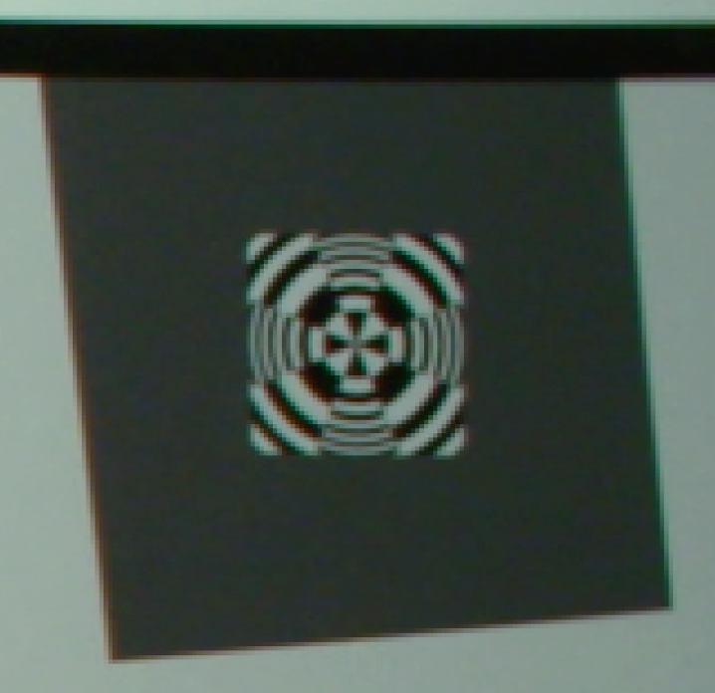
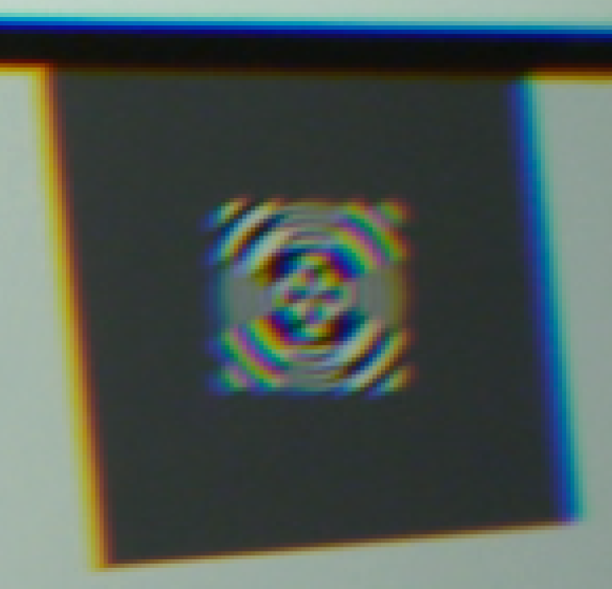
PL Mount Lens Comparison - Edge
Sony F-5, SCL-P11X15 Lens, 400 lux, 70 IRE, Target 36 inches File: Test_13X.tiff ($6000)
Sony F-5, Zeiss 12mm Lens, 520 lux, 70 IRE, Target 36 inches
File: Test_12A.tiff (lightened 20%) ($6-23,000)
Sony F-5, Optex 10.5mm Lens, 400 lux, 80 IRE, Target 34 inches
File: Test_8.tiff ($6500)

Slide 9
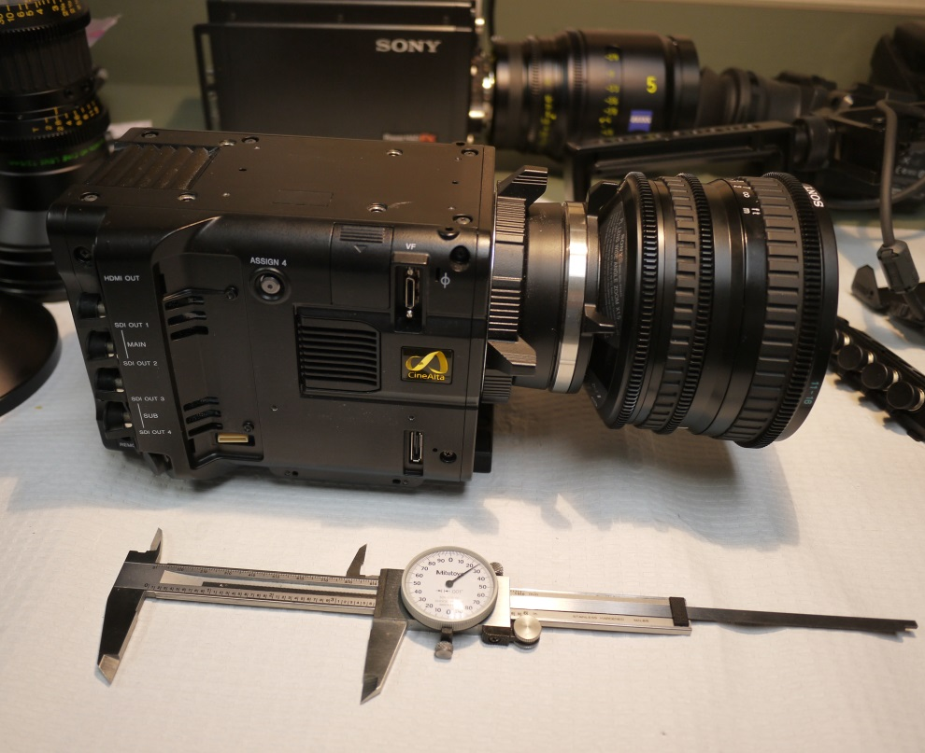
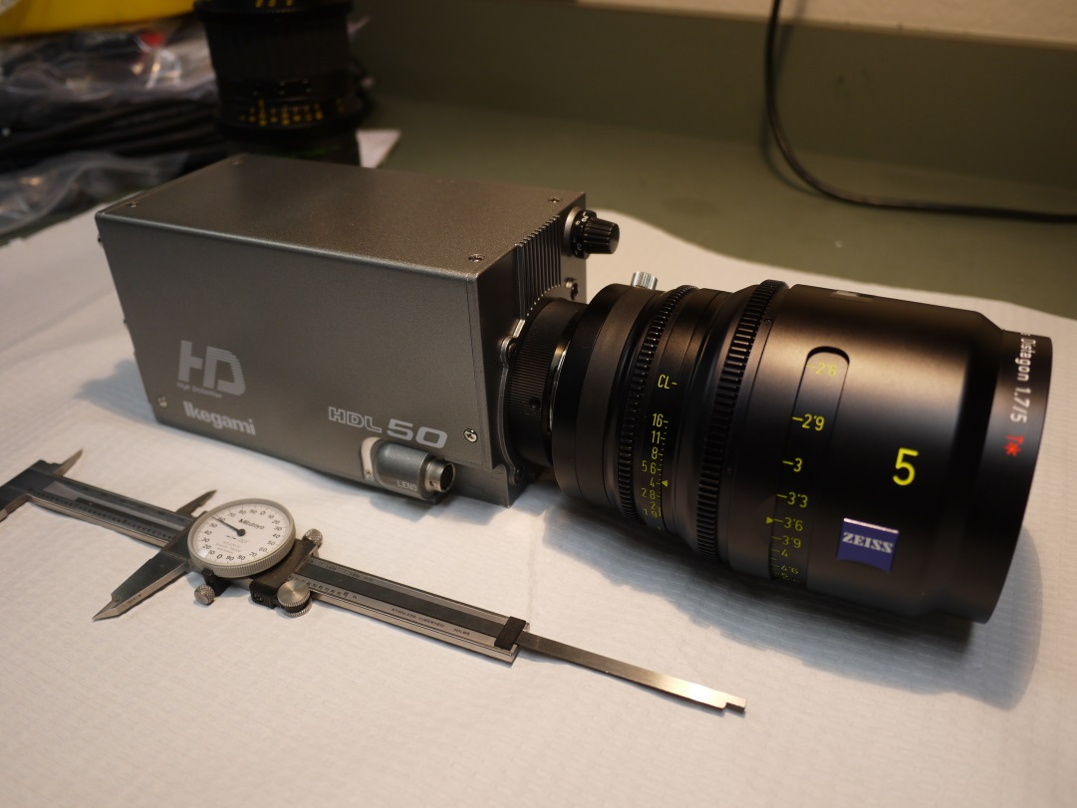
Camera Comparison
Sony F-5 vs. Ikegami HDL50/HS
THIS IS THE SELECTED CAMERA AND LENS
The PL and B4 mount Lens Winners Were Used for The Camera Test
Sony SCL-P11X15 Lens and Zeiss Digi Prime T1,9/5mm

Slide 10
Distance (DOF) Requirements for the Identification of Representative Organisms in the Camera Field-of View
Required I.D. Distance (Required Depth-of-Field)
Species
Front of Camera Dome
Measured First I.D. Distance (cm) (Rob Sherlock)

Slide 11
Test Showing the Sony F-5 and the Sony SCL-P11X15 Lens Meets the i2MAP Depth of Field Requirements (at F 5.6)
Sony F-5, Sony SCL-P11X15 lens set to 11mm, 560 lux, 75 IRE, Target 18 inches (10cm from dome equiv.), F 5.6, focus distance 31.5 inches
File: Test_14.tiff
Sony F-5, Sony SCL-P11X15 lens set to 11mm, 560 lux, 75 IRE, Target 113 inches (2.5m from dome equiv.), F 5.6, focus distance 31.5 inches
File: Test_45.tiff

Slide 12
Example of 4k Resolution
The next two slides illustrate the increased resolution visible with full 4k image capture.
Note that the lens used was the Zeiss 12mm Lens. 4K testing with the Sony 11mm lens is pending.
By selecting the F-5 (or F-55) we hope to migrate to 4k image capture as soon as recording capability is available (2015?).
Lens and optical adapter system must support 4k imaging resolution.

Slide 13
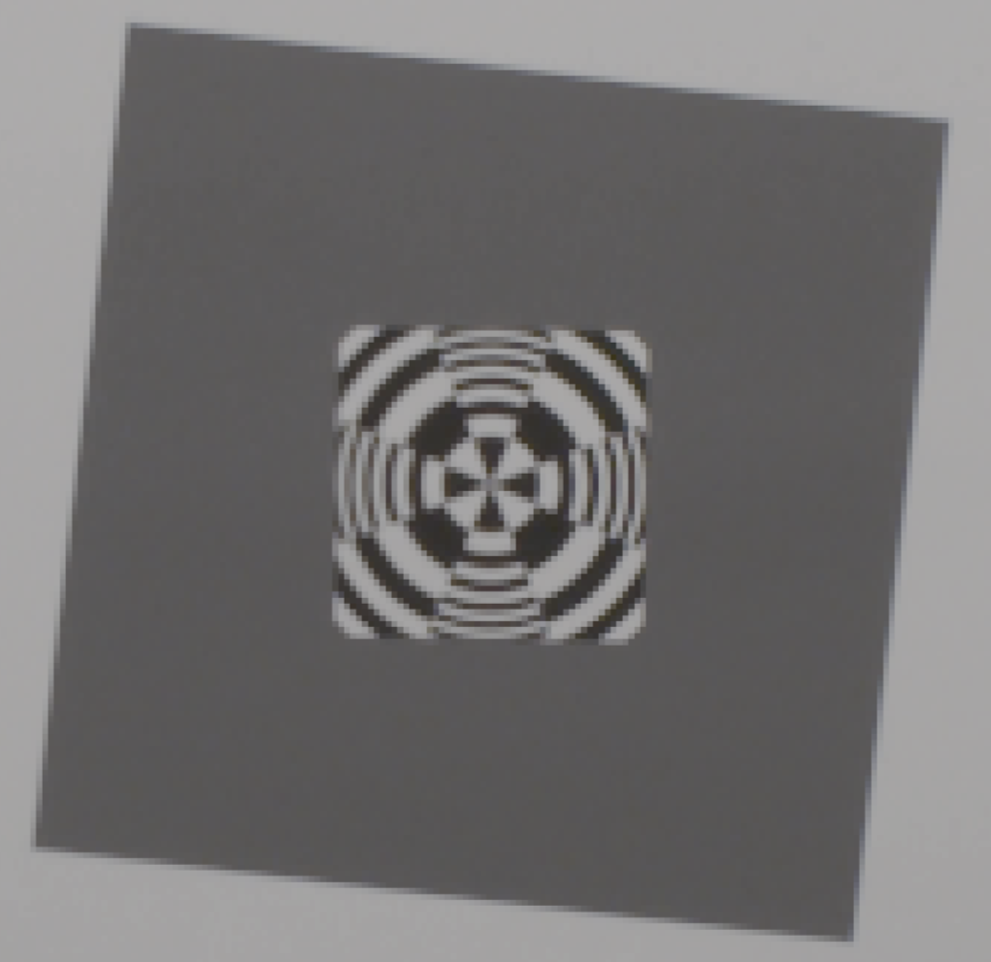
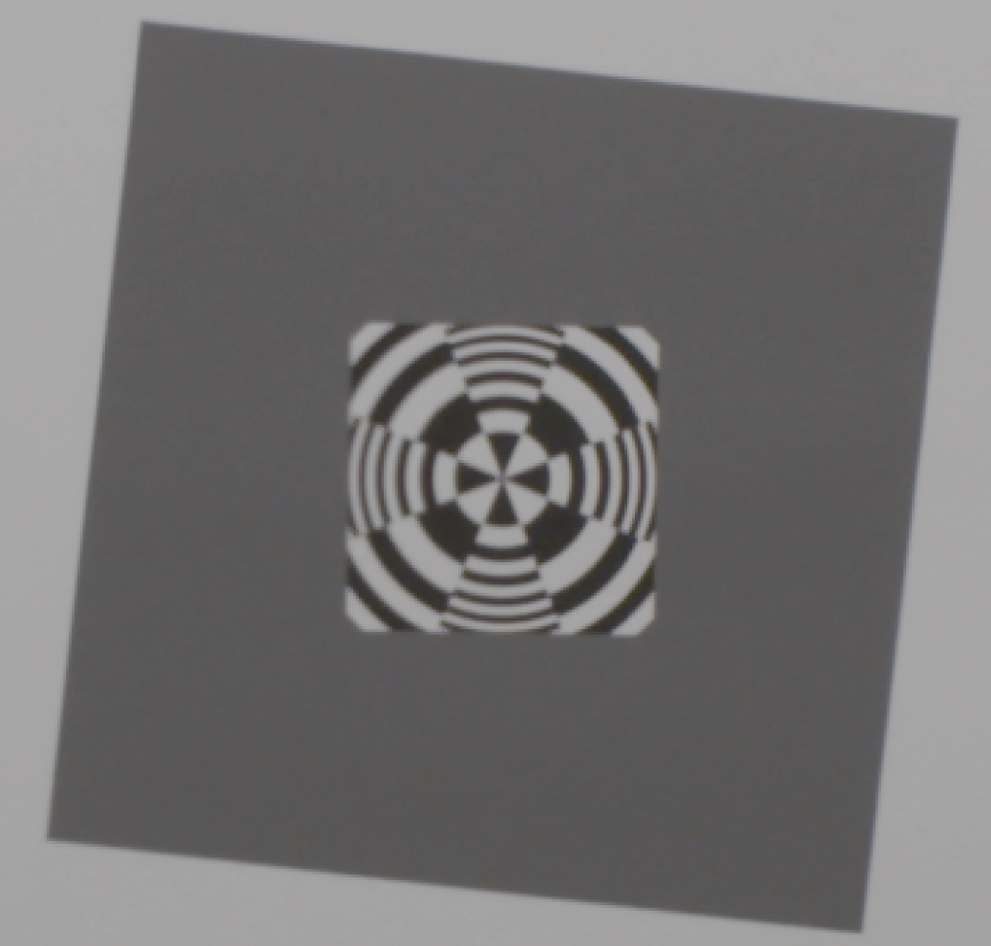
Sony F-5 1920 X 1080 vs. Sony F-5 4096 X 2160 (4K)
Center Resolution
Sony F-5, Zeiss 12mm Lens, 400 lux,
IE 800, Target 36 inches, 1920x 1080 P60
(no color correction)
File: Test_54_1920_4444.tiff
Sony F-5, Zeiss 12mm Lens, 800 lux,
IE 2000, Target 34 inches, 4K P60
(no color correction)
File: Test_54_4K4444.tiff

Slide 14
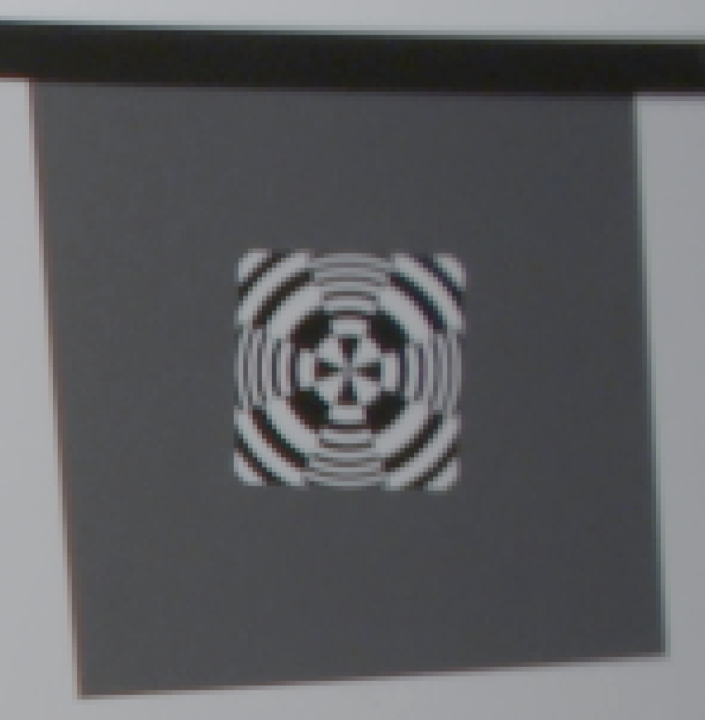
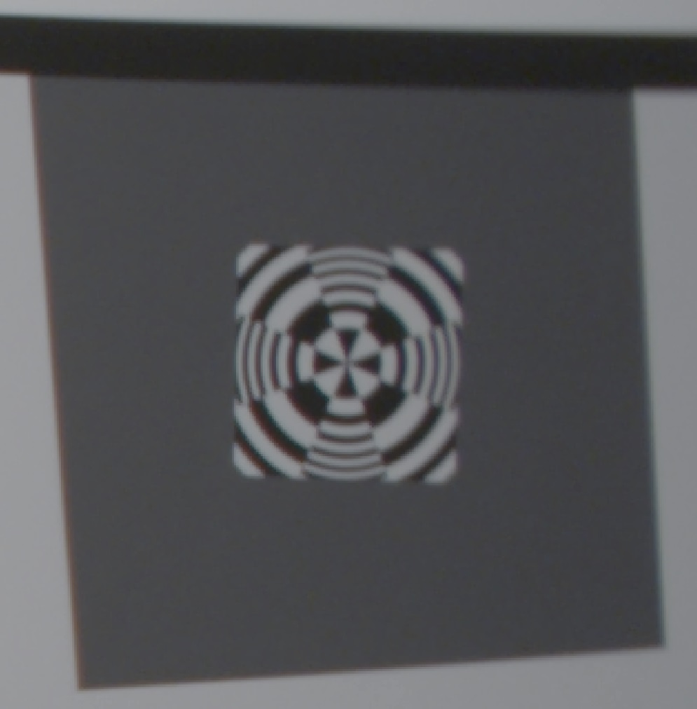
Sony F-5 1920 X 1080 vs. Sony F-5 4096 X 2160 (4K)
Edge Resolution
Sony F-5, Zeiss 12mm Lens, 400 lux, ISO 800, Target 34 inches, 1920x 1080 P60
(no color correction)
File: Test_54_1920_4444.tiff
Sony F-5, Zeiss 12mm Lens, 800 lux, IE 2000, Target 34 inches, 4K P60
(no color correction)
File: Test_54_4K4444.tiff

