Slide 1
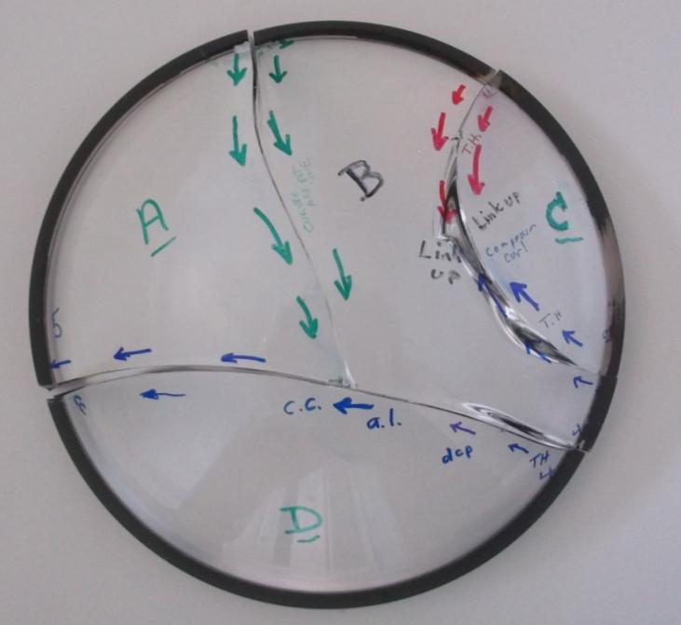
File: Dome 1 Quinn analysis March 3.pptx March 3, 2016
Quinn’s fractographic analysis Dome 1
There are 4 separate fracture origins and running cracks. They are labeled #1 - #4. They are all contact damage cracks. The arrows show the direction of crack propagation “dcp”
The grinding-machining seems to have been done quite well, even on the sharp inside edge, which was not beveled.
There are multiple arrest lines, meaning the crack advanced in stages, multiple events.
Most likely, origin 4 was the first to start the overall fracture. Figure 4-13 of Quinn’s Guide book shows a similar pattern. I suspect that contact cracks were in existence at the other sites and led to cracks that may have popped in part ways. Certainly crack 1 occurred after crack 4. Cracks 2 and 3 started independently, but the cracks curved around and linked with each other, part way through the dome.
The stresses were such that tension was greater on the dome inside surface. Initially stresses were simple hoop tension expansion at the rim, but by the time the cracks propagated towards the middle, the stress changed to bending with tension on the inner dome surface. This suggest that the applied pressure caused “splaying” of the dome.
here are no fracture mirror boundary features, nor do any of the cracks branch. This means stresses were low, most likely less than 1,500 psi = 10 MPa.
1
2
3
4
Continued on next slide

Slide 2

All 4 cracks came in fairly straight from the rim, indicating uniform hoop tension at the rim, but they evolved as they propagated into the dome middle. The cracks became curved, with the leading edge on the dome inside. This indicates bending stresses. This is not too surprising.
Thus all 4 crack systems were propagated by hoop expansion – tensile stresses at the rim. The tension stresses were small, less than about 1,500 psi (10 MPa) since there were no fracture mirror boundaries, and the cracks did not branch, and the fracture surfaces were fairly smooth = low energy fractures.
The cracks all seemed to go in stages. There inevitably was one major arrest line, and sometimes more than 1. This means the cracks popped in, and then with additional loading or exposure, they ran further. It is a sort of pop-pop crack propagation sequence. The fact that the cracks did pop in and stop, also confirms that the tensile stresses were not high. In highly stressed parts, once a crack start moving, it often runs completely through a part.
The 4 origin sites, are shown bellow, starting with #4, the likely first main crack to run into the dome. Origin #4 was somewhat unusual. The other three were quite simple and very similar.
1
A tilted but straight arrest line with Twist hackle
2
Arrest line her
It is relatively straight indicating uniform hoop tensile
Twist hackle and compression curl indicating stress state changing to bending
Another arrest line here, but curved strongly indicating stresses have evolved to bending with tension on the inside
Cracks 2 and 3 link up here
A tilted but straight arrest line with Twist hackle
Twist hackle
Crack 1 stopped here since crack 4 already had run through the piece.
Relatively featureless, low energy fracture surface
3
A big curved arrest line in crack 4 here
Compression curl on fracture surface, indicates bending stresses her with tension on the inside surface
A very strangely shaped arrest line is here.
4
I suspect his was the first fracture. More images on later slides.

Slide 3
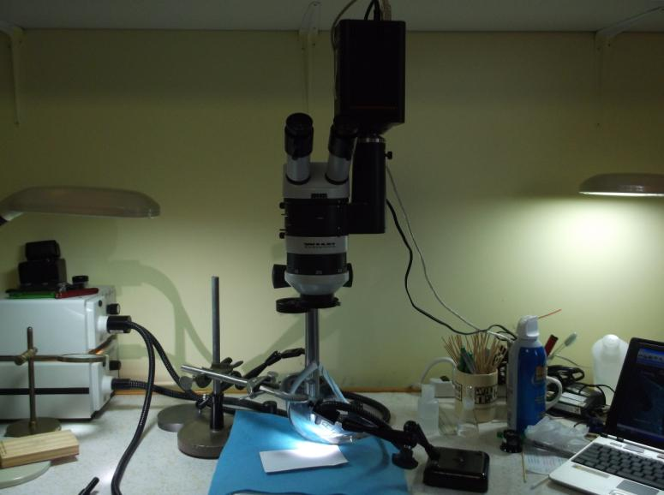
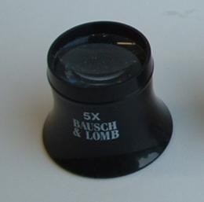

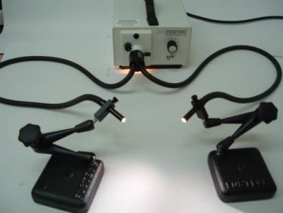
Inspection techniques
Loupe, small consumer digital camera, stereoptical microscope, Wild M5, with Spot insight digital camera, maximum magnification to the eyes: 125 x
Directional lighting capable of tiny angular adjustments

Slide 4
There is an interesting analogue to the dome failures. People often test glass disks or ceramic disks under pressure or mechanical ring-on–ring type loading. See Figure 4-13 of Quinn’s Fractography Guide.
First , a crack forms and runs across the disk as shown here. Origins can be areas marked by the black arrows. The crack will run to the left and to the right out to the rim.
Then, the forces acting on the disk still press down on the large top half of the dome that is still intact. That bends the piece, and fracture often starts at the points marked by the red arrows. Fractures then run out to the rim, and the pieces fall out of the test fixture or frame, and no more fractures occur.
Ring-on-ring mechanical loading
The MBARI domes are like this but with two important exceptions:
The first fracture started at the rim, probably at site 4, and then ran all the way across.
The other fractures also started out at the rim and ran inwards. I suspect there were already modest sized cracks at locations 1, 2, 3 , and these propagated into the dome middle, since there was no meaningful flaw in the dome middle.

Slide 5
If the tensile stress in the glass was 1,500 psi = 10 MPa or less,
then what size flaw should we be looking for?
Answer: Use fracture mechanics.
For a surface semicircular flaw in a tension stress field: K_{Ic} = Y σ√a
where K_{Ic} is fracture toughness, which for BK-7 is about 0.85 to 1.0 MPa√m
σ is the tensile stress, = 10 MPa
Y is the flaw stress intensity shape factor, a dimensionless factor, which is 1.3 for a
semicircular surface flaw
a is the flaw depth
Substituting, we get: a = .0043 to .0059 meters = 4.3 mm - 5.9 mm flaw depth
So let’s be on the lookout for flaws that are a few mm in size.
If the stresses are less than 10 MPa, then the flaw might even be larger.
This calculation would be for the size of a flaw when it went critical, possibly after some slow crack growth, if that occurs. With the exception of origin #4, I did not see any markings that were indicative of environmentally-assisted (e.g., water or humidity in air) slow crack growth.

Slide 6
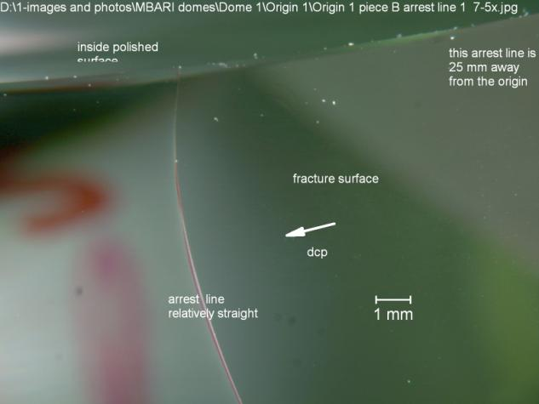

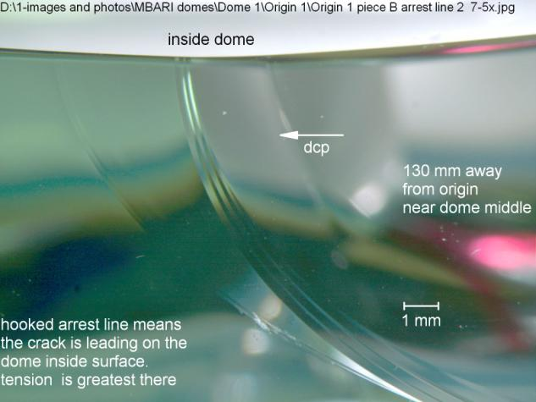
Examples of arrest lines.
Crack emanating from #1 site
Arrest line #1, about 25 mm away from the outer rim. It is relatively straight, which means the tension was even through the thickness.
1
2
3
4
Arrest line #2, near the middle of the dome, it is very curved, meaning the stresses varied through the thickness with tension on the inner surface and some compression on the outer surface. This means bending stresses.
dcp in the figures means “direction of crack propagation”

Slide 7

Origin 4
1
2
3
4

Slide 8
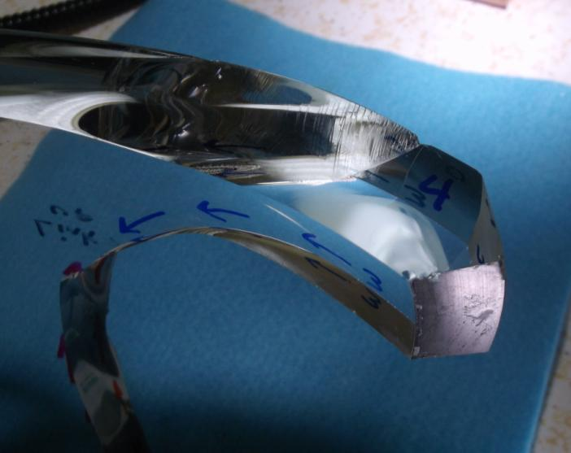

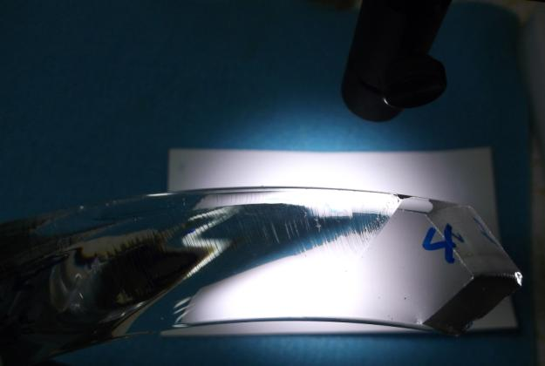
Origin #4 suspected initial break
1
2
3
4
Piece B, view of origin 4 site

Slide 9
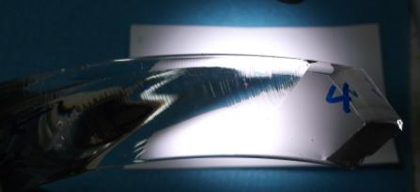
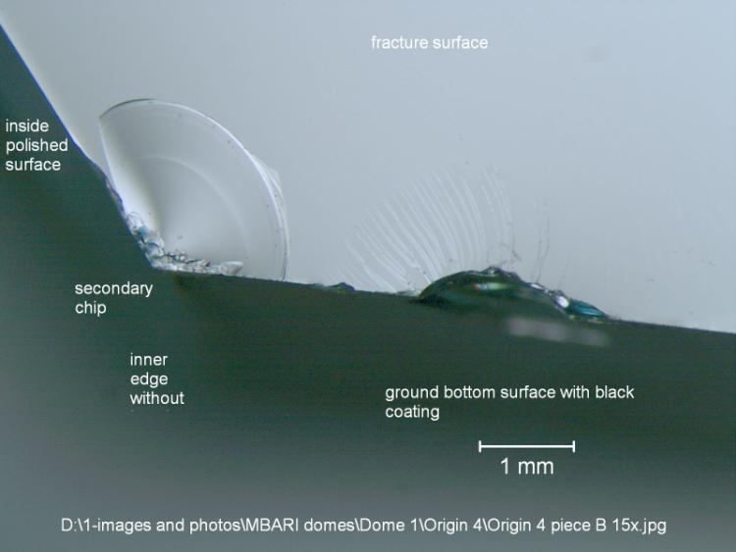
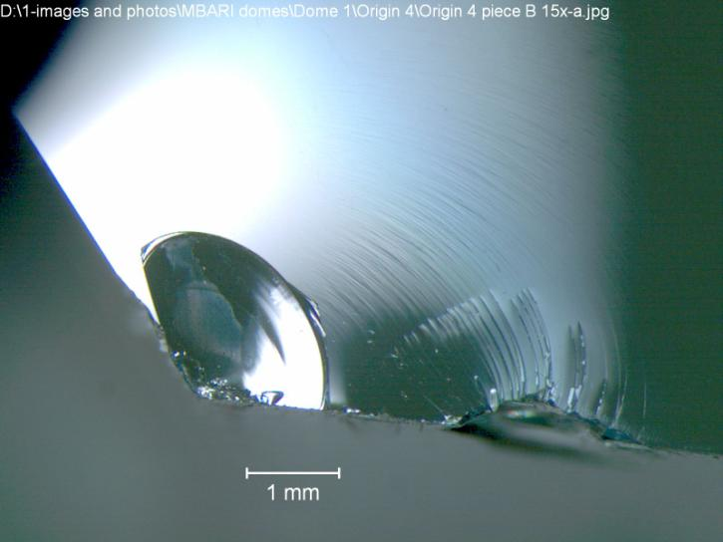
Origin #4 as seen on piece B
The actual flaw is this thing. It is a contact crack with radiating twist hackle lines fanning out from it as fracture progressed.
The depth of the initial flaw is about 0.5 mm , but it pops into a larger flaw (arrest line) about 1.5 to 2mm deep,
which is what we expect from the fracture mechanics calculation.
The contact crack is located about 2-4 mm away from the inside edge of the dome, on the bottom ground surface.
The chip on the left is of no consequence. It is a secondary chip formed when the piece bumped each other after fracture, or during the handling afterwards. We know this because these features do not exist on the matching glass piece.
Two views at same magnification but with different lighting
Arrest line
Origin flaw
3 mm
Origin flaw
Contact crack

Slide 10
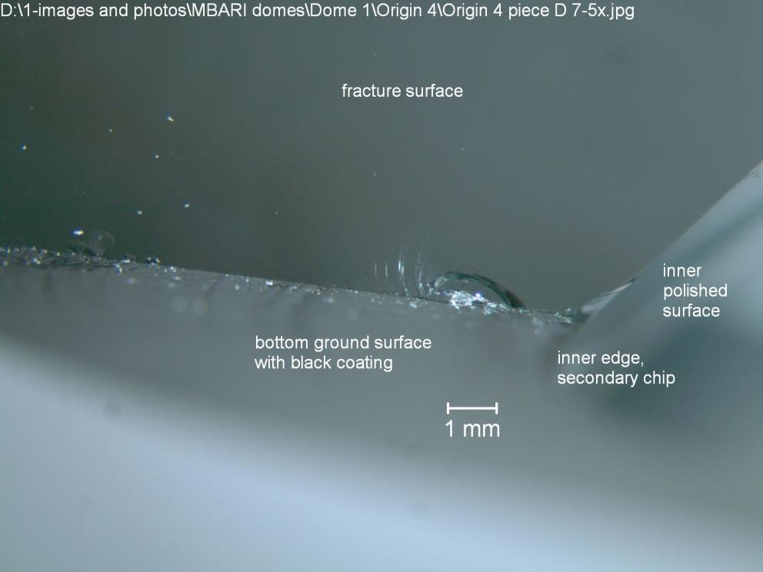
Origin #4 as seen on piece D
1
2
3
4

Slide 11
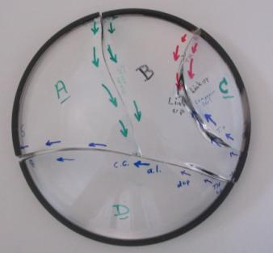
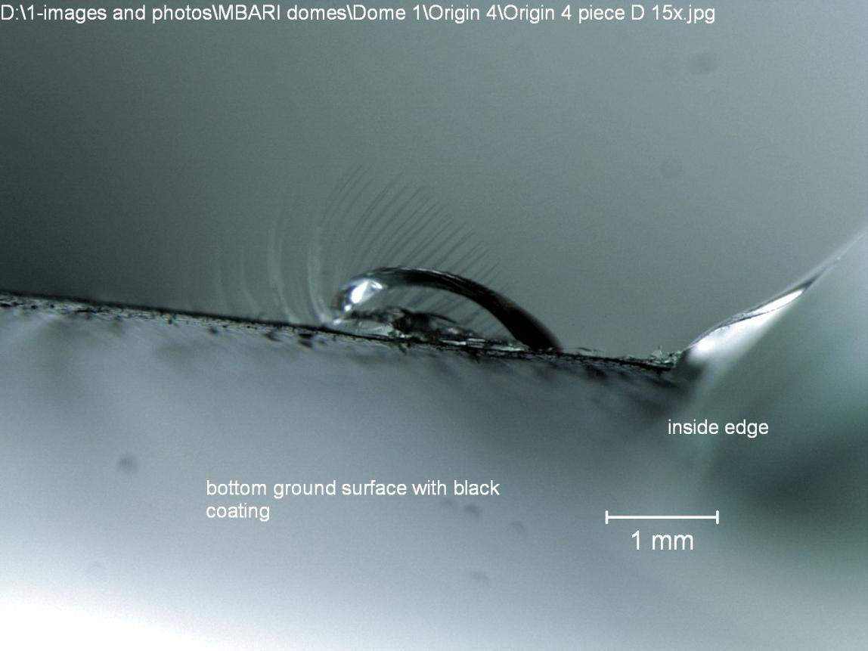
1
2
Origin #4 as seen on piece D
3
4

Slide 12
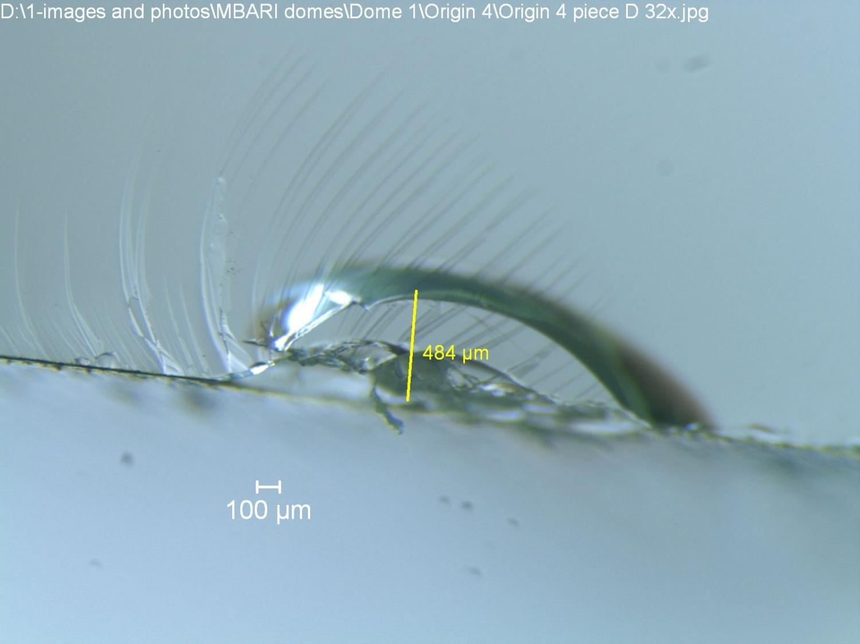
Origin #4 as seen on piece D

Slide 13
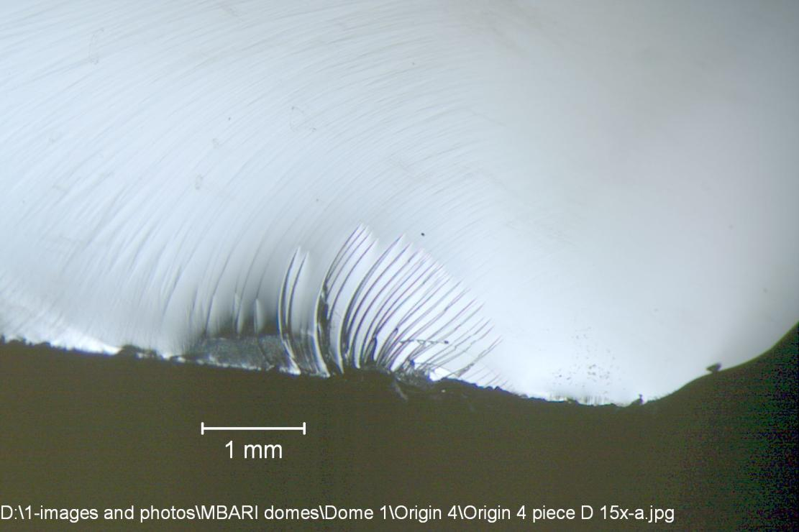
1
2
Origin #4 as seen on piece D
There is something odd about this flaw-origin. There are very faint hackle lines extending well up into the fracture surface. They were difficult to see and very hard to photograph, but they are real. They bear a remembrance to cavitation hackle lines which are sometimes seen when fracture occurs in the presence of water.
The faint lines were visible on the opposing piece as well.
The line twist and turn in an odd manner on the fracture surface as shown in some of the photos on the next slide.
3
4

Slide 14
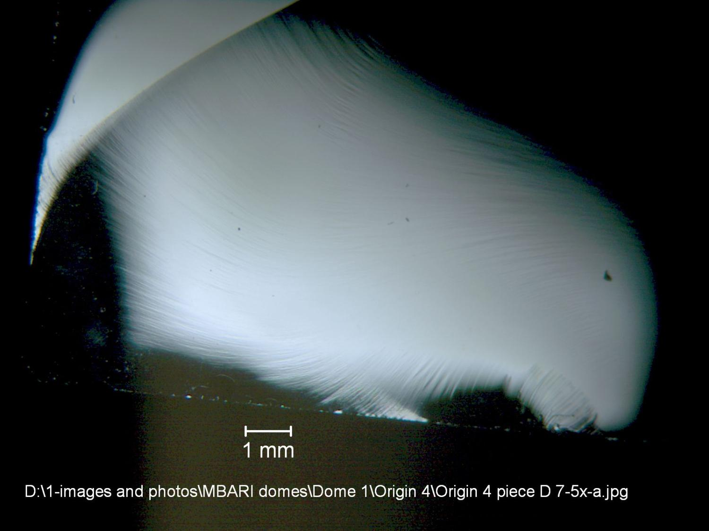
What puzzles me is that the lines seem to converge on an area on the inside surface of the dome, away from any water. They do not seem to converge on the flaw itself.
An arrest line
origin

Slide 15


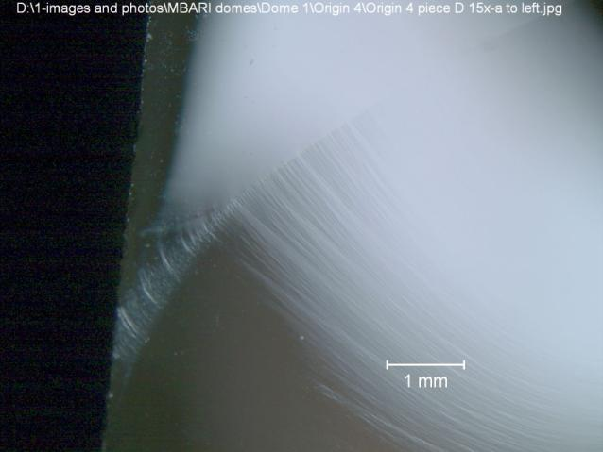
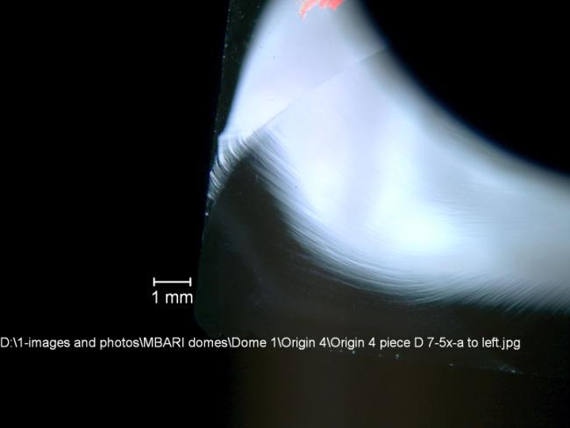
Origin #4 as seen on piece D
1
2
More views of the mysterious lines.
3
4
Origin flaw
These lines were not present anywhere else on the dome fractures.

Slide 16
Origin 1
1
2
3
4

Slide 17
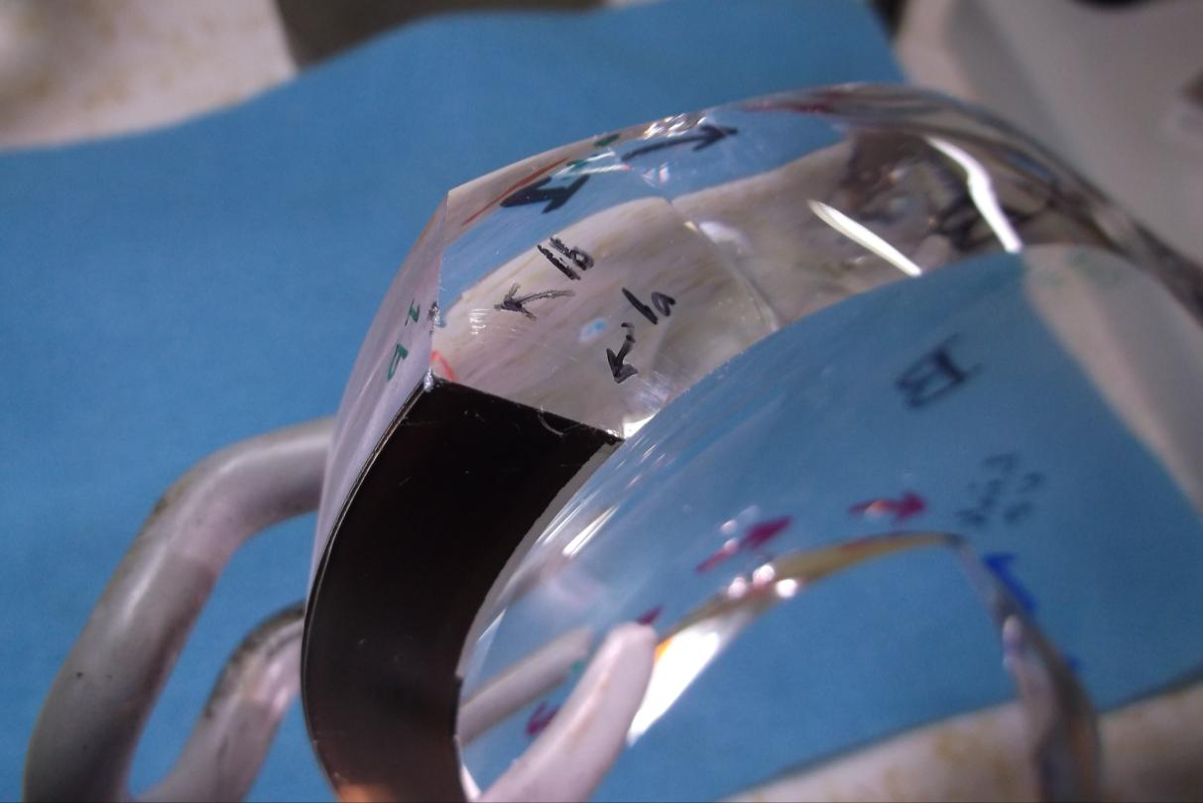
Origin #1 as seen on piece B
1
2
There were two contact cracks: 1a and 1b
1a is on the bottom ground surface with the black coating.
1b is on the outer ground surface. Origin 1b is primary.
Site 1a is incidental.
3
4
Piece B

Slide 18

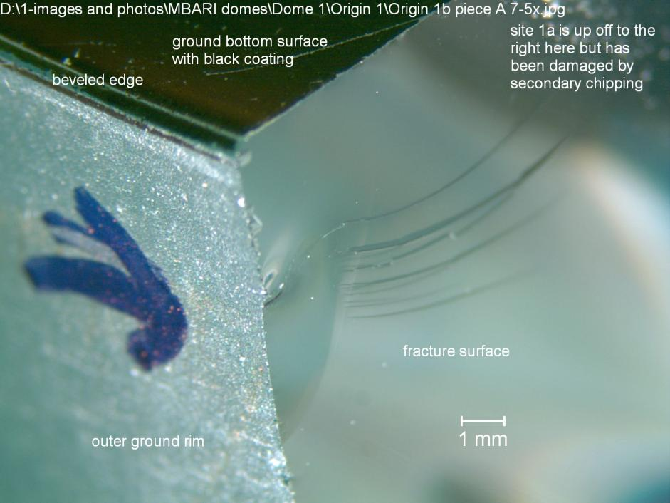
1
2
Primary Origin #1b as seen on piece B
3
4
Primary Origin #1b as seen on matching piece A
(rotated)

Slide 19
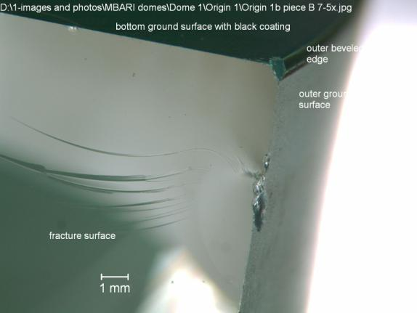
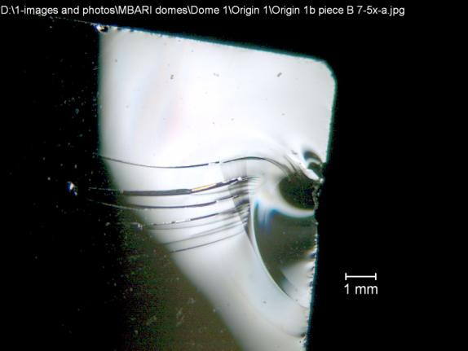
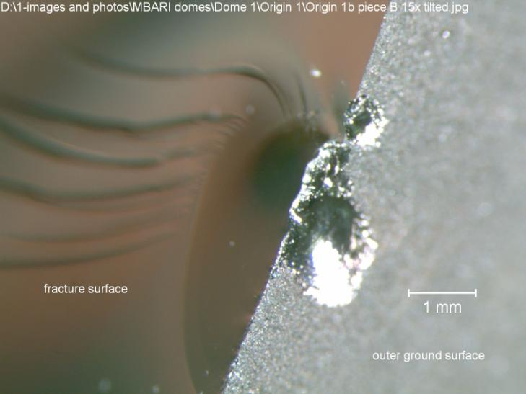
Primary Origin #1b as seen on piece B. I think this is the primary origin.
More of the overall fracture lines seem to radiate from this area,
but the crack did run over and intersect another flaw site 1a.
2 views, different lighting
Pop in
arrest line
There are some interesting arrest lines and Wallner lines around this flaw.
Something contacted and impacted the outer rim at this site.
The origin popped in to several mm deep.
Close up
Pop in
arrest line
Original flaw, pops in further

Slide 20

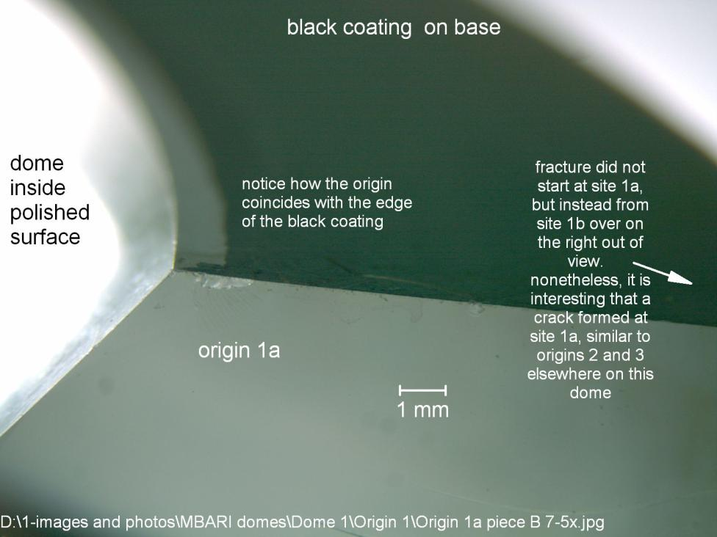
Incidental Origin #1a as seen on piece B
1
2
3
4
I rotated the piece to get better lighting on the origin area.

Slide 21


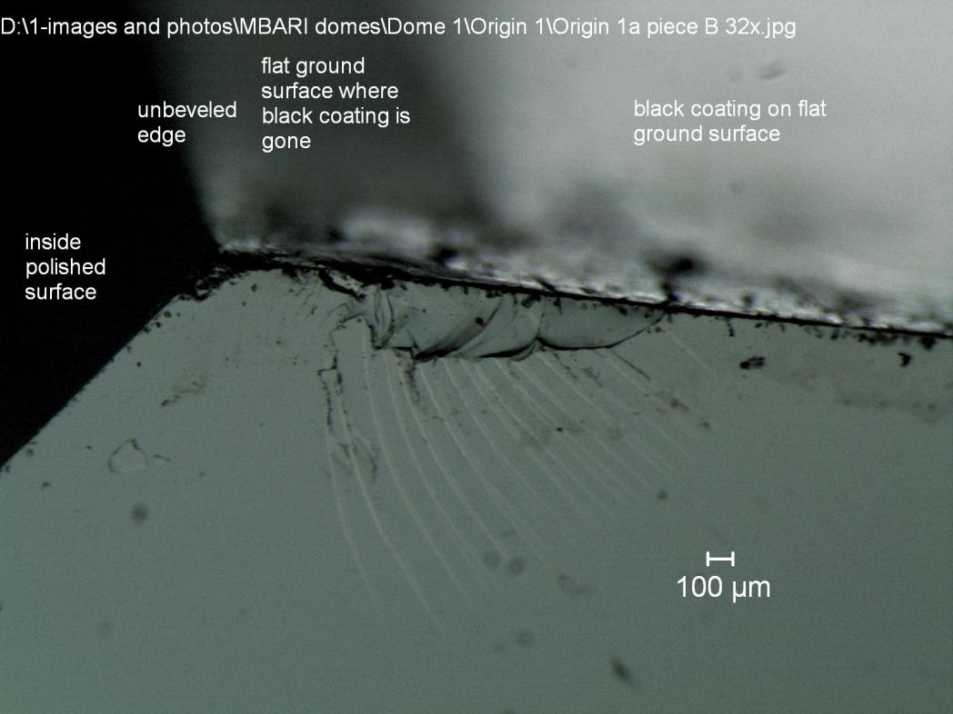
Incidental Origin #1a as seen on piece B
This is a contact damage crack on the bottom ground surface. It did not seem to correlate with any damage on the ground surface from the grinding.
It has nothing to do with the sharp inner edge either.
It is about the right size from a fracture mechanics perspective.
IMPORTANT? It lines up with the edge of the black coating.
Origin contact damage crack

Slide 22
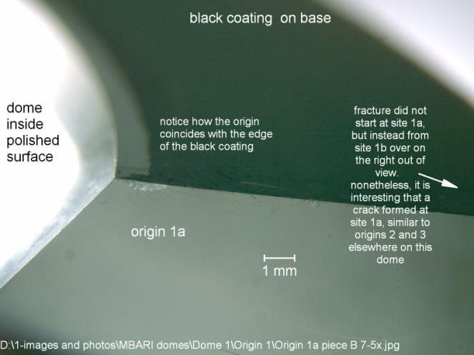
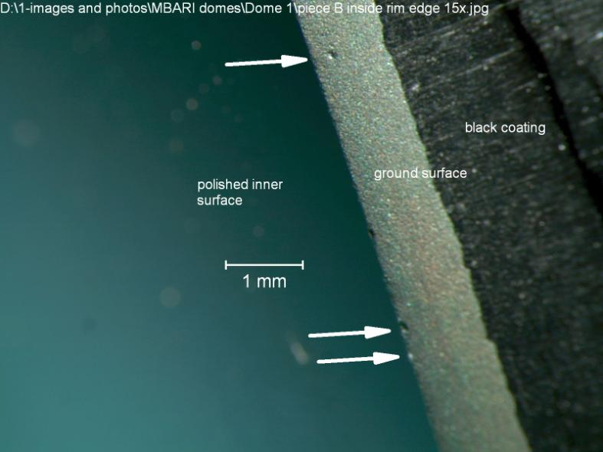
Incidental Origin #1a as seen on piece B
I looked at the dome on another portion of the inside edge and ground surface.
The unchamfered inside edge was surprisingly good. There were a few pock mark – gouges that seemed harmless.
The ground surface also looked pretty good, with no scratches or chips.
Yet the 1 mm wide gap was clear.
Notice the inside 1 mm of the ground bottom dome surface has had the black coating removed. I noticed the flaw coincides with this location.

Slide 23
Origin 2
1
2
3
4

Slide 24

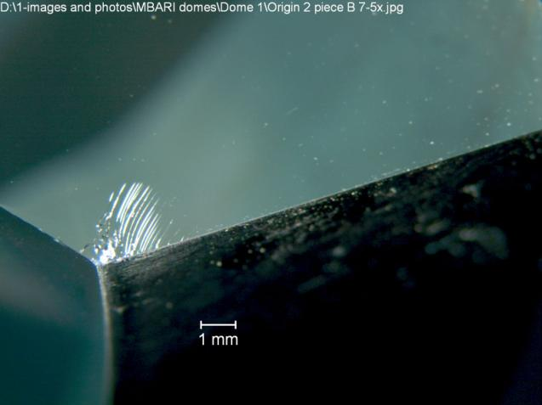
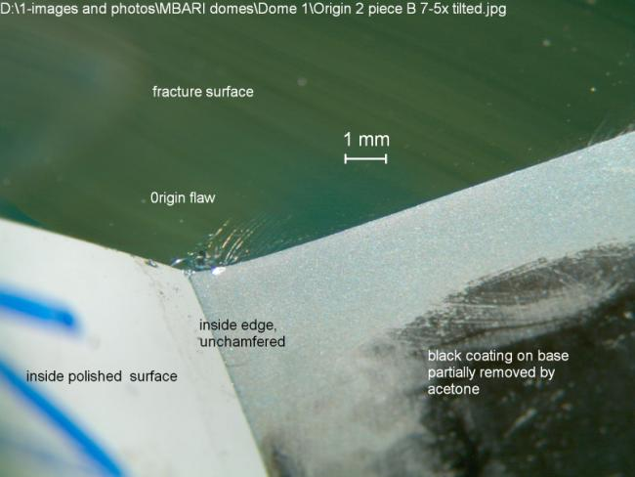
Origin #2
This was a simple origin. It was a single flaw and it matched on both piece B and C.
I did clean off a lot of the black coating on piece B by use of acetone and a Q tip. I did this to observe the condition of the ground surface, but I later realized that I removed evidence of how far the black coating extended.
1
2
3
Origin 2 on piece B
4
2 low power views with different lighting at same magnification

Slide 25
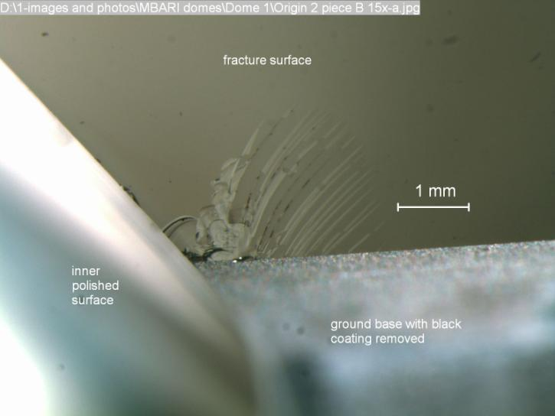
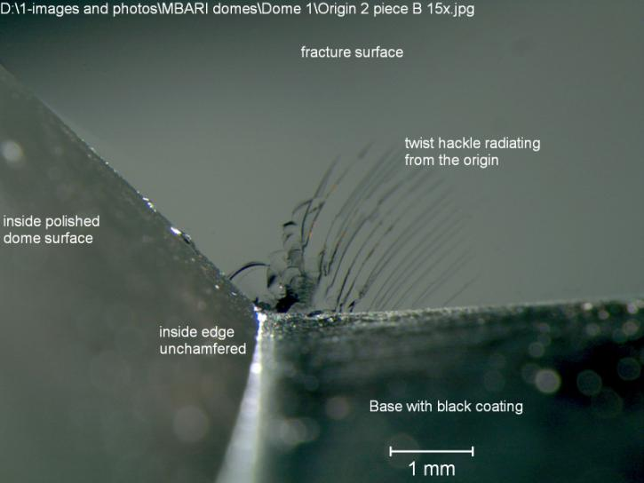
Origin 2 on piece B
2 low power views with different lighting at same magnification
Piece B

Slide 26
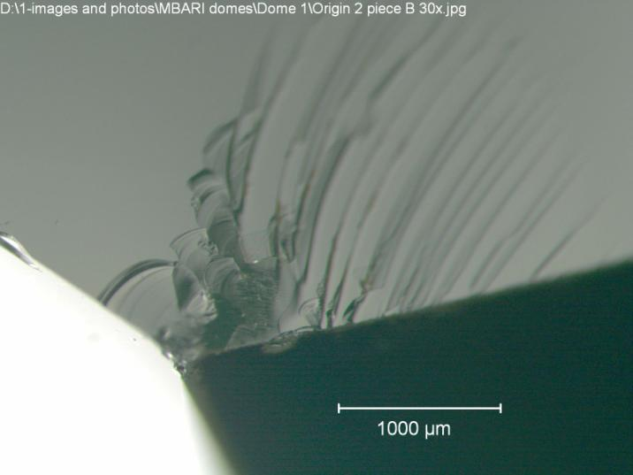
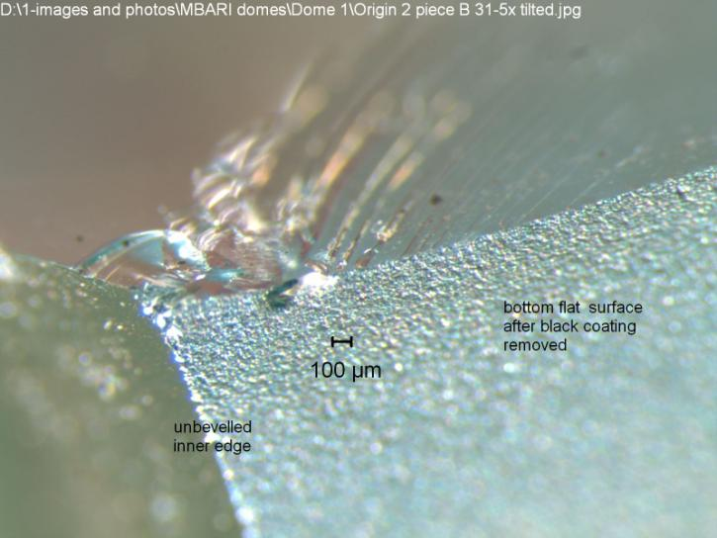
Origin 2 on piece B
2 low power views with different lighting at same magnification
Piece B
This is the origin center. It is a contact damage crack on the bottom ground surface.
It is about 1 mm in from the unbeveled edge, which was not the origin.

Slide 27
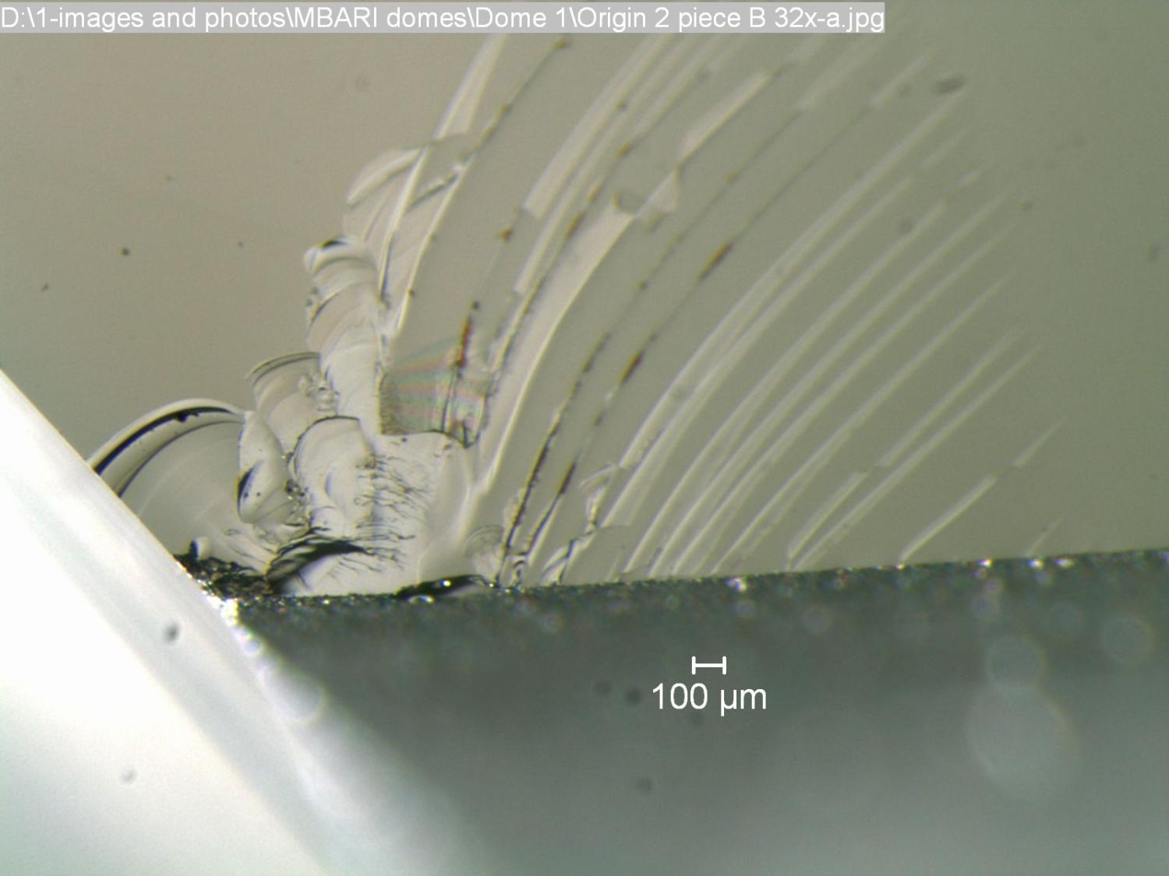
Many of these arcs are secondary chips that do not match anything on the opposite glass piece.
Origin 2 on piece B

Slide 28
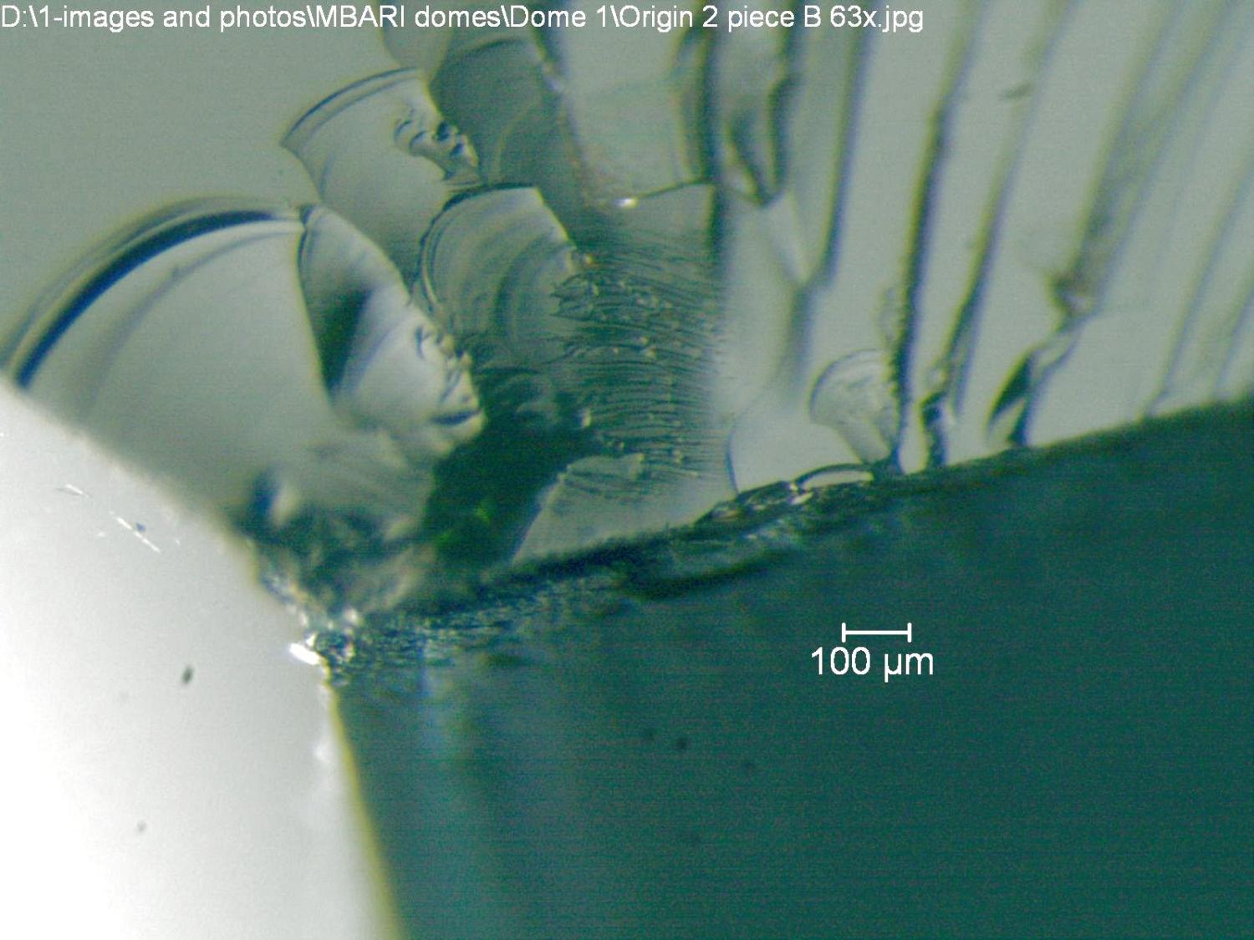

Slide 29
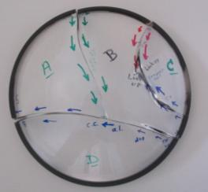
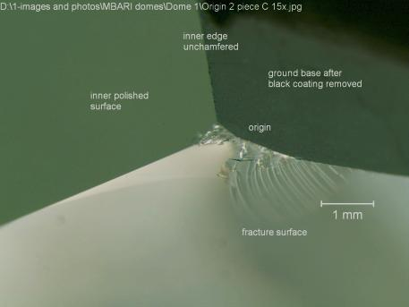
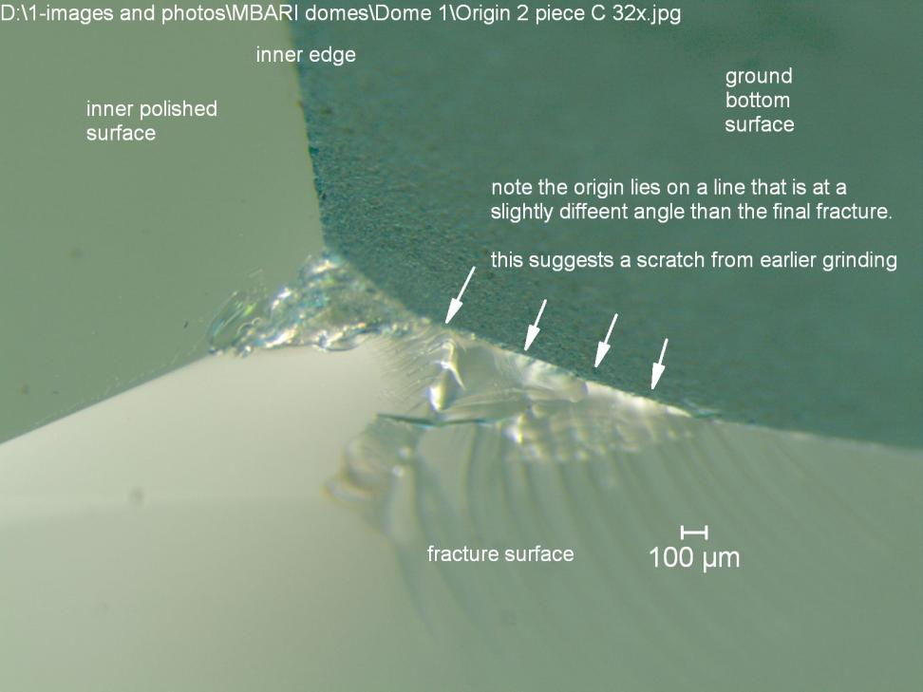
Origin 2 on piece C
The same flaw was apparent. There was a little more chipping at the unbeveled edge, but since this did not match up on the opposite piece, it was secondary damage.
1
2
3
4

Slide 30
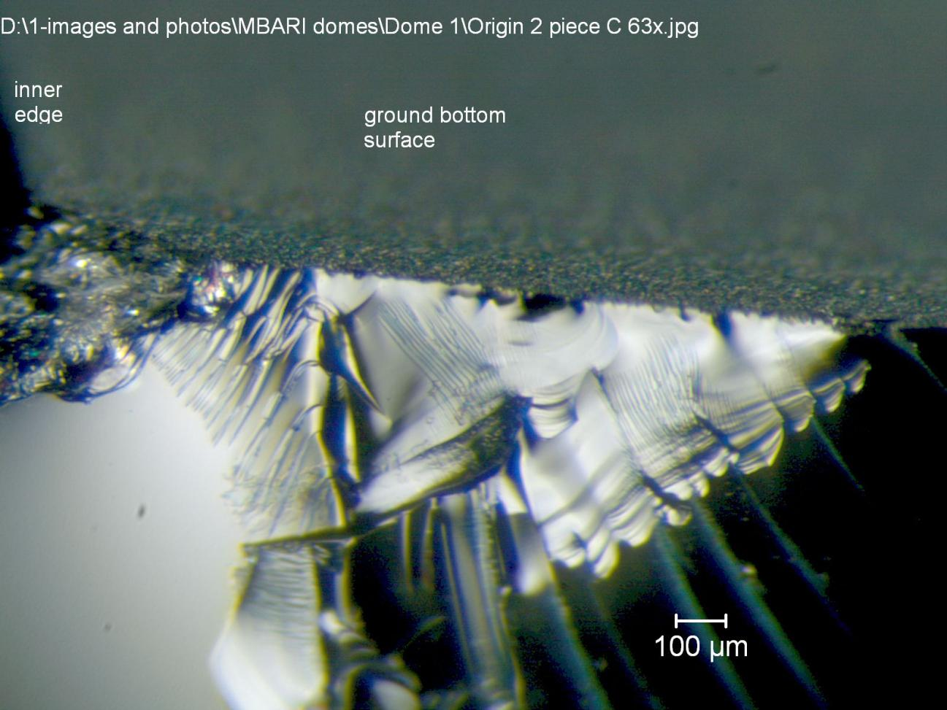
Origin 2 on piece C
Note that it is about 1 mm in from the unbeveled inner edge
1 mm

Slide 31
Origin 3
1
2
3
4

Slide 32

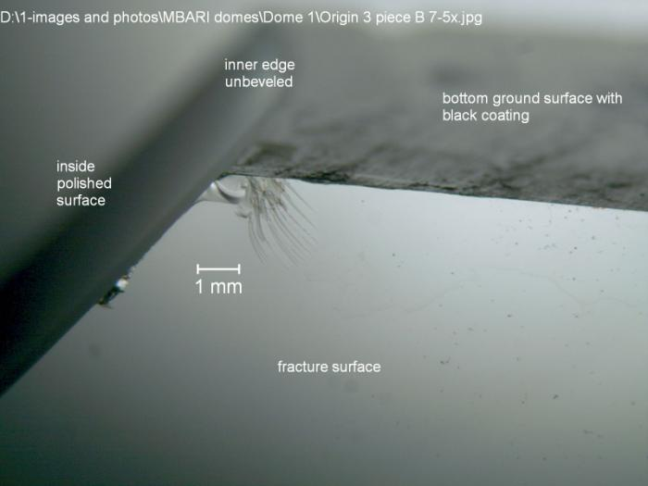
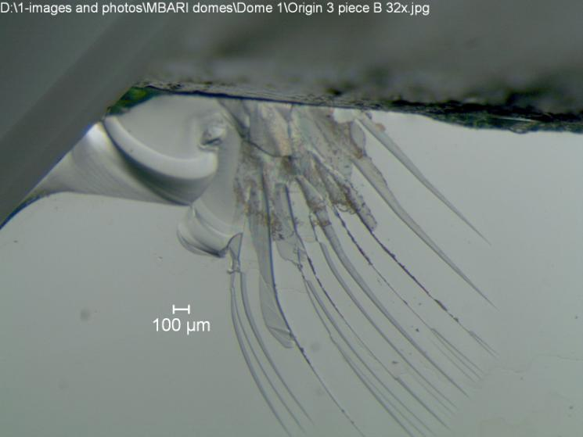
1
Origin 3 on piece B
2
Origin is a contact damage crack on the bottom ground surface, located about 1 mm in from the unbeveled inner edge.
3
This chip does not appear on the matching piece. Therefore it is a secondary chip.
4

Slide 33

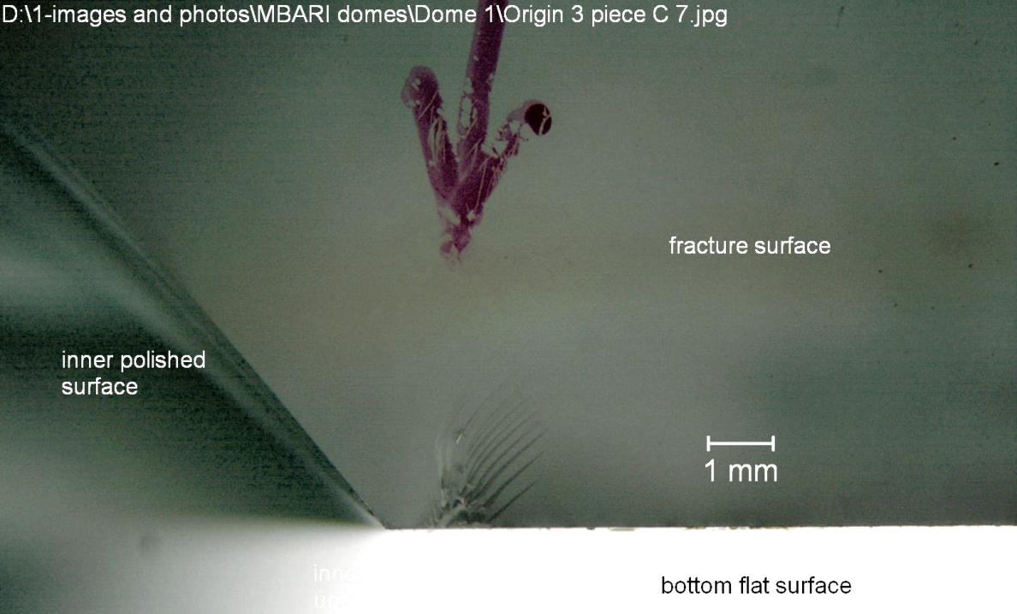
1
Origin 3 on piece C
2
3
4

Slide 34
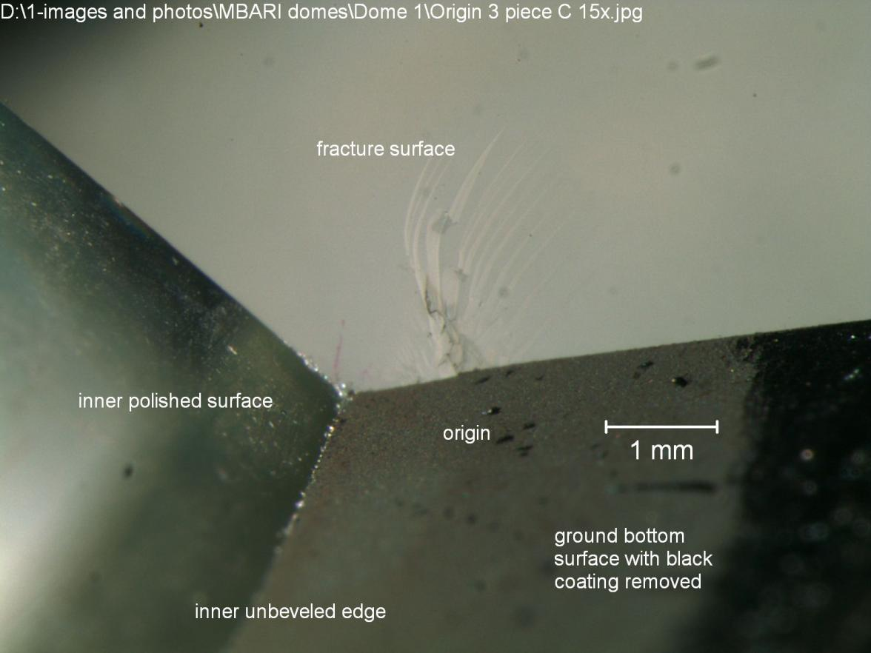
Origin 3 on piece C
Origin is a contact damage crack on the bottom ground surface, located about 1 mm in from the unbeveled inner edge.

Slide 35
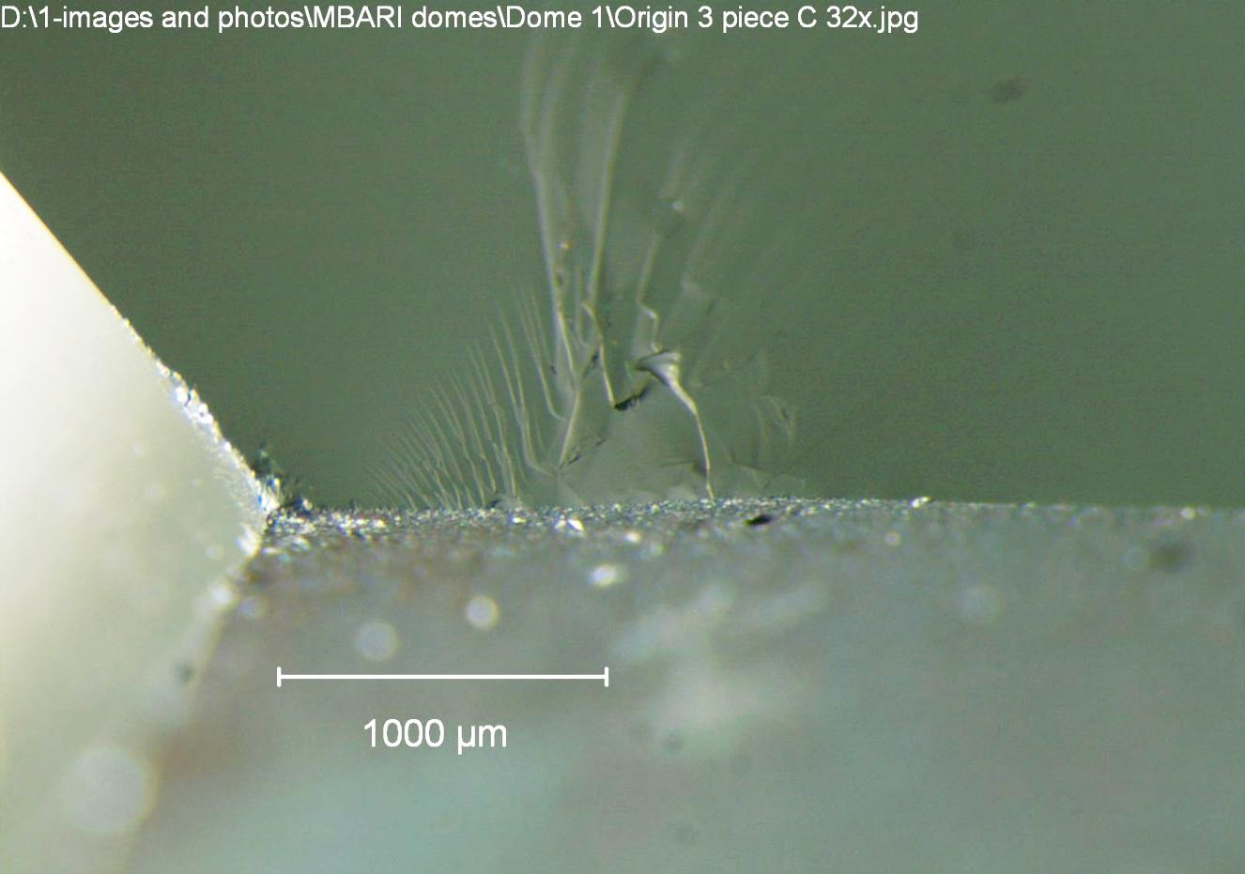
Origin 3 on piece C
The ground bottom surface is good.
Little tiny cracks can be seen coming in from the surface pock marks, but they are much smaller than the contact damage crack which penetrates much deeper.

Slide 36
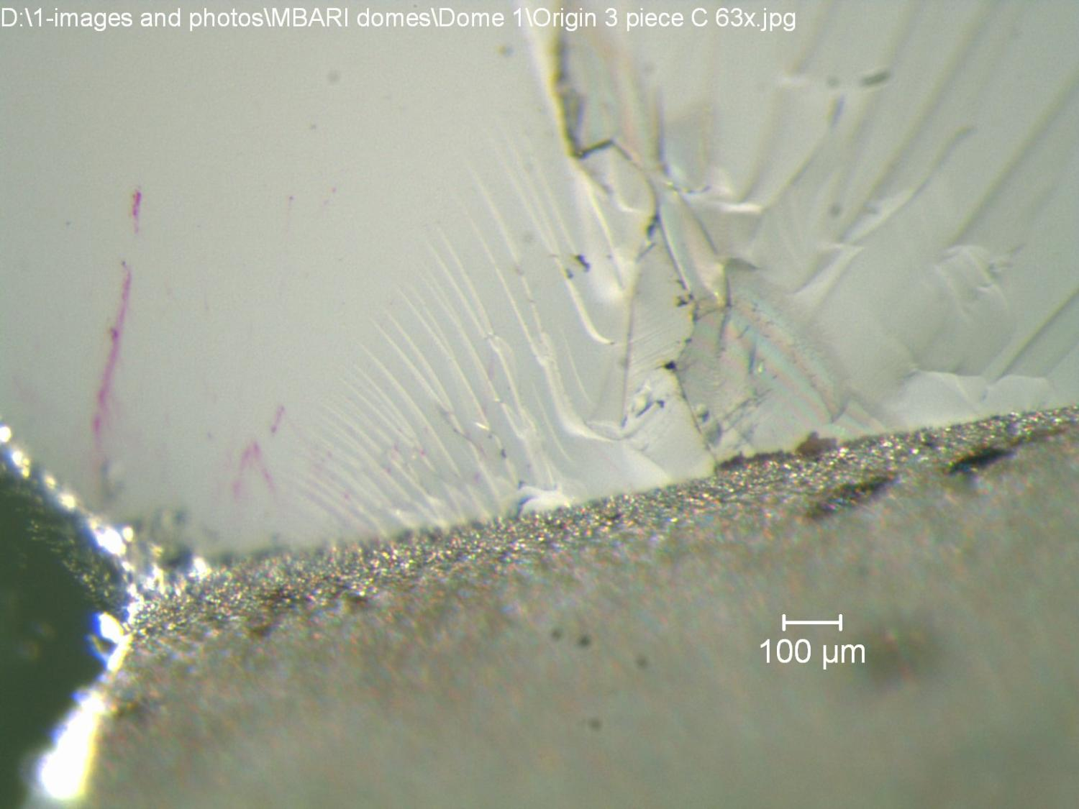
Origin 3 on piece C tilted back a bit
In this view, you can see the ground surface. Grinding cracks usually pop in about 10 times or so what you can see from surface pock marks.
The contact crack damage is much deeper.

Slide 37
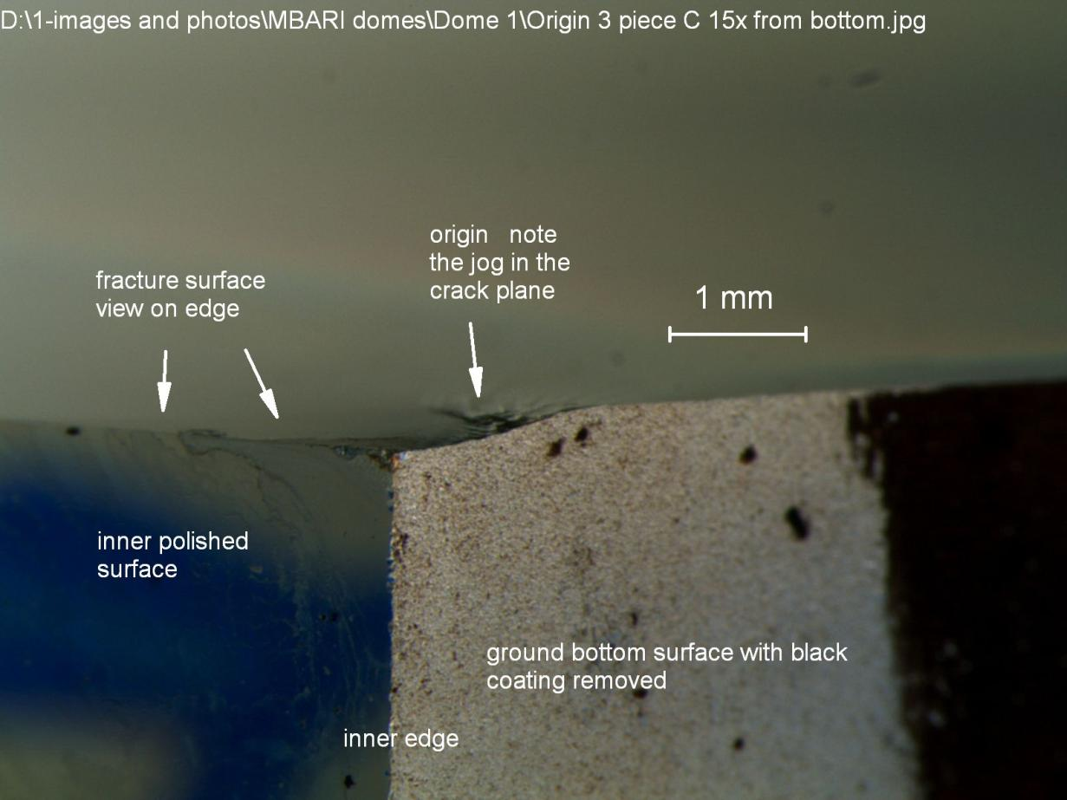
Origin 3 on piece C
This is a view looking directly onto the ground surface and the inner polished surface (which is fine),
while showing just a bit of the fracture surface so that you can see where the flaw is relative to everything else.

Slide 38

#1
2 contact damage cracks.
1a on the bottom ground surface, about 1 mm in from the inner edge
1b on the outer ground surface, 5 mm up from the beveled outer edge
Summary
#2
Contact damage crack on the bottom ground surface, about 1 mm in from the inner edge
1
2
#3
Contact damage crack on the bottom ground surface, about 1 mm in from the inner edge
3
#4
Contact damage crack on the bottom ground surface, about 2-3 mm in from the inner edge.
Some odd additional markings.
4

Slide 39
Some consideration should be given to understanding how contact damage cracking could be occurring so consistently on the bottom ground surface 1 to 3 mm in from the inner edge.
It could happen either in manufacture-grinding, or later during handling, or installation,
or even if the coatings are applied or removed.
or possibly even if the dome deflects a bit under pressure loading and contacts the metal stepped support.
One additional thought.
I wonder what the circumferential expansion of the metal support base is relative to the circumferential expansion of the glass.
If the expansions are different and that of the metal greater, then metal-glass friction forces might occur that will create additional tensile stresses in the glass and can cause contact cracks to pop in with the orientations we observed. Direct metal-glass contact would be needed for this to happen.
Examination of Dome 2 may give additional insights as things observed in Dome 1.
end

