Slide 1
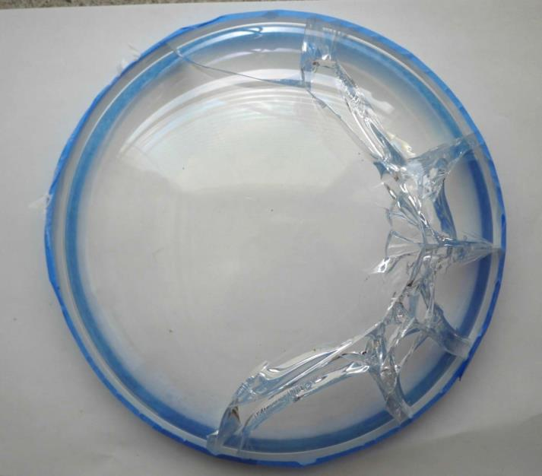
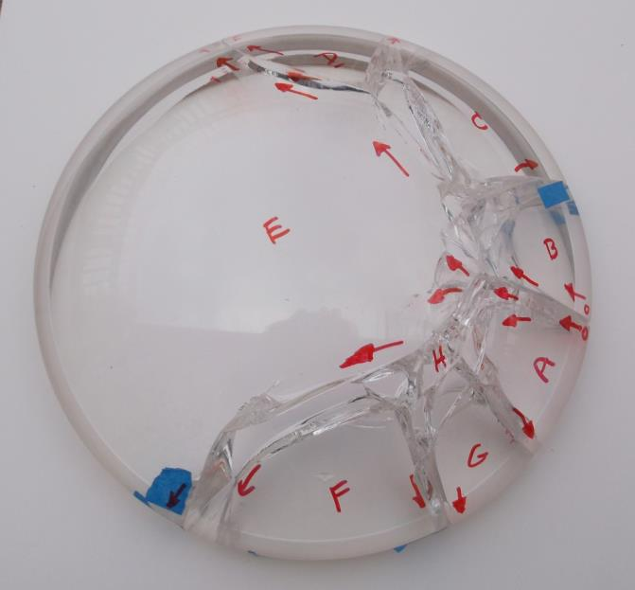
File: Dome 2 Quinn analysis March 5.pptx March 5, 2016
Quinn’s fractographic analysis Dome 2
This dome broke at a higher stress in the glass than dome 1. This caused more extensive crack branching.
There was only one origin site, on the right side as seen in both views. This was site 4 in the MBARI preliminary assessment . The red arrows show the direction of crack propagation.
4
Origin

Slide 2
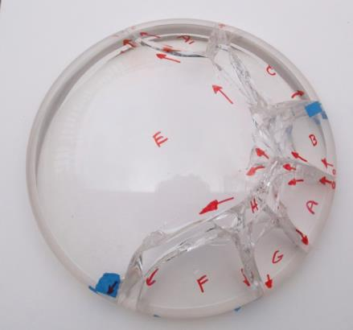
This breakage pattern is very similar to what happens on ring-on-ring loaded glass disks, if they fracture, with the difference that the MBARI domes had reduced stress in the dome middle, and hence the cracks slowed down and stopped when going in that direction.
The branching and curling back of the cracks to the rim is telltale and is a consequence of the biaxial stress state, where the part has both hoop and radial stresses
Ring-on-ring mechanical loading
σ_{radial}
σ_{hoop}
σ_{hoop}
σ_{radial}
The large branching angles indicated a biaxial stress state: meaning that there were two tension stresses, one in the hoop direction, and one radially. At the rim, the stresses are primarily hoop, and there can be no radial stress right at the rim, but a short distance into the dome, the radial stresses increase.

Slide 3
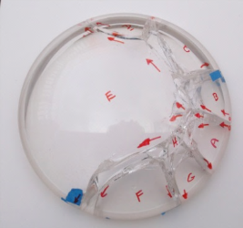
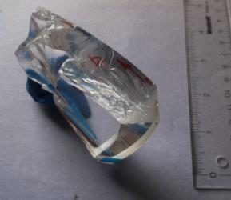
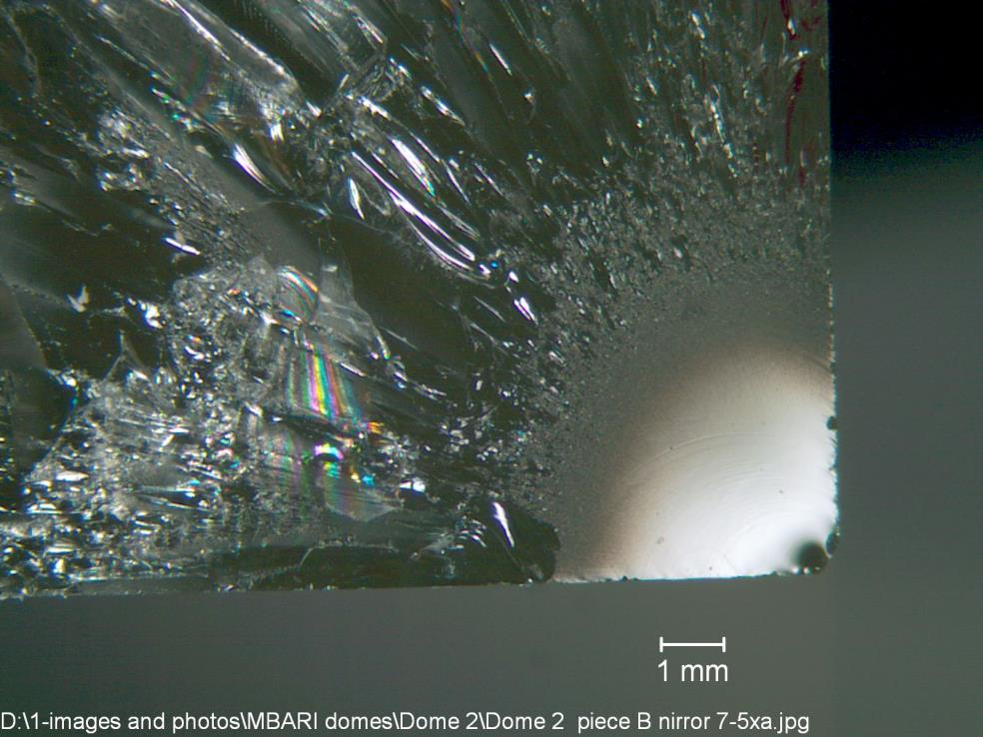
Piece B
It has a classic fracture mirror, centered on a flaw at the outer edge, at the junction of the polished base surface and the ground outer wall.
Piece B
Ground
outer
surface
Polished base

Slide 4
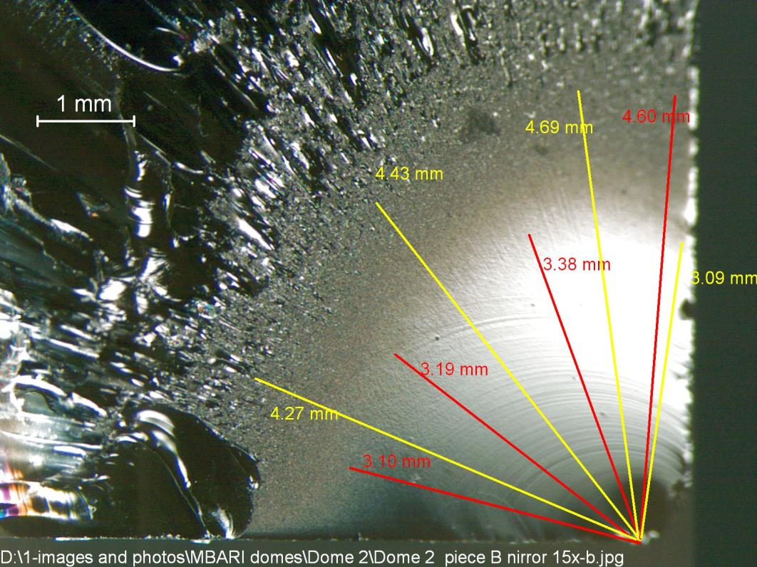
Piece B
This photo shows the fracture mirror and some size measurements of it. There are two types of radii to measure:
a. Radius to the smooth mirror-mist boundary.
Radius to the mist/hackle boundary.
Each can be used to estimate the stress in the glass, acting in the hoop direction and thus perpendicular to the mirror plane.
The mirror is almost a nice quarter circle. This means that the hoop stress was reasonably uniform through the dome thickness at this location.
(Once the cracks propagated towards the dome middle, the crack shapes became strongly bowed indicating that stresses were in bending, with tension on the inside and compression on the outside dome surface. This is all well beyond what the photo here shows.
Ground
outer
surface
Polished base

Slide 5
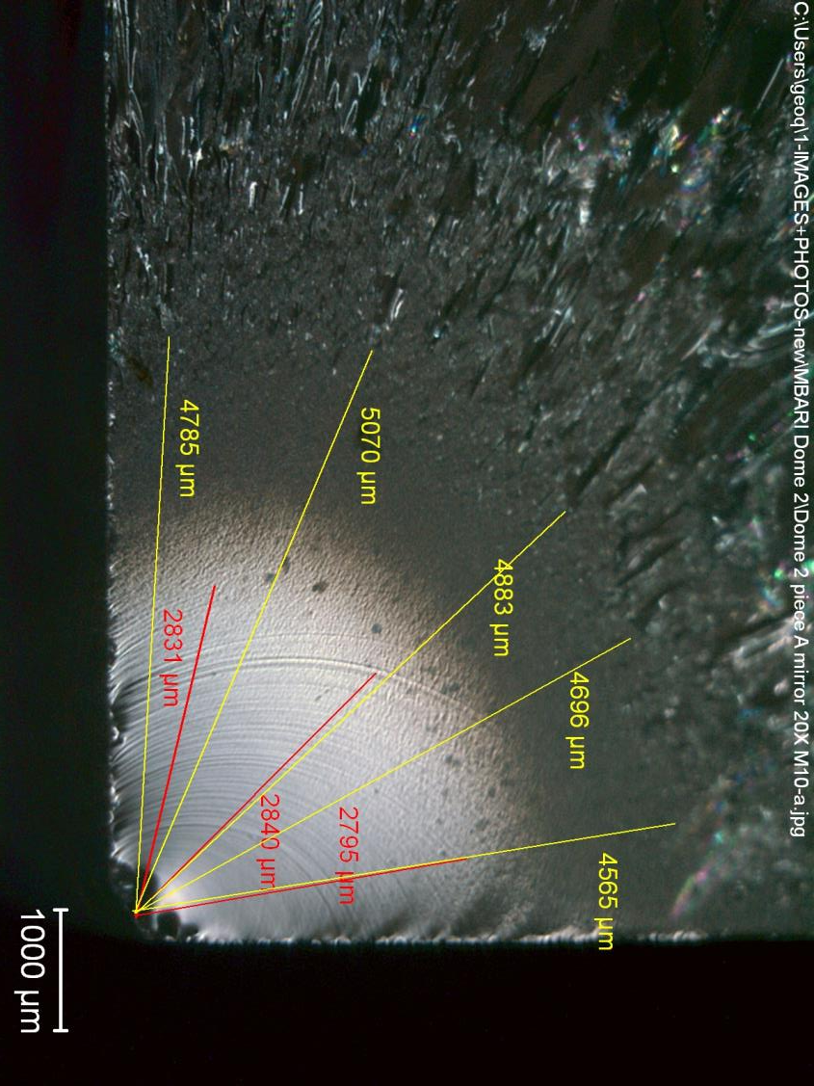
The mirror mist boundary is not really a well defined boundary. It can be influenced by lighting and magnification.
I tried different set ups.
The mist/hackle boundary was somewhat more consistent.
Piece A
Ground outer surface
Polished base surface

Slide 6
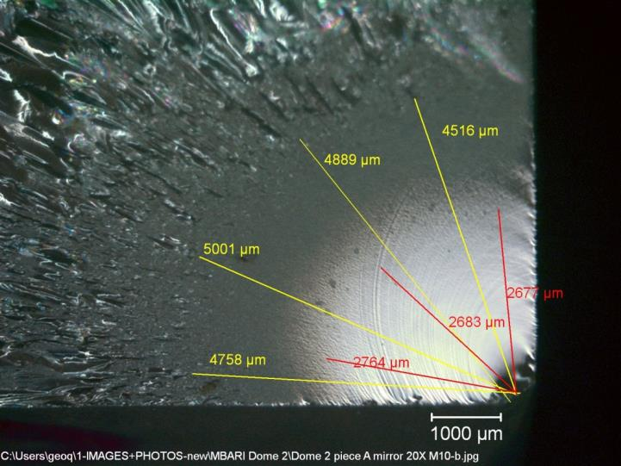
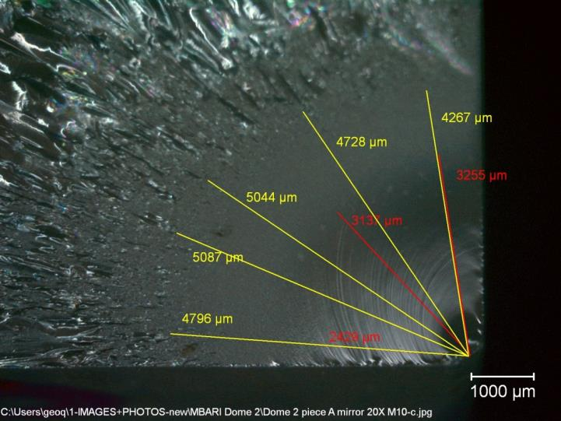
Repeat mirror measurements
Piece A
Ground outer surface
Ground outer surface
Polished base surface
Polished base surface
This view shows the “Wallner lines” in the mirror. They are little ripples formed on the fracture pane as the crack radiates out. These are “secondary Wallner lines generated by little irregularities on the dome surface.
These are normal, and are just something that helps us interpret the fracture.

Slide 7
The relationship between the mirror size (its radius) and the tensile stress, σ, is:
σ √R = A
A is a material constant corresponding to the different boundaries. They have units of: Force / length^{1.5}
MN/m^{1.5} MPa√m ksi √ in
A_{inner} at the mirror/mist boundary
A_{outer} at the mist/hackle boundary
A_{branch} at the branching distance
hackle
mist
mirror
Origin flaw
“boundaries”
These are numerical constants that you can look up in papers or tables.
Appendix C of my Guide book has tabulations.
For BK-7 glass, the mist/hackle boundary has a value of A_{outer} of about 2.3.
It was derived from extensive work done by Dr. Janet Quinn (my dearly departed spouse), and written up in a paper by her. It was based on testing of 3 inch diameter BK-7 disk strength specimens.

Slide 8
One microscope that I used gave an average mirror/mist radius of 3.2 mm.
Another microscope gave an average of 2.82 mm.
The difference was due to the set up and lighting.
One microscope that I used gave an average mist/hackle radius of 4.50 mm.
Another microscope gave an average of 4.80 mm.
The difference was due to the set up and lighting.
σ √R = A
σ = 2.3 MPa / √4.50 x 10⁻³ m = 34 MPa
σ = 2.3 MPa / √4.80 x 10⁻³ m = 33 MPa
Better estimates can be obtained by using Dr. Quinn’s actual data on Schott BK-7 glass, which showed a slight offset in the size-stress trends. Her trend equations are in the figure captions.
Dome 2 data marked on the graphs in green arrows.
These gives estimates of 40 to 47 MPa tensile stress = 5,000 to 6,800 psi tensile stress at the rim.
J. B. Quinn, “Extrapolation of Fracture Mirror and Crack-Branch Sizes to Large Dimensions in Biaxial Strength Tests of Glass,” J. Amer. Ceram. Soc. 82 [8] (1999) pp. 2126-32.

Slide 9

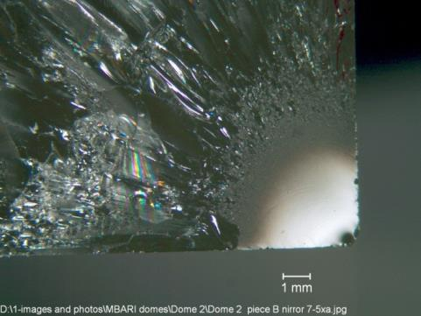
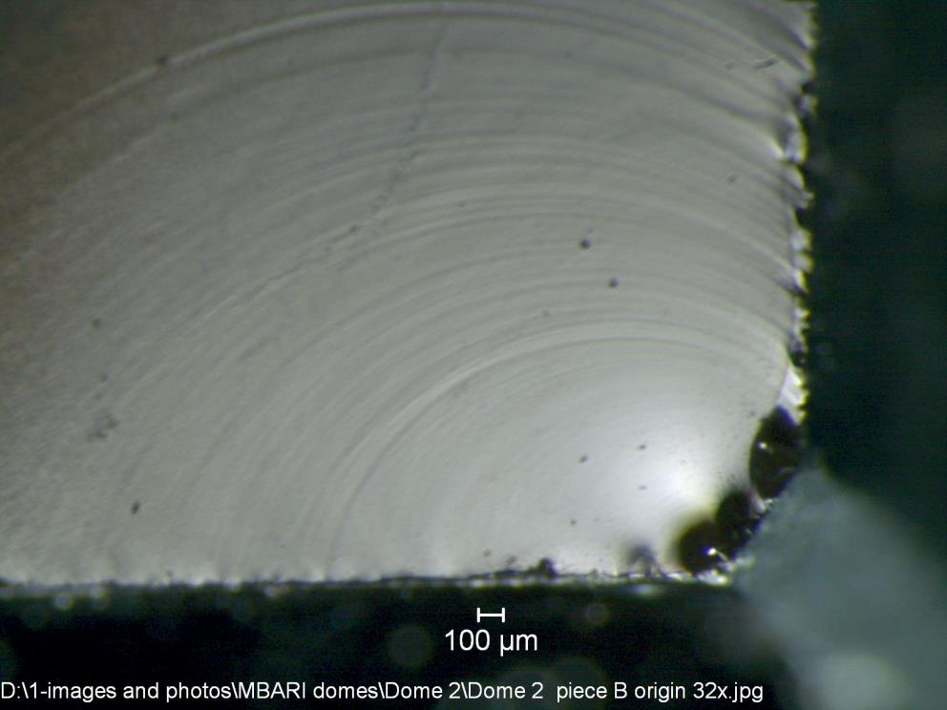
What was the fracture origin flaw?
This is the ground outer surface. Minor irregularities on the surface have triggered the arc like Wallner lines as the crack progresses at a very high speed.
Piece B
When the crack is forming the fracture mirror, it is accelerating rapidly. By the time the hackle roughness lines are formed, it is running at terminal velocity of 1,700m/sec or 1,800 m/sec.
Yes, this is indeed very fast.
As the crack extends into the dome, it branches out and some segments even slow down and stop as they reach regions of reduced stress.
Others speed back up and reach terminal velocity again.
Bottom polished surface

Slide 10

Piece B
There are irregularities along the chamfer, but this is the largest.

Slide 11

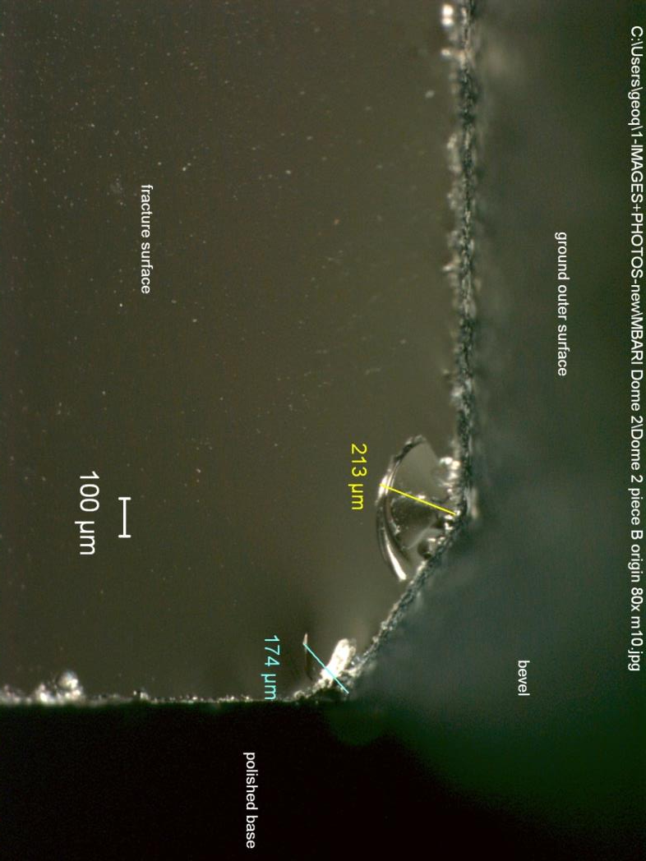
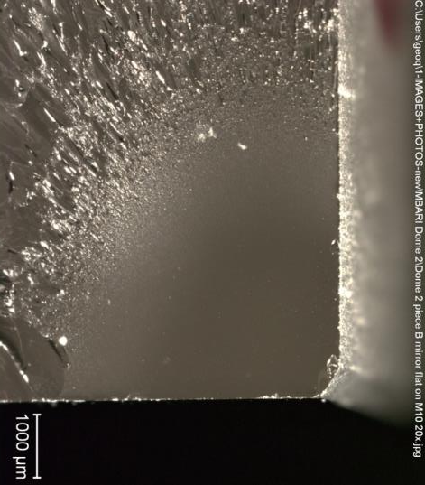
Piece B

Slide 12
Check on the detected flaw. Is it about the right size to be the critical flaw?
Answer: Use fracture mechanics.
For a surface quarter circular flaw in a tension stress field: K_{Ic} = Y σ√a
where K_{Ic} is fracture toughness, which for BK-7 is about 0.85 to 1.0 MPa√m
σ is the tensile stress, = 10 MPa
Y is the flaw stress intensity shape factor, a dimensionless factor, which is about 1.5
a is the flaw depth, radius = 213 x 10⁻⁶ m
Substituting, we get: σ = 39 to 46 MPa or 5,600 to 6,600 psi hoop tension stress
This is an exact match to what we got from the fracture mirror size analysis.
This confirms that we have found the precise flaw that triggered fracture.

Slide 13
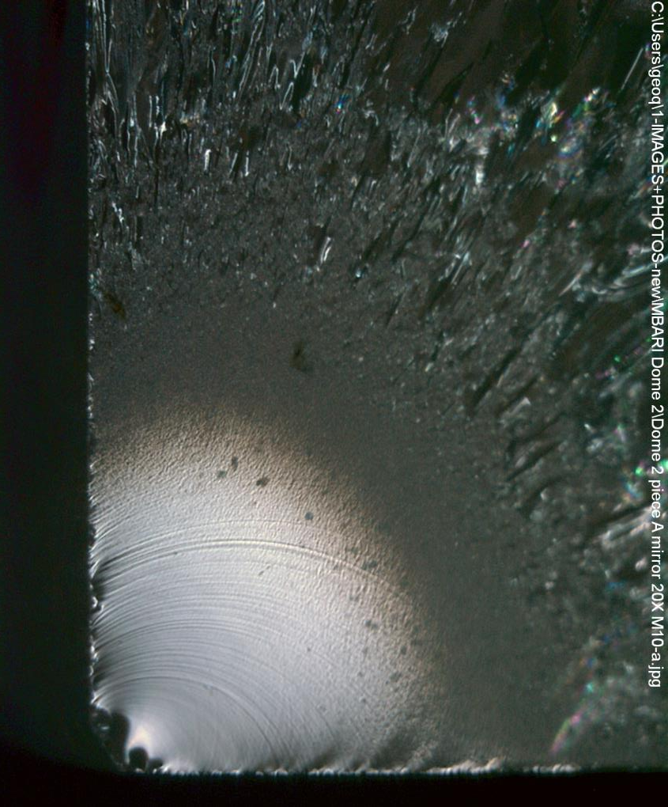
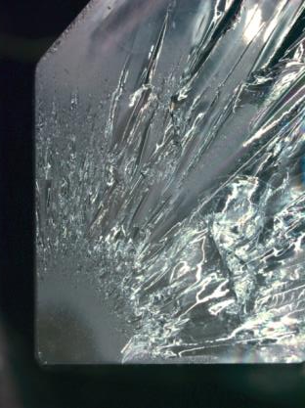
Let us check the matching piece A, to make sure the flaw is correct.
Piece A
Ground side surface
Polished base surface

Slide 14
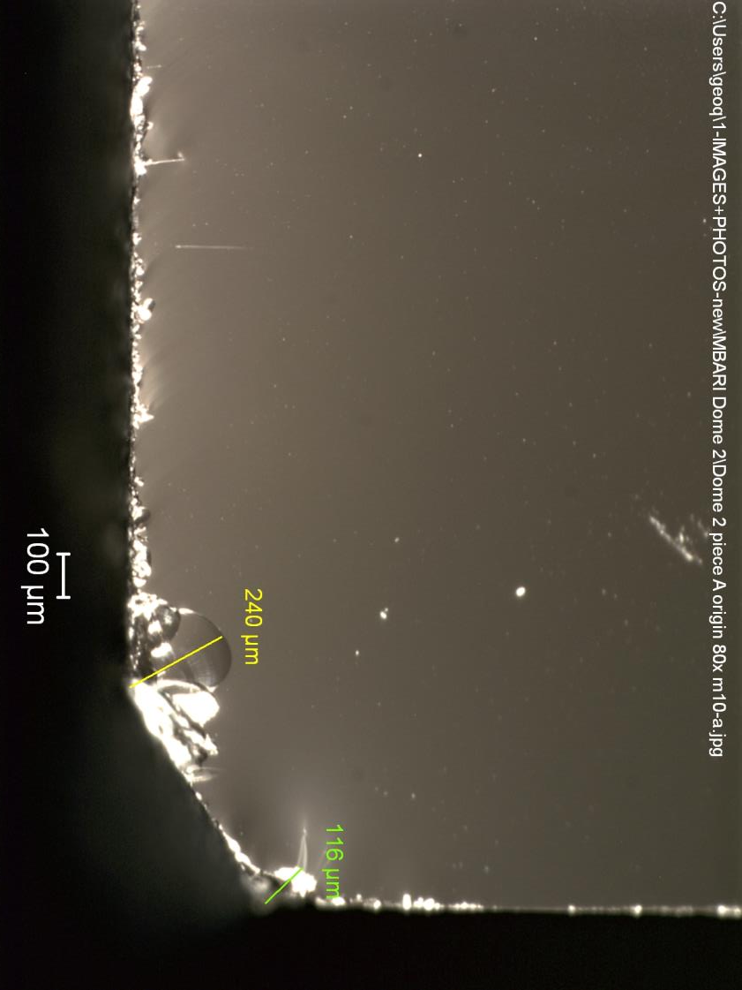
Piece A
The exact same flaw is on piece A at the same location.
On the next slide, the piece is tilted to get a better view.

Slide 15
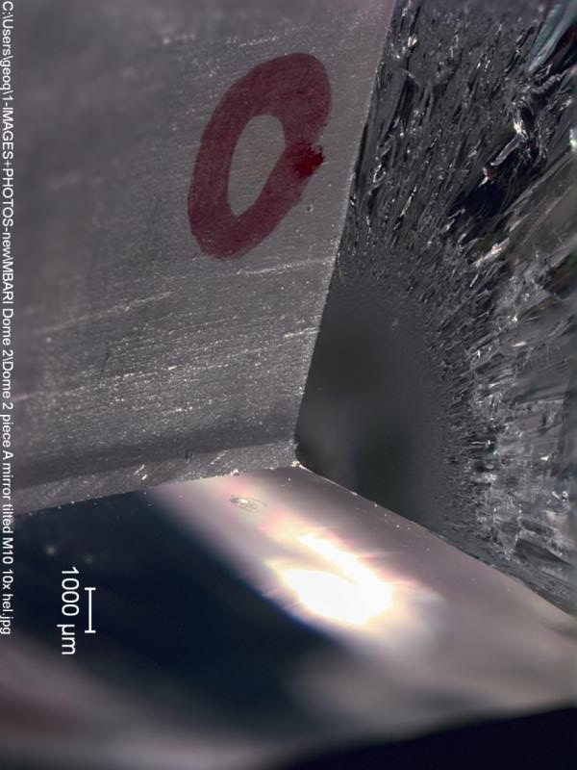
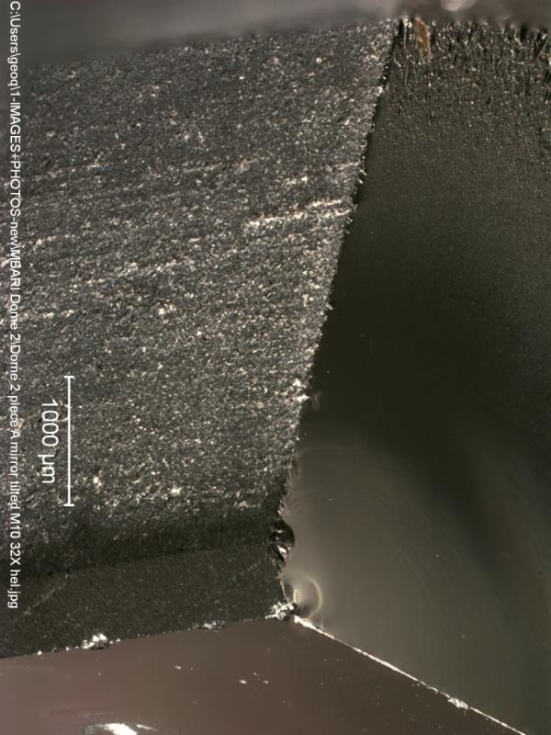
Piece A tilted Special digital focus stacking techniques with as many as 30 images were used to acquire there images
Origin flaw
Nominal 10x to the eyes in the microscope
Nominal 32x to the eyes in the microscope
Notice the ground outer beveled edge to the dome. The flaw is exactly at the edge of the bevel. Notice a slight directionality of the grinding marks on the bevel surface.

Slide 16
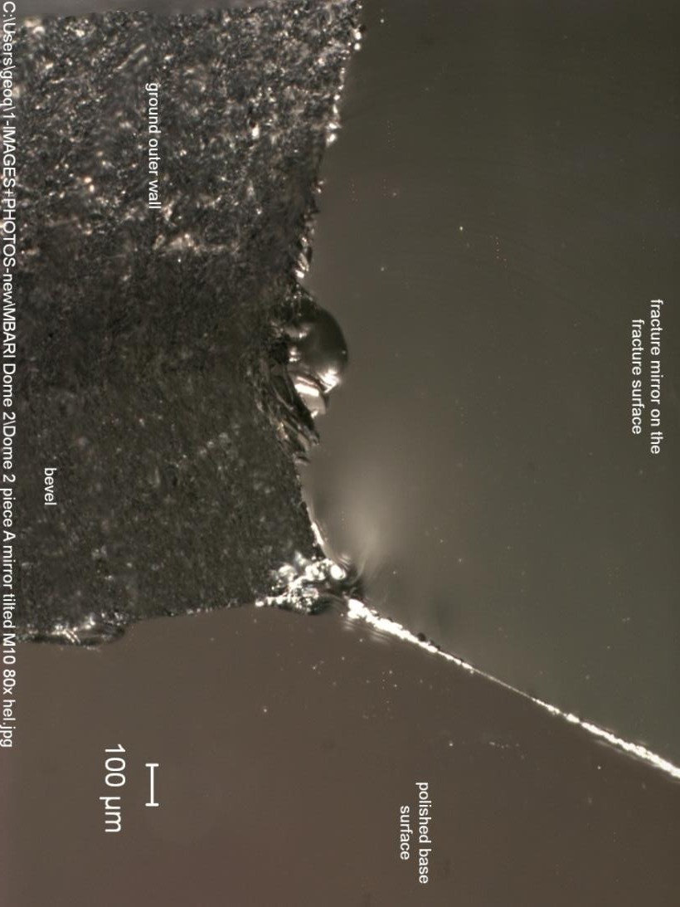
Piece A
This is the closest image of the flaw.
It is a crack associated with grinding in the bevel.
Notice the different in the polished bottom surface, the side wall ground surface, and the bevel itself.
The next slide shows a direct view looking onto the bevel surface.
Origin flaw

Slide 17
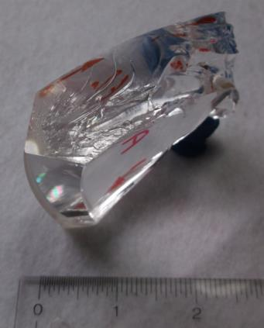

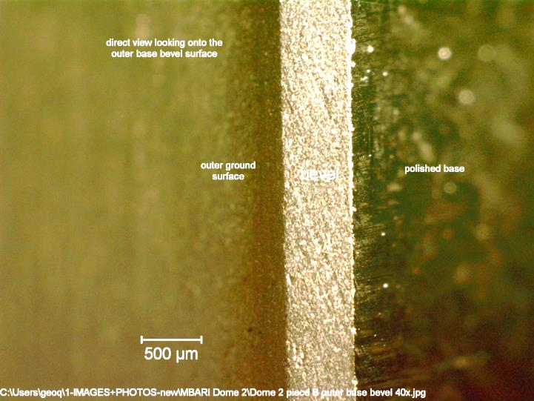
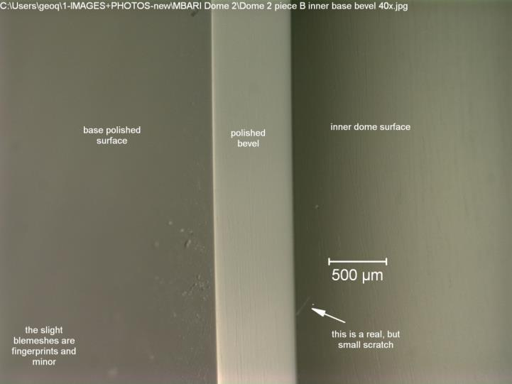
Views of the bevels and the surfaces
Outer ground
surface
Inner
polished
surface
base
The outer edge is beveled, but notice the slight but very important angularity of the direction of the grinding. This angularity is what creates a crack, often right at the very edge of the bevel.
The inner edge is very well polished.

Slide 18
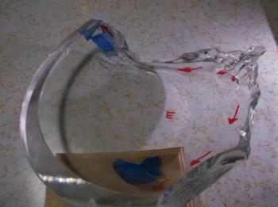
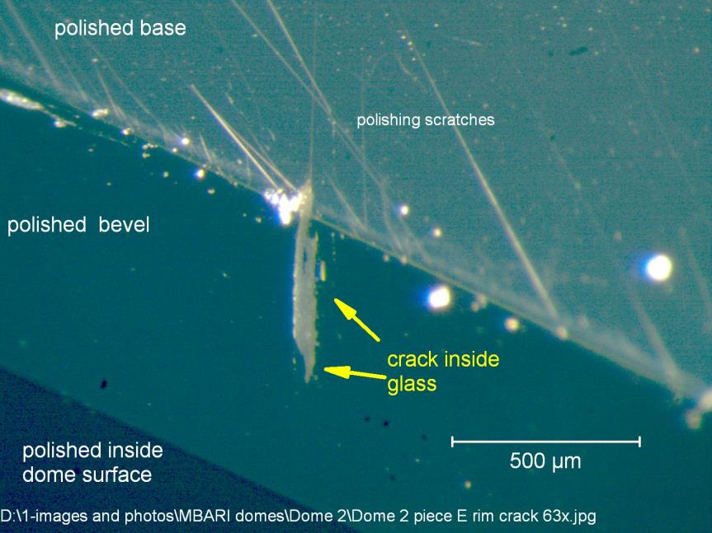
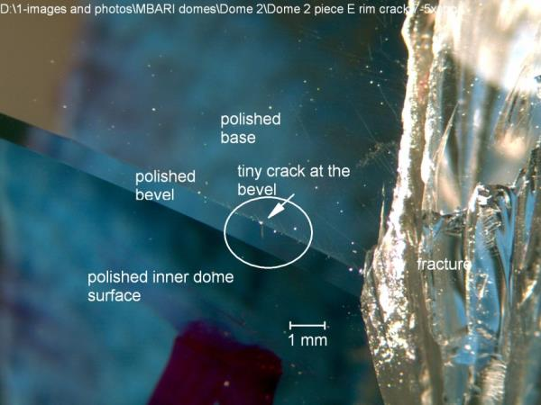
Additional Examination
The high quality of the beveled inner edge impressed me, but I inspected it nonetheless. I took the largest piece E and examined it with bright light and a hand 7X loupe. I did get a reflection that was not a scratch, so I put it into the microscope. Sure enough, it was a crack starting at the bevel and penetrating into the glass.
I recommend in the future that all domes be carefully inspected like this: bright light with a hand inspection loupe. The loupe won’t resolve the crack clearly, but you can get the piece into a stereooptical microscope with a bright light and rotate it and manipulate the light, in order to see if it simply a surface blemish or a real subsurface crack.
In any case, the rims should be meticulously protected since they are vulnerable sites.
Piece E
To see polishing scratches like these, you need the light on them just right. Normally they are invisible.

Slide 19

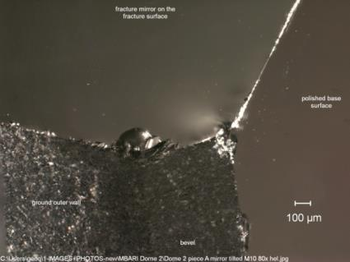
Summary
A single grinding crack was the origin of fracture in this dome. It was 210 – 240 um deep. It was located right at the edge of the bevel and outer ground surface near the dome base.
The peak tensile hoop stresses were between 40 and 47 MPa, or 5,00 to 6,800 psi.
The peak tensile stress was much greater that what caused the fractures in dome 1. The greater stress in dome 2 caused more crack branching and fragmentation. The crack even got to terminal velocity.
The tensile stresses were relatively uniform through the thickness at the origin site on the rim, but they quickly evolved into biaxial bending stresses part way into the dome. There were negligible stresses in the dome middle, since the cracks did not extend into it.
Polishing the base and the inner bevel was very effective. This should be done to the outer edge as well.
Caution: the polishing must be done carefully. Sometimes people only polish enough material away to get a good looking surface finish. In fact, the polishing should be done somewhat deeper, so as to eliminate any residual cracking in the piece from prior grinding.
end

