Slide 1
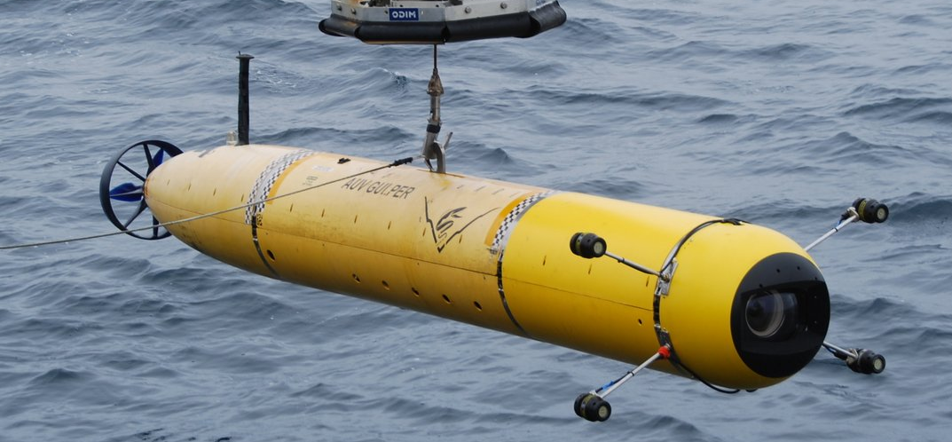
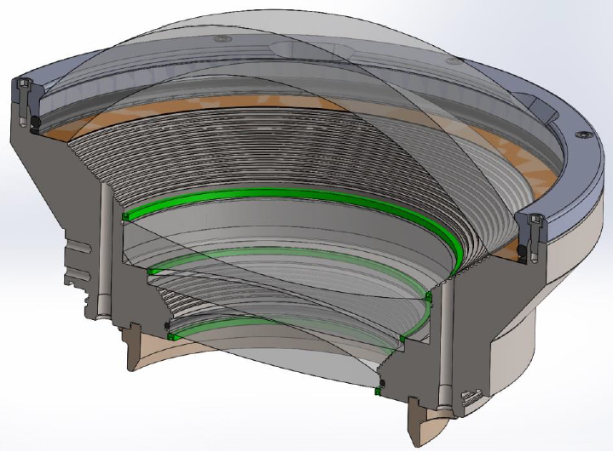
Optical Dome Reliability Analysis
Monterey Bay Aquarium Research Institute (MBARI)
Eric H. Baker
Connecticut Reserve Technologies, Inc.
October 2016
PRELIMINARY ANALYSIS: Provided for demonstration of progress. Not intended to be a complete or final analysis.

Slide 2
Outline
Perform Brittle Material Reliability Predictions on the Deep Water Camera Port of MBARI’s Autonomous Underwater Vehicle (AUV)
Acquire Dome and Dome Support geometry from MBARI
Generate finite element analyses of 3 Dome Configurations and calibrate models to MBARI FEA as well as Pressure Test Measurements
Estimate Weibull Material Properties from provided specimen failure data
Apply the Ceramics Analysis and Reliability Evaluation of Structures (CARES) program to predict the Brittle Material Reliability of the Dome Configurations
Establish a Proof Test Protocol to improve the Reliability
8/2/16

Slide 3
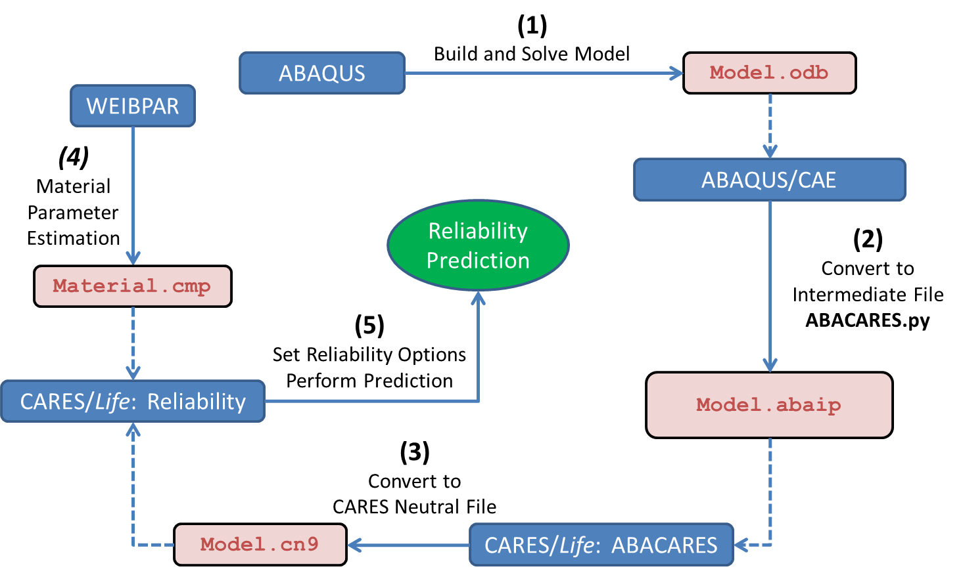
CARES with ABAQUS Flowchart
CARES predicts the brittle material reliability of a component by post-processing finite element analysis stress results.
CARES requires region based Weibull material properties, Volume and/or Surface, where different Surface conditions are characterized by different parameter sets.
8/15/16

Slide 4
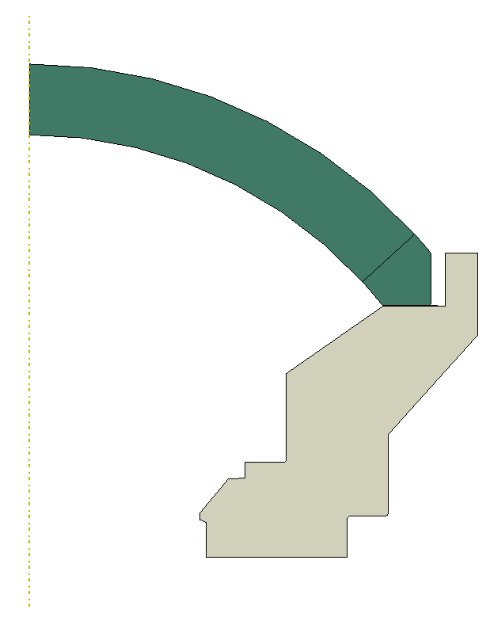

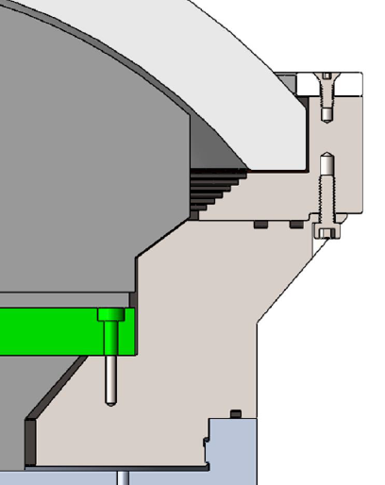
Dome Configurations
#1
#2
#3
Dome Restricted from Moving Radially
Dome Free to Move Radially
Dome Free to Move Radially
Dome
Kapton
0.005”
Added Bevel
Kapton
0.020”
Groove
Support
8/2/16

Slide 5
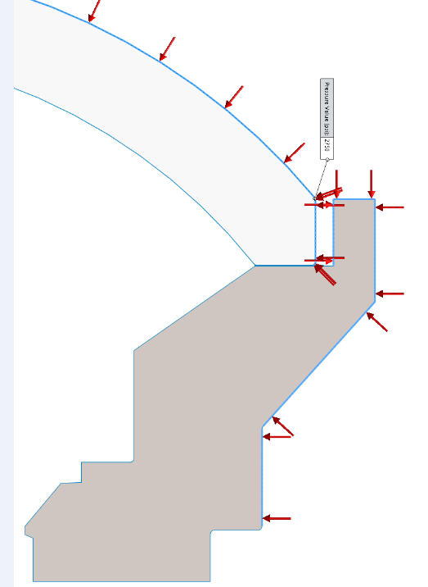
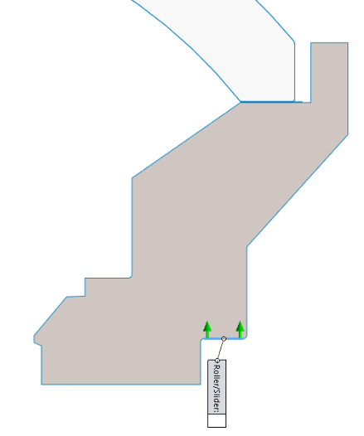
Boundary Conditions
Pressure
BC Axial: Fixed
Radial: Free
7/27/16
Per MBARI

Slide 6
Material Properties: Mechanical
Configuration #3
Dome Support
Material Trade-study
Configuration #3
Resin vs. Epoxy Material Trade-study
10/14/16

Slide 7
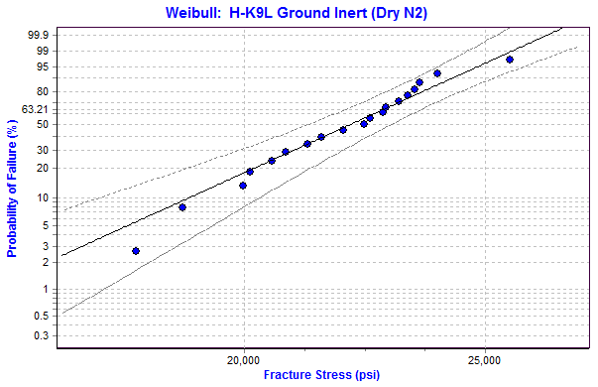
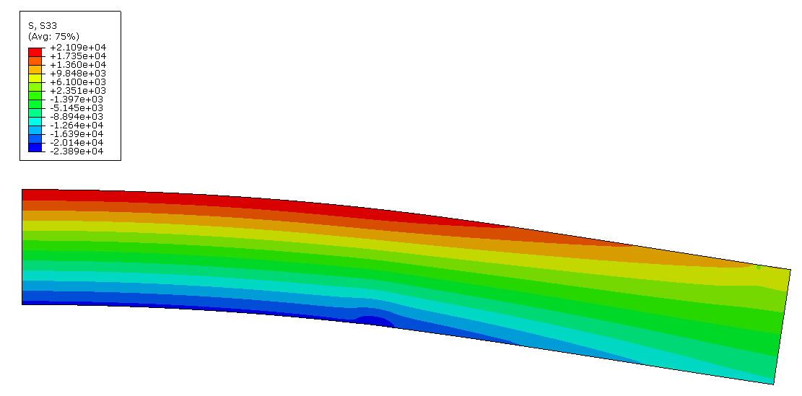
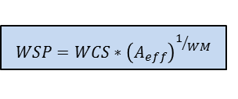
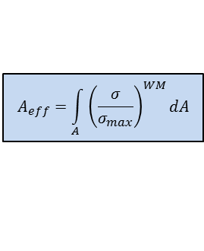

Material Properties: Weibull
WeibPar (Weibull parameter estimation program) is used for the WM and WCS calculations of the failure specimen data as well as calculating the Effective Area from a FEA of the R-o-R specimen
Ground Inert
Flaws were all assumed to originate on the Surface of the Failure Specimens
$$P_{f_{i}}=1−exp{\left(\frac{σ_{i}}{WCS}\right)}^{WM}$$
2D Axisymmetric Model of the Ring-on-Ring Specimen
Weibull Modulus (WM)
Weibull Characteristic Strength (WCS)
$$A_{eff}=\int_{A}^{ }{{\left(\frac{σ}{σ_{max}}\right)}^{WM}dA}$$
WM = 13.6 [-]
WCS = 22,714 [psi]
Weibull Effective Area (A_{eff})
$$WSP=WCS∗{\left(A_{eff}\right)}^{1/{WM}}$$
A_{eff} = 0.229 [in^2]
Weibull Material Scale Parameter (WSP)
WSP = 20,386 [psi*in^(2/13.6)]
Where WM & WSP are used in CARES
9/22/16

Slide 8
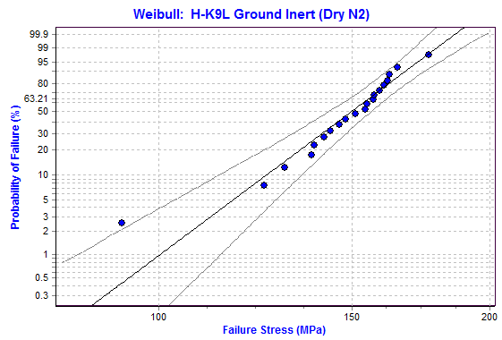
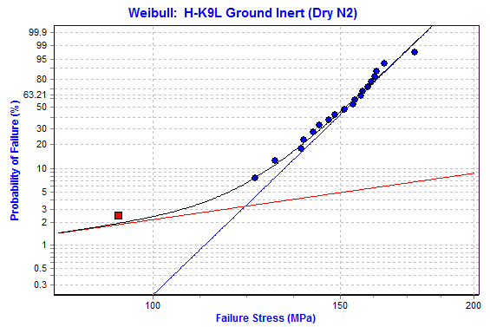
Material Properties: Weibull – Ground, Inert
Outlier ?
Censored
Includes Potential Outlier
# of Specimens 20
WM 11.375
WCS 155.0 MPa (22.48 ksi)
Excludes Outlier
# of Specimens 19
WM 13.626 [-]
WCS 22,714 [psi]
A_{eff} 0.229 [in^2]
WSP 20,386 [psi*in^(2/13.626)]
Censor Outlier
# of Specimens 19 & 1
WM 13.628
WCS 156.6 MPa (22.71 ksi)
MLE2B Estimation
90% Confidence Bounds
9/22/16

Slide 9
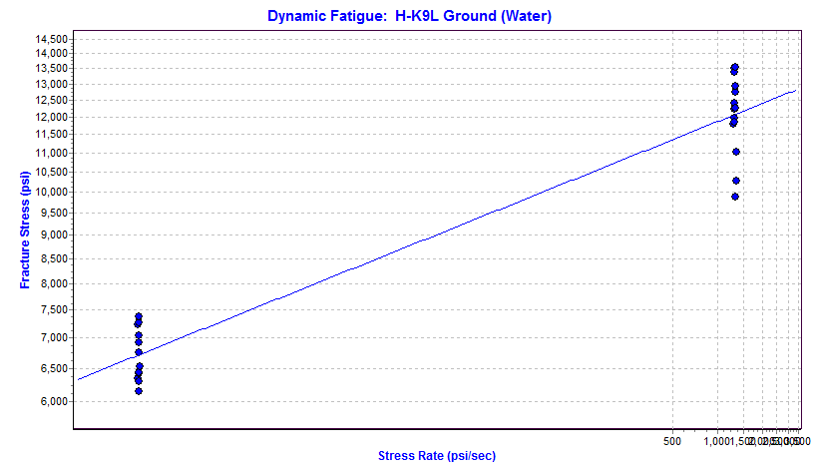
Material Properties: Time Dependent (SCG) – Ground
Ground in Water
Time Dependent (SCG)
# of Specimens 26
WM 13.626 [-]
WSP 20,386 [psi*in^(2/13.63)]
N 14.7413 [-]
D 7,648 [psi]
WM2 15.765 [-]
A_{eff} 0.2197 [in^2]
B_Dynamic 36,437 [psi^2*sec]
B_Static 2,315 [psi^2*sec]
LIN2 Estimation
9/20/16

Slide 10
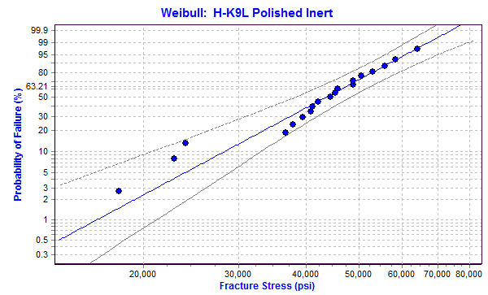
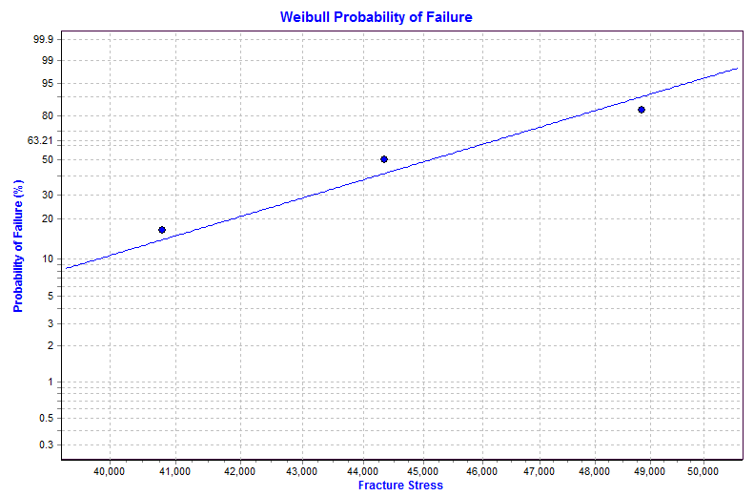
Material Properties: Weibull – Polished, Inert
Polished Inert
# of Specimens 19
WM 4.346 [-]
WCS 47,304 [psi]
A_{eff} 0.353 [in^2]
WSP 37,235 [psi*in^(2/4.346)]
low
MLE2B Estimation
90% Confidence Bounds
9/22/16

Slide 11
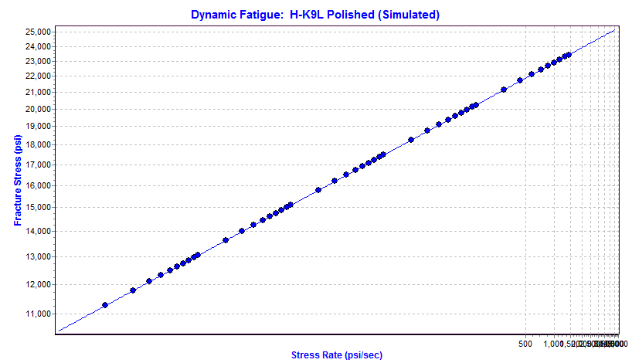
Material Properties: Time Dependent (SCG) – Polished
Polished (Water)
Time Dependent (SCG)
# of Specimens 0 (simulated)
WM 4.346 [-]
WSP 37,235 [psi*in^(2/4.346)]
N 14.74 [-]
D 14,310 [psi]
WM2 5.028 [-]
A_{eff} 0.3311 [in^2]
B_Dynamic 109,202 [psi^2*sec]
B_Static 6,938 [psi^2*sec]
Simulated from Ground
LIN2 Estimation
9/22/16

Slide 12
Dome Configuration #3
Design
Titanium Ring prevents Radial Displacement of Dome
7/27/16

Slide 13
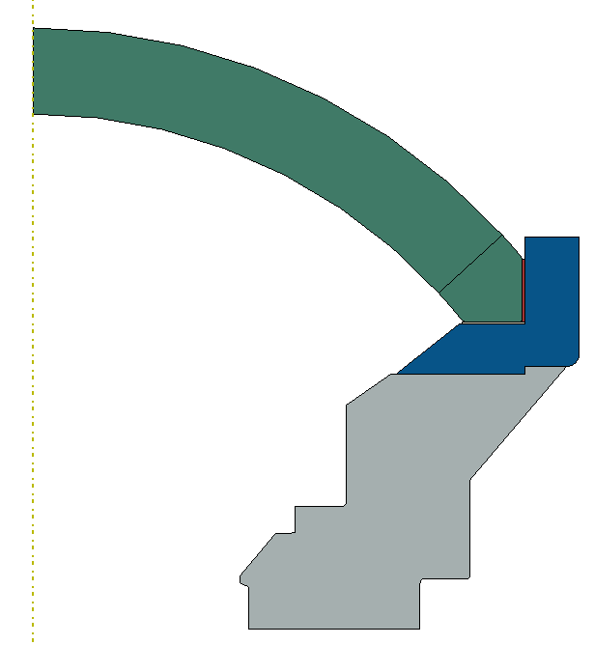
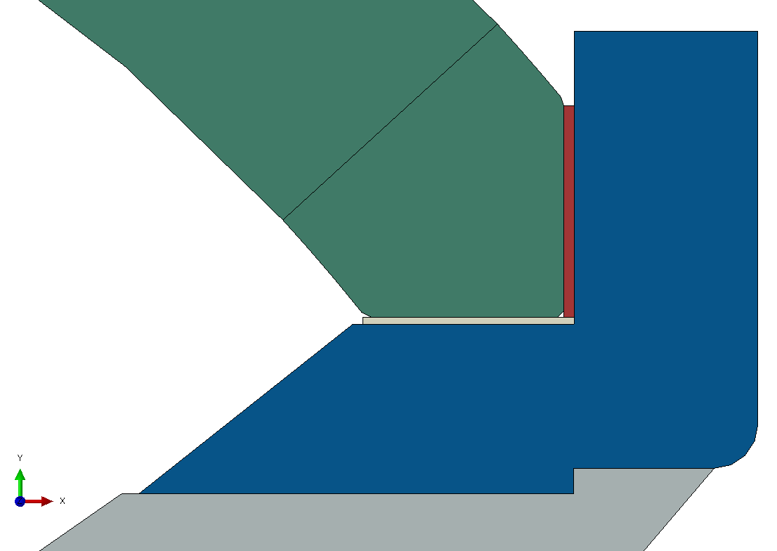
Dome Configuration #3
Model v15
Dome
H-K9L
Trade Study
Resin or Epoxy
0.030”
Dome Coupler Ring
Ti-6Al-4V
Kapton 0.020”
Bonded
Dome Support
Actual: Ti-6Al-4V
Test: 6061-T6
Frictionless
Axial = fixed
Radial = free
10/14/16

Slide 14
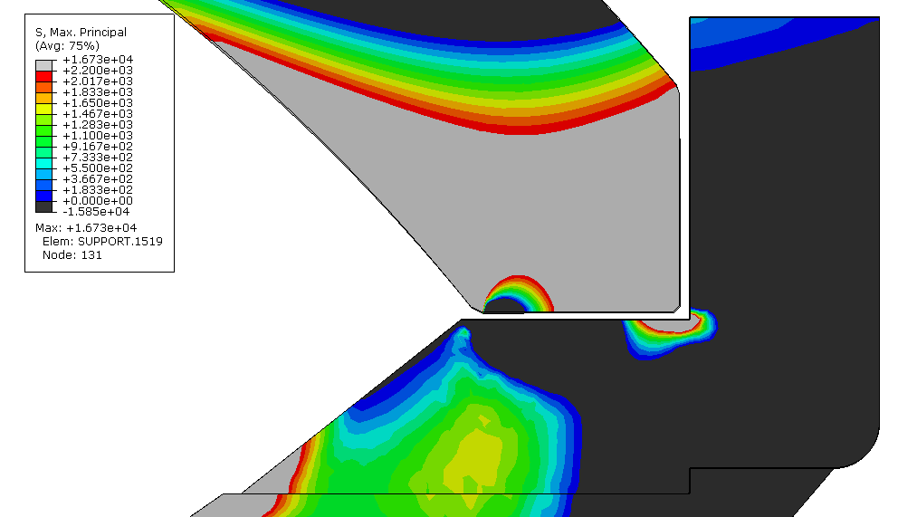
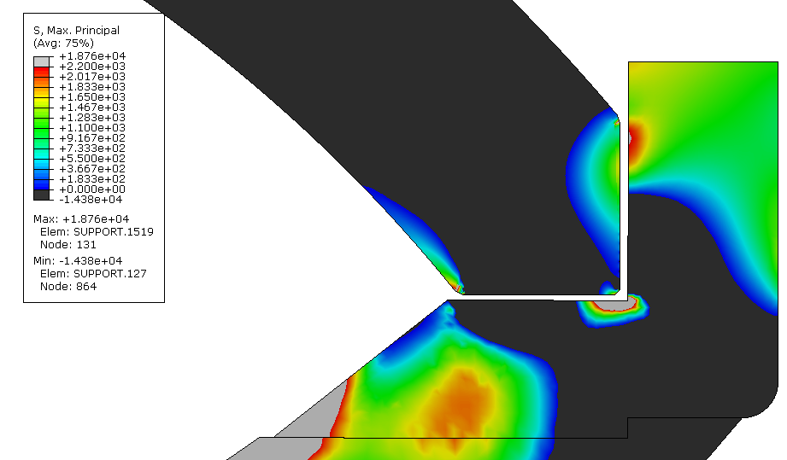
Dome Configuration #3
Resin vs. Epoxy Trade Study
Model v15
Resin Model
Epoxy Model
Tensile Stresses
Frictionless: Dome-2-Kapton, Ring-2-Resin
All the Rest Tied
Compressive Stresses
Load Step #4 includes ΔT and 2750 psi
10/14/16
Resin/Epoxy and Kapton Parts Hidden

Slide 15
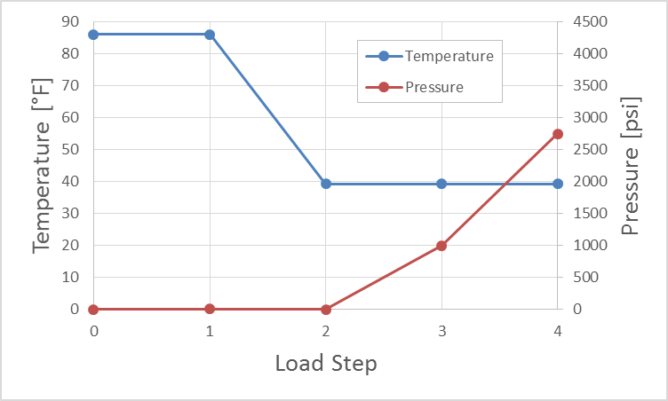
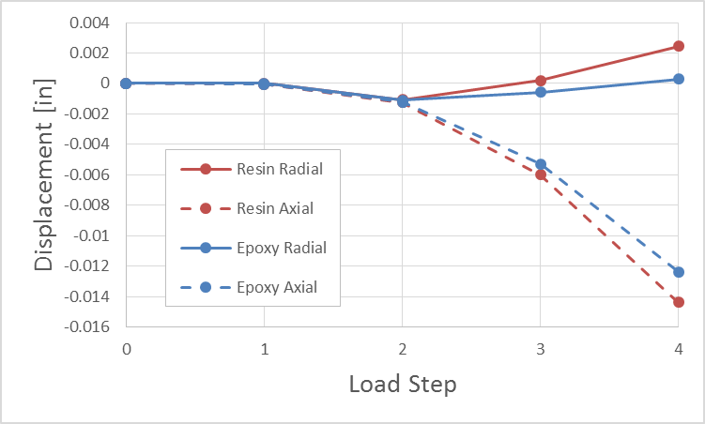
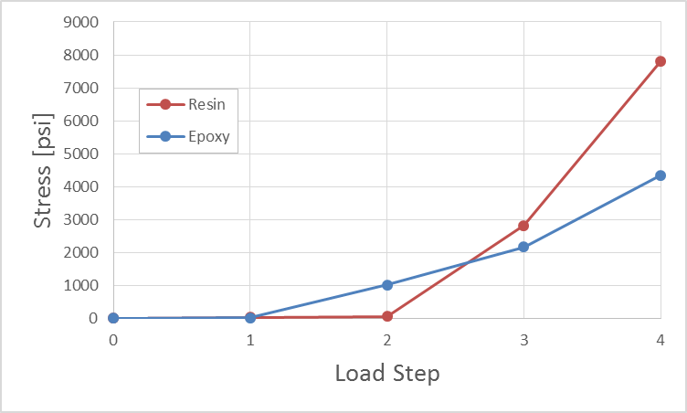
Dome Configuration #3
Resin vs. Epoxy Trade Study
Model v15
Resin allows more Radial Displacement than Epoxy
Greater Radial Displacement leads to Greater Hoop and Tangential Stresses (and therefore Max Principal Stresses)
Load Steps
Displacements
Maximum Principal Stress
Axial @ Dome Center
Radial @ Dome Rim
Max Stress found anywhere in Dome
10/14/16

Slide 16
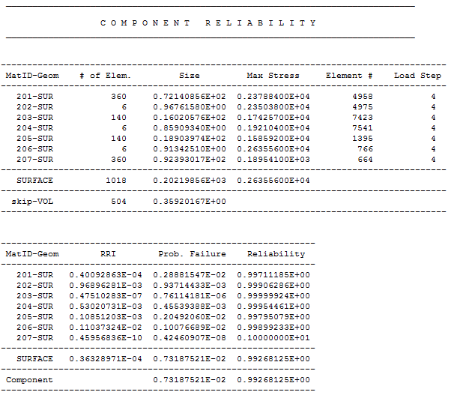
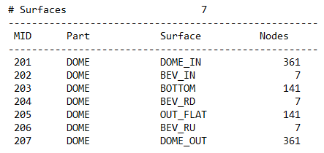
Dome Configuration #3
Epoxy Model
Model v15
CARES Output Example
2750 psi for 60 hrs
Max Stress
Polished
Lowest Individual
Surface Reliability
One Ground
Polished
Overall Reliability
Counterclockwise from Dome Inner to Dome Outer
10/17/16

Slide 17
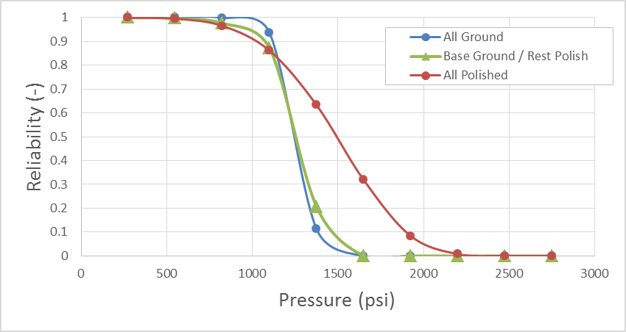
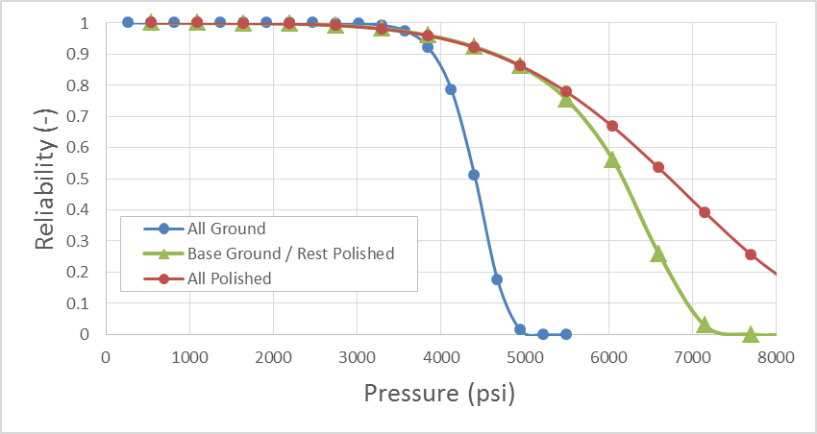
Dome Configuration #3
Resin vs. Epoxy Trade Study
Model v15
Reliability as a Function of Service Pressure
where Service Time is 60 hrs.
Resin Model
Epoxy Model
FEA Stress Solution @ 2750 psi
Assumes Stresses Scale Linearly with Pressure
Assumes other parts of Assembly can handle the increased Applied Pressure
10/17/16

Slide 18
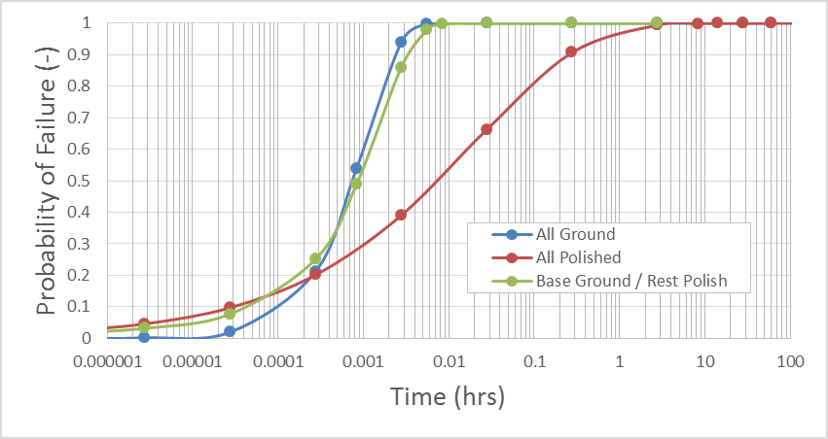
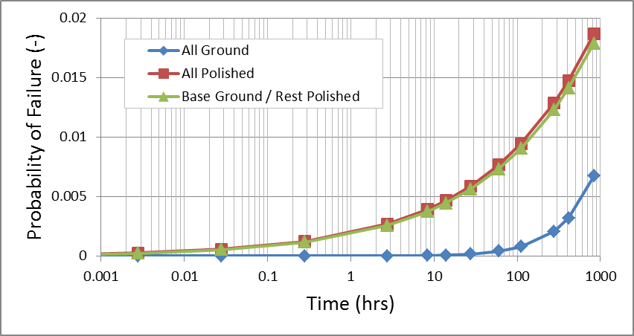
Dome Configuration #3
Resin vs. Epoxy Trade Study
Model v15
Reliability as a Function of Service Time
@ Applied Pressure 2750 psi
Resin Model
Epoxy Model
60 hrs.
Pf = 0.73%
10/17/16

Slide 19
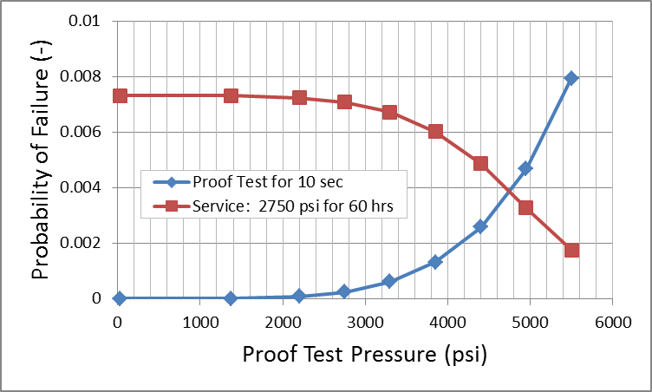
Dome Configuration #3
Epoxy Model
Model v15
60 hrs. Service @ 2750 psi
with no Proof Test
Pf = 0.73%
Failure Rate = 1 out of 137
60 hrs. Service @ 2750 psi
with 10 sec Proof Test @ 4950 psi
Pf = 0.33%
Failure Rate = 1 out of 306
Risk of Failing the
10 sec Proof Test @ 4950 psi
Pf = 0.47%
Failure Rate = 1 out of 214
Proof Test
FEA Stress Solution @ 2750 psi
Assumes Stresses Scale Linearly with Pressure
Assumes other parts of Assembly can handle the increased Applied Pressure
Base Ground / Rest Polished
10/17/16

