Slide 1
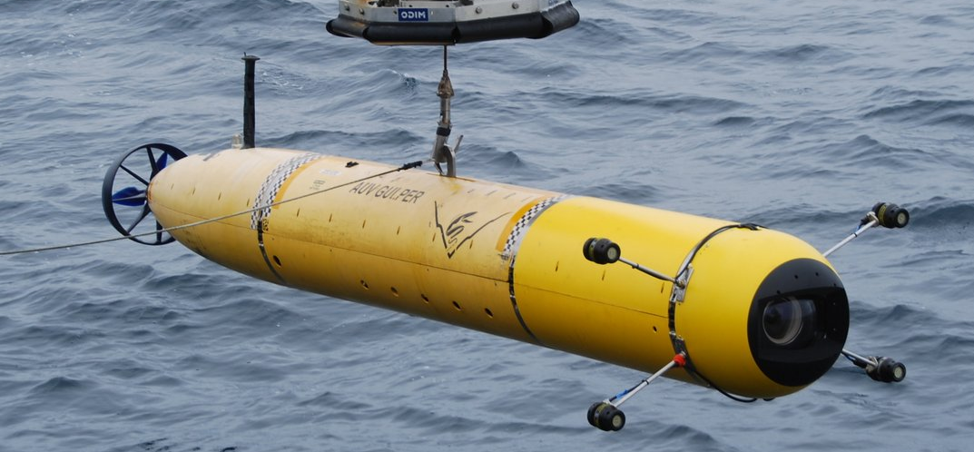
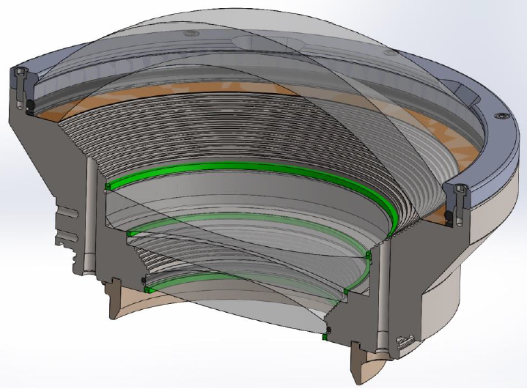
Optical Dome Reliability Analysis
Monterey Bay Aquarium Research Institute (MBARI)
Eric H. Baker
Connecticut Reserve Technologies, Inc.
December 2016
PRELIMINARY ANALYSIS: Provided for demonstration of progress. Not intended to be a complete or final analysis.

Slide 2
Outline
Perform Brittle Material Reliability Predictions on the Deep Water Camera Port of MBARI’s Autonomous Underwater Vehicle (AUV)
Acquire Dome and Dome Support geometry from MBARI
Generate finite element analyses of 3 Dome Configurations and calibrate models to MBARI FEA as well as Pressure Test Measurements
Estimate Weibull Material Properties from provided specimen failure data
Apply the Ceramics Analysis and Reliability Evaluation of Structures (CARES) program to predict the Brittle Material Reliability of the Dome Configurations
Establish a Proof Test Protocol to improve the Reliability
8/2/16

Slide 3
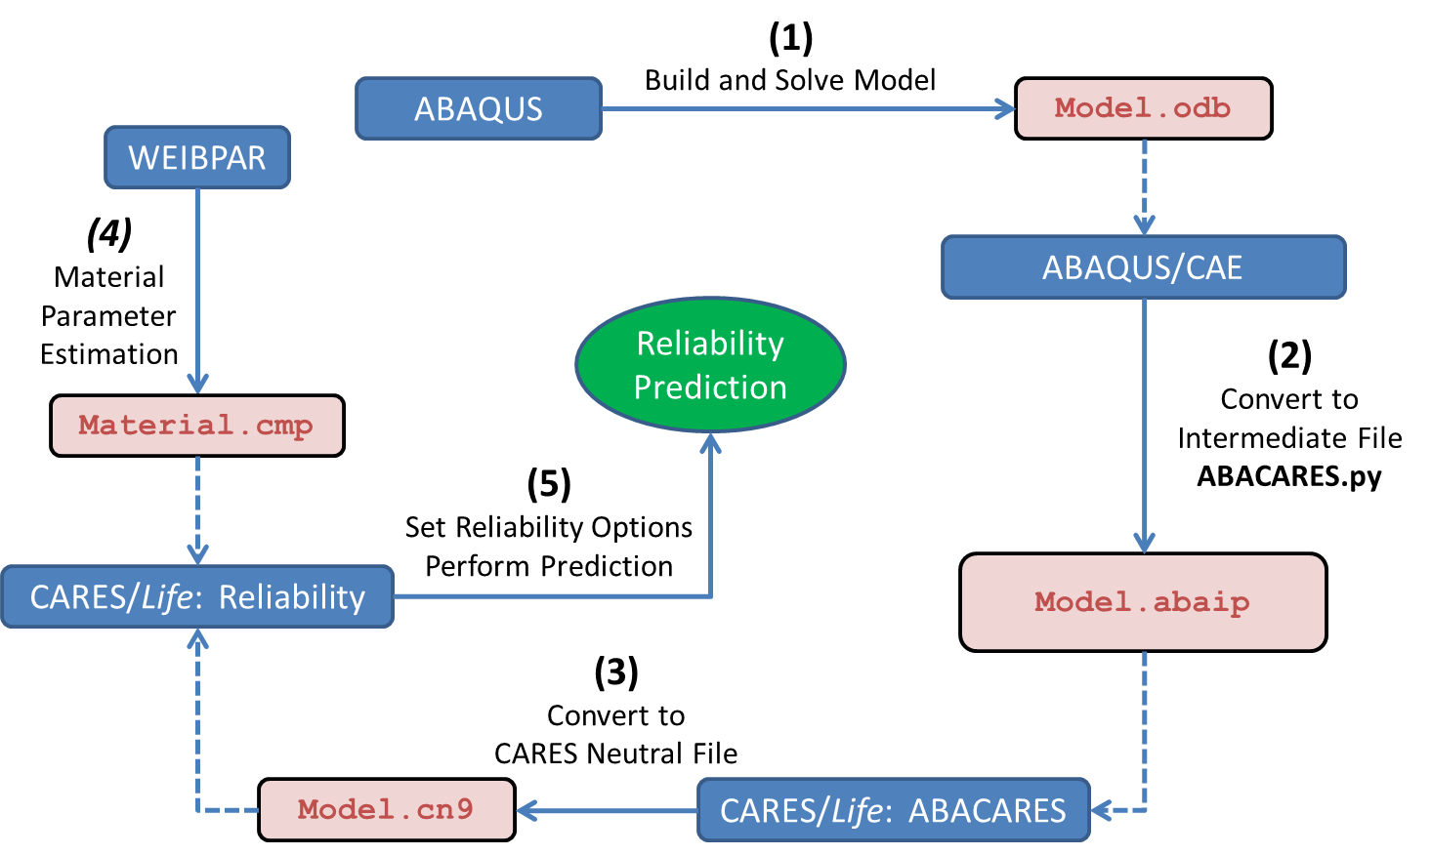
CARES with ABAQUS Flowchart
CARES predicts the brittle material reliability of a component by post-processing finite element analysis stress results.
CARES requires region based Weibull material properties, Volume and/or Surface, where different Surface conditions are characterized by different parameter sets.
8/15/16

Slide 4
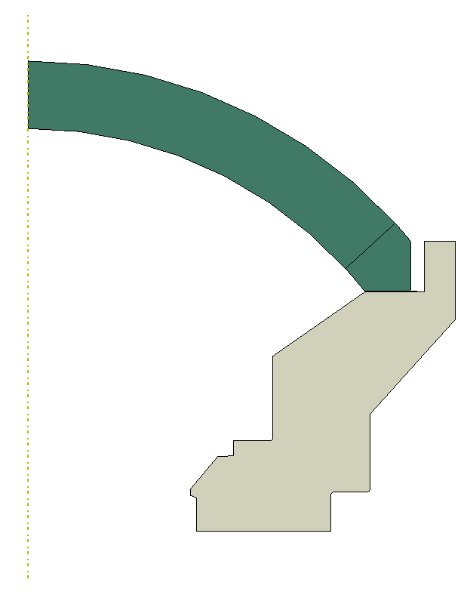

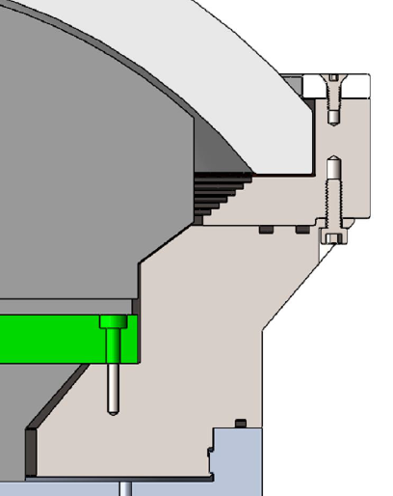
Dome Configurations
#1
#2
#3
Dome Restricted from Moving Radially
Dome Free to Move Radially
Dome Free to Move Radially
Dome
Kapton
0.005”
Added Bevel
Kapton
0.020”
Groove
Support
8/2/16

Slide 5
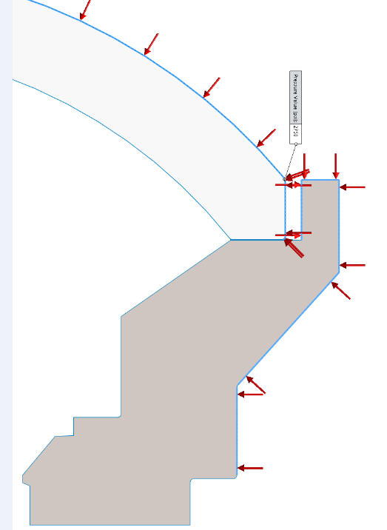
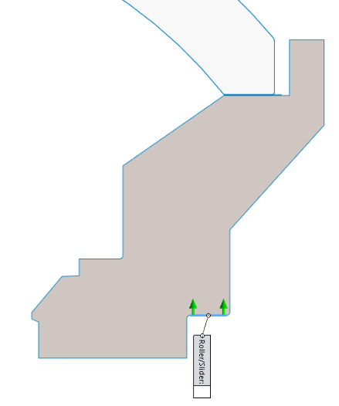
Boundary Conditions
Pressure
BC Axial: Fixed
Radial: Free
7/27/16
Per MBARI

Slide 6
Material Properties: Mechanical
Configuration #3
Dome Support
Material Trade-study
Configuration #3
Resin vs. Epoxy Material Trade-study
10/14/16

Slide 7
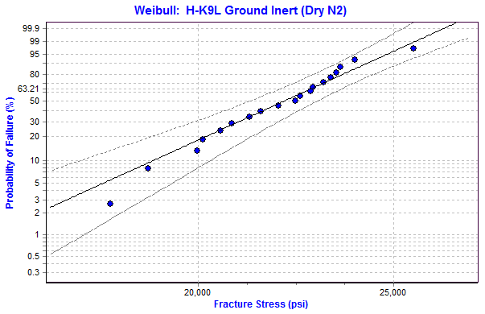
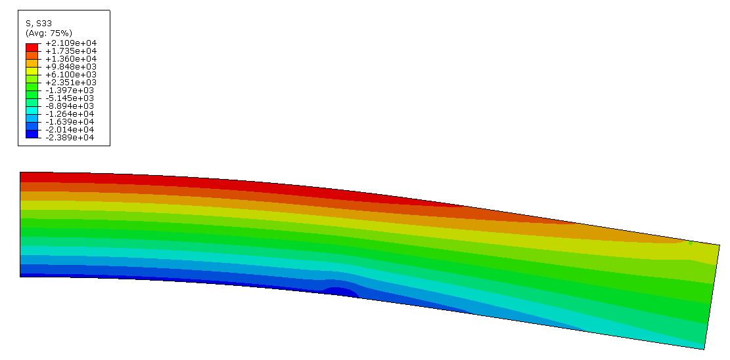
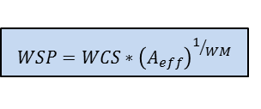
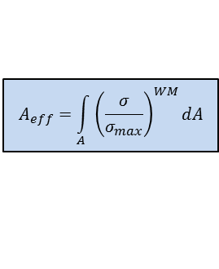

Material Properties: Weibull
WeibPar (Weibull parameter estimation program) is used for the WM and WCS calculations of the failure specimen data as well as calculating the Effective Area from a FEA of the R-o-R specimen
Ground Inert
Flaws were all assumed to originate on the Surface of the Failure Specimens
$$P_{f_{i}}=1−exp{\left(\frac{σ_{i}}{WCS}\right)}^{WM}$$
2D Axisymmetric Model of the Ring-on-Ring Specimen
Weibull Modulus (WM)
Weibull Characteristic Strength (WCS)
$$A_{eff}=\int_{A}^{ }{{\left(\frac{σ}{σ_{max}}\right)}^{WM}dA}$$
WM = 13.6 [-]
WCS = 22,714 [psi]
Weibull Effective Area (A_{eff})
$$WSP=WCS∗{\left(A_{eff}\right)}^{1/{WM}}$$
A_{eff} = 0.229 [in^2]
Weibull Material Scale Parameter (WSP)
WSP = 20,386 [psi*in^(2/13.6)]
Where WM & WSP are used in CARES
9/22/16

Slide 8
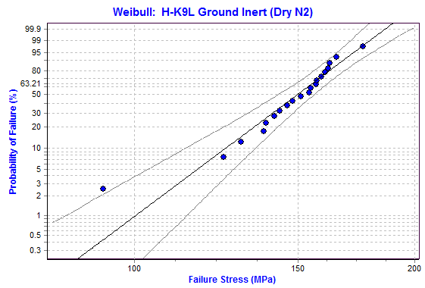
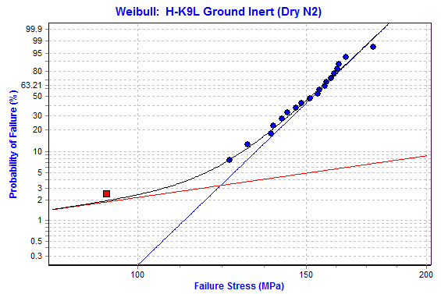
Material Properties: Weibull – Ground, Inert
Outlier ?
Censored
Includes Potential Outlier
# of Specimens 20
WM 11.375
WCS 155.0 MPa (22.48 ksi)
Excludes Outlier
# of Specimens 19
WM 13.626 [-]
WCS 22,714 [psi]
A_{eff} 0.229 [in^2]
WSP 20,386 [psi*in^(2/13.626)]
Censor Outlier
# of Specimens 19 & 1
WM 13.628
WCS 156.6 MPa (22.71 ksi)
MLE2B Estimation
90% Confidence Bounds
9/22/16

Slide 9
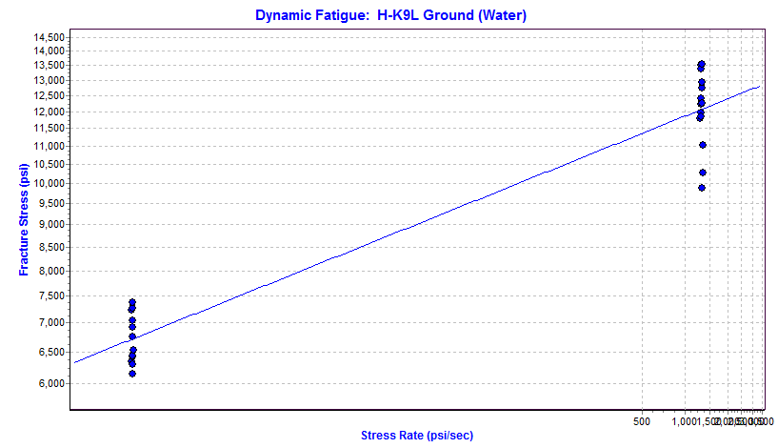
Material Properties: Time Dependent (SCG) – Ground
Ground in Water
Time Dependent (SCG)
# of Specimens 26
WM 13.626 [-]
WSP 20,386 [psi*in^(2/13.63)]
N 14.7413 [-]
D 7,648 [psi]
WM2 15.765 [-]
A_{eff} 0.2197 [in^2]
B_Dynamic 36,437 [psi^2*sec]
B_Static 2,315 [psi^2*sec]
LIN2 Estimation
9/20/16

Slide 10
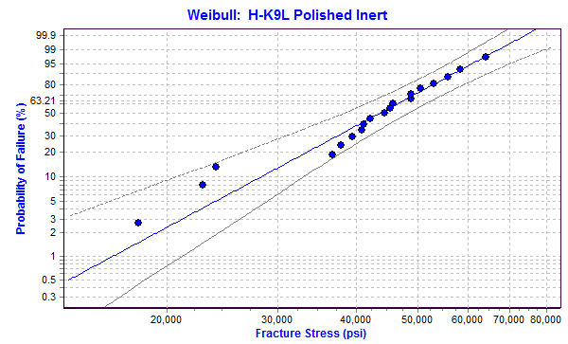
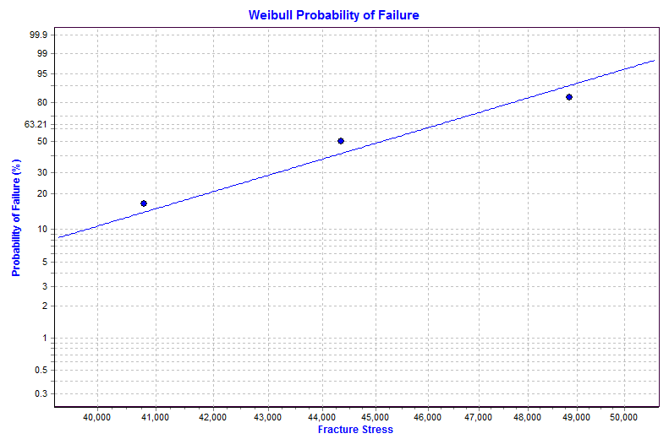
Material Properties: Weibull – Polished, Inert
Polished Inert
# of Specimens 19
WM 4.346 [-]
WCS 47,304 [psi]
A_{eff} 0.353 [in^2]
WSP 37,235 [psi*in^(2/4.346)]
low
MLE2B Estimation
90% Confidence Bounds
9/22/16

Slide 11
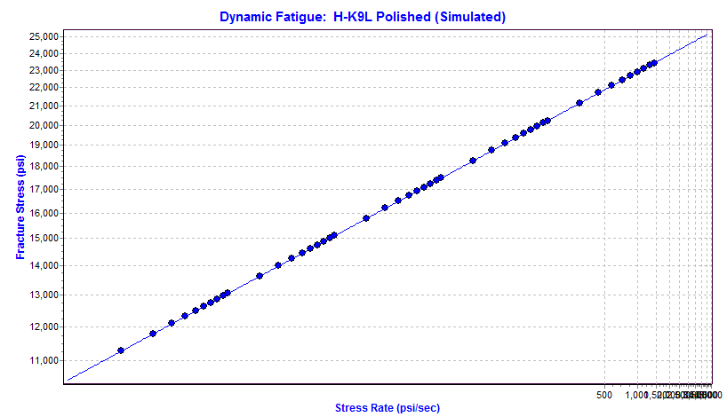
Material Properties: Time Dependent (SCG) – Polished
Polished (Water)
Time Dependent (SCG)
# of Specimens 0 (simulated)
WM 4.346 [-]
WSP 37,235 [psi*in^(2/4.346)]
N 14.74 [-]
D 14,310 [psi]
WM2 5.028 [-]
A_{eff} 0.3311 [in^2]
B_Dynamic 109,202 [psi^2*sec]
B_Static 6,938 [psi^2*sec]
Simulated from Ground
LIN2 Estimation
9/22/16

Slide 12
Dome Configuration #3
Design
Titanium Ring prevents Radial Displacement of Dome
7/27/16

Slide 13
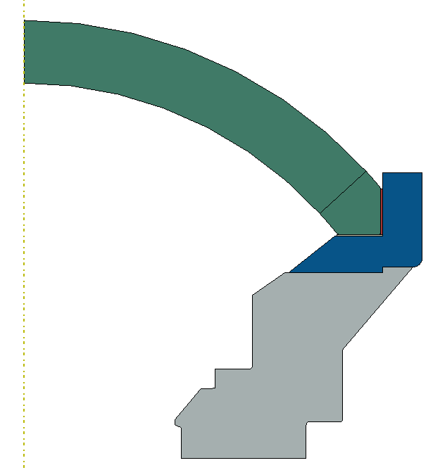
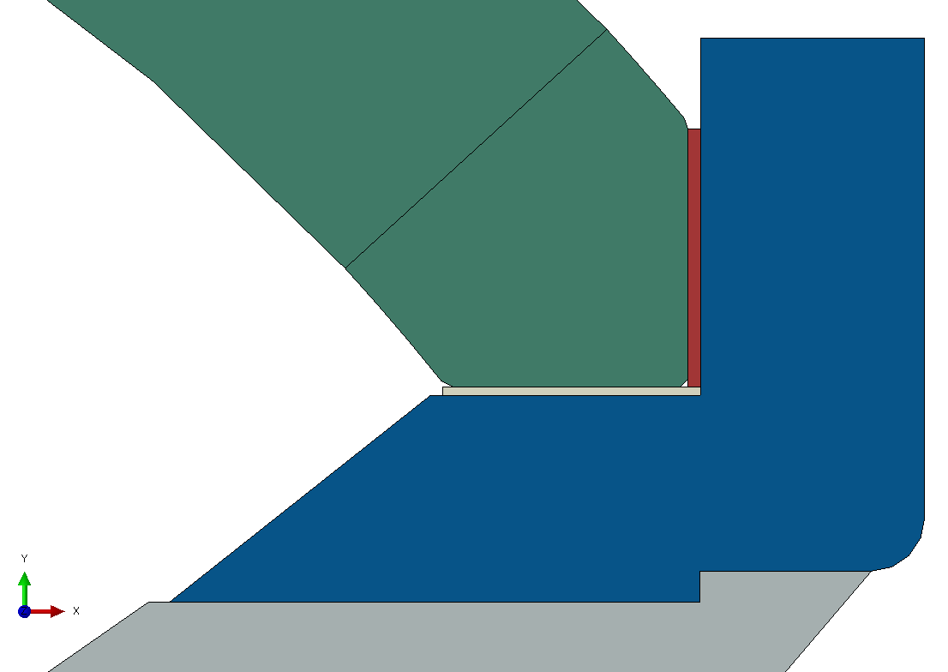
Dome Configuration #3
Model v15
Dome
H-K9L
Trade Study
Resin or Epoxy
0.030”
Dome Coupler Ring
Ti-6Al-4V
Kapton 0.020”
Bonded
Dome Support
Actual: Ti-6Al-4V
Test: 6061-T6
Frictionless
Axial = fixed
Radial = free
10/14/16

Slide 14
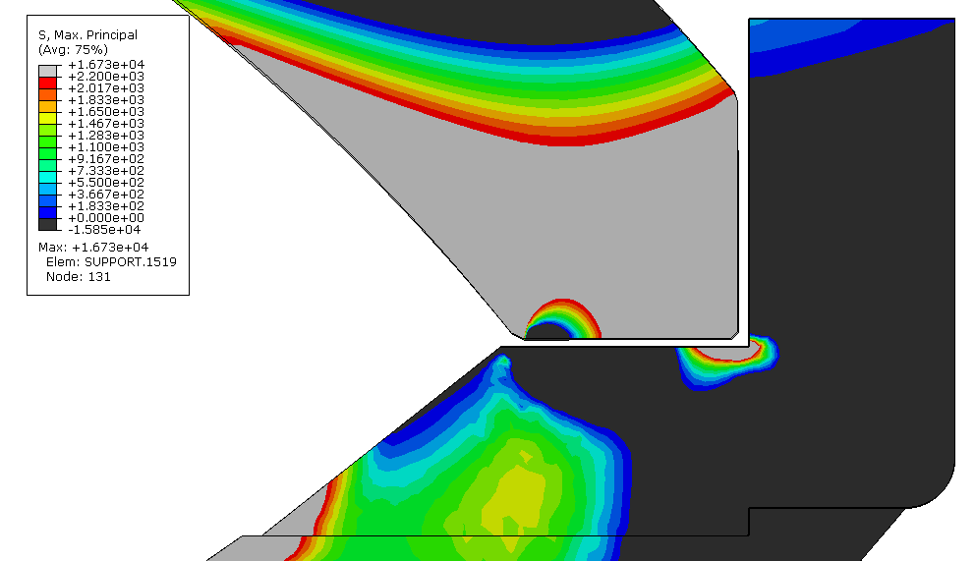
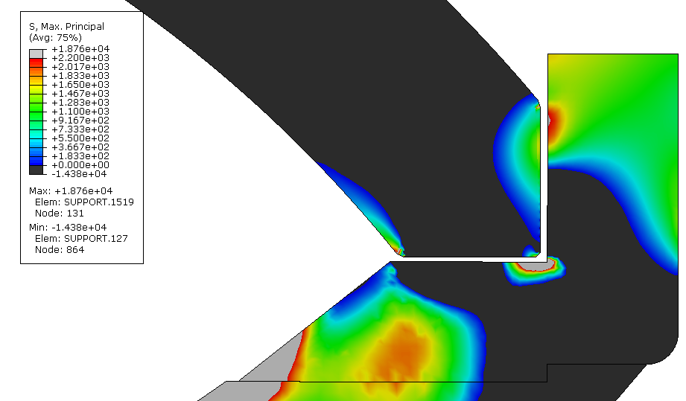
Dome Configuration #3
Resin vs. Epoxy Trade Study
Model v15
Resin Model
Epoxy Model
Tensile Stresses
Frictionless: Dome-2-Kapton, Ring-2-Resin
All the Rest Tied
Compressive Stresses
Load Step #4 includes ΔT and 2750 psi
10/14/16
Resin/Epoxy and Kapton Parts Hidden

Slide 15
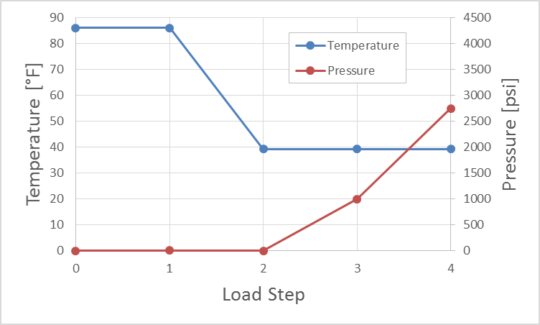
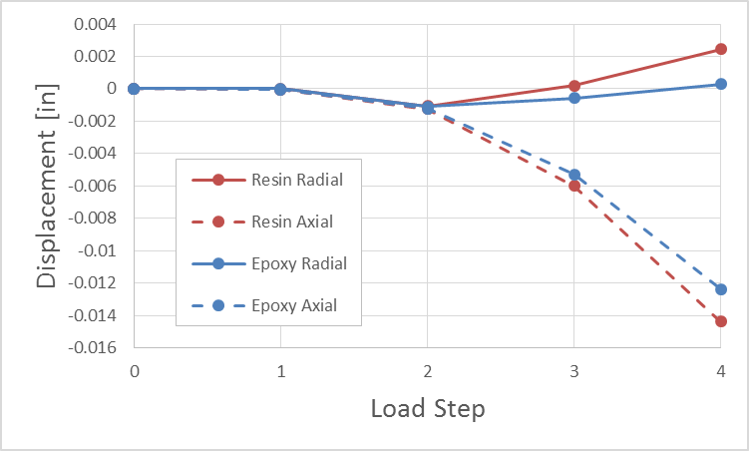
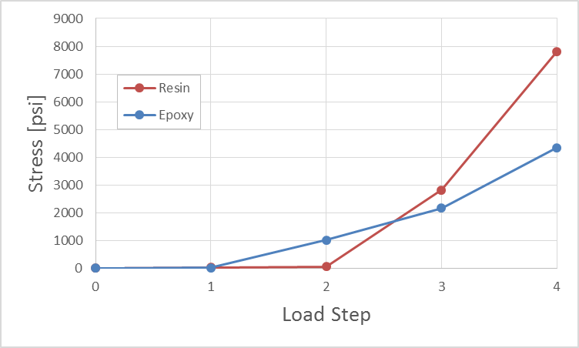
Dome Configuration #3
Resin vs. Epoxy Trade Study
Model v15
Resin allows more Radial Displacement than Epoxy
Greater Radial Displacement leads to Greater Hoop and Tangential Stresses (and therefore Max Principal Stresses)
Load Steps
Displacements
Maximum Principal Stress
Axial @ Dome Center
Radial @ Dome Rim
Max Stress found anywhere in Dome
10/14/16

Slide 16
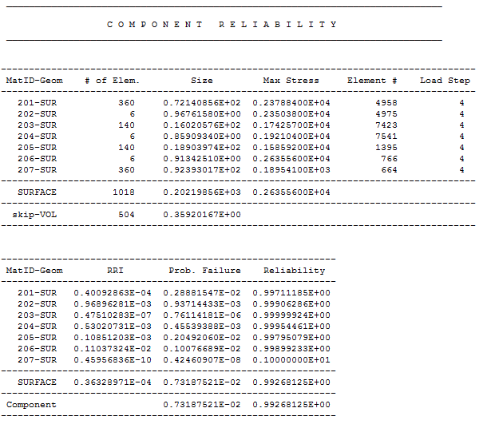
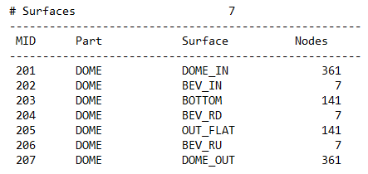
Dome Configuration #3
Epoxy Model
Model v15
CARES Output Example
2750 psi for 60 hrs
Max Stress
Polished
Lowest Individual
Surface Reliability
One Ground
Polished
Overall Reliability
Counterclockwise from Dome Inner to Dome Outer
10/17/16

Slide 17
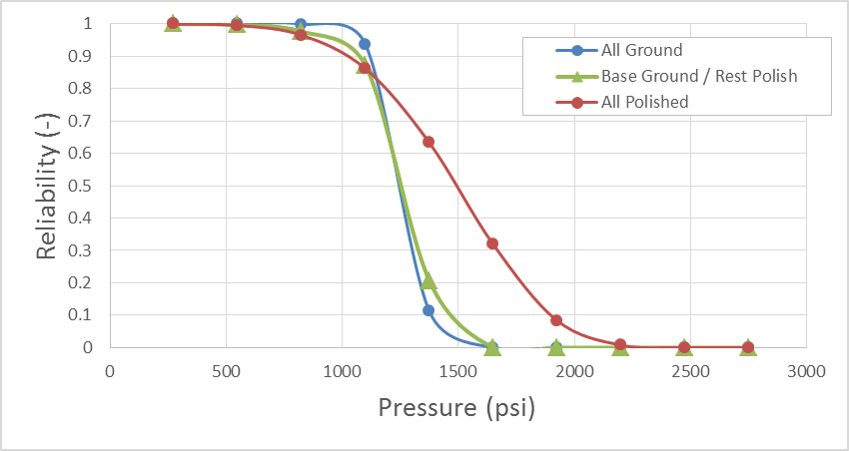
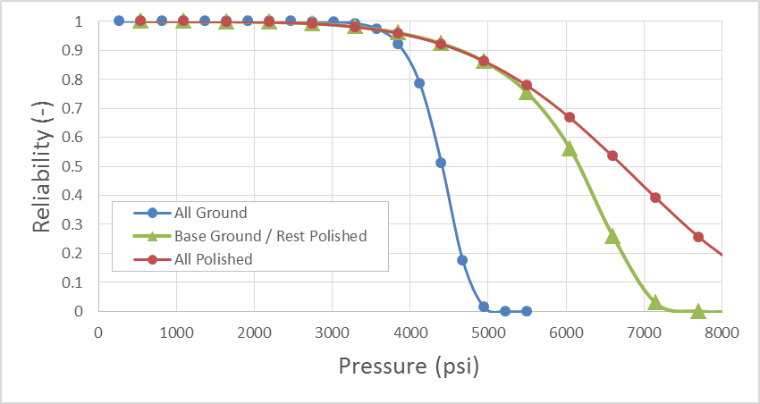
Dome Configuration #3
Resin vs. Epoxy Trade Study
Model v15
Reliability as a Function of Service Pressure
where Service Time is 60 hrs.
Resin Model
Epoxy Model
FEA Stress Solution @ 2750 psi
Assumes Stresses Scale Linearly with Pressure
Assumes other parts of Assembly can handle the increased Applied Pressure
10/17/16

Slide 18
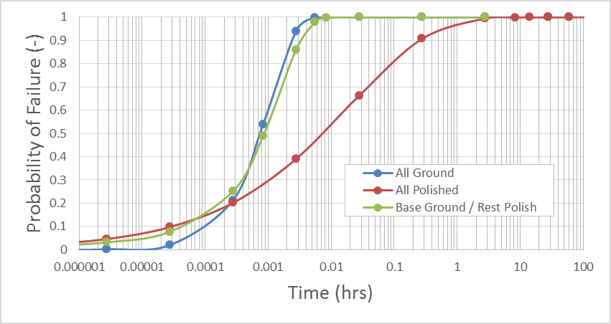
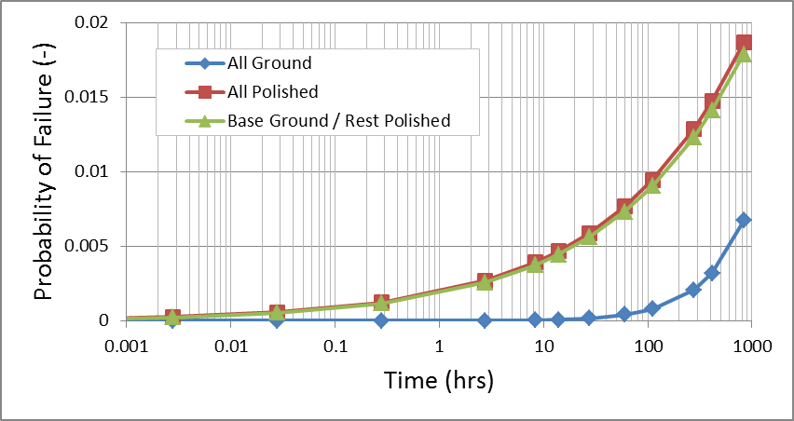
Dome Configuration #3
Resin vs. Epoxy Trade Study
Model v15
Reliability as a Function of Service Time
@ Applied Pressure 2750 psi
Resin Model
Epoxy Model
60 hrs.
Pf = 0.73%
10/17/16

Slide 19
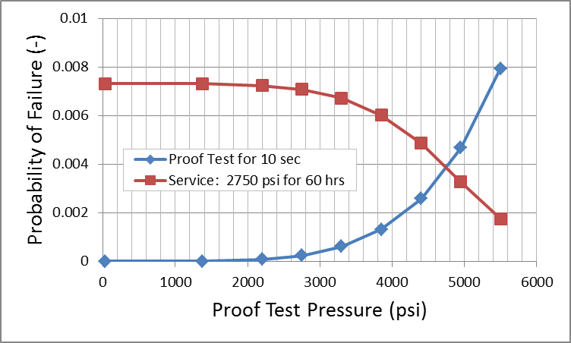
Dome Configuration #3
Epoxy Model
Model v15
60 hrs. Service @ 2750 psi
with no Proof Test
Pf = 0.73%
Failure Rate = 1 out of 137
60 hrs. Service @ 2750 psi
with 10 sec Proof Test @ 4950 psi
Pf = 0.33%
Failure Rate = 1 out of 306
Risk of Failing the
10 sec Proof Test @ 4950 psi
Pf = 0.47%
Failure Rate = 1 out of 214
Proof Test
FEA Stress Solution @ 2750 psi
Assumes Stresses Scale Linearly with Pressure
Assumes other parts of Assembly can handle the increased Applied Pressure
Base Ground / Rest Polished
10/17/16

Slide 20
Additional Cases dated 11/8/16
Case #1: Proof test protocol for existing assembled dome, 0.005 pf at 1,475 PSI (1000m depth) for 100 hours. That would allow us to use the current dome for now. The pressure test we have already performed on this dome might even be sufficient (we pressurized it to 2400 PSI, it's the May 5 2016 test). The fact that the dome passed this test seems to indicate that the resin has better mechanical properties than we thought.
Case #2: Proof test protocol for spare dome assembled with epoxy for 100 h operation at 1,475 PSI, 0.005 pf.
Case #3: Proof test protocol for spare dome assembled with epoxy for 100 h operation at 2,200 PSI, 0.005 pf.
For all 3 options above, the dome is all polished, expect the rim which is ground.
The proof test will be performed at about 4 deg C. The rate of pressure change will be 600 PSI per minute.
11/30/16

Slide 21
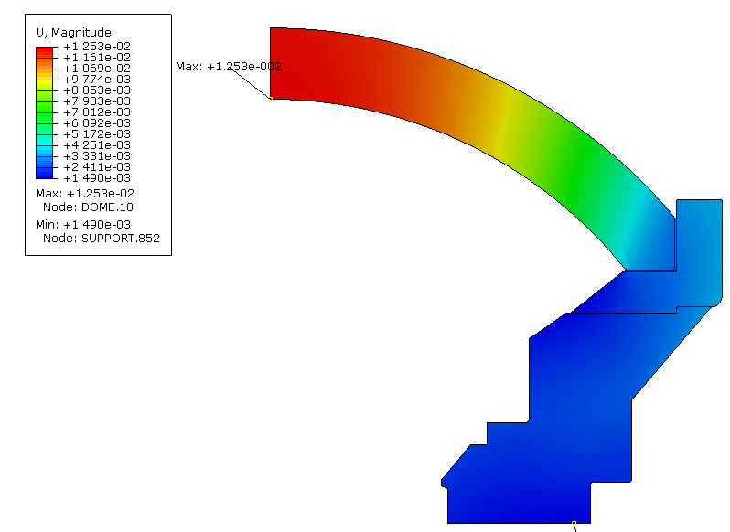
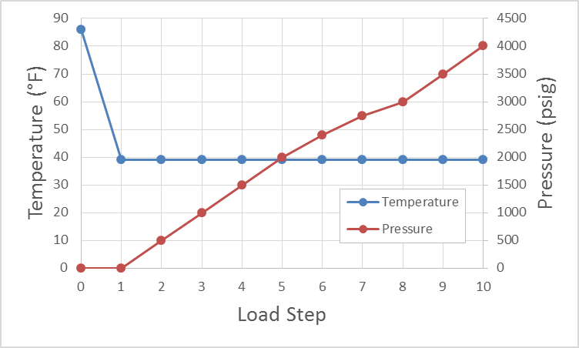
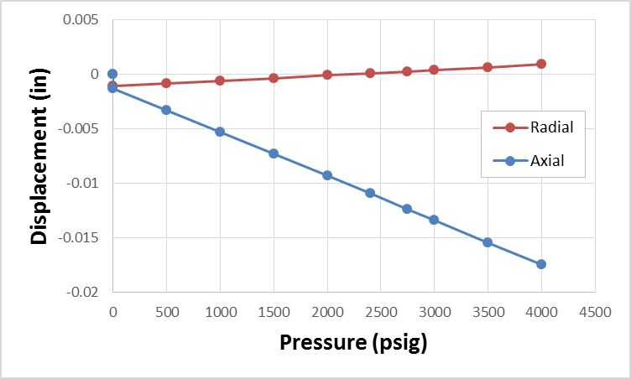
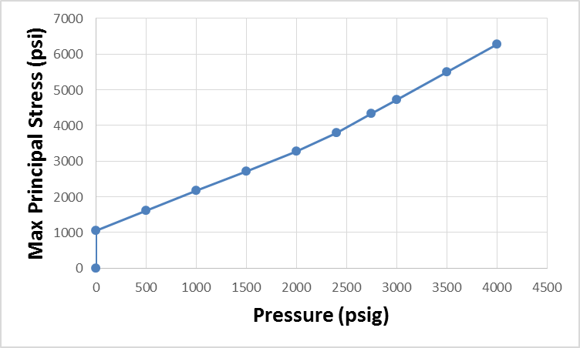
Dome Configuration #3
Epoxy Model v16
Load Steps
Displacements
Max Principal Stress
Axial @ Dome Center
Radial @ Dome Rim
Max Stress found anywhere in Dome
11/28/16

Slide 22
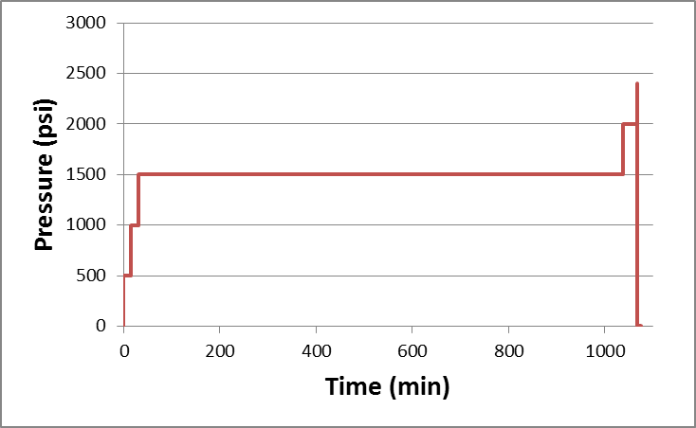
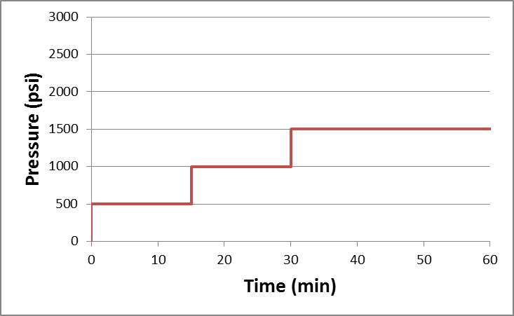
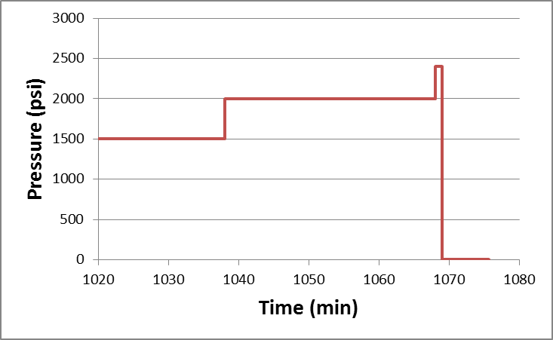
May 5, 2016 Pressure Cycles (combined)
Multiple Pressure Cycles Combined into Single Pressures for the Combined Duration @ that Pressure Level
This Pressure History acts as both the Proof Test Loads as well as the first part of the overall Service Load History
16.8 hrs. @ 1,500 psi
1 min.
60 min.
15 min.
15 min.
12/1/16

Slide 23
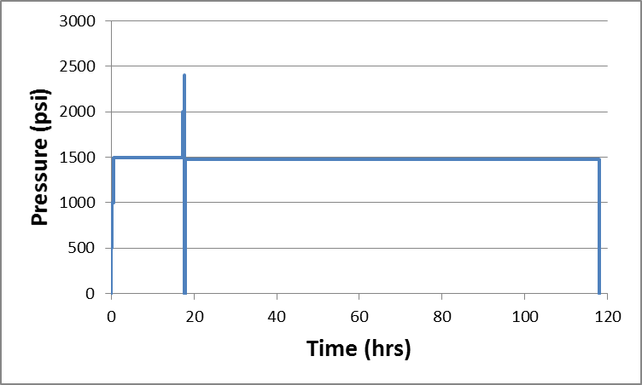
Case #1: Service Load applied to the Dome that survived the May 5 Test
Proof Test Load: multiple Pressure Levels peaking at 2400 psi, total duration 17.82 hrs.
Target Service Load: 1,475 psi for 100 hrs.
Actual Service Load will also include the Proof Test Load: multiple Pressure Levels, total duration 117.82 hrs.
SERVICE
PROOF
12/1/16
Resin Model v17 – Weibull Normal

Slide 24
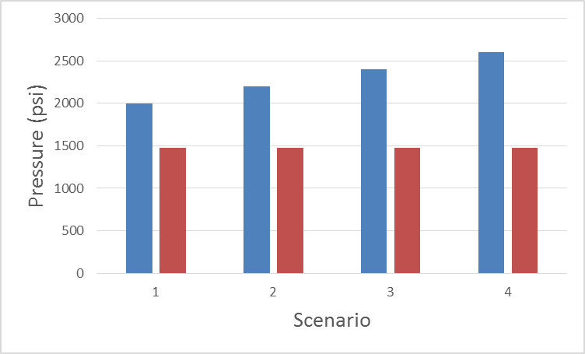
Case #2: Service Load applied to the Dome secured with Epoxy
Proof Test Load: one of various Pressure Levels held for 15 min.
Target Service Load: 1,475 psi for 100 hrs.
Actual Service Load will also include the Proof Test Load: multiple Pressure Levels, total duration 100.004 hrs.
SERVICE
SERVICE
SERVICE
SERVICE
PROOF
PROOF
PROOF
PROOF
12/1/16
Epoxy Model v17 – Weibull Normal

Slide 25
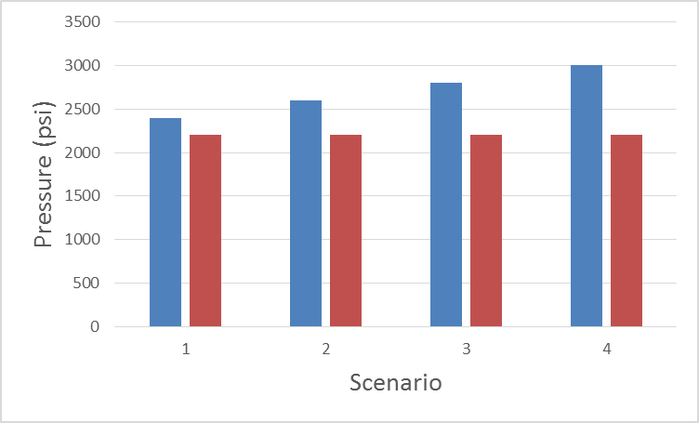
Case #3: Service Load applied to the Dome secured with Epoxy
Proof Test Load: one of various Pressure Levels held for 15 min.
Target Service Load: 2,200 psi for 100 hrs.
Actual Service Load will also include the Proof Test Load: multiple Pressure Levels, total duration 100.004 hrs
SERVICE
SERVICE
SERVICE
SERVICE
PROOF
PROOF
PROOF
PROOF
12/1/16
Epoxy Model v17 – Weibull Normal

Slide 26
SUMMARY Additional Cases
Case #1: Resin, 1475 psi for 100 hours, May 5 Proof Test Pressures, target Pf < 0.005
  Steps 1 through 5: Likelihood of surviving the May 5 Pressure Cycles: Reliability = 0.0049
  The Dome survived the May 5 test -- this indicates that our Resin Model needs to be revised.
  Including the desired Service Pressure: Steps 1 through 6 leads to a lower Reliability = 1.19e-5
  Treating the May 5 Cycles as a Proof Test that the Dome survived and the entire history as a Service Load: Pf = 9.18E-8
  This meets the Target Pf; however, the resin properties should be refined so that the model shows a higher reliability that a Dome can actually survive the May 5 Proof Test.
Case #2: Epoxy, 1475 psi for 100 hours, target Pf < 0.005
  If the Target Service Load alone is applied to the Dome: Pf = 0.00041 which meets the Target Pf < 0.005
  Various Proof Test Load Levels are shown as an exercise
  The 2400 psi Proof Test leads to the lowest Pf = 0.00023
  The higher Proof Test level, 2600 psi, adds enough risk to the overall Service Load History to countermand the benefit of Proofing to that level.
Case #3: Epoxy, 2200 psi for 100 hours, target Pf < 0.005
  If the Target Service Load alone is applied to the Dome: Pf = 0.00204 which meets the Target Pf < 0.005
  Various Proof Test Load Levels are shown as an exercise
  The 3000 psi Proof Test leads to the lowest Pf = 0.00116
12/1/16
Epoxy Model v17 – Weibull Normal

