Slide 1
i2MAP Camera Selection (working draft)

Slide 2
Distance Requirements for the Identification of Representative Organisms in the Camera Field-of View
Required I.D. Distance
Species
Front of Camera Dome
Measured First I.D. Distance (cm) (Rob Sherlock)

Slide 3
2/3” 3-chip Sensor Cameras
Use f 1.4 optical prism and three arrays – need special lens design.
Use B4 lens mount.
Lenses are compatible across same type of camera.
Not a large selection of prime lenses.
Known for good sensitivity and resolution.
Hard to find faster frame rates.
Small array has large depth of field (DOF).

Slide 4
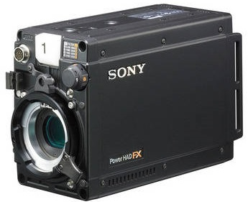
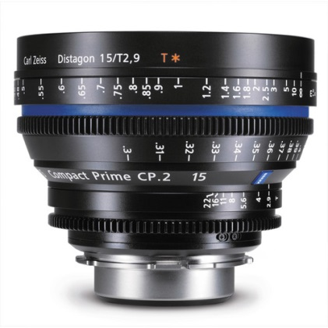
Sony HDCP1
Max frame rate: 1920 x 1080 at 60P
Internal recorder: None
Recorder interface: 1 x 14-bit HD-SDI 4:2:2
Lens: Sony 2/3-type bayonet mount (B4).
Control interface : LAN based Sony system (CCU compatible).
Budget ~ $76k

Slide 5
2/3” Prism Camera with Zeiss Digi Prime T1,9/5 mm @ f 2.5 Calculated Depth of Field Focused at 0.9 meter
Measurement point | Imager | Dome ~
Imager to dome distance (meters) | 0.39
Focus Distance d (meters) | 0.9
Focal length f (mm) | 5
Aperture N (f number) | 2.5
Circle of confusion c (mm) | 0.009
Hyperfocal distance H (meters) | 1.116 | 0.726
Front Focus (meters) | 0.497 | 0.107
Rear Focus (meters) | 4.627 | 4.237
DOF (Meters) | 4.130
Relative exposure to current lens : 0.7
Imager to dome distance 39cm
Notes:
For the prime lens on a 2/3” prism camera the distance from the imager to the end of the dome is much less – the lens is shorter. This makes it more difficult to focus close to the dome. To compensate we need to move the close focus point closer and stop down the iris to 3.2 to increase the depth of field to get a similar viewing area.

Slide 6
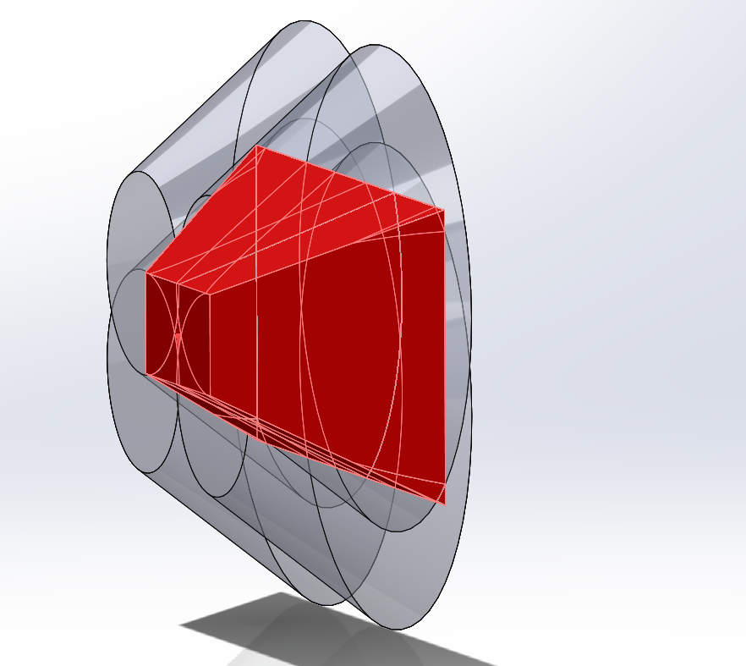
Zeiss Digi Prime T1,9/5 mm on 2/3” Prism camera
Volume = 2.26 cubic meters

Slide 7
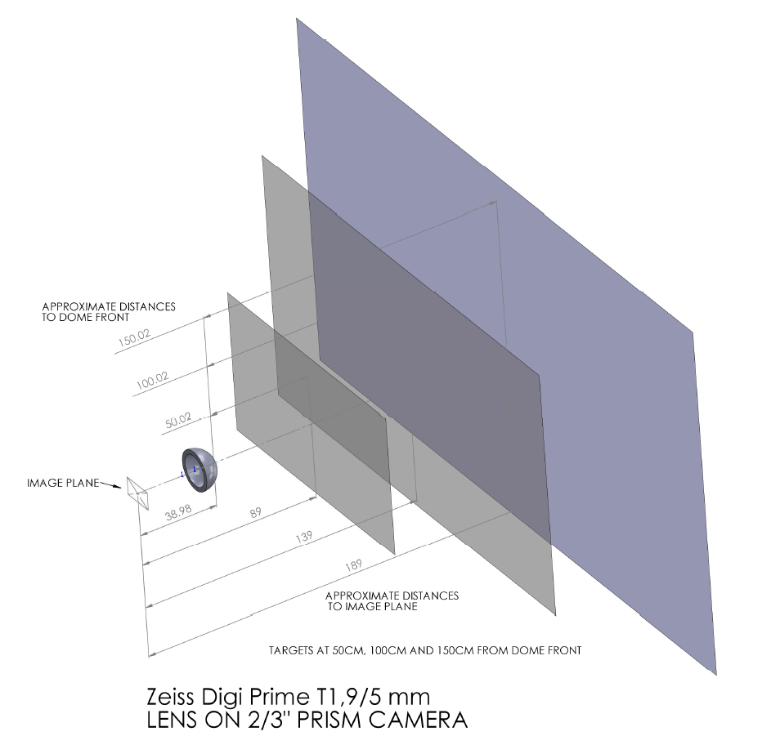
Notes:
For camera temporal resolution testing purposes, we used the “sweet spot” at 0.5 meters from the dome.

Slide 8
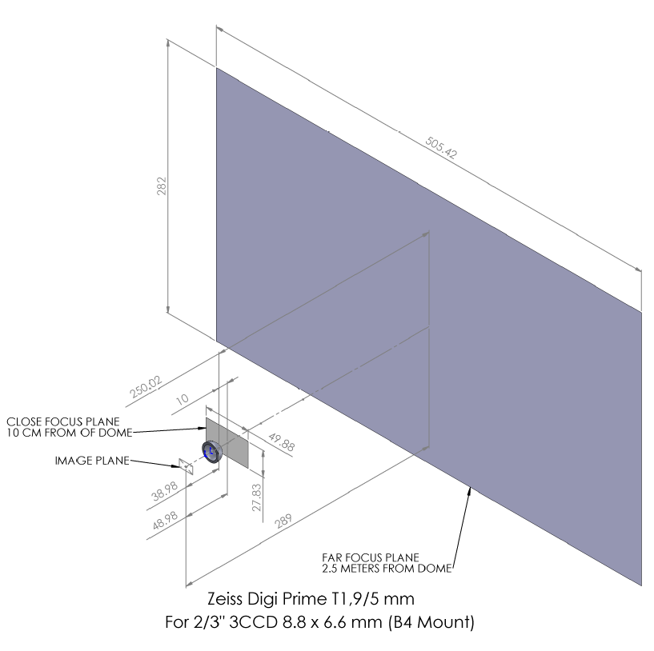
Depth of Field Test Requirement
(all lens and camera combinations)

Slide 9
Camera Temporal Resolution Test Target
Test Target ~ .66 meters from Camera Lens (approx. 0.5 m from dome)
Viewing Area 16:9 Aspect Ratio
75%
50%
25%
Rotation Speed to Simulate 55cm and 100cm per second transect speeds

Slide 10
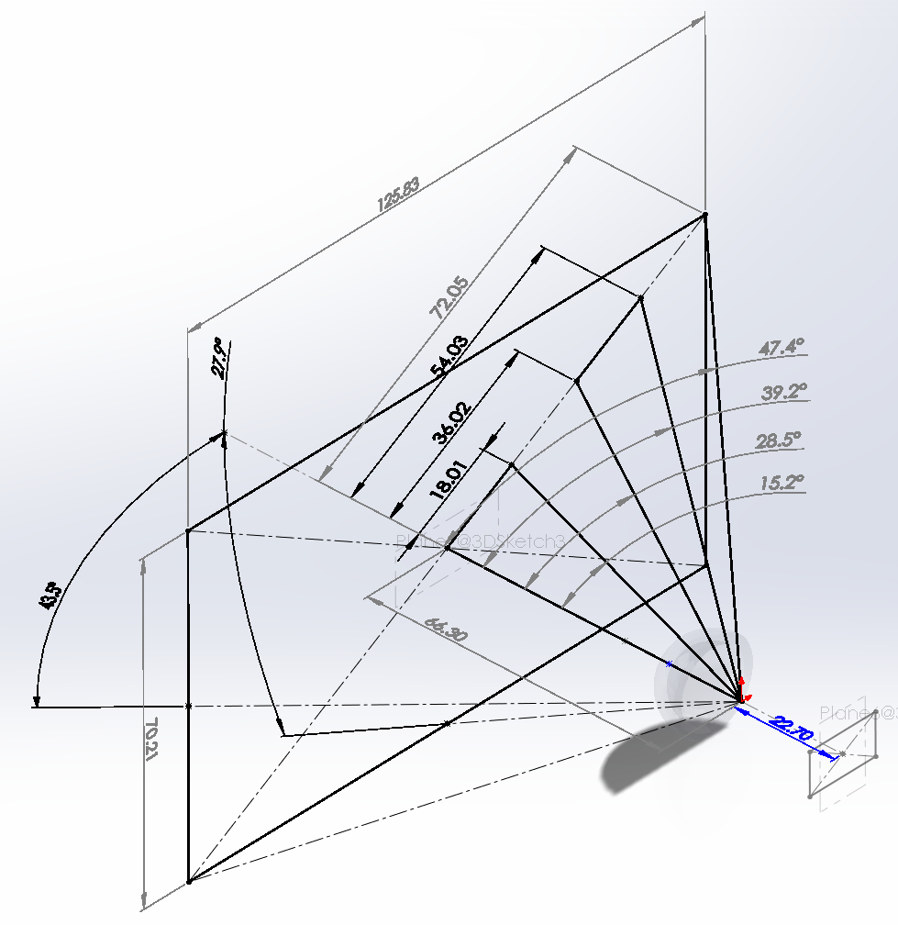
Temporal Resolution Test – 2/3” imager
Test Conditions:
Target rotates at a speed equivalent to the angular motion of particles in the actual field transect.
The two rotational speeds are tested equivalent to advance speeds of 55cm and 100cm per second.
The target distance from the lens entrance pupil is 66.3 cm (89 cm from imager plane).
The test points are a percent of total diagonal field of view.
Lens: Zeiss Digi Prime T1,9/5 mm
Imager: 2/3" 3CCD 8.8 x 6.6 mm (B4 Mount)
Estimated Target Width
Maximum diagonal
Test point 75%
Test point 50%
Test point 25%
Entrance Pupil
Estimated Target Height
Estimated Image Plane

Slide 11
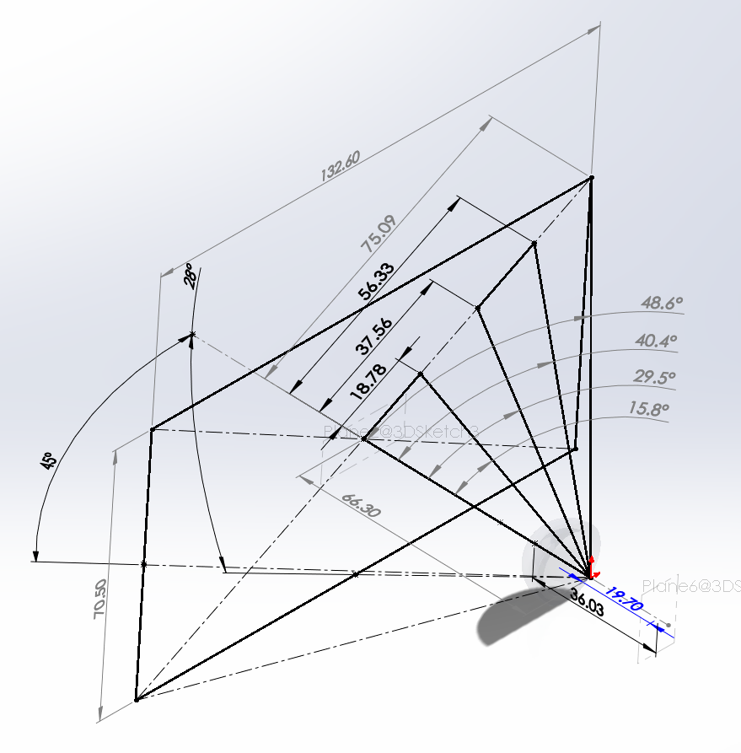
Temporal Resolution Test – super 35 imager
Test Conditions:
Target rotates at a speed equivalent to the angular motion of particles in the actual field transect.
The two rotational speeds are tested equivalent to advance speeds of 55cm and 100cm per second.
The target distance from the lens entrance pupil is 66.3 cm (89 cm from imager plane).
The test points are a percent of total diagonal field of view.
Lens: Arri/Zeiss Ultra Prime UP 12 mm/T2
Estimated Target Width
Imager: DIN Super 35 24 x 12.7 mm Bayer Array (PL mount)
Maximum diagonal
Test point 75%
Test point 50%
Test point 25%
Entrance Pupil
Estimated Target Height
Estimated Image Plane

Slide 12
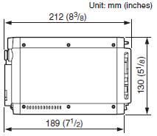
Sony HDCP1 Dimensions

Slide 13
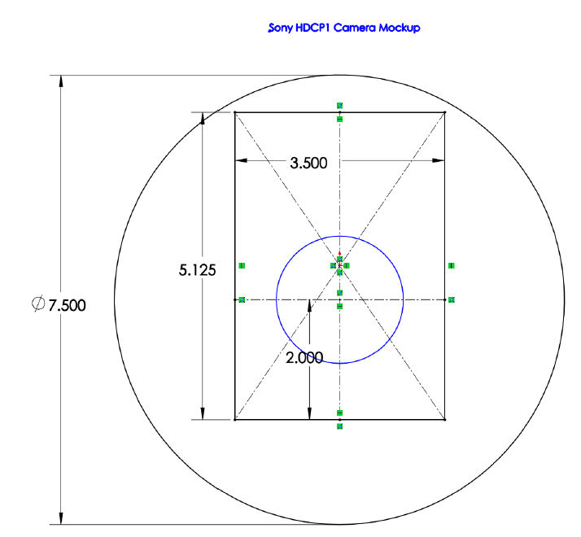
Sony HDCP1 Housing Dia. Mockup

Slide 14
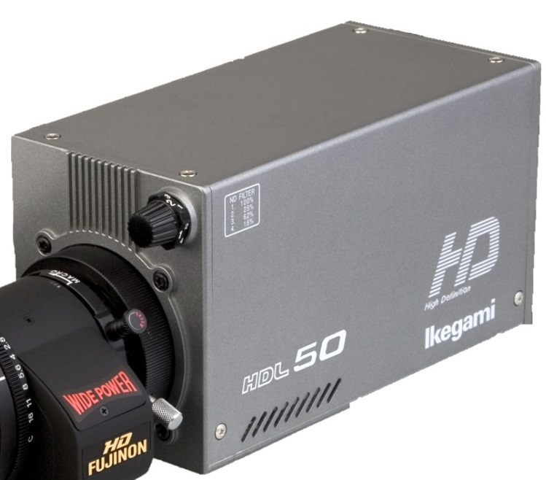
Ikegami HDL-50/HS
Max frame rate: 1920 x 1080 at 60P
Internal recorder: None
Recorder interface: 2 x HD-SDI 4:2:2 (dual link)
Lens: B4 2/3-type bayonet mount.
Control interface : RM-50, RM-51, RM-11, OCP-200 & MCP-200
Field of view 87 degrees with Zeiss Digi Prime T1,9/5 mm lens.
+ Side
- Side
Very good picture (3CCD).
Good form factor for housing.
No extra peripherals.
Mechanical shutter.
High quality lens available.
Good DOF
Max frame rate: 1920 x 720 at 60P
Same $ as Sony P1.
Ikegami does not make there own imagers.
Poor sensitivity.

Slide 15
Large sensor cameras
Known as “cine type”
Single array with Bayer pattern has about 70% of the resolution as 3-chip array.
Single array creates film-like optical path, can use almost any large format lens, i.e. PL mount, Canon EF mount, Nikon, etc.
Cameras often have internal storage and the best compression engines (CODECS).
Large sensor reduces the depth of field for a given focal length.

Slide 16
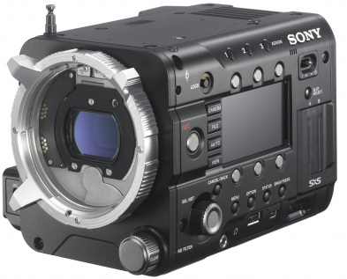
Sony PMW-F5
Max frame rate: 1920 x 1080 at 60P with XAVC codec, 240 FPS 2K RAW (full res. 60P max.)
Internal recorder: XAVC codec
Recorder interface: 3G-SDI with 2K and 4K capability or HDMI 1.4
Lens: Sony FZ-mount with PL adapter.
Control interface : LANC ??
Field of view 80 degrees with 15mm Zeiss CP.2 15mm/T2.9 E-mount prime lens.

Slide 17
DIN Super 35 Camera with Arri Ultra Prime UP 10 mm/T2.1 @ f 4.5 Calculated Depth of Field Focused at 0.85 meter
Measurement point | Imager | Dome ~
Imager to dome distance (meters) | 0.37
Focus Distance d (meters) | 0.85
Focal length f (mm) | 10
Aperture N (f number) | 4.5
Circle of confusion c (mm) | 0.02
Hyperfocal distance H (meters) | 1.121 | 0.751
Front Focus (meters) | 0.481 | 0.111
Rear Focus (meters) | 3.484 | 3.114
DOF (Meters) | 3.002
Relative exposure to current lens : 0.9
Imager to dome distance 37cm

Slide 18
DIN Super 35 Camera with SONY SCL-P11X15 @ f 5.6 Calculated Depth of Field Focused at 0.8 meter
Measurement point | Imager | Dome ~
Imager to dome distance (meters) | 0.34
Focus Distance d (meters) | 0.8
Focal length f (mm) | 11
Aperture N (f number) | 5.6
Circle of confusion c (mm) | 0.02
Hyperfocal distance H (meters) | 1.091 | 0.751
Front Focus (meters) | 0.460 | 0.120
Rear Focus (meters) | 2.966 | 2.626
DOF (Meters) | 2.507
Relative exposure to current lens : 0.7
Imager to dome distance 34cm

Slide 19
DIN Super 35 Camera with Arri/Zeiss Ultra Prime UP 12 mm/T2 @ f 6.7 Calculated Depth of Field Focused at 0.8 meter
Measurement point | Imager | Dome ~
Imager to dome distance (meters) | 0.36
Focus Distance d (meters) | 0.8
Focal length f (mm) | 12
Aperture N (f number) | 6.7
Circle of confusion c (mm) | 0.02
Hyperfocal distance H (meters) | 1.087 | 0.727
Front Focus (meters) | 0.459 | 0.099
Rear Focus (meters) | 2.999 | 2.639
DOF (Meters) | 2.540
Relative exposure to current lens : 0.57
Imager to dome distance 36cm

Slide 20
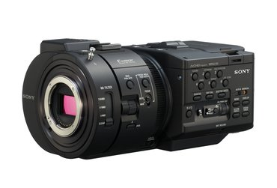
Sony NEX-FS700UK
Max frame rate: 1920 x 1080 at 60P with AVCHD codec, 240 FPS 2K RAW (full res. 60P max.)
Internal recorder: AVCHD codec
Recorder interface: 3G-SDI with 2K and 4K capability or HDMI 1.4
Lens: Sony E-mount hot shoe.
Control interface : LANC
Field of view 80 degrees with 15mm Zeiss CP.2 15mm/T2.9 E-mount prime lens.
+ Side
- Side
High frame rate.
High sensitivity.
Can change lens.
Low cost ($7700).
Low cost lens ($5700)
Unknown picture quality in our application.
Not needed features, LCD screen, etc.

Slide 21
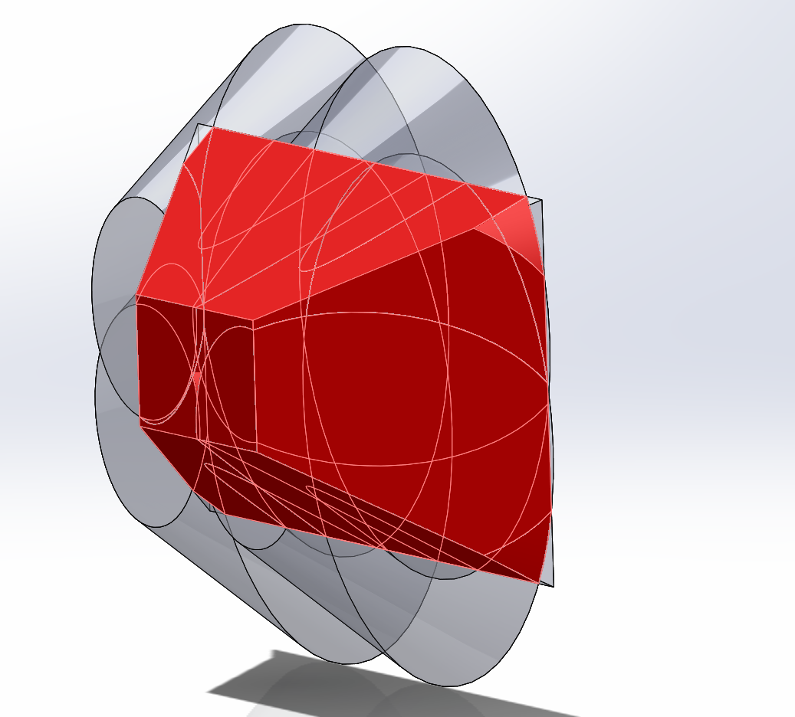
Arri Ultra Prime UP 10 mm/T2.1 on DIN Super 35 camera
Volume = 3.40 cubic meters

Slide 22
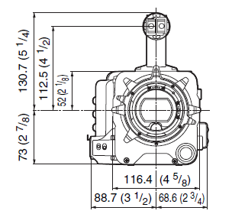
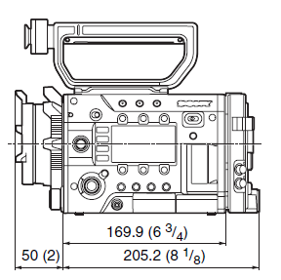
Sony PMW-F5 Dimensions

Slide 23
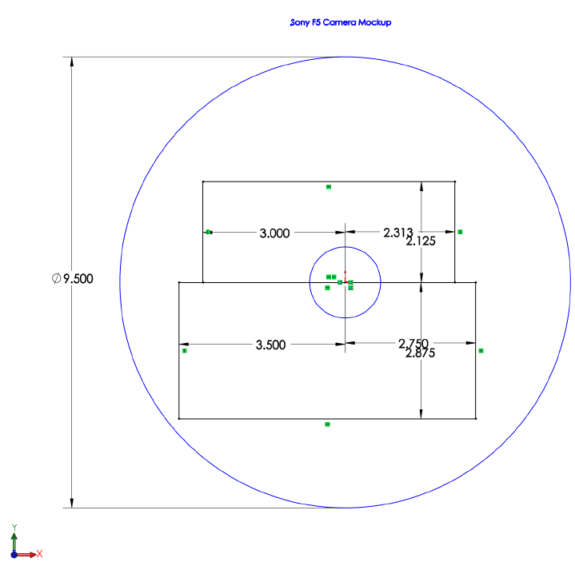
Sony PMW-F5 Housing Dia. Mockup

Slide 24
Rob’s distance to resolve data
Time Calc. Distance (cm)
Time Calc. Distance (cm)
Aegina | 3.3 | 183.3
Aegina citrea | 4.0 | 220.0
Apolemia | 5.0 | 275.0
Atolla | 2.0 | 110.0
Atolla wyvillei | 3.0 | 165.0
Bargmannia elongata | 3.0 | 165.0
Beroe | 3.0 | 165.0
Chuniphyes | 2.5 | 137.5
Clione | 2.0 | 110.0
Doliolula | 2.0 | 110.0
Forskalia | 3.0 | 165.0
Gigantocypris | 2.0 | 110.0
Hastigerinella digitata | 1.8 | 100.8
Kephyes ovata | 2.0 | 110.0
Lampocteis cruentiventer | 2.0 | 110.0
Melanostigma pammelas | 3.0 | 165.0
Mysidae | 2.0 | 110.0
Nanomia bijuga | 3.4 | 187.0
Pasiphaeidae | 4.0 | 220.0
Periphylla | 3.0 | 165.0
Periphylla periphylla | 3.0 | 165.0
Poeobius meseres | 3.3 | 180.0
Pseudothecosomata | 2.0 | 110.0
Salpa | 4.0 | 220.0
Salpa fusiformis | 3.0 | 165.0
Solmissus | 3.5 | 192.5
Solmundella bitentaculata | 2.5 | 137.5
Grand mean: | 3.0 | 165.0

Slide 25
2/3” Prism Camera with Fujinon HA 10X5.2 @ f 2.2
Calculated Depth of Field Focused at 1.0 meter
Measurement point | Imager | Dome ~
Imager to dome distance (meters) | 0.46
Focus Distance d (meters) | 1
Focal length f (mm) | 5.2
Aperture N (f number) | 2.2
Circle of confusion c (mm) | 0.009
Hyperfocal distance H (meters) | 1.371 | 0.911
Front Focus (meters) | 0.577 | 0.117
Rear Focus (meters) | 3.682 | 3.222
DOF (Meters) | 3.105
Imager to dome distance 46cm
Notes:
Current Ikegami setup. This is a 2/3” imager with a beam splitting prism between the imager and the zoom lens. The lens is in the full wide position (5.2mm focal length)
Focus distance calculation is from the imager. I adjusted to also be from the dome end to compare with field data.
This is with the iris wide open.
Note that the far focal distance is about 3.2 meters – just past the graph.

Slide 26
Sony PMW-F55
Max frame rate: 1920 x 1080 at 60P with AVCHD codec, 240 FPS 2K RAW (full res. 60P max.)
Internal recorder: XAVC codec
Recorder interface: 3G-SDI with 2K and 4K capability or HDMI 1.4
Lens: Sony FZ-mount with PL adapter.
Control interface : LANC ??
Field of view 80 degrees with 15mm Zeiss CP.2 15mm/T2.9 PL-mount prime lens.
+ Side
- Side
Very high frame rate.
High sensitivity.
Can change lens.
Low cost lens ($5700)
Better 4k performance.
Unknown picture quality in our application.
Not needed features, LCD screen, etc.
High cost ($29k).

Slide 27
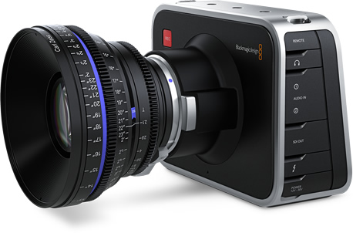
Blackmagic Cinema Camera EF
Max frame rate: 1920 x 1080 at 30P
Internal recorder: Apple ProRes. All compressed recording in 1920x1080 10-bit YUV with choice of Film or Video Dynamic Range.
Recorder interface: 1 x 10-bit HD-SDI 4:2:2
Lens: EF (Canon) and ZE (Zeiss) mount compatible with electronic iris control.
Control interface: LANC
+ Side
- Side
Lens: EF (Canon) and ZE (Zeiss) mount with electronic iris control (or micro 4/3)
Very good picture.
Low cost. ($2k)
Max frame rate: 1920 x 1080 at 30P
Not the best form factor for housing.
Has unnecessary LCD display interface.

Slide 28
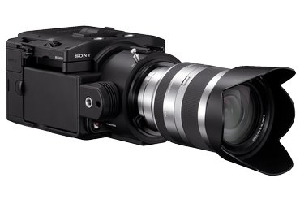
Sony NEXFS100UK
Max frame rate: 1920 x 1080 at 60P
Internal recorder: AVCHD codec
Recorder interface: HD-SDI, 8-bit HDMI 1.4 4:2:2
Lens: Sony E-mount hot shoe.
Control interface : LANC
Field of view 80 degrees with 15mm Zeiss CP.2 15mm/T2.9 E-mount prime lens.
+ Side
- Side
High frame rate.
High sensitivity.
Low cost ($5k).
Can change lens.
Low cost lens ($5700)
Unknown picture quality in our application.
Not needed features, LCD screen, etc.

Slide 29
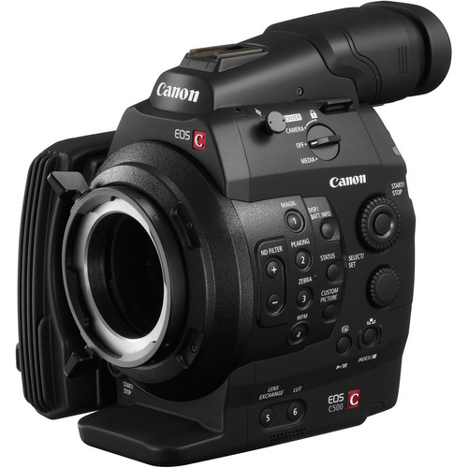

Canon EOS C500 4K
Max frame rate: 1920 x 1080 at 60P with MPG 4 codec, 120 FPS 2K RAW (full res. 60P max.)
Internal recorder: AVCHD codec
Recorder interface: 3G-SDI with 2K and 4K capability
Lens: EF or PL mount.
Control interface : LANC Remote control through WFT-E6A accessory is also possible
Field of view 85+? degrees with 14mm Canon CN-E14mm T3.1 L F EF-mount prime lens.
+ Side
- Side
High frame rate.
High sensitivity.
Can change lens.
Low cost lens ($5500)
Better 4k performance.
Unknown picture quality in our application.
Not needed features, viewfinder, etc.
Have to disassemble viewfinder for housing.
High cost ($20k).

Slide 30

Canon EOS-1D C
Max frame rate: 1920 x 1080 at 60P
Internal recorder: MOV, Motion JPEG, MPEG-4 AVC (H.264)
Recorder interface: Does not appear to be available except 1080 60i or 1080 24p.
Lens: EF mount.
Control interface : LANC Remote control through WFT-E6A accessory is also possible
Field of view 85+? degrees with 14mm Canon CN-E14mm T3.1 L F EF-mount prime lens.
+ Side
- Side
High resolution.
Can change lens.
Low cost lens ($5500)
Unknown picture quality in our application.
Not needed features, viewfinder, etc.

Slide 31
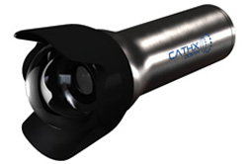
Cathx Ocean M-12 Wide angle HD
Max frame rate: 1920 x 1080 at 30P, 1920 x 720 at 60p
Internal recorder: 256GB or 512GB(?)
Recorder interface: SDI
Internal recorder: H.264 MPEG4
Lens: Included zoom
Control interface : 485 serial and Ethernet.
Field of view 88 degrees with 11.5-46mm f/2.8 zoom lens.
- Side
+ Side
COTs system
Compact housing
Unknown picture quality in our application.
High cost, $58k (may not be too much with housing).
Not great at 60P frame rate.

Slide 32
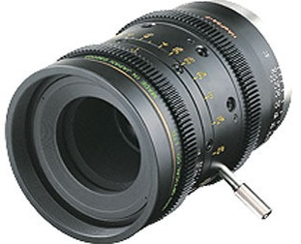
Ikegami HDL-50/HS
Max frame rate: 1920 x 1080 at 60P
Internal recorder: None
Recorder interface: 2 x HD-SDI 4:2:2 (dual link)
Lens: B4 2/3-type bayonet mount.
Control interface : RM-50, RM-51, RM-11, OCP-200 & MCP-200
Field of view 87 degrees with Fujinon HAeF5 5mm prime cine lens.
+ Side
- Side
Very good picture (3CCD).
Good form factor for housing.
Good sensitivity.
No extra peripherals.
Mechanical shutter.
High quality lens available.
Good DOF
Max frame rate: 1920 x 720 at 60P
Expensive ($?k).
Lens expensive ($35k).

Slide 33
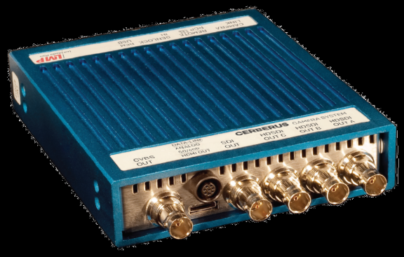
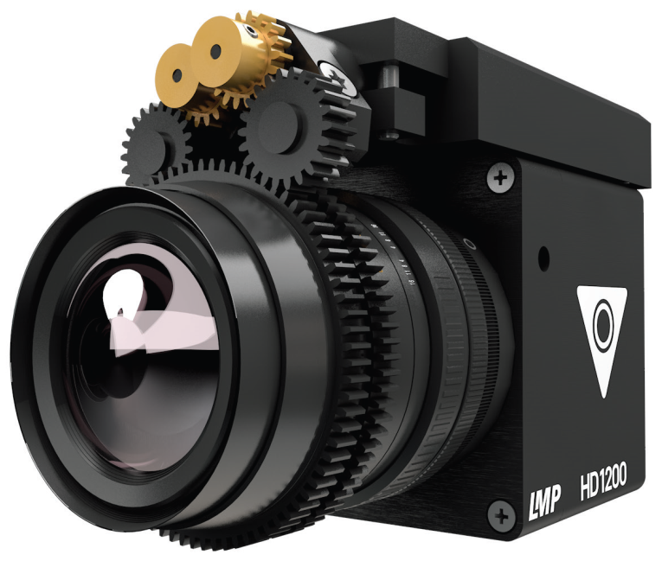
Cerberus LMP HD1200 (single Bayer array)
Max frame rate: 1920 x 1080 at 60P
Internal recorder: No
Recorder interface: 1080p Dual Link SDI or HDSDI RAW Data in 12/10 bit Cineform DFX.
Lens: C, B4 mount.
Control interface : 232C serial and USB.
Field of view ?? degrees with ? prime lens.
- Side
+ Side
Small.
Can change lens.
Low cost lens.
Unknown picture quality in our application.
Single 2/3” sensor.

Slide 34
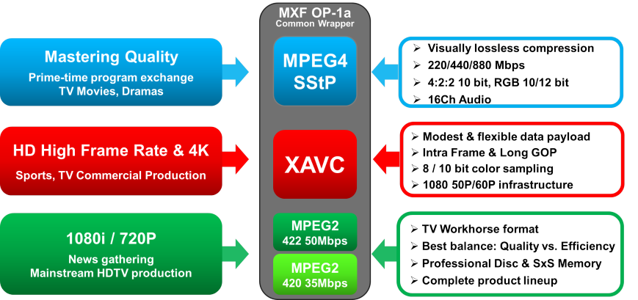

Slide 35
