Slide 1
i2MAP Dome Failures
Two variations of the dome seat were tested, design #1 with a flat seat and design #2 with a flat seat with some compliance from a machined groove.
Project engineer Mark Chaffey chma@mbari.org
Mechanical engineer Francois Cazenave francois@mbari.org
Assembled by mrc 2/17/2016
Rev. B 26FEB16

Slide 2
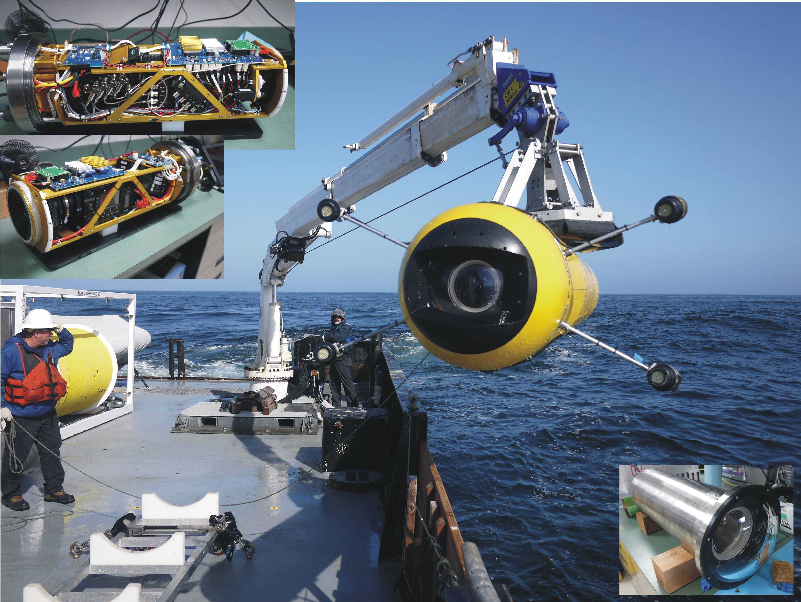
The Application

Slide 3
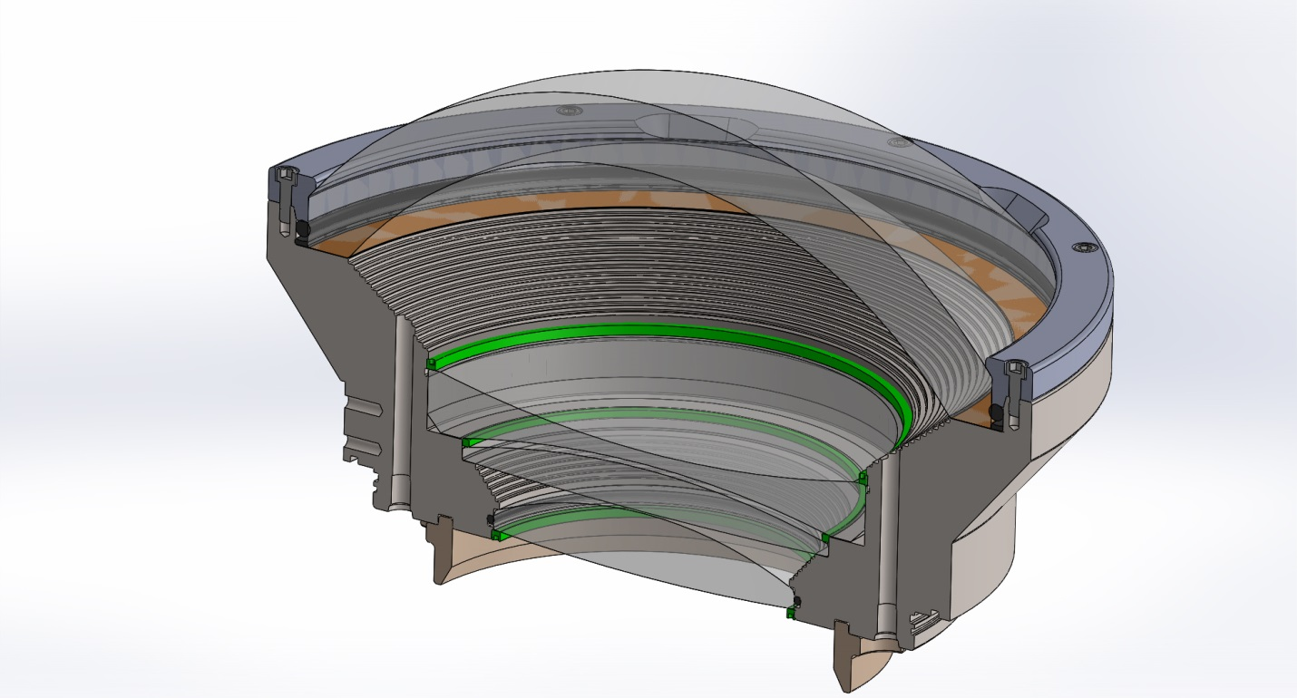
Dome Seat Design #1
Dome material: H-K9L glass (similar to BK7)
Outer Diameter: 250mm
Thickness at apex: 22mm
Design depth: 1500 meters seawater (~2175 p.s.i)
Kapton support gasket thickness: 0.005”

Slide 4
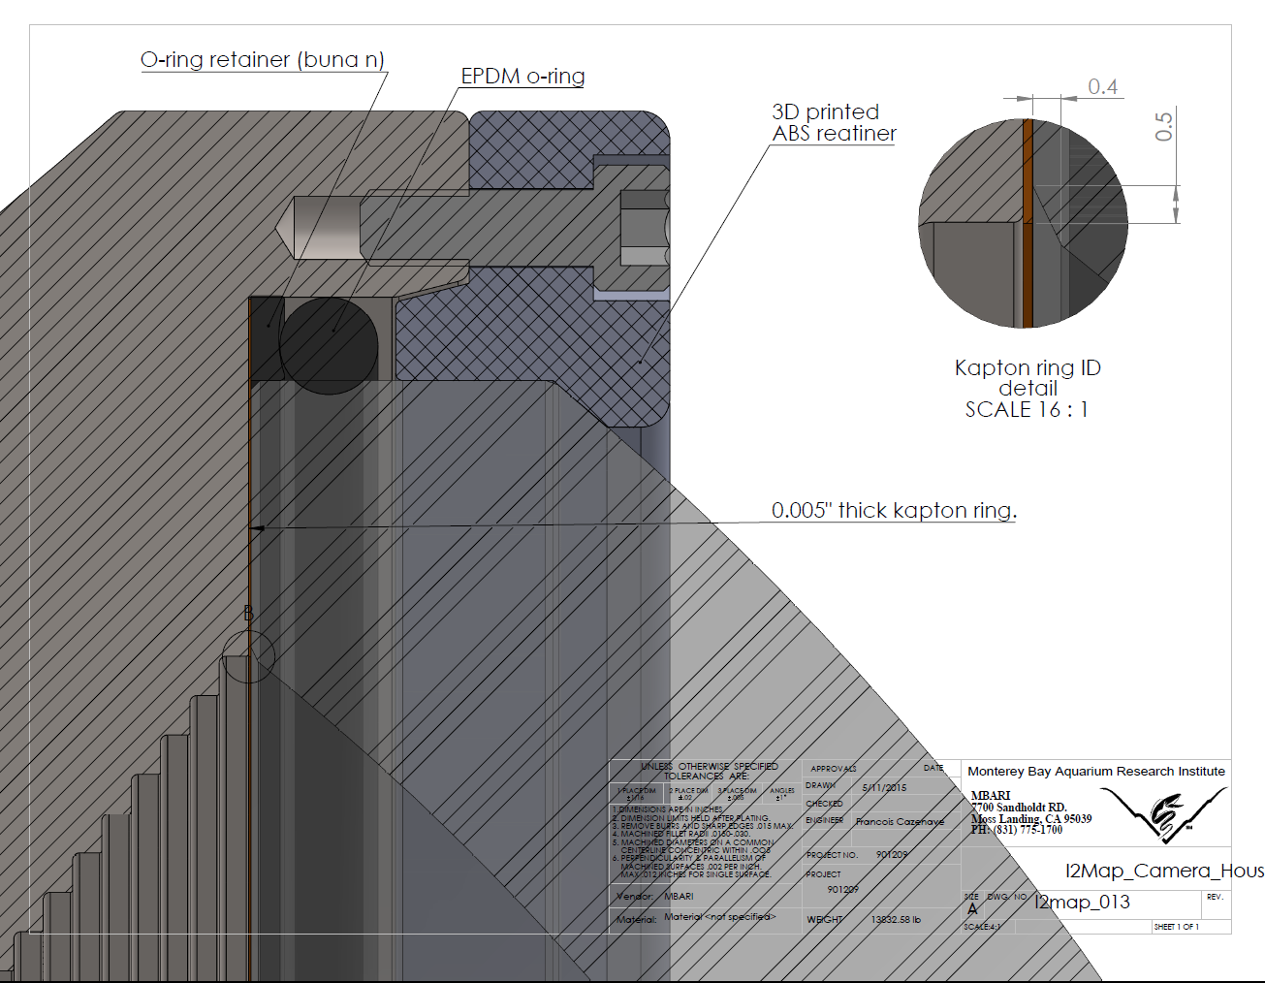
Detail of Design #1 Dome Seat

Slide 5
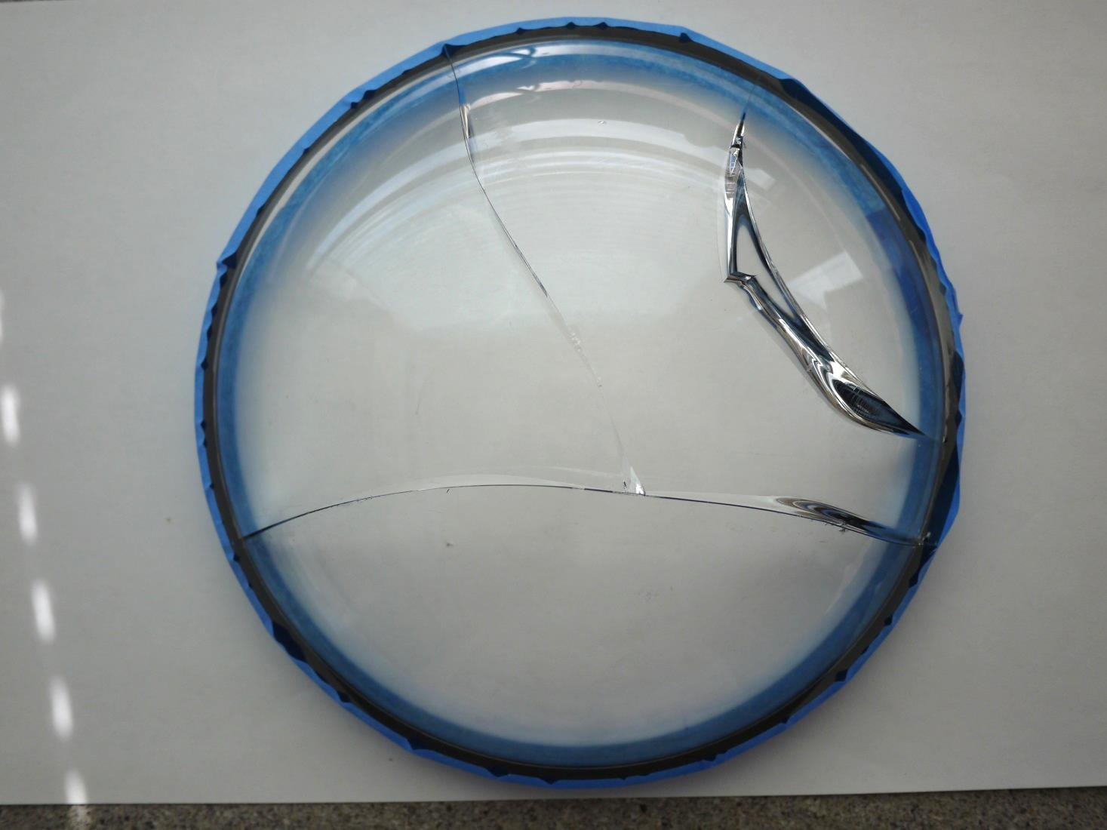
Design #1 Dome Failure
Initial failure points?

Slide 6
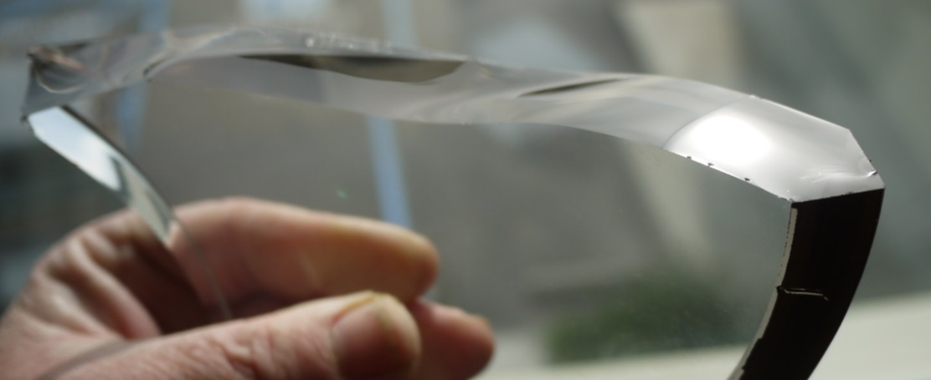
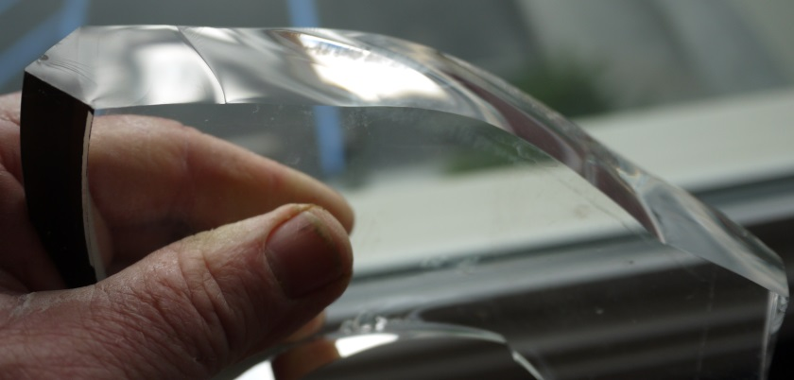
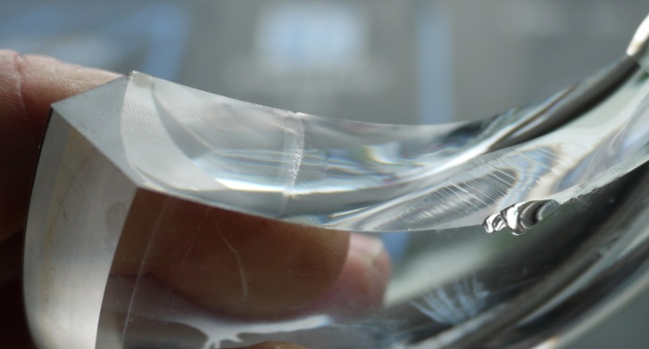
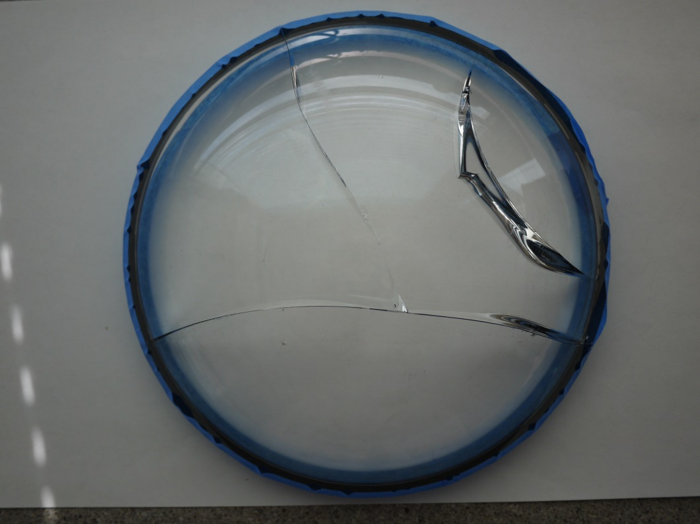
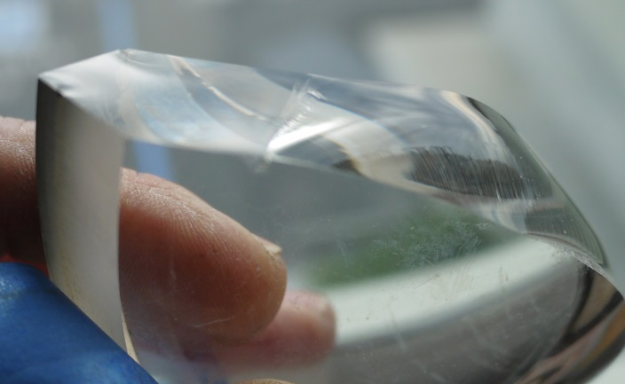
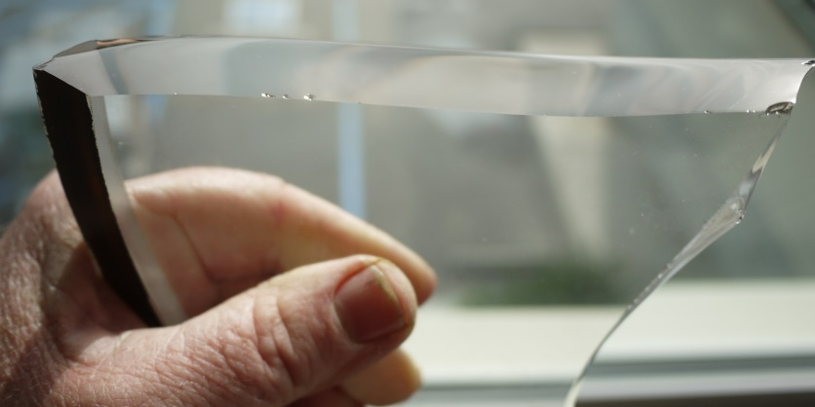
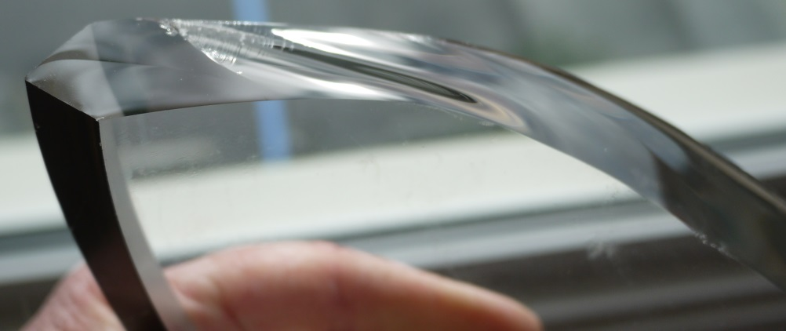
#1
#2
#3
#4
#5

Slide 7
Description of Dome #1 Cracks
#1 Appears to show slow crack growth through a mirror section to 27mm then a distinct boundary which probably is a transition to rapid failure.
#2 Also shows a mirror section of 27mm and a boundary.
#3 Also shows a mirror section of 25mm and a boundary.
#4 Also shows a mirror section of 24mm and a boundary.
#5 Show no boundary and no lead-in mirror region implying that the failure along this crack occurred all at once.
The conclusion drawn from this is that the dome slowly cracked under continuous stress at locations #1-4 until the cracks reached about 25mm and then the dome rapidly failed at all locations.
Note that this same design suffered no damage in subsequent testing at a slightly lower pressure:

Slide 8
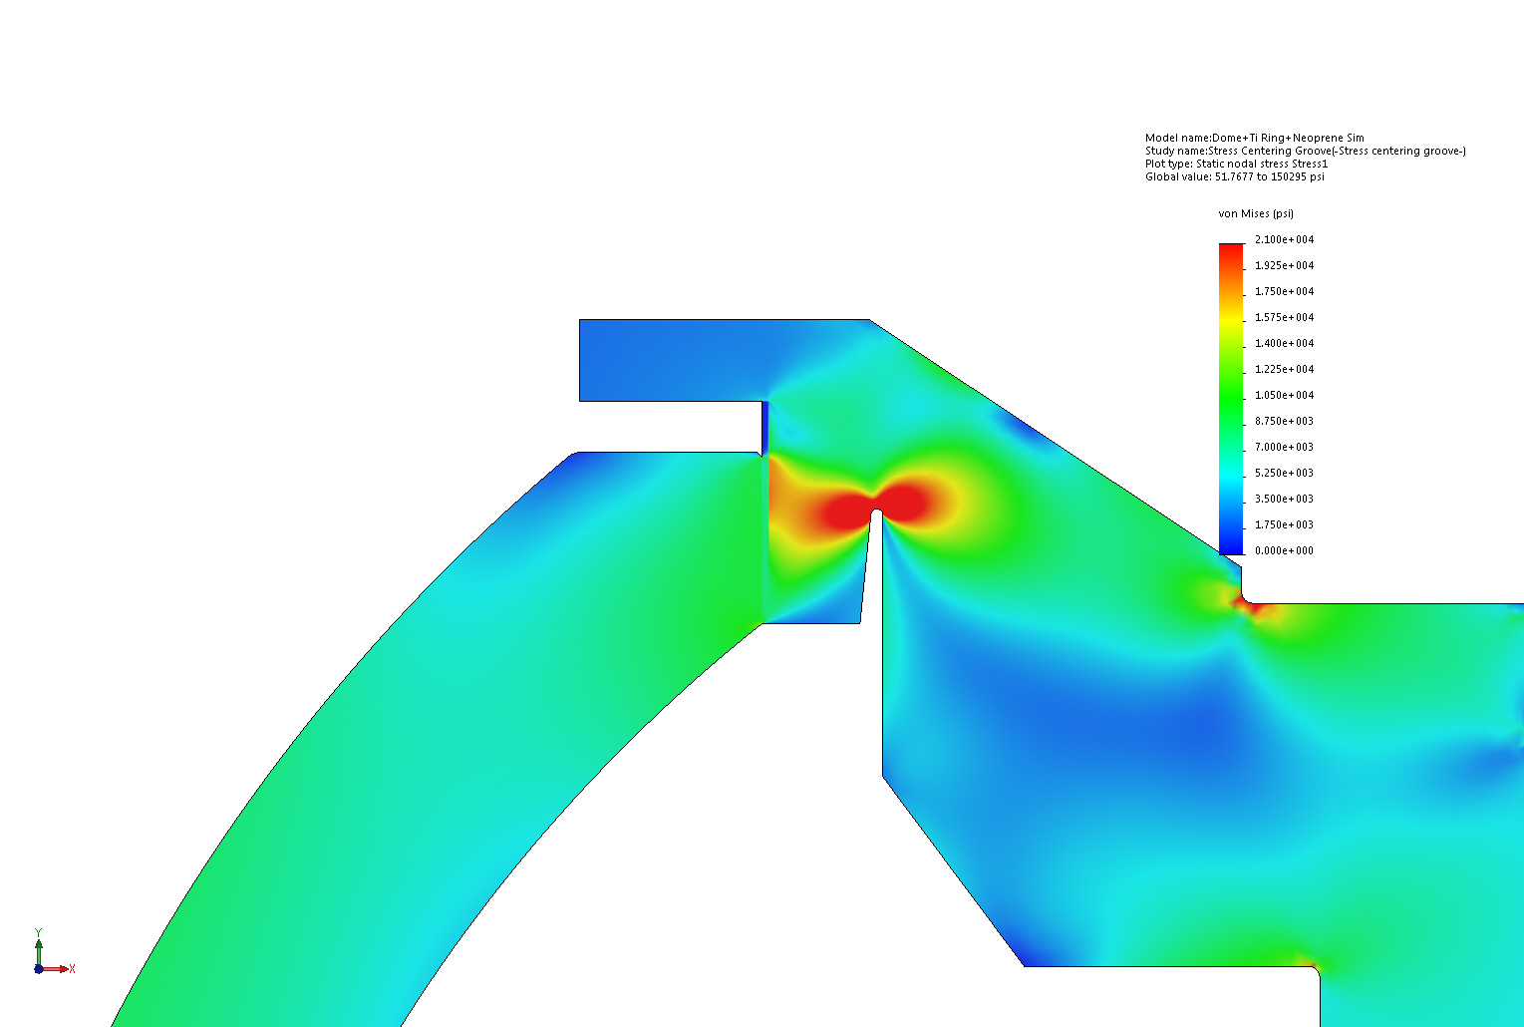
Dome Seat Design #2
Added chamfer to glass
Same design as #1 except for; addition of groove below the seat to allow slight flexure of dome seat under hydrostatic pressure, Kapton ring thickness under dome seat was increased from 0.005 to 0.020 thickness, the seat areas was optically polished, and a small polished chamfer was added to the dome inside radius (outside radius already had a ground chamfer).

Slide 9
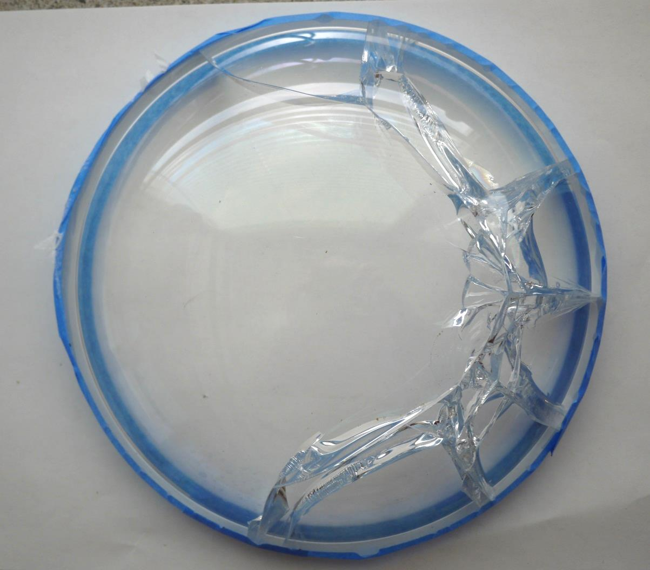
Design #2 Dome Failure
Initial failure point?

Slide 10
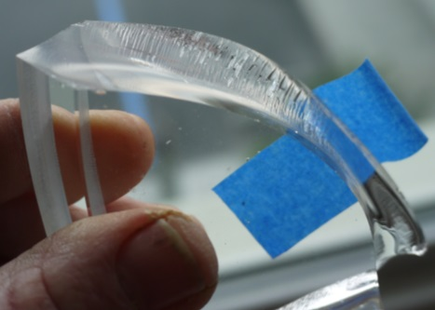
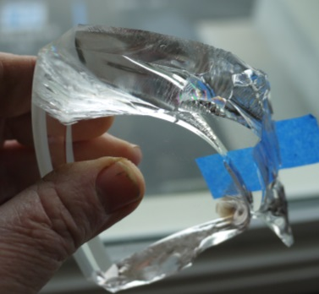
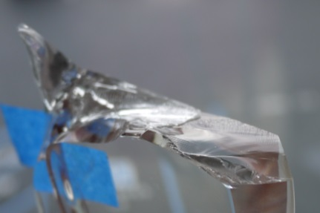
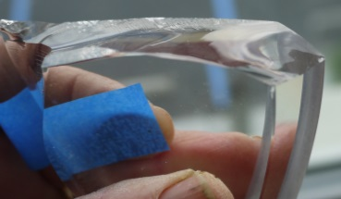
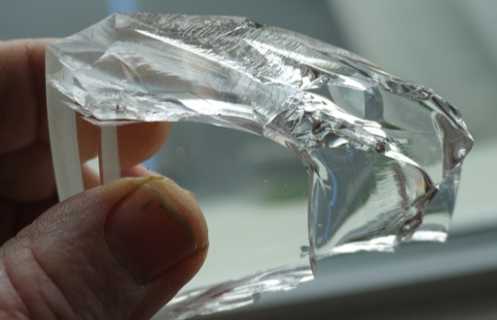
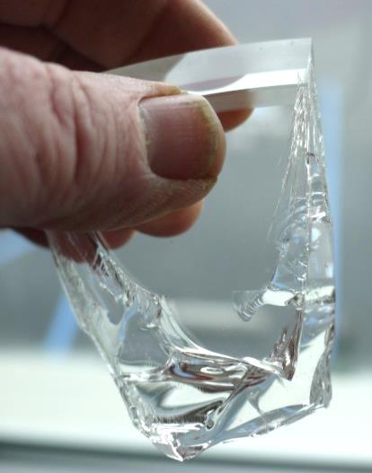
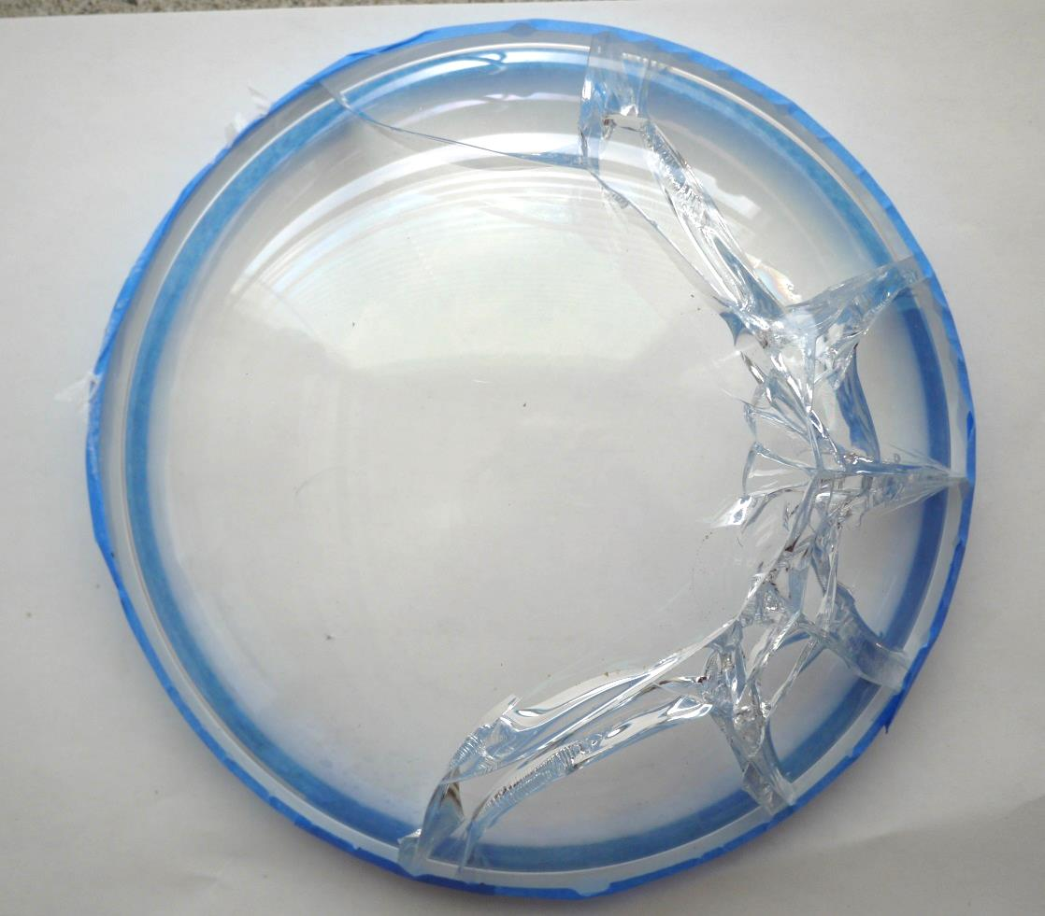
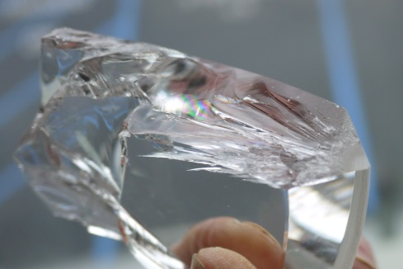
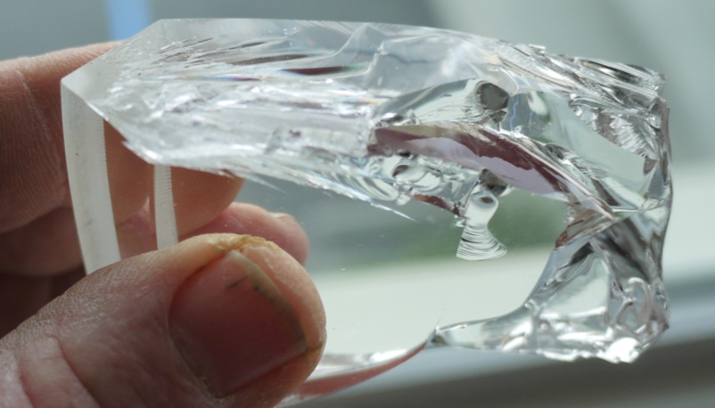
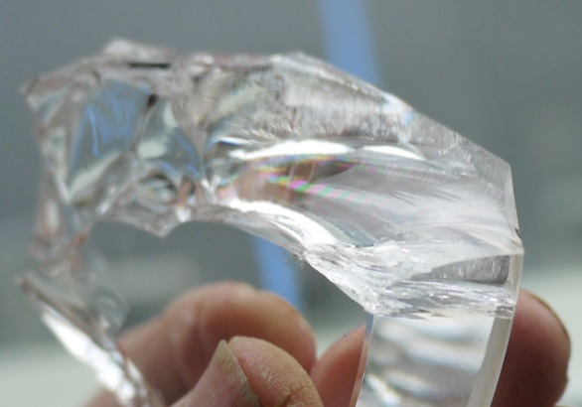
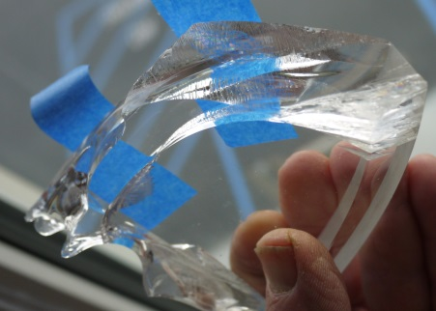
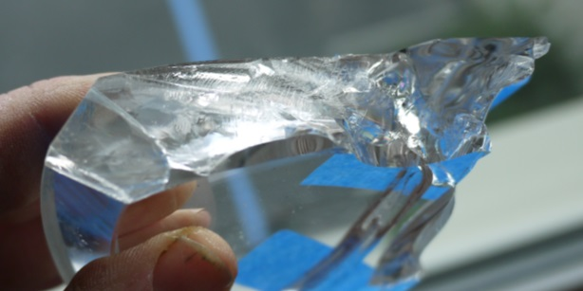
Radiating fracture lines
#4
#2
#1
#3
#4
#5
#7
#6

Slide 11
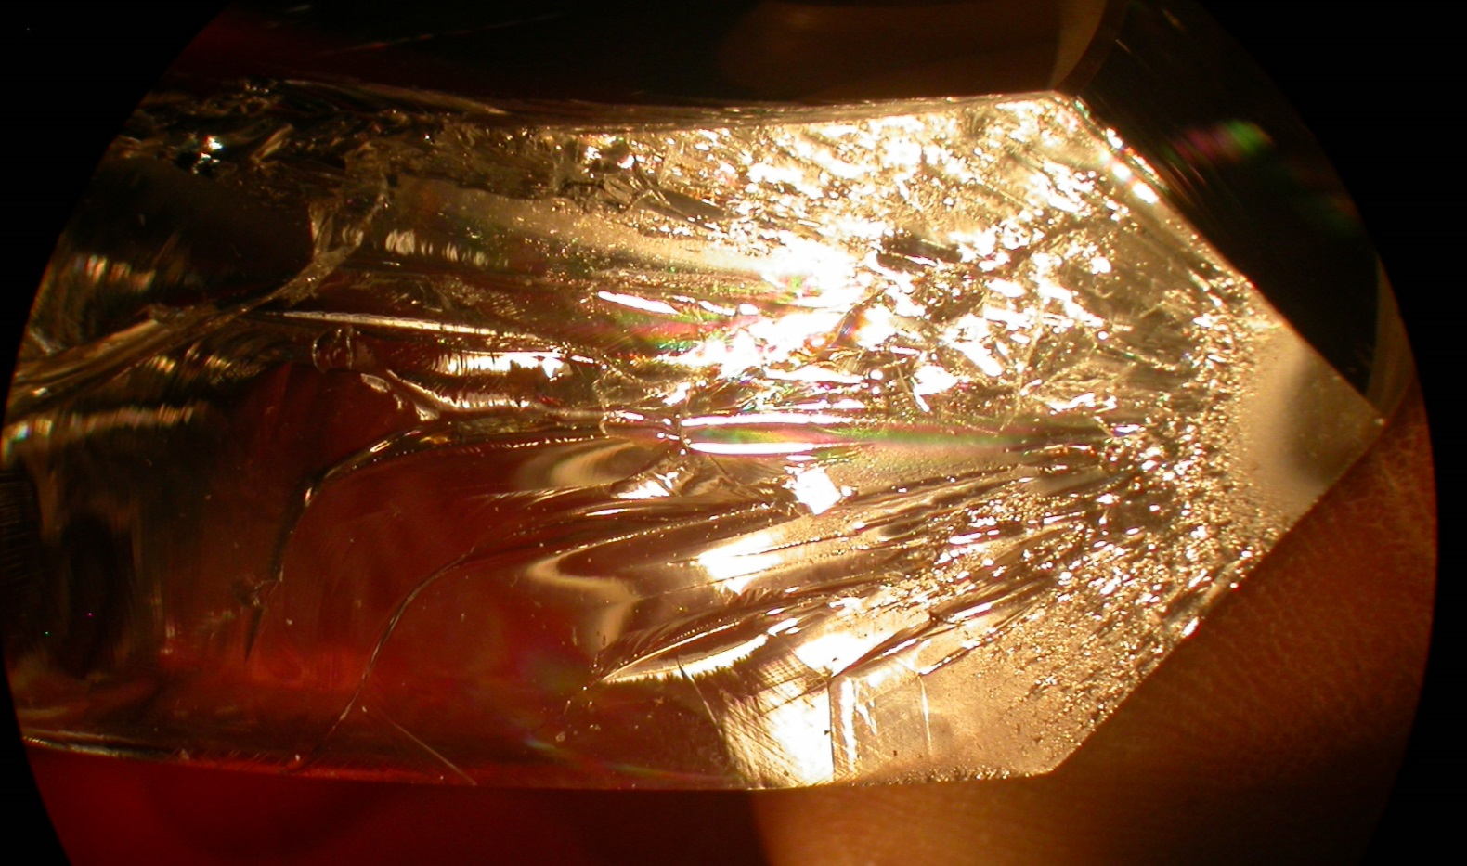
Close-up of fracture #4

Slide 12
Description of Dome #2 Cracks
Note that a surface defect was observed on the outer rim of the dome before pressure test. It was a small ~ 1mm chip in the outer ground chamfer. It was marked with a (now faint) black magic marker line. One of the radius cracks did occur at this location.
#1 Appears to indicate a failure along the inside radius of the dome that simultaneously expanded to the dome edge and seat. It did not originate at the rim or seat area.
#2 Appears similar to #1.
#3 Also appears similar to #1 although slightly more chaotic. The last place to fail was at the dome inner seat chamfer.
#3 The other split on #3 also appears similar to #1 although, again, slightly more chaotic. It appears that the crack radiated from the center inner radius of the dome toward the seat area.
#4 Appears to slowly start precisely at the junction of the seat and the outer radius of the glass dome. The crack grew to 3mm in a “mirror” region, then extended rapidly into a mist and hackle region up into the dome. Radiating cracks indicate the glass was highly stressed around the area of failure and that the failure was rapid once the crack developed beyond 3mm. This crack may have been the initial failure point.
#5 Again is similar to #1 and the failure appears to have first occurred on the inner radius and radiated out to the dome edge and seat area.
#6 Is fairly chaotic but appears to possibly have originated in the inner edge and outer edge dome seat area, but probably during the complete dome failure. No evidence of slow crack growth.
#7 Appears to have originated on the dome inner edge and migrated out to the dome edge and seat area.
The conclusion is that the initial cracking was at location #4, precisely at the outer edge of the dome seat. The crack only grew to 3mm before the entire dome failed, implying that the glass along the failures was highly stressed. This is supported by the radiating cracks from this location. All of the other cracks are more chaotic. Only crack #6 bears any indications that it might have originated along the outer dome edge. The fact that there is little evidence of slow crack growth and that the failure occurred at much lower pressures than dome #1 leads to the conclusion that the dome in design #2 is much more highly stressed.

