Slide 1
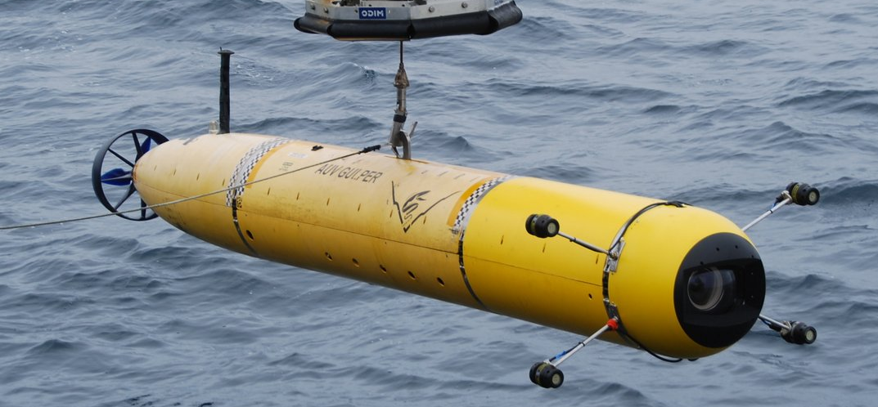
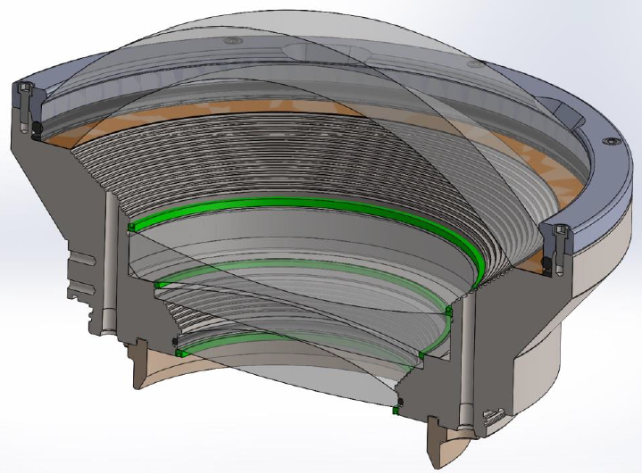
Optical Dome Reliability Analysis
Monterey Bay Aquarium Research Institute (MBARI)
Eric H. Baker
Connecticut Reserve Technologies, Inc.
August 2016
PRELIMINARY ANALYSIS: Provided for demonstration of progress. Not intended to be a complete or final analysis.

Slide 2
Outline
Perform Brittle Material Reliability Predictions on the Deep Water Camera Port of MBARI’s Autonomous Underwater Vehicle (AUV)
Acquire Dome and Dome Support geometry from MBARI
Generate finite element analyses of 3 Dome Configurations and calibrate models to MBARI FEA as well as Pressure Test Measurements
  Challenge: Coefficient of Friction of Kapton Gasket unknown
Estimate Weibull Material Properties from provided specimen failure data
Establish a Proof Test Protocol to improve the Reliability
8/2/16

Slide 3
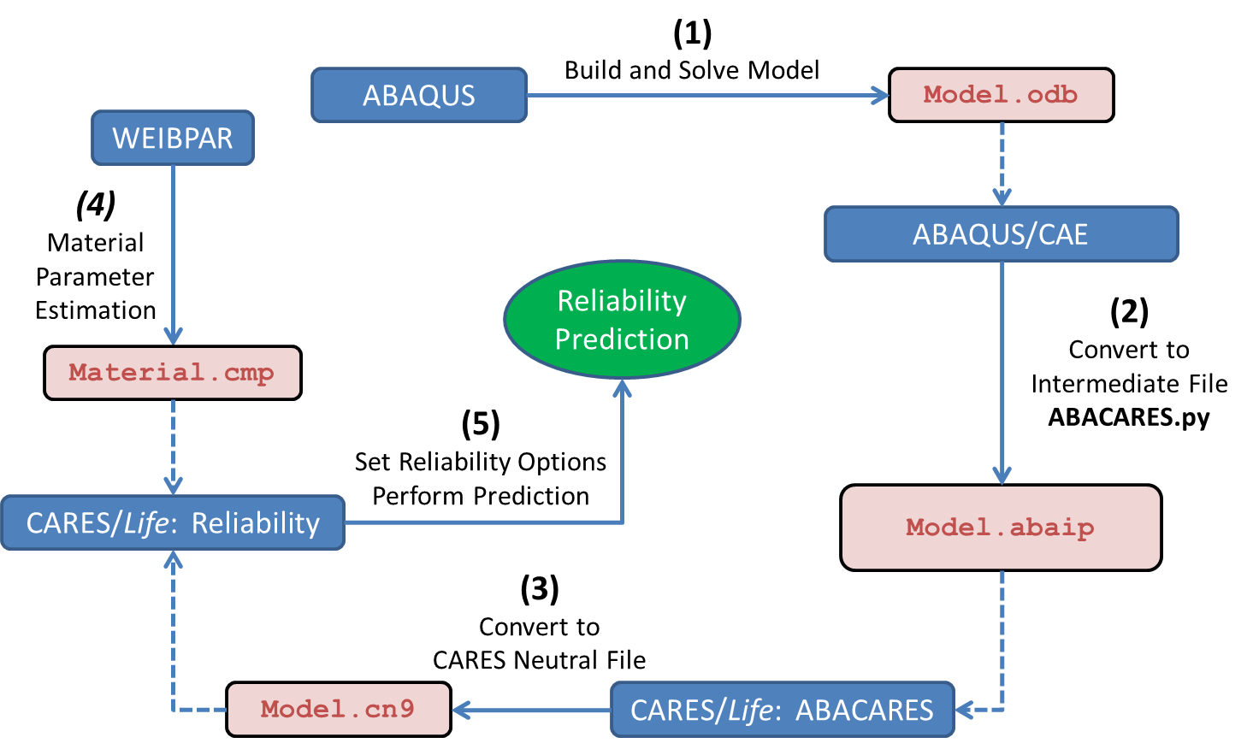
CARES with ABAQUS Flowchart
CARES predicts the brittle material reliability of a component by post-processing finite element analysis stress results.
CARES requires region based Weibull material properties, Volume and/or Surface, where different Surface conditions are characterized by different parameter sets.
8/15/16

Slide 4
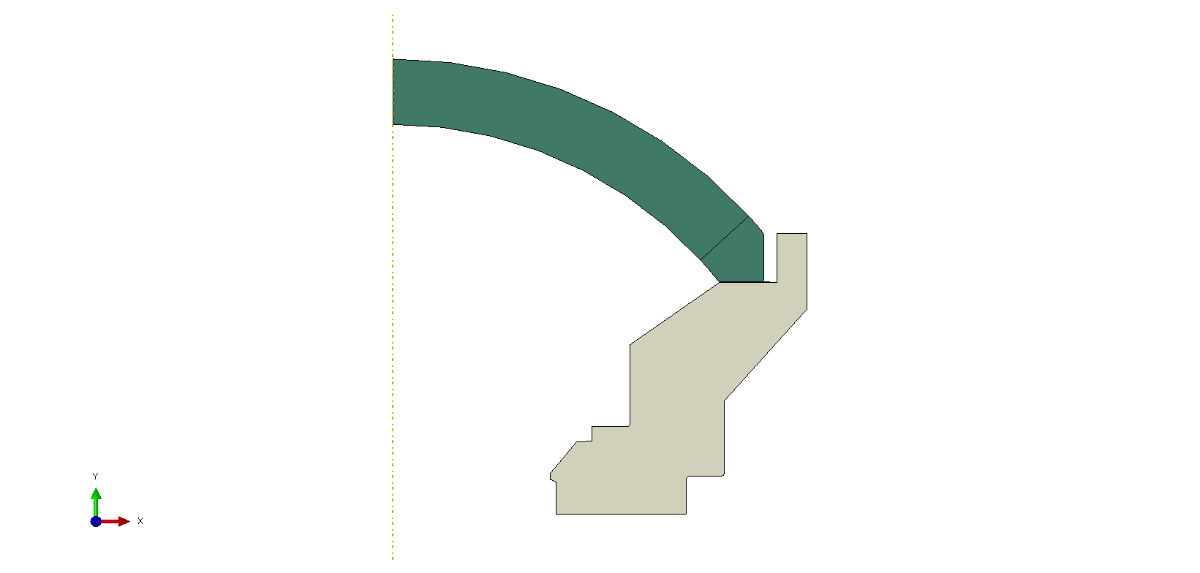

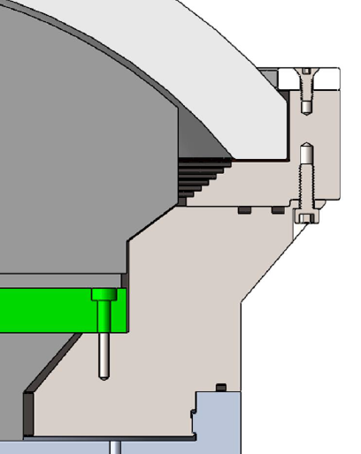
Dome Configurations
#1
#2
#3
Dome Restricted from Moving Radially
Dome Free to Move Radially
Dome Free to Move Radially
Dome
Kapton
0.005”
Added Bevel
Kapton
0.020”
Groove
Support
8/2/16

Slide 5
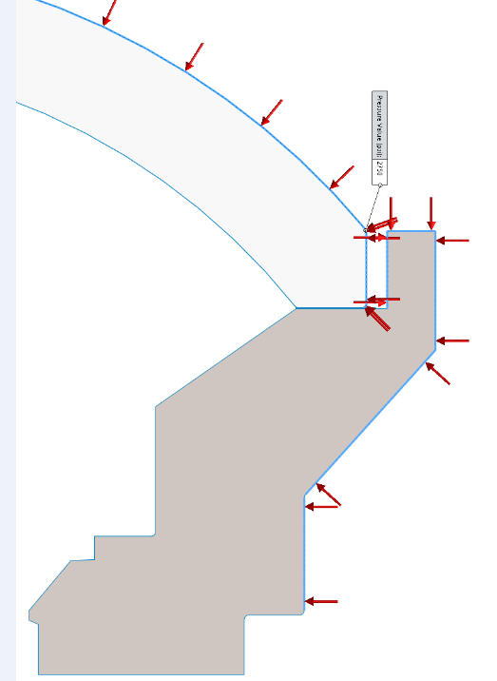
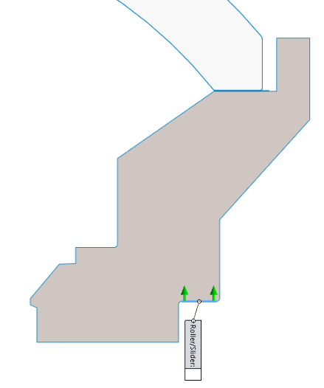
Boundary Conditions
Pressure
BC Axial: Fixed
Radial: Free
7/27/16
Per MBARI

Slide 6
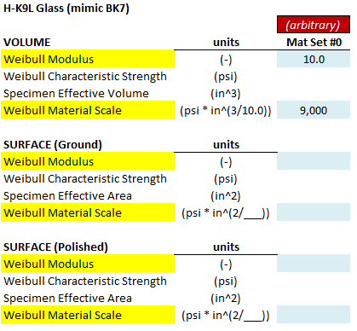
Material Properties
Mechanical
Weibull
Configuration #3
Dome Support
Material Trade-study
Values needed
Waiting for Material Testing…
8/5/16

Slide 7
Dome Configuration #1

Slide 8
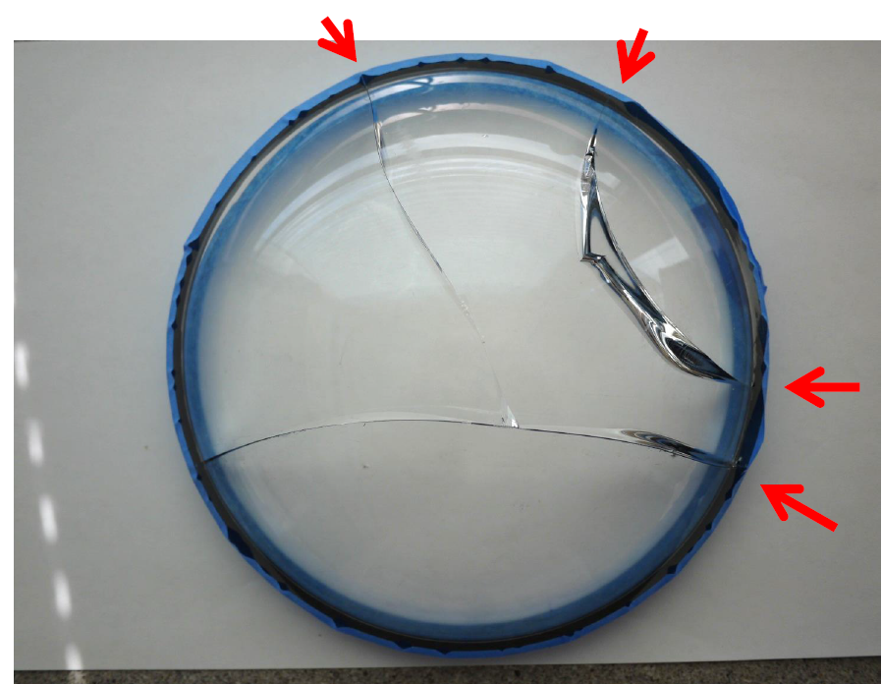
Dome Configuration #1
Design
Failure During External Pressure Test
2,750 psi
Dome Free to Move Radially
Dome
Kapton
0.005”
Support
7/27/16

Slide 9
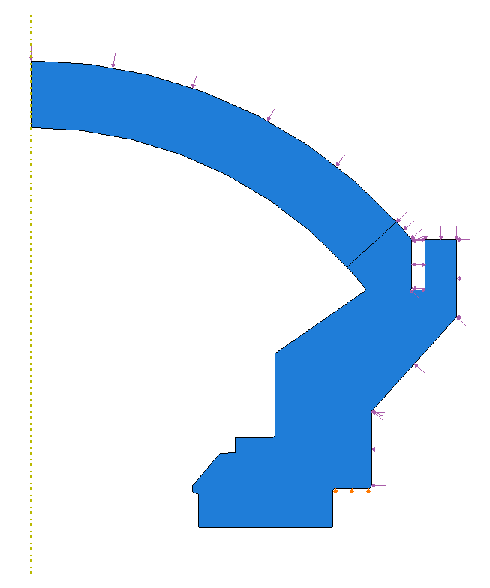
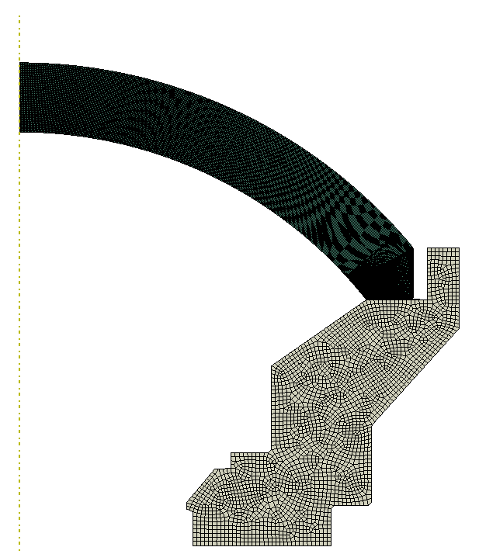
2D Axisymmetric Model: Configuration #1
External Pressure Load
Partition Line
for Mesh
Dome
Kapton
Mesh
Support
Dome is free to move Radially
BC: Radial = free, Axial = fixed
8/2/16
Configuration #1

Slide 10
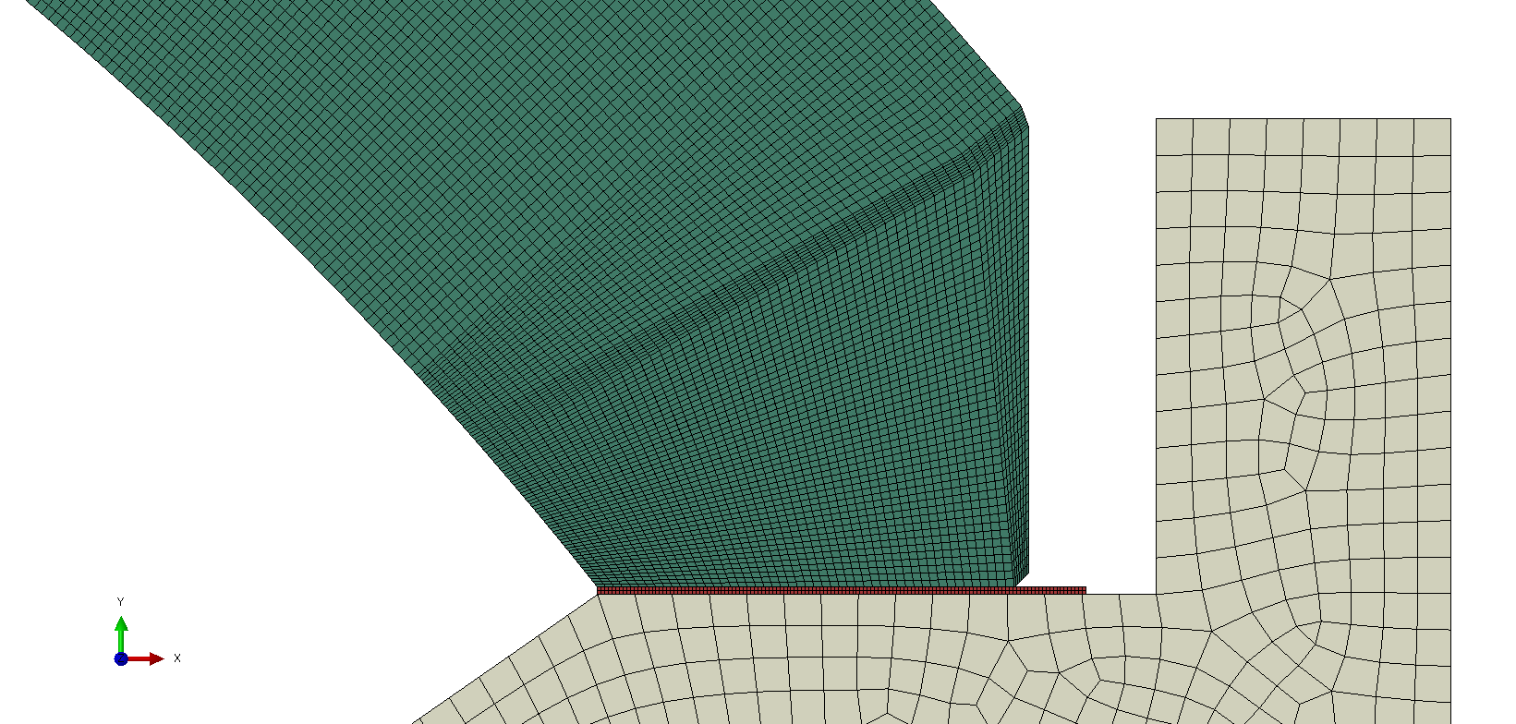
Dome Mesh Refinements on Bevels
Bevels
Dome
Analyses will study Bonded and Frictionless Interfaces between Dome and Kapton
Kapton 0.005”
Support
7/28/16
Configuration #1

Slide 11
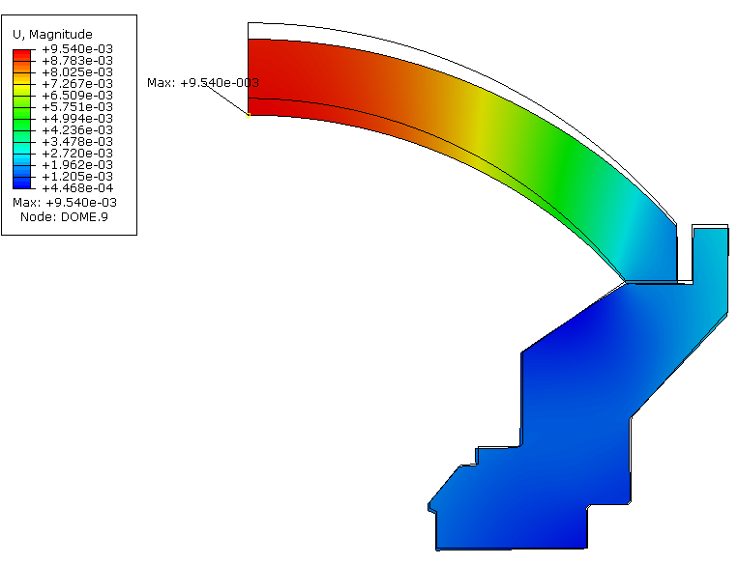
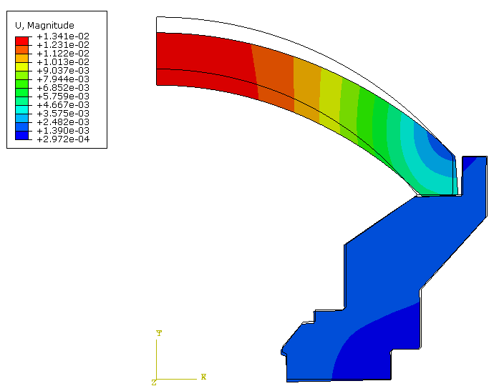
Displacements: External Pressure 2,750 psi
0.0095 in
0.0134 in
Dome-2-Kapton – Bonded
Kapton-2-Support – Bonded
Dome-2-Kapton – Frictionless
Kapton-2-Support – Bonded
Deformation Scale: 20x
8/2/16
v07
Configuration #1 @ 2750 psi

Slide 12
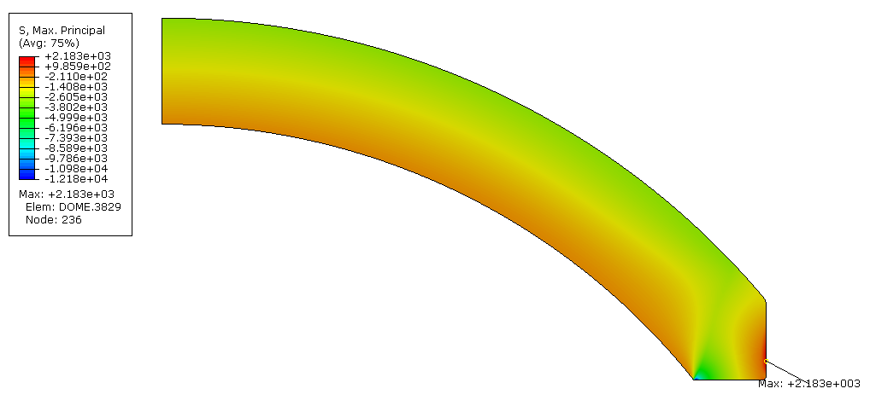
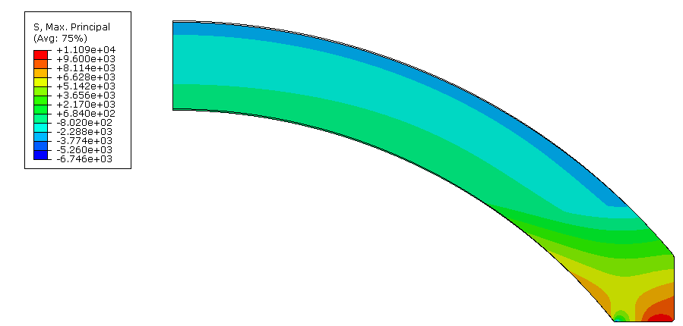
Maximum Principal Stress & Volume Reliability (example)
11,090 psi
2,183 psi
Dome-2-Kapton – Bonded
Kapton-2-Support – Bonded
Dome-2-Kapton – Frictionless
Kapton-2-Support – Bonded
8/15/16
v07
Configuration #1 @ 2750 psi

Slide 13
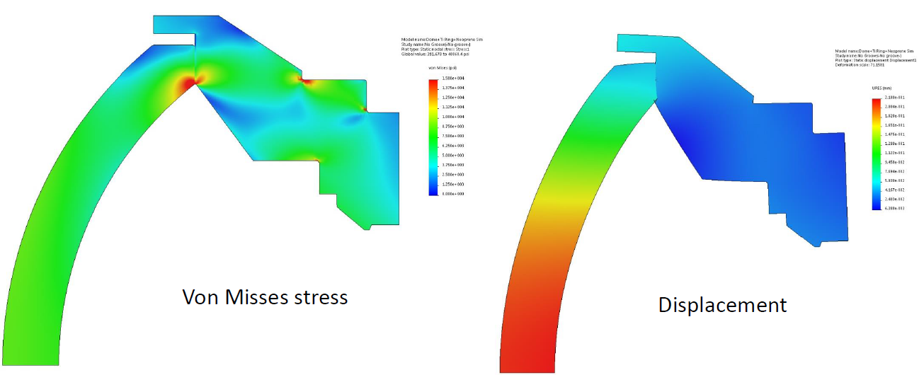
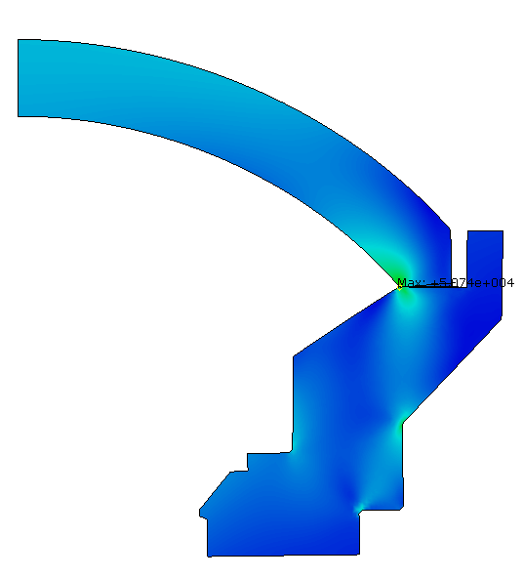
Solidworks FEA (provided results)
Pressure: unknown Coefficient of Friction: 0.5 (arbitrary)
Solidworks
Solidworks
von Mises Stress
Scale: 0 to 15 ksi
Displacement
Scale: 0.006 to 0.218 mm
0.00024 to 0.0086 in
ABAQUS
Geometry Different!
Can not compare to ABAQUS
8/5/16

Slide 14
Dome Configuration #2

Slide 15
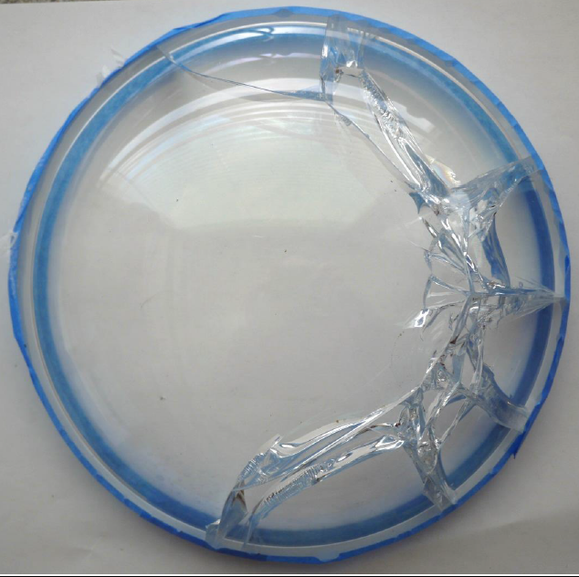
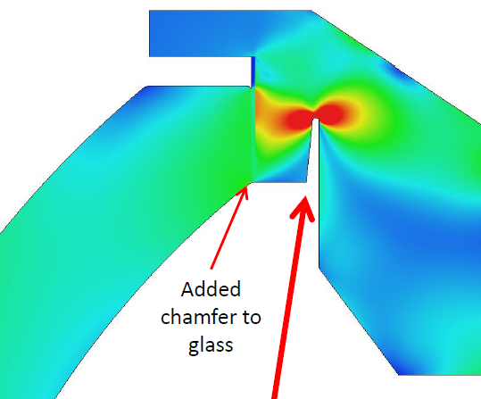
Dome Configuration #2
Design
Failure During External Pressure Test
Added Groove to Support
7/27/16

Slide 16
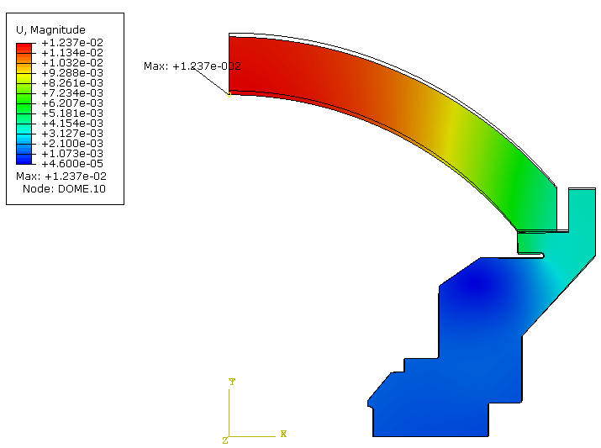
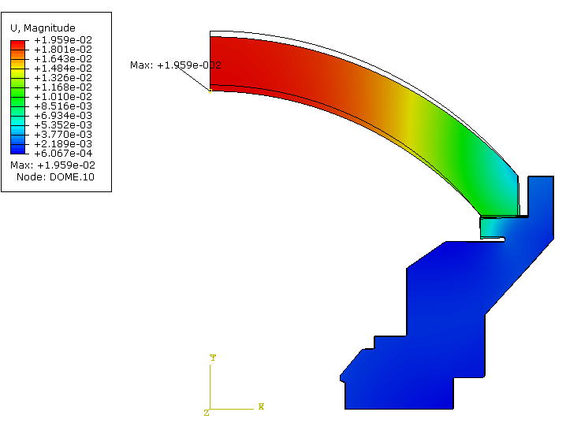
Displacements: External Pressure 2,750 psi
0.0124 in
0.0196 in
Dome-2-Kapton – Bonded
Kapton-2-Support – Bonded
Dome-2-Kapton – Frictionless
Kapton-2-Support – Bonded
Deformation Scale: 5x
8/15/16
v08
Configuration #2 @ 2750 psi

Slide 17
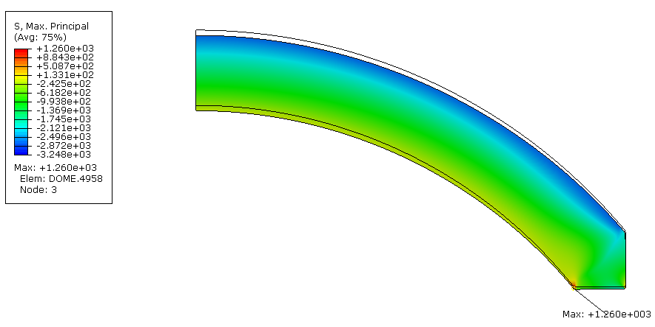
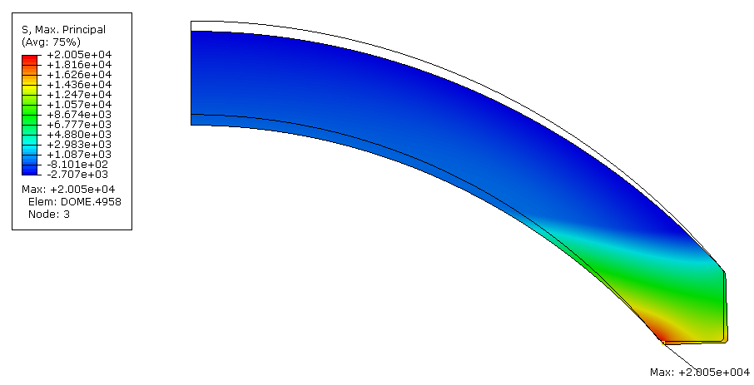
Maximum Principal Stress & Volume Reliability (example)
20,050 psi
1,260 psi
Dome-2-Kapton – Bonded
Kapton-2-Support – Bonded
Dome-2-Kapton – Frictionless
Kapton-2-Support – Bonded
8/15/16
v08
Configuration #2 @ 2750 psi

Slide 18
Dome Configuration #3

Slide 19
Dome Configuration #3
Design
External Pressure Test:
to be performed
Titanium Ring prevents Radial Displacement of Dome
7/27/16

Slide 20
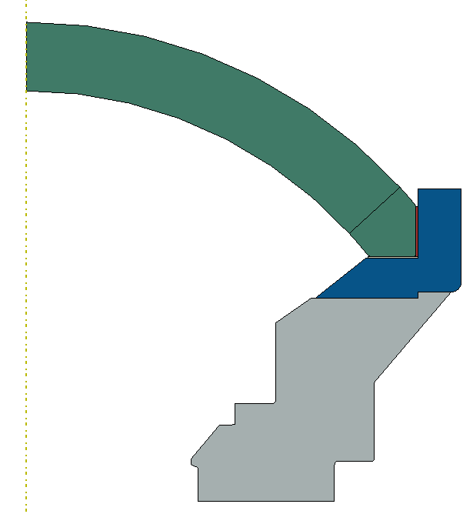
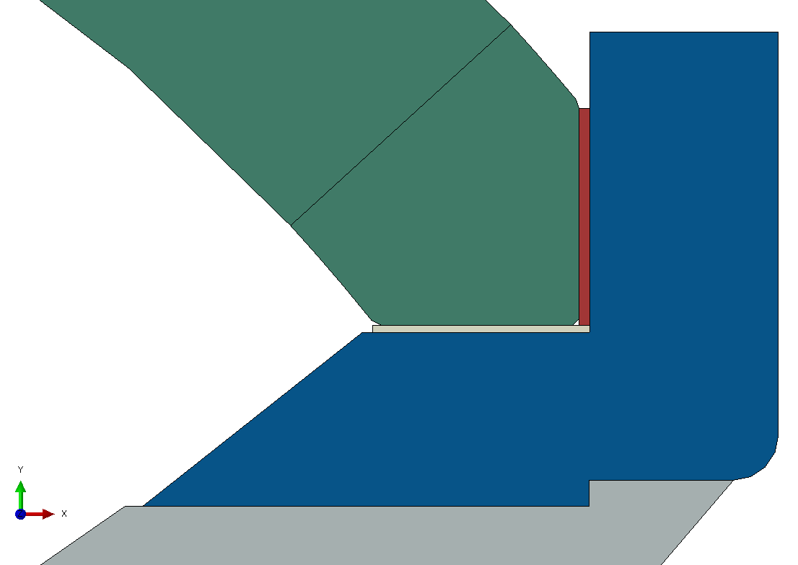
Dome Configuration #3
Dome
H-K9L
Resin 0.030”
Crystal Clear #200
Dome Coupler Ring
Ti-6Al-4V
Kapton 0.020”
Dome Support
Actual: Ti-6Al-4V
Test: 6061-T6
bonded
Frictionless – free to separate
Axial = fixed
Radial = free
8/5/16

Slide 21
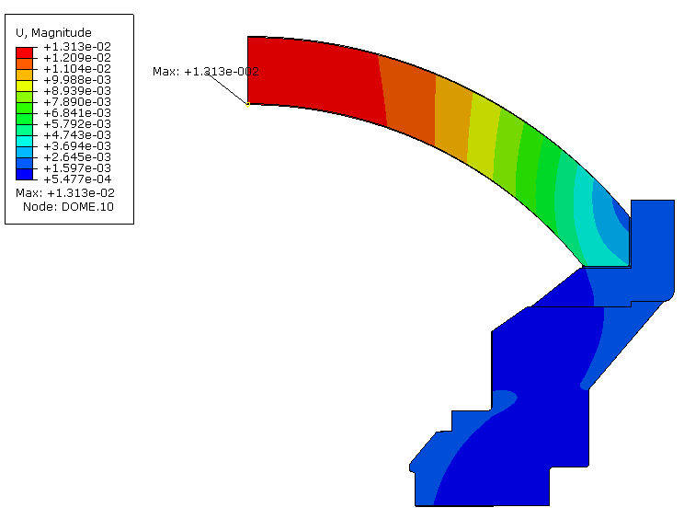
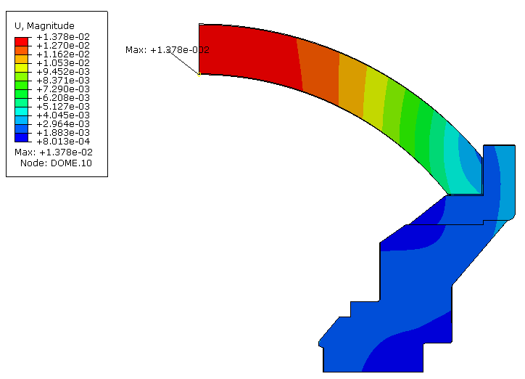
Displacements: External Pressure 2,750 psi
0.0131 in
0.0138 in
Titanium Coupler Ring
Aluminum Coupler Ring
Deformation Scale: 1x
8/15/16
v10
Configuration #3 @ 2750 psi

Slide 22
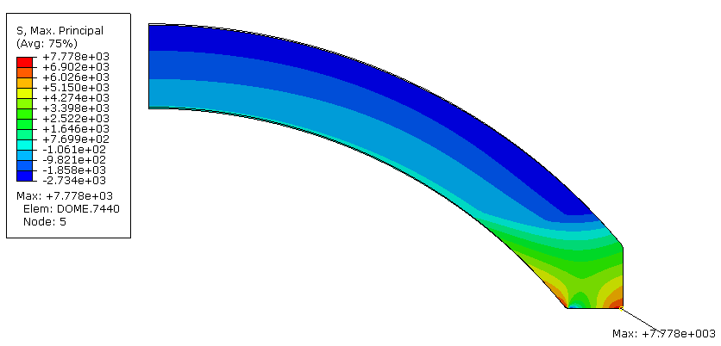
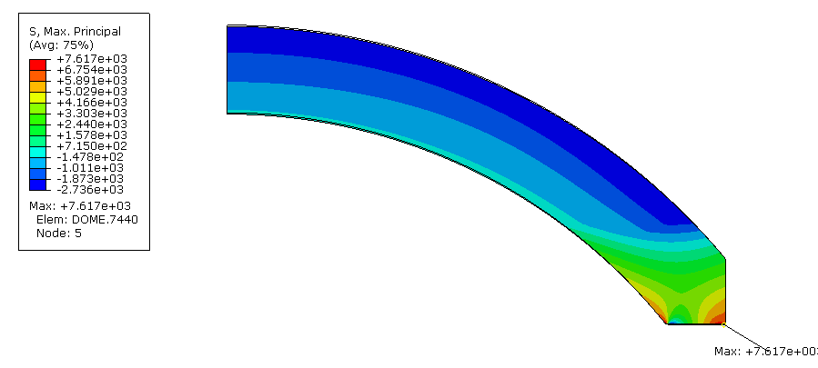
Maximum Principal Stress & Volume Reliability (example)
7,617 psi
7,778 psi
Titanium Dome Support
Aluminum Dome Support
8/15/16
v10
Configuration #3 @ 2750 psi

Slide 23
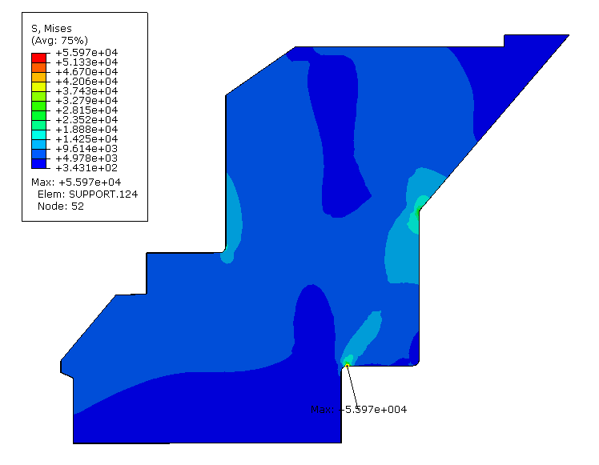
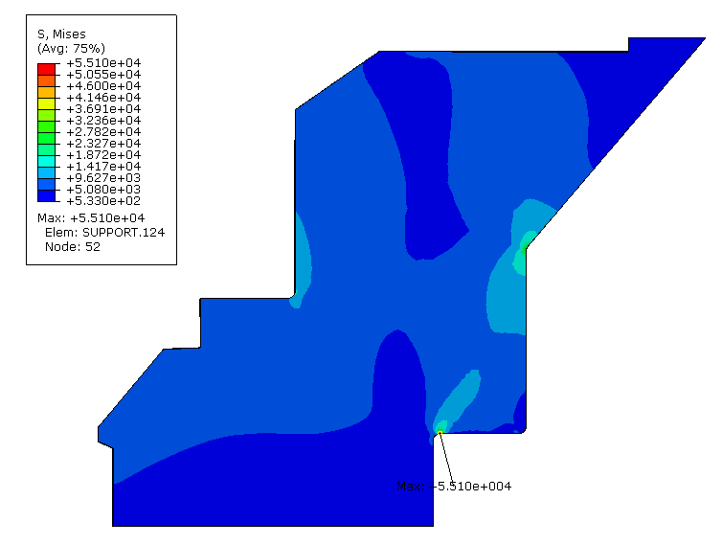
Dome Support Material Trade Study
Dome Support
Ti-6Al-4V
Dome Support
6061-T6
55.97 ksi < 120 ksi (yield)
55.10 ksi > 40 ksi (yield)
8/5/16

Slide 24
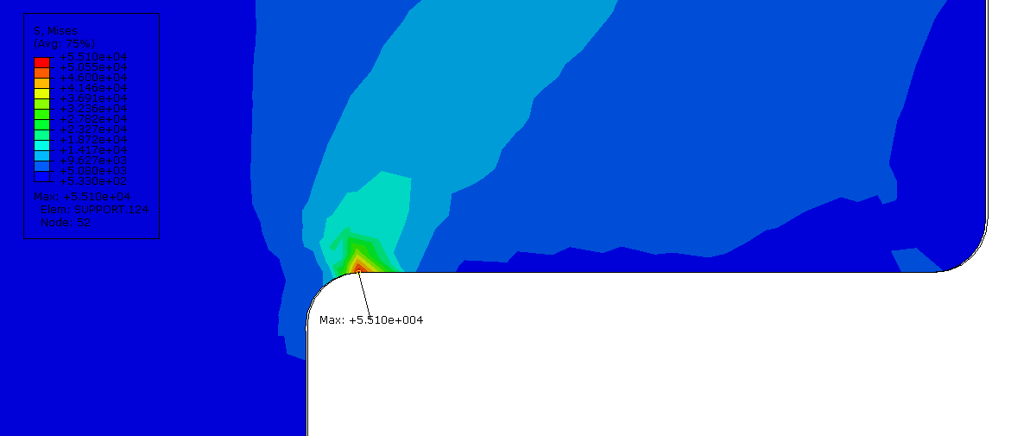
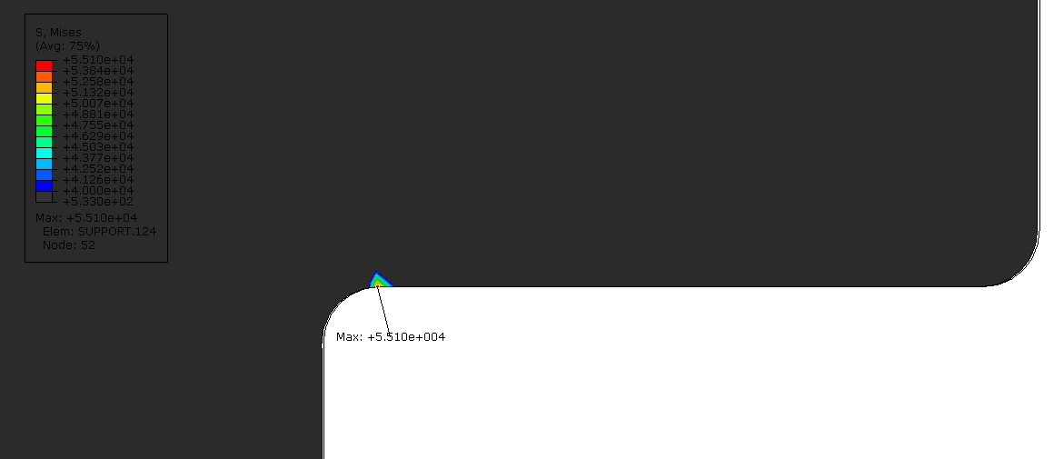
Dome Support – Aluminum
Dome (glass) stresses are very similar whether the Support is Titanium or Aluminum.
A very small region of the Aluminum Support exceeds the Aluminum yield strength – potentially due to the Boundary Condition
Colors Scaled 40 ksi to 55.1 ksi
8/5/16

Slide 25
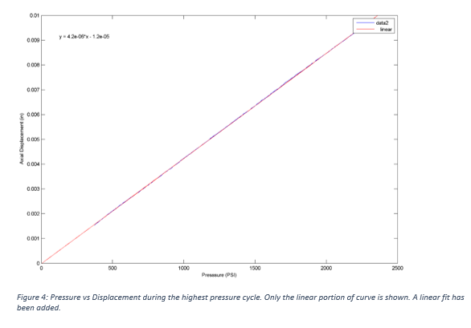
Dome Configuration #3 Test Measurment
Based on Chart 1500 psi would be ~0.0062” displacement …
REF: DescriptionOfPressureTestsOfDomePort.docx
8/25/16

Slide 26
RESULTS

Slide 27
COMPARSION of FEA’s & Test Measurements
Read from Chart – different than text…
8/25/16

Slide 28
SUMMARY OF RESULTS
PRELIMINARY
Arbitrary Weibull Parameters
10 & 9,000
8/25/16

Slide 29
BACKUP

Slide 30
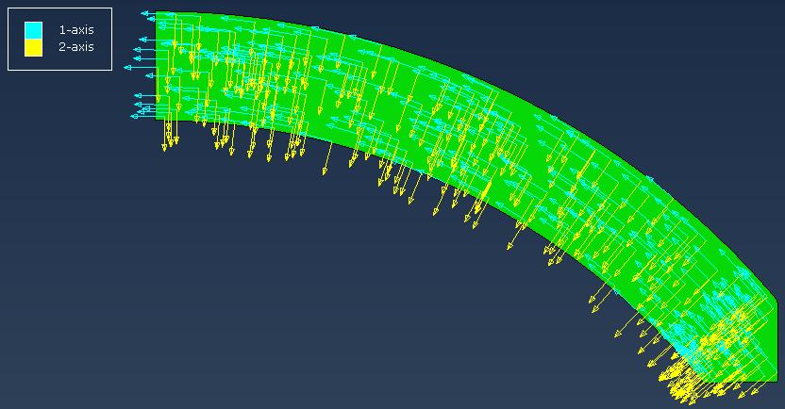
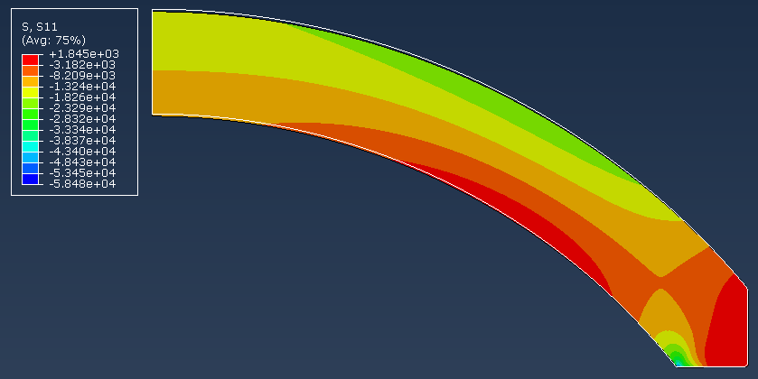
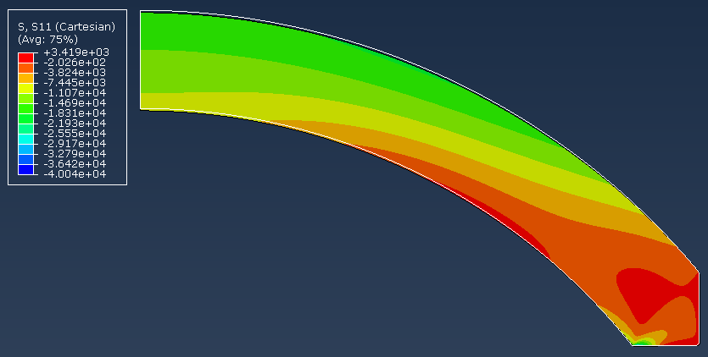
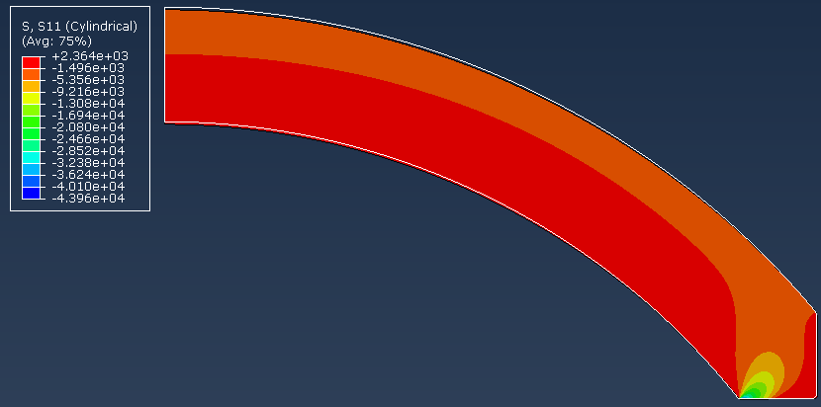
Local Coordinate System
Local Coordinate System
Tangential Stresses
Global X-direction Stresses
Normal (Radial) Stresses
7/27/16
Configuration #1

Slide 31
8/5/16

