Slide 1
I2map dome port design
Description of previous designs and failures.
Description of new designs.
3/31/2016 update

Slide 2
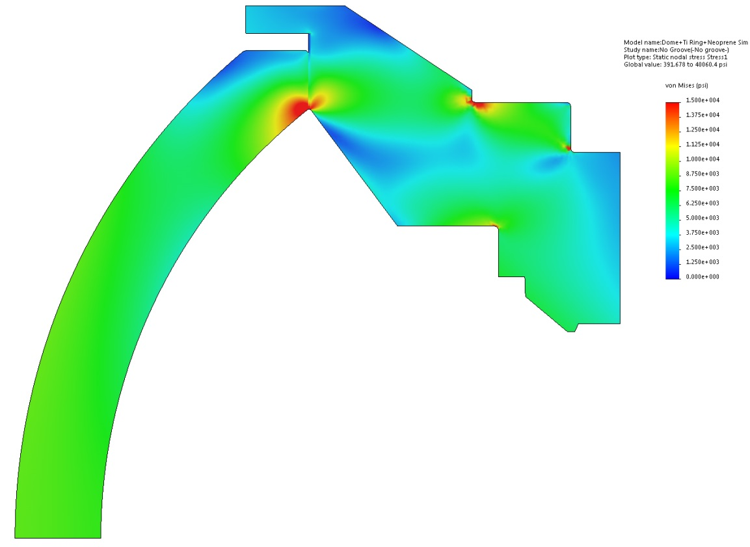
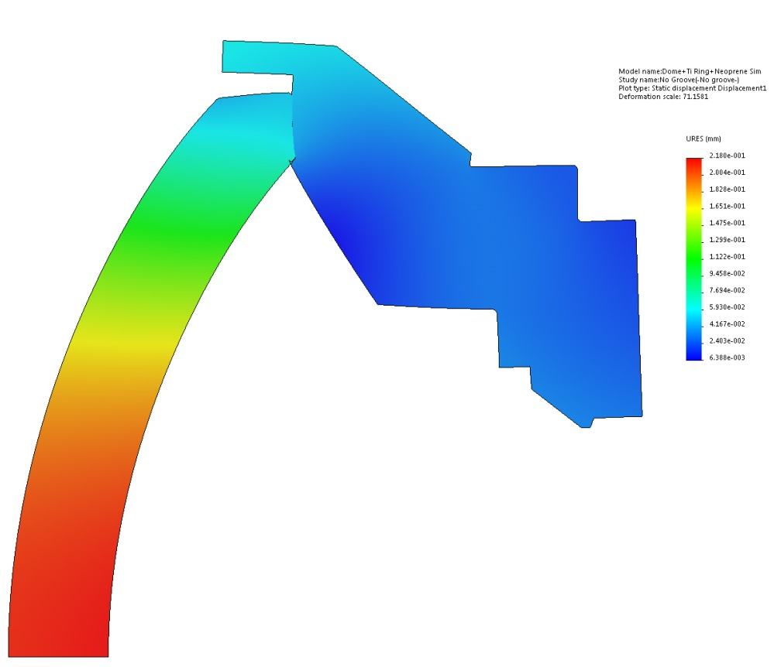
First design
Von Misses stress
Displacement
The coefficients of friction between glass and titanium, and between titanium and kapton are unknown. When using a medium (0.5) COF in SW Simulation, no sliding would occur between the glass and support ring so I assumed it was the case in reality.
I was most concerned with compressive stress near the inner edge and I thought tensile stress was low.
During the first test, there was no sliding and tensile stress was low (glass exhibits low stress failure). The failure occurred at 2750PSI after 10 cycles and several hours under pressure.

Slide 3
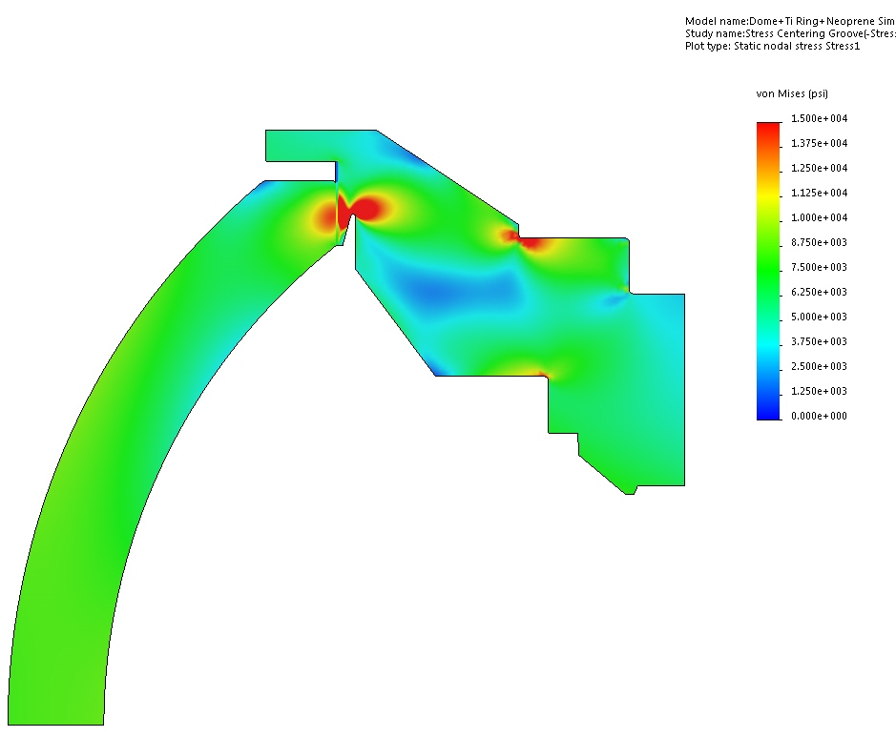
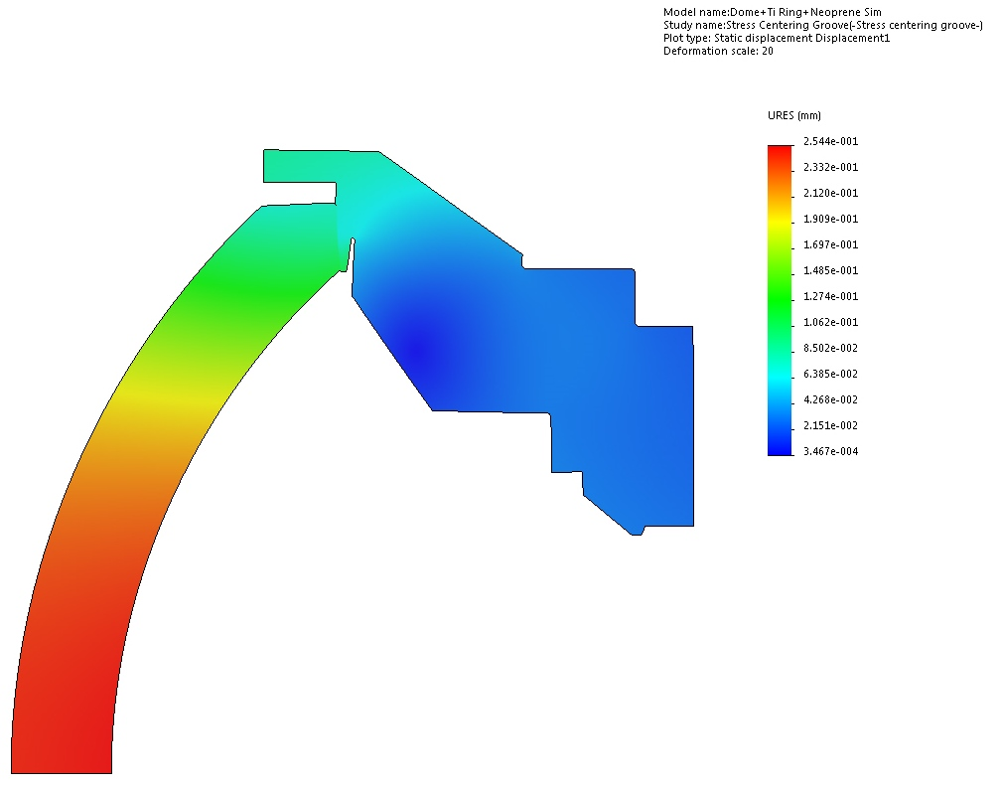
Second Design
we added a groove in the titanium to decrease compressive stress and to center it.
We had the glass polished and increased the kapton thickness. The smoother surface and even stress across the seat decreased friction and resulted in sliding.
Glass failed in tension due to hoop stresses on the periphery. Hoop tensile stress at failure was about 9000 PSI and radial displacement was 0.0045”, according to FEA (6000 PSI according to glass facture analysis). The failure occurred at 1570PSI, during the first cycle.

Slide 4
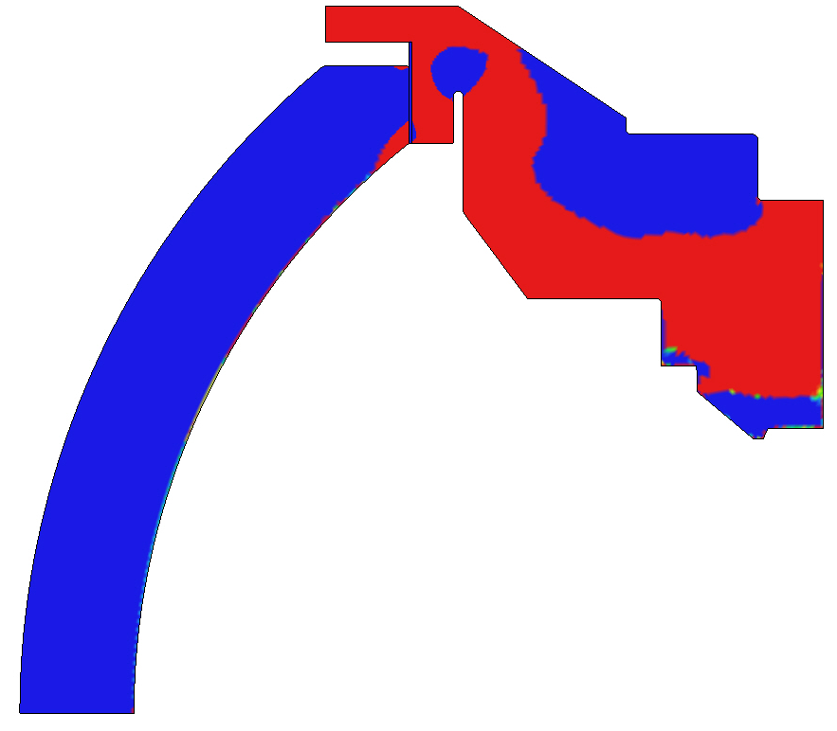
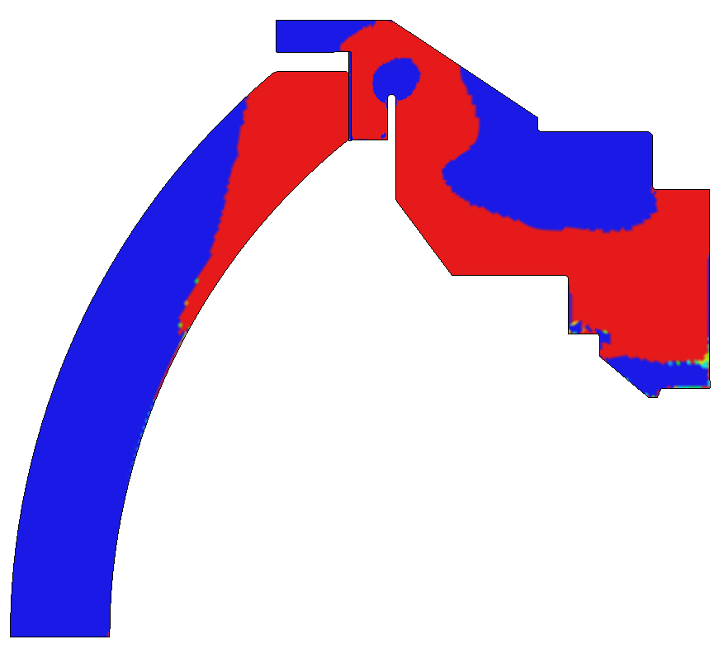
Comparison of sliding/no sliding cases
Blue: compressive stress
Red: tensile stress
Case with friction: no sliding
There is almost no tensile stress.
Mean 1st principal stress (at 1577 psi hydrostatic pressure):
on periphery: -188PSI
on seat: -355PSI
(negative means compressive stress)
Case with no friction: sliding occurred.
High tensile stress on periphery
MFPS on periphery: 6513PSI
on seat: 8982PSI
(positive means tensile stress)
Notes:
No grove case is not as bad

Slide 5
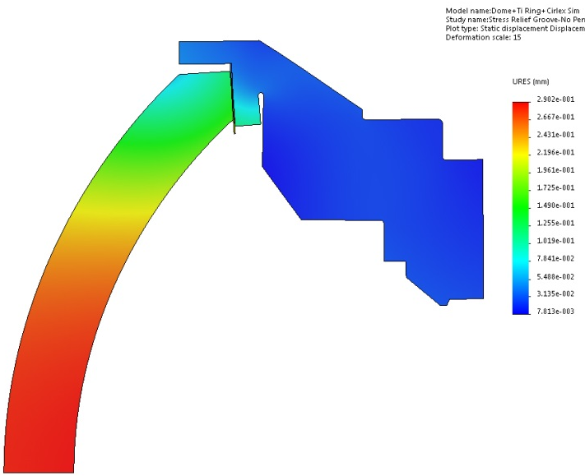
Comparison of sliding/no sliding, groove/no groove cases
Stress analysis for 1577 PSI (failure pressure)
Distances are in inches
Stresses are in PSI
FPS: first principal stress (pure normal stress, positive is tension, negative is compression)
 | Groove in titanium ring |  | No groove
 | No Friction | Friction | No Friction | Friction
Maximum displacement on dome axis | 0.0114 | 0.007 | 0.008 | 0.006
Maximum radial displacement | 0.0046 | 0.001 | 0.003 | 0.0006
FPS on outside surface | 6513 | -188 | 4723 | 705
FPS on Seat | 8982 | -355 | 6471 | -758
Measurement of axial displacement during test shows that the FEA matches exactly the case where sliding is allowed.
Sliding causes large hoop stresses (tension in the glass near the perimeter).
The groove causes even larger tensile stress when sliding is allowed.
Notes:
No grove case is not as bad

Slide 6
Solution: constrain the glass on the perimeter to prevent radial deflection
The glass will be mounted to a titanium ring
Solution 1: The glass will be bonded to the titanium ring using resin.
Solution 2: A plastic buffer with tight fit will be used to hold the glass in the titanium ring
Both solutions will be implemented and tested. The best solution will be adopted.

Slide 7
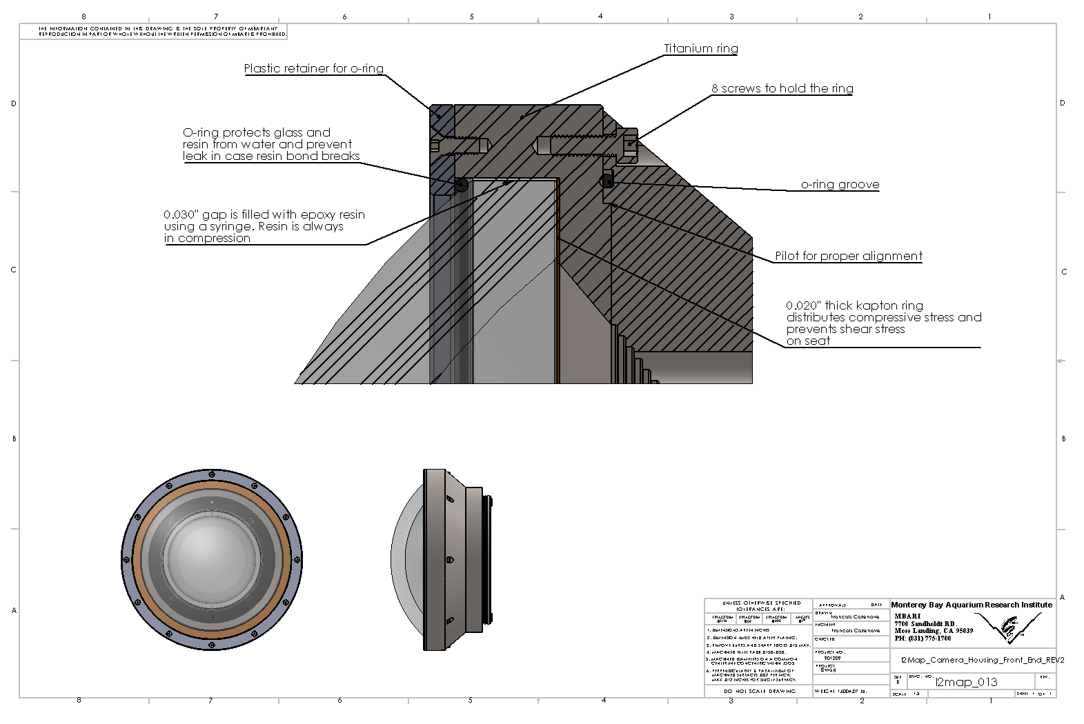
Solution 1: glass bonded to titanium with resin

Slide 8
Solution 1: Glass bonded to titanium
Overview
In this design, the glass is supported by a kapton ring on the bottom, and by resin on the perimeter. This purpose of this design is to make assembly easier (compared to having resin on both surfaces) and to provide an even support for the glass. The coupler ring will be made out of titanium. Stainless steel was first considered but the large difference in coefficient of expansion with the glass makes it inappropriate. The design relies on tensile hoop stresses in the titanium ring to cancel out the radial force exerted by the glass. FEA has shown that at 2200PSI and 4ºC, the radial displacement of the titanium is close to zero.
Assembly procedure:
- All components (titanium rings assembled with aluminum dummy endcap, and glass port) are placed in the oven overnight at 30ºC.
- Titanium rings are placed on a work bench, dome seat facing up. Ideally, the operation should be done in a room where the temperature is 30ºC.
- Kapton gasket is placed on the titanium ring.
- Glass port is placed on the kapton ring, and 0.030" shims are placed in the groove around it to center it.
- A vacuum is pulled on the housing, resulting in about 1000 lb force on the glass (I tested this using the old kapton gasket, it held a vacuum for several hours).
- Shims can be removed
- Epoxy resin is inserted in the groove using a syringe (I have been experimenting with various resins and syringe/needle sizes)
- Once the groove is filled, the assembly is placed in the oven at 30ºC for several days (until material has fully cured).

Slide 9
Solution 1: Glass bonded to titanium
Resin choice:
I have been experimenting with various resins. The best candidate so far is a clear urethane. It has very low viscosity, negligible shrinkage, it’s not brittle, it has a fairly low tensile strength (which prevents high tensile stress from building), and a high compressive strength. I subjected a 2in², 0.020” thick sample to 30000 PSI (30 tons) for several hours and it did not fail. Also, it has a fairly long pot life (20 min) making application easier.
Material cost and machine shop time
The material cost for two titanium rings is $650.
Cost of resin is negligible
Cost of kapton sheet needed to make 2 gaskets: $250
Machine shop time to build two titanium rings, to modify existing titanium ring, and to cut kapton ring is about 1.5 to 2 weeks and about $400 in materials for fixtures

Slide 10
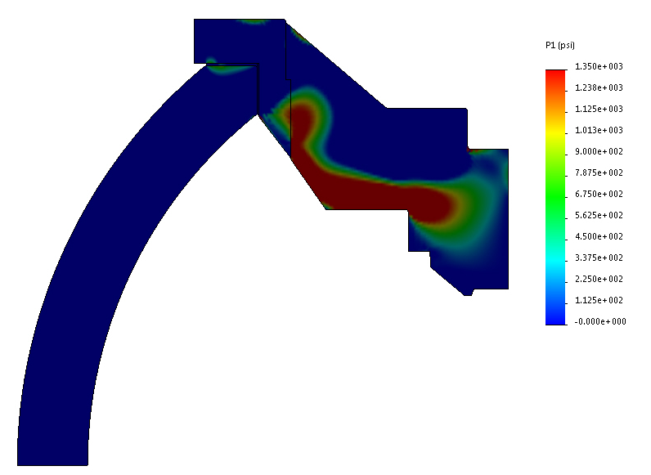
Glass bonded to titanium: FEA results
Initial temperature: 30ºC
Pressure applied: 2200 PSI (1500m depth)
Temperature applied: 4ºC
Thickness of resin buffer: 0.030”
Max radial displacement of glass: -0.0005”
Max axial displacement of glass: 0.007”
Contact force of perimeter: 44000 lb
Mean contact pressure on perimeter: 2328 PSI
Contact force on seat: 170000 lb
Mean contact pressure on seat: 10300 PSI
Stress is compressive in most of the glass.
Max principal stress in glass: Approximately 800 PSI.
There is also a risk of higher tensile stress (2000PSI) developing at the upper edge of the outer surface. The titanium moves away from the resin and pulls on it. This could be remedied by applying mold release on the glass or titanium to prevent bonding.

Slide 11
Solution 2: Glass held with plastic buffer
This design is very similar to the first one, except a plastic spacer (0.020” thick ABS film) is used instead of resin. This design requires very tight machining tolerances on the dome diameter and the titanium ring ID. There must be near zero clearance between the glass, the plastic spacer and the titanium.
The assembly process has been successfully tested with aluminum pieces of the same size. The steps are outlined below:
1- The titanium spacer will have been machined such that at room temperature:
OD of glass port + 2 x thickness of plastic spacer = ID of titanium ring +0.0000”- 0.0005”
I have spoken with Ray and he thinks he can meet the tolerances.
2- the titanium spacer ring will be mounted to the titanium base and placed in an oven at 70ºC overnight. This will result in a 0.004” increase in diameter. The glass will be kept at room temperature.
3- The components will be taken out of the oven and the kapton gasket and the glass dome will be inserted. Then the plastic spacer will be inserted in the gap around the glass.
4- A vacuum will be pulled inside the chamber to make sure that the glass is properly seated and the assembly will be left to cool at room temperature. At room temperature, the glass will be under slight compression from the titanium ring.

Slide 12
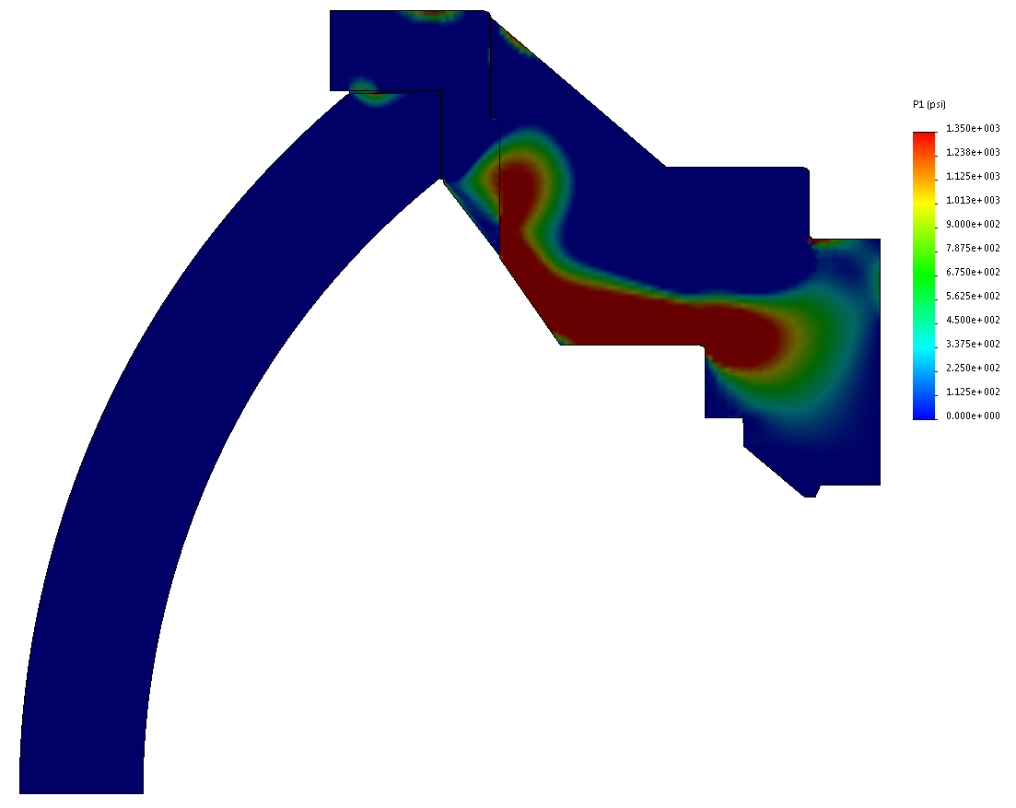
Solution 2: FEA
The results are very similar to the case with resin. The main difference is that no tensile stress can occur at the glass to plastic interface because there is no bond.
Initial temperature: 30ºC
Pressure applied: 2200 PSI (1500m depth)
Temperature applied: 4ºC
Buffer material: Kapton or ABS, 0.020” thick
Max radial displacement of glass: -0.0004”
Max axial displacement of glass: 0.007”
Contact force of periphery: 46000 lb
Mean contact pressure on periphery: 2433 PSI
Contact force on seat: 168000 lb
Mean contact pressure on seat: 10178 PSI
Stress is compressive is most of the glass.
Max principal stress in glass: Approximately 1400PSI.

Slide 13
O-ring compression
An o-ring will be used to seal the port. Even in the case of the resin bonded dome, an o-ring will be used to prevent water intrusion in case the bond is broken. A retainer will be used to hold the o-ring in the groove an provide the required compression
O-ring size: 178, material: EPDM, A70 durometer.
According to Figure 2-5 of parker o-ring handbook, the compression load for 10% compression is up to 9lb per linear inches. Total for entire o-ring is 9x31” = 279lb.
To determine the proper thickness and material for the o-ring retainer, I modeled it in SW simulation.
A 3/16” thick titanium ring held by 12 screws would only deflect 0.0001”. A delrin ring of the same size would deflect 0.004”. An ABS ring would deflect 0.006”.
ABS is the easiest because it can easily be printed so we will use it for the prototype. If it appears to be too soft, we use thicker ring or stiffer material.

Slide 14
Proof testing
PhD Students at UC Berkeley are currently working on a proof testing protocol. Their work is based on the literature suggested by the facturographer (George Quinn).
Proof testing pressure will be determined to insure 95% confidence that the dome will not fail during its life cycle (5 years of operation, 60 dives, 60 hours under pressure).
During proof testing, deflection of the dome and pressure will be measured and recorded to make sure that it matches the FEA.

Slide 15
Schedule
  Week of 3/28
  Review design, Jon Erickson reviews FEA, Francois finishes drawing
  4/4
  Ordering materials, Refining assembly process, Preparing components pressure for testing
  Working on pressure test protocol with students
  4/11
  Ray starts machining, Preparing components for pressure testing, Working on pressure test protocol with students
  4/25
  Machining continues. Revisions are made as needed
  Assembly of 2 domes at end of the if parts are ready (domes must have been shipped back from China)
  Preparation of pressure testing (calibration, wiring, software etc
  5/2
  Pressure testing at Port Hueneme (3-4 days there)
  5/9
  Assembly of camera housing
  The schedule is very tight but can be met if everything goes right. Lead time of glass port could be an issue.

