Slide 1
Proof testing of deep water camera port
Francois Cazenave
Monterey Bay Aquarium Research Institute
May 24, 2016

Slide 2
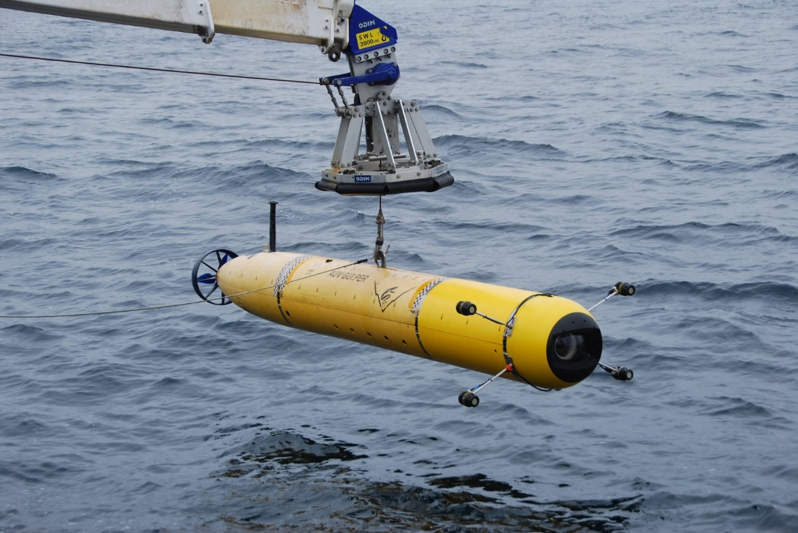
Application
AUV (autonomous underwater vehicle) based imaging of
midwater animals from 50m to 1500m depth.
Only 1 unit will be built.

Slide 3
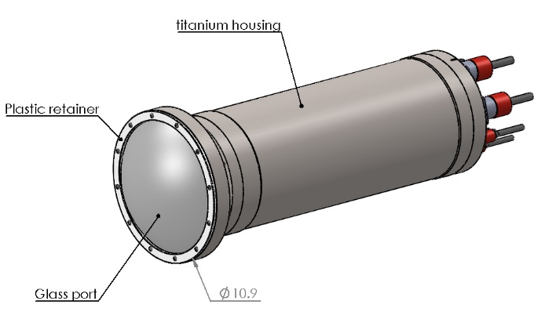
Camera Housing design
Depth rating: 1500m
Temperature: Max 40 degC in the lab, minimum 4 degC at depth.
12 dives per year. 1 hour per dive at 1500m.
Minimum service life: 100 hours at depth.

Slide 4
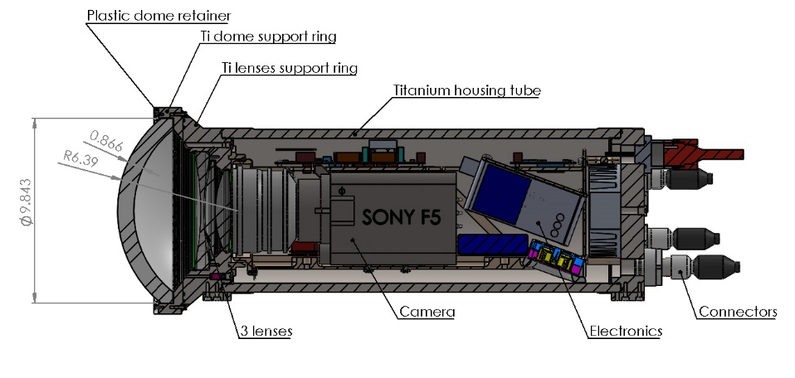
Camera housing cross section

Slide 5
Dome mechanical design
FEA was performed using Solidworks simulation
Materials:
Grade 5 titanium
H-K9L glass (Chinese BK7)
Kapton (polyimide)
Polyurethane resin
Design was optimized for optical quality, not for mechanical properties.
5 domes were purchased ($1800 each). 2 were broken during pressure testing.
The following slides shows previous designs that failed during pressure testing.

Slide 6
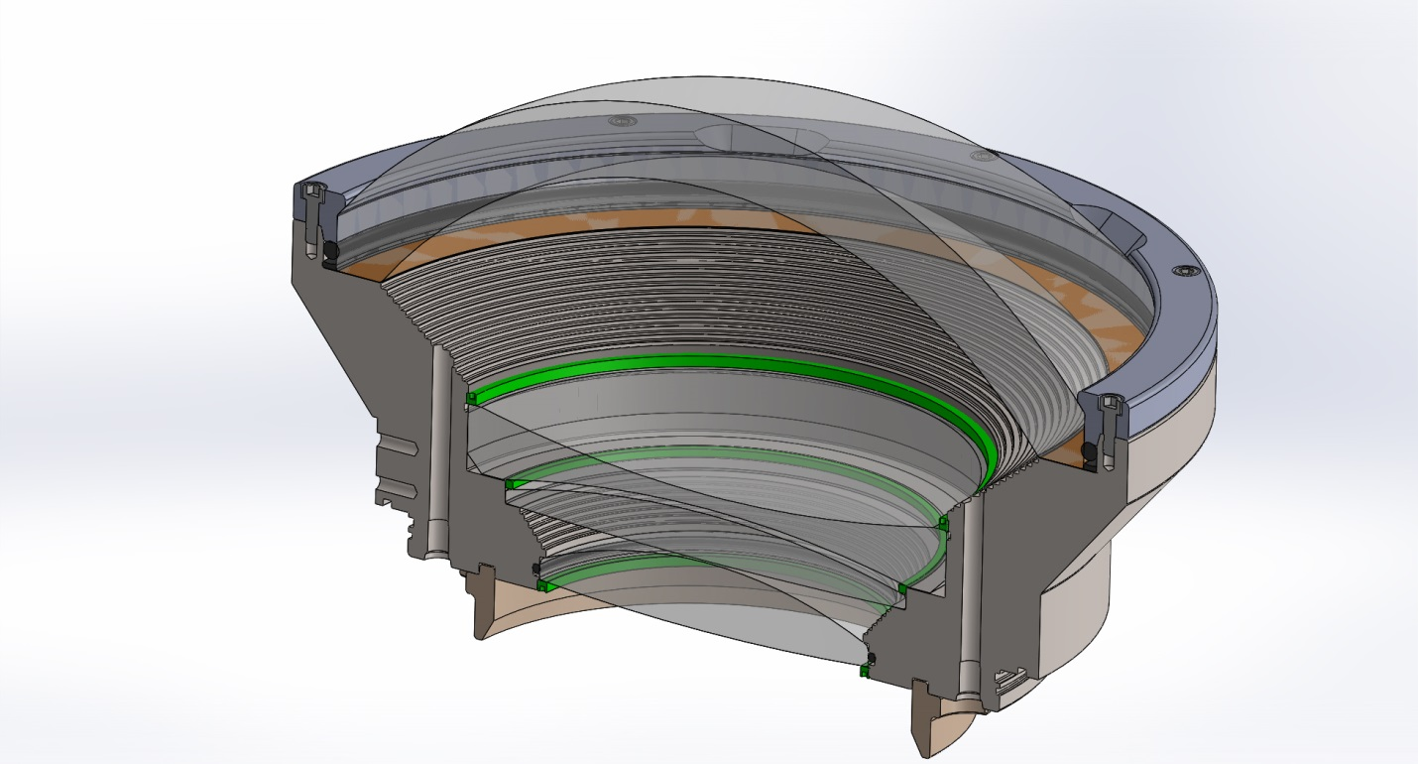
Dome Seat Design #1
Dome material: H-K9L glass (similar to BK7)
Outer Diameter: 250mm
Thickness at apex: 22mm
Design depth: 1500 meters seawater (~2175 p.s.i)
Kapton support gasket thickness: 0.005”

Slide 7
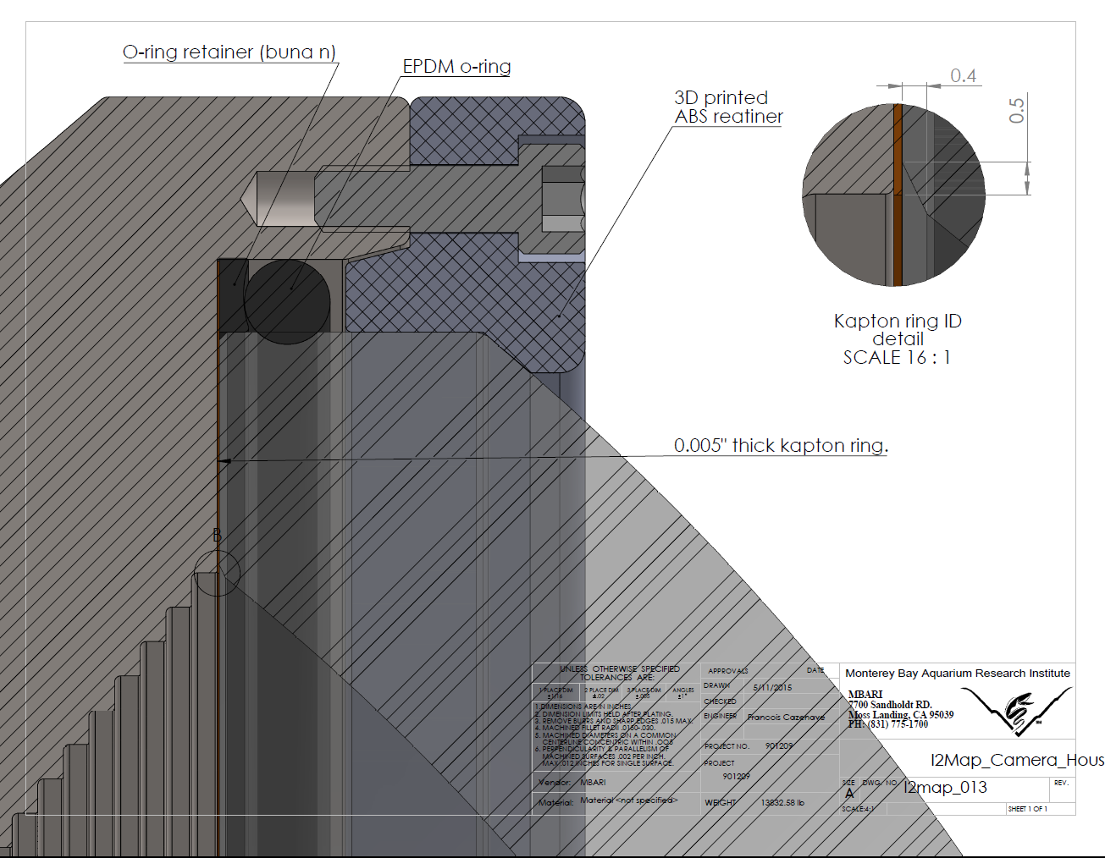
Detail of Design #1 Dome Seat

Slide 8
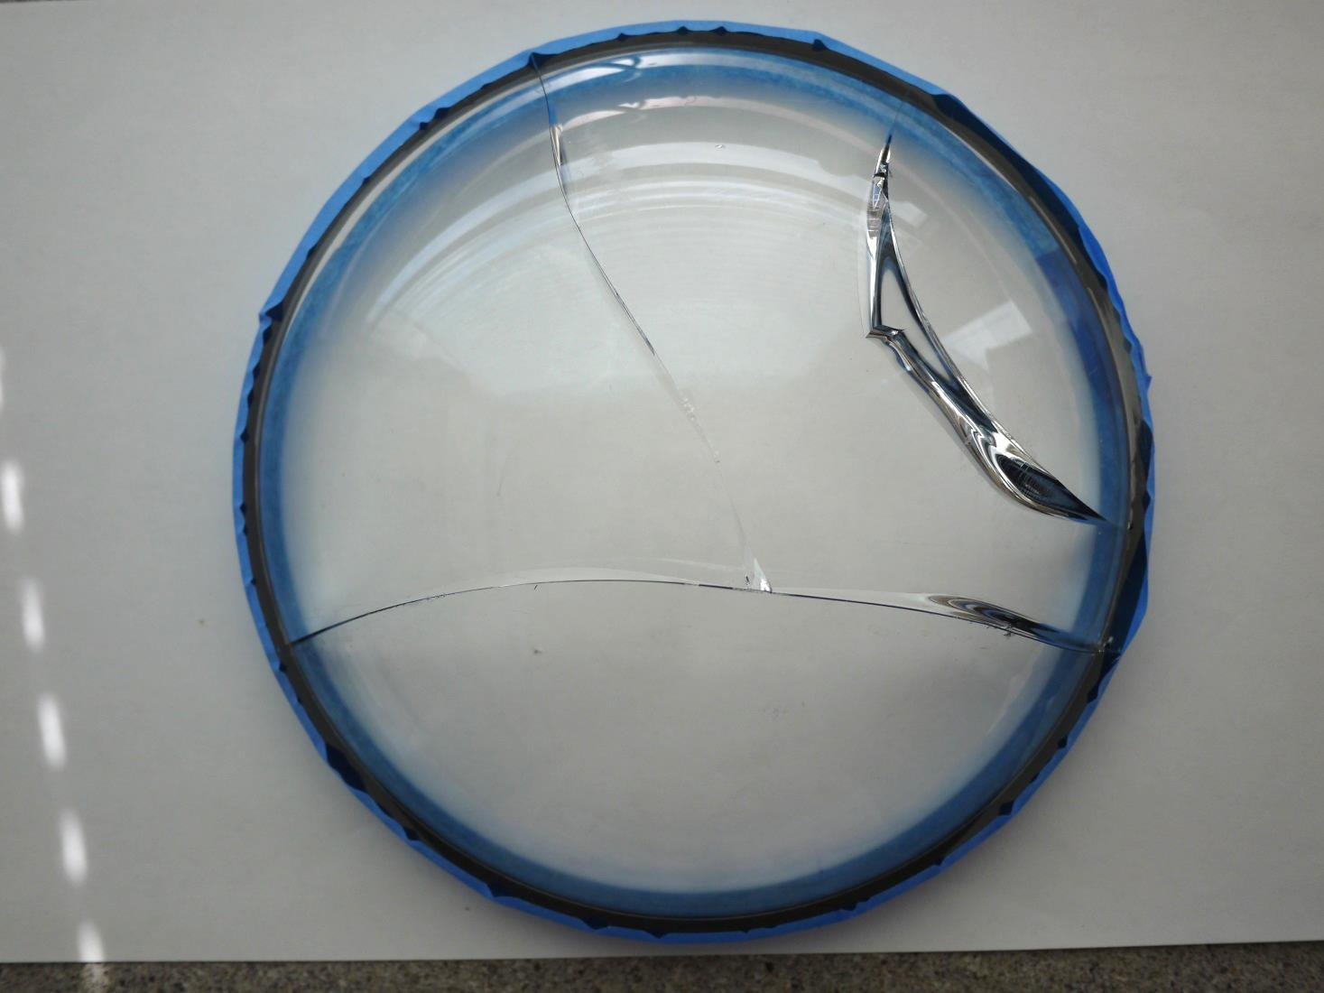
Design #1 Dome Failure
Initial failure points?

Slide 9
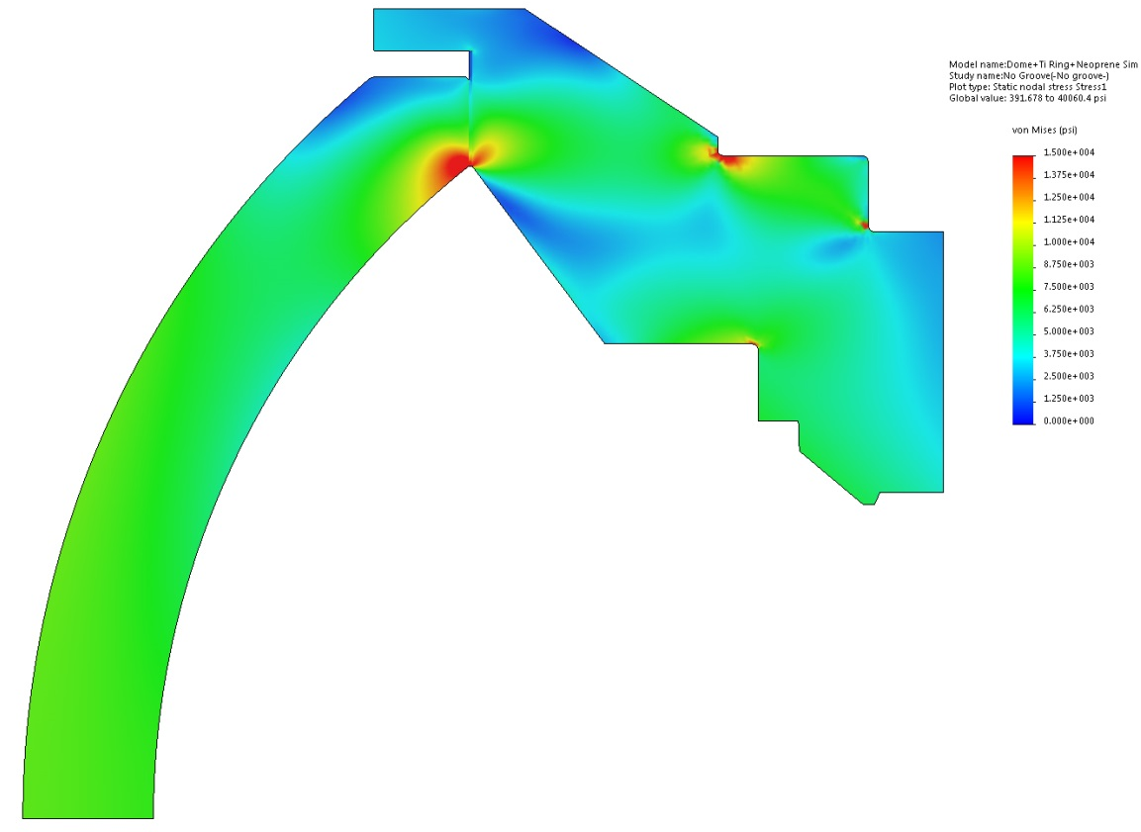
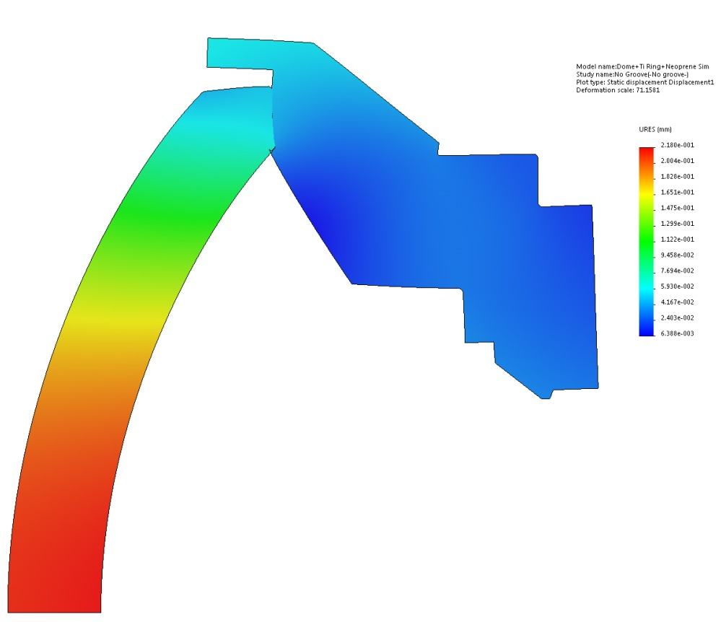
FEA of first design
Von Misses stress
Displacement
The coefficients of friction between glass and titanium, and between titanium and kapton are unknown. When using a medium (0.5) COF in SW Simulation, no sliding would occur between the glass and support ring so I assumed it was the case in reality.
I was most concerned with compressive stress near the inner edge and I thought tensile stress was low.
During the first test, there was no sliding and tensile stress was low (glass exhibits low stress failure). The failure occurred at 2750PSI after 10 cycles and several hours under pressure.

Slide 10
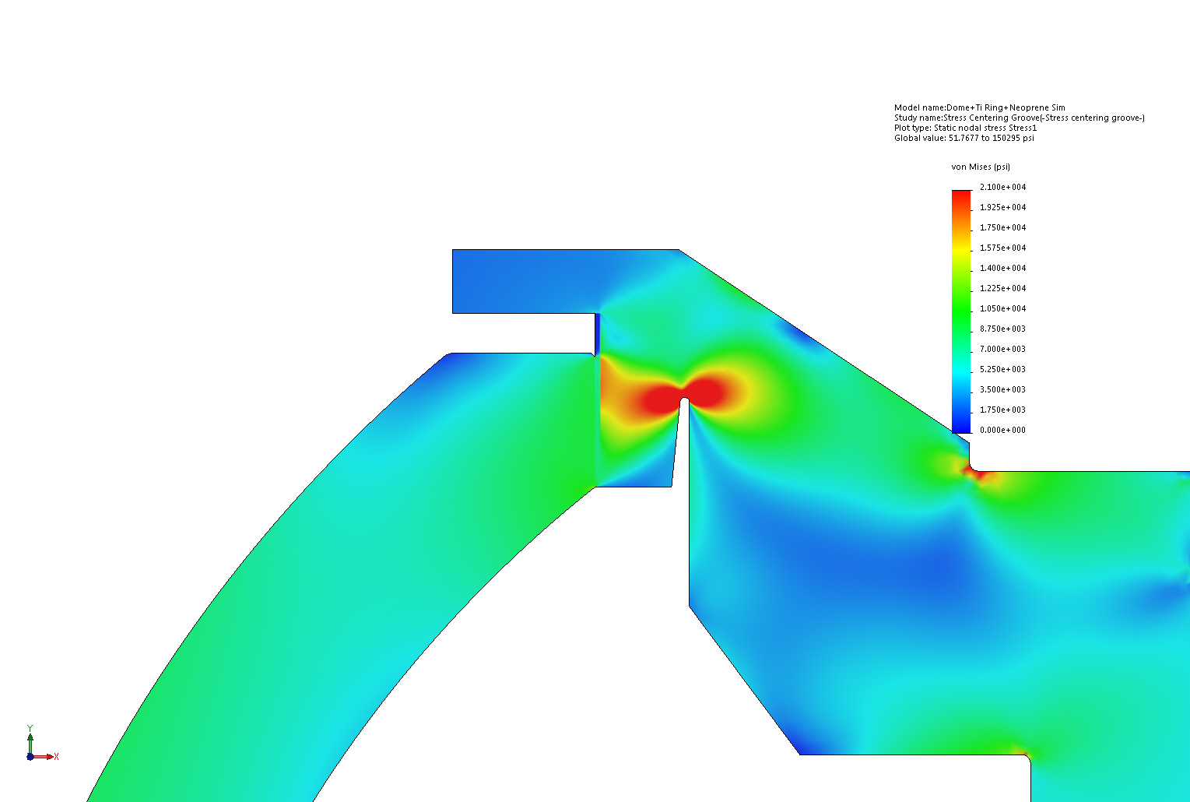
Dome Seat Design #2
Added chamfer to glass
Same design as #1 except for; addition of groove below the seat to allow slight flexure of dome seat under hydrostatic pressure, Kapton ring thickness under dome seat was increased from 0.005 to 0.020 thickness, the seat areas was optically polished, and a small polished chamfer was added to the dome inside radius (outside radius already had a ground chamfer).

Slide 11
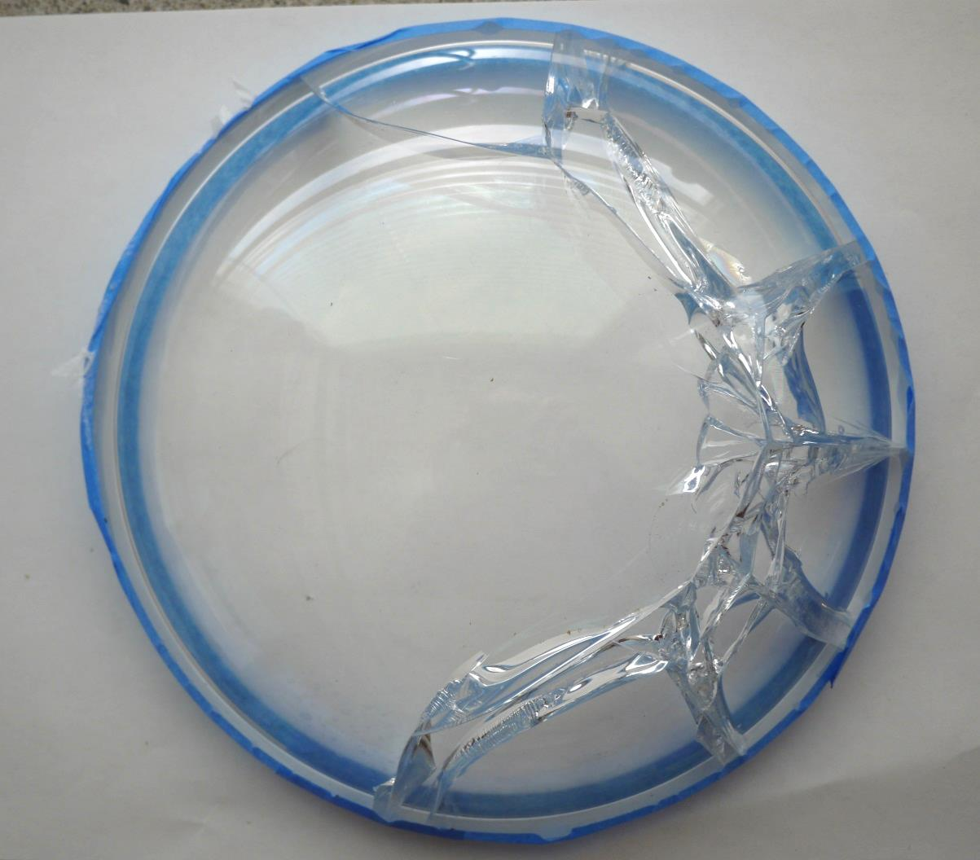
Design #2 Dome Failure
Initial failure point?

Slide 12
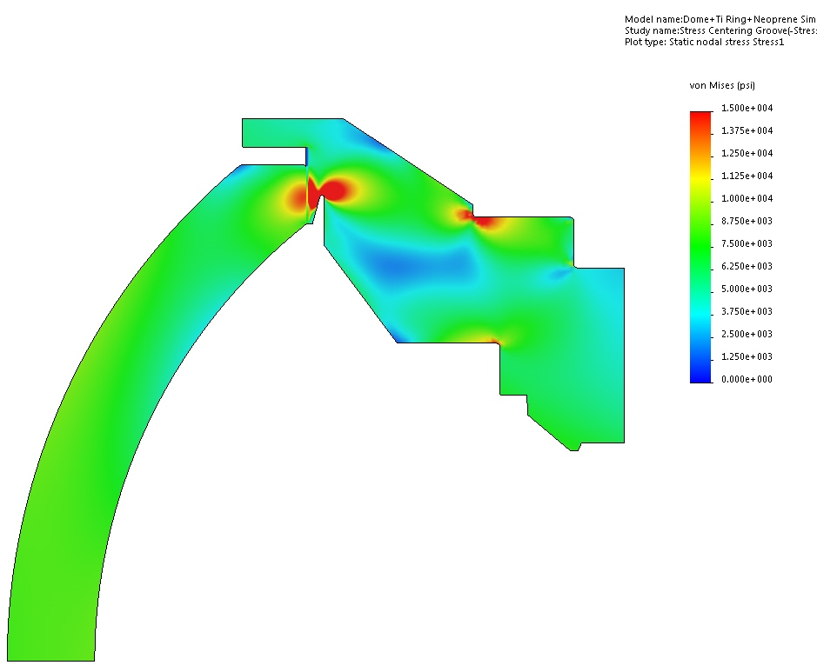
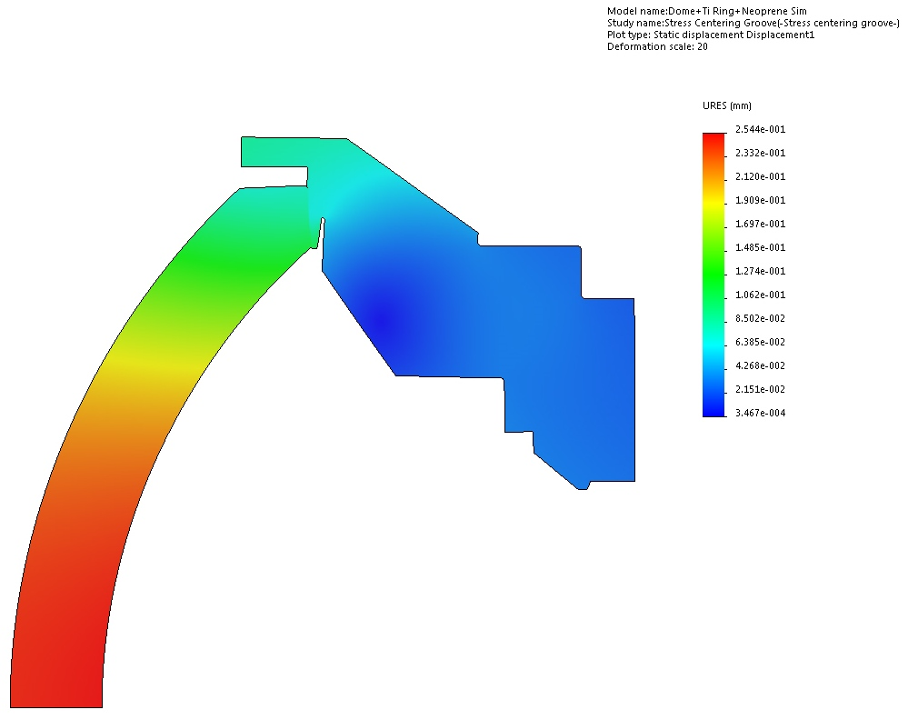
FEA of second design:
we added a groove in the titanium to decrease compressive stress and to center it.
We had the glass polished and increased the kapton thickness. The smoother surface and even stress across the seat decreased friction and resulted in sliding.
Glass failed in tension due to hoop stresses on the periphery. Hoop tensile stress at failure was about 9000 PSI and radial displacement was 0.0045”, according to FEA (6000 PSI according to glass facture analysis). The failure occurred at 1570PSI, during the first cycle.

Slide 13
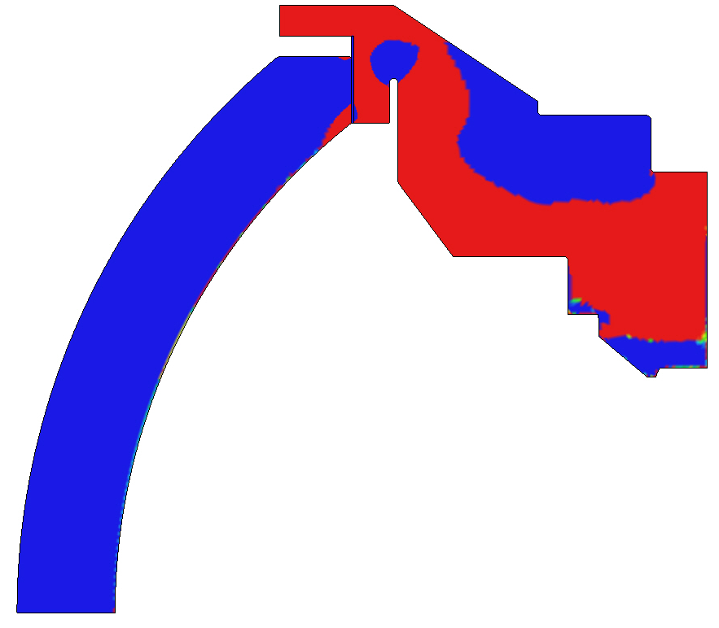
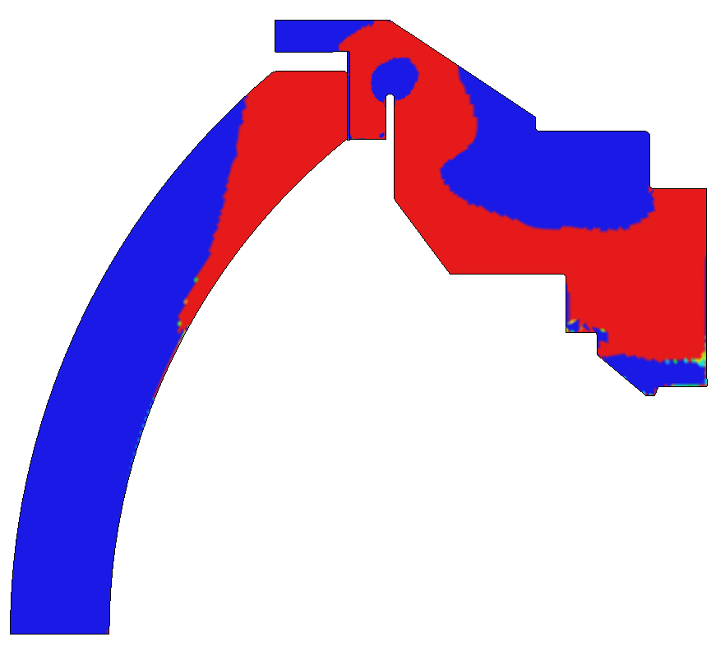
Comparison of sliding/no sliding cases
Blue: compressive stress
Red: tensile stress
Case with friction: no sliding
There is almost no tensile stress.
Mean 1st principal stress (at 1577 psi hydrostatic pressure):
on periphery: -188PSI
on seat: -355PSI
Case with no friction: sliding occurred.
High tensile stress on periphery
MFPS on periphery: 6513PSI
on seat: 8982PSI
Notes:
No grove case is not as bad

Slide 14
Third and latest design:
The glass is bonded to a titanium ring using PU resin. The titanium prevents radial displacement of the dome and eliminates tensile hoop stress.
This design was successfully pressure tested to 1600m. Measurement of axial displacement of the glass matches FEA.

Slide 15
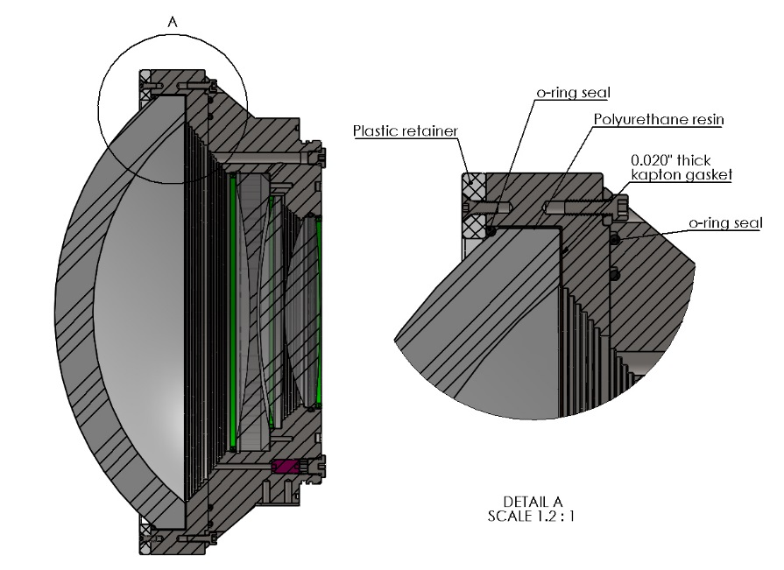
Camera front end cross section

Slide 16
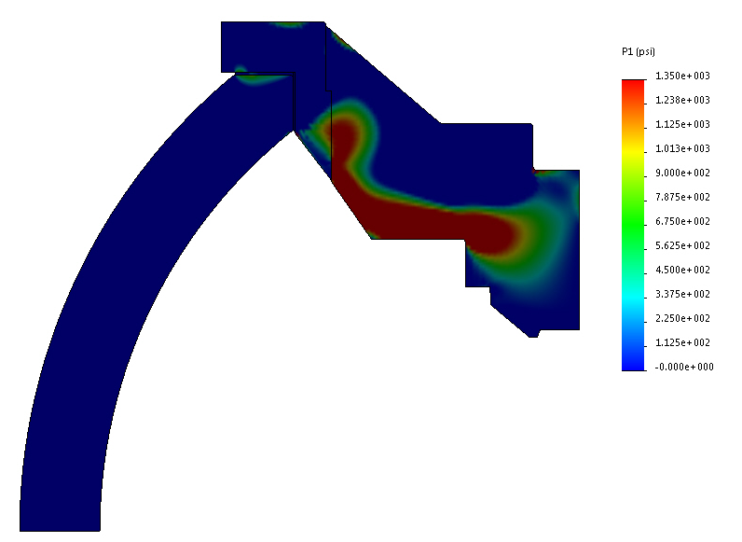
Glass bonded to titanium: FEA results
Initial temperature: 30ºC
Pressure applied: 2200 PSI (1500m depth)
Temperature applied: 4ºC
Thickness of resin buffer: 0.030”
Max radial displacement of glass: -0.0005”
Max axial displacement of glass: 0.007”
Contact force of perimeter: 44000 lb
Mean contact pressure on perimeter: 2328 PSI
Contact force on seat: 170000 lb
Mean contact pressure on seat: 10300 PSI
Stress is compressive in most of the glass.
Max principal stress in glass: Approximately 800 PSI.
There is also a risk of higher tensile stress (2000PSI) developing at the upper edge of the outer surface. The titanium moves away from the resin and pulls on it. This could be remedied by applying mold release on the glass or titanium to prevent bonding.

Slide 17
Proof testing
PhD Students at UC Berkeley calculated proof test values. Their work was based on the literature suggested by the facturographer (George Quinn). They suggested 3.3:1 test pressure ratio. Quinn looked at their report and thought it was in error.
Proof testing pressure should be determined to insure 95% confidence that the dome will not fail during its life cycle (5 years of operation, 60 dives, 100 hours under pressure).

