Slide 1
Proposed assembly procedure for I2map optics
Francois Cazenave, MBARI
5/21/15

Slide 2
Myriad to provide:
- clean work environment
- glass handling supplies
- vacuum pump with vacuum gauge and appropriate hoses
- cleaning supplies for glass and metal parts
- o-ring lubricant
MBARI to provide:
- dome port
- all metal components (titanium ring, spacers, retainer)
- Kapton ring
- plastic dome retainer and screws
- all o-rings
- vacuum port plugs and hose barb adapter
- vacuum cup for lifting lenses
- cap for dome port
Fathom imaging to provide:
- 3 lenses.

Slide 3
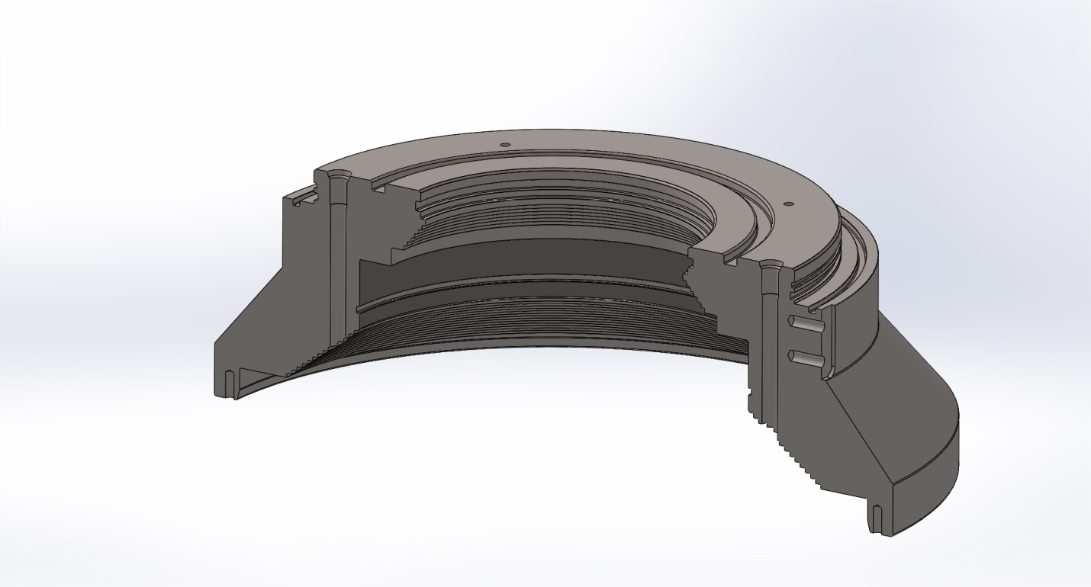
1- Thoroughly clean all components. Place titanium ring on bench, dome side down.
Ring OD: 11”. Weight: 20 lbs

Slide 4

2- Insert o-ring in rear lens o-ring groove.

Slide 5
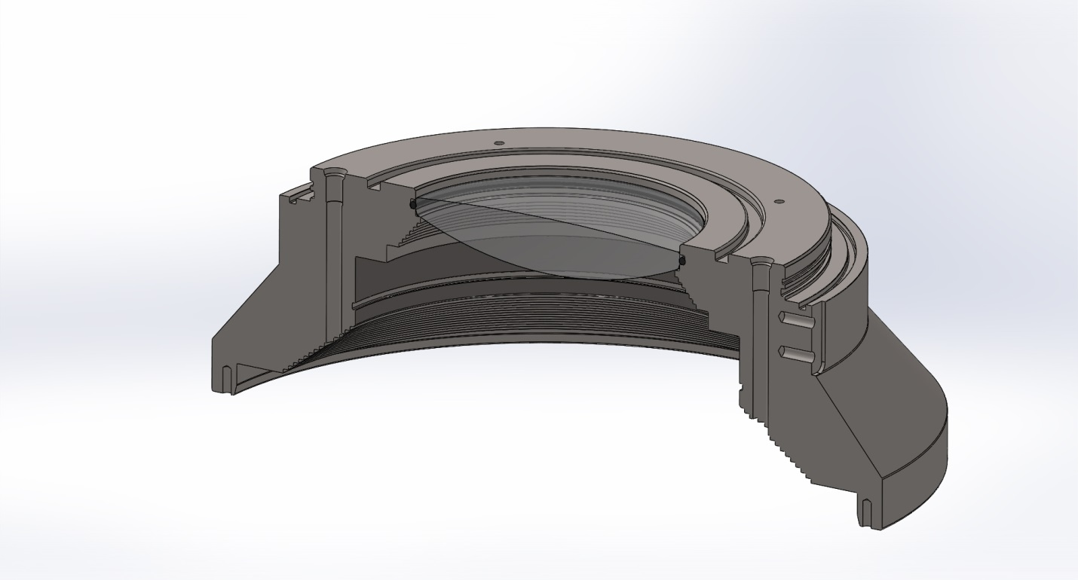
3- Insert rear lens

Slide 6
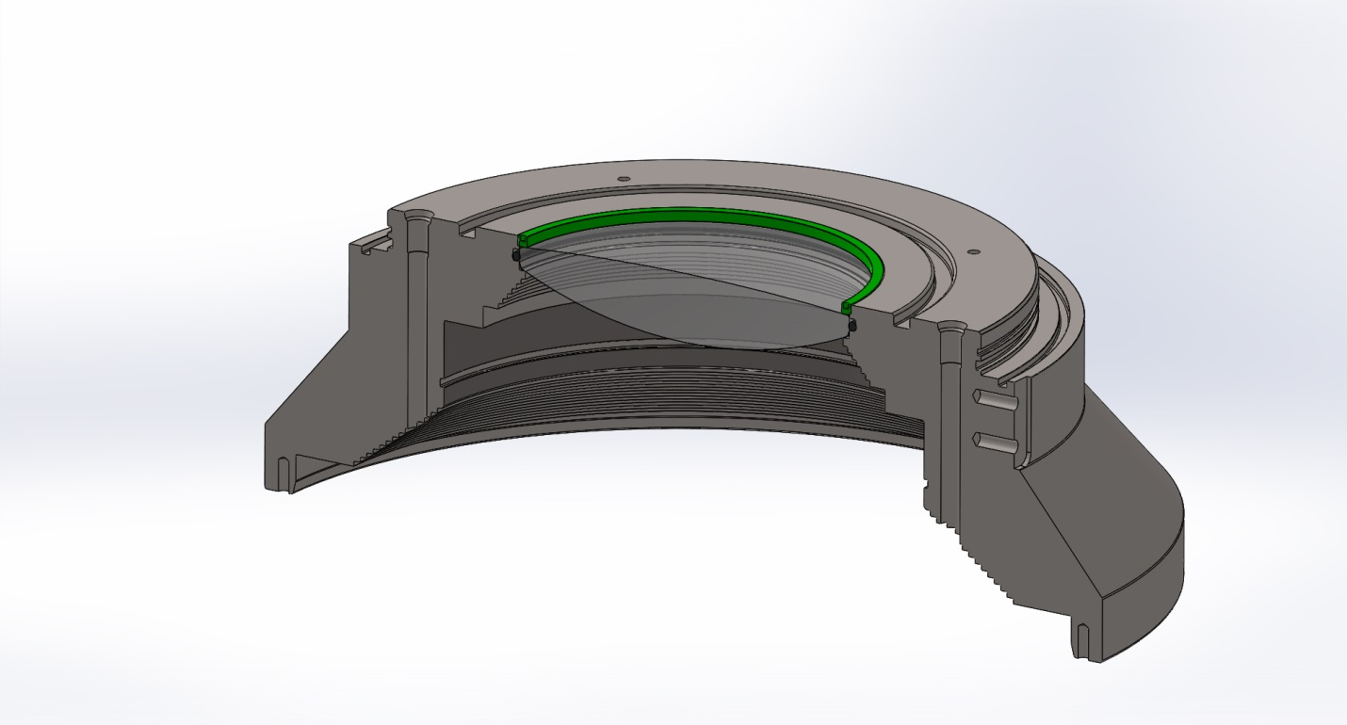
4- Secure rear lens with threaded retainer.

Slide 7
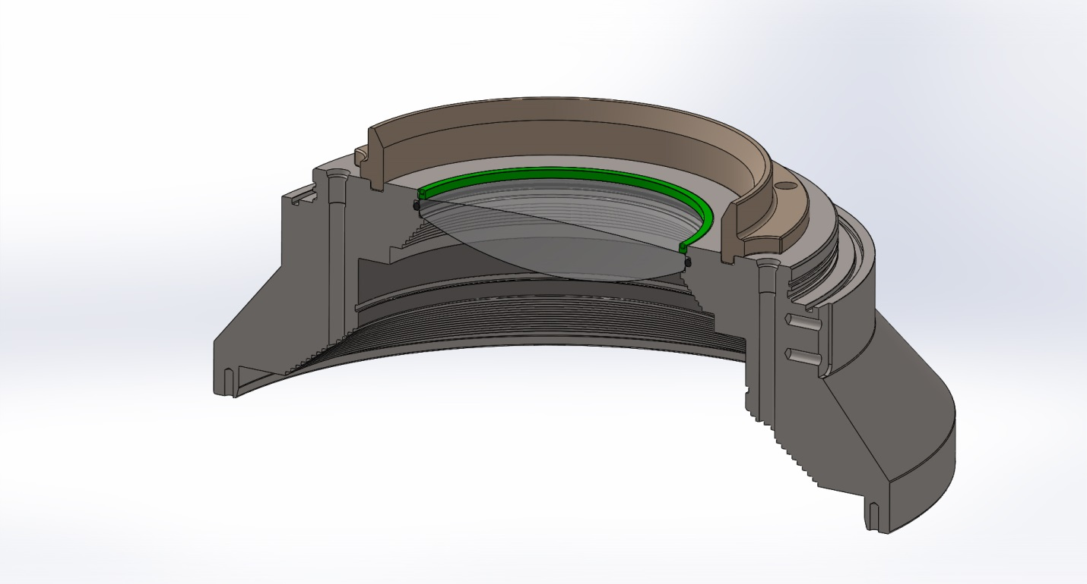
5- Mount aluminum ring to give lens some protection

Slide 8
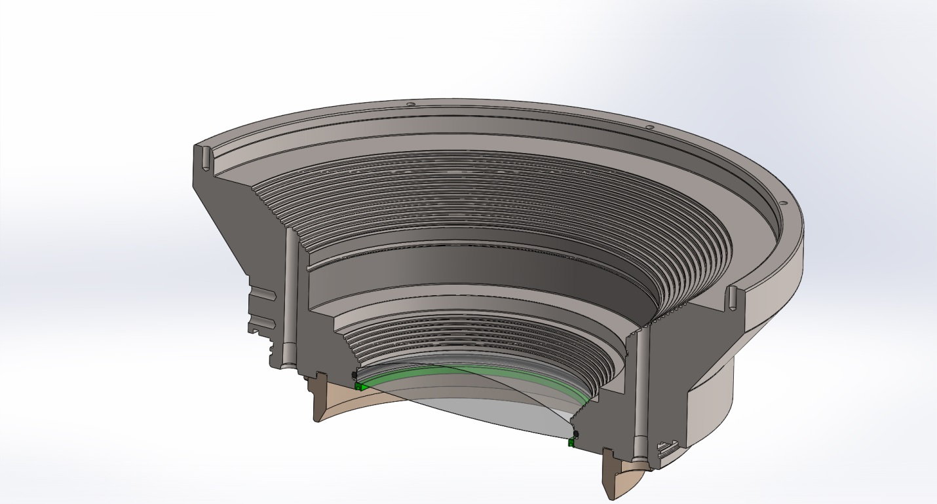
6- Place titanium ring dome side up

Slide 9
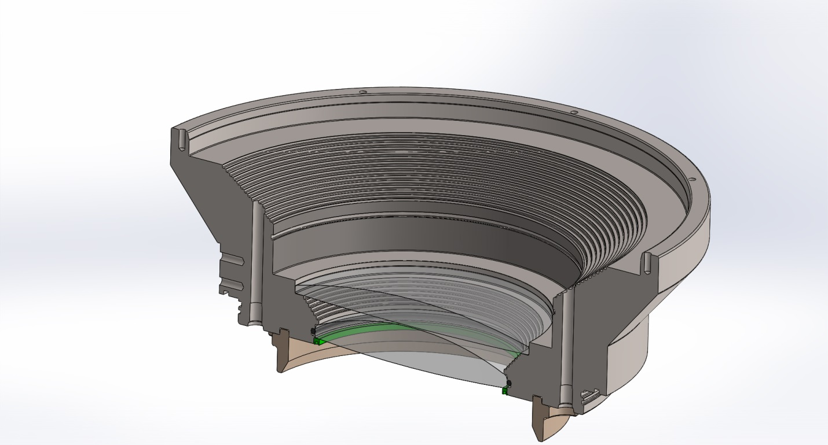
8- Insert middle lens. Suction cup can be used to lower lens.

Slide 10
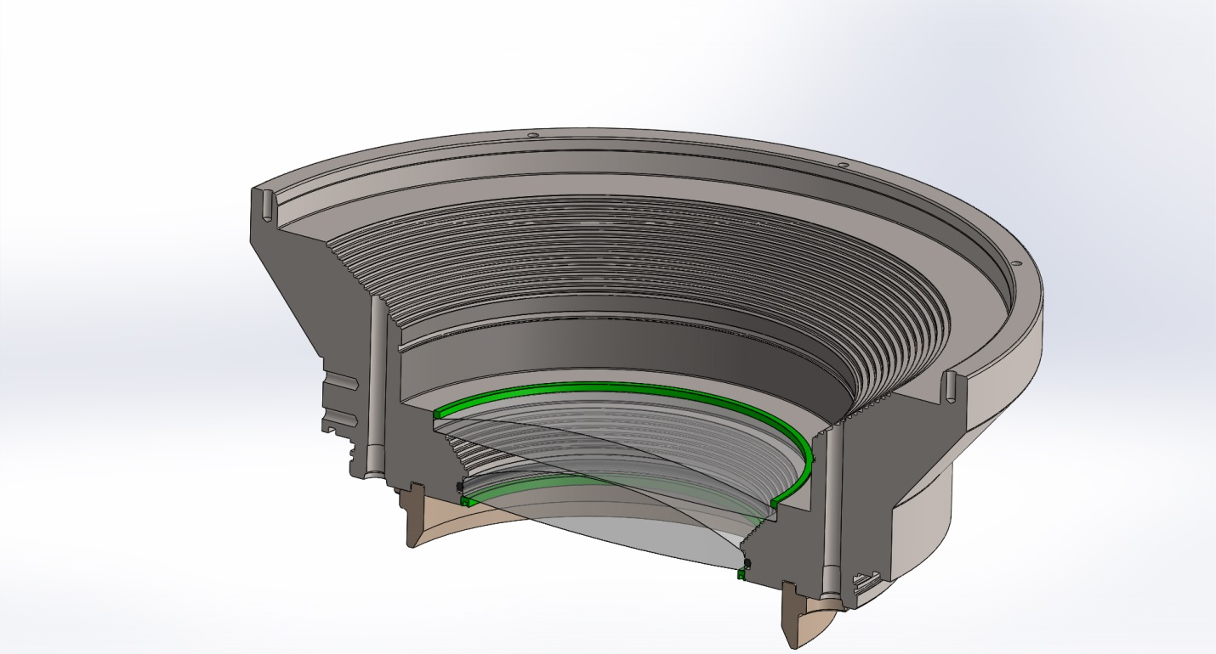
9- Insert lens spacer

Slide 11
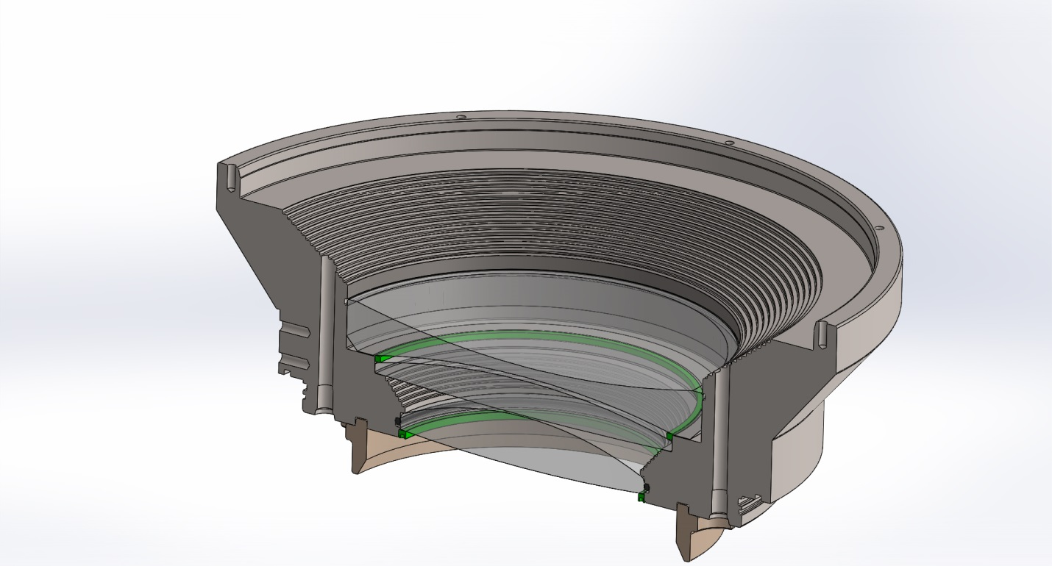
10- Insert double concave lens

Slide 12
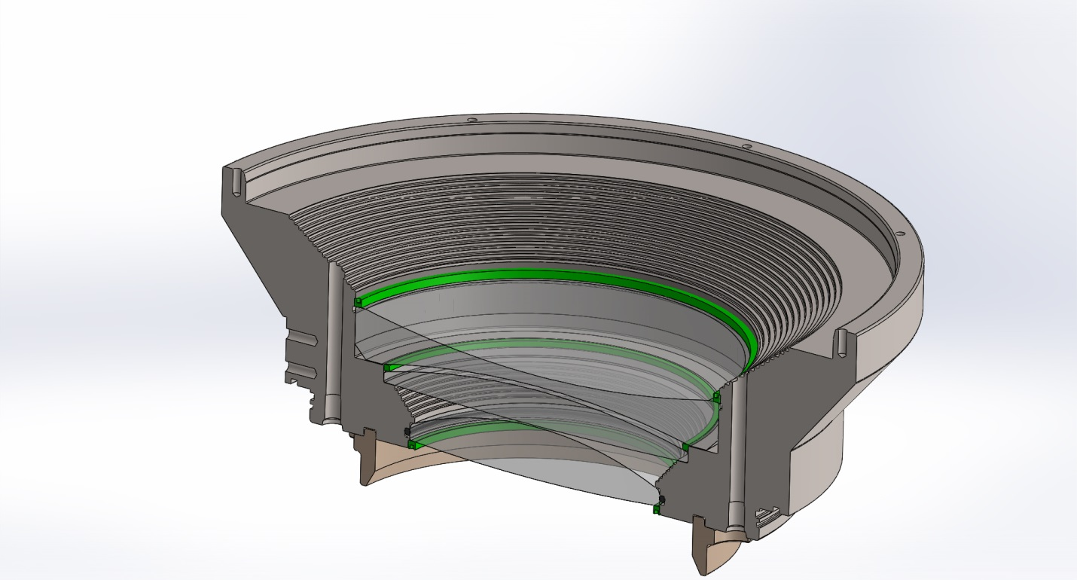
11- Secure lens with threaded retainer

Slide 13
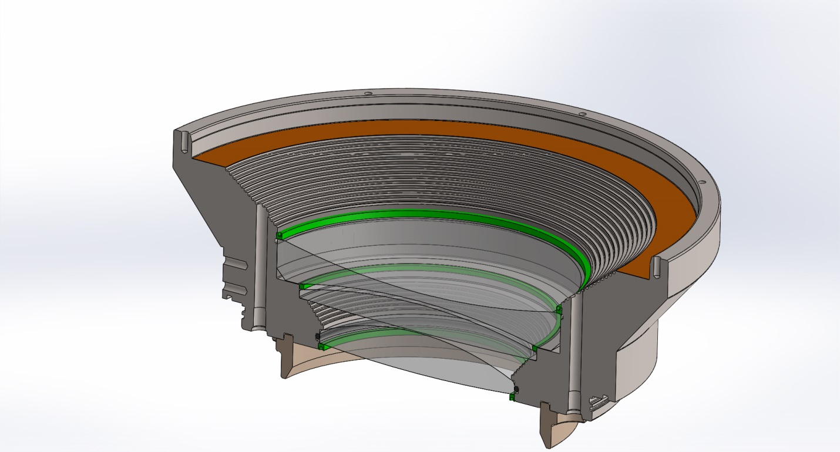
12- Insert Kapton ring

Slide 14
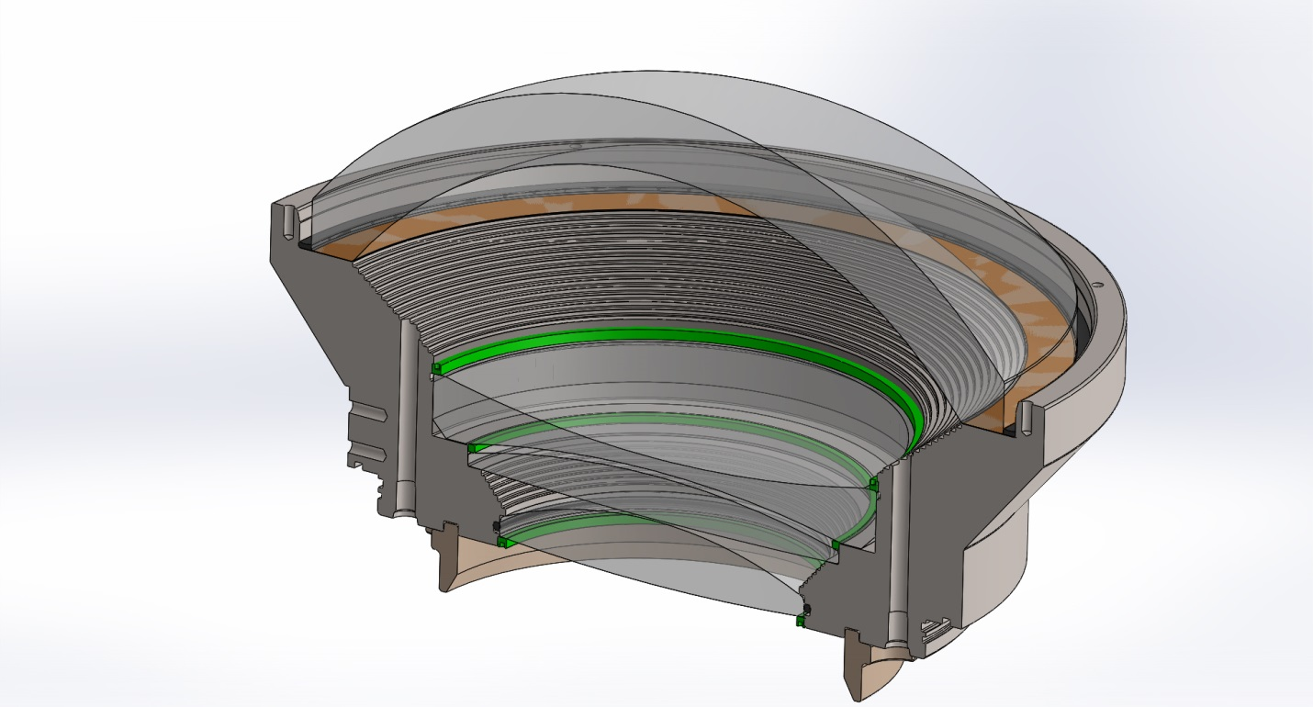
13- Insert dome in titanium ring. Insert back-up ring in groove around dome using fine tipped tool.

Slide 15
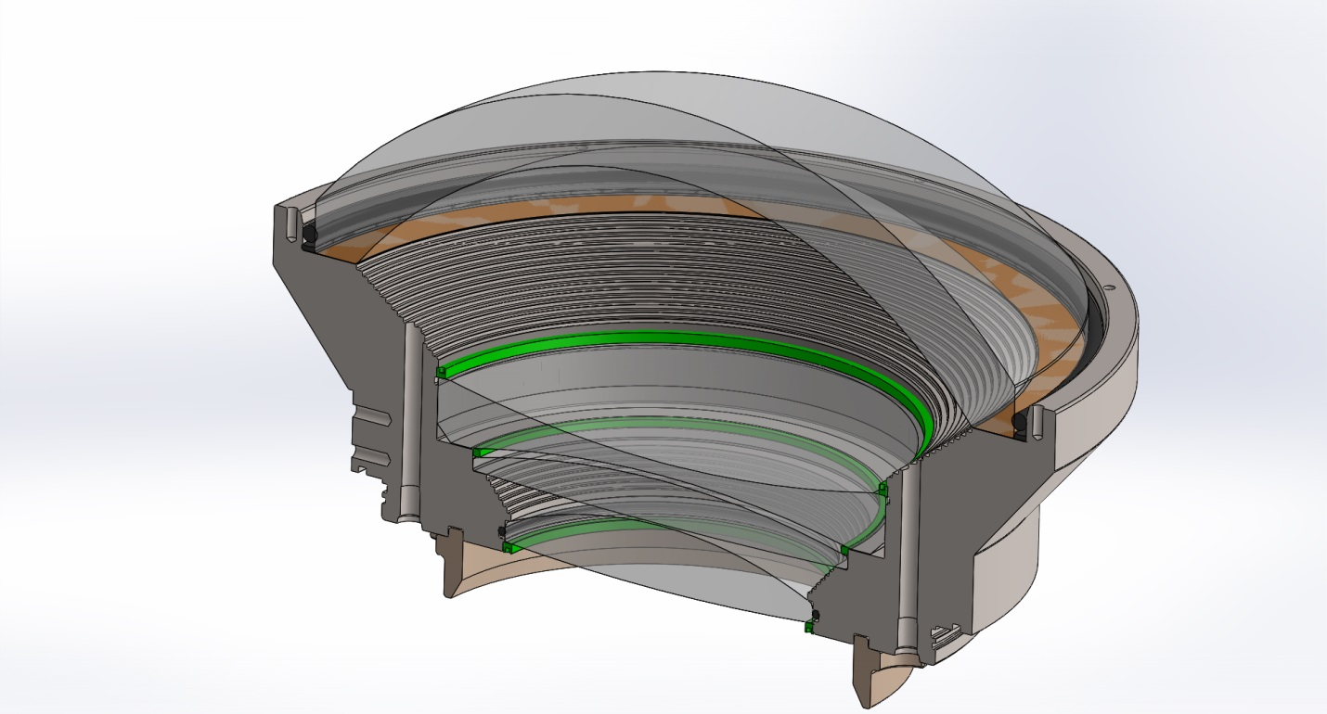
14- Insert o-ring in the groove using fine tipped tool.

Slide 16
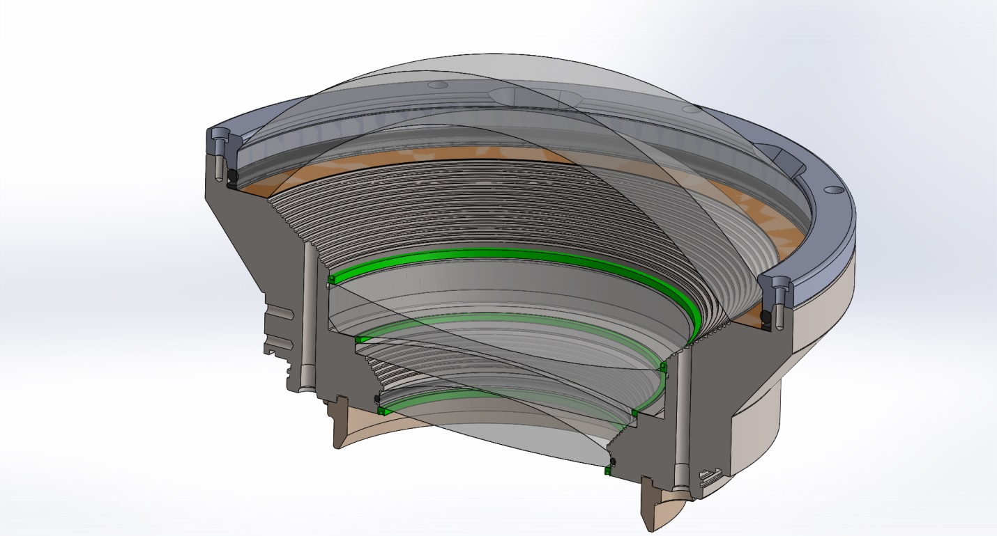
15- Place ABS retainer on top of dome port

Slide 17
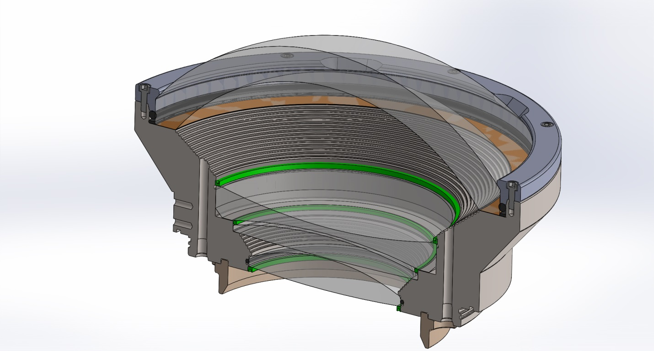
16- Secure retainer with 8 screws.

Slide 18
Final steps:
Place cap on dome port
Turn assembly dome side down
Connect hose barb adapter to check valve equipped vacuum port
Connect vacuum pump to hose barb
Very slowly pull vacuum to avoid creating a potentially dangerous pressure differential between lenses.
Disconnect vacuum pump, cap vacuum port.

