Slide 1
Design and testing of a large sub-hemispherical glass port for a deep-sea camera
Francois Cazenave¹; Eric H. Baker²
Nathan D. Card³; George D. Quinn⁴
Paul Remijan⁵; Jonathan Salem⁶
Arun K. Varshneya³
1. Monterey Bay Aquariun Research Institute, Moss Landing, CA
2. Connecticut Reserve Technologies, Gates Mills, OH
3. Saxon Glass technologies, Alfred, NY
4. National institute of Standard and Technology, Gaithersburg, MD
5. Fathom Imaging Inc., Brimfield, MA
6. NASA Glenn Research Center, Cleveland, OH

Slide 2
Outline
Introduction
  Optical design
Experimental procedure
  Early design and failure
  Fractography
  Modified design
  Chemical strengthening
Testing and reliability analysis
  Non-pressure
  Pressure
Conclusions

Slide 3
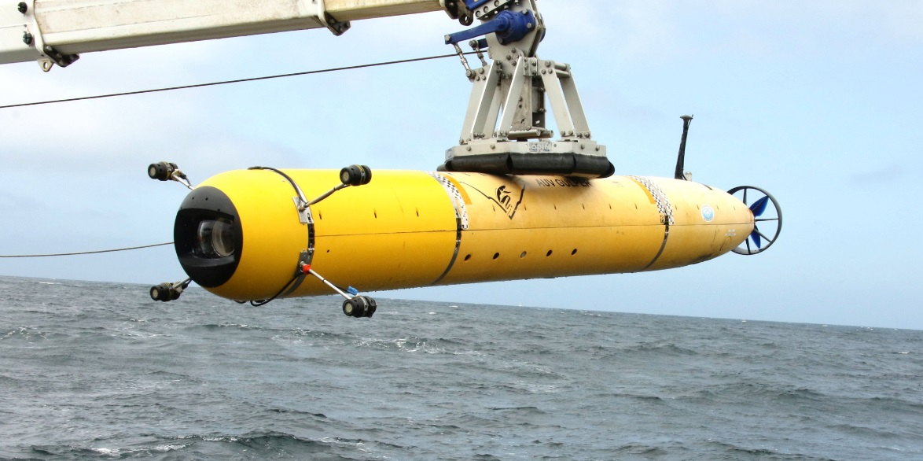
Introduction
  MBARI operates an autonomous underwater vehicle to carry out video surveys in Monterey Bay from 50m to 1500m depth.
  A new camera system was designed with the goal of achieving the highest image quality.
  A glass port was designed, built and tested.

Slide 4
Optical design
  Typical camera port
  Shape is optimized to resist hydrostatic pressure
  Small diameter (<200mm)
  Hemispherical shape
  Even and easy to predict stress and strain.
  High distortion
  BK-7 glass
  New camera port
  Shape is optimized for high optical quality
  Large diameter (250mm)
  Flattened hemispherical shape
  Uneven and hard to predict stress and strain.
  HK9-L glass (Chinese equivalent to BK-7)

Slide 5
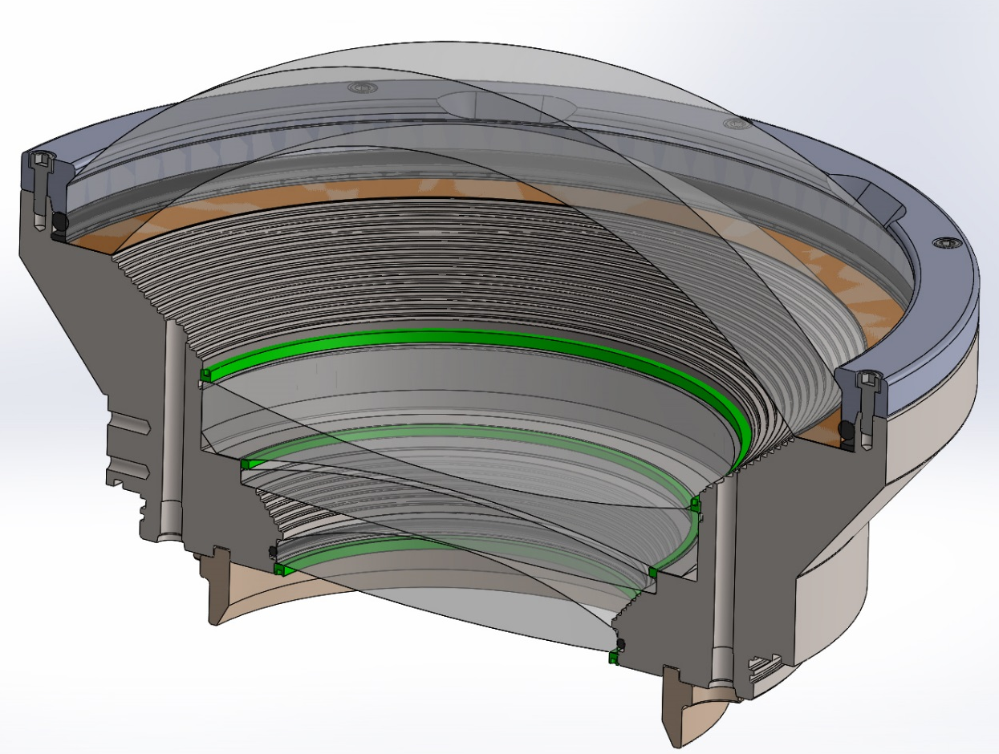
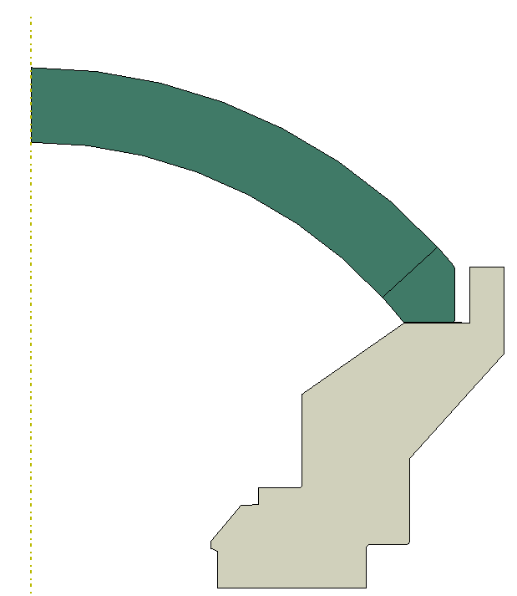
Early design and failure
Dome sits on kapton gasket
Dome is held with plastic retainer.
O-ring around dome

Slide 6
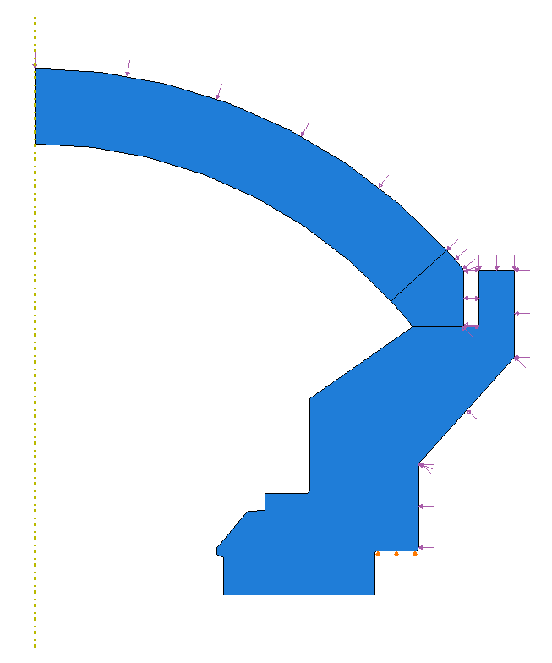
FEA of early design:
2D Axisymmetric Model
External Pressure Load
Glass dome
Kapton gasket
Titanium support
Dome is free to move Radially
8/2/16
BC: Radial = free, Axial = fixed

Slide 7
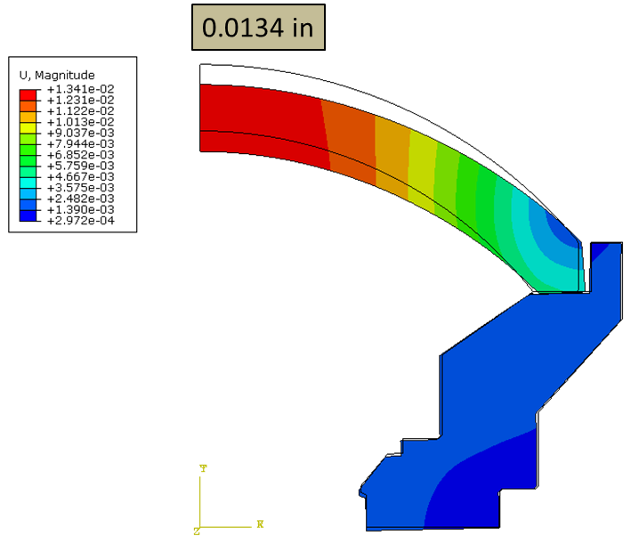
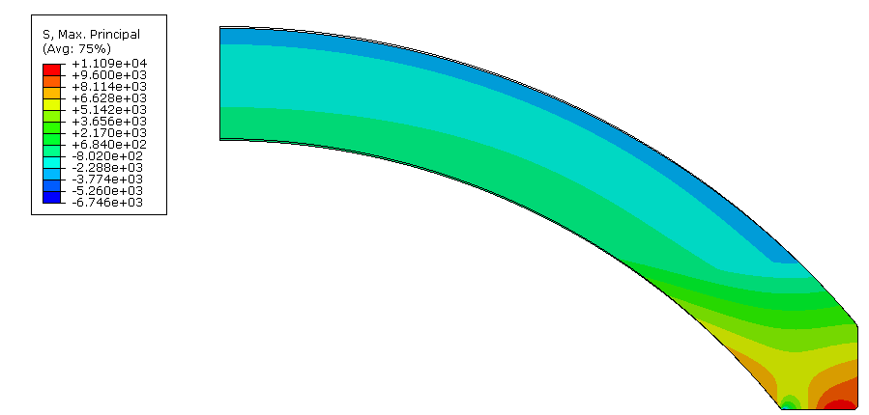
FEA results at 2750 PSI
Displacements
First principal (max tensile) Stress
11,090 psi
First principal stress at 6,750 PSI
Max = 11,090 PSI (76.5 MPa)

Slide 8
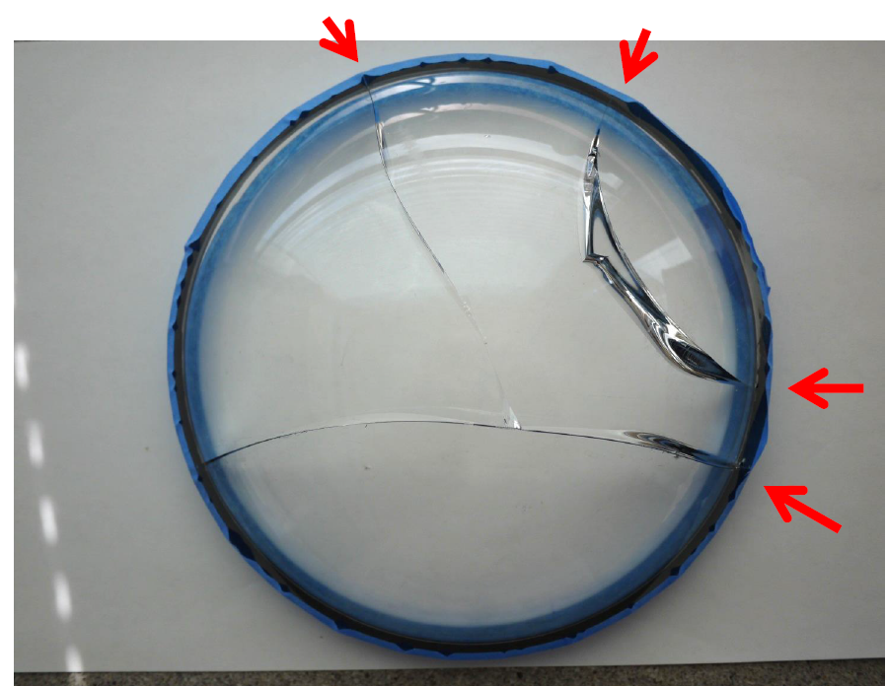
Failure of early design
Failure occurred during external pressure test after numerous cycles to 2,750 PSI (19.0 MPa).
Failure was from …..(extraneous damage, bas edge finish etc.)

Slide 9
Factography
George Quinn slides.

Slide 10
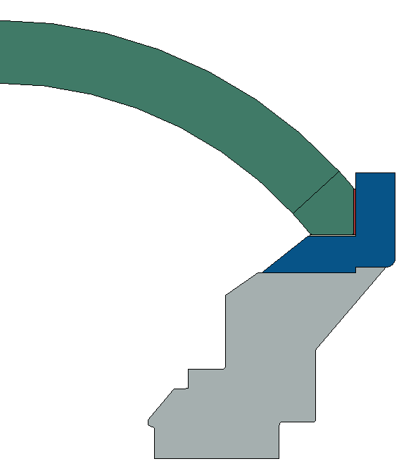
Modified design
Dome was bonded to titanium ring with epoxy to prevent lateral motion of dome seat
Edges were beveled and polished
Seat was polished and flatness tolerance was decreased
Thicker kapton ring
Dome Coupler Ring
Ti-6Al-4V
Dome Support
Ti-6Al-4V

Slide 11
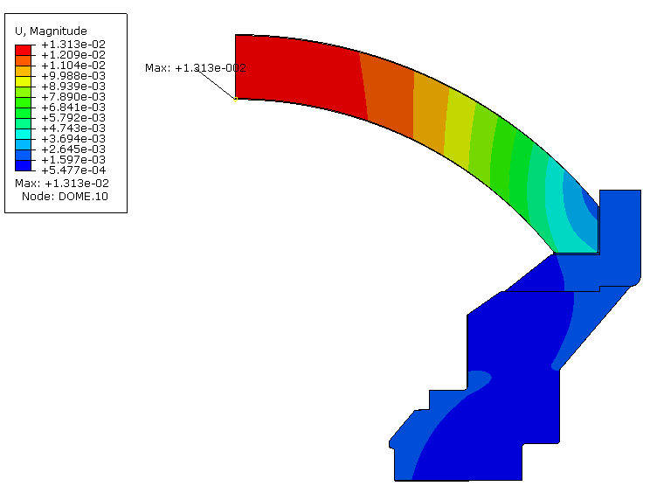
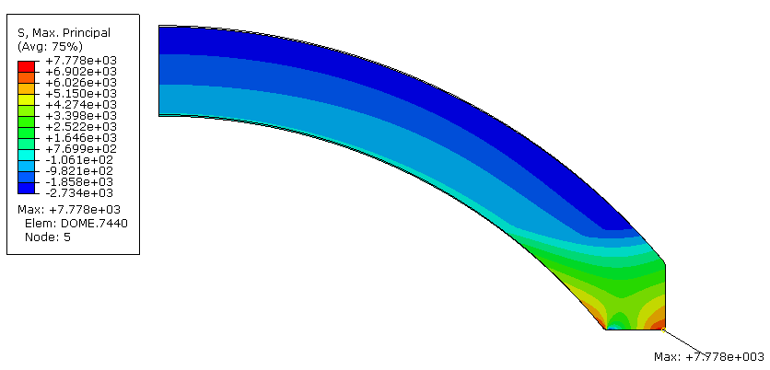
FEA of Modified design
Axial displacement unchanged
Tensile stress reduced 30%
First principal stress at 2750 PSI
Max = 7779 PSI (54 MPa)
70% of original design stress.
Axial displacement at 2,750 PSI pressure
= 0.013”.
Same displacement as original design.

Slide 12
Chemical Strengthening of glass
Submerge in a bath of molten KNO₃
How it works:
Original surface
Surface in compression
Ion Size
*Not drawn to scale, demonstration only
Na⁺ (0.95 Å)
K⁺ (1.33 Å)

Slide 13
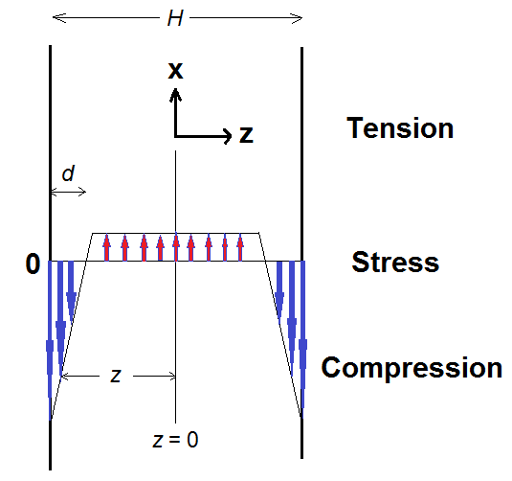
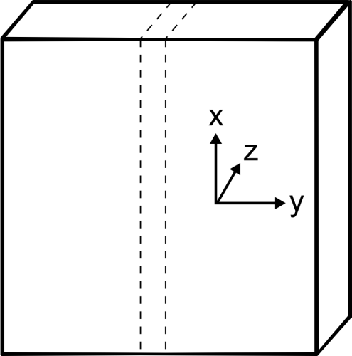
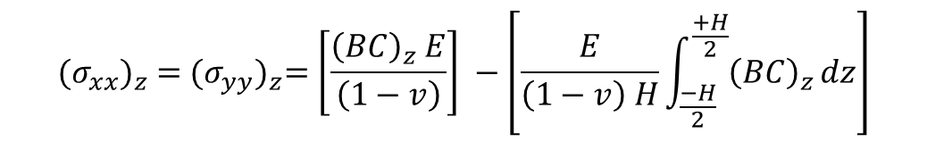

The Math…
In-plane stresses
$${(σ_{xx})}_{z} ={(σ_{yy})}_{z}=\left[\frac{{\left(BC\right)}_{z} E}{\left(1−v\right)}\right] −\left[\frac{E}{\left(1−v\right) H}\int_{\frac{−H}{2}}^{\frac{+H}{2}}{{\left(BC\right)}_{z}}dz\right]$$
= CS
perpendicular stress
$${(σ_{zz})}_{z} =0$$
C = concentration of the invading ion
H = plate width ; d = case-depth = DOL
E = Young’s modulus; ν = Poisson’s ratio
B = linear network dilation coefficient ( = “Cooper Coefficient”)

Slide 14
Glass composition and physical properties
Type: H-K9L (similar to Schott BK7)
Nominal composition (wt%):
69.13 SiO₂; 10.75 B₂O₃;3.07 CaO; 10.40 Na₂O; 6.29 K₂O; 0.36 As₂O₃
Density = 2.55 g/cm3
Tg = 550°C
TEC = 70x10⁻⁷/°C
E = 71.GPa
ν = 0.219
n_{d} = 1.523

Slide 15
Chemical strengthening of the domes
Four domes
15 witness disk samples 2” dia x 2 mm thick,
(for subsequent biaxial testing and CS/DOL measurement)
Hold domes in a stainless steel wire cage
Immerse in electrically heated steel tank containing molten KNO₃ salt.
Ion exchange at 450 °C for 24 hrs.
After extraction, carefully cool, wash and dry.
Compression layer (case depth “DOL”) = 45 μm.
Compression (“CS”) = - 430 MPa
(measured by FSM-6000LE)

Slide 16
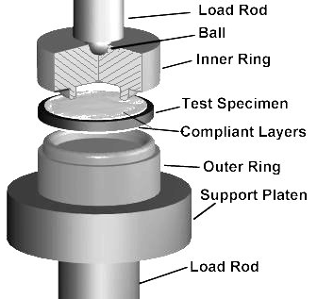
Material testing
Fracture strength, slow crack growth parameters and fracture toughness are needed for the reliability analysis but are not published by the manufacturers.
MBARI had Jon Salem to measure these parameters for BK-& and HK-9L (HK-9L is marketed as equal to BK7 but much cheaper)
Chemically strengthened BK7 and HK-9L were also tested.
ASTM C1499
S_{i}
B
S_{o}
ASTM C1421

Slide 17
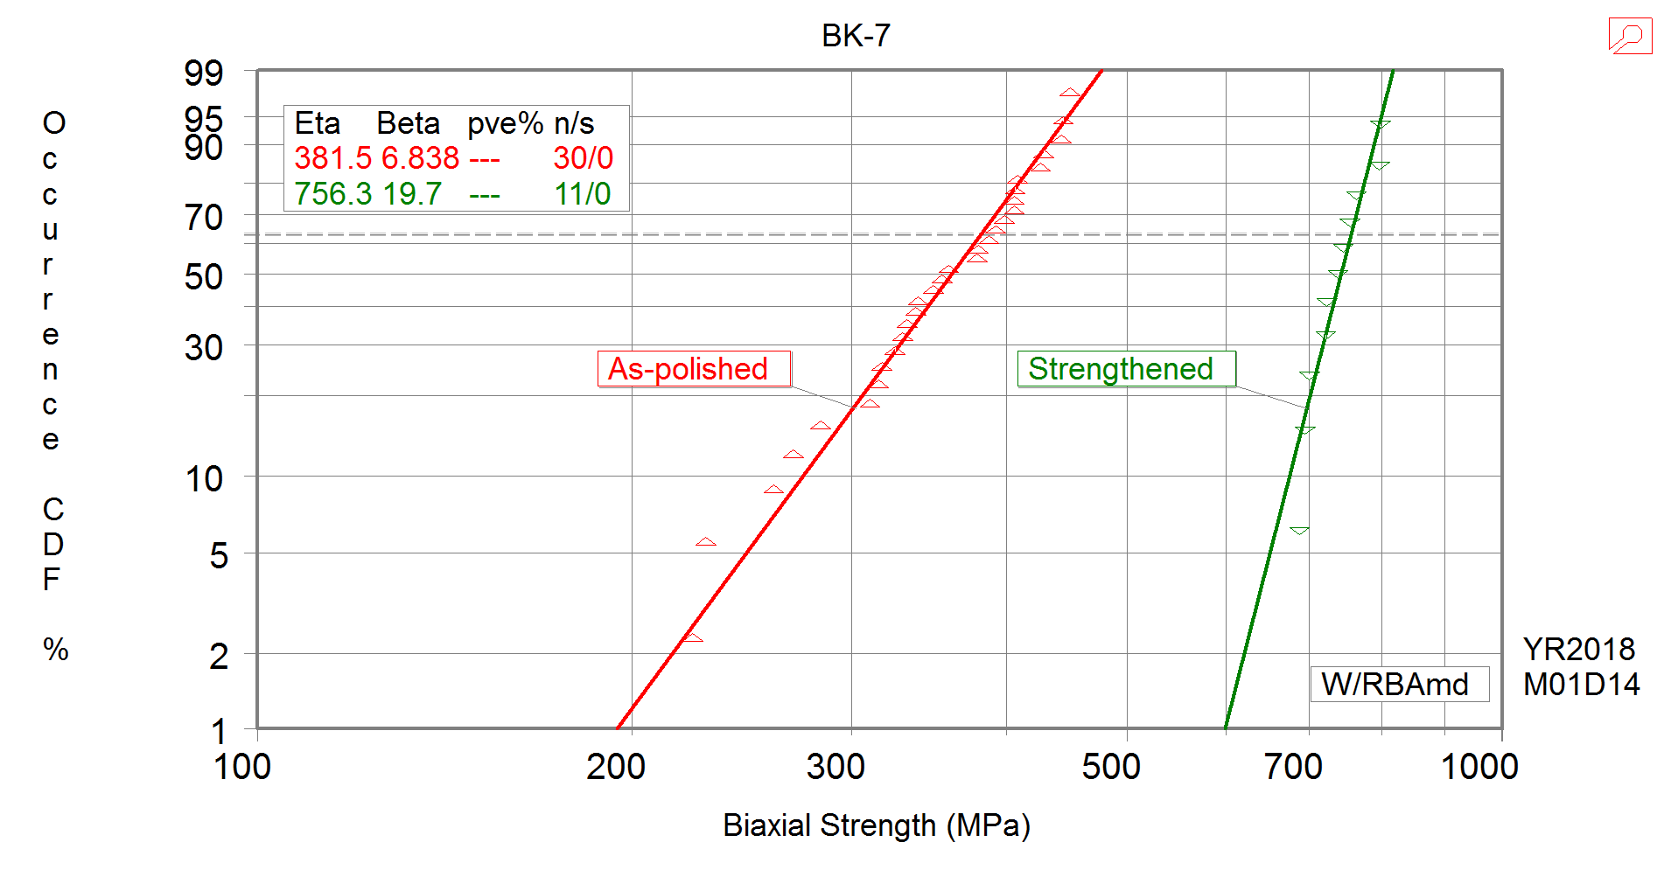
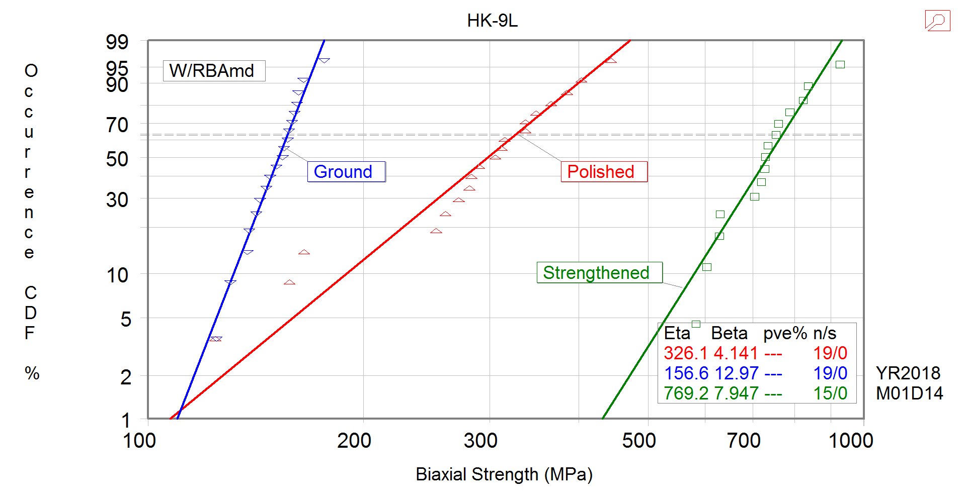
Results: Comparison of plain and strengthened glass
Similar strengths exhibited by both materials.
BK-7 exhibited less scatter.
Ion exchange more than doubles the strength.

Slide 18
Results: Comparison of plain and strengthened glass
Similar strengths exhibited by both materials.
BK-7 exhibited less scatter (greater Weibull modulus).
Ion exchange more than doubles the strength.

Slide 19
Results: crack growth behavior
Crack velocity as a function of stress intensity.
Material parameters determined in unstrengthened state.
Effective parameters derived for the strengthened state.
BK7 and HK-9L exhibit similar crack growth behavior.
BK-7 has slightly higher fracture toughness and slope n (good), but higher A (bad). Balances out.
t_{f} = BS_{I}^{n-2}σ_{a}^{-n}

