Slide 1
Design and testing of a large sub-hemispherical glass port for a deep-sea camera
Francois Cazenave¹; Eric H. Baker²
Nathan D. Card³; George D. Quinn⁴
Paul Remijan⁵; Jonathan Salem⁶
Arun K. Varshneya³
1. Monterey Bay Aquariun Research Institute, Moss Landing, CA
2. Connecticut Reserve Technologies, Gates Mills, OH
3. Saxon Glass technologies, Alfred, NY
4. National institute of Standard and Technology, Gaithersburg, MD
5. Fathom Imaging Inc., Brimfield, MA
6. NASA Glenn Research Center, Cleveland, OH

Slide 2
Outline
Introduction
  Optical design
Experimental procedure
  Early design and failure
  Fractography
  Modified design
  Chemical strengthening
Testing and reliability analysis
  Glass testing procedure and results
  Reliability analysis
  Proof testing
Conclusions

Slide 3
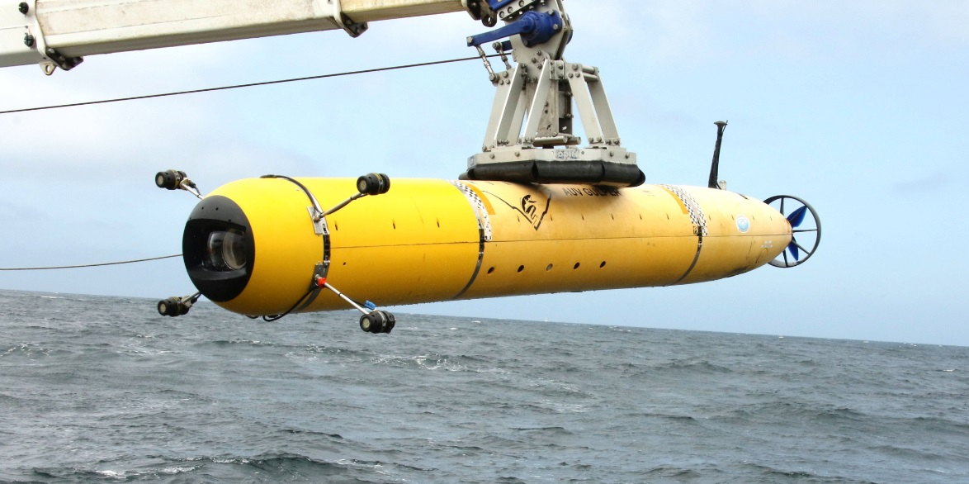
Introduction
  MBARI operates an autonomous underwater vehicle to carry out video surveys in Monterey Bay from 50m to 1500m depth.
  A new camera system was designed with the goal of achieving the highest image quality.
  A glass port was designed, built and tested.

Slide 4
Optical design
  Typical camera port
  Shape is optimized to resist hydrostatic pressure
  Small diameter (<200mm)
  Hemispherical shape
  Even and easy to predict stress and strain.
  High distortion
  BK-7 glass
  New camera port
  Shape is optimized for high optical quality
  Large diameter (250mm)
  Flattened hemispherical shape
  Uneven and hard to predict stress and strain.
  HK9-L glass (Chinese equivalent to BK-7

Slide 5
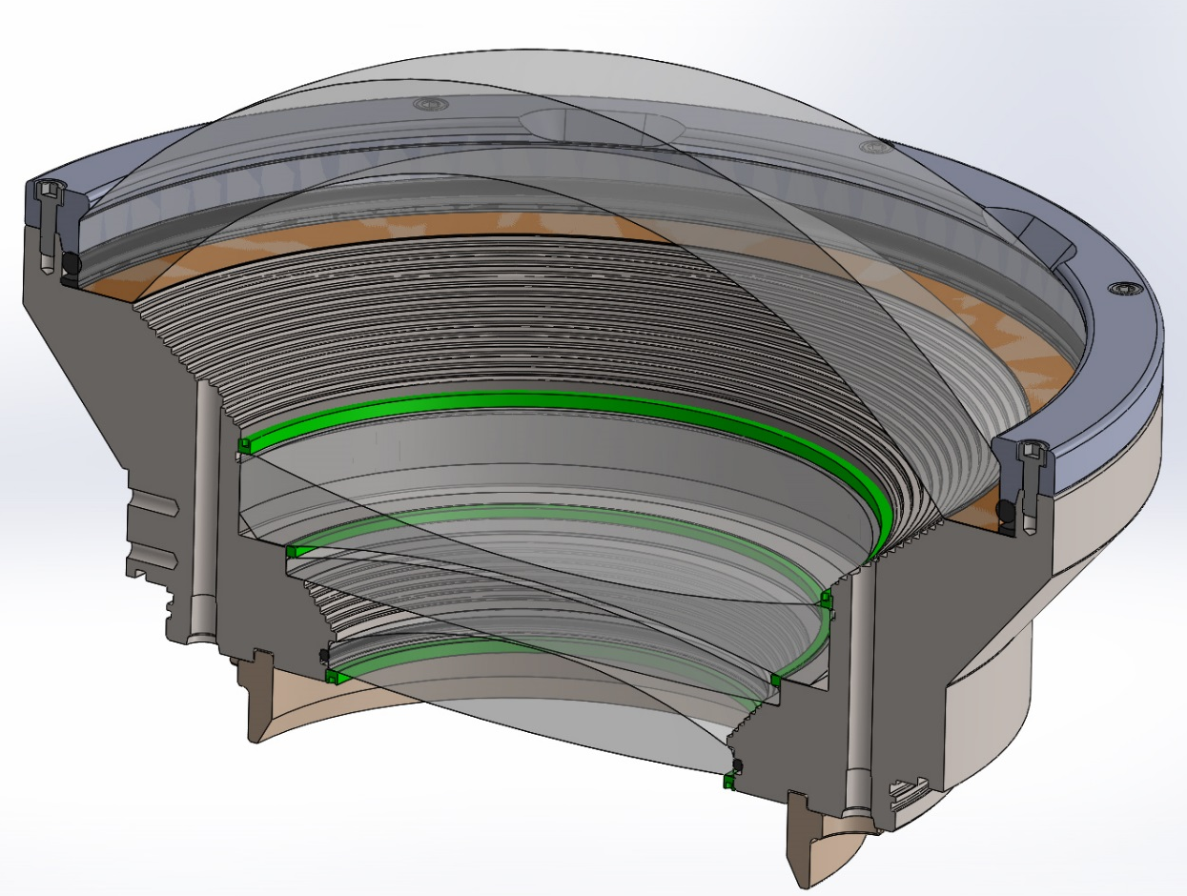
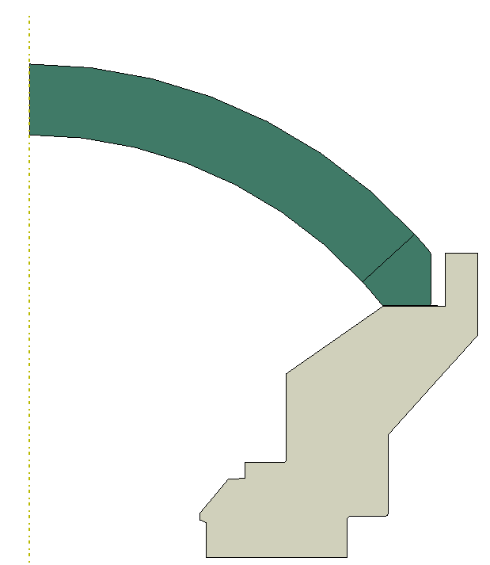
Early design and failure
Dome sits on kapton gasket
Dome is held with plastic retainer.
O-ring around dome

Slide 6
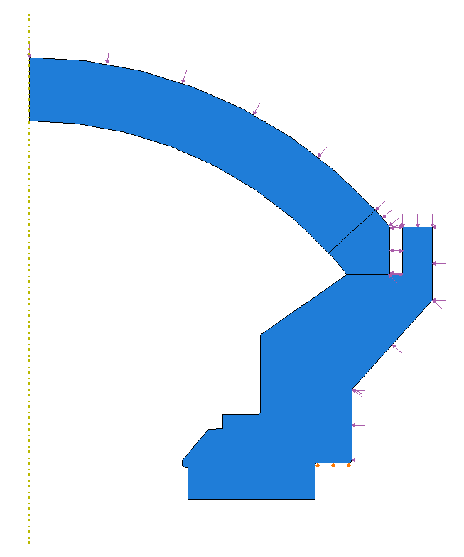
FEA of early design:
2D Axisymmetric Model
External Pressure Load
Glass dome
Kapton gasket
Titanium support
Dome is free to move Radially
8/2/16
BC: Radial = free, Axial = fixed

Slide 7
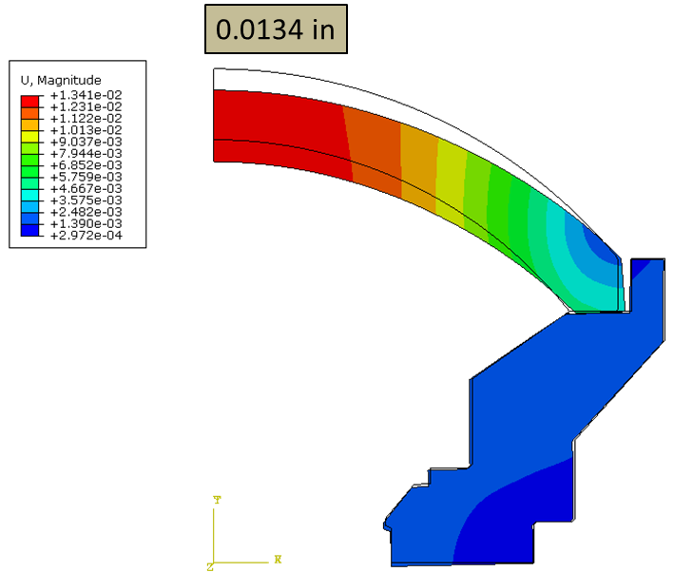
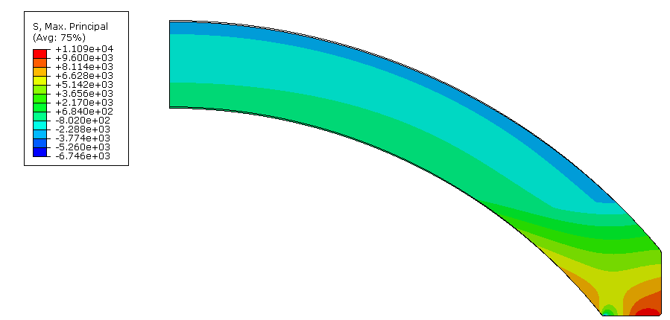
FEA results at 2750 PSI
Displacements
First principal (max tensile) Stress
11,090 psi

Slide 8
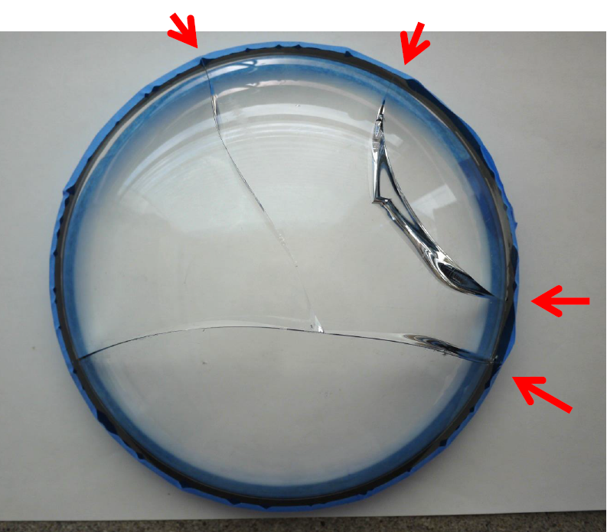
Failure of early design
Two domes failed during external pressure test:
The first dome failed after numerous cycles to 2750 PSI.
The second dome failed at 800PSI during first pressure cycle.
Notes:
The second dome failed at much lower pressure because the dome support was modified in a way that made things even worse. It was a design mistake basically. We could omit the second dome althogether for the sake of clarity if needed.

Slide 9
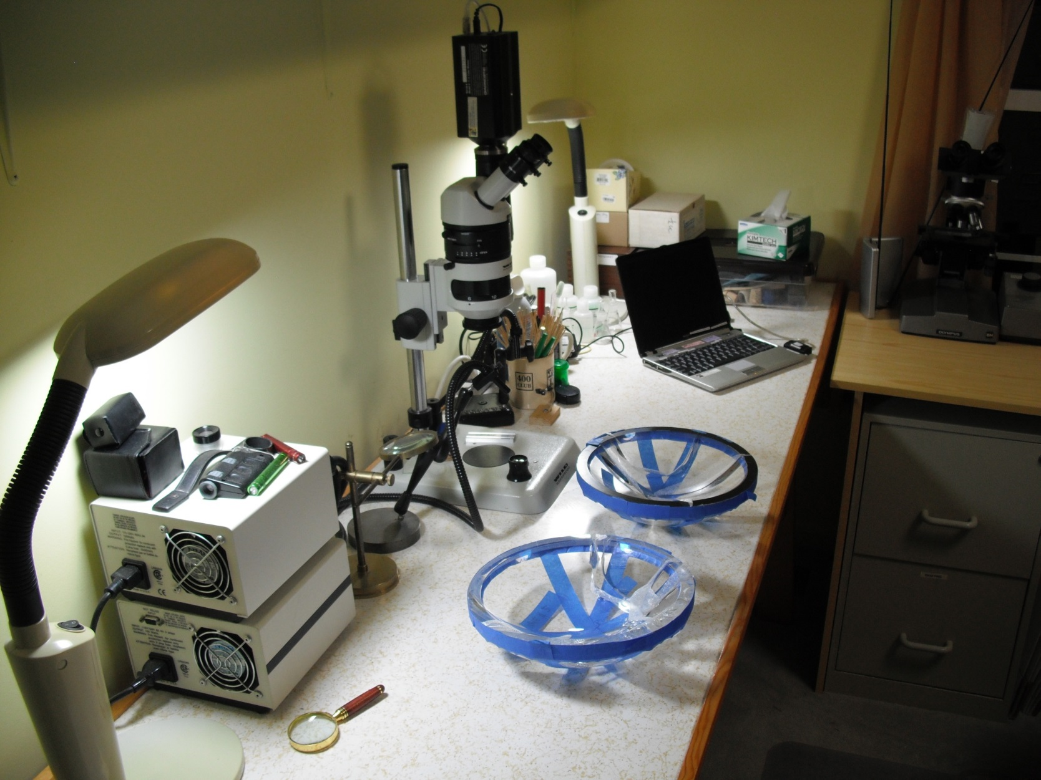
The first generation domes were fractographically analyzed by G. Quinn
using a WILD stereo optical microscope with a digital camera.
(Blue carpenters tape with small paper inserts between the fracture surfaces held the pieces together during shipment.)
Notes:
Notes for Francois
This slide shows the two broken domes.
It also is summarizes the experimental procedure.

Slide 10
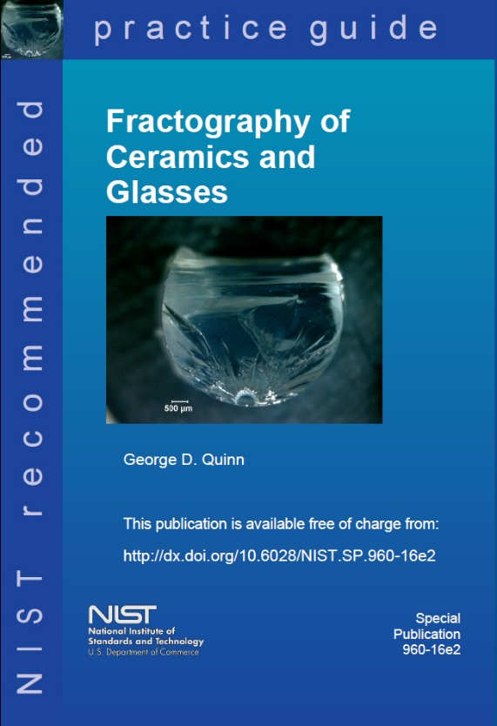
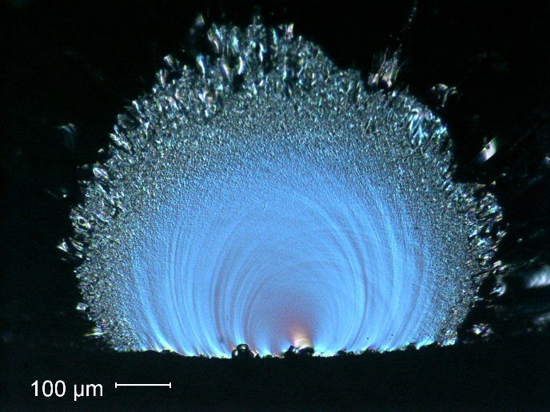

The fractographic analysis included study of the
crack patterns and the fracture surfaces.
How to look
Patterns of breakage
What to look for and how to interpret it.

Slide 11
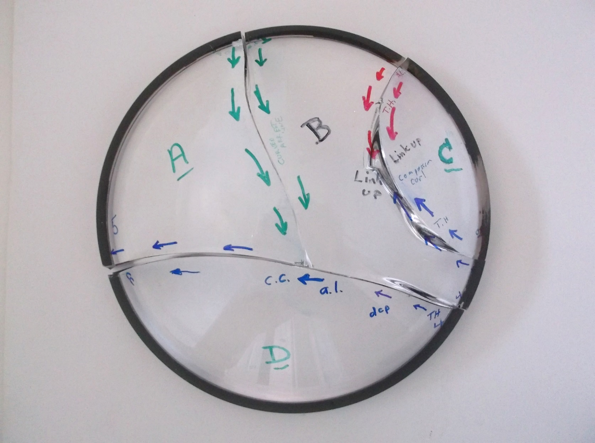
Fractographic analysis Dome 1
The directions of crack propagation were then marked on the assembly.
There were 4 crack systems. All 4 had the same type origins and same stresses driving them.
1
2
3
4

Slide 12
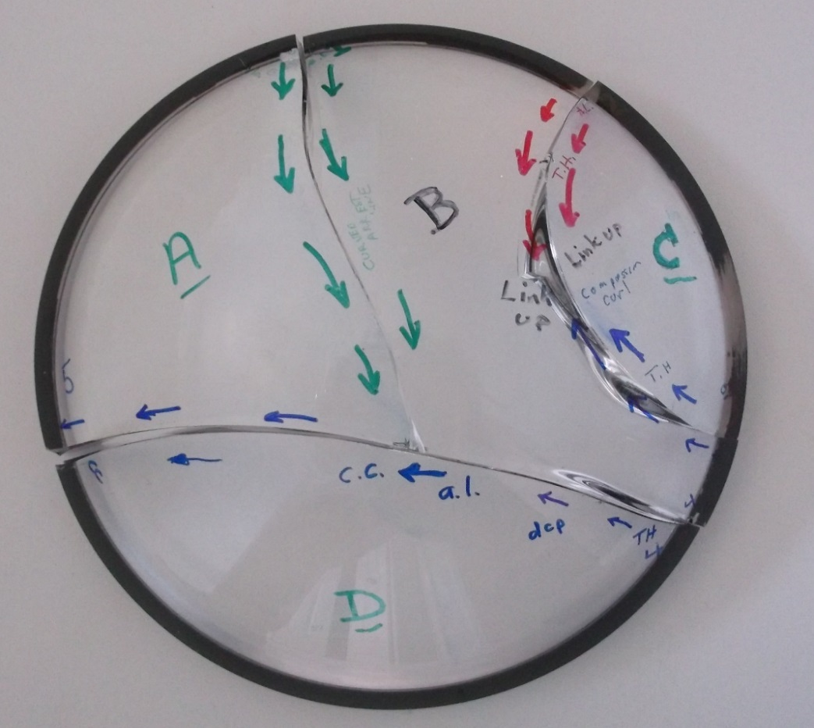
Fractographic analysis Dome 1
All four origins were contact crack damage at the outer rim area.
Origin 4 was the first to start the overall fracture.
All flaws and initial crack propagation were driven by circumferential hoop tensile stresses.
By the time the cracks propagated towards the middle, the stress changed to bending with tension on the inner dome surface. This suggest that the external pressure caused “splaying” of the dome.
There were no fracture mirror boundary features, nor did any of the cracks branch. This means tensile stresses were low,
less than 1,500 psi = 10 MPa.
1
2
3
4

Slide 13
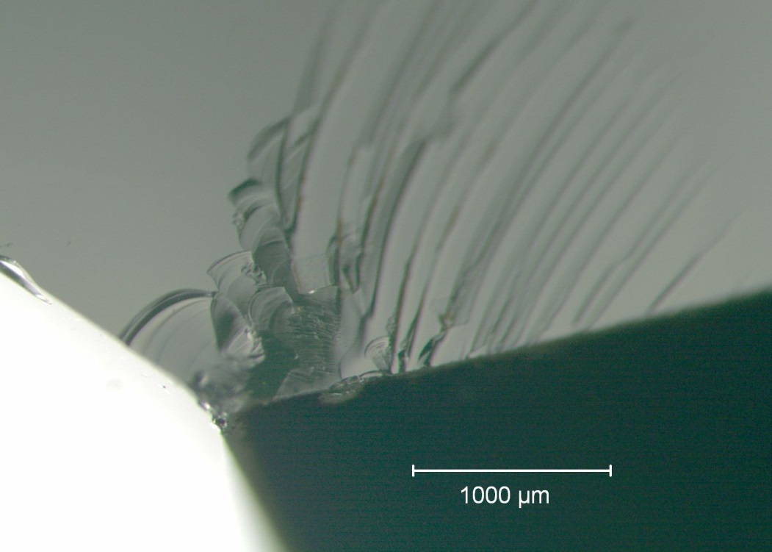
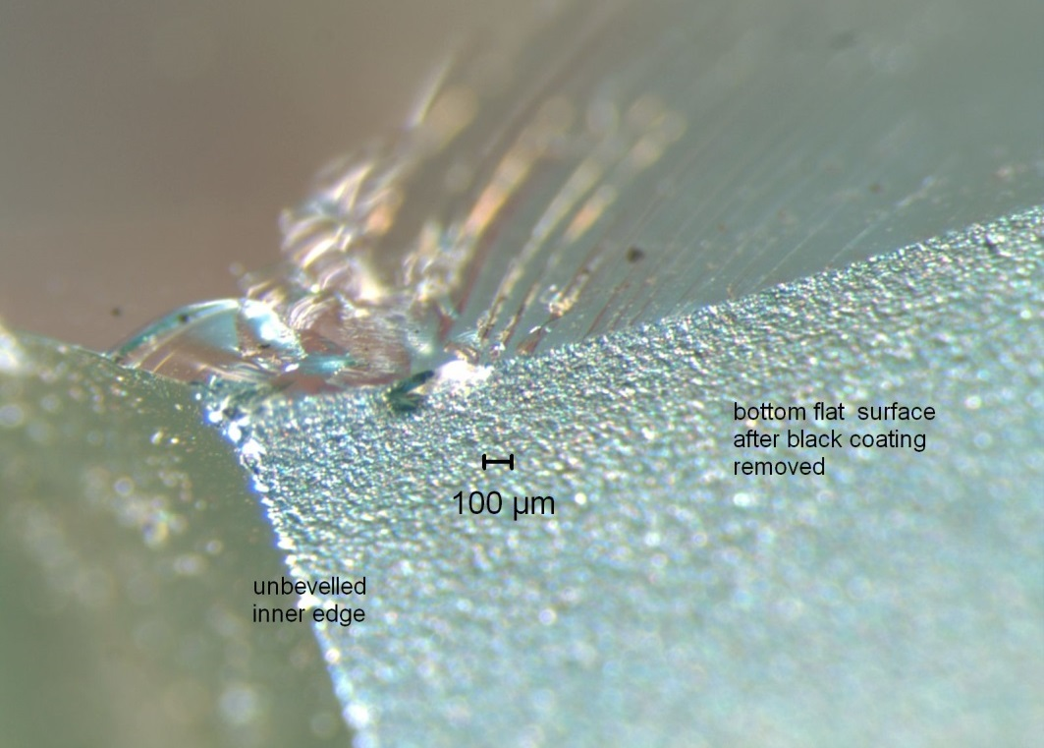
Fractographic analysis Dome 1
Example: One of the rim contact damage cracks
2 views with different lighting at same magnification
Fracture surface
Fracture surface
Inner dome surface
Inner dome surface
Dome ground base
Dome ground base
The origin is a contact damage crack on the bottom ground surface.
It is about 1 mm in from the unbeveled edge.

Slide 14
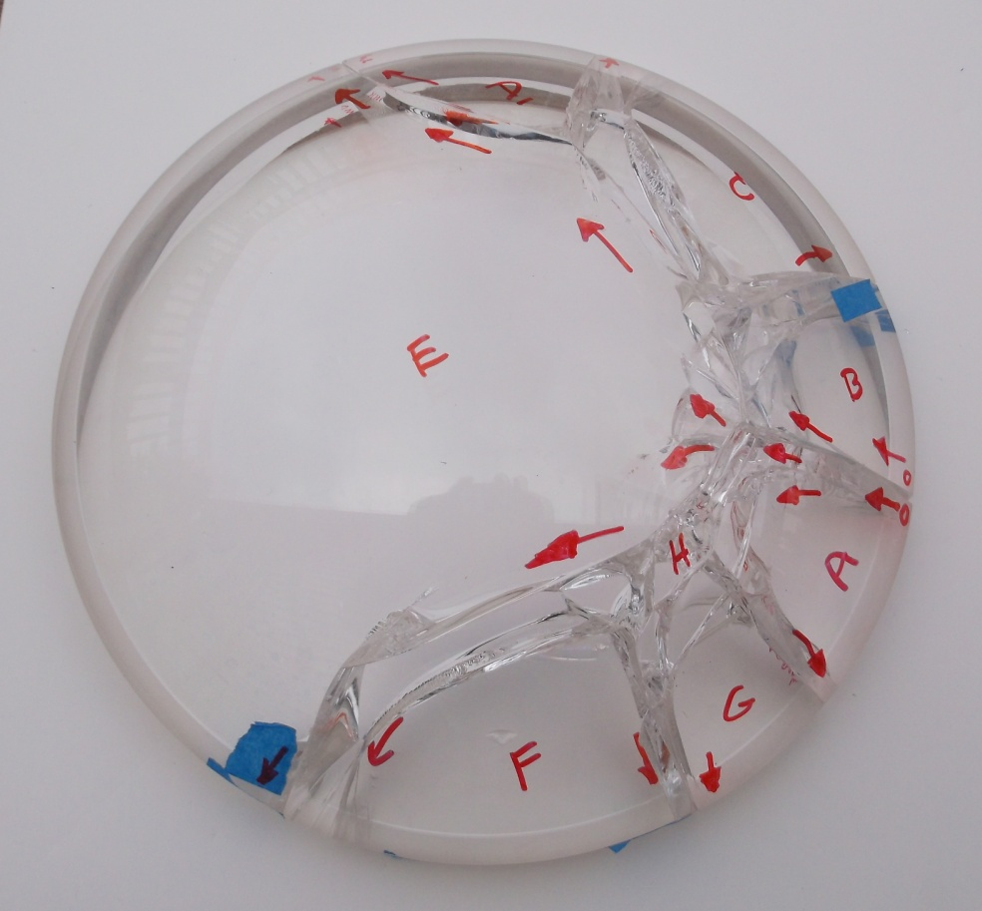
Fractographic analysis Dome 2
This dome broke at a higher stress.
This caused more extensive crack branching.
There was only one origin site, on the right side. It was a bevel grinding crack.
Origin

Slide 15
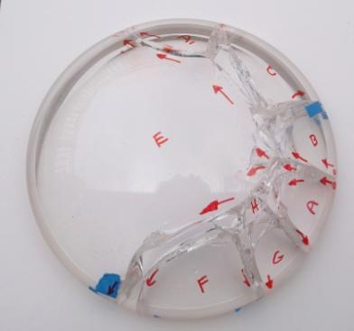
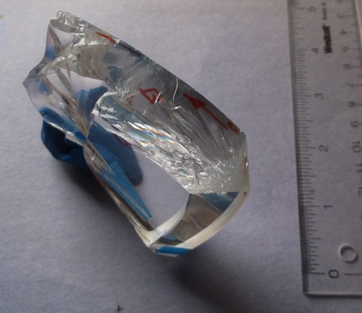
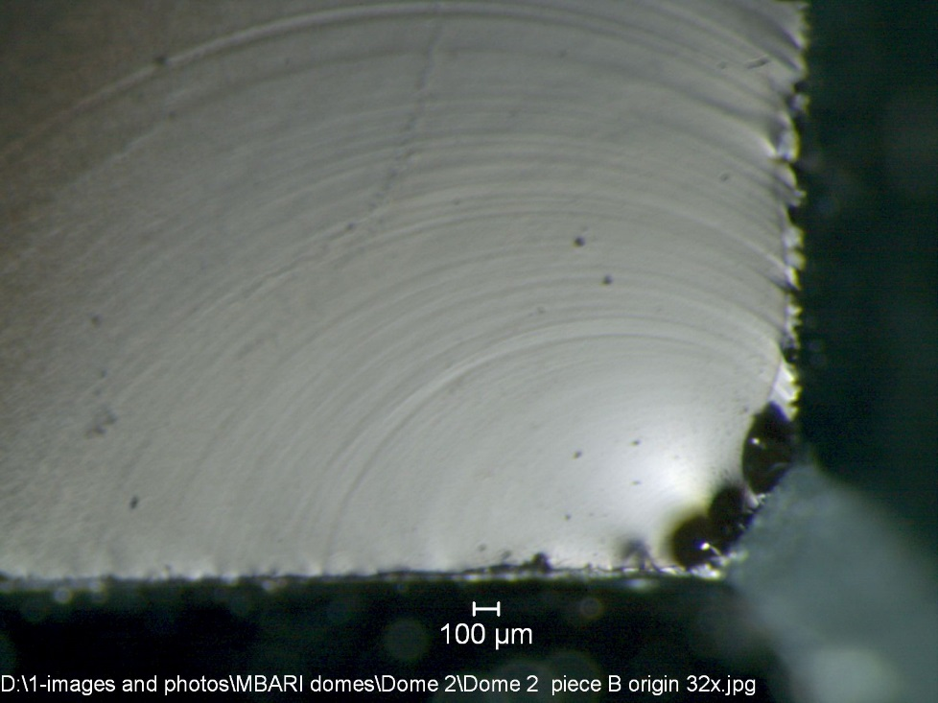
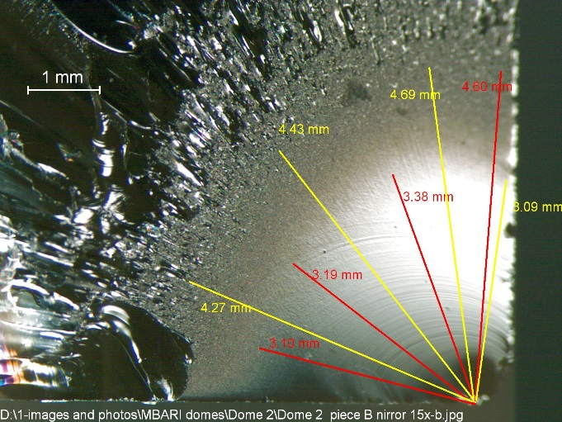
Fractographic analysis Dome 2
Grinding crack at the outer bevel.
Ground
outer
surface
A fracture mechanics analysis of the flaw itself indicated the stress at fracture was: 39 to 46 MPa (5,600 to 6,600 psi).
A fracture mirror size analysis gave estimates of:
40 to 47 MPa (5,000 to 6,800 psi).
These estimates match.
Polished base

Slide 16
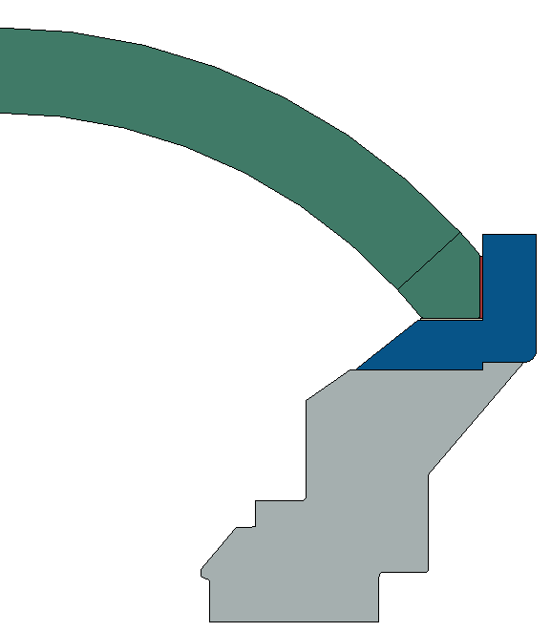
Modified design
Dome was bonded to titanium ring with epoxy to prevent lateral motion of dome seat
Edges were beveled and polished
Seat was polished and flatness tolerance was decreased
Thicker kapton ring
Dome Coupler Ring
Ti-6Al-4V
Dome Support
Ti-6Al-4V

Slide 17
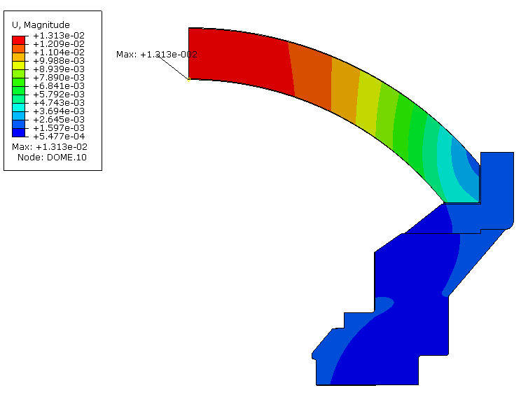
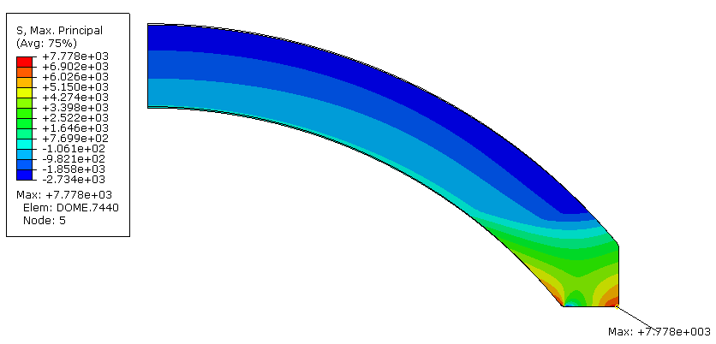
FEA of Modified design
Axial displacement unchanged
Tensile stress reduced 30%
Axial displacement at 2750 PSI
Max = 0.013”
First principal stress at 2750 PSI
Max = 7779 PSI (

Slide 18
Chemical Strengthening of glass
Submerge in a bath of molten KNO₃
How it works:
Original surface
Surface in compression
Ion Size
*Not drawn to scale, demonstration only
Na⁺ (0.95 Å)
K⁺ (1.33 Å)
Notes:
Transition: In addition making modification to the design, we hired Saxon G. T. to strengthen the domes.

Slide 19
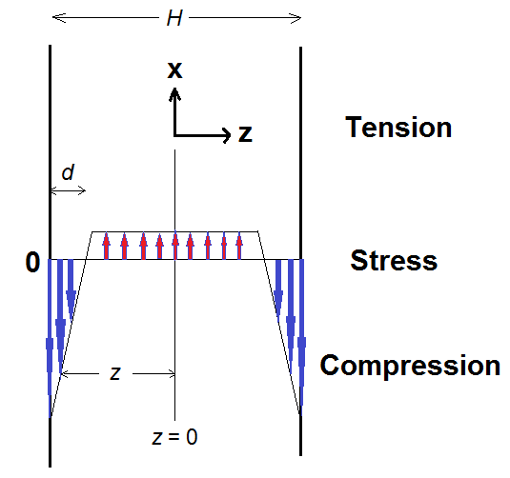
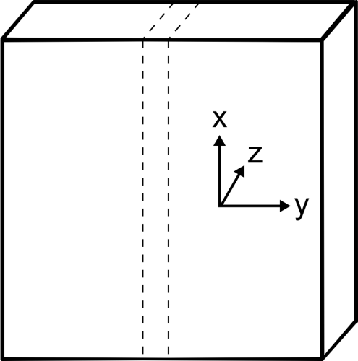
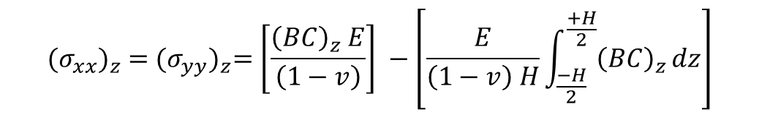

The Math…
In-plane stresses
$${(σ_{xx})}_{z} ={(σ_{yy})}_{z}=\left[\frac{{\left(BC\right)}_{z} E}{\left(1−v\right)}\right] −\left[\frac{E}{\left(1−v\right) H}\int_{\frac{−H}{2}}^{\frac{+H}{2}}{{\left(BC\right)}_{z}}dz\right]$$
= CS
perpendicular stress
$${(σ_{zz})}_{z} =0$$
C = concentration of the invading ion
H = plate width ; d = case-depth = DOL
E = Young’s modulus; ν = Poisson’s ratio
B = linear network dilation coefficient ( = “Cooper Coefficient”)

Slide 20
Glass composition and physical properties
Type: H-K9L (similar to Schott BK7)
Nominal composition (wt%):
69.13 SiO₂; 10.75 B₂O₃;3.07 CaO; 10.40 Na₂O; 6.29 K₂O; 0.36 As₂O₃
Density = 2.55 g/cm3
Tg = 550°C
TEC = 70x10⁻⁷/°C
E = 71.GPa
ν = 0.219
n_{d} = 1.523

Slide 21
Chemical strengthening of the domes
Four domes
15 witness disk samples 2” dia x 2 mm thick,
(for subsequent biaxial testing and CS/DOL measurement)
Hold domes in a stainless steel wire cage
Immerse in electrically heated steel tank containing molten KNO₃ salt.
Ion exchange at 450 °C for 24 hrs.
After extraction, carefully cool, wash and dry.
Compression layer (case depth “DOL”) = 45 μm.
Compression (“CS”) = - 430 MPa
(measured by FSM-6000LE)

Slide 22
Material testing
Fracture strength, slow crack growth parameters and fracture toughness are needed for the reliability analysis but are not published by the manufacturers.
MBARI hired Jon Salem to measure these parameters for BK-& and HK-9L (HK-9L is marketed as equal to BK7 but much cheaper)
chemically strengthened BK7 and HK-9L were also tested.

Slide 23
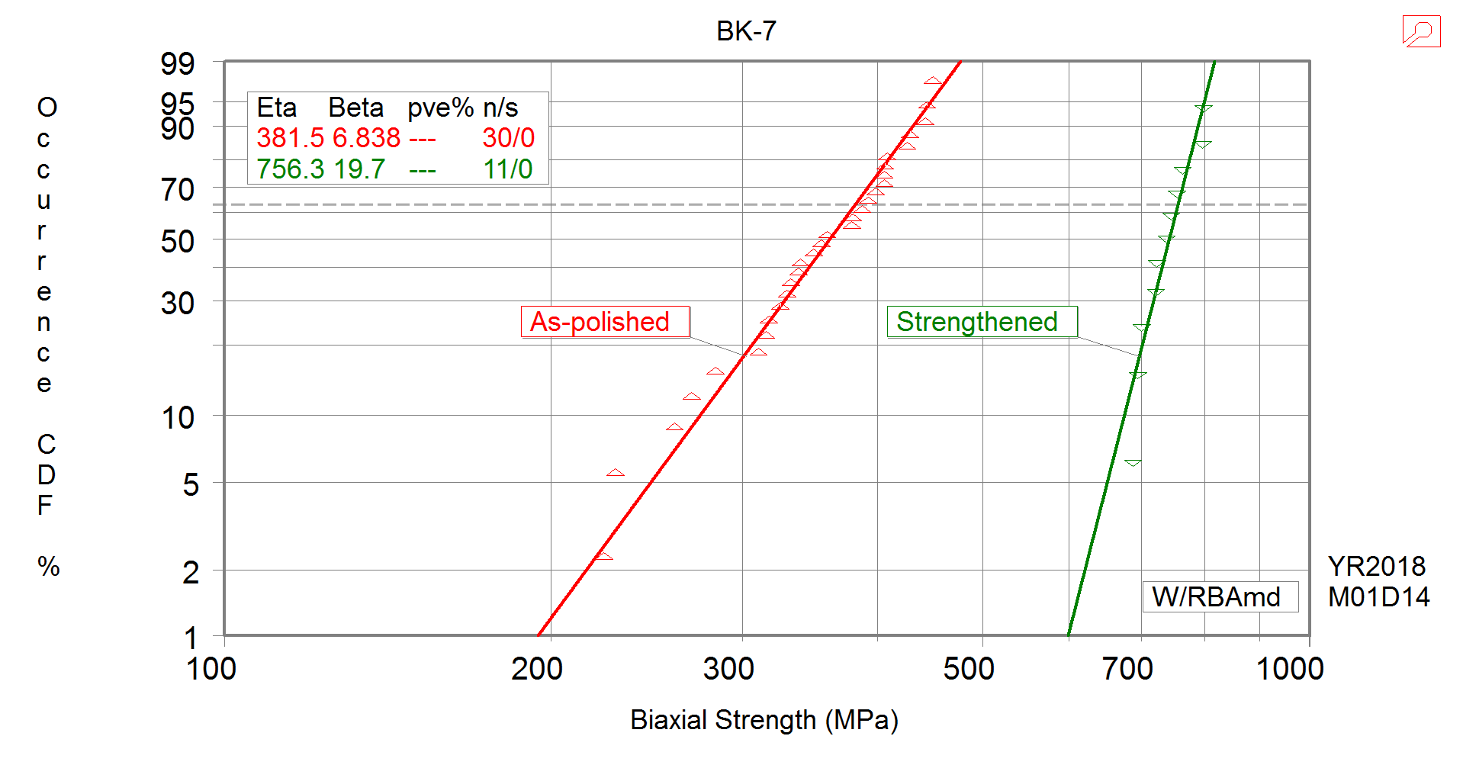
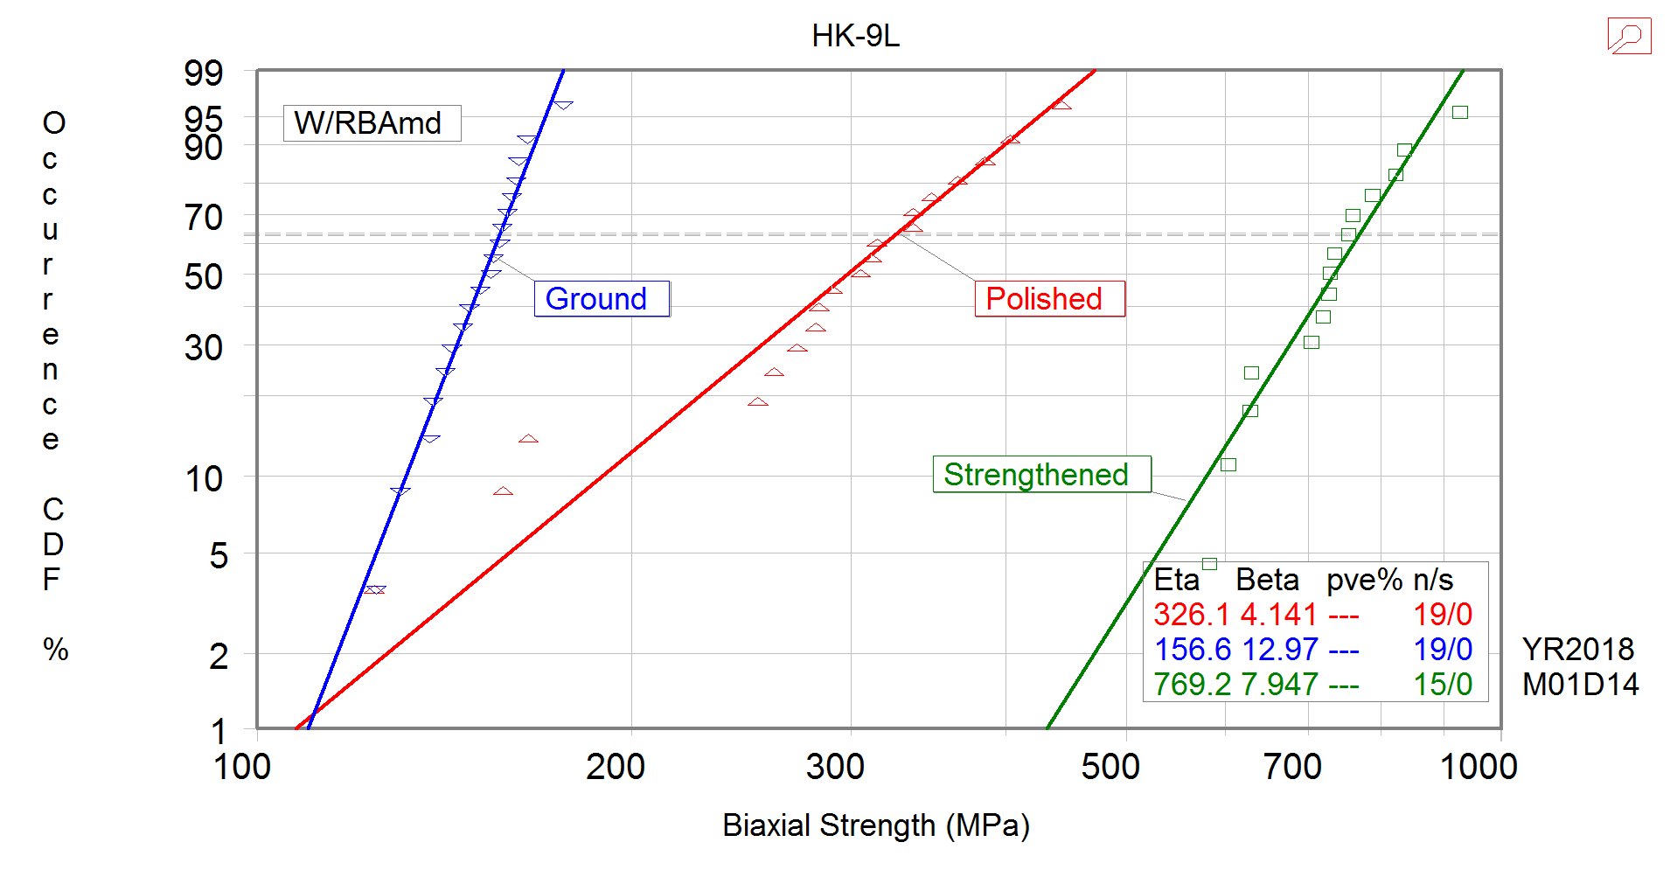
Results: Comparison of plain and strengthened glass

Slide 24
Results: crack growth behavior
Crack velocity as a function of stress intensity.
BK7 and HK-9L exhibit similar crack growth behavior.

Slide 25
Reliability analysis
MBARI hire Eric Baker of Connecticut Reserve Technology to perform brittle material reliability predictions on the camera port:
Acquired dome and dome support geometry from MBARI
Generated finite element analyses of dome configurations and calibrated models to MBARI FEA as well as pressure test measurements
Estimated Weibull Material Properties from provided test data
Applied the Ceramics Analysis and Reliability Evaluation of Structures (CARES) program to predict the brittle material reliability of the dome configurations
Established a proof test protocol to improve the reliability
8/2/16

Slide 26
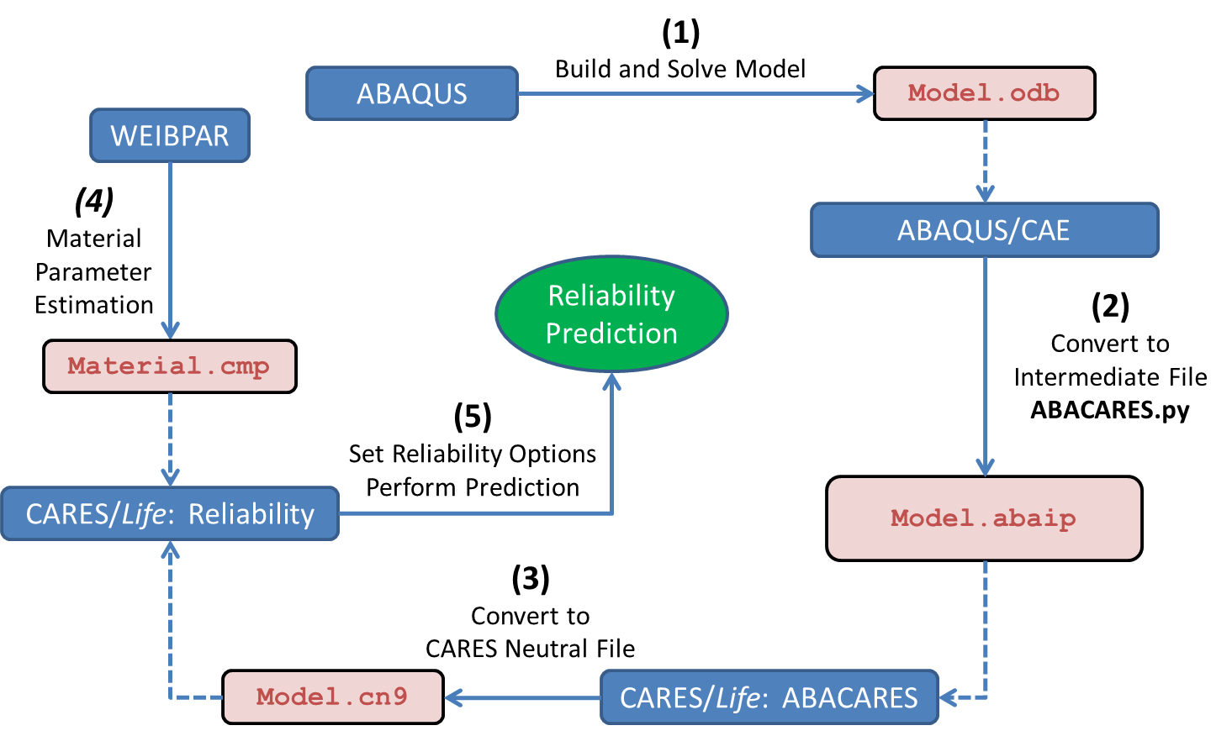
CARES with ABAQUS Flowchart
CARES predicts the brittle material reliability of a component by post-processing finite element analysis stress results.
CARES requires region based Weibull material properties, Volume and/or Surface, where different Surface conditions are characterized by different parameter sets.
8/15/16

