Slide 1

Design and testing of a large sub-hemispherical glass port for a deep-sea camera
Francois Cazenave¹; Eric H. Baker²
Nathan D. Card³; George D. Quinn⁴
Paul Remijan⁵; Jonathan Salem⁶
Arun K. Varshneya³
1. Monterey Bay Aquarium Research Institute, Moss Landing, CA
2. Connecticut Reserve Technologies, Gates Mills, OH
3. Saxon Glass technologies, Alfred, NY
4. National institute of Standard and Technology, Gaithersburg, MD
5. Fathom Imaging Inc., Brimfield, MA
6. NASA Glenn Research Center, Cleveland, OH

Slide 2
Outline
Introduction
  Optical design
Experimental procedure
  Early design and failure
  Fractography
  Modified design
  Chemical strengthening
Testing and reliability analysis
  Glass testing procedure and results
  Reliability analysis
  Proof testing
Conclusion

Slide 3
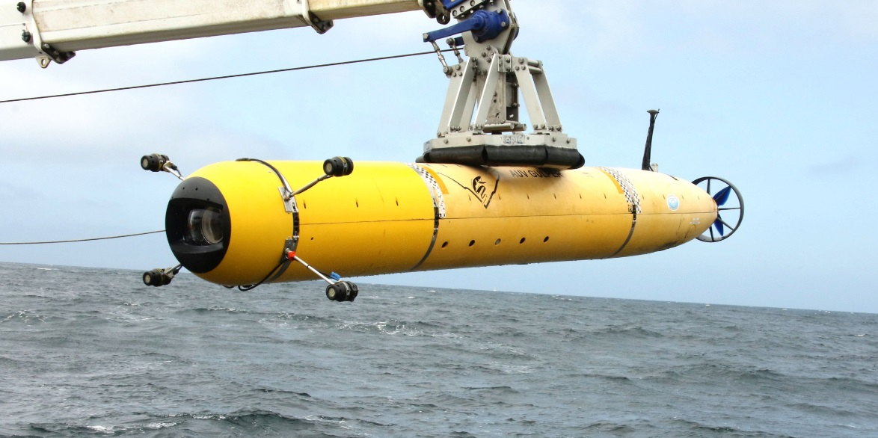
Introduction
  MBARI operates an autonomous underwater vehicle to carry out video surveys in Monterey Bay from 50m to 1000m depth.
  A new camera system was designed with the goal of achieving the highest image quality and a depth rating of 1500m.
  A glass dome port was designed, built and tested.
Notes:
The dome can be see in the front of the vehicle, protected by a black plastic shield.
The 4 appendages near the front are LED lights.

Slide 4
Optical design
  Typical camera dome port
  Shape is optimized to resist hydrostatic pressure
  Small diameter (<200mm)
  Hemispherical shape
  Even and easy to predict stress and strain.
  High distortion
  BK-7 glass
  New camera dome port
  Shape is optimized for high optical quality
  Large diameter (250mm)
  Flattened hemispherical shape
  Uneven and hard to predict stress and strain.
  H-K9L glass (Chinese equivalent to BK-7)

Slide 5
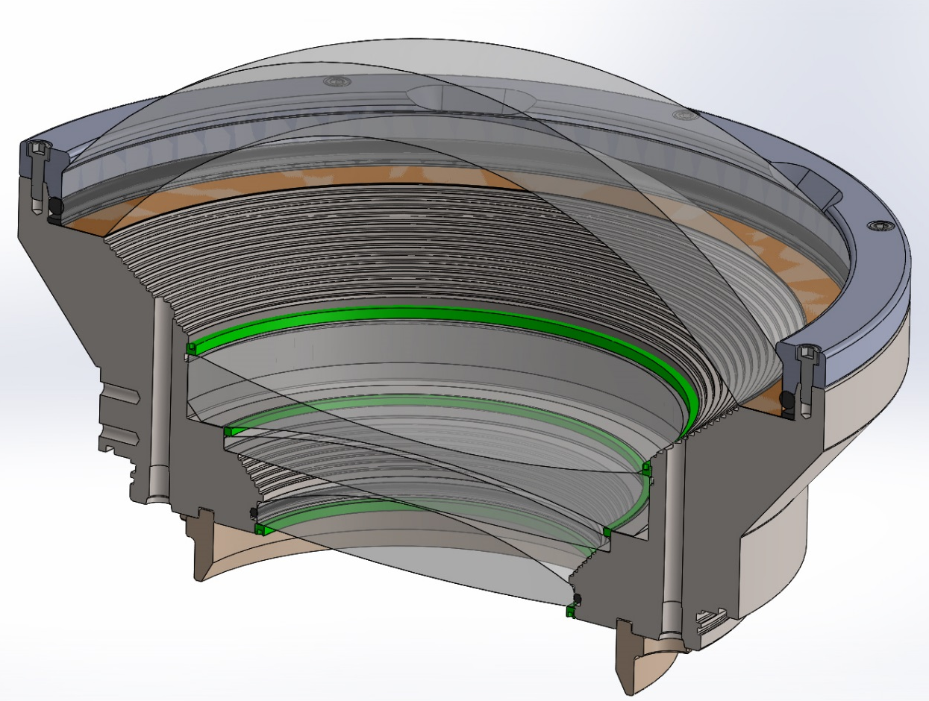
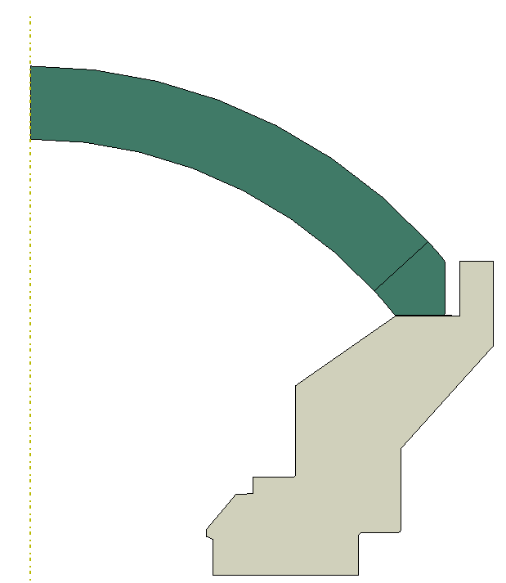
Early design of dome
Dome sits on kapton gasket
Dome is held with plastic retainer.
O-ring around dome

Slide 6
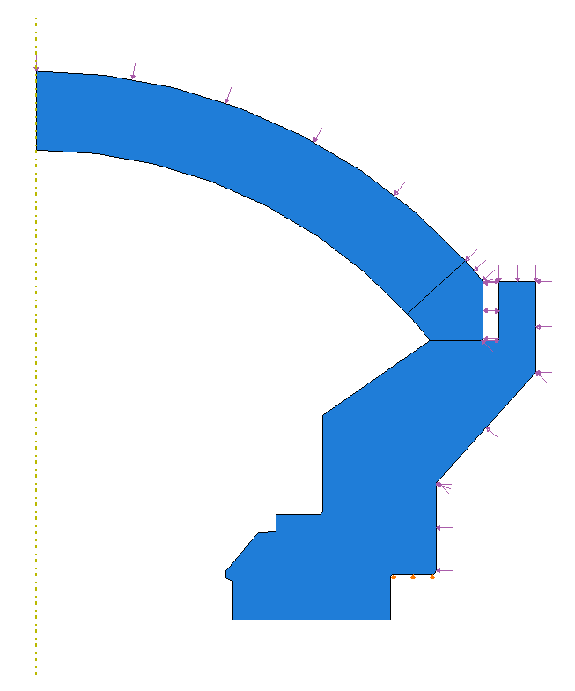
FEA of early design:
2D Axisymmetric Model
External Pressure Load
Glass dome
Kapton gasket
Titanium support
Dome is free to move Radially
8/2/16
BC: Radial = free, Axial = fixed

Slide 7
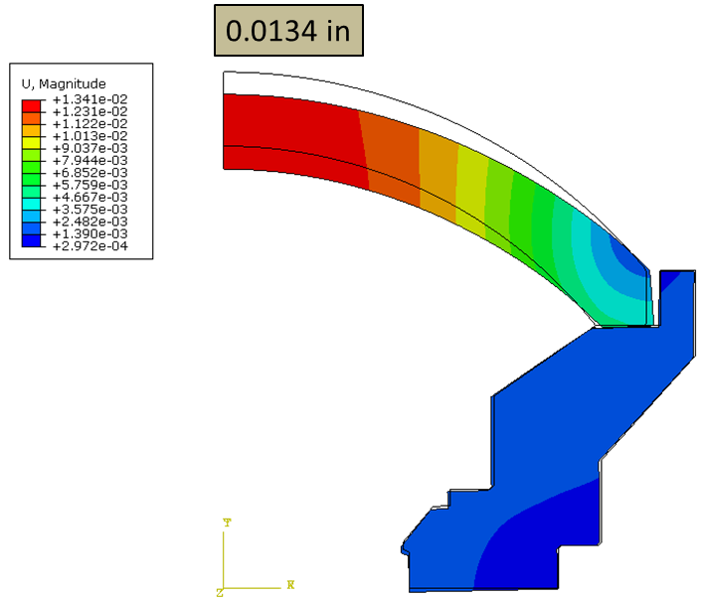
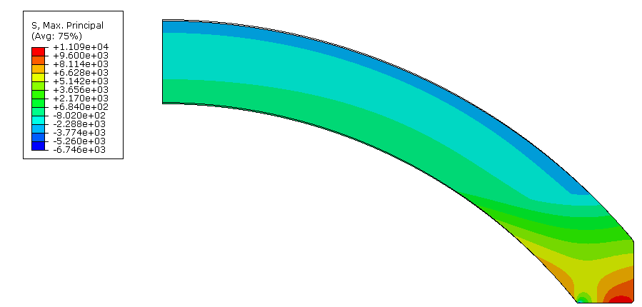
FEA results at 2750 PSI (19MPa)
Displacements
First principal (max tensile) Stress
11,090 psi
Maximum axial displacement 0.0134” (0.34mm)
Maximum first principal stress
11090 PSI (76.5MPa)
Notes:
2750PSI is the pressure at the rated depth (1500m) + 25%
25% is a safety margin that I chose somewhat arbitrarily at the time I started working on this.

Slide 8
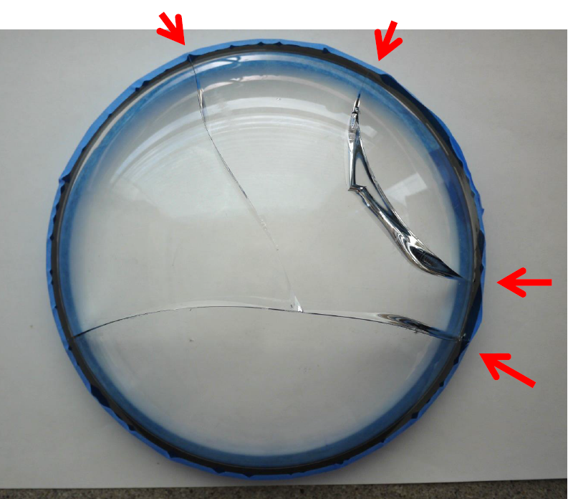
Failure of early design
Dome failed during external pressure test after numerous cycles to 2750 PSI (19MPa)
Notes:
The second dome failed at much lower pressure because the dome support was modified in a way that made things even worse. It was a design mistake basically. We could omit the second dome altogether for the sake of clarity if needed.

Slide 9
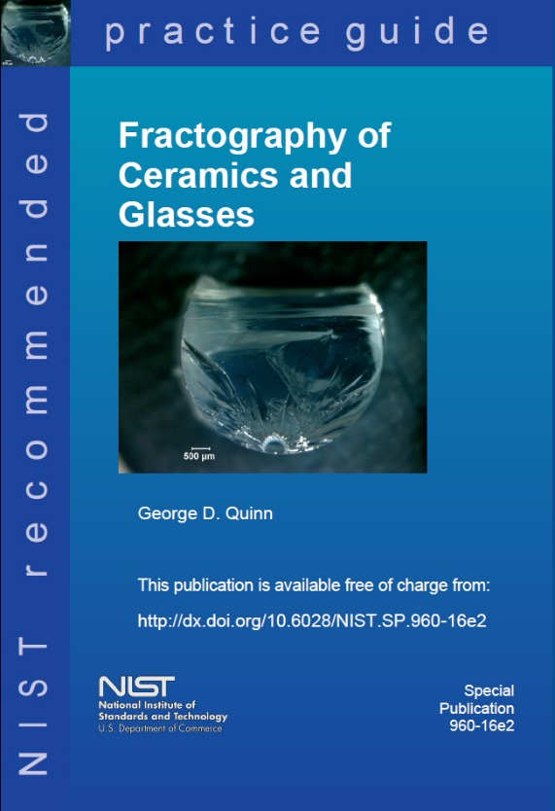
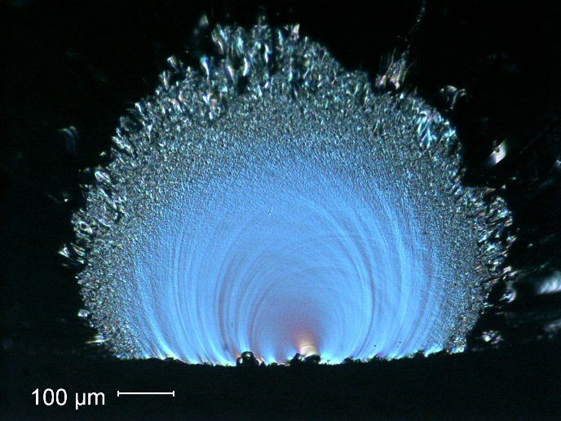
The broken dome was fractographically analyzed by G. Quinn
using a WILD stereo optical microscope with a digital camera.
The fractographic analysis included study of the
crack patterns and the fracture surfaces.
How to look
Patterns of breakage
What to look for and how to interpret it.

Slide 10
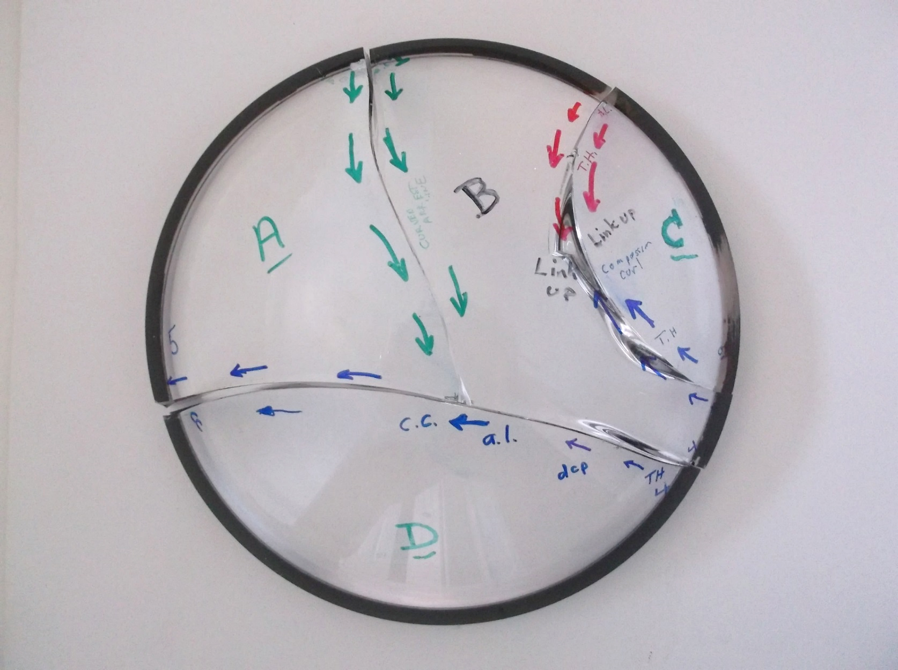
Fractographic analysis
The directions of crack propagation were then marked on the assembly.
There were 4 crack systems. All 4 had the same type origins and same stresses driving them.
1
2
3
4

Slide 11
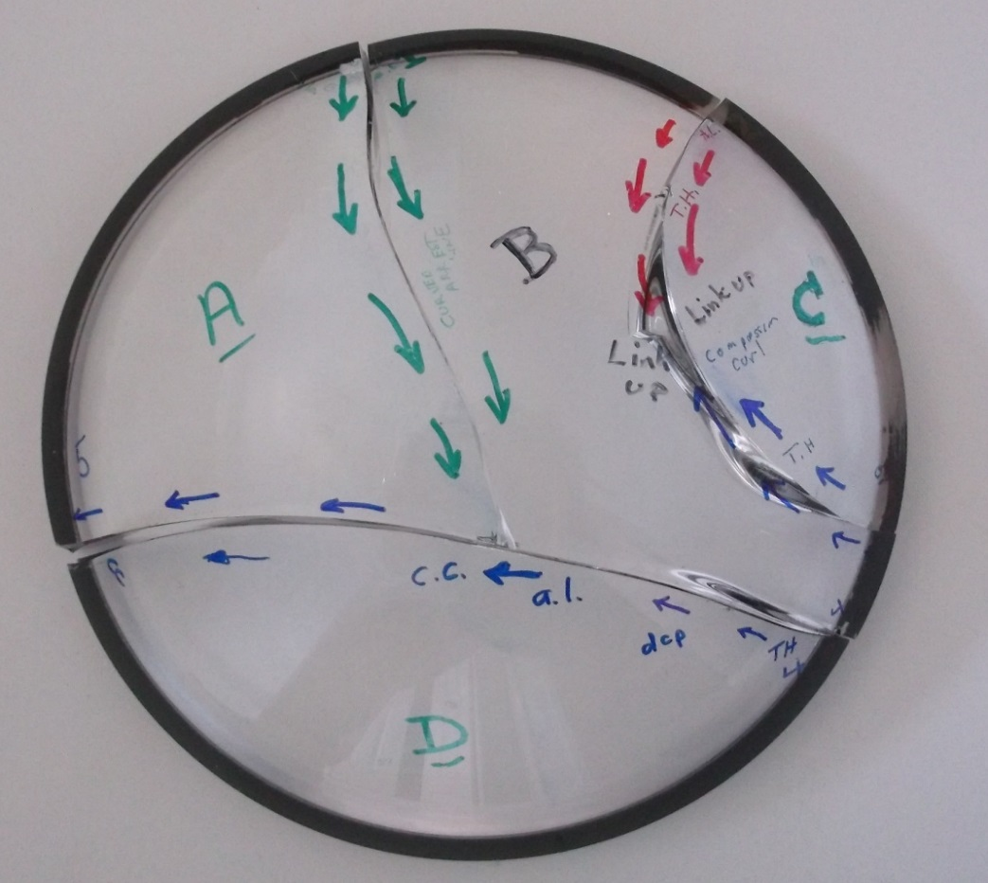
Fractographic analysis
All four origins were contact crack damage at the outer rim area.
Origin 4 was the first to start the overall fracture.
All flaws and initial crack propagation were driven by circumferential hoop tensile stresses.
By the time the cracks propagated towards the middle, the stress changed to bending with tension on the inner dome surface. This suggest that the external pressure caused “splaying” of the dome.
There were no fracture mirror boundary features, nor did any of the cracks branch.
1
2
3
4

Slide 12
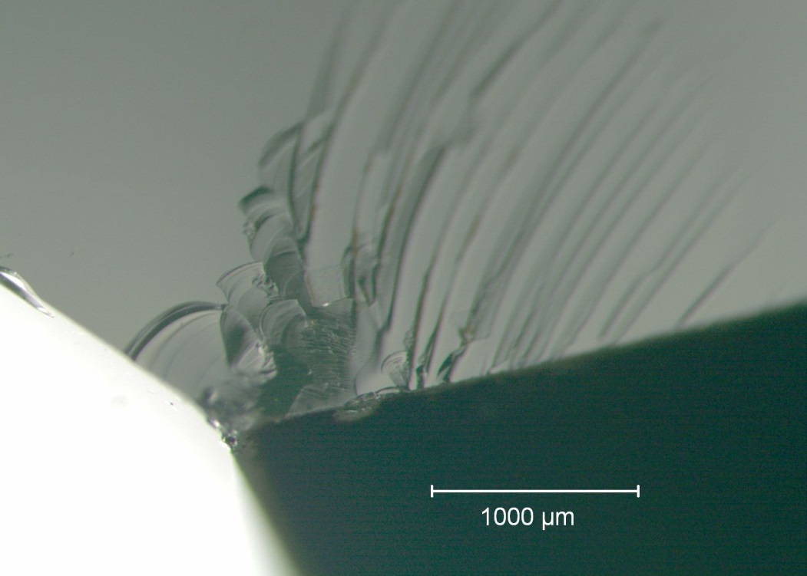
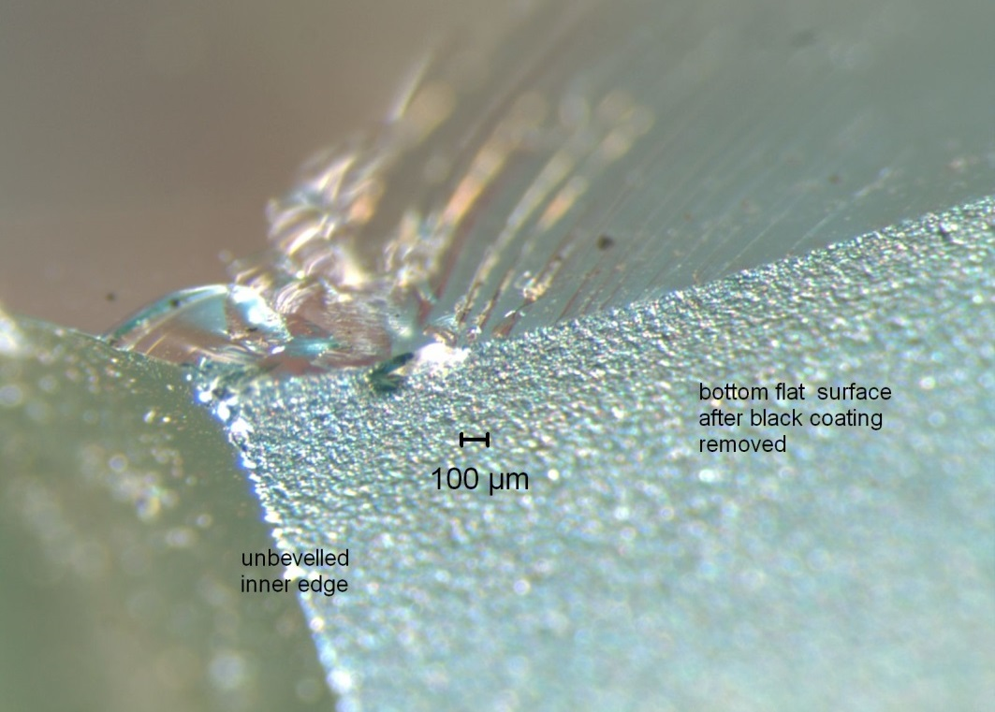
Fractographic analysis
Example: One of the rim contact damage cracks
2 views with different lighting at same magnification
Fracture surface
Fracture surface
Inner dome surface
Inner dome surface
Dome ground base
Dome ground base
The origin is a contact damage crack on the bottom ground surface.
It is about 1 mm in from the unbeveled edge.
Notes:
Summary of fractography: dome failed because of tensile hoop stress, and because of manufacturing defect.

Slide 13
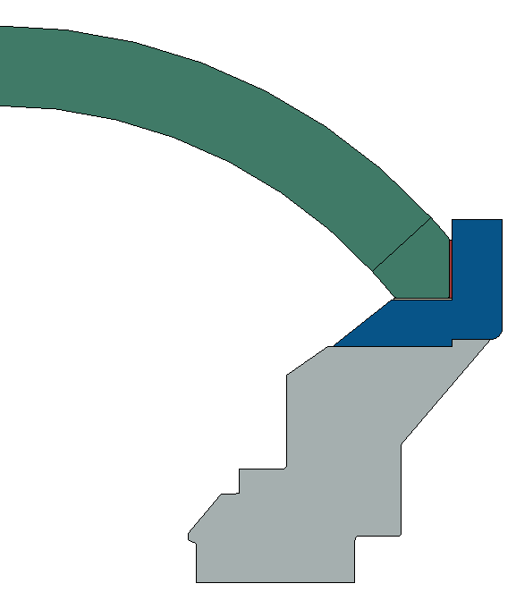
Modified design
Dome was bonded to titanium ring with epoxy to prevent lateral motion of dome seat
Edges were beveled and polished
Seat was polished and flatness tolerance was decreased
Thicker kapton ring
Dome Coupler Ring
Ti-6Al-4V
Dome Support
Ti-6Al-4V

Slide 14
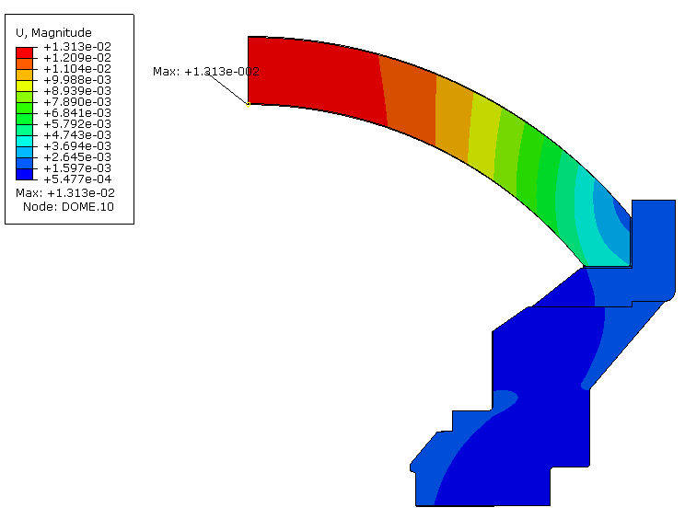
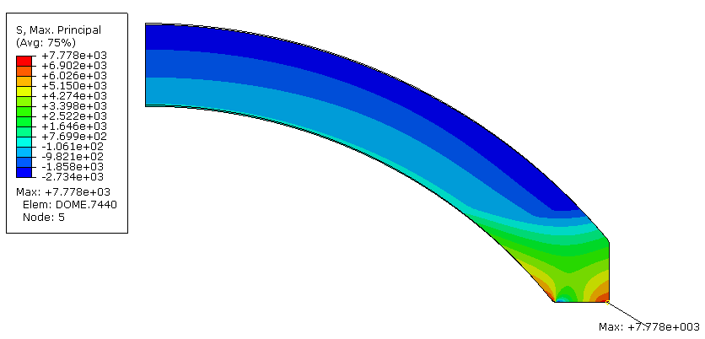
FEA of Modified design
Axial displacement unchanged
Tensile stress reduced 30%
Axial displacement at 2750 PSI
Max = 0.013” (0.33mm)
First principal stress at 2750 PSI
Max = 7779 PSI (5.37MPa) (30% decrease)
Notes:
There is a 30% decrease in tensile stress compared to the first design

Slide 15
Chemical Strengthening of glass
Submerge in a bath of molten KNO₃
How it works:
Original surface
Surface in compression
Ion Size
*Not drawn to scale, demonstration only
Na⁺ (0.95 Å)
K⁺ (1.33 Å)
Notes:
Transition: In addition making modification to the design, we hired Saxon G. T. to strengthen the domes.

Slide 16
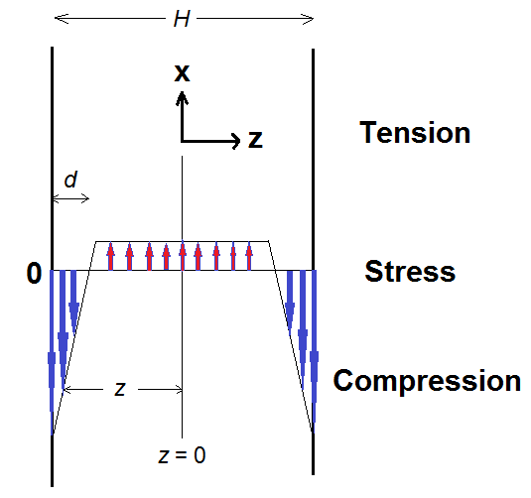
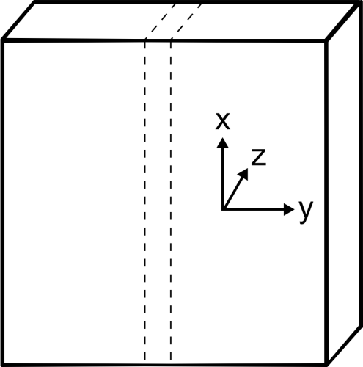
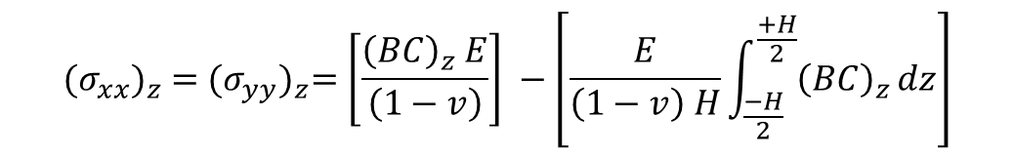

The Math…
In-plane stresses
$${(σ_{xx})}_{z} ={(σ_{yy})}_{z}=\left[\frac{{\left(BC\right)}_{z} E}{\left(1−v\right)}\right] −\left[\frac{E}{\left(1−v\right) H}\int_{\frac{−H}{2}}^{\frac{+H}{2}}{{\left(BC\right)}_{z}}dz\right]$$
= CS
perpendicular stress
$${(σ_{zz})}_{z} =0$$
C = concentration of the invading ion
H = plate width ; d = case-depth = DOL
E = Young’s modulus; ν = Poisson’s ratio
B = linear network dilation coefficient ( = “Cooper Coefficient”)

Slide 17
Glass composition and physical properties
Type: H-K9L (similar to Schott BK7)
Nominal composition (wt%):
69.13 SiO₂; 10.75 B₂O₃;3.07 CaO; 10.40 Na₂O; 6.29 K₂O; 0.36 As₂O₃
Density = 2.55 g/cm3
Tg = 550°C
TEC = 70x10⁻⁷/°C
E = 71.GPa
ν = 0.219
n_{d} = 1.523

Slide 18
Chemical strengthening of the domes
Four domes
15 witness disk samples 2” dia x 2 mm thick,
(for subsequent biaxial testing and CS/DOL measurement)
Hold domes in a stainless steel wire cage
Immerse in electrically heated steel tank containing molten KNO₃ salt.
Ion exchange at 450 °C for 24 hrs.
After extraction, carefully cool, wash and dry.
Compression layer (case depth “DOL”) = 45 μm.
Compression (“CS”) = - 430 MPa
(measured by FSM-6000LE)

Slide 19
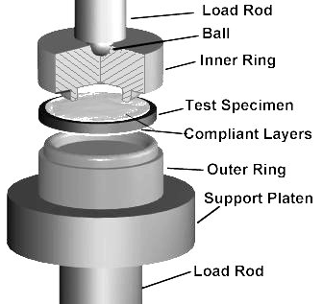
Material testing
Fracture strength, slow crack growth parameters and fracture toughness are needed for the reliability analysis but are not published by the manufacturers.
MBARI hired Jon Salem to measure these parameters for HK9-L (HK9-L is marketed as equal to BK-7 but is much cheaper)
Chemically strengthened HK9-L was also tested.
ASTM C1499
S_{i}
B
S_{o}
ASTM C1421

Slide 20
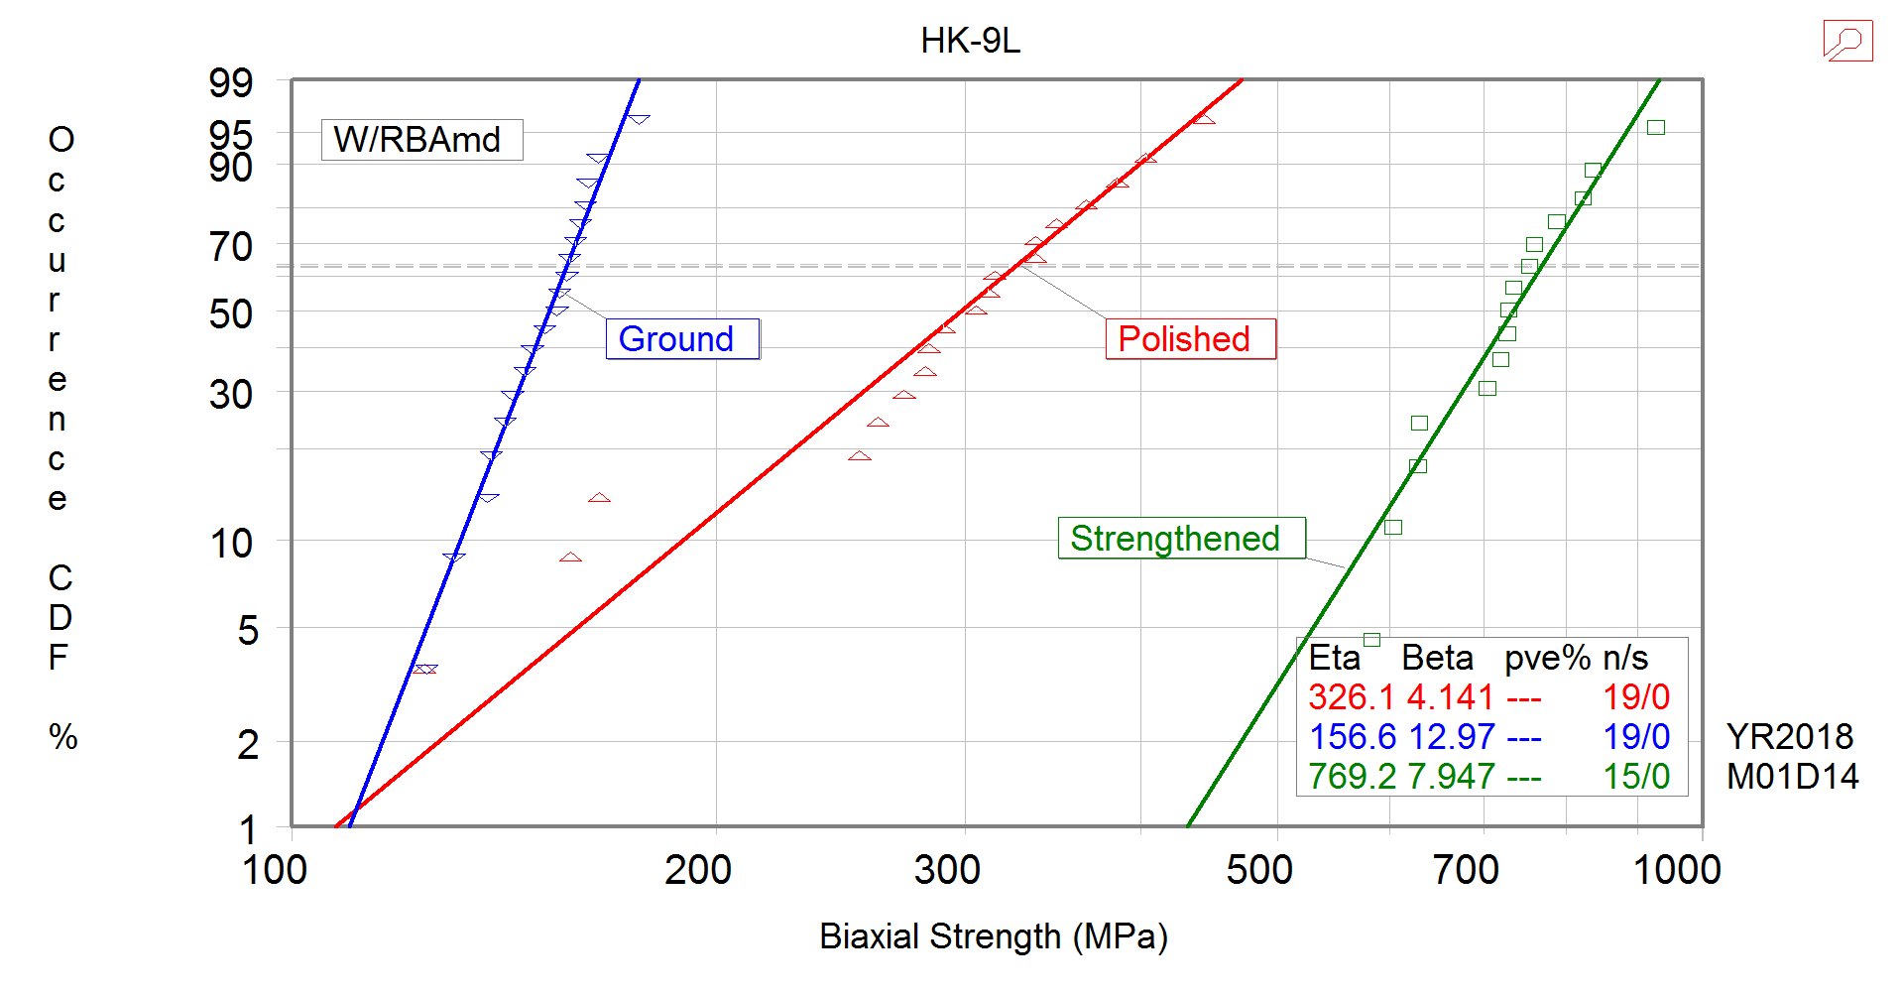
Results: Comparison of plain and strengthened glass
Eta = Weibull Modulus
Beta = Characteristic strength
n = number of specimens
s = number of censored specimens

Slide 21
Reliability analysis
MBARI hired Eric Baker of Connecticut Reserve Technology to perform brittle material reliability predictions on the camera port:
Generated finite element analyses of dome configurations and calibrated models to MBARI FEA as well as pressure test measurements
Estimated Weibull Material Properties from provided test data using WeibPar program
Applied the Ceramics Analysis and Reliability Evaluation of Structures (CARES) program to predict the brittle material reliability of the dome configurations
Established a proof test protocol to improve the reliability
This analysis was performed for unstrengthened and strengthened glass.

Slide 22
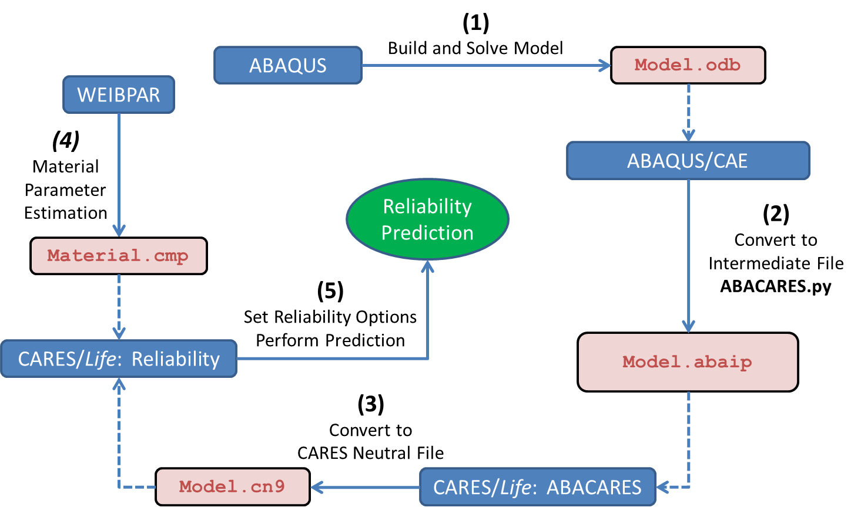
CARES with ABAQUS Flowchart
CARES predicts the brittle material reliability of a component by post-processing finite element analysis stress results.
CARES requires region based Weibull material properties, Volume and/or Surface, where different Surface conditions are characterized by different parameter sets.
Notes:
ABAQUS is FEA software.

Slide 23
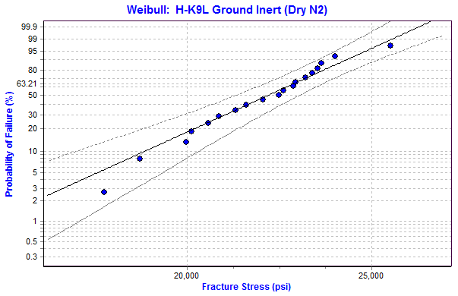
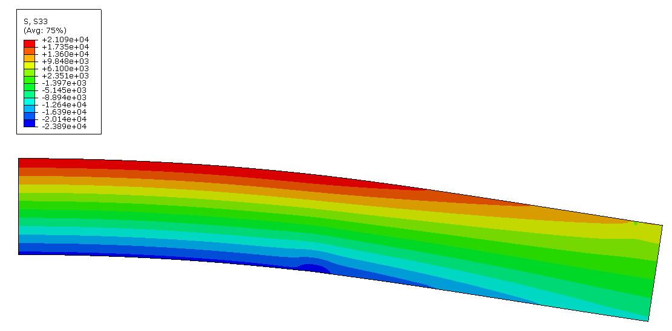

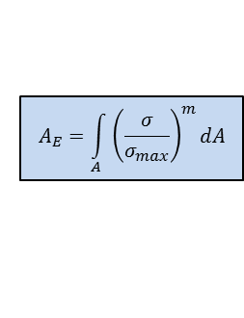

Material Properties: Weibull
WeibPar (Weibull parameter estimation program) is used for the WM and WCS calculations of the failure specimen data as well as calculating the Effective Area from a FEA of the R-o-R specimen
Ground Inert
Flaws were all assumed to originate on the Surface of the Failure Specimens
$$P_{f_{i}}=1−exp{\left(\frac{σ_{i}}{\text{σ}\text{̑}\text{­­}\text{θ} }\right)}^{\text{m}}$$
2D Axisymmetric Model of the Ring-on-Ring Specimen
Weibull Modulus (m)
Weibull Characteristic Strength (σ̑­­_{θ})
$$A_{E}=\int_{A}^{ }{{\left(\frac{σ}{σ_{max}}\right)}^{m}dA}$$
m = 13.6 [-]
σ̑­­_{θ}= 22,714 [psi]
Weibull Effective Area (A_{E})
$$\text{σ}\text{̑}\text{­­}\text{o}=\text{σ}\text{̑}\text{­­}\text{θ}∗{\left(A_{E}\right)}^{1/m}$$
A_{E} = 0.229 [in²]
Weibull Material Scale Parameter (σ̑­­_{o})
Where m & σ̑­­_{o} are used in CARES
σ̑­­_{o} = 20,386 [psi*in^(2/13.6)]
m = Weibull Modulus
σ̑­­_{θ =} Weibull Characteristic Strength
A_{E} = Weibull Effective Area
σ̑­­_{o} = Weibull Material Scale Parameter

Slide 24
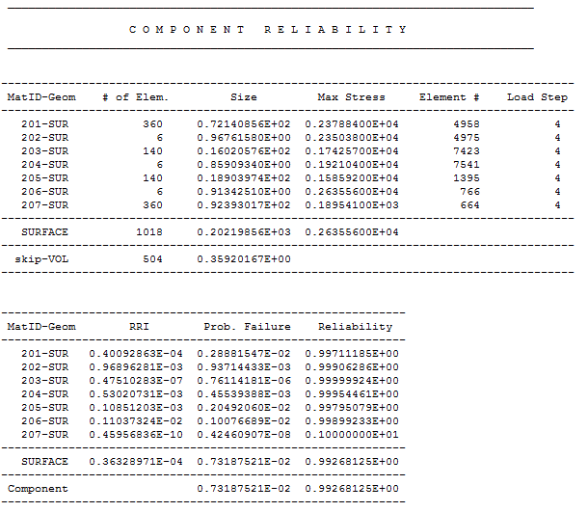
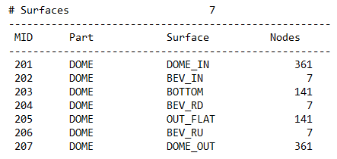
Example of CARES output
Unstrengthened H-K9L glass
Pressure: 2750 psi
Duration: 60 hrs
Max Stress
Polished
Lowest Individual
Surface Reliability
One Ground
Polished
Overall Reliability
Counterclockwise from Dome Inner to Dome Outer
Notes:
Numbers 201 to 207 represent the different surfaces of the domes (inside, outside, 3 edge beveled, base, and perimeter)

Slide 25
Example of CARES output
Unstrengthened H-K9L glass
Reliability as a Function of Service Pressure
where Service Time is 60 hrs.
Reliability as a Function of Service Time
@ Applied Pressure 2750 psi
FEA Stress Solution @ 2750 psi (19MPa)
Assumes Stresses Scale Linearly with Pressure
Assumes other parts of Assembly can handle the increased Applied Pressure

Slide 26
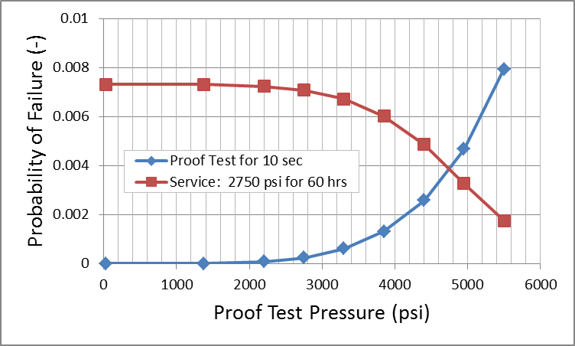
Example of proof test
The dome is subjected to a high pressure for a short time to decrease its probability of failure during service.
No Proof Test
Pf = 0.73%
Failure Rate = 1 out of 137
10 sec Proof Test @ 4950 psi
Pf = 0.33%
Failure Rate = 1 out of 306
10 sec Proof Test @ 4950 psi
Pf = 0.47%
Failure Rate = 1 out of 214
Blue line shows probably of failure during 10s proof test.
Red line shows probably of failure during 60-hour service life of proof-tested dome

Slide 27
Reliability of chemically strengthened dome
Pf = probability of failure
Predicted reliability of strengthened dome is very high even without proof test.

Slide 28
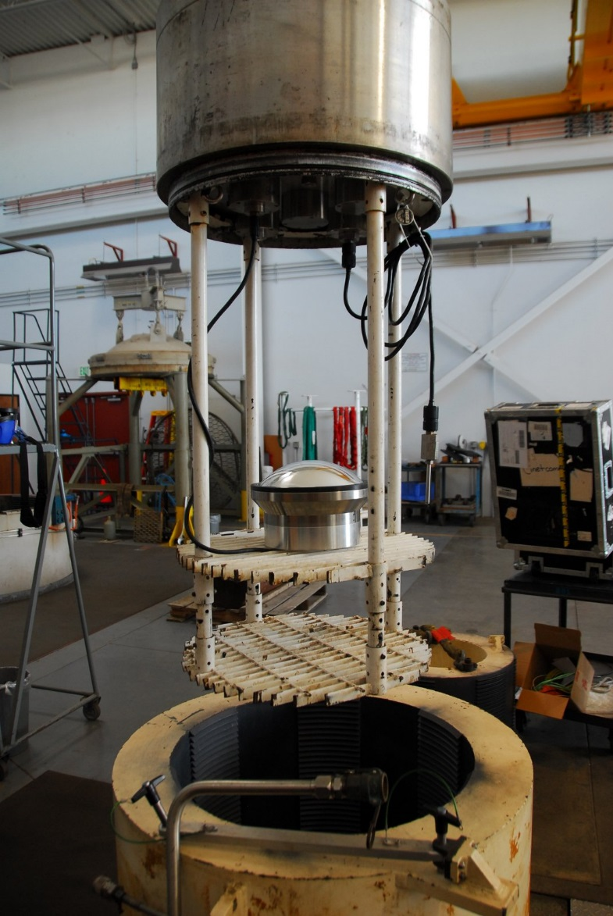
Proof testing
Domes were proof tested following the protocol determined by Eric Baker.
Pressure and axial displacement of glass port were logged. Displacement matched FEA prediction.
2 strengthened domes were tested to 3000 PSI (20.7MPa).
1 strengthened dome was tested to 5000 PSI (34.5MPa).
Notes:
The photo shows the dome mounted on a test housing (the real camera housing is much longer), about to be lower in the pressure at the Navy’s pressure testing facility is Port Hueneme. A LVDT sensor was placed inside the housing to measure the axial displacement of the glass. Pressure was also measured and logged.

Slide 29
Conclusion
After the failure of an early design, several steps were taken to improve the reliability of the glass port:
The edges and the base of the dome were polished, the flatness of the base was controlled.
The dome was bonded to a titanium ring to prevent hoop tensile stress from appearing.
Chemical strengthening greatly improved the strength of the glass.
Reliability was predicted using CARES software.
The camera housing can now be operated at 1500m with very low probability of failure.
Using this method, deep sea cameras are no longer limited to small hemispherical domes. Sub-hemispheres with large radii with better optical performance can be used and their reliability can be predicted.
More research is needed on life prediction for strengthened glass. The residual stress field should be incorporated into the model for a better prediction.

