Slide 1

Design and testing of a large sub-hemispherical glass port for a deep-sea camera
Francois Cazenave¹; Eric H. Baker²
Nathan D. Card³; George D. Quinn⁴
Paul Remijan⁵; Jonathan Salem⁶
Arun K. Varshneya³
1. Monterey Bay Aquarium Research Institute, Moss Landing, CA
2. Connecticut Reserve Technologies, Gates Mills, OH
3. Saxon Glass technologies, Alfred, NY
4. National institute of Standard and Technology, Gaithersburg, MD
5. Fathom Imaging Inc., Brimfield, MA
6. NASA Glenn Research Center, Cleveland, OH

Slide 2
Outline
  Optical design
  First structural design and failure
  Fractography
  Modified design
  Material testing
  Reliability analysis
  Chemical strengthening
  Proof testing

Slide 3
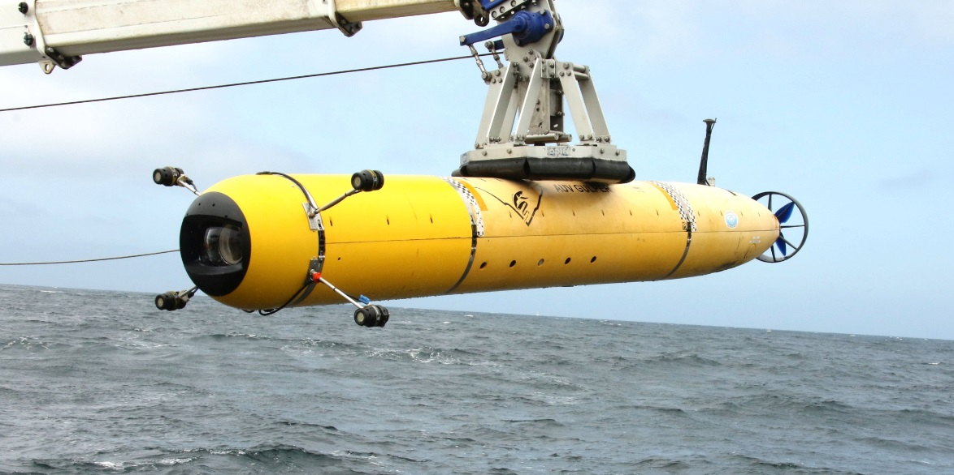
Introduction
  MBARI operates an autonomous underwater vehicle to carry out video surveys in Monterey Bay from 50m to 1000m depth.
  A new camera system was designed with the goal of achieving the highest image quality and a depth rating of 1500m.
  A glass dome port was designed, built and tested.
Notes:
The dome can be see in the front of the vehicle, protected by a black plastic shield.
The 4 appendages near the front are LED lights.

Slide 4
Optical design
  Typical COTS dome port
  Shape is optimized to resist hydrostatic pressure
  Small diameter (<200mm)
  Hemispherical shape
  Even and easy to predict stress and strain.
  Poor optical performance
  BK-7 glass
  I2map dome port
  Shape is optimized for high optical quality
  Large diameter (250mm)
  Flattened hemispherical shape
  Uneven and hard to predict stress and strain.
  H-K9L glass (Chinese equivalent to BK-7)
Notes:
A field curvature aberration decreases with larger optical surface radius.
Field curvature aberration is worse with large sensors
such that an image formed by a wide angle lens located behind the dome port is not focused on a flat surface, but rather focused onto a curved surface.
A camera image sensor is flat, so if the center of the image is focused at the center of the sensor, outer portions of the image will be focused behind the image sensor and become blurred.
Small diameter concentric dome ports with smaller optical surface radii produce a large field curvature aberration.
In addition, the field curvature aberration associated with a specific concentric port increases substantially as the size of image sensor is increased.
The “Corrector Group” has the additional feature of correcting port aberrations for any size image sensor.
could use any high resolution camera / sensor combination with field of view up to ~ 98 degrees, corner to corner

Slide 5
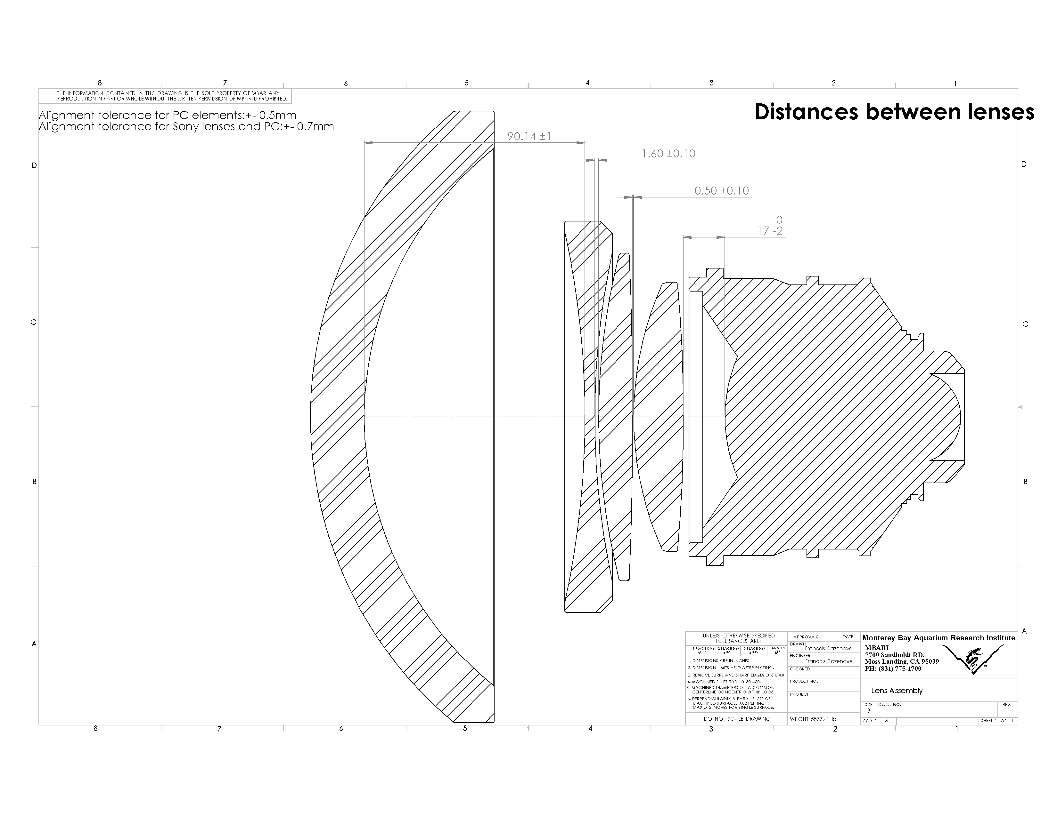
Could use any high resolution camera / sensor combination with field of view up to ~ 98 degrees, corner to corner

Slide 6
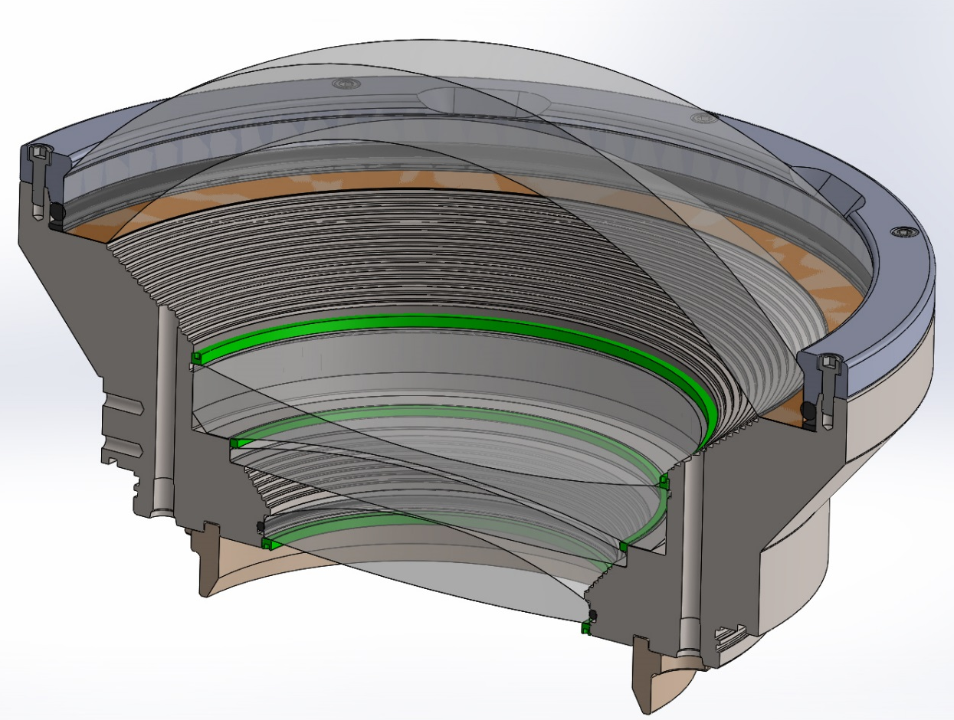
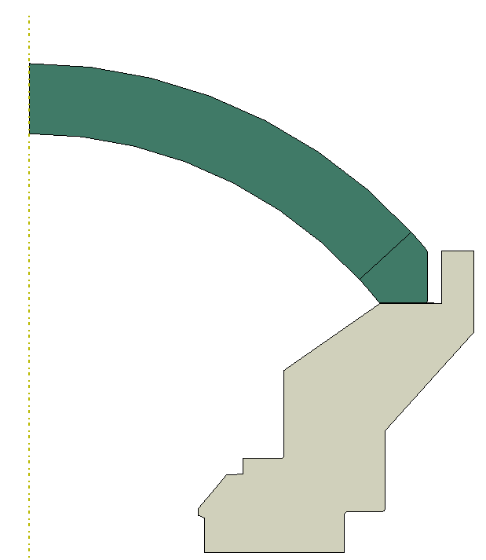
Early design of dome
Dome sits on kapton gasket
Dome is held with plastic retainer.
O-ring around dome

Slide 7
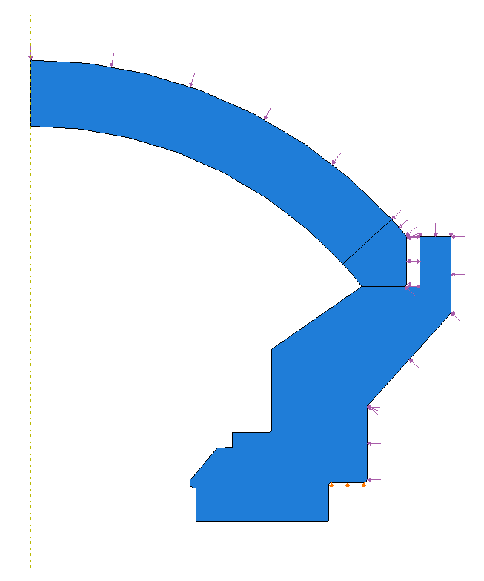
FEA of early design:
2D Axisymmetric Model
External Pressure Load
Glass dome
Kapton gasket
Titanium support
Dome is free to move Radially
8/2/16
BC: Radial = free, Axial = fixed

Slide 8
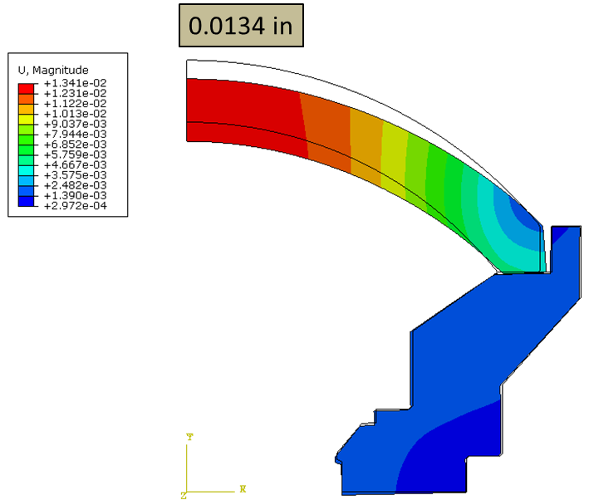
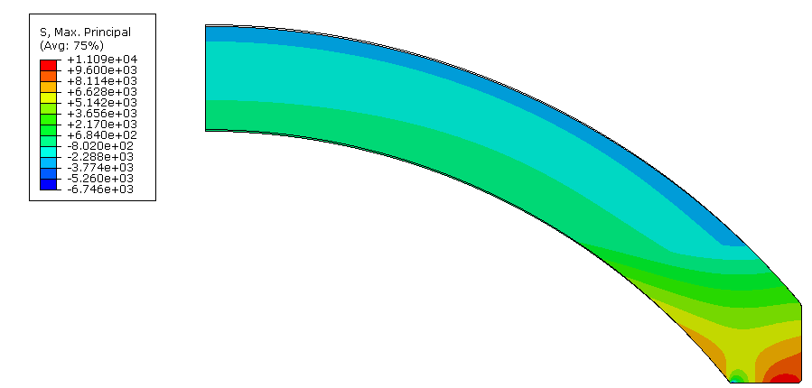
FEA results at 2750 PSI (19MPa)
Displacements
First principal (max tensile) Stress
11,090 psi
Maximum axial displacement 0.0134” (0.34mm)
Maximum first principal stress
11090 PSI (76.5MPa)
Notes:
2750PSI is the pressure at the rated depth (1500m) + 25%
25% is a safety margin that I chose somewhat arbitrarily at the time I started working on this.

Slide 9
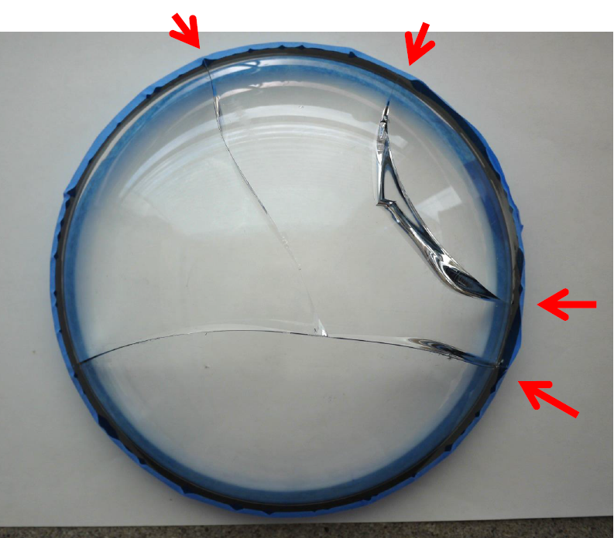
Failure of early design
Dome failed during external pressure test after numerous cycles to 2750 PSI (19MPa)
Notes:
The second dome failed at much lower pressure because the dome support was modified in a way that made things even worse. It was a design mistake basically. We could omit the second dome altogether for the sake of clarity if needed.

Slide 10
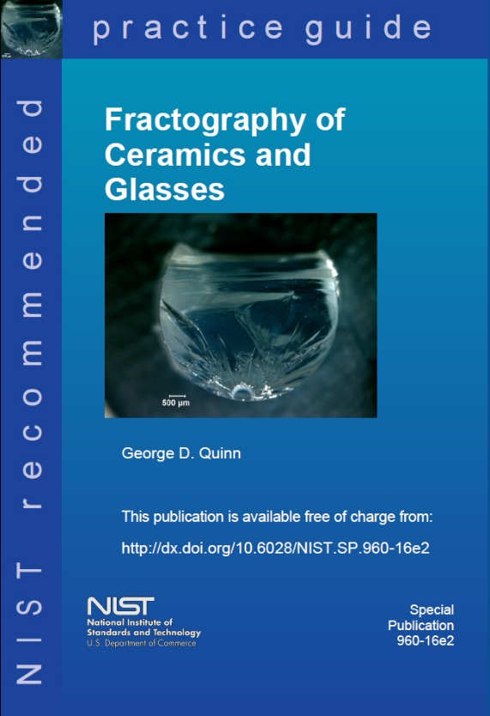
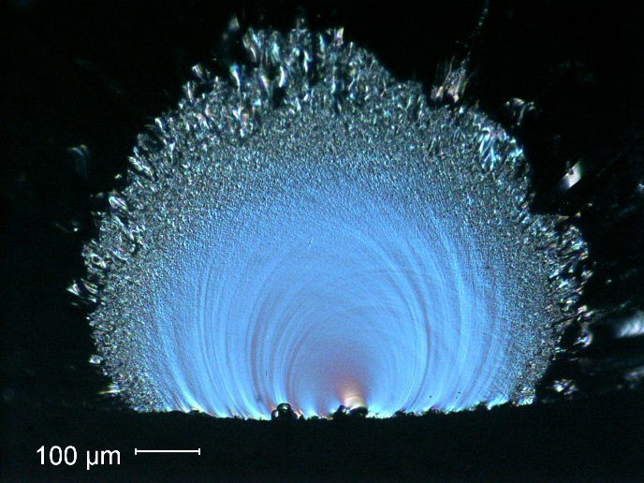
The broken dome was fractographically analyzed by G. Quinn
using a WILD stereo optical microscope with a digital camera.
The fractographic analysis included study of the
crack patterns and the fracture surfaces.
How to look
Patterns of breakage
What to look for and how to interpret it.

Slide 11
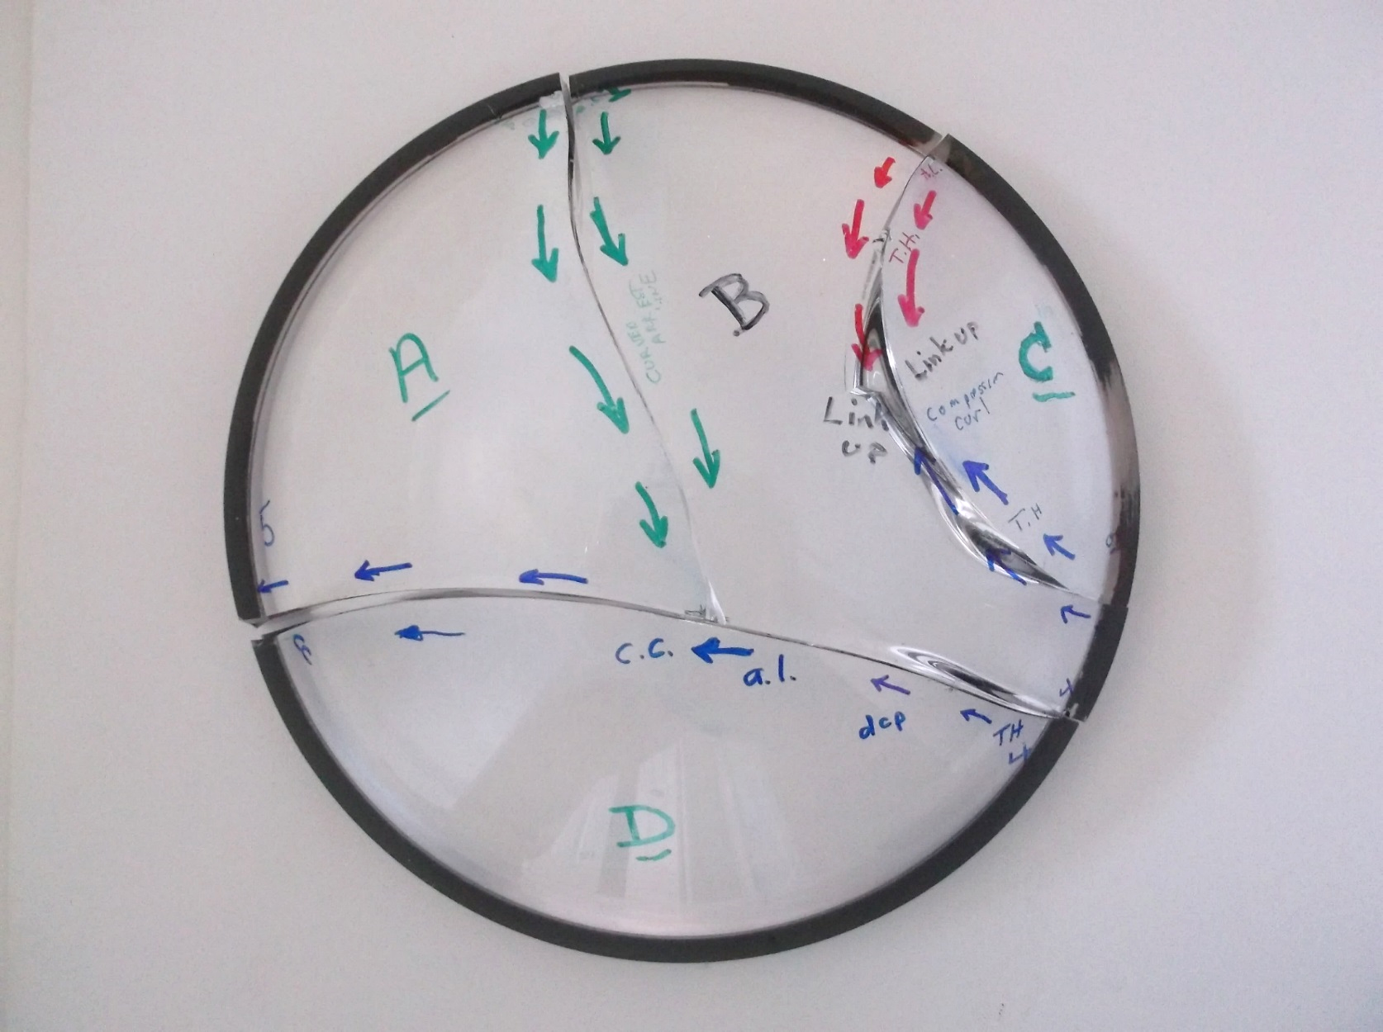
Fractographic analysis
George Quinn fractographer, performed an analysis of the broke dome.
There were 4 crack systems. All 4 had the same type origins and same stresses driving them.
1
2
3
4

Slide 12
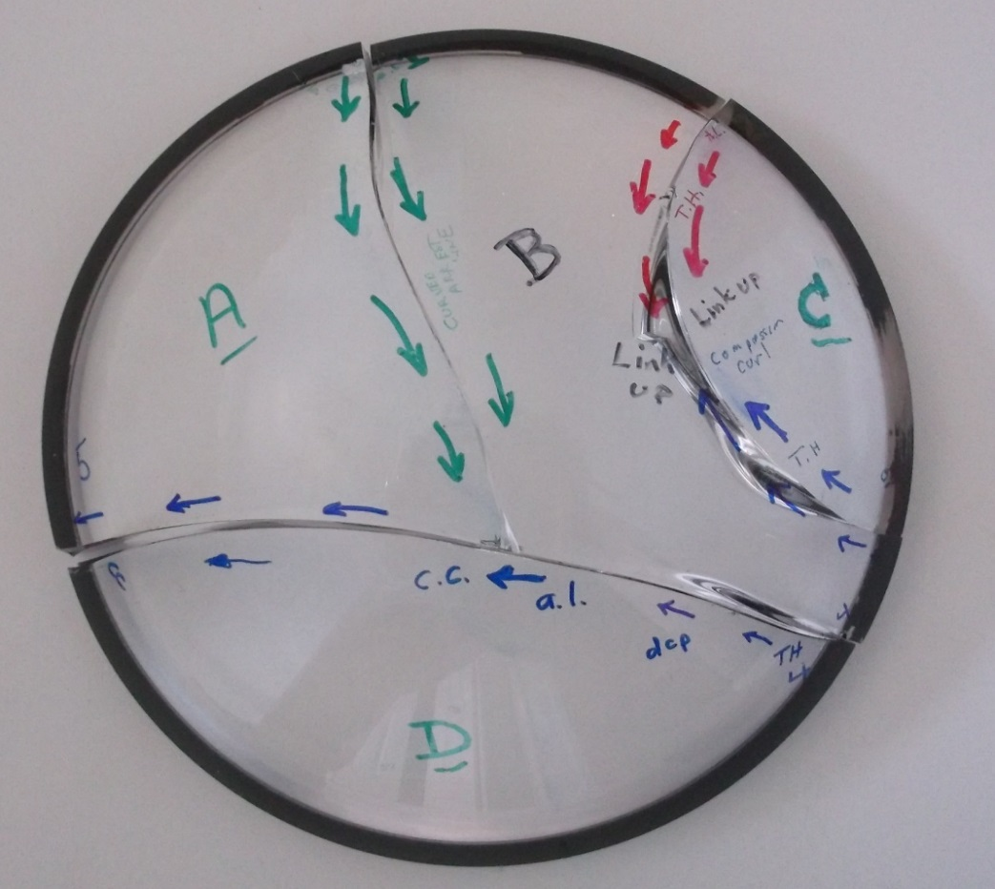
Fractographic analysis
All four origins were contact crack damage at the outer rim area.
Origin 4 was the first to start the overall fracture.
All flaws and initial crack propagation were driven by circumferential hoop tensile stresses.
By the time the cracks propagated towards the middle, the stress changed to bending with tension on the inner dome surface. This suggest that the external pressure caused “splaying” of the dome.
There were no fracture mirror boundary features, nor did any of the cracks branch.
1
2
3
4

Slide 13
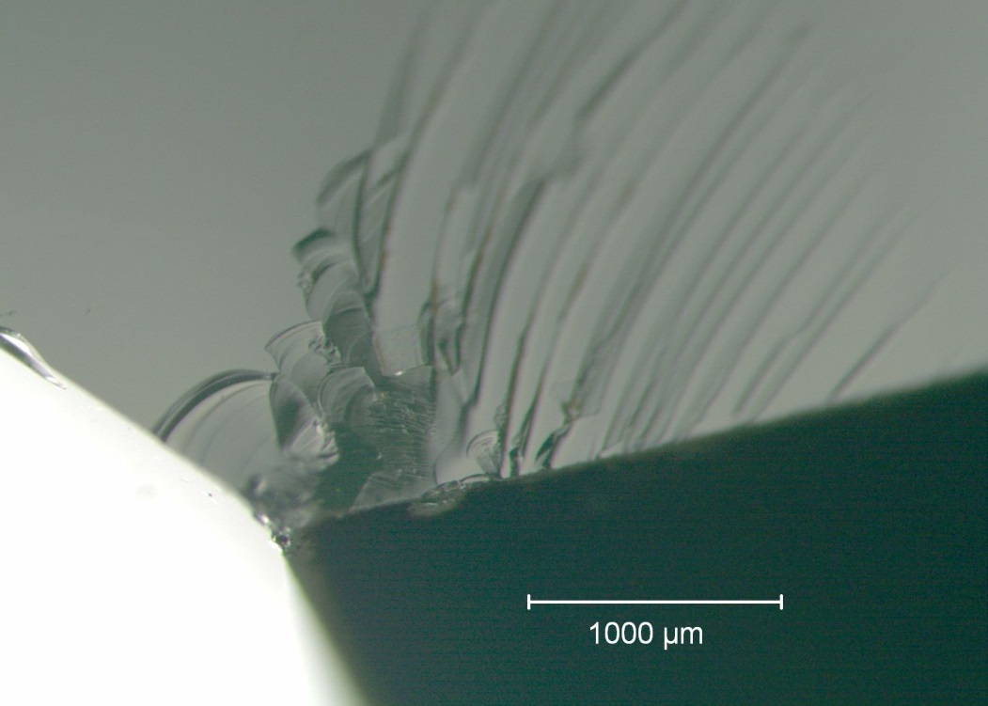
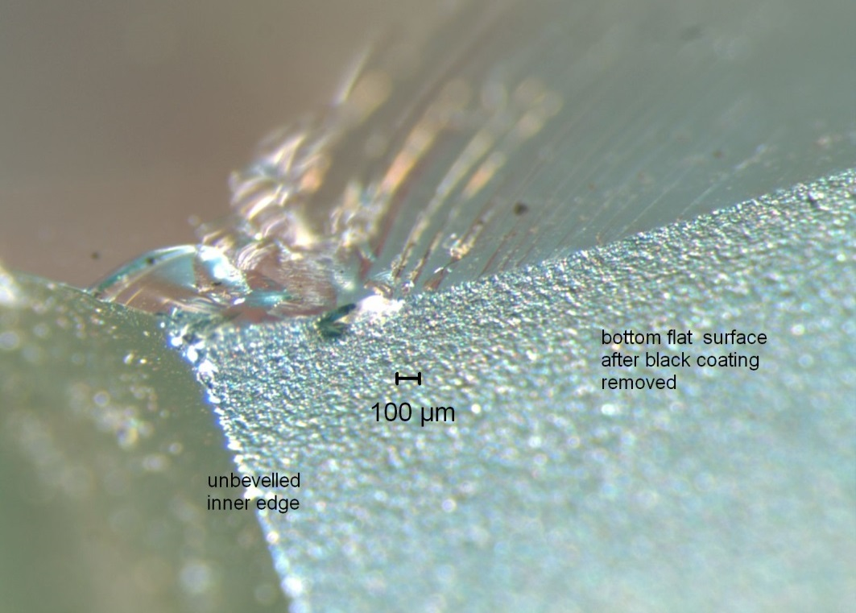
Fractographic analysis
Example: One of the rim contact damage cracks
2 views with different lighting at same magnification
Fracture surface
Fracture surface
Inner dome surface
Inner dome surface
Dome ground base
Dome ground base
The origin is a contact damage crack on the bottom ground surface.
It is about 1 mm in from the unbeveled edge.
Notes:
Summary of fractography: dome failed because of tensile hoop stress, and because of manufacturing defect.
George Quinn recommend that we hire Eric Baker to perform the reliability analysis

Slide 14
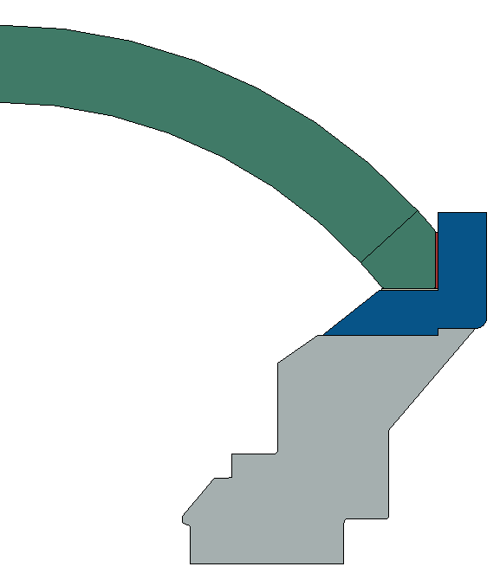
Modified design
Dome was bonded to titanium ring with epoxy to prevent lateral motion of dome seat
Edges were beveled and polished
Seat was polished and flatness tolerance was decreased
Thicker kapton ring
Dome Coupler Ring
Ti-6Al-4V
Dome Support
Ti-6Al-4V

Slide 15
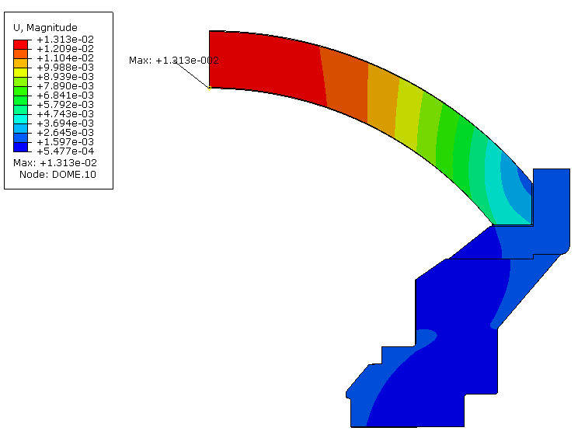
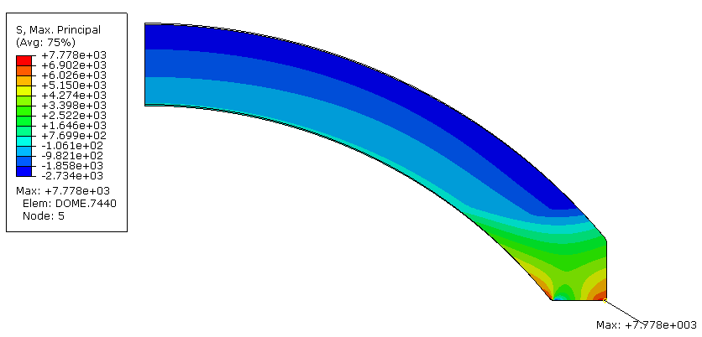
FEA of Modified design
Axial displacement unchanged
Tensile stress reduced 30%
Axial displacement at 2750 PSI
Max = 0.013” (0.33mm)
First principal stress at 2750 PSI
Max = 7779 PSI (5.37MPa) (30% decrease)
Notes:
There is a 30% decrease in tensile stress compared to the first design

Slide 16
External consultants
MBARI hired Eric Baker, ceramics reliability expert (CRT), to perform an analysis of the glass dome
MBARI hired Jon Salem, material scientist (NASA) to measure the mechanical properties of H-K9L glass and BK-7, and of chemically strengthened glass
MBARI hired Arun Varshneya (Saxon Glass Technology) to perform the chemical strengthening of the glass

Slide 17
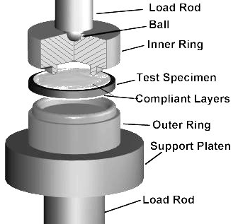
Material testing
Fracture strength, slow crack growth parameters and fracture toughness are needed for the reliability analysis but are not published by the manufacturers.
MBARI hired Jon Salem to measure these parameters for HK9-L (HK9-L is marketed as equal to BK-7 but is much cheaper) and BK-7.
Chemically strengthened HK9-L was also tested.
ASTM C1499
S_{i}
B
S_{o}
ASTM C1421

Slide 18
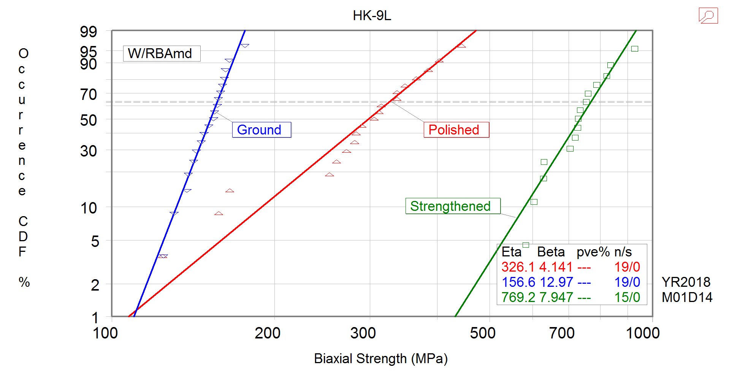
Results: Comparison of plain and strengthened glass
Eta = Weibull Modulus
Beta = Characteristic strength
n = number of specimens
s = number of censored specimens
Notes:
Strength distribution of plain and strengthened glass.
Strength more than doubled for strengthened glass.
BK7 was slightly stronger that HK9L

Slide 19
Chemical Strengthening of glass
Submerge in a bath of molten KNO₃
How it works:
Original surface
Surface in compression
Ion Size
*Not drawn to scale, demonstration only
Na⁺ (0.95 Å)
K⁺ (1.33 Å)
Notes:
Bath of molten Potassium nitrate.
Exchange of ion between the glass and the salt solution
K potassium enter the glass and replace Sodium ion.

Slide 20
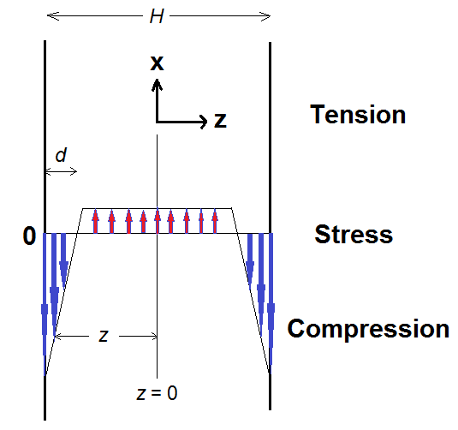
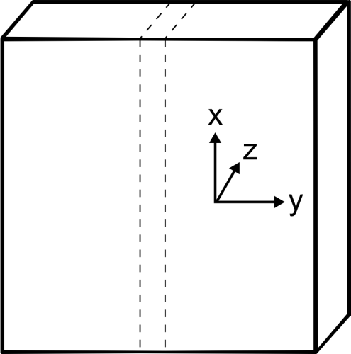
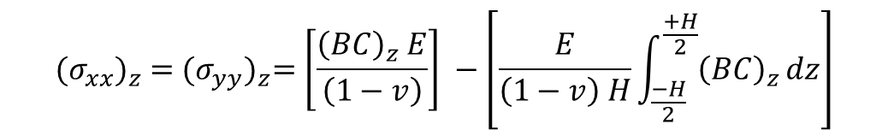

The Math…
In-plane stresses
$${(σ_{xx})}_{z} ={(σ_{yy})}_{z}=\left[\frac{{\left(BC\right)}_{z} E}{\left(1−v\right)}\right] −\left[\frac{E}{\left(1−v\right) H}\int_{\frac{−H}{2}}^{\frac{+H}{2}}{{\left(BC\right)}_{z}}dz\right]$$
= CS
perpendicular stress
$${(σ_{zz})}_{z} =0$$
C = concentration of the invading ion
H = plate width ; d = case-depth = DOL
E = Young’s modulus; ν = Poisson’s ratio
B = linear network dilation coefficient ( = “Cooper Coefficient”)

Slide 21
Glass composition and physical properties
Type: H-K9L (similar to Schott BK7)
Nominal composition (wt%):
69.13 SiO₂; 10.75 B₂O₃;3.07 CaO; 10.40 Na₂O; 6.29 K₂O; 0.36 As₂O₃
Density = 2.55 g/cm3
Tg = 550°C
TEC = 70x10⁻⁷/°C
E = 71.GPa
ν = 0.219
n_{d} = 1.523

Slide 22
Chemical strengthening of the domes
Four domes
15 witness disk samples 2” dia x 2 mm thick,
(for subsequent biaxial testing and CS/DOL measurement)
Hold domes in a stainless steel wire cage
Immerse in electrically heated steel tank containing molten KNO₃ salt.
Ion exchange at 450 °C for 24 hrs.
After extraction, carefully cool, wash and dry.
Compression layer (case depth “DOL”) = 45 μm.
Compression (“CS”) = - 430 MPa
(measured by FSM-6000LE)

Slide 23
Reliability analysis
MBARI hired Eric Baker of Connecticut Reserve Technology to perform brittle material reliability predictions on the camera port:
Generated finite element analyses of dome configurations and calibrated models to MBARI FEA as well as pressure test measurements
Estimated Weibull Material Properties from provided test data using WeibPar program
Applied the Ceramics Analysis and Reliability Evaluation of Structures (CARES) program to predict the brittle material reliability of the dome configurations
Established a proof test protocol to improve the reliability
This analysis was performed for unstrengthened and strengthened glass.

Slide 24
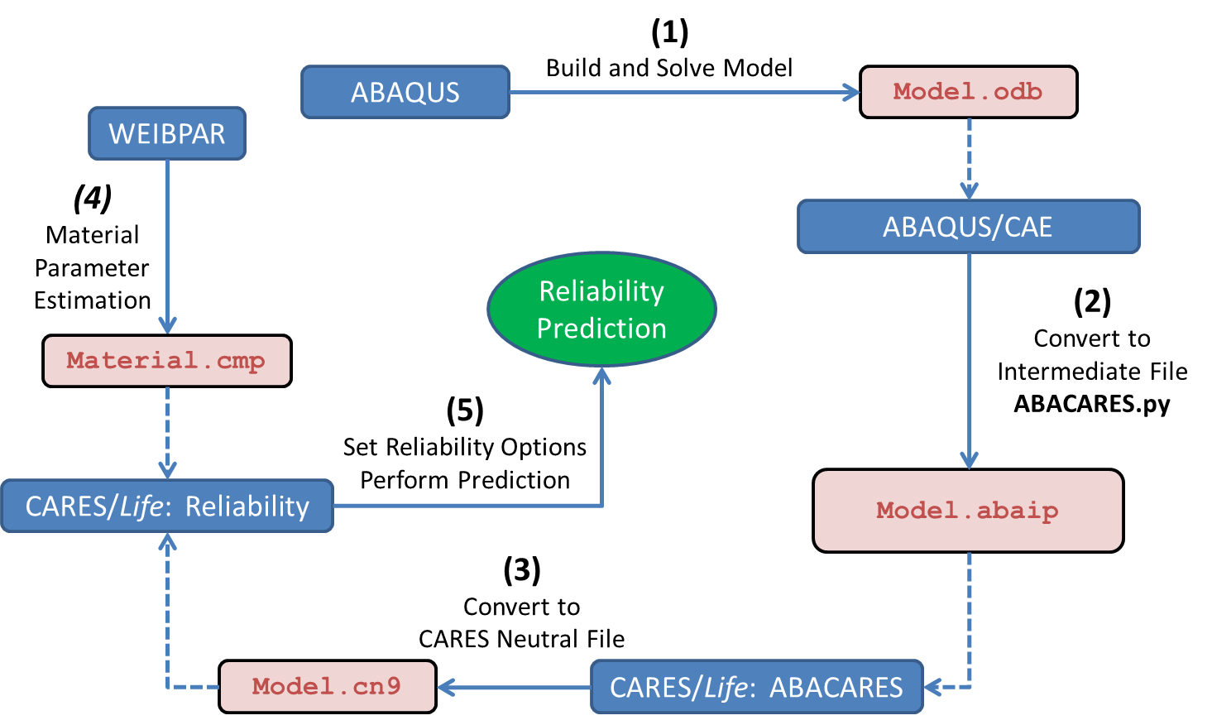
CARES with ABAQUS Flowchart
CARES predicts the brittle material reliability of a component by post-processing finite element analysis stress results.
CARES requires region based Weibull material properties, Volume and/or Surface, where different Surface conditions are characterized by different parameter sets.
Notes:
ABAQUS is FEA software.

Slide 25
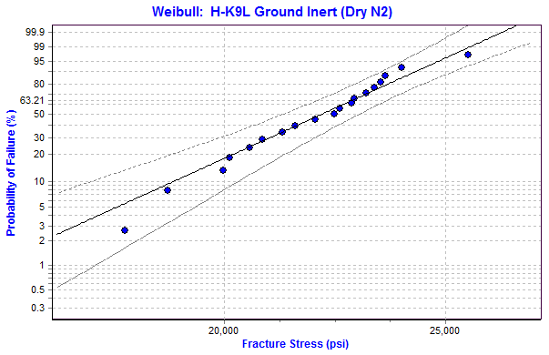
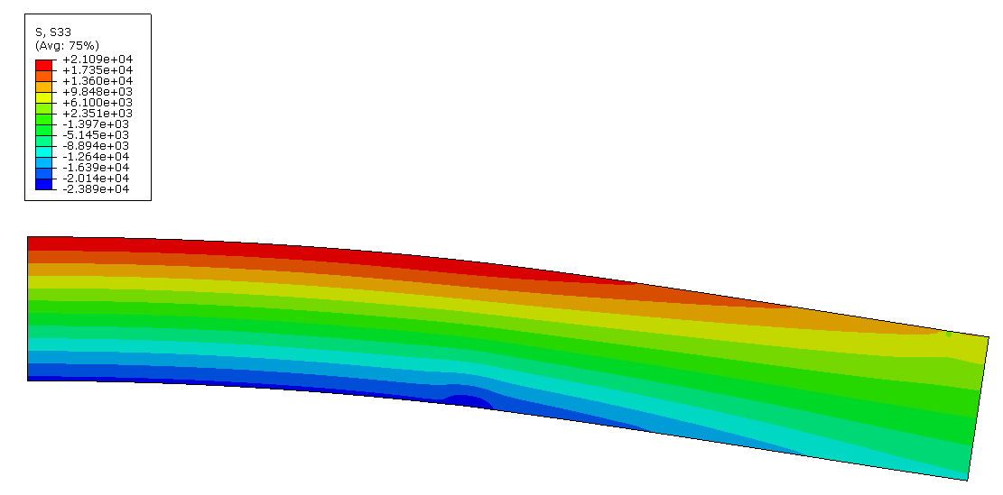

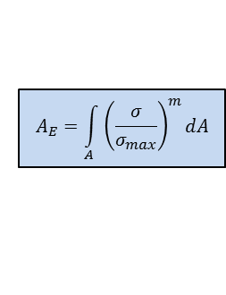

Material Properties: Weibull
WeibPar (Weibull parameter estimation program) is used for the WM and WCS calculations of the failure specimen data as well as calculating the Effective Area from a FEA of the R-o-R specimen
Ground Inert
Flaws were all assumed to originate on the Surface of the Failure Specimens
$$P_{f_{i}}=1−exp{\left(\frac{σ_{i}}{\text{σ}\text{̑}\text{­­}\text{θ} }\right)}^{\text{m}}$$
2D Axisymmetric Model of the Ring-on-Ring Specimen
Weibull Modulus (m)
Weibull Characteristic Strength (σ̑­­_{θ})
$$A_{E}=\int_{A}^{ }{{\left(\frac{σ}{σ_{max}}\right)}^{m}dA}$$
m = 13.6 [-]
σ̑­­_{θ}= 22,714 [psi]
Weibull Effective Area (A_{E})
$$\text{σ}\text{̑}\text{­­}\text{o}=\text{σ}\text{̑}\text{­­}\text{θ}∗{\left(A_{E}\right)}^{1/m}$$
A_{E} = 0.229 [in²]
Weibull Material Scale Parameter (σ̑­­_{o})
Where m & σ̑­­_{o} are used in CARES
σ̑­­_{o} = 20,386 [psi*in^(2/13.6)]
m = Weibull Modulus
σ̑­­_{θ =} Weibull Characteristic Strength
A_{E} = Weibull Effective Area
σ̑­­_{o} = Weibull Material Scale Parameter

Slide 26
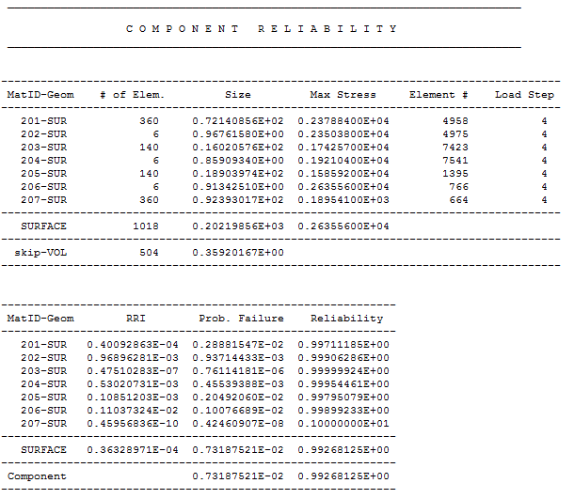
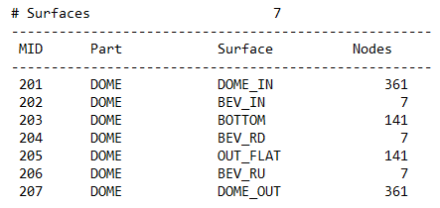
Example of CARES output
Unstrengthened H-K9L glass
Pressure: 2750 psi
Duration: 60 hrs
Max Stress
Polished
Lowest Individual
Surface Reliability
One Ground
Polished
Overall Reliability
Counterclockwise from Dome Inner to Dome Outer
Notes:
Numbers 201 to 207 represent the different surfaces of the domes (inside, outside, 3 edge beveled, base, and perimeter)

Slide 27
Example of CARES output
Unstrengthened H-K9L glass
Reliability as a Function of Service Pressure
where Service Time is 60 hrs.
Reliability as a Function of Service Time
@ Applied Pressure 2750 psi
FEA Stress Solution @ 2750 psi (19MPa)
Assumes Stresses Scale Linearly with Pressure
Assumes other parts of Assembly can handle the increased Applied Pressure

Slide 28
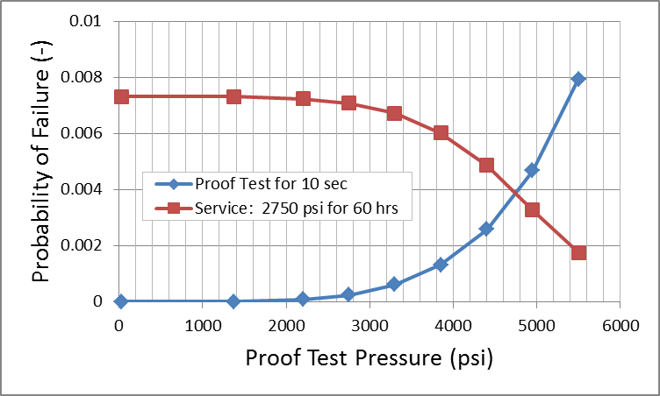
Example of proof test
The dome is subjected to a high pressure for a short time to decrease its probability of failure during service.
No Proof Test
Pf = 0.73%
Failure Rate = 1 out of 137
10 sec Proof Test @ 4950 psi
Pf = 0.33%
Failure Rate = 1 out of 306
10 sec Proof Test @ 4950 psi
Pf = 0.47%
Failure Rate = 1 out of 214
Blue line shows probably of failure during 10s proof test.
Red line shows probably of failure during 60-hour service life of proof-tested dome

Slide 29
Reliability of chemically strengthened dome
Pf = probability of failure
Predicted reliability of strengthened dome is very high even without proof test.

Slide 30
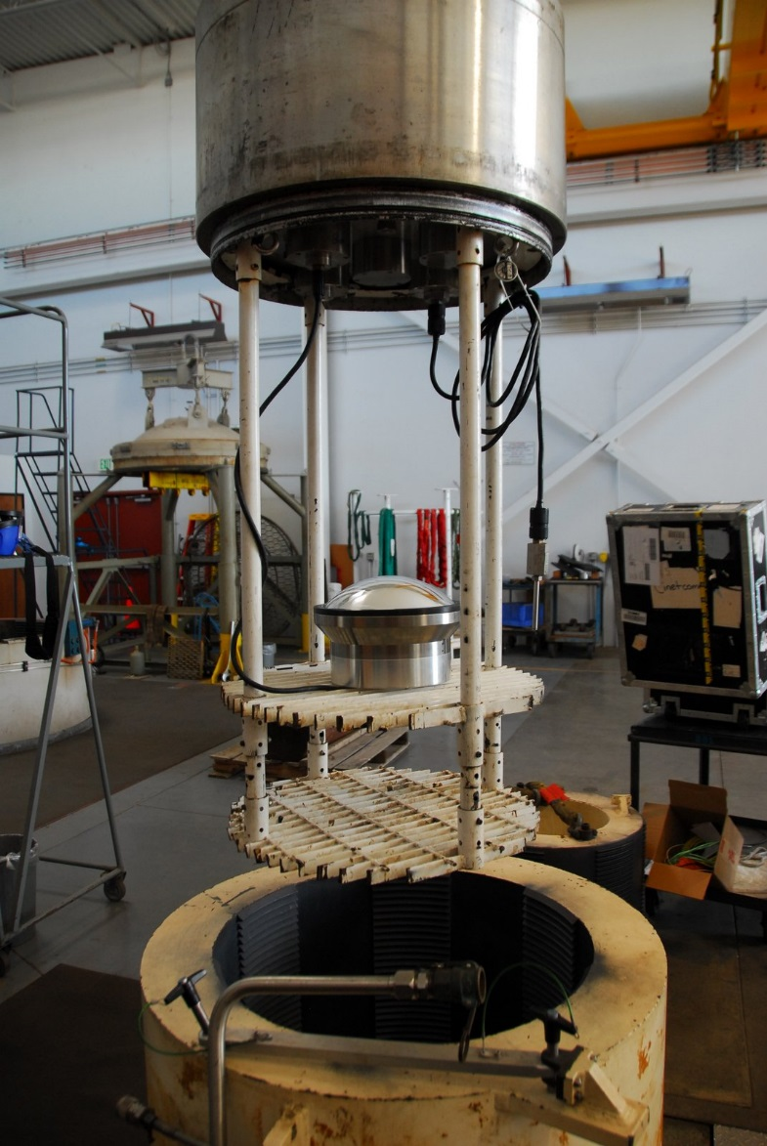
Proof testing
Domes were proof tested following the protocol determined by Eric Baker.
Pressure and axial displacement of glass port were logged. Displacement matched FEA prediction.
2 strengthened domes were tested to 3000 PSI (20.7MPa).
1 strengthened dome was tested to 5000 PSI (34.5MPa).
Notes:
The photo shows the dome mounted on a test housing (the real camera housing is much longer), about to be lower in the pressure at the Navy’s pressure testing facility is Port Hueneme. A LVDT sensor was placed inside the housing to measure the axial displacement of the glass. Pressure was also measured and logged.

Slide 31
Cost of components
Dome port: $1500-$2000
Adapter lens set: $1200-$1500
Chemical strengthening: $4000 per batch
Mounting parts: $2500 materials, 3 weeks of machine shop time.

Slide 32
Conclusion
After the failure of an early design, several steps were taken to improve the reliability of the glass port:
The edges and the base of the dome were polished, the flatness of the base was controlled.
The dome was bonded to a titanium ring to prevent hoop tensile stress from appearing.
Chemical strengthening greatly improved the strength of the glass.
Reliability was predicted using CARES software.
The camera housing can now be operated at 1500m with very low probability of failure.
Using this method, deep sea cameras are no longer limited to small hemispherical domes. Sub-hemispheres with large radii with better optical performance can be used and their reliability can be predicted.
More research is needed on life prediction for strengthened glass. The residual stress field should be incorporated into the model for a better prediction.

Slide 33
Conclusion
MBARI owns what may be the highest quality deep sea optical system in existence.
The I2map dome can be operated at 2000m with very low probability of failure.
Deeper operation is possible, with some modifications.
It’s currently only used for one application (I2map). Let’s use it for other applications!

