Slide 1
File: Quinn slides for Francois-Arun presentation May 2018 – draft 1 compressed.pptx March 8, 2018
The next slides were compiled by G. Quinn for the Glass Division presentation in May 2018.
Do not worry about there being more than 2-3 slides.
They are mostly pretty pictures. They will go quickly.
I “compressed” the image file sizes using Powerpoint, “Format option – compress”) so that the file size will not ne too large.
Delete this first slide.
G. Q March 8, 2018

Slide 2
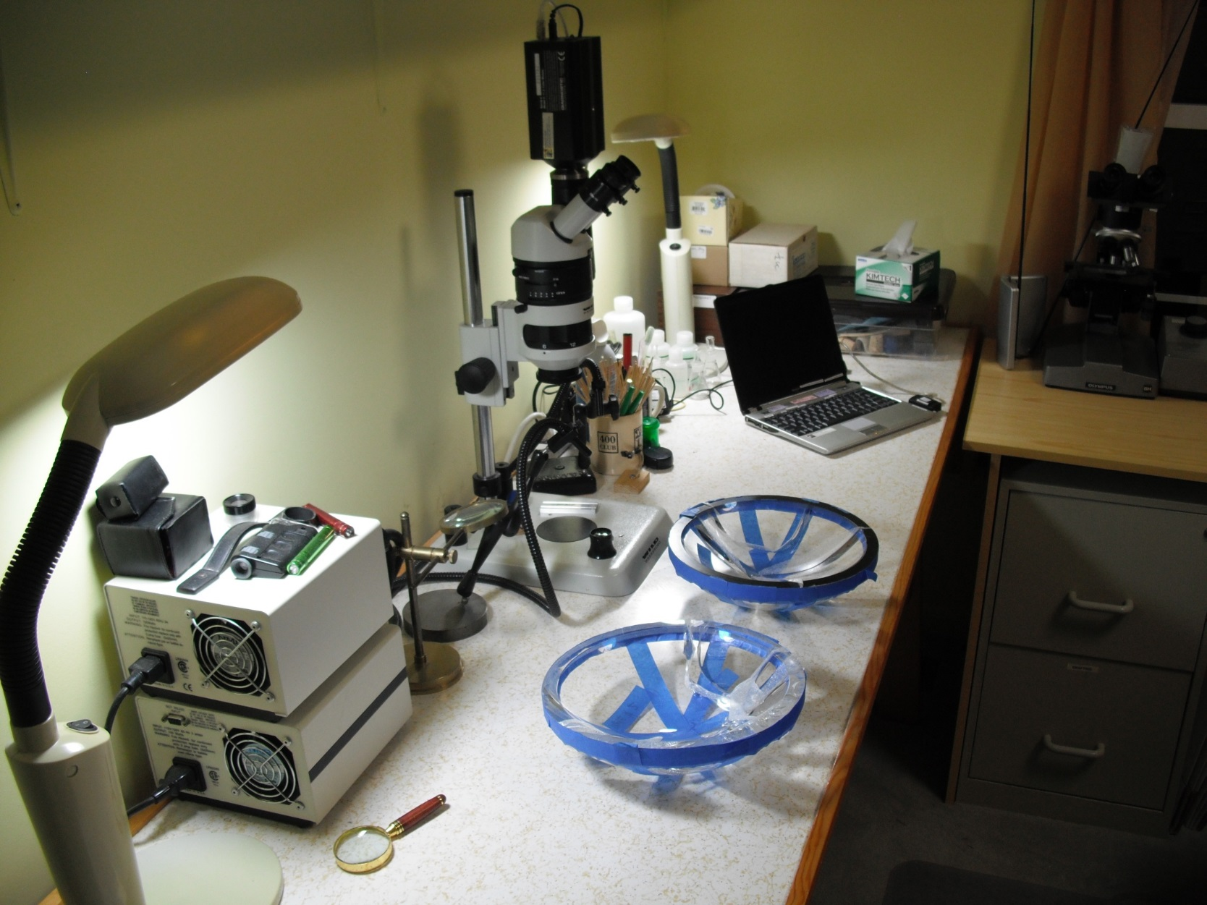
The first generation domes were fractographically analyzed by G. Quinn
using a WILD stereo optical microscope with a digital camera.
(Blue carpenters tape with small paper inserts between the fracture surfaces held the pieces together during shipment.)
Notes:
Notes for Francois
This slide shows the two broken domes.
It also is summarizes the experimental procedure.

Slide 3
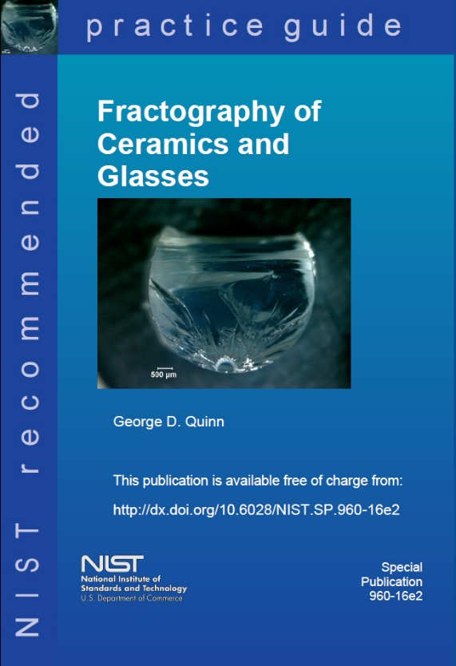
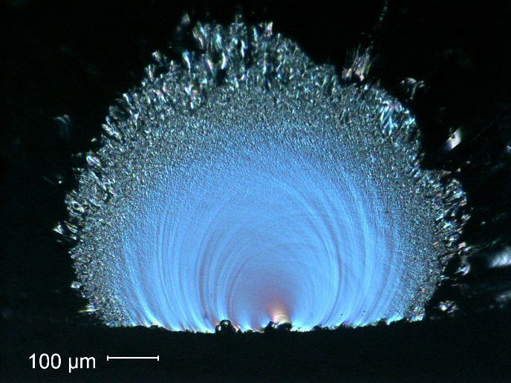

The fractographic analysis included study of the
crack patterns and the fracture surfaces.
How to look
Patterns of breakage
What to look for and how to interpret it.

Slide 4
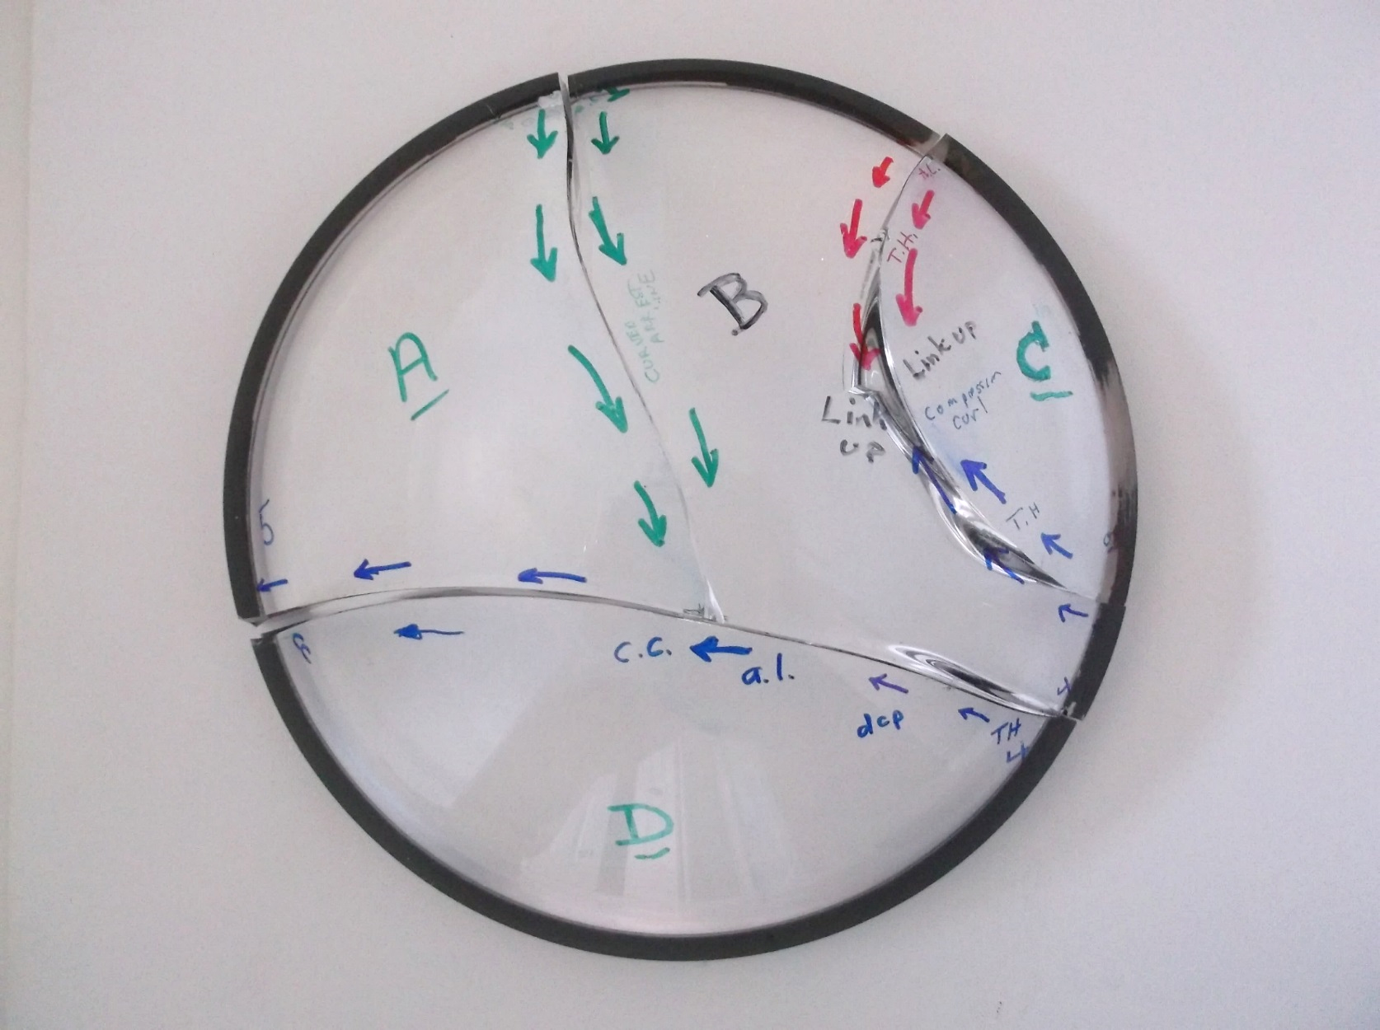
Fractographic analysis Dome 1
The directions of crack propagation were then marked on the assembly.
There were 4 crack systems. All 4 had the same type origins and same stresses driving them.
1
2
3
4

Slide 5
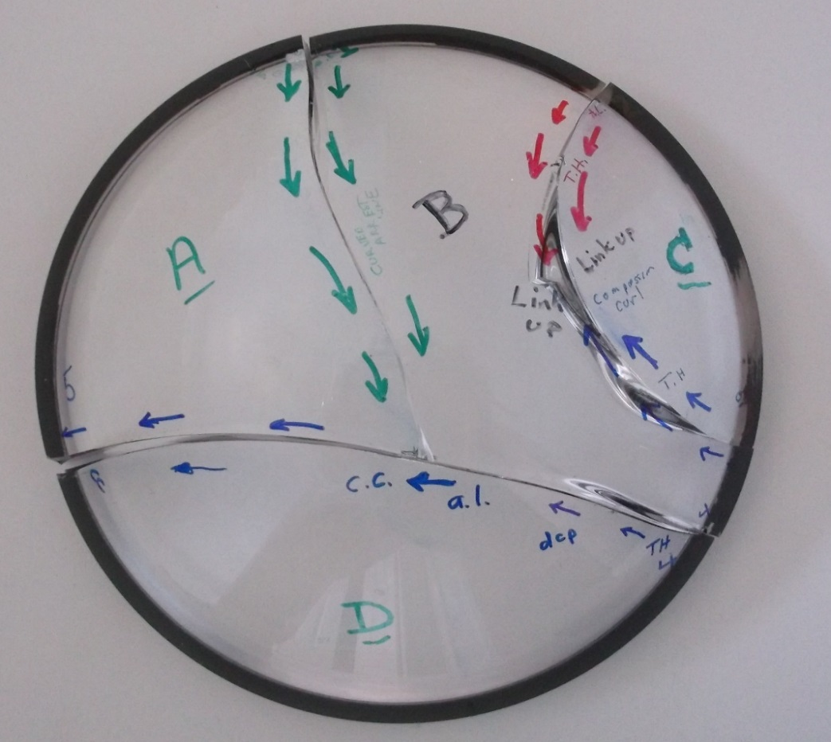
Fractographic analysis Dome 1
All four origins were contact crack damage at the outer rim area.
Origin 4 was the first to start the overall fracture.
All flaws and initial crack propagation were driven by circumferential hoop tensile stresses.
By the time the cracks propagated towards the middle, the stress changed to bending with tension on the inner dome surface. This suggest that the external pressure caused “splaying” of the dome.
There were no fracture mirror boundary features, nor did any of the cracks branch. This means tensile stresses were low,
less than 1,500 psi = 10 MPa.
1
2
3
4

Slide 6
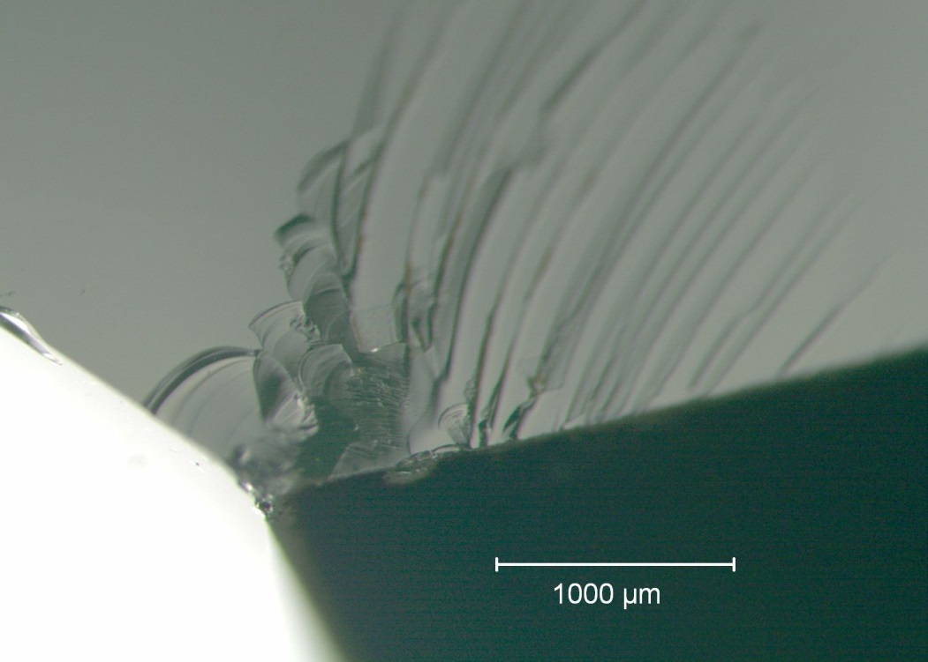
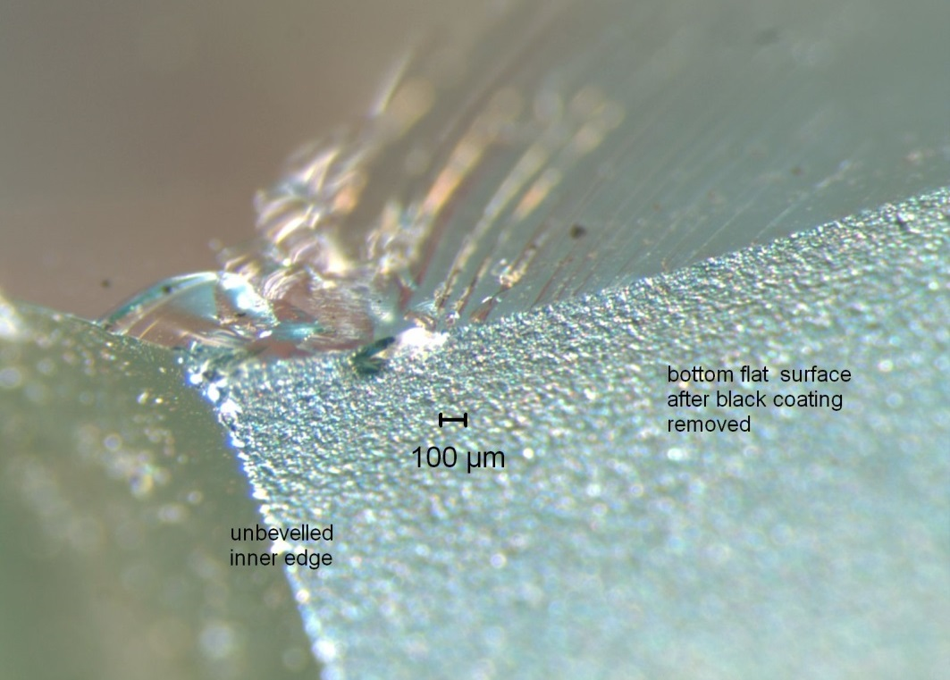
Fractographic analysis Dome 1
Example: One of the rim contact damage cracks
2 views with different lighting at same magnification
Fracture surface
Fracture surface
Inner dome surface
Inner dome surface
Dome ground base
Dome ground base
The origin is a contact damage crack on the bottom ground surface.
It is about 1 mm in from the unbeveled edge.

Slide 7
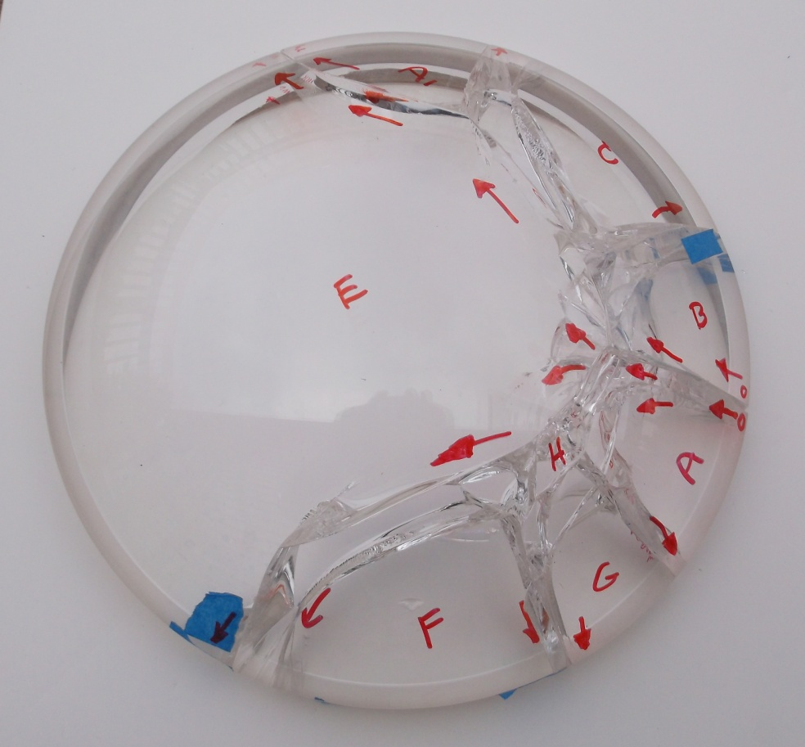
Fractographic analysis Dome 2
This dome broke at a higher stress.
This caused more extensive crack branching.
There was only one origin site, on the right side. It was a bevel grinding crack.
Origin

Slide 8
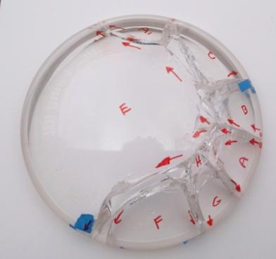
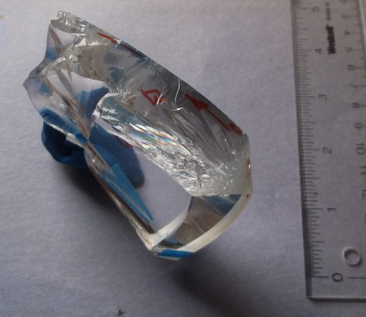
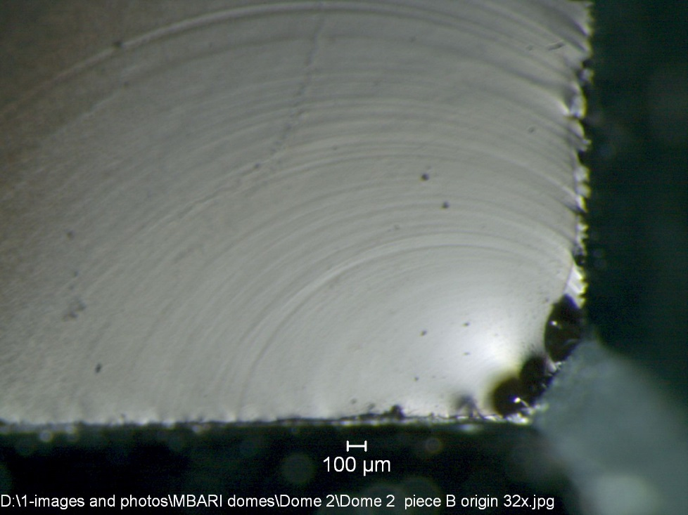
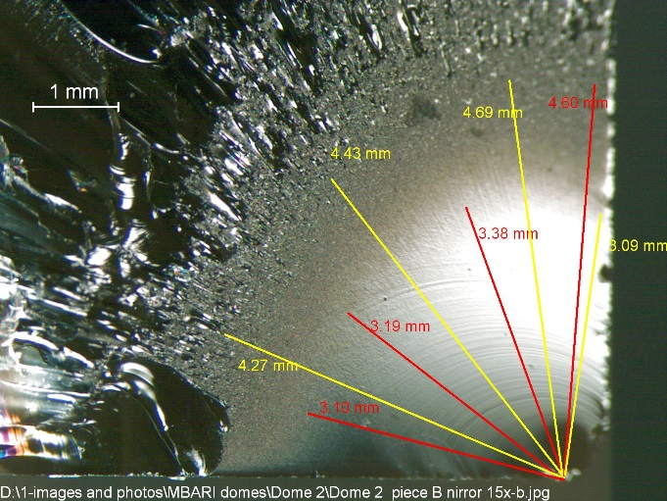
Fractographic analysis Dome 2
Grinding crack at the outer bevel.
Ground
outer
surface
A fracture mechanics analysis of the flaw itself indicated the stress at fracture was: 39 to 46 MPa (5,600 to 6,600 psi).
A fracture mirror size analysis gave estimates of:
40 to 47 MPa (5,000 to 6,800 psi).
These estimates match.
Polished base

Slide 9
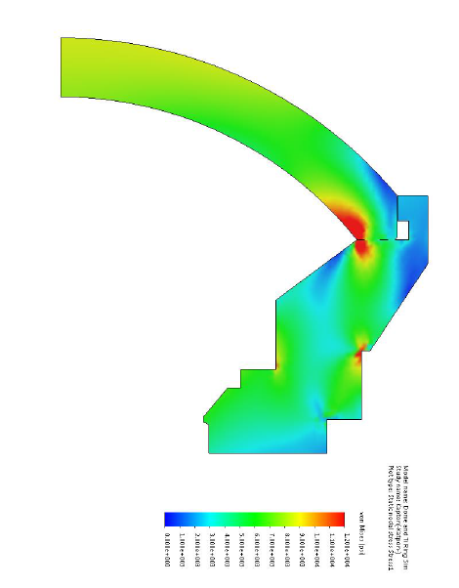
Glass dome
Metal support frame
Notes:
Show them the stress analysis and the localized stresses at the base of the dome,
but add the overall images so they have context.

