Slide 1
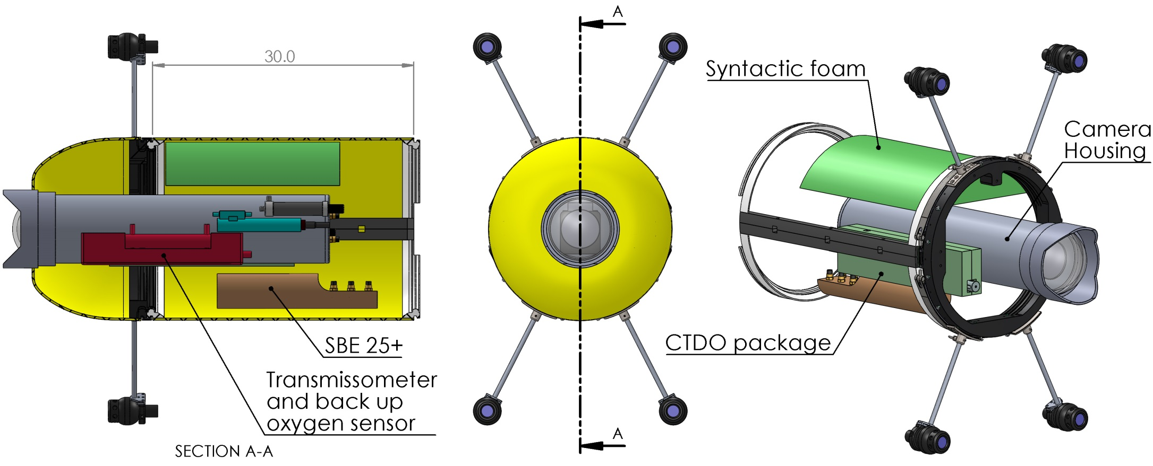
Mechanical layout of I2Map section
Total mass (without bracketry) = 160 lbs
Displacement = 2.9cf or 185 lb of seawater
Foam density: 24 lb/cf , less than 1cf needed

Slide 2
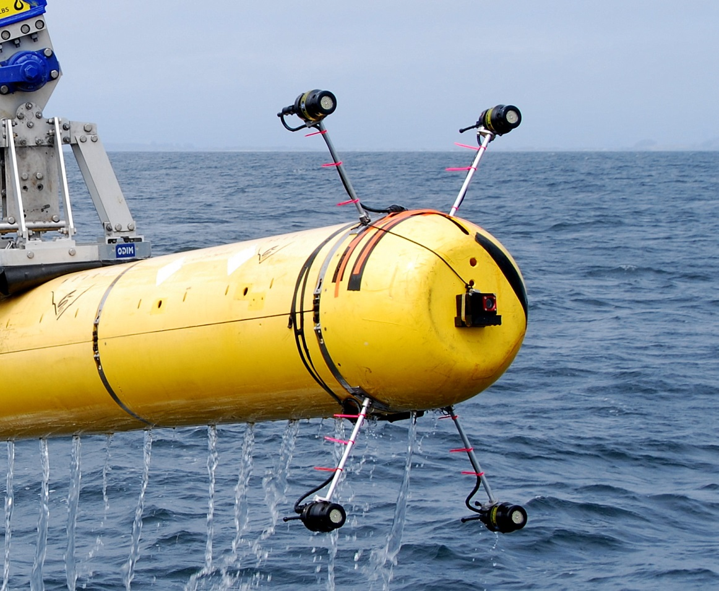
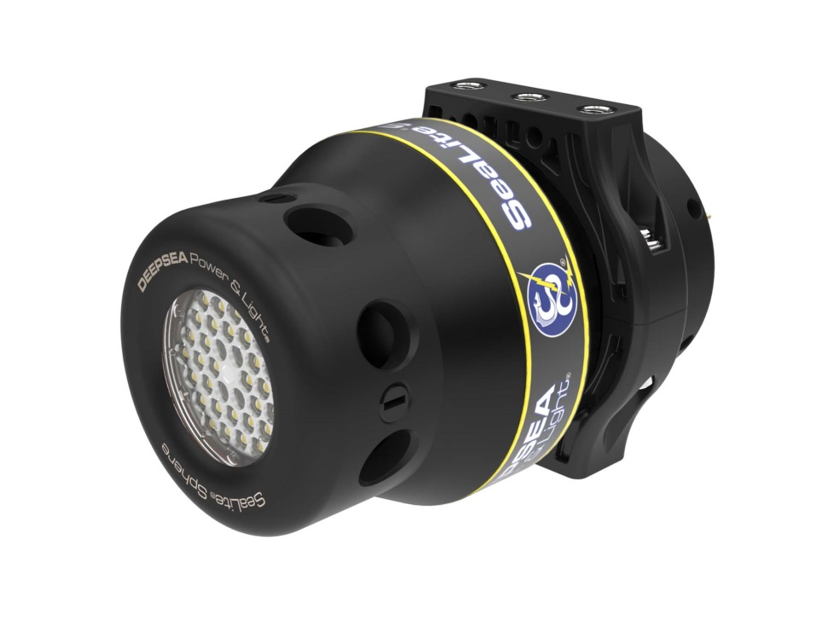
Lighting
4 DSPL Sealight spheres.
Mounted on rods to reduce backscatter

Slide 3
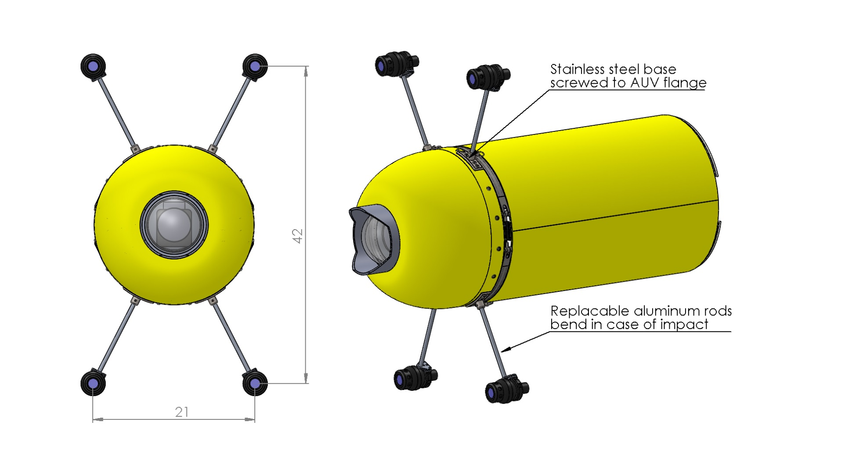
Problem | Solution
Lights are vulnerable during deployment and recovery | Rods will bend in case of collision to avoid damage to lights and fairing. Damaged rods can be replaced easily. Light can be protected in a plastic shell.
Lines or other objects could get caught in the light bars | Risk is minimal according to AUV team. A guard line can be used when operating in high risk areas.
Drag is increased | See Rob’s analysis

Slide 4
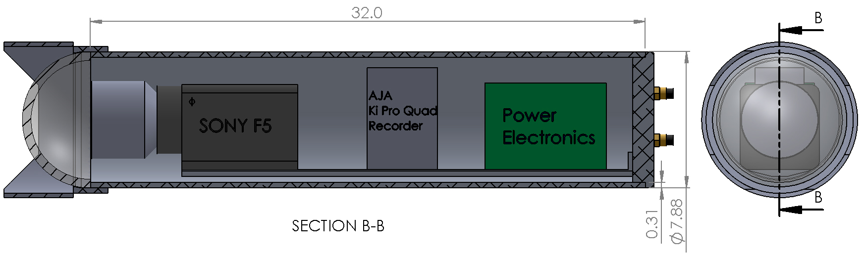
Camera housing
Material: 8” OD, ½” wall extruded aluminum tubing
Crush depth: 2200m
Mass: 50 lbs
Working on dome and optical elements with optical engineer
Mounting of camera and optical elements still TBD

Slide 5
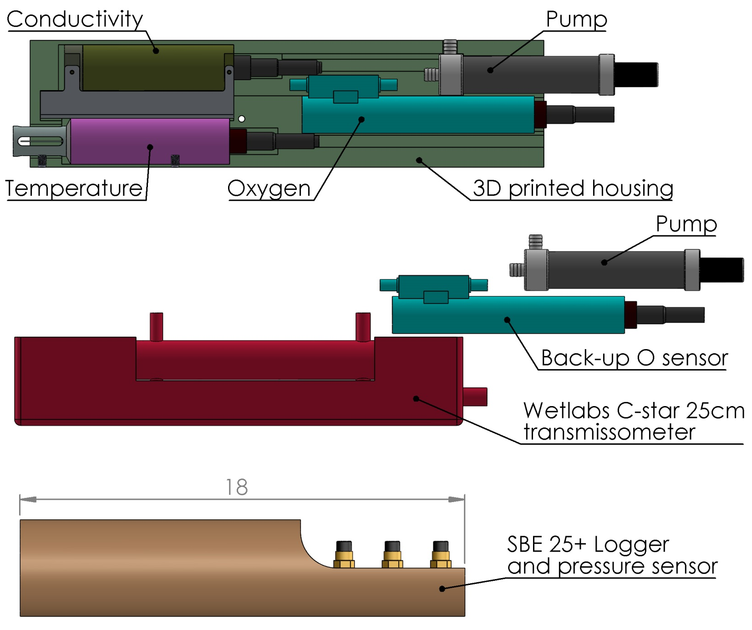
Environmental sensors

