Slide 1
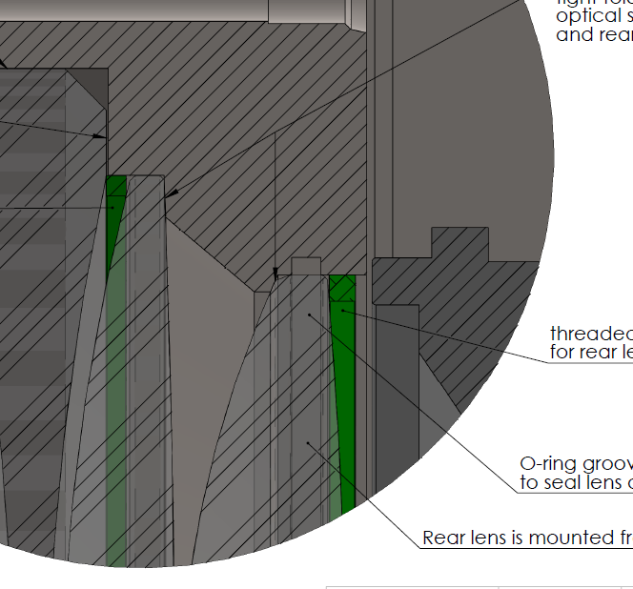
Should this surface for the lens contact be squared off rather than beveled?

