Slide 1
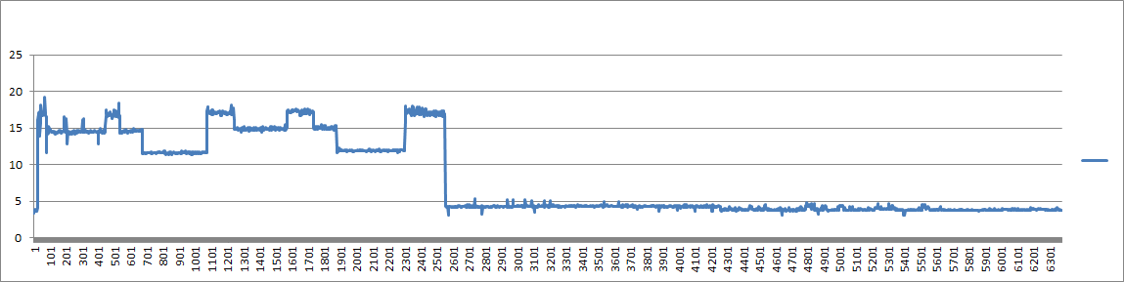
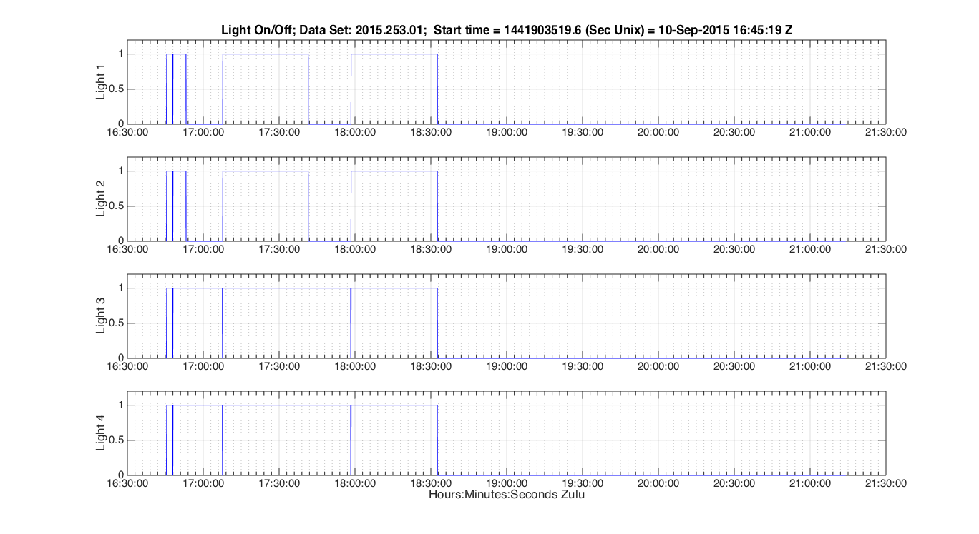
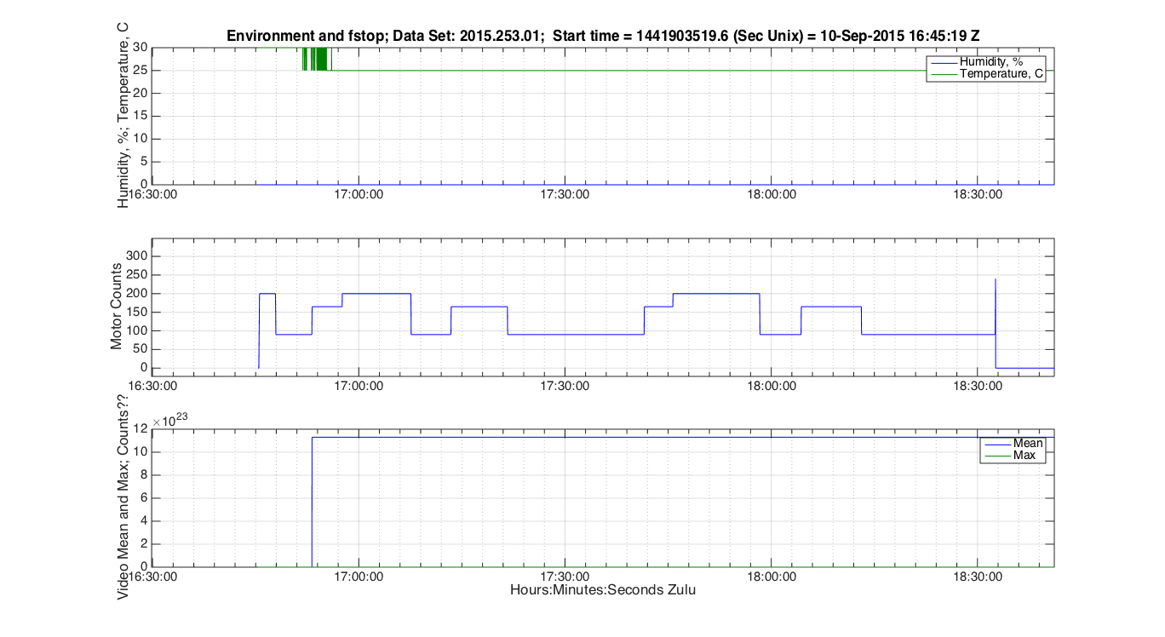
I2MAP AUV Data from Sept. 10, 2015 test dive
CAMERA
ƒ – STOP CHANGE COMMANDS THAT EFFECT CURRENT OR SWITCH READ-BACK
AUV BAT CURRENT
ANOMALY ON TEMPERATRE READING? SHOULD HAVE MUCH MORE RESOLUTION THAN 5 DEGREES.
CAMERA
ƒ - STOP
ƒ 5.6
ƒ 5.6
ƒ 4.6
ƒ 5.6
ƒ 4.6
WHAT SHOULD IRIS DO AT END OF TRANSECTS? WOULD LIKE TO BE CLOSED BEFORE CAMERA SHUTDOWN.
ƒ 4.0
ƒ 4.6
ƒ 4.0
ƒ 4.0
ƒ 4.0
ƒ 4.0
WTF ON VIDEO MEAN AND MAX READINGS?
VIDEO 1
2015-09-10T14_40_32_2 2.mov
START: 16:45:32
END: 16:47:54
VIDEO 2
2015-09-10T16_47_58_1.mov
START: 16:47:59
END: 17:07:34
VIDEO 3
2015-09-10T17_07_39_1.mov
START: 17:07:40
END: 17:37:21
VIDEO 4
2015-09-10T17_37_27_1.mov
START: 17:37:27
END: 17:58:17
VIDEO 5
2015-09-10T17_58_23_1.mov
START: 17:58:24
END: 18:32:32

