Slide 1
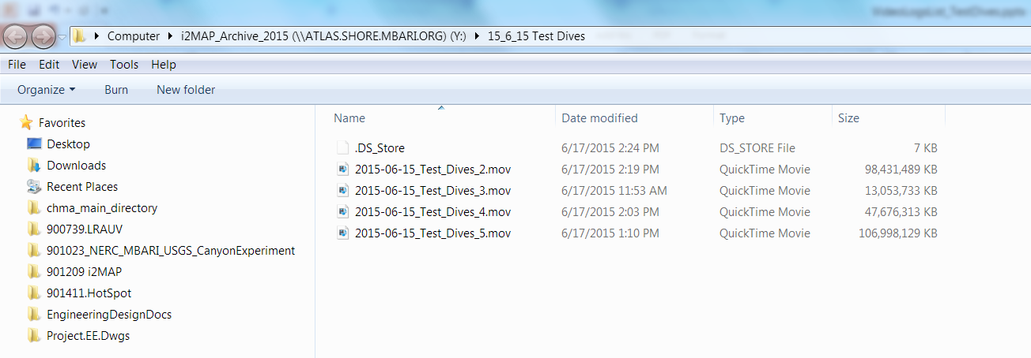
June 15, 2015 Mission

Slide 2
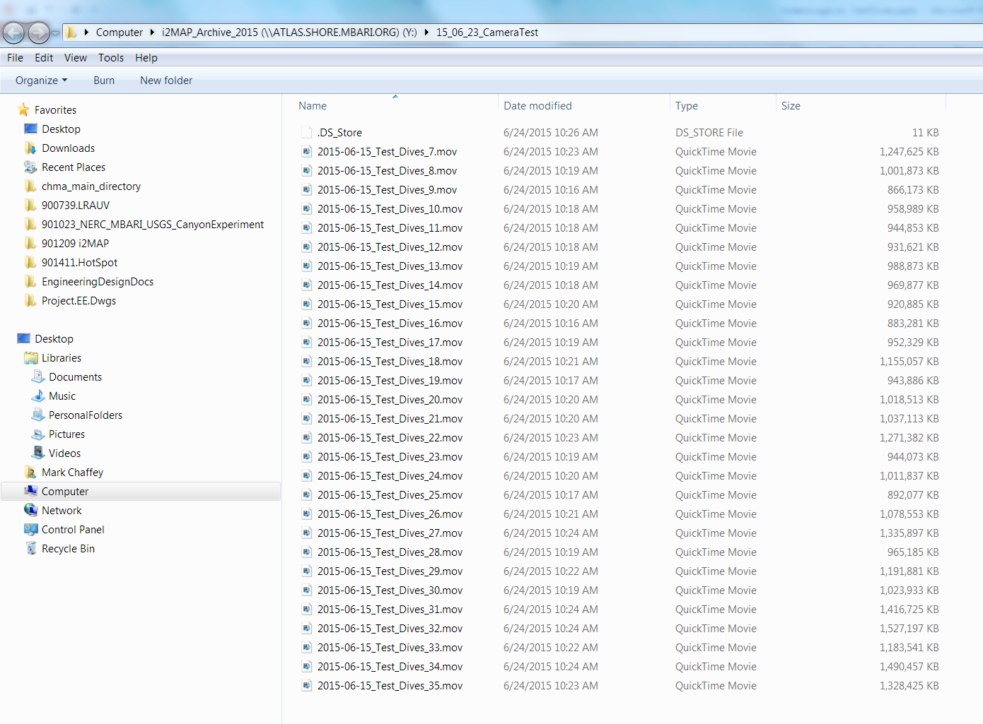
June 25, 2015 Mission

Slide 3
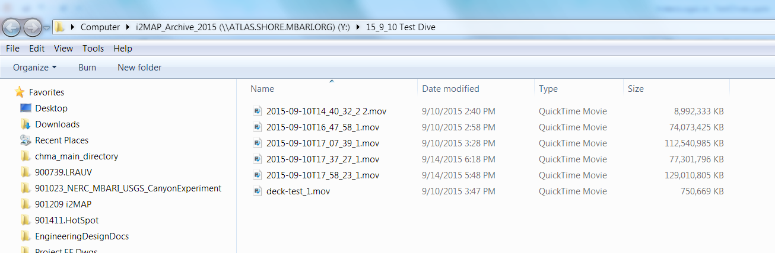
September 10, 2015 Mission

Slide 4
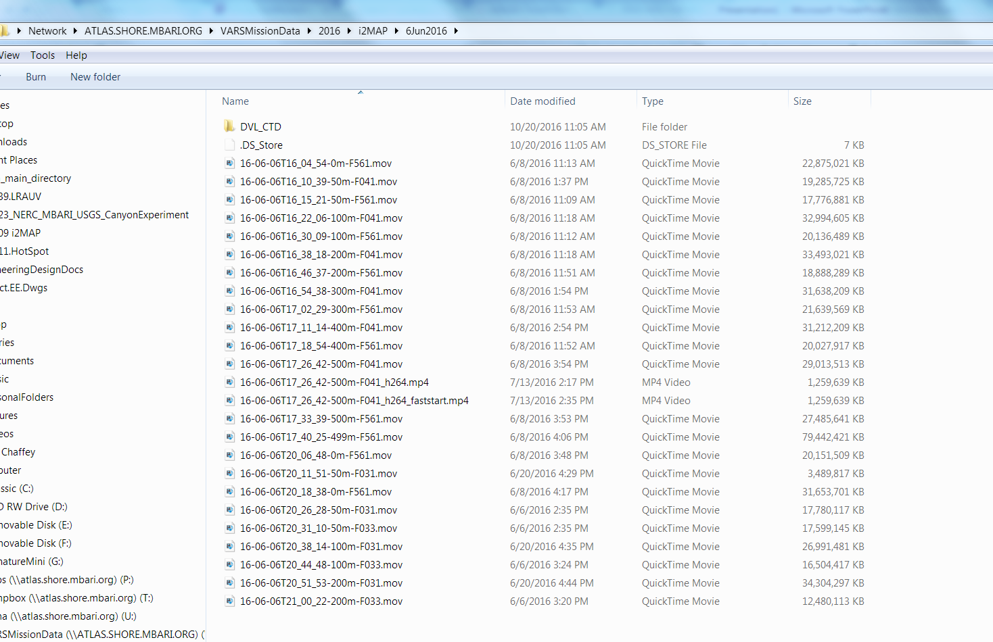
June 6, 2016 Mission

Slide 5
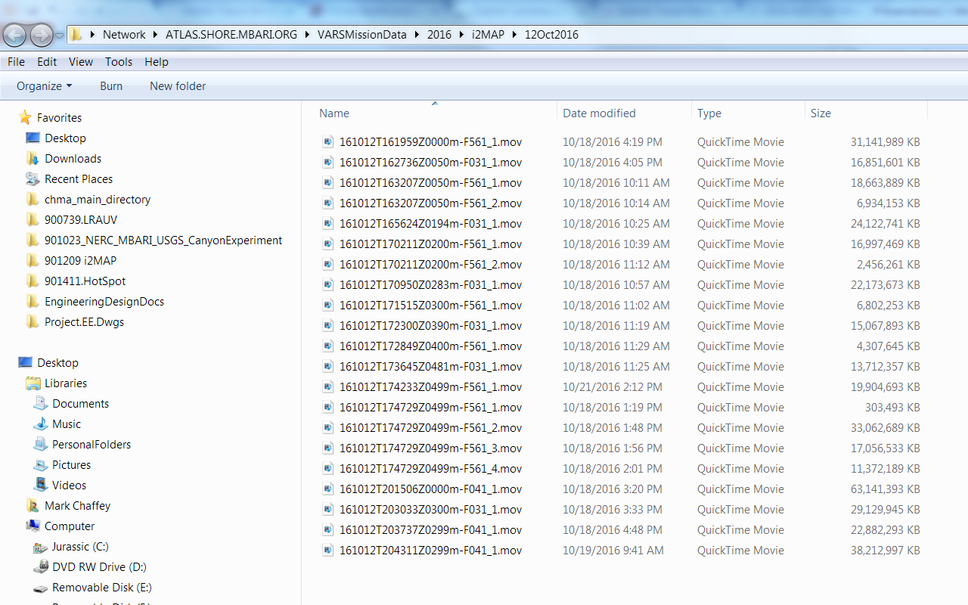
October 12, 2016 Mission

Slide 6
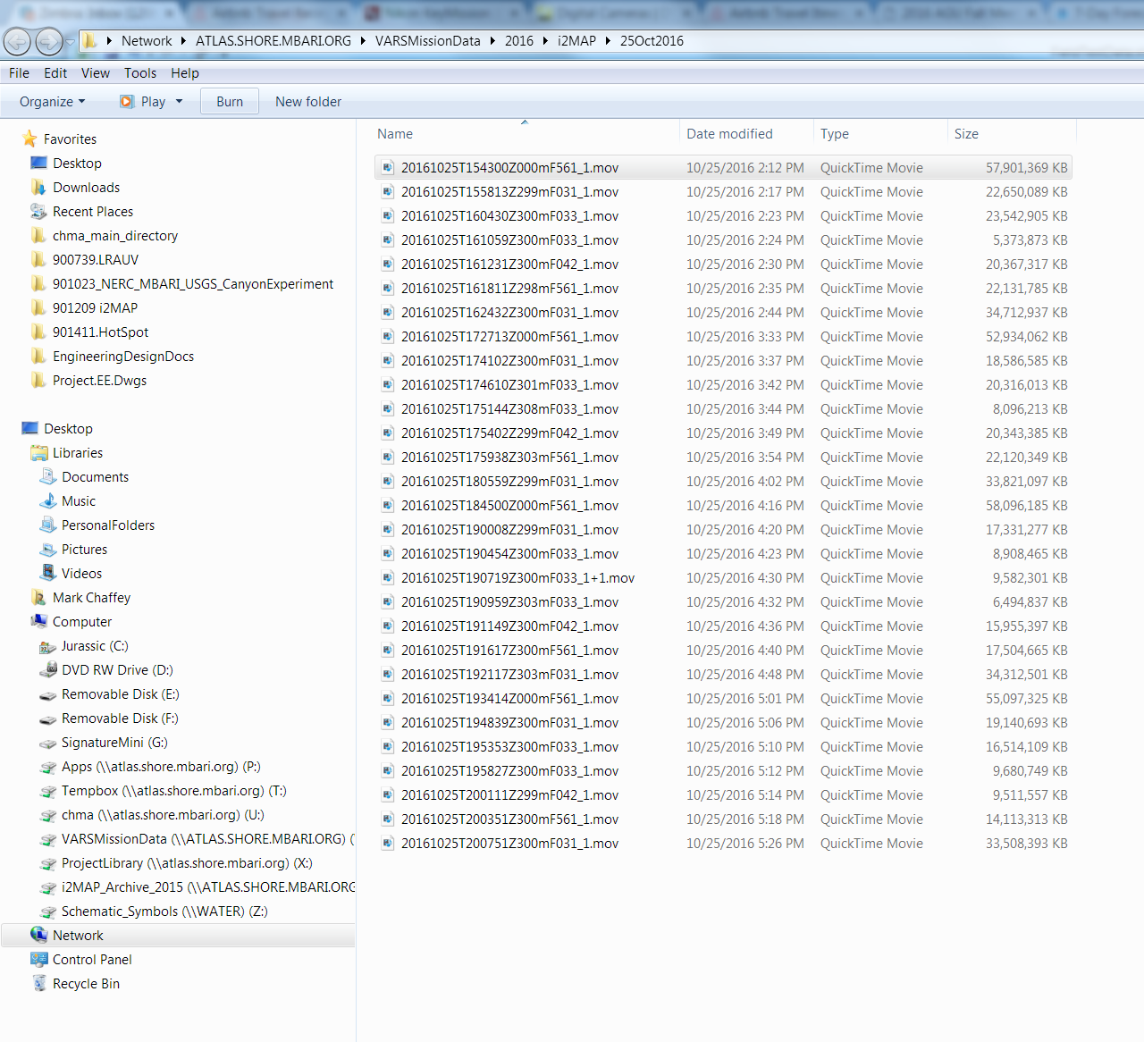
October 25, 2016 Mission

Slide 7
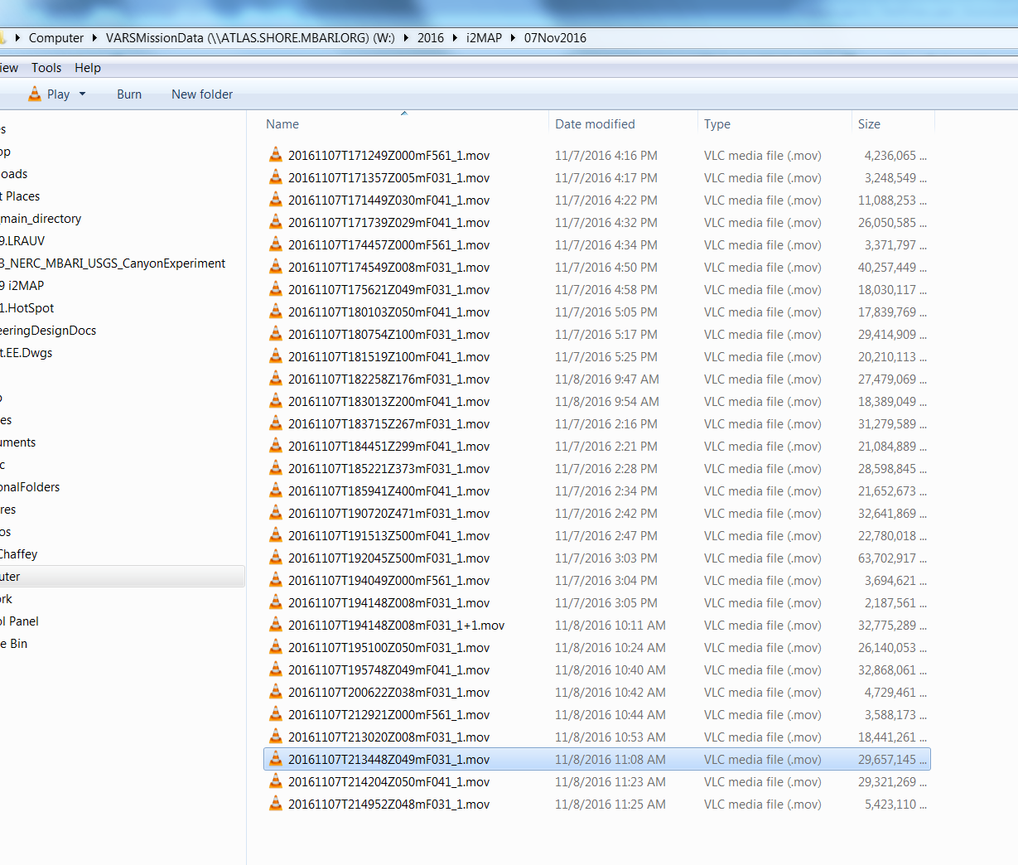
November 7, 2016 Mission

