Slide 1
Investigations of Imaging for Midwater Autonomous Platforms (i2MAP)
Abstract Presentation
PI – Bruce Robison
PM & Chief Scientist - Kim Reisenbichler
Lead Engineer – Mark Chaffey
11:30 July 7, 2015 mrc
Notes:
Start off with a brief introduction to Imaging for midwater autonomous platforms.

Slide 2
i2MAP Project Goals
Replicate the existing ROV based quantitative mid-water transects such that the results of the transects can be compared in a scientifically valid way..
Maintain the current image data processing and video annotation chain OR create a new processing chain that can be executed with a similar degree of complexity and effort .. i.e. must support VARS annotation.
Be installed and removed from the AUV Dorado with a minimum of effort, consistent with similar nose cone payloads..
Notes:
As we all are aware, ROV based transects have been conducted and annotated at MBARI for many years and the data base of species identifications it contains are a truly unique asset for studying midwater ecology.
The most important requirement of the project is that we at least match the quality of the current ROV transects.

Slide 3
Imaging is Challenging on the AUV Platform
Lighting
  Need large amount of lighting due to poor reflectivity of targets and water absorption.
    AUV connectors limit the total power available for lighting.
  AUV platform shape limits the camera/lighting separation.
Camera
  Higher transit speeds requested (100cm/sec) than with ROV (55cm sec).
    AUV operations do not want the added complication of stability wings for routine missions.
    Science requests higher transit speeds for investigating sampling bias.
Combination of limited lighting and high transect speeds challenges the ability to produce quality images.

Slide 4
Current i2MAP Project Timeline
Camera Testing Starts
Optical Design Completed
System Fabrication & Testing
AUV Test Dives
2013
2014
2015
2016
First Draft of Requirements
Concept Design Review
Preliminary Design Review
Final Design Review
1 Additional Year Proposed

Slide 5
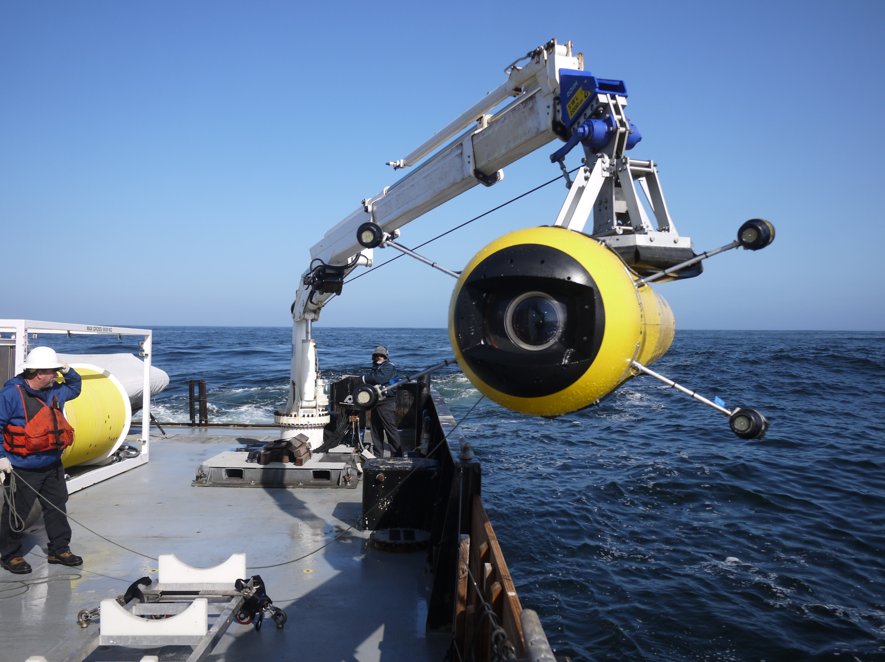
i2MAP Project Accomplishments
i2MAP Project Accomplishments
Defined the science needs and the engineering requirements necessary for success.
  Transect ranges, speeds, etc.
  Camera field of view and depth of field.
  Tested that the AUV could operate at 0.5 meters per second with wings if required.
Designed and fabricated the camera and optical system.
Field deployed the camera system on Dorado for test & verification dives in June 2015.

Slide 6
Video Examples
AUV
100 cm per second transect AUV_300_100cm-s_adj.mov
ROV
50 cm per second transect ROV_V3839_55cm-s.mov
AUV
slowed to annotation speed
AUV_300_slow_short_adj.mov
ROV
slowed to annotation speed
ROV_V3839slow.mov

Slide 7
AUV Still Frame Example (100cm/sec.)
1920x1080 - 60 FPS Progressive

Slide 8
ROV Still Frame Example (50cm/sec.)
1920x1080 - 30 FPS interlaced

Slide 9
AUV Still Frame Example 2 (100cm/sec.)
1920x1080 - 60 FPS Progressive

Slide 10
Proposed Work for 2016
In priority order
  Increase the dome depth rating to 1500 meters.
  Conduct comparative transects with the ROV and AUV for data comparison.
  Refine the operational workflow and documentation.
  Minor System Upgrades

Slide 11
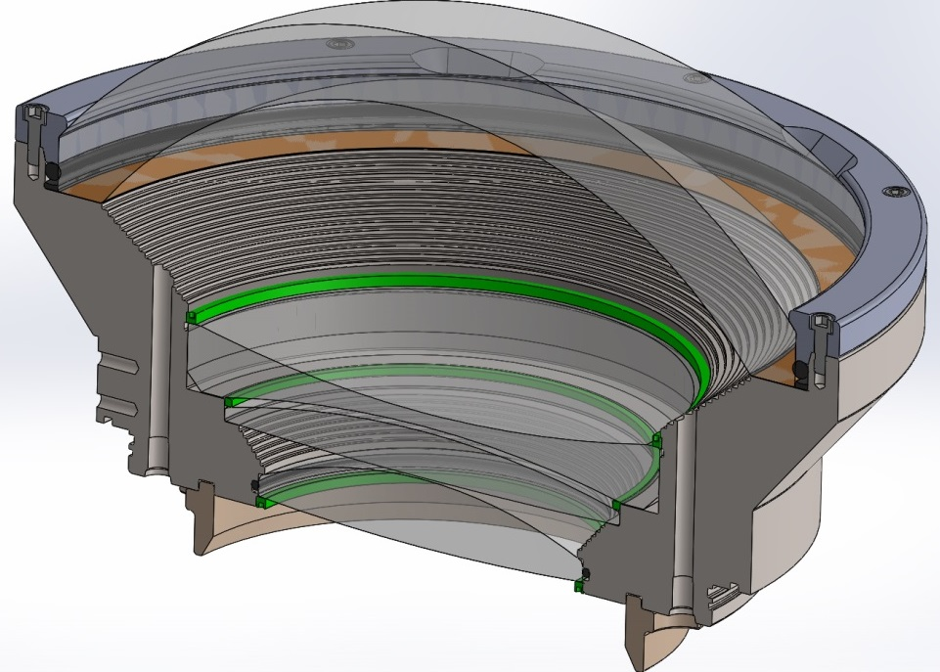
Increase the Dome Port Depth Rating to 1500 Meters.
  Dome history:
    Tested to 1896 meters, failed during 96 hour soak.
    Tested to 1275 meters, passed 48 hour + soak.
    De-rated to 300 meters (s.f. 4.25).
  Need to determine the required proof test value through glass fracture mechanics analysis.
    Require a proof test to this value.
  Plan A:
    Have dome edges modified for small radius.
    Change dome seat material to neoprene.
    Polish dome mating surface.
  Plan B:
    Modify the Titanium dome seat.
-Francois Cazenave
Notes:
- Describe glass fracture mechanics analysis.
- Have established a good source for dome and are paying $800 each. Allows testing of multiple articles.

Slide 12
Conduct Comparative ROV/AUV Transects for Data Comparison.
  Verifies usefulness of AUV transect data for continuing time series work.
  Investigate possible sampling bias influenced by:
    vehicle properties.
      ROV slower and noisier.
      AUV quieter and faster.
    Camera properties.

Slide 13
Refine Operational Workflow and Complete Documentation.
  Continue to improve procedures for field operations for easy, routine operations.
    Refining the integration of the camera system operation into the Dorado mission scripting.
    Refining the user documentation and field checklist.
  Refine processing steps for importing video records into VARS and annotating.
    Improve scrips for converting native ProRes HQ files into proxy files for annotation.

Slide 14
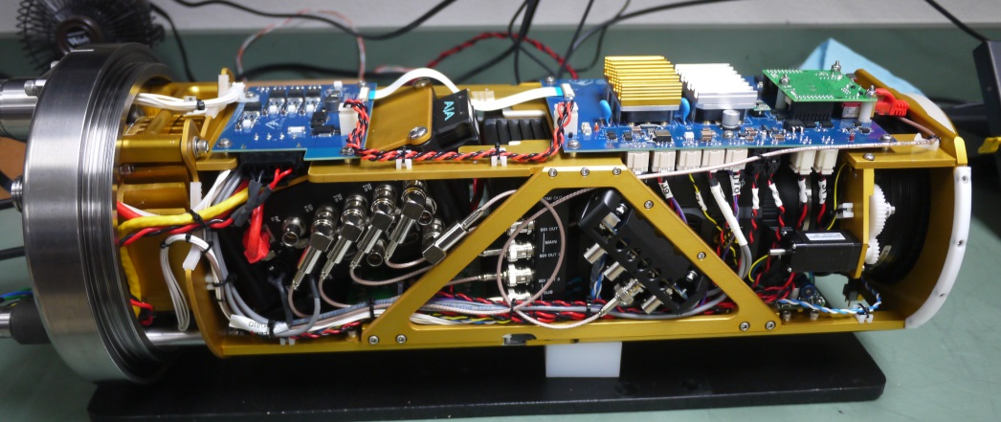
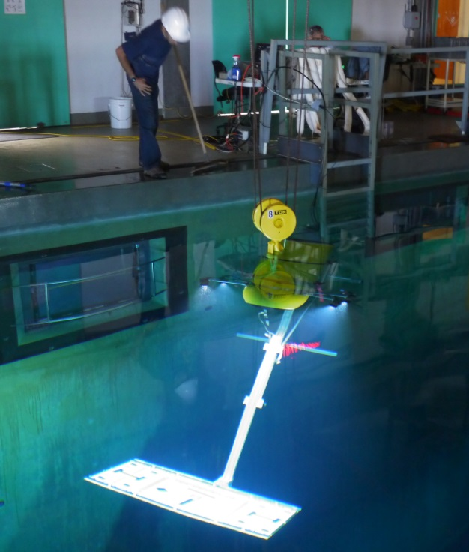
Minor System Upgrades
Develop iris control algorithm.
  Increased mission flexibility.
    Would allow operation in near-surface waters <50m) with high ambient light levels.
Minor revision to the electronics to allow separate camera and recorder power switching.
  Lower heat load during long in-air download time.
Camera tuning for best picture.
  Re-flash camera firmware to latest revision.
  Develop lens files for in-camera correction of lens flare and color shading.

Slide 15
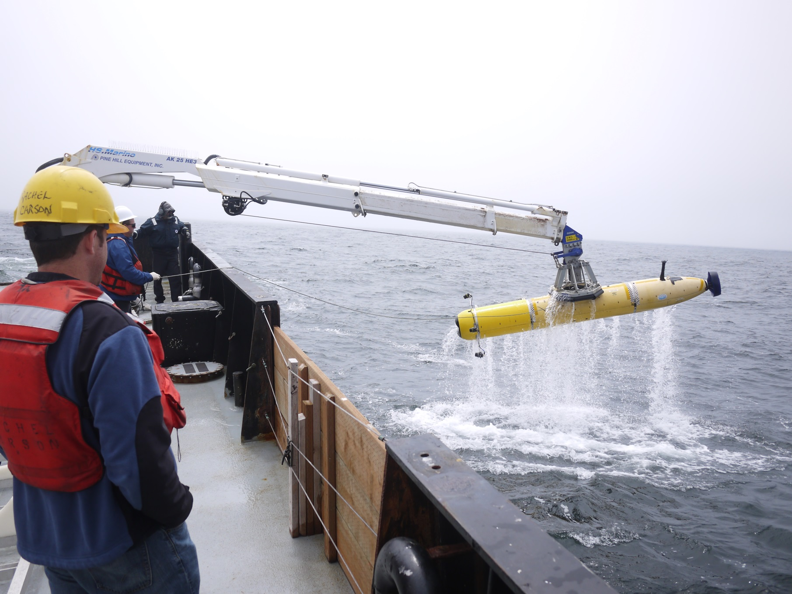
END

