Slide 1
Supervisory Control Software
Component Power Switching
Data logging
Digital Recorder Control
Recorder/AUV Time Synchronization

Slide 2

Power Switching
Cycle power to lights
Approach: COTS Device Server
  Digital I/O switches (lights)
  Ethernet/HTTP interfaces
  Serial to Ethernet (CTD, temp & humid, servo)
Candidate: MicroX SBC65EC
  HTTP Interface to switches
  C++ API to 2 RS232 ports and 1 I2C port (is this enough?)

Slide 3
Digital Recorder Control
Testing the Ki Pro Quad unit from AJA
HTTP command interface
  Change settings (file names, format, etc.)
  Start/Stop recording
Recorder/AUV Time synchro

Slide 4
Data Logging
CTD Data
Environmental
  Temperature, humidity
Peak and average light intensity
Log all data originating from serial ports

Slide 5
Design Approach
All functionality will reside in MVC software modules
Use familiar Server Interface to expose settings, switches, and data to other MVC modules (standard practice)
Functional interfaces to devices implemented in one or more MVC driver modules
Needed control parameters will be available in a mission script behavior

Slide 6
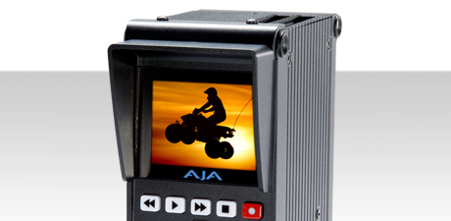
Block Diagram
KiPro Quad
MicroX
- HTTP Settings
- C++ Data
- HTTP Settings
MVC

Slide 7
Video CAmera Recorder and Logging
VCARL
All software will reside in MVC software stack
Server executes only when requested
Not polling state from KiPro
Supervisor
VCARL Server
= active process
KiPro Quad
Interface
MicroX Driver
= static interface
MicroX
Interface
Driver runs independently
Continuously waits for and logs serial data from MicroX

