Slide 1
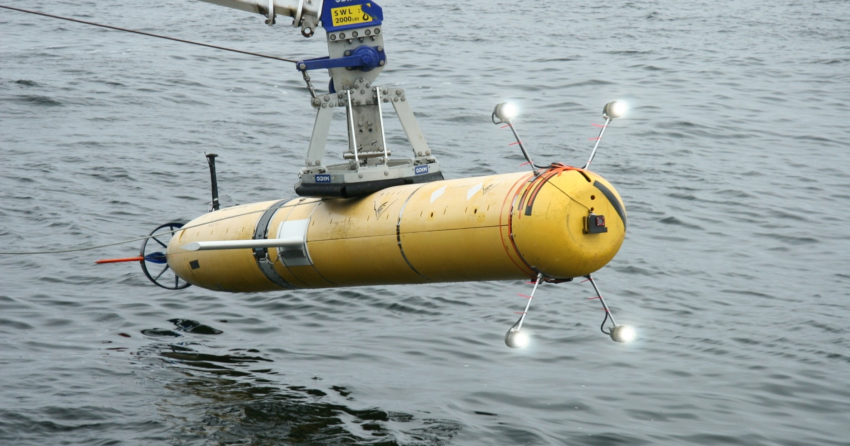
i2MAP Dorado Midwater Imaging AUV Preliminary Design Review
Rev 1.0

Slide 2
Scientific Requirements
  The goal of the i2MAP project is to develop an autonomous imaging system that will allow us to automate the midwater time-series data collection process; to shift from ROVs to AUVs.
  Basic scientific requirement: To build a system capable of collecting video transecting imagery and environmental data of the quality of that currently collected with the ROVs, or better.
  ROV transecting data is currently collected under the following conditions:
  Video quality = 1080i, 30 fps
  Wide field of view (~85º horizontal)
  Adequate and even lighting throughout the field of view
  120 minutes of video storage (11 depths x 10 minute transect each + leader/trailer)
  Speed: 1.0 knots (~55 cm/sec)
  Environmental sensors:
    CTD (salinity, temperature and depth)
    Oxygen sensors x2 (dissolved O2 concentration)
    Transmissometer, 25 cm (water clarity/relative concentration of particulates in water)

Slide 3
Functional Requirements
(see full text in 901209 project folder)
The AUV transecting imaging system must replicate the existing ROV based quantitative mid-water transects such that the results of the transects can be compared in a scientifically valid way.
Maintain the current image data processing and video annotation chain OR create a new processing chain that can be executed with a similar degree of complexity and effort.
Provide for simultaneous operation with an environmental sensing package (CTD, oxygen X 2, and transmissometer sensors) comparable with that of the ROVs.
Meet the weight, balance, interface and configuration requirements of a Dorado AUV payload such that extraordinary measures are not required for routine AUV operation.
Be installed and removed from the AUV Dorado with a minimum of effort, consistent with similar nose cone payloads.

Slide 4
Design Requirements
(see full text in 901209 project folder)
Capture format. The imaging system must capture in a progressive scan format with a minimum resolution of 1920x1080 4:2:2 format at 10 bits at 60 frames per second or greater ( 1080 60P) for 120 minutes.
The video records must include SMPTE timecode data that is synchronous with the environmental instrumentation data.
Depth of field. The imaging system shall allow the identification of small plankton at a range from 0.1 to 2.5 meters from the camera dome with the camera lens in a fixed focus position. Note: it is desirable but not required that the camera system be able to image objects further from the camera than 2 meters, ideally out to 10 meters distance.
      Width of field. The lens system shall have at least an 80 degree horizontal viewing angle.
      The light bars shall hold 4 DSPL Sealights in a position that minimizes backscatter and glaring.
The Dorado camera payload shall provide for simultaneous operation with the standard CTD, oxygen (x2) and 25 cm transmissometer instruments of the CTD AUV OR duplicate these instruments on the camera payload. The data must be available as part of the standard AUV data load path and be accessible to VARS.
Operate at specific depths from 50 meters to 1500 meters performing 11 individual transects of 330 meters length.
  Dorado shall maintain a constant depth during a commanded transect to within +/- 1 meter.
  Dorado shall maintain a constant pitch angle during a commanded transect of +/- 10 degrees.
  Dorado shall maintain a constant roll angle during a commanded transect of +/- 20 degrees.
The electrical interface to the Dorado AUV must be compatible with:
    18 to 36 Volts DC, 15 Amperes maximum continuous current. Note that SeaCon reports 16A
    The data interface is 10/100BaseT Ethernet.

Slide 5
Overall System Design
  System Layout
  Energy budget
  AUV interface
  CTD and other environmental sensors

Slide 6
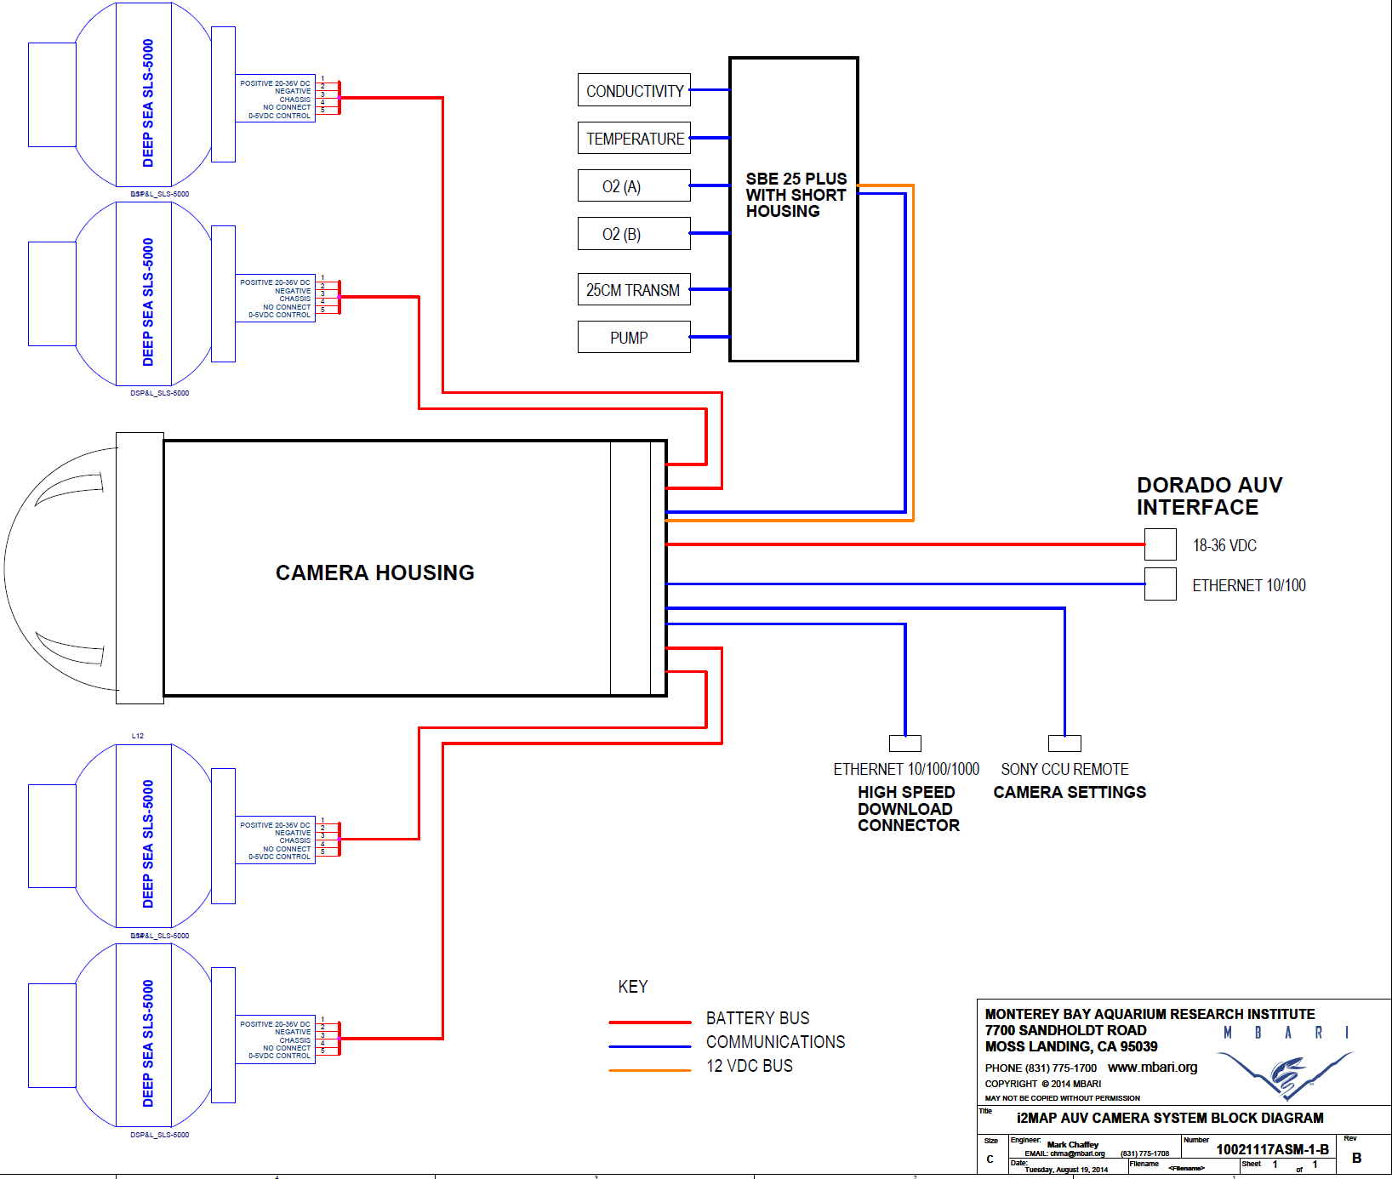

Slide 7
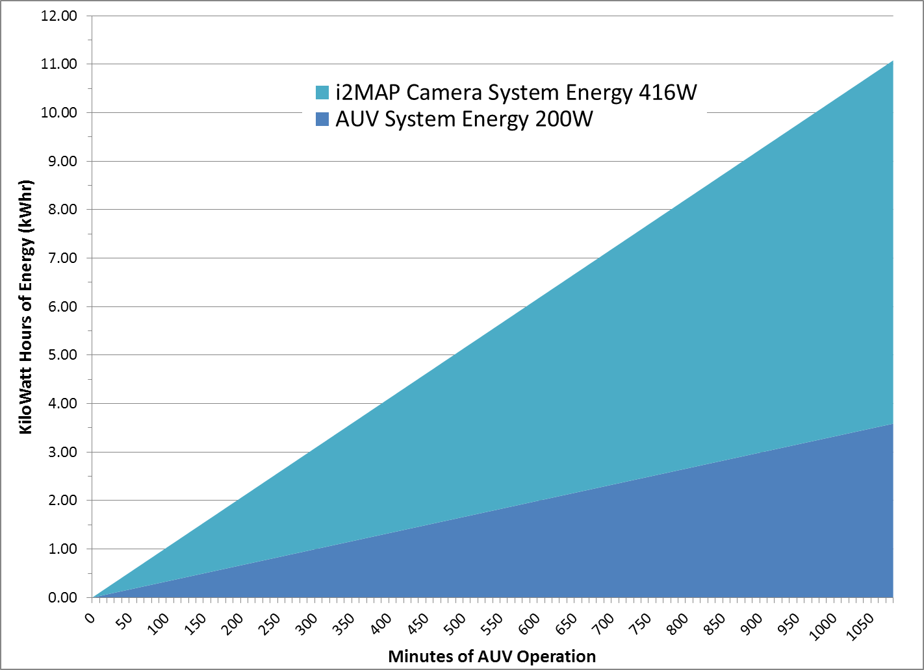
Total Energy Use by Dorado (Velocity 1 m/sec.)
2 Battery Spheres (7.4 kWhr)
Energy Limited Recording Time
1 Battery Sphere (3.7 kWhr)
1 TB Memory Limited Recording Time
Notes:
On the total energy budget we are completely OK with one or two battery spheres.

Slide 8
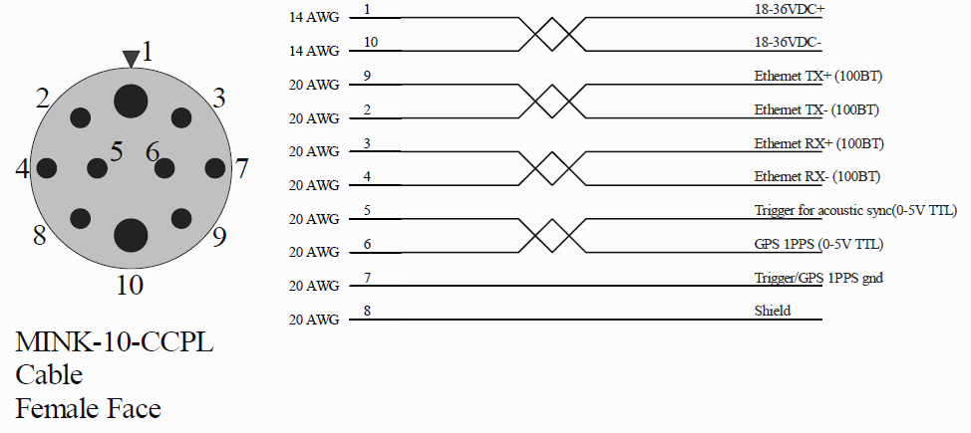
Dorado AUV interface & Power Budget
Hardware Interface.
  The electrical interface to the Dorado AUV must be compatible with:
    18 to 36 Volts DC. (new battery will be 20-36V)
    15 Amperes maximum continuous current . (SeaCon reports 16A)
  NOTE: this is 270 Watts at low battery and 540 Watts at high battery. We need about 390 Watts to run 4 lights full power (20A @ 18VDC).
  The data interface is 10/100BaseT Ethernet.
(Received via email from Hans Thomas February 25, 2014)

Slide 9
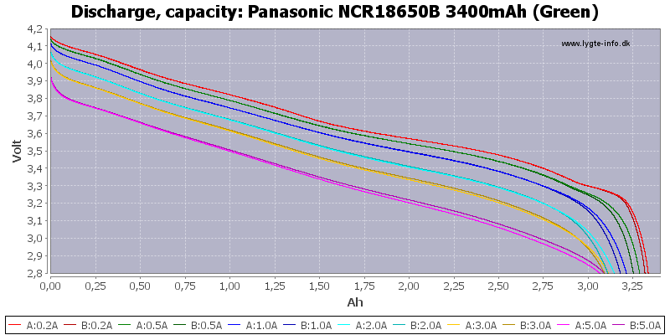
i2MAP Limited by the AUV Connector Maximum Current
With 4 x 80 Watt lights we are limited by the Dorado interface connector 16 Ampere maximum at low battery voltages (<25 Volts).
Required solution:
  Cut off i2MAP lights or reduce output when AUV battery voltage drops below 25 Volts.
New Dorado Battery Discharge Curve
Connector Limit 16A - 25 Volt Cutoff for 390 Watt i2MAP System

Slide 10
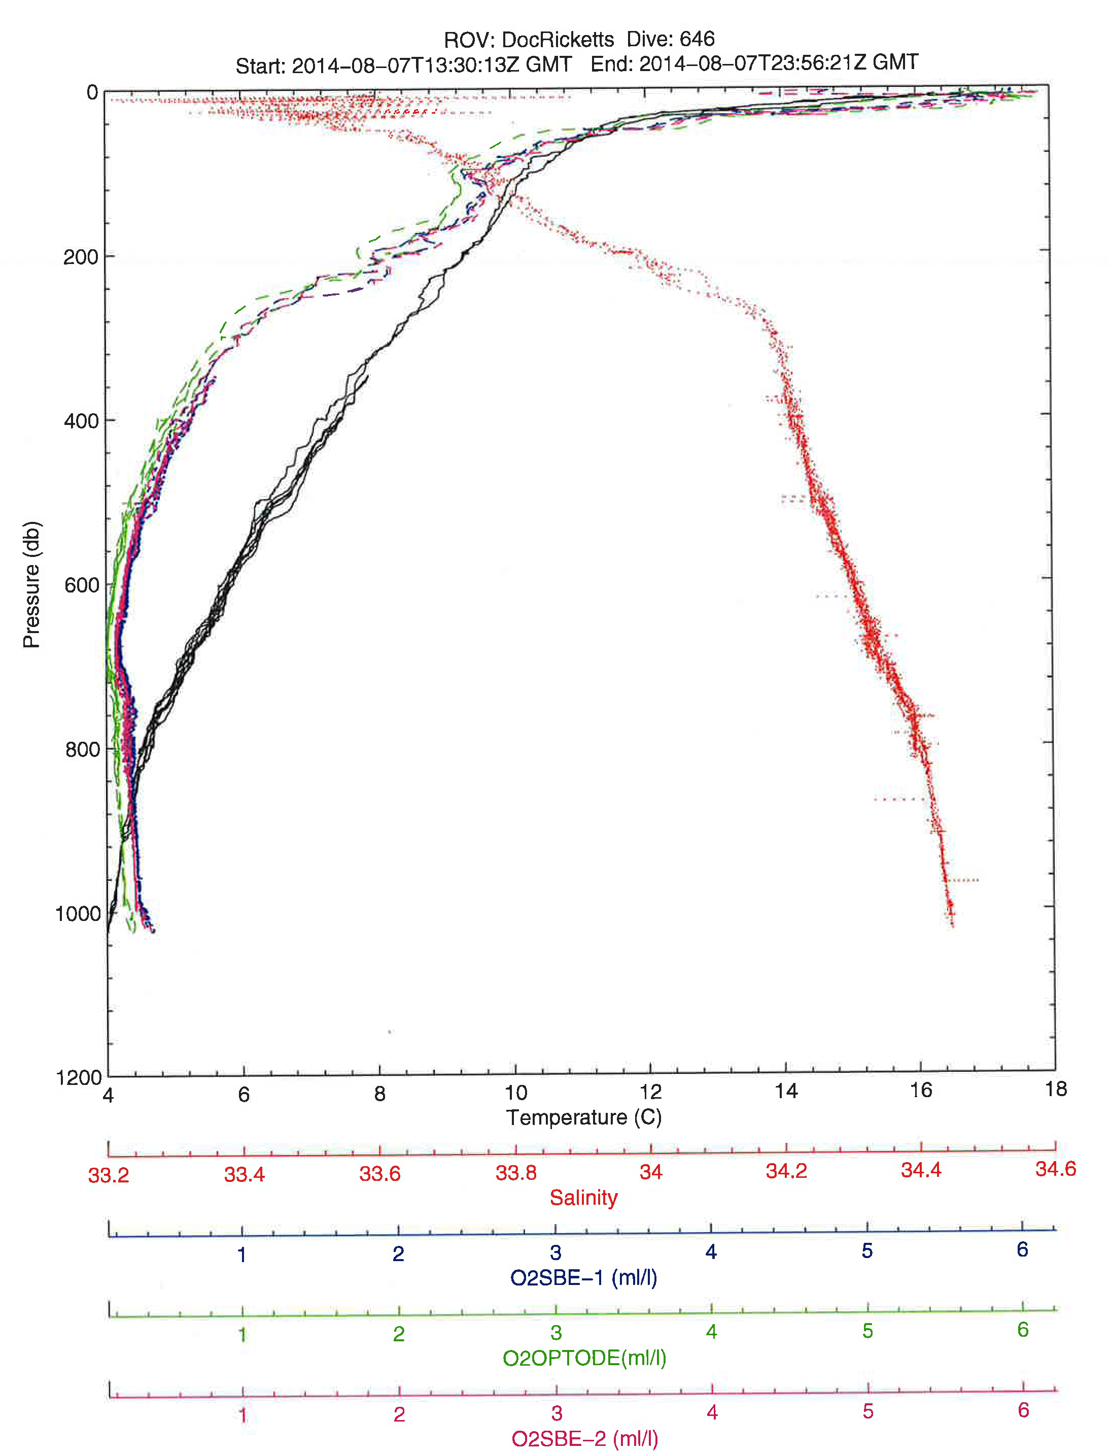
Environmental Sensing

Slide 11
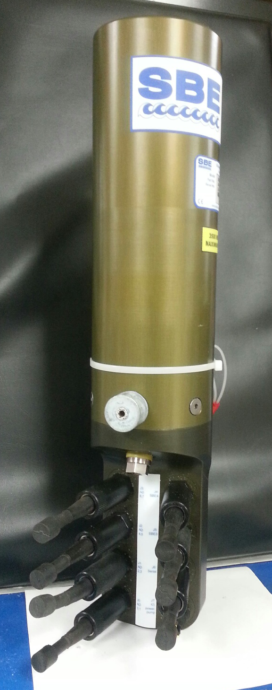
Environmental Sensor Suite
Sea-Bird 25plus in shortened 6800 m housing
  Eight 0-5 volt A/D input channels
  Two RS-232 input channels
  2000 m depth sensor (accuracy = 2 m, resolution = 0.3 m)
  SBE 3F temperature sensor (initial accuracy ± 0.001 ºC)
  SBE 4C conductivity sensor (range = 0.0 – 7.0 Siemens/m, initial accuracy ± 0.003 S/m)
  SBE 5 submersible pump
SBE 43 dissolved oxygen sensor (x2) w/ flow duct (initial accuracy ± 2% of saturation)
Wet Labs C-Star 25 cm path length Transmissometer
Second pump, O2 sensor and transmissometer will be integrated into system in 2015

Slide 12
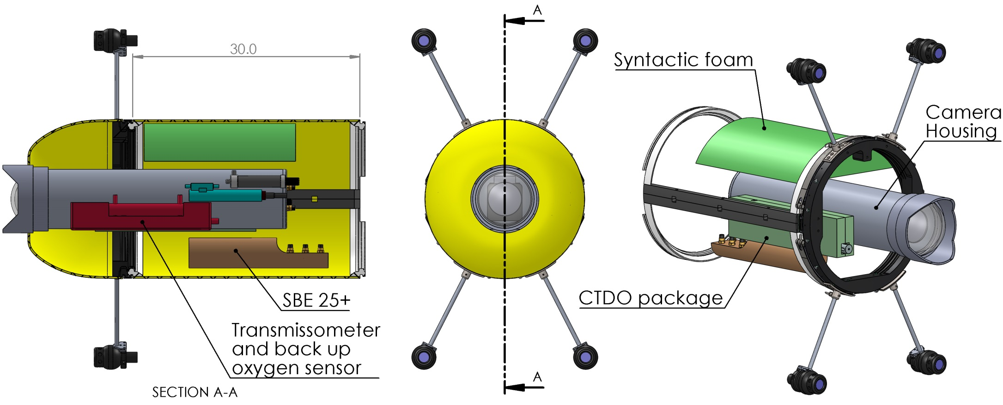
Mechanical layout of I2Map section
Total mass (without bracketry) = 160 lbs
Displacement = 2.9cf or 185 lb of seawater
Foam density: 24 lb/cf , less than 1cf needed

Slide 13
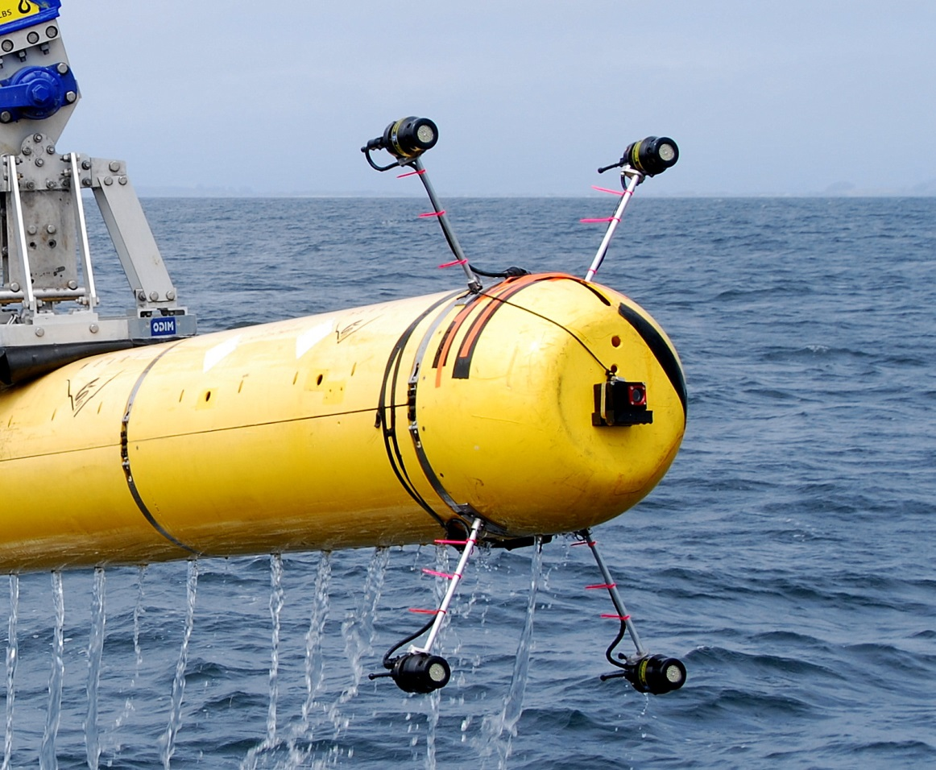
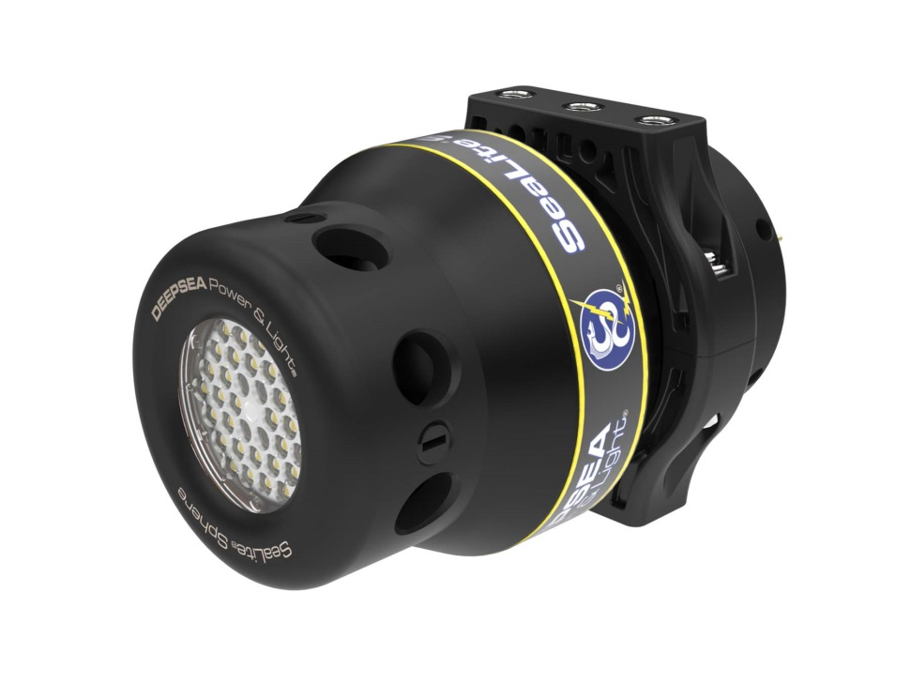
Lighting
4 DSPL Sealight spheres.
Mounted on rods to reduce backscatter

Slide 14
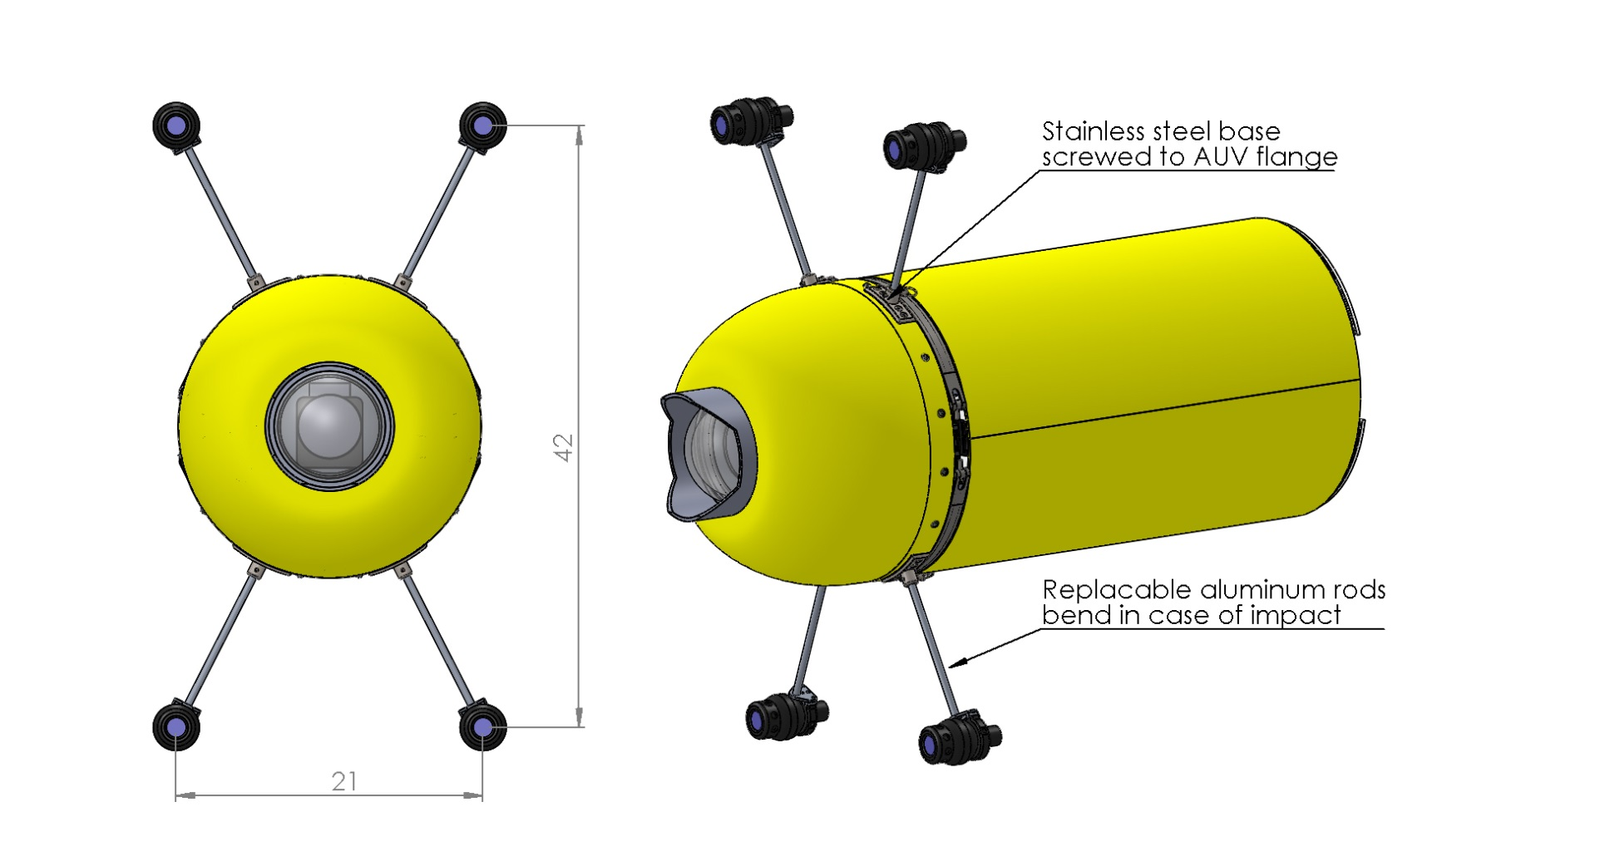
Problem | Solution
Lights are vulnerable during deployment and recovery | Rods will bend in case of collision to avoid damage to lights and fairing. Damaged rods can be replaced easily. Light can be protected in a plastic shell.
Lines or other objects could get caught in the light bars | Risk is minimal according to AUV team. A guard line can be used when operating in high risk areas.
Drag is increased | See Rob’s analysis

Slide 15
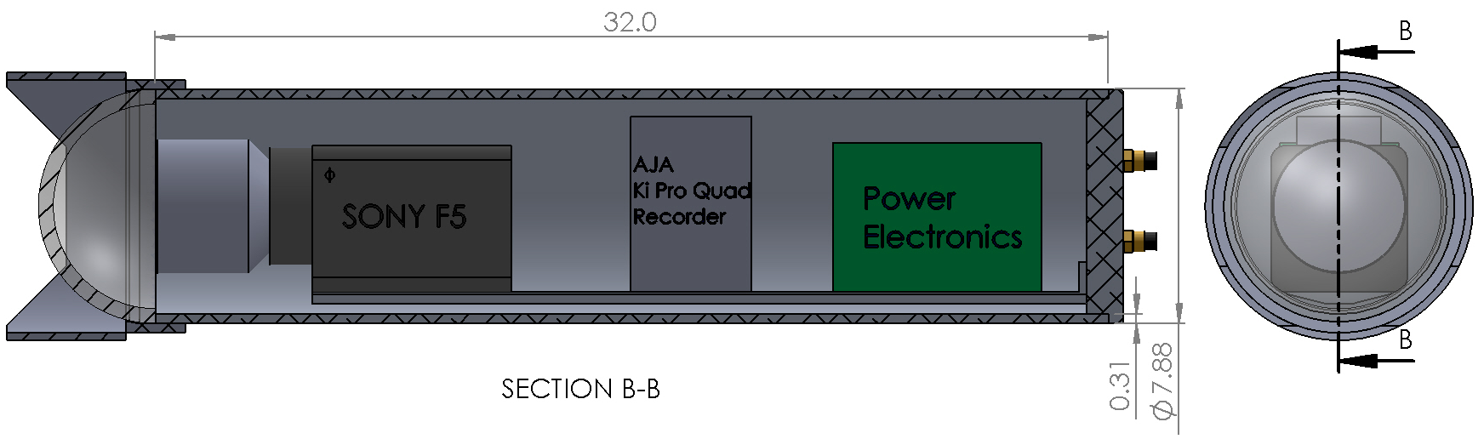
Camera housing
Material: 8” OD, ½” wall extruded aluminum tubing
Crush depth: 2200m
Mass: 50 lbs
Working on dome and optical elements with optical engineer
Mounting of camera and optical elements still TBD

Slide 16
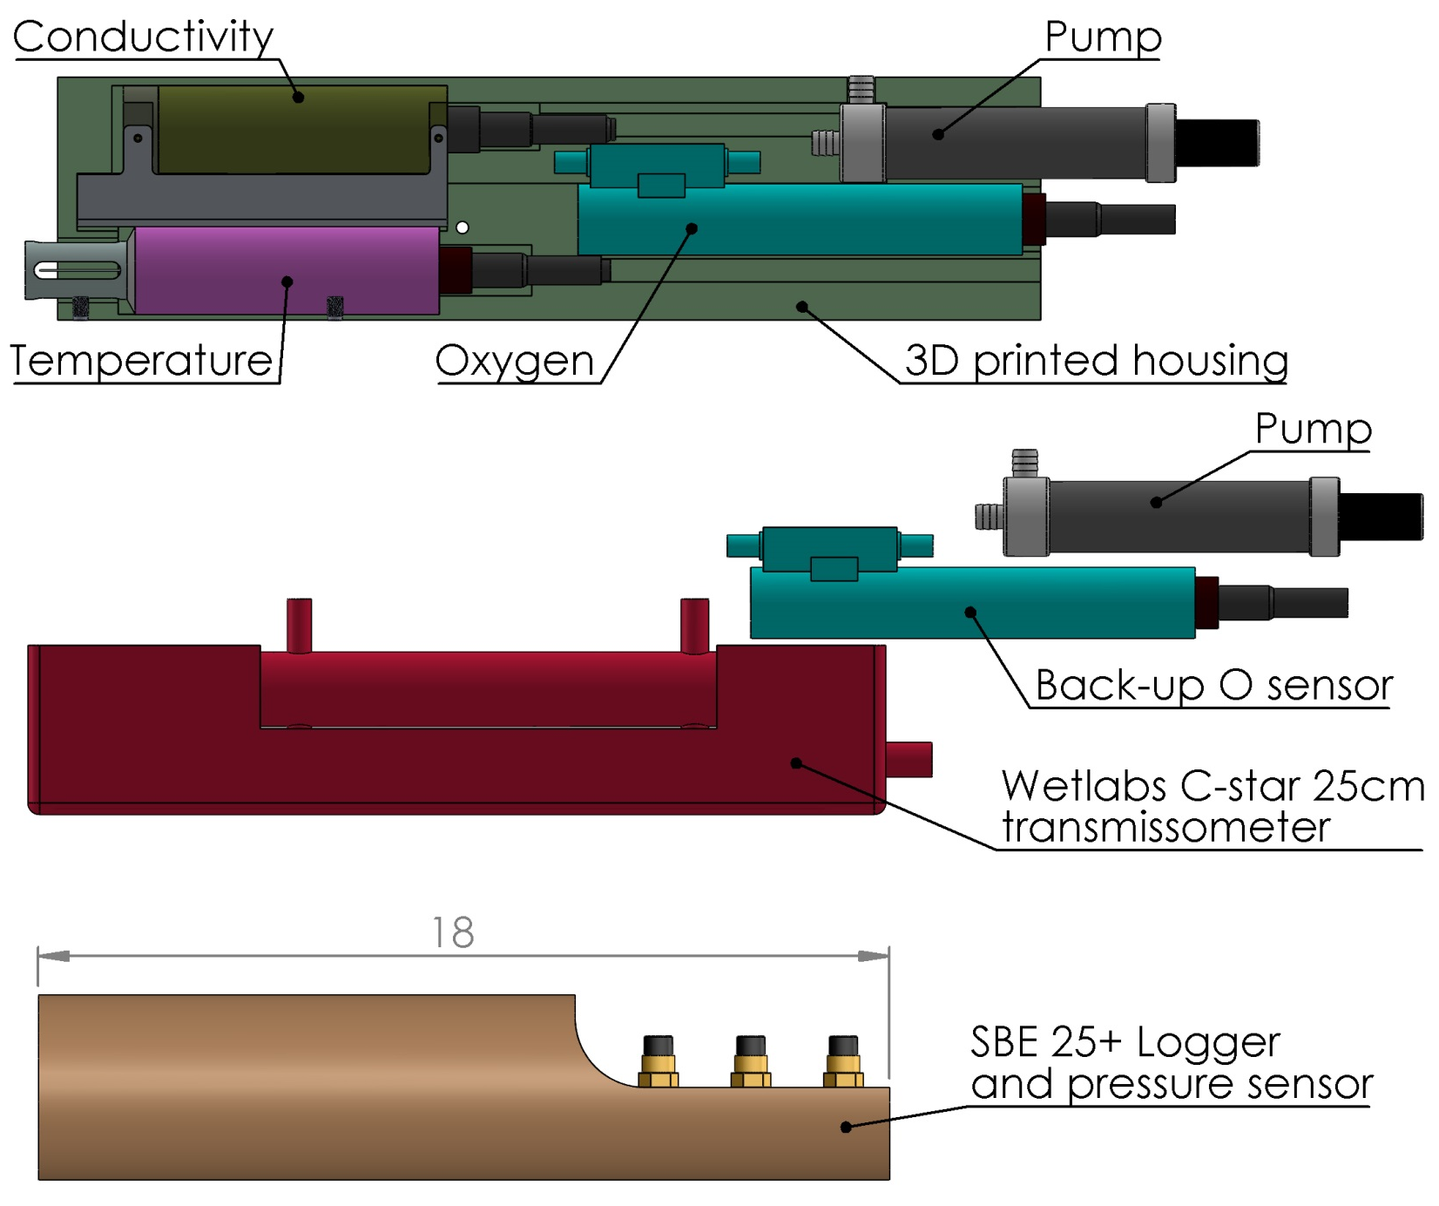
Environmental sensors

Slide 17
Vehicle Control And Stability

Slide 18
Design Speed Raised to 1.0 m/s (2kts)
May be able to eliminate body wings.
Probably will retain winglets on the duct.
  May add vertical winglets!
The next sea trial will determine the answers.
Quick review of stability and control situation:

Slide 19
Three Problems:
How to prevent buoyancy from dragging vehicle up at low speed?
  Add body wings.
  Ballast low; about 4 lbf.
How to control the vehicle (steering and diving) at low speed?
  Add winglets to the duct.
  Increase the control gains.
How to damp oscillations caused by drag at the nose?
  Add winglets to the duct.

Slide 20
First Two Problems:
How to Maintain Depth (Resist Buoyancy) and Change Depths at Low Speed?

Slide 21
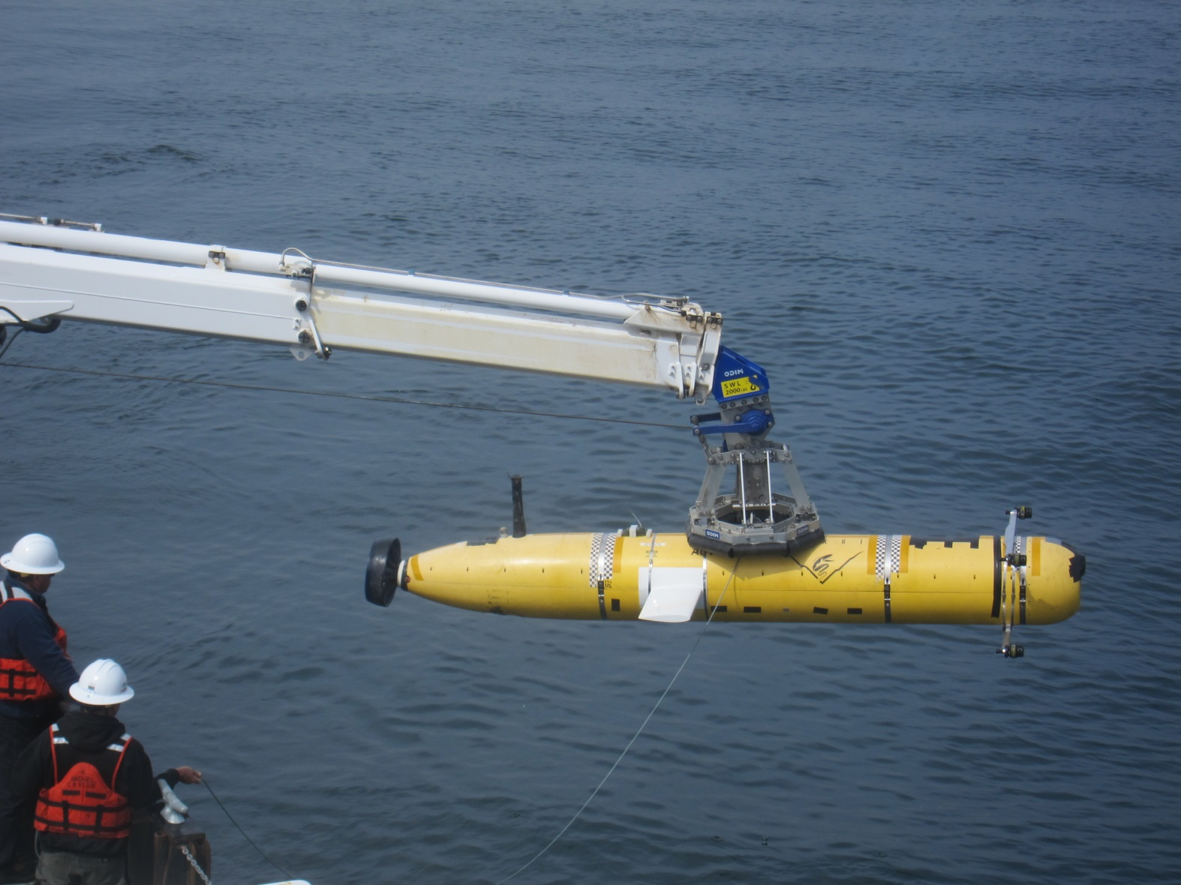
Wings 14” Behind Eye Center, With Bars

Slide 22
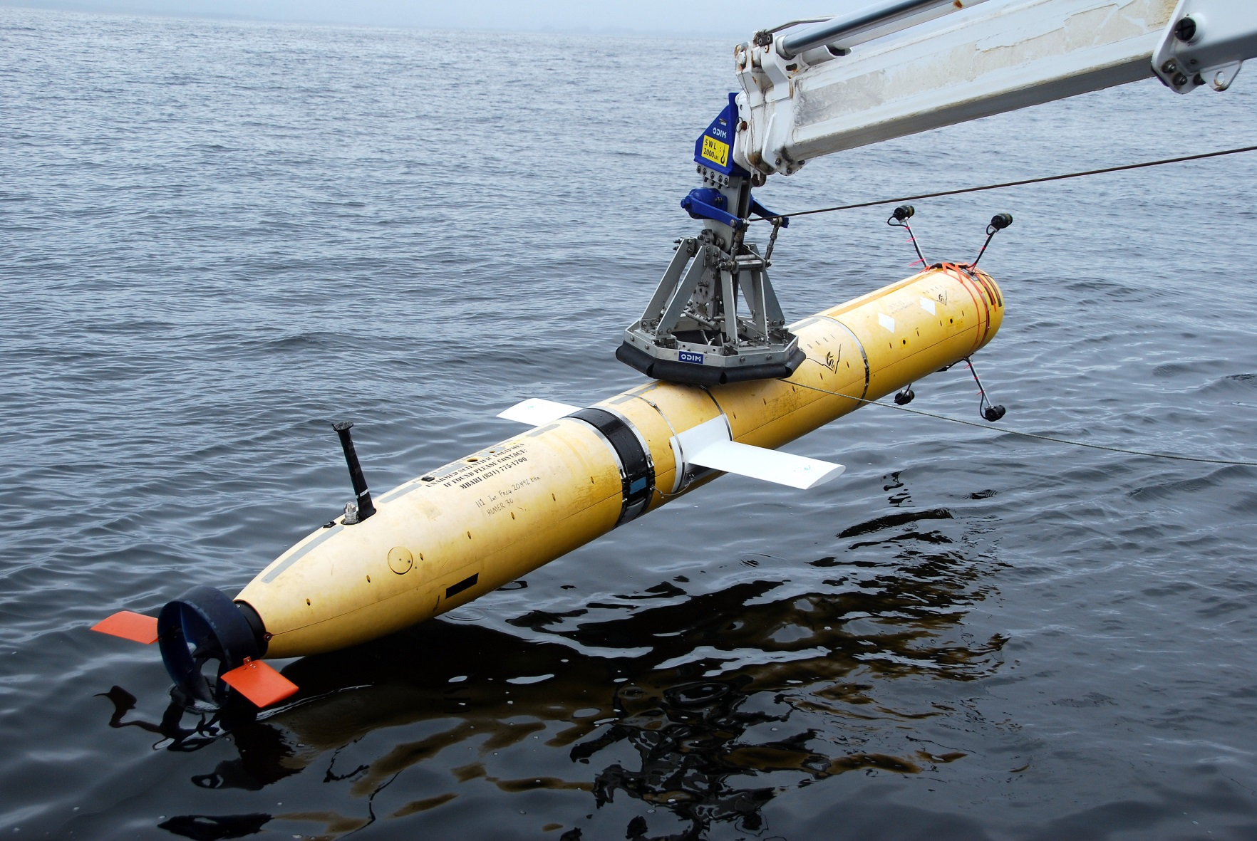
MAUV with Wings, Winglets, Round Bars

Slide 23
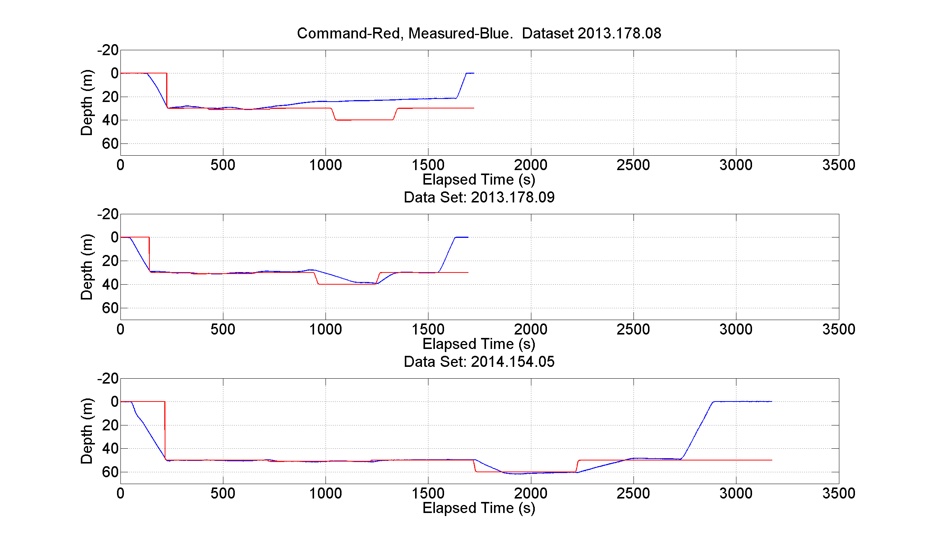
Improvement in Depth Control at 0.5 m/s
Ctd vehicle.
Streamlined bars.
With lights.
No Wings.
No Winglets.
5.8 lbf buoyant.
With Wings.
Mapping vehicle.
Round bars.
With lights.
With Wings.
With Winglets.
With Gain Adjust.
5(?) lbf buoyant.
Controllability will improve at 1.0 m/s.
May be able to eliminate body wings.
If wings are needed, will design/fabricate a swept version.

Slide 24
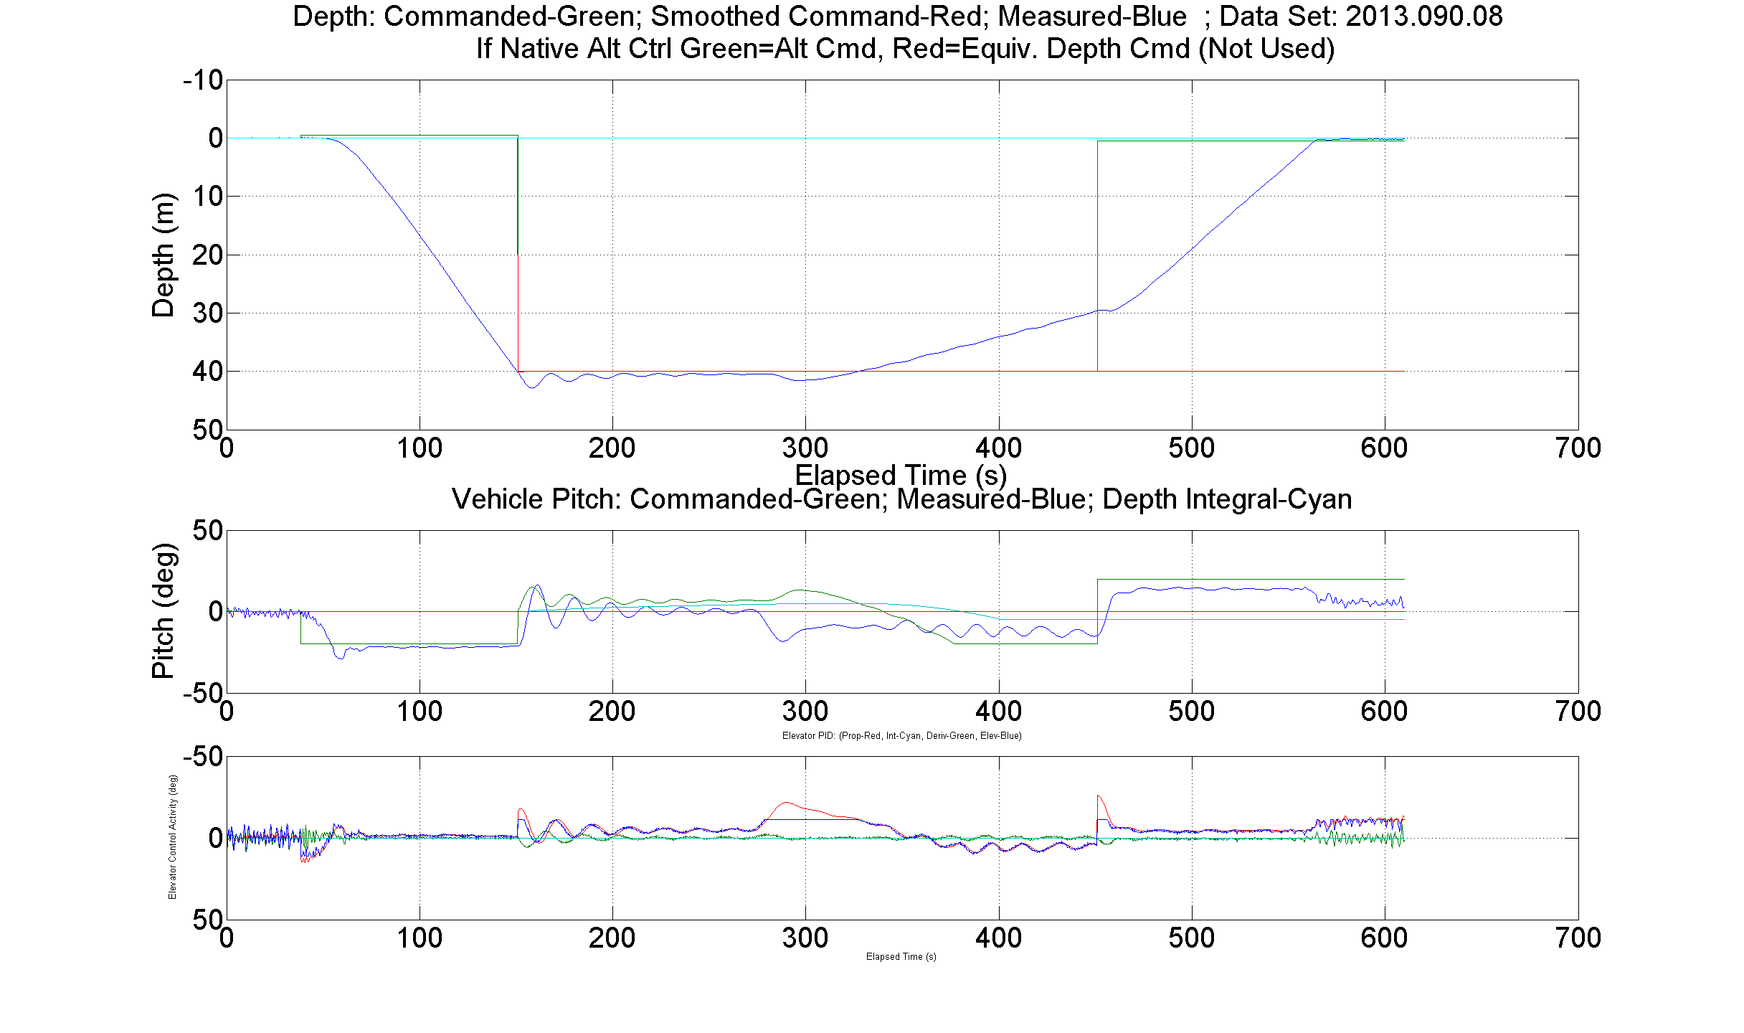
Third Problem: Oscillations Caused by Lights
Adding drag or lift or both to the bow is destabilizing.
Ctd vehicle.
Streamlined bars.
With lights.
No Wings.
No Winglets.
4.5 lbf buoyant.
Speed = 0.5 m/s.
1.4 m/s
.45m/s

Slide 25
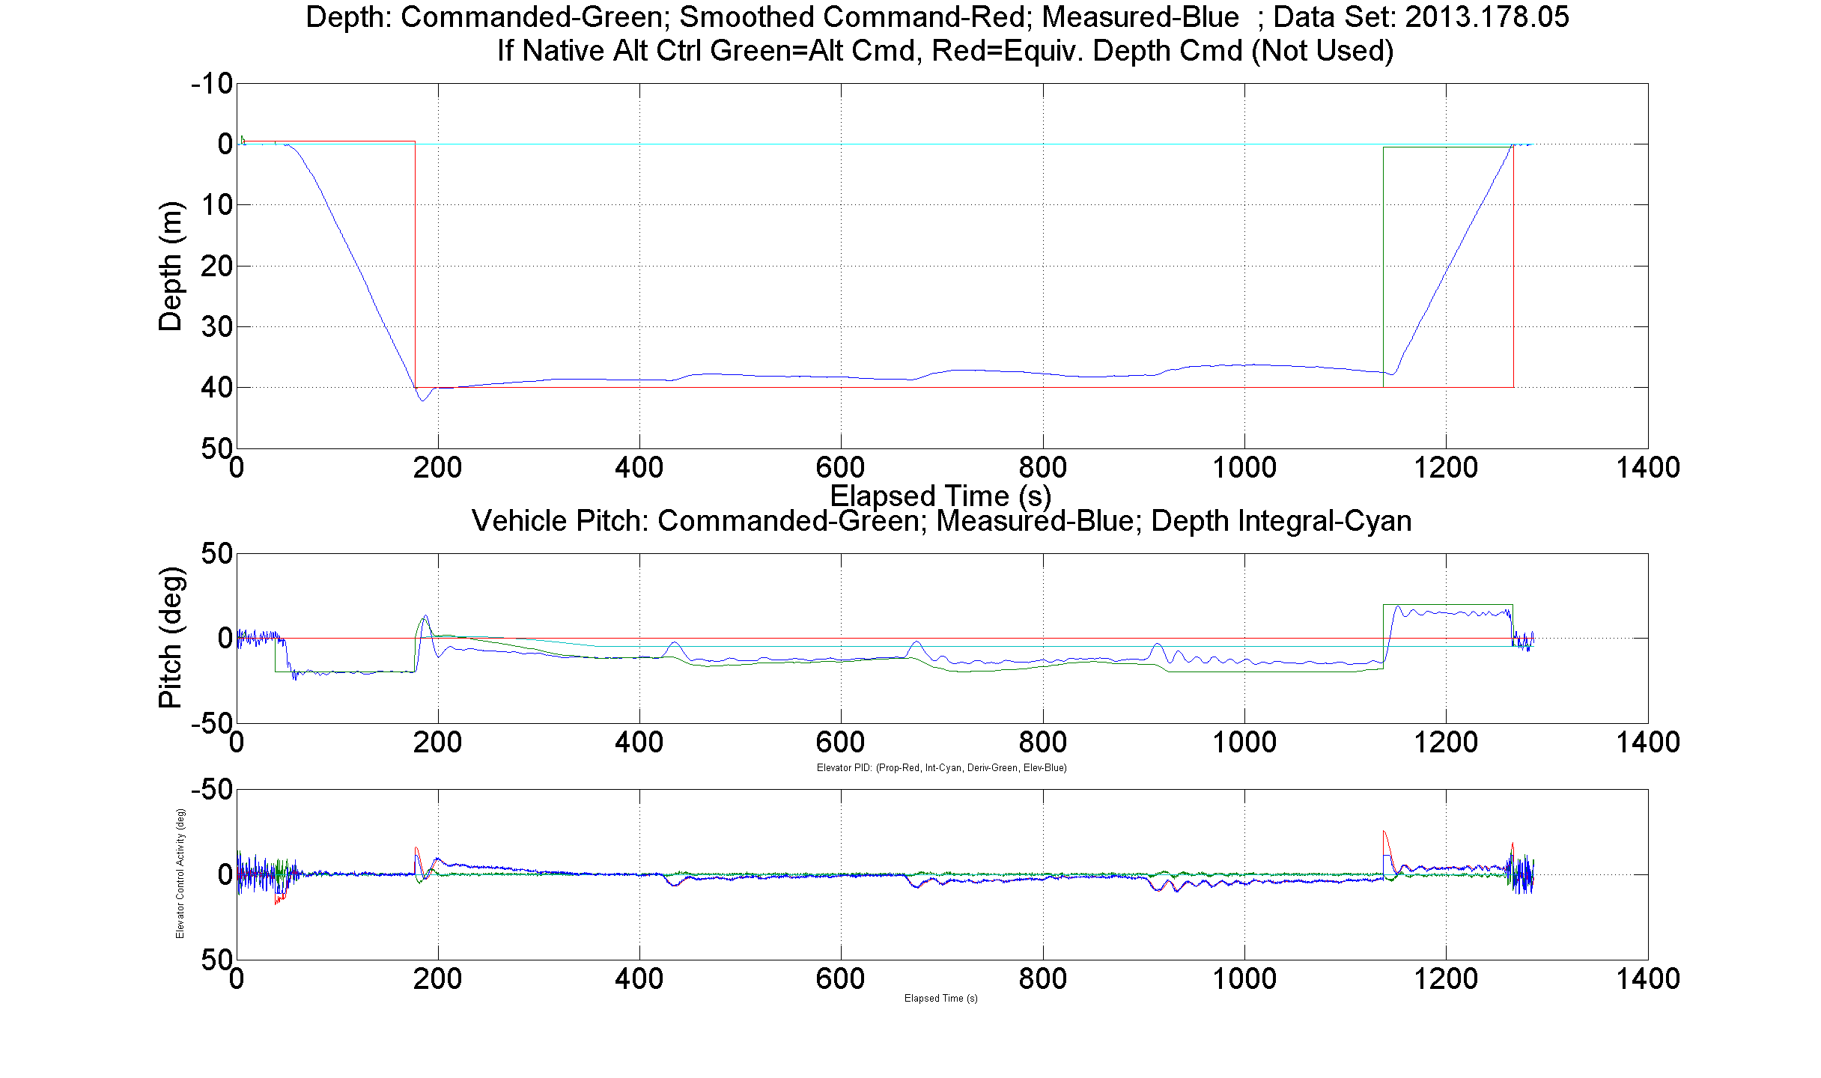
Third Problem: Second Case
Ctd vehicle.
Streamlined bars.
With lights.
No Wings.
No Winglets.
5.8 lbf buoyant.
Speed = 0.5 m/s.

Slide 26
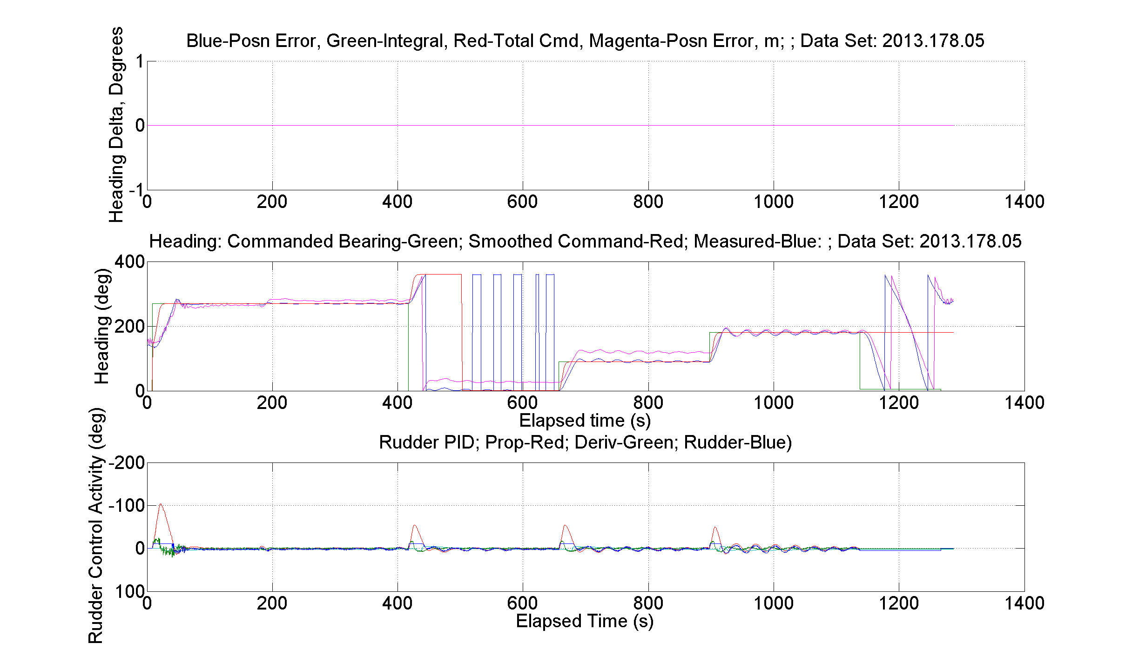
Second Case: Heading
Ctd vehicle.
Streamlined bars.
With lights.
No Wings.
No Winglets.
5.8 lbf buoyant.
Speed = 0.5 m/s.

Slide 27
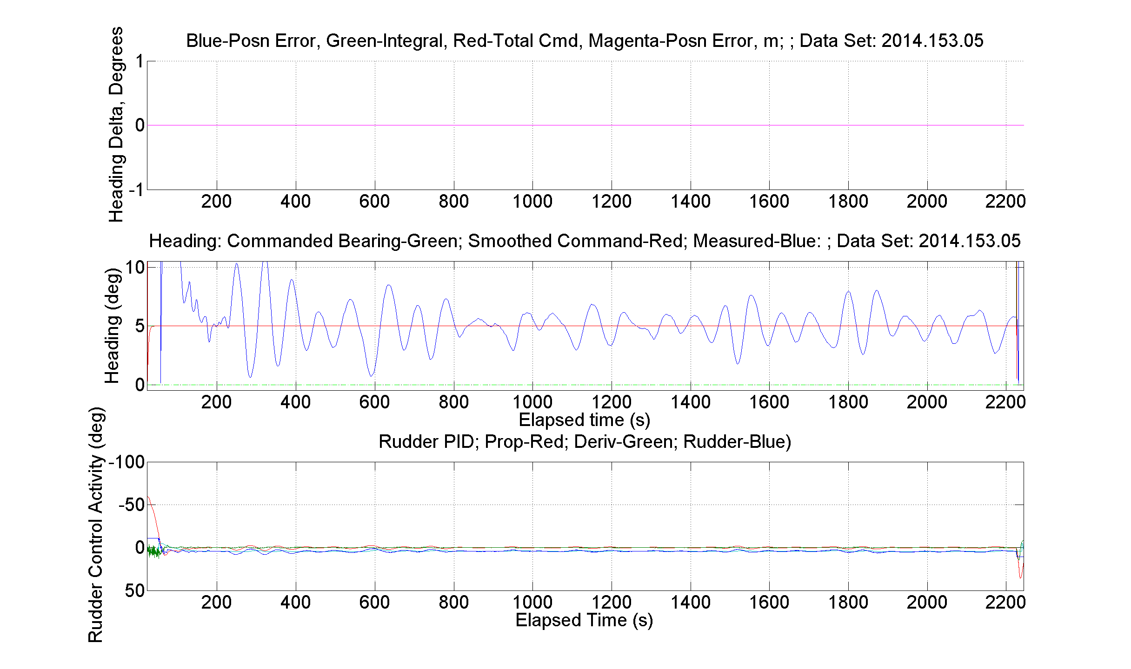
Third Case: Heading
Mapping vehicle.
Round bars.
With lights.
With Wings.
With Winglets.
5 lbf buoyant (?).
Speed = 0.5 m/s.

Slide 28
Angular Rates
0.5 m/s.
Approximate maximum angular rate of particle:
  Horizontal plane: 0.37 rad/sec (21 deg/sec)
  Vertical plane: .31 rad/sec (18 deg/sec)
2013 CTD Vehicle with horizontal streamlined bars:
  Heading: 30 second period, max yaw rate .04 rad/sec. (178.05)
  Vertical no winglets: 17 sec period, max pitch rate .03 rad/sec. (178.05)
2014 Mapping Vehicle with round bars, wings, winglets:
  Heading: 70 second period, max yaw rate .01 rad/sec.
  5-10 degrees peak-to-peak (153.05).

Slide 29
Next Steps
Predict steady-state performance at 1.0 m/s with simulation.
  Wings necessary?
  Winglets necessary?
  Angles of attack below stall?
  Duct not railed?
Predict oscillation frequency and amplitude at 1.0 m/s with (another) simulation
  Large enough to smear video frames?
Conduct sea trials at 1.0 m/s
  Try without wings.
Adjust analytic models to match sea-trial results.
  Reliable simulation can quickly answer questions and avoid expensive, risky, and time-consuming sea trials.

Slide 30
Conclusions
Buoyancy and controllability problems now low risk.
May be able to eliminate body wings.
Winglets damp light-bar-induced oscillations? Working on this now.
Next
Use simulators to predict controllability and oscillation parameters at 1.0 m/s.
1.0 m/s sea trial to verify.
Incorporate recent sea-trial data into simulators to improve accuracy.
End-to-end test of final system

Slide 31
Camera System
  Camera and Lens Testing
  Optical Dome and adapter design
  Video Format Selection
    Temporal Resolution
    CODEC Performance
  Recorder
    Recording Capacity
    Post mission workflow
  Conclusions

Slide 32
Distance Requirements for the Identification of Representative Organisms in the Camera Field-of View
Required I.D. Distance
Species
Front of Camera Dome
Measured First I.D. Distance (cm) (Rob Sherlock)

Slide 33
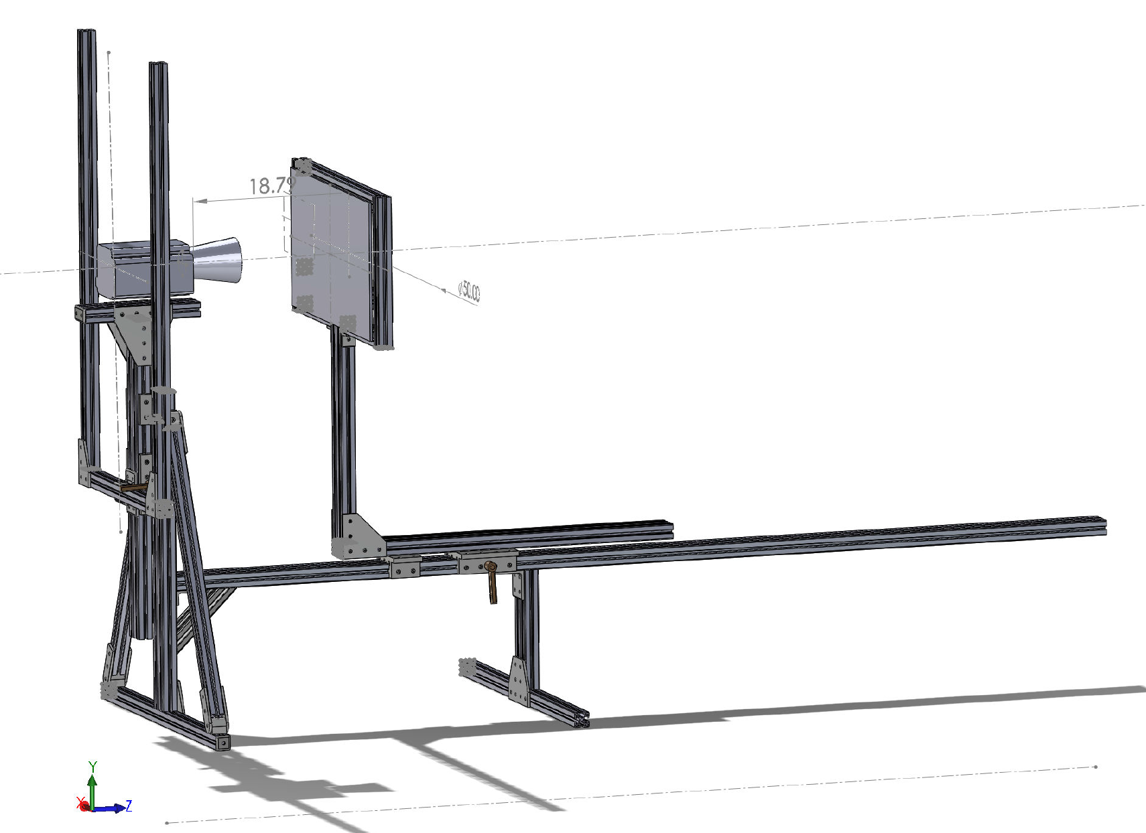
Close Focus Test (~10cm from dome)

Slide 34
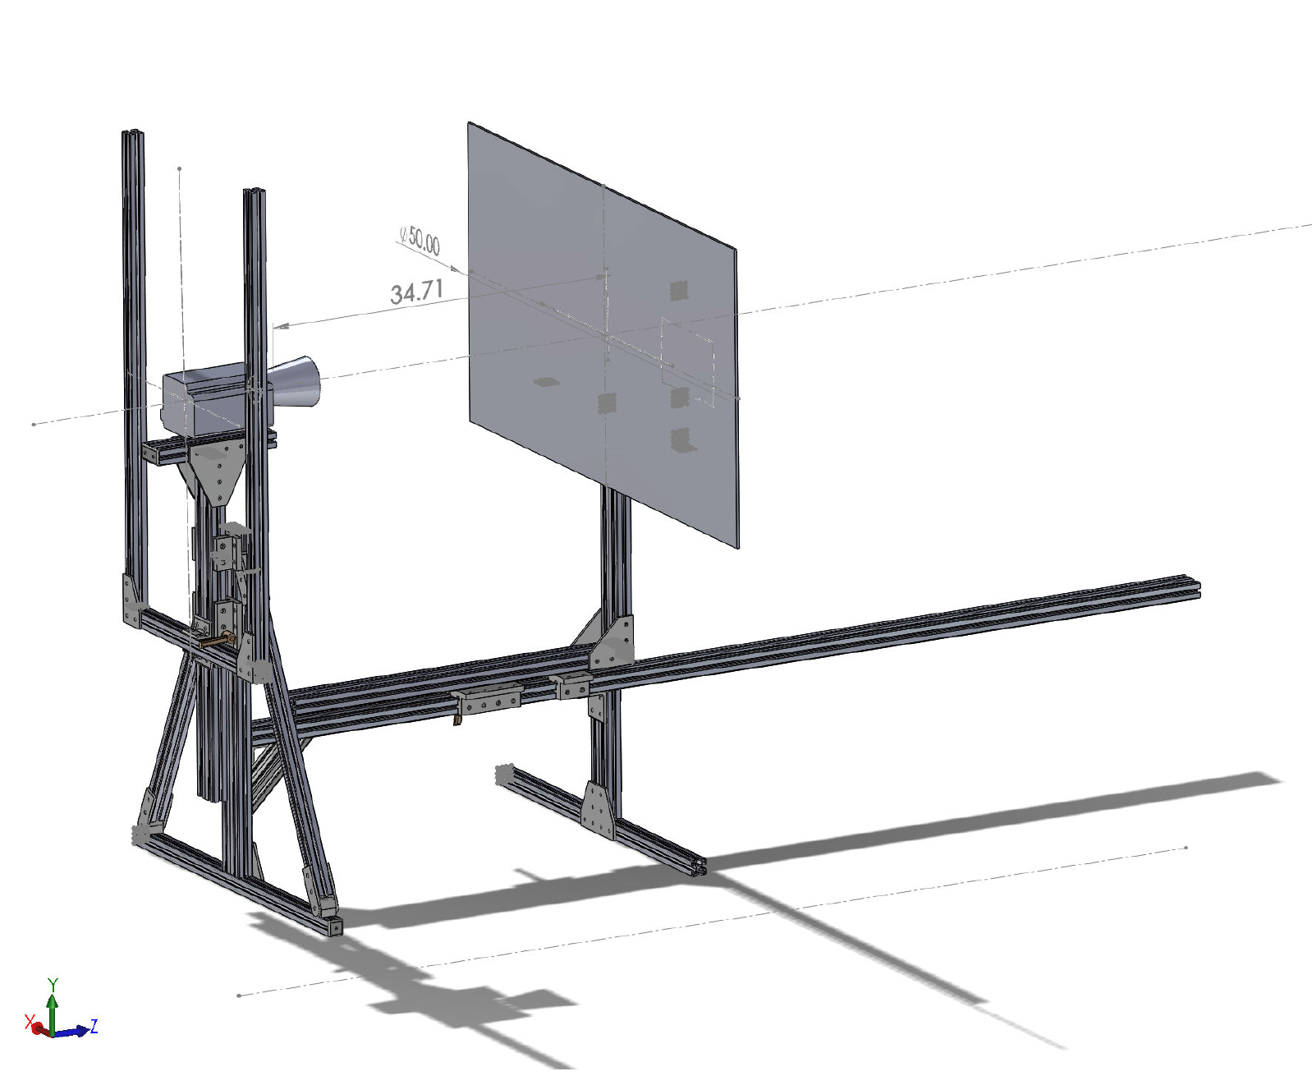
Resolution Testing (~ 0.5 m from dome)

Slide 35
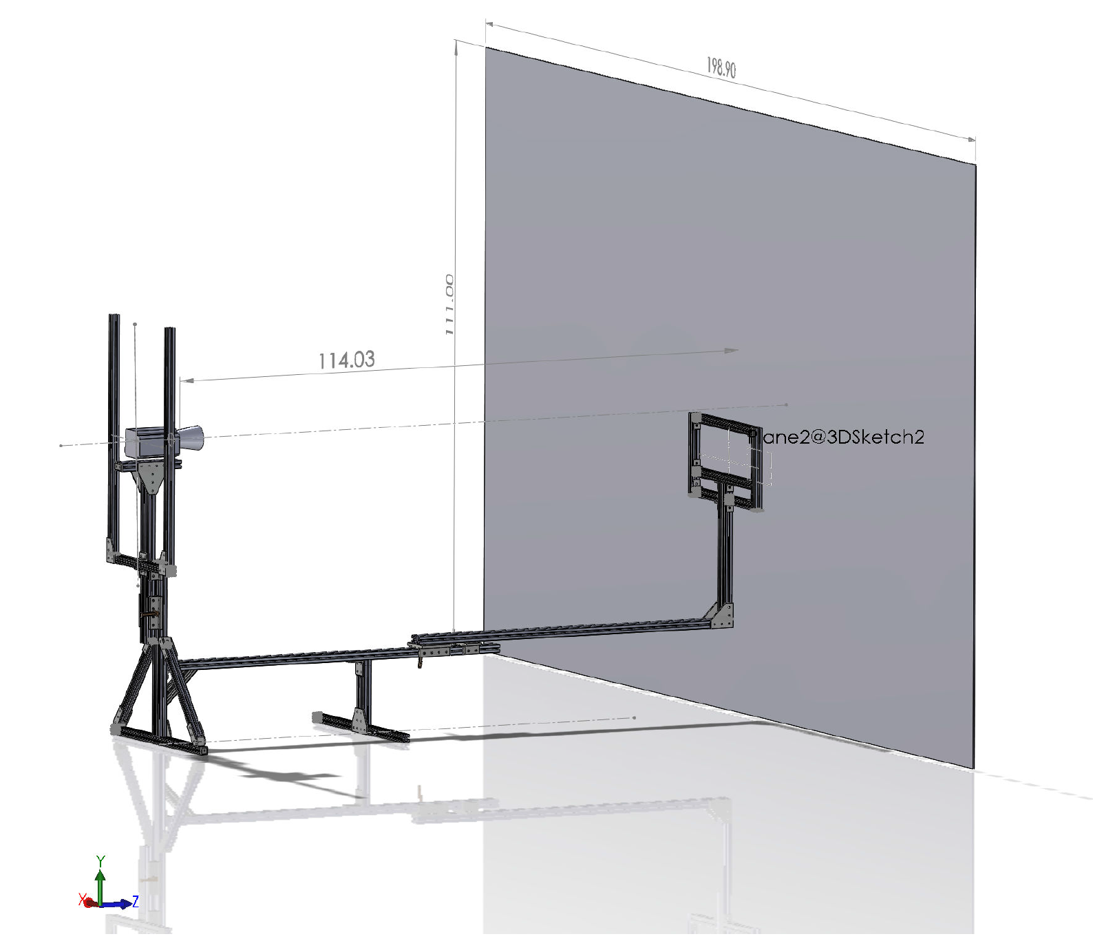
Far Focus (~2.5m from dome)

Slide 36
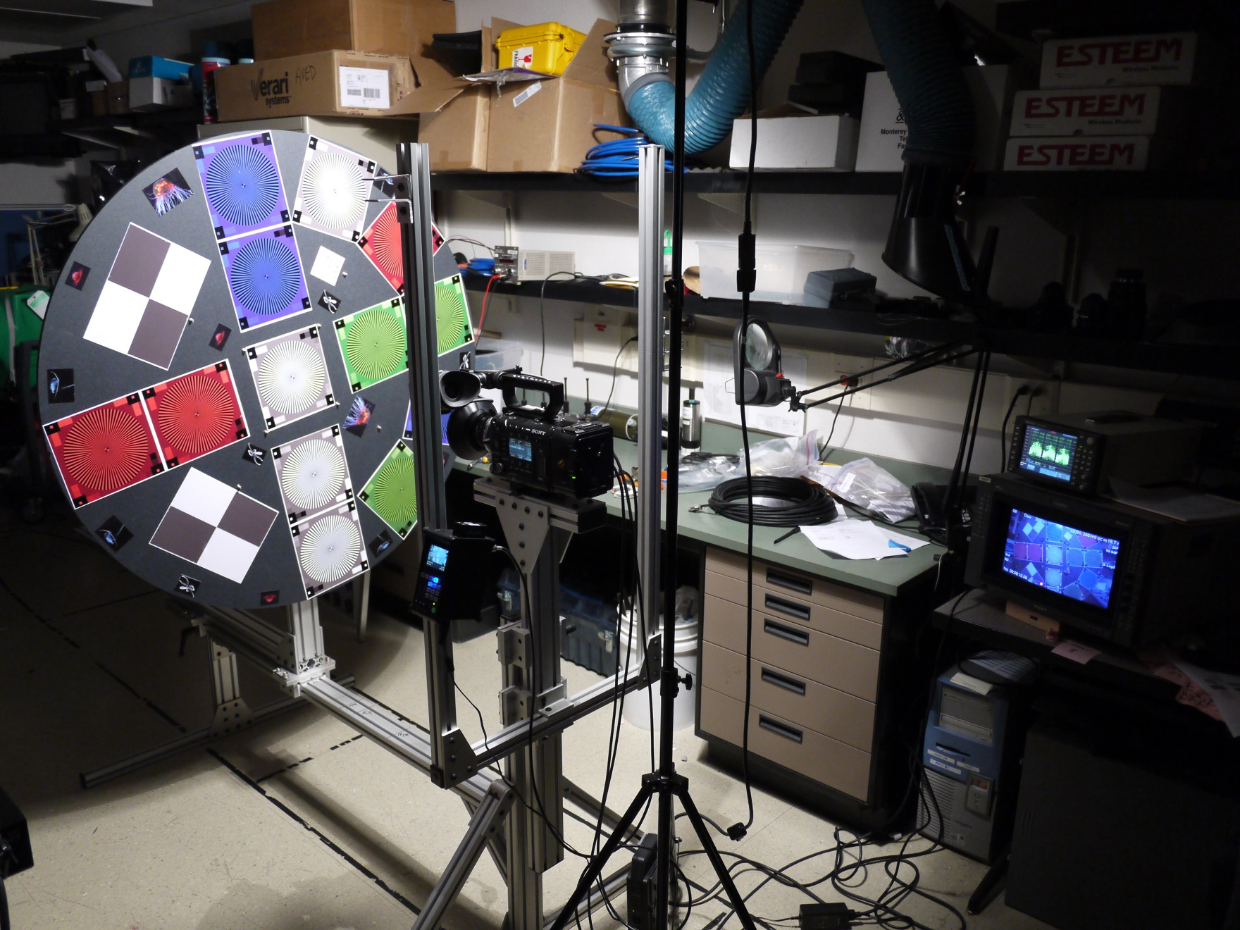
Camera Test Setup

Slide 37
Camera Test Work Flow
CAMERAS
Ikegami
HDL 50/HS
Sony
HDCP1,
NEX-FS700U
Pixel Resolutions
1.9k = 1920 x 1080
2k = 2048 x 1080
4k = 4096 x 2160
AJA Quad Pro ProRes 10 bit 422 (HQ) Recording
1.9k
Sony XAVC Recording (F-5 only)
1.9k
Capture Still Frame in .tiff Format
Export to ProRes 10 bit 422 HQ
2k
Export to ProRes 10 bit 4444
CAMERA
Sony F-5
Sony 16 bit Raw Recording (F-5 only)
4k
Export to DPX Frames
Open in PhotoShop
1.9k
CODEC Comparison Reference
Export to DPX Frames
Open in PhotoShop

Slide 38
Camera Detail Resolution Comparison Locations
Target Distance at “Sweet Spot” ~ 0.5 Meters From Dome
Detail Areas
Edge
Center
Sony F-5, SCL-P11X15 Lens, 400 lux, 70 IRE, Target 36 inches

Slide 39
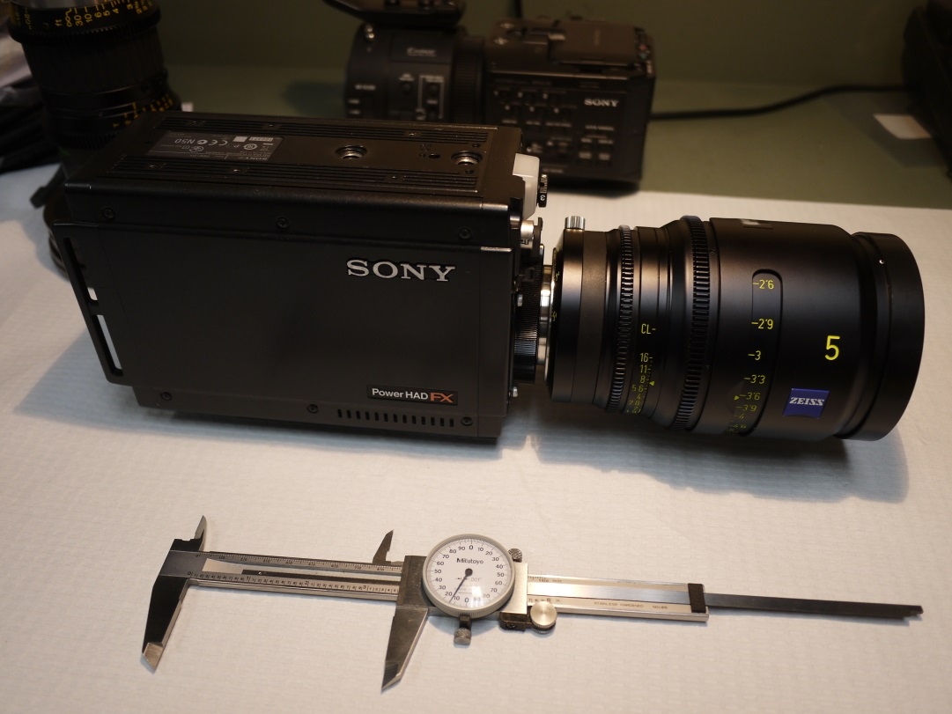
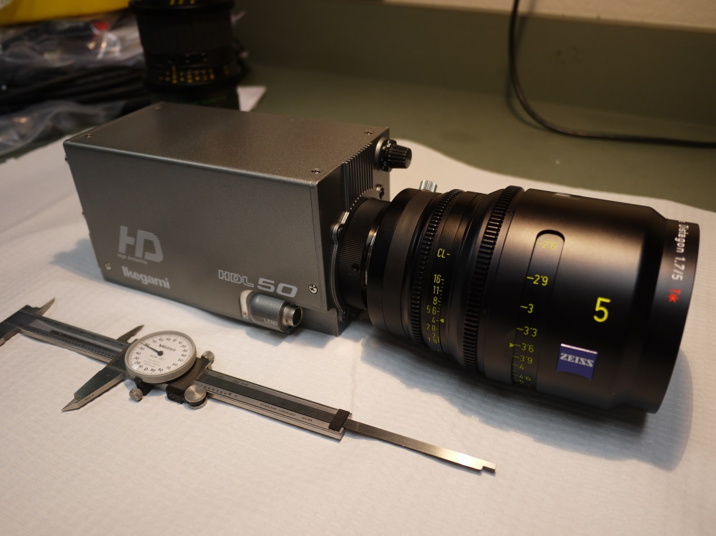
Camera Comparison
Sony HDCP1 vs. Ikegami HDL50/HS
The B4 Mount Lens Winner Was Used for The Camera Test
Zeiss Digi Prime T1,9/5mm

Slide 40
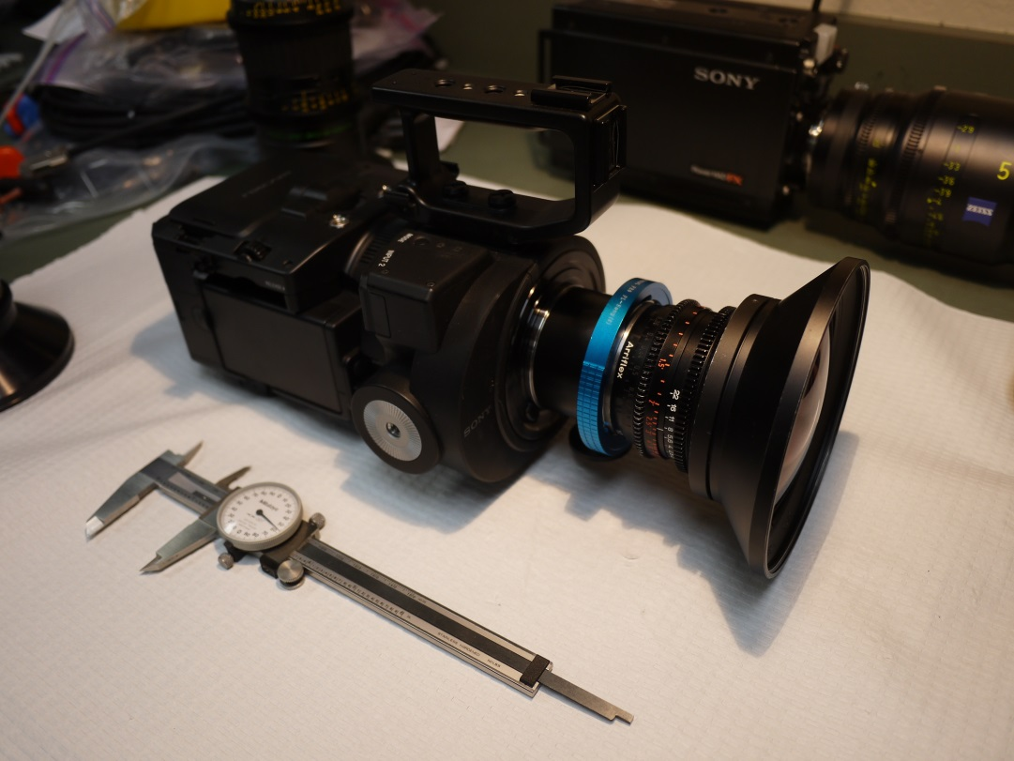
Camera Comparison
Sony NEX-FS700U vs. Ikegami HDL50/HS
The PL and B4 mount Lens Winners Were Used for The Camera Test
Sony SCL-P11X15 Lens and Zeiss Digi Prime T1,9/5mm

Slide 41
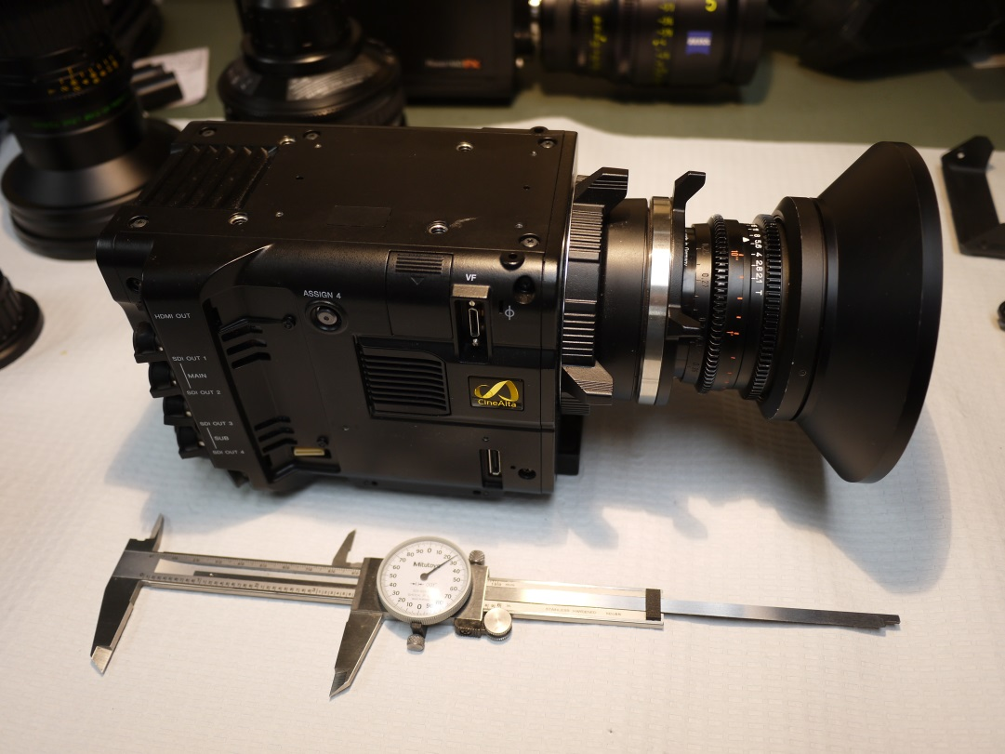
Camera Comparison
Sony F-5 vs. Ikegami HDL50/HS
The PL and B4 mount Lens Winners Were Used for The Camera Test
Sony SCL-P11X15 Lens and Zeiss Digi Prime T1,9/5mm

Slide 42
Finalist #1 Sony F-5 and Sony SCL-P11X15 Lens
Sony F-5, SCL-P11X15 Lens, 400 lux, 70 IRE, Target 36 inches File: Test_13X.tiff

Slide 43
Finalist #2, Ikegami HDL-50/H and Zeiss Digi Prime T1,9/5mm Lens
Ikegami HDL50/HS, 5mm Lens, 140 lux, 80 IRE, Target 39 inches File: Test_77.tiff

Slide 44
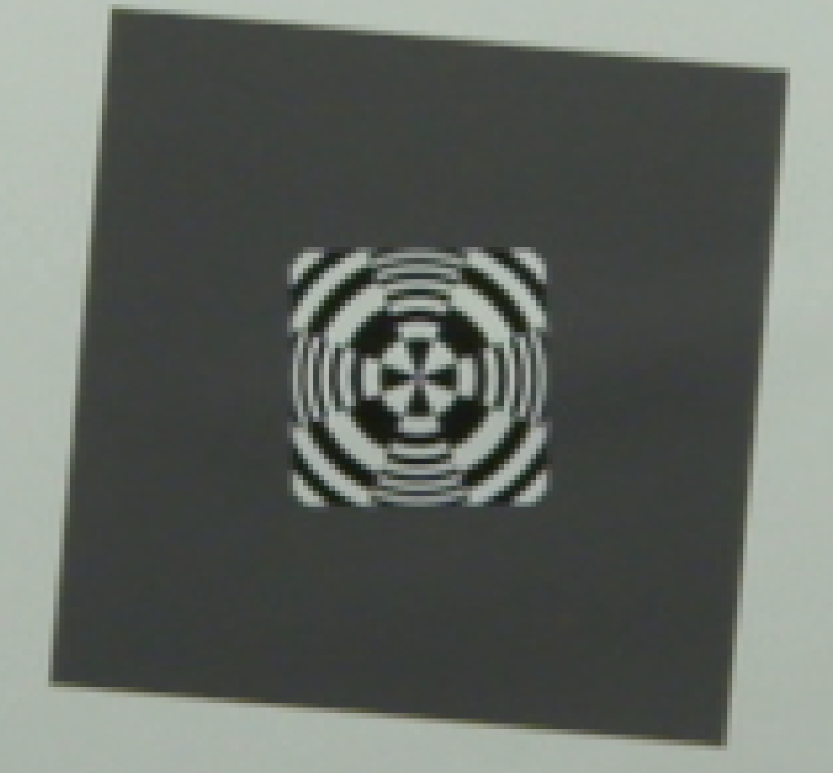
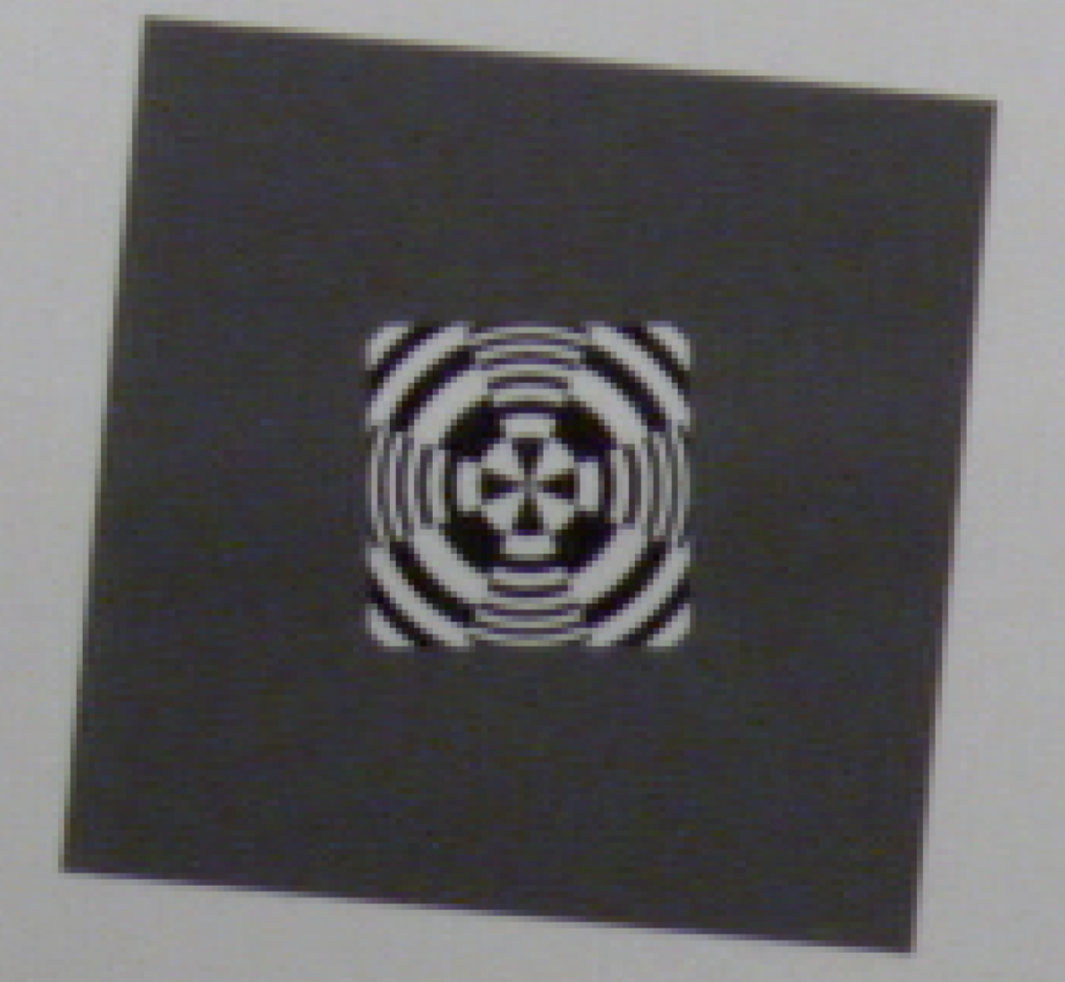
Sony F-5 vs. Ikegami HDL50/HS
Center Resolution
Sony F-5, Sony 11mm Lens, 400 lux,
ISO 800, Target 36 inches, 1920x 1080 P60
File: Test_13X.tiff
Ikegami HDL-50/HS, Zeiss 5mm Lens, 140 lux, 80 IRE, Target 38 inches
File: Test_77.tiff

Slide 45
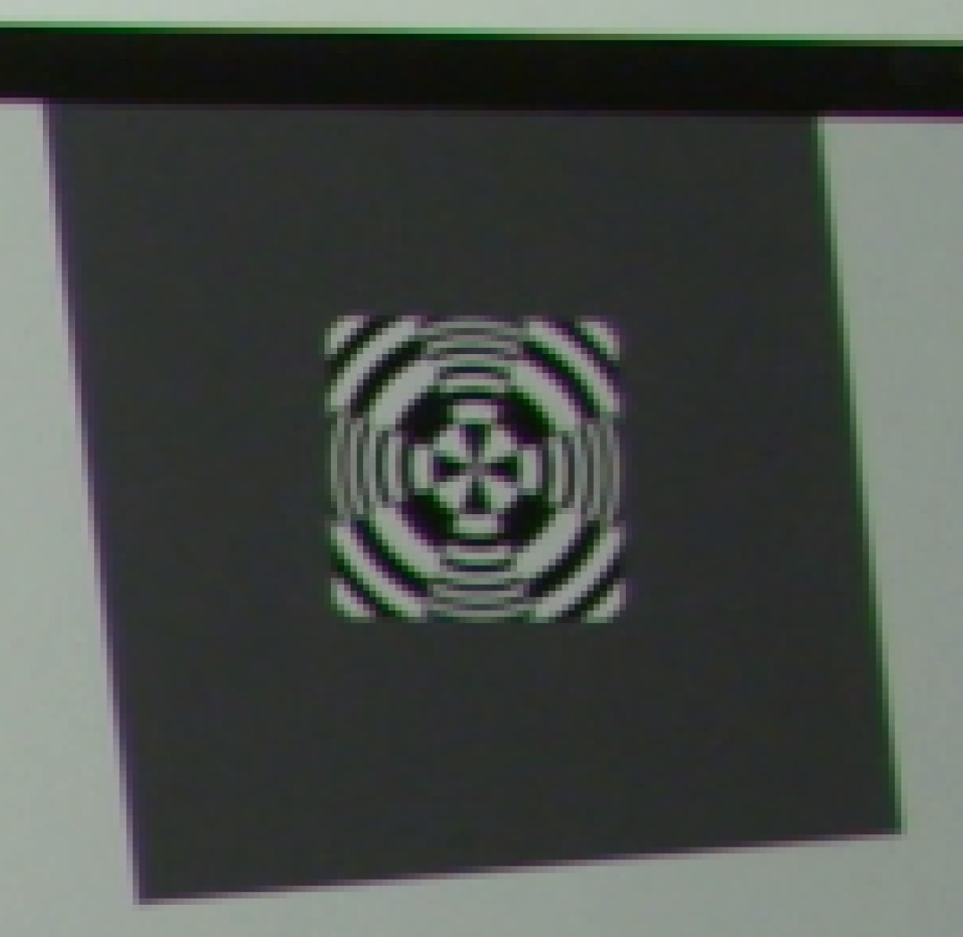
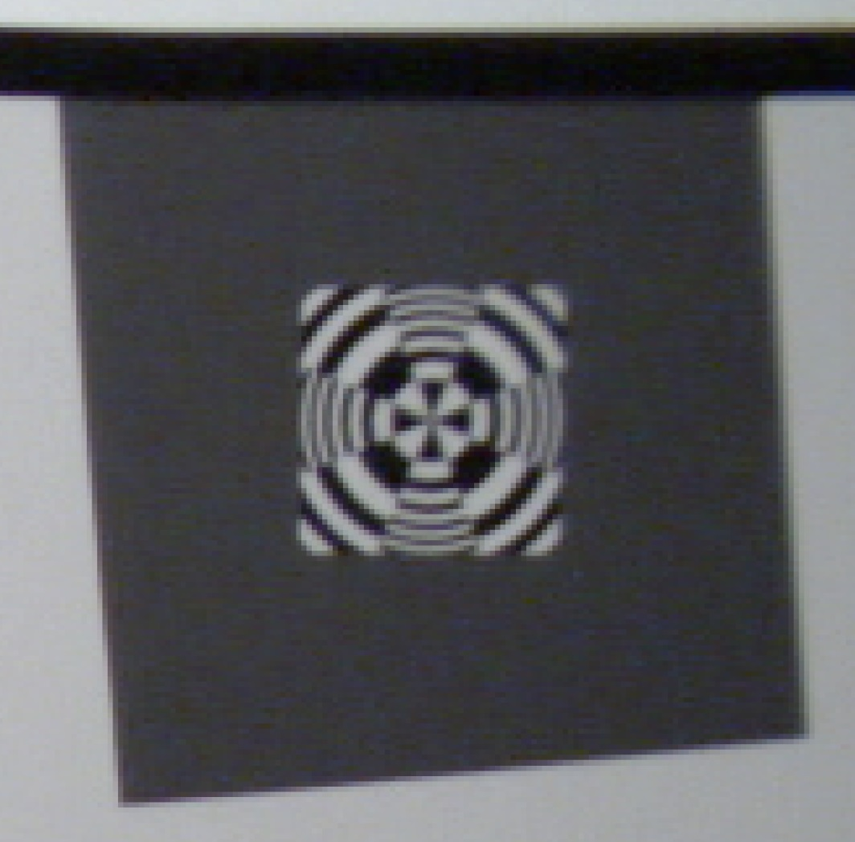
Sony F-5 vs. Ikegami HDL50/HS
Edge Resolution
Sony F-5, Sony 11mm Lens, 400 lux,
ISO 800, Target 36 inches, 1920x 1080 P60
File: Test_13X.tiff
Ikegami HDL-50/HS, Zeiss 5mm Lens, 140 lux, 80 IRE, Target 38 inches
File: Test_77.tiff

Slide 46
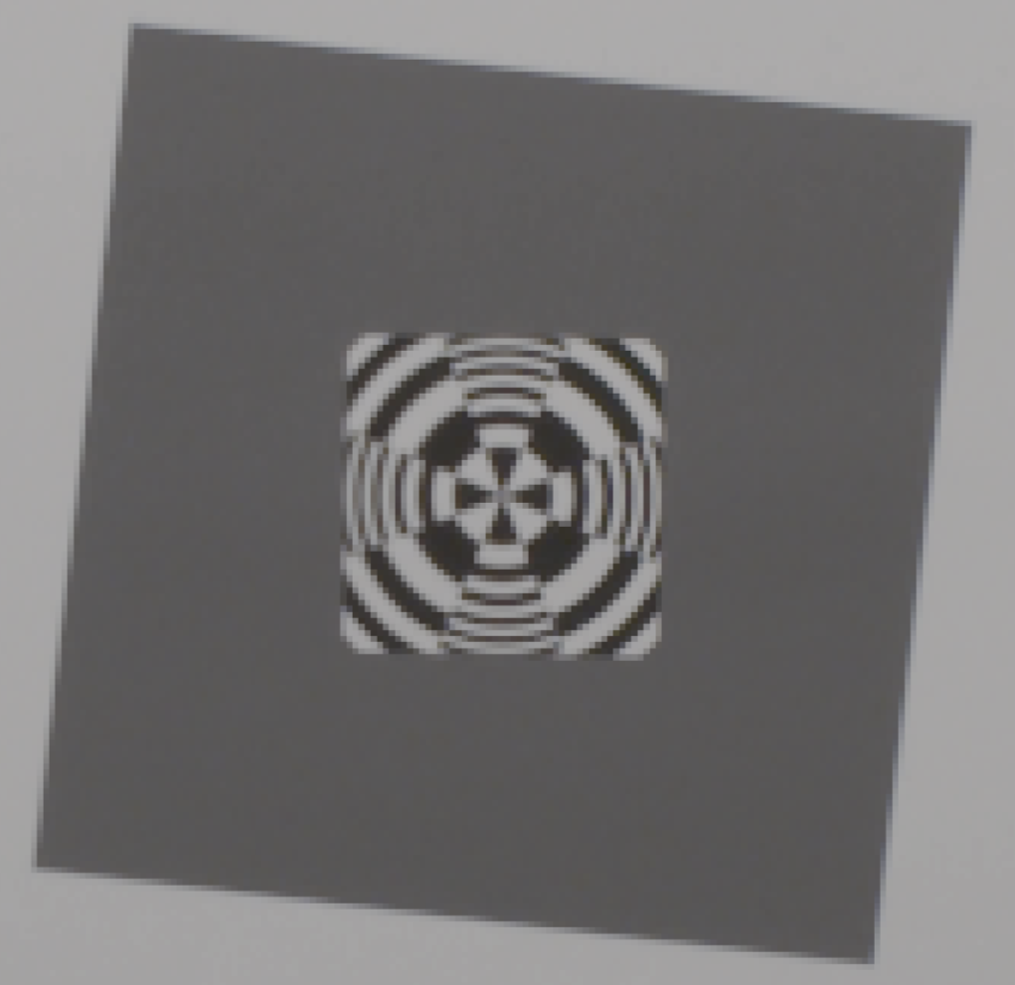
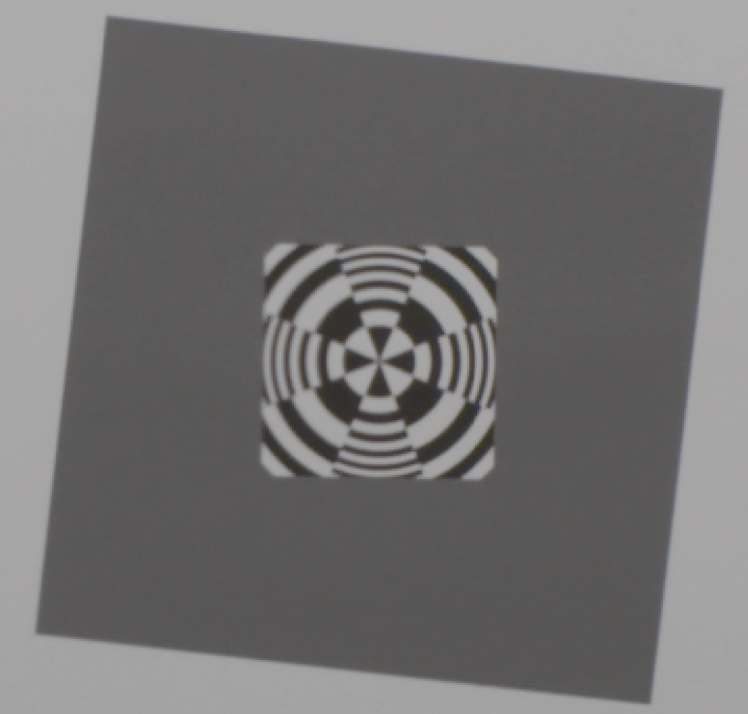
Sony F-5 1920 X 1080 vs. Sony F-5 4096 X 2160 (4K)
Center Resolution
Sony F-5, Zeiss 12mm Lens, 400 lux,
IE 800, Target 36 inches, 1920x 1080 P60
(no color correction)
File: Test_54_1920_4444.tiff
Sony F-5, Zeiss 12mm Lens, 800 lux,
IE 2000, Target 34 inches, 4K P60
(no color correction)
File: Test_54_4K4444.tiff

Slide 47

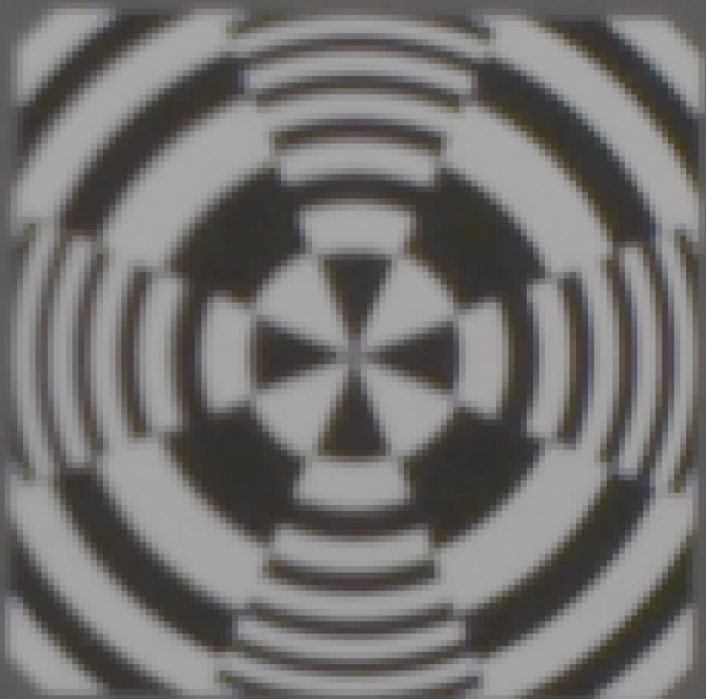
Sony F-5 1920 X 1080 vs. Sony F-5 4096 X 2160 (4K)
Center Resolution - Detail
Sony F-5, Zeiss 12mm Lens, 400 lux, ISO 800, Target 34 inches, 1920x 1080 P60
(no color correction)
File: Test_54_1920_4444.tiff
Sony F-5, Zeiss 12mm Lens, 800 lux, IE 2000, Target 34 inches, 4K P60
(no color correction)
File: Test_54_4K4444.tiff

Slide 48
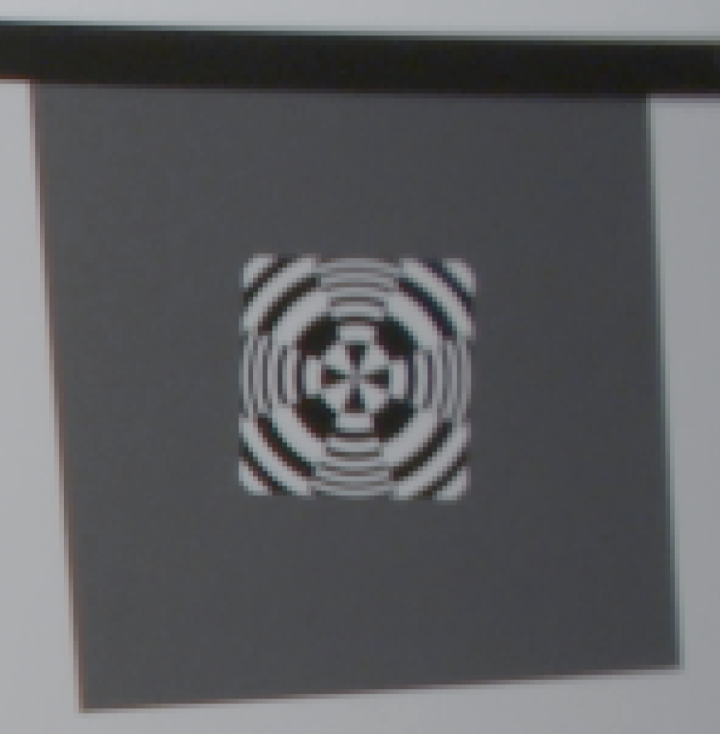
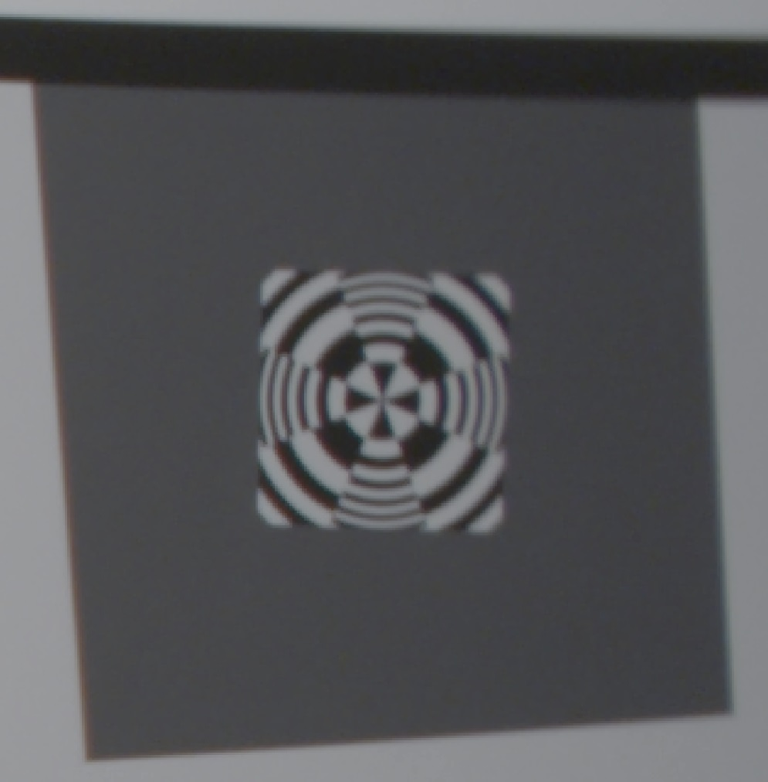
Sony F-5 1920 X 1080 vs. Sony F-5 4096 X 2160 (4K)
Edge Resolution
Sony F-5, Zeiss 12mm Lens, 400 lux, ISO 800, Target 34 inches, 1920x 1080 P60
(no color correction)
File: Test_54_1920_4444.tiff
Sony F-5, Zeiss 12mm Lens, 800 lux, IE 2000, Target 34 inches, 4K P60
(no color correction)
File: Test_54_4K4444.tiff

Slide 49
Sony F-5 vs. Ikegami HDL50/HS
Color Reproduction (4:2:2 Format)
Sony F-5, Sony 11mm Lens, 400 lux, ISO 800, Target 36 inches, 1920x 1080 P60 (no color correction)
Ikegami HDL-50/HS, Zeiss 5mm Lens, 140 lux, 80 IRE, Target 38 inches
(no color correction)

Slide 50
Test Showing the Sony F-5 and the Sony SCL-P11X15 Lens Meets the i2MAP Depth of Field Requirements (at F 5.6)
Sony F-5, Sony SCL-P11X15 lens set to 11mm, 560 lux, 75 IRE, Target 18 inches (10cm from dome equiv.), F 5.6, focus distance 31.5 inches
File: Test_14.tiff
Sony F-5, Sony SCL-P11X15 lens set to 11mm, 560 lux, 75 IRE, Target 113 inches (2.5m from dome equiv.), F 5.6, focus distance 31.5 inches
File: Test_45.tiff

Slide 51
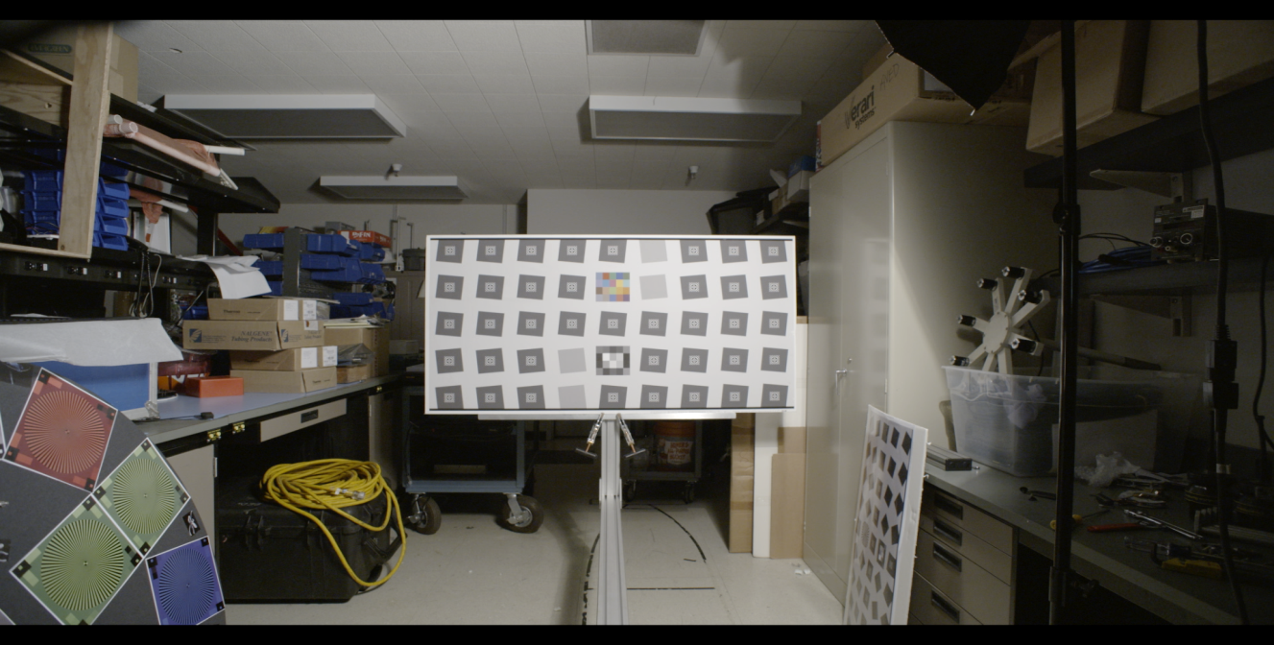
Sony F-5 1920 X 1080 vs. Sony F-5 4096 X 2160 (4K)
Resolution Example
Detail Area
Sony F-5, Zeiss 12mm Lens, 500 lux, IE 2000, Target 113 inches, 2K P60
(no color correction)
File: Test_53_2K.tiff

Slide 52
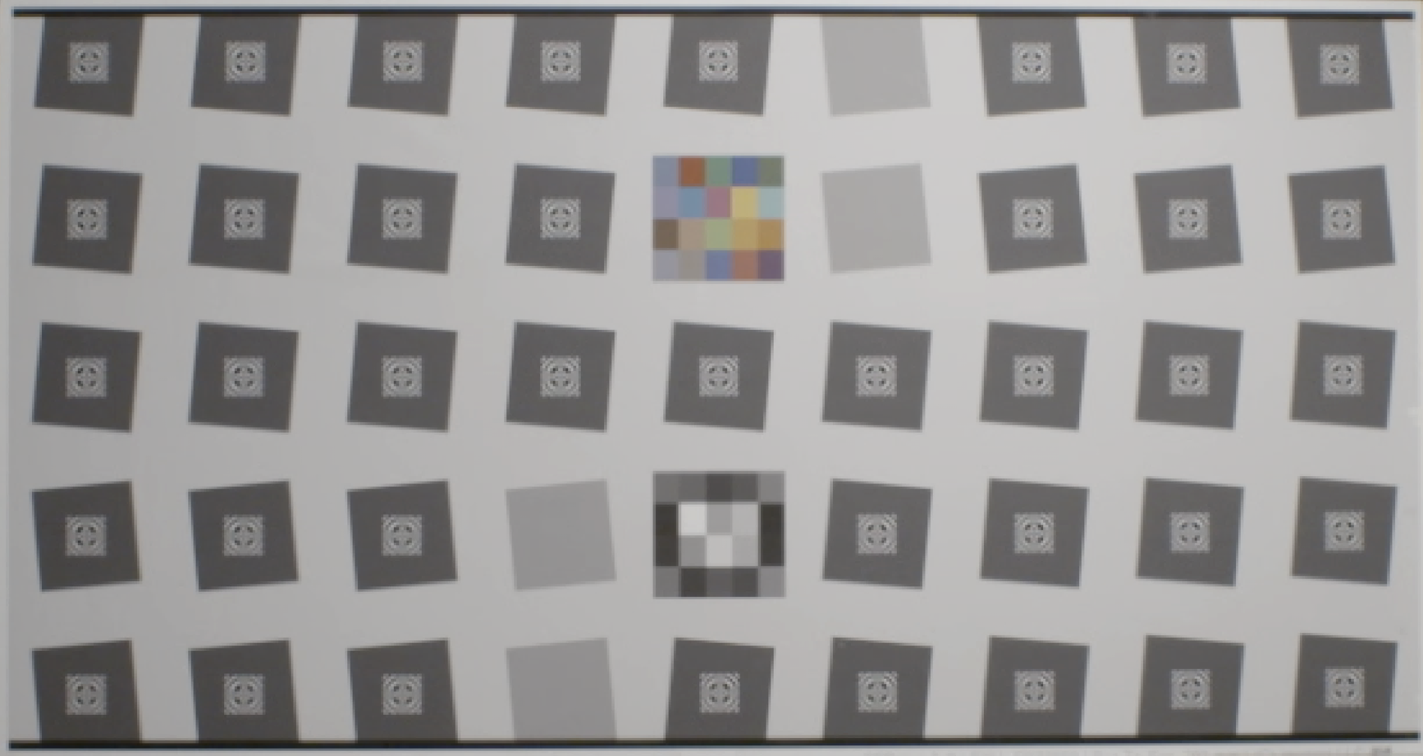
Sony F-5 1920 X 1080 vs. Sony F-5 4096 X 2160 (4K)
Resolution Example 2A
Sony F-5, Zeiss 12mm Lens, 500 lux, IE 2000, Target 113 inches, 2K P60 (Lightened 10%) File: Test_53_2K.tiff

Slide 53
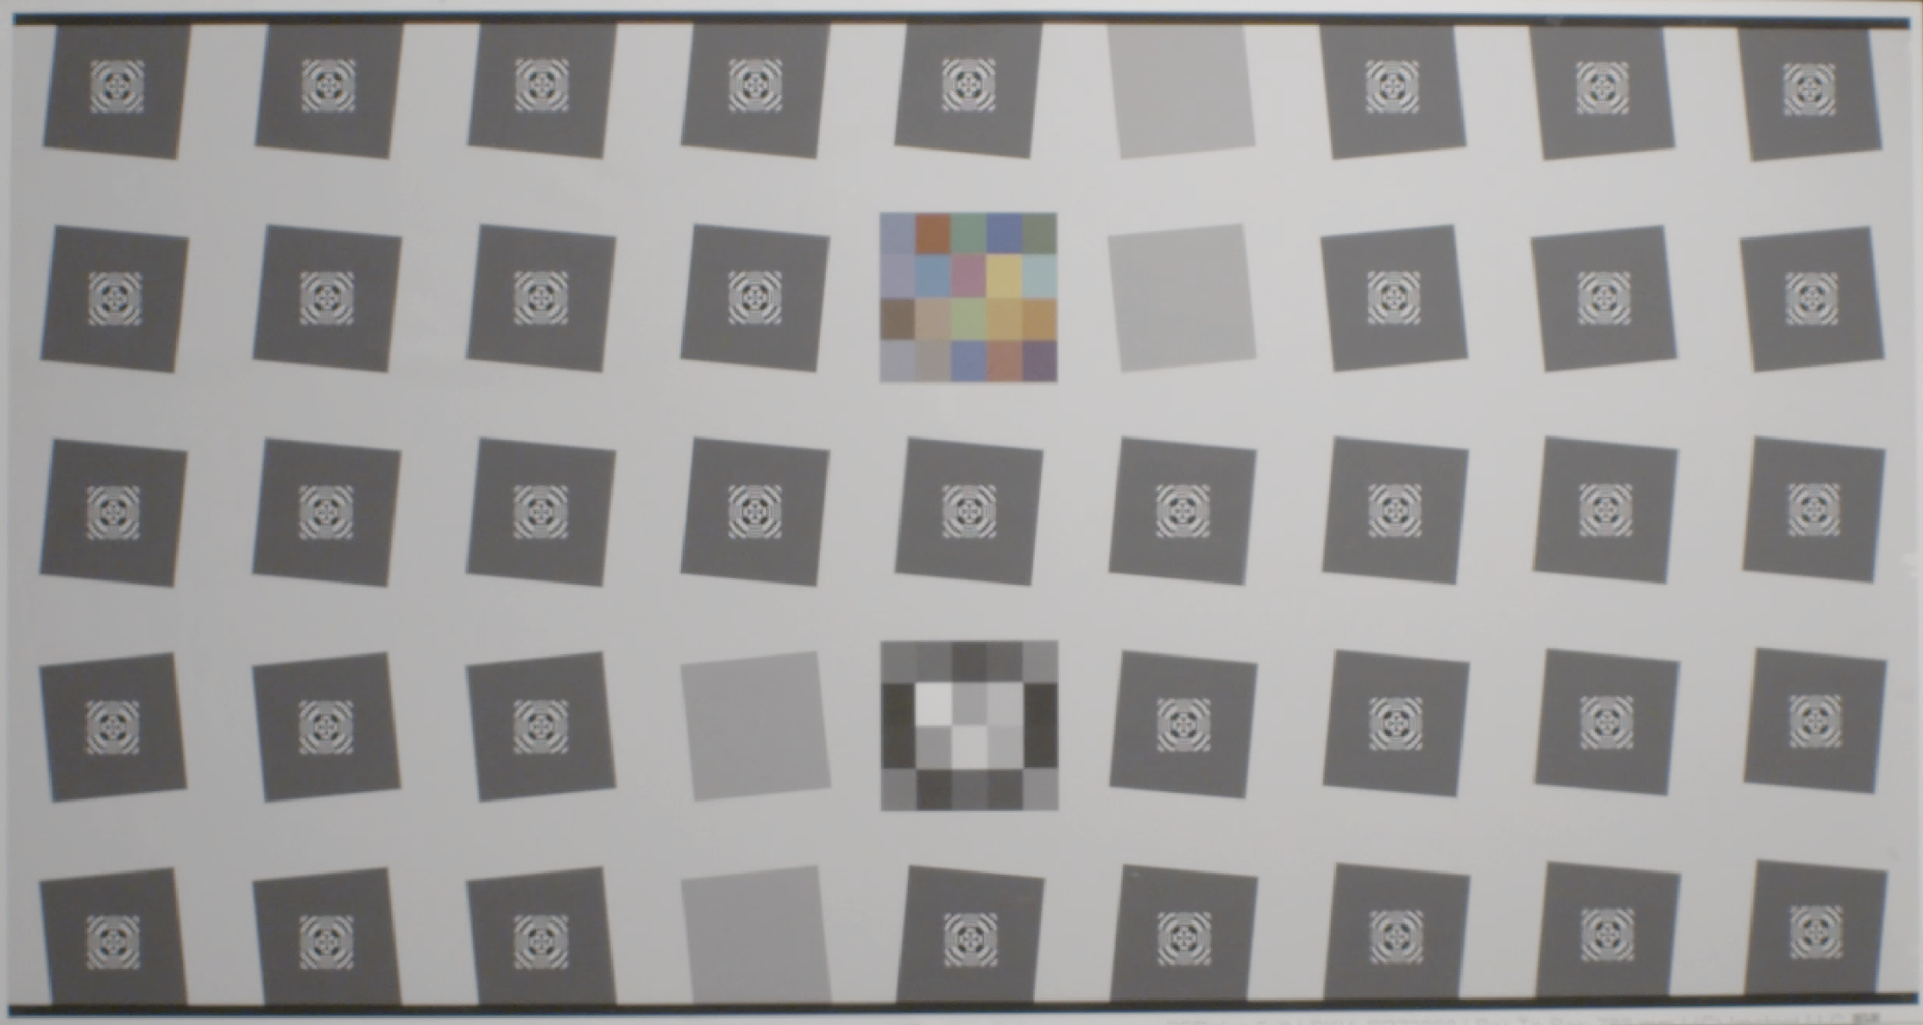
Sony F-5 1920 X 1080 vs. Sony F-5 4096 X 2160 (4K)
Resolution Example 2B
Sony F-5, Zeiss 12mm Lens, 500 lux, IE 2000, Target 113 inches,
4K P60 (Lightened 20%) File: Test_53_4K444.tiff

Slide 54

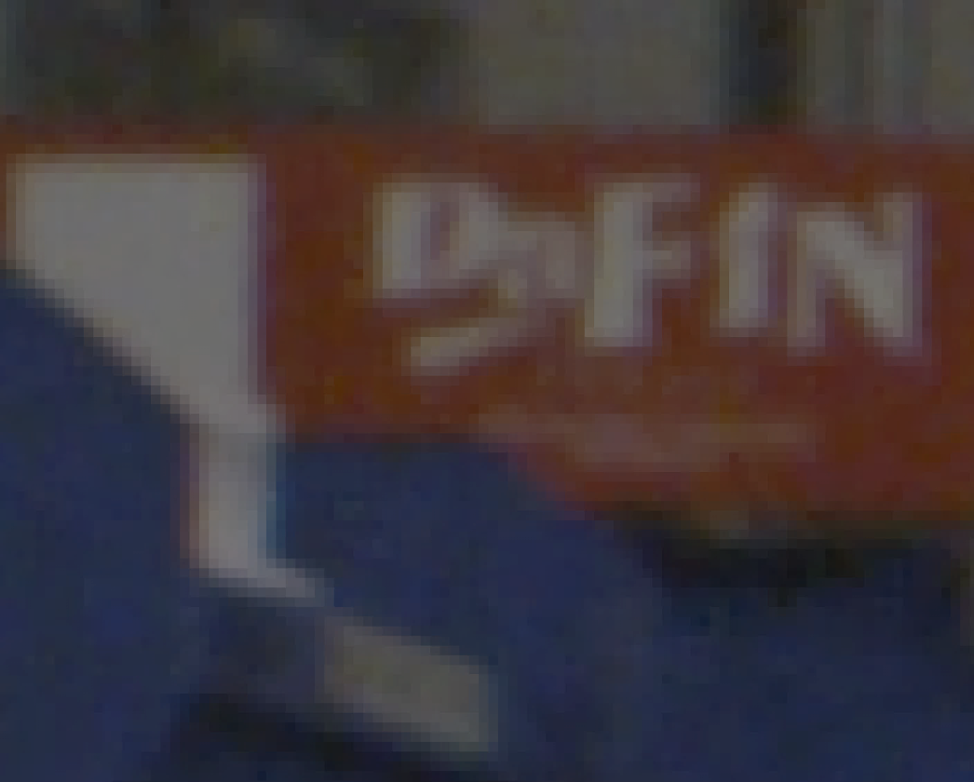
Sony F-5 1920 X 1080 vs. Sony F-5 4096 X 2160 (4K)
Resolution Example 1
Sony F-5, Zeiss 12mm Lens, 400 lux,
IE 800, 1920x 1080 P60
(+20% brightness correction)
File: Test_53_2K4444.tiff
Sony F-5, Zeiss 12mm Lens, 800 lux,
IE 2000, 4K P60
(+20% brightness correction)
File: Test_53_4K4444.tiff

Slide 55
Optical Dome Design
In the final process of selecting the optical design consultant.
Aspherical front dome design is recommended to support 4k resolution (minimize field curvature).
Mechanical design would be done in house.

Slide 56
Temporal Resolution Testing
Rotating Test Target Reproduced Object Angular Velocities Simulating AUV Speeds of 0.55 and 1.0 meters per second

Slide 57
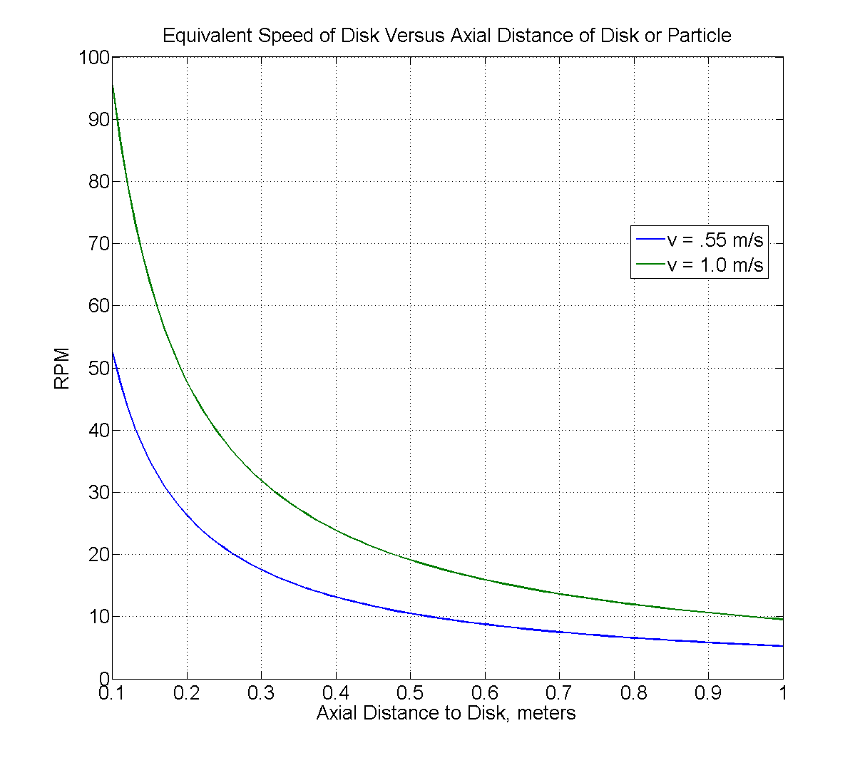
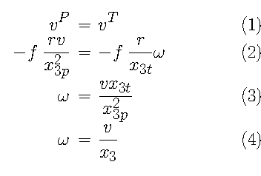
Translation of Vehicle Motion to Focal-Plane
x_3p – focal plane to particle
x_3t – focal plane to disk
Eqn. 3 => 4 if they’re equal.
Super-35 Camera Distance
(adjusted for 0.5 meters from dome front)
2/3” Camera Distance
1.0 m/sec. = 11 RPM
0.55 m/sec. = 6 RPM

Slide 58
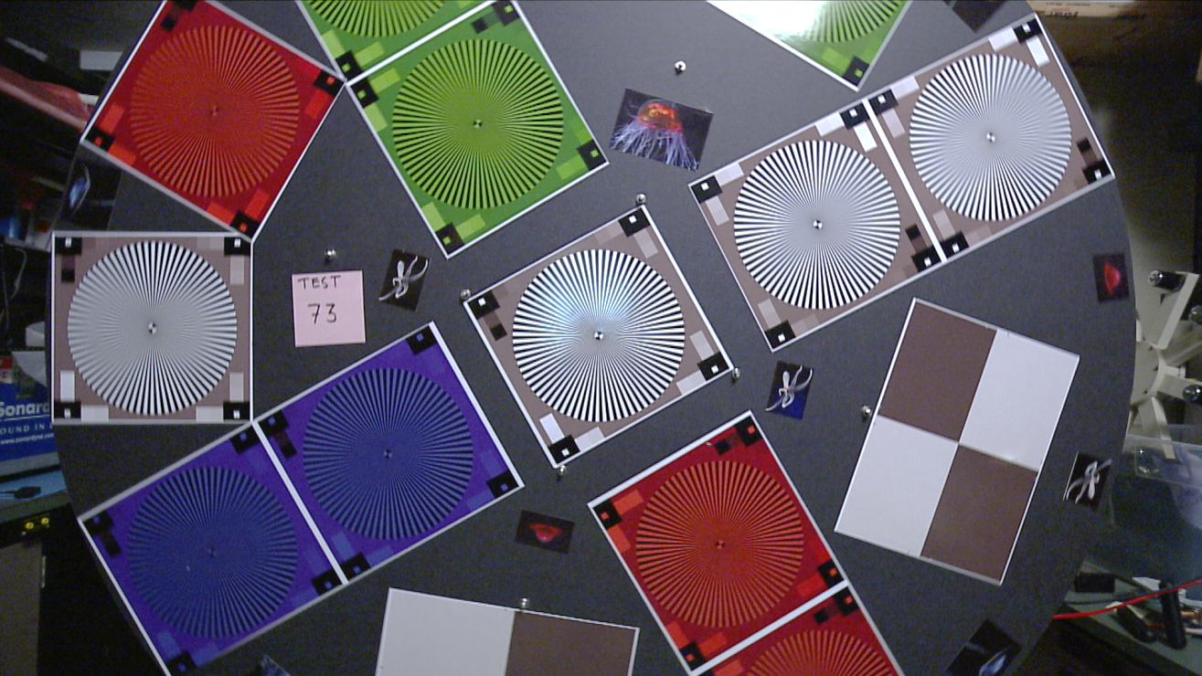
Temporal Resolution, Can We Get Good Image Quality at 1 Meter Per Second? Enter The Wheel of Death
Detail Test Area
Ikegami HDL50/HS, Zeiss 5mm Lens, 100 lux, 1920x 1080i 30
Disk 6 RPM (~0.5 m/sec), File: Test_73_White.tiff (DeInterlaced)

Slide 59
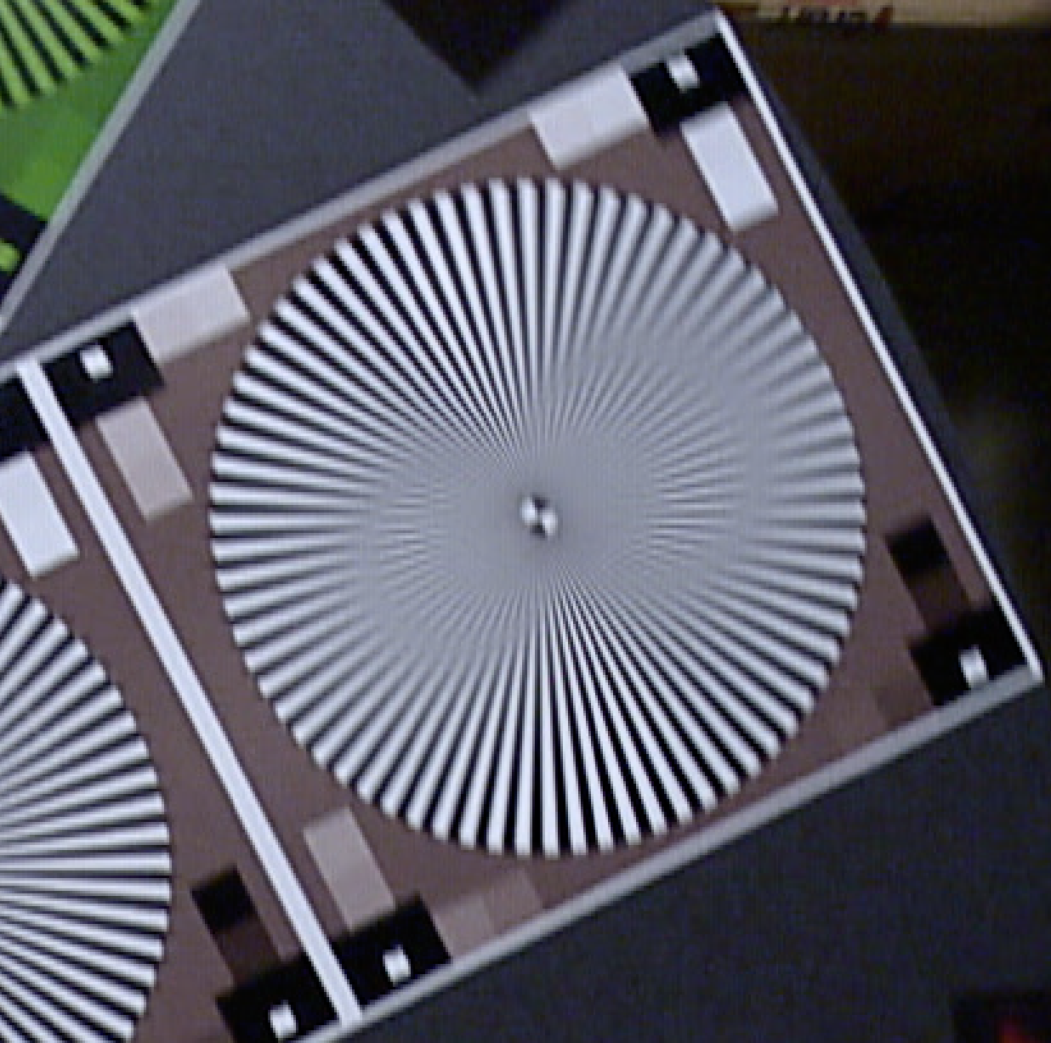
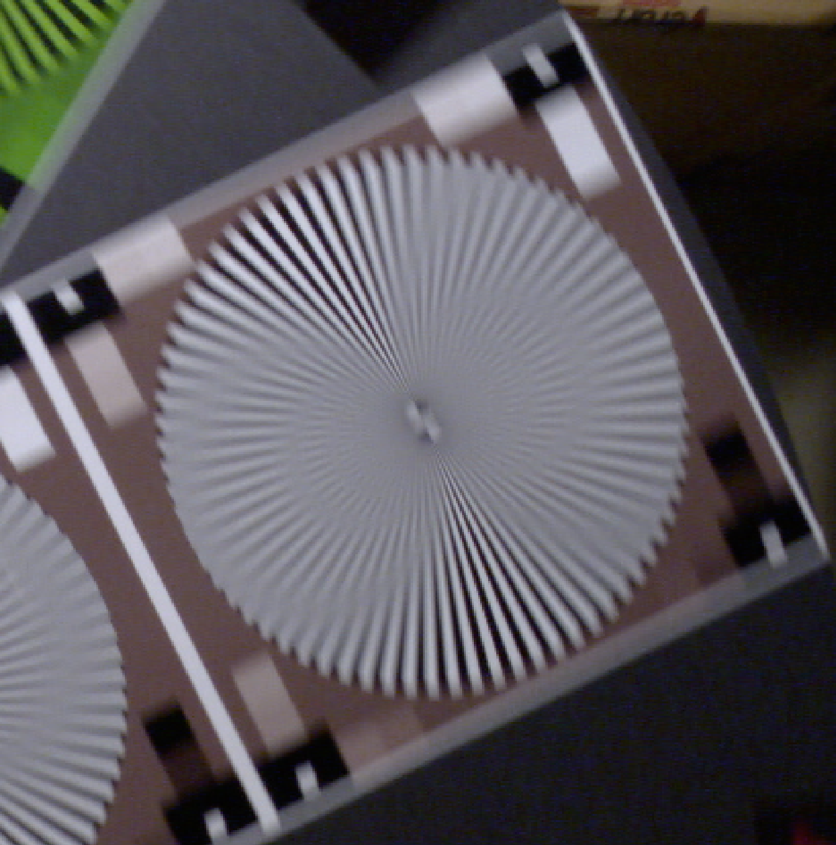
Comparison of Current (0.5 m/sec.) and Planned (1.0 m/sec.) Temporal Resolution at the 0.5 Meter from Dome “Sweet Spot”.
Ikegami HDL50/HS, Zeiss 5mm Lens,
110 lux, 1920x 1080i 30
Disk 6 RPM (~0.5 m/sec)
File: Test_73_White.tiff (DeInterlaced)
Ikegami HDL50/HS, Zeiss 5mm Lens,
170 lux, 1920x 1080 P60
Disk 11 RPM (~1 m/sec)
File: : Test_76_White.tiff

Slide 60
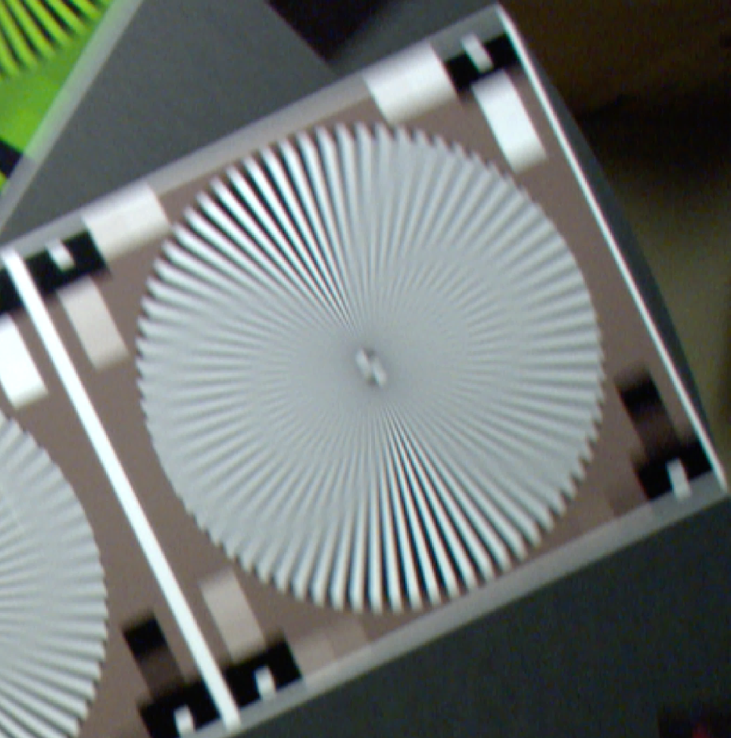
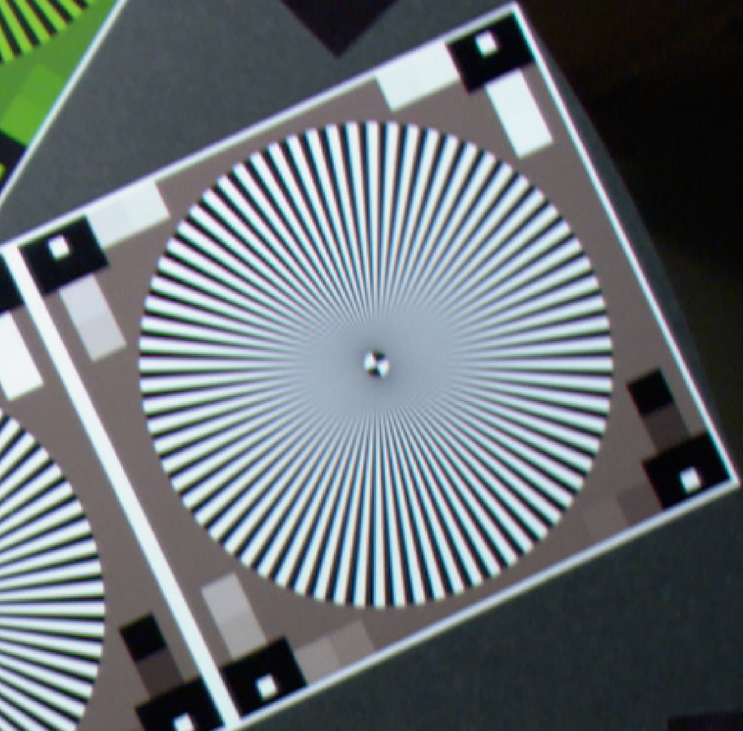
The Effect of Camera Shutter at The Planned (1.0 m/sec.) AUV Velocity tested at the 0.5 Meter from Dome “Sweet Spot”.
Sony HDCP1, Zeiss 5mm Lens,
120 lux, 1920x 1080 P60
Disk 11 RPM (~1 m/sec), No Shutter
File: Test_66_White.tiff
Sony HDCP1, Zeiss 5mm Lens,
800 lux, 1920x 1080 P60
Disk 11 RPM (~1 m/sec), Shutter 1/250
File: Test_68_White.tiff

Slide 62
Post-Mission Work Flow
2014-2015
Annotate in VARS using current H.264 file based version
Export to H.264
Archive .mov files in Atlas Server
6 TeraBytes Maximum thru 2015
AJA Quad Pro ProRes 10 bit 422 (HQ) Recording (.mov)
Timecode lost
Timecode must be reconstructed
CAMERA
Sony F-5 or F-55
Annotate in VARS using updated QuickTime file based version
Timecode preserved
Beyond 2015

Slide 63
Estimated System Cost Comparison
Budget was ~ $57,592

Slide 64
Camera and Recorder Testing Conclusions
Camera
  The F-5 camera is about 2 stops slower when depth of field control is taken into account.
  Shutter speed of 1/250 is needed to completely freeze the motion of 1 meter per second transect.
  Ikegami has black adjustment issues on power-up boot. Suggest putting 100% filter in one position in filter wheel – would require camera control.
Video Recorder
  The Apple ProRes 422(HQ) CODEC is visually lossless.
We should have adequate illumination.
  Need ~ 3200 lux maximum with F-5 at 0dB gain and 1/250th shutter.
  4 lights measure at ~ 3500 – 5000 lux at 0.5 meters from dome.

Slide 65
Which is the best camera for us?
Ikegami HDL-50/HS 2/3” box camera
  Box camera has a great picture but is limited to 1920 X 1080 60 frames per second.
  Box camera is the smallest and would be slightly easier to integrate – except for auto black balance on boot-up.
Sony F-5 super 35 format camera.
  F-5 Cine camera has 4K sensor and offers a migration path to higher resolution formats, 2K and 4K.
    Current recording limitation is 2048 X 1080 60 frames per second.
    AJA has recording hardware in development that supports 4K at 60 frames per second that may be available in the future.
    Sony F-5 can be upgraded to 4K output for $12,000.
Cost is very similar – Go with the F-5

Slide 66
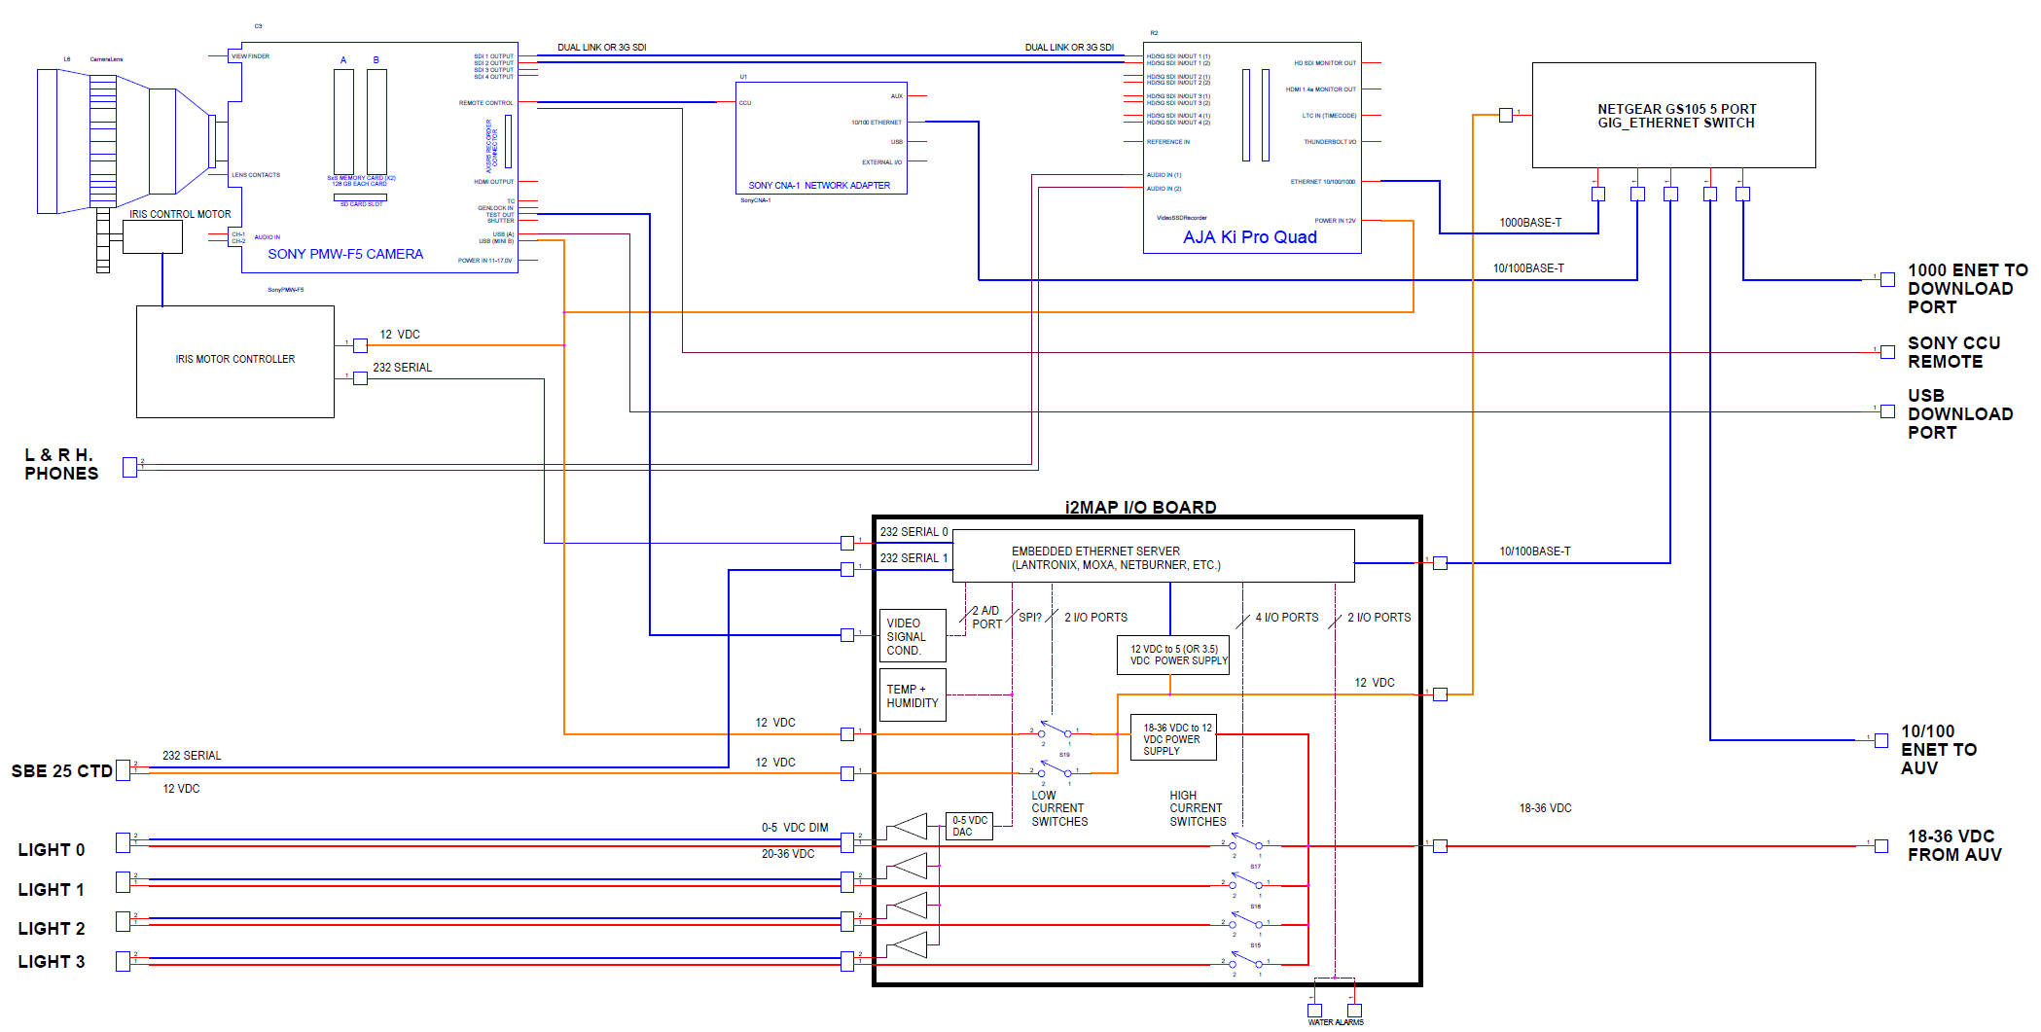
CAMERA HOUSING BLOCK DIAGRAM

Slide 67
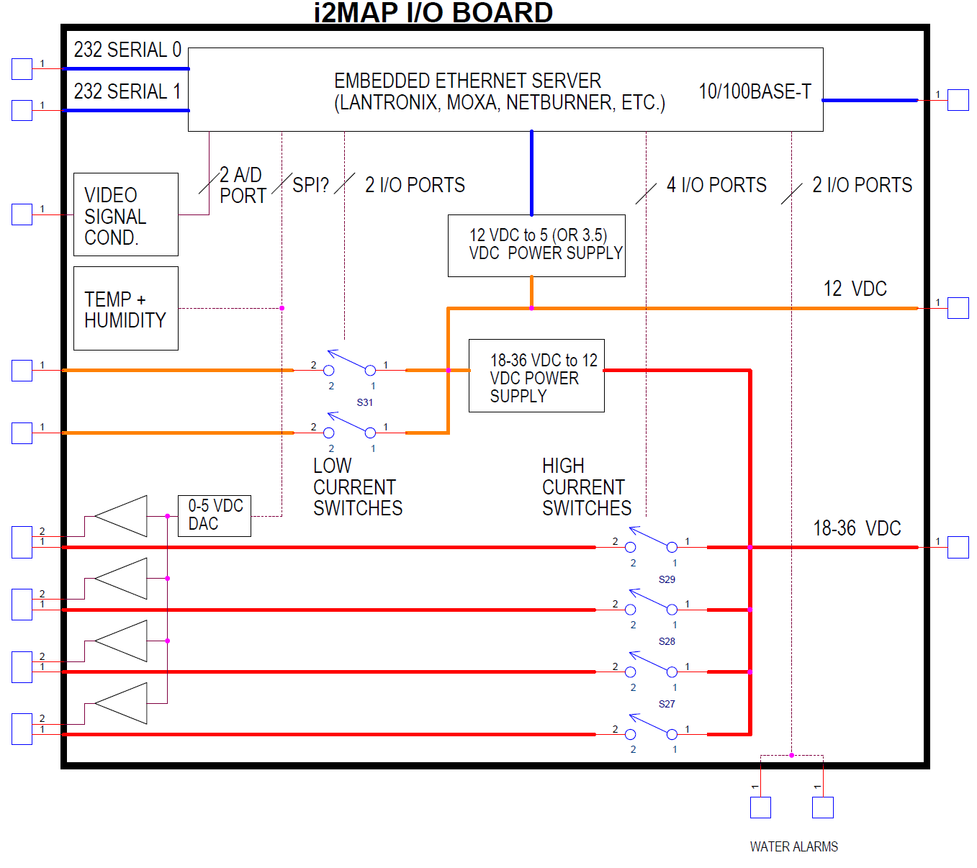

Slide 68
Supervisory Control Software
Component Power Switching
Digital Recorder Control
Camera Control
Data logging
Recorder/AUV Time Synchronization

Slide 69

Power Switching
Cycle power to:
  Lights
  Camera
  Recorder
Approach: COTS Device Server
  Digital I/O switches (lights)
  Ethernet/HTTP interfaces
  Serial to Ethernet (CTD, temp & humid, servo)
Example: Moxa NPORT SDS

Slide 70
Digital Recorder Control
Testing the Ki Pro Quad unit from AJA
Ethernet communication
HTTP command interface
  Change settings (file names, format, etc.)
  Start/Stop recording
Easily test command functionality using browser

Slide 71
Camera Control
To be implemented in 2015
Ethernet Communication
Command interface TBD
Configuration Settings TBD
  White balance
  Load predetermined configurations

Slide 72
Data Logging
CTD Data
Environmental
  Temperature, humidity
Peak and average light intensity
  From video signal
  May use to adjust aperture (2015)

Slide 73
Time Synchronization
Adjusting the recorder time to match Main Vehicle Computer (MVC)
Physically set the AJA date and time using buttons on the device
Programmatically change the output file name to include the MVC time
  19-37-54_200m.mov (12:37:54 PDT)
Adjust video timecodes in postprocessing

Slide 74
Design Approach
All functionality will reside in MVC software modules
Use familiar Server Interface to expose settings, switches, and data to other MVC modules (standard practice)
Functional interfaces to devices implemented in one or more MVC driver modules
Needed control parameters will be available in a mission script behavior

Slide 75
Mission Script
behavior waypoint
{
depth = 200;
}
:
behavior videocam
{
videoname = “200m”;
record = start;
}
:
behavior videocam
{
record = stop;
}

Slide 76
Pros and Cons vs. Microcontroller
Pros
  No middleware development
  Functionality implemented in one place
  Reduced testing time
  Maintenance is simplified
  Familiarity to Engineering and AUV ops
Cons
  Interface to the AUV section is more complicated
  Porting to another system requires re-implementation

Slide 77
Post-Mission Work Flow
2014-2015
Annotate in VARS using current H.264 file based version
Export to H.264
Archive .mov files in Atlas Server
6 TeraBytes Maximum thru 2015
AJA Quad Pro ProRes 10 bit 422 (HQ) Recording (.mov)
Timecode lost
Timecode must be reconstructed
CAMERA
Sony F-5 or F-55
Annotate in VARS using updated QuickTime file based version
Timecode preserved
Beyond 2015

Slide 78
Budget
Descriptions in black were budgeted for 2014
Descriptions in green and red were budgeted in 2013 but not used due to schedule delays and were not granted roll over into the 2014 budget.
Roll over request for items described in red were not funded.
Roll over request for items described in green were given a “Will consider” later, as needed.

Slide 79

Schedule Update

Slide 80
END

Slide 81
Extra Slides

Slide 82


Comparison of the current ROV standard of 1920x 1080i 29.97 at simulated AUV Speed of 0.5 m/sec. and 1920x 1080 P59.4 (Progressively Scanned)
Ikegami HDL45, Fujinon 5.5x10 Lens,
110 lux, 1920x 1080i 29.97
Disk 6 RPM (~0.5 m/sec)
File: Test_103_White.tiff (not DeInterlaced)
Ikegami HDL50/HS, Zeiss 5mm Lens,
170 lux, 1920x 1080 P60
Disk 6 RPM (~0.5 m/sec)
File: : Test_74_White.tiff

Slide 83


Comparison of the current ROV standard of 1920x 1080i 29.97 at simulated 0.5 m/sec. and the same image de-interlaced using Photoshop
Ikegami HDL45, Fujinon 5.5x10 Lens,
110 lux, 1920x 1080i 29.97
Disk 6 RPM (~0.5 m/sec)
File: Test_103_White.tiff (not DeInterlaced)
Ikegami HDL45, Fujinon 5.5x10 Lens,
110 lux, 1920x 1080i 29.97
Disk 6 RPM (~0.5 m/sec)
File: Test_103_White.tiff (DeInterlaced)

Slide 84

Comparison of the current ROV standard of 1920x 1080i 29.97 at simulated 0.5 m/sec. De-Interlaced and 1920x 1080 P59.4 (Progressively Scanned)
Ikegami HDL45, Fujinon 5.5x10 Lens,
110 lux, 1920x 1080i 29.97
Disk 6 RPM (~0.5 m/sec)
File: Test_103_White.tiff (DeInterlaced)
Ikegami HDL50/HS, Zeiss 5mm Lens,
170 lux, 1920x 1080 P60
Disk 6 RPM (~0.5 m/sec)
File: : Test_74_White.tiff

