Slide 1
Overall System Design
  System Layout
  Energy budget
  AUV interface
  CTD and other environmental sensors

Slide 2
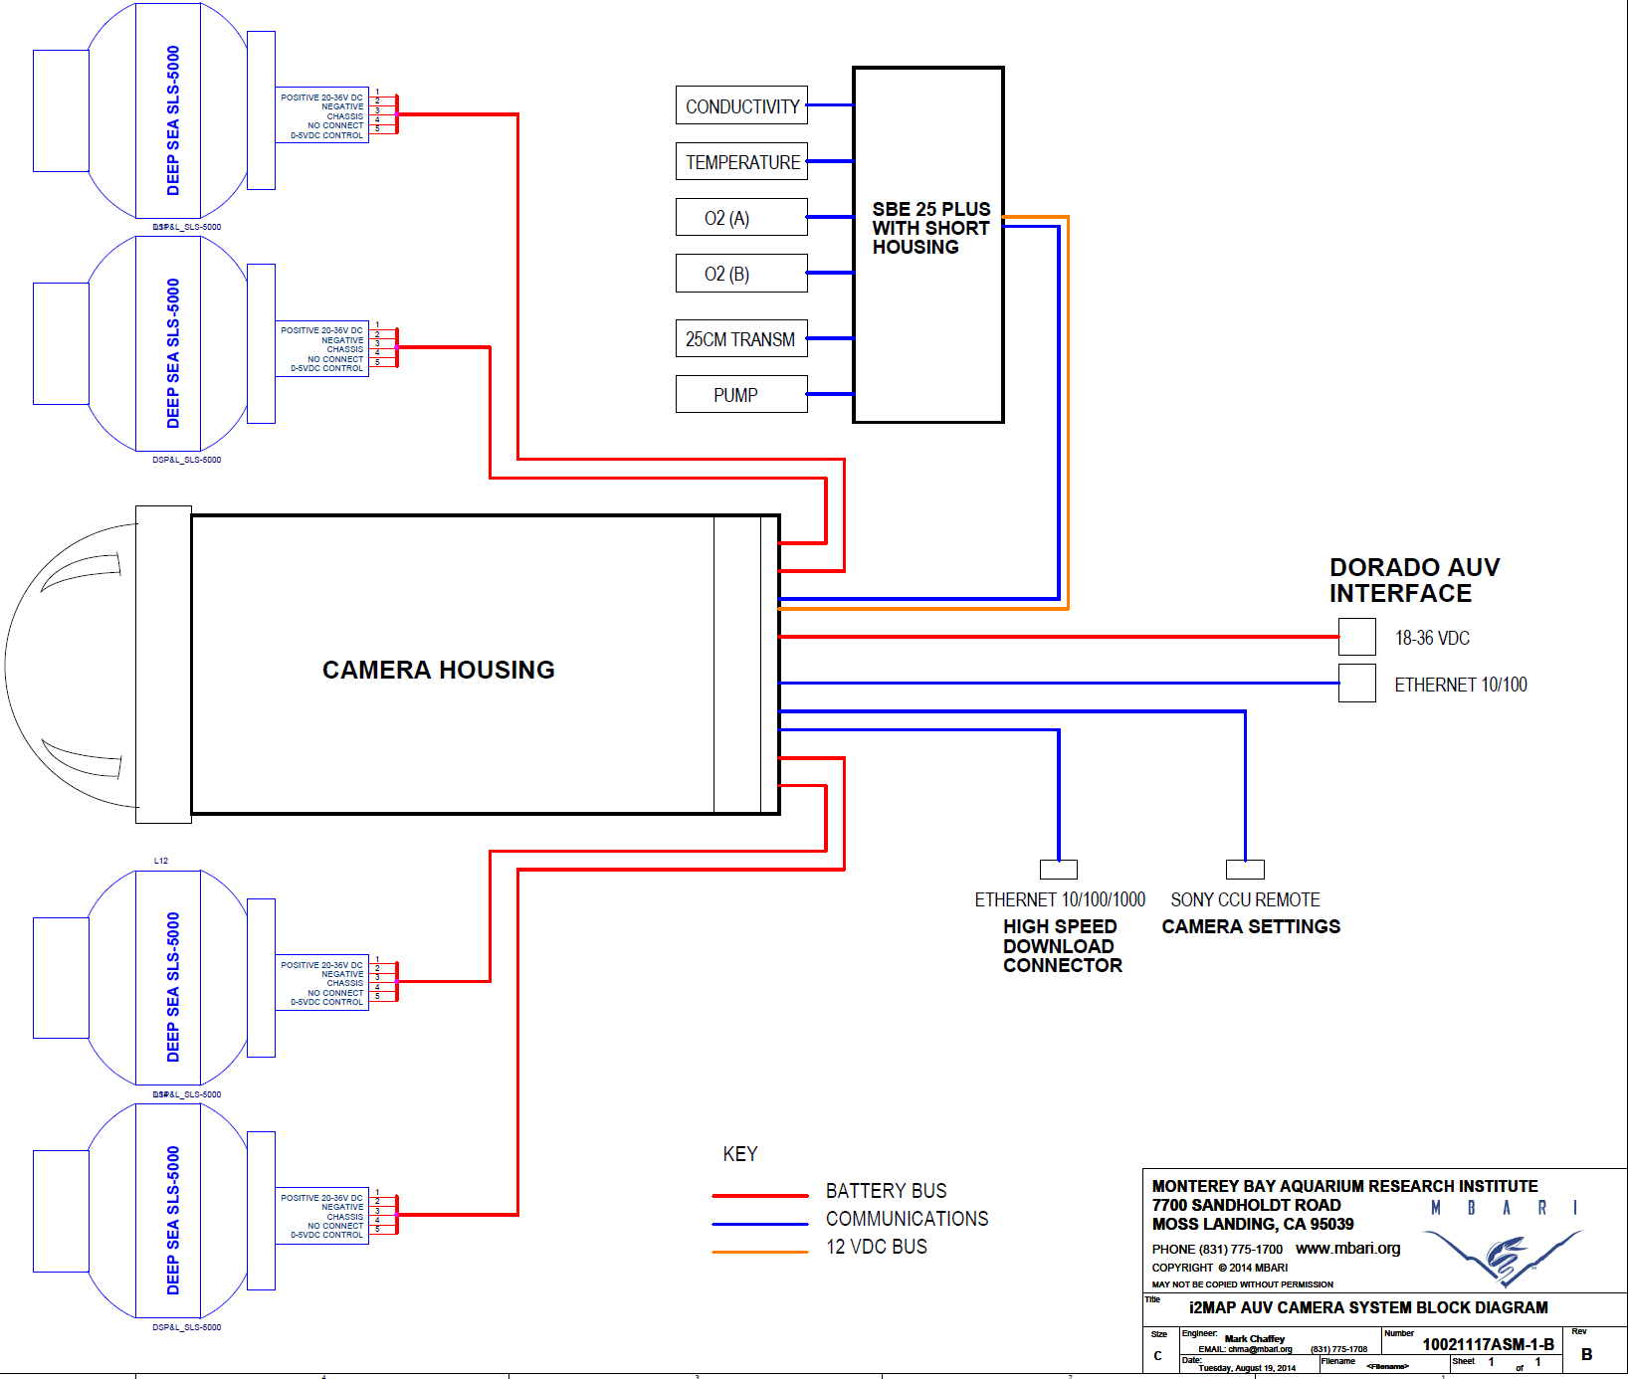

Slide 3
Camera System
  Camera and Lens Testing
  Optical Dome and adapter design
  Video Format Selection
    Temporal Resolution
    CODEC Performance
  Recorder
    Recording Capacity
    Post mission workflow
  Conclusions

Slide 4
Distance Requirements for the Identification of Representative Organisms in the Camera Field-of View
Required I.D. Distance
Species
Front of Camera Dome
Measured First I.D. Distance (cm) (Rob Sherlock)

Slide 5
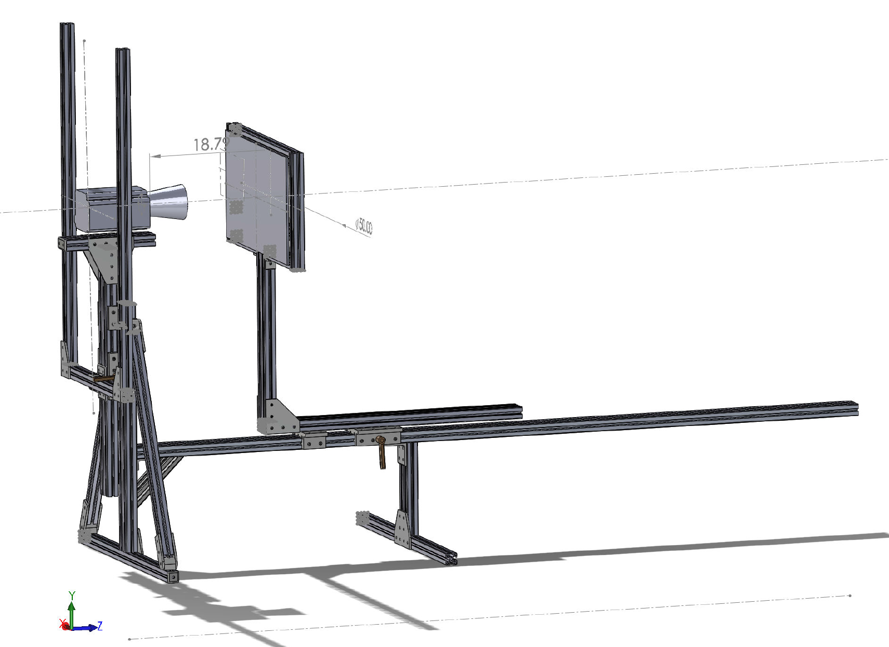
Close Focus Test (~10cm from dome)

Slide 6
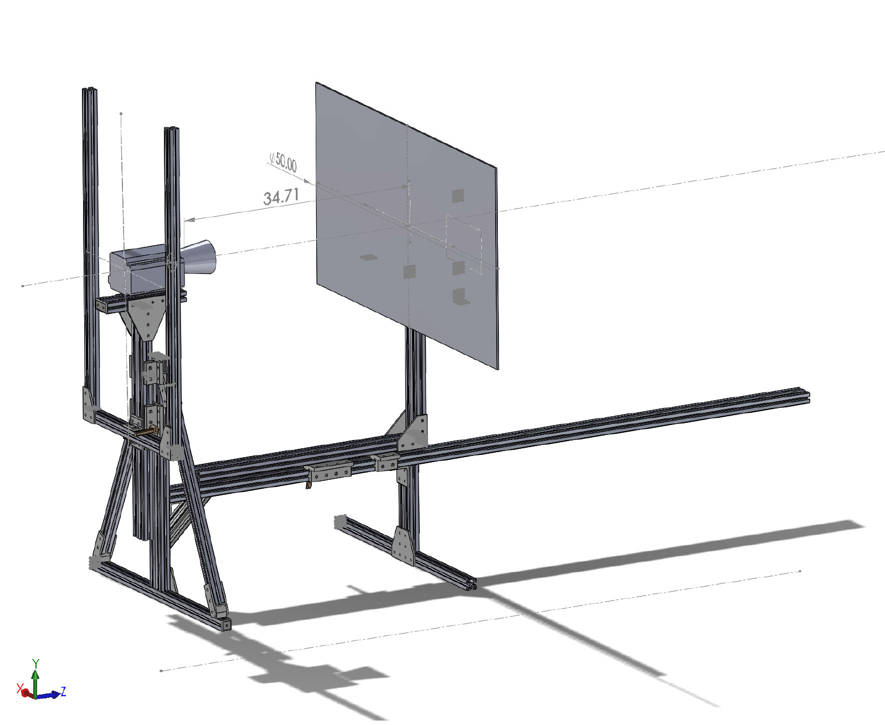
Resolution Testing (~ 0.5 m from dome)

Slide 7
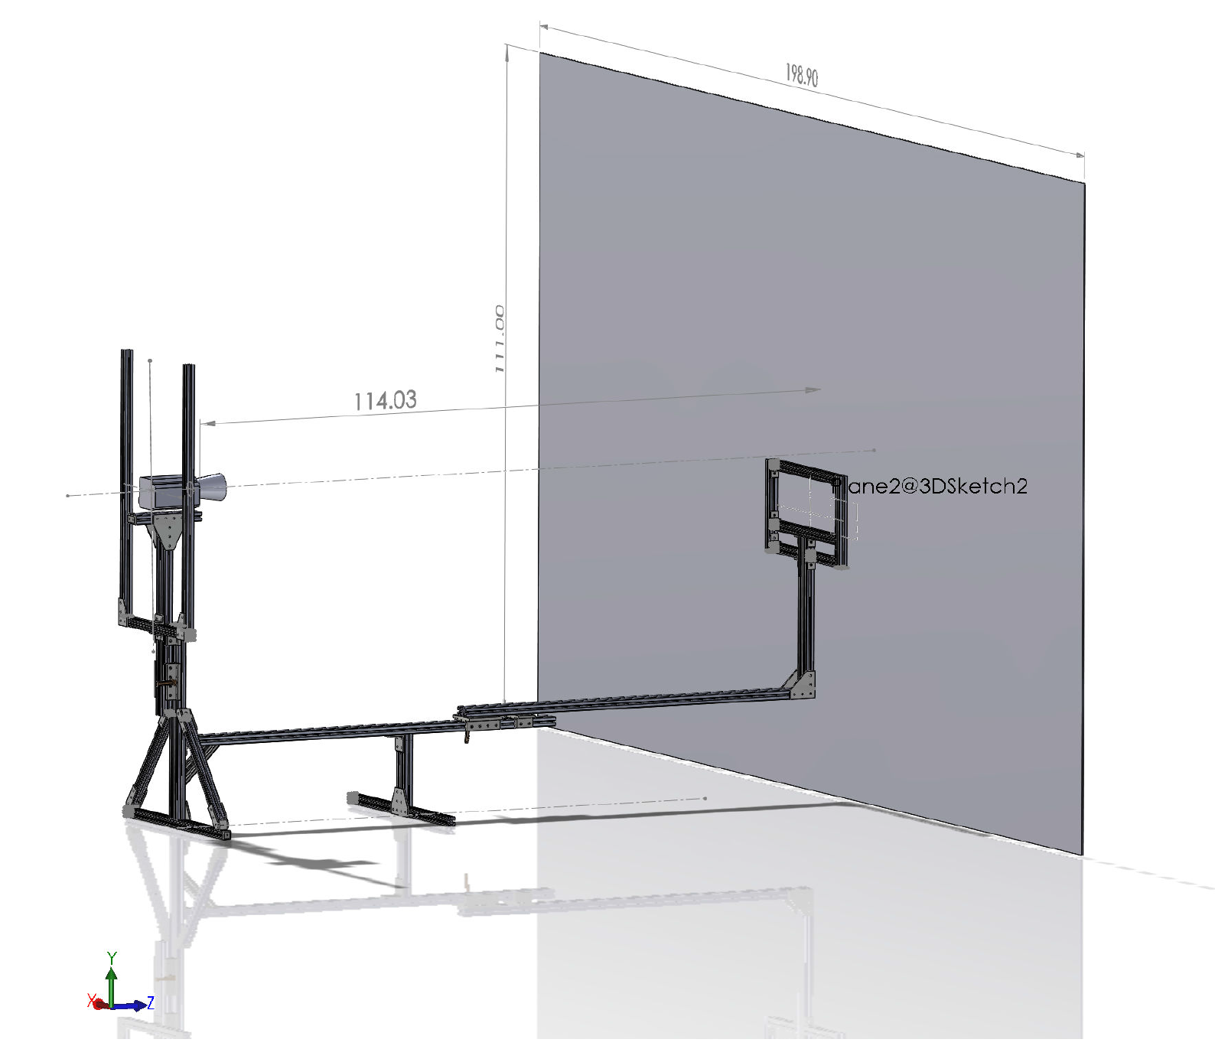
Far Focus (~2.5m from dome)

Slide 8
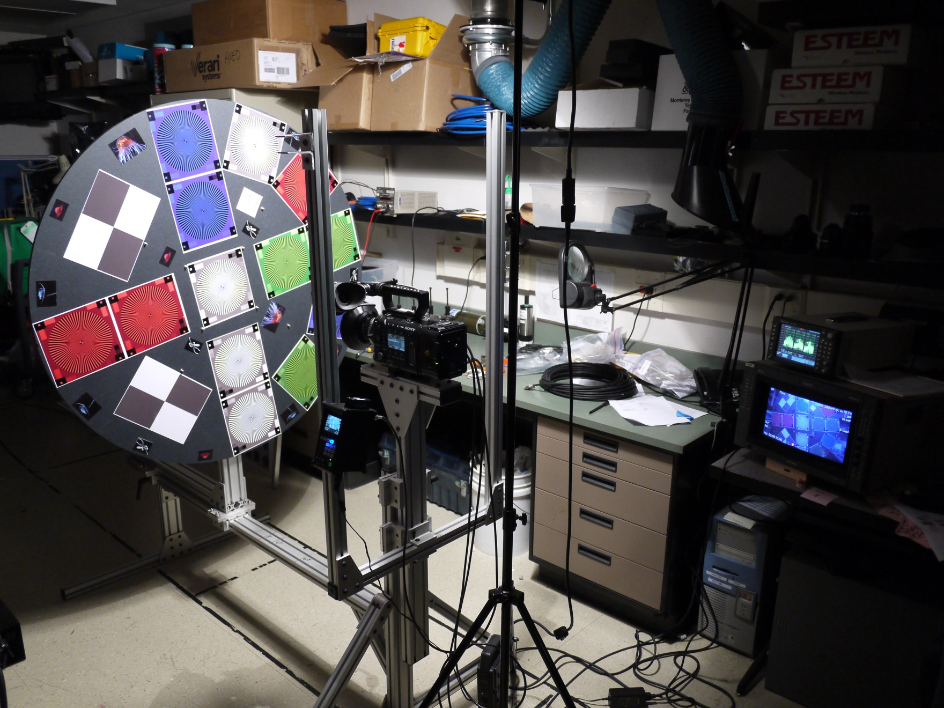
Camera Test Setup

Slide 9
Camera Test Work Flow
CAMERAS
Ikegami
HDL 50/HS
Sony
HDCP1,
NEX-FS700U
Pixel Resolutions
1.9k = 1920 x 1080
2k = 2048 x 1080
4k = 4096 x 2160
AJA Quad Pro ProRes 10 bit 422 (HQ) Recording
1.9k
Sony XAVC Recording (F-5 only)
1.9k
Capture Still Frame in .tiff Format
Export to ProRes 10 bit 422 HQ
2k
Export to ProRes 10 bit 4444
CAMERA
Sony F-5
Sony 16 bit Raw Recording (F-5 only)
4k
Export to DPX Frames
Open in PhotoShop
1.9k
CODEC Comparison Reference
Export to DPX Frames
Open in PhotoShop

Slide 10
Camera Detail Resolution Comparison Locations
Target Distance at “Sweet Spot” ~ 0.5 Meters From Dome
Detail Areas
Edge
Center
Sony F-5, SCL-P11X15 Lens, 400 lux, 70 IRE, Target 36 inches

Slide 11
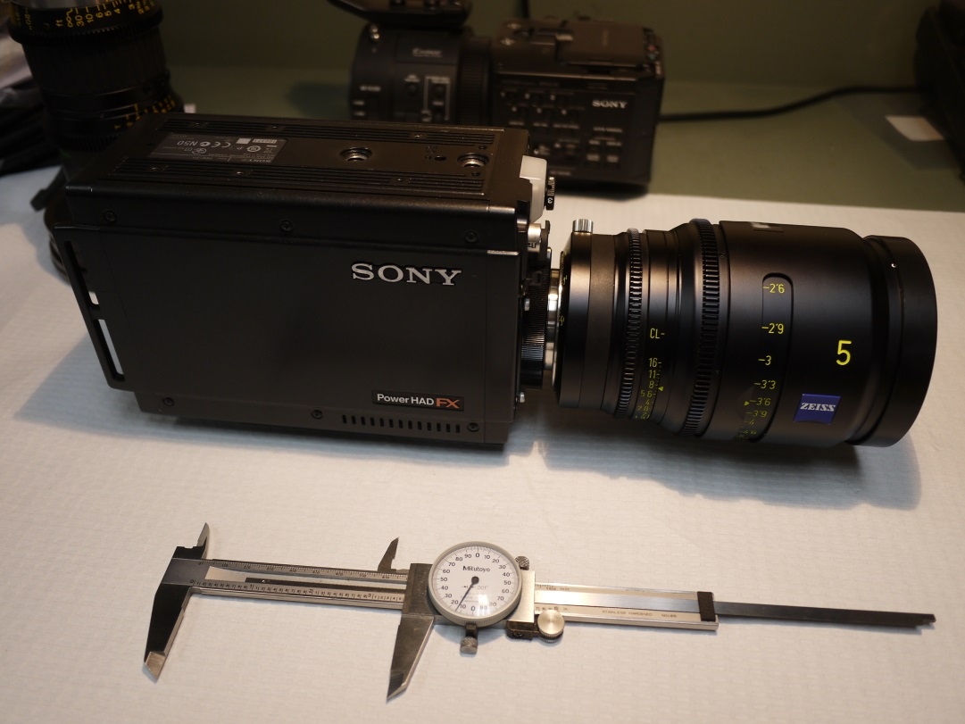
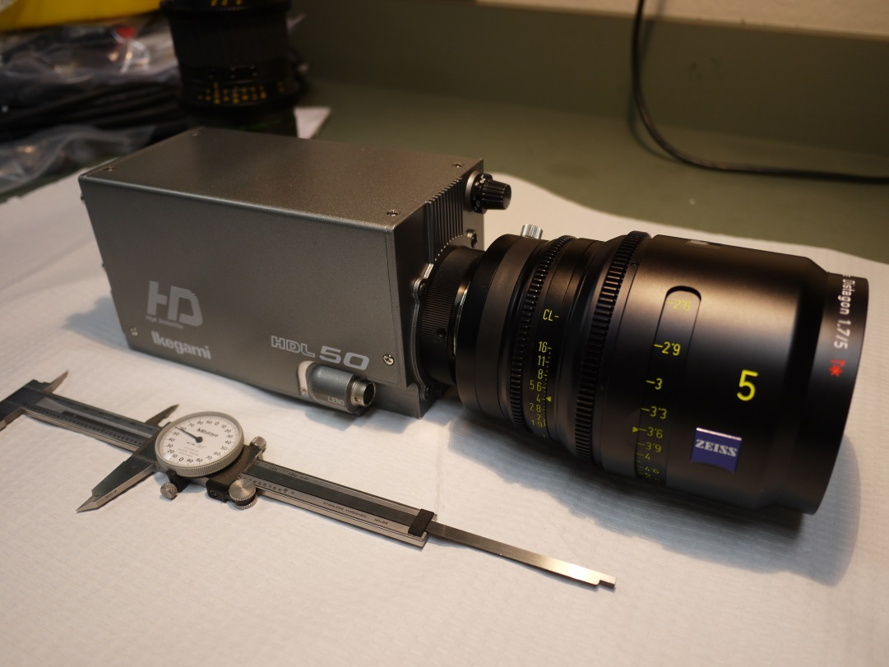
Camera Comparison
Sony HDCP1 vs. Ikegami HDL50/HS
The B4 Mount Lens Winner Was Used for The Camera Test
Zeiss Digi Prime T1,9/5mm

Slide 12
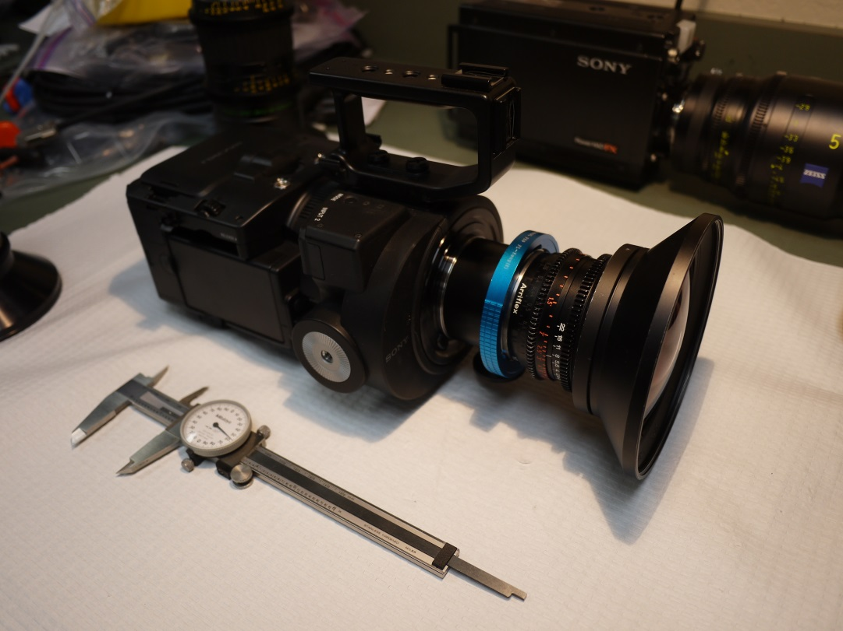
Camera Comparison
Sony NEX-FS700U vs. Ikegami HDL50/HS
The PL and B4 mount Lens Winners Were Used for The Camera Test
Sony SCL-P11X15 Lens and Zeiss Digi Prime T1,9/5mm

Slide 13
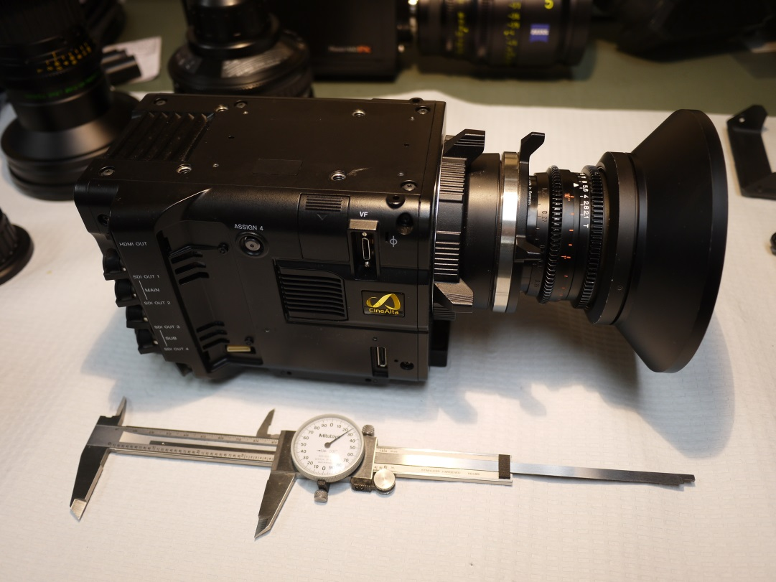
Camera Comparison
Sony F-5 vs. Ikegami HDL50/HS
The PL and B4 mount Lens Winners Were Used for The Camera Test
Sony SCL-P11X15 Lens and Zeiss Digi Prime T1,9/5mm

Slide 14
Finalist #1 Sony F-5 and Sony SCL-P11X15 Lens
Sony F-5, SCL-P11X15 Lens, 400 lux, 70 IRE, Target 36 inches File: Test_13X.tiff

Slide 15
Finalist #2, Ikegami HDL-50/H and Zeiss Digi Prime T1,9/5mm Lens
Ikegami HDL50/HS, 5mm Lens, 140 lux, 80 IRE, Target 39 inches File: Test_77.tiff

Slide 16
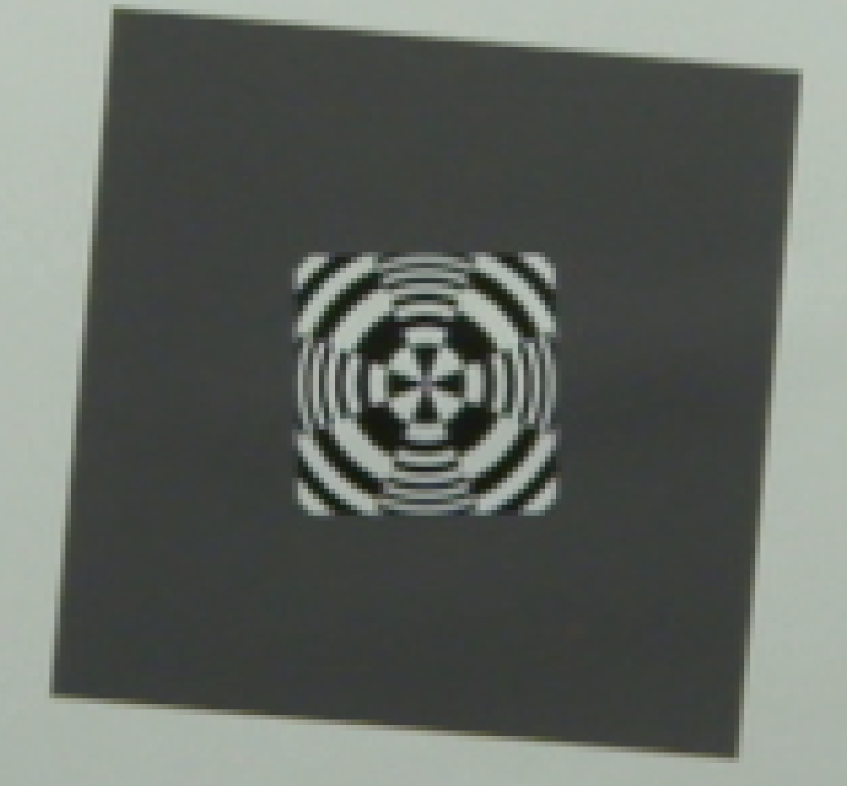
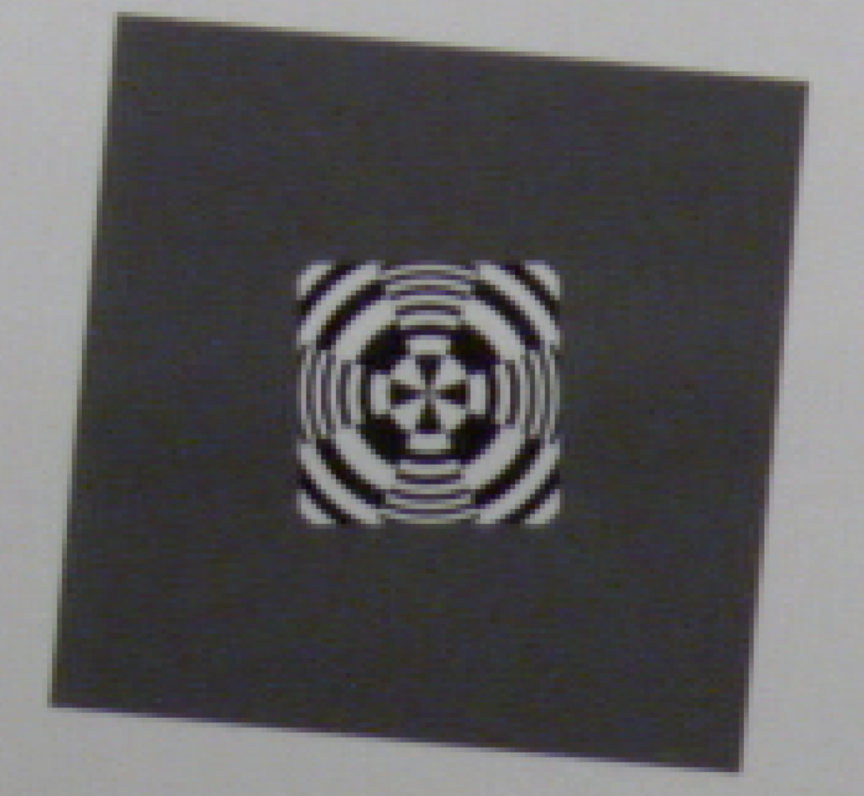
Sony F-5 vs. Ikegami HDL50/HS
Center Resolution
Sony F-5, Sony 11mm Lens, 400 lux,
ISO 800, Target 36 inches, 1920x 1080 P60
File: Test_13X.tiff
Ikegami HDL-50/HS, Zeiss 5mm Lens, 140 lux, 80 IRE, Target 38 inches
File: Test_77.tiff

Slide 17
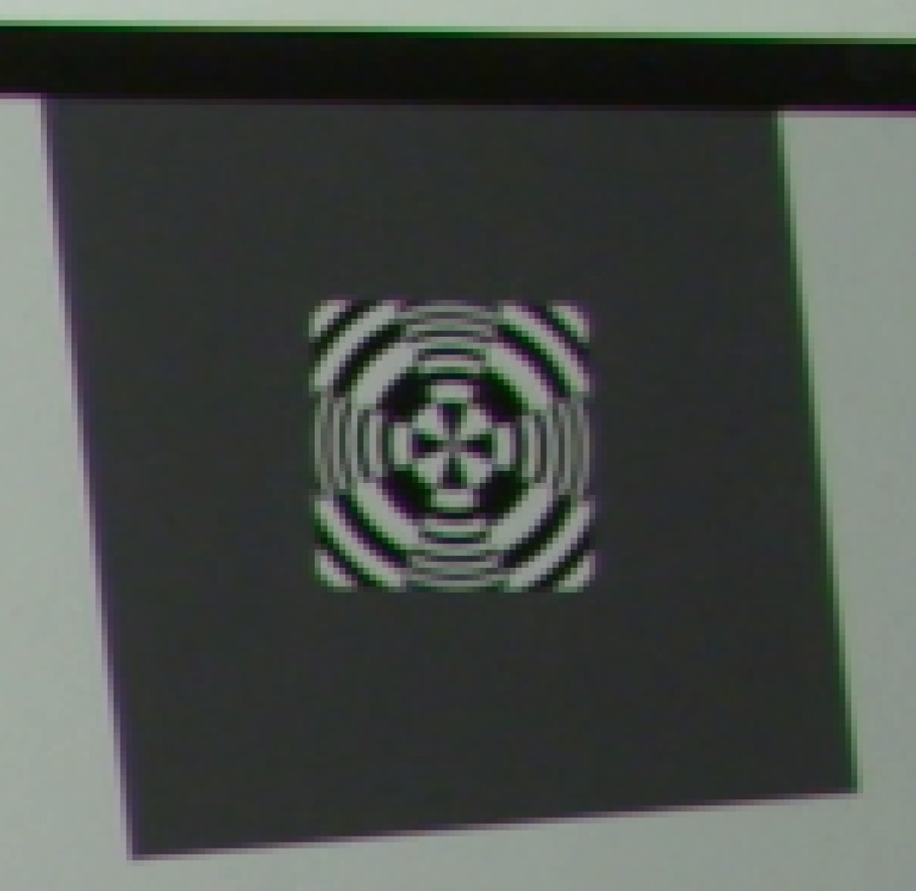
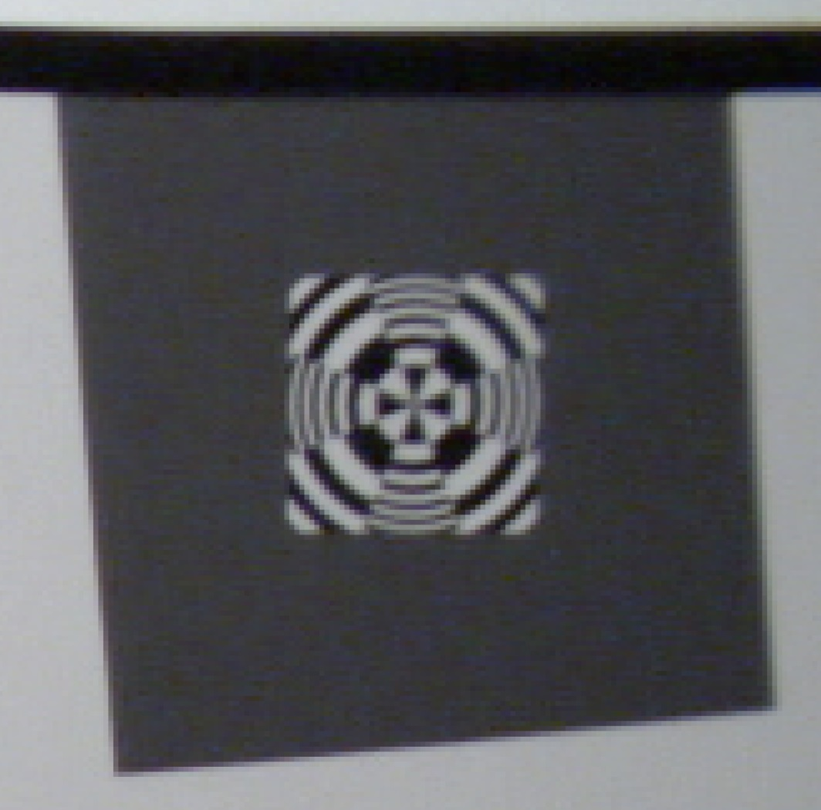
Sony F-5 vs. Ikegami HDL50/HS
Edge Resolution
Sony F-5, Sony 11mm Lens, 400 lux,
ISO 800, Target 36 inches, 1920x 1080 P60
File: Test_13X.tiff
Ikegami HDL-50/HS, Zeiss 5mm Lens, 140 lux, 80 IRE, Target 38 inches
File: Test_77.tiff

Slide 18
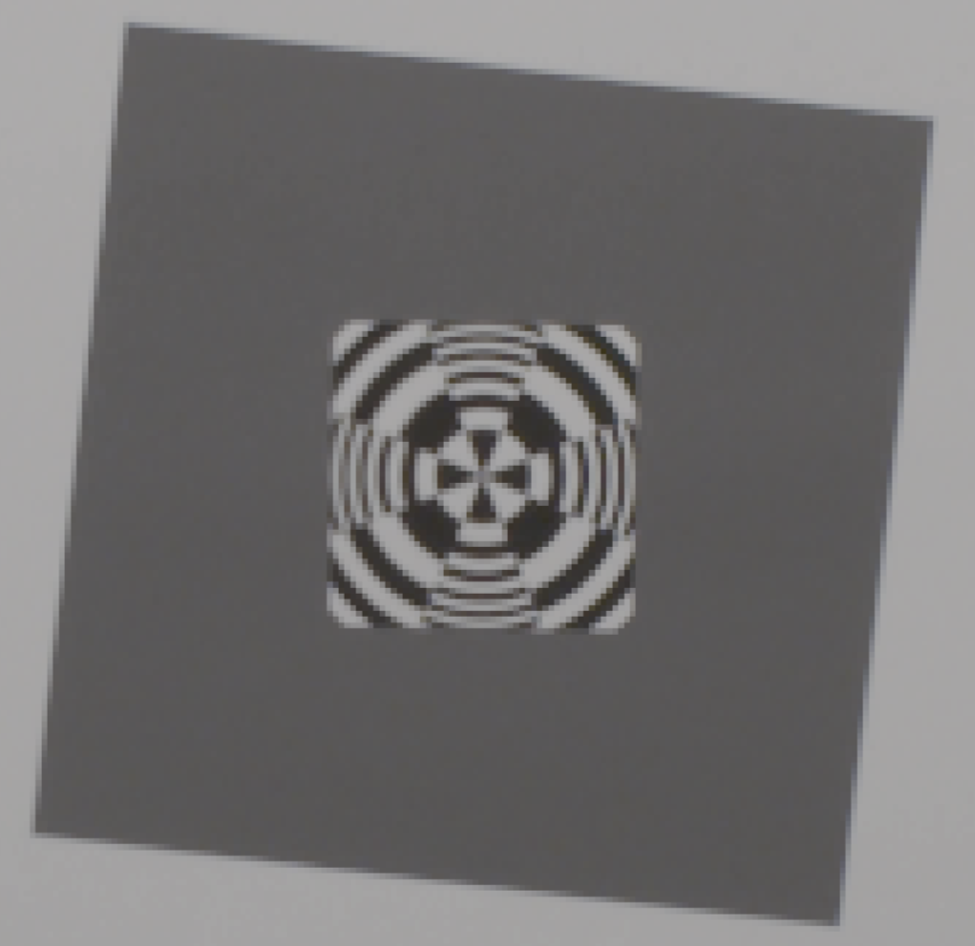
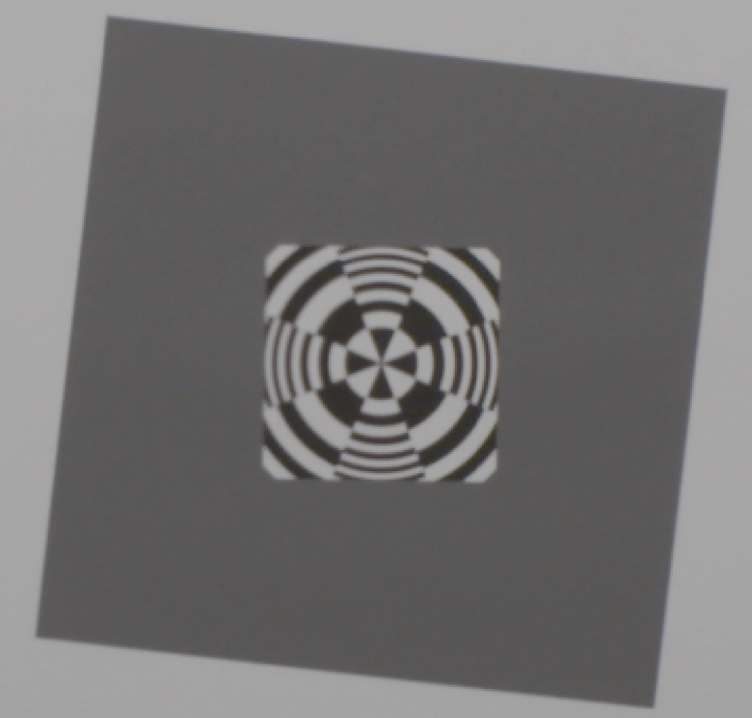
Sony F-5 1920 X 1080 vs. Sony F-5 4096 X 2160 (4K)
Center Resolution
Sony F-5, Zeiss 12mm Lens, 400 lux,
IE 800, Target 36 inches, 1920x 1080 P60
(no color correction)
File: Test_54_1920_4444.tiff
Sony F-5, Zeiss 12mm Lens, 800 lux,
IE 2000, Target 34 inches, 4K P60
(no color correction)
File: Test_54_4K4444.tiff

Slide 19

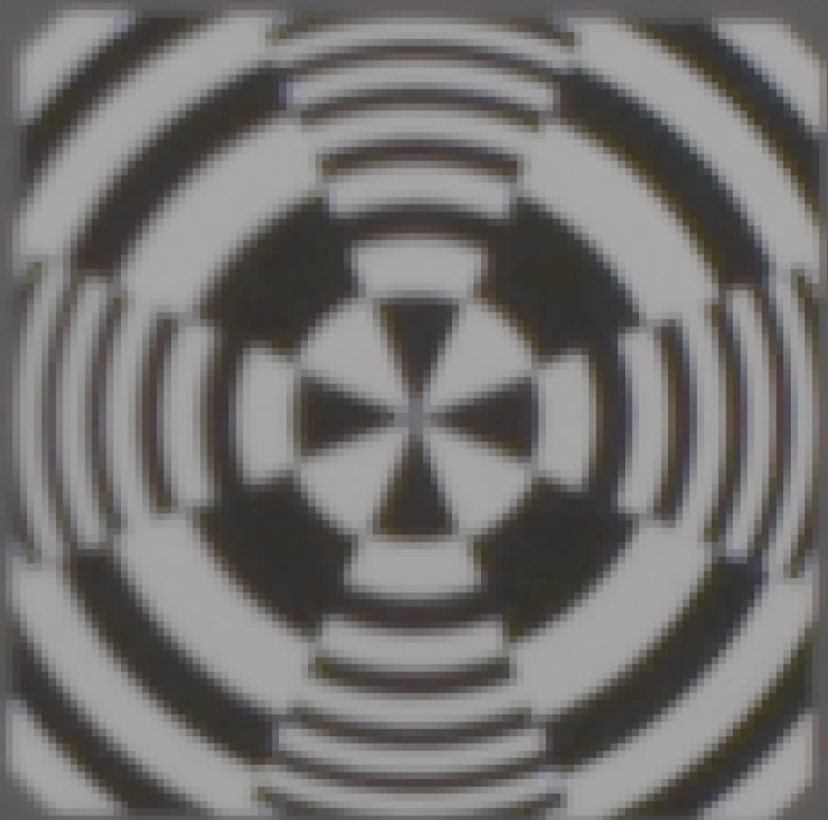
Sony F-5 1920 X 1080 vs. Sony F-5 4096 X 2160 (4K)
Center Resolution - Detail
Sony F-5, Zeiss 12mm Lens, 400 lux, ISO 800, Target 34 inches, 1920x 1080 P60
(no color correction)
File: Test_54_1920_4444.tiff
Sony F-5, Zeiss 12mm Lens, 800 lux, IE 2000, Target 34 inches, 4K P60
(no color correction)
File: Test_54_4K4444.tiff

Slide 20
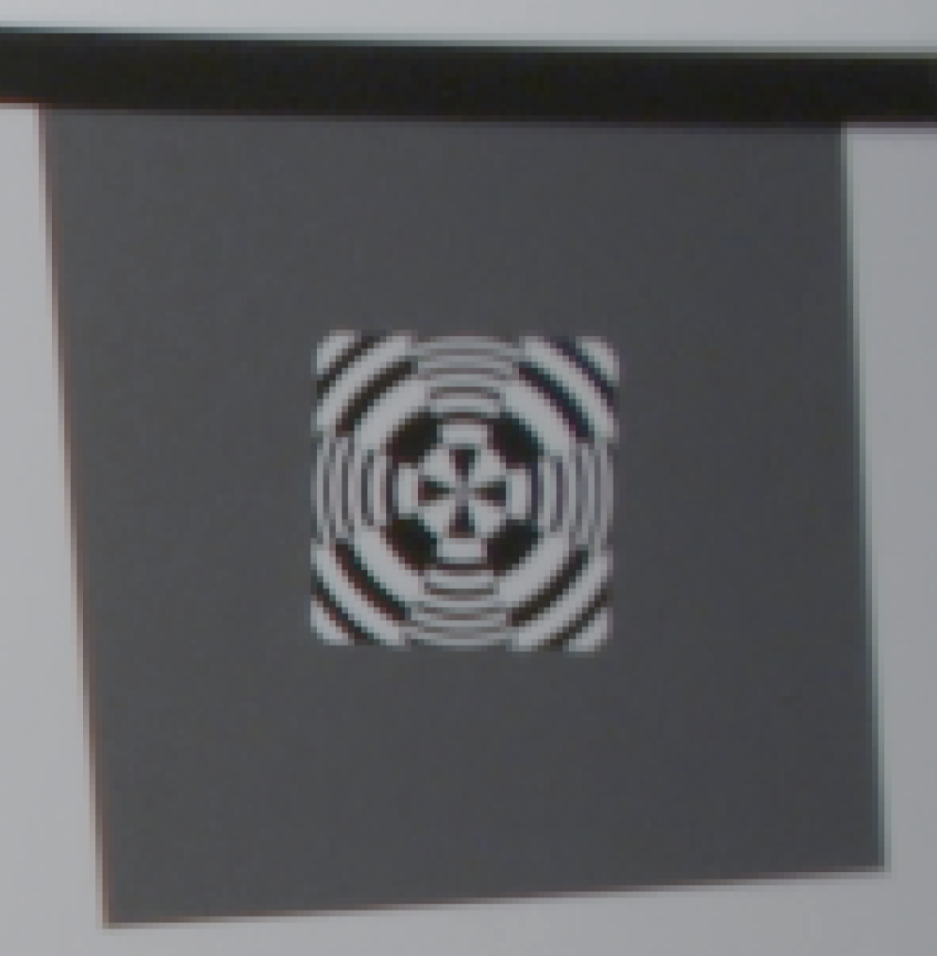
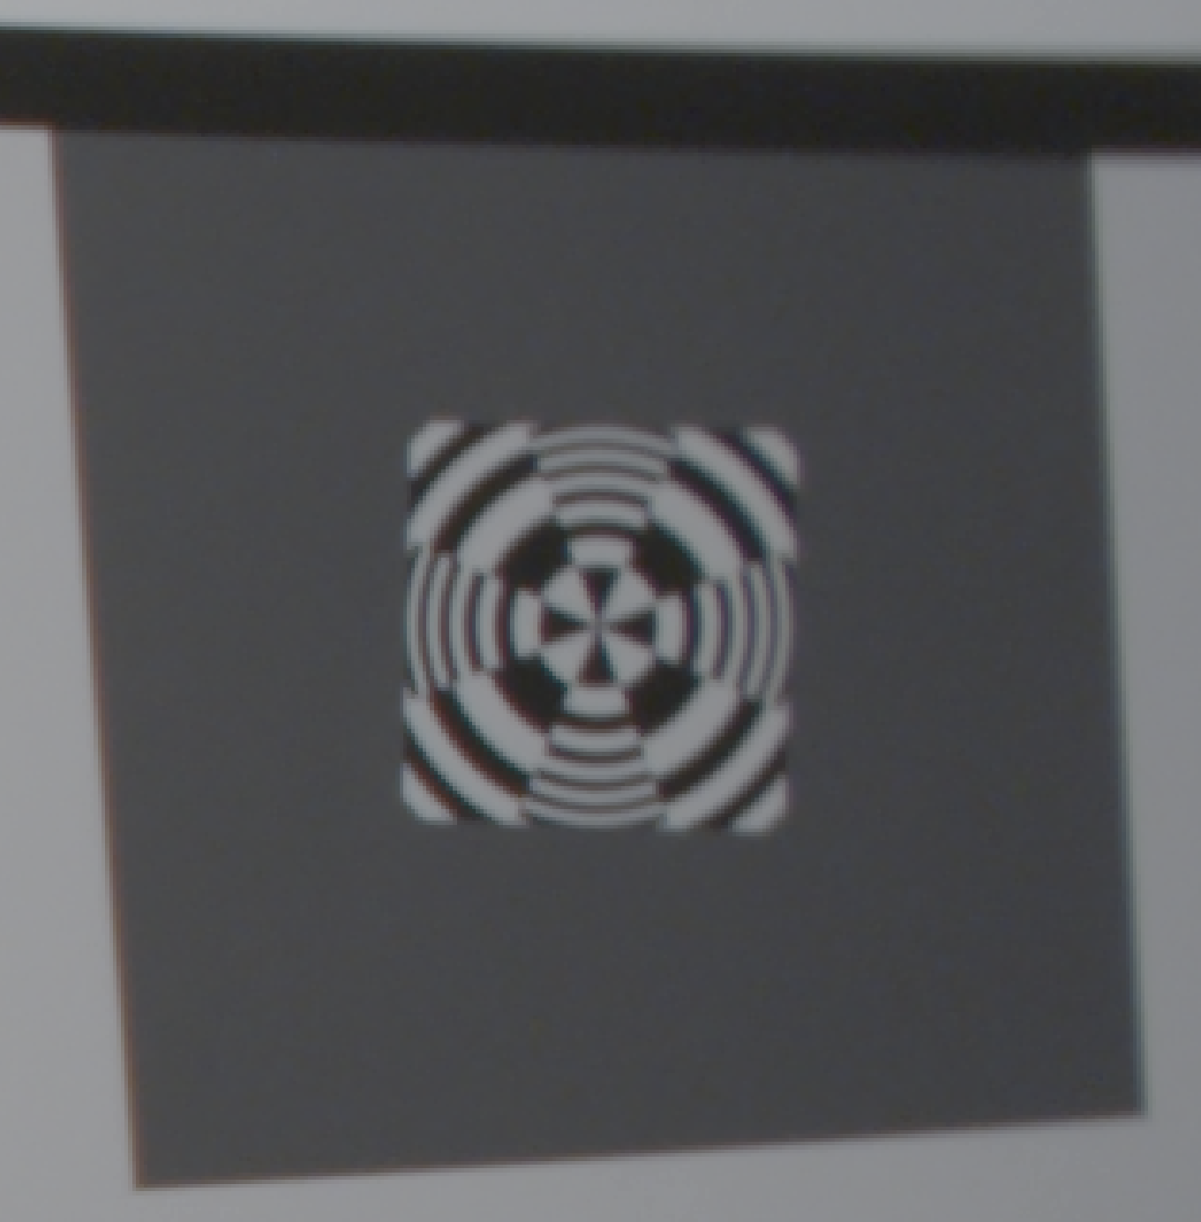
Sony F-5 1920 X 1080 vs. Sony F-5 4096 X 2160 (4K)
Edge Resolution
Sony F-5, Zeiss 12mm Lens, 400 lux, ISO 800, Target 34 inches, 1920x 1080 P60
(no color correction)
File: Test_54_1920_4444.tiff
Sony F-5, Zeiss 12mm Lens, 800 lux, IE 2000, Target 34 inches, 4K P60
(no color correction)
File: Test_54_4K4444.tiff

Slide 21
Sony F-5 vs. Ikegami HDL50/HS
Color Reproduction (4:2:2 Format)
Sony F-5, Sony 11mm Lens, 400 lux, ISO 800, Target 36 inches, 1920x 1080 P60 (no color correction)
Ikegami HDL-50/HS, Zeiss 5mm Lens, 140 lux, 80 IRE, Target 38 inches
(no color correction)

Slide 22
Test Showing the Sony F-5 and the Sony SCL-P11X15 Lens Meets the i2MAP Depth of Field Requirements (at F 5.6)
Sony F-5, Sony SCL-P11X15 lens set to 11mm, 560 lux, 75 IRE, Target 18 inches (10cm from dome equiv.), F 5.6, focus distance 31.5 inches
File: Test_14.tiff
Sony F-5, Sony SCL-P11X15 lens set to 11mm, 560 lux, 75 IRE, Target 113 inches (2.5m from dome equiv.), F 5.6, focus distance 31.5 inches
File: Test_45.tiff

Slide 23
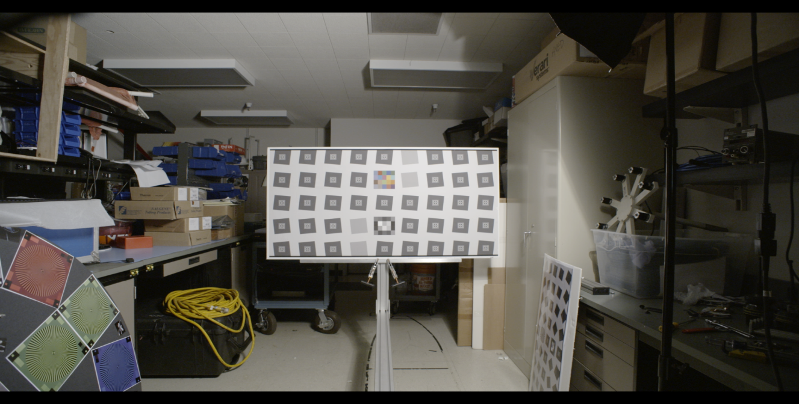
Sony F-5 1920 X 1080 vs. Sony F-5 4096 X 2160 (4K)
Resolution Example
Detail Area
Sony F-5, Zeiss 12mm Lens, 500 lux, IE 2000, Target 113 inches, 2K P60
(no color correction)
File: Test_53_2K.tiff

Slide 24
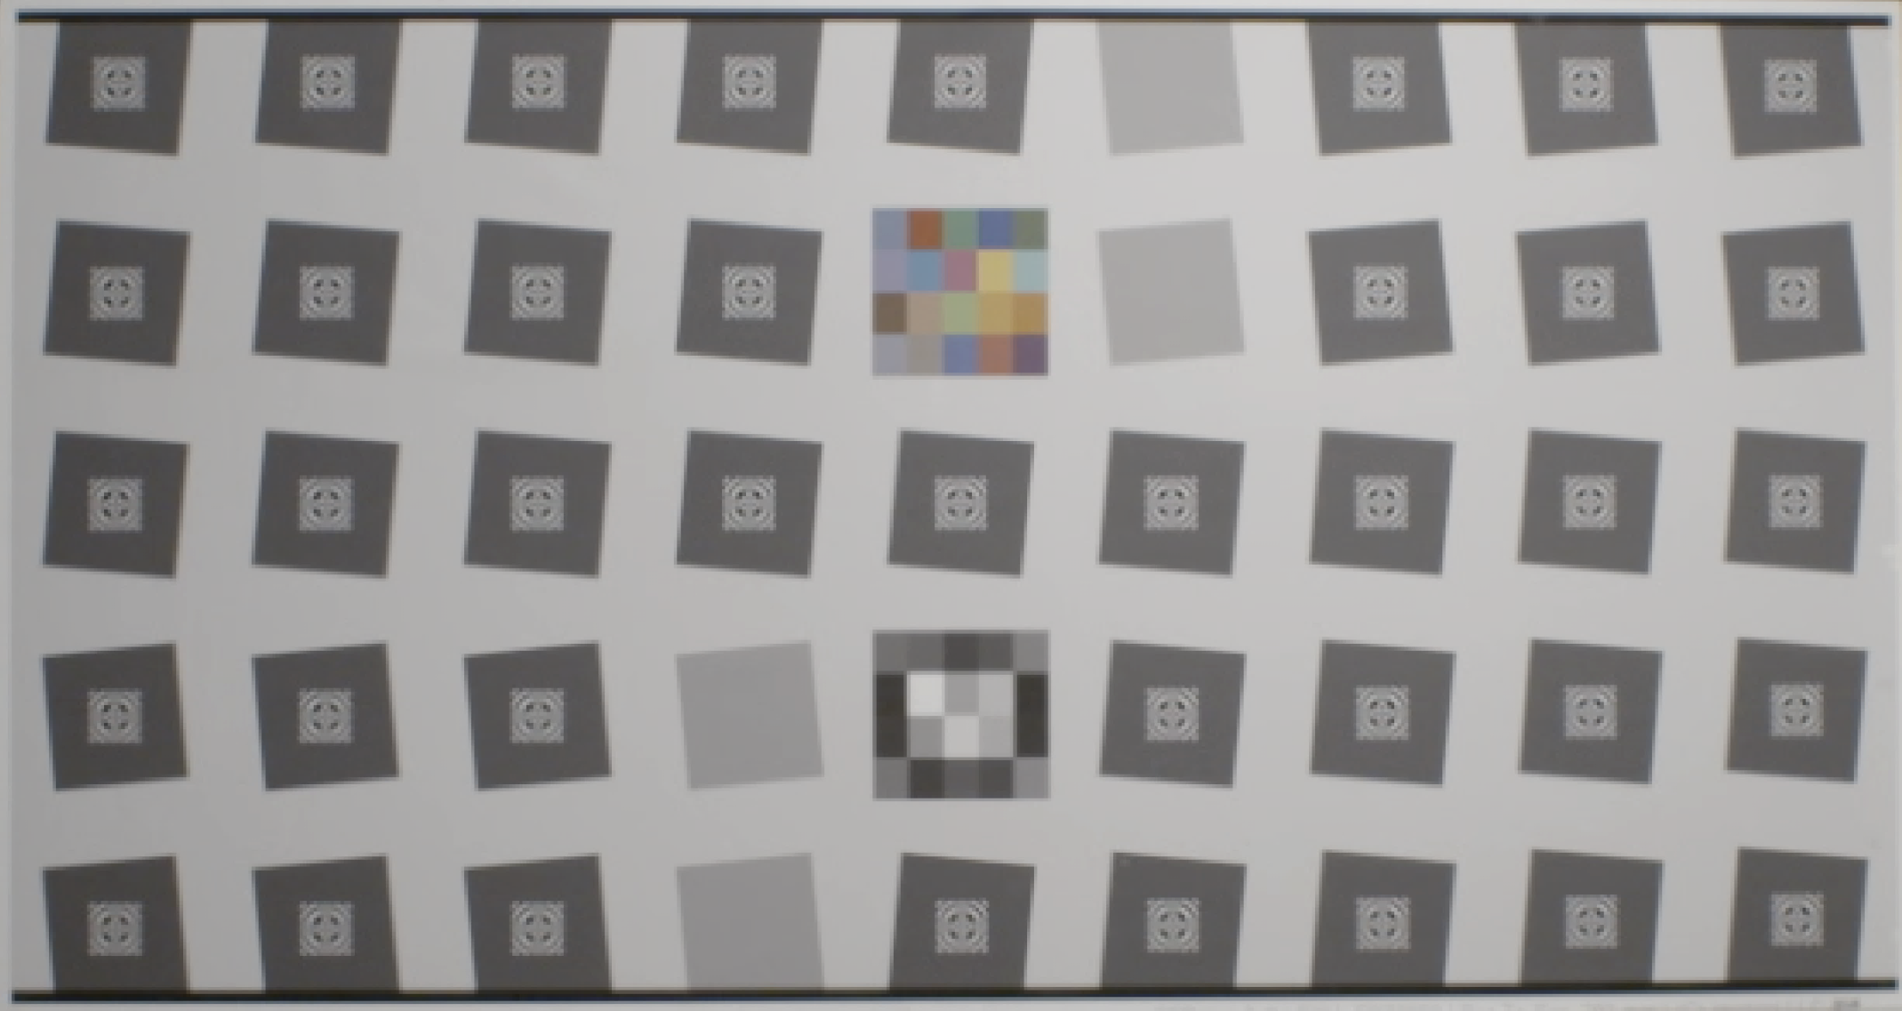
Sony F-5 1920 X 1080 vs. Sony F-5 4096 X 2160 (4K)
Resolution Example 2A
Sony F-5, Zeiss 12mm Lens, 500 lux, IE 2000, Target 113 inches, 2K P60 (Lightened 10%) File: Test_53_2K.tiff

Slide 25
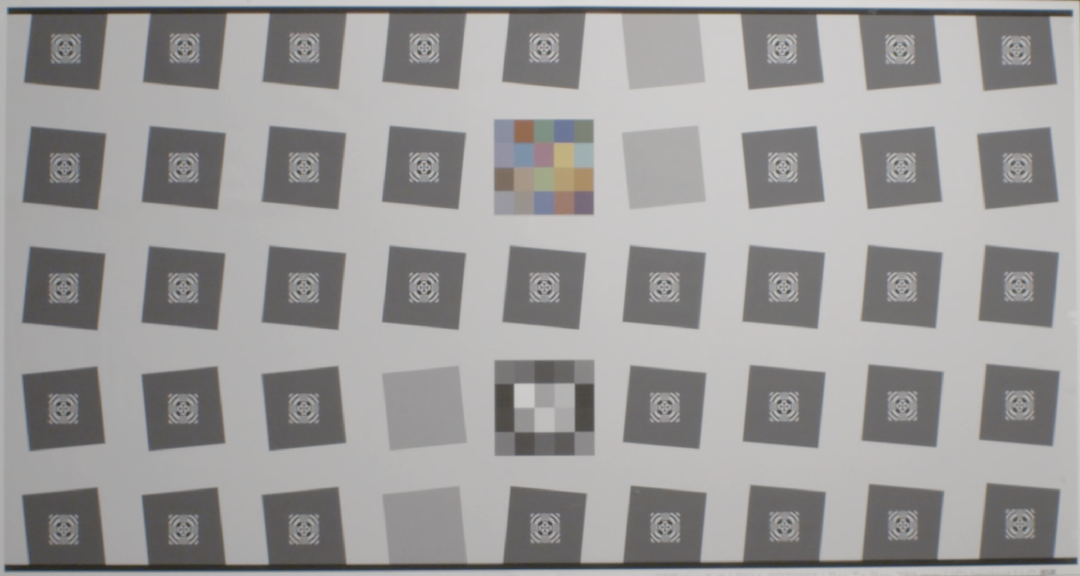
Sony F-5 1920 X 1080 vs. Sony F-5 4096 X 2160 (4K)
Resolution Example 2B
Sony F-5, Zeiss 12mm Lens, 500 lux, IE 2000, Target 113 inches,
4K P60 (Lightened 20%) File: Test_53_4K444.tiff

Slide 26

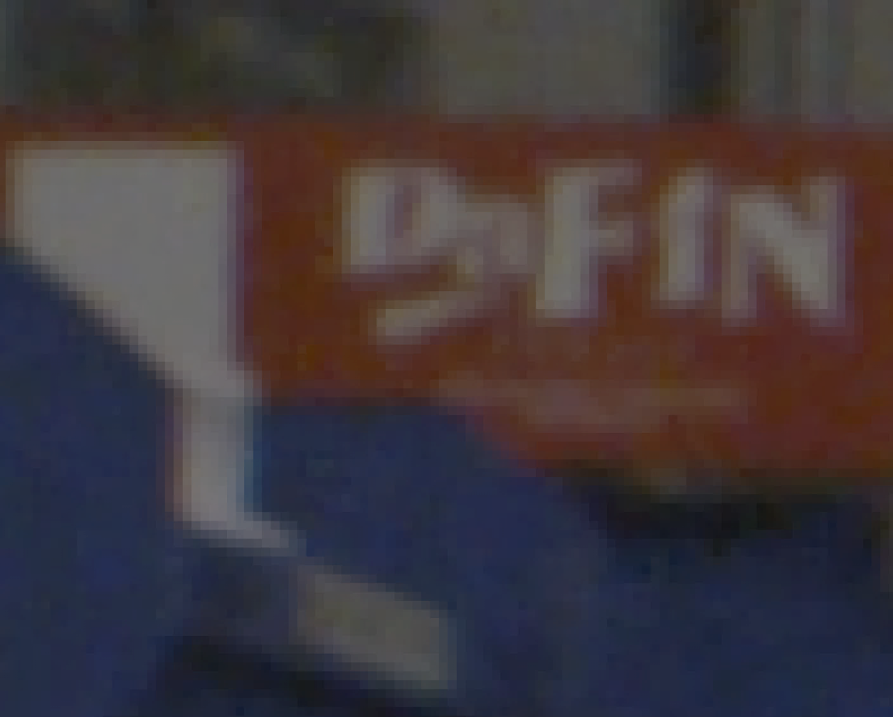
Sony F-5 1920 X 1080 vs. Sony F-5 4096 X 2160 (4K)
Resolution Example 1
Sony F-5, Zeiss 12mm Lens, 400 lux,
IE 800, 1920x 1080 P60
(+20% brightness correction)
File: Test_53_2K4444.tiff
Sony F-5, Zeiss 12mm Lens, 800 lux,
IE 2000, 4K P60
(+20% brightness correction)
File: Test_53_4K4444.tiff

Slide 27
Optical Dome Design
In the final process of selecting the optical design consultant.
Aspherical front dome design is recommended to support 4k resolution (minimize field curvature).
Mechanical design would be done in house.

Slide 28
Temporal Resolution Testing
Rotating Test Target Reproduced Object Angular Velocities Simulating AUV Speeds of 0.55 and 1.0 meters per second

Slide 29
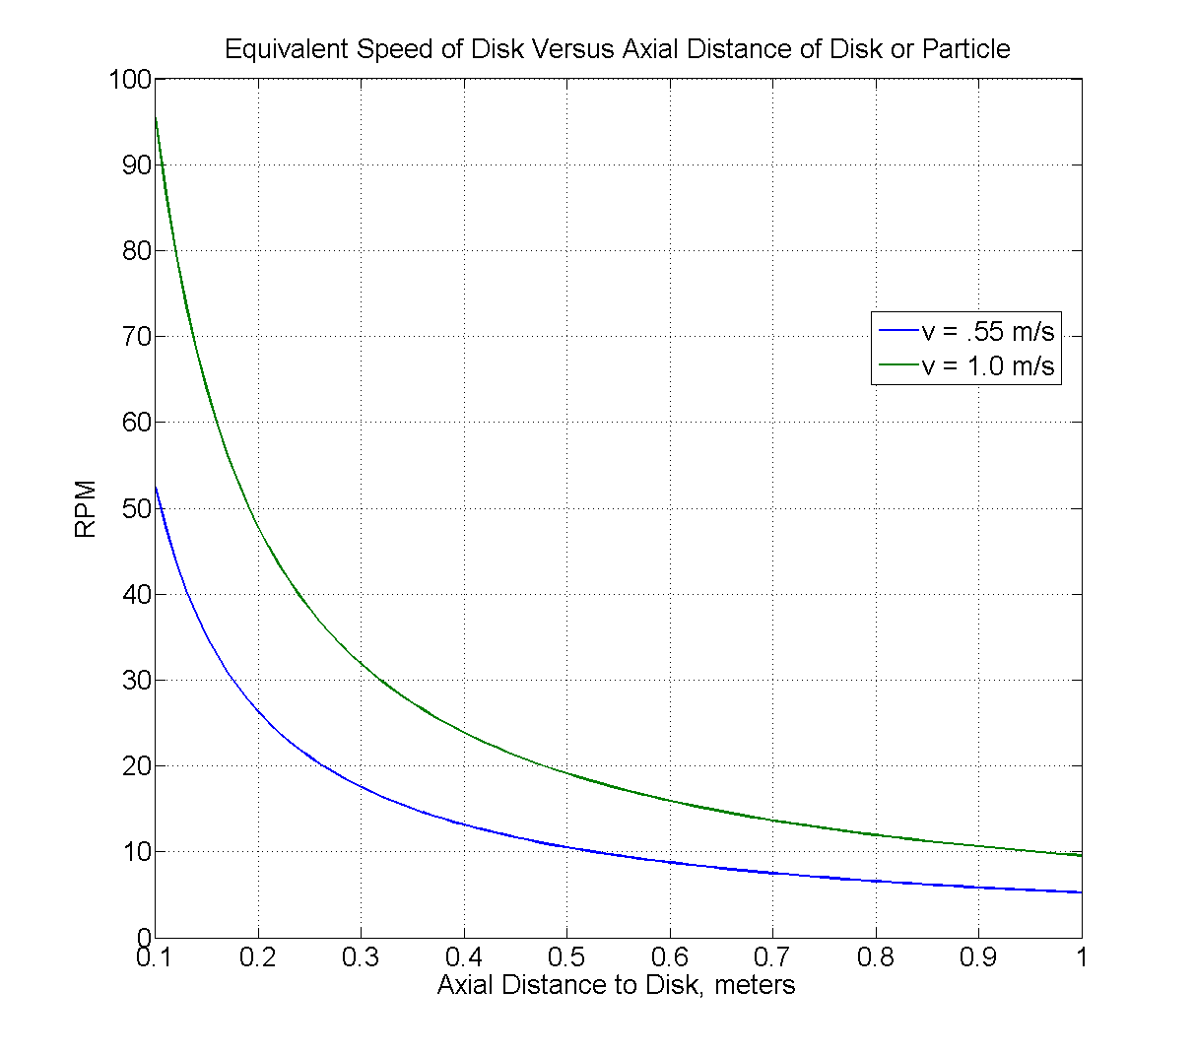
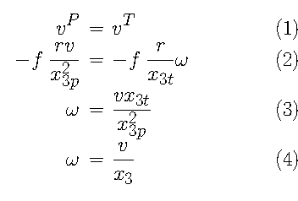
Translation of Vehicle Motion to Focal-Plane
x_3p – focal plane to particle
x_3t – focal plane to disk
Eqn. 3 => 4 if they’re equal.
Super-35 Camera Distance
(adjusted for 0.5 meters from dome front)
2/3” Camera Distance
1.0 m/sec. = 11 RPM
0.55 m/sec. = 6 RPM

Slide 30
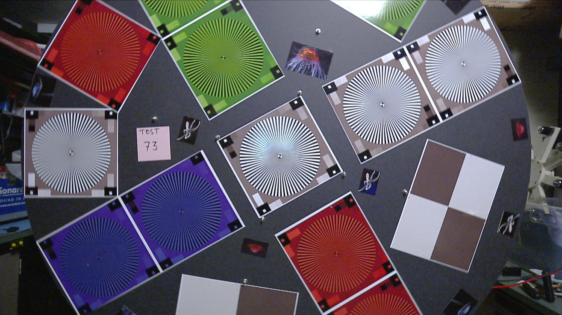
Temporal Resolution, Can We Get Good Image Quality at 1 Meter Per Second? Enter The Wheel of Death
Detail Test Area
Ikegami HDL50/HS, Zeiss 5mm Lens, 100 lux, 1920x 1080i 30
Disk 6 RPM (~0.5 m/sec), File: Test_73_White.tiff (DeInterlaced)

Slide 31
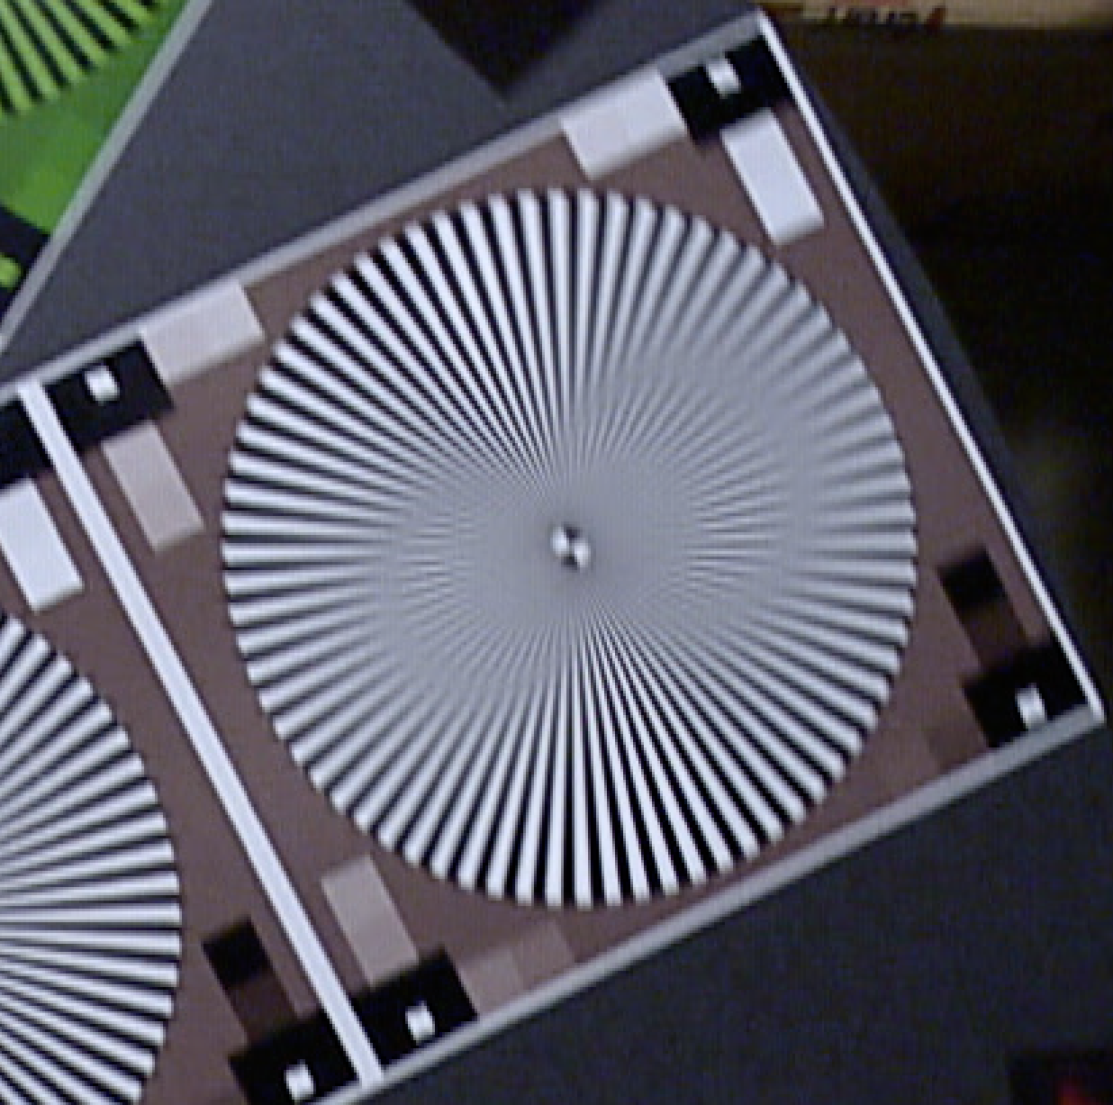
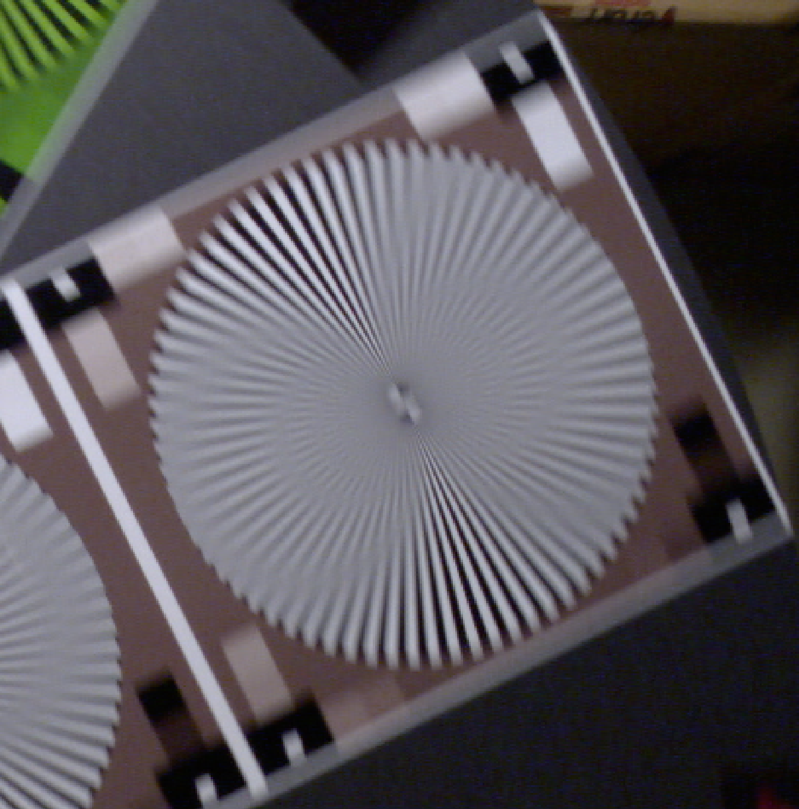
Comparison of Current (0.5 m/sec.) and Planned (1.0 m/sec.) Temporal Resolution at the 0.5 Meter from Dome “Sweet Spot”.
Ikegami HDL50/HS, Zeiss 5mm Lens,
110 lux, 1920x 1080i 30
Disk 6 RPM (~0.5 m/sec)
File: Test_73_White.tiff (DeInterlaced)
Ikegami HDL50/HS, Zeiss 5mm Lens,
170 lux, 1920x 1080 P60
Disk 11 RPM (~1 m/sec)
File: : Test_76_White.tiff

Slide 32
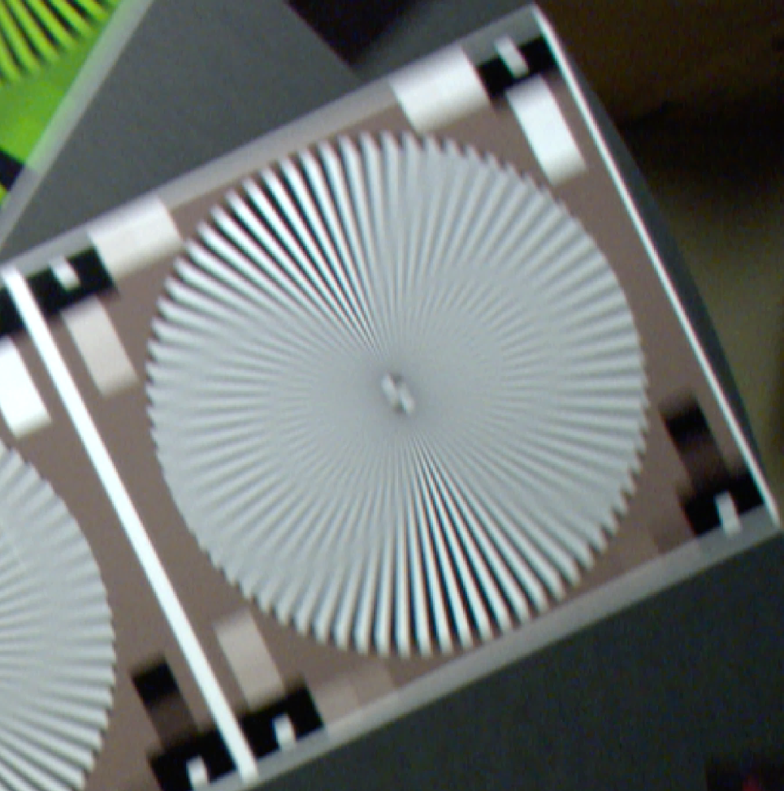
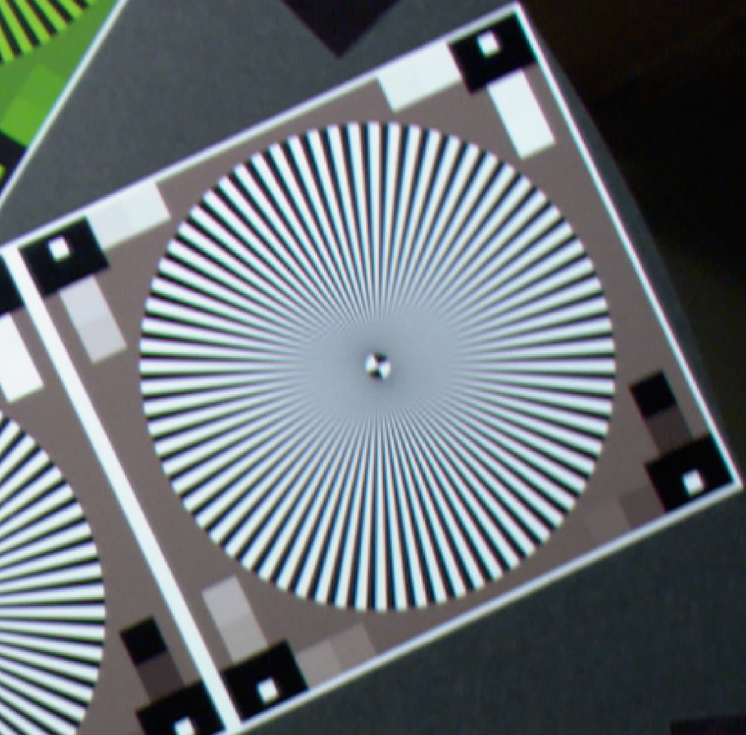
The Effect of Camera Shutter at The Planned (1.0 m/sec.) AUV Velocity tested at the 0.5 Meter from Dome “Sweet Spot”.
Sony HDCP1, Zeiss 5mm Lens,
120 lux, 1920x 1080 P60
Disk 11 RPM (~1 m/sec), No Shutter
File: Test_66_White.tiff
Sony HDCP1, Zeiss 5mm Lens,
800 lux, 1920x 1080 P60
Disk 11 RPM (~1 m/sec), Shutter 1/250
File: Test_68_White.tiff

Slide 34
Post-Mission Work Flow
2014-2015
Annotate in VARS using current H.264 file based version
Export to H.264
Archive .mov files in Atlas Server
6 TeraBytes Maximum thru 2015
AJA Quad Pro ProRes 10 bit 422 (HQ) Recording (.mov)
Timecode lost
Timecode must be reconstructed
CAMERA
Sony F-5 or F-55
Annotate in VARS using updated QuickTime file based version
Timecode preserved
Beyond 2015

Slide 35
Estimated System Cost Comparison
Budget was ~ $57,592

Slide 36
Camera and Recorder Testing Conclusions
Camera
  The F-5 camera is about 2 stops slower when depth of field control is taken into account.
  Shutter speed of 1/250 is needed to completely freeze the motion of 1 meter per second transect.
  Ikegami has black adjustment issues on power-up boot. Suggest putting 100% filter in one position in filter wheel – would require camera control.
Video Recorder
  The Apple ProRes 422(HQ) CODEC is visually lossless.
We should have adequate illumination.
  Need ~ 3200 lux maximum with F-5 at 0dB gain and 1/250th shutter.
  4 lights measure at ~ 3500 – 5000 lux at 0.5 meters from dome.

Slide 37
Which is the best camera for us?
Ikegami HDL-50/HS 2/3” box camera
  Box camera has a great picture but is limited to 1920 X 1080 60 frames per second.
  Box camera is the smallest and would be slightly easier to integrate – except for auto black balance on boot-up.
Sony F-5 super 35 format camera.
  F-5 Cine camera has 4K sensor and offers a migration path to higher resolution formats, 2K and 4K.
    Current recording limitation is 2048 X 1080 60 frames per second.
    AJA has recording hardware in development that supports 4K at 60 frames per second that may be available in the future.
    Sony F-5 can be upgraded to 4K output for $12,000.
Cost is very similar – Go with the F-5

Slide 38
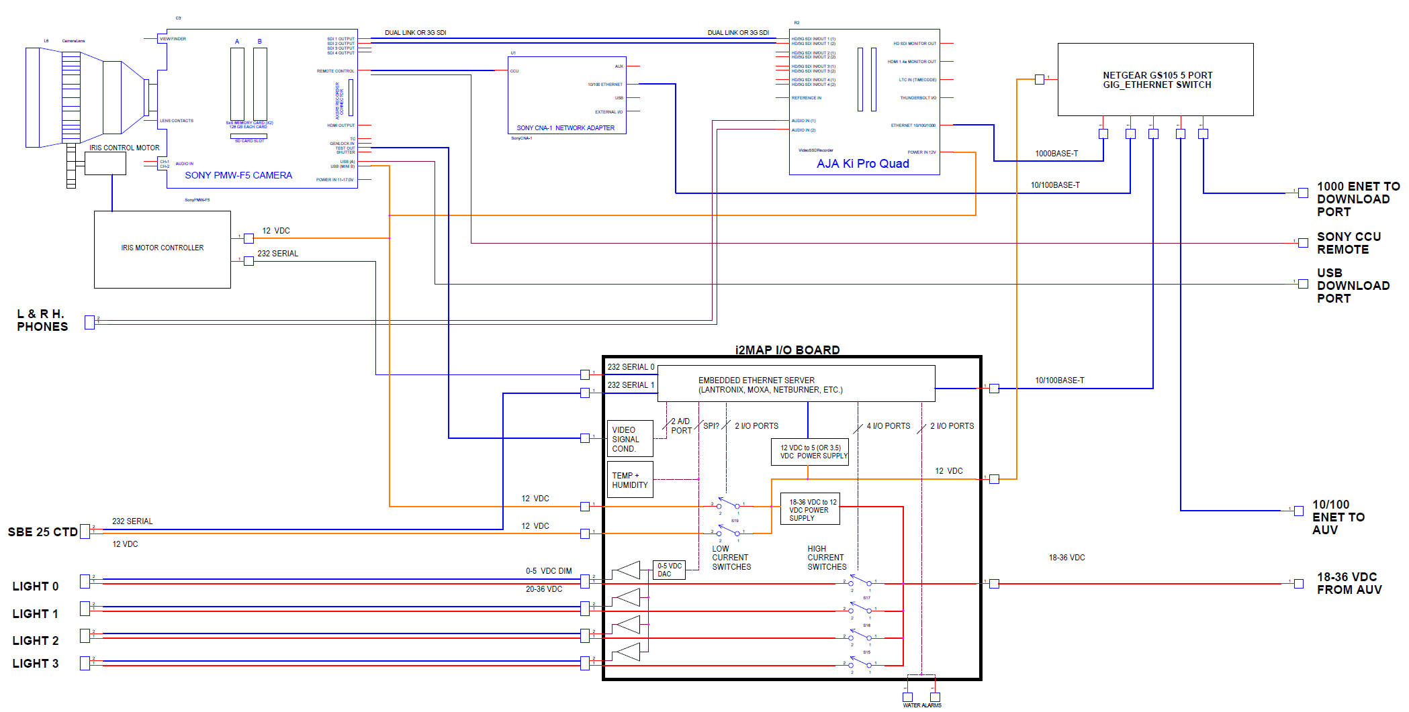
CAMERA HOUSING BLOCK DIAGRAM

Slide 39
