Slide 1
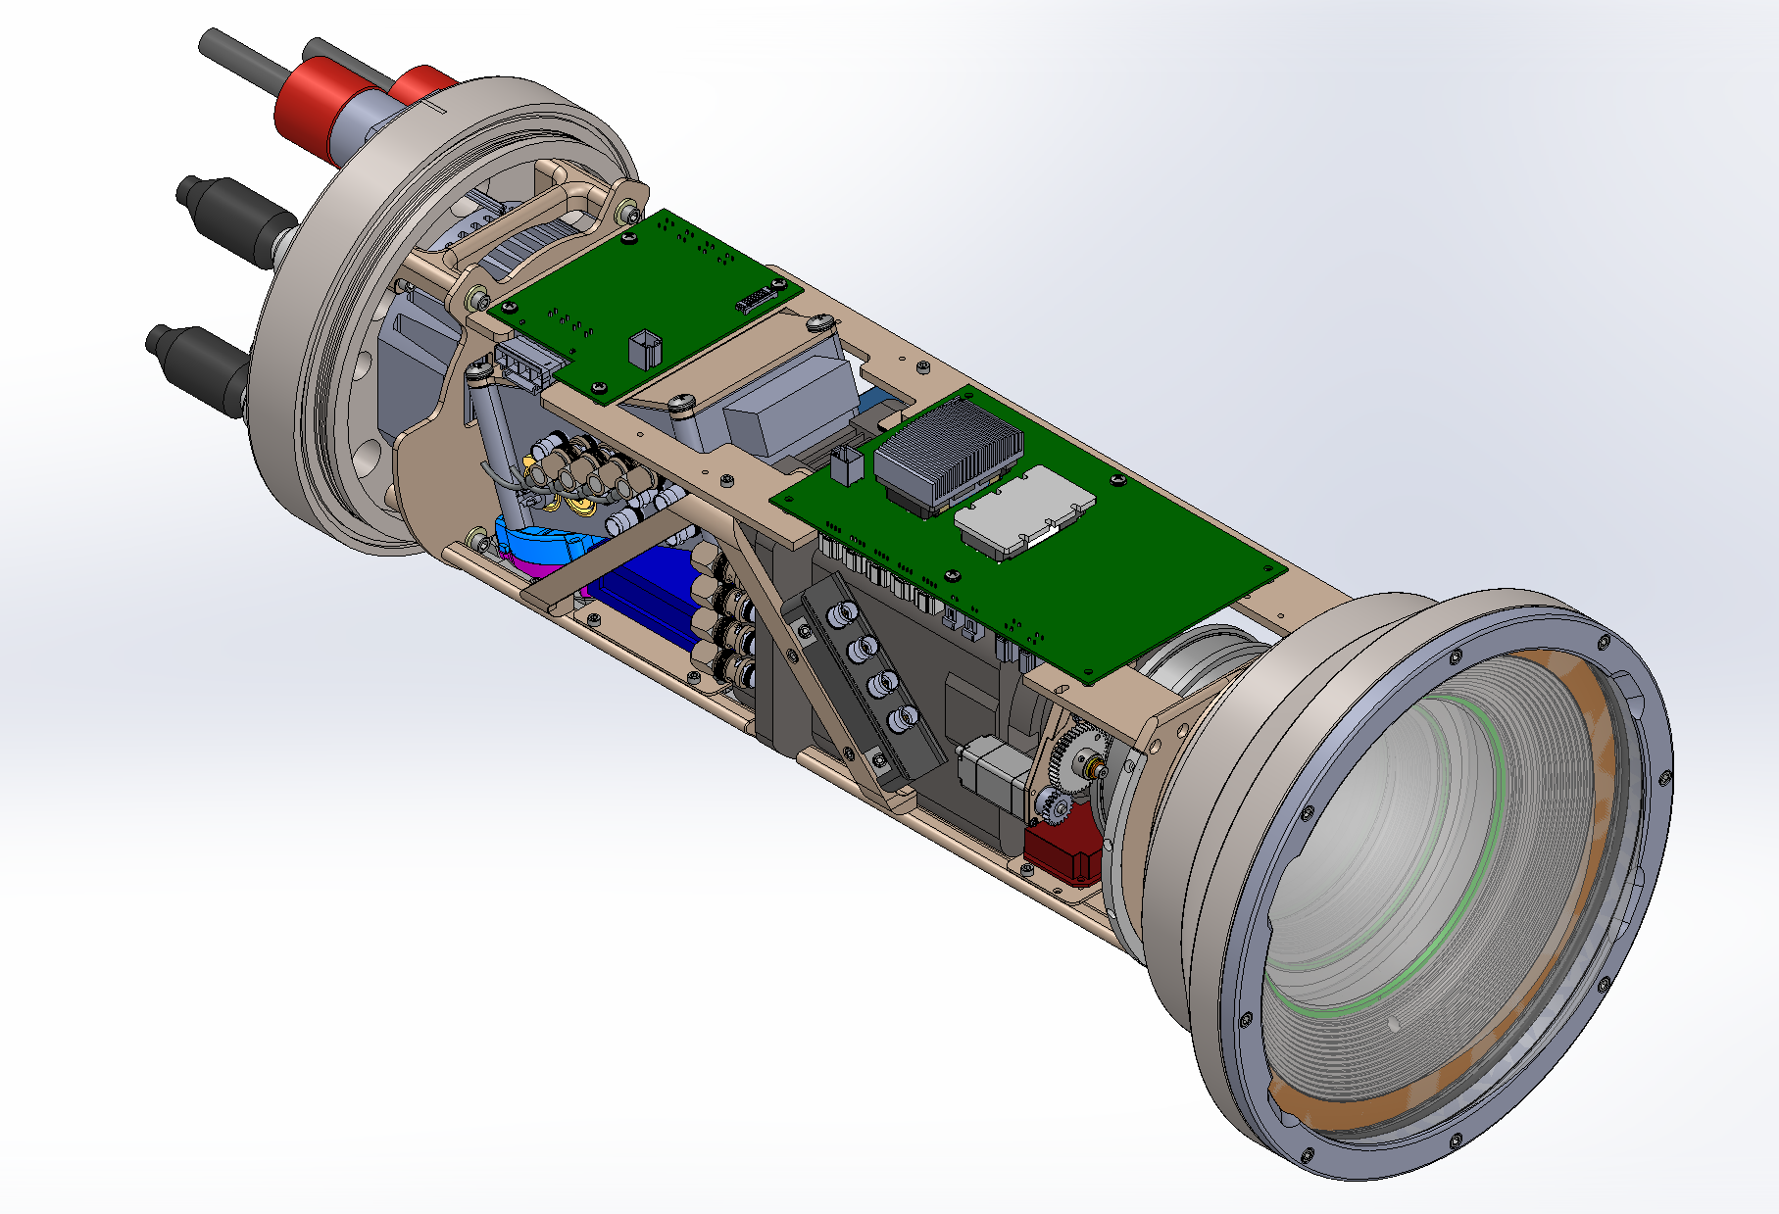
i2MAP Dorado Camera Chassis & Electronics Critical Design Review
Mark Chaffey

Slide 2
Scientific Requirements
  The goal of the i2MAP project is to develop an autonomous imaging system that will allow us to automate the midwater time-series data collection process; to shift from ROVs to AUVs.
  Basic scientific requirement: To build a system capable of collecting video transecting imagery and environmental data of the quality of that currently collected with the ROVs, or better.
  ROV transecting data is currently collected under the following conditions:
  Video quality = 1080i, 30 fps
  Wide field of view (~85º horizontal)
  Adequate and even lighting throughout the field of view
  120 minutes of video storage (11 depths x 10 minute transect each + leader/trailer)
  Speed: 1.0 knots (~55 cm/sec)
  Environmental sensors:
    CTD (salinity, temperature and depth)
    Oxygen sensors x2 (dissolved O2 concentration)
    Transmissometer, 25 cm (water clarity/relative concentration of particulates in water)

Slide 3
Functional Requirements
(see full text in 901209 project folder)
The AUV transecting imaging system must replicate the existing ROV based quantitative mid-water transects such that the results of the transects can be compared in a scientifically valid way.
Maintain the current image data processing and video annotation chain OR create a new processing chain that can be executed with a similar degree of complexity and effort.
Provide for simultaneous operation with an environmental sensing package (CTD, oxygen X 2, and transmissometer sensors) comparable with that of the ROVs.
Meet the weight, balance, interface and configuration requirements of a Dorado AUV payload such that extraordinary measures are not required for routine AUV operation.
Be installed and removed from the AUV Dorado with a minimum of effort, consistent with similar nose cone payloads.
BLUE = Relevant to camera electronics review

Slide 4
Design Requirements
(see full text in 901209 project folder)
Capture format. The imaging system must capture in a progressive scan format with a minimum resolution of 1920x1080 4:2:2 format at 10 bits at 60 frames per second or greater ( 1080 60P) for 120 minutes.
The video records must include SMPTE timecode data that is synchronous with the environmental instrumentation data.
Depth of field. The imaging system shall allow the identification of small plankton at a range from 0.1 to 2.5 meters from the camera dome with the camera lens in a fixed focus position. Note: it is desirable but not required that the camera system be able to image objects further from the camera than 2 meters, ideally out to 10 meters distance.
      Width of field. The lens system shall have at least an 80 degree horizontal viewing angle.
      The light bars shall hold 4 DSPL Sealights in a position that minimizes backscatter and glaring.
The Dorado camera payload shall provide for simultaneous operation with the standard CTD, oxygen (x2) and 25 cm transmissometer instruments of the CTD AUV OR duplicate these instruments on the camera payload. The data must be available as part of the standard AUV data load path and be accessible to VARS.
Operate at specific depths from 50 meters to 1500 meters performing 11 individual transects of 330 meters length.
  Dorado shall maintain a constant depth during a commanded transect to within +/- 1 meter.
  Dorado shall maintain a constant pitch angle during a commanded transect of +/- 10 degrees.
  Dorado shall maintain a constant roll angle during a commanded transect of +/- 20 degrees.
The electrical interface to the Dorado AUV must be compatible with:
    18 to 36 Volts DC, 15 Amperes maximum continuous current. Note that SeaCon reports 16A
    The data interface is 10/100BaseT Ethernet.

Slide 5
Mechanical System Design
    Chassis design overview
      Material selection
    Positioning tolerance requirements
      Fore-aft positioning
        Rear stand-offs
        Front alignment cone
      Radial alignment
      Stiffness to prevent sag (tilt effects)
    Effects on tolerances of Thermal changes

Slide 6
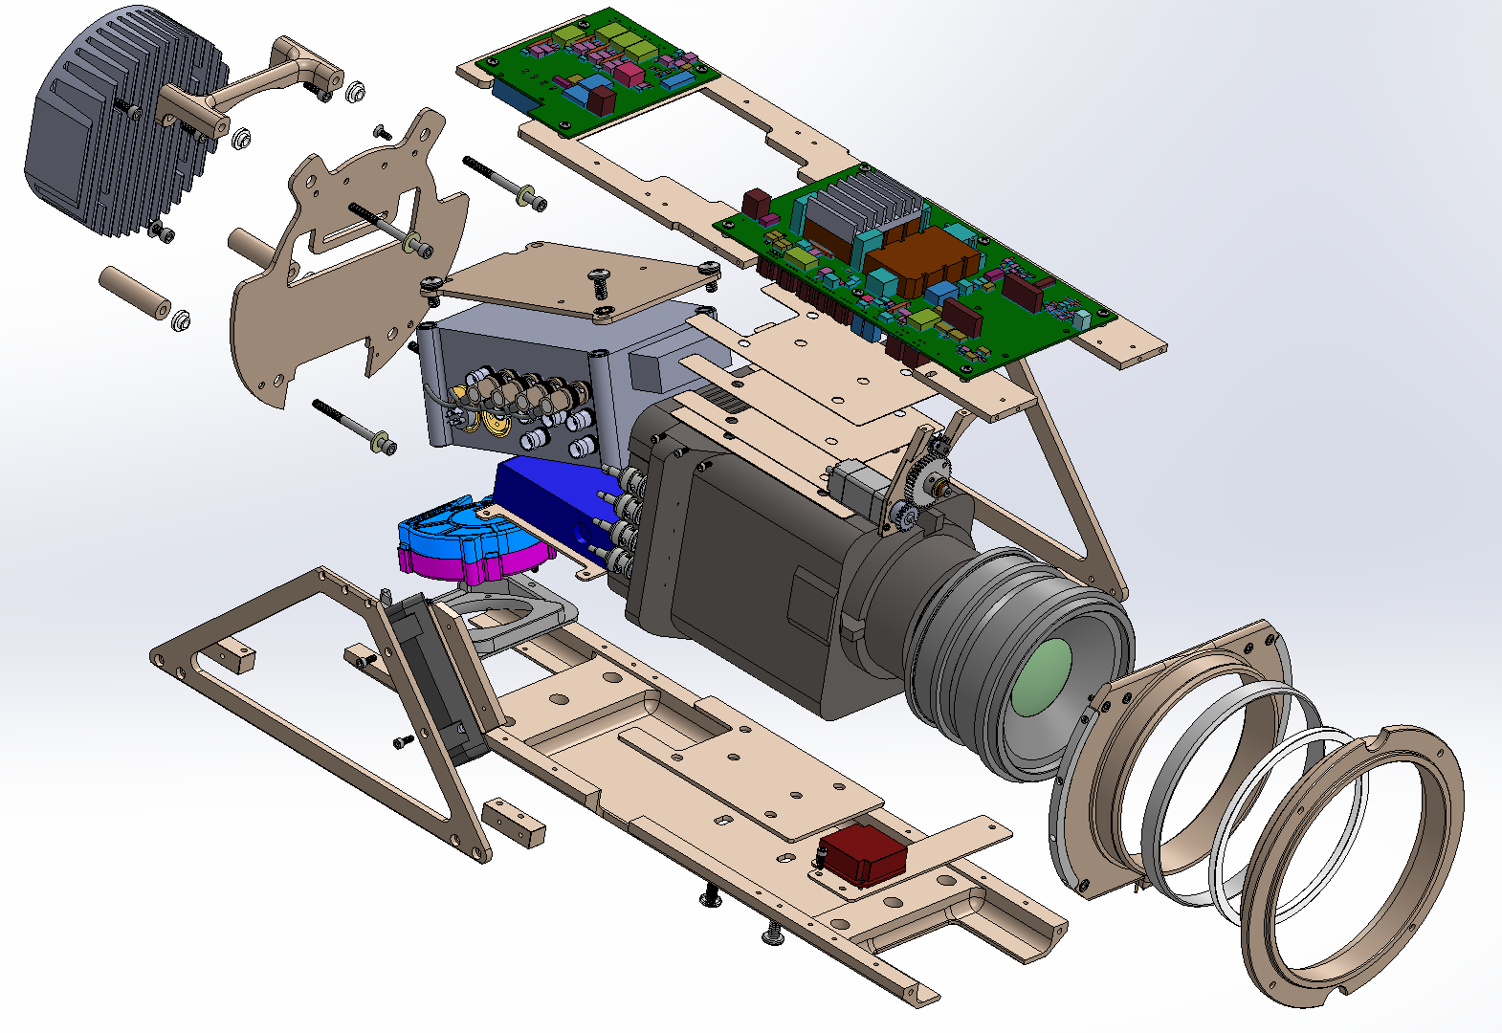
Mechanical Overview - Exploded

Slide 7
Material Selection
Polymer parts are specified for low outgassing properties:

Slide 8
Critical Mechanical Tolerances
Camera lens to port adapter optics distance.
  Effects of thermal expansion.
Camera lens and imager axial alignment with port adapter optics.
Mating tolerance of chassis during housing closure.

Slide 9
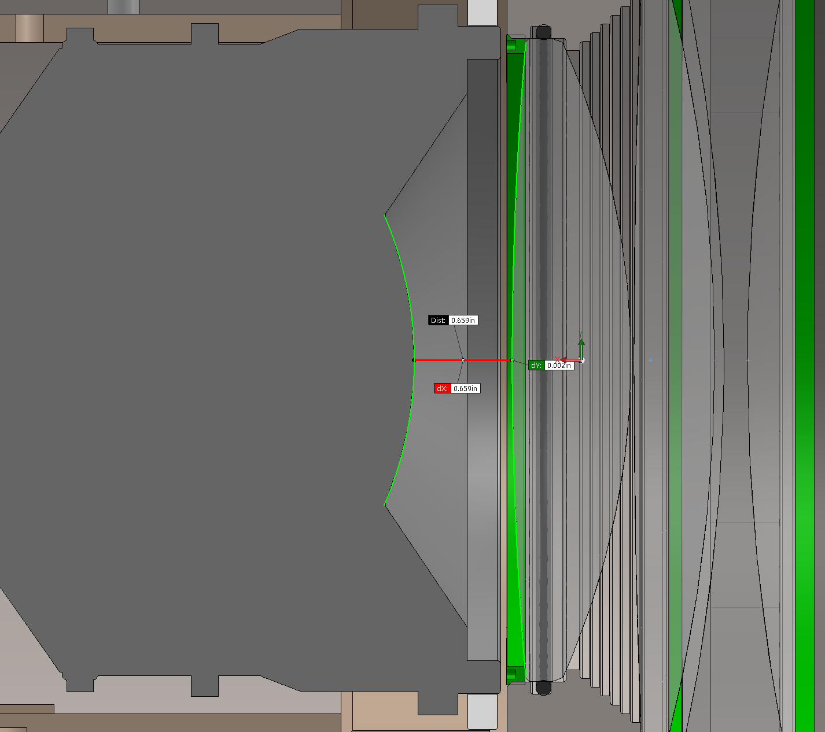
Critical Tolerances – Camera Lens to Port Adapter Lens
Optical design specification:
17 +0 -2 mm
Current design value 16.74mm

Slide 10
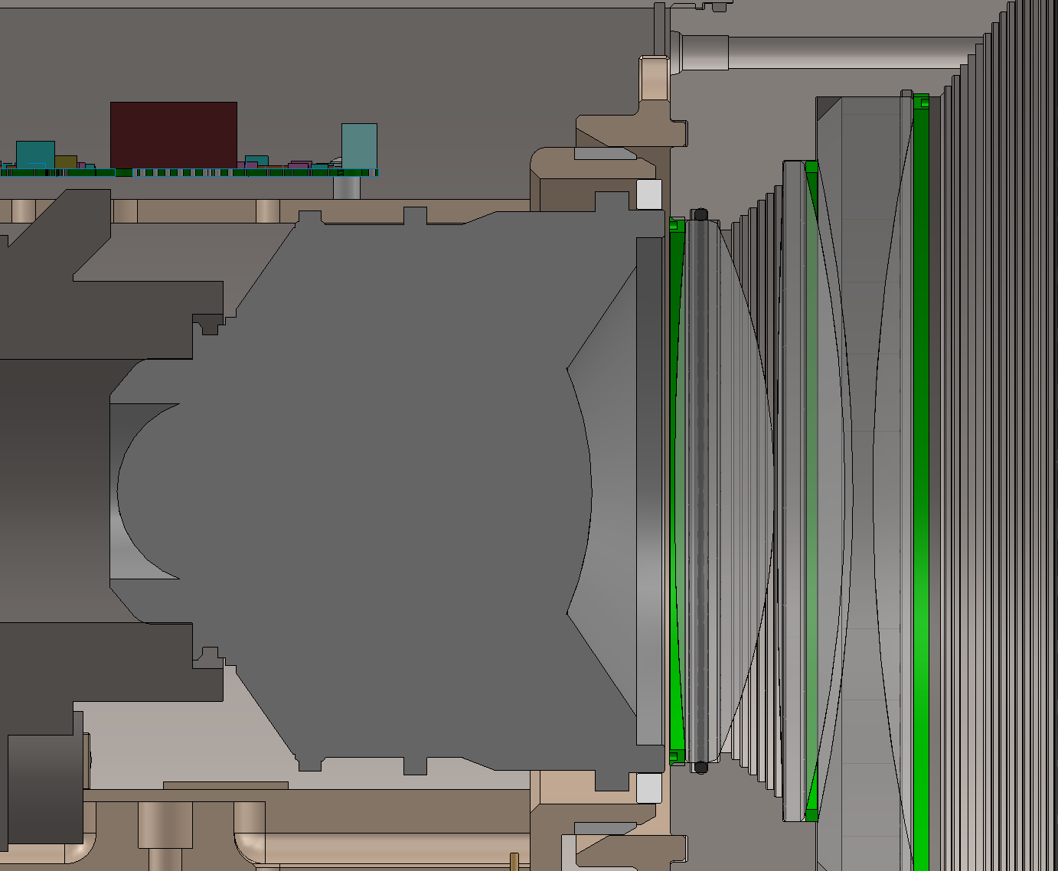
Critical Tolerances – Camera Axial Alignment with Port Adapter
Optical design specification:
+/- 0.7 mm (0.027”)
Current design value 0.47mm (0.0185”)

Slide 11
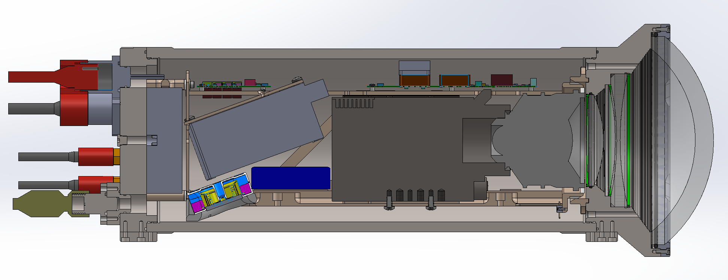
Critical Tolerances – Thermal Changes
Assumptions:
Housing and camera chassis are toleranced at 21 degrees Celsius.
Worst case is housing goes to 0 degrees and chassis goes to 40 degrees.
Aluminum distance
Titanium distance

Slide 12
Thermal Calculation
OK!

Slide 13
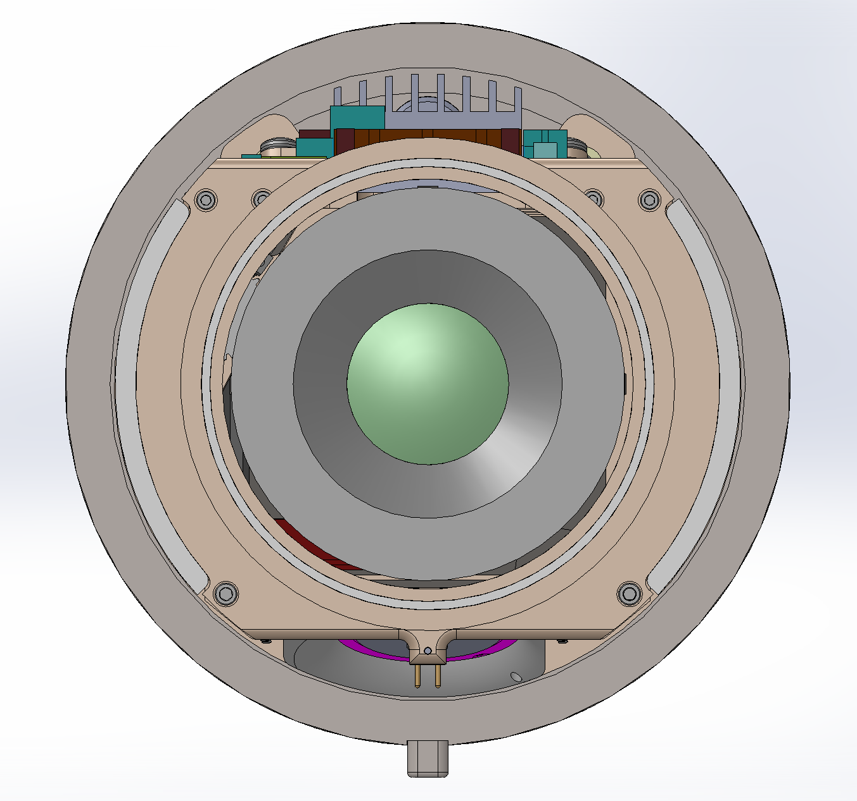
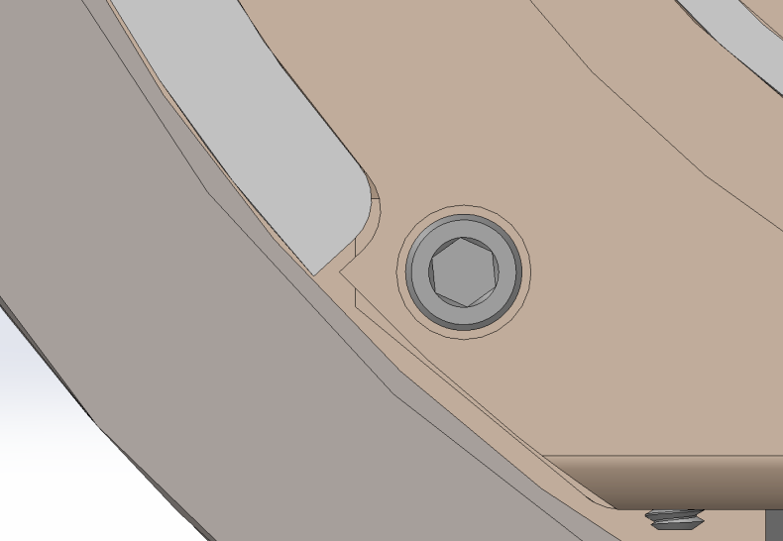
Critical Tolerances - Vertical Clearance
0.070”

Slide 14
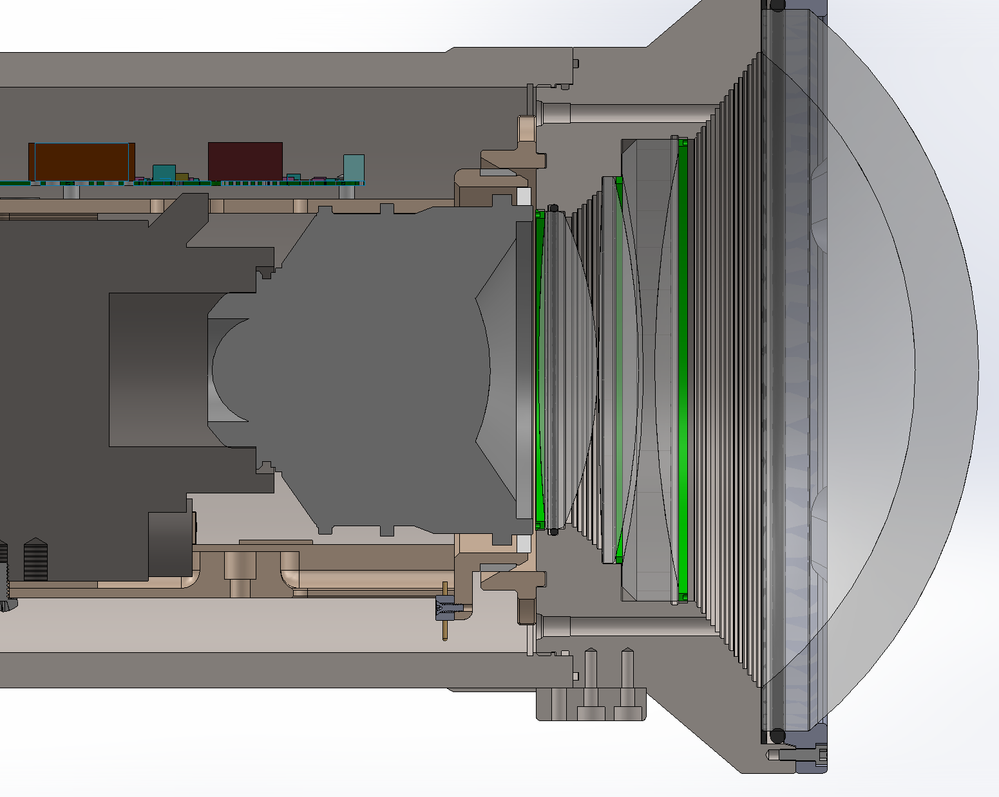
Critical Tolerances – Vertical Clearance
Design maximum assembly
miss-alignment = 0.307”

Slide 15
Electrical System Design
  AUV wet wiring
  Camera housing internal wiring
  Input & light switching printed circuit board
      Current limits & fault reporting
        MOSFET AUV BUS switches and PCB traces
      Thermal analysis
        High current switches

Slide 16
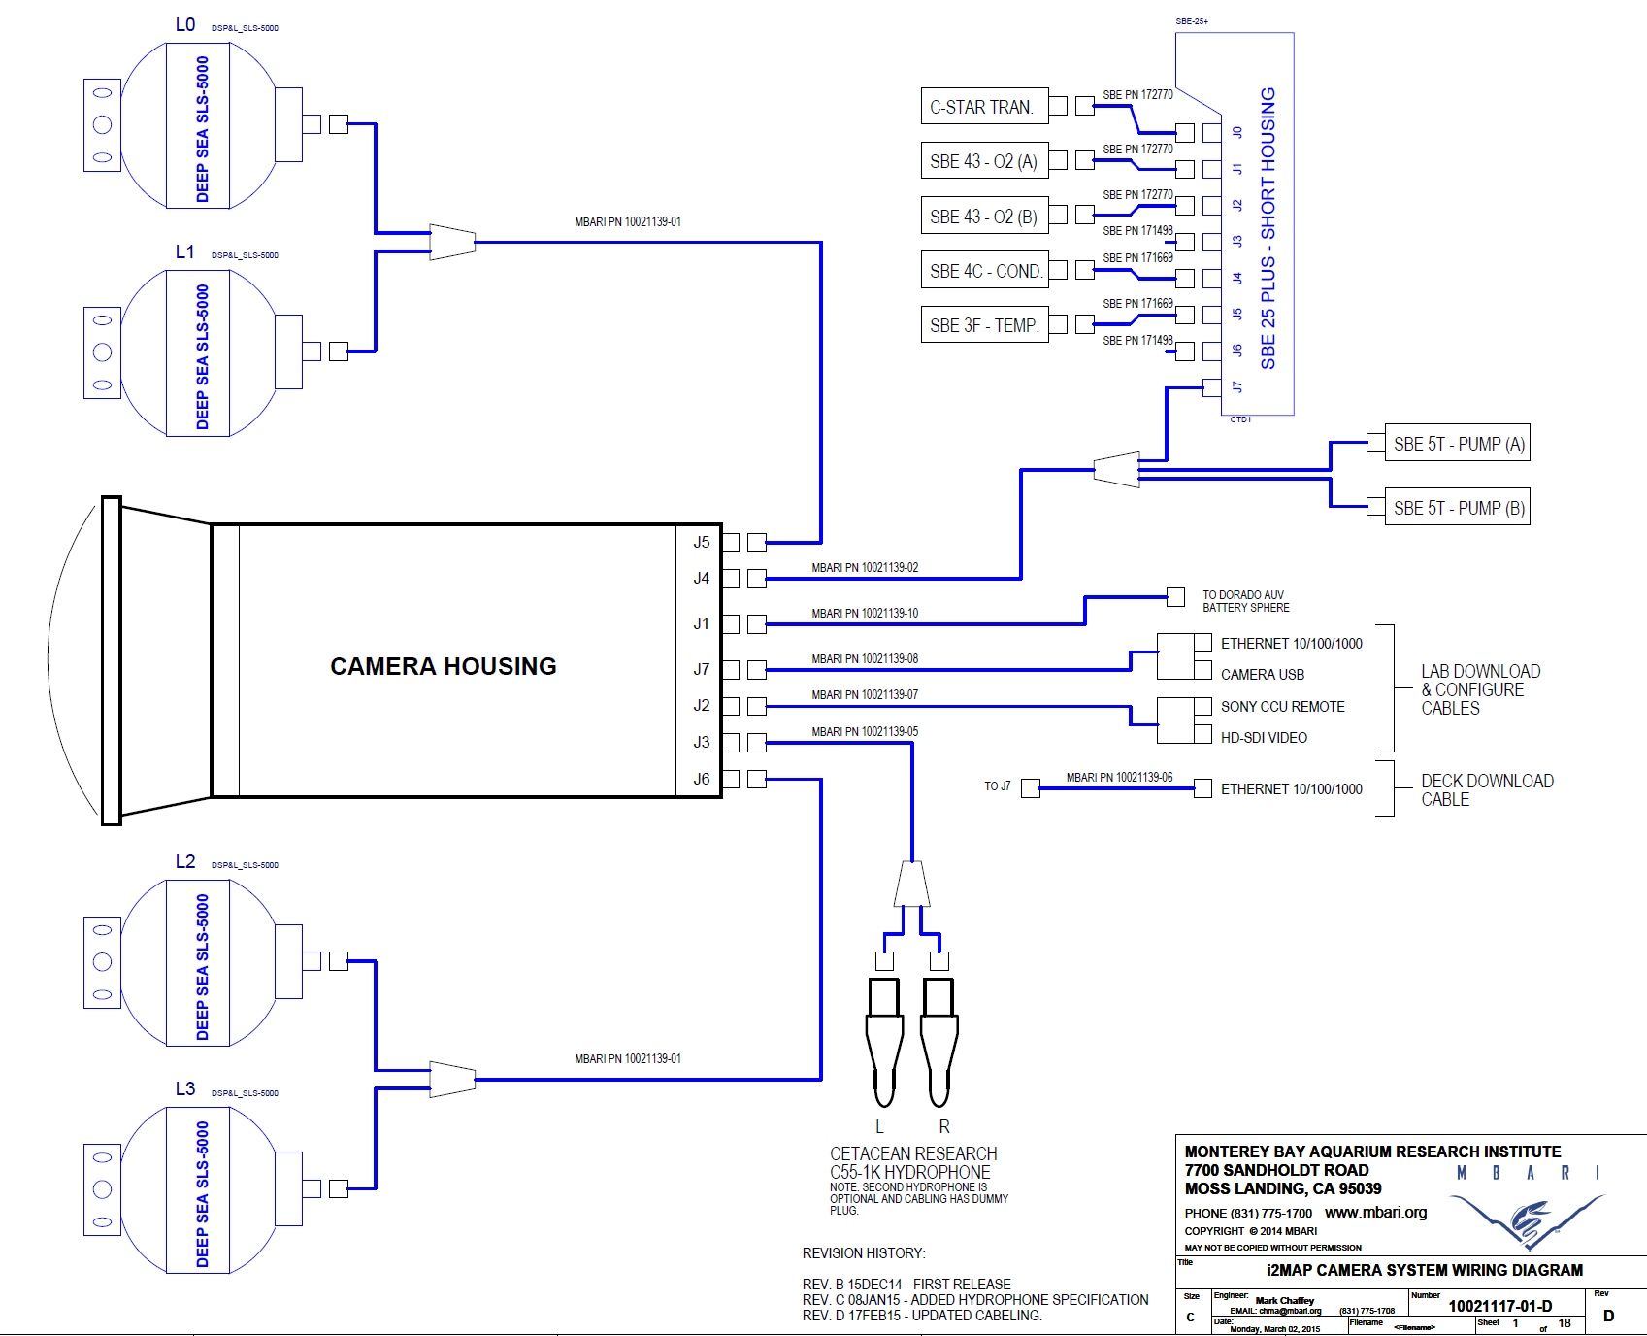
i2MAP System Wiring

Slide 17
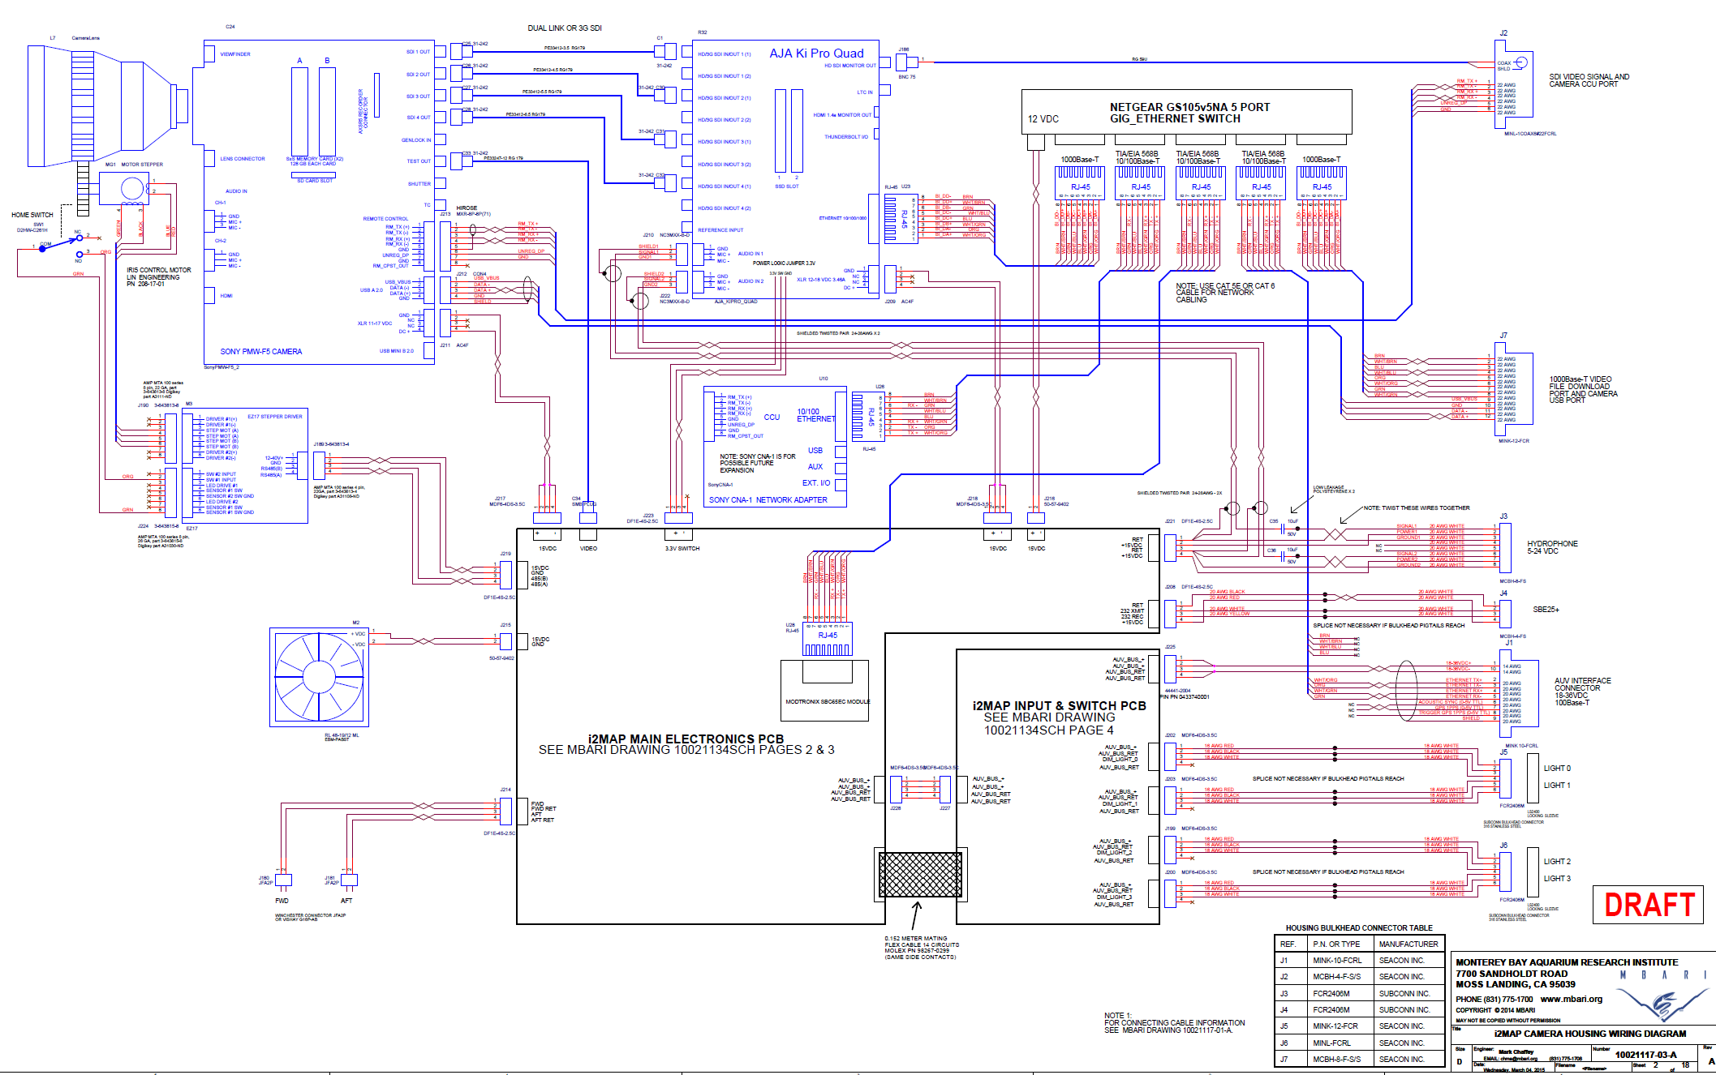
Camera Housing Internal Wiring

Slide 18
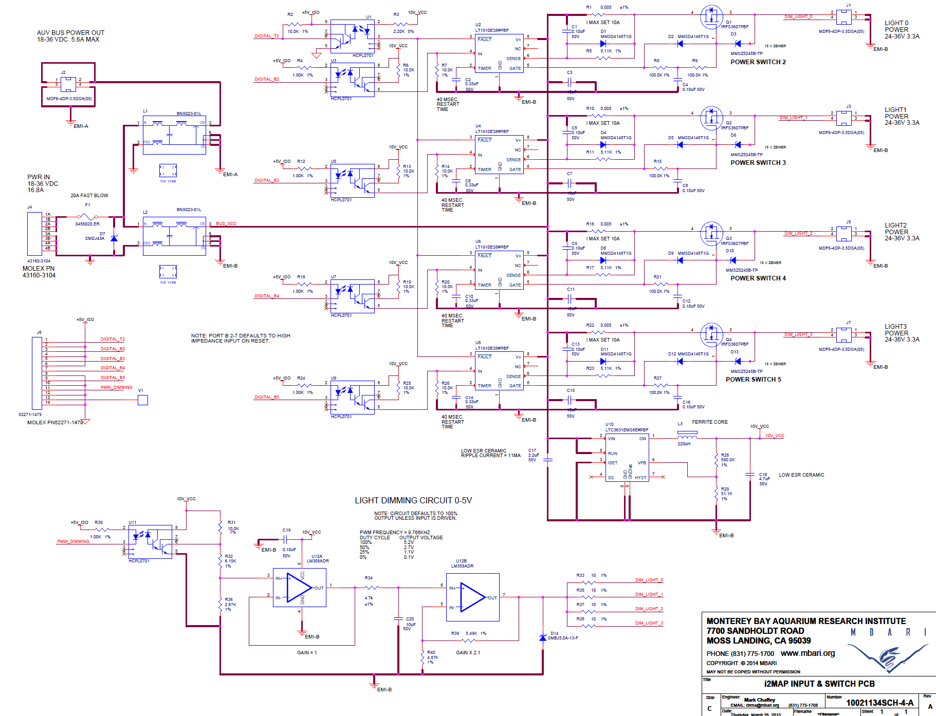
Input & Switching PCB

Slide 19
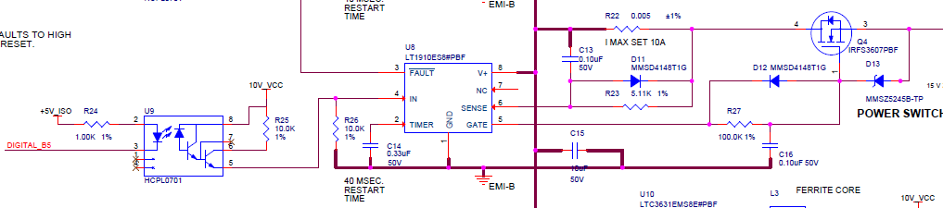
AUV BUS Level Light Switch
Current limit delay network
Current inrush limiting network
Design current 10A max. (lights are 3.2A).
MOSFET dissipation 1.35W worst case.
Worst case junction operating temp. 94C @ 40C ambient.
Max. allowable MOSFET junction temp. 175C!

Slide 20
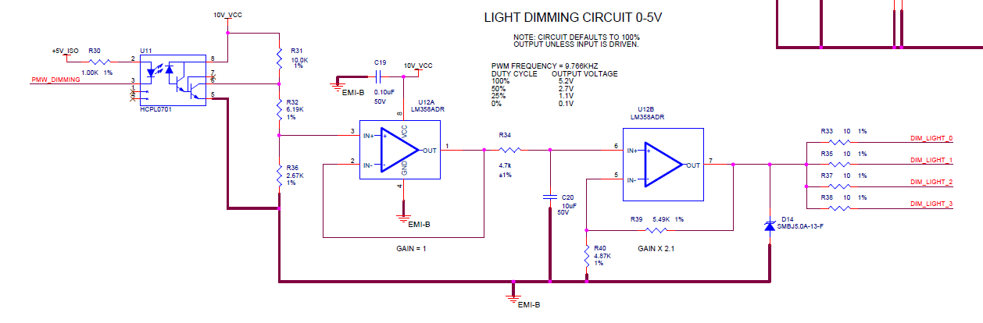
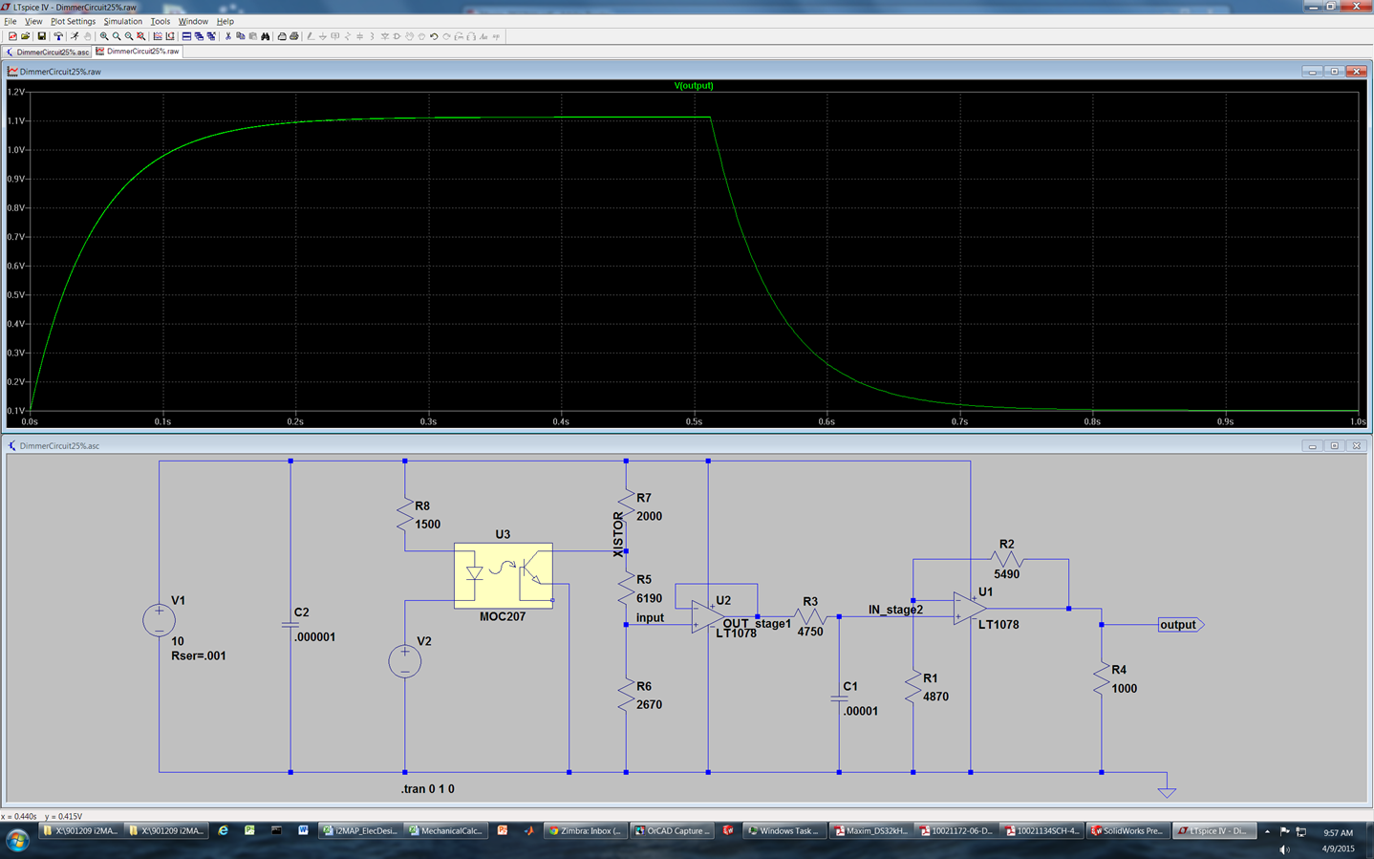
Dimming Circuit
Example of 25% Duty Cycle

Slide 21
Electrical System Design-continued
  Main electronics PCB
      Loads on individual switch circuits
      Thermal analysis
        15 Volt bus witches
        Vicor & heatsink
      Housing environmental sensors
        Overtemperature shutdown circuit
        Water alarms
        Humidity sensor
      Video circuits
        Video recorder switch
        Average and peak detector
      Modtronics CPU module
        I/O pin list

Slide 22
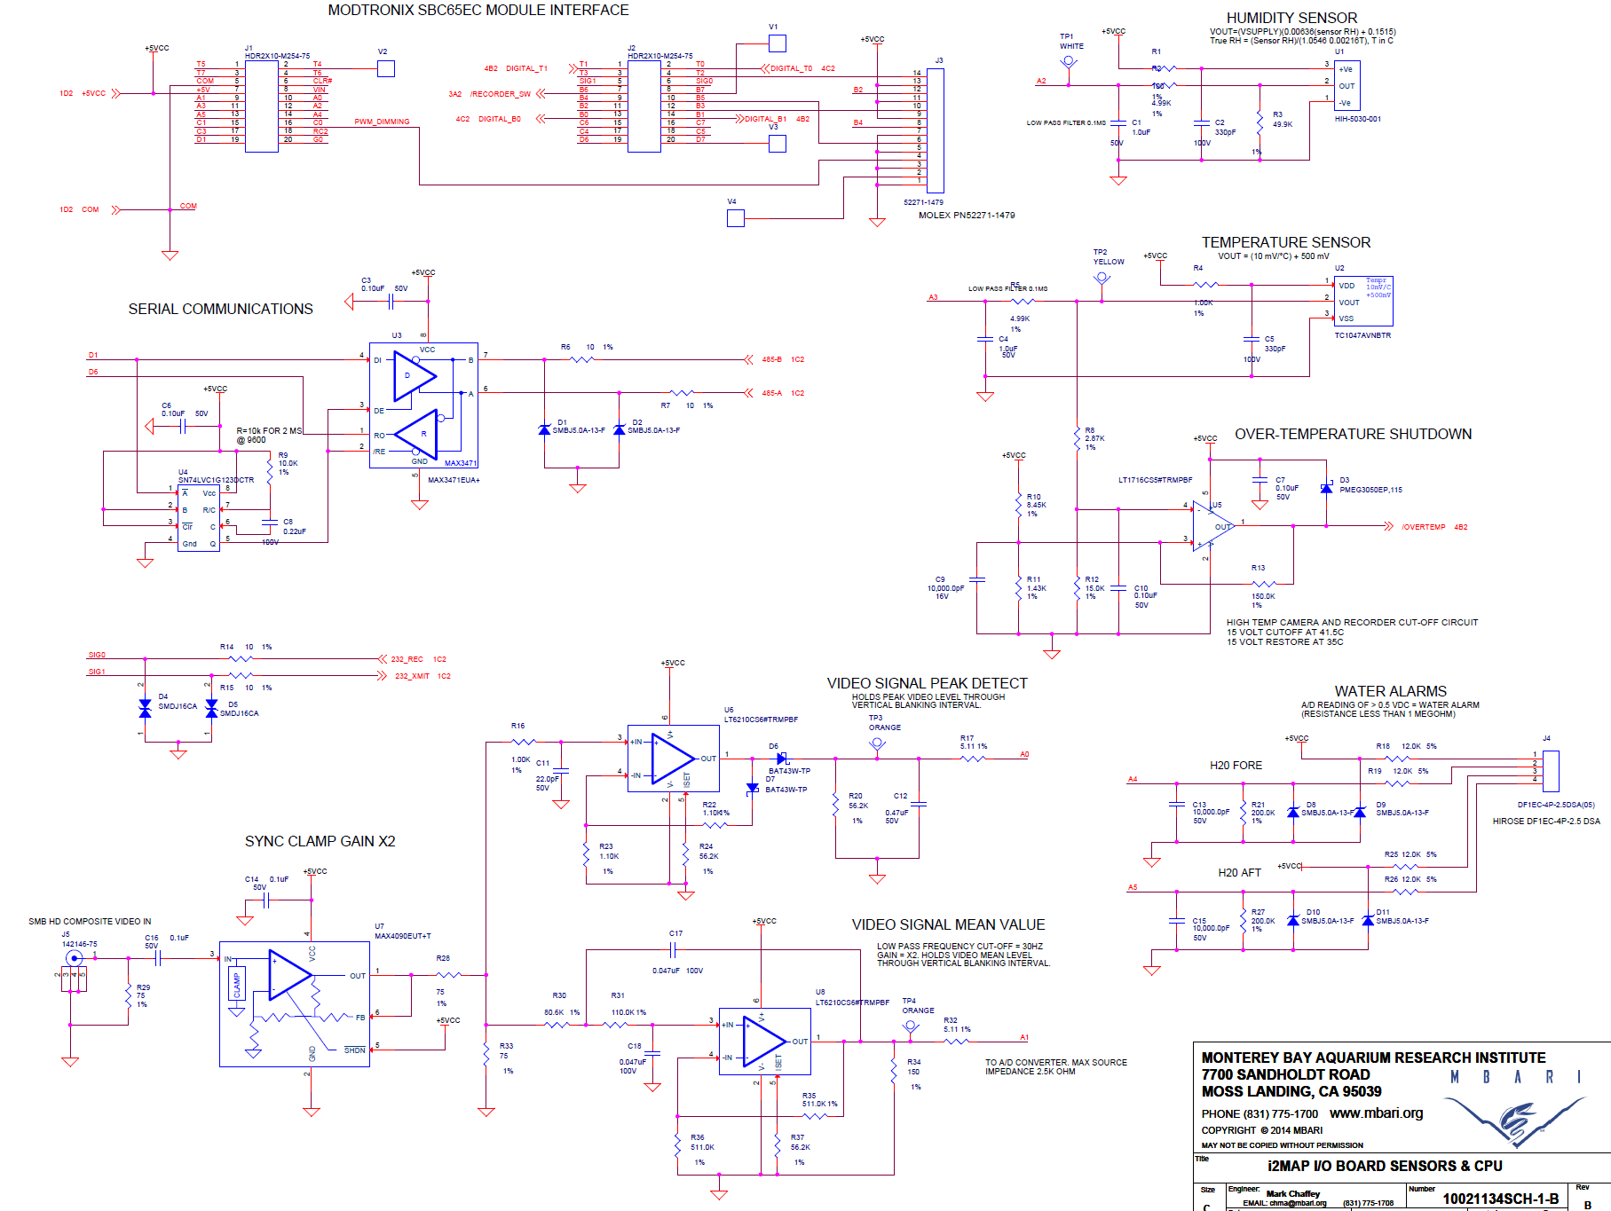
Main Electronics PCB pg.1

Slide 23
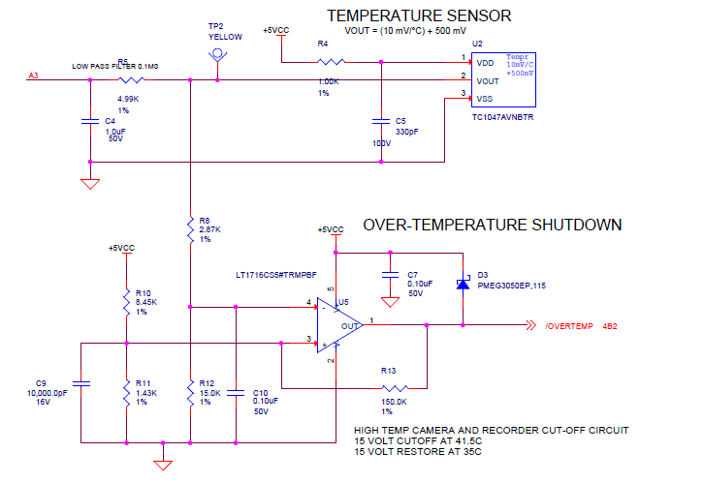
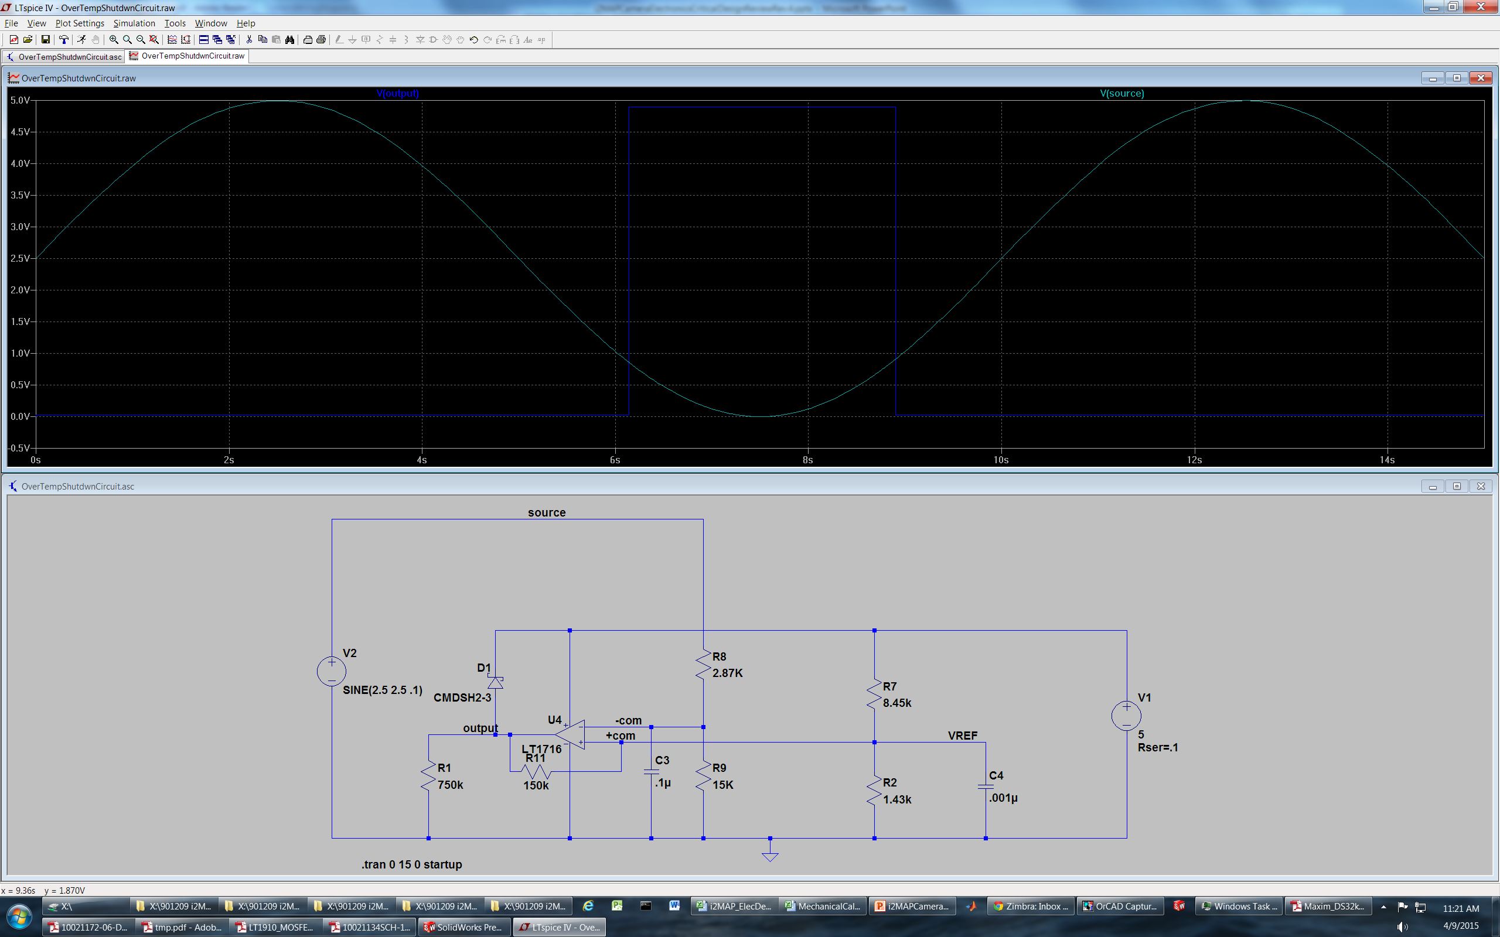
Over Temperature Shut-Down

Slide 24
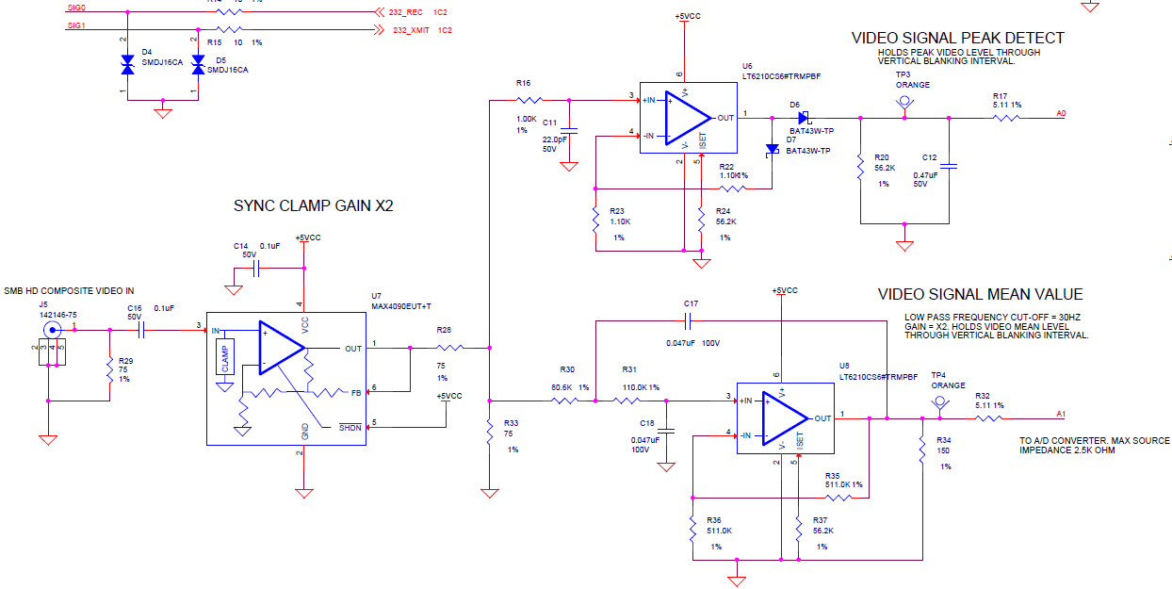
Video Circuits

Slide 25
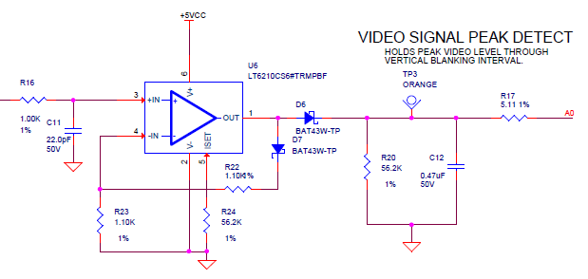
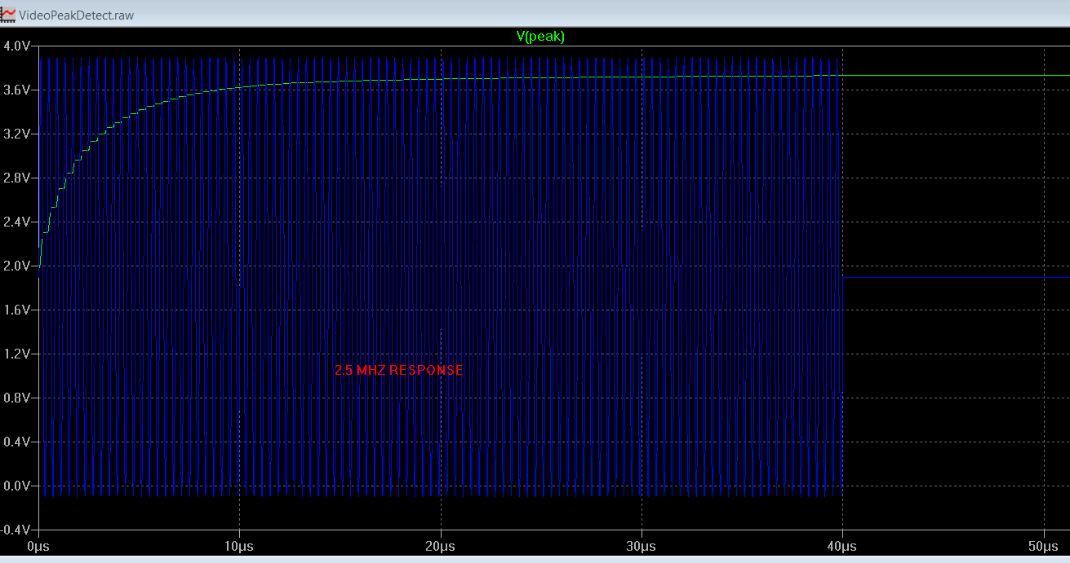
Video Peak Detect

Slide 26
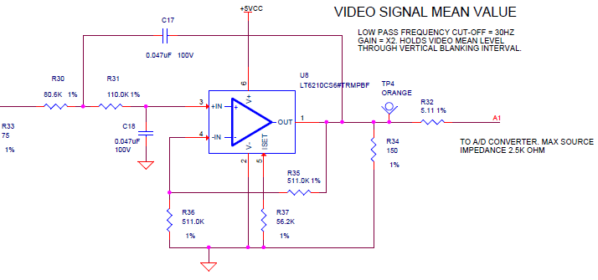
Video Mean Level

Slide 27
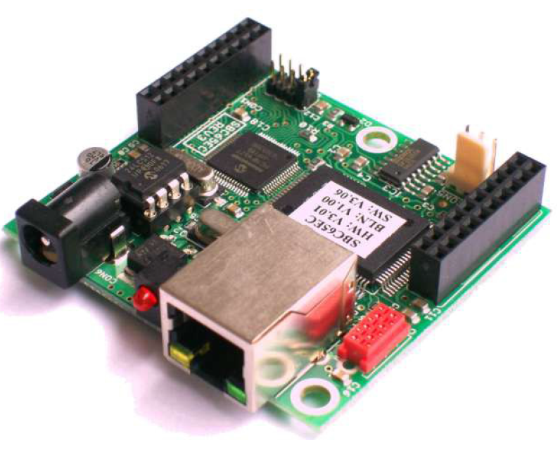
Modtronix SBC65EC Micro
Simple HTML based API
Based on PIC18F6627 CPU
32 channels of analog and digital I/O
Two USART interfaces

Slide 28
Modtronix SBC65EC I/O

Slide 29
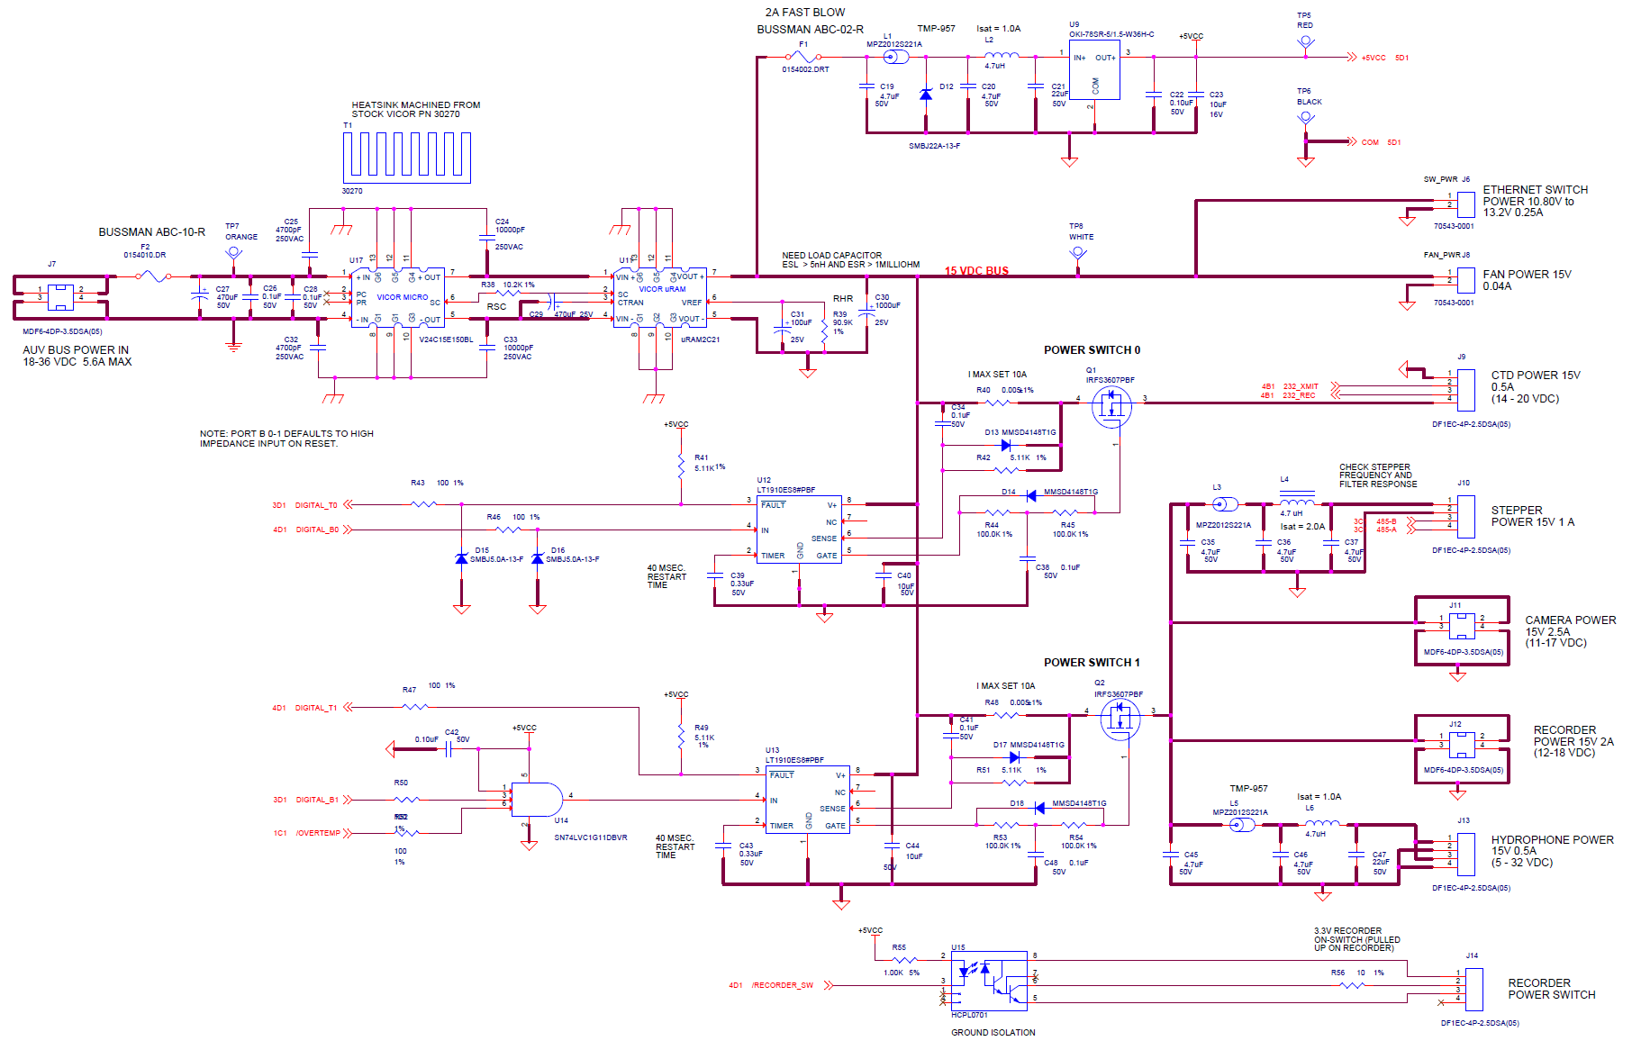
Main Electronics PCB pg.2

Slide 30
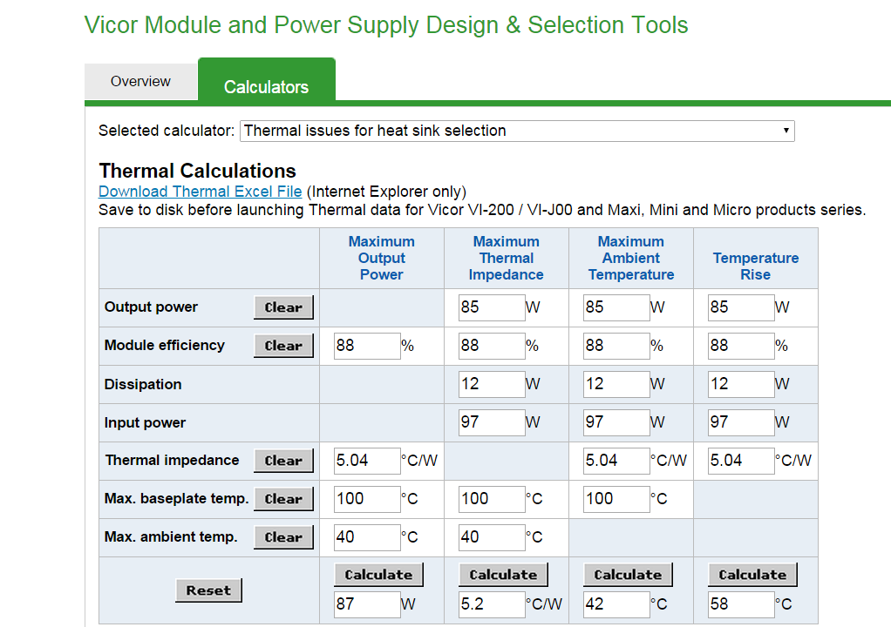
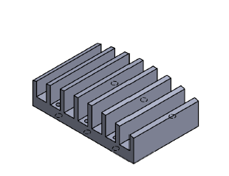
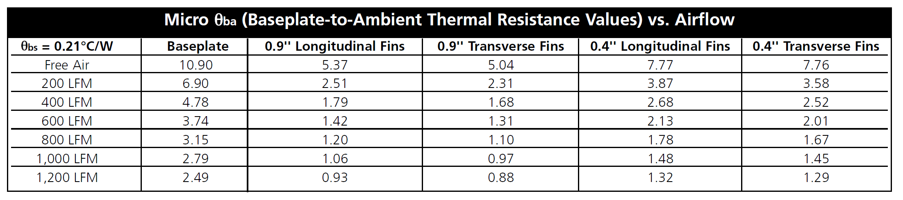
Vicor Power Dissipation
Thermal dissipation is very close or over the limit in still air – depending on air flow for good performance

Slide 31
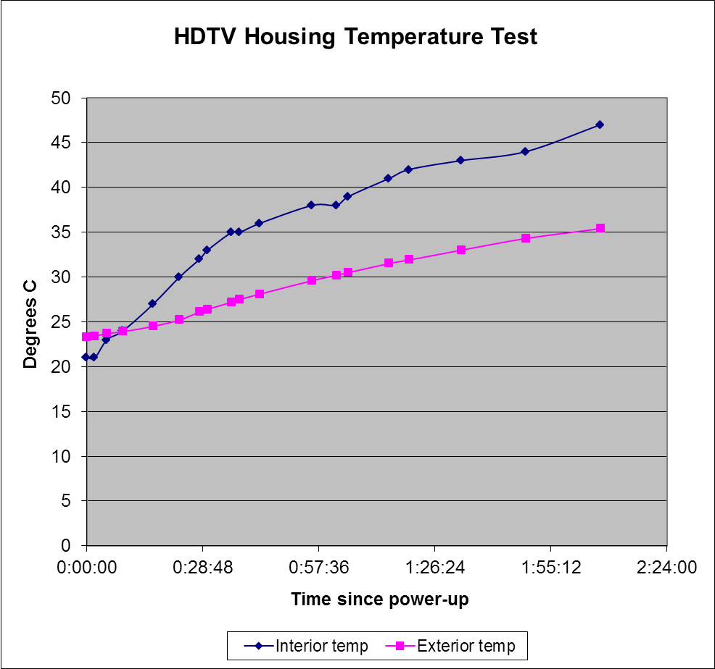
HDTV Housing Thermal Testing

Slide 32
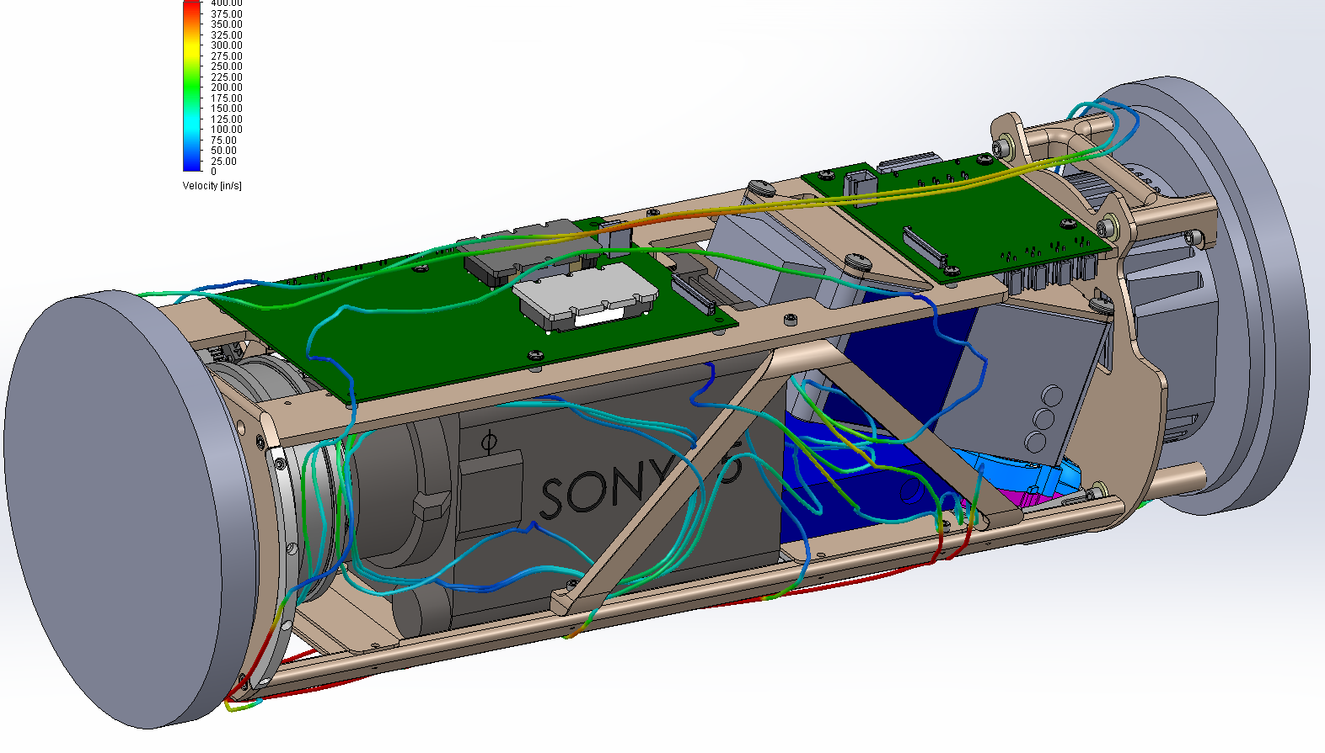
Housing Internal Air Flow (x1)
200 in./second = 1000 linear feet/minute
OK!

Slide 33
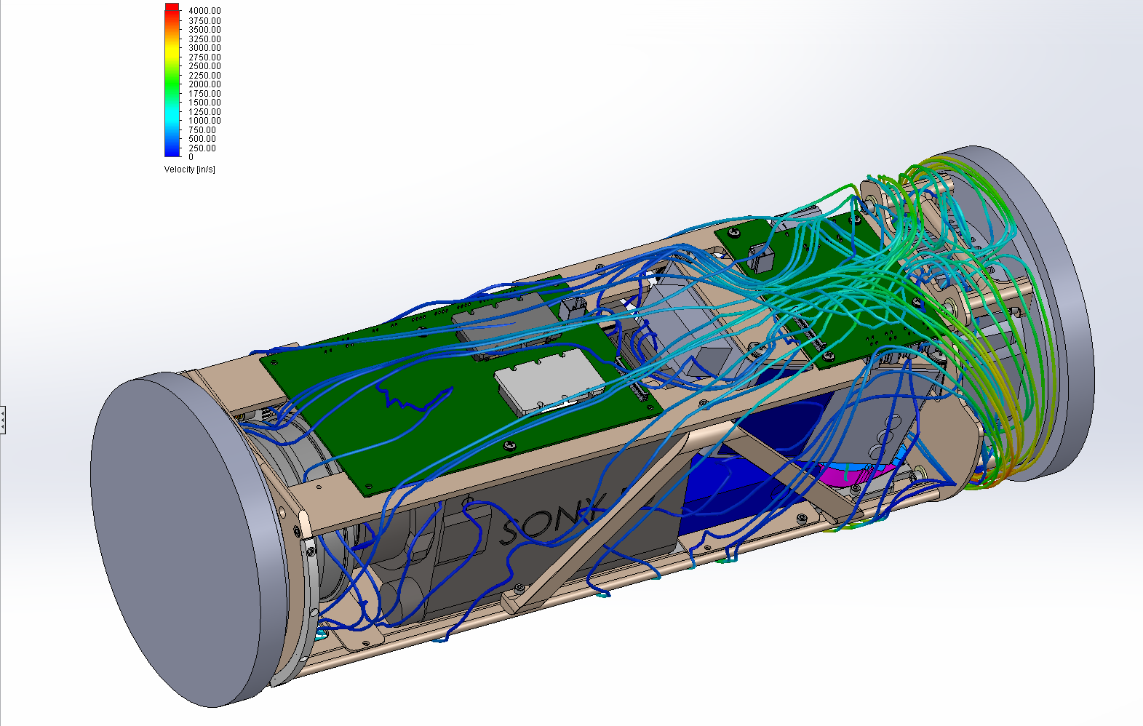
Housing Internal Air Flow (x 100)

Slide 34
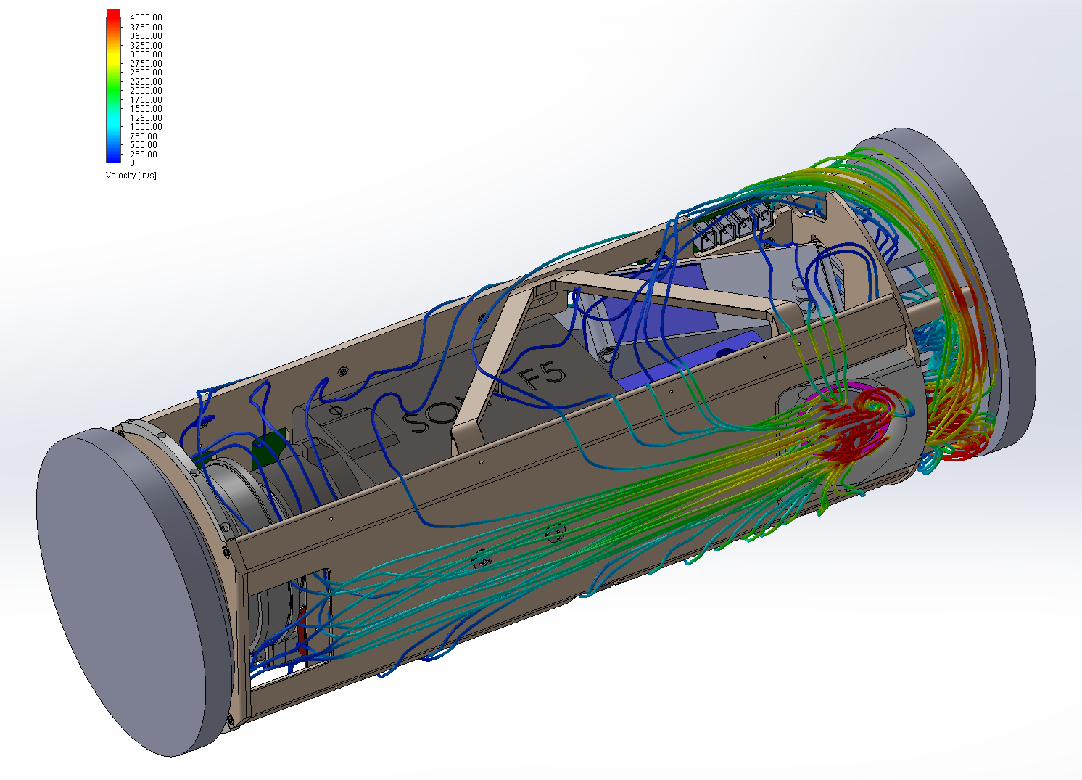
Housing Internal Air Flow (x 100)

Slide 35
Electrical System Design-continued
  Energy budget
    Re-visit AUV energy budget
  AUV and data downloading interface
    AUV connector
      Current limit
  CTD and other environmental sensors

Slide 36
i2MAP Payload Energy Budget
SEE INTERFACE PAGE

Slide 37
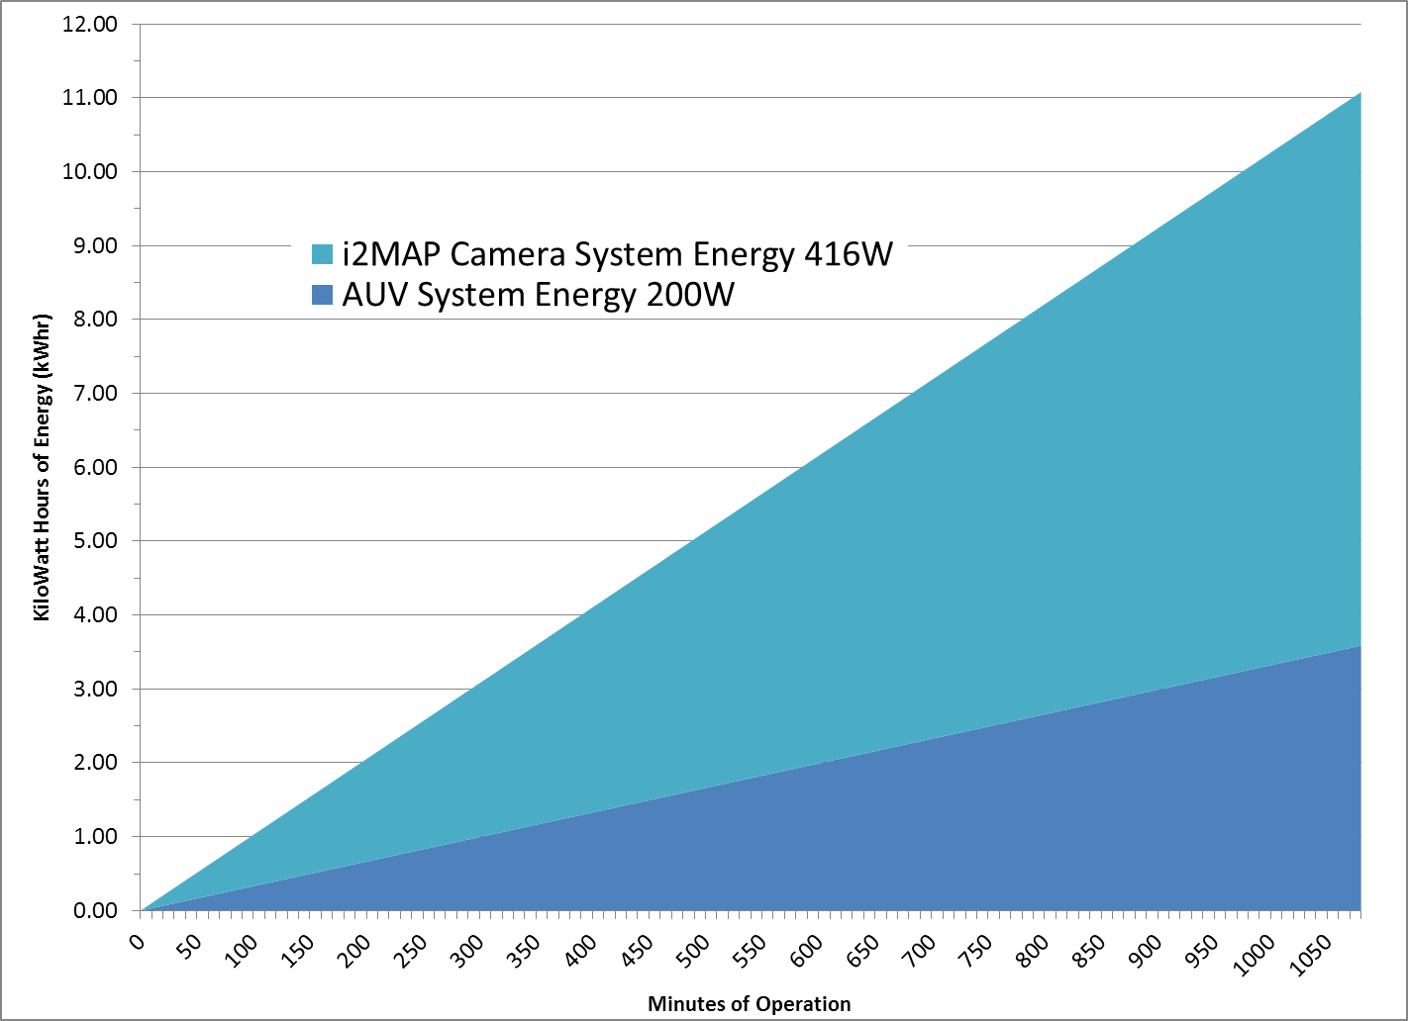
Total Energy Use by Dorado (@ 1 m/sec.)
2 Battery Spheres (7.4 kWhr)
i2MAP
1 Battery Sphere (3.7 kWhr)
AUV
Notes:
On the total energy budget we are completely OK with one or two battery spheres.

Slide 38
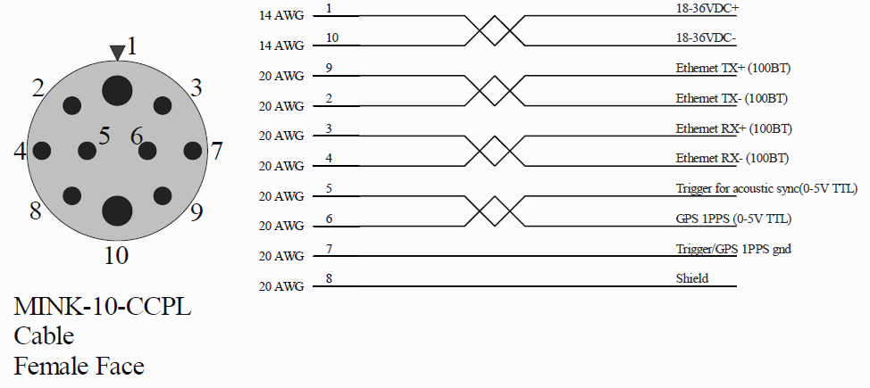
Dorado AUV interface & Power Budget
Hardware Interface.
  The electrical interface to the Dorado AUV must be compatible with:
    18 to 36 Volts DC. (new battery will be 20-36V)
    16 Amperes maximum continuous current . (SeaCon reports 16A)
  NOTE: this is 288 Watts at low battery and 576 Watts at high battery. We need about 416 Watts to run 4 lights full power (16A @ 26VDC).
  The data interface is 10/100BaseT Ethernet.
(Received via email from Hans Thomas February 25, 2014)

Slide 39
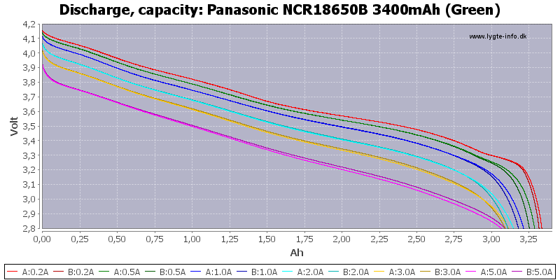
i2MAP Limited by AUV Connector Maximum Current
With 4 x 80 Watt lights we are limited by the Dorado interface connector 16 Ampere maximum at low battery voltages (<26 Volts).
Required solution:
  Cut off i2MAP lights or reduce output when AUV battery voltage drops below 26 Volts.
  This cutoff will not have a significant effect on the mission endurance.
New Dorado Battery Discharge Curve
Green = 1 sphere rate
2 sphere
Connector limit 16A - 25 Volt Cutoff for 416 Watt i2MAP system

Slide 40
Post-Mission Work Flow
2014-2015
Annotate in VARS using current H.264 file based version
Export to H.264
Archive .mov files in Atlas Server
6 TeraBytes Maximum thru 2015
AJA Quad Pro ProRes 10 bit 422 (HQ) Recording (.mov)
Timecode lost
Timecode must be reconstructed
CAMERA
Sony F-5 or F-55
Annotate in VARS using updated QuickTime file based version
Timecode preserved
Beyond 2015

