Slide 1
Required Camera & Lens Depth of Field
Species
Front of Camera Dome
Species Initial Identification Distance (cm)

Slide 2
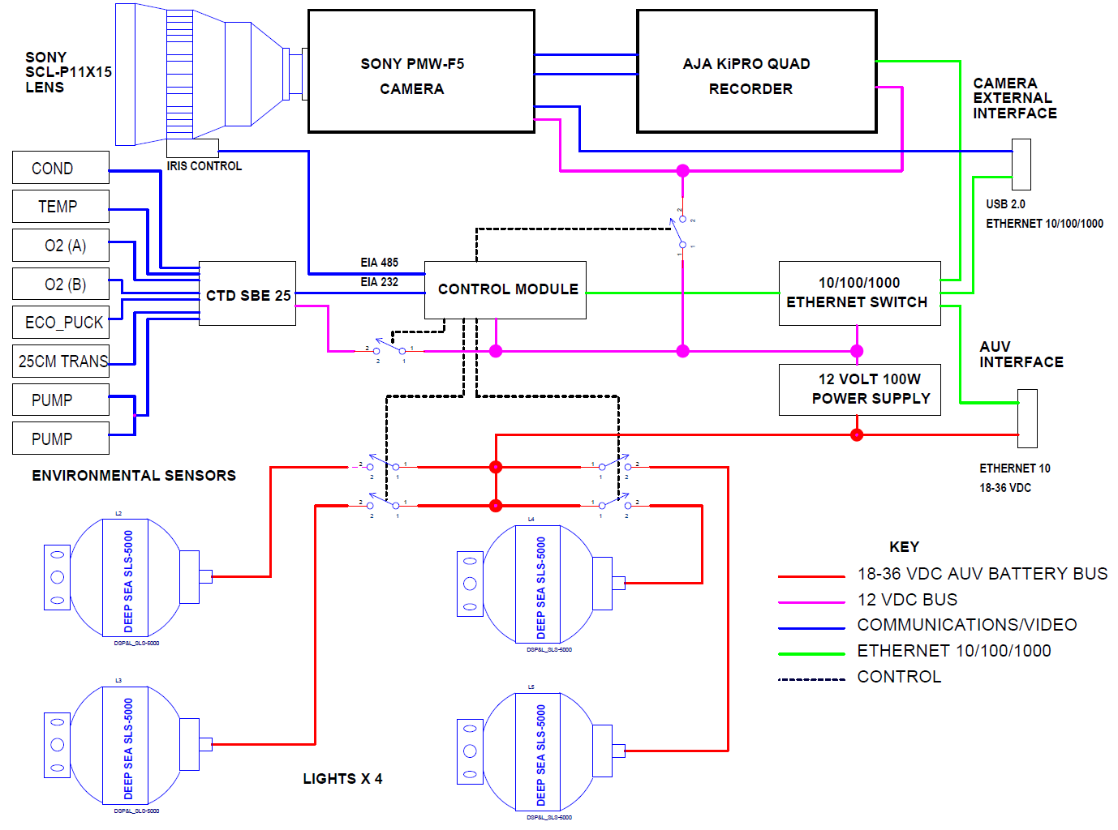

Slide 3
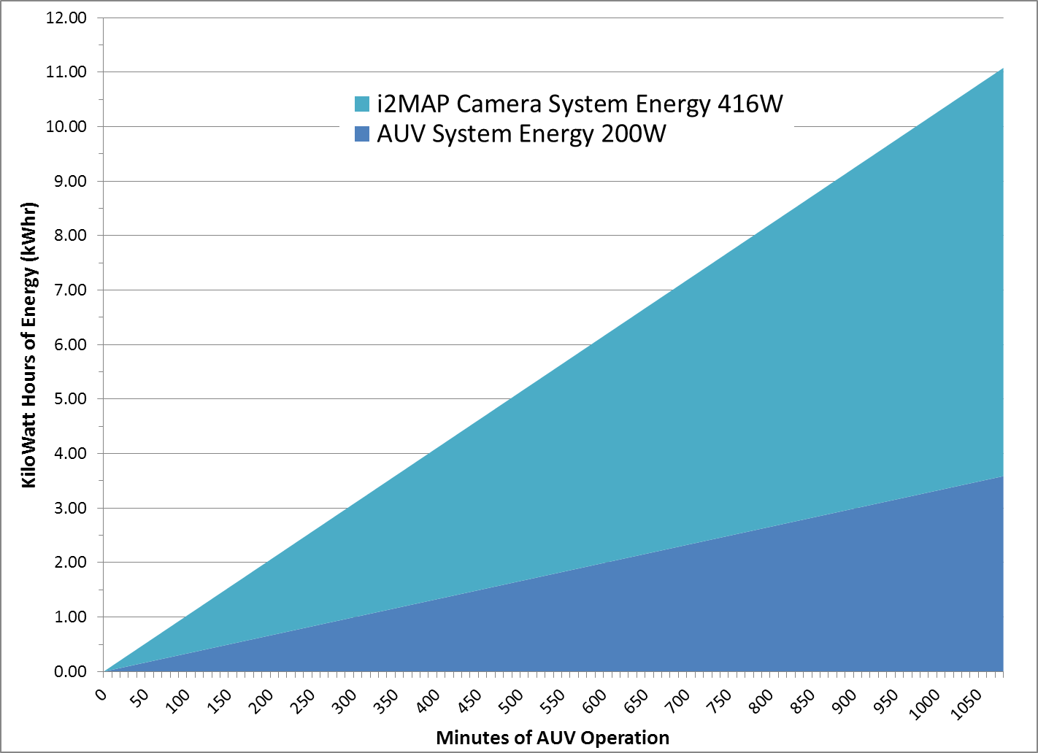
2 Battery Spheres (7.4 kWhr)
Energy Limited Recording Time
1 Battery Sphere (3.7 kWhr)
1 TB Memory Limited Recording Time
Notes:
On the total energy budget we are completely OK with one or two battery spheres.

