Slide 1
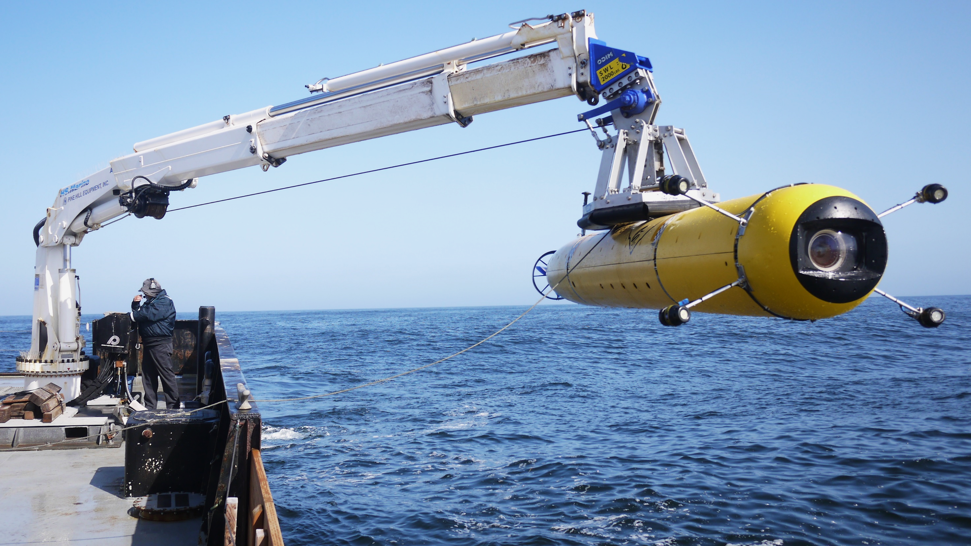

Slide 2
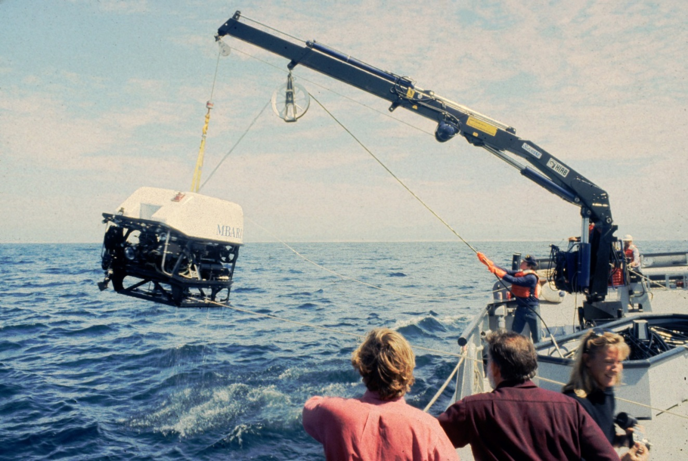
Ventana ca. 1989

Slide 3
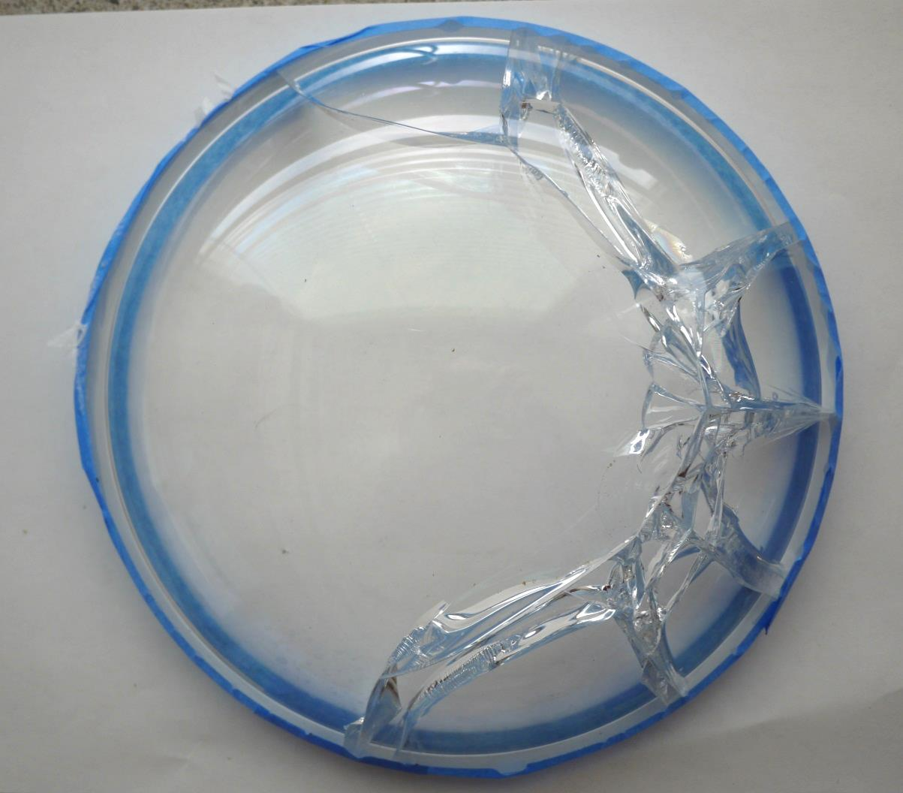
Notes:
Details of the mechanical and optical design.
Detailed design description.
Problems of using a relatively flat dome section.
The challenges of glass under stress.
Glass fatigue design methodology.
Design solution.

Slide 4
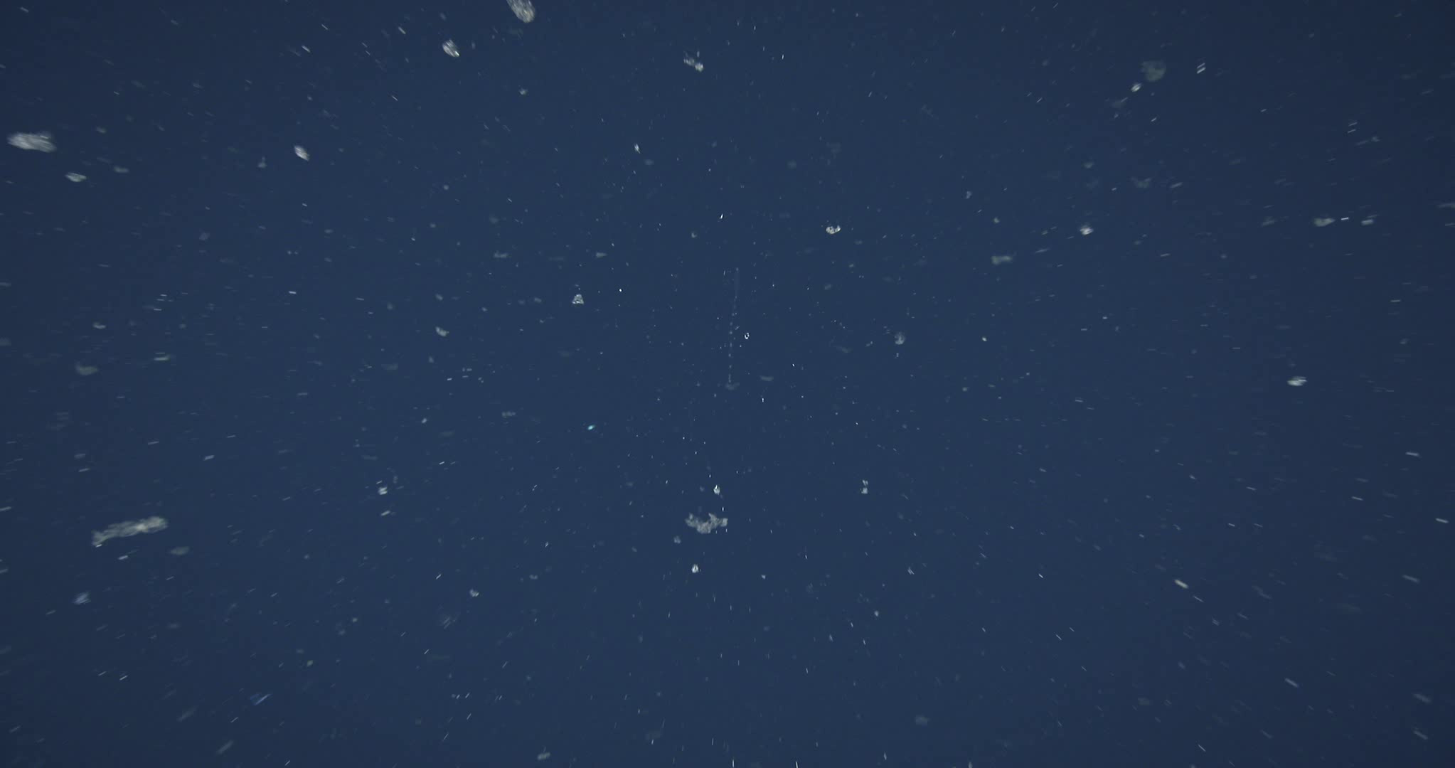
Notes:
i2MAP AUV 300 meter Transect Video (100 cm/sec.)
2048 x 1080 progressively scanned at 60 frames per second
real time playback speed.

Slide 5
Notes:
i2MAP AUV 300 meter Transect Video (100 cm/sec.)
4 x slowed down playback for human annotation

Slide 6
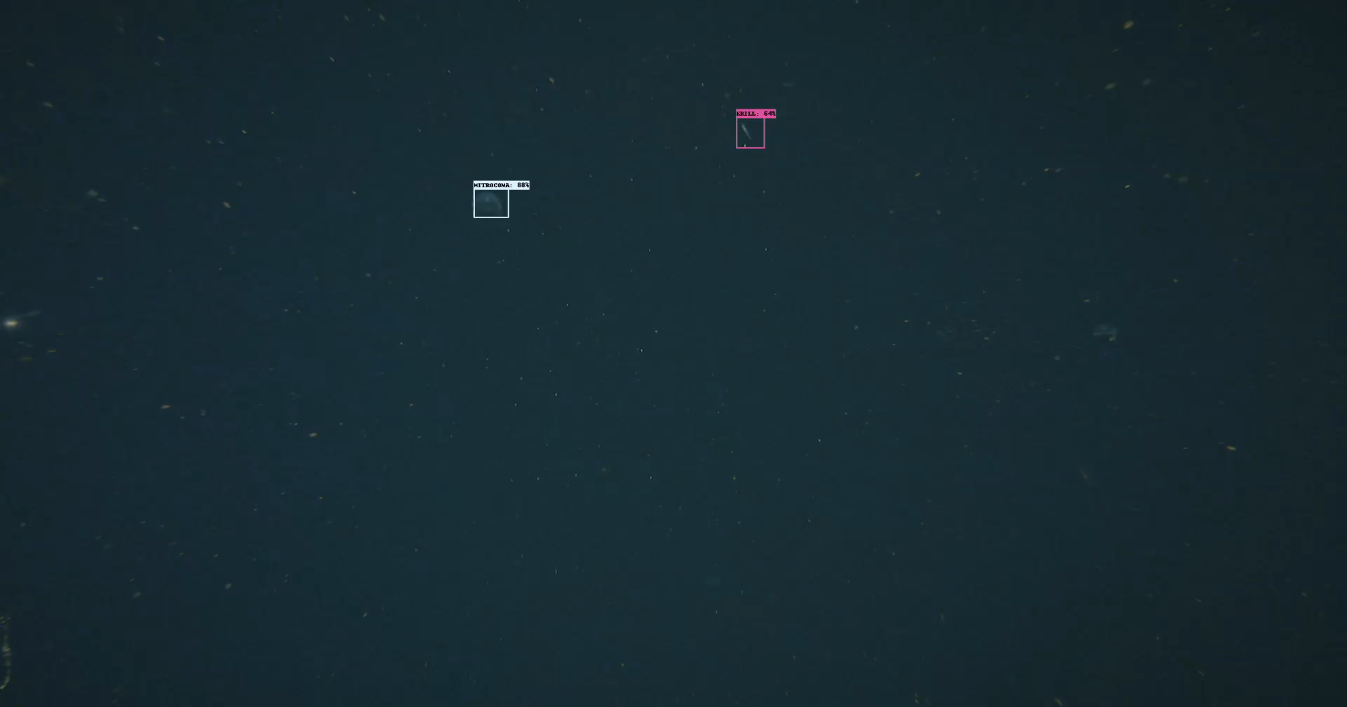

Slide 7


Slide 8
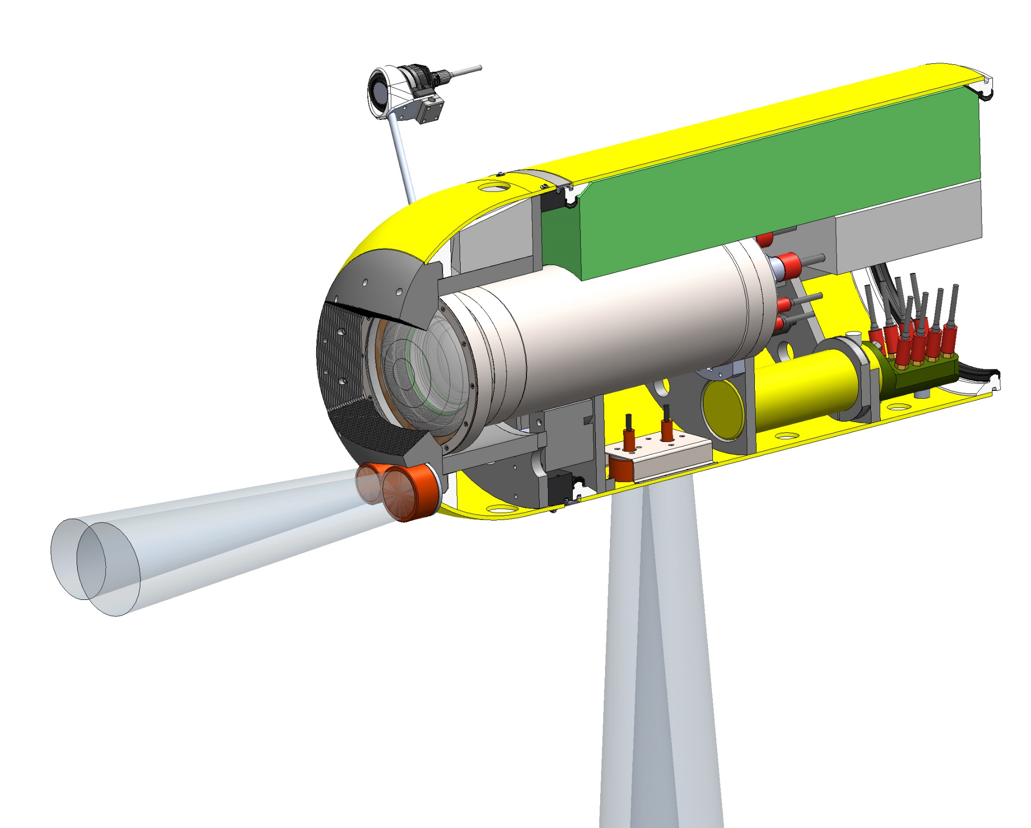

Slide 9
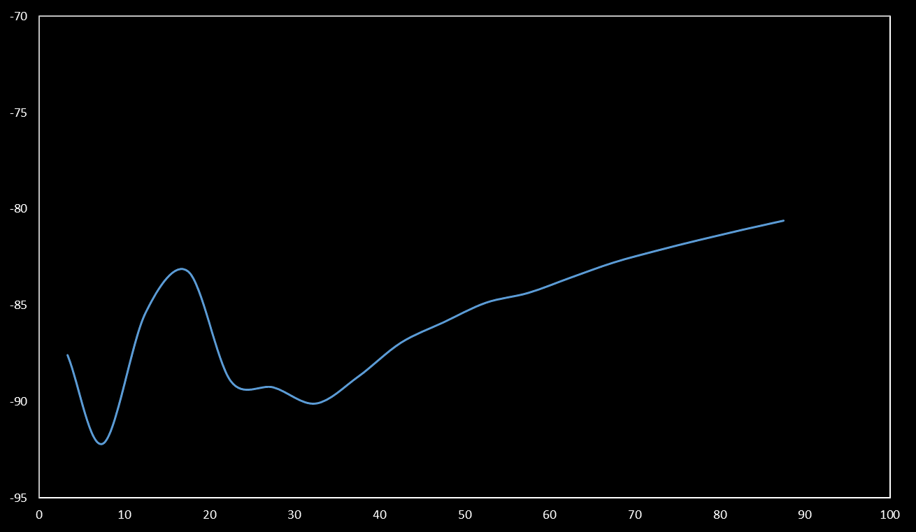
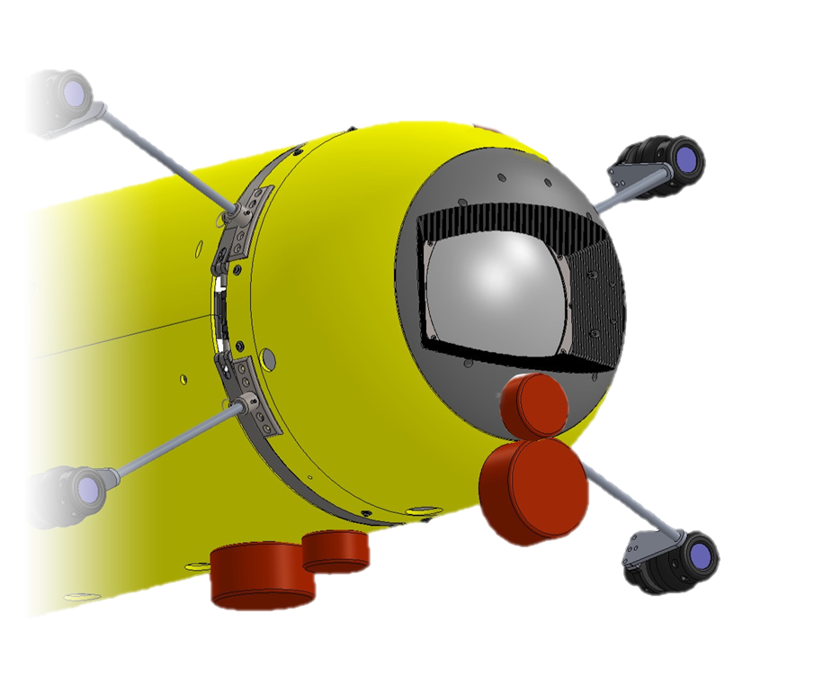
Acoustic biomass
(S_{v} in dB re 1 m-1)
Range (m)

