Slide 1
Distributed Image Recognition and Classification (DIRAC)
Bellingham, Haddock, Matsumoto, and Godin

Slide 2
Problem Statement(s)
Many critical aspects of the environment are captured only by visual imagery, e.g.
  Abundance of organisms like jellies
  Seafloor characteristics & organisms
We have many new platforms capable of generating scientifically interesting imagery.
Our current bottleneck is the ability to interpret imagery.

Slide 3
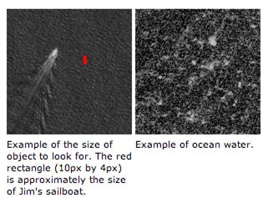
Crowd-sourcing Image Interpretation
Best computer image classification worse than poorly trained human.
Solution: Serve imagery to humans via a portal so that people can provide interpretation/classification function
Examples:
  Amazon Mechanical Turk
  Search for Jim Gray
  Search for Steve Fossett
  Galaxy Zoo
Jim Gray, a prominent computer scientist, was lost at sea off California. Near real-time imagery from various satellite systems was obtain, but inspecting the enormous volume of imagery was a problem. The team loaded the imagery on the Mechanical Turk, along with training data sets. Twelve thousand volunteers inspected the imagery, locating a number of possible hits, which in turn were turned over to experts for classification.

Slide 4
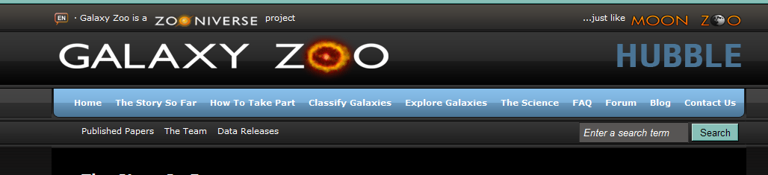
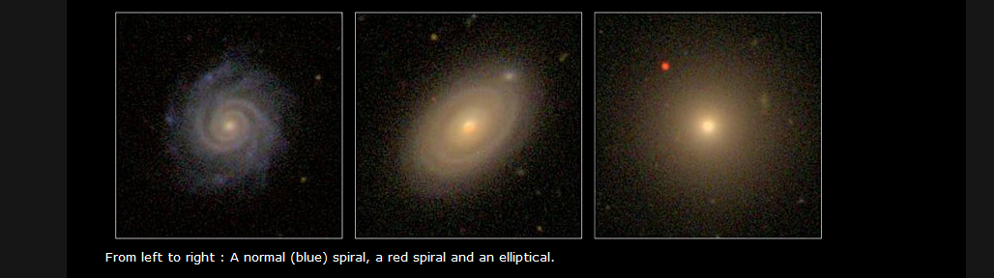
Citizen Science
….is a term used for projects or ongoing program of scientific work in which … volunteers … perform or manage research-related tasks such as observation, measurement, or computation. (Wikipedia)
Example: Galaxy Zoo
  classify galaxies from Sloan Digital Sky Survey
  ten minute training session,.
  early days of operation, the site generated 1,500,000 hits/day,
  Galaxy 2 has 60,000,000 classifications,
  famous for finding an unusual blue object with no known classification.
Kevin Schawinski: “Galaxy Zoo volunteers do real work. They’re not just passively running something on their computer and hoping that they’ll be the first person to find aliens. They have a stake in science that comes out of it, which means that they are now interested in what we do with it, and what we find.”

Slide 5
Why Now?
Proliferation of opportunities to acquire scientifically interesting imagery at MBARI including potential new sources such as:
  Self-Contained Plankton Imager, Benthic Imaging AUV, etc.
  Platforms that can image include LRAUV, MARS, MOOS, etc.
  Visualization initiative.
Quantitative imagery is critical for some MBARI science activities,
  In the 2010 CANON field program we know there was a an enormous jelly bloom in the experiment domain from ship/boat reports. While these jellies undoubtedly impact the ecosystem in question, none of our sensors detect or characterize them.
Technologically the tools are available to solve the problem.
Scientifically, we can still lead in this domain (citizen science) in the ocean sciences.
Engaging the public in MBARI science activities will likely be attractive to the Packard Foundation.

Slide 6
System assumptions
Streams of images will be available
  Stream will only include “interesting” images, automatically sub-selected.
  Some images will be in time series order
  (i.e., several pictures of the same organism(s).
Multiple participants will review each image
  Statistically improves odds of good science
  Improves understanding of what kinds of images are difficult to classify.

Slide 7
User assumptions
Some users will be familiar with biological taxonomy
  Visual interface similar to VARS knowledge base
  Allow them to go as detailed as they can

Slide 8

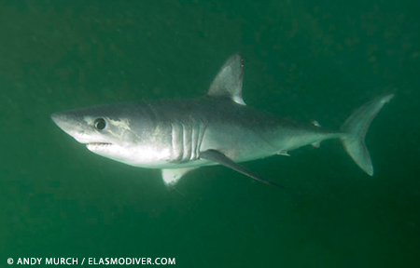
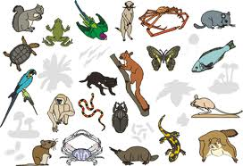
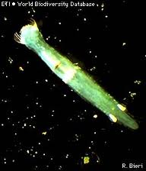
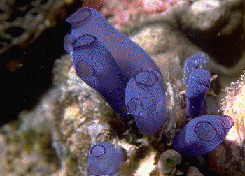

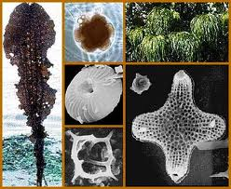
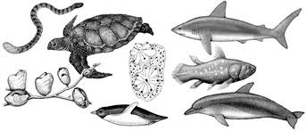
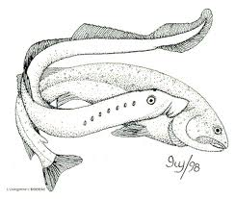

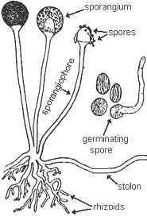
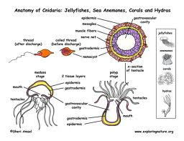
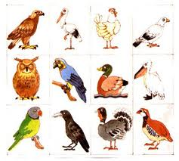
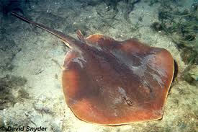

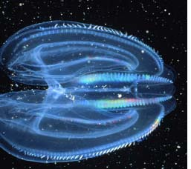

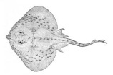
Taxonomy Example
DIRAC
http://dirac.mbari.org
Image # Ts20120923151234
At: -122.45°, 37.23°, 45 m
Local Time of Day: 7:12 am
Platform: LRAUV Tethys
Revisit
Skip
Copy Previous
1
Classify by:
Phylum, Class, Order, Family, Genus, Species
Features, Shape, Color, Species
Animalia
Chaetognatha
Urochordata
Batoidea
Chromista
Chordata
Agnatha
Galeomorphi
Fungi
Cnidaria
Aves
Myliobatiformes
Plantae
Ctenophora
Chondrichthyes
Squalomorphi

Slide 9
User assumptions
Some users will be familiar with biological taxonomy
  Visual interface similar to VARS knowledge base
  Allow them to go as detailed as they can
Some users will prefer to describe what they see in terms of features.
  i.e, does it have eyes, appendages, hair like extensions, what colors does it have, etc.

Slide 10
Feature Example
DIRAC
http://dirac.mbari.org
Image # Ts20120923151234
At: -122.45°, 37.23°, 45 m
Local Time of Day: 7:12 am
Platform: LRAUV Tethys
Revisit
Skip
Copy Previous
1
Classify by:
Phylum, Class, Order, Family, Genus, Species
Features, Shape, Attributes
Is this or was this a living thing?
Does it have appendages?
More than 6 appendages?
Does it have eyes?
Yes
No
Yes
No
Back
Yes
No
Back
Yes
No
Back

Slide 11
User assumptions
Some users will be familiar with biological taxonomy
  Visual interface similar to VARS knowledge base
  Allow them to go as detailed as they can
Some users will prefer to describe what they see in terms of features.
  i.e, does it have eyes, appendages, hair-like extensions, what colors does it have, etc.
Combination of two approaches valuable
  future automation
  understanding of organisms

Slide 12








Long-term hosting options
Mechanical Turk & Public Data Sets
User-supported model like

Slide 13
Relevance to MBARI and Packard Foundation
This project addresses these themes of MBARI’s Strategic plan:
  Develop innovative technologies to address important questions: image classification is required for many biological sensing problems.
  Utilize developments to explore and understand natural systems: we envision supporting efforts like CANON and possibly also ocean visualization initiative.
The Packard Foundation’s Ocean Vision includes a monitoring activity, for which our citizen science approach may prove useful.
  Example: Monitoring programs require comparatively simple observational programs to be affordable. The Coral Health Index is an example of a monitoring program that depends of three types of observation, one of which is an evaluation of the state of the benthic habitat. This is done using bottom imagery, for which DIRAC could provide an analysis framework.

Slide 14
Transition Opportunities & External Funding
A successful citizen science portal might prove so productive that MBARI would want to maintain it as part of an institutional data stream,
…or it might be transitioned to an entity like CenCOOS
…or it might be funded by entities ranging from the usual (NSF) to the less typical (Sloan Foundation)
  http://www.citizensciencealliance.org/proposals.html

