Slide 1
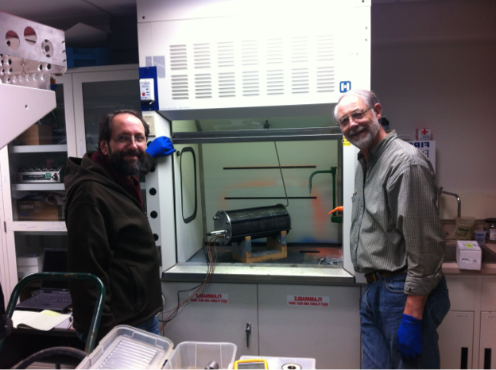
Destructive Testing of Lithium Ion Cells
www.evaluationengineering.com
© MBARI
Paul McGill and Jon Erickson
Monterey Bay Aquarium Research Institute

Slide 2
Agenda
Motivation to test Li cells
Previous work
Li cell protection devices
Test setup
Test results
Next steps

Slide 3
MBARI
© MBARI
Moss Landing, California

Slide 4
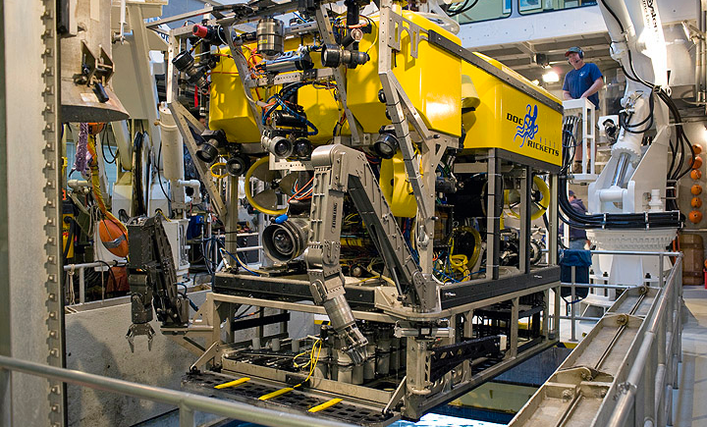
ROVs
© MBARI
Remotely Operated Vehicles

Slide 5
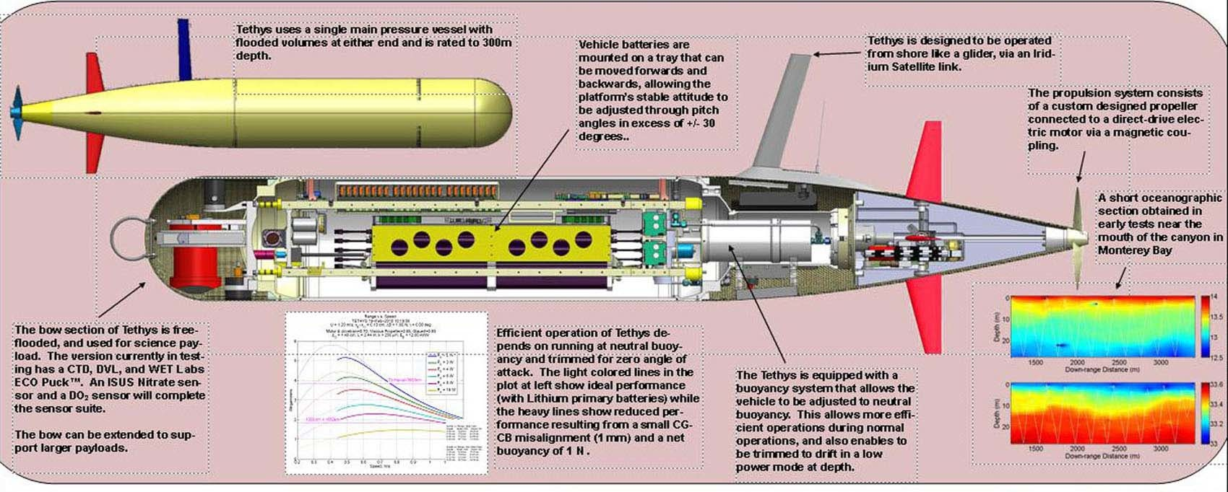
AUVs
Autonomous Underwater Vehicles
AUVs
Autonomous Underwater Vehicles

Slide 6
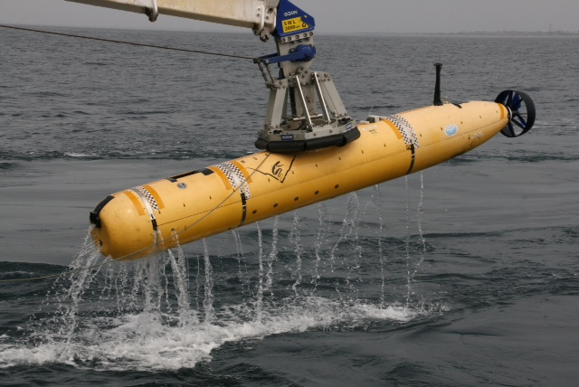
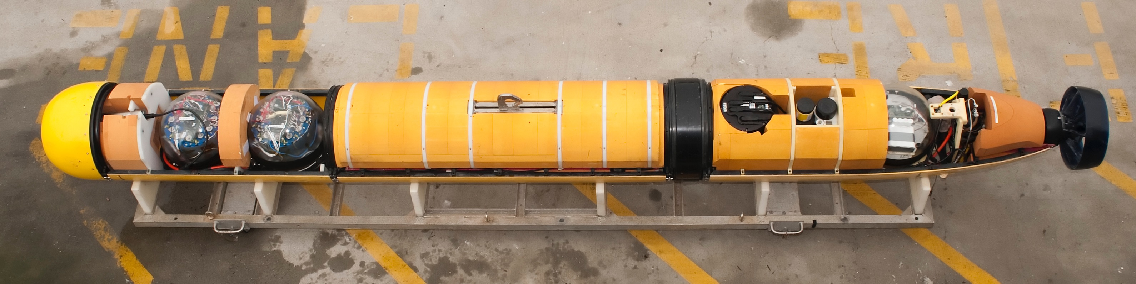
© MBARI

Slide 7
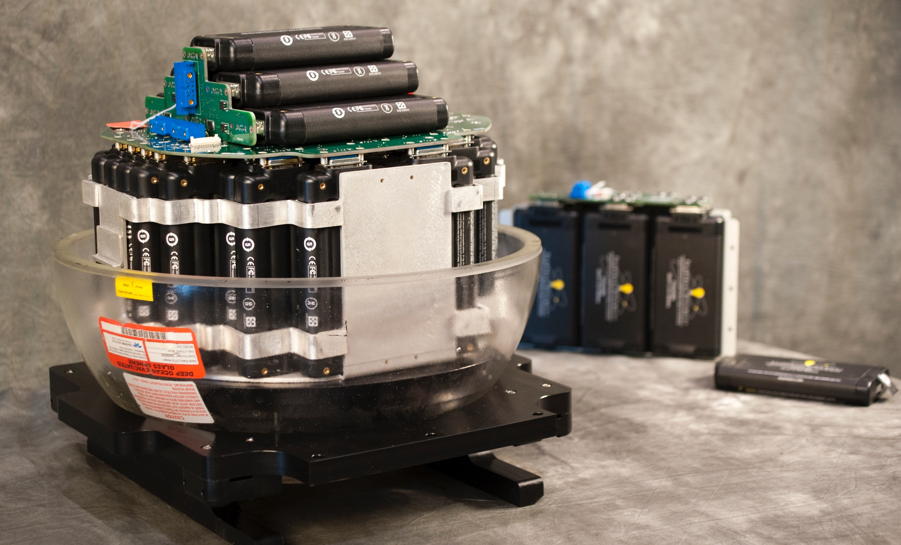
© MBARI
55 x 89 Wh modules per sphere
2 spheres per vehicle
Total of 9.8 kWh

Slide 8
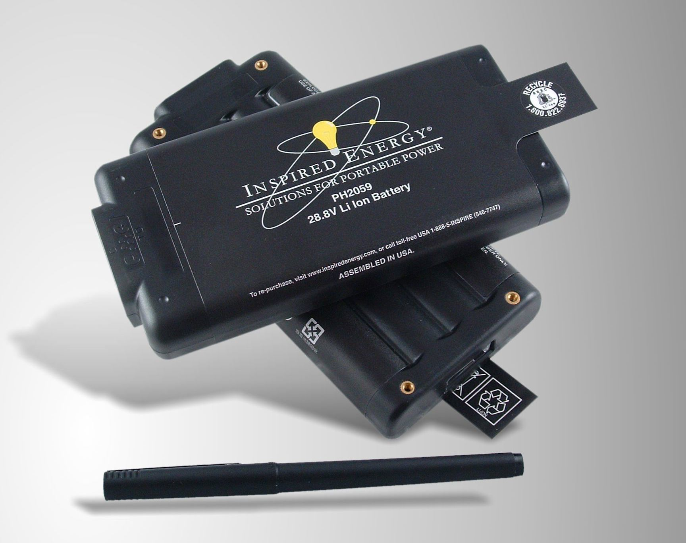
Contains 8 Panasonic 18650 cells with BMS

Slide 9
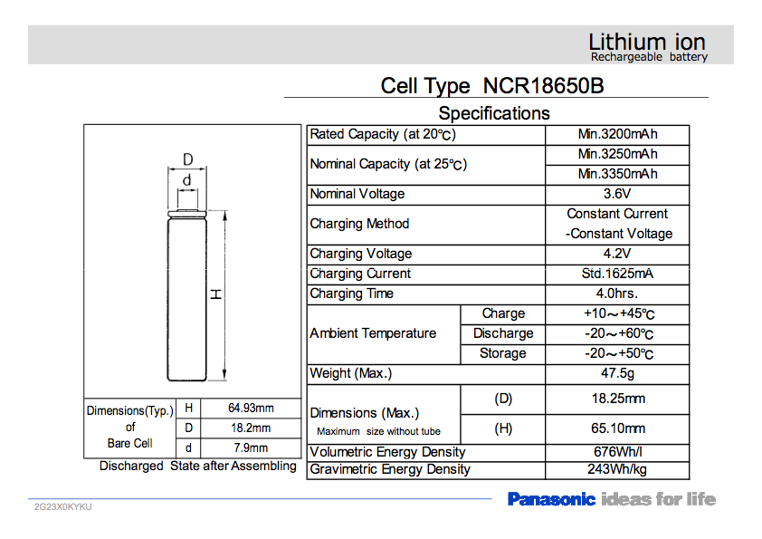
“3400” mAh Li-ion 18650 cells

Slide 10
Cell failure in an MBARI AUV
Is a Li battery failure in an AUV survivable?
Will a single-cell failure propagate?
How much gas at what temperatures is produced?
Can combustion gases be vented outboard?
Will particulates foul a pressure relief valve?

Slide 11
Testing Goals
  Determine the following:
  Temperature at which thermal runaway begins
  Temperature of gases produced
  Volume of gases produced
  Likelihood that thermal runaway propagates from cell to cell

Slide 12
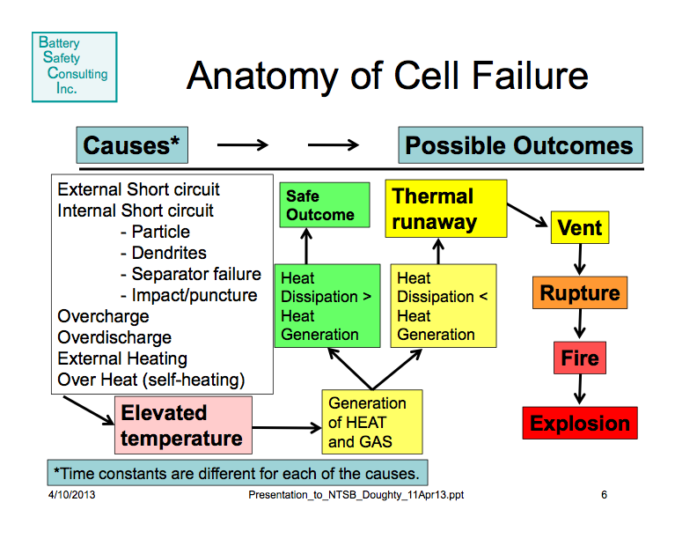
http://www.ntsb.gov/news/events/2013/batteryforum/presentations/Doughty%20Sandia%20Presentation%20-%20Battery%20Forum.pdf

Slide 13
S. Harris, et al. (2009), A combustion chemistry analysis of carbonate solvents used in Li-ion batteries

Slide 14
Failures Rates
“Field failures arising from manufacturing defects that cause internal short circuits have very low probabilities of occurrence (estimates for 18650-size cells that fail catastrophically are 1 in 10 million cells to 1 in 40 million cells).”
D. Doughty, et al. (2012), Vehicle Battery Safety Roadmap Guidance

Slide 15
Improving Chemistries

Slide 16
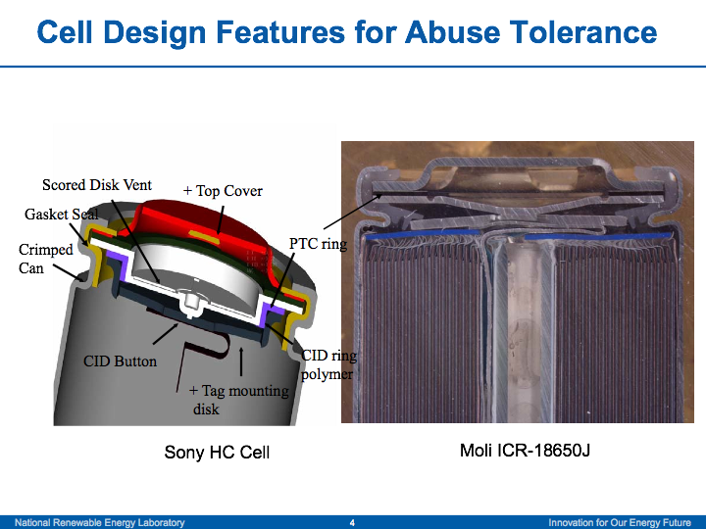
http://www.nrel.gov/vehiclesandfuels/energystorage/pdfs/45388.pdf

Slide 17
“For a power input of 28 +/- 1 W, thermal runaway occurs at about 230 ˚C +/- 15 ˚C. Thermal runaway is defined here as the onset of a sharp change in the slope of the temperature over time. At times the entire contents of a battery can be expelled after thermal runaway; however, in most cases gases are expelled slowly or as a sudden jet with particulates. Auto as well as piloted ignition can occur. The mass of the contents expelled increases with initial charge, with preliminary data indicating nearly half of the initial mass (44 g) expelled for 100 % charge. The internal energy stored in the battery during runaway increases nearly linearly with charge to about 100 kJ at 100 %. The electrochemical energy stored at 100 % charge is 36 kJ. So an increase in energy is due to the exothermic behavior of the battery components. If all of the gases expelled burn, that energy could reach over 400 kJ at 100 % charge.”
J. G. Quintiere and S. B. Crowley (2013), Thermal Dynamics of 18650 Li-ion Batteries, The Seventh Triennial International Fire & Cabin Safety Research Conference

Slide 18
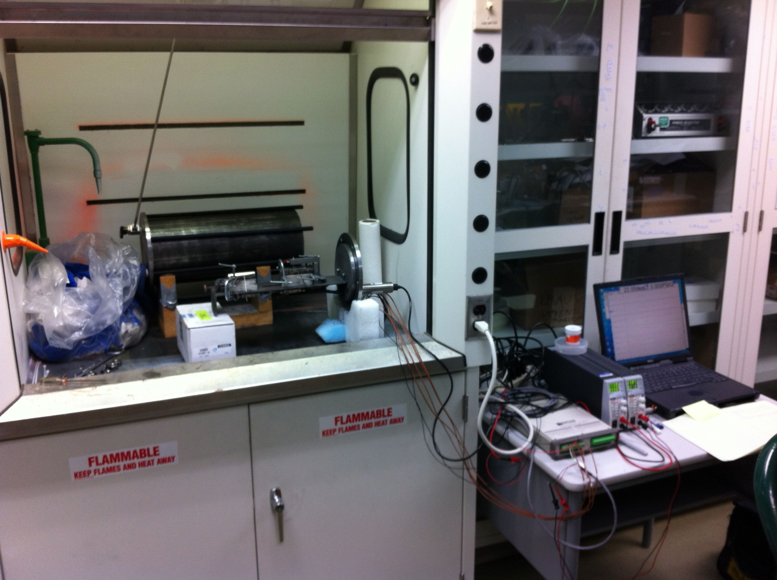
Test Setup
© MBARI

Slide 19
Test Chamber Wiring

Slide 20
Test Protocol
Test 1 - Data recording test with heater on dummy 18650 cell made from cylinder of stainless steel. Only Cell 1 Temp and Chamber Pressure were recorded.
Tests 2 thru 6 - Single-cell thermal runaway tests, heating NCR18650B cell to failure. Cells charged to 100% SOC for these and all subsequent tests.
Test 7 and 8 - Two-cell thermal runaway propagation tests, with cells positioned end-to-end. Nose of heated cell was 5 mm from tail of non-heated cell.
Test 9 - Two-cell thermal runaway propagation test, with cells positioned end-to-end. Nose of heated cell was 65 mm (one cell length) from tail of non-heated cell.
Test 10 - Two-cell thermal runaway propagation test, with cells positioned end-to-end. Nose of heated cell was 32 mm (one-half cell length) from tail of non-heated cell.

Slide 21
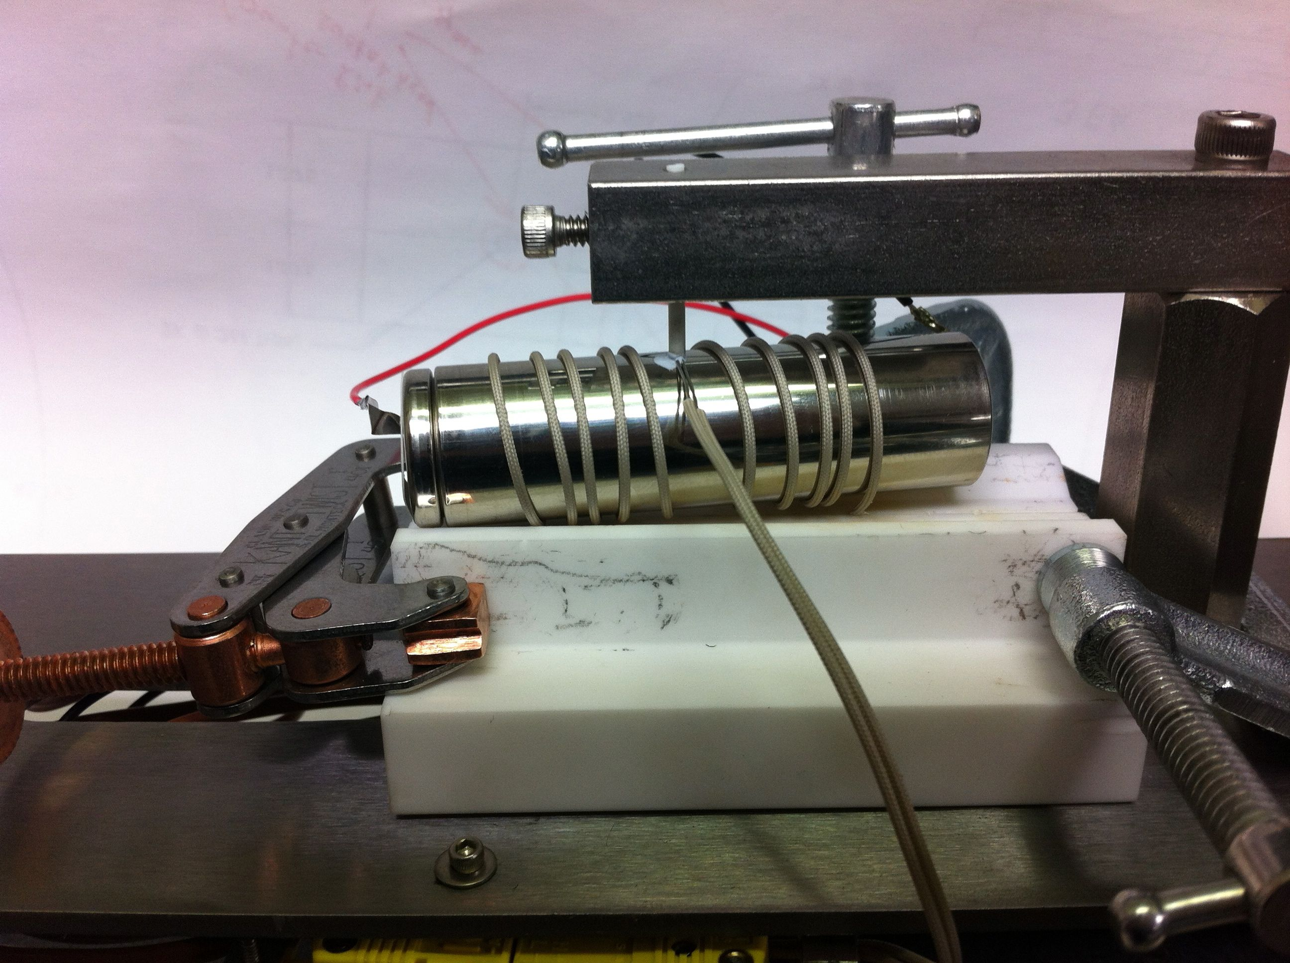
Test 2
Single Cell
© MBARI

Slide 22
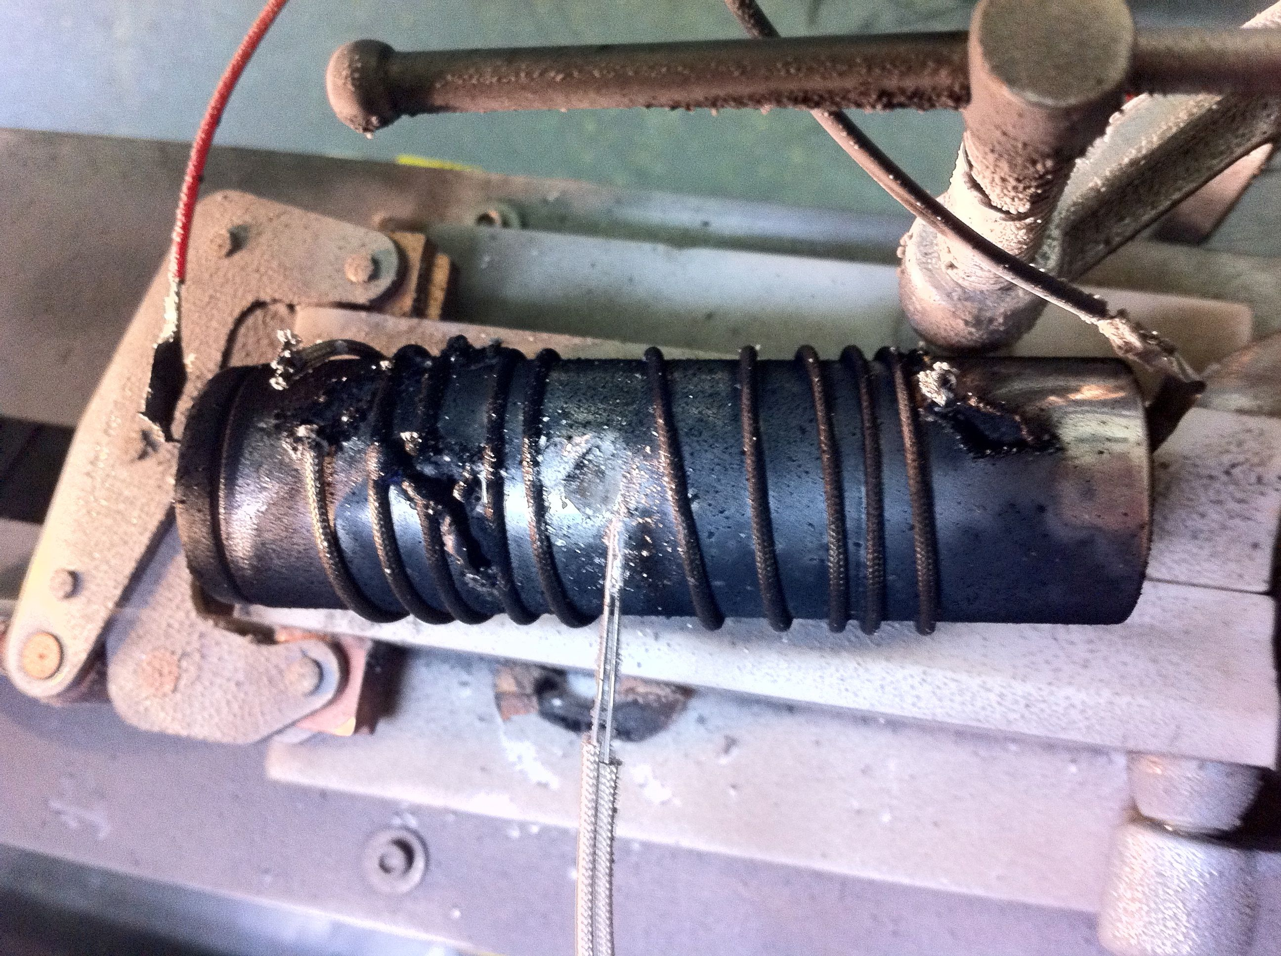
Test 2
Single Cell
© MBARI

Slide 23
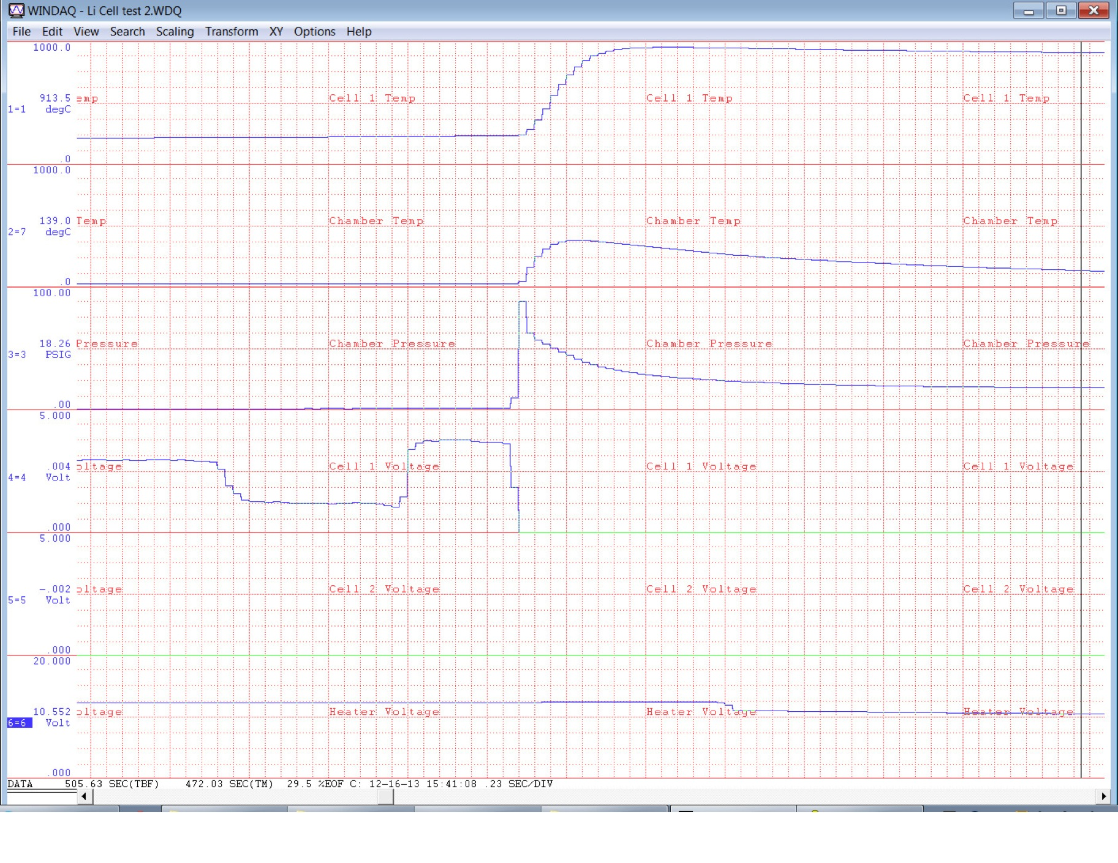

Slide 24
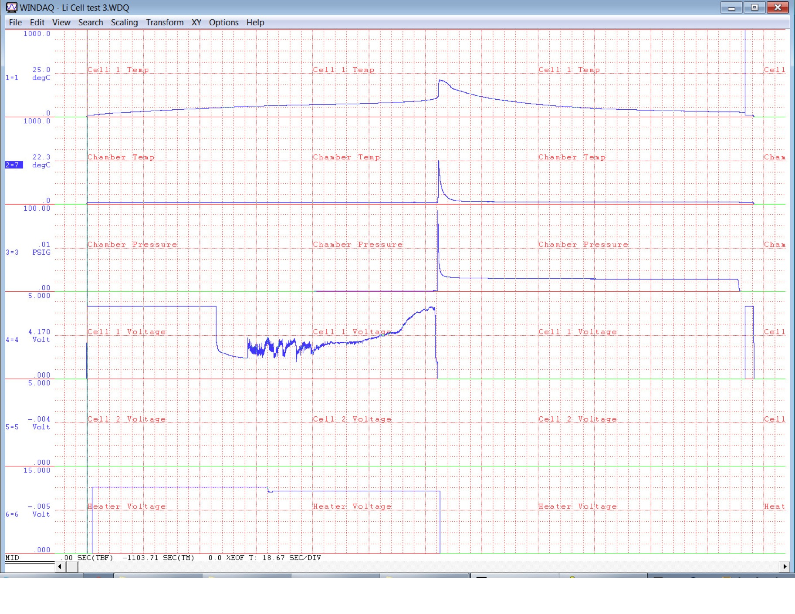

Slide 25
Evolved Gas Computation
Gas is 22.4 liters/mole at STP

Slide 26
Compiled Results for Single-Cell Tests
Test # | Fail temp (˚C) | Pk cell 1 temp (˚C) | Peak press (PSIG) | Start temp (˚C) | Final temp (˚C) | Final press (PSIG) | Evolved gas (L) | Failure mode
2 | 237 | 956 | 89 | 22 | 29 | 14.8 | 5.59 | case
3 | 230 | 427 | 93 | 22 | 30 | 14.5 | 5.43 | vent
4 | 219 | 431 | 97 | 23 | 32 | 15.9 | 5.92 | vent
5 | 223 | 809 | 97 | 24 | 31 | 16.3 | 6.13 | vent
6 | 216 | 823 | 95 | 23 | 32 | 13.5 | 5.00 | vent

Slide 27
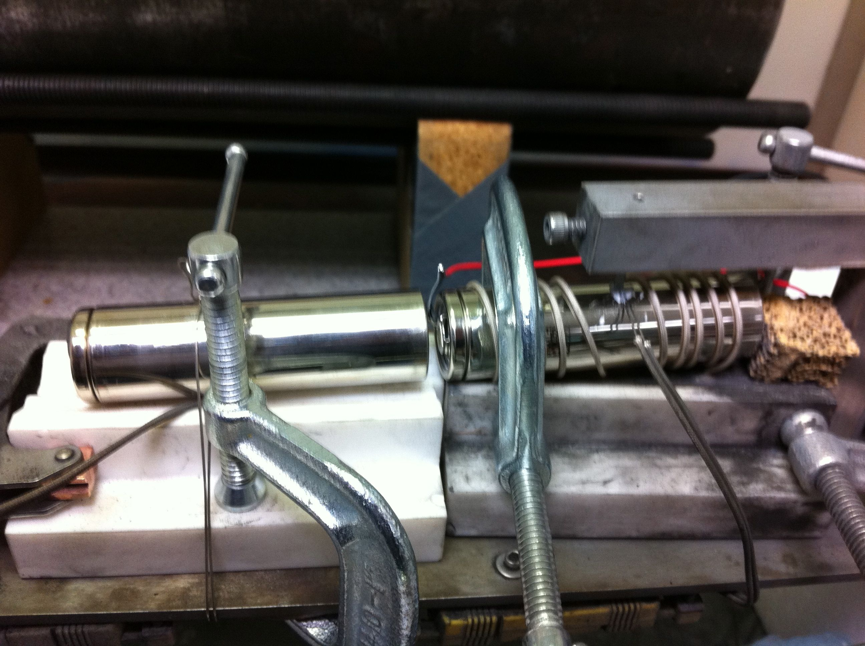
Test 7
5 mm spacing
© MBARI

Slide 28
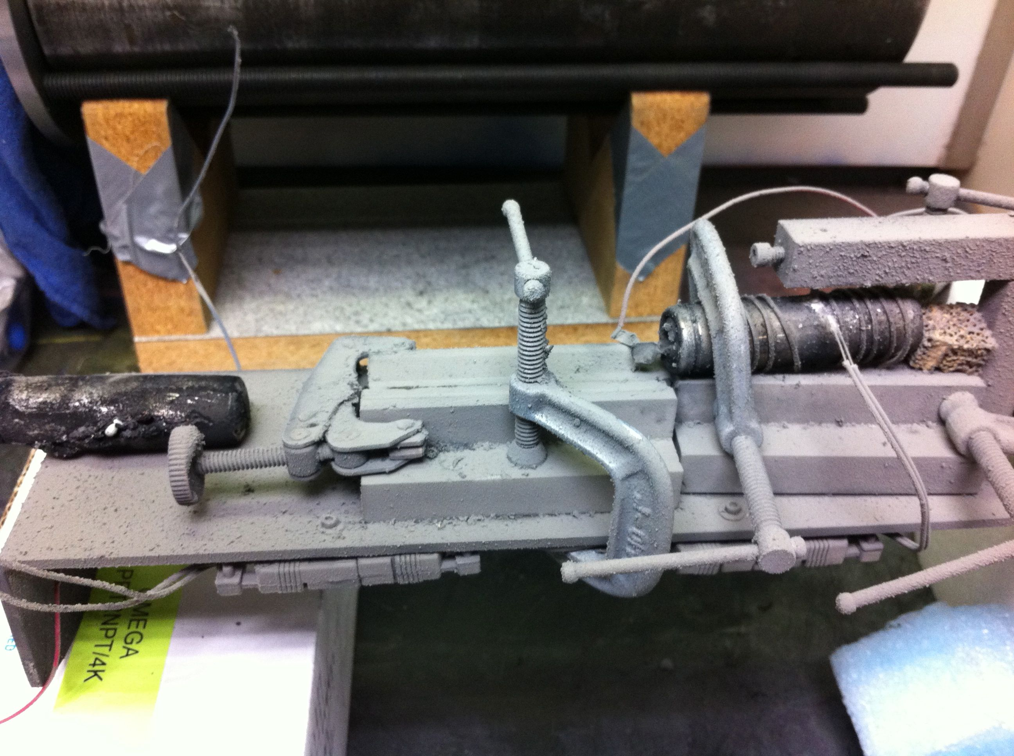
Test 7
5 mm spacing
© MBARI

Slide 29
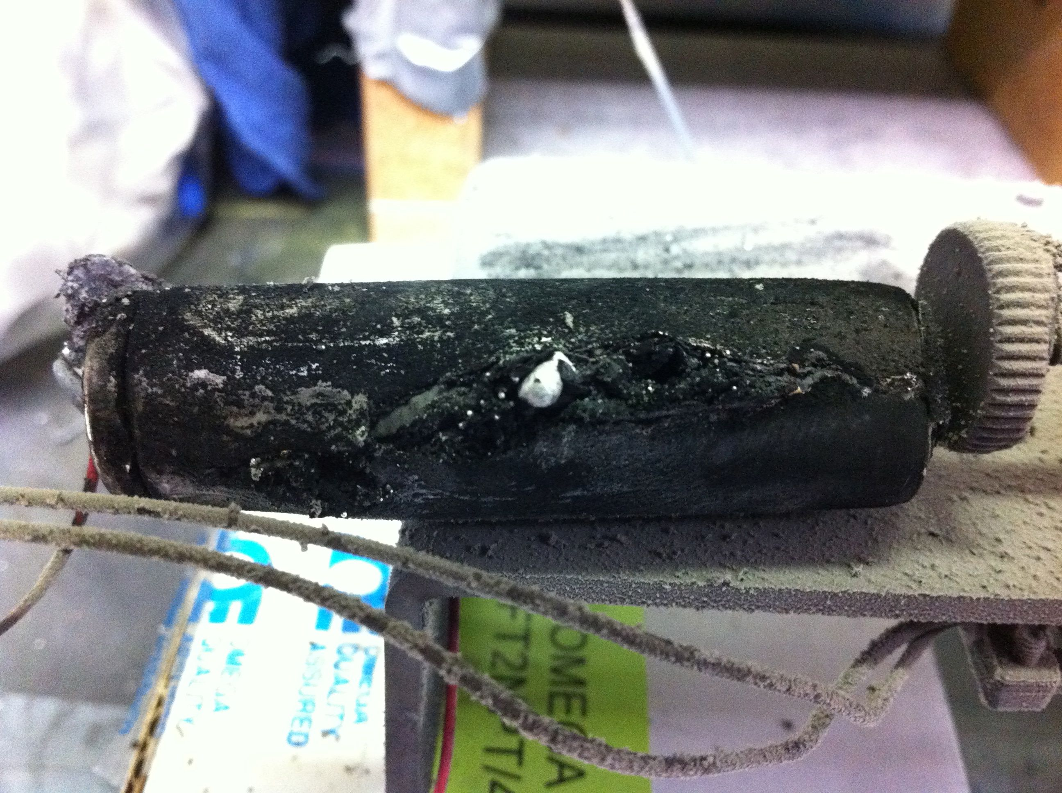
Test 7
5 mm spacing
© MBARI

Slide 30
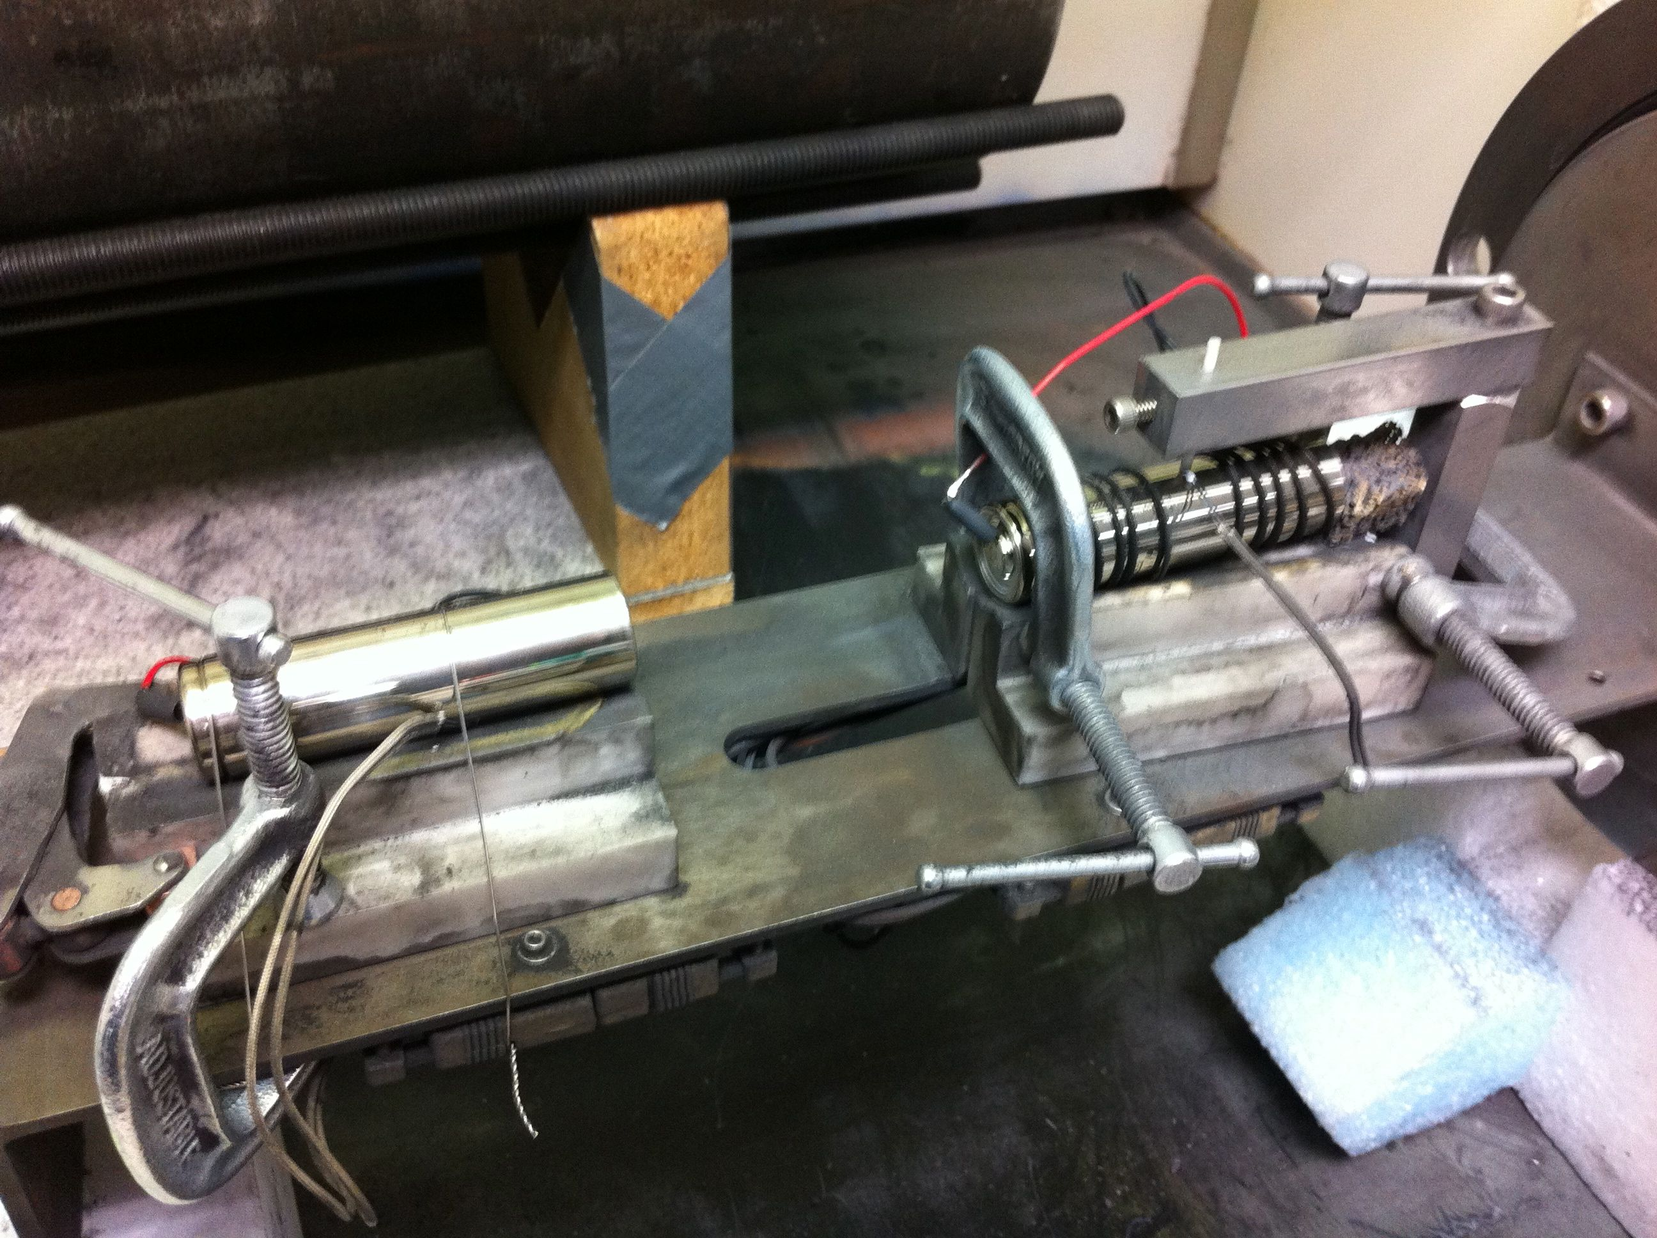
Test 9
65 mm spacing
© MBARI

Slide 31
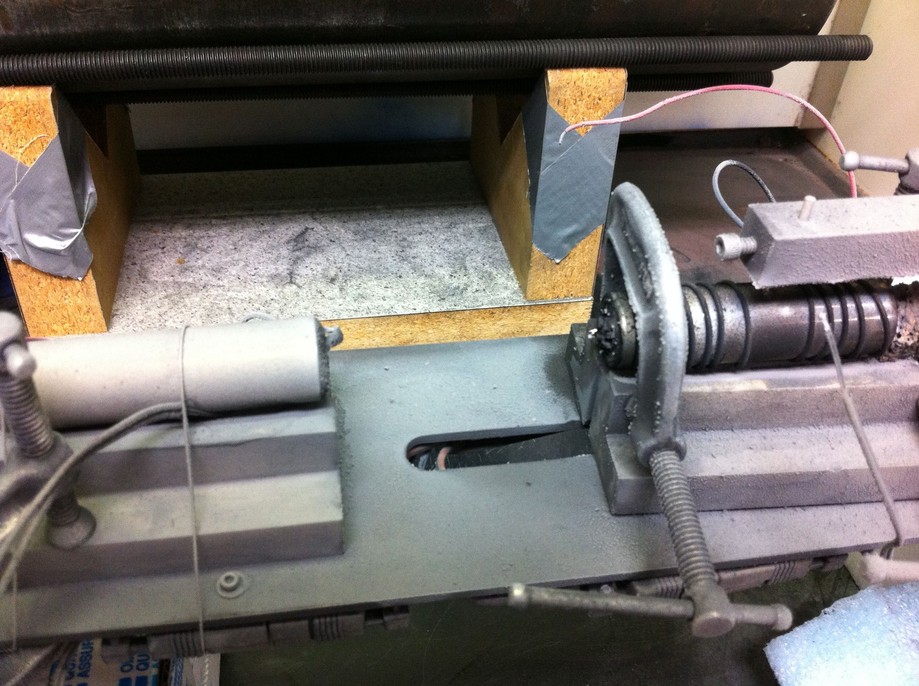
Test 9
65 mm spacing
© MBARI

Slide 32
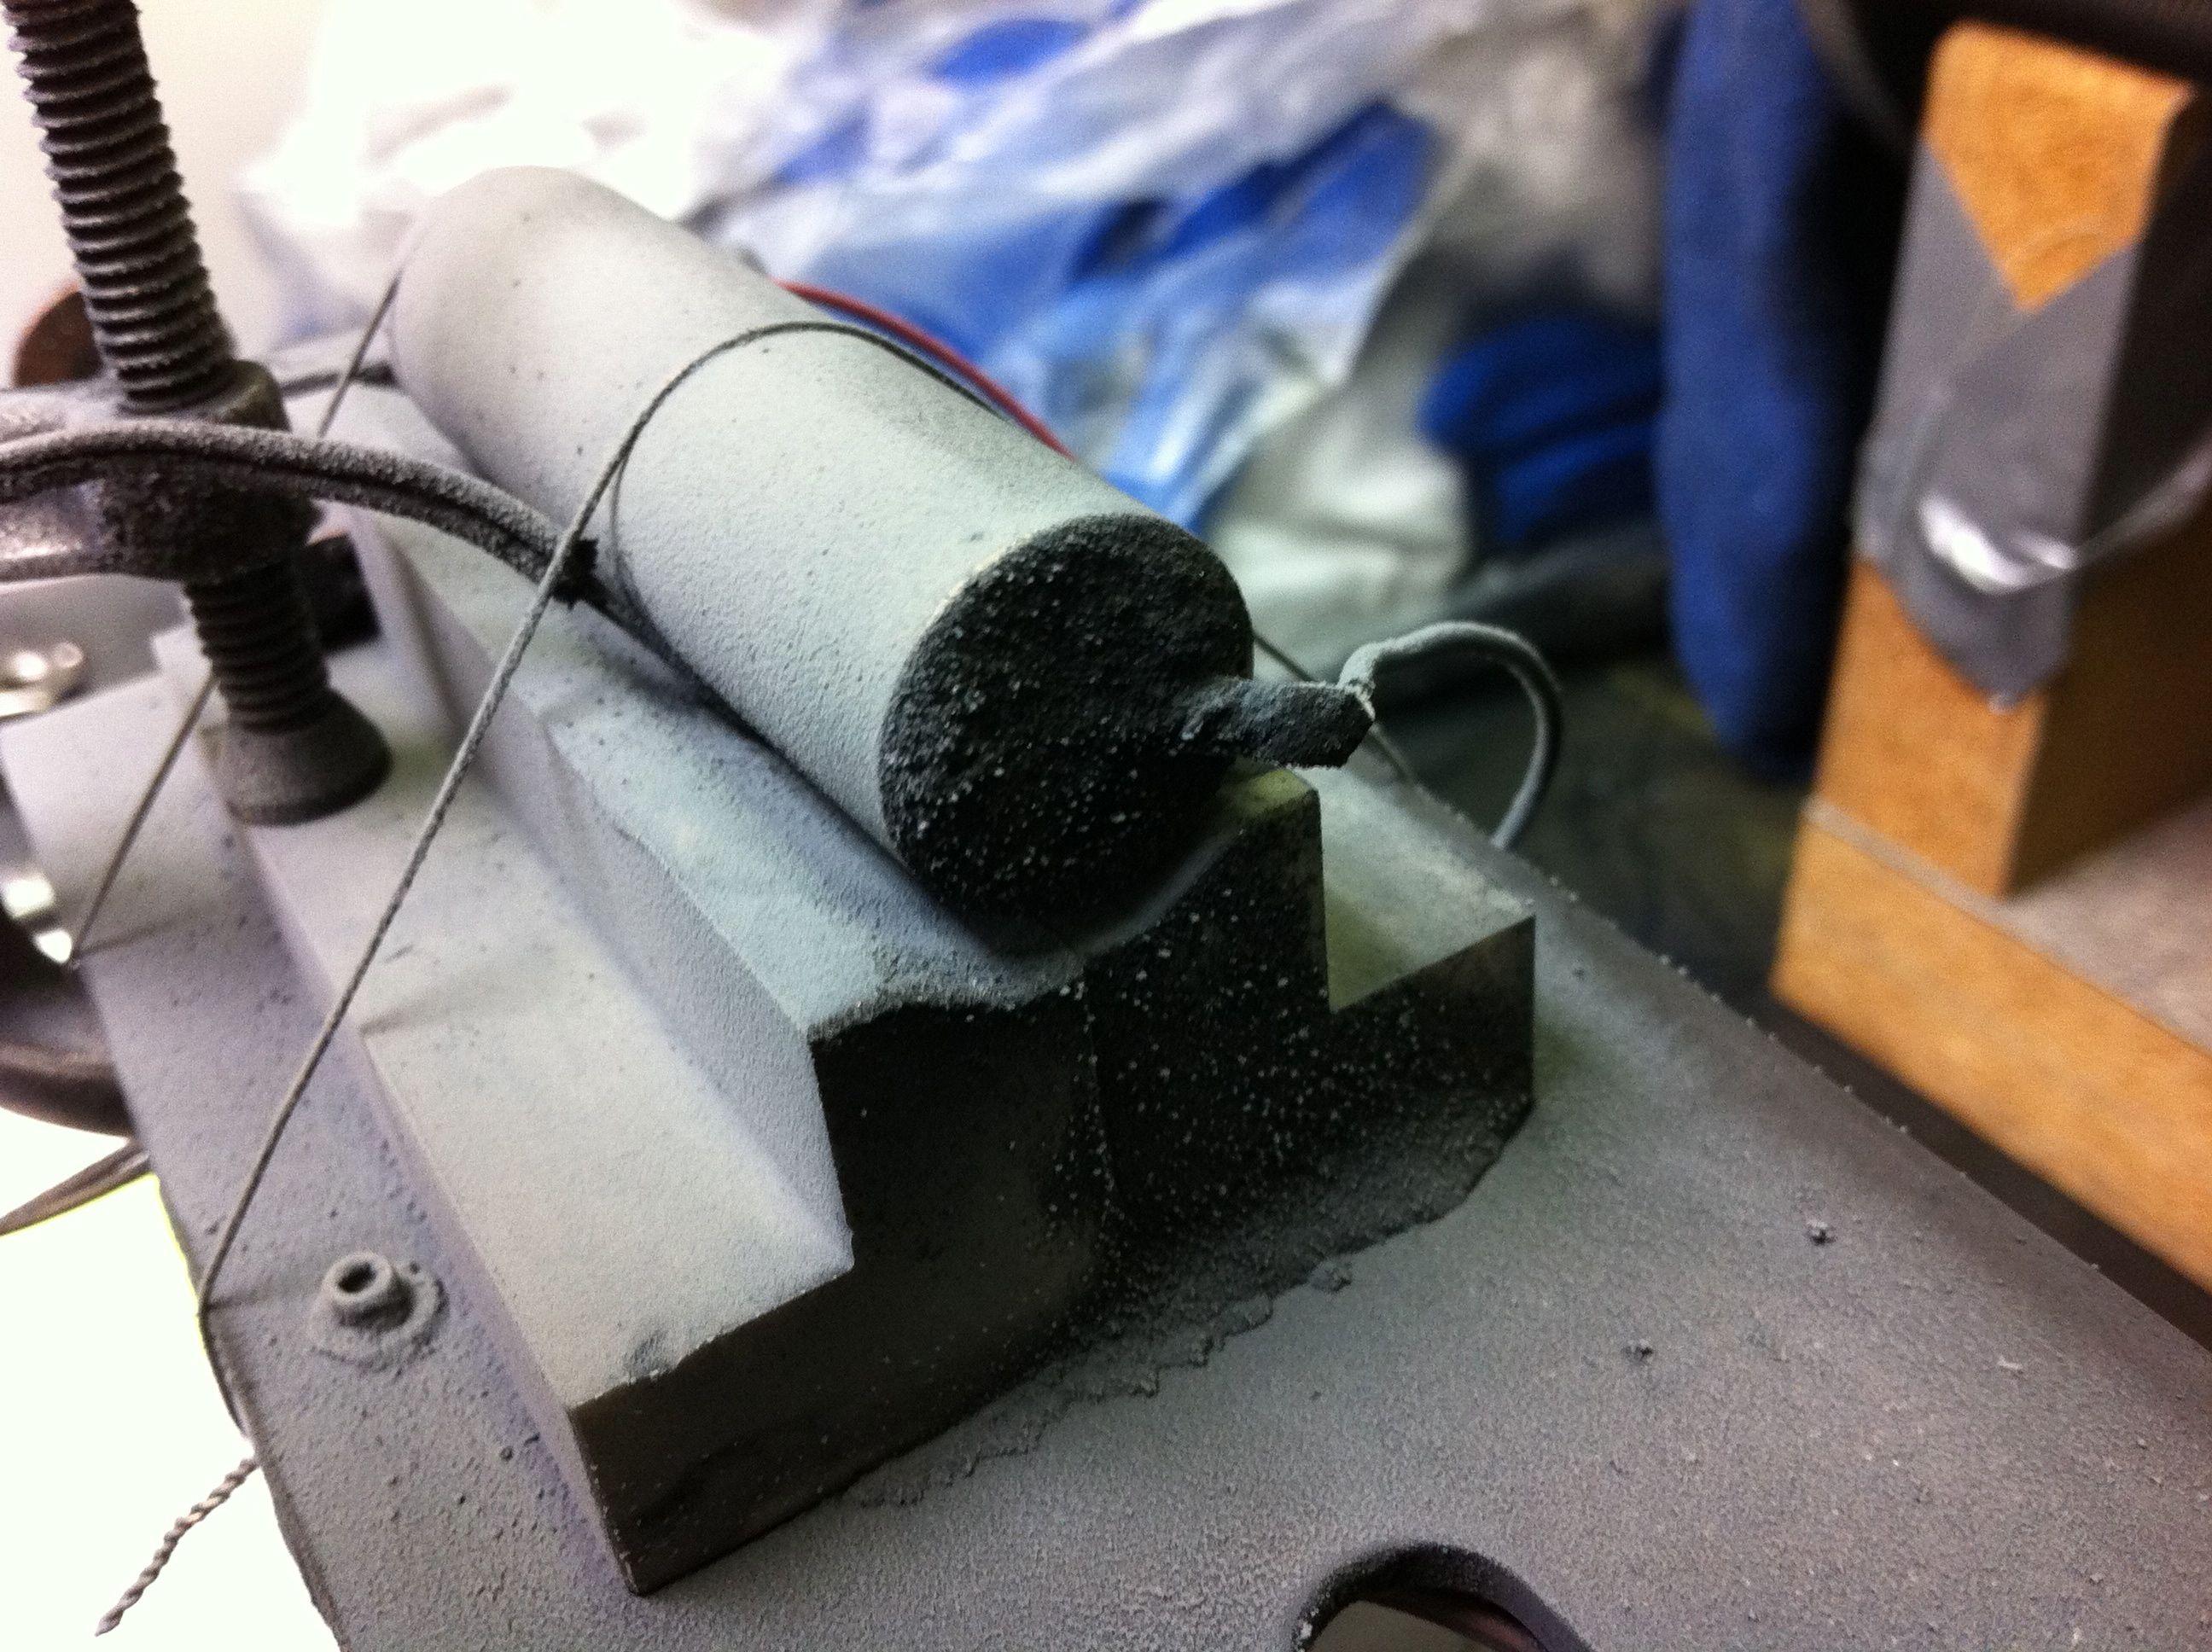
Test 9
65 mm spacing
© MBARI

Slide 33
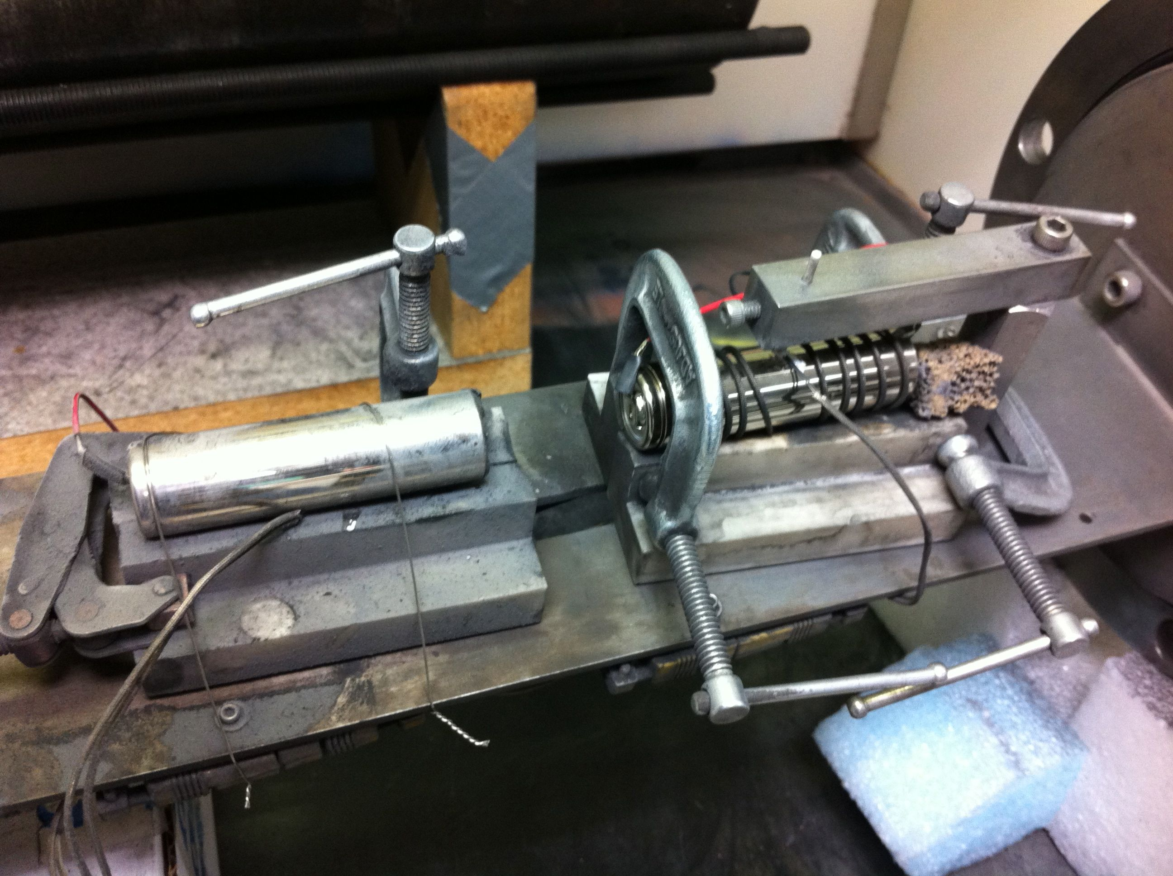
Test 10
32 mm spacing
© MBARI

Slide 34
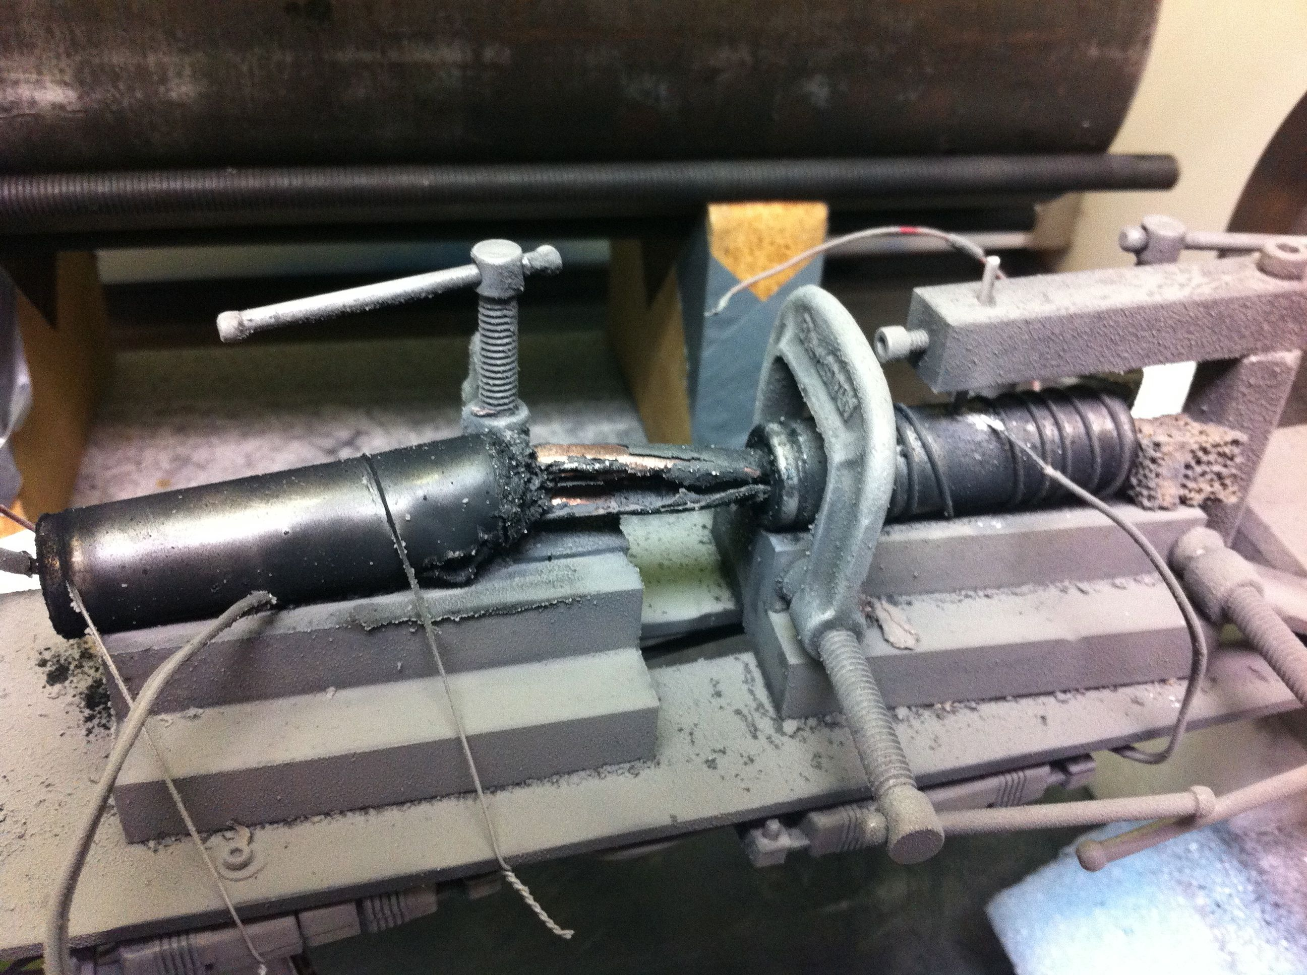
Test 10
32 mm spacing
© MBARI

Slide 35
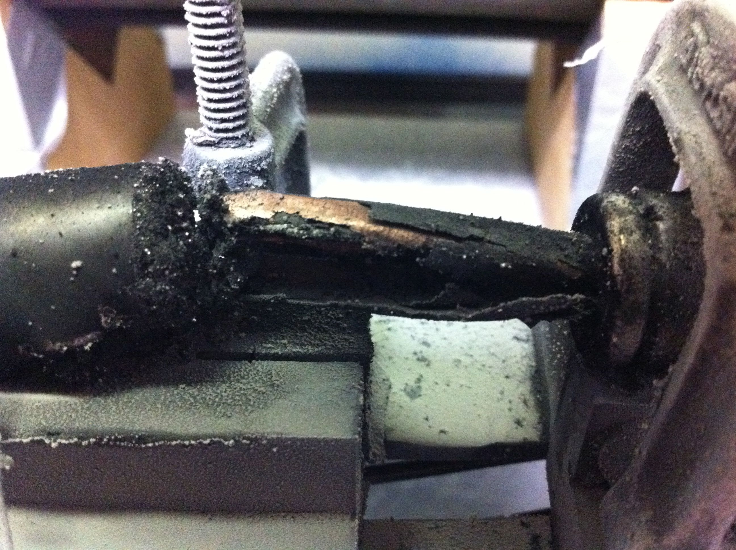
Test 10
32 mm spacing
© MBARI

Slide 36
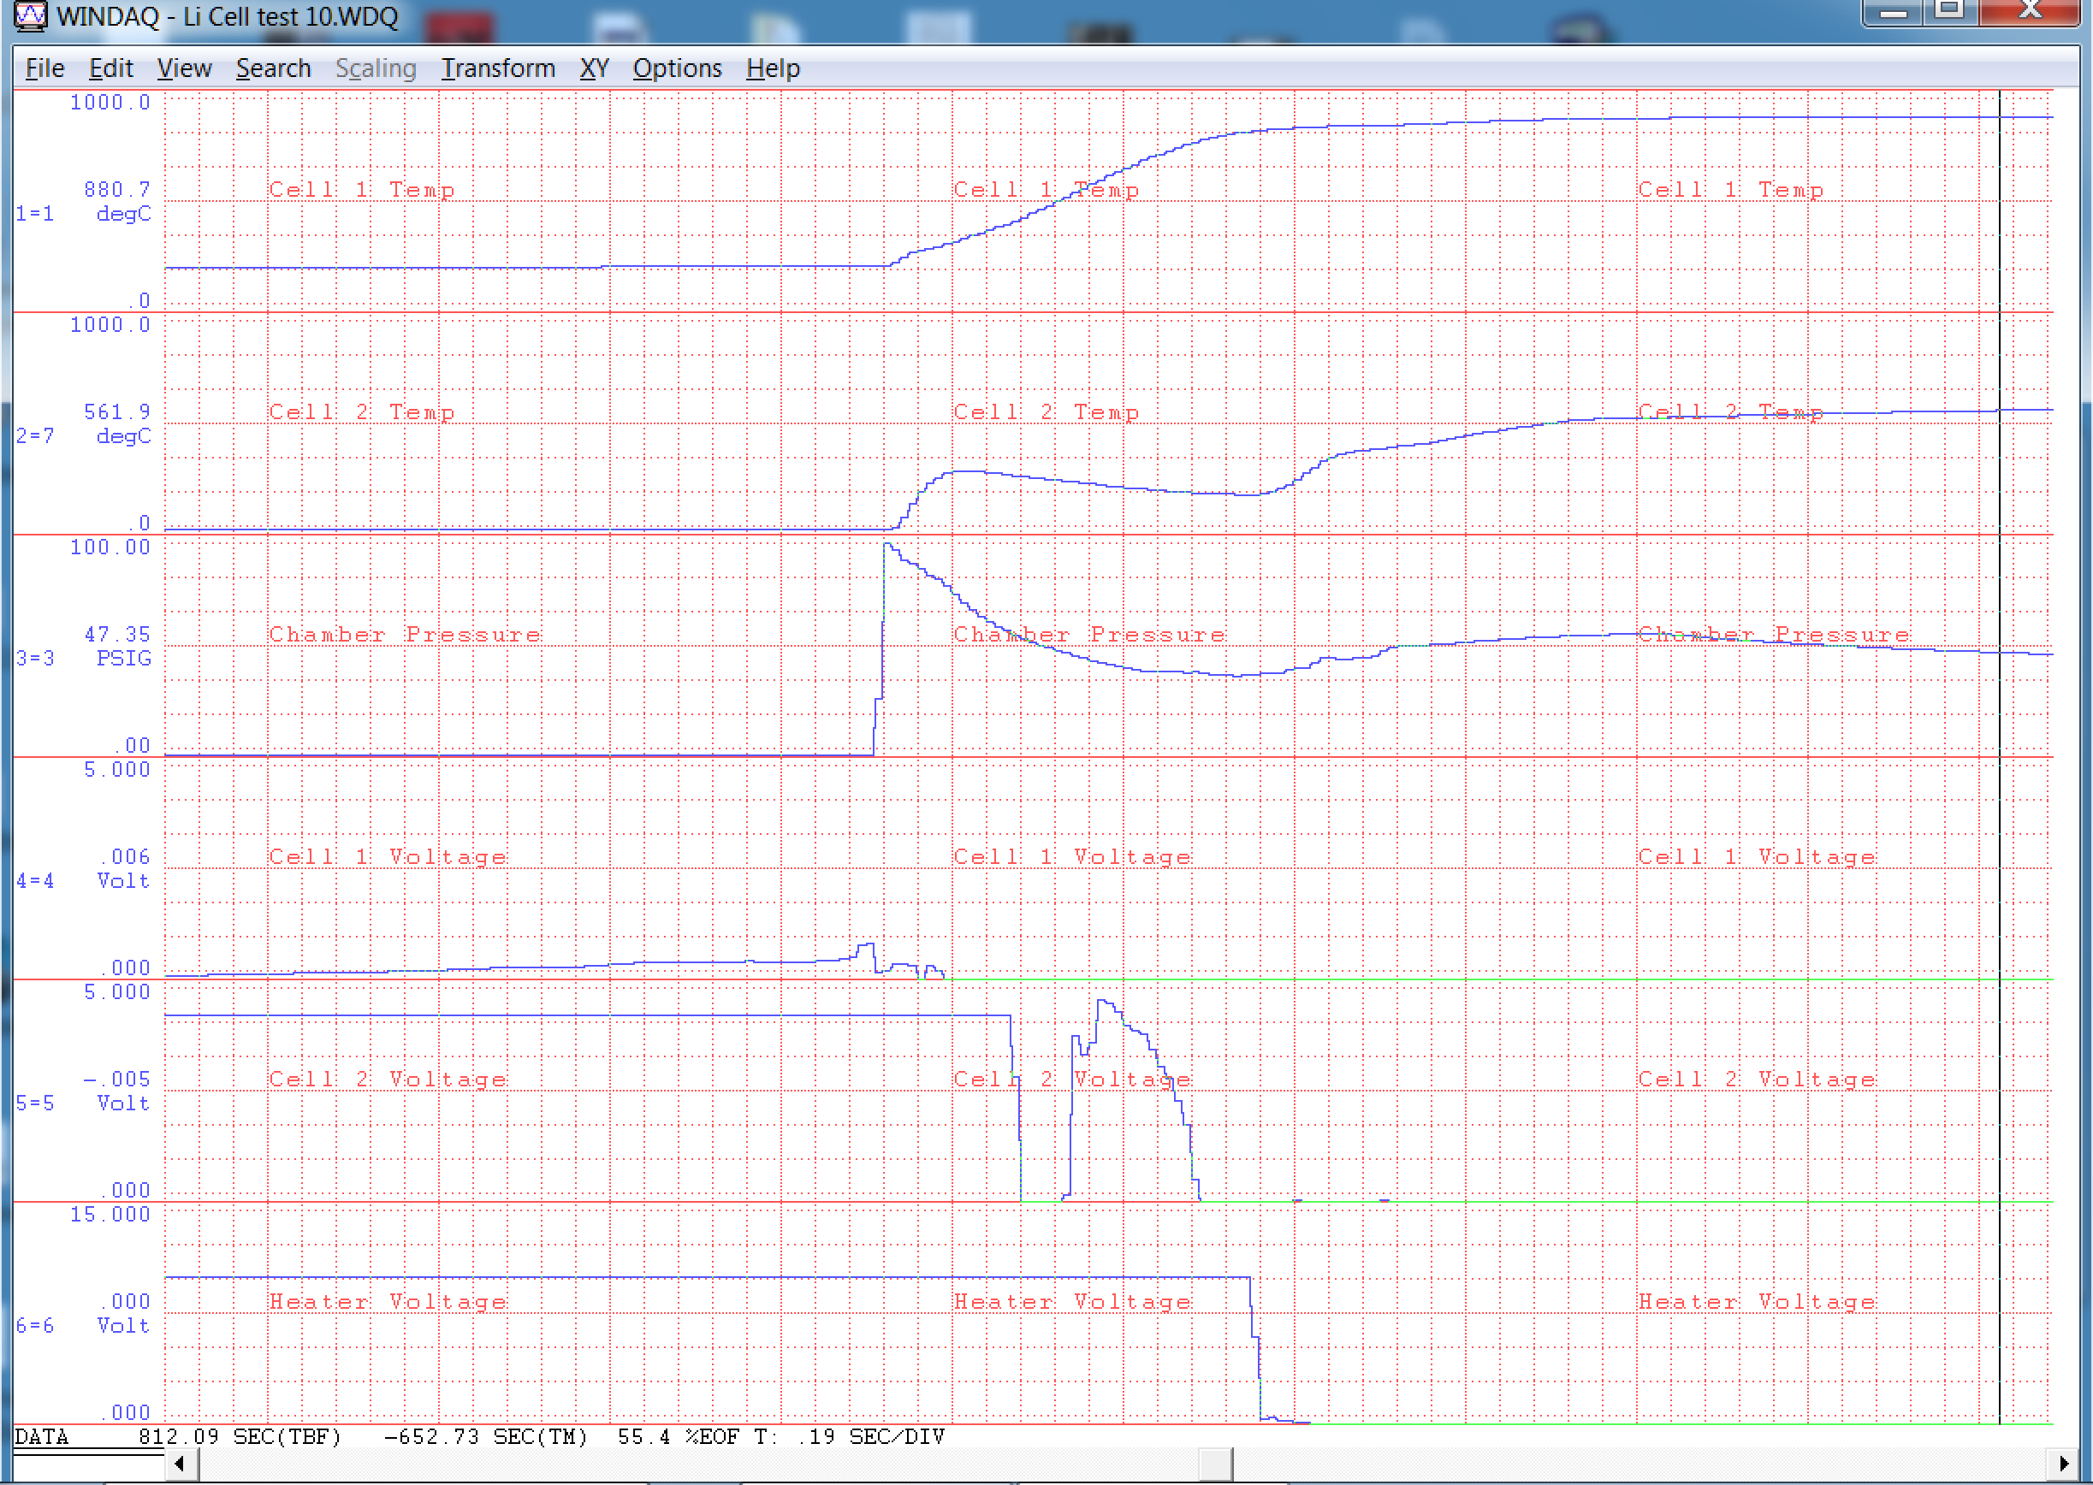

Slide 37
Compiled Results for Two-Cell Tests
Test # | Fail temp (˚C) | Pk cell 1 temp (˚C) | Peak press (PSIG) | Start temp (˚C) | Final temp (˚C) | Final press (PSIG) | Evolved gas (L) | Fail mode | Notes
7 | 229 | 857 | 97 | 24 | 46 | 30.9 | 10.9 | vent/case | 5 mm gap
8 | 217 | 879 | 76 | 22 | bad seal | bad seal | bad seal | vent/case | 5 mm gap, bad o-ring
9 | 215 | 361 | 96 | 23 | 52 | 15.9 | 5.19 | vent/no fail | 65 mm gap
10 | 213 | 881 | 97 | 24 | 57 | 31.1 | 10.4 | vent/case | 32 mm gap

Slide 38
Significant Findings
Gas temperatures can exceed 1000 ˚C
Cells casings don't always fail at vent
Failure can propagate to another cell at least 32 mm away in somewhat open environment
More gas is released for NCR18650B than older cells tested in published literature
Ejecta from cell can include not just ash, but large pieces of metal electrodes
PTC fuses may fail as cell temperature is increased

Slide 39
Next Steps
Perform more tests to obtain statistically significant results
Perform tests in inert gas environment
Perform tests within battery pack shell to check for failure propagation within confined space
See if failure propagation can be mitigated with separating materials such as metal or ceramic

