Slide 1
Lithium Battery Safety for MBARI AUVs
Causes of cell and pack failure
Types of cells in use on MBARI vehicles
Likelihood of thermal runaway
Consequences of thermal runaway
Modeling of thermal runaway
Ways to mitigate thermal runaway
Bonus topic – modeling of cell parameters

Slide 2
Goals of this meeting
Bring everyone up to speed on the safety issues of the Li cells we use
Decide what, if any, testing we want to do here at MBARI

Slide 3
Causes of cell and pack failure

Slide 5
Types of Cells used on MBARI vehicles

Slide 6
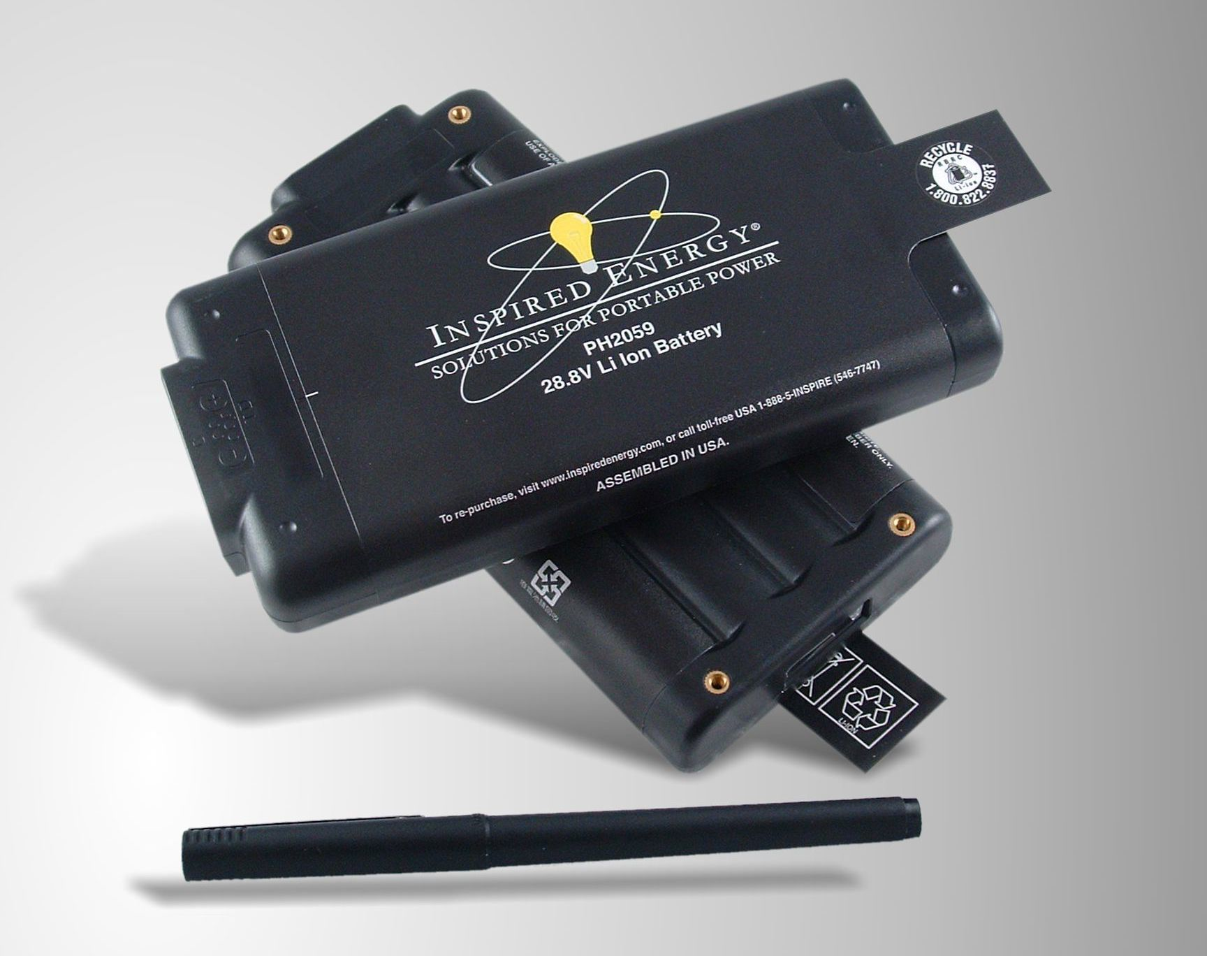
Contains eight Panasonic 18650 cells with BMS

Slide 8
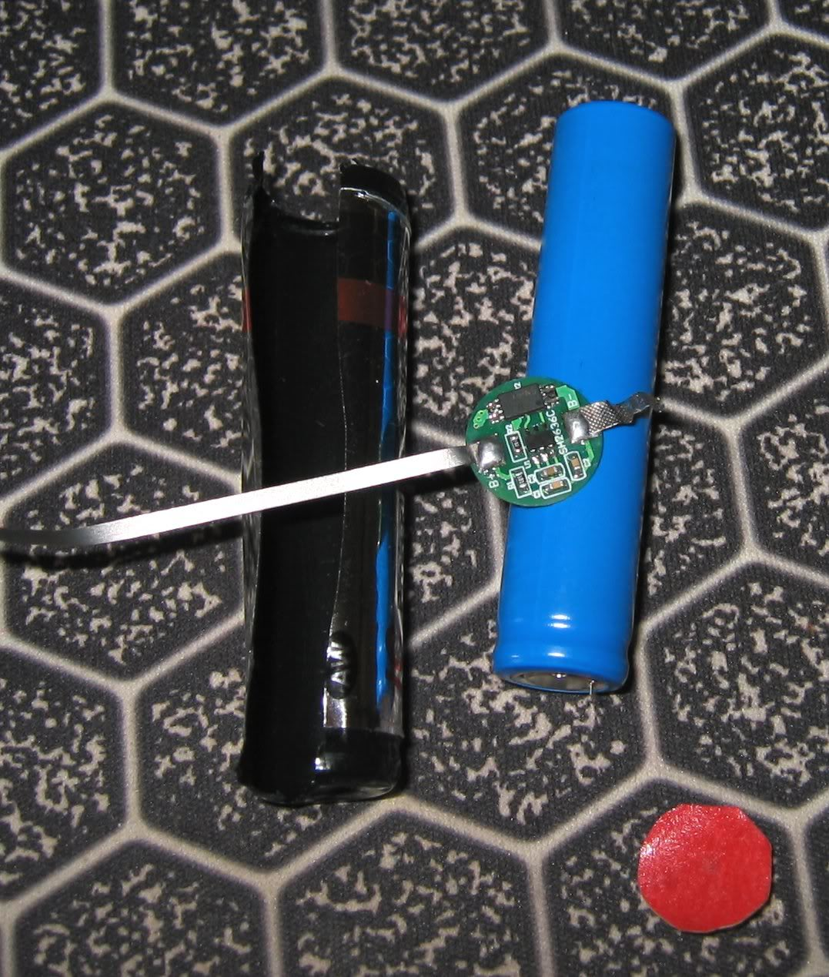

Slide 9
Likelihood of thermal runaway

Slide 10
“Field failures arising from manufacturing defects that cause internal short circuits have very low probabilities of occurrence (estimates for 18650-size cells that fail catastrophically are 1 in 10 million cells to 1 in 40 million cells).”
D. Doughty, et al. (2012), Vehicle Battery Safety Roadmap Guidance

Slide 12
Consequences of thermal runaway

Slide 13
S. Harris, et al. [2009], A combustion chemistry analysis of carbonate solvents used in Li-ion batteries

Slide 14
Cell failure in an MBARI AUV
Is a Li cell failure in an AUV survivable?
Will a single-cell failure propagate?
How much gas and heat are produced?
Will nitrogen fill reduce combustion?
Can gasses be vented outboard?
Will particulates foul a pressure relief valve?

Slide 15
“For a power input of 28 +/- 1 W, thermal runaway occurs at about 230 ˚C +/- 15 ˚C. Thermal runaway is defined here as the onset of a sharp change in the slope of the temperature over time. At times the entire contents of a battery can be expelled after thermal runaway; however, in most cases gases are expelled slowly or as a sudden jet with particulates. Auto as well as piloted ignition can occur. The mass of the contents expelled increases with initial charge, with preliminary data indicating nearly half of the initial mass (44 g) expelled for 100 % charge. The internal energy stored in the battery during runaway increases nearly linearly with charge to about 100 kJ at 100 %. The electrochemical energy stored at 100 % charge is 36 kJ. So an increase in energy is due to the exothermic behavior of the battery components. If all of the gases expelled burn, that energy could reach over 400 kJ at 100 % charge.”
J. G. Quintiere and S. B. Crowley (2013), Thermal Dynamics of 18650 Li-ion Batteries, The Seventh Triennial International Fire & Cabin Safety Research Conference

Slide 17
VSP2 Calorimeter

Slide 20
How much gas is produced?
(269 psi/14.7 psi) x 100 ml = 1.83 liters
Probably much less because the gas cools as it expands.
How long does it take? Very rough estimate of minimum time:
15,123 psi/min x 1 min/60 sec = 252 psi/sec
269 psi/ (252 psi/sec) = 1.1 sec

Slide 21
Modeling of thermal runaway

Slide 25
Paper’s conclusions
“The thermal abuse tolerance of a pack is extremely sensitive to the exothermic behavior of the cells. A small increase in the heat released by the exothermic reaction of a single cell can cause the pack to go into thermal runaway.”
“This work also shows the importance of heat-transfer from the pack.”

Slide 26
Ways to manage thermal runaway

Slide 28
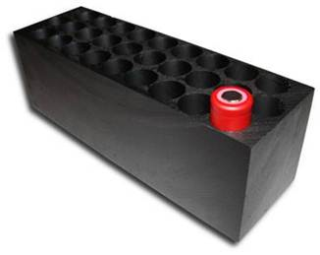
Paraffin-impregnated graphite
Really? Surround your cells with a conductive material impregnated with a combustible material?
http://www.allcelltech.com/technology/thermal-management-with-phase-change-material

Slide 33
Conclusions
PCM graphite is effective if you can afford the weight and volume.
Interstitial space reduces heat conduction between cells, reducing likelihood of failure propagation between cells.
Interstitial space reduces heat conduction between cells, increasing likelihood of thermal runaway of a failed cell.

Slide 34
Modeling of cell parameters

Slide 44
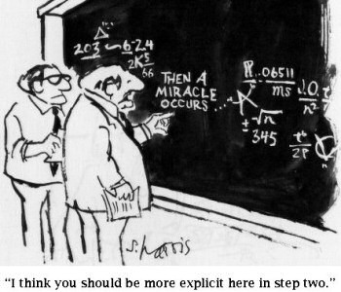
How do we extract model parameters from the test data?
All the paper says is “Finally, all the model parameters are extracted from these experimental curves.”
I used constrained global optimization

Slide 45
Possibilities
Cell/battery modeling may be an interesting mathematical exercise with little practical use
Model could be used for mission planning to predict when voltage dips too low to operate vehicle
Model could be run on vehicle during mission and compared with measured bus voltage to detect battery failures

