Slide 1
Feasibility Study to Develop Safety Guidelines for the Failure Modes of Li Ion Batteries
Bellingham, Mellinger, Erikson, and Smith (as part of battery safety committee)

Slide 2
Problem Statement
Li-ion batteries are heavily used for untethered/uncabled ocean instruments and platforms
These batteries pose a significant safety hazard if they fail
Safe cells ≠ safe battery pack
Little guidance exists for safe use of these batteries in large quantities, in a marine environment and/or inside pressure vessels.

Slide 3
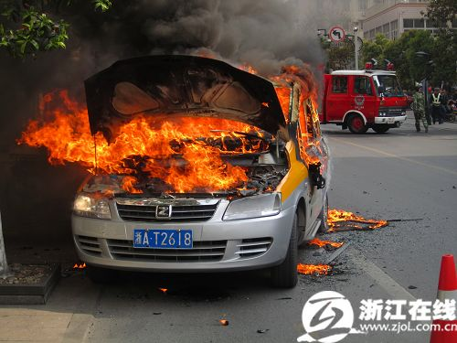
Electric Car Incident
“Firefighters rushed to the scene in minutes but couldn’t do much as the car quickly turned into a big fireball, and then ashes and an empty, back shell. No one was injured; the driver and two passengers in the vehicle got out in time.”
http://chinaautoweb.com/2011/04/hangzhou-halts-all-electric-taxis-as-a-zotye-langyue-multipla-ev-catches-fire/

Slide 4
Why Now?
Battery safety committee has existed for two years, and has been developing informal contacts & collecting information.
  Steinberg, Norm; Bellingham, James; Smallwood, Tara; Whaling, Patrick; Erickson, Jon; Mellinger, Ed; Smith, Ken; Massion, Gene
We have excellent contacts with leaders in the field (Joe Farmer, LLNL, Martin Eberhard, Marc Tarpening, PolyPlus, NPS faculty, etc.)
Some simple experimentation could clarify key issues.

Slide 5
General landscape:
Safety information on batteries typically (almost always?) not provided by manufacturers
Extensive testing on batteries done by (some) electric car industry players
Academic focus on battery safety growing (including at NPS)
We put batteries in pressure vessels & operate batteries under pressure, which is different from most other users
Battery architectures used at MBARI are probably not the safest possible

Slide 6
What information do we need?
For example:
What is vented when a battery fails?
How should individual cells be connected to simplify monitoring and minimize failures?
Are there simple ways to minimize the probability of cell failure cascade?

Slide 7
Our Output
Guidelines that can be used by MBARI engineers in designing and reviewing integrated Li Ion battery.

Slide 8
Transition Opportunities & External Funding
Battery safety a major concern for the US Navy – funding possible from either ONR or NAVFAC if needed.
NPS junior faculty could take ownership of battery safety guidelines
Possible entrainment of other oceanographic institutions (we aren’t the only ones with this problem!)

