Slide 1
Kelp Forest Array Ground Fault Technical Review
Chad Kecy
Feb. 26 2014

Slide 2
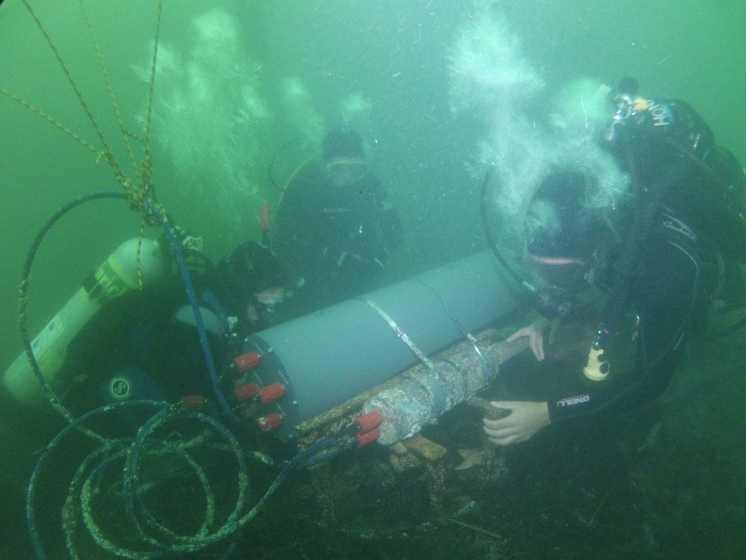
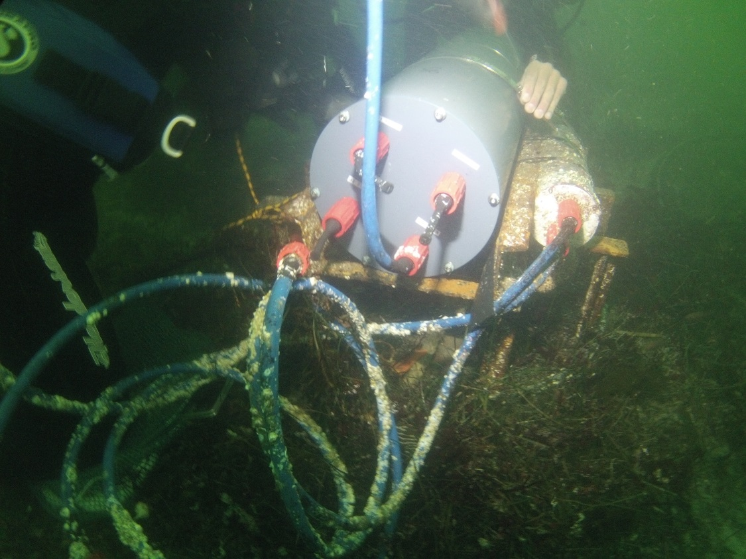
KFA As Deployed (Oct 2013)

Slide 3
KFA As Deployed July 2012
Diver Lockout Box
KFA DC Power Supply
swFOCE DC Power Supply
Hopkins Pump House
Sub Sea
Tether (200m)
5 x 14AWG
KFA Micro Node
M
F
swFOCE 375V OUT
M
F
KFA 300V OUT
F
F
KFA Central Node
M
M
F
M
KFA 300V IN
M
F
KFA 300V OUT
F
M
swFOCE 375V IN
M
F
M
F
swFOCE 375V OUT

Slide 4
KFA August 30, 2013
Diver Lockout Box
KFA DC Power Supply
KFA GF Detection Module
swFOCE DC Power Supply
swFOCE GF Detection Module
Hopkins Pump House
GF on 300V return line
~200kohms to trip in ~45 minutes
Sub Sea
Tether (200m)
5 x 14AWG
KFA Micro Node
M
F
swFOCE 375V OUT
M
F
KFA 300V OUT
F
F
KFA Central Node
M
M
F
M
KFA 300V IN
M
F
KFA 300V OUT
F
M
swFOCE 375V IN
M
F
M
F
swFOCE 375V OUT

Slide 5
KFA Sept. 11, 2013
Diver Lockout Box
KFA DC Power Supply
KFA GF Detection Module
swFOCE DC Power Supply
swFOCE GF Detection Module
Hopkins Pump House
Sub Sea
Tether (200m)
5 x 14AWG
KFA Micro Node
M
F
swFOCE 375V OUT
M
F
KFA 300V OUT
F
F
M
M

Slide 6
MBARI Sept. 12-17, 2013
swFOCE DC Power Supply
swFOCE GF Detection Module
F
F
KFA Central Node
M
M
F
M
KFA 300V IN
M
F
KFA 300V OUT
F
M
swFOCE 375V IN
M
F
M
F
swFOCE 375V OUT
1. Opened KFA CN: No shorts or visual problems
2. Independently tested GF detection module: working correctly
3. Tested for GFs on bench: OK
4. Placed KFA CN in test tank: measured 900kohms (~300uA)
(only left in tank ~10 minutes)
5. Assumption: KFA CN does not have a seawater short

Slide 7
KFA Oct. 17, 2013 Dive #1
Diver Lockout Box
KFA DC Power Supply
KFA GF Detection Module
swFOCE DC Power Supply
swFOCE GF Detection Module
Hopkins Pump House
GF on 300V return line
360kohms; short test
Sub Sea
Tether (200m)
5 x 14AWG
KFA Micro Node
M
F
swFOCE 375V OUT
M
F
KFA 300V OUT
F
F
M
M
Ti Housing (Seawater Reference)
F
M

Slide 8
KFA Oct. 17, 2013 Dive #2
Diver Lockout Box
KFA DC Power Supply
KFA GF Detection Module
swFOCE DC Power Supply
swFOCE GF Detection Module
Hopkins Pump House
GF on 300V return line
300kohms; short test
Sub Sea
Tether (200m)
5 x 14AWG
KFA Micro Node
M
F
swFOCE 375V OUT
M
F
KFA 300V OUT
F
F
M
M
Ti Housing (Seawater Reference)
F
M

Slide 9
KFA Oct. 17, 2013 Dive #3
Diver Lockout Box
KFA DC Power Supply
KFA GF Detection Module
swFOCE DC Power Supply
swFOCE GF Detection Module
Hopkins Pump House
GF on 300V return line
300kohms to 98kohms in ~10 minutes (shut off)
Sub Sea
Tether (200m)
5 x 14AWG
KFA Micro Node
M
F
swFOCE 375V OUT
M
F
KFA 300V OUT
F
F
KFA Central Node
M
M
F
M
KFA 300V IN
M
F
KFA 300V OUT
F
M
swFOCE 375V IN
M
F
M
F
swFOCE 375V OUT

Slide 10
KFA Oct. 24, 2013
Diver Lockout Box
KFA DC Power Supply
KFA GF Detection Module
swFOCE DC Power Supply
swFOCE GF Detection Module
Hopkins Pump House
GF on 300V return line
200kohms to trip in ~60 minutes
Sub Sea
Tether (200m)
5 x 14AWG
Swapped out KFA extension cable
KFA Micro Node
M
F
swFOCE 375V OUT
M
F
KFA 300V OUT
F
KFA Central Node
M
F
M
KFA 300V IN
M
F
KFA 300V OUT
F
M
swFOCE 375V IN
M
F
M
F
swFOCE 375V OUT

Slide 11
KFA Nov. 7, 2013
Diver Lockout Box
KFA DC Power Supply
KFA GF Detection Module
swFOCE DC Power Supply
swFOCE GF Detection Module
Hopkins Pump House
GF on 300V return line
GF (line not noted)
Sub Sea
Swapped out KFA extension cable
Tether (200m)
5 x 14AWG
*
Added Type 44 molyKote
to female connectors
(underwater, box method)
*
KFA Micro Node
M
F
swFOCE 375V OUT
*
*
M
F
KFA 300V OUT
F
F
*
M
M
*
KFA Central Node
F
M
KFA 300V IN
M
F
KFA 300V OUT
*
*
F
M
swFOCE 375V IN
*
M
F
M
F
swFOCE 375V OUT
*

Slide 12
Sheila B Dec. 5, 2013
Diver Lockout Box
KFA DC Power Supply
KFA GF Detection Module
swFOCE DC Power Supply
swFOCE GF Detection Module
Hopkins Pump House
KFA: 1.9Mohms and rising
swFOCE: >10Mohms
Jim stayed onsite for 90 minutes
Cleaned every connector
Re-applied MolyKote
Tested on deck: OK
Dropped both nodes in
water: OK
5. Redeployed: OK
Sub Sea
*
Added Type 44 molyKote
to female connectors
(deck of Sheila B)
Tether (200m)
5 x 14AWG
*
KFA Micro Node
M
F
swFOCE 375V OUT
*
*
M
F
KFA 300V OUT
F
F
*
M
M
*
KFA Central Node
F
M
KFA 300V IN
M
F
KFA 300V OUT
*
*
*
F
M
swFOCE 375V IN
*
M
F
M
F
M
F
swFOCE 375V OUT
*

Slide 13
KFA Dec. 11, 2013
Diver Lockout Box
KFA DC Power Supply
KFA GF Detection Module
swFOCE DC Power Supply
swFOCE GF Detection Module
Hopkins Pump House
GF on 300V return line (30kohms)
GF both lines (6kohms)
Sub Sea
Tether (200m)
5 x 14AWG
KFA Micro Node
M
F
swFOCE 375V OUT
M
F
KFA 300V OUT
F
F
KFA Central Node
M
M
F
M
KFA 300V IN
M
F
KFA 300V OUT
F
M
swFOCE 375V IN
M
F
M
F
M
F
swFOCE 375V OUT

Slide 14
KFA Dec. 19, 2013 Test #1
OFF
OFF
Diver Lockout Box
KFA DC Power Supply
KFA GF Detection Module
OFF
ON
ON
swFOCE DC Power Supply
swFOCE GF Detection Module
ON
Hopkins Pump House
GF both lines (4kohms)
Sub Sea
Tether (200m)
5 x 14AWG
KFA Micro Node
M
F
swFOCE 375V OUT
M
F
KFA 300V OUT
F
F
KFA Central Node
M
M
F
M
KFA 300V IN
M
F
KFA 300V OUT
F
M
swFOCE 375V IN
M
F
M
F
M
F
swFOCE 375V OUT

Slide 15
KFA Dec. 19, 2013 Test #2
ON
ON
Diver Lockout Box
KFA DC Power Supply
KFA GF Detection Module
ON
OFF
OFF
swFOCE DC Power Supply
swFOCE GF Detection Module
OFF
Hopkins Pump House
GF on 300V return line (100kohms)
Sub Sea
Tether (200m)
5 x 14AWG
KFA Micro Node
M
F
swFOCE 375V OUT
M
F
KFA 300V OUT
F
F
KFA Central Node
M
M
F
M
KFA 300V IN
M
F
KFA 300V OUT
F
M
swFOCE 375V IN
M
F
M
F
M
F
swFOCE 375V OUT

Slide 16
KFA Dec. 19, 2013 Test #3
OFF
OFF
Diver Lockout Box
KFA DC Power Supply
KFA GF Detection Module
OFF
OFF
ON
swFOCE DC Power Supply
swFOCE GF Detection Module
ON
Hopkins Pump House
swFOCE >10Mohms
Sub Sea
Tether (200m)
5 x 14AWG
KFA Micro Node
M
F
swFOCE 375V OUT
M
F
KFA 300V OUT
F
F
KFA Central Node
M
M
F
M
KFA 300V IN
M
F
KFA 300V OUT
F
M
swFOCE 375V IN
M
F
M
F
M
F
swFOCE 375V OUT

Slide 17
KFA Dec. 19, 2013 Test #4
OFF
ON
Diver Lockout Box
KFA DC Power Supply
KFA GF Detection Module
ON
OFF
OFF
swFOCE DC Power Supply
swFOCE GF Detection Module
OFF
Hopkins Pump House
KFA >10Mohms
Sub Sea
Tether (200m)
5 x 14AWG
KFA Micro Node
M
F
swFOCE 375V OUT
M
F
KFA 300V OUT
F
F
KFA Central Node
M
M
F
M
KFA 300V IN
M
F
KFA 300V OUT
F
M
swFOCE 375V IN
M
F
M
F
M
F
swFOCE 375V OUT

Slide 18
KFA Dec. 19, 2013 Test #5
ON
ON
Diver Lockout Box
KFA DC Power Supply
KFA GF Detection Module
OFF
OFF
OFF
swFOCE DC Power Supply
swFOCE GF Detection Module
OFF
Hopkins Pump House
KFA >10Mohms
Earth Return from Pumphouse
Sub Sea
Tether (200m)
5 x 14AWG
KFA Micro Node
M
F
swFOCE 375V OUT
M
F
KFA 300V OUT
F
F
KFA Central Node
M
M
F
M
KFA 300V IN
M
F
KFA 300V OUT
F
M
swFOCE 375V IN
M
F
M
F
M
F
swFOCE 375V OUT

Slide 19
KFA Dec. 19, 2013 Test #6
OFF
OFF
Diver Lockout Box
KFA DC Power Supply
KFA GF Detection Module
OFF
ON
ON
swFOCE DC Power Supply
swFOCE GF Detection Module
OFF
Hopkins Pump House
swFOCE >10Mohms
Earth Return from Pumphouse
Sub Sea
Tether (200m)
5 x 14AWG
KFA Micro Node
M
F
swFOCE 375V OUT
M
F
KFA 300V OUT
F
F
KFA Central Node
M
M
F
M
KFA 300V IN
M
F
KFA 300V OUT
F
M
swFOCE 375V IN
M
F
M
F
M
F
swFOCE 375V OUT

Slide 20
KFA Dec. 19, 2013 Test #7
OFF
OFF
Diver Lockout Box
KFA DC Power Supply
KFA GF Detection Module
OFF
ON
ON
swFOCE DC Power Supply
swFOCE GF Detection Module
ON
Hopkins Pump House
Earth Return from Pumphouse
GF both lines (100kohms)
Sub Sea
Tether (200m)
5 x 14AWG
KFA Micro Node
M
F
swFOCE 375V OUT
M
F
KFA 300V OUT
F
F
KFA Central Node
M
M
F
M
KFA 300V IN
M
F
KFA 300V OUT
F
M
swFOCE 375V IN
M
F
M
F
M
F
swFOCE 375V OUT

Slide 21
KFA Dec. 19, 2013 Test #8
ON
ON
Diver Lockout Box
KFA DC Power Supply
KFA GF Detection Module
ON
OFF
OFF
swFOCE DC Power Supply
swFOCE GF Detection Module
OFF
Hopkins Pump House
GF on 300V return line (16kohms)
Earth Return from Pumphouse
Sub Sea
Tether (200m)
5 x 14AWG
KFA Micro Node
M
F
swFOCE 375V OUT
M
F
KFA 300V OUT
F
F
KFA Central Node
M
M
F
M
KFA 300V IN
M
F
KFA 300V OUT
F
M
swFOCE 375V IN
M
F
M
F
M
F
swFOCE 375V OUT

Slide 22
KFA Dec. 19, 2013 Test #9
ON
ON
Diver Lockout Box
KFA DC Power Supply
KFA GF Detection Module
OFF
OFF
OFF
swFOCE DC Power Supply
swFOCE GF Detection Module
OFF
Hopkins Pump House
KFA >10Mohms
Sub Sea
Tether (200m)
5 x 14AWG
KFA Micro Node
M
F
swFOCE 375V OUT
M
F
KFA 300V OUT
F
F
KFA Central Node
M
M
F
M
KFA 300V IN
M
F
KFA 300V OUT
F
M
swFOCE 375V IN
M
F
M
F
M
F
swFOCE 375V OUT

Slide 23
KFA Dec. 19, 2013 Test #10
ON
ON
Diver Lockout Box
KFA DC Power Supply
KFA GF Detection Module
ON
OFF
OFF
swFOCE DC Power Supply
swFOCE GF Detection Module
OFF
Hopkins Pump House
KFA >10Mohms
Sub Sea
Tether (200m)
5 x 14AWG
KFA Micro Node
M
F
swFOCE 375V OUT
M
F
KFA 300V OUT
F
F
KFA Central Node
M
M
F
M
KFA 300V IN
M
F
KFA 300V OUT
F
M
swFOCE 375V IN
M
F
M
F
M
F
swFOCE 375V OUT

Slide 24
KFA Dec. 19, 2013 Test #11
OFF
OFF
Diver Lockout Box
KFA DC Power Supply
KFA GF Detection Module
OFF
ON
ON
swFOCE DC Power Supply
swFOCE GF Detection Module
OFF
Hopkins Pump House
swFOCE >10Mohms
Sub Sea
Tether (200m)
5 x 14AWG
KFA Micro Node
M
F
swFOCE 375V OUT
M
F
KFA 300V OUT
F
F
KFA Central Node
M
M
F
M
KFA 300V IN
M
F
KFA 300V OUT
F
M
swFOCE 375V IN
M
F
M
F
M
F
swFOCE 375V OUT

Slide 25
KFA Dec. 19, 2013 Test #12
OFF
OFF
Diver Lockout Box
KFA DC Power Supply
KFA GF Detection Module
OFF
ON
ON
swFOCE DC Power Supply
swFOCE GF Detection Module
ON
Hopkins Pump House
swFOCE >10Mohms
Sub Sea
Tether (200m)
5 x 14AWG
KFA Micro Node
M
F
swFOCE 375V OUT
M
F
KFA 300V OUT
F
F
KFA Central Node
M
M
F
M
KFA 300V IN
M
F
KFA 300V OUT
F
M
swFOCE 375V IN
M
F
M
F
M
F
swFOCE 375V OUT

Slide 26
MBARI Jan. 22, 2014 Test #1
Megger
OFF
OFF
swFOCE DC Power Supply
swFOCE GF Detection Module
F
M
Test Tank Dry Side
Cable was meggered dry in lab.
15 Meter SubConn GigE Cable
 | 1 (V Pos) | 2 (SW Ref) | 3 (V Ret) | 12 (V Pos) | 13 (V Ret)
1 (V Pos) | X | 32.4 G | 77.5 G | 79 G | 70 G
2 (SW Ref) | X | X | 35.4 G | 36 G | 30 G
3 (V Ret) | X | X | X | 76.5 G | 71.5 G
12 (V Pos) | X | X | X | X | 62 G
13 (V Ret) | X | X | X | X | X
F
M

Slide 27
MBARI Jan. 22, 2014 Test #2
Megger
OFF
OFF
swFOCE DC Power Supply
swFOCE GF Detection Module
F
M
Test Tank Dry Side
Female end of the cable and dummy plug had type 44 MolyKote applied,
then weighted and sent to bottom of the test tank.
Test Tank subsea
15 Meter SubConn GigE Cable
 | 1 (V Pos) | 2 (SW Ref) | 3 (V Ret) | 12 (V Pos) | 13 (V Ret)
1 (V Pos) | X | 27.8 G | 56.5 G | 53 G | 50.5 G
2 (SW Ref) | X | X | 28.4 G | 28.8 G | 25 G
3 (V Ret) | X | X | X | 54 G | 51.6 G
12 (V Pos) | X | X | X | X | 43.8 G
13 (V Ret) | X | X | X | X | X
F
M

Slide 28
MBARI Jan. 22, 2014 Test #3
Megger
OFF
OFF
swFOCE DC Power Supply
swFOCE GF Detection Module
F
M
Test Tank Dry Side
Female end of the cable and dummy plug were placed in tank unconnected
then shaken off, and re-connected. (Simulating an underwater mating).
The mated connection was placed in the test tank for 30 minutes and then
pulled back out; meggering was done on deck.
15 Meter SubConn GigE Cable
 | 1 (V Pos) | 2 (SW Ref) | 3 (V Ret) | 12 (V Pos) | 13 (V Ret)
1 (V Pos) | X | 28.6 G | 23.8 G | 38.6 G | 34.2 G
2 (SW Ref) | X | X | 24.6 G | 33.6 G | 22 G
3 (V Ret) | X | X | X | 39.2 G | 35.6 G
12 (V Pos) | X | X | X | X | 36.6 G
13 (V Ret) | X | X | X | X | X
F
M

Slide 29
MBARI Jan. 22, 2014 Test #4
Megger
OFF
OFF
swFOCE DC Power Supply
swFOCE GF Detection Module
F
M
Test Tank Dry Side
Female end of the cable and dummy plug were then placed back in the tank
and soaked overnight. Meggering performed the following morning.
Test Tank subsea
15 Meter SubConn GigE Cable
 | 1 (V Pos) | 2 (SW Ref) | 3 (V Ret) | 12 (V Pos) | 13 (V Ret)
1 (V Pos) | X | 28.4 G | 53 G | 53.5 G | 48.8 G
2 (SW Ref) | X | X | 28.8 G | 29.2 G | 24.8 G
3 (V Ret) | X | X | X | 53.5 G | 51.5 G
12 (V Pos) | X | X | X | X | 46.6 G
13 (V Ret) | X | X | X | X | X
F
M

Slide 30
KFA Jan 22, 2014 Test #1
Diver Lockout Box
Megger
OFF
OFF
swFOCE DC Power Supply
swFOCE GF Detection Module
Hopkins Pump House
 | KFA Pos | KFA Neg | swF Pos | swF Neg | SW Ref | Armor | Earth Ref
KFA Pos | X | 2.9 G | 27 M | 0.16 M | 14 M | 0.37 M
KFA Neg | X | X | 1.2 G | 3.3 G | 3.2 G | 3 M
swF Pos | X | X | X | 15.6 M | 29.4 M | 27 M
swF Neg | X | X | X | X | 13 M | 1.2 M
SW Ref | X | X | X | X | X | 12.6 M
Armor | X | X | X | X | X | X | 0 ohm, 0V
Earth Ref | X | X | X | X | X | X | X
Sub Sea
Tether (200m)
5 x 14AWG
KFA Micro Node
M
F
swFOCE 375V OUT
M
F
KFA 300V OUT
F
F
M
M
F
M
F
M

Slide 31
KFA Jan 22, 2014 Test #2
Diver Lockout Box
Megger
OFF
OFF
swFOCE DC Power Supply
swFOCE GF Detection Module
Hopkins Pump House
 | KFA Pos | KFA Neg | swF Pos | swF Neg | SW Ref | Armor | Earth Ref
KFA Pos | X | 2.8 G | 9.1 M | 0.7 M |  | 0.6 M | 0.7 M
KFA Neg | X | X | 130 G | 139 G |  | 2.6 M | 3.8 G
swF Pos | X | X | X | 20 G |  | 22 M | 19.1 M
swF Neg | X | X | X | X |  | 1.5 M | 2.3 M
SW Ref | X | X | X | X | X
Armor | X | X | X | X | X | X
Earth Ref | X | X | X | X | X | X | X
Sub Sea
Tether (200m)
5 x 14AWG
KFA Micro Node
M
F
swFOCE 375V OUT
M
F
KFA 300V OUT
F
F
M
M
F
M
F
M

Slide 32
MBARI Jan. 22, 2014 Test #5
ON
ON
swFOCE DC Power Supply
swFOCE GF Detection Module
F
M
Test Tank Dry Side
Ran for 60 minutes, GF >10Mohms
Test Tank Sub Sea
Al Block
15 Meter SubConn GigE Cable
Dummy plug attached dry
F
M

Slide 33
MBARI Jan. 22, 2014 Test #6
ON
ON
swFOCE DC Power Supply
swFOCE GF Detection Module
F
M
Test Tank Dry Side
Lowered the Test Housing to bottom of tank.
Ran for 60 minutes, GF >10Mohms
Test Tank Sub Sea
15 Meter SubConn GigE Cable
V = 375Vdc
I = 0.179A
P = 67W
Connector attached dry
Ti Test Housing
Vicor Maxi
Pwr Res
1A (50W)
F
M
375V:48V
600W
50ohms
160W

Slide 34
MBARI Jan. 23, 2014 Test #1
ON
ON
swFOCE DC Power Supply
swFOCE GF Detection Module
F
M
Test Tank Dry Side
Left the Test Housing at the bottom of the tank overnight.
Ran for 60 minutes, GF >10Mohms
Test Tank Sub Sea
15 Meter SubConn GigE Cable
V = 375Vdc
I = 0.179A
P = 67W
Connector attached dry
Ti Test Housing
Vicor Maxi
Pwr Res
1A (50W)
F
M
375V:48V
600W
50ohms
160W

Slide 35
MBARI Jan. 23, 2014 Test #2
ON
ON
swFOCE DC Power Supply
swFOCE GF Detection Module
F
M
Test Tank Dry Side
Female end of the cable and dummy plug were placed in tank unconnected
then shaken off, and re-connected. (Simulating an underwater mating).
Test Tank Sub Sea
On deck, no power applied, GF > 10 Mohms
On deck, power applied, GF > 10 Mohms
In tank, power applied, GF>10 Mohms
(left in tank 60 minutes)
15 Meter SubConn GigE Cable
V = 375Vdc
I = 0.179A
P = 67W
Connector attached dry
Ti Test Housing
Vicor Maxi
Pwr Res
1A (50W)
F
M
375V:48V
600W
50ohms
160W

Slide 36
MBARI Jan. 23, 2014 Test #3
ON
ON
swFOCE DC Power Supply
swFOCE GF Detection Module
F
M
Test Tank Dry Side
Attached cable to swFOCE connector dry.
Ran GF test on deck.
Ran for 60 minutes, GF > 10 Mohms
15 Meter SubConn GigE Cable
Connector attached dry
KFA Central Node
F
M
KFA 300V IN
M
F
KFA 300V OUT
F
M
swFOCE 375V IN
M
F
swFOCE 375V OUT

Slide 37
MBARI Jan. 23, 2014 Test #4
ON
ON
swFOCE DC Power Supply
swFOCE GF Detection Module
F
M
Test Tank Dry Side
Attached cable to KFA connector dry.
Ran GF test on deck.
Ran for 60 minutes, GF > 10 Mohms
Connector attached dry
15 Meter SubConn GigE Cable
KFA Central Node
F
M
KFA 300V IN
M
F
KFA 300V OUT
F
M
swFOCE 375V IN
M
F
swFOCE 375V OUT

Slide 38
MBARI Jan. 23, 2014 Test #5
OFF
ON
swFOCE DC Power Supply
swFOCE GF Detection Module
F
M
Test Tank Dry Side
Test Tank Sub Sea
Attached cable to KFA connector dry.
Placed CN on bottom of tank.
No power applied.
15 Meter SubConn GigE Cable
Time | GF (ohms)
1:34 | 234k
1:35 | 260k
1:36 | 299k
1:39 | 326k
1:40 | 314k
1:50 | 163k
1:51 | 205k
1:52 | 520k
1:53 | 153k
1:54 | 182k
Connector attached dry
KFA Central Node
F
M
KFA 300V IN
M
F
KFA 300V OUT
F
M
swFOCE 375V IN
M
F
swFOCE 375V OUT

Slide 39
MBARI Jan. 23, 2014 Test #6
ON
ON
swFOCE DC Power Supply
swFOCE GF Detection Module
F
M
Test Tank Dry Side
Test Tank Sub Sea
Attached cable to KFA connector dry.
Placed CN on bottom of tank.
Power applied.
Time | GF (ohms)
1:55 | 300k
1:58 | 389k
2:06 | 610k
2:09 | 850k
2:10 | 108k
2:14 | 215k
2:16 | 1.1M
2:18 | 750k
2:20 | 1.4M
2:21 | 1.6M
2:30 | 1.7M
2:31 | 2.0M
2:39 | 2.4M
2:42 | 2.8M
2:45 | 3.0M
15 Meter SubConn GigE Cable
Connector attached dry
KFA Central Node
F
M
KFA 300V IN
M
F
KFA 300V OUT
F
M
swFOCE 375V IN
M
F
swFOCE 375V OUT

Slide 40
MBARI Jan. 27, 2014 Test #1
ON
ON
swFOCE DC Power Supply
swFOCE GF Detection Module
F
M
Test Tank Dry Side
15 Meter SubConn GigE Cable
KFA Central Node
F
M
KFA 300V IN
M
F
KFA 300V OUT
F
M
swFOCE 375V IN
M
F
swFOCE 375V OUT
Brought KFA CN back to lab and removed both endcaps and gave a visual inspection.
Hooked into earth return and ran GF test dry.
Ran for 30 minutes, GF >10Mohms

Slide 41
MBARI Jan. 27, 2014 Test #2
ON
ON
swFOCE DC Power Supply
swFOCE GF Detection Module
F
M
Test Tank Dry Side
15 Meter SubConn GigE Cable
KFA Central Node
KFA 300V IN
KFA 300V OUT
swFOCE 375V IN
M
F
M
F
swFOCE 375V OUT
F
M
F
M
Placed HV endcap into a bucket with seawater.
Hooked into earth return and ran GF test.
Ran for 30 minutes, 1.2 Mohms < GF < 9.0 Mohms

Slide 42
MBARI Jan. 27, 2014 Test #3
ON
ON
swFOCE DC Power Supply
swFOCE GF Detection Module
F
M
Test Tank Dry Side
15 Meter SubConn GigE Cable
KFA Central Node
KFA 300V IN
KFA 300V OUT
swFOCE 375V IN
M
F
M
F
swFOCE 375V OUT
F
M
F
M
Cleaned all 4 HV connectors and applied Molykote
Placed HV endcap into a bucket with seawater.
Connected KFA input.
Hooked into earth return and ran GF test.
Ran for 90 minutes, GF > 10 Mohms

Slide 43
MBARI Jan. 27, 2014 Test #4
ON
ON
swFOCE DC Power Supply
swFOCE GF Detection Module
F
M
Test Tank Dry Side
15 Meter SubConn GigE Cable
KFA Central Node
KFA 300V IN
KFA 300V OUT
swFOCE 375V IN
M
F
M
F
swFOCE 375V OUT
F
M
F
M
Cleaned all 4 HV connectors and applied Molykote
Placed HV endcap into a bucket with seawater.
Connected swFOCE input.
Hooked into earth return and ran GF test.
Ran for 60 minutes, GF > 10 Mohms

Slide 44
MBARI Jan. 28, 2014 Test #1
ON
ON
swFOCE DC Power Supply
swFOCE GF Detection Module
F
M
Test Tank Dry Side
Attached cable to KFA connector dry.
Ran GF test on deck.
Ran for 60 minutes, GF > 10 Mohms
15 Meter SubConn GigE Cable
Connector attached dry
** Note: CN had sat overnight in lab
KFA Central Node
F
M
KFA 300V IN
M
F
KFA 300V OUT
F
M
swFOCE 375V IN
M
F
swFOCE 375V OUT

Slide 45
MBARI Jan. 28, 2014 Test #2
ON
ON
swFOCE DC Power Supply
swFOCE GF Detection Module
F
M
Test Tank Dry Side
Attached cable to swFOCE connector dry.
Ran GF test on deck.
Ran for 60 minutes, GF >10 Mohms
15 Meter SubConn GigE Cable
Connector attached dry
KFA Central Node
F
M
KFA 300V IN
** Note: No load on swFOCE at this time
M
F
KFA 300V OUT
F
M
swFOCE 375V IN
M
F
swFOCE 375V OUT

Slide 46
MBARI Jan. 28, 2014 Test #3
OFF
ON
swFOCE DC Power Supply
swFOCE GF Detection Module
F
M
Test Tank Dry Side
Test Tank Sub Sea
Placed CN on bottom of tank.
No power applied.
15 Meter SubConn GigE Cable
Connector attached dry
Ran for 10 minutes, GF > 10 Mohms
KFA Central Node
F
M
KFA 300V IN
** Note: No load on swFOCE at this time
M
F
KFA 300V OUT
F
M
swFOCE 375V IN
M
F
swFOCE 375V OUT

Slide 47
MBARI Jan. 28, 2014 Test #4
ON
ON
swFOCE DC Power Supply
swFOCE GF Detection Module
F
M
Test Tank Dry Side
Test Tank Sub Sea
CN on bottom of tank.
Power applied.
15 Meter SubConn GigE Cable
Connector attached dry
Ran for 60 minutes, GF >10 Mohms
KFA Central Node
F
M
KFA 300V IN
** Note: No load on swFOCE at this time
M
F
KFA 300V OUT
F
M
swFOCE 375V IN
M
F
swFOCE 375V OUT

Slide 48
MBARI Jan. 28, 2014 Test #5
ON
ON
swFOCE DC Power Supply
swFOCE GF Detection Module
F
M
Test Tank Dry Side
Attached cable to KFA connector dry.
CN on deck.
Power applied.
15 Meter SubConn GigE Cable
Time | GF (ohms)
12:51 | 8.4M
12:52 | 9.2M
12:53 | 10M
12:54 | 9.8M
12:55 | 10M
Connector attached dry
KFA Central Node
F
M
KFA 300V IN
** Note: CN had been in tank >60 minutes
just prior to this test.
M
F
KFA 300V OUT
F
M
swFOCE 375V IN
M
F
swFOCE 375V OUT

Slide 49
MBARI Jan. 28, 2014 Test #6
ON
ON
swFOCE DC Power Supply
swFOCE GF Detection Module
F
M
Test Tank Dry Side
Blew out KFA connector with shop air (high pressure)
CN on deck.
Power applied.
15 Meter SubConn GigE Cable
Ran for 10 minutes, GF >10 Mohms
Connector attached dry
KFA Central Node
F
M
KFA 300V IN
M
F
KFA 300V OUT
F
M
swFOCE 375V IN
M
F
swFOCE 375V OUT

Slide 50
MBARI Jan. 28, 2014 Test #7
ON
ON
swFOCE DC Power Supply
swFOCE GF Detection Module
F
M
Test Tank Dry Side
Test Tank Sub Sea
Placed CN on bottom of tank.
Power applied.
15 Meter SubConn GigE Cable
Time | GF (ohms)
1:15 | 10M
1:16 | 3.2M
1:17 | 3.7M
1:18 | 4.2M
1:19 | 4.1M
1:22 | 5.4M
1:30 | 6.4M
1:34 | 7.0M
1:44 | 8.1M
1:50 | 6.8M
2:05 | 7.2M
14:15 | 8.1M
Connector attached dry
KFA Central Node
F
M
KFA 300V IN
M
F
KFA 300V OUT
F
M
swFOCE 375V IN
M
F
swFOCE 375V OUT

Slide 51
MBARI Jan. 28, 2014 Test #8
ON
ON
swFOCE DC Power Supply
swFOCE GF Detection Module
F
M
Test Tank Dry Side
15 Meter SubConn GigE Cable
Test Tank Sub Sea
Attached power to swFOCE input.
Used test simulator as a load on the
swFOCE output.
Placed CN & test simulator on
bottom of tank.
Power applied.
KFA Central Node
F
M
KFA 300V IN
M
F
KFA 300V OUT
F
M
swFOCE 375V IN
Connectors attached dry
M
F
swFOCE 375V OUT
Ti Test Housing
Vicor Maxi
Pwr Res
Ran for 60 minutes, GF >10 Mohms
1A (50W)
F
M
1 Meter SubConn GigE Cable
375V:48V
600W
50ohms
160W
** Note: Load on swFOCE = 70 Watts

Slide 52
MBARI Jan. 29, 2014
We suspect the KFA input connector may be bad.
Internal to the CN, we are swapping the connections of the KFA
input and swFOCE input connectors.
Meaning, the physical connector for the swFOCE input
will power the internal KFA electronics.
The KFA connector will power the swFOCE Output (external test load).
If the KFA connector is bad, then the GF should show up when
powering the external load AND no GF should appear when powering
up the KFA.
KFA Central Node
KFA 300V IN
M
Original KFA Wiring
KFA Central Node Internal Electronics
KFA 300V OUT
F
Original swFOCE Wiring
swFOCE 375V IN
M
Temporary KFA Wiring
swFOCE 375V OUT
F
Temporary swFOCE Wiring

Slide 53
MBARI Jan. 29, 2014 Test #1
ON
ON
Ran Test on Deck
swFOCE DC Power Supply
swFOCE GF Detection Module
F
M
Test Tank Dry Side
15 Meter SubConn GigE Cable
KFA Central Node
J1
F
M
KFA Central Node Internal Electronics
M
Ran for 30 minutes,
GF >10 Mohms
F
J4
F
M
J2
M
F
J3
Ti Test Housing
Vicor Maxi
Pwr Res
J1 - KFA 300V IN
1A (50W)
J2 - swFOCE 375V IN
F
M
J3 - swFOCE 375V OUT
375V:48V
600W
50ohms
160W
J4 - KFA 300V OUT

Slide 54
MBARI Jan. 29, 2014 Test #2
ON
ON
Ran Test on Deck
swFOCE DC Power Supply
swFOCE GF Detection Module
F
M
Test Tank Dry Side
15 Meter SubConn GigE Cable
KFA Central Node
J1
F
M
KFA Central Node Internal Electronics
M
F
J4
F
M
Ran for 30 minutes,
GF >10 Mohms
J2
M
F
J3
J1 - KFA 300V IN
J2 - swFOCE 375V IN
J3 - swFOCE 375V OUT
J4 - KFA 300V OUT

Slide 55
MBARI Jan. 29, 2014 Test #3
ON
ON
swFOCE DC Power Supply
swFOCE GF Detection Module
F
M
Test Tank Dry Side
15 Meter SubConn GigE Cable
Test Tank Sub Sea
KFA Central Node
J1
F
M
KFA Central Node Internal Electronics
M
F
J4
F
M
Ran for 30 minutes,
GF >10 Mohms
J2
M
F
J3
J1 - KFA 300V IN
J2 - swFOCE 375V IN
J3 - swFOCE 375V OUT
J4 - KFA 300V OUT

Slide 56
MBARI Jan. 29, 2014 Test #4
ON
ON
swFOCE DC Power Supply
swFOCE GF Detection Module
F
M
Test Tank Dry Side
15 Meter SubConn GigE Cable
Test Tank Sub Sea
KFA Central Node
J1
F
M
KFA Central Node Internal Electronics
M
Ran for 30 minutes,
GF >10 Mohms
F
J4
F
M
J2
M
F
J3
Ti Test Housing
Vicor Maxi
Pwr Res
J1 - KFA 300V IN
1A (50W)
J2 - swFOCE 375V IN
F
M
J3 - swFOCE 375V OUT
375V:48V
600W
50ohms
160W
J4 - KFA 300V OUT

Slide 57
MBARI Jan. 30, 2014 Test #1
Soaked CN & Test Sim
in tank overnight.
ON
ON
swFOCE DC Power Supply
swFOCE GF Detection Module
F
M
Test Tank Dry Side
15 Meter SubConn GigE Cable
Test Tank Sub Sea
KFA Central Node
J1
F
M
KFA Central Node Internal Electronics
M
Ran for 30 minutes,
GF >10 Mohms
F
J4
F
M
J2
M
F
J3
Ti Test Housing
Vicor Maxi
Pwr Res
J1 - KFA 300V IN
1A (50W)
J2 - swFOCE 375V IN
F
M
J3 - swFOCE 375V OUT
375V:48V
600W
50ohms
160W
J4 - KFA 300V OUT

Slide 58
MBARI Jan. 30, 2014 Test #2
Rewired KFA CN back
to original wiring.
ON
ON
swFOCE DC Power Supply
swFOCE GF Detection Module
F
M
Test Tank Dry Side
On Deck
15 Meter SubConn GigE Cable
Connections made under
optimal conditions.
KFA Central Node
J1
F
M
KFA Central Node Internal Electronics
Ran for 30 minutes,
GF >10 Mohms
M
F
J4
F
M
J2
M
F
J3
J1 - KFA 300V IN
J2 - swFOCE 375V IN
J3 - swFOCE 375V OUT
J4 - KFA 300V OUT

Slide 59
MBARI Jan. 30, 2014 Test #3
Rewired KFA CN back
to original wiring.
ON
ON
swFOCE DC Power Supply
swFOCE GF Detection Module
F
M
Test Tank Dry Side
15 Meter SubConn GigE Cable
Test Tank Sub Sea
KFA Central Node
J1
F
M
KFA Central Node Internal Electronics
Ran for 5 minutes,
GF = 87kohms
M
F
J4
F
M
J2
M
F
J3
J1 - KFA 300V IN
J2 - swFOCE 375V IN
J3 - swFOCE 375V OUT
J4 - KFA 300V OUT

Slide 60
MBARI Jan. 30, 2014 Test #4
Pulled back
on deck.
ON
ON
swFOCE DC Power Supply
swFOCE GF Detection Module
F
M
Test Tank Dry Side
15 Meter SubConn GigE Cable
KFA Central Node
J1
F
M
KFA Central Node Internal Electronics
Ran for 30 minutes,
GF >10 Mohms
M
F
J4
F
M
J2
M
F
J3
J1 - KFA 300V IN
J2 - swFOCE 375V IN
J3 - swFOCE 375V OUT
J4 - KFA 300V OUT

Slide 61
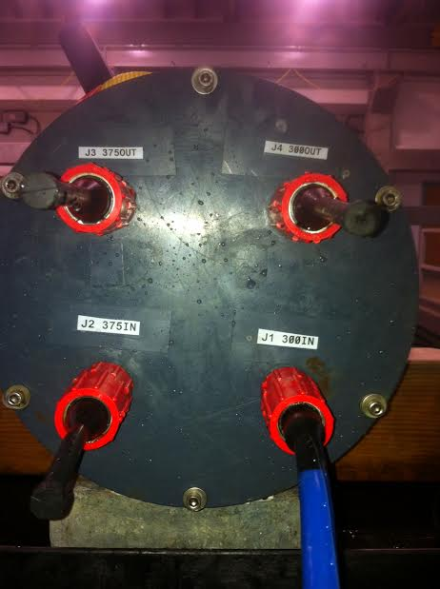
MBARI Feb. 4-6, 2014
During our testing up to this point, the likely
culprit appeared to be one or more of the
Subconn high voltage connectors.
During a series of tests, I rotated the housing
in the crane such that I could lower the CN
into the tank one connector at a time.
J1 - KFA 300V IN
J2 - swFOCE 375V IN
J3 - swFOCE 375V OUT
J4 - KFA 300V OUT

Slide 62
MBARI Feb. 4-6, 2014 Test #1
ON
ON
swFOCE DC Power Supply
F
M
15 Meter SubConn GigE Cable
swFOCE GF Detection Module
Test Tank Dry Side
GF = 1.6 Mohms
Test Tank Sub Sea
J3
J4
J2
J1
J1 - KFA 300V IN
KFA Central Node
J2 - swFOCE 375V IN
J3 - swFOCE 375V OUT
J4 - KFA 300V OUT

Slide 63
MBARI Feb. 4-6, 2014 Test #2
ON
ON
swFOCE DC Power Supply
F
M
15 Meter SubConn GigE Cable
swFOCE GF Detection Module
Test Tank Dry Side
GF >10 Mohms
J3
J4
Test Tank Sub Sea
J2
J1
J1 - KFA 300V IN
KFA Central Node
J2 - swFOCE 375V IN
J3 - swFOCE 375V OUT
J4 - KFA 300V OUT

Slide 64
MBARI Feb. 4-6, 2014 Test #3
ON
ON
swFOCE DC Power Supply
F
M
15 Meter SubConn GigE Cable
swFOCE GF Detection Module
Test Tank Dry Side
On Deck
GF >10 Mohms
J3
J4
J2
J1
J1 - KFA 300V IN
KFA Central Node
J2 - swFOCE 375V IN
J3 - swFOCE 375V OUT
J4 - KFA 300V OUT

Slide 65
MBARI Feb. 4-6, 2014 Test #4
ON
ON
swFOCE DC Power Supply
F
M
15 Meter SubConn GigE Cable
swFOCE GF Detection Module
Test Tank Dry Side
GF = 1.1 Mohms
Test Tank Sub Sea
J3
J4
J2
J1
J1 - KFA 300V IN
KFA Central Node
J2 - swFOCE 375V IN
J3 - swFOCE 375V OUT
J4 - KFA 300V OUT

Slide 66
MBARI Feb. 4-6, 2014 Test #5
ON
ON
swFOCE DC Power Supply
F
M
15 Meter SubConn GigE Cable
swFOCE GF Detection Module
Test Tank Dry Side
GF > 10 Mohms
J3
J4
J2
J1
Test Tank Sub Sea
J1 - KFA 300V IN
KFA Central Node
J2 - swFOCE 375V IN
J3 - swFOCE 375V OUT
J4 - KFA 300V OUT

Slide 67
MBARI Feb. 4-6, 2014 Test #6
ON
ON
swFOCE DC Power Supply
F
M
15 Meter SubConn GigE Cable
swFOCE GF Detection Module
Test Tank Dry Side
GF > 10 Mohms
J3
J4
J2
J1
Test Tank Sub Sea
J1 - KFA 300V IN
KFA Central Node
J2 - swFOCE 375V IN
J3 - swFOCE 375V OUT
J4 - KFA 300V OUT

Slide 68
MBARI Feb. 4-6, 2014 Test #7
ON
ON
swFOCE DC Power Supply
F
M
15 Meter SubConn GigE Cable
swFOCE GF Detection Module
Test Tank Dry Side
GF > 10 Mohms
J3
J4
J2
J1
Test Tank Sub Sea
J1 - KFA 300V IN
KFA Central Node
J2 - swFOCE 375V IN
J3 - swFOCE 375V OUT
J4 - KFA 300V OUT

Slide 69
MBARI Feb. 4-6, 2014 Test #8
ON
ON
swFOCE DC Power Supply
F
M
15 Meter SubConn GigE Cable
swFOCE GF Detection Module
Test Tank Dry Side
GF = 3.7 Mohms
J3
J4
J2
J1
Test Tank Sub Sea
J1 - KFA 300V IN
KFA Central Node
J2 - swFOCE 375V IN
J3 - swFOCE 375V OUT
J4 - KFA 300V OUT

Slide 70
MBARI Feb. 4-6, 2014 Test #9
ON
ON
swFOCE DC Power Supply
F
M
15 Meter SubConn GigE Cable
swFOCE GF Detection Module
Test Tank Dry Side
On Deck
GF >10 Mohms
J3
J4
J2
J1
J1 - KFA 300V IN
KFA Central Node
J2 - swFOCE 375V IN
J3 - swFOCE 375V OUT
J4 - KFA 300V OUT

Slide 71
MBARI Feb. 4-6, 2014 Test #10
ON
ON
swFOCE DC Power Supply
F
M
15 Meter SubConn GigE Cable
swFOCE GF Detection Module
Test Tank Dry Side
GF = 1.7 Mohms
J3
J4
J2
J1
J1 - KFA 300V IN
Test Tank Sub Sea
KFA Central Node
J2 - swFOCE 375V IN
J3 - swFOCE 375V OUT
J4 - KFA 300V OUT

Slide 72
MBARI Feb. 4-6, 2014 Test #11
ON
ON
swFOCE DC Power Supply
F
M
15 Meter SubConn GigE Cable
swFOCE GF Detection Module
Test Tank Dry Side
GF = 1.6 Mohms
J3
J4
J2
J1
J1 - KFA 300V IN
Test Tank Sub Sea
KFA Central Node
J2 - swFOCE 375V IN
J3 - swFOCE 375V OUT
J4 - KFA 300V OUT

Slide 73
MBARI Feb. 4-6, 2014 Test #12
ON
ON
swFOCE DC Power Supply
F
M
15 Meter SubConn GigE Cable
swFOCE GF Detection Module
Test Tank Dry Side
GF = 1.6 Mohms
J3
J4
J2
J1
J1 - KFA 300V IN
Test Tank Sub Sea
KFA Central Node
J2 - swFOCE 375V IN
J3 - swFOCE 375V OUT
J4 - KFA 300V OUT

Slide 74
MBARI Feb. 4-6, 2014 Test #13
ON
ON
swFOCE DC Power Supply
F
M
15 Meter SubConn GigE Cable
swFOCE GF Detection Module
Test Tank Dry Side
GF = 1.6 Mohms
J3
J4
J2
J1
J1 - KFA 300V IN
Test Tank Sub Sea
KFA Central Node
J2 - swFOCE 375V IN
J3 - swFOCE 375V OUT
J4 - KFA 300V OUT

Slide 75
MBARI Feb. 4-6, 2014 Test #14
ON
ON
swFOCE DC Power Supply
F
M
15 Meter SubConn GigE Cable
swFOCE GF Detection Module
Test Tank Dry Side
GF >10 Mohms
J3
J4
J2
J1
J1 - KFA 300V IN
Test Tank Sub Sea
KFA Central Node
J2 - swFOCE 375V IN
J3 - swFOCE 375V OUT
J4 - KFA 300V OUT

Slide 76
MBARI Feb. 10, 2014
Replaced J4
Analysis of “bad” J4 revealed no obvious
defects or problems.

Slide 77
MBARI Feb. 11, 2014
ON
ON
swFOCE DC Power Supply
swFOCE GF Detection Module
F
M
Test Tank Dry Side
15 Meter SubConn GigE Cable
KFA Central Node
J1
F
M
KFA Central Node Internal Electronics
M
F
J4
F
M
J2
M
F
J3
Ran for 60 minutes,
GF >10 Mohms
J1 - KFA 300V IN
J2 - swFOCE 375V IN
J3 - swFOCE 375V OUT
J4 - KFA 300V OUT

Slide 78
MBARI Feb. 12, 2014 Test #1
Ran for 30 minutes,
GF >10 Mohms
ON
ON
swFOCE DC Power Supply
swFOCE GF Detection Module
F
M
Test Tank Dry Side
15 Meter SubConn GigE Cable
2 Meter SubConn GigE Cable
KFA Central Node
F
M
F
M
KFA 300V IN
M
F
M
F
KFA 300V OUT
F
M
F
M
swFOCE 375V IN
M
F
M
F
swFOCE 375V OUT

Slide 79
MBARI Feb. 12, 2014 Test #2
Ran for 30 minutes,
GF >10 Mohms
ON
ON
swFOCE DC Power Supply
swFOCE GF Detection Module
F
M
Test Tank Dry Side
15 Meter SubConn GigE Cable
2 Meter SubConn GigE Cable
KFA Central Node
F
M
F
M
KFA 300V IN
M
F
M
F
KFA 300V OUT
F
M
F
M
swFOCE 375V IN
M
F
M
F
swFOCE 375V OUT
Vicor Maxi
Pwr Res
M
F
1A (50W)
375V:48V
600W
50ohms
160W

Slide 80
MBARI Feb. 12, 2014 Test #3
ON
ON
KFA DC Power Supply
KFA GF Detection Module
F
M
ON
ON
swFOCE DC Power Supply
swFOCE GF Detection Module
F
M
Test Tank Dry Side
15 Meter SubConn GigE Cable
15 Meter SubConn GigE Cable
2 Meter SubConn GigE Cable
KFA Central Node
F
M
F
M
KFA 300V IN
Ran for 30 minutes,
GF >10 Mohms
M
F
M
F
KFA 300V OUT
F
M
F
M
swFOCE 375V IN
M
F
M
F
swFOCE 375V OUT
Vicor Maxi
Pwr Res
M
F
1A (50W)
375V:48V
600W
50ohms
160W

Slide 81
MBARI Feb. 12, 2014 Test #4
ON
ON
KFA DC Power Supply
KFA GF Detection Module
F
M
ON
ON
swFOCE DC Power Supply
swFOCE GF Detection Module
F
M
Test Tank Dry Side
15 Meter SubConn GigE Cable
15 Meter SubConn GigE Cable
2 Meter SubConn GigE Cable
KFA Central Node
F
M
F
M
KFA 300V IN
Ran for 3 hours
GF >10 Mohms
M
F
M
F
KFA 300V OUT
F
M
F
M
swFOCE 375V IN
M
F
M
F
swFOCE 375V OUT
Vicor Maxi
Pwr Res
M
F
1A (50W)
375V:48V
600W
50ohms
160W

Slide 82
MBARI Feb. 13, 2014
Soaked overnight
with power OFF.
ON
ON
KFA DC Power Supply
KFA GF Detection Module
F
M
ON
ON
swFOCE DC Power Supply
swFOCE GF Detection Module
F
M
Test Tank Dry Side
15 Meter SubConn GigE Cable
15 Meter SubConn GigE Cable
2 Meter SubConn GigE Cable
KFA Central Node
F
M
F
M
KFA 300V IN
KFA GF = 2.1M
swFOCE GF =8.0M
M
F
M
F
KFA 300V OUT
F
M
F
M
swFOCE 375V IN
M
F
M
F
swFOCE 375V OUT
Vicor Maxi
Pwr Res
M
F
1A (50W)
375V:48V
600W
50ohms
160W

Slide 83
Peter Walz and I noticed the GFs only
appeared when the whip:BH connection
was subsea, not the whip:whip sections.

Slide 84
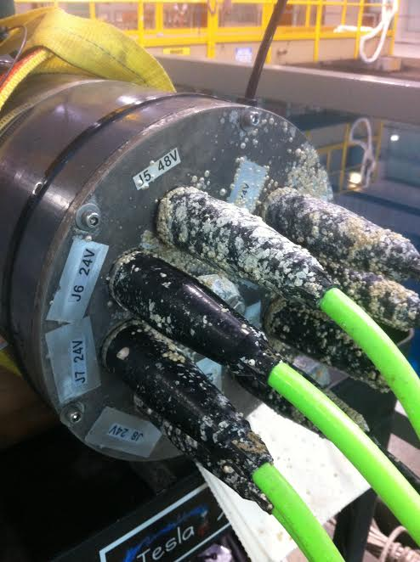
Proposed solution: Replace all HV
bulkhead connectors with Penetrator
style whips.
This also reduces the total number of
subsea connections.

Slide 85
Proposed Interconnections
KFA MicroNode
2 Meters
375V Out
300V Out
2 Meters
KFA Central Node
300V In
2 Meters
300V Out
2 Meters
swFOCE Central Node
375V In
2 Meters
48V Out
2 Meters
48V Out
2 Meters
Need 15 Meter sections
to individual swFOCE
experiments

Slide 86
Megger readings on KFA Tether
 | KFA Pos | KFA Neg | swFOCE Pos | swFOCE Neg | SW Ref | Earth Ref | K-Tube | Inner Jacket | Armor | Outer Jacket
KFA Pos | X | 5.1 G | 3.2 G | 1.8 G | 605 M | 13.5 M | 1.4 G | 90 M | 14.3 M | 1.9 G
KFA Neg | X | X | 9.5 G | 6.9 G | 3.8 G | 6.3 G | 7.1 G | 3.0 G | 5.9 G | 1.7 G
swFOCE Pos | X | X | X | 5.9 G | 3.5 G | 3.3 G | 5.3 G | 2.1 G | 3.0 G | 1.9 G
swFOCE Neg | X | X | X | X | 2.7 G | 1.9 G | 3.4 G | 1.3 G | 1.9 G | 2.3 G
SW Ref | X | X | X | X | X | 680 M | 2.5 G | 645 M | 660 M | 2.1 G
Earth Ref | X | X | X | X | X | X | 1.4 G | 79 M | 0,0 | 2.0 G
K-Tube | X | X | X | X | X | X | X | 1.2 G | 1.2 G | 2.2 G
Inner Jacket | X | X | X | X | X | X | X | X | 62 M | 1.7 G
Armor | X | X | X | X | X | X | X | X | X | 1.7 G
Outer Jacket | X | X | X | X | X | X | X | X | X | X

Slide 87
Outer Jacket
Inner Jacket
Armor
Mylar
Tape

Slide 88
Outer Jacket
Armor
Inner Jacket
swFOCE Pos
swFOCE Neg
K-Tube
KFA Pos
KFA Neg
Seawater Ref
90M
62M
0,0
14.3M
79M
Earth Ref
13.5M

