Slide 1
Kelp Forest Array Ground Fault Technical Review
Chad Kecy
Dec. 19 2013

Slide 2
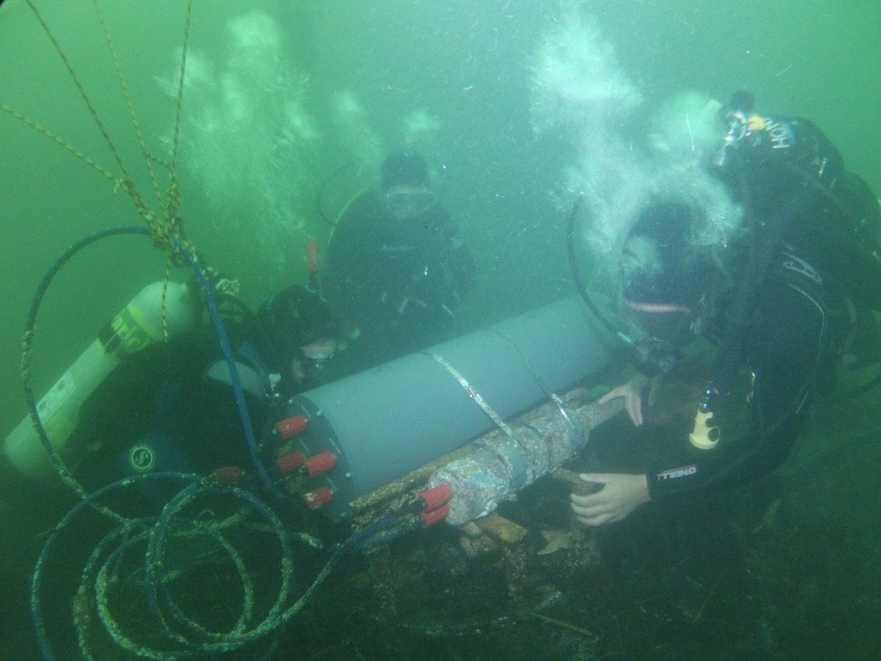
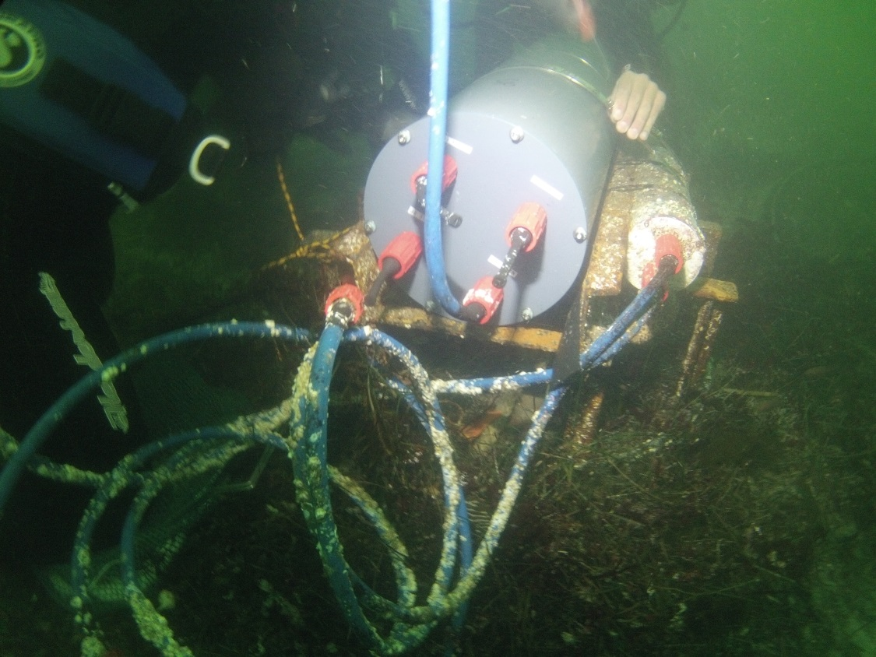
KFA Deployed (Oct 2013)

Slide 3
KFA As Deployed July 2012
Diver Lockout Box
KFA DC Power Supply
swFOCE DC Power Supply
Hopkins Pump House
Sub Sea
Tether (200m)
5 x 14AWG
KFA Micro Node
M
F
swFOCE 375V OUT
M
F
KFA 300V OUT
F
F
KFA Central Node
M
M
F
M
KFA 300V IN
M
F
KFA 300V OUT
F
M
swFOCE 375V IN
M
F
M
F
swFOCE 375V OUT

Slide 4
KFA August 30, 2013
Diver Lockout Box
KFA DC Power Supply
KFA GF Detection Module
swFOCE DC Power Supply
swFOCE GF Detection Module
Hopkins Pump House
GF on 300V return line
~200kohms to trip in ~45 minutes
Sub Sea
Tether (200m)
5 x 14AWG
KFA Micro Node
M
F
swFOCE 375V OUT
M
F
KFA 300V OUT
F
F
KFA Central Node
M
M
F
M
KFA 300V IN
M
F
KFA 300V OUT
F
M
swFOCE 375V IN
M
F
M
F
swFOCE 375V OUT

Slide 5
KFA Sept. 11, 2013
Diver Lockout Box
KFA DC Power Supply
KFA GF Detection Module
swFOCE DC Power Supply
swFOCE GF Detection Module
Hopkins Pump House
Sub Sea
Tether (200m)
5 x 14AWG
KFA Micro Node
M
F
swFOCE 375V OUT
M
F
KFA 300V OUT
F
F
M
M

Slide 6
MBARI Sept. 12-17, 2013
swFOCE DC Power Supply
swFOCE GF Detection Module
F
F
KFA Central Node
M
M
F
M
KFA 300V IN
M
F
KFA 300V OUT
F
M
swFOCE 375V IN
M
F
M
F
swFOCE 375V OUT
1. Opened KFA CN: No shorts or visual problems
2. Independently tested GF detection module: working correctly
3. Tested for GFs on bench: OK
4. Placed KFA CN in test tank: measured 900kohms (~300uA)
(only left in tank ~10 minutes)
5. Assumption: KFA CN does not have a seawater short

Slide 7
KFA Oct. 17, 2013 Dive #1
Diver Lockout Box
KFA DC Power Supply
KFA GF Detection Module
swFOCE DC Power Supply
swFOCE GF Detection Module
Hopkins Pump House
GF on 300V return line
360kohms; short test
Sub Sea
Tether (200m)
5 x 14AWG
KFA Micro Node
M
F
swFOCE 375V OUT
M
F
KFA 300V OUT
F
F
M
M
Ti Housing (Seawater Reference)
F
M

Slide 8
KFA Oct. 17, 2013 Dive #2
Diver Lockout Box
KFA DC Power Supply
KFA GF Detection Module
swFOCE DC Power Supply
swFOCE GF Detection Module
Hopkins Pump House
GF on 300V return line
300kohms; short test
Sub Sea
Tether (200m)
5 x 14AWG
KFA Micro Node
M
F
swFOCE 375V OUT
M
F
KFA 300V OUT
F
F
M
M
Ti Housing (Seawater Reference)
F
M

Slide 9
KFA Oct. 17, 2013 Dive #3
Diver Lockout Box
KFA DC Power Supply
KFA GF Detection Module
swFOCE DC Power Supply
swFOCE GF Detection Module
Hopkins Pump House
GF on 300V return line
300kohms to 98kohms in ~10 minutes (shut off)
Sub Sea
Tether (200m)
5 x 14AWG
KFA Micro Node
M
F
swFOCE 375V OUT
M
F
KFA 300V OUT
F
F
KFA Central Node
M
M
F
M
KFA 300V IN
M
F
KFA 300V OUT
F
M
swFOCE 375V IN
M
F
M
F
swFOCE 375V OUT

Slide 10
KFA Oct. 24, 2013
Diver Lockout Box
KFA DC Power Supply
KFA GF Detection Module
swFOCE DC Power Supply
swFOCE GF Detection Module
Hopkins Pump House
GF on 300V return line
200kohms to trip in ~60 minutes
Sub Sea
Tether (200m)
5 x 14AWG
Swapped out KFA extension cable
KFA Micro Node
M
F
swFOCE 375V OUT
M
F
KFA 300V OUT
F
KFA Central Node
M
F
M
KFA 300V IN
M
F
KFA 300V OUT
F
M
swFOCE 375V IN
M
F
M
F
swFOCE 375V OUT

Slide 11
KFA Nov. 7, 2013
Diver Lockout Box
KFA DC Power Supply
KFA GF Detection Module
swFOCE DC Power Supply
swFOCE GF Detection Module
Hopkins Pump House
GF on 300V return line
GF (line not noted)
Sub Sea
Swapped out KFA extension cable
Tether (200m)
5 x 14AWG
*
Added Type 44 molyKote
to female connectors
(underwater, box method)
*
KFA Micro Node
M
F
swFOCE 375V OUT
*
*
M
F
KFA 300V OUT
F
F
*
M
M
*
KFA Central Node
F
M
KFA 300V IN
M
F
KFA 300V OUT
*
*
F
M
swFOCE 375V IN
*
M
F
M
F
swFOCE 375V OUT
*

Slide 12
Sheila B Dec. 5, 2013
Diver Lockout Box
KFA DC Power Supply
KFA GF Detection Module
swFOCE DC Power Supply
swFOCE GF Detection Module
Hopkins Pump House
KFA: 1.9Mohms and rising
swFOCE: >10Mohms
Jim stayed onsite for 90 minutes
Cleaned every connector
Re-applied MolyKote
Tested on deck: OK
Dropped both nodes in
water: OK
5. Redeployed: OK
Sub Sea
*
Added Type 44 molyKote
to female connectors
(deck of Sheila B)
Tether (200m)
5 x 14AWG
*
KFA Micro Node
M
F
swFOCE 375V OUT
*
*
M
F
KFA 300V OUT
F
F
*
M
M
*
KFA Central Node
F
M
KFA 300V IN
M
F
KFA 300V OUT
*
*
*
F
M
swFOCE 375V IN
*
M
F
M
F
M
F
swFOCE 375V OUT
*

Slide 13
KFA Dec. 11, 2013
Diver Lockout Box
KFA DC Power Supply
KFA GF Detection Module
swFOCE DC Power Supply
swFOCE GF Detection Module
Hopkins Pump House
GF on 300V return line (30kohms)
GF both lines (6kohms)
Sub Sea
Tether (200m)
5 x 14AWG
KFA Micro Node
M
F
swFOCE 375V OUT
M
F
KFA 300V OUT
F
F
KFA Central Node
M
M
F
M
KFA 300V IN
M
F
KFA 300V OUT
F
M
swFOCE 375V IN
M
F
M
F
M
F
swFOCE 375V OUT

