Slide 1
Kelp Forest Array Ground Fault Technical Review
Chad Kecy
Xxx. yy 2014

Slide 2
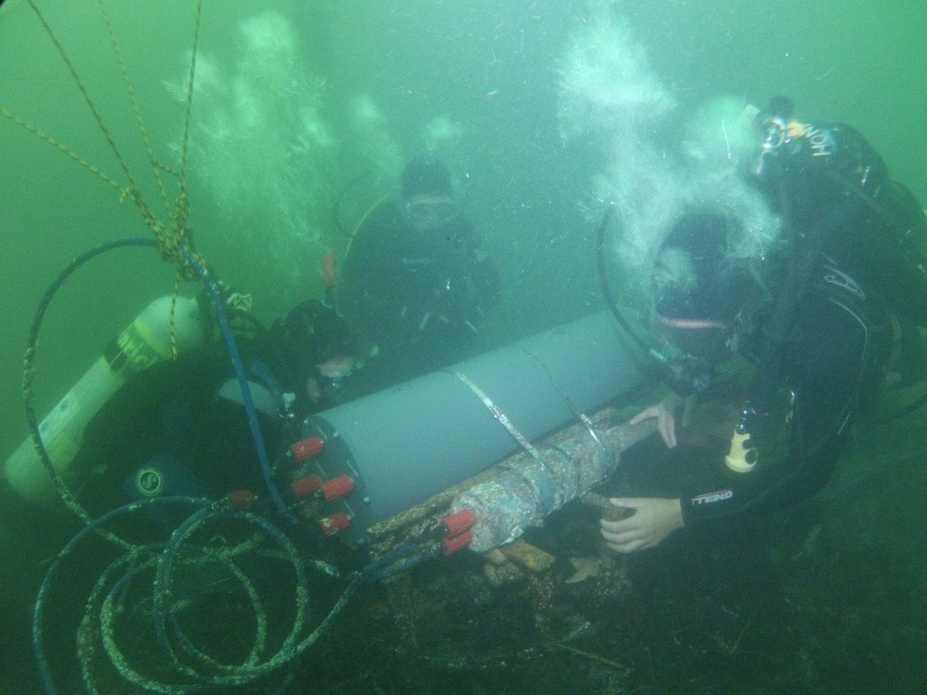
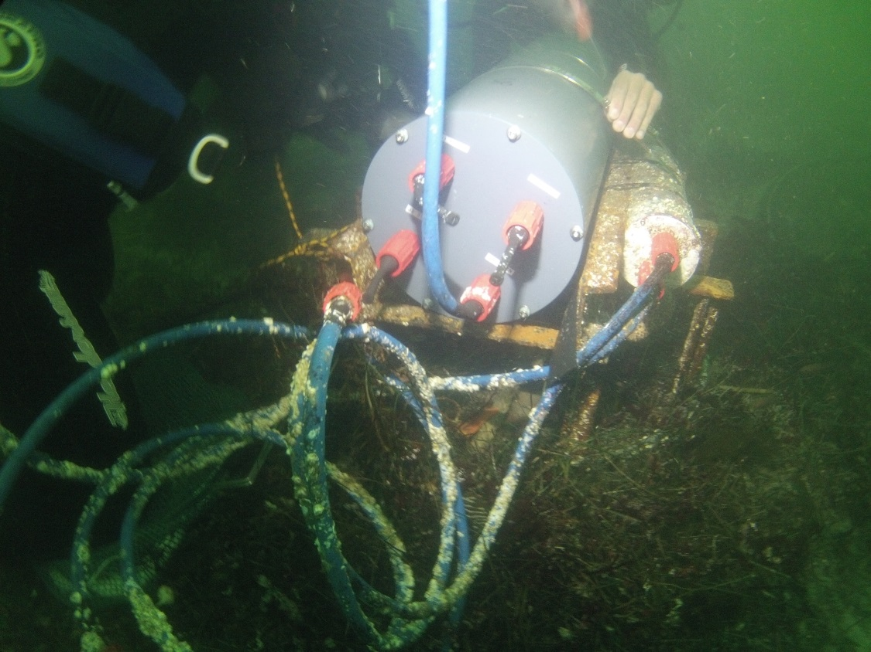
KFA Deployed (Oct 2013)

Slide 3
KFA As Deployed July 2012
Diver Lockout Box
KFA DC Power Supply
swFOCE DC Power Supply
Hopkins Pump House
Sub Sea
Tether (200m)
5 x 14AWG
KFA Micro Node
M
F
swFOCE 375V OUT
M
F
KFA 300V OUT
F
F
KFA Central Node
M
M
F
M
KFA 300V IN
M
F
KFA 300V OUT
F
M
swFOCE 375V IN
M
F
M
F
swFOCE 375V OUT

Slide 4
KFA August 30, 2013
Diver Lockout Box
KFA DC Power Supply
KFA GF Detection Module
swFOCE DC Power Supply
swFOCE GF Detection Module
Hopkins Pump House
GF on 300V return line
~200kohms to trip in ~45 minutes
Sub Sea
Tether (200m)
5 x 14AWG
KFA Micro Node
M
F
swFOCE 375V OUT
M
F
KFA 300V OUT
F
F
KFA Central Node
M
M
F
M
KFA 300V IN
M
F
KFA 300V OUT
F
M
swFOCE 375V IN
M
F
M
F
swFOCE 375V OUT

Slide 5
KFA Sept. 11, 2013
Diver Lockout Box
KFA DC Power Supply
KFA GF Detection Module
swFOCE DC Power Supply
swFOCE GF Detection Module
Hopkins Pump House
Sub Sea
Tether (200m)
5 x 14AWG
KFA Micro Node
M
F
swFOCE 375V OUT
M
F
KFA 300V OUT
F
F
M
M

Slide 6
MBARI Sept. 12-17, 2013
swFOCE DC Power Supply
swFOCE GF Detection Module
F
F
KFA Central Node
M
M
F
M
KFA 300V IN
M
F
KFA 300V OUT
F
M
swFOCE 375V IN
M
F
M
F
swFOCE 375V OUT
1. Opened KFA CN: No shorts or visual problems
2. Independently tested GF detection module: working correctly
3. Tested for GFs on bench: OK
4. Placed KFA CN in test tank: measured 900kohms (~300uA)
(only left in tank ~10 minutes)
5. Assumption: KFA CN does not have a seawater short

Slide 7
KFA Oct. 17, 2013 Dive #1
Diver Lockout Box
KFA DC Power Supply
KFA GF Detection Module
swFOCE DC Power Supply
swFOCE GF Detection Module
Hopkins Pump House
GF on 300V return line
360kohms; short test
Sub Sea
Tether (200m)
5 x 14AWG
KFA Micro Node
M
F
swFOCE 375V OUT
M
F
KFA 300V OUT
F
F
M
M
Ti Housing (Seawater Reference)
F
M

Slide 8
KFA Oct. 17, 2013 Dive #2
Diver Lockout Box
KFA DC Power Supply
KFA GF Detection Module
swFOCE DC Power Supply
swFOCE GF Detection Module
Hopkins Pump House
GF on 300V return line
300kohms; short test
Sub Sea
Tether (200m)
5 x 14AWG
KFA Micro Node
M
F
swFOCE 375V OUT
M
F
KFA 300V OUT
F
F
M
M
Ti Housing (Seawater Reference)
F
M

Slide 9
KFA Oct. 17, 2013 Dive #3
Diver Lockout Box
KFA DC Power Supply
KFA GF Detection Module
swFOCE DC Power Supply
swFOCE GF Detection Module
Hopkins Pump House
GF on 300V return line
300kohms to 98kohms in ~10 minutes (shut off)
Sub Sea
Tether (200m)
5 x 14AWG
KFA Micro Node
M
F
swFOCE 375V OUT
M
F
KFA 300V OUT
F
F
KFA Central Node
M
M
F
M
KFA 300V IN
M
F
KFA 300V OUT
F
M
swFOCE 375V IN
M
F
M
F
swFOCE 375V OUT

Slide 10
KFA Oct. 24, 2013
Diver Lockout Box
KFA DC Power Supply
KFA GF Detection Module
swFOCE DC Power Supply
swFOCE GF Detection Module
Hopkins Pump House
GF on 300V return line
200kohms to trip in ~60 minutes
Sub Sea
Tether (200m)
5 x 14AWG
Swapped out KFA extension cable
KFA Micro Node
M
F
swFOCE 375V OUT
M
F
KFA 300V OUT
F
KFA Central Node
M
F
M
KFA 300V IN
M
F
KFA 300V OUT
F
M
swFOCE 375V IN
M
F
M
F
swFOCE 375V OUT

Slide 11
KFA Nov. 7, 2013
Diver Lockout Box
KFA DC Power Supply
KFA GF Detection Module
swFOCE DC Power Supply
swFOCE GF Detection Module
Hopkins Pump House
GF on 300V return line
GF (line not noted)
Sub Sea
Swapped out KFA extension cable
Tether (200m)
5 x 14AWG
*
Added Type 44 molyKote
to female connectors
(underwater, box method)
*
KFA Micro Node
M
F
swFOCE 375V OUT
*
*
M
F
KFA 300V OUT
F
F
*
M
M
*
KFA Central Node
F
M
KFA 300V IN
M
F
KFA 300V OUT
*
*
F
M
swFOCE 375V IN
*
M
F
M
F
swFOCE 375V OUT
*

Slide 12
Sheila B Dec. 5, 2013
Diver Lockout Box
KFA DC Power Supply
KFA GF Detection Module
swFOCE DC Power Supply
swFOCE GF Detection Module
Hopkins Pump House
KFA: 1.9Mohms and rising
swFOCE: >10Mohms
Jim stayed onsite for 90 minutes
Cleaned every connector
Re-applied MolyKote
Tested on deck: OK
Dropped both nodes in
water: OK
5. Redeployed: OK
Sub Sea
*
Added Type 44 molyKote
to female connectors
(deck of Sheila B)
Tether (200m)
5 x 14AWG
*
KFA Micro Node
M
F
swFOCE 375V OUT
*
*
M
F
KFA 300V OUT
F
F
*
M
M
*
KFA Central Node
F
M
KFA 300V IN
M
F
KFA 300V OUT
*
*
*
F
M
swFOCE 375V IN
*
M
F
M
F
M
F
swFOCE 375V OUT
*

Slide 13
KFA Dec. 11, 2013
Diver Lockout Box
KFA DC Power Supply
KFA GF Detection Module
swFOCE DC Power Supply
swFOCE GF Detection Module
Hopkins Pump House
GF on 300V return line (30kohms)
GF both lines (6kohms)
Sub Sea
Tether (200m)
5 x 14AWG
KFA Micro Node
M
F
swFOCE 375V OUT
M
F
KFA 300V OUT
F
F
KFA Central Node
M
M
F
M
KFA 300V IN
M
F
KFA 300V OUT
F
M
swFOCE 375V IN
M
F
M
F
M
F
swFOCE 375V OUT

Slide 14
KFA Dec. 19, 2013 Test #1
OFF
OFF
Diver Lockout Box
KFA DC Power Supply
KFA GF Detection Module
OFF
ON
ON
swFOCE DC Power Supply
swFOCE GF Detection Module
ON
Hopkins Pump House
GF both lines (4kohms)
Sub Sea
Tether (200m)
5 x 14AWG
KFA Micro Node
M
F
swFOCE 375V OUT
M
F
KFA 300V OUT
F
F
KFA Central Node
M
M
F
M
KFA 300V IN
M
F
KFA 300V OUT
F
M
swFOCE 375V IN
M
F
M
F
M
F
swFOCE 375V OUT

Slide 15
KFA Dec. 19, 2013 Test #2
ON
ON
Diver Lockout Box
KFA DC Power Supply
KFA GF Detection Module
ON
OFF
OFF
swFOCE DC Power Supply
swFOCE GF Detection Module
OFF
Hopkins Pump House
GF on 300V return line (100kohms)
Sub Sea
Tether (200m)
5 x 14AWG
KFA Micro Node
M
F
swFOCE 375V OUT
M
F
KFA 300V OUT
F
F
KFA Central Node
M
M
F
M
KFA 300V IN
M
F
KFA 300V OUT
F
M
swFOCE 375V IN
M
F
M
F
M
F
swFOCE 375V OUT

Slide 16
KFA Dec. 19, 2013 Test #3
OFF
OFF
Diver Lockout Box
KFA DC Power Supply
KFA GF Detection Module
OFF
OFF
ON
swFOCE DC Power Supply
swFOCE GF Detection Module
ON
Hopkins Pump House
swFOCE >10Mohms
Sub Sea
Tether (200m)
5 x 14AWG
KFA Micro Node
M
F
swFOCE 375V OUT
M
F
KFA 300V OUT
F
F
KFA Central Node
M
M
F
M
KFA 300V IN
M
F
KFA 300V OUT
F
M
swFOCE 375V IN
M
F
M
F
M
F
swFOCE 375V OUT

Slide 17
KFA Dec. 19, 2013 Test #4
OFF
ON
Diver Lockout Box
KFA DC Power Supply
KFA GF Detection Module
ON
OFF
OFF
swFOCE DC Power Supply
swFOCE GF Detection Module
OFF
Hopkins Pump House
KFA >10Mohms
Sub Sea
Tether (200m)
5 x 14AWG
KFA Micro Node
M
F
swFOCE 375V OUT
M
F
KFA 300V OUT
F
F
KFA Central Node
M
M
F
M
KFA 300V IN
M
F
KFA 300V OUT
F
M
swFOCE 375V IN
M
F
M
F
M
F
swFOCE 375V OUT

Slide 18
KFA Dec. 19, 2013 Test #5
ON
ON
Diver Lockout Box
KFA DC Power Supply
KFA GF Detection Module
OFF
OFF
OFF
swFOCE DC Power Supply
swFOCE GF Detection Module
OFF
Hopkins Pump House
KFA >10Mohms
Earth Return from Pumphouse
Sub Sea
Tether (200m)
5 x 14AWG
KFA Micro Node
M
F
swFOCE 375V OUT
M
F
KFA 300V OUT
F
F
KFA Central Node
M
M
F
M
KFA 300V IN
M
F
KFA 300V OUT
F
M
swFOCE 375V IN
M
F
M
F
M
F
swFOCE 375V OUT

Slide 19
KFA Dec. 19, 2013 Test #6
OFF
OFF
Diver Lockout Box
KFA DC Power Supply
KFA GF Detection Module
OFF
ON
ON
swFOCE DC Power Supply
swFOCE GF Detection Module
OFF
Hopkins Pump House
swFOCE >10Mohms
Earth Return from Pumphouse
Sub Sea
Tether (200m)
5 x 14AWG
KFA Micro Node
M
F
swFOCE 375V OUT
M
F
KFA 300V OUT
F
F
KFA Central Node
M
M
F
M
KFA 300V IN
M
F
KFA 300V OUT
F
M
swFOCE 375V IN
M
F
M
F
M
F
swFOCE 375V OUT

Slide 20
KFA Dec. 19, 2013 Test #7
OFF
OFF
Diver Lockout Box
KFA DC Power Supply
KFA GF Detection Module
OFF
ON
ON
swFOCE DC Power Supply
swFOCE GF Detection Module
ON
Hopkins Pump House
Earth Return from Pumphouse
GF both lines (100kohms)
Sub Sea
Tether (200m)
5 x 14AWG
KFA Micro Node
M
F
swFOCE 375V OUT
M
F
KFA 300V OUT
F
F
KFA Central Node
M
M
F
M
KFA 300V IN
M
F
KFA 300V OUT
F
M
swFOCE 375V IN
M
F
M
F
M
F
swFOCE 375V OUT

Slide 21
KFA Dec. 19, 2013 Test #8
ON
ON
Diver Lockout Box
KFA DC Power Supply
KFA GF Detection Module
ON
OFF
OFF
swFOCE DC Power Supply
swFOCE GF Detection Module
OFF
Hopkins Pump House
GF on 300V return line (16kohms)
Earth Return from Pumphouse
Sub Sea
Tether (200m)
5 x 14AWG
KFA Micro Node
M
F
swFOCE 375V OUT
M
F
KFA 300V OUT
F
F
KFA Central Node
M
M
F
M
KFA 300V IN
M
F
KFA 300V OUT
F
M
swFOCE 375V IN
M
F
M
F
M
F
swFOCE 375V OUT

Slide 22
KFA Dec. 19, 2013 Test #9
ON
ON
Diver Lockout Box
KFA DC Power Supply
KFA GF Detection Module
OFF
OFF
OFF
swFOCE DC Power Supply
swFOCE GF Detection Module
OFF
Hopkins Pump House
KFA >10Mohms
Sub Sea
Tether (200m)
5 x 14AWG
KFA Micro Node
M
F
swFOCE 375V OUT
M
F
KFA 300V OUT
F
F
KFA Central Node
M
M
F
M
KFA 300V IN
M
F
KFA 300V OUT
F
M
swFOCE 375V IN
M
F
M
F
M
F
swFOCE 375V OUT

Slide 23
KFA Dec. 19, 2013 Test #10
ON
ON
Diver Lockout Box
KFA DC Power Supply
KFA GF Detection Module
ON
OFF
OFF
swFOCE DC Power Supply
swFOCE GF Detection Module
OFF
Hopkins Pump House
KFA >10Mohms
Sub Sea
Tether (200m)
5 x 14AWG
KFA Micro Node
M
F
swFOCE 375V OUT
M
F
KFA 300V OUT
F
F
KFA Central Node
M
M
F
M
KFA 300V IN
M
F
KFA 300V OUT
F
M
swFOCE 375V IN
M
F
M
F
M
F
swFOCE 375V OUT

Slide 24
KFA Dec. 19, 2013 Test #11
OFF
OFF
Diver Lockout Box
KFA DC Power Supply
KFA GF Detection Module
OFF
ON
ON
swFOCE DC Power Supply
swFOCE GF Detection Module
OFF
Hopkins Pump House
swFOCE >10Mohms
Sub Sea
Tether (200m)
5 x 14AWG
KFA Micro Node
M
F
swFOCE 375V OUT
M
F
KFA 300V OUT
F
F
KFA Central Node
M
M
F
M
KFA 300V IN
M
F
KFA 300V OUT
F
M
swFOCE 375V IN
M
F
M
F
M
F
swFOCE 375V OUT

Slide 25
KFA Dec. 19, 2013 Test #12
OFF
OFF
Diver Lockout Box
KFA DC Power Supply
KFA GF Detection Module
OFF
ON
ON
swFOCE DC Power Supply
swFOCE GF Detection Module
ON
Hopkins Pump House
swFOCE >10Mohms
Sub Sea
Tether (200m)
5 x 14AWG
KFA Micro Node
M
F
swFOCE 375V OUT
M
F
KFA 300V OUT
F
F
KFA Central Node
M
M
F
M
KFA 300V IN
M
F
KFA 300V OUT
F
M
swFOCE 375V IN
M
F
M
F
M
F
swFOCE 375V OUT

Slide 26
MBARI Jan. aa, 2014 Test #1
Megger
OFF
OFF
swFOCE DC Power Supply
swFOCE GF Detection Module
F
M
Test Tank Dry Side
F
M

Slide 27
MBARI Jan. aa, 2014 Test #2
Megger
OFF
OFF
swFOCE DC Power Supply
swFOCE GF Detection Module
F
M
Test Tank Dry Side
F
M

Slide 28
MBARI Jan. aa, 2014 Test #3
Megger
OFF
OFF
swFOCE DC Power Supply
swFOCE GF Detection Module
F
M
Test Tank Dry Side
F
M

Slide 29
MBARI Jan. aa, 2014 Test #4
Megger
OFF
OFF
swFOCE DC Power Supply
swFOCE GF Detection Module
F
M
Test Tank Dry Side
Test Tank Sub Sea
Dummy plug attached dry
F
M

Slide 30
MBARI Jan. aa, 2014 Test #5
Megger
OFF
OFF
swFOCE DC Power Supply
swFOCE GF Detection Module
F
M
Test Tank Dry Side
Test Tank Sub Sea
Dummy plug attached dry
F
M

Slide 31
MBARI Jan. aa, 2014 Test #6
Megger
OFF
OFF
swFOCE DC Power Supply
swFOCE GF Detection Module
F
M
Test Tank Dry Side
Test Tank Sub Sea
Dummy plug attached dry
F
M

Slide 32
MBARI Jan. aa, 2014 Test #7
Megger
OFF
OFF
swFOCE DC Power Supply
swFOCE GF Detection Module
F
M
Test Tank Dry Side
Test Tank Sub Sea
Simulate box method by getting both ends wet then mating.
Dummy plug attached wet
F
M

Slide 33
MBARI Jan. aa, 2014 Test #8
Megger
OFF
OFF
swFOCE DC Power Supply
swFOCE GF Detection Module
F
M
Test Tank Dry Side
Test Tank Sub Sea
Simulate box method by getting both ends wet then mating.
Dummy plug attached wet
F
M

Slide 34
MBARI Jan. aa, 2014 Test #9
Megger
OFF
OFF
swFOCE DC Power Supply
swFOCE GF Detection Module
F
M
Test Tank Dry Side
Test Tank Sub Sea
Simulate box method by getting both ends wet then mating.
Dummy plug attached wet
F
M

Slide 35
MBARI Jan. aa, 2014 Test #10
ON
ON
swFOCE DC Power Supply
swFOCE GF Detection Module
F
M
Test Tank Dry Side
Test Tank Sub Sea
Long term test (dry connection)
Dummy plug attached dry
F
M

Slide 36
MBARI Jan. bb, 2014 Test #1
ON
ON
swFOCE DC Power Supply
swFOCE GF Detection Module
F
M
Test Tank Dry Side
Test Tank Sub Sea
15 Meter Cable
Long term test (dry connection)
Connector attached dry
Ti Test Housing
Vicor Maxi
Pwr Res
1A (50W)
F
M
375V:48V
600W
50ohms
160W

Slide 37
MBARI Jan. cc, 2014 Test #1
ON
ON
swFOCE DC Power Supply
swFOCE GF Detection Module
F
M
Test Tank Dry Side
Test Tank Sub Sea
Long term test (dry connection)
Connectors attached dry
1 Meter Cable
15 Meter Cable
M
F
Ti Test Housing
Vicor Maxi
Pwr Res
1A (50W)
F
M
375V:48V
600W
50ohms
160W

Slide 38
MBARI Jan. dd, 2014 Test #1
ON
ON
swFOCE DC Power Supply
swFOCE GF Detection Module
F
M
Test Tank Dry Side
Test Tank Sub Sea
Long term test (wet connection)
Whip connectors attached wet using box method
Simulate box method by getting both ends wet then mating.
1 Meter Cable
15 Meter Cable
M
F
Ti Test Housing
Vicor Maxi
Pwr Res
1A (50W)
F
M
375V:48V
600W
50ohms
160W

