Slide 1
xFOCE Electrical
Chad Kecy
Electrical Engineer

Slide 2
Big Picture
Cabled vs Non-Cabled
Power
  Generation
  Distribution
Communications
  Shore to subsea
  Subsea to instruments
Reliability
  Environmental condition monitoring
  Electrical protection of instruments/subsystems
  Ground fault protection

Slide 3
Cabled System
Shore Side
Underwater
Connection
Tether

Slide 4
Shore Side
Physical Requirements
  Location
  Type of Installation
  Weather / Environmental Conditions
  Cable path (buried, exposed)
  Permitting
Electrical Requirements
  Power Source
  Communication Equipment
  Ground Fault Detection / Safety
Notes:
Trawling
Anchoring
How to deploy

Slide 5
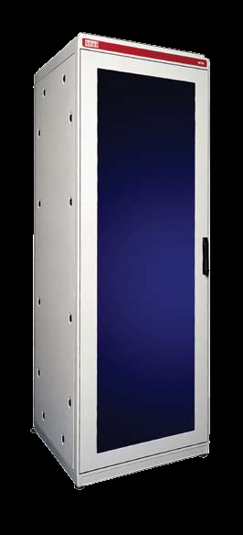
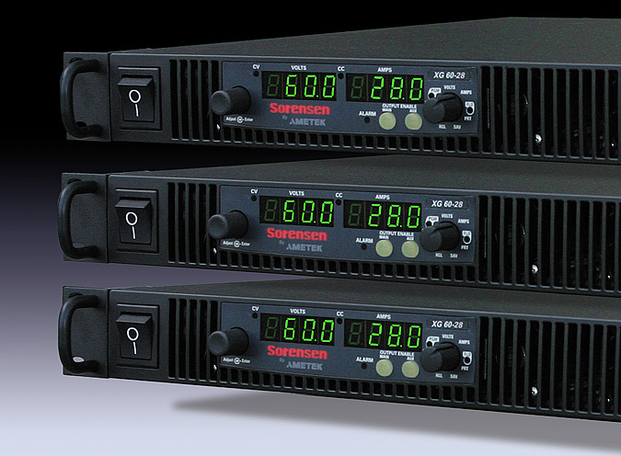
Shore Side
Rack mountable components
  Power Supplies
  Isolation Transformer
  Router
  CO₂ generation control
  Data Acquisition

Slide 6
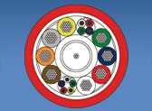
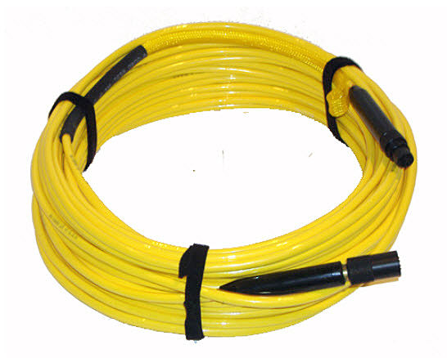
Cabled Tether
Electrical Requirements
  Power rating
  Communication speed / bandwidth
  Number of conductors (twisted pairs)
  Use of fiber optics?
  Connector selection
Mechanical Requirements
  Length
  Strength
  Anchoring
  Trawl Resistant
  How to Deploy

Slide 7
High Voltage Source
Advantages
Disadvantages
Minimizes i²r losses in cable.
Allows for less copper in cable (less $$)
Need to down convert to lower DC voltages downstream.
Safety concerns
Higher insulation resistance

Slide 8
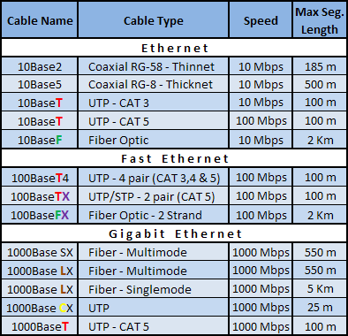
Ethernet Standards

Slide 9
Serial Standards
Specifications | RS-232 | RS-422 | RS-485
Mode of Operation | Single-Ended | Differential | Differential
Total # of Transmitters and Receivers | 1 Trans 1 Rcvr | 1 Trans 10 Rcvrs | 32 Trans 32 Rcvrs
Maximum Cable Length | 50 ft | 4000 ft | 4000 ft
Maximum Data Rate | 1MBit/s | 10MBit/s | 10MBit/s
Notes:
Add in DSL

Slide 10
DSL Standards
Technology | Distance | Download Speed | Upload Speed
ADSL | 18,000 ft / 5.4 km | 8 Mbit/s | 1 Mbit/s
SDSL | 18,000 ft / 5.4 km | 1.5 Mbit/s | 1.5 Mbit/s
IDSL | 36,000 ft / 10.8 km | 144 kbit/s | 144 kbit/s
HDSL | 15,000 ft / 4.5 km | 1.5 Mbit/s | 1.5 Mbit/s
VDSL | 4,000 ft / 1.2 km | 50 Mbit/s | 8 Mbit/s

Slide 11
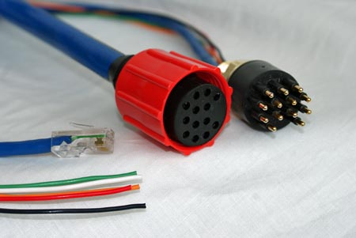
Underwater Connectors
Types
  Wet-mateable
  Dry-mateable
Considerations
  Deployment
  Servicing
Ratings
  Power conductors: voltage/current
  Communication conductors: speed/bandwidth
Notes:
#1 failure point
Speed/power issues

Slide 12
Non-Cabled System
Comms by telemetry
Buoy or Platform

Slide 13
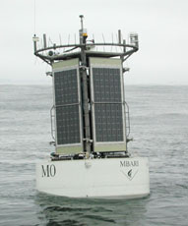
Mooring
Power Generation
  Solar, Diesel
  Battery Storage
Shore Communication
  Wireless Telemetry
Tether to Subsea Component
  Power
  Communication

