Slide 1
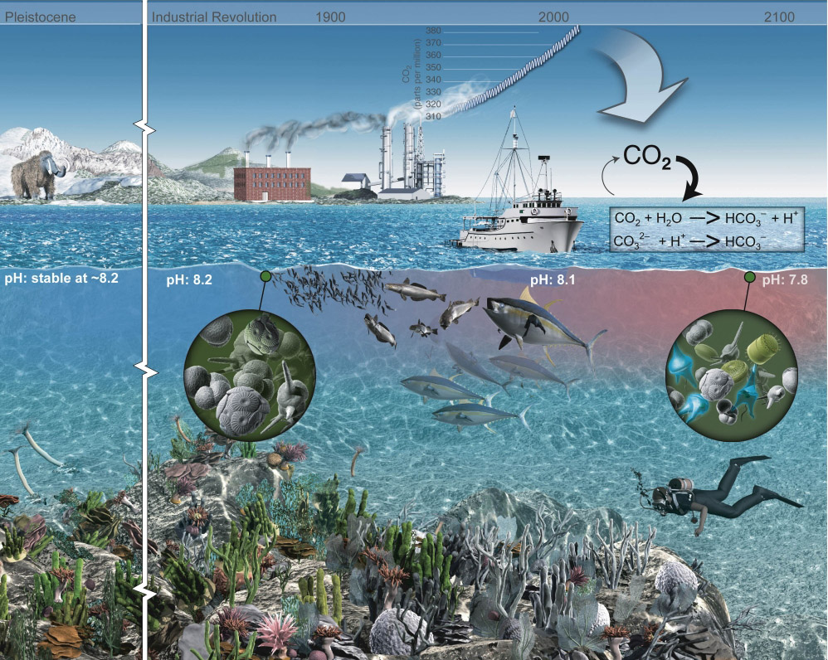
Free Ocean CO₂ Enrichment
An illustration of the atmospheric CO₂ increase and the change in ocean pH

Slide 2
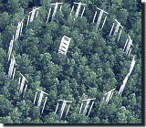

FOCE and OA Research
Free Ocean CO₂ Enrichment experiments are based on an existing base of scientific work that started in the early 1990’s. The Free Air CO₂ Enrichment (FACE) experiments.
Dr. Peter Brewer first proposed this type of experiment to MBARI engineering in 2003 as part of his greenhouse gases research. The drawing to the right is the initial concept from engineering and presented to NOAA’s Dr. Dick Feely later that year.
Concept using the MARS cable in Monterey Bay, later deployed as deep FOCE (dpFOCE)

Slide 3



Why xFOCE?
The problem: Some scientists are misinterpreting our publications and what is required to make a FOCE system work.
MBARI was contacted and we gave feedback about how to use the existing hardware and reconfigure it to become a functional FOCE.
The scientist did some of it but still didn’t grasp what FOCE is an how to properly set up a system to get meaningful science results.
It became apparent that a resource clearly outlining FOCE and how to get started would be useful.

Slide 4


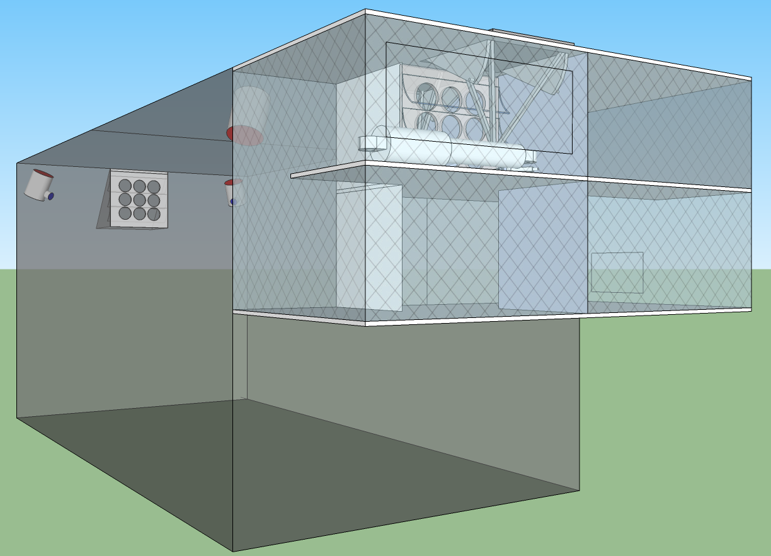





xFOCE
Deep FOCE (dpFOCE) is the original FOCE built for multi-science users on a cabled observatory.
Coral Prototype FOCE (cpFOCE) is the first tech transfer of FOCE built for multi-science users on the Great Barrier Reef. Solar and wind powered except for the creation of the enriched CO₂ water.
European FOCE (eFOCE) is currently under construction and scheduled for deployment in May 2012. This system uses a cable but the CO2 is delivered in bottles to a surface expression.
Antarctic FOCE (antFOCE) proposal submitted and partially funded. Proposal for other 50% of funding underway.

Slide 5
xFOCE
xFOCE shall support 2 test chambers (1 active and 1 control)
xFOCE shall maintain a desired pH offset from ambient within +/- .2 pH
xFOCE shall be capable of pH offsets of between .2 and .8 pH units
xFOCE shall hold a selected pH offset for a minimum of 2 weeks
xFOCE shall be capable of deployments greater than 6 months in duration
xFOCE shall be fully functional in external currents of 50 cm/sec
xFOCE shall mimic surge to the extent possible based on chamber scale
xFOCE shall maximize the allowance of full spectrum natural light
xFOCE shall include pH, CTD, O2, flow rate or calculated flow using velocity

Slide 6
xFOCE
xFOCE shall provide internal environmental data for all instruments on the required list from each active chamber
xFOCE shall provide internal environmental data for
xFOCE shall be diver maintainable
xFOCE shall not use materials that are toxic to the marine environment
xFOCE shall not be dangerous to maintenance divers
xFOCE shall minimized impacts on local marine life
xFOCE shall be capable of being fully recovered and leave no components behind
xFOCE shall be capable of being built, installed and maintained by a typical university oceanographic research lab with a minimum of 1 scientist and 2 graduate students

Slide 7
xFOCE
xFOCE shall maximize use of commercially “off-the-shelf” or readily available technology to the fullest extent possible
xFOCE shall be capable of working in ocean waters where the velocity does not exceed 75 cm/sec.

Slide 8
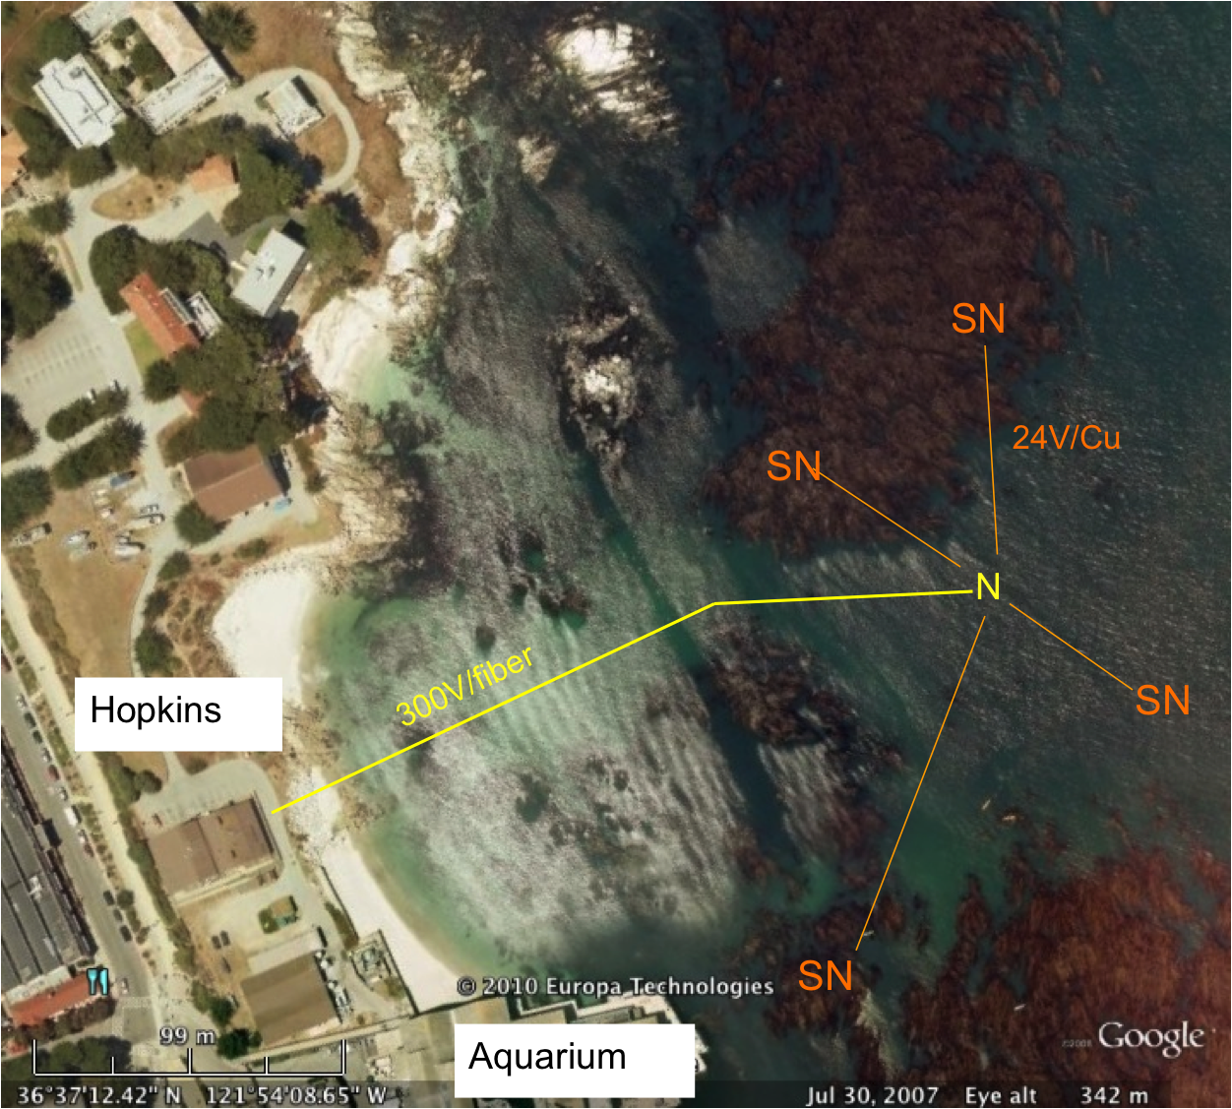
swFOCE
swFOCE shall meet all xFOCE requirements
swFOCE shall not require a support ship greater than 50’ for deployment and recovery
swFOCE shall include a camera system capable of variable time lapse digital data collection suitable for publication, the camera (and light source if included) shall also be adjustable within the swFOCE structure
swFOCE shall use the Stanford Hopkins
Marine Station’s submarine cable
swFOCE shall provide a separate power and communications links form the planned Hopkins science use and will not interfere with other science operations.

Slide 9
xFOCE Concept of Ops cable
Science interface on shore
CO2 and Enriching process on shore
Air / sea interface managed using buried cable
Capable of supporting 6 to 8 xFOCE units
(4 active pH chg and 4 control)
Depth rating
min - XX
max - XX
Anchored to bottom
Uses ??? to prevent erosion

Slide 10
xFOCE Concept of Ops no cable
Science interface on shore
CO2 and Enriching process off shore
Air / sea interface managed using surface expression
Capable of supporting 2 xFOCE units minimum
1 active pH chg and 1 control, 3 active and 3 control desired
Buoy or Platform
Comms by telemetry
Depth rating
max – 40m
Anchored to bottom

Slide 11
xFOCE Functional Requirements
Max depth: 40m (130 ft)
pH Range: 0.0 to -0.6 continuous based on CO₂ available. Brief excursions to -0.8 or -1.0 offset potentially
pH resolution: resolution: 0.05 pH units, 0.1 unit may be OK (prefer best resolution possible)
Temp range: -2 to 30 degrees C
Max ext. velocity: 50 cm/sec
Max int. velocity: 10 cm/sec
Full spectrum light: Max transmission of sunlight at depth
Number of Units: System support for 1 active and 1 control chamber

Slide 12
swFOCE Additional Requirements
Surge: Imitate surge to extent possible
Temp range: -2 to 30 degrees C
Number of Units: System support for 3 active and 3 control chamber

Slide 13

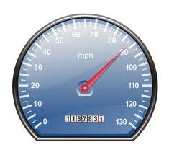
xFOCE/swFOCE Concept of Ops
Flow Vel
Science selected velocity

Slide 14
xFOCE Functional Interfaces
House Power
Internet
Power
Generation
CO2
ESW
Mixer
Comms
Data
Distribution
GUI
Distribution/Protection
SW Pump
Configuration & Control
Data Archive
Control System
Storage
Console
Enriched
Seawater
System
Monitoring/
Health/Status
Data Acquisition
Surface
xFOCE Control
Science / Control System
Subsea
Subsea Electronics
ESW Distributor
ESW injector(s)
Instruments
ESW injector(s)
Flow effector(s)
Camera(s)
Flow effector(s)

Slide 15



xFOCE Mooring Concept
Exhaust used for CO₂
Diesel Fuel
Particle Scrubber
CO₂ Mix Electronics
System Control Electronics

Slide 16

xFOCE Systems concept
Blue circles are included for swFOCE
Proposed minimum instrumentation for an active pH controlled chamber. The blue elements are options and controls would only have CTD and pH. Not shown is the other option of a motor and fan to control flow.

Slide 17
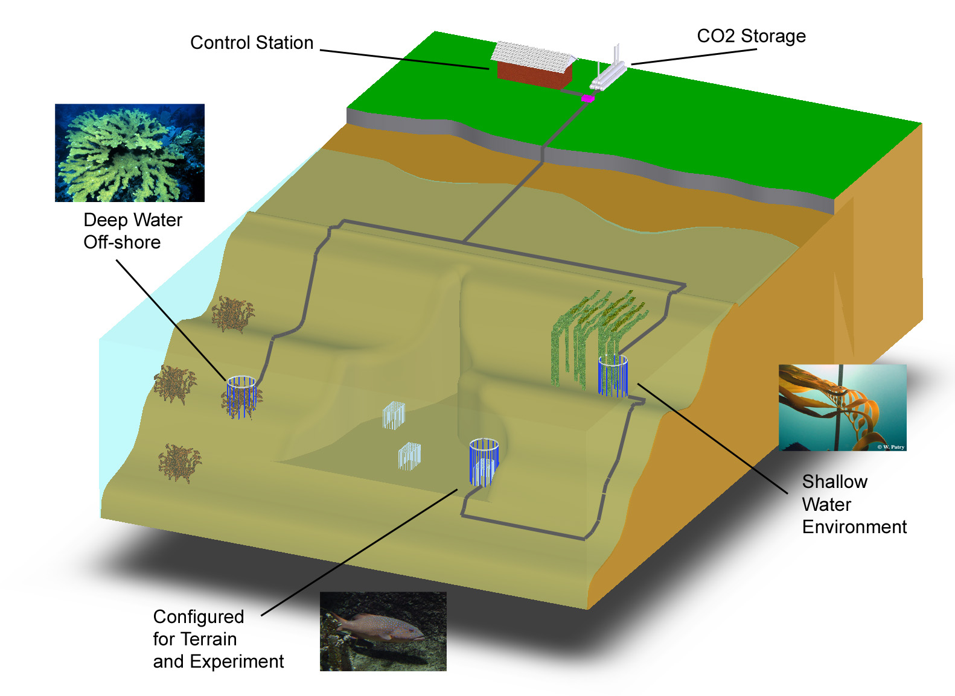
swFOCE Basic Concept
Schematic View of the Hopkins Site
Multi-Site
Multi- Discipline
Multi-Year
Shallow Water
Off-Shore
Shallow Water Corals
Benthic Biology

Slide 18
swFOCE Concept
Bottomside FOCE chamber for swFOCE
pH Sensor
Camera and Light
Ducting
(Time delay)
Flow meter
Animal
Restrictor
CTDO Sensor
Thruster
Anchors
CO₂ Enriched Water
Power and Comm
Cabling
FOCE Controller

Slide 19
swFOCE Cable Concept
Sea Water
Barrier End Cap
Low pH Sea Water
Power and Comms
Existing Drain at
Hopkins
Sea Level
Intake Filter

Slide 20
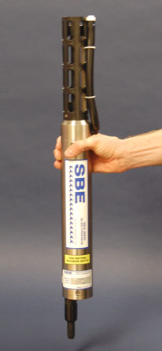
xFOCE Core Instrument Suite
pH : +/- .01 pH unit or better and suitable for
control loop applications
CTD: Comparable to current units at MBARI, unit is
FastCAT SBE49 (oxygen can be included)
Flow sensor: TBD, likely electromagnetic to get smooth
flow numbers and volumetric data. From dpFOCE acoustic velocity sensors are not suitable.
Suggested architecture allows for expansion of additional instrumentation
PAR* - Photosynthetically Active Radiation

Slide 21
swFOCE Core Instrument Suite
pH : +/- .01 pH unit or better and suitable for control loop applications
CTD: Comparable to current units at MBARI, baseline unit is FastCAT SBE49 (oxygen can be included)
Flow sensor: TBD, likely electromagnetic to get smooth
flow numbers and volumetric data. From dpFOCE acoustic velocity sensors are not suitable.
PAR* Sensor: 400 – 700 nm / calibrated t0 0 – 5000 μmol photons•m ⁻² •s ⁻¹
Camera/Lights: 1080p - 16:9 ratio format – light source either natural and/or color balanced LED
PAR* - Photosynthetically Active Radiation

Slide 22
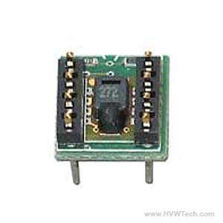
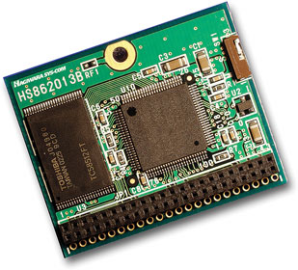
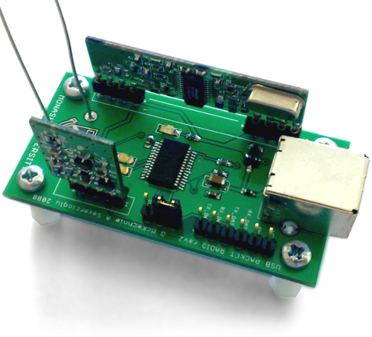
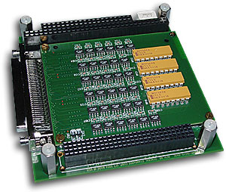
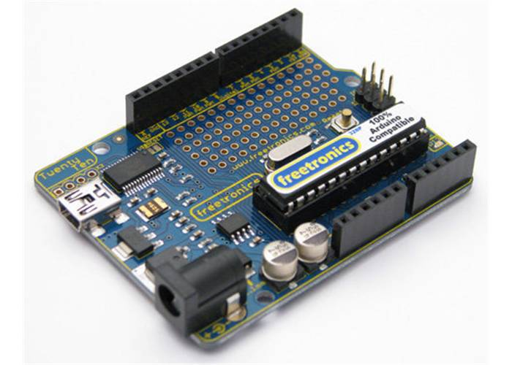
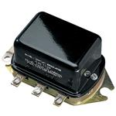
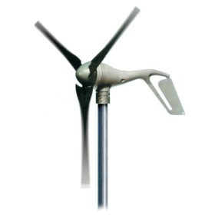
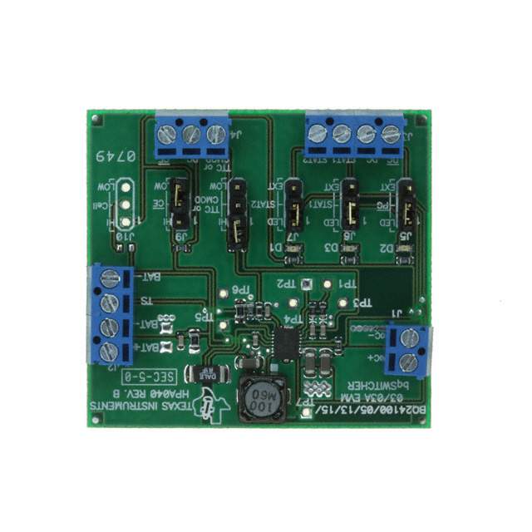
xFOCE /swFOCE Components
Humidity Sensor
Flash Storage
Wireless Comm
Instrument Interface
CPU
Voltage Regulator
Wind ??
Battery Charger
Deep Cycle Batteries

Slide 23
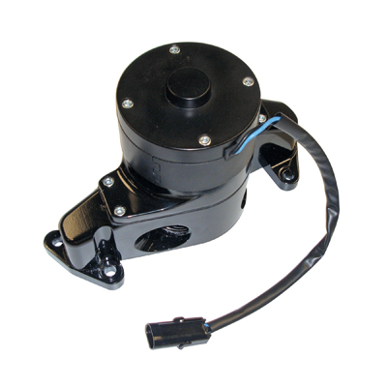
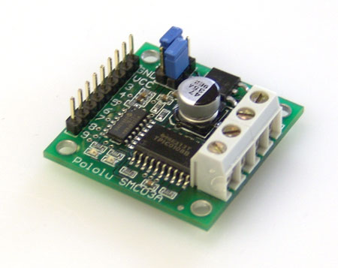
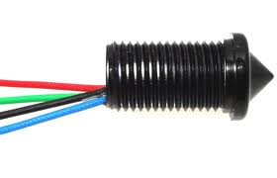
xFOCE /swFOCE Components
Motor Controller
Small Water Pump
Voltage Regulator
Level Sensor
CPU
Deep Cycle Batteries

Slide 24
xFOCE /swFOCE Data Reqs.
Health and Status: Ability to query system status from web page (data dependent on sensors included)
Timing Accuracy: Network Time Protocol (NTP) protocol for synchronizing computers
Sample Rates: System will support 10 Hz standard operation
Basic Data Format: Comma delimited string, time stamped
swFOCE: Compatible with the current dpFOCE data streams and SSDS (Shore Side Data System*)
Near real time ground fault monitoring
*SSDS – Open source from MBARI

Slide 25


xFOCE Engineering Trades
Color Frequency Wavelength
violet 668–789 THz 380–450 nm
blue 631–668 THz 450–475 nm
cyan 606–630 THz 476–495 nm
green 526–606 THz 495–570 nm
yellow 508–526 THz 570–590 nm
orange 484–508 THz 590–620 nm
red 400–484 THz 620–750 nm
infrared longer than 750 nm
Since these wavelengths penetrate water easier but most plastic materials respond poorly to high freq light the materials selections will focus on this end of the spectrum
The selection of materials will likely transmit this end of the spectrum fairly well but in selection, if required, we would trade attenuation here to maximize shorter frequencies.
Acrylic (vs Polycarbonate) has less attenuation overall and carries much further into the ultraviolet when comparing the blue lines.

Slide 26
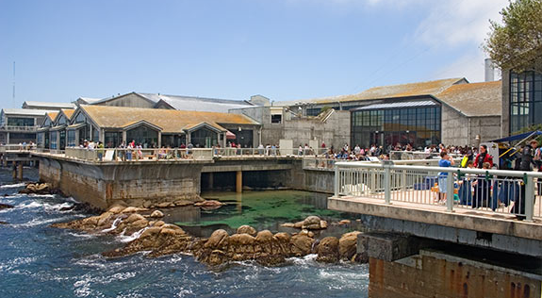
FOCE: A tool to understand local impacts of Ocean Acidification
Funding Provided by The David and Lucile Packard Foundation

Slide 28
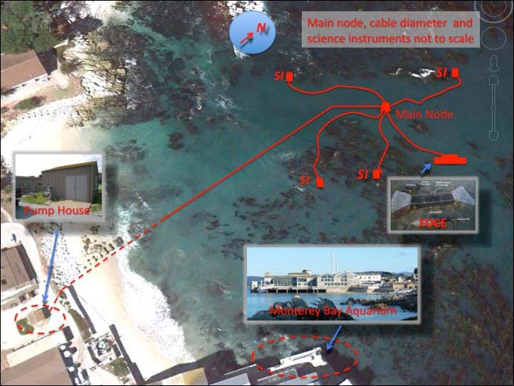
SW-FOCE Takes Shape
Build a consortium of researchers and engineers to tackle large, real-world issue of increasing relevance
Center for Ocean Solutions: Ideal fit to highlight ocean acidification
Hopkins: Cable/infrastucture and numerous potential research opportunities

Slide 29

Permits at Every Level
From earliest meetings with COS & Hopkins, realized permitting was a significant hurdle to overcome.
Brock Woodson initially procured permit from Monterey Bay Sanctuary to install cable
Innovative work, like SW-FOCE, would require the involvement of multiple regulatory agencies
  Monterey Bay National Marine Sanctuary
  California Coastal Commission
  California Department of Fish & Game
  Central Coast Regional Water Quality Control Board
  City of Pacific Grove

Slide 30
Permitting Issues
Project Site: Highly Sensitive Location
  Federal: Marine Sanctuary
  State: Coastal Zone & MPAs
  Regional: Water Quality
  Local: City of Pacific Grove
Notes:
First issue that triggered all this regulatory oversite was the project site itself.
Project Site – create maps of Sanctuary jurisdiction – zoom to state jurisdiction – zoom to MLPA designations – PG jurisdiction

Slide 31
Permitting Issues: cont’d
CO2 in the ocean poorly understood
  Experimental releases considered “toxic waste”
  Needed to change some agency staff (and public) perception about experiment
    Education about ocean acidification processes occurring today and why research extremely important
    Understanding scale: Created comparison examples that could be understood by general public (e.g., SCUBA diver and motor boat equivalents)
    Process much easier when agency staff understood the chemistry
Notes:
SCUBA equivalents: CO2 release in one SW-FOCE chamber for 1 day would = 4 people breathing (all day)
35 SCUBA man-hours
The CO2 produced by burning 0.42 gallons of gasoline
The CO2 produced by burning 0.38 gallons of diesel fuel
Deep FOCE: MBARI was recently granted an increase of CO2 release to 400L per year. The maximum quantities the research team foresees using are far below the CO₂ distributed into Monterey Bay by other methods. To demonstrate just how minor this amount of liquid CO₂ is in the big picture, Jim Barry provided calculations estimating the amount of liquid CO₂ released by one motorized boat operating in the bay. Assuming the boat has an approximately 150-horsepower motor, running at 12 gallons per hour, it will release approximately1800 L of liquid CO₂ per 8-hour-day.

Slide 32
Permitting Issues: cont’d
Inconsistent or lack of permit process
  Every agency has different process
  First research project request in recently established MPA, as well as Area of Special Biological Significance
Notes:
Agency staff didn’t know how to move forward with applications because a process had not been determined even though regulations had gone into effect

Slide 33

Permitting Issues: cont’d
Inter-Agency Interactions
  Each agency regulating different aspects of project
  Order of response from agencies
  Project exposed shortcomings in permitting process among multiple agencies
Notes:
Each agency regulating different aspects of project so there is increased potential for conflicting opinions on project impacts and mitigation measures (e.g., use of local vs. non-local populations for perturbation experiments.
Depending on the project, each agency has a system of waiting for another agency to make a determination first before issuing their own authorization. Staff got creative with how to deal with this, but acknowledged system needed refining.

Slide 34
Kudos to Agency Staff
  Agency staff highly professional
  Agency staff understood their respective agency permitting shortcomings due to recent changes in regulations
  Genuine interest by all agency staff we worked with to help us come up with a solution to get the projects permitted
Notes:
MBARI benefitted from existing positive relationship with agency staff, especially MBNMS.
Staff needed authorization from higher up to be able to proceed.

Slide 35
How to Move Forward -
Go to the Top
Peter Brewer met with Governor Brown
Meg Caldwell helped streamline the process with two key State agencies (CCC & CDFG) through discussions with high level personnel

Slide 36
Lessons Learned
Site location can determine how much regulation you will be faced with
Allow plenty of time for permitting
  Process took 2 years to complete
Good rapport with agency personnel key
  Not necessarily trying to make life difficult, but often operating within bureaucratic box
  Future interactions
Advocate(s) who can work with bureaucracy highly valuable
Getting the process streamlined is critical to prevent valuable research from being discouraged due to concerns about permitting.
Notes:
Future interactions – probably will end up working with same staff on similar or other projects. Good to keep positive rapport.

Slide 38
Computing elements of xFOCE
(Architecture and system trades)

Slide 39
Computing Architectures
User Concerns
Performance: valid scientific approach, data quality
Flexibility: wide range of environments, scenarios
Ease:
  Build
  Test
  Use, maintain
  Extend
Cost
Notes:
----- Meeting Notes (4/19/12 09:27) -----
power constrained slide 2

Slide 40
A few assumptions
Implementer profile | Researchers plus 2-4 post docs, grad students 0-1 engineer
Technical | Access to modest manufacturing facilities Software is harder than hardware, mechanical Strong preference for familiar COTS solutions
Implementation schedule | ~6 months
Experiments | Campaign-style deployments 12 month service life Remote and/or restricted sites
Lifecycle | Prefer to extend capability, rather than re-spin from scratch for successive funding rounds

Slide 41

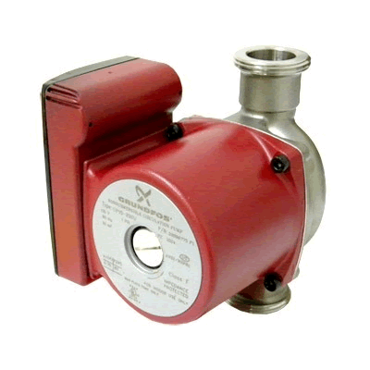

Power
Data
Data, Control
Power
CO₂
H₂O
Enriched
Seawater
Controller
FOCE Essentials
ESW
pH
CTD
CTD
pH
Flow
Chamber
Flow
DO₂
Flow
DO
External
Notes:
----- Meeting Notes (4/19/12 09:27) -----
pump hard to recognize
workstation graphic
remo
----- Meeting Notes (4/19/12 09:36) -----
expand DO2?

Slide 42
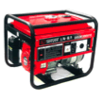

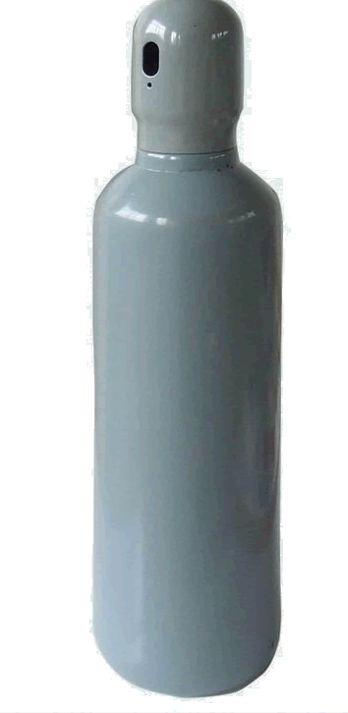


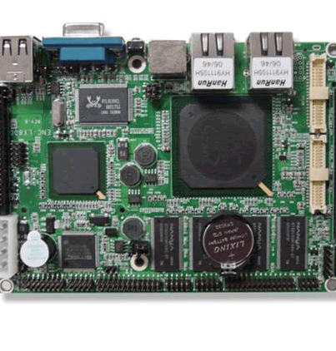



Computing Architectures
Elements
Instruments
Electronics
Housings
Cabling
Software
Computers
Many ways to arrange them
In a FOCE experiment
For each, many options
Notes:
----- Meeting Notes (4/19/12 09:36) -----
computer heads in periodic table

Slide 43
Computing Architectures
Shrinking the Universe of Trades
Look at decisions that have greatest impact on user concerns
  Build vs Buy
  Location matters: Shore vs Surface vs Seafloor
  Topology: how the pieces are connected

Slide 44

Build vs Buy
General Principles
Buy what you can’t/shouldn’t build
  Processors, instruments, cabling
  Software
Build (or borrow) as needed
  Chambers, housings
  Use COTS components if possible
  Get help on tough key builds
    contract, open source
Beware Frankensystem
  Patchwork integration of COTS parts
  Power consumption
  Rube Goldberg-ness of mechanical/electrical interfaces

Slide 45

Location Matters
General Principles
Connected vs Disconnected
  Generally easier to generate and store power, ESW on shore
  Telemetry bandwidth
Trades for off-shore elements
  Accessibility (to you, the elements, others)
  Reliability
Keep what’s offshore/sub-surface as simple and robust as possible
  Basics: Enriched seawater, power
  HW: Cables, connectors, housings
  SW: Applications, protocols, processes
Play to your application, tech strengths and budget
  Permits, environment
  Experiment duration, depth
  Data access requirements
  Maintenance schedule, spares
  Available design/fabrication resources

Slide 46
Power
Data
The software developer sees…
The user needs to consider
CO₂
H₂O
Controller
Enriched
Seawater
What’s inside?
Build or Buy?
Where to put the pieces?
How are pieces connected?
ESW
pH
CTD
CTD
pH
Flow
Chamber
Flow
DO₂
Flow
DO₂
External
Notes:
----- Meeting Notes (4/19/12 09:45) -----
not clear about thought bubbles

Slide 47
Some things must be on the seafloor
  Chamber, instruments
  Actuators (pumps, fans, etc.)
But location of everything else is flexible…
  Power, ESW
  Controller
  Data storage, user interfaces
And, there are many ways to implement all of it…

Slide 48
xFOCE helps to simplify the choices
  Experience, Designs, Community
Choices depend on experiment and constraints
  Budget, schedule
  Environment
  Technical resources
xFOCE community may draw from different approaches

Slide 49
A study of some approaches
  Centralized Workstation
  Industrial Computers
  Sensor Node
3 views to evaluate key features and trades
  Location: shore, surface, seafloor
  Build/buy: hardware, software
  Connections: topology and infrastructure

Slide 50
Next up: Centralized Workstation…
  Workstation computing
  Similar to dpFOCE implementation
  Mixed Common Off The Shelf (COTS) /custom hardware
  Shown here using cabled configuration

Slide 51
Component | Location | Why
Controller HW | Seafloor | Could run on shore Experiment continues if comms fails
Controller Software | Seafloor | ‘’
UI Software | Shore | Easier maintenance
Power | Seafloor | Need fine-grained power management at site
Data | Seafloor And Shore | Experiment continues if comms fails
Centralized Workstation
Data
Archive
Location View
Power
Source
Surface
Shore
Seafloor
Data
Controller
Power
Distribution
ESW
pH
CTD
CTD
pH
Flow
Chamber
Flow
DO₂
Flow
DO₂
External
Notes:
----- Meeting Notes (4/19/12 09:50) -----
purpose of flow

Slide 52
Centralized Workstation
Build/Buy
View
Component | Build/Buy | Implementation
Controller HW | Buy | PC104 Pentium Serial port cards (16 total)
Controller Software | Build Open Source | Linux, Java Custom: SIAM Data Acquisition software Open Source: DataTurbine, e.g.
Archive, UI | Build | PC Workstation MacOS, Windows, Linux, Java Custom: SSDS, FOCE GUI
Power | Build | Custom: load switching and monitoring chassis
ESW | Build | Custom: electronics, software, chassis COTS: pumps, controllers
SIAM: Software Infrastructure and Applications for MOOS
SSDS: Shore Side Data System

Slide 53
Centralized Workstation
Ethernet
Connection
View
Data
Power
Source
Surface
100 MBps
Ethernet
Shore
Fiber Optic
Power and Data Cable
Seafloor
Data
Controller
1 kW
Ethernet-Serial
Power
Distribution
Serial
ESW
pH
CTD
CTD
pH
Flow
Chamber
Flow
DO₂
Flow
DO₂
External

Slide 54
Summary
Centralized Workstation
Pros
  One software platform
  COTS computers
  COTS serial I/O solutions
Cons
  Extensibility in packaging and housings…have to put a lot of holes in housings
    Can use junction boxes
  Need lots of serial ports
    Custom serial IO Power consumption
  Less modular
  Custom HW/SW

Slide 55
Next up: Industrial Computers…
  Industrial automation computers (WAGO, Compact Rio, e.g.)
  Similar to CP-FOCE implementation
  Uses primarily COTS hardware and software
  Shown here using moored configuration

Slide 56
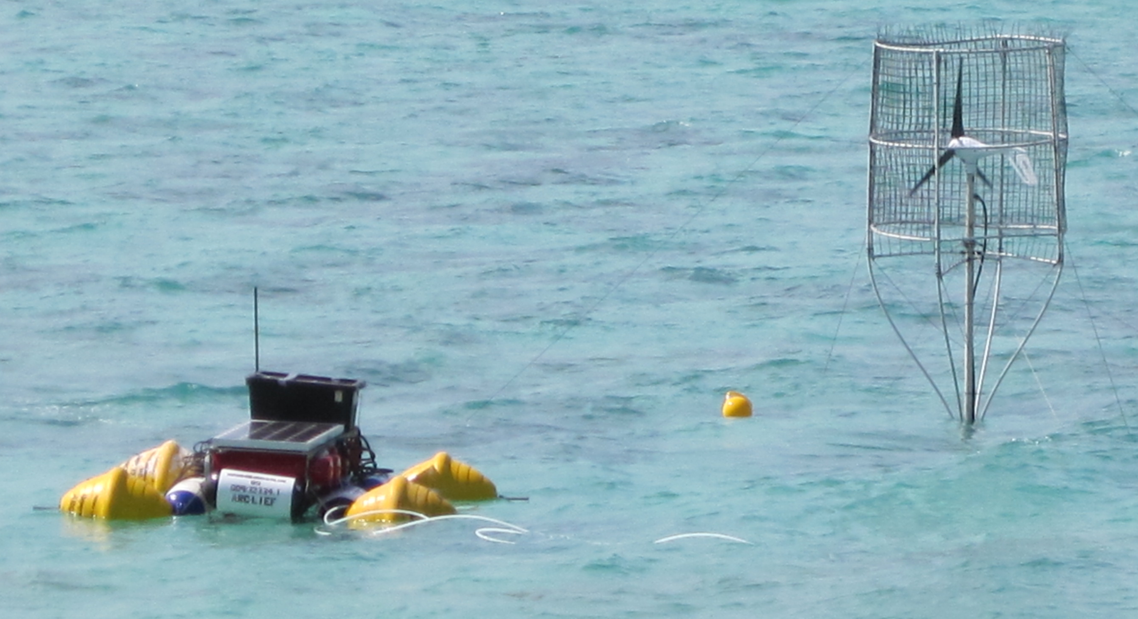
Component | Location | Why
Controller HW | Surface and/or Shore | Easier access Large housings
Controller Software | Surface And Shore | Co-located w/ HW
UI Software | Shore | Easier maintenance
Power | Surface or Shore | Easier access
Data | Surface and/or Shore | Co-located w/ control
ESW | Shore Or Surface | Permitting, depth, distance from shore
Industrial Computers
Location View
Data
Data
Power
Controller
Controller
Wireless
Controller
UI
Controller
Surface
Shore
Seafloor
Junction
ESW
pH
CTD
CTD
pH
Flow
Chamber
Flow
DO₂
Flow
DO₂
External

Slide 57
Industrial Computers
Component | Build/Buy | Implementation
Controller HW | Buy | COTS: WAGO, National Instruments Compact-Rio (NI-CRIO), Serial MUX, Video MUX
Controller Software | Buy | COTS: LabView (custom drivers) Open Source: DataTurbine
Archive, UI | Buy | PC Workstation MacOS, Windows, Linux Open Source: DataTurbine, RDV, Pachube... COTS: LabView (custom archive), MATLAB
Power | Build/Buy | COTS: WAGO, NI-CRIO Custom: Ground fault detection, isolation
ESW | Build/Buy | Custom: pump and valve drivers COTS: WAGO, NI-CRIO, LabView, pumps, motor controllers
Build/Buy
View
COTS: Common Off The Shelf
OSDT: Open Source Data Turbine
RDV: Real-time Data Viewer OSDT client
WAGO, CRIO: Industrial computer implementations
MUX: multiplexer

Slide 58
Industrial Computers
ConnectionView
Data
Data
Power
Controller
Controller
UI
Controller
Controller
Surface
RF Wireless
WiFi
Cell
Satellite
Shore
Seafloor
Serial
Ethernet
Serial
Ethernet
Junction
ESW
pH
CTD
CTD
pH
Flow
Chamber
Flow
DO₂
Flow
DO₂
External

Slide 59
Summary
Industrial Computers
Pros
  Mostly COTS components
  Vendor and user community support
  Easier to build
  COTS software provides much infrastructure
Cons
  High cost of software and hardware
  High power consumption
  Large electronics form factors require larger housings

Slide 60
Next up: Sensor Node…
  Small COTS embedded PCs and microprocessors
  Modularize and aggregate power switching and/or data acquisition
  Similar to eFOCE implementation
  Reduce power consumption
  Shown here using moored configuration

Slide 61
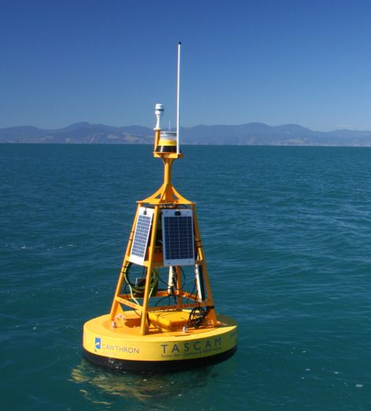
Component | Location | Why
Controller HW | Surface/Seafloor | Surface: telemetry, UI Seafloor: experiment control
Controller Software | Seafloor | Gateway: control, telemetry Node: data acquisition
UI Software | Shore/Surface | Easier maintenance
Power | Surface | Probably use generator, solar, wind on surface
Data | Seafloor And Shore | Local data needed for control Central archive for redundancy, easier access
Sensor Node
Data
Location View
Power
Data
Controller/
Gateway
Wireless
Surface
Shore
Seafloor
Controller
/Gateway
Data
Experiment Control for 1 chamber
Load switching,
Data Acquisition for
1-4 Devices
Node
Node
Node
Node
ESW
pH
CTD
CTD
pH
Flow
Chamber
Flow
DO₂
Flow
DO₂
External
Notes:
----- Meeting Notes (4/19/12 09:50) -----
purpose of flow

Slide 62
Sensor Node
Build/Buy View
Component | Build/Buy | Implementation
Controller HW | Buy | Gateway: BeagleBoard, Android, Gumstix Node: Arduino, MSP430, SmartSensor
Controller Software | Build | Gateway: Linux, Java, C++/Java Node: C/C++, Wiring, e.g. Instrument drivers
Archive, UI | Build/Buy | Custom: back end interface Open Source: web server on gateway
Power | Build | Custom: load switch, ground fault detection, isolation
ESW | Build/Buy | Custom: pump and valve drivers COTS: pumps, motor controllers
Notes:
----- Meeting Notes (4/19/12 09:50) -----
purpose of flow

Slide 63
Sensor Node
Data
Connection
View
Power
Data
Controller
Gateway
RF Wireless
Cell
Satellite
WiFi
Ethernet
(Serial?)
Surface
Shore
Seafloor
Controller
Gateway
Data
Serial
Node
Node
Node
Node
Serial
ESW
pH
CTD
CTD
pH
Flow
Chamber
Flow
DO₂
Flow
DO₂
External
Notes:
----- Meeting Notes (4/19/12 09:50) -----
purpose of flow

Slide 64
Summary
Sensor Node
Pros
  Reduce power
  No custom serial IO expansion
  Modularizes data acquisition
  Many variations possible
    COTS processors, languages
    Topologies
    Connection backbone (cost: power)
    Component upgrades
    Drivers on Gateway
Cons
  Two software development platforms
  More custom hardware to build, configure, maintain
  More cables, connectors, housings
  Video expansion path unclear
  Multiple system clocks
Notes:
The Bottom Line
It’s a good design pattern, with balance of build/buy
flexible, extensible, moderate cost
Variants trade complexity, power, modularity

Slide 65
Approach Tradeoffs
Approach | Performance | Flexibility | Ease |  |  | Cost
 |  |  | Build | Use | Extend
Centralized Workstation |  | ■ |  | ■ | ■ | 
Industrial Computer | ■ | ■ | ■ |  | ■ | 
Sensor Node | ■ |  | ■ | ■ | ■ | ■
Con

Pro

Slide 66
Questions?

Slide 67
UI
Help users to understand and simplify key choices
What UI choices will the user make related to UI
  Network, interfaces, security
How do those choices affect concerns (performance, flexibility, ease, cost)
What are pros/cons of various choices
  Cost, power, bandwidth, software skill, processing capability, software/system dependencies
Modularity
  Interfaces that support flexibility in UI choices
  Expansion path: what’s needed up front to start simply and build capability
Sketch out a couple of concepts at either end of the spectrum
Specific choice/detail more important for SWFOCE

Slide 69
Mechanical Components
Comprising
xFOCE / swFOCE
Farley F. Shane

Slide 70
xFOCE Mechanical
Sub-Systems
        Seafloor System
          Experiment Chamber
          Ancillary Support Equipment
        Surface Support Systems
          Seawater Enrichment System
            Generation
            Delivery
          Power

Slide 71
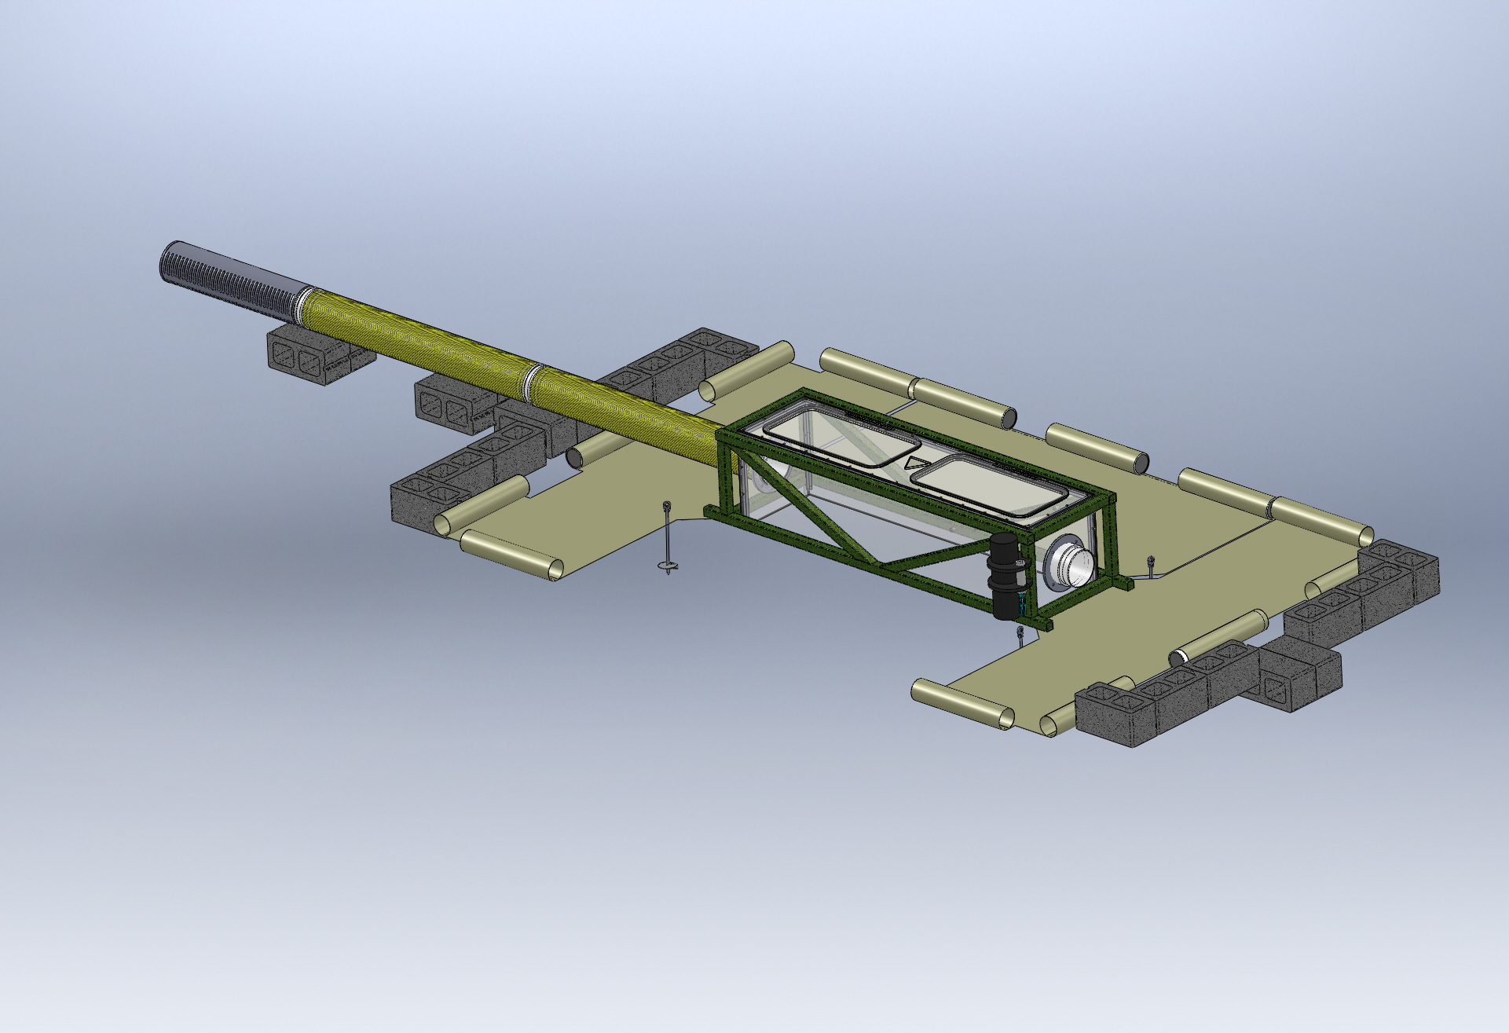
Typical Seafloor System Comprising an xFOCE
As needed
Enriched Seawater Delivery
From Surface
Enriched Seawater
Experiment Chamber
(Both Ends)
Perimeter Weights
Seawater Inlet
Valve Manifold
(Both Ends)
Fan Module
Location
(Both Ends)
Delay Path Section
(Both Ends)
(Conformal Sealing Mat
Removed for Clarity)
Conformal Sealing Mat(s)
Chamber Anchors (at corners)
Shear Skirt
(Bottom Perimeter
Scour Protection Elements

Slide 72

Sample Experiment Chambers
Fans to
Control Current
Buoyancy Blocks
Access Hatches
Control System in
Pressure Housing
Exo-Frame
Fitting for Time
Delay Section
Delay Path
Experiment Chamber
Conformal Seal
Subsea CO2 Reservoir
Enriched SW
Delay Path
Anchors
MBARI Deep FOCE
SWFOCE Prototype
Surge Translation Paddle
Surface Available for Instrumentation
Fan
Fan
Handle
Side Access Opening
(Hatch Not Shown)
Modular Fan Section
Perimeter Shear Skirt
Hemi- Cylindrical
Trapezoidal

Slide 73
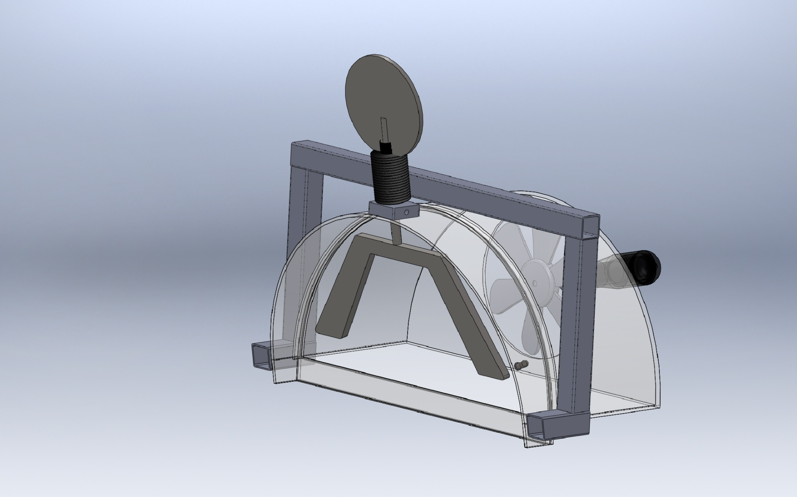
Longitudinal Surge Translation Mechanism
Pivot
Paddles
Section View

Slide 74
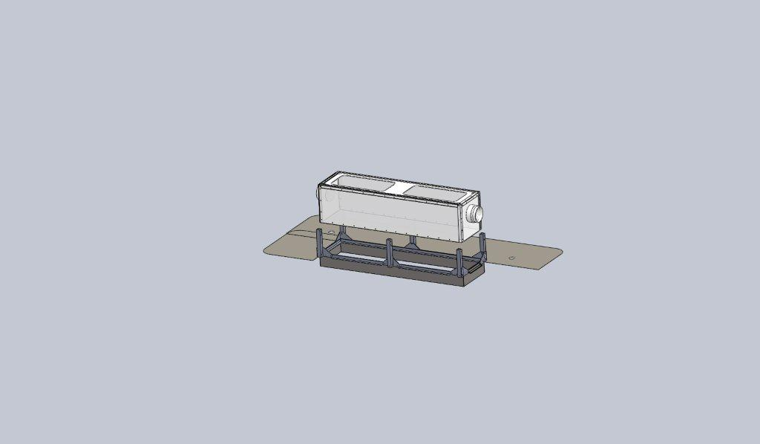
Chamber Dock w/Shear Skirt and Interface Seal
Experiment Chamber
Chamber Dock
Interface Seal
Rigid Perimeter Shear Skirt

Slide 75


Time Delay Mixing Section
Offset pH = -0.7
Bkgrd pH ~ 8.1
Offset pH = -0.5
Offset pH = -0.3
(34.9 deg. F)
Flexible Duct
(39.2 deg. F)
(50 deg. F)
Length
  Calculated using 2 Tau time delay and desired maximum current speed.
  Provides the time necessary for the CO2 and seawater to chemically react and establish stabilized pH.
Cross-sectional area and current speed
(volume/time) will approximate the rate of change
of the enriched seawater in the Experiment Chamber.
(77 deg. F)
Tau = 67.8 secs
*
*
Tau = 51.3 secs
*
Tau = 31.1 secs
*
Curves from the Zeebe-Wolf Gladrow CO2 kinetic model
showing e-folding time at various temperatures as a function
of pH.

Slide 76



Simulating Current
Trolling Motors
  Compatible with shallow depths
  Reasonably predictable reliability (MTBF)
  Easy maintenance/replacement
  Compatible with available power (AC/DC, etc.)
  Controllable according to requirements
  Capable of reasonable volume/rate delivery
Commercial Thrusters
  Technadyne Model 520 DC Brushless - $3700, 520 Watts, various voltages available, analog or digital control, magnetically coupled prop
  CrustCrawler 400 HFL - $600, 0-50 VDC, 400 watts, lip seals, 300 ft
Submersible Bilge Pumps
  Compatible with shallow depths
  Large range of flow rates
  Large range of DC voltages
  Readily available/replaceable
  Very inexpensive
  Brand Names: Rule, Attwood, Lovett, Johnson, Jabsco,…
  May need replacing more often
  Not designed to run continuously
Trolling Motor
Commercial Thruster
Submersible Bilge Pump

Slide 77
Simulating Current
Type
Pro
Con
  Compatible with shallow depths
  Easy maintenance/replacement
  Compatible with available power (AC/DC, etc.)
  Controllable according to requirements
  Capable of reasonable volume/rate delivery
  Low Cost --$50-$200
Requires modification to fit shroud
Not designed for long term running
Requires close monitoring of shaft seals
Trolling Motor
Technadyne Model 520 Brushless DC
  Multiple voltages
  Analog or digital control
  Magnetically coupled prop
CrustCrawler 400 HFL
  0-50VDC 400watts
  300 ft Depth
  Low Cost --$600
High Cost --$3700
Lip seals
Commercial Thruster
  Compatible with shallow depths
  Large range of flow rates
  Large range of DC voltages
  Readily available/replaceable
  Very inexpensive-- $20-$50
  Not designed to run continuously
  May need replacing more often
Submersible Bilge Pump
Brand Names: Rule, Attwood, Lovett, Johnson, Jabsco,…

Slide 78
Anchoring
Anchors
  Related to type of seafloor, longevity, access, etc.
    Semi, Consolidated, and Unconsolidated Sand, Silt, and Clay
      Deadweight
        Concrete Block
        Other
      Direct Embedment
        Helix
        Keyed Plate
      Drag Embedment (Primarily for buoy moorings)
        Danforth, CQR, Delta, Bruce, etc.
      Self –Burying (Better for loose sand, silt)
        Dor-Mor
        Mushroom
    Rock and Coral
      Deadweight
        Concrete Block
        Other
      Direct Embedment
        Powder Actuated Stud Gun (down to 46 meter (150’) depth)
        Epoxied Stud (Drilled hole)
        Expansion Bolt (Drilled hole)

Slide 79











Examples of Anchors
CQR
Epoxied Anchor Pins in Coral
Installation of
Anchor Pins
Claw or Bruce
Danforth
Drag Embedment Anchors for Mooring Buoy
Powder Actuated Stud Gun
Self Embedment Anchors
Deadweight Block
Single or
Multiple Helix
Dor-Mor
Helix Anchor

Slide 80
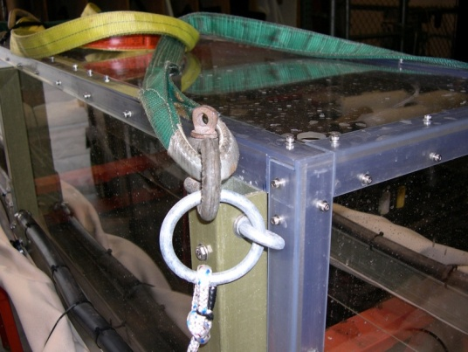
Anchor Notes
Helix type easy to install by diver
  Screw-It Beach anchor, removable handle, Corrosion resistant - $70
  Ironwood Pacific – 21”, 4” helix, powder coated steel, $40 each
  MilSpec Anchors -- set of 4 for $23
Keyed Plate type requires digging out for retrieval
  Triangular earth anchors with galvanized cables, set of 4. ~$40
Drag embedment anchors require setting by boat.
Installation of anchor pins require drilling holes in coral or rock.
SWFOCE method of securing anchor to frame

Slide 81
Enriched Seawater Generation and Delivery
  This system mixes CO2 with seawater and delivers the enriched seawater to each Seafloor Experiment System.
  The Delivery System is comprised of at least the following components:
    Mixing Tank
      Contains CO2 and seawater at 2 atmospheres.
      Designed for the creation and buffered storage of
      enriched seawater.
      Adequate volume to supply the requirements for all Experiment Systems
      Vaporizing Nozzle(s) to create enriched seawater
      Instrumentation to assure adequate monitoring and mixing of enriched seawater.
    Pump and Motor
      Provides recirculating seawater to mixing tank
      Provides enriched seawater to experiment systems
    Seawater Delivery Source
    CO2 Delivery Source
    Ancillary equipment and instrumentation
      Valves
      Gauges
      Filters
      Sensors

Slide 82
Enriched Seawater Generation and Delivery
(Cont.)
(SWFOCE shown)

Slide 83



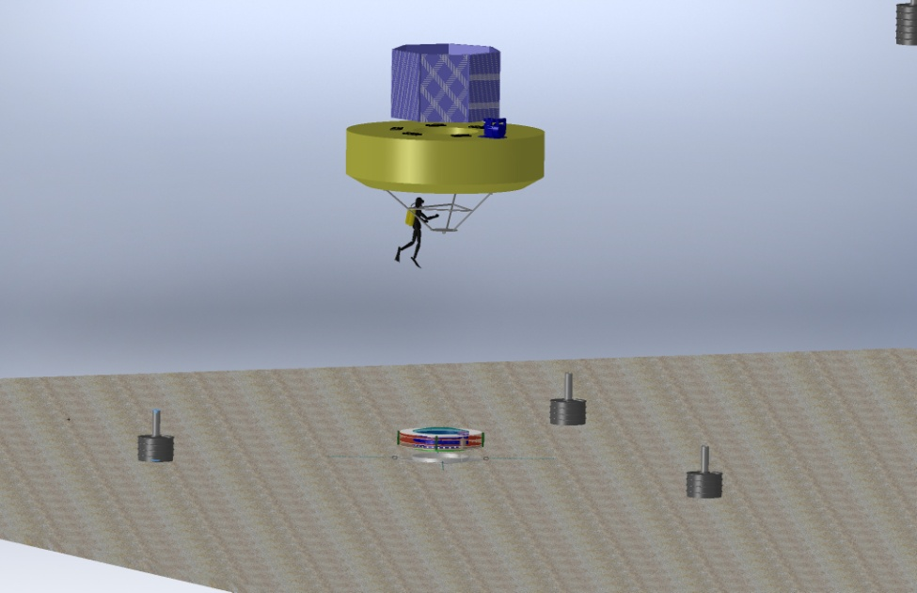
Power for XFOCE
Diesel Generator
3500 Watt Output
0.3 Gallon per Hr.
Onshore Power
  Power supply Unit
  UPS
Remote Location Power
Onshore or Offshore
  Diesel Generator
    Batteries
    Bonus of CO2 generation
  Wind Powered Generator
    Batteries
  Solar Cells
    Batteries
Offshore
  Moored Buoy
Wind Generator
400 Watt Output
240 Watt Panel
Buoy
xFOCE
Anchor
  Moored Buoy

Slide 84


Supporting Information
Extracting CO2 from Exhaust
Carbon Dioxide Emissions from 1 gallon of fuel
Source: U.S. Environmental Protection Agency, "Emission Facts: Average Carbon Dioxide Emissions Resulting from Gasoline and Diesel Fuel," February 2009.

Slide 85
Low Cost Shallow Water Pressure Housing
PVC - Polyvinyl Chloride
strong and rigid
resistant to a variety of acids and bases
maximum usable temperature 140ºF (60ºC)
PVC Pipe
Nominal Pipe Size (inches) | Schedule 40 | Schedule 80
1/2 | 358 | 509
3/4 | 289 | 413
1 | 270 | 378
1 1/4 | 221 | 312
1 1/2 | 198 | 282
2 | 166 | 243
2 1/2 | 182 | 255
3 | 158 | 225
4 |  | 194
5 |  | 173
6 |  | 167
8 |  | 148
(psi)
(psi)
Operating Temp (°F) | De-Rating Factor
73 | 1.00
80 | 0.88
90 | 0.75
100 | 0.62
110 | 0.51
120 | 0.40
130 | 0.31
140 | 0.22
Needs Revision
Design Parameters
Operating Depth = 40 Meters (~131 ft.)
Maximum Pressure = .444 x Depth (ft.) +14.7 psi → 73 psi
Factor of Safety = 2 Therefore 2 x 73 psi = ~146 psi max.

Slide 86
XFOCE Website Reference Material
Spreadsheet
Estimation of Shallow-FOCE CO₂ enriched seawater release rate:
Assumptions:
 | 1. Shallow FOCE is smaller than FOCE at MARS by 1/2: 0.5m X 0.5m.
 | 2. Water velocity thru flume set as "on average" a 1 cm/s flow through chamber.
 |  | - residence time for a 1 meter length chamber is 100 secs.
 |  | - internal cyclic flow indiced by a paddle.
 |  | cm/sec | ht (m) | w (m)
 |  | 10 | 0.5 | 0.5 | 25 | L/s
 | 3. Concentration of CO2-ESW: |  |  | 40 | mM | pH: | 4.75
 | 4. FOCE uses different amounts of CO2 depending upon pH offset:
 |  |  |  |  | Vol CO2-ESW |  |  |  | Amt CO2
 |  | pH offset | +TCO2 | Amt CO2 | mL/s | L/min | L/day |  | kg/day | lb/day
 |  |  | μmol/kg | µmole/s
 |  | 0.2 | 74.5 | 1862.5 | 46.563 | 2.794 | 4023 |  | 7.082 | 15.61
 |  | 0.4 | 136.1 | 3402.5 | 85.062 | 5.104 | 7349 |  | 12.938 | 28.52
 |  | 0.8 | 257.3 | 6432.5 | 160.813 | 9.649 | 13894 |  | 24.459 | 53.92
 |  | 1.5 | 767.7 | 19192.5 | 479.813 | 28.789 | 41456 |  | 72.978 | 160.89

Slide 87
XFOCE Website Reference Material
Spreadsheet
 |  | FOCE Delay Section Lengths and Flow(Q)
Assumption for this version - pH delta of - 0.3, 10 deg. C, so 2 Tau ~ 135 seconds |  |  |  |  |  |  |  |  | 4/2/2012
 |  | -Ambient pH ~8.1
 |  | -Mixing Section is Round tubing or pipe
 |  | -Flow thru Test Section is the bulk (average) flow
INPUTS | 47.0 | cm, Height of Test Section |  |  |  | Note: swFOCE dim's Ht, W, L
 |  |  |  |  |  |  | 47cm,49cm, 2m
 | 49.0 | cm, Width of Test Section
 | 2.0 | meters, Length of Test Section
 | 2 | cm/second, Flow velocity in Test Section
 | 30.5 | cm, Diameter of Mixing Section tubing |  |  |  | 12.0 | inches
RESULTS | 2303.0 | cm sqd, Cross Sectional Area of Test Section
 | 730.2 | cm sqd, Cross Sectional Area of Mixing Section
 | 6.3 | cm/sec, Flow vel in mixing section
 | 8.5 | meters, Length of mixing section req'd for 2 Tau
 | 4.6 | Liters/sec, Quantity of S.W. req'd
 | 16582 | Liters/hr
 | 4381 | Gallons/hr
 | 100 | seconds, Residence Time in Test Section

Slide 88
Flow Rate of Stabilized Enriched Seawater Relative to Chamber Cross-Section and Internal Current Speed
XFOCE Website Reference Material
*Liters/minute (Gallons/minute)
Current Speed
Cross Section of Experiment Chamber | 2 cm/sec | 4 cm/sec | 6 cm /sec | 8 cm/sec | 10 cm/sec
.5 m x .5 m | 602 (159) | 1200 (317) | 1802 (476) | 2400 (634) | 3001 (793)
.25 m x .25 m | 299 (79) | 450 (119) | 901 (238) | 1200 (317) | 1503 (397)
.13 m x .13 m | 151 (40) | 299 (79) | 450 (119) | 598 (158) | 749 (198)
*3.785 liters = 1 gallon
NOTE: The relative cross-sectional areas of the time delay mixing section (provides
delivery of stabilized enriched seawater) and the experiment chamber must
be considered when desiring to minimize the time for stabilizing pH in the
chamber.

Slide 89
XFOCE Website Reference Material
Potential Polymer Materials for Large Panels
Polycarbonate-colored or clear
Nearly unbreakable
Scratch resistant
Relatively easy to fabricate
Excellent corrosion resistance
High notch sensitivity (crack propagation)
Difficult to saw
Visible light transmission good ~86%
Yellows when exposed to UV
Acrylic- colored or clear
Fair impact resistance
Excellent corrosion resistance
High notch sensitivity (crack propagation)
Difficult to work with
Requires non-solvent based cutting fluid during fabrication
Visible light transmission is very good, 92%
UV transmission falls off rapidly at ~350 nm
  G UVT formulation available with 275 nm cut-off
Less yellowing from UV
Easily bonded with methyl chloride, or Weld-On #16
PVC – pale blue or clear
Fair impact resistance
Fair notch sensitivity (crack propagation)
Good UV resistance
  Thicker materials retain resistance longer
  Starts to yellow over long term > 20 months
Good chemical resistance
Excellent corrosion resistance

Slide 90
Potential Materials and Components
p.2
XFOCE Website Reference Material
(Cont.)
If using an External Frame to support Panels:
FRP-fiber reinforced plastic (fiberglass)
  Easy to work with
  Available in many structural shapes
  Excellent for long term immersion
  Can dull cutting/boring tools quickly
  Does not hold threads well
  Sheet metal screws can be used in >.25“ thick materials.
6061 Aluminum
  Easy to work with
  Available in many structural shapes
  Corrosion issues when in contact with SS fasteners
    Insulating washers may be used
  Excellent for long term immersion
    Cathodic protection may be used
PVC - polyvinyl chloride
  Easy to work with
    Drilled and tapped easily
    Bonds well with adhesives
  Available in many structural shapes
  Clear version is UV resistant
    Angles used for reinforcing edges allow good passage of light
UHMW- ultra-high molecular weight polyethylene
  Easy to work with
  Common shapes are sheets, bars, rods
  Lower specific gravity than seawater
  Black formulation precludes light but is UV resistant
COMPONENTS
LATCHES
  Must be sturdy
  Corrosion resistant
  Easily operated by diver with gloves on
  Commercially available
    Cabinet type, SS
    Block and pin, plastic or SS
  Custom Design
    Cam lock, single or paired
    Other
HINGES
Must be sturdy, corrosion resistant
-piano type, SS
-solid rubber, 1/8-1/4” thick, screwed in with facing plate
FASTENERS
Use stainless steel
  316 is preferable, 18-8 is acceptable

Slide 91
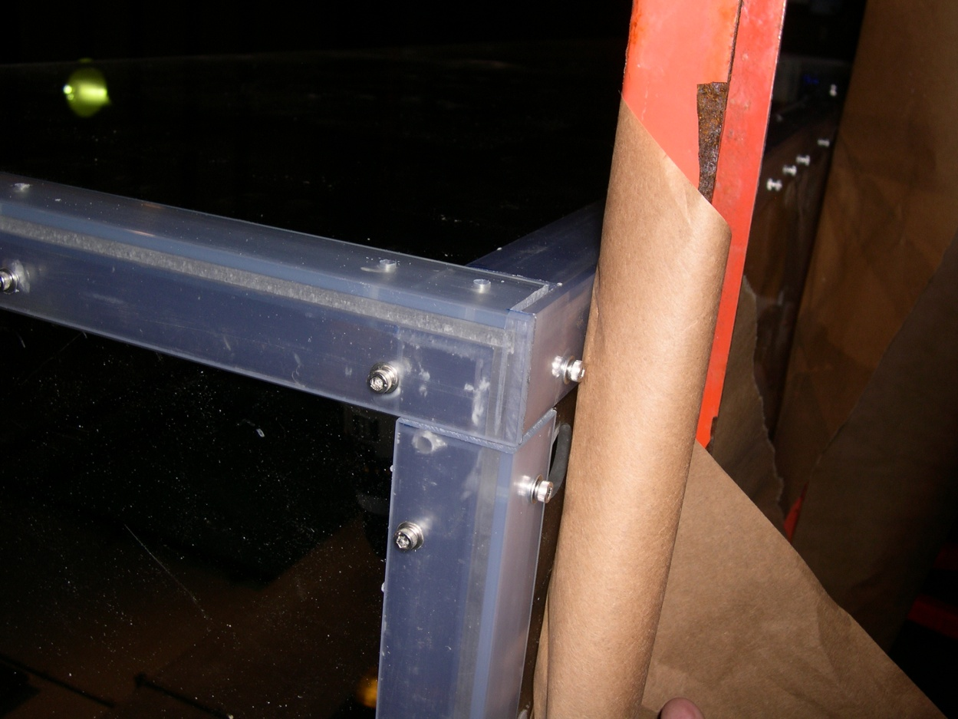
Proven Fabrication Methods
XFOCE Website Reference Material
Outer Angle
Inner Angle
Wall
Clearance
Outer Angle
Wall
Threaded
Inner Angle
Fastening Angles for Stiffness
Use of appropriate materials will maximize light
transmission into the test chamber.
-1/4” Clear Acrylic Panels
-3/16” x 1.5” x 1.5” clear PVC angle used as outside support structure.
-3/16” x1.25” x1.25” clear PVC used inside.
-8-32 x 5/8” screws tapped into inner PVC pieces, 6” Center to Center.
FABRICATION Note: Drilling holes in plastics, polycarbonate and especially acrylic can be difficult because the drill tends to grab and “dig” into the material. Modify the cutting edge of the drill’s flutes by filing or sanding the cutting edge to a more vertical “scraping” edge (i.e. perpendicular to the surface being cut). Keep it sharp and a very nice hole without breakout on the back surface will result.

Slide 92
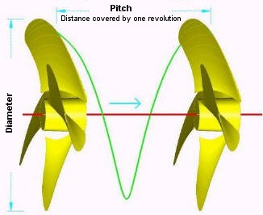
XFOCE Website Reference Material
Custom Thruster using Propellor and Motor
Disk Theory for Moving Water
Ppropellor x RPM x Areapropellor / 100 = Volumewater / minute
Where:
* Ppropellor = Propellor Pitch (cm.)
RPM = Revolutions per minute
Areapropellor = Area of the diameter projected by rotated propellor (cm. sq.)
Volumewater = volume of water moved by propellor (liters)
Equation for motor H.P. Requirement
HP = (psi x GPM) / (1714 x efficiencyMotor)
*NOTE: Pitch is defined as "the distance a propellor would move in one revolution
if it were moving through a soft solid, like a screw through wood." For example,
a 21-pitch propellor would move forward 21 inches (53.3 cm) in one revolution.

Slide 93
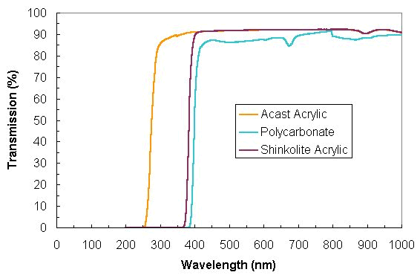
XFOCE Website Reference Material
Light Transmission through
Polycarbonate and Acrylic

Slide 94
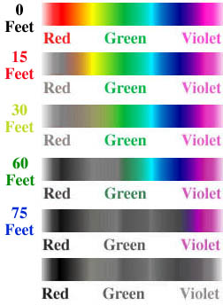
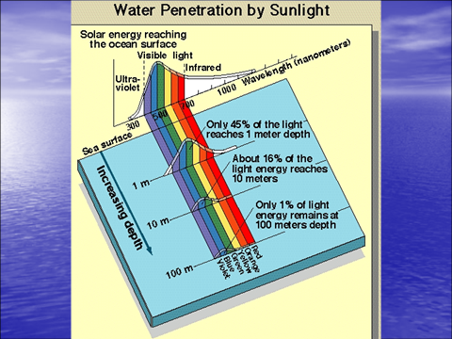
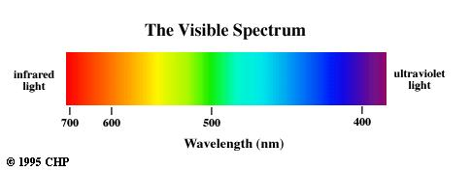
400nm through 700 nm
XFOCE Website Reference Material
Photosynthetically Active Radiation (PAR)
(0 Meters)
(4.6 Meters)
(9.1 Meters)
(18.3 Meters)
(22.9 Meters)

Slide 96
xFOCE Electrical Design
Chad Kecy
Electrical Engineer

Slide 97
Preliminary Considerations
Cabled vs Non-Cabled
Power
  Generation
  Distribution
  Heat Dissipation
Communications
  Shore to subsea
  Subsea to instruments
  Type / amount of data
Reliability
  Environmental condition monitoring
  Electrical protection of instruments/subsystems
  Ground fault protection

Slide 98
Cabled System
Shore Side
Station
Tether
Underwater
Connection

Slide 99
Shore Side Station
Physical Requirements
  Location
  Type of Installation
  Weather / Environmental Conditions
  Cable path (buried, exposed)
  Permitting
Electrical Requirements
  Power Source
  Communication Equipment
  Ground Fault Detection / Safety
Notes:
Trawling
Anchoring
How to deploy

Slide 100
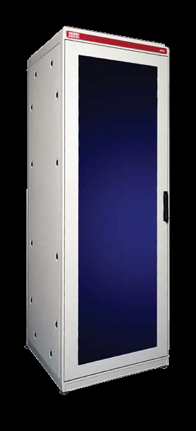
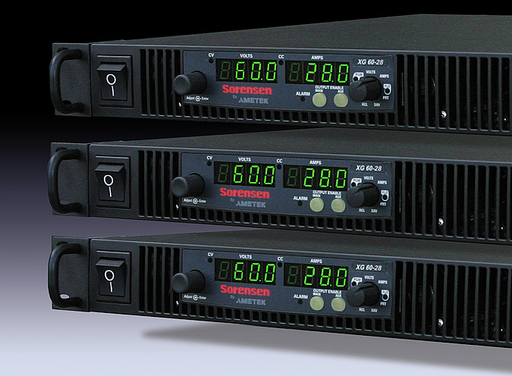
Shore Side Electronics
Rack mountable components
  Power Supplies
  Isolation Transformer
  Router
  CO₂ generation control
  Data Acquisition

Slide 101
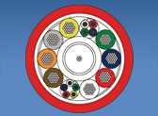
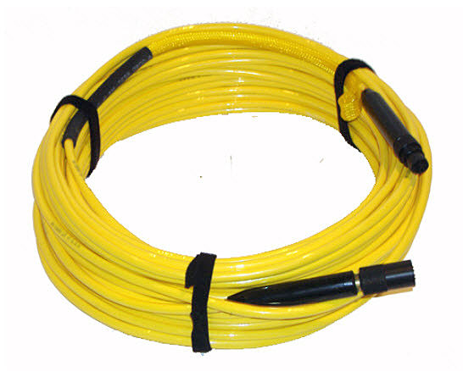
Cabled Tether
Electrical Requirements
  Power rating
  Communication speed / bandwidth
  Number of conductors (twisted pairs)
  Fiber optics?
  Connector selection
Mechanical Requirements
  Length
  Strength
  Anchoring
  Trawl Resistant
  Deployment Method

Slide 102
High Voltage Source
Advantages
Disadvantages
Minimizes i²r losses in cable
Allows for less copper in cable (less $$)
Need to down convert to lower DC voltages downstream
Safety concerns
Higher insulation resistance (specialty cable)

Slide 103
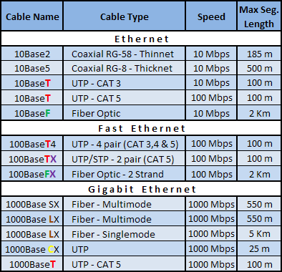
Ethernet Standards

Slide 104
Serial Standards
Specifications | RS-232 | RS-422 | RS-485
Mode of Operation | Single-Ended | Differential | Differential
Total # of Transmitters and Receivers | 1 Trans 1 Rcvr | 1 Trans 10 Rcvrs | 32 Trans 32 Rcvrs
Maximum Cable Length | 50 ft | 4000 ft | 4000 ft
Maximum Data Rate | 1MBit/s | 10MBit/s | 10MBit/s
Notes:
Add in DSL

Slide 105
DSL Standards
Technology | Distance | Download Speed | Upload Speed
ADSL | 18,000 ft / 5.4 km | 8 Mbit/s | 1 Mbit/s
SDSL | 18,000 ft / 5.4 km | 1.5 Mbit/s | 1.5 Mbit/s
IDSL | 36,000 ft / 10.8 km | 144 kbit/s | 144 kbit/s
HDSL | 15,000 ft / 4.5 km | 1.5 Mbit/s | 1.5 Mbit/s
VDSL | 4,000 ft / 1.2 km | 50 Mbit/s | 8 Mbit/s

Slide 106
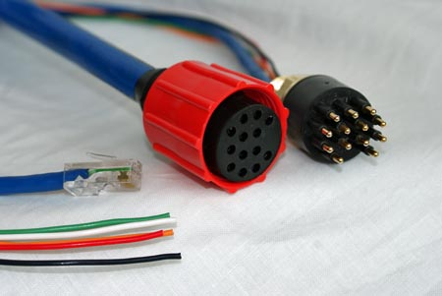
Underwater Connectors
Types
  Wet-mateable
  Dry-mateable
Considerations
  Deployment
  Servicing
Ratings
  Power conductors: voltage/current
  Communication conductors: speed/bandwidth
Notes:
#1 failure point
Speed/power issues

Slide 107
Non-Cabled System
Wireless
Communication
Buoy or Platform
Local Power
Generation

Slide 108
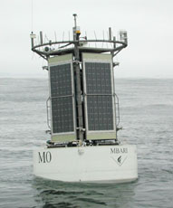
Mooring
Power Generation
  Solar, Diesel
  Battery Storage
Shore Communication
  Wireless Telemetry
Tether to Subsea Component
  Power
  Communication

Slide 109
xFOCE Subsea Node Electronics
Chad Kecy
Electrical Engineer

Slide 110
System Level Functions
Distribution of DC power to external instruments and internal subsystems
Bidirectional communication to external instruments and internal subsystems
Health monitoring for entire the subsea node
Computer
  Collection and dissemination of data
  Closed loop control of the experiment

Slide 111
DC Power
DC-DC Converters
  Converts input DC voltage to all necessary lower DC bus voltages.
Conditioning and monitoring
  Provides filtering and power monitoring.
Patch panel
  Distributes lower DC bus voltages to internal subsystems.
Load switching to individual instruments
  Provides galvanic isolation, over/under current/voltage protection, power monitoring, and ground fault detection to each instrument.

Slide 112
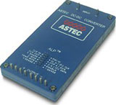
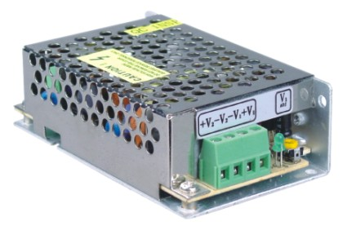
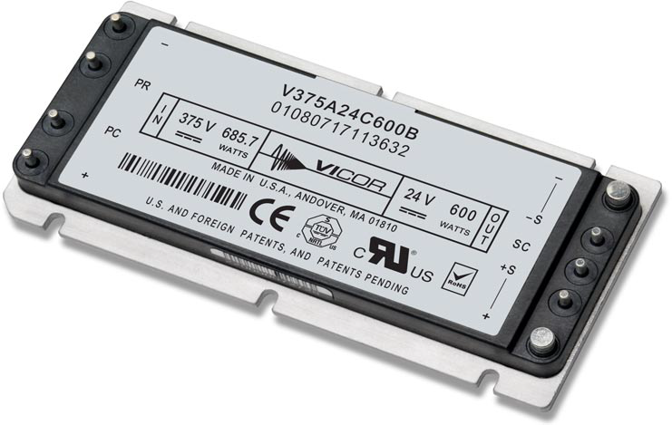
DC-DC Converters
Multitude of form factors
COTS vs Custom
Standard package for wiring consideration
Choice of bus voltage
Built-in Conditioning?

Slide 113
DC Power Example
Subsea Node
48V to 24V
Conditioning
Patch Panel
Inrush
Limiting
48V to 12V
Conditioning
12V
Ethernet
Switch
12V
Load Switching
24V
24V
Computer
pH Probe
CTD
ADCP
Camera
Thruster

Slide 114
Instrument Level Power Control
Load Switcher
12V
Load
Switching
Inrush
Limiting
Volt/Curr
Monitoring
Circuit
Breaker
Volt/Curr
Filtering
Over/Under
Volt/Curr
Detection
ADC
Ground Fault Monitor
Amp
Mosfet
ADC
R
Curr Limit
Seawater Ref
ADCP

Slide 115
Communication
Communication from shore to subsea node
  Factors:
    Is your FOCE tethered or standalone?
    Distance
    Bandwidth requirements
    Shore based infrastructure
  Potential choices:
    Tethered: Ethernet, RS-422, DSL
    Standalone: Wireless ethernet
Communication from subsea node to individual external instruments
  Most instruments utilize serial comms
    RS-232 and RS-485 most common

Slide 116
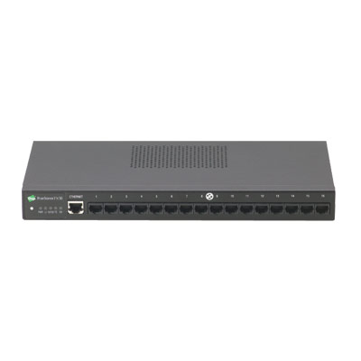
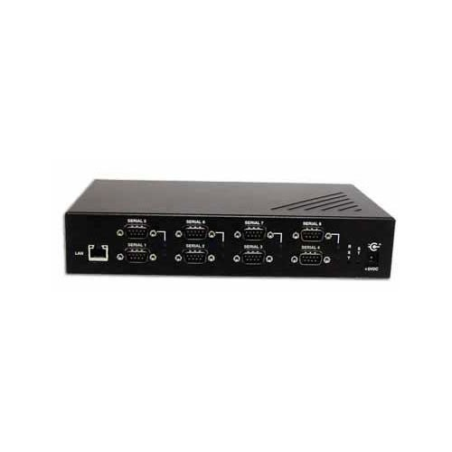
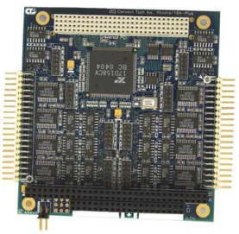
Serial Port Expansion
Large number of serial ports often needed.
DC Powered expanders & servers are plentiful.

Slide 117
Communications Example
Subsea Node
Ethernet
Switch
Computer
Video
Server
Serial
Expander/Server
Serial
UARTs +
Transceivers
Optional Paths
pH Probe
CTD
ADCP
Camera
Thruster

Slide 118
System Health Monitoring
Provides top side users with status of environmental conditions in the subsea node.
Can be used to automatically power down instruments in the event of a failure.
Conditions measured:
  Temperature
  Humidity
  Water presence
  Housing pressure
  Orientation

Slide 119
Health Monitoring Example
Subsea Node
Thermocouple
Ethernet
Switch
Computer
Ambient Temp
48V to 24V
Ambient Humidity
Health
Monitor
Ambient Pressure
Thermocouples
48V to 12V
Cooling Fan
H2O Sensor

Slide 120
Computer
Can be of almost any variety based upon intended usage in subsea node.
Potential usage:
  Collection and dissemination of data from external instruments and internal subsystems.
  Performing the closed loop operation control of the pH experiments.
  Housing the individual instrument drivers.

Slide 121
Four Potential Electrical Systems
1. PC/104 Stack
2. Wago I/O System
3. Instrument Chassis
4. Sensor Node

Slide 122



PC/104 Stack
What is PC/104?

Slide 123
PC/104 Stack
Modules available (multiple manufacturers):
  CPU
  Data storage
  Power Supply
  Digital I/O, Analog I/O (DAQ)
  Relay control
  Serial expansion
  Environmental input (temp, hum, etc…)
  Video Server/Encoder
  Ethernet switch
  Others

Slide 124
PC/104 Stack
Advantages
Disadvantages
Rapid prototype/design
Expandable/reconfigurable
Extensive functionality
Relatively inexpensive
Industry standard
Often software drivers included
Can incorporate custom boards
Power consumption
Maintenance
  Need to disassemble the stack to get to middle boards.
Limit on # of boards in stack
Sometimes, no software drivers….

Slide 125
PC/104 Stack
Function | Model # | Manufacturer | Notes | Watts | Cost | Quan | Tot Watts | Tot Cost
Computer | Cool RoadRunner-LX800 | Lippert |  | 6.5 | $500 | 1 | 6.5 | $500
Storage | 500Gb Scorpio Blue | Western Digital |  | 4 | $100 | 1 | 4 | $100
Power Supply | HE104+ DX | Tri-M |  | 10 | $300 | 1 | 10 | $300
Load Switching | DM6956 | RTD Embedded Tech | 16 Channels | 5 | $500 | 2 | 10 | $1000
Circuit Breaker | N/A
Ground Faulting | N/A
Load Power Monitoring | MM-32DX-AT | Diamond Sys | 32 Chan Analog | 3 | $600 | 1 | 3 | $600
Environmental Sensing | Model 518 | SensoRay | Temp/Hum only | 1 | $325 | 1 | 1 | $325
Serial Expansion | Xtreme/104-Plus Port | Connect Tech | 16 Channels | 4 | $350 | 2 | 8 | $700
 |  |  |  |  |  |  | 42.5 | $3525

Slide 126

Wago I/O System
What is a Wago I/O System?

Slide 127
Wago I/O System
Modules available:
  Controller
  Power Supply
  Relay Modules
  Digital I/O, Analog I/O (DAQ)
  Thermocouple inputs
  DC Motor Driver
  Others

Slide 128
Wago I/O System
Advantages
Disadvantages
Rapid prototype/design
Expandable/reconfigurable
Industry Standard
Generic software interface
Can incorporate custom boards
Limited functionality for our requirements
  More custom designs
Power consumption

Slide 129
Wago I/O System
Function | Model # | Manufacturer | Notes | Watts | Cost | Quan | Tot Watt | Tot Cost
Computer | 750-341 | Wago | Eth-Fieldus Coupler | 12 |  | 1 | 12 | 0
Storage | N/A |  |  |  |  |  | 0 | 0
Power Supply | N/A |  |  |  |  |  | 0 | 0
Load Switching | 857-304 | Wago | Single SPST Relay | 0.5 |  | 20 | 10 | 0
Circuit Breaker | N/A |  |  |  |  |  | 0 | 0
Ground Faulting | N/A |  |  |  |  |  | 0 | 0
Load Voltage Monitoring | 750-483 | Wago | Dual Voltage Analog Inputs | 2 |  | 10 | 20 | 0
Load Current Monitoring | 750-475 | Wago | Dual Current Analog Inputs | 2 |  | 10 | 20 | 0
Envr Sensing - Temp | 750-469 | Wago | Dual Thermocouple input | 1.5 |  | 3 | 4.5 | 0
Envr Sensing - Hum |  |  |  |  |  |  | 0 | 0
 |  |  |  |  |  |  | 0 | 0
Serial Expansion | N/A |  |  |  |  |  | 0 | 0
 |  |  |  |  |  |  | 66.5

Slide 130




Instrument Chassis
What is the Instrument Chassis?

Slide 131
Instrument Chassis
Modules available:
  CPU Board
  Power Supply
  Environmental Monitoring Board
  Low Voltage Load Switcher (8 channels)
  Medium Voltage Load Switcher (4 channels)
  Ground Fault Detection Board (16 channels)
  Others

Slide 132
Instrument Chassis
Advantages
Disadvantages
Was designed specifically for use in the shallow water FOCE system
Modular; new boards can be designed.
Low Power design
Simple software interface
Design complexity
Expensive to produce
Custom firmware needed
Currently, no serial expansion included

Slide 133
Instrument Chassis
Function | Model # | Manuf | Notes | Watts | Cost | # | Tot Watt | Tot Cost
CPU |  | MBARI |  | 0.680 | $253 | 1 | 0.680 | $253
Power Supply |  | MBARI |  | 0.335 | $324 | 1 | 0.335 | $324
Backplane |  | MBARI |  | 0.000 | $193 | 1 | 0.000 | $193
Environmental Board |  | MBARI | 8-hum, 4-temp, pressure, X,Y,Z, H2O Sense | 0.200 | $316 | 1 | 0.200 | $316
Low Voltage Load Switcher |  | MBARI | 8-channels, 0-24V | 0.250 | $550 | 3 | 0.750 | $1650
Medium Voltage Load Switcher |  | MBARI | 4-channels 24V-48V | 0.250 | $425 | 1 | 0.250 | $425
Ground Fault Detection Board |  | MBARI | 16-Channels (with 4 HV) | 0.200 | $325 | 1 | 0.200 | $325
 |  |  |  |  |  | Q | 2.4
 |  |  |  |  |  | Act | 10 | $3,486

Slide 134
Sensor Node Board
What is the Sensor Node Board?
DC Power from Bus
DC Power to Instrument
Pluggable
CPU
Module
BeagleBone?
Arduino?
Microchip PIC?
SmartSensor?
Load Switching
Inrush
Limiting
Circuit
Breaker
Over/Under
Curr/Volt
Det / Mon
Ground Fault Detection
UART
Serial Transceiver
Ethernet Comms from Switch
Serial comms to Instrument

Slide 135
Sensor Node Board
Modules available?
  None, it is a fully functional standalone unit
  1-3 instruments per Sensor Node board
Functions available:
  CPU, storage
    Device driver could be active locally
  Serial interface (uart + transceiver)
  Load switching
    Over/under curr/voltage detection
    Ground fault monitoring
    Current/Voltage monitoring

Slide 136
Sensor Node Board
Advantages
Disadvantages
All functions on one board
CPU simple to program
Single board design can handle a large variety of instruments
Open source HW and SW
Custom design
Cost?
Distribution

Slide 137
Electrical System Comparison
 | PC/104 | Wago | Instrument Chassis | Sensor Node Board
Central CPU | Yes | No | No | No
Local CPU | No | Yes | Yes | Yes
Local Storage | Hard Drive | No | SD Card | ?
Ethernet Interface | Yes | Yes | Yes | ?
Serial Expansion | Yes | No | No | One per
Load Control Relays | Yes | Yes | Yes | Yes
Circuit Breaker Protection | No | No | Yes | Yes
Inrush Limiting | No | No | Yes | Yes
Ground Fault Detection | No | No | Yes | Yes
Thermal Inputs | Yes | Yes | Yes | Yes
Humidity Inputs | Yes | No | Yes | Yes
H2O Sensor Inputs | Yes | Yes | Yes | Yes
Pressure Sensor Input | Yes | Yes | Yes | Yes
3-Axis Orientation | No | No | Yes | ?
Power Usage (Watts) | 45 | 70 | 10
Cost per System ($) | $3500 |  | $ 3486

Slide 138
Proposed swFOCE Electrical System
Cabled System
  Tether carries 375Vdc and fiber optics for ethernet
Downconverting to 48Vdc in a central node
Copper Gigabit ethernet to swFOCE node
Utilizing star topology architecture with Sensor Node boards
More
More

Slide 140
xFOCE/swFOCE Data System

Slide 141
xFOCE Data
Clients
Archive
Configuration
& Control
Basic requirements
  Sample rates, Timestamp accuracy (1 s)
  Time-stamped archive of experiment data
  Flexible data archive format (time-stamped CSV)
  Health and status monitoring
Users will prefer different ways to access data
  MATLAB, Excel, LabView, custom utilities…
Well defined (and standard) interfaces are key
  Configuration and control interfaces
  Data access interfaces:
    Services, clients, applications
    Simple, efficient, support low-bandwidth links
  Data archive formats
Metadata
  Science and system contextual data
    Changes to instruments, sampling, calibrations
    Ground faults, leaks and other system faults
  Enables understanding of what is (or did) happen
  Provides insight into anomalies, troubleshooting
Transformation
Presentation
Query
Links
Archive
Distribution
Distribution
Distribution
Controller
Controller
Controller
Driver
Driver
Device
Device

Slide 142
swFOCE Data
Added requirements
  Remote access
    Multi-user
    Separate administrative access
  Metadata management
  Compatibility w/ dpFOCE data
  Ground fault monitoring
  Still/video image data

Slide 143




swFOCE Data
Seafloor
Hopkins
Remote
Shore Side Data System (SSDS)
Primary data archive
MBARI internal standard
SSDS Server
Controller
TCP, UDP
HTTPS
Java RMI
Controller
SSDS Data
Archive
Controller
User
Tools
Instrument Data
Archive
HTTPS
Instrument Data
Archive
Local Data
Archive
SSDS
Controller Software
Access
Server
Control Service
Access
Service
Data ACQ
Services
FOCE GUI
Control, monitor
Data ACQ
Services
OSDT?
Data ACQ
Services
OSDT Server
TCP, UDP
OSDT Data
Archive
Data
ACQ
•••
Data
ACQ
Real-time Data Viewer (RDV) OSDT client
Live, post-experiment
data playback
Open Source
DataTurbine
Flow
ESW
CTD
pH
DO
Flow

Slide 144
swFOCE Data interfaces and formats
  Local archive:
  SSDS archive:
  OSDT archive:
  Metadata:

