Slide 1
Shallow Water FOCE
Kelp Forest Array
Shore Side High Voltage Distribution
Chad Kecy
June xx, 2012

Slide 2
What is the KFA Cabled Observatory?
Underwater observatory
8 Science ports + 2 Expansion ports
  4 Primary: 48v, 24v, 24v, 24v [10/100 Ethernet]
  4 Secondary: 12v, 12v, 12v, 12v [Serial]
  1 High Voltage: 300v [Gigabit Ethernet]
  1 swFOCE Pass Through: 375v [Gigabit Ethernet]

Slide 3
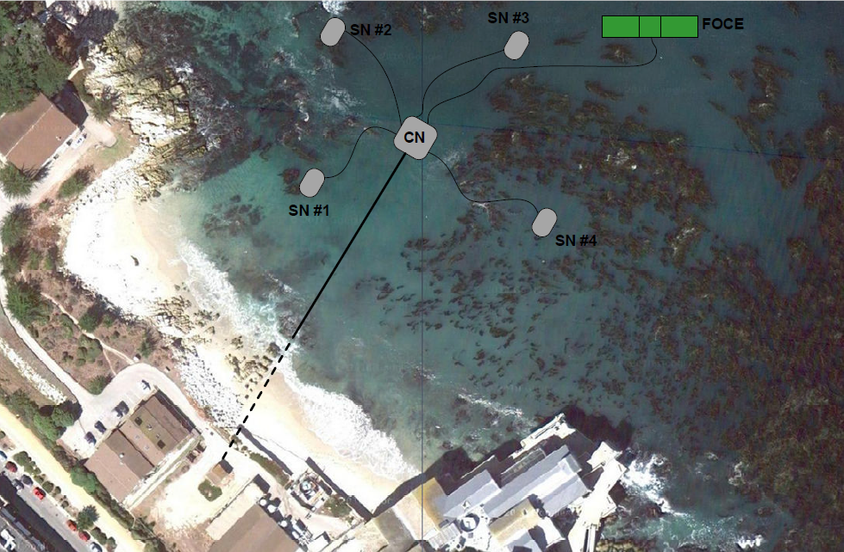
KFA Deployment Site

Slide 4
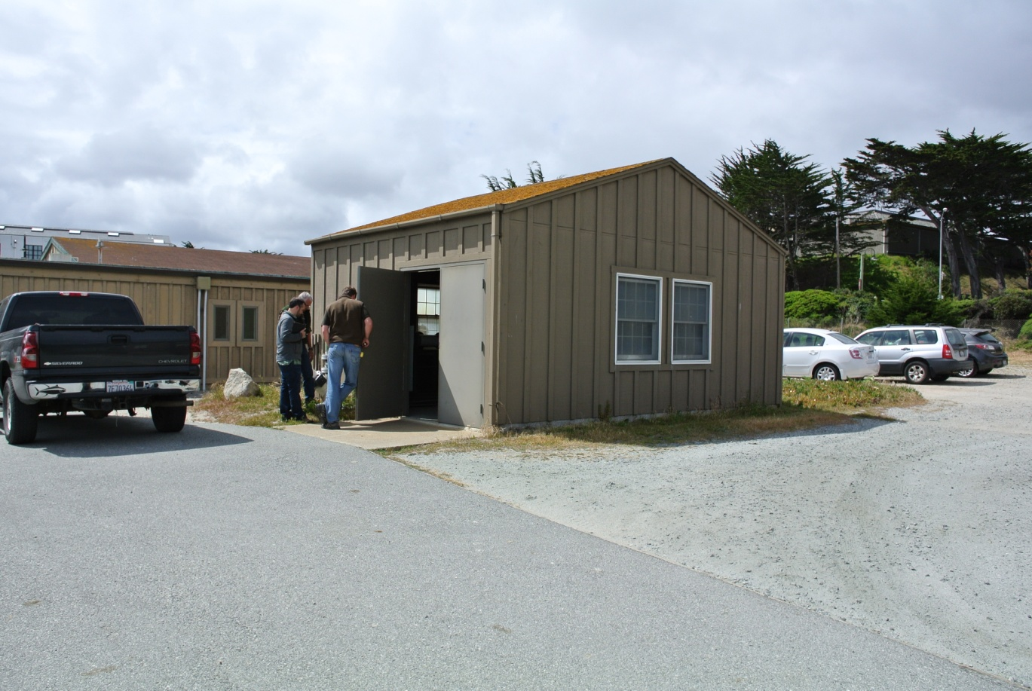
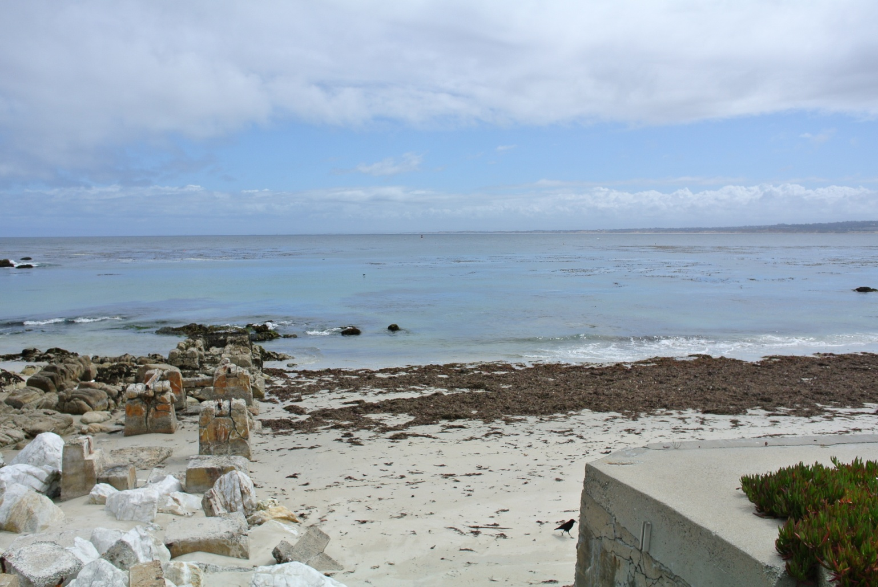

Slide 5
Shore Side Functionality
Generate HV for KFA (300V @ 3A)
Generate HV for swFOCE (375V @ 6A)
Ethernet Comms for KFA (Gigabit)
Ethernet Comms for swFOCE (Gigabit)
Generate and deliver enriched seawater to swFOCE
Publish and store scientific data

Slide 6
Pumphouse Components
Electronics Rack
375V/300V/Fibers
Tether
T1 Line
ESW Tubing
Control
Signals
208VAC 20A
Enriched
Seawater
Chamber

Slide 7
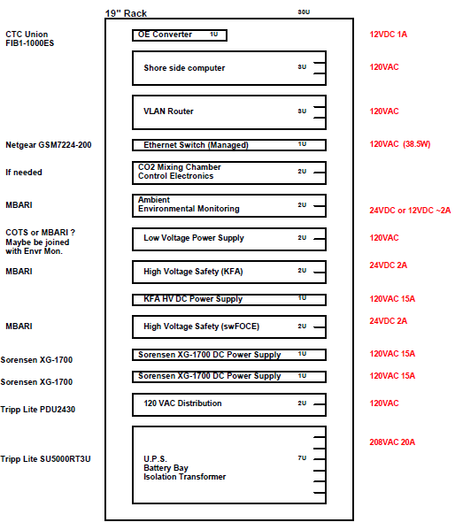
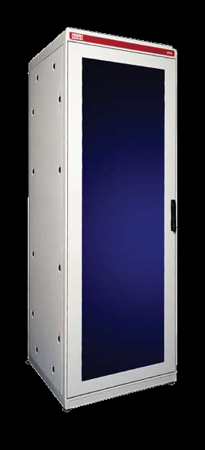

Slide 8
High Voltage Schematic
See OrCad schematic
208VAC 20A available in pumphouse
UPS + Isolation xfmr
4 individually breakered 120VAC outputs
375v / 300v Generation
Ground fault protection
Physical lock out box

Slide 9
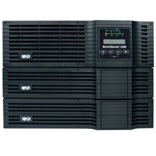
TrippLite SU5000RT3U UPS System
208Vac, 24A Input
208/120Vac Output
3500W Output
8min at full load
20min at half load
120Vac output isolated
3U Power Module
2U Isolation Transformer
2U Battery Module

Slide 10
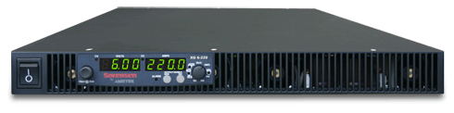
Sorensen XG600-2.8 HV Power Supply
0-600Vdc , 2.8A
1.05kW available at 375Vdc
Running two in parallel for 2.1kW at 375Vdc
Interlock shutoff

Slide 11
KFA Power Supply

Slide 12
Ground Fault Assembly
From XG600-2.8
HV Power Supplies
To High Voltage
Lockout Box
GigaVAC GX12
Relay
SSC800-25
SS Relay
IXYS
Diode
375Vdc
Bender IRDH275
Ground Fault Monitor
To PS
Interlock
Seawater
Ground

Slide 13
High Voltage Lockout Box
HBLDS Disconnect Switch
HBLDS Disconnect Switch
To swFOCE
GF Module
To KFA
GF Module
KFA
Tether
Fiber connections not shown

Slide 14
Diver Safety
The KFA Observatory will be de-energized while divers are in the vicinity.
The divers will have possession of the key to the high voltage lockout box while diving.

Slide 15
High Voltage Safety Features
Safety switch to remove 208VAC from entire rack enclosure.
20A 208VAC circuit breaker at main bldg panel
Over/under voltage and over current protection at the XG600-2.8 DC Power Supply
Seawater ground fault detection with built in circuit breaker functionality
Physical lockout box for diver safety

Slide 16
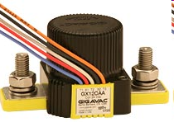
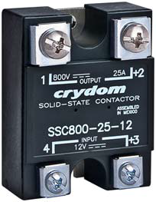
GF Module Relays
Gigavec HV DC Contactor
750V, 20 A
13,500 life cycles
Release time = 20 ms
<$150 each
Crydom SSC
800V, 25A
Ron = 60mohm
0.3 mA max leakage current
Max turn off time = 1.5 msec
$109

Slide 17
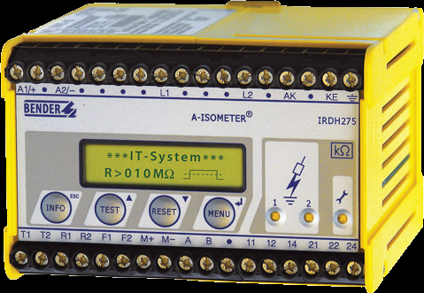
GF Module GFCI Module
Bender IRDH275 Module

