Slide 1
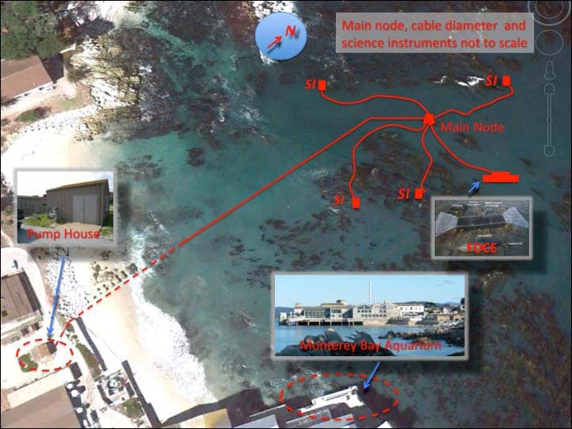
SW-FOCE Takes Shape
Build a consortium of researchers and engineers to tackle large, real-world issue of increasing relevance
Center for Ocean Solutions: Ideal fit to highlight ocean acidification
Hopkins: Cable/infrastucture and numerous potential research opportunities

Slide 2

Permits at Every Level
From earliest meetings with COS & Hopkins, realized permitting was a significant hurdle to overcome.
Brock Woodson initially procured permit from Monterey Bay Sanctuary to install cable
Innovative work, like SW-FOCE, would require the involvement of multiple regulatory agencies
  Monterey Bay National Marine Sanctuary
  California Coastal Commission
  California Department of Fish & Game
  Central Coast Regional Water Quality Control Board
  City of Pacific Grove

Slide 3
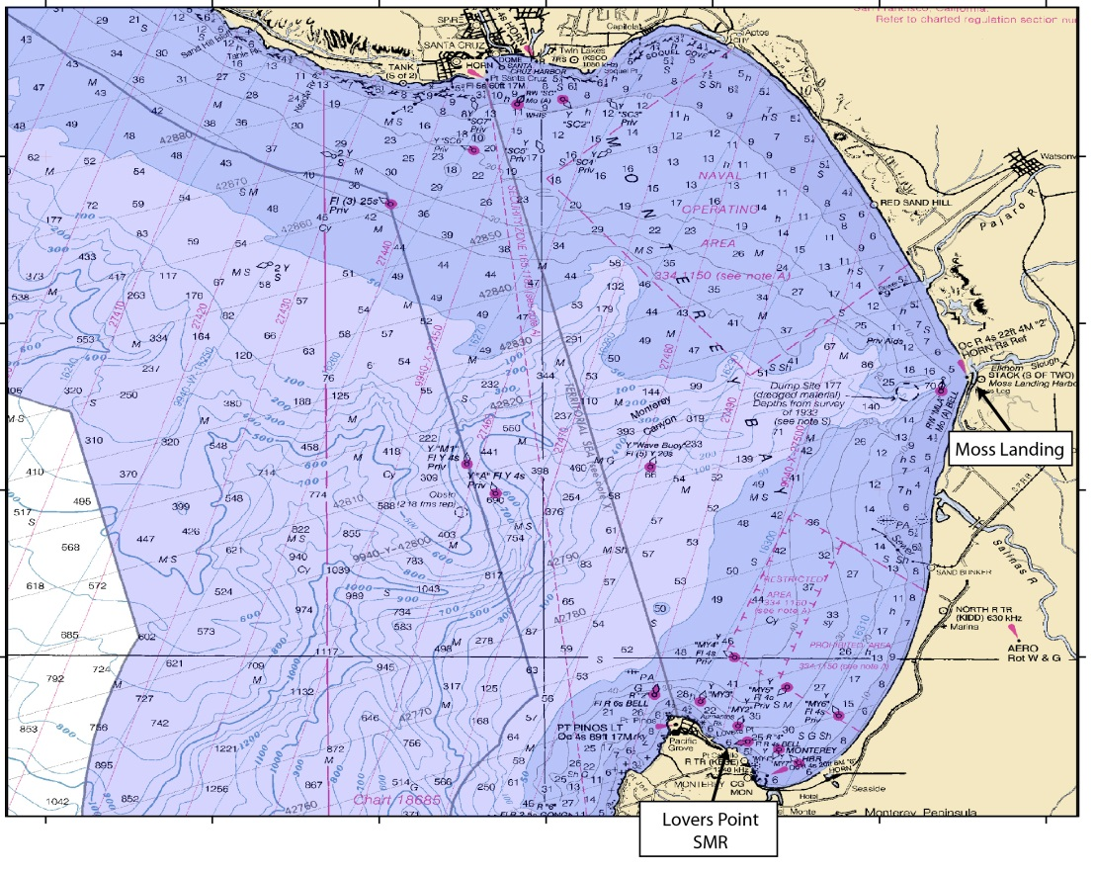
Permitting Issues
Project Site: Highly Sensitive Location
  Federal: Marine Sanctuary
Notes:
First issue that triggered all this regulatory oversite was the project site itself.
Project Site – create maps of Sanctuary jurisdiction – zoom to state jurisdiction – zoom to MLPA designations – PG jurisdiction

Slide 4
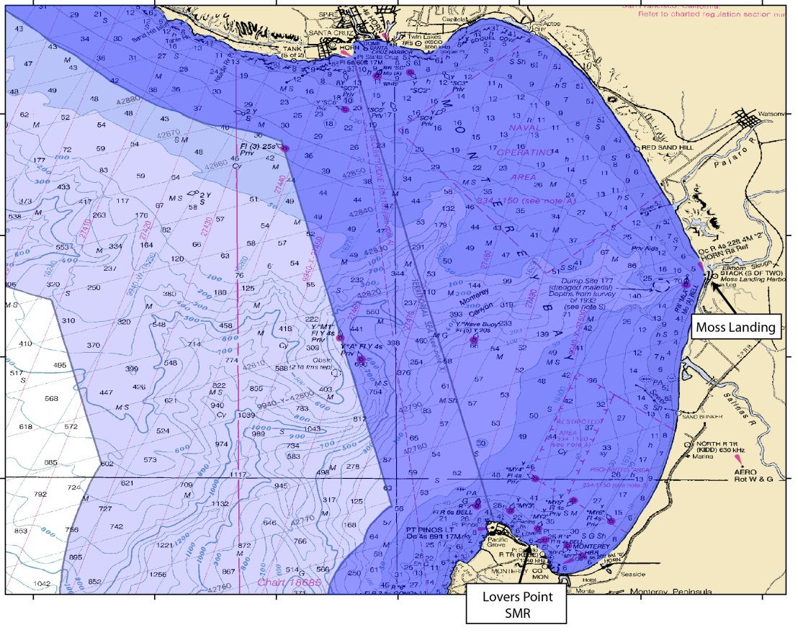
Permitting Issues: cont’d
Project Site: Highly Sensitive Location
  Federal: Marine Sanctuary
  State: Coastal Zone
Notes:
First issue that triggered all this regulatory oversite was the project site itself.
Project Site – create maps of Sanctuary jurisdiction – zoom to state jurisdiction – zoom to MLPA designations – PG jurisdiction

Slide 5

Permitting Issues: cont’d
Project Site: Highly Sensitive Location
  Federal: Marine Sanctuary
  State: Coastal Zone & MPAs
Notes:
First issue that triggered all this regulatory oversite was the project site itself.
Project Site – create maps of Sanctuary jurisdiction – zoom to state jurisdiction – zoom to MLPA designations – PG jurisdiction

Slide 6
Permitting Issues: cont’d
Project Site: Highly Sensitive Location
  Federal: Marine Sanctuary
  State: Coastal Zone & MPAs
  Regional: Water Quality
  Local: City of Pacific Grove
Notes:
First issue that triggered all this regulatory oversite was the project site itself.
Project Site – create maps of Sanctuary jurisdiction – zoom to state jurisdiction – zoom to MLPA designations – PG jurisdiction

Slide 7
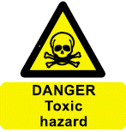
Permitting Issues: cont’d
CO2 in the ocean poorly understood
  Experimental releases considered “toxic waste”
  Needed to change some agency staff (and public) perception about experiment
    Education about ocean acidification processes occurring today and why research extremely important
    Understanding scale: Created comparison examples that could be understood by general public (e.g., SCUBA diver and motor boat equivalents)
    Process much easier when agency staff understood the chemistry
Notes:
SCUBA equivalents: CO2 release in one SW-FOCE chamber for 1 day would = 4 people breathing (all day)
35 SCUBA man-hours
The CO2 produced by burning 0.42 gallons of gasoline
The CO2 produced by burning 0.38 gallons of diesel fuel
Deep FOCE: MBARI was recently granted an increase of CO2 release to 400L per year. The maximum quantities the research team foresees using are far below the CO₂ distributed into Monterey Bay by other methods. To demonstrate just how minor this amount of liquid CO₂ is in the big picture, Jim Barry provided calculations estimating the amount of liquid CO₂ released by one motorized boat operating in the bay. Assuming the boat has an approximately 150-horsepower motor, running at 12 gallons per hour, it will release approximately1800 L of liquid CO₂ per 8-hour-day.

Slide 8
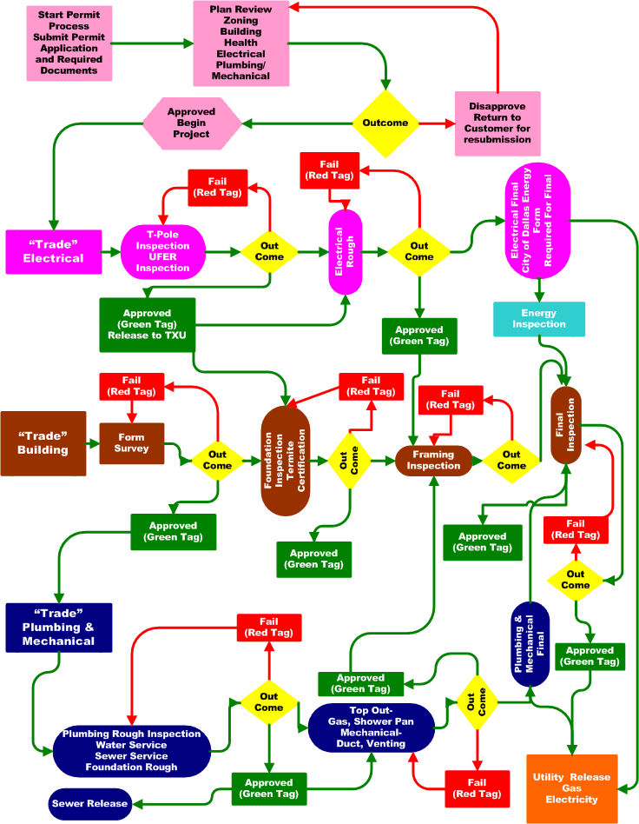
Permitting Issues: cont’d
Inconsistent or lack of permit process
  Every agency has different process
  First research project request in recently established MPA, as well as Area of Special Biological Significance
Notes:
Agency staff didn’t know how to move forward with applications because a process had not been determined even though regulations had gone into effect

Slide 9
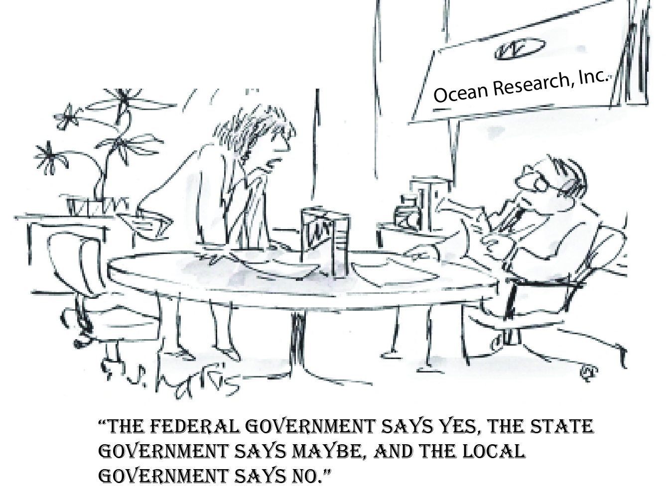
Permitting Issues: cont’d
Inter-Agency Interactions
  Each agency regulating different aspects of project
  Order of response from agencies
  Project exposed shortcomings in permitting process among multiple agencies
Notes:
Each agency regulating different aspects of project so there is increased potential for conflicting opinions on project impacts and mitigation measures (e.g., use of local vs. non-local populations for perturbation experiments.
Depending on the project, each agency has a system of waiting for another agency to make a determination first before issuing their own authorization. Staff got creative with how to deal with this, but acknowledged system needed refining.

Slide 10
Support From Agency Staff
  Agency staff highly professional
  Agency staff understood their respective agency permitting shortcomings due to recent changes in regulations
  Genuine interest by all agency staff we worked with to help us come up with a solution to get the projects permitted
Notes:
MBARI benefitted from existing positive relationship with agency staff, especially MBNMS.
Staff needed authorization from higher up to be able to proceed.

Slide 11
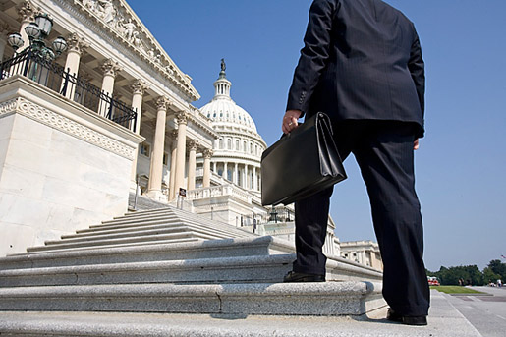
How to Move Forward -
Go to the Top
Peter Brewer met with Governor Brown
Meg Caldwell helped streamline the process with two key State agencies (CCC & CDFG) through discussions with high level personnel

Slide 12
Lessons Learned
Site location can determine how much regulation you will be faced with
Allow plenty of time for permitting
  Process took 2 years to complete
  Coordination of permitting cable & projects
Good rapport with agency personnel key
  Not necessarily trying to make life difficult, but often operating within bureaucratic box
  Future interactions
Advocate(s) who can work with bureaucracy highly valuable
Getting the process streamlined is critical to prevent valuable research from being discouraged due to concerns about permitting.
Notes:
If applying fro permits to install infrastructure, can save time & effort if you recognize that agencies may treat these as associated projects. Can help streamline the process.
Future interactions – probably will end up working with same staff on similar or other projects. Good to keep positive rapport.

